Slide 1
BlooME
Nourish your body,
Grow your mind
A6: Medium Fi Prototyping

Slide 2


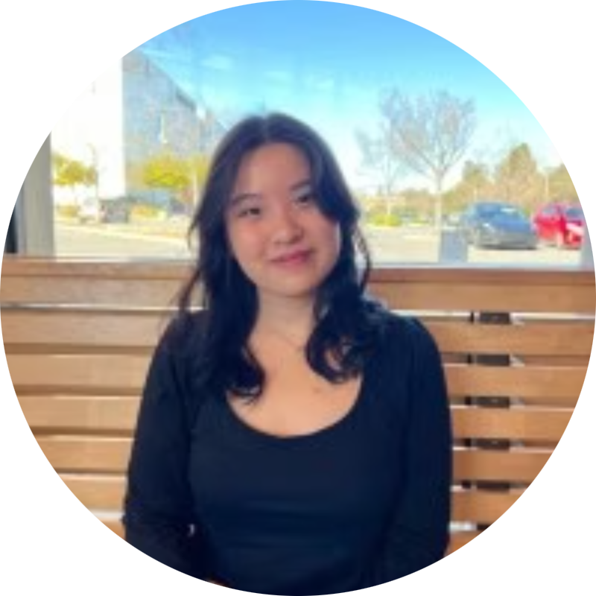
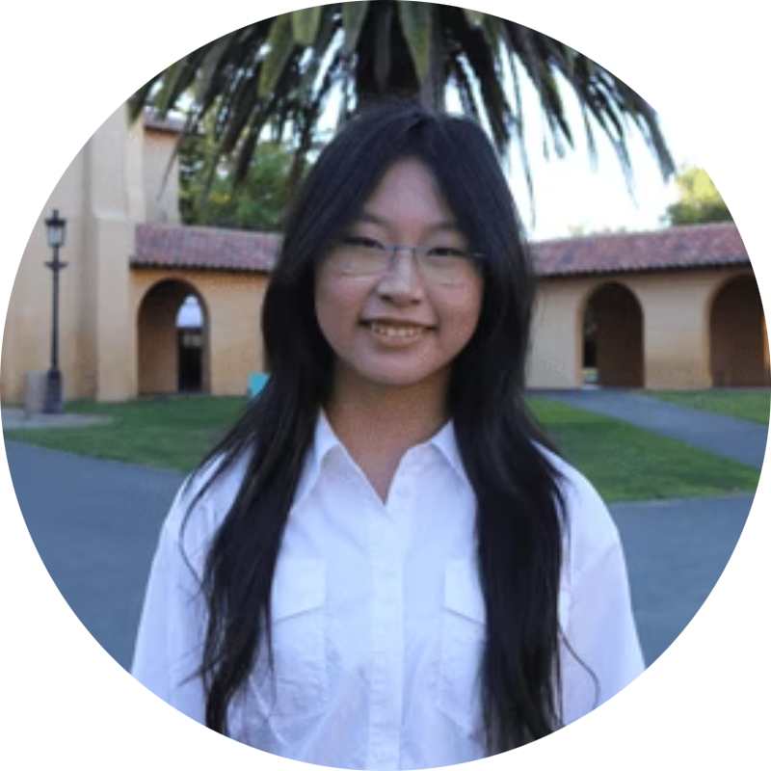
MEET JJYC
JASMINE X.
YUJEN L.
JADE C.
CLARE L.
Psychology & CS ‘27
Symbolic Systems ‘27
Symbolic Systems ‘27
Design ‘28

Slide 3
Table of contents
01
02
Problem + Solution Overview
Values in Design
03
04
Tasks
Medium Fi Prototype

Slide 4
BlooME Value Proposition
BlooME empowers individuals navigating through food challenges to feel less alone by combining community connection, guided self-reflection, and gentle recovery support. BlooME offers a safe space to help users rebuild compassionate relationship with food and themselves, fostering lasting recovery and self-kindness.

Slide 5
Problem + Solution

Slide 6
Problem
Many people who struggle with food, whether they fall into subclinical or clinical categories, often keep their pain to themselves. They hesitate to reach out to friends, family, or professionals because they feel a persisting anxiety in being a burden to others, and continue to live with their guilt around eating.

Slide 7
Solution
BlooMe is a peer-to-peer story-sharing app that pairs community warmth with daily structure. It also offers journaling prompts, a personal “butterfly sanctuary” to store encouraging messages, and meal reminders with affirmations to guide recovery routines.

Slide 8
Values in Design

Slide 9
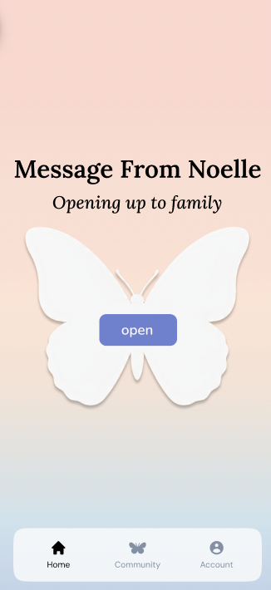
Value 1: Compassion
By approaching healing with gentleness, care, and understanding, users should feel compassion and empathy. They feel seen throughout their struggles.
By sharing a story from another person everyday, the user encounters a moment of connection.
The butterfly represents how our messages spread throughout the world and bring people together.
Notes:
Growth: Healing is a journey of continuous inner expansion and blooming.
Community: Fosters connection and shared support in the recovery journey.

Slide 10
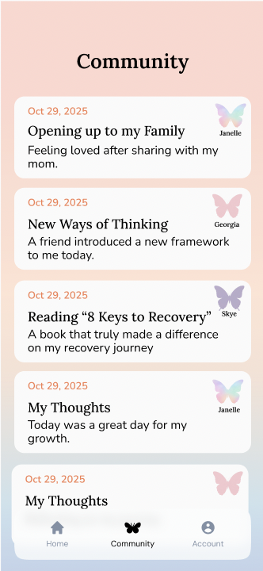
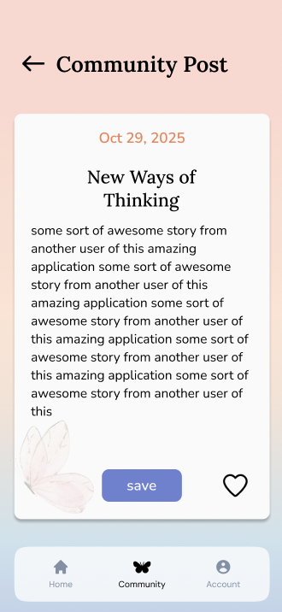
Value 2: Community
Beyond the story of the day, users can continue to connect and read other public stories, resonating with similar experiences.
User’s can collect notes from others and create collections with themes tied to them.
Notes:
Value Proposition
Growth: Healing is a journey of continuous inner expansion and blooming.
Compassion: Approaches healing with gentleness, care, and understanding.
Community: Fosters connection and shared support in the recovery journey.

Slide 11
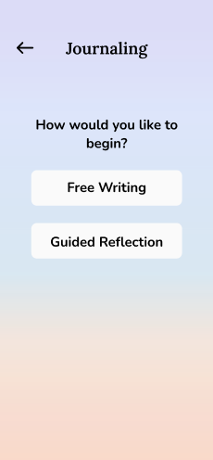
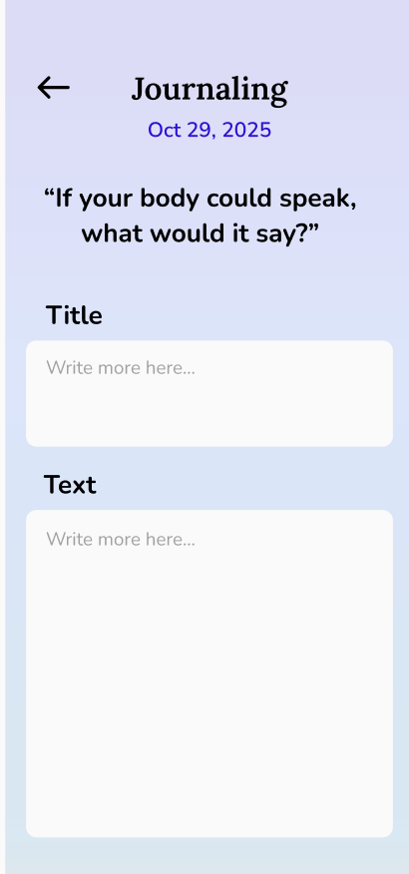
Value 3: Growth
Healing is a journey of continuous inner expansion and blooming.
By being able to create notes, public or private, users can see how their mindset changes and bloom.
Notes:
e Proposition
Growth: Healing is a journey of continuous inner expansion and blooming.
Compassion: Approaches healing with gentleness, care, and understanding.
Community: Fosters connection and shared support in the recovery journey.

Slide 12
Tensions in Values
01
Community and Compassion
As a social sharing application focused on healing, there is the ethical tension of encouraging compassion without allowing users to overshare or experience any emotional burnout. To address this, we will intentionally limit and simplify sharing features, as well as utilizing content filters that flag sensitive keywords. This minimalist and balanced approach will help to ensure that users can express vulnerability within boundaries that protect themselves and others.
Notes:
Ethical question of being a social sharing app, how do we integrate compassion, but not oversharing and possible harm to someone’s mental health? Considering reducing features or filtering, like other social platforms, that makes the compassion and community productive.
With growth and community, we also see that it is possible that sharing can be a source of inspiration for negative behaviors. How do we promote growth in a positive sense more explicitly?

Slide 13
Tensions in Values
02
Community and Growth
While community interacts can spark growth, there is also the tension of pressure or comparisons with others. To address this, BlooME will put an emphasis on personal milestones and have gentle reflection tools, instead of a public metric. Along with having a self-check in feature, this will encourage users to celebrate their own progress within a community that encourages growth.
Notes:
Ethical question of being a social sharing app, how do we integrate compassion, but not oversharing and possible harm to someone’s mental health? Considering reducing features or filtering, like other social platforms, that makes the compassion and community productive.
With growth and community, we also see that it is possible that sharing can be a source of inspiration for negative behaviors. How do we promote growth in a positive sense more explicitly?

Slide 14
Tasks

Slide 15
Simple: Collect the “Message From”
Moderate: Collect note from Community
Complex: Share your own note
Notes:
Side off mention like we kind of added a text of revisiting notes which we would put in the moderate category because it takes a few more steps to get there, and then if there is an editing function then it would become complex.
Why Simple: Accessible to all users at any stage of their journey, involves little to no cognitive or emotional load, and can be done repeatedly and casually. The task is introductory and universal, users will do this often.
Why Moderate: This task requires for active engagement and light reflection from the users to identify what contents matters to them the most. This is a little more involved than simply receiving a note, but still approachable for most users.
Why Complex: This task involves sharing personal experiences with a larger community, which required high vulnerability, cognitive effort, as well as intentionality. Not all users will feel ready or willing to do this, so this task will be done by more engaged users who feel comfortable opening up to others.

Slide 16
Why Simple?
Why Moderate?
Why Complex?
Accessible to all users at any stage of their journey, involving little to no cognitive or emotional load, and can be done repeatedly and casually. The task is introductory and universal, users will do this often.
This task requires active engagement and light reflection from users to identify what contents matters the most to them. This is more involved than simply receiving a note, but still approachable for most users.
This task involves sharing personal experiences with a larger community, which required high vulnerability, cognitive effort, as well as intentionality. Not all users will feel ready or willing to do this, so this task will be done by more engaged users who feel comfortable opening up to others.
Notes:
Side off mention like we kind of added a text of revisiting notes which we would put in the moderate category because it takes a few more steps to get there, and then if there is an editing function then it would become complex.
Why Simple: Accessible to all users at any stage of their journey, involves little to no cognitive or emotional load, and can be done repeatedly and casually. The task is introductory and universal, users will do this often.
Why Moderate: This task requires for active engagement and light reflection from the users to identify what contents matters to them the most. This is a little more involved than simply receiving a note, but still approachable for most users.
Why Complex: This task involves sharing personal experiences with a larger community, which required high vulnerability, cognitive effort, as well as intentionality. Not all users will feel ready or willing to do this, so this task will be done by more engaged users who feel comfortable opening up to others.

Slide 17
Additional Task
Throughout the process, and the nature of our peer to peer note sharing app, we have added an additional moderate/complex task. By having a history of notes, this requires another flow to enter collections, pick the note, and then perform an action on them. This task turns complex when the action is editing the post, entering the journaling flow.
Notes:
Side off mention like we kind of added a text of revisiting notes which we would put in the moderate category because it takes a few more steps to get there, and then if there is an editing function then it would become complex.
Why Simple: Accessible to all users at any stage of their journey, involves little to no cognitive or emotional load, and can be done repeatedly and casually. The task is introductory and universal, users will do this often.
Why Moderate: This task requires for active engagement and light reflection from the users to identify what contents matters to them the most. This is a little more involved than simply receiving a note, but still approachable for most users.
Why Complex: This task involves sharing personal experiences with a larger community, which required high vulnerability, cognitive effort, as well as intentionality. Not all users will feel ready or willing to do this, so this task will be done by more engaged users who feel comfortable opening up to others.

Slide 18
Usability Goals and Measurements
Usability goals | Measurements
Efficiency | Measured by time spent on each task
2. Effectiveness | Measured by # of misclicks
3. Enjoyment | Qualitative Feedback

Slide 19
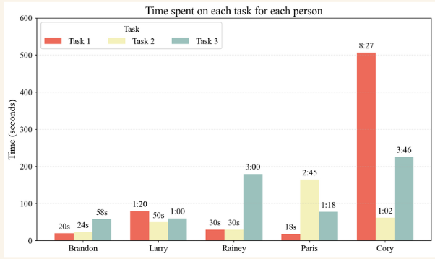
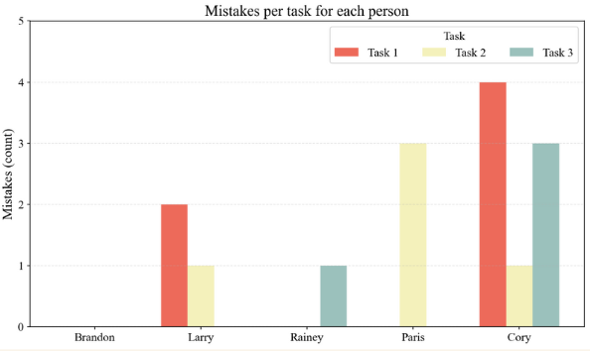
Recap of data/evidence on these Goals & Measurements
People spent more time as the task got more complex, with some outliers.

Slide 20
Changes Made
Changes made to better hit our goals | How this change will better hit key goals and measurements
Instant pop up of daily message from community | Reduces cognitive load of finding the daily message; lessens the time spent on locating the message (improves efficiency)
Navigation of stored posts in categories (public/private/saved/pinned etc.) | Makes filtering easier; quicker location of desired message you want to find (improves efficiency & effectiveness)
Addition of an onboarding tutorial | Reduces the learning curve and errors made when exploring app (improves effectiveness)
UI Rework + Reactions | Using a traditional SNS layout to improve intuitiveness and engagement (scrolling, cleanliness). Added reactions for a layer of personalization. (improving enjoyment)

Slide 21
Revised Interface Sketches

Slide 22
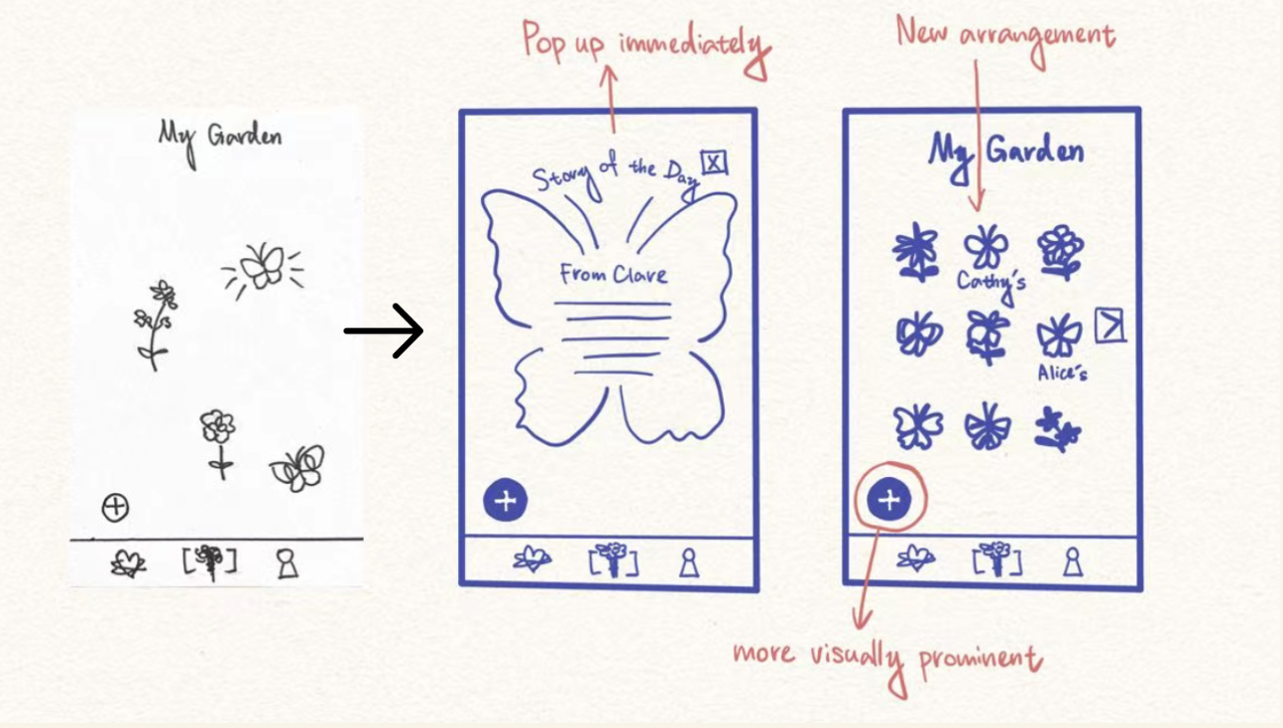
Revisions from our Lofi Prototype

Slide 23
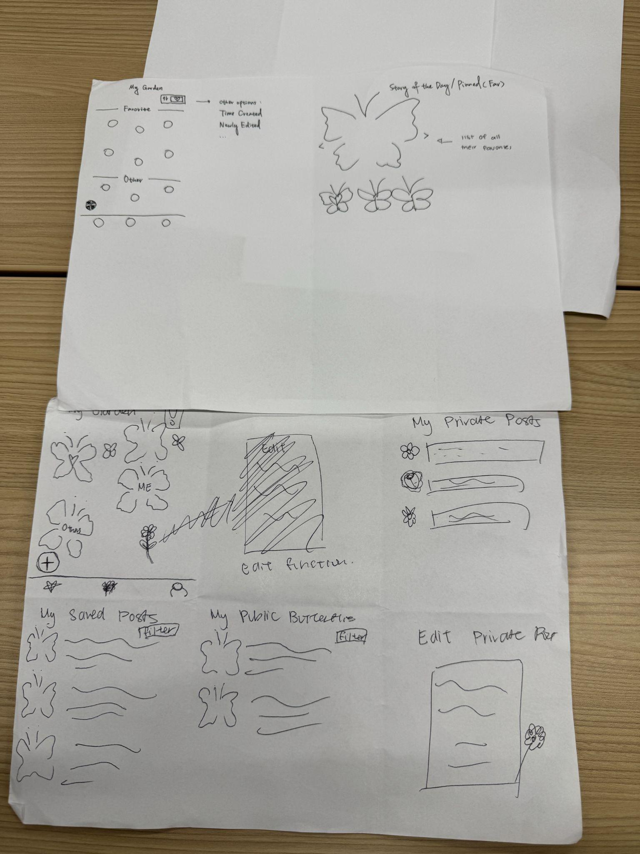
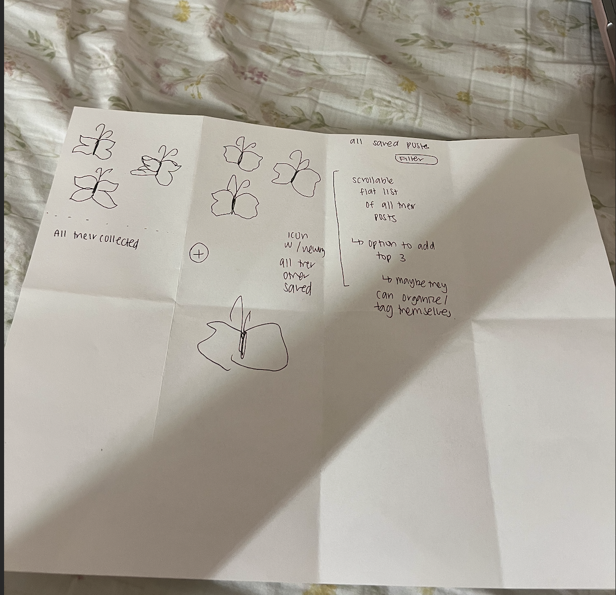
Draft ideas from class!

Slide 24
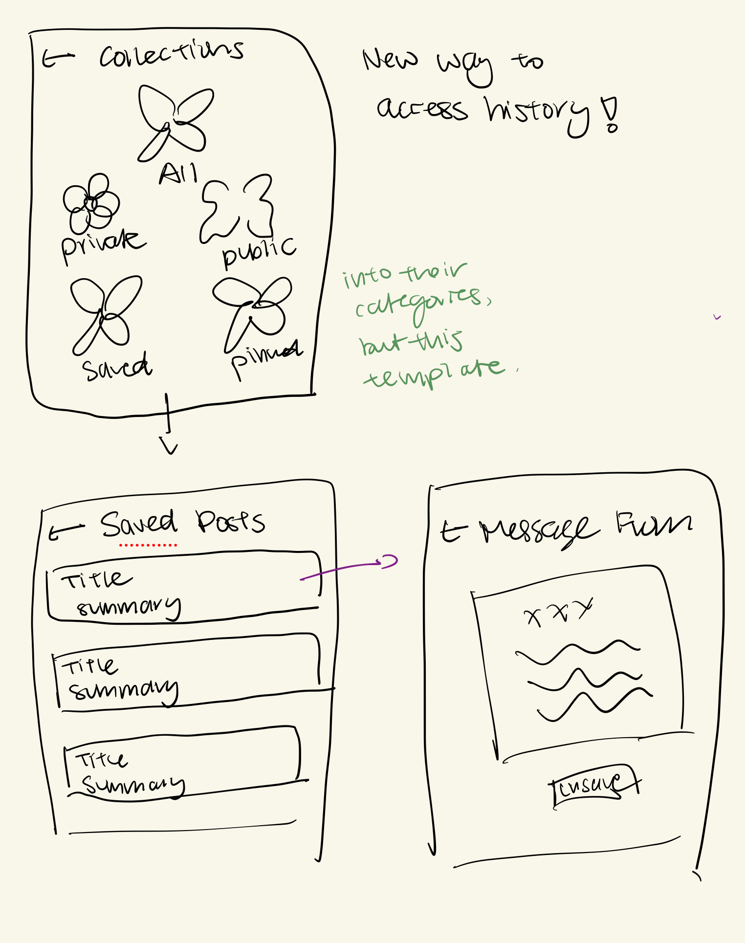
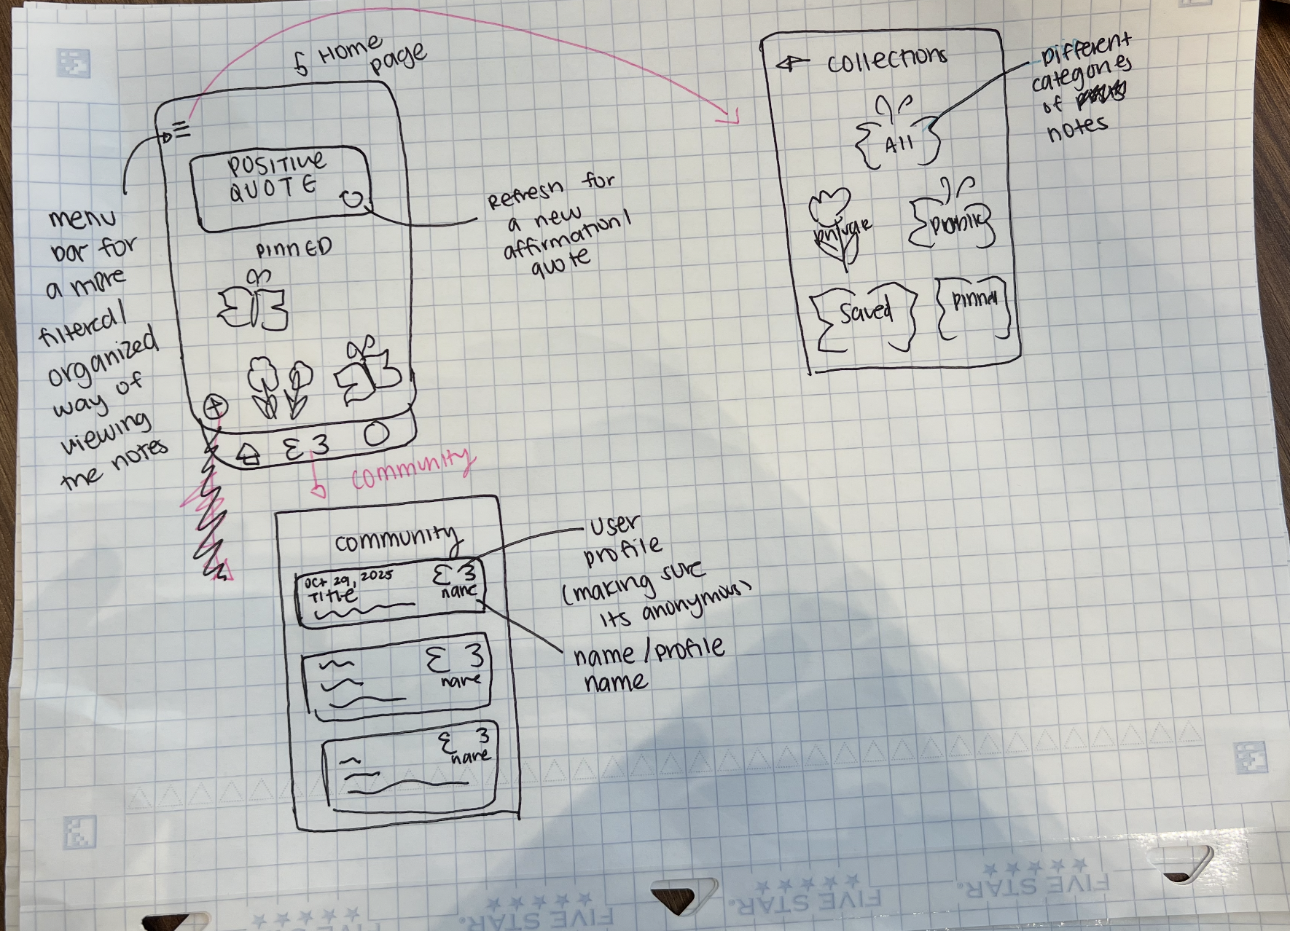
New Community Flow
New Home Page
New Reactions to Posts
Additions of Collections

Slide 25
Change 1: Landing Page, Pinned Logic, and Daily Affirmation
Redesigned the layout of our Home page (previously My Garden). It now shows a Daily Affirmation at the top and showcases the users pinned notes (up to 5), that are easily accessible whenever the user wants to revisit them.
Usability Goal:
A cleaner layout with more indications to make this easy to use. Makes the positive messages much more accessible for the user, encouraging them to revisit notes that make them feel good. Daily affirmations to spread positivity the moment the user returns to the homepage.
Notes:
Confusion from class sessions in studio + reminder of a comment we got in an interview that wanted to see a positive message right away. Higher up on the page for hierarchy

Slide 26
Addressing Feedback:
Throughout studio and prototyping interviews, we got confusion about what our icons meant. This led us to pivot and use the homepage as a way to see our pinned and most effective messages. Inspired by a previous interview, we added the Daily Affirmations, because an interviewee told us that upon opening the app, she would love to see a positive message right away to feel seen and supported. This helped us define a hierarchy and clean up our landing page logic to make it feel more intuitive.
Notes:
This is basically the collections page. a. Major changes – 3 biggest changes between original and revised sketches b. How will these changes aid in progressing forward with your usability goals? c. Explain how the changes address issues identified from low-fi testing results, studio feedback, user needs, etc. Include evidence to back up the changes made. d. Before and after comparisons with annotations and labels as needed e. If you have more than 3 changes you want to show, add the rest to the appendix

Slide 27
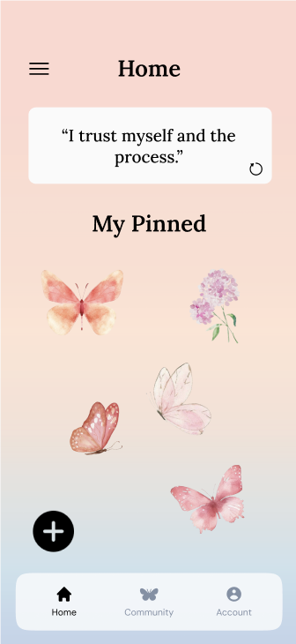
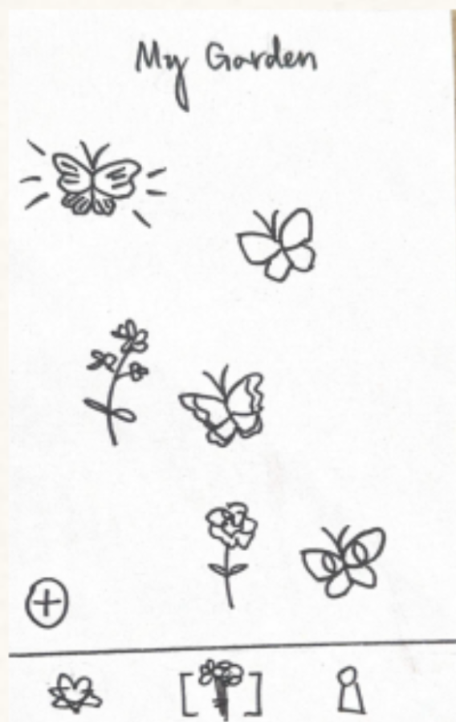
Before & After Comparisons
Shows an obvious my pinned categories, letting the user know about their pinned notes
Daily affirmation at the top, using hierarchy, to pay attention to the positive message first
Navigation is more intuitive
The icons were confusing
No labeling
No positive affirmations on the page.
Notes:
This is basically the collections page. a. Major changes – 3 biggest changes between original and revised sketches b. How will these changes aid in progressing forward with your usability goals? c. Explain how the changes address issues identified from low-fi testing results, studio feedback, user needs, etc. Include evidence to back up the changes made. d. Before and after comparisons with annotations and labels as needed e. If you have more than 3 changes you want to show, add the rest to the appendix

Slide 28
Change 2: Organized ability to access personal notes and notes from others.
Redesigned the navigation system with a menu bar in the top-right corner of the home screen. When pressed, it expands to display 5 butterfly icons (All, Pinned, Saved, Public, and Private), which represents a different post category.
Usability Goal:
Thinking about the scalability, this makes sure that users can easily and quickly browse through their growing number of community and personal posts over time (improving clarity & control).
Notes:
This is basically the collections page. a. Major changes – 3 biggest changes between original and revised sketches b. How will these changes aid in progressing forward with your usability goals? c. Explain how the changes address issues identified from low-fi testing results, studio feedback, user needs, etc. Include evidence to back up the changes made. d. Before and after comparisons with annotations and labels as needed e. If you have more than 3 changes you want to show, add the rest to the appendix

Slide 29
Addressing Feedback:
Throughout our low-fi prototype testing, some users were confused about the different posting categories and how to access them. Some of them also brought up concerns about the app’s longevity as their saved and personal posts started to accumulate. Having this new organized & centralized menu offers a more clear and structured way to navigate through these categories as contents grow with the user.

Slide 30
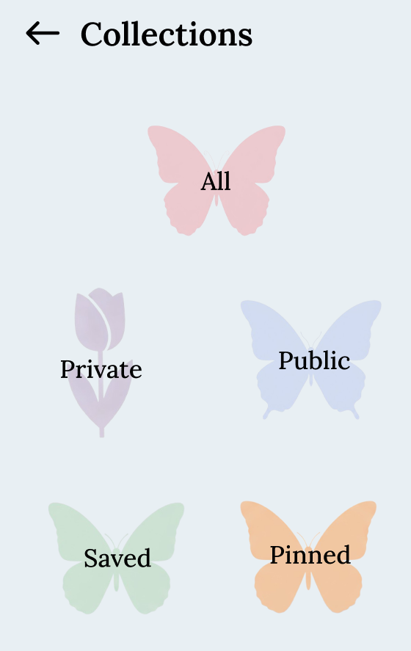
Before & After Comparisons
Unified menu that allows users to locate posts in one area.
Navigation is more intuitive and long-term as contents grow.
Scattered Posts
Confusion on what each icon means
Notes:
This is basically the collections page. a. Major changes – 3 biggest changes between original and revised sketches b. How will these changes aid in progressing forward with your usability goals? c. Explain how the changes address issues identified from low-fi testing results, studio feedback, user needs, etc. Include evidence to back up the changes made. d. Before and after comparisons with annotations and labels as needed e. If you have more than 3 changes you want to show, add the rest to the appendix

Slide 31
Change 3: Positive Phrasing & Journal Prompt Layering
For the guided journaling feature, the reflection prompts includes a gentle & positive framing, and layered reflection prompts that gently build on top of each response.
Usability Goal:
This feature will help users move from surface-level reflections to deeper emotional understanding of self. Encouraging a more positive self-reflection and mindset shift, while also making sure emotional safety and ethical sensitivity is maintained.
Notes:
a. Major changes – 3 biggest changes between original and revised sketches b. How will these changes aid in progressing forward with your usability goals? c. Explain how the changes address issues identified from low-fi testing results, studio feedback, user needs, etc. Include evidence to back up the changes made. d. Before and after comparisons with annotations and labels as needed e. If you have more than 3 changes you want to show, add the rest to the appendix

Slide 32
Addressing Feedback:
From studio feedback from our guest speaker, Ananya, he emphasized the importance of digging deeper in reflections while keeping the tone more positive and ethically mindful. And from our prototype testings, users shared that they wanted guided reflections that felt more supportive rather than heavy-feeling.
Notes:
a. Major changes – 3 biggest changes between original and revised sketches b. How will these changes aid in progressing forward with your usability goals? c. Explain how the changes address issues identified from low-fi testing results, studio feedback, user needs, etc. Include evidence to back up the changes made. d. Before and after comparisons with annotations and labels as needed e. If you have more than 3 changes you want to show, add the rest to the appendix

Slide 33
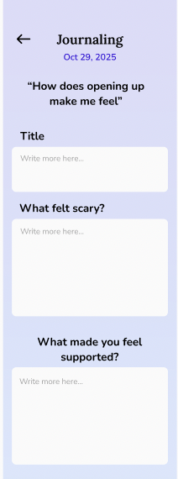
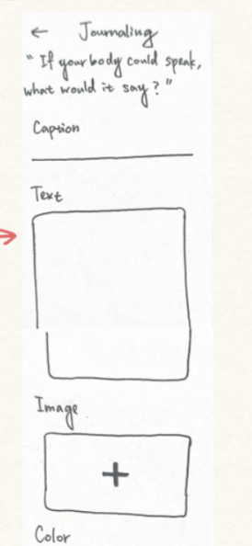
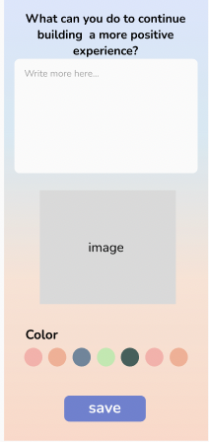
Before & After Comparisons
A multi-layered and positive framed reflection prompt that guides users to dig deeper.
A direct and single- layered prompt.

Slide 34
Medium Fi Task Flows

Slide 35
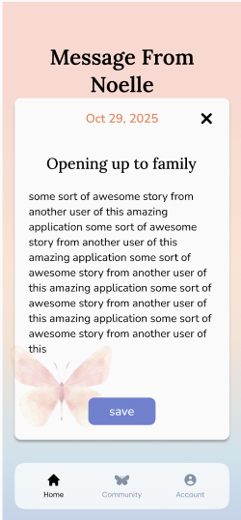
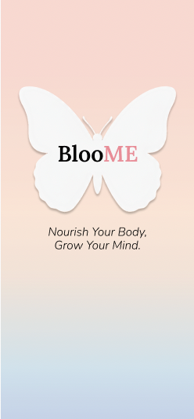
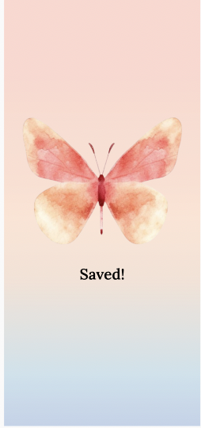
Simple: Access Daily Message
Exit to homepage
Goes to homepage after delay
After delay

Slide 36
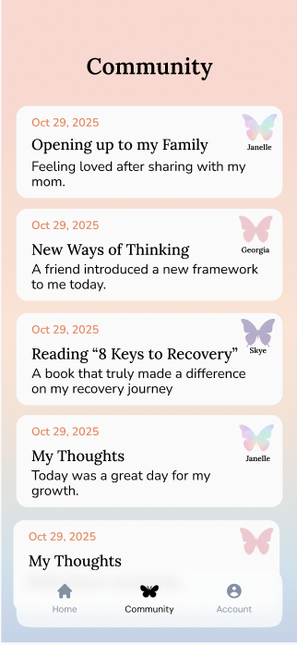
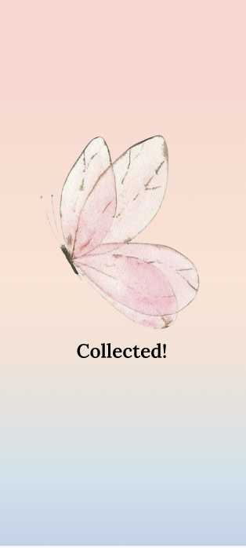
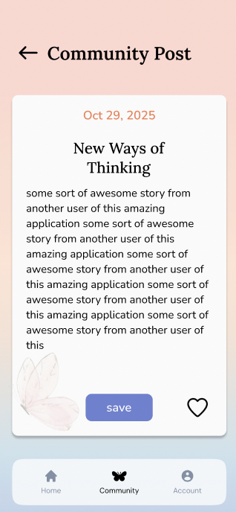
Moderate: Save from Community
Infinite scroll page
Goes back to community
Goes back to community after delay
React to the post to show support
Works for any post

Slide 37
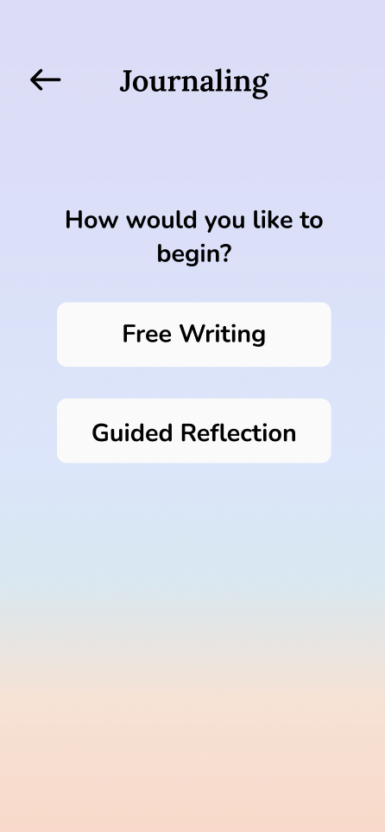
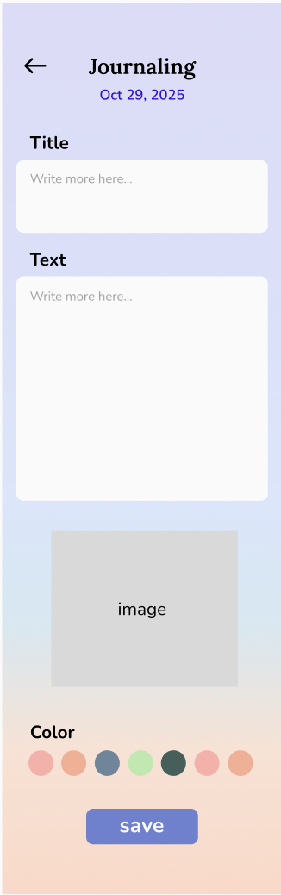
Complex: Create Own Note
Add own title/caption + text
Upload media
Moves into confirmation of private or public post page.
Two options: either a free writing or guided reflection. We will follow freewriting first

Slide 38
Complex: Create Own Note
Layered prompting. Multiple prompts to choose from.
Guided Reflection flow
Moves into confirmation of private or public post page.

Slide 39
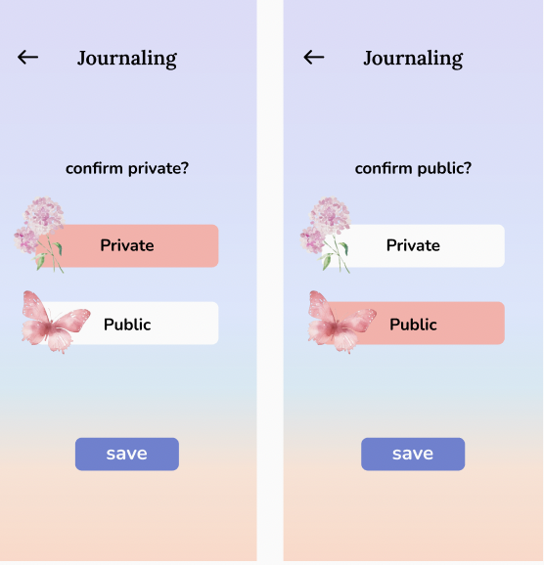
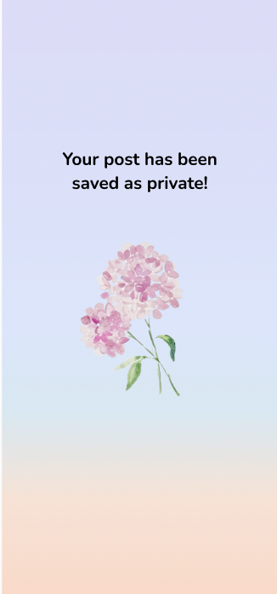

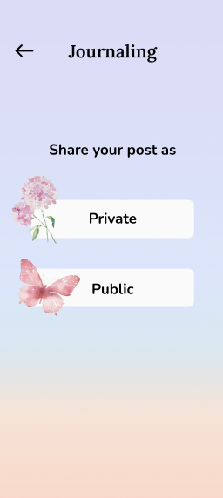
Complex: Create Own Note
After delay, goes back to the homepage
Click on private or public button

Slide 40

Prototype Implementation Tool: Figma
Pros | Cons
Real-time collaboration: Multiple team members could design and edit simultaneously | Steep learning curve: Needed time to gain familiarity with tool
Component reusability: Enabled consistent UI design through reusable assets and frames (use of design systems) | No user input capture: Figma prototypes can’t store or analyze user behavior, making it harder to test how users would actually interact with features on the backend.
The tradeoff was acceptable since Figma offered the optimal balance between design capability and usability for our med-fi prototype.
Notes:
rototype implementation a. Tools: What did you use? Pros and cons of using this tool(s)? b. Why the pros/cons tradeoff was acceptable for your implementation c. Limitations of the prototype: What was left out? Why? d. Hard-coded and Wizard-of-Oz features e. What was the impact of these limitations on the user experience?

Slide 41

Prototype Implementation Tool: Lovart
Pros | Cons
Time Efficient: We could work on other parts of our project while Lovart was generating the icons we needed. | Confusion in Task: Even with refined prompting skills, the AI could still get confused, and we would have to re-run the generation of a component.
Ease of use: Minimal learning curve to learn how to prompt in order to generate the things we needed. | Credits: Can run out of credits when we rely on the free starter pack.
Overall, the tradeoffs were a good choice as we ultimately could generate the components we need while saving time. It would take us a few tries, but it didn’t mean we wasted more time on just this one part.
Notes:
rototype implementation a. Tools: What did you use? Pros and cons of using this tool(s)? b. Why the pros/cons tradeoff was acceptable for your implementation c. Limitations of the prototype: What was left out? Why? d. Hard-coded and Wizard-of-Oz features e. What was the impact of these limitations on the user experience?

Slide 42
Limitations and Trade-Offs
Components left out | Reason
Lack of Infinite Scroll: only a limited number of community messages could be displayed at a time rather than an endless feed. | Creating a simulated “infinite” feed in Figma would’ve required manually duplicating tons of content frames, which isn’t practical or necessary for demonstrating the core flow.
Limited Animation Capabilities: dynamic animations of butterflies could not be implemented in Figma. | Animation is only a cherry-on-top, enhancing the experience but is not essential to the core framework.
No Backend Functionality: no backend logic or data storage.. | Adding backend systems or advanced animations would have required custom code and extended development time, and is not yet required at the med-fi stage.

Slide 43
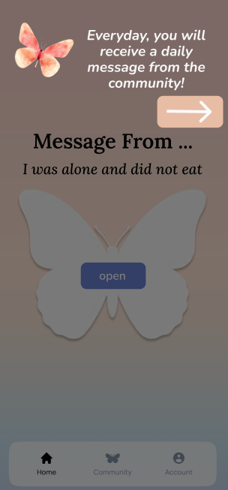
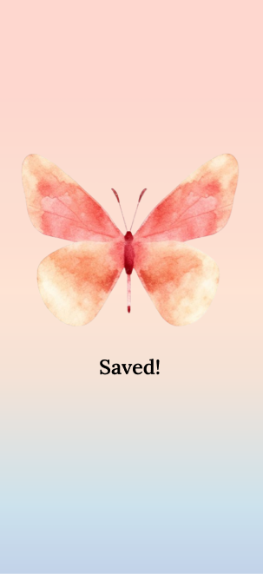
Wizard-of-Oz Features
Simulated engagement: The user appears to “receive” a daily message at random, but the message delivered is predetermined.
Artificial state changes: Buttons, transitions, and screens were set up to mimic real functionality (e.g., showing “Saved!”) even though no data was actually stored.
Pre-populated interface: The user begins with pinned and saved posts to create the illusion of prior activity.
Ability to type: Lack of ability to type, therefore inhibiting creating captions and message content, which now all magically appear without the opportunity to personalize them.
Notes:
Wizard of Oz Techniques
To simulate realistic app behavior without a functional backend, we used several Wizard of Oz techniques:
The user magically begins with a pre-populated set of pinned, saved, and created posts, giving the illusion of prior engagement and activity.
Certain features, such as collecting posts or viewing personalized recommendations, were manually simulated through preset screens and transitions rather than dynamic functionality.
The user experience was designed to feel seamless and interactive, even though the underlying data and logic were not automated.
As of right now, there isn’t the ability to type, so the post captions and message content all magically appear without the opportunity to personalize and modify them. The selection process of media, such as pictures and the color of the butterfly/flower icon, was also omitted.

Slide 44
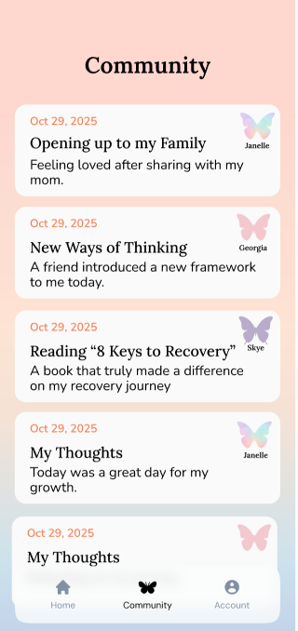
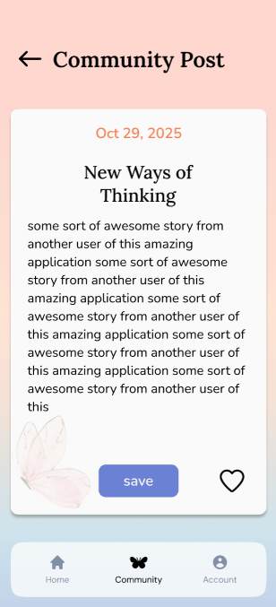
Hard Coded Features
User-related posts: Pinned, saved, and created posts were fixed in advance.
Daily Message: A static community message automatically appears on app launch, simulating the “daily message” feature.
Community Feed: Messages displayed on the Community page were pre-defined examples rather than dynamically generated content.
Daily Affirmation: There is no way to refresh the affirmation and it is hard coded to be one message.
Icons: The butterfly and flower icons on the homepage cannot be changed. Also the butterfly profile pictures and journaling prompts.
Notes:
The messages already saved and generated by the user (e.g., pinned, saved, and created posts).
The Daily Message from the community that appears when the app is opened.
The community messages that are displayed on the Community page.
The Daily affirmation at the top of our Home page.
The butterfly/flower icons that appear on the Home page, as well as the butterfly profile pictures from others’ posts.
journaling prompts

Slide 45
Thanks!
Do you have any questions?
Please keep this slide for attribution

Slide 46
Appendix

Slide 47
Link to Figma
Link to Prototype
Link to Design File

Slide 48
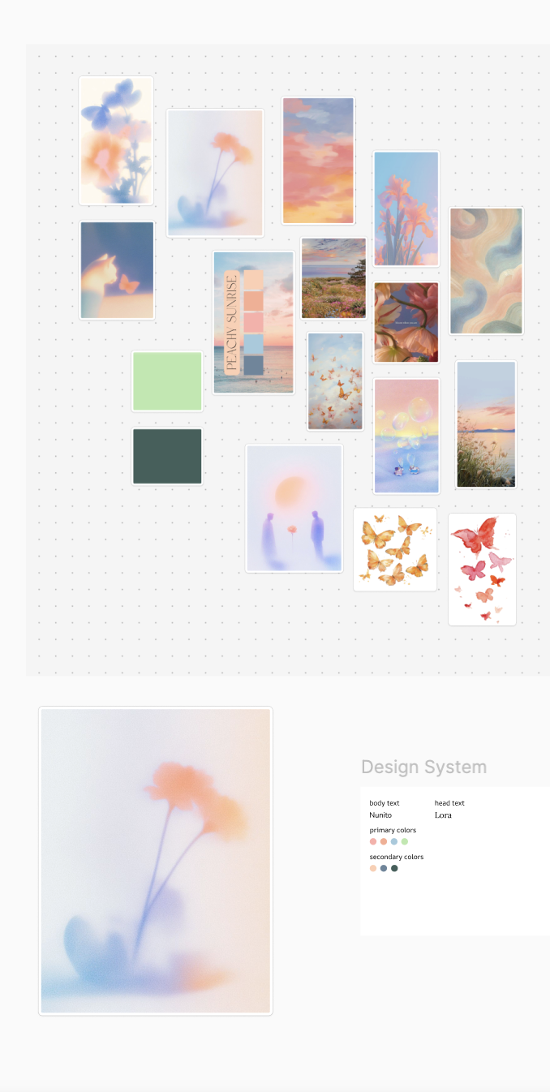
Mood Board

Slide 49
Additional Tasks:
Account Creation
Tutorial Task Flow
Entering Collections

Slide 50
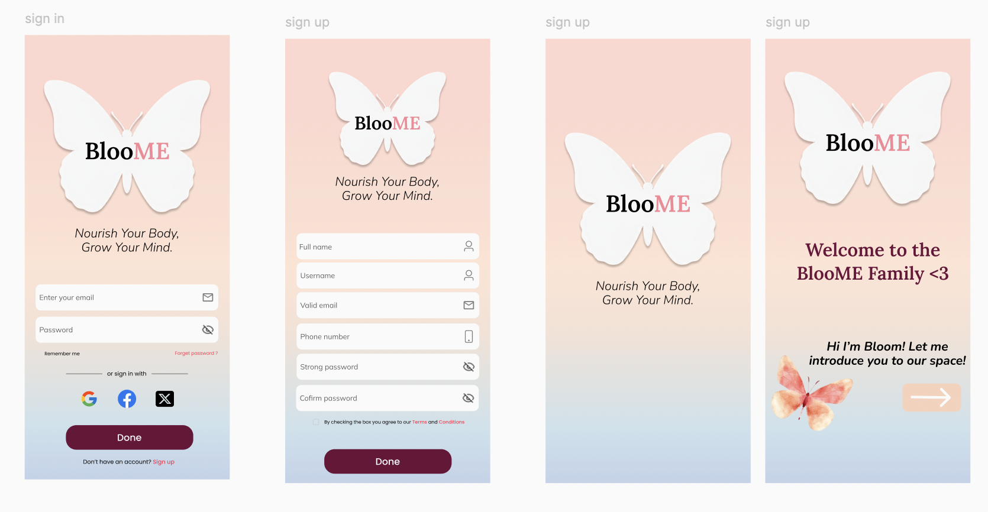
Account Task Flow
If you already have an account, navigates to transition page to home.
Account created and it will move you into the tutorial walkthrough
Click here to sign up for an account

Slide 51
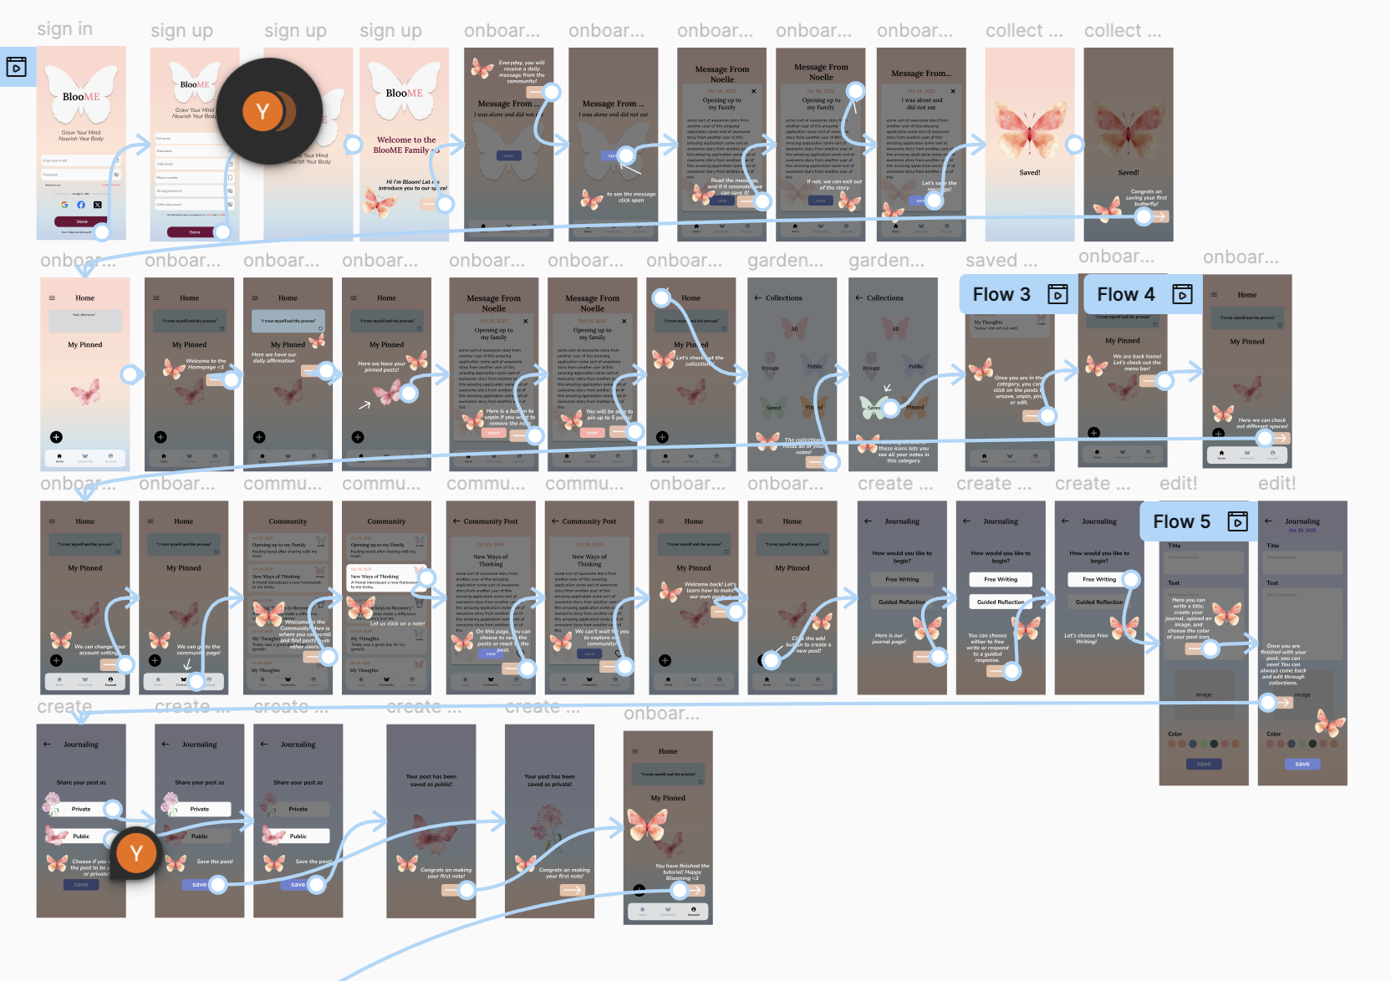
Tutorial Task Flow
In depth tutorial, for the 3 main tasks, led by Bloom, our butterfly companion.
Notes:
This almost took the life out of me <3

Slide 52
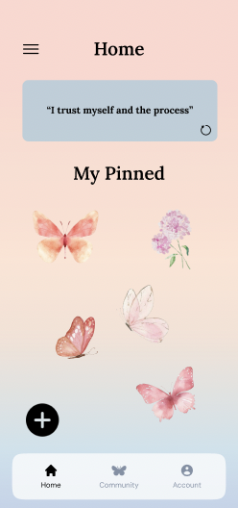
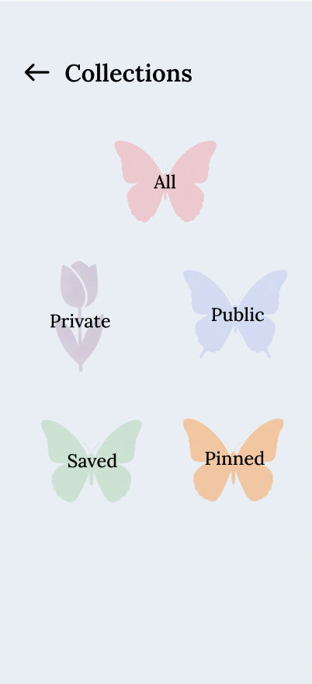
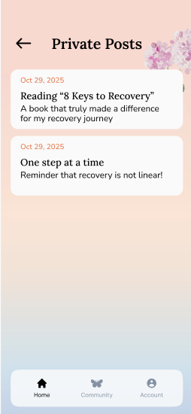
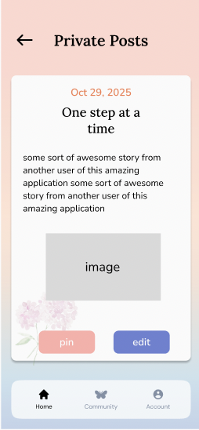
Collections Task Flow
Enter collections
Enter editing mode for a post
Can pin your post
Flow is the same for all the categories

Slide 53
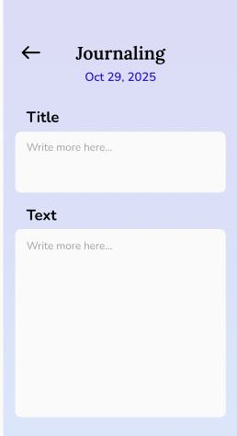
Collections Task Flow
Editing Mode:
Free write or guided reflection based on the choice made when creating the post
Goes back to the post that was being edited.

