Slide 1

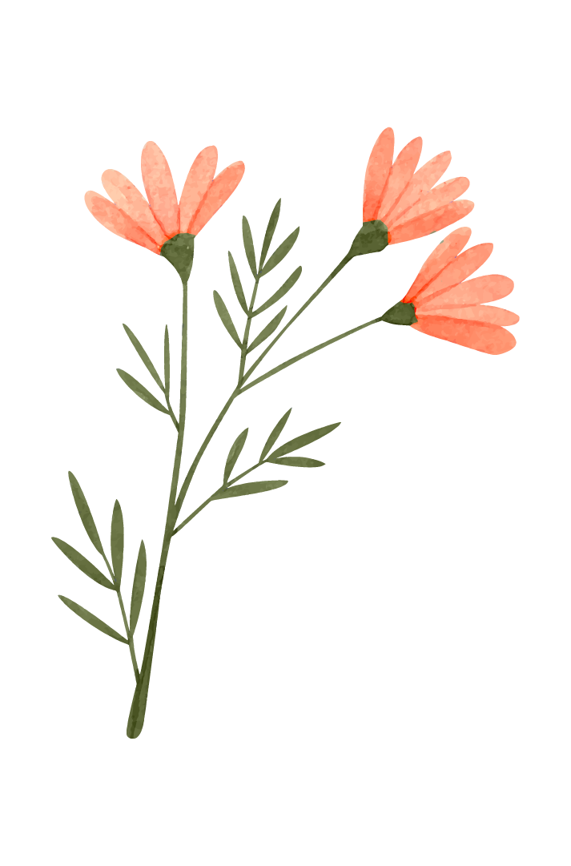


A8: Hi-fi Prototype
BlooME
Nourish Your Body, Grow Your Mind.

Slide 2
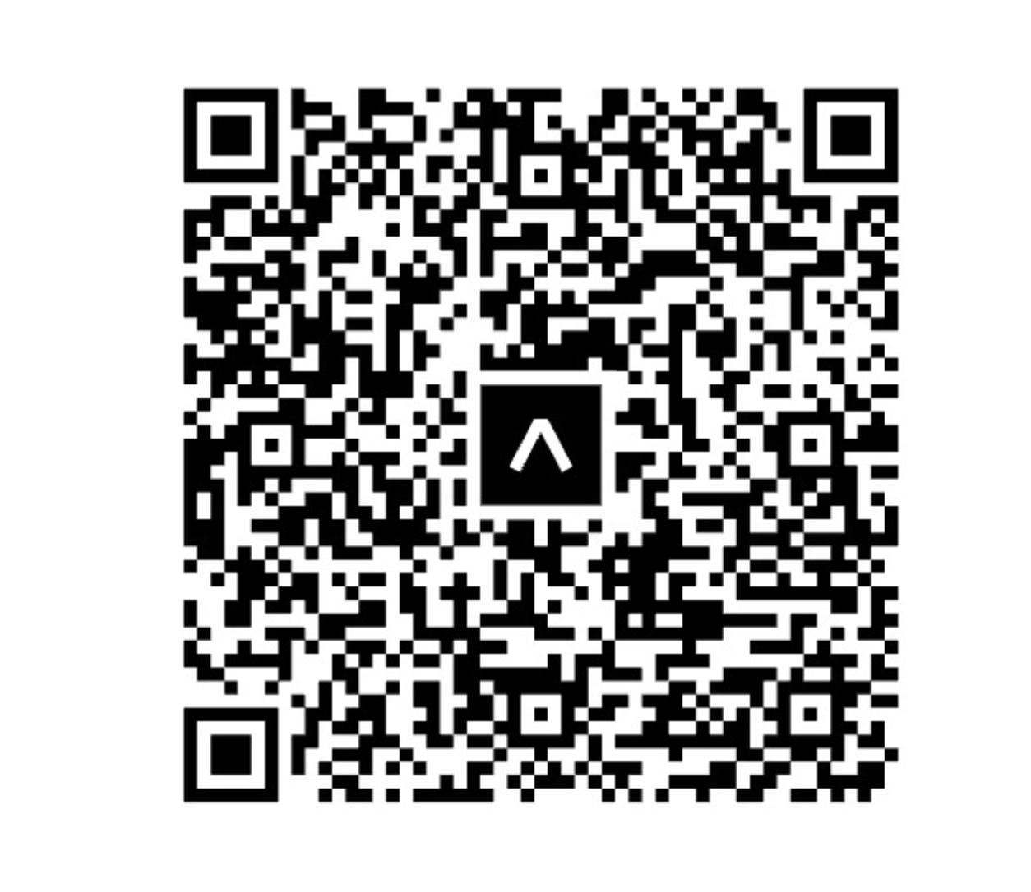
A8: Hi-fi Prototype
Nourish Your Body, Grow Your Mind.

Slide 3

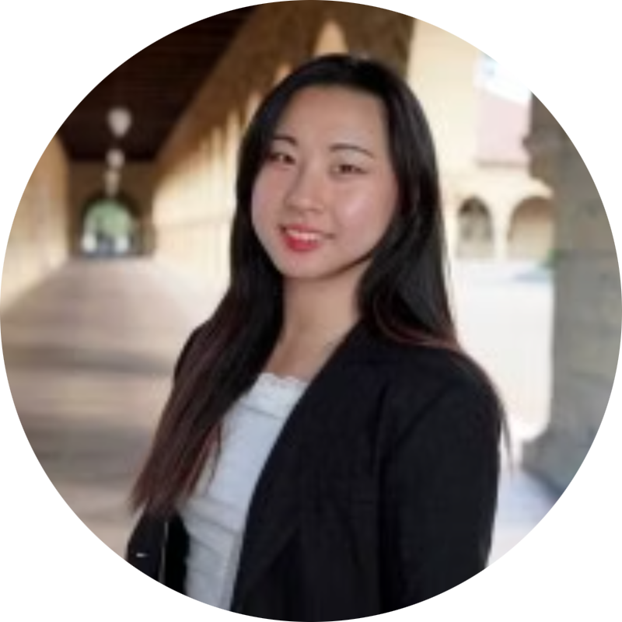
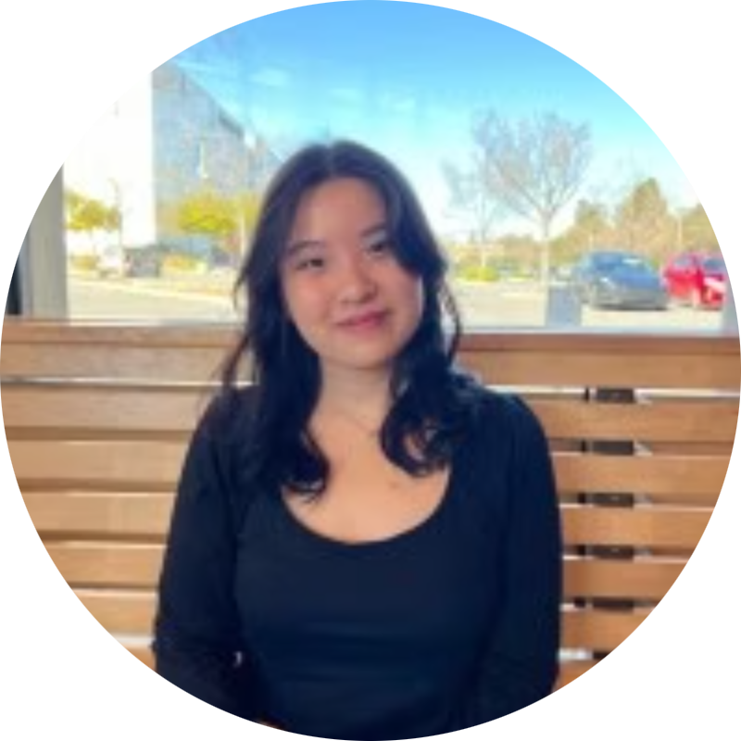
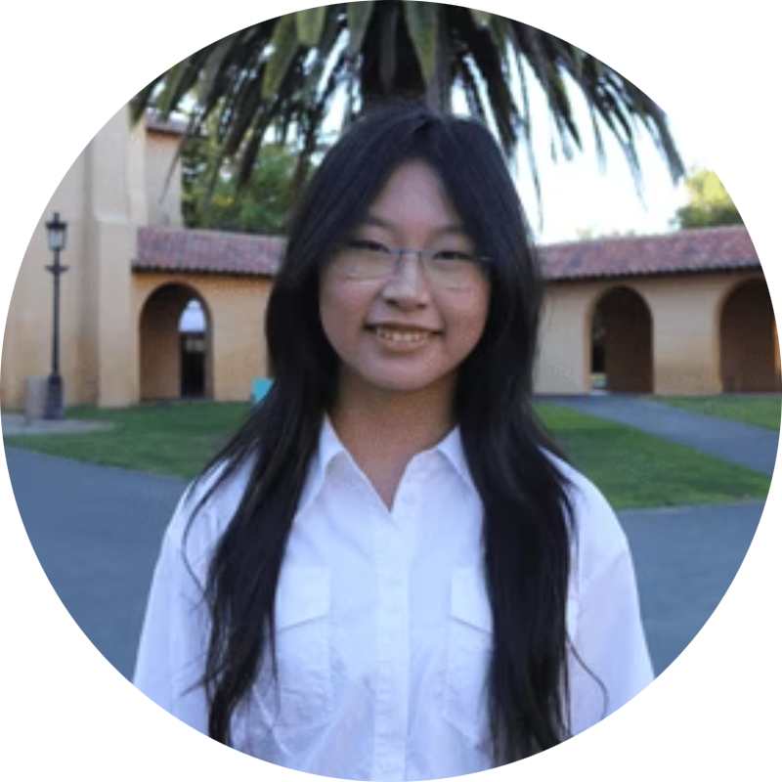
MEET JJYC
JASMINE X.
YUJEN L.
JADE C.
CLARE L.
Psychology & CS ‘27
Symbolic Systems ‘27
Symbolic Systems ‘27
Design ‘28

Slide 4



Presentation Outline
01.
02.
Problem & Solution Overview
HE Results Summary
03.
04.
UI and Product Revisions
Prototype Implementation Status + Demo

Slide 5

01.
Problem & Solution
Notes:
A supportive recovery companion combining peer stories with daily routines.

Slide 6
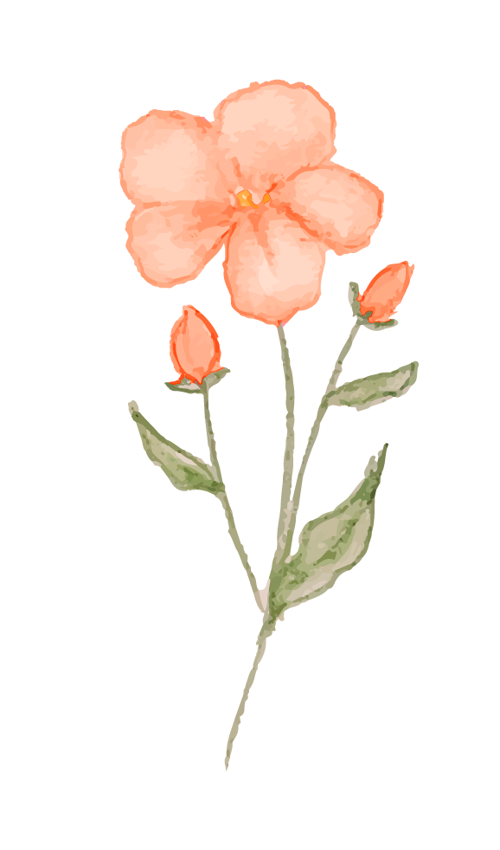
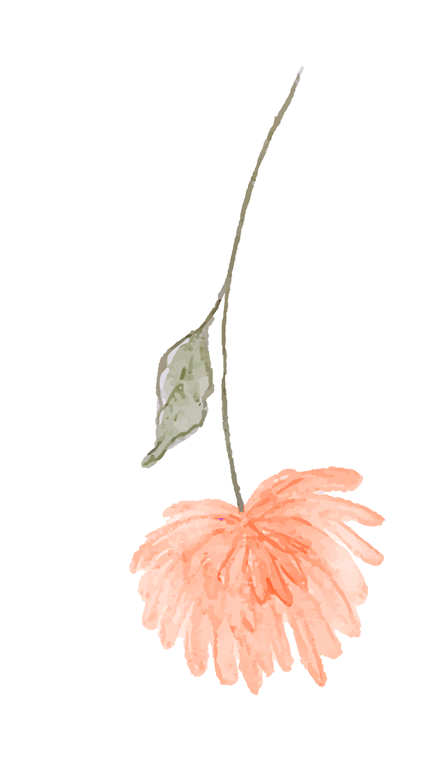


Problem
Many people who struggle with food, whether they fall into subclinical or clinical categories, often keep their pain to themselves. They hesitate to reach out to friends, family, or professionals because they feel a persisting anxiety in being a burden to others, and continue to live with their guilt around eating.

Slide 7
Solution
BlooMe is a peer-to-peer story-sharing app that pairs community warmth with daily structure. It also offers journaling prompts, a personal “butterfly sanctuary” to store encouraging messages, and community affirmations to guide recovery routines.

Slide 8
02.
HE Results Summary

Slide 9
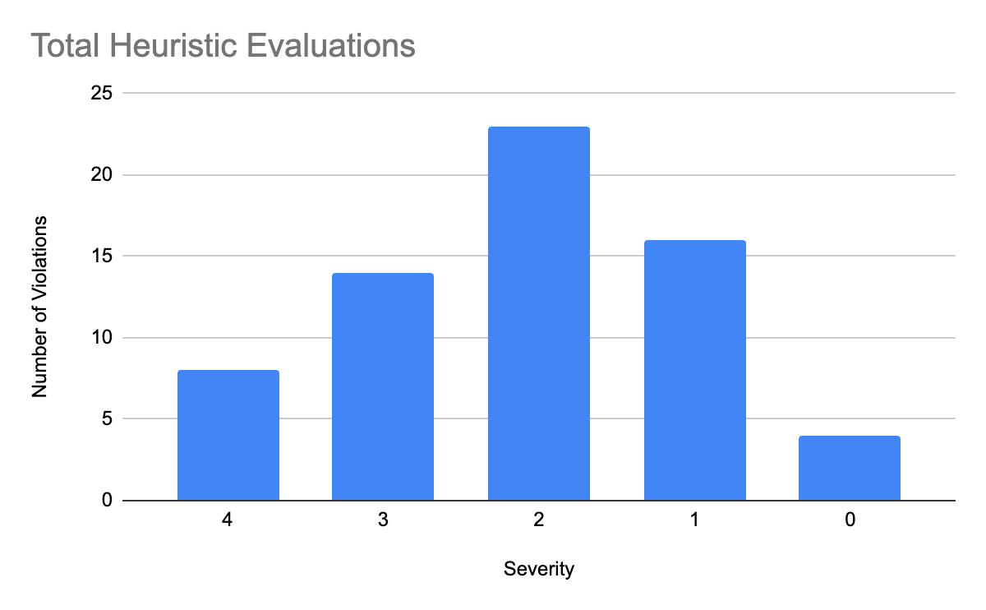
Total violations: 68
4’s: 8
3’s: 14
2’s: 23
1’s: 16
0’s: 4
Notes:
High-level summary of results: total violations, severity breakdown, most common violations, total number of UI revisions needed to be made based on the major severity 3 & 4 violations as well as any severity 1 & 2 violations deemed necessary
Consider communicating your results through a visual representation of these statistics and reflecting on how these high-level trends informed your approach to addressing the violations

Slide 10
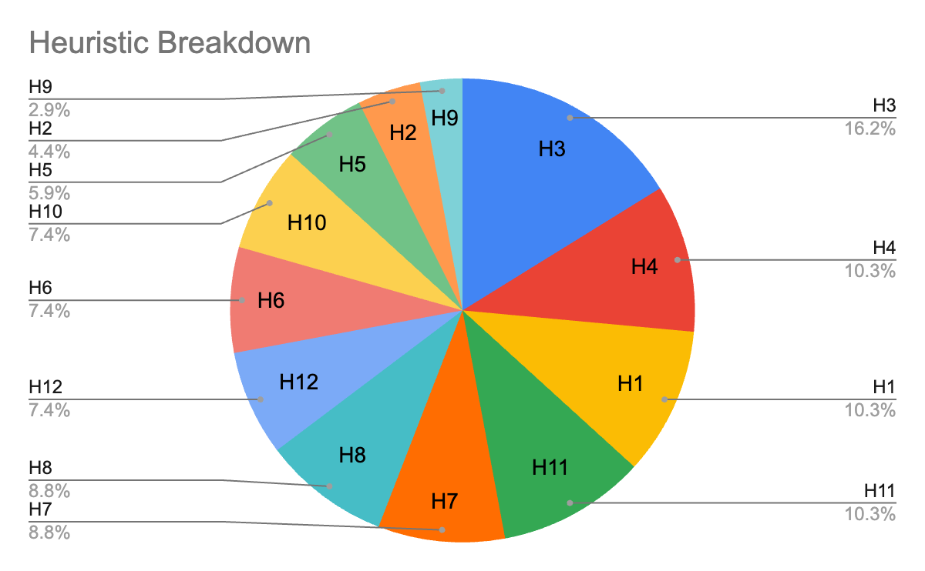
Most Common
H3: User Control & Freedom (11)
H4: Consistency & Standards (7)
H1: Visibility of System Status (7)
H11: Accessible Design (7)
Notes:
High-level summary of results: total violations, severity breakdown, most common violations, total number of UI revisions needed to be made based on the major severity 3 & 4 violations as well as any severity 1 & 2 violations deemed necessary
Consider communicating your results through a visual representation of these statistics and reflecting on how these high-level trends informed your approach to addressing the violations

Slide 11
Results Summary
Total # of UI revisions:
Severity 3’s and 4’s: 14 (cut down from 17 due to overlap)
Extra Revisions:
Severity 1’s and 2’s:
13
Notes:
High-level summary of results: total violations, severity breakdown, most common violations, total number of UI revisions needed to be made based on the major severity 3 & 4 violations as well as any severity 1 & 2 violations deemed necessary
Consider communicating your results through a visual representation of these statistics and reflecting on how these high-level trends informed your approach to addressing the violations

Slide 12
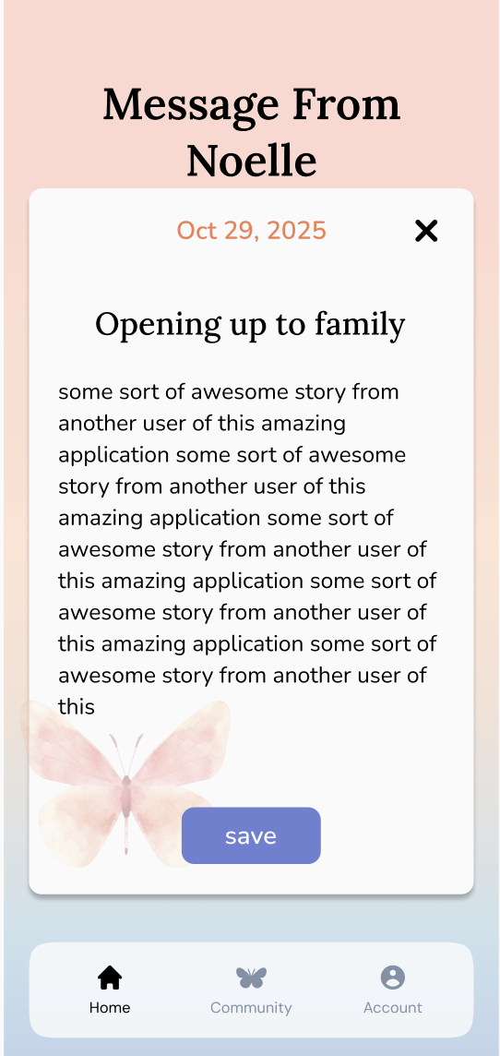
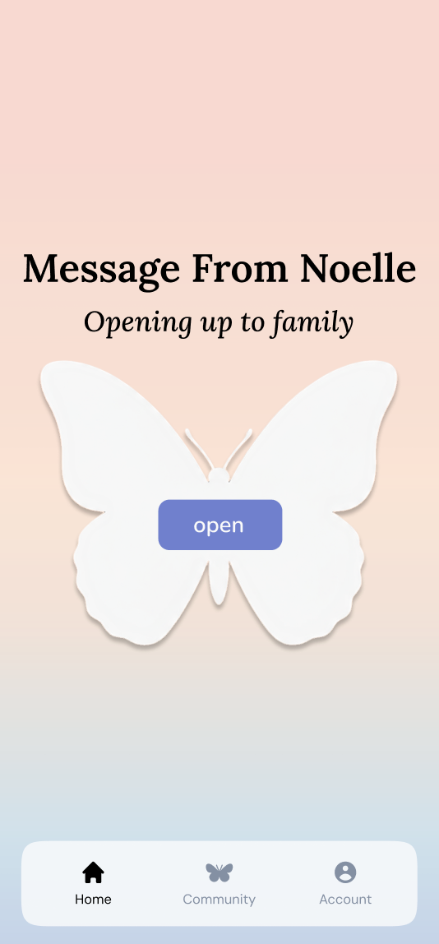
List of proposed changes: Simple
Being able to exit the daily message, but only after a delay for 5 seconds
Removing the daily affirmation and replacing it with daily message so users can revisit
Notes:
Discuss and justify changes to address all severity 3 and 4 violations
i. Violations should be clearly connected to the changes made in part 6. Consider using visuals to explain specific issues.

Slide 13
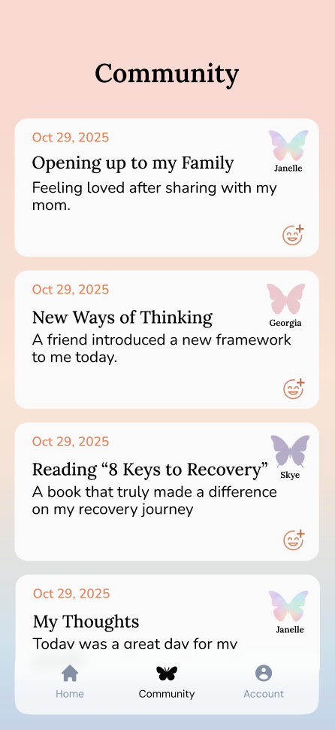
List of proposed changes: Moderate
Adding tags (reflective, uplifting, tips) to appeal to categorization and clear values
Add a customizable profile picture feature (confusion in iconography)
Add more captioning and description
After pressing save, staying on the page of the message rather than going home
Notes:
Discuss and justify changes to address all severity 3 and 4 violations
i. Violations should be clearly connected to the changes made in part 6. Consider using visuals to explain specific issues.

Slide 14
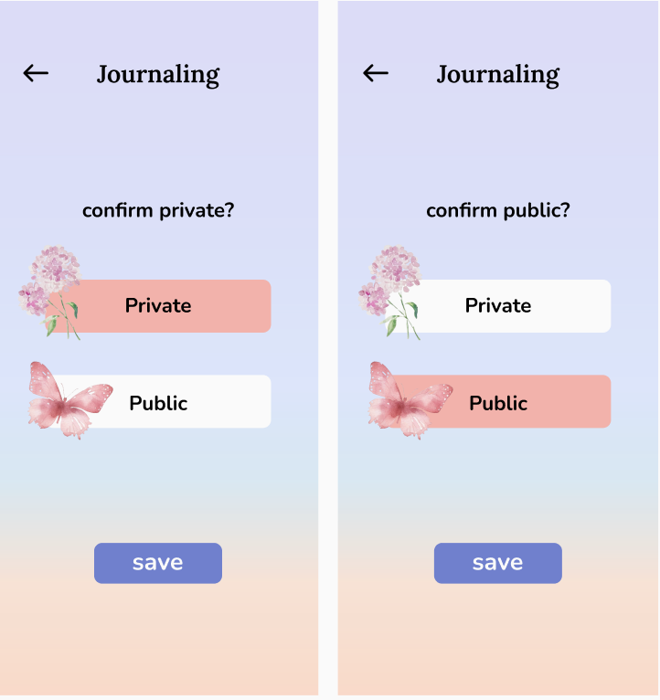
List of proposed changes: Complex
Adding a delete/undo button for unwanted posts
Adding progress bar
Not always landing home after an action (staying on feed after post)
Reframing language for journaling guidance to be more supportive for the user, aligning with our values
Toggling between private and public in edit mode
Notes:
Discuss and justify changes to address all severity 3 and 4 violations
i. Violations should be clearly connected to the changes made in part 6. Consider using visuals to explain specific issues.

Slide 15
List of proposed changes: All Tasks
Adjust saturation and luminance of text colors against light backgrounds
Flipped account and collections, to make it easier to find
Adding error messages (blank boxes, inability to post, etc.)
Navigation inconsistencies, will finalize pathways
Realign our visual components through a grid
Change the vocabulary all to post for things shared and message for things received
Notes:
Discuss and justify changes to address all severity 3 and 4 violations
i. Violations should be clearly connected to the changes made in part 6. Consider using visuals to explain specific issues.

Slide 16
Justification of Rejected Suggestions
H11: Accessible Design
Prototype lacks keyboard navigation or screen-reader structure
While accessibility is important, and we agree, this feature isn’t high on our priority list. It is not feasible, but we want to add text size changing and taking advantage of dictation for creating posts
Notes:
i. Violations should be clearly connected to the changes made in part 6. Consider using visuals to explain specific issues.

Slide 17
Additional Accepted
H12: Value Alignment and Inclusion (Complex)
Tone of the reflection can be further refined
To use language that are aligned with the values of compassion and gentle growth. Show encouragement
H2: Match w/ System and World (All)
Confusing terms that make an unclear mental model.
Make our terminology consistent internally and externally.
Notes:
31

Slide 18
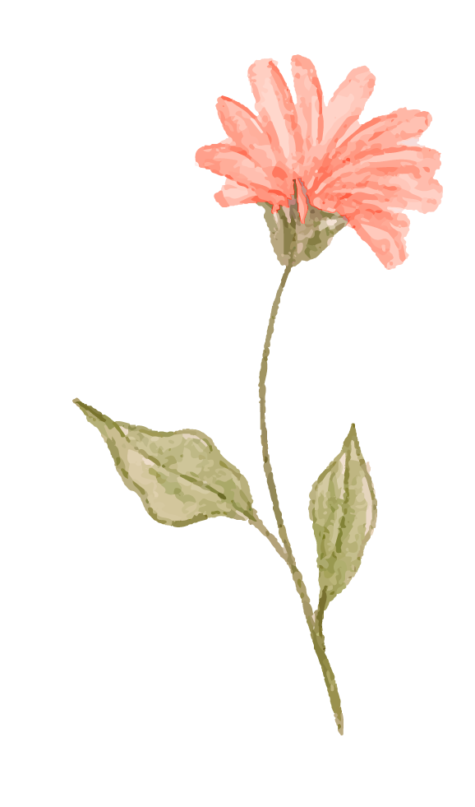

03.
UI & Product Revisions
Notes:
Before and after shots b. Rationale for changes c. Progress towards each usability goal made by the revised designs. Discuss the impact of the progress made on design values, project next steps, and/or overall success metrics

Slide 19
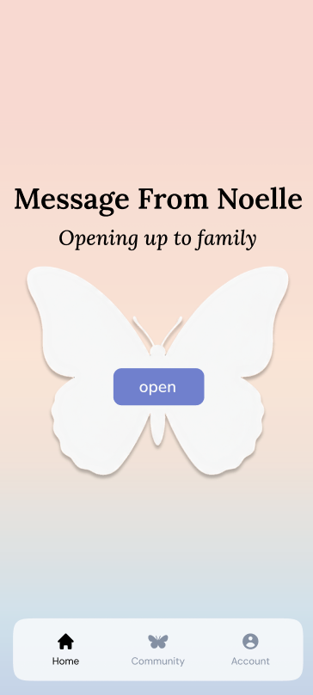
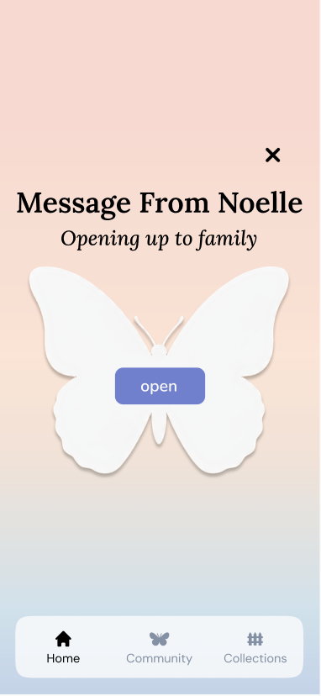
Simple Task Change: Reject Note of the Day
Change of the delay in the adding an option to exit out of the Note of the Day.
After delay
Improve Flexibility
Notes:
Progress towards each usability goal made by the revised designs. Discuss the impact of the progress made on design values, project next steps, and/or overall success metrics.

Slide 20
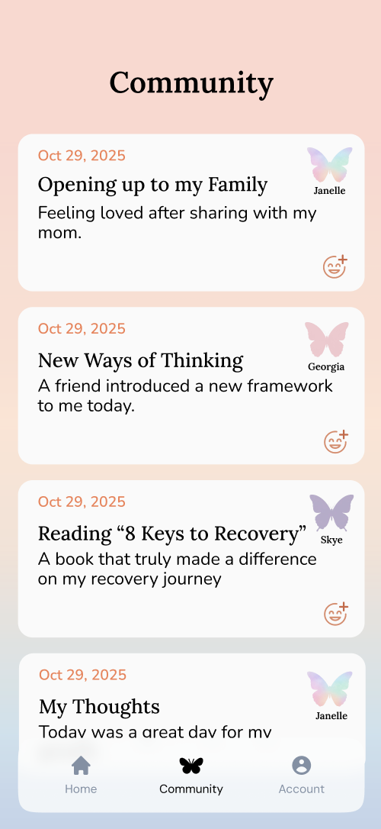
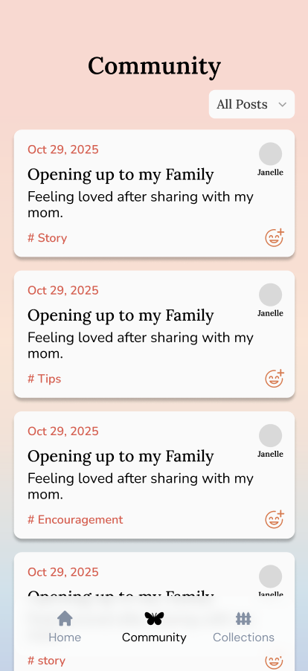
Medium Task Change: Incorporating Filter
Incorporated a tags and filtering feature for organization and to be transparent about our product’s values
Improve on Compassion
Flexibility
Efficiency

Slide 21
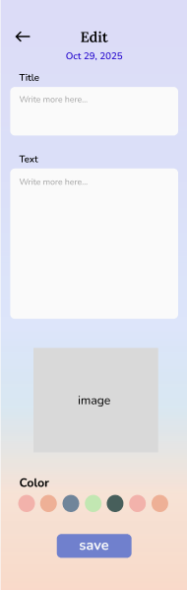
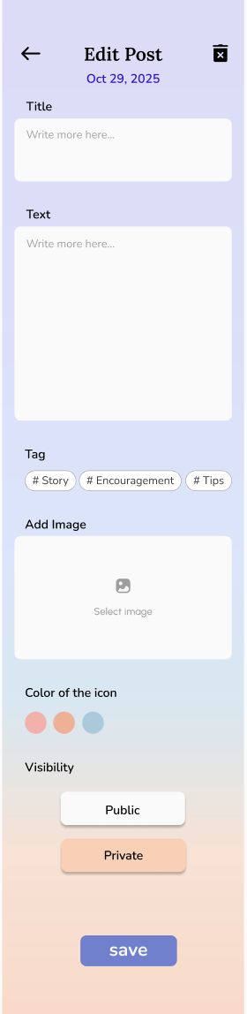
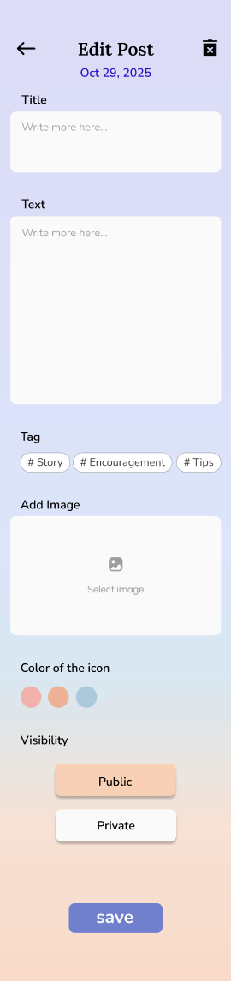
Complex Change: Private and Public Toggle
Allowing a user to toggle between private and public after posting
Improve Flexibility
Efficiency

Slide 22
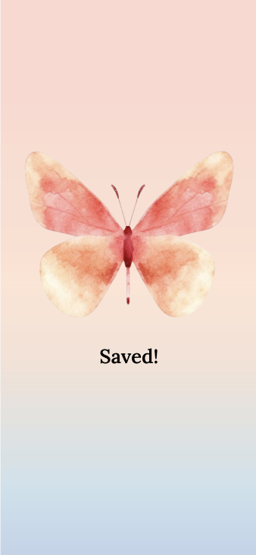
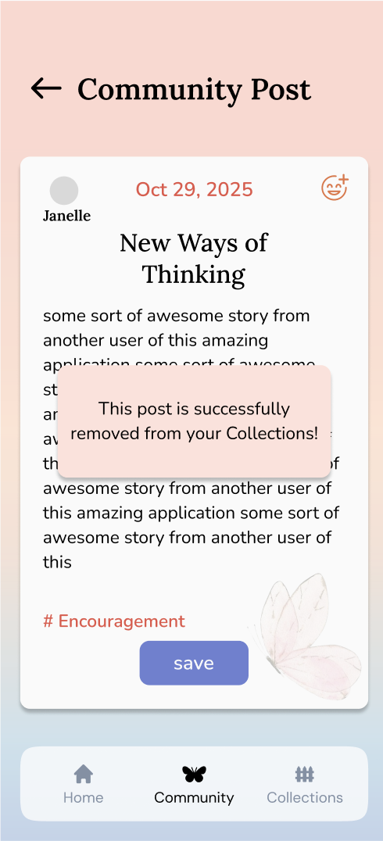
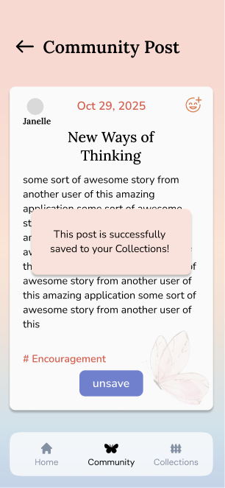
Change: Landing Page After Saved
After saving a post, rather than returning to home, the user stays on the feed for further interaction and user freedom.
Improve Flexibility

Slide 23
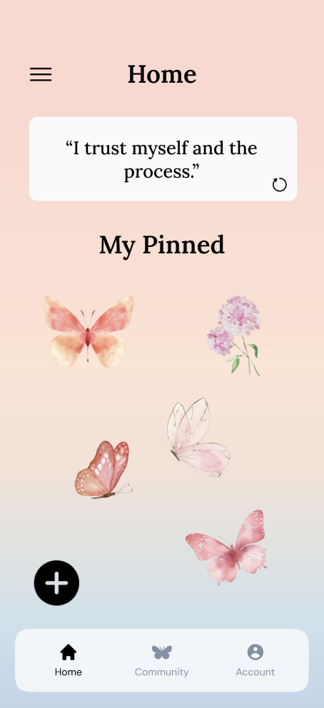
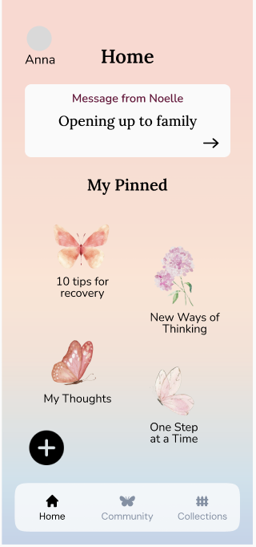
Change: Navigation Bar + Account
Changed the sandwich menu to the account page
Made the collections a new button in the navigation bar for clarity.
Improve Recognition
Efficiency
Clarity

Slide 24
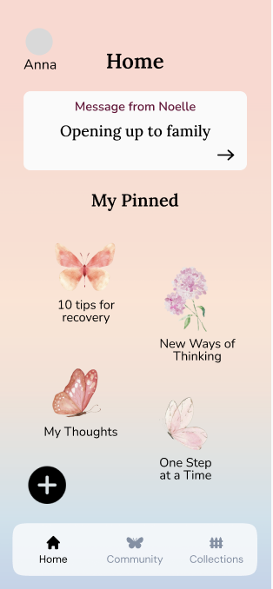
Change: Recognition of Pinned
Captioned the pinned with their respective titles to appeal to recognition rather than having the user click around to figure out the function of the icons.
Improve Recognition

Slide 25
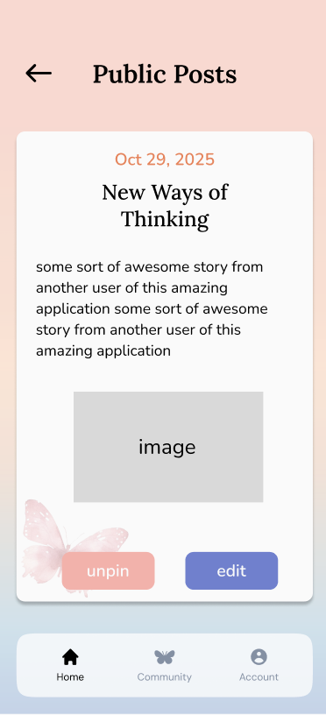
Change: Delete Post
Have a trash or undo button. If a user wants to take down a post after it goes into feed, they now have the option to.
Improve Flexibility

Slide 26
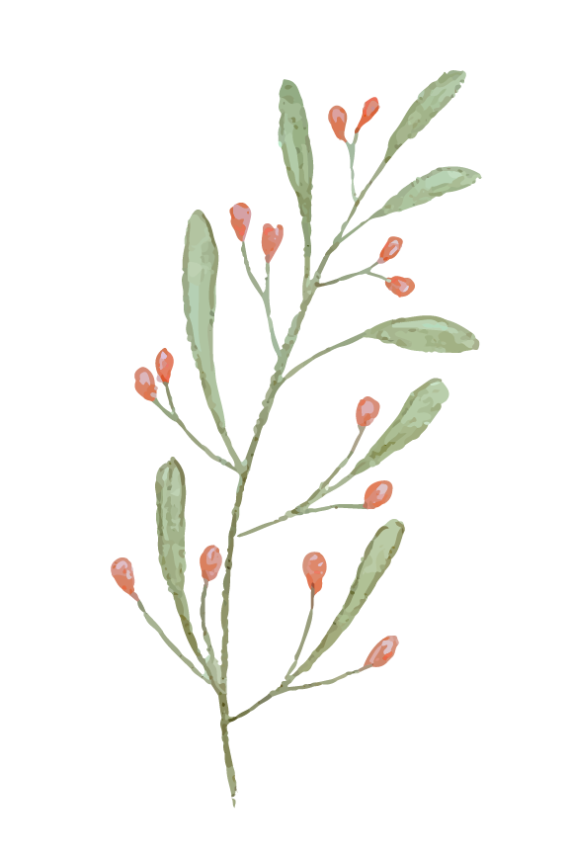
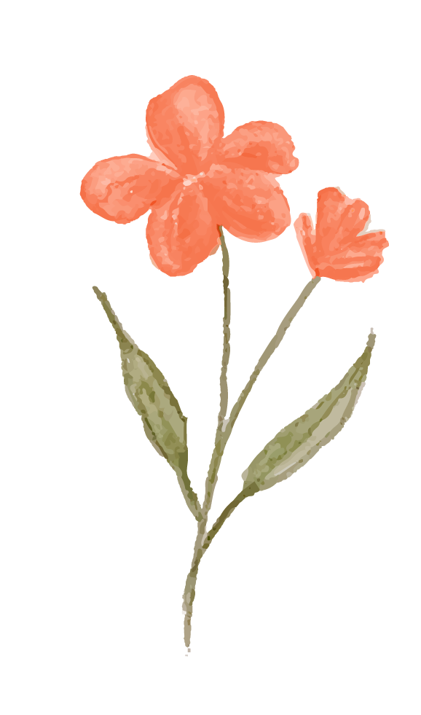

04.
Prototype Implementation Status + Demo
Notes:
Framework/tools being used and what each is being used for b. (if applicable) How AI was used in implementation and visual design: explain exactly where AI was used with justification of why c. Implemented features d. Unimplemented features & plans to finish with an estimated timeline e. Wizard of Oz techniques (& justify why Wizard of Oz was necessary) f. Hard-coded aspects (& justify why hard coding was necessary) g. Issues/Questions: Anything you are unsure of how to do? h. Discussion on plan for finishing i. Consider including a discussion of how your team will prioritize the remaining work and who will be responsible for what

Slide 27






Tools Used
ReactNative (development framework)
Expo (app framework) & Expo Router (Navigation)
Supabase (database)
Visual Studio Code (IDE)
Figma (for design components)
GitHub (collaboration)
Notes:
a. Framework/tools being used and what each is being used for b. (if applicable) How AI was used in implementation and visual design: explain exactly where AI was used with justification of why

Slide 28

Implemented features
Moderate Task
Community Feed
Filtering
Reactions
Click into Posts
Saving Posts
Simple Task
Receiving the Message of the Day
Saving the Message
Other Tasks:
Home Screen
Small Animations

Slide 29
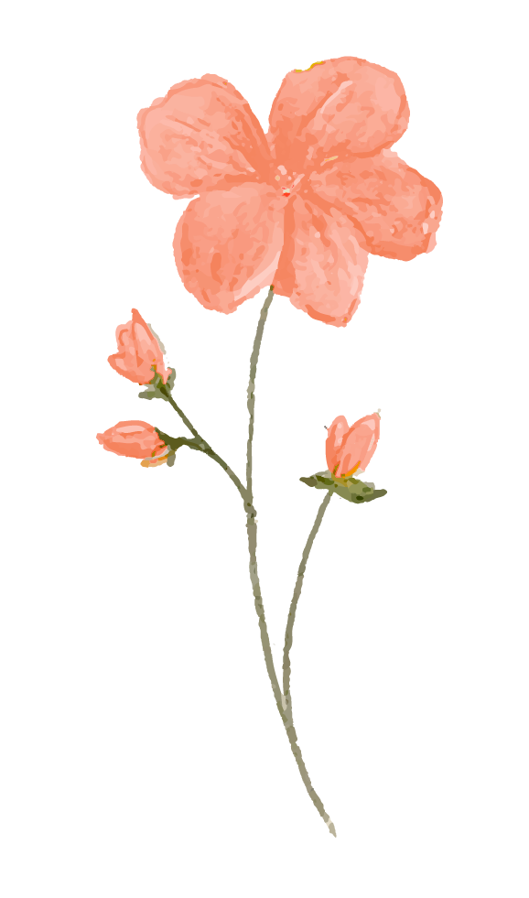
Unimplemented features
Task 3: Journaling and Posting
Collections Page + Editing Page
Account Set Up
Tutorial
Timeline:
Over Thanksgiving: Set up databases ( need to set up 6: users, profiles, journal posts (for both private and public), reactions, saved post, pinned post) and called in within the screens
Work on Task 3
Having the screens ALL visually set up.
Setting up the backend, making sure that the navigation are calling the right files
Work on Account Setup
Week 10:
Adding animations and small detail
Add Tutorial
Notes:
Unimplemented features & plans to finish with an estimated timeline

Slide 30
Wizard of Oz
Simulated reactions: Reactions shown beneath posts are not created by real users, but are placeholder reactions to simulate social engagement. Reactions are also not saved to a database.
Sharing Journals: Publishing appears instantaneous to mimic a robust backend, but the confirmation is purely UI-based.
Simulated saving: When a user “saves” a post, the action is visual only. The app displays a saved-state icon, but no data is written to a backend or persistent storage.
Notes:
Moved some stuff here:
Just for this demo, several features are mocked rather than fully implemented (these will be adjusted for full demo in Week 10):
Reactions (they aren’t saved in a database yet)
All the community posts are just magically appearing. (for most of these the actual database will not be implemented since we need the journaling page that connects to it).

Slide 31
Wizard of Oz
Justification:
These Wizard-of-Oz techniques were used because all user-to-user interaction features, such as public journals, community posts, and reactions, require an active user base to function authentically.
Since the app does not yet have real users, we needed a way to simulate the presence of a community in order to test the core peer-support concept. By using WOZ methods, we were able to demonstrate the intended social experience and evaluate the value of community-based support, even without a fully populated user base.
Notes:
Moved some stuff here:
Just for this demo, several features are mocked rather than fully implemented (these will be adjusted for full demo in Week 10):
Reactions (they aren’t saved in a database yet)
All the community posts are just magically appearing. (for most of these the actual database will not be implemented since we need the journaling page that connects to it).

Slide 32
Hard Coded Aspects
Daily Message: A static community message automatically appears on app launch, simulating the “daily message” feature.
Static User Profiles: Profile details (e.g., username, avatar, tags) are hard-coded and identical across sessions rather than editable or personalized per user.
Prepopulated Database of Posts: Messages displayed on the Community page were pre-defined examples in the database rather than dynamically generated content.
Non-Persistent Data: New posts, reactions, or changes made during testing are not stored.
Notes:
Moved the stuff about prepopulated posts and daily messages to here (seems more hard coded rather than WOZ)

Slide 33
Hard Coded Aspects
Justification: Because we did not yet have real users interacting with the platform, and given the time required to implement backend logic for dynamic content, we chose to hardcode the daily message and pre populate the community database.
This allowed us to simulate core user flows, focus on the UX experience, and ensure consistent behavior during testing without building full backend infrastructure.
Notes:
Moved the stuff about prepopulated posts and daily messages to here (seems more hard coded rather than WOZ)

Slide 34
Looking Ahead
Coding our Backend & Front End(Main Developer Jade + Support from the Rest)
Finalize Design Details (Clare and Yujen)
Poster, Pitch + Final Report, and README File (Yujen and Jasmine)
Working on our project + Turkey
Notes:
Discussion on plan for finishing i. Consider including a discussion of how your team will prioritize the remaining work and who will be responsible for what
Issues/Questions: Anything you are unsure of how to do?

Slide 35
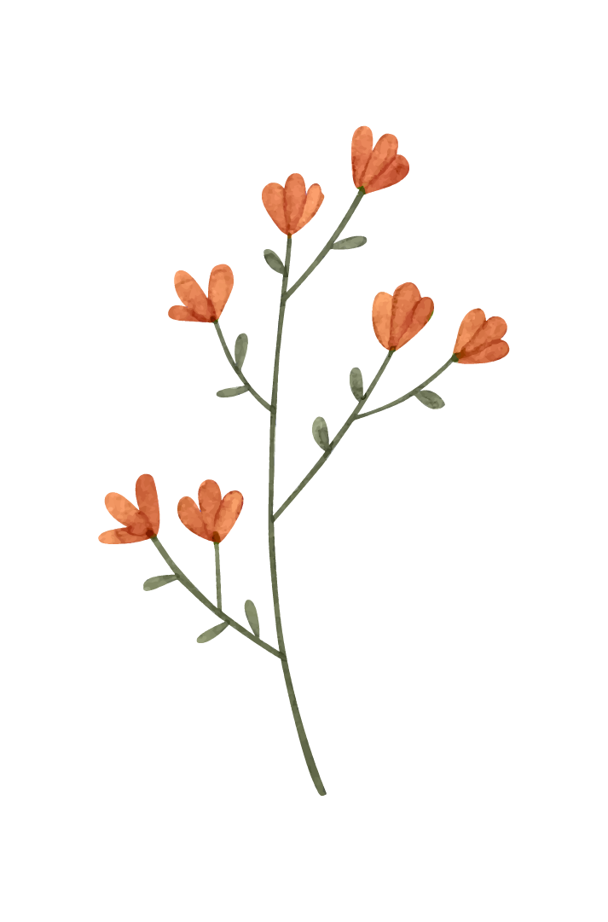
Demo!

Slide 36
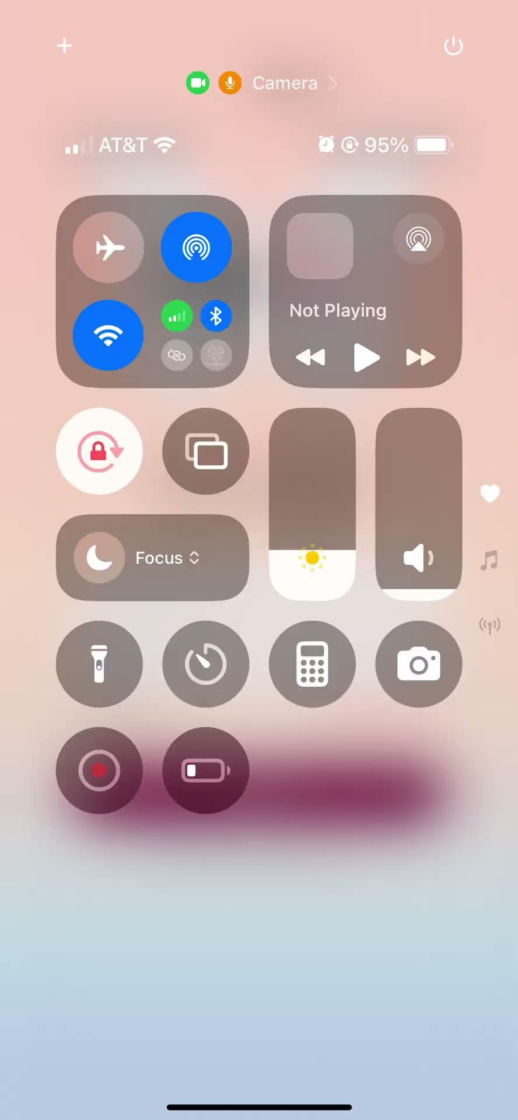
Notes:
Discussion on plan for finishing i. Consider including a discussion of how your team will prioritize the remaining work and who will be responsible for what
Issues/Questions: Anything you are unsure of how to do?

Slide 37

Thanks!
Do you have any questions?

Slide 38
Appendix

Slide 39
Simple Task Change: Removed Daily Affirmation
Changed the daily affirmations to the message of the day as an easy way to access if a user wants to repeat, or they initially rejected the message.
Improve Flexibility
Notes:
When the app loads the “Daily Affirmation,” there’s no indicator that it’s refreshing or up-to-date, it just appears statically.

Slide 40
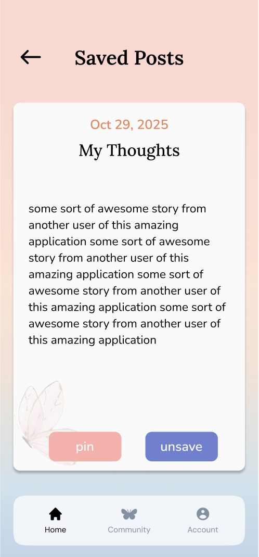
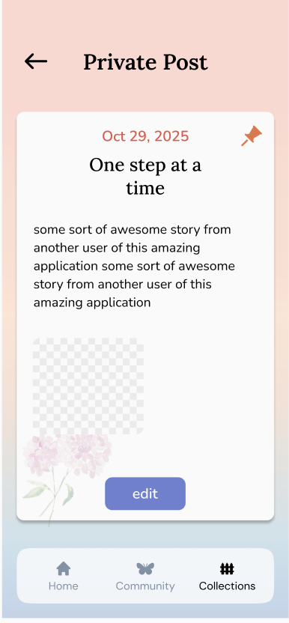
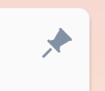
Change: Pin Icon
Pin and unpin icon to make the function more intuitive
If pinned, highlighted orange, if not it is gray
Improve Recognition

Slide 41
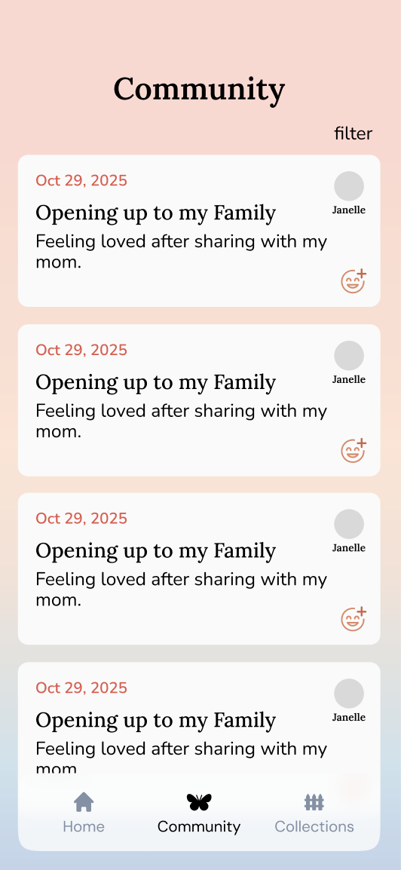
Medium Task Change: Profile Icon
Changed the profile iconography to minimize confusion in repeated icons and their meaning
Improve Clarity

Slide 42
Medium Task Change: Color Luminance and Saturation
Using a pastel shade for the font made it difficult for the user to see. We chose a deeper color to make it more visually apparent.
Improve Visual Design

Slide 43

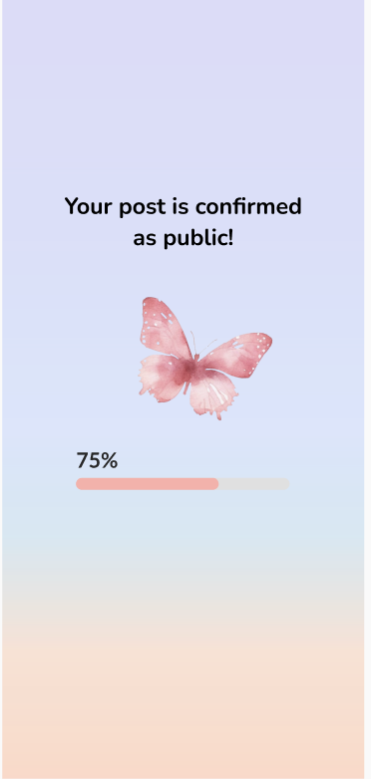
Change: Progress Bar
Added a progress bar to show the system status when sharing a post rather than leaving the user blind.
Improve System Visibility

Slide 44
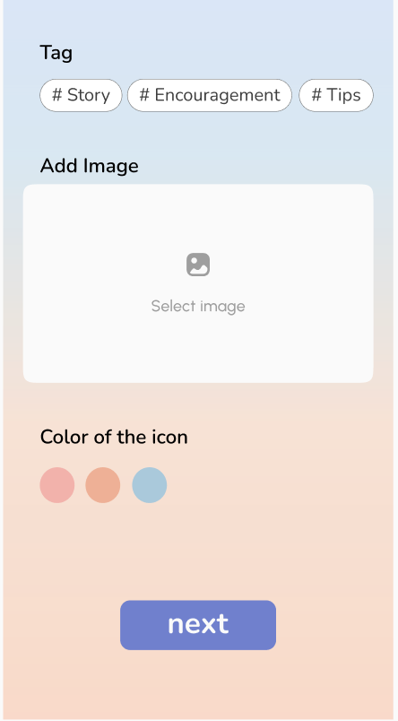
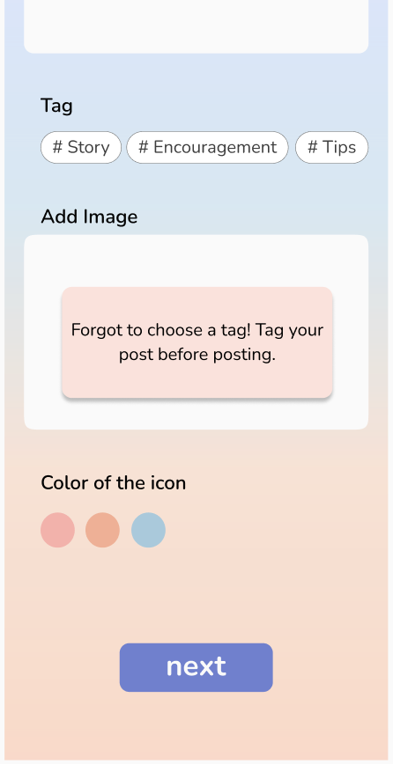
Change: Error Messages
Adding error messages to guide the user to work through problems when encountered
Improve Efficiency

Slide 45
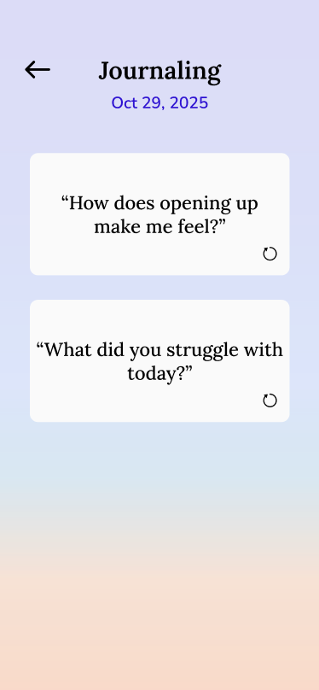
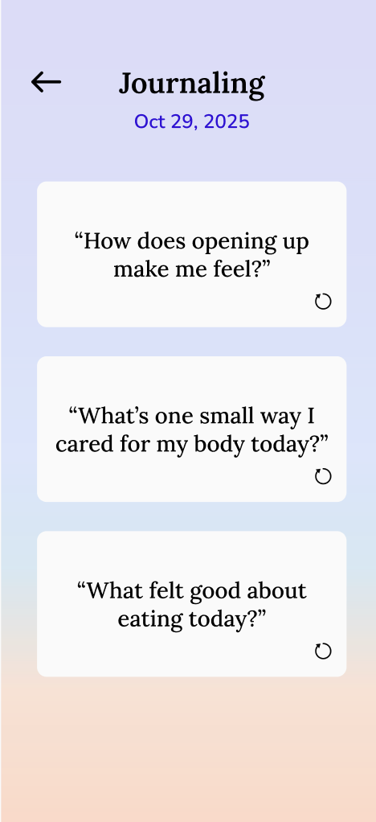
Complex Task Change: Reframe Guidance Language
Being aware of our values and framing our language in an encouraging, positive, and reflective manner
Improve Compassion

Slide 46
Minor UI Changes
We had some trouble with alignment throughout our design, so we utilized the grid and made our alignment and design choices consistent throughout the frames.

