Slide 1



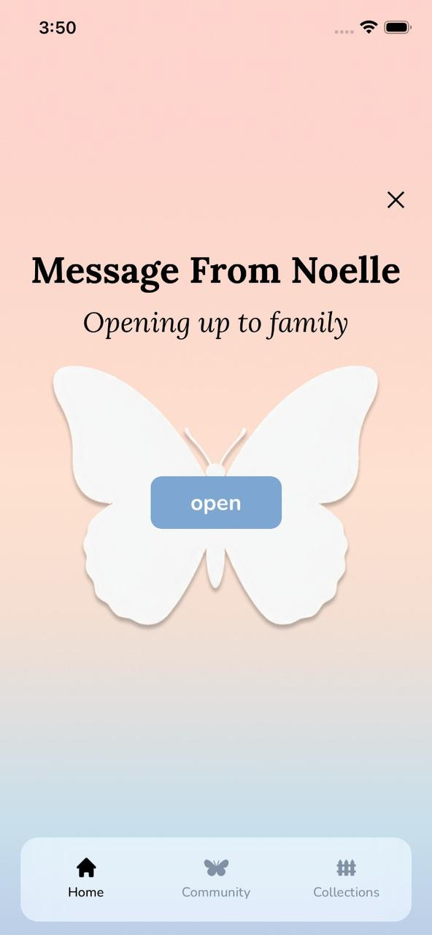
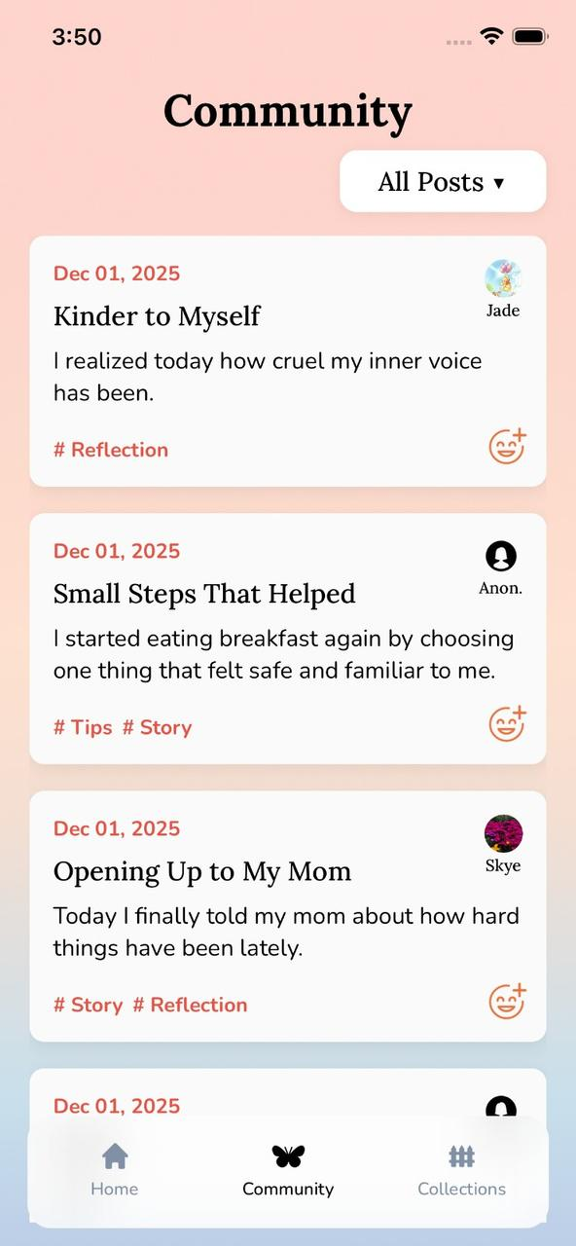
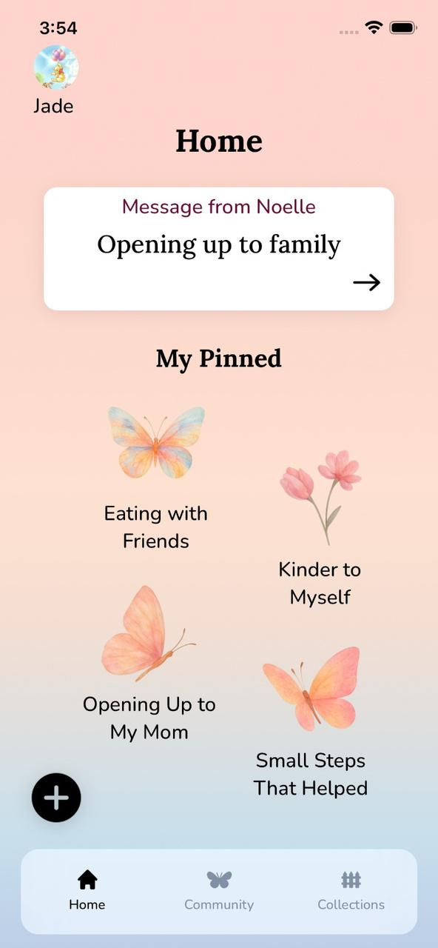


Nourish your body,
Grow your mind
Notes:
Your poster should include:
● Logo
● Project title
● Value proposition (short phrase)
● Problem/solution
● Key features (images of screens) w/ brief captions below
● Images of needfinding and testing
● Design iterations (all fidelities) including testing
● Team member names (first name, last initial)
● CS 147 Autumn 2024
● Project website URL of the form:
https://hci.stanford.edu/courses/cs147/2024/au/projects/[theme]/[project-title]

