Slide 1
01
Intro
02
Need finding Methodology
03
Interview Results
04
Analysis
05
Summary
NeedFinding

Slide 2
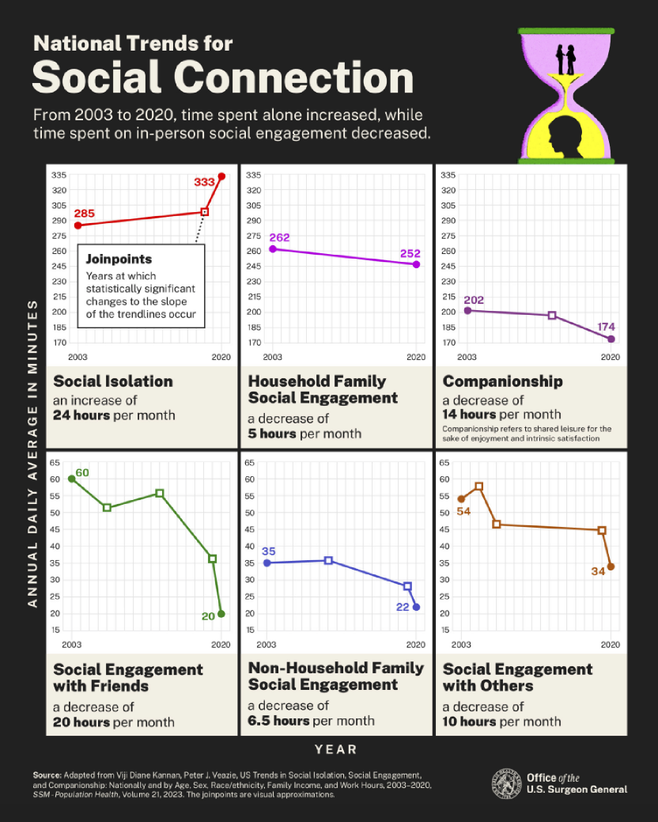
Project Domain
Connection, emotional processing,
loneliness, coregulation
Communal Mental Health —> Personal Mental Health
HHS.GOV

Slide 3
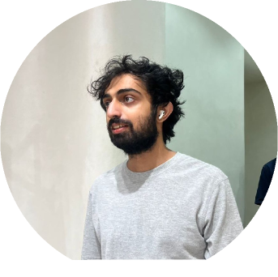



MEET THE TEAM
FAYEZ
ZIMIN
ZAFAR
YUINA
Senior
Computer Science
Senior
Computer Science
Junior
Computer Science
Masters
Computer Science
TEAM NAME
TODAY’S DATE

Slide 4
01
NEEDFINDING METHODOLGY

Slide 5
BRAINSTORM QUESTIONS
EMOTIONS/MENTAL HEALTH
CONNECTION
PHONE ADDICTION
How does your relationship affect mental health?
What makes up a sincere interaction?
When was the last time you felt connected to a stranger, tell me about the interaction and what did you guys talk about?
When do you feel the most lonely and what do you do when you feel lonely?
When was the last time you felt connected to a stranger, tell me about the interaction and what did you guys talk about?
What are the apps and platforms that you use the most?
What are your favorite memories associated with your phone?
What would a day in your life be like without your phone?
How do you feel when you are not on your phone?
What times of the day do you use your phone?
Asking older generations how they spent their time as a kid and what are kids missing out in the digital age?
What emotion do you struggle the most with?
When do you feel the most regulated and unregulated? What did you do to get there?
TALK / PANEL TITLE
TODAY’S DATE

Slide 6
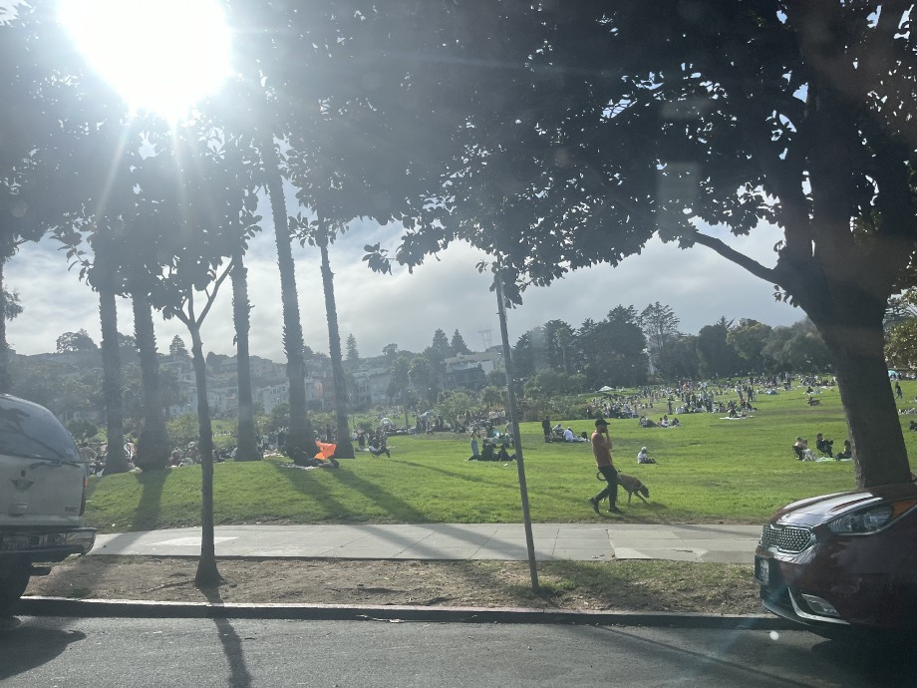
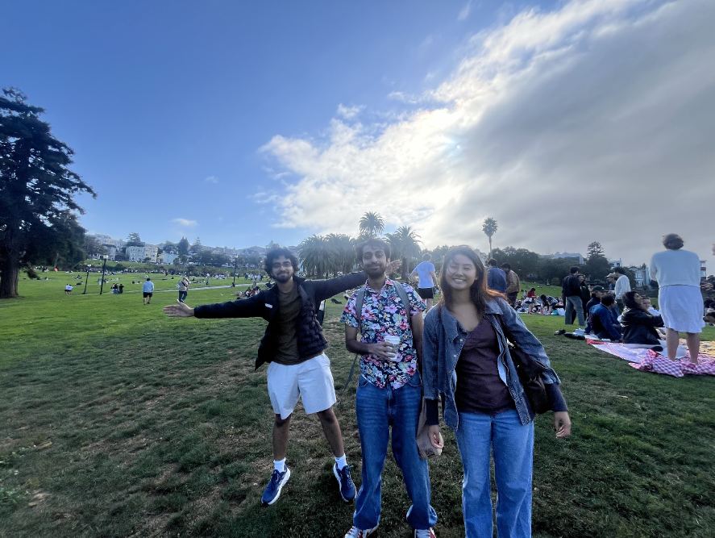
FIND EXTREME USERS
DIVERSE POOL OF PEOPLE
LOCATION: MISSION DOLORES PARK
TOOLS: SMARTPHONE FOR RECORDING AUDIO, PEN PAPER FOR TAKING NOTES
ROLES: TOOK TURNS NOTE TAKING AND INTERVIEWING.
TEAM NAME
TODAY’S DATE

Slide 7
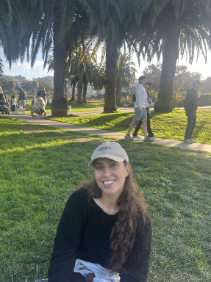
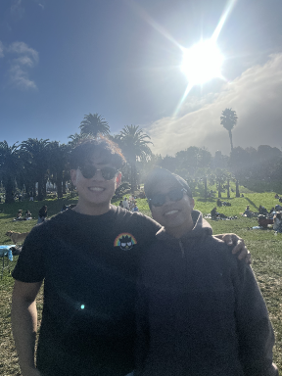


PARTICIPANTS
Mary: International Data Science Intern in SF from Morocco, who lived in France/grew up in Morocco
Bella: 25-year-old woman from the Bay who recently quit her stressful job
Gus and Andrew two buddies who feel like they struggle with the emotion of “outrage’ the most(specifically in the workplace)
Max: from Richmond, California
Laura: from LA Pasadena

Slide 8


SECTION TITLE
OUR EXTREME USER: LAURA
Queer
Muslim
Recovery despite religious trauma
Disowned by family
Artist
DJ Mixer in LA
TALK / PANEL TITLE
TODAY’S DATE

Slide 9
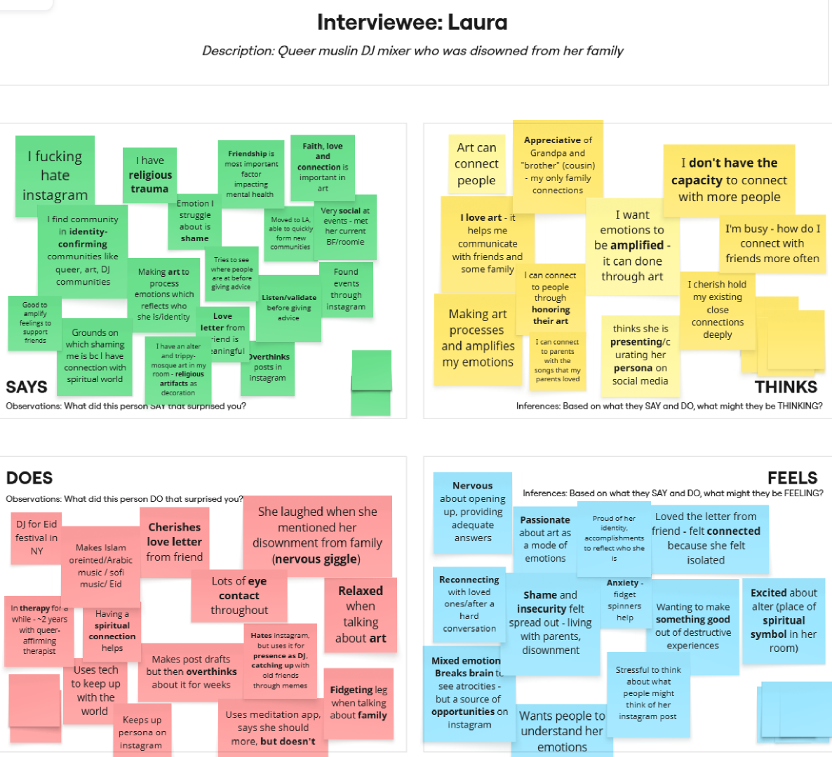
SECTION TITLE
TALK / PANEL TITLE
TODAY’S DATE

Slide 10
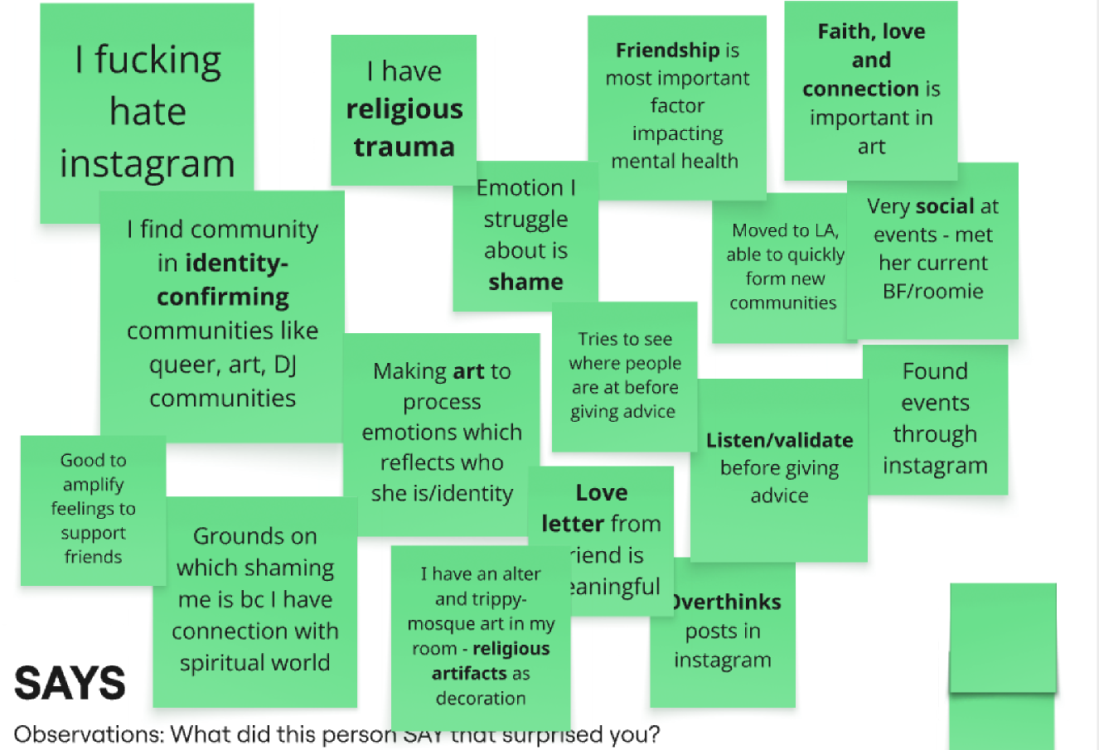
SECTION TITLE
LAURA
TALK / PANEL TITLE
TODAY’S DATE

Slide 11
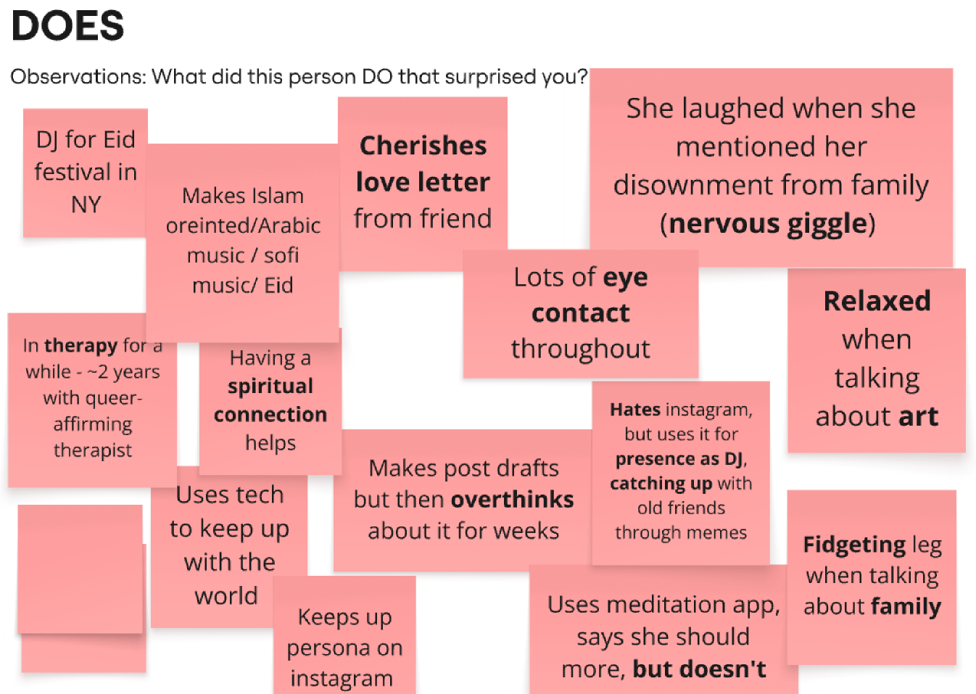
SECTION TITLE
LAURA
TALK / PANEL TITLE
TODAY’S DATE

Slide 12
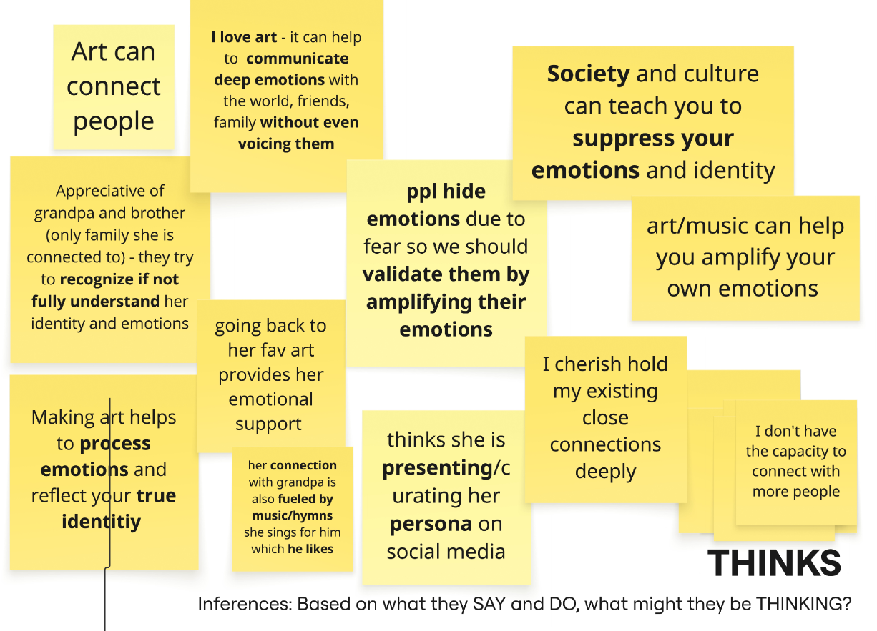
SECTION TITLE
LAURA
TALK / PANEL TITLE
TODAY’S DATE

Slide 13
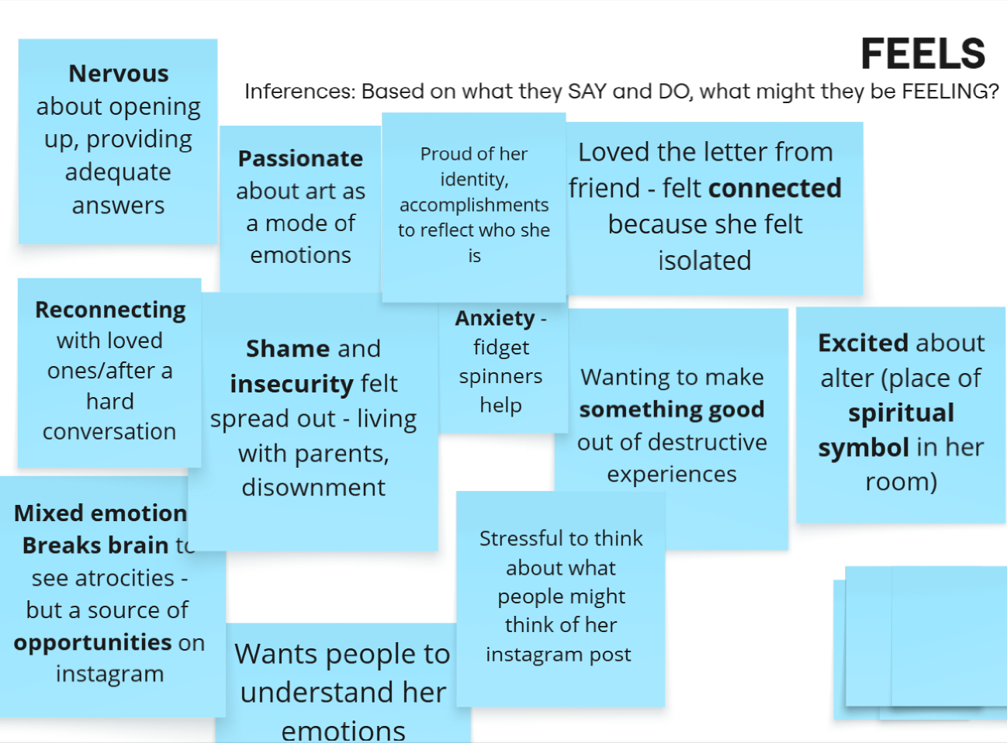
SECTION TITLE
LAURA
TALK / PANEL TITLE
TODAY’S DATE

Slide 14
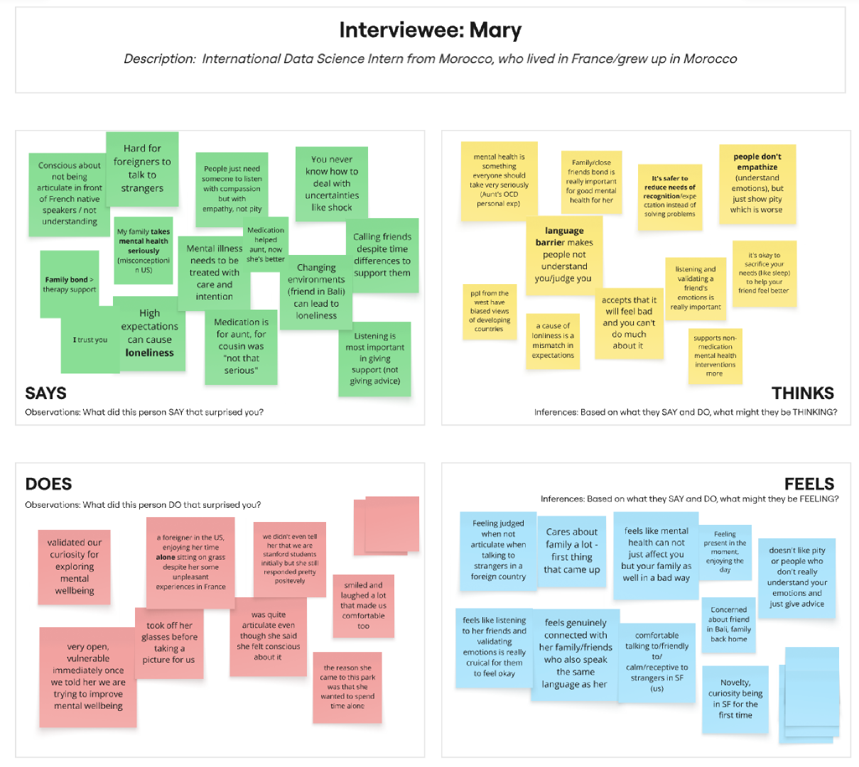


Slide 15
01
INSIGHTS

Slide 16











I don't have the capacity to connect with more people
Nervous about opening up/being vulnerable
language barriers can also mean emotional barriers; different vocabulary of expressions
INSIGHTS
a lot of people journal, not a habit but not a forced habit
People don’t remember the last real connection they had with a stranger
love letters from friends are meaningful
people find different ways to process their emotions and it helps them
Making art helps to process and amplify emotions
love and connection is a really fundamental core human need
Roommates are grounding for moving to new country+ loneliness
High expectations can cause loneliness
Social Media encourages personas,
not authenticity

Slide 17

DATE XX, 2024
PRODUCT / FEATURE NAME
COMPANY NAME
Art is powerful mode of communication in order to heal SUBLIMATION!
KEY INSIGHTS & CORE NEEDS
Loneliness != not having people around you
Loneliness =
When people don’t understand your emotions / what you are going through,
When you are unable to express what is important to you,
EVEN IF you have people around you
Reasons could be:
Danger/Isolation (e.g. Laura)
Language barriers (Mary)
Non-authentic work environments (Bella)

Slide 18
SECTION TITLE
KEY TAKEAWAYS
1.
2.
3.
Genuine
social-emotional connection is a
core human need
Communication needs both
expression
(you → others) and
reception
(others → you)
Art = a broad form of communicating emotions
TALK / PANEL TITLE
TODAY’S DATE

Slide 19
NEXT STEPS — reframing the POV
We met... [Laura, a queer Muslim who got disowned by her family]
We were surprised to notice... [amplified her suppressed emotions using art]
We wonder if this means [emotional expression and validation is a core need]
It would be game-changing to... [explore how art can be used to help people process & express their emotions intentionally]
TODAY’S DATE

Slide 20
NEXT STEPS — Brainstorming....
Emotion Journal (helps you process your emotions using relevant art, helps you express your emotions by creating art, connects you with people feeling similar emotions/validation via art: “emotional media rather than social media”
Connecting people in a close radius, neighborhood/college specific (specifically allowing physical spaces for experiencing emotions together through fun, art, skill-building, meditation...)
Teaching and learning art? (emphasizing the importance of human emotions as work automates )
Bridging the gap between learning a foreign language and the emotional-cultural context

