Slide 1
Simmr.
"Where every recipe tells a story"
Autumn 2025
CS 147

Slide 2
Problem/Solution Overview
Nicole, a home cook who wants to make cooking more enjoyable, social, and engaging for herself and others.
Primary User:
Cooking often feels repetitive and lacks engagement, making it difficult for users to stay motivated, connect socially, or involve kids in the process.
Problem:
Simmr blends storytelling, mini skill lessons, and adaptive voice guidance to make cooking an interactive experience — from solo story sessions, to group cooking with friends, to fun, family-centered adventures that keep kids entertained and inspired.
Proposed Solution:

Slide 3
Market Research

Slide 4
ReciMe is a recipe collector/manager with meal planning and grocery lists which is optimized for use with TikTok, Instagram, Youtube, Pinterest and the Web. It automatically extracts ingredients/steps and preserves source links. Currently, #1 app to save recipes from social media.
ReciMe:
What’s working?
Gaps to learn from
Key similarities
Key differences
Import from social is a standout differentiator vs Paprika/Mela; UI praised as intuitive
Auto-extraction (ingredients/steps), preserves original link; one reviewer mentions extracting “just from audio” if no text is available
Grocery lists + meal planning are core user flows
Perceived limitations in deeper meal-planning and shopping-list workflows compared with competitors
Price sensitivity called out by users (high subscription cost)
No explicit voice, story-driven guidance, or real-time adaptive step adjustment in public materials
Both reduce cognitive load through structured steps and planning
Both can drive “what to cook” decisions (ReciMe via saved recipes/meal plans; our app works via narrative recommendations)
Our app is voice-first and story-driven; ReciMe is library-first and text-centric
Our app dynamically adjusts steps/ingredients and can teach mini-skills inline (e.g., knife grips, timing)
Our app interweaves stories with cooking; turns books/PDFs/free texts into audio narratives ReciMe doesn’t position as an educational platform.

Slide 5
A recipe recommendation and cooking guidance app owned by Whirlpool. It uses personalized suggestions, smart appliance integration, and visual recipe steps to help users cook efficiently.
Yummly:
What’s working?
Gaps to learn from
Key similarities
Key differences
Personalized recipe recommendations based on taste, diet, and allergies
Smart integration with Whirlpool ovens and timers
Step-by-step visual and voice-guided recipes
Grocery list and meal planning tools
Visual search (image-to-recipe) and AR ingredient scanning
Users reported fatigue from excessive filtering or data setup before cooking.
There was a low emotional connection because it is focused on utility rather than joy or creativity.
The engagement was passive because the voice and video guidance remained one-way, and not conversational.
Both provide step-by-step assistance while cooking
Both tailor experiences to user preferences (Yummly through data; your app through narrative/mood)
Both aim to make cooking easier and more engaging
Both support hands-free or low-touch cooking interactions (voice and visual aid)
Yummly is functional and structured, while Simmr is emotional and narrative-based.
Yummly relies on app menus, filters, and visual guides, while Simmr uses conversational storytelling and adaptive narration.
Yummly has minimal emotional depth, while Simmr is designed to build engagement.

Slide 6
Samsung Food:
Mobile and Web app for recipe saving, meal planning, grocery shopping and recipe sharing.
What’s working?
Gaps to learn from
Key similarities
Key differences
Samsung food converts plans into meal prep guides, grocery lists and saves recipes reducing time waste and increasing convenience
Samsung Food can personalize recipes with the help of Vision Ai to reduce decision fatigue
Backed by Samsung + former Whisk user base so there is trust.
Some of Samsung's best features are behind a subscription which users are frustrated by.
Some of the best features of Samsung Food are only applicable when you own other Samsung devices like their connected oven.
Samsung Food emphasizes logistics so users seeking engagement may feel underserved.
Both include hands-free guidance. (Samsung voiceover, Simmr with VoiceAi)
Both take into account what ingredients you have/preferences for types of foods.
Samsung Food optimizes planning/cooking but Simmr centers around storytelling themes and is immersive.
Samsung Food has no mini-lessons it focus on personalization and appliance control
Samsung Food excels when you own Samsung appliances but Simmr is hardware-agnostic.

Slide 7
SideChef:
Robust digital kitchen assistant offering a comprehensive cooking ecosystem. It focuses on task optimization and AI-enhanced personalization, guiding users step-by-step, planning meals, managing groceries, and optimizing ingredient use.
What’s working?
Gaps to learn from
Key similarities
Key differences
Strong utility integration: Users appreciate the “all-in-one” experience, from recipe discovery to grocery delivery.
AI innovation: The use of modular AI systems (e.g., RecipeGen, MySubstitution) provides tangible value.
Visual clarity: Step-by-step visuals (StepShot AI) enhance trust and learning.
Lack of emotional engagement: SideChef focuses heavily on efficiency but underdelivers on enjoyment and connection.
Overwhelming features: The abundance of tools can make the user experience feel complex or transactional.
Low stickiness for casual cooks: Once users learn to cook basic meals, there’s limited incentive to keep using the app daily.
Step-by-step guidance: Both provide structured cooking instructions that reduce cognitive load.
AI integration: Each leverages AI to personalize the user experience, though in different ways (SideChef through optimization, Simmr through engagement).
Dietary customization: Both accommodate dietary restrictions and preferences.
Cooking as a guided experience: Both act as intelligent companions in the kitchen, offering real-time feedback or adjustments.
Simmr transforms cooking into an interactive, story-driven adventure, while SideChef focuses on functional convenience and efficiency.
Simmr motivates users to make cooking fun and engaging; SideChef aims to simplify meal prep and save time.
Simmr’s VoiceAI storytelling companion adapts narratives and confirms steps; SideChef uses multiple AIs for optimization and substitution.
Simmr is designed for family-oriented, experiential use, while SideChef targets individual or household efficiency.

Slide 8
 | Simmr | StoreaTime | SideChef | Recime | Samsung Food | Yummly
Voice AI step-by-step instruction | ✅ | ❌ | ❌ | ❌ | ❌ | ❌
Text step by step cooking instruction | ✅ | ❌ | ✅ | ✅ | ✅ | ✅
Meal Recommendations | ✅ | ❌ | ✅ | ✅ | ✅ | ✅
Storytelling | ✅ | ❌ | ❌ | ❌ | ❌ | ❌
Connection Building | ✅ | ✅ | ❌ | ❌ | ❌ | ❌
Reusing ingredients | ❌ | ❌ | ✅ | ❌ | ✅ | ✅
Substitutions | ❌ | ❌ | ✅ | ❌ | ✅ | ✅
Multi-Recipe Cooking/Planning | ❌ | ❌ | ✅ | ✅ | ✅ | ✅

Slide 9
Values in Design

Slide 10
Direct Stakeholders
Primary Users (core target):
Stay-at-home parents (especially moms) seeking to make cooking more engaging and less monotonous.
Single parents balancing cooking with childcare who want to turn meal prep into shared fun or self-care time.
Parents cooking with children who want a safe, educational, and creative co-cooking experience.
Their Stakes:
Emotional fulfillment (reducing boredom or stress in daily cooking).
Desire for bonding moments and shared learning experiences.
Interest in accessible, hands-free guidance to simplify multitasking.
Secondary Users:
Children engaging in storytelling and simple cooking steps alongside the parent.
Friends or family participating in “themed cooking sessions”.

Slide 11
Indirect Stakeholders
Educators and Family Organizations
Parenting bloggers, family activity educators, or community centers. Could use the app to promote creative family time or skill learning.
Their Stakes:
Offering a tool that aligns with family bonding, education, or child development goals.
2. Partner Brands and Services
Grocery delivery platforms (e.g., Instacart, Whole Foods, Walmart+). Could integrate ingredient lists for “story recipes.”
Smart kitchen device companies (e.g., Amazon Alexa, Google Home, Samsung SmartThings). VoiceAI integration or data sharing for enhanced experience.
Their Stakes:
Increased engagement and cross-platform utility.
Brand exposure through recipe partnerships or integrations.

Slide 12
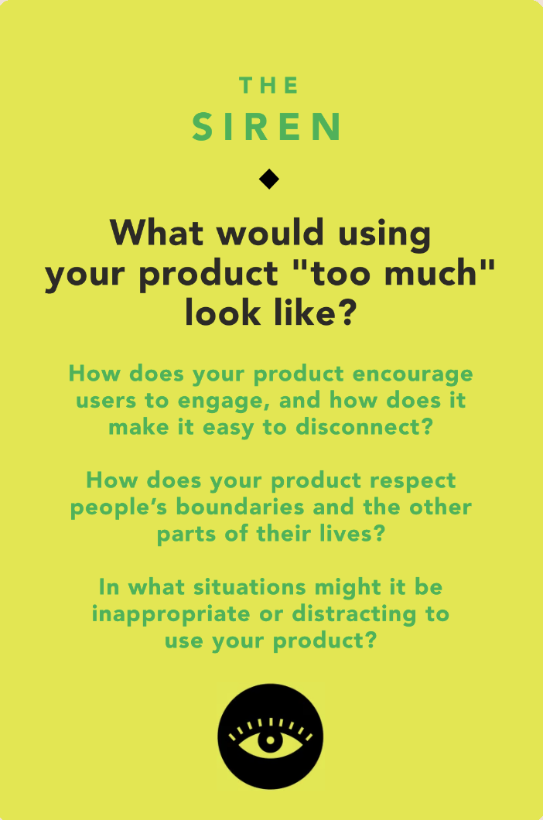
Tarot card of Tech #1
Ethical implications
Over-Dependence on AI Guidance: Users could become so reliant on the AI guidance that they lose confidence experimenting without a step-by-step guide or they stop learning to cook independently.
Blurring Downtime Boundaries: If our products’ immersive stories and mood music make cooking feel like a performance, it may leave no room for quiet unmediated cooking moments. This could turn a personal activity into constant engagement.
Reflections
Cooking has a natural rhythm that the AI should enhance and not replace. This tarot card reminds us to designate moments of silence, completion and autonomy where users can pause, reflect or cook freely without constant guidance. “The Siren” asks us to balance engagement with empowerment, which means users should feel more capable after using the app not more dependent on it. Adding in natural stopping points or optional modes and gentle reminders to step away perfect that balance.

Slide 13
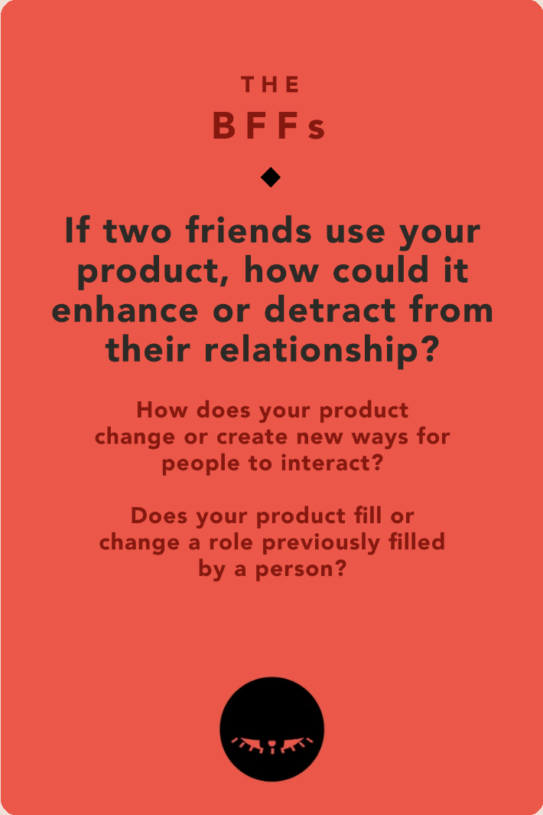
Tarot card of Tech #2
Ethical implications
Shared Experience vs. Isolation: This app can make cooking together more fun through storytelling and collaboration, but if both users retreat into their own audio experiences, it might isolate them instead of connecting them to each other.
Replacing Human Coaching: This AI ‘Host’ or ‘Narrator’ could unintentionally take over social teaching roles that could belong to a friend, parent or partner in the kitchen therefore taking away that social interaction.
Reflections
Cooking has and always will be a social ritual that should be full of laughter, mistakes and teamwork. “The BFFs” tarot card asks us to ensure that our AI framework facilitates human connection and doesn’t always replace it. Features like group story modes, shared challenges, or moments where the AI invites real conversations (“ask your cooking partner what they’d add next”) could help turn this technology into a bridge rather than a wall. Ethical design here means amplifying warmth, not convenience alone.

Slide 14

Tarot card of Tech #1
Ethical implications
Manipulation through Narratives or Data: Because Simmr uses AI-generated storytelling and voice narration, there is potential for manipulation through biased, inappropriate, or exploitative content. A bad actor, could subtly shape narratives that reinforce harmful stereotypes (e.g., gender roles in cooking).
Indirect Stakeholders as Potential Bad Actors: Our indirect stakeholders could become bad actors if they exploit Simmr’s integrations for data harvesting or manipulative upselling. By accessing user behavior they could target users with predatory recommendations, pushing unnecessary purchases or promoting branded products under the guise of convenience.
Reflections
This ethical challenge reveals a broader value tension between personalization and consumer protection. While integrations can streamline the cooking experience, they also open pathways for commercial entities to commodify private household behavior. The emotional nature of Simmr’s storytelling makes users more susceptible to persuasive nudges, amplifying the potential for manipulation. As designers, it’s crucial to ensure data minimization, transparent permissions, and explicit separation between storytelling content and commerce. Ultimately, Simmr must maintain user trust by making ethical boundaries visible, prioritizing creativity and joy in the kitchen over monetization or surveillance.

Slide 15
Tasks

Slide 16
SIMPLE
Listening to a story while completing a recipe
Nicole cooks everyday for her family and finds it repetitive and boring. She would like to make cooking more engaging for herself by immersing herself in a story while completing a recipe.
Description:
This is a simple, introductory task that represents the core and most frequent use case of the app. Most users, especially those cooking alone, will use Simmr to make everyday cooking more enjoyable through immersive storytelling. This task introduces users to the app’s central value proposition: transforming routine cooking into an entertaining experience. Because it applies to nearly all users and occurs regularly, it is classified as a simple task.
Justification:
Timestamp:
0:36 - 0:53

Slide 17
MODERATE
Cooking with friends as an activity
Nicole wants to host her friends at home and make cooking together more fun. She hopes to turn an ordinary recipe into an interactive cooking experience for her friends to enjoy.
Description:
This is a moderate task because it builds on the core use case but involves multiple participants and a more social context. While still common among users who want to make cooking engaging, this task requires slightly more coordination and interaction than solo cooking. Most users will complete this task occasionally, using the app to create fun, story-driven cooking sessions when hosting friends. It demonstrates how Simmr extends beyond solo use to support shared, experiential cooking.
Justification:
Timestamp:
0:53 - 1:10

Slide 18
COMPLEX
Entertaining kids while cooking
Nicole needs to make cooking with her kids a more engaging and enjoyable experience. Her goal is to keep them entertained throughout the process and inspire them to look forward to cooking together again.
Description:
This is a complex task because it is less frequent and intended for “power customers”: users who use Simmr not only for engagement but also for family bonding and child involvement. Kids have varying attention spans and energy levels, making it more advanced than typical sessions. Therefore, cooking with kids introduces more unpredictability, multitasking, and the need for adaptable storytelling. It highlights how Simmr can scale from personal enjoyment to interactive, family-centered experiences.
Justification:
Timestamp:
1:11 - 1:16

Slide 19
Video Storyboards

Slide 20
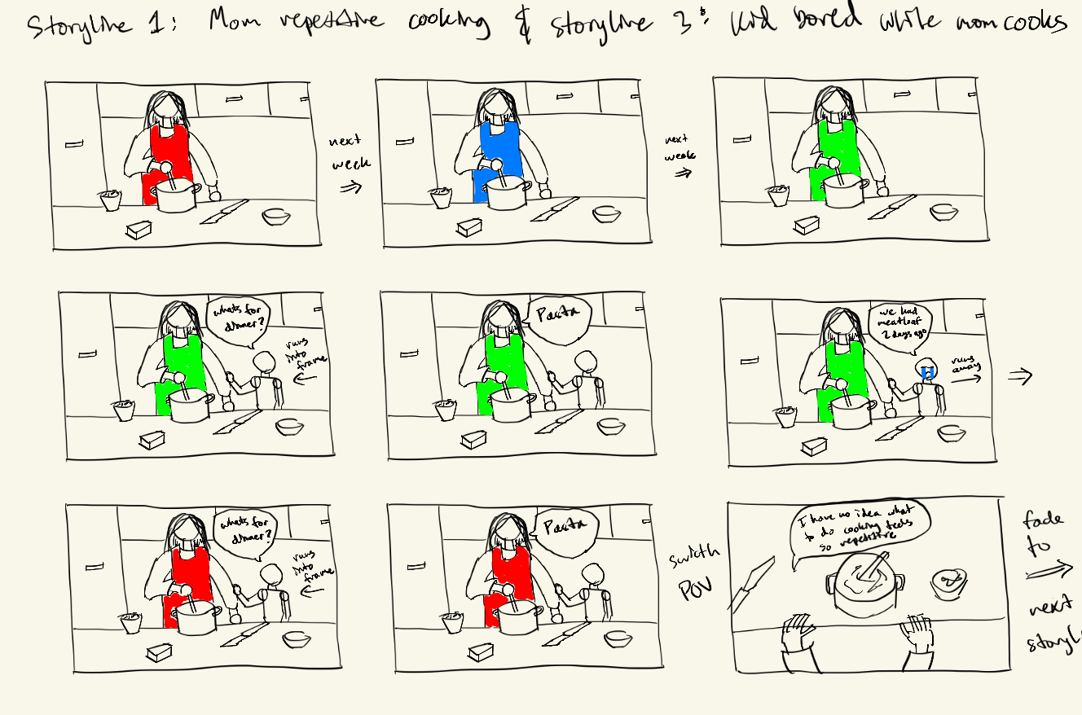

Slide 21
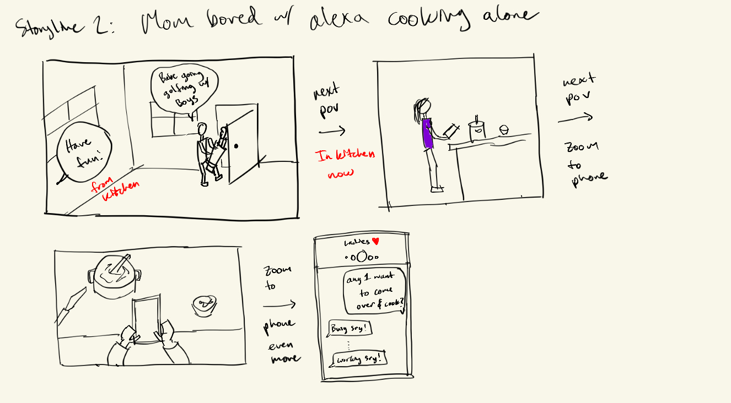

Slide 22
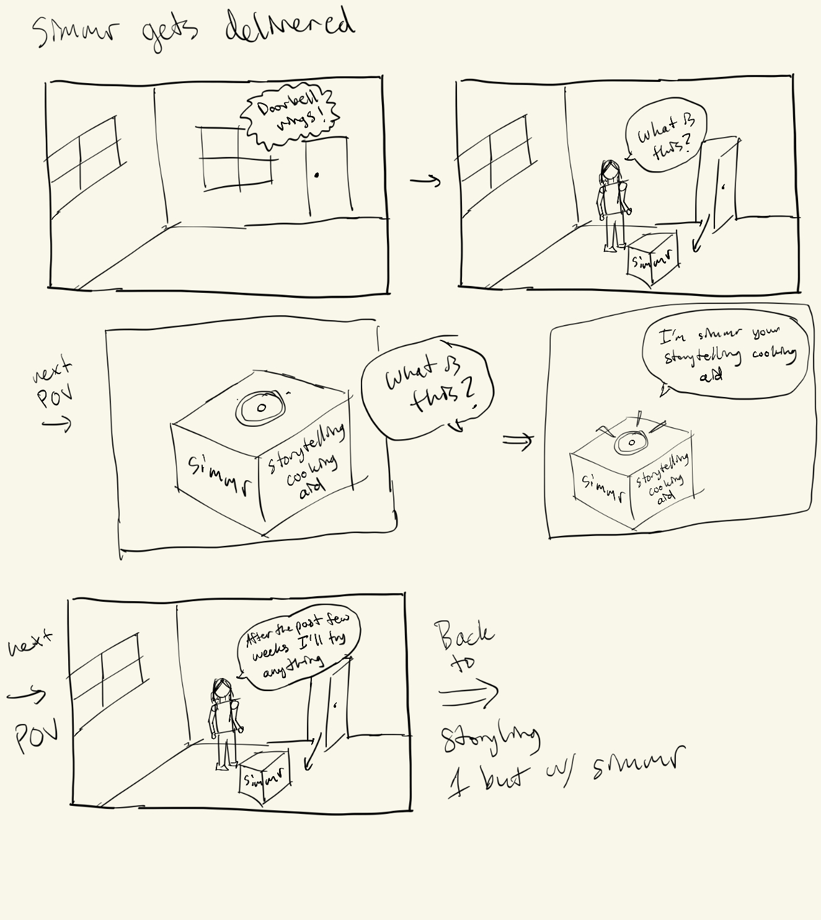

Slide 23
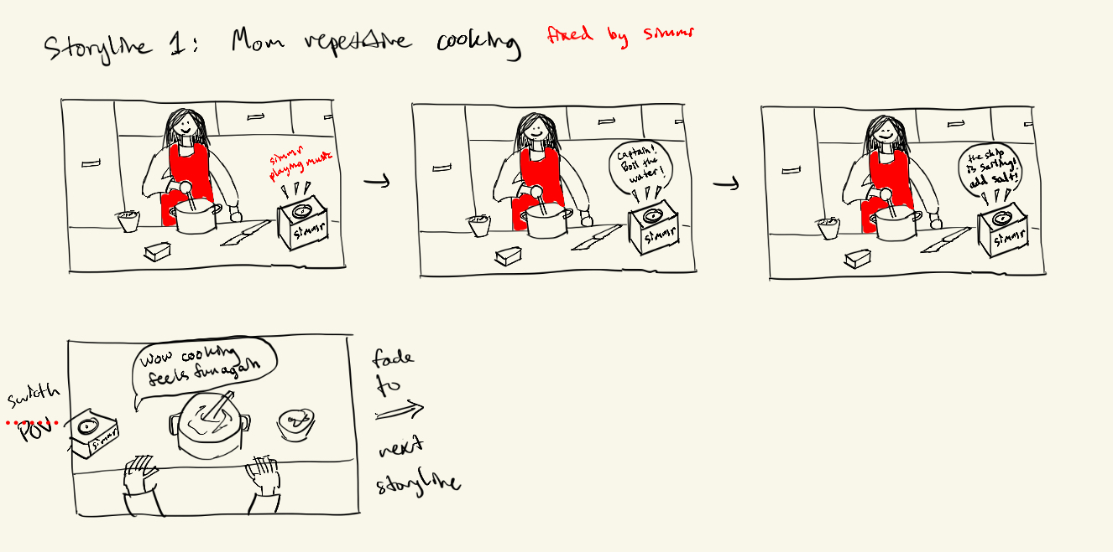

Slide 24
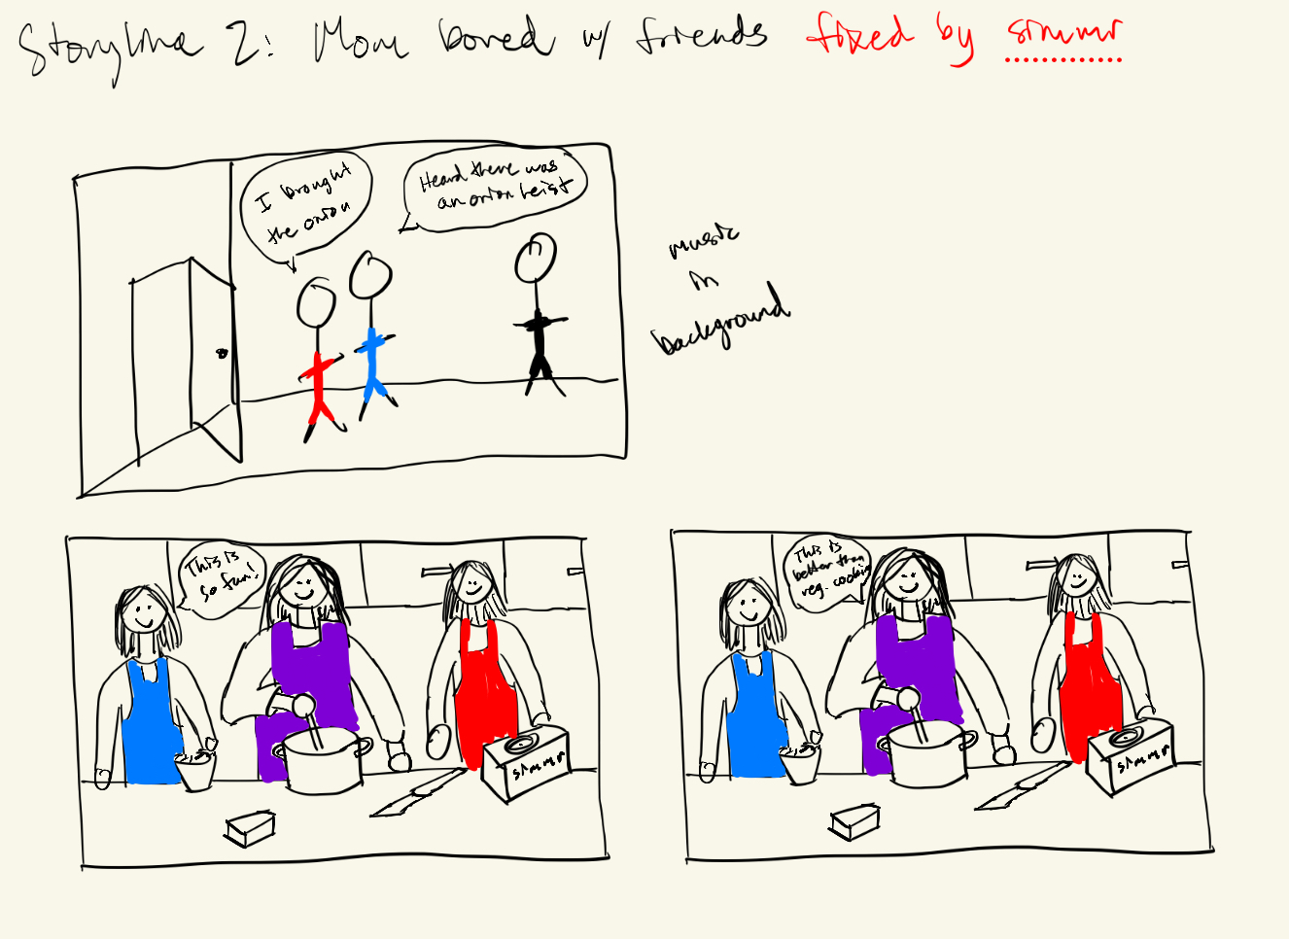

Slide 25
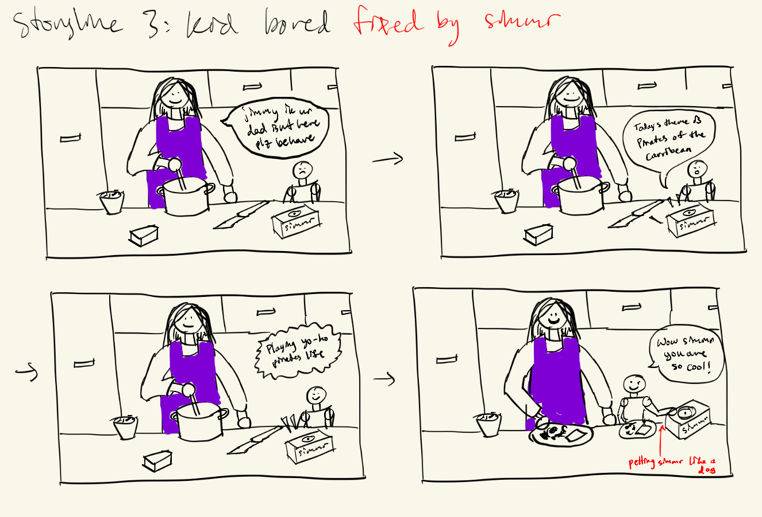

Slide 26
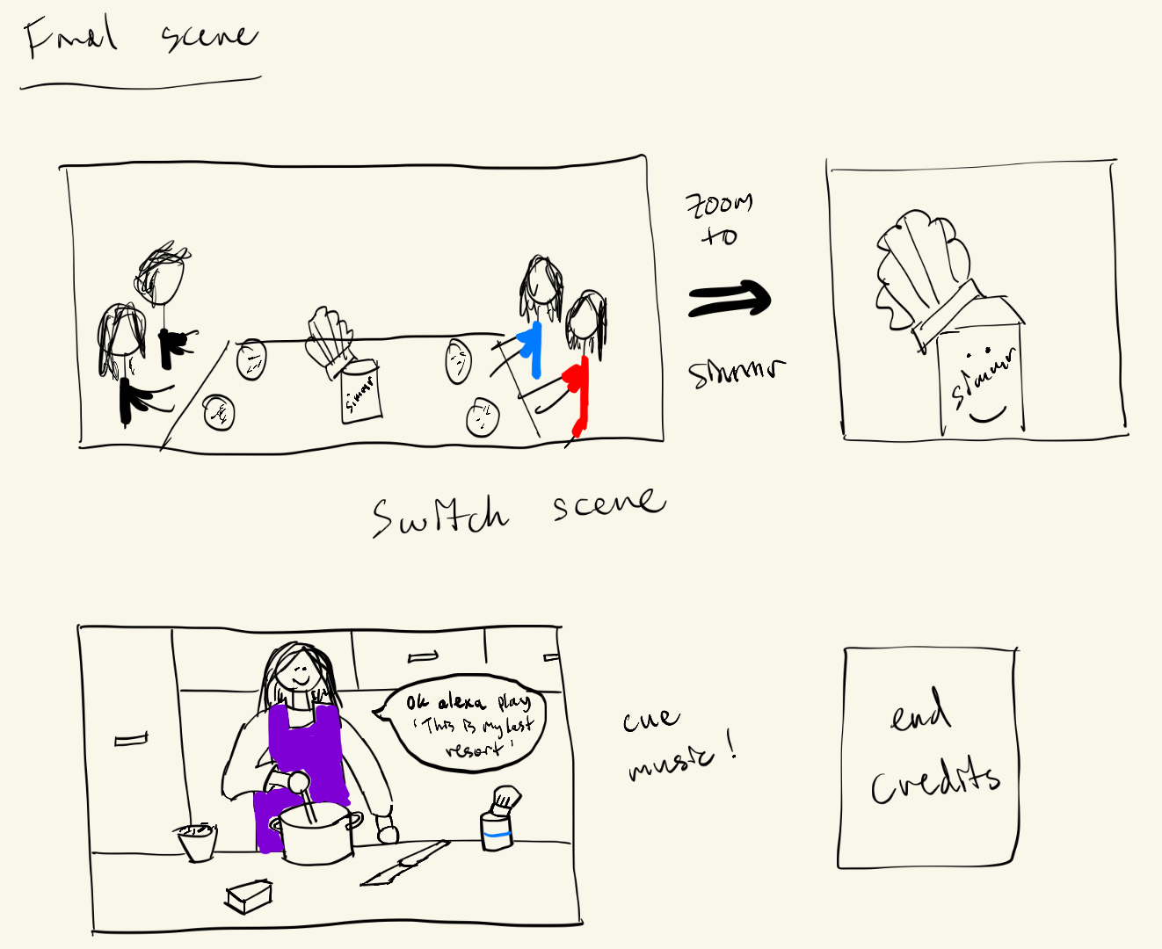

Slide 27
Video Link
https://youtu.be/bHdXtFz9PuY

Slide 28
Appendix

Slide 29
Script:
🎬 simmr — “The Box That Saved Dinner”
Length: 1:30
Style: mockumentary + cinematic montage + absurd physical comedy
Main characters:
Mom (Nicole) – overworked, witty, breaking the fourth wall
Dad – oblivious, upbeat
Kid - easily bored daughter
Friends (Lena & Tasha) – hype women
simmr (the Box) – glowing cardboard box
SCENE 1 — “Pasta” (0:00–0:25)
[Fast jump cuts — same kitchen, same dinner, different outfit.]
Kid #1: “What’s for dinner?”
Mom: “pasta.”
Kid #1: “Didn’t we just—”
[Montage repeats. Each time, Mom looks more done.]
Pasta Pasta Pasta

Slide 30
Script Cont.
Cut to talking-head confessional:
Mom (flat): “Some people meal prep. I meal repeat.”
SCENE 2 — “dad leaves” (0:25–0:45)
Dad heads out the door and leaves Nicole with the kid.
Dad: “I’ll be back after the game!”
Mom’s left chopping potatoes.
Mom: Looks over at group chat with her friends. They’re texting about hanging out, going out for dinner
She texts her friend group chat: “I have to watch the kid. Anyone down to hang out here?”
Text bubble says “typing…” then disappears.
Mom sighs.
DING DONG.
She opens the door — a glowing cardboard box with a chef's hat sits there.
Note on top: “Find the joy in cooking.”

Slide 31
Script Cont.
Mom (half-sarcastic): “Alexa… I can’t keep chopping this onion and burning the same pasta day after day. Can you help me?”
Alexa (flat): “Playing Papa Roach — Last Resort.”
(guitar riff blasts)
SCENE 3 — “simmr arrives” (0:45–1:00)
She pokes it.
Simmr (cheerful): “Hi! I’m simmr — your storytelling kitchen companion!”
Mom (startled): “Okay… what is this?”
[Lights blink. Dramatic sound cue.]
Simmr: “Tonight’s story: The Great Onion Heist.”
Camera pans the room, the kitchen lights shift like a spy movie.
Mom raises one eyebrow to camera.

Slide 32
Script Cont.
SCENE 4 — “THE SIMMR EFFECT” (1:00–1:20)
Simple Task (Cooking Alone)
Mom stirs pasta confidently.
Simmr: “Now stir, Nicole… like you’re auditioning for your own cooking show!”
Mom (smirking to camera): “Finally, someone gets it.”
Moderate Task (Friends Over)
[Two friends enter in sunglasses.]
Lena: “Heard there was a heist.”
Tasha: “And I brought onion.” (pulls bag from purse)
Simmr: “Welcome, accomplices. Phase one: chop like your life depends on it.”
Lena: “I was born for this.”
Tasha: “I could do this in my sleep!”
[They all dive into the kitchen, Mission Impossible music playing faintly.]

Slide 33
Script Cont.
Complex Task (Cooking with Kids)
Simmr: “All hands on deck! The macaroni seas are boiling!”
Mom yells: “Captain! The noodles are al dente!”
Kids salute the box.
Simmr: “Victory is ours! Set course to feast!”
Mom: “Aye aye, Chef!”
SCENE 5 — “THE PLOT TWIST” (1:20–1:30)
Dinner table — laughter, everyone eating happily.
The box sits proudly at the end of the table.
Simmr (smugly): “Anyone want pasta?!”
Everyone groans and laughs.
[Freeze frame of the glowing box; “CUT MY LIFE INTO PIECES” song.]
Edit: The Voice AI for your meal prep.
TITLE CARD: SIMMR – Cook. Listen. Laugh.

