Slide 1
Interactive High-Fi Prototype
CS 147
Autumn 2025
Simmr.

Slide 2
VALUE PROPOSITION
Simmr.
“The voice that turns every
recipe into a story.”

Slide 3
The Problem
Our Solution
Cooking feels repetitive and isolating.
Most recipe apps focus on efficiency, not enjoyment.
Home cooks struggle to stay engaged or make cooking feel social and creative.
Simmr turns cooking into a story.
Voice-guided, story-driven recipes blend narration, music, and mini lessons.
Transforms routine cooking into an interactive, social, and fun experience.
Simmr.

Slide 4
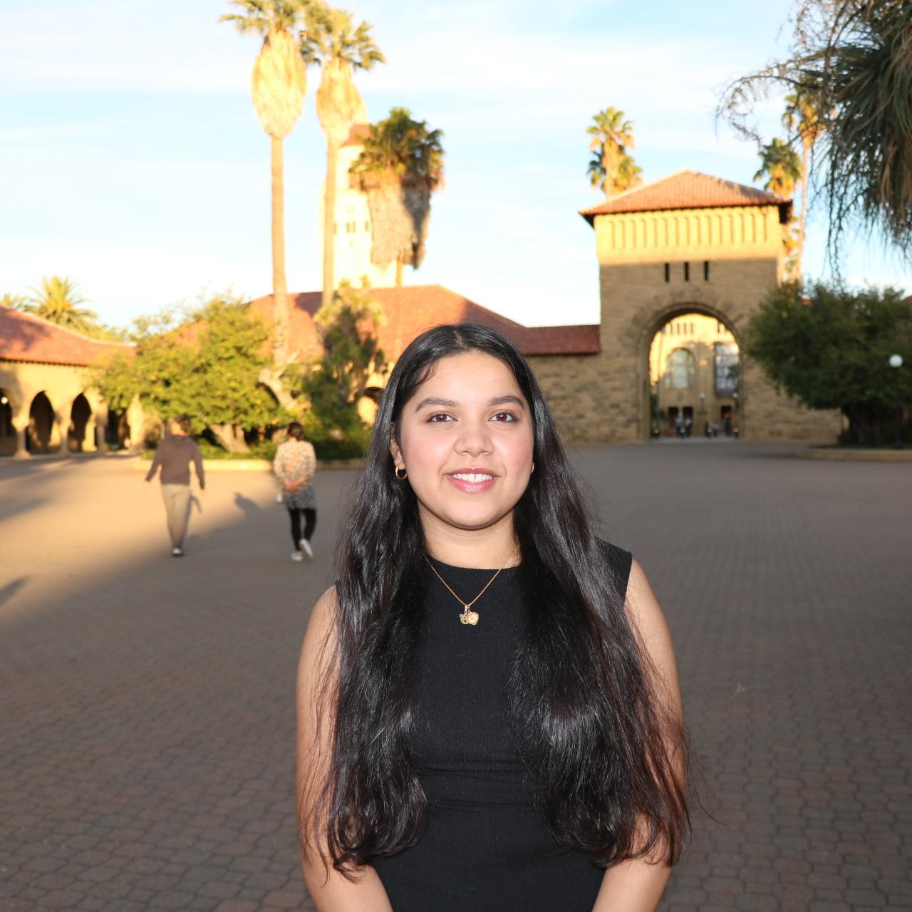

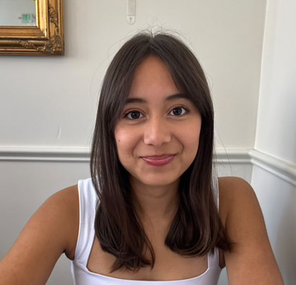
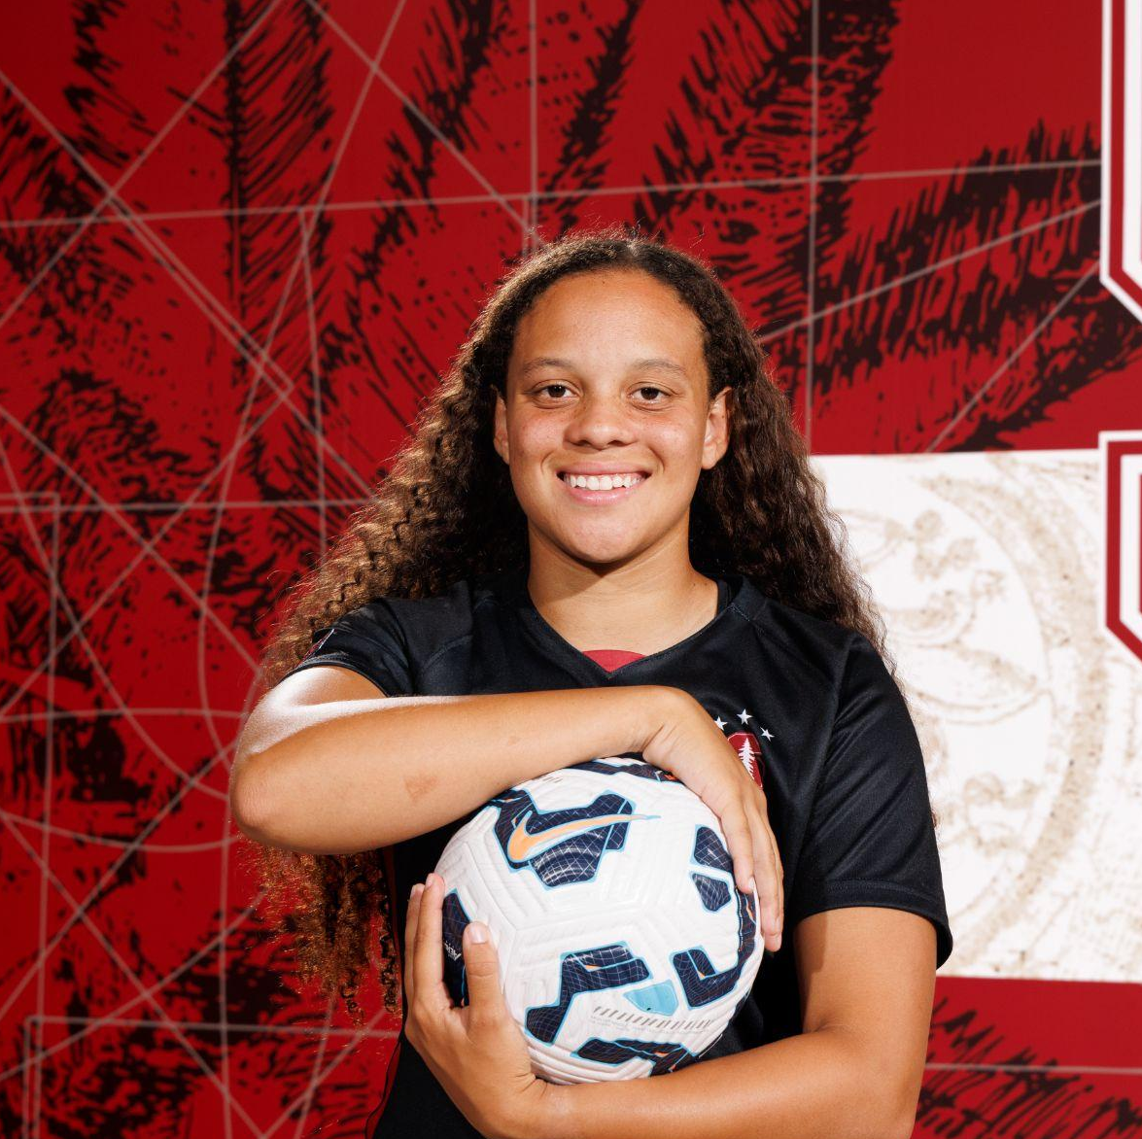
Meet the team
Jasleen S.
‘26
Mara B.
‘26
Jasmine T.
‘26
Jasmine A.
‘26

Slide 5
Presentation Outline
Heuristic Evaluation Results
Major UI and Product Revisions
High-Fidelity Prototype Implementation Status
High-Fidelity Prototype Demo
Notes:
Here’s a quick overview

Slide 6
Heuristic Evaluation
results

Slide 7
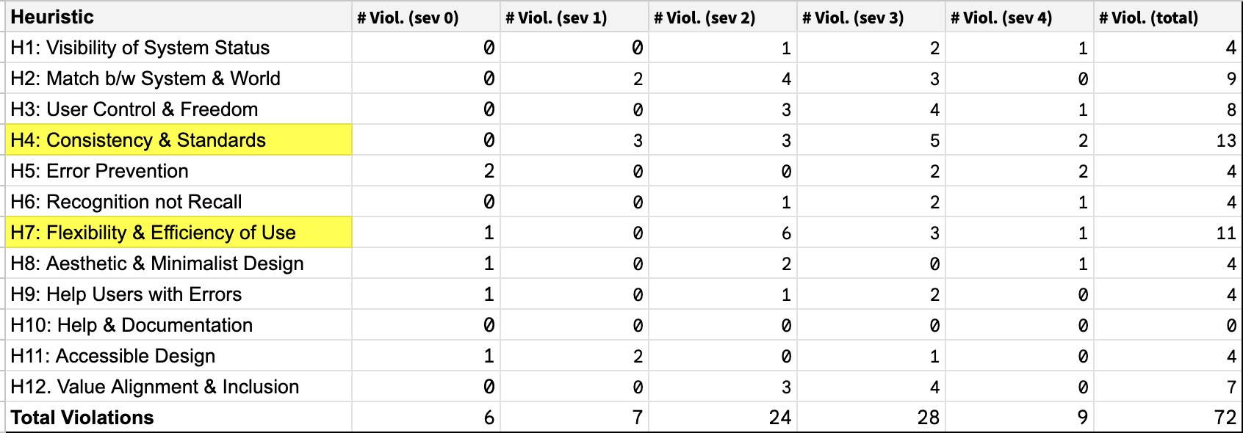
Heuristic Evaluation
Total Violations:
72

Slide 8
Summary of Results
Most Violated Heuristics
Severity 3-4: 37
Severity 1-2: 31
Severity 0: 6
H4:
Consistency & Standards
13 violations
H7:
Flexibility & Efficiency of Use
11 violations

Slide 9
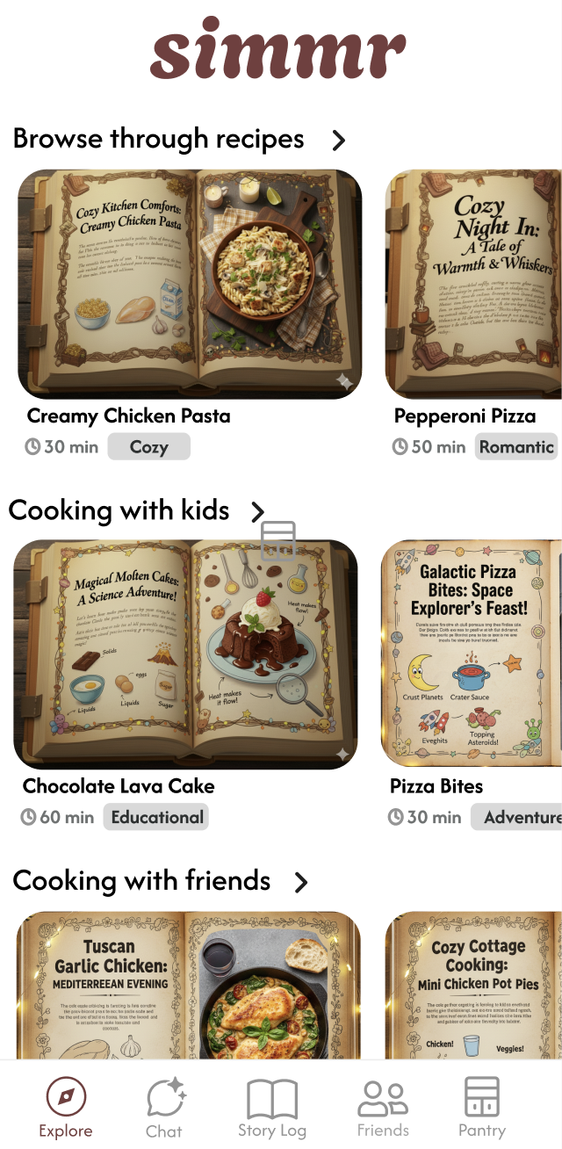
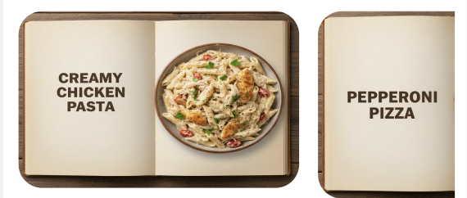
Simple Task Violations
(Browsing recipes)
Before: Recipe book images use tiny unreadable text
After: Simple cover images with a photo and title
Before
After
Notes:
Recipe book images use tiny unreadable text. Switch to simple cover images with a photo and title.
Camera flow needs a review step so users can retake, keep, or crop photos.
Recipe steps should include measurements so users do not have to recall them.

Slide 10
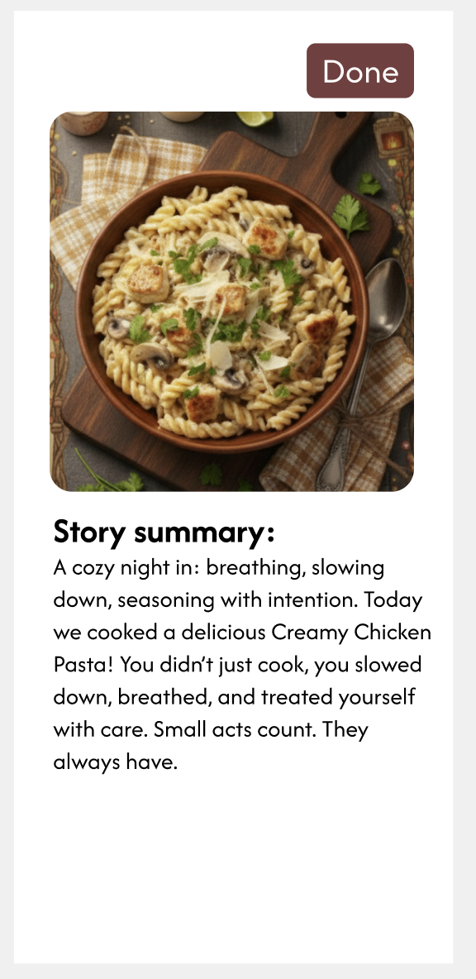
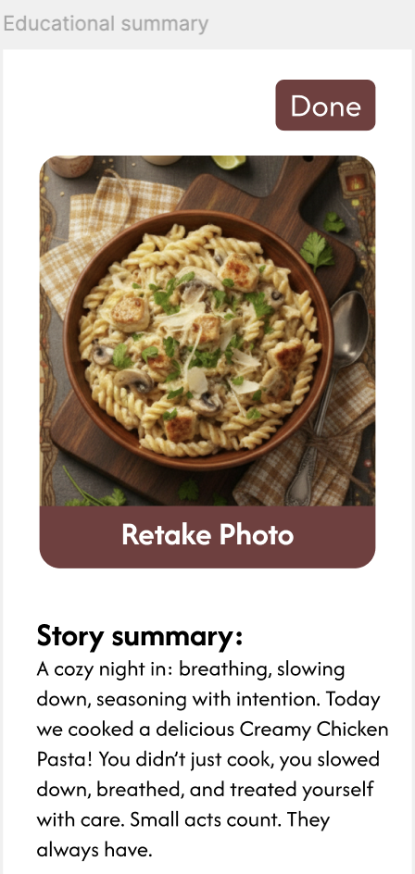
Simple Task Violations
Before
After
Before: Lacks error prevention when taking a photo of dish
After: Camera flow allows a retake option so users can review, keep, or crop photos
Notes:
Recipe book images use tiny unreadable text. Switch to simple cover images with a photo and title.
Camera flow needs a review step so users can retake, keep, or crop photos.
Recipe steps should include measurements so users do not have to recall them.

Slide 11
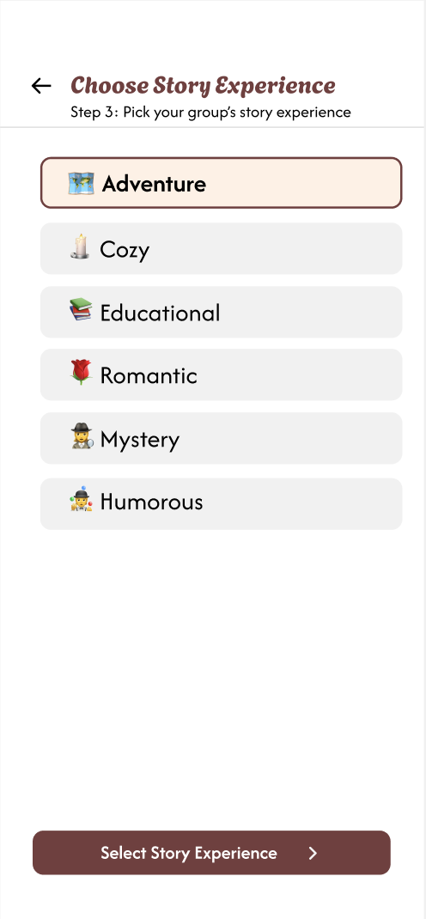
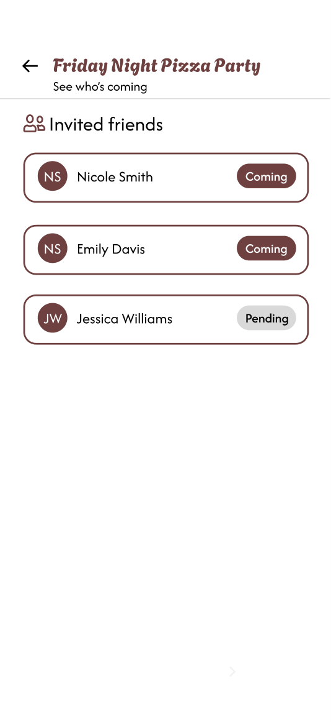
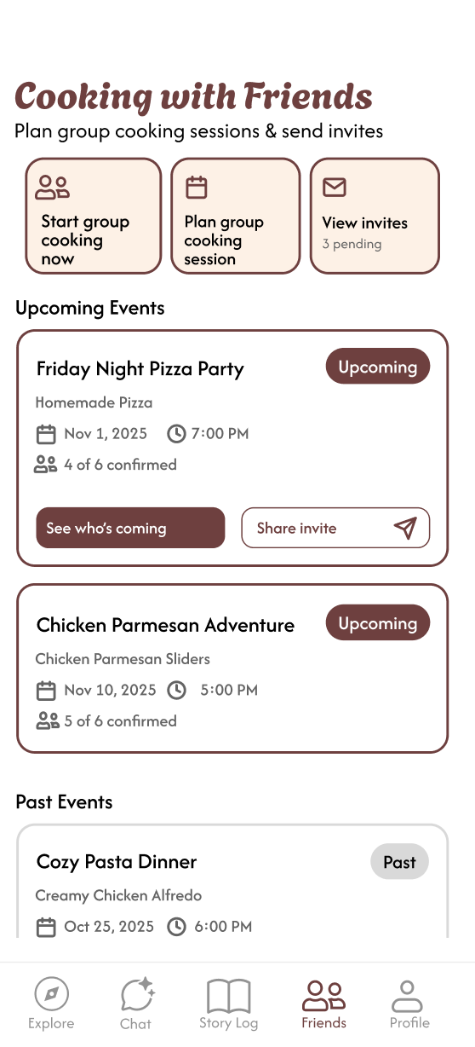
Moderate Task Violations
Our Revisions:
Users could not customize storytelling in the creation flow
  Added a story selection step
“Invited” is used inconsistently
  Use clearer terms for invited vs confirmed users
The plus button and “Start Group Cooking” are confusing
  Simplify or combine them
(1)
(2)
(3)
Notes:
The “Build Story Book” button feels unclear and does not match the story metaphor. Clarify its purpose and make the page functional.
Story type appears toggleable in the group invite confirmation page but cannot be chosen in the creation flow. Add a step to select the story vibe.
“Invited” is used inconsistently across screens. Use clear language to distinguish confirmed users from those only invited.

Slide 12
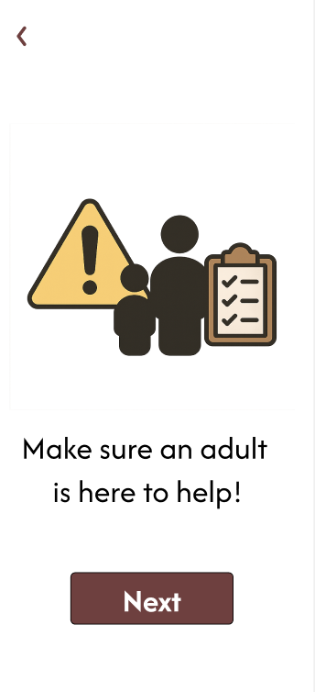
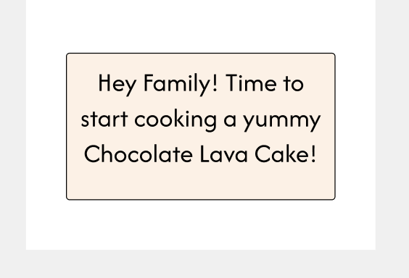
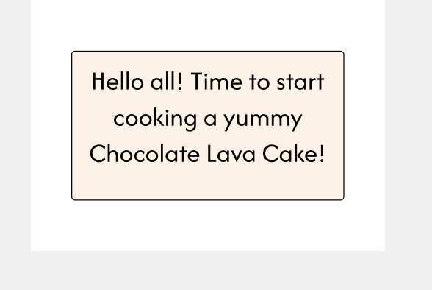
Complex Task Violations
Our Revisions:
Kid recipes need safety cues
  We added a hazard badge
Replace the “Hey family” greeting with something more inclusive
  We replaced with: “Hello all”
(1)
(2)
Notes:
Kid recipes with hazards need clear warnings. Add a hazard badge
Temperatures are only in Fahrenheit. Show both units
The “Hey family” greeting assumes a family context. Use more inclusive language.
The small plus button and large “Start Group Cooking” button are confusing. Redesign or combine them for clarity.
The close button appears only on the final screen. Include it consistently across all recipe and voice AI pages.

Slide 13
High Severity Violations (All tasks)
Recipes do not have allergen badges.
Speech to text does not display what was heard.
No hands-busy gesture options.
Primary call-to-action buttons change location across screens.
Missing step progress and time remaining.
No confirmation that a session saved to StoryLog.
Inconsistent navigation arrows.
Voice UI does not show speaking or listening states.
No narration speed control.
No way to cancel a recipe mid-flow.

Slide 14
Working toward
Usability Goals:
UI and
product revisions

Slide 15
Usability Goals
Usability Goal 1
Enhance Learnability & Ease of Navigation
Our revised designs significantly reduce navigation friction and make core actions predictable and findable
Usability Goal 2
Increase Discovery & Emotional Enjoyment During Cooking
Our revisions deepen the fun, emotion, and story-driven quality of Simmr’s cooking experience.

Slide 16
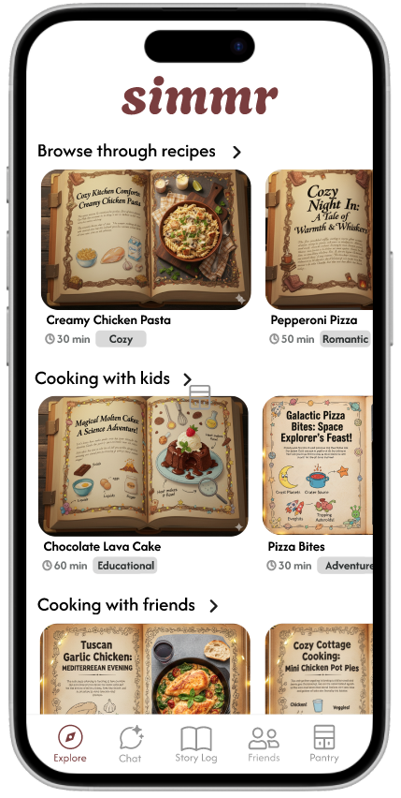
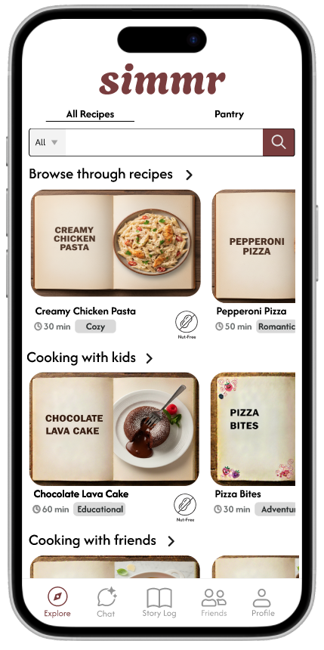
Explore landing page
Before
After
New recipe images with larger text
New top tabs with a pantry tab
Reverted back to profile

Slide 17
Before
After
Rationale for the Change
Moving the pantry tab to explore page and restoring the Profile button to nav bar improves discoverability for settings
Pantry in a top tab on the main screen allows users to quickly switch between browsing recipes and managing ingredients
Progress Toward Usability Goals and Design Values
Enhanced Learnability & Ease of Navigation: Users access pantry and recipe functions directly from main screen
Discovery & Enjoyment: Users explore recipes that are recommended based on ingredients they have
Key Success Metrics: Task Success Rate, Time to First Action, Navigation Error Rate

Slide 18
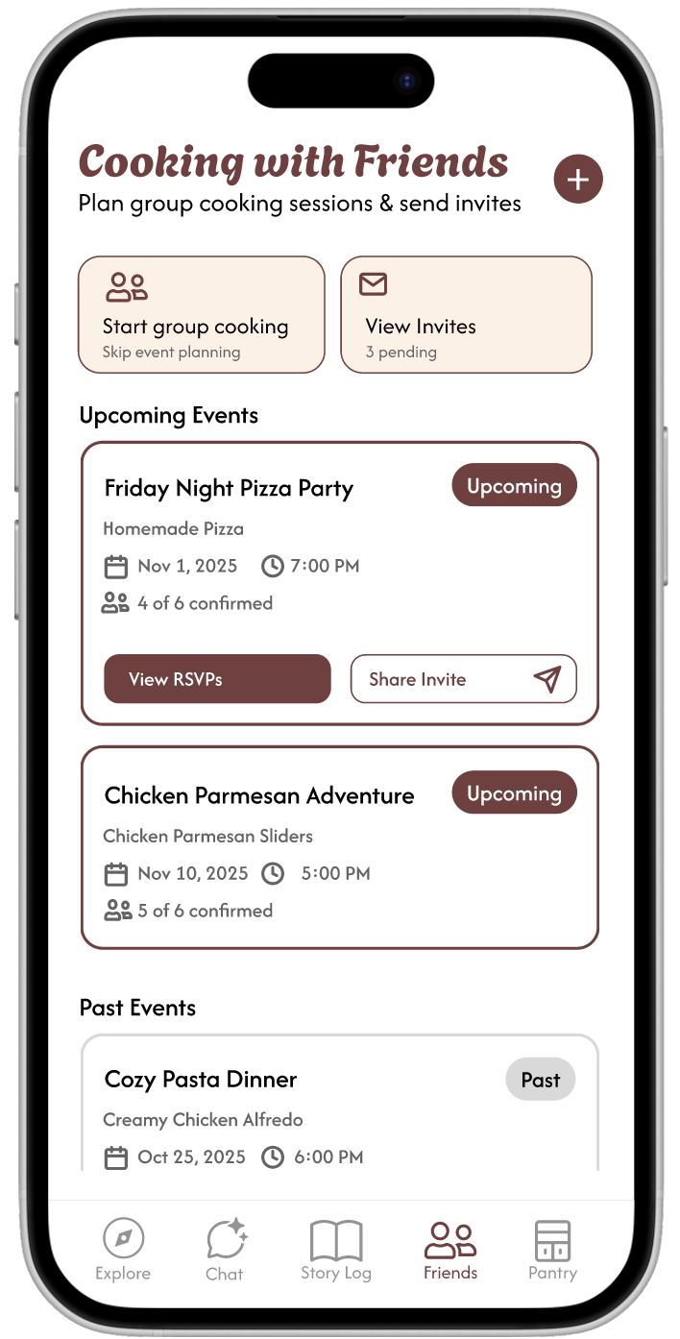
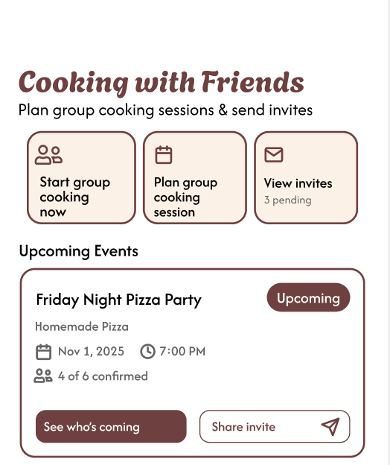
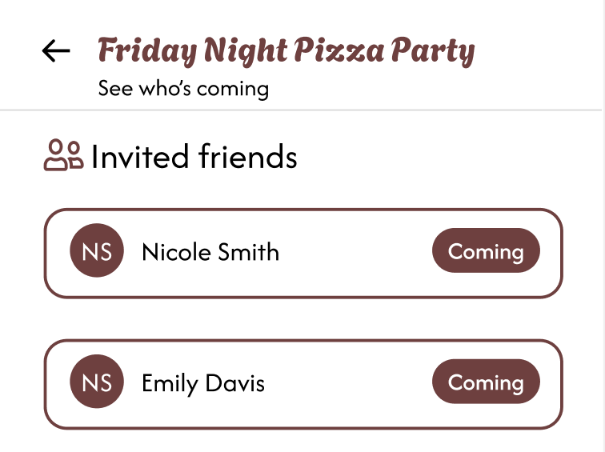
Cooking with friends landing page
Before
After
Changed the ‘+’ button for clarity
Removed “RSVPs” wording to match other screens

Slide 19
Before
After
Rationale for the Change
The original “+” button lacked clarity, created friction in the “Cooking with Friends” task flow
Replaced it with a larger, labeled action button (“Plan a group cooking session”)
  Improves immediate comprehension
  Aligns with core navigation patterns
Updated “View RSVPs” to “See who’s coming”
  Ensures terminology matches the rest of the app’s conversational style
Progress Toward Usability Goals and Design Values
Enhanced Learnability & Ease of Navigation: Reduces guesswork and navigation errors for users trying to create a session
Inclusivity: Labels ensure all users, including those less familiar with event-planning terminology, understand how to participate
Key Success Metrics: Task success rate, engagement duration, NPS/user reported enjoyment

Slide 20
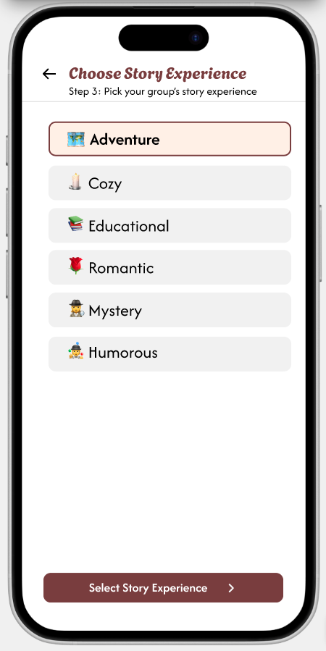
Moderate Task: New Screen
Rationale for the Change
We want users to have direct control over the story experience when choosing the tone and style
Resolves reported heuristic issues by improving visibility and strengthening flow consistency.
Progress Toward Usability Goals and Design Values
Enhanced Learnability & Navigation: The new screen gives users a clear, predictable step in the session setup sequence
Increased Engagement & Emotional Enjoyment: Allowing users to choose the story upfront improves personalization
Joyful Connection: Friends can jointly choose the shared story experience they want, improving collaborative enjoyment
Key Success Metrics: User reported enjoyment, story selection rate, repeat session rate, engagement duration

Slide 21
Prototype implementation status

Slide 22





Framework & Tools
React Native (frontend)
  React Navigation
Expo Go
Supabase (database)
  Tables to store recipes and user info
  Storage to store images
  Authentication
Figma (design)
Github (version control)

Slide 23


AI Tools
Google Gemini – Recipe Images
Used to generate images of books and food.
Justification: Ensured a consistent, high-quality, and visually cohesive look across the app without needing custom photoshoots.
ChatGPT – Recipe Ingredients
Assisted in generating recipe ingredient lists.
Justification: Team members are not culinary experts; AI provided accurate, realistic, and diverse recipes efficiently.
Figma Make – Visual Design
Used for generating revisions based on heuristic feedback.
Justification: Streamlined design iterations, allowing rapid prototyping and alignment with usability improvements.

Slide 24
Implemented Features
Simple Task Flow:
Explore Landing Page – Quickly discover recipes and stories.
Browse Page – Filter and search for recipes efficiently.
Recipe Details – View ingredients, recipe details, and launch cooking flow
Voice AI Screens – Hands-free interaction for cooking guidance.
Story Summary / Capture Dish Screen – Summary of cooking experience.
Story Log – Track your cooking history view your captured images.

Slide 25
Unimplemented Features
Moderate Task Flow (Target: Thanksgiving break → Demo)
Complete all remaining screens
Import contacts implementation
Create cooking sessions
View invites, RSVPs, etc.
Visuals for Cooking with Kids
Target completion: Beginning–Middle of Week 10
Voice AI Backend (Using OpenAI credits)
Target completion: Week 10 + finals week (CS 147L integration)
Chat AI
Frontend: Complete by Week 10
Backend: Week 10 + Thanksgiving break
Profile Screen
Target completion: Beginning–Middle of Week 10

Slide 26
Wizard of Oz Technique + Hardcoded Aspects
Wizard of Oz Techniques:
Simulated Voice AI responses: All recipe narration, step-by-step instructions, and “listening” states were simulated by the team rather than generated in real time
  Justification: A functioning voice backend was outside the scope of the high-fi prototype timeline. This will be worked on in the coming weeks.
Simulated story personalization (e.g., tone of narration, references to group cooking)
  Justification: Generating dynamic story scripts is something we will work on in the coming weeks
Hardcoded Aspects:
Story Log entries are all pre-loaded, static images
  Justification: We do not have real users or real session data yet
Kid-friendly icons, hazard badges, and progression indicators were placed statically
  Justification: Dynamic state management (e.g., hazard detection, kid-safety steps) requires backend reasoning

Slide 27
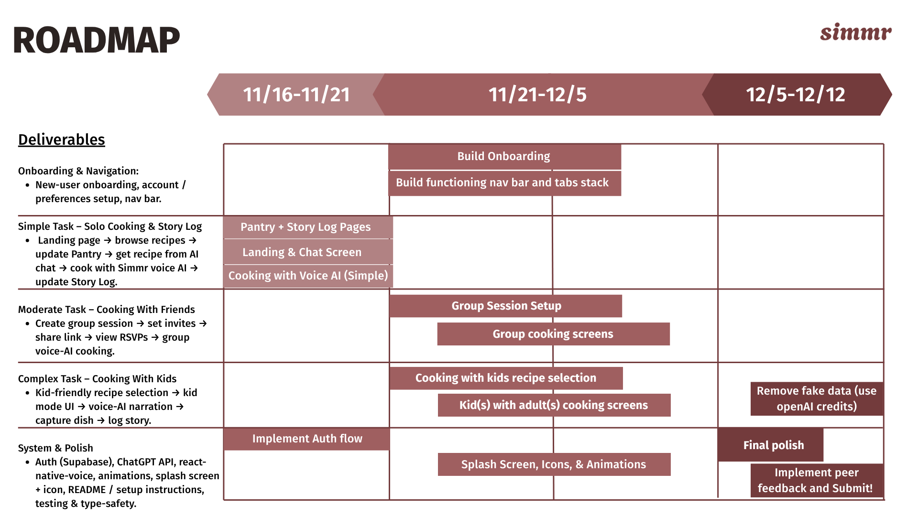
Plan for Finishing

Slide 28
Plan for Finishing pt. 2:
Issues/Questions:
  Integrating Voice AI for the cooking flow (how to listen, store, and respond to what the user is saying)
Split of Remaining Work:
  Jasmine A.: Chat screen, Integrating AI
  Jasmine T.: Integrating AI, Moderate Task Flow
  Jasleen S.: Profile and Complex Task Flow
  Mara B.: Moderate Task Flow, Visuals for cooking with kids

Slide 29
Prototype Demo

Slide 30
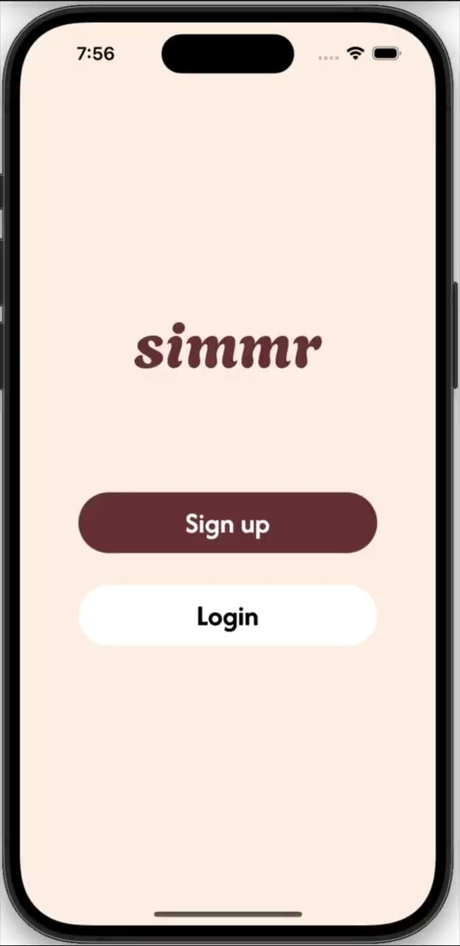

Slide 31
Appendix

Slide 32
Rationale for Level 3 + 4 Violations
Not Addressed
Unclear what the visibility is when sharing a picture. - We thought it was pretty self explanatory that if you took a picture within the app it would stay on your phone in the story log unless you explicitly tried to share it elsewhere.
Finish immediately, end session with no option to undo or resume the action. - User does not understand the functionality of the app. Once you choose to end a recipe you are saying you are done. You can use the back and undo features throughout the entire recipe process.
No take photo later entry point from story log - This feature is meant to capture in the moment photos after following a recipe not for taking pictures after the fact.
No exit/undo for accidental starts - We have already implemented a back button (an ‘x’ in the top left corner) so this didn’t make sense
After pressing "Start group cooking" in the friends tab, a page shows up that looks like the "explore" page where you can browse different recipes. The flow after the "Start group cooking" and the "explore" page is different and inconsistent - we used the same explore screens, we changed the header/button names depending on what the user is doing: starting right away vs not.
The recipes on the "explore" page are not clickable - We just haven’t fully implemented every story. The recipe that was meant to be used was clickable so this wasn’t applicable.

Slide 33
Rationale for Level 3 + 4 Violations
Not Addressed
There are no options to help with "cooking" errors - There is no way for our app to know if you messed up unless you utilize the voice ai and ask for help with a step.
Chat with AI feature doesn't adjust to fit the specific needs of entertaining children when entered from the "cooking with kids" page - We thought this was beyond the scope of the app. You can always tell the AI you want to cook with kids so it can adjust the prompts itself.
AI assistant is not inclusive for children beyond the first two steps - The AI assistant will be inclusive once actually implemented however this was figma and we did not include the full scope of the voice AI.
Cannot navigate to all story log pages from one another even though all pages are built out - We weren’t sure what this meant because you can navigate through the story log using the buttons at the top of the page.
No narration audio preview on recipe details - We thought this would add too much clutter on a mobile device.
Start button is always enabled, even when ingredients not available - We are not forcing users to input every ingredient
App emphasizes a narrative-based approach to cooking to make things more fun, but the "story" reads more like quotes from a self-help book - This was all AI-generated and used as an example. Other stories would have different themes and would be based on the users choice.

Slide 34
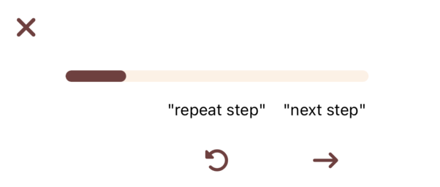
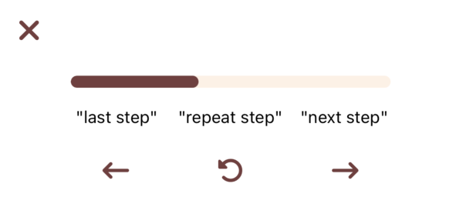
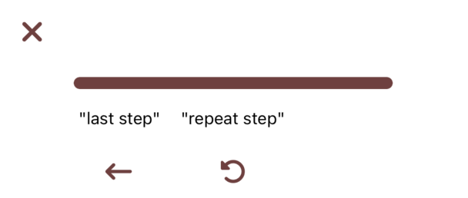
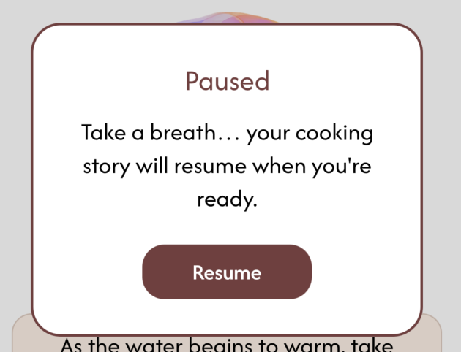

Level 1 + 2 UI Revisions
The "Next Step" button is in a different position for the first step and all of the rest of the steps.
The "X" close button is aligned a bit differently in almost each of the screens in the recipe.
No pause/mute buttons.
(1/2)
(3)

Slide 35
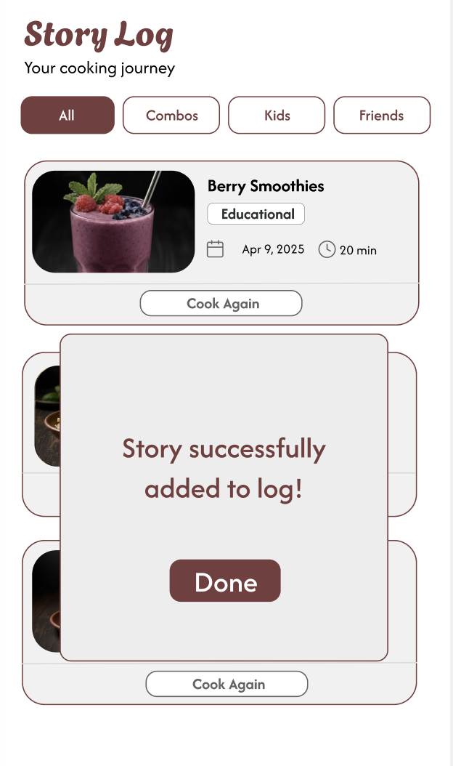
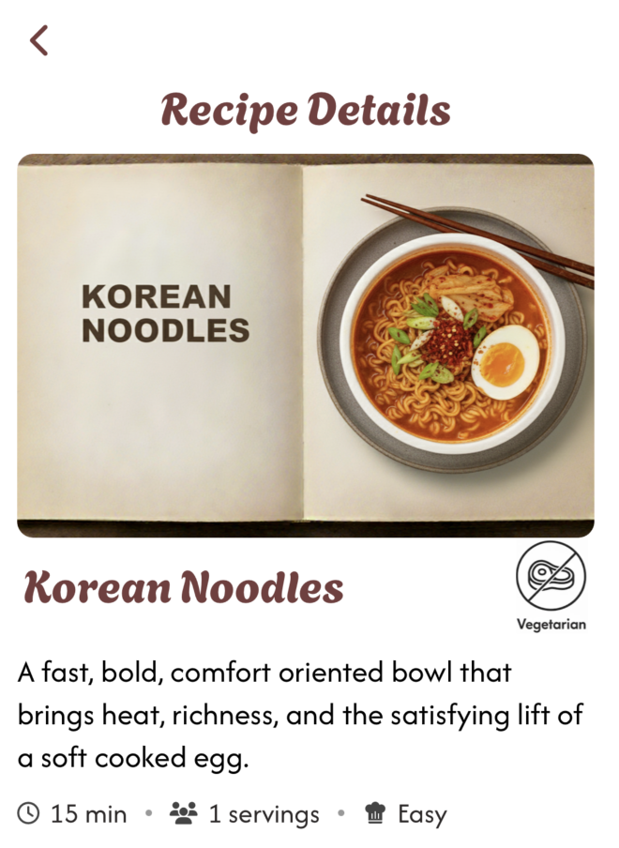
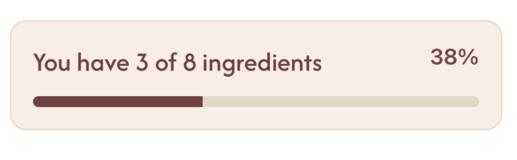
Level 1 + 2 UI Revisions
The ingredient progress bar uses very low contrast between the" ingredients you have" part of the progress bar to the full bar color, making it difficult for users with low vision to read the percentage or understand their ingredient status.
No visible status of picture upload after finishing capture.
The home screen of recipes mostly displays only Western cuisine recipes without visible indicators of dietary accommodations or foods of other cultures.
(3)
(2)
(1)

Slide 36
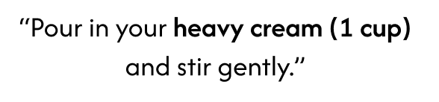
Simple Task Violations
Recipe book images use tiny unreadable text. Switch to simple cover images with a photo and title.
Camera flow needs a review step so users can retake, keep, or crop photos.
Recipe steps should include measurements so users do not have to recall them.
Notes:
Recipe book images use tiny unreadable text. Switch to simple cover images with a photo and title.
Camera flow needs a review step so users can retake, keep, or crop photos.
Recipe steps should include measurements so users do not have to recall them.

Slide 37
Explore landing page
Before
After
New recipe images with larger text
New top tabs with a pantry tab
Reverted back to profile

Slide 38
Before
After
Rationale for the Change
Moving the Pantry out of the bottom tab navigator and restoring the Profile button improves discoverability for settings and personal info.
Placing Pantry in a top tab on the main screen allows users to quickly switch between browsing recipes and managing ingredients, aligning with feedback that users rarely navigate to Profile for settings.
Combines the user’s desire for exploration with the practical need to edit ingredients, supporting both discovery and everyday cooking decisions.
Progress Toward Usability Goals and Design Values
Enhanced Learnability & Ease of Navigation: Users can now access pantry and recipe functions directly from the main screen without unnecessary navigation.
Inclusivity: Centralizing pantry and profile options ensures all users, regardless of tech comfort or cooking style, can efficiently manage their ingredients and dietary preferences.
Discovery: Keeping exploration front and center encourages users to browse recipes while simultaneously considering what ingredients they have, supporting experimentation and practical planning.

Slide 39
Cooking with friends landing page
Before
After
Changed the ‘+’ button for clarity
Removed “RSVPs” wording to match other screens

Slide 40
Before
After
Rationale for the Change
The original “+” button lacked clarity, creating friction around initiating a group cooking session. Replacing it with a larger, labeled action button (“Plan a group cooking session”) improves immediate comprehension and aligns with core navigation patterns.
Updating “View RSVPs” → “See who’s coming” ensures terminology matches the rest of the app’s conversational style and addresses the heuristic feedback .
Progress Toward Usability Goals and Design Values
Enhanced Learnability & Ease of Navigation: Users can now instantly recognize where to create a session, reducing guesswork and navigation errors. The clearer RSVP label also improves scannability and minimizes cognitive load.
Inclusivity: Descriptive labels ensure all users, including those less familiar with event-planning terminology, understand how to participate.
Discovery: By surfacing the group cooking entry point more prominently, users are encouraged to explore collaborative features they might otherwise overlook.

Slide 41
Moderate Task: New Screen
Rationale for the Change
We wanted users, especially when cooking with friends, to have direct control over the story experience, choosing the tone and style they want before the session begins.
This resolves prior heuristic issues by improving visibility, reducing mismatched expectations, and strengthening flow consistency.
Progress Toward Usability Goals and Design Values
Enhanced Learnability & Navigation: The new screen gives users a clear, predictable step in the setup sequence, reducing ambiguity and navigation detours.
Increased Engagement & Emotional Enjoyment: Allowing users to choose the story upfront heightens anticipation and personalization, improving emotional resonance during the cooking session.
Joyful Connection: Friends can intentionally choose the shared story experience they want, fostering deeper collaborative enjoyment.

