Slide 1
Assignment 4: Concept Video
Flippin: Team 1

Slide 2




Our Team
Jenny Li
Cecilia Wu
Ana Nguyen
Viviana Martinez
Computer Science
Guangzhou, China
Computer Science
Portland, Oregon
Computer Science
Torrance, CA
Computer Science
Laredo, TX

Slide 3

Problem
Solution
Job seekers rather stay in a field they are used to, even if it is unfulfilling. Furthermore, by speaking with well-experienced individuals, we learned that no person’s career trajectory is clear-cut, and without self-confidence to pursue new contexts, someone might be miss out on life changing positions.
Match users with peers who also want to take more risks. They hold each other accountable for saying yes to new things, take action on career exploration, and share reflections afterward. We believe this will build social reinforcement and reduces fear of failure.
Mid-Career Transitioners

Slide 4
What we wanted…
“1-2 Syllables”
“Easy to Remember”
“Cute”
“Something like switch or flip”
“What if we square the word”

Slide 5
Introducing…

Slide 6
Flippin
Flip Your Future
We liked that it was simple, incorporated the word flip, and can be used in positive connotation like “What’s fizzin?”
Our one-liner sparks curiosity in what a “flipped” future might be.
Value Proposition: Features of our platform may be incorporated in other brands but approaches the problem from an individual self-learning perspective. Instead, we are valuing the collaboration and mentorship our interviewees owe their career switches to.

Slide 7
Market Research
01

Slide 8

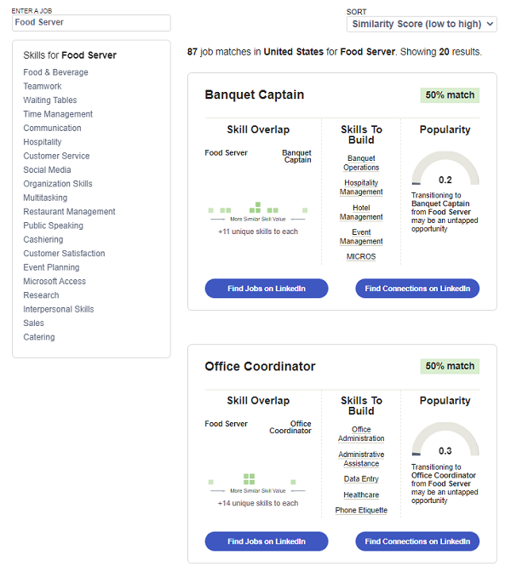
LinkedIN Career Explorer
Feature within LinkedIN that helps users understand how their current skills transfer to new roles.
WORKS WELL
NOT SO WELL
Offers data-driven insights, visualizes transferable skills, integrates existing professional network.
Offers low community support, lacks action accountability, relies on users to reach out to mentor
Implication: Users would value career path insights and a large network of professionals to be accessible and visualized.

Slide 9

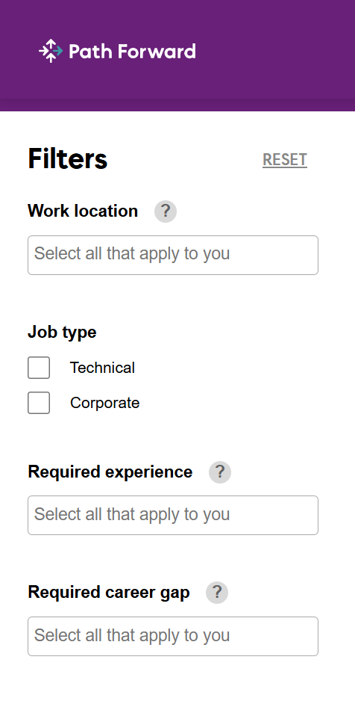
Path Forward
A nonprofit initiative that empowers individuals to explore, prepare for, and transition into meaningful new roles, especially after a break from the workforce.
WORKS WELL
NOT SO WELL
Visualized re-entry paths, offers low-risk opportunities, uses mentorship/workshops/job matching.
Lacks focus on long-term career trajectory, preferring a short-notice job matching, and has limited peer and mentors.
Implication: Switching careers is not always about having employment and seeking another, it also means supporting those who have large gaps of employment. We also want to make sure give adaptive feedback and empower individuals through a community.

Slide 10

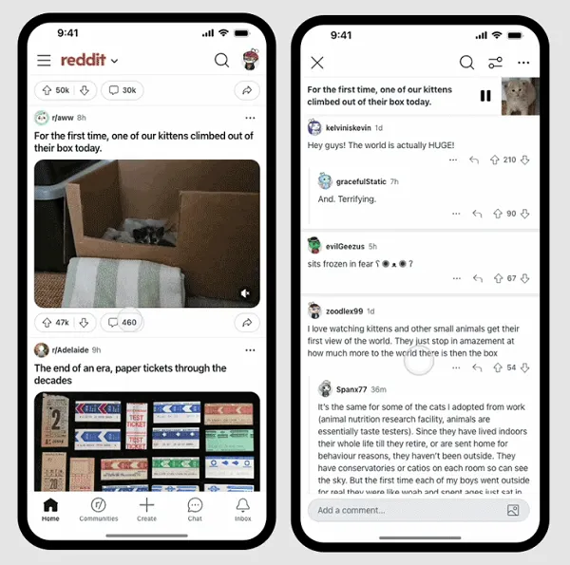
Reddit
A social news and entertainment platform where users post photos, stories, tips, and more onto “subreddits,” or topic-based communities.
WORKS WELL
NOT SO WELL
Anonymous, comfortable to share personal stories, empower communities through niche relatableness, support career subreddit.
Only offers emotional and social support, but does not incite action. No verification for the information posted.
Implication: Users value anonymity and having an answer/peer for every story, question, conflict, or interest.

Slide 11

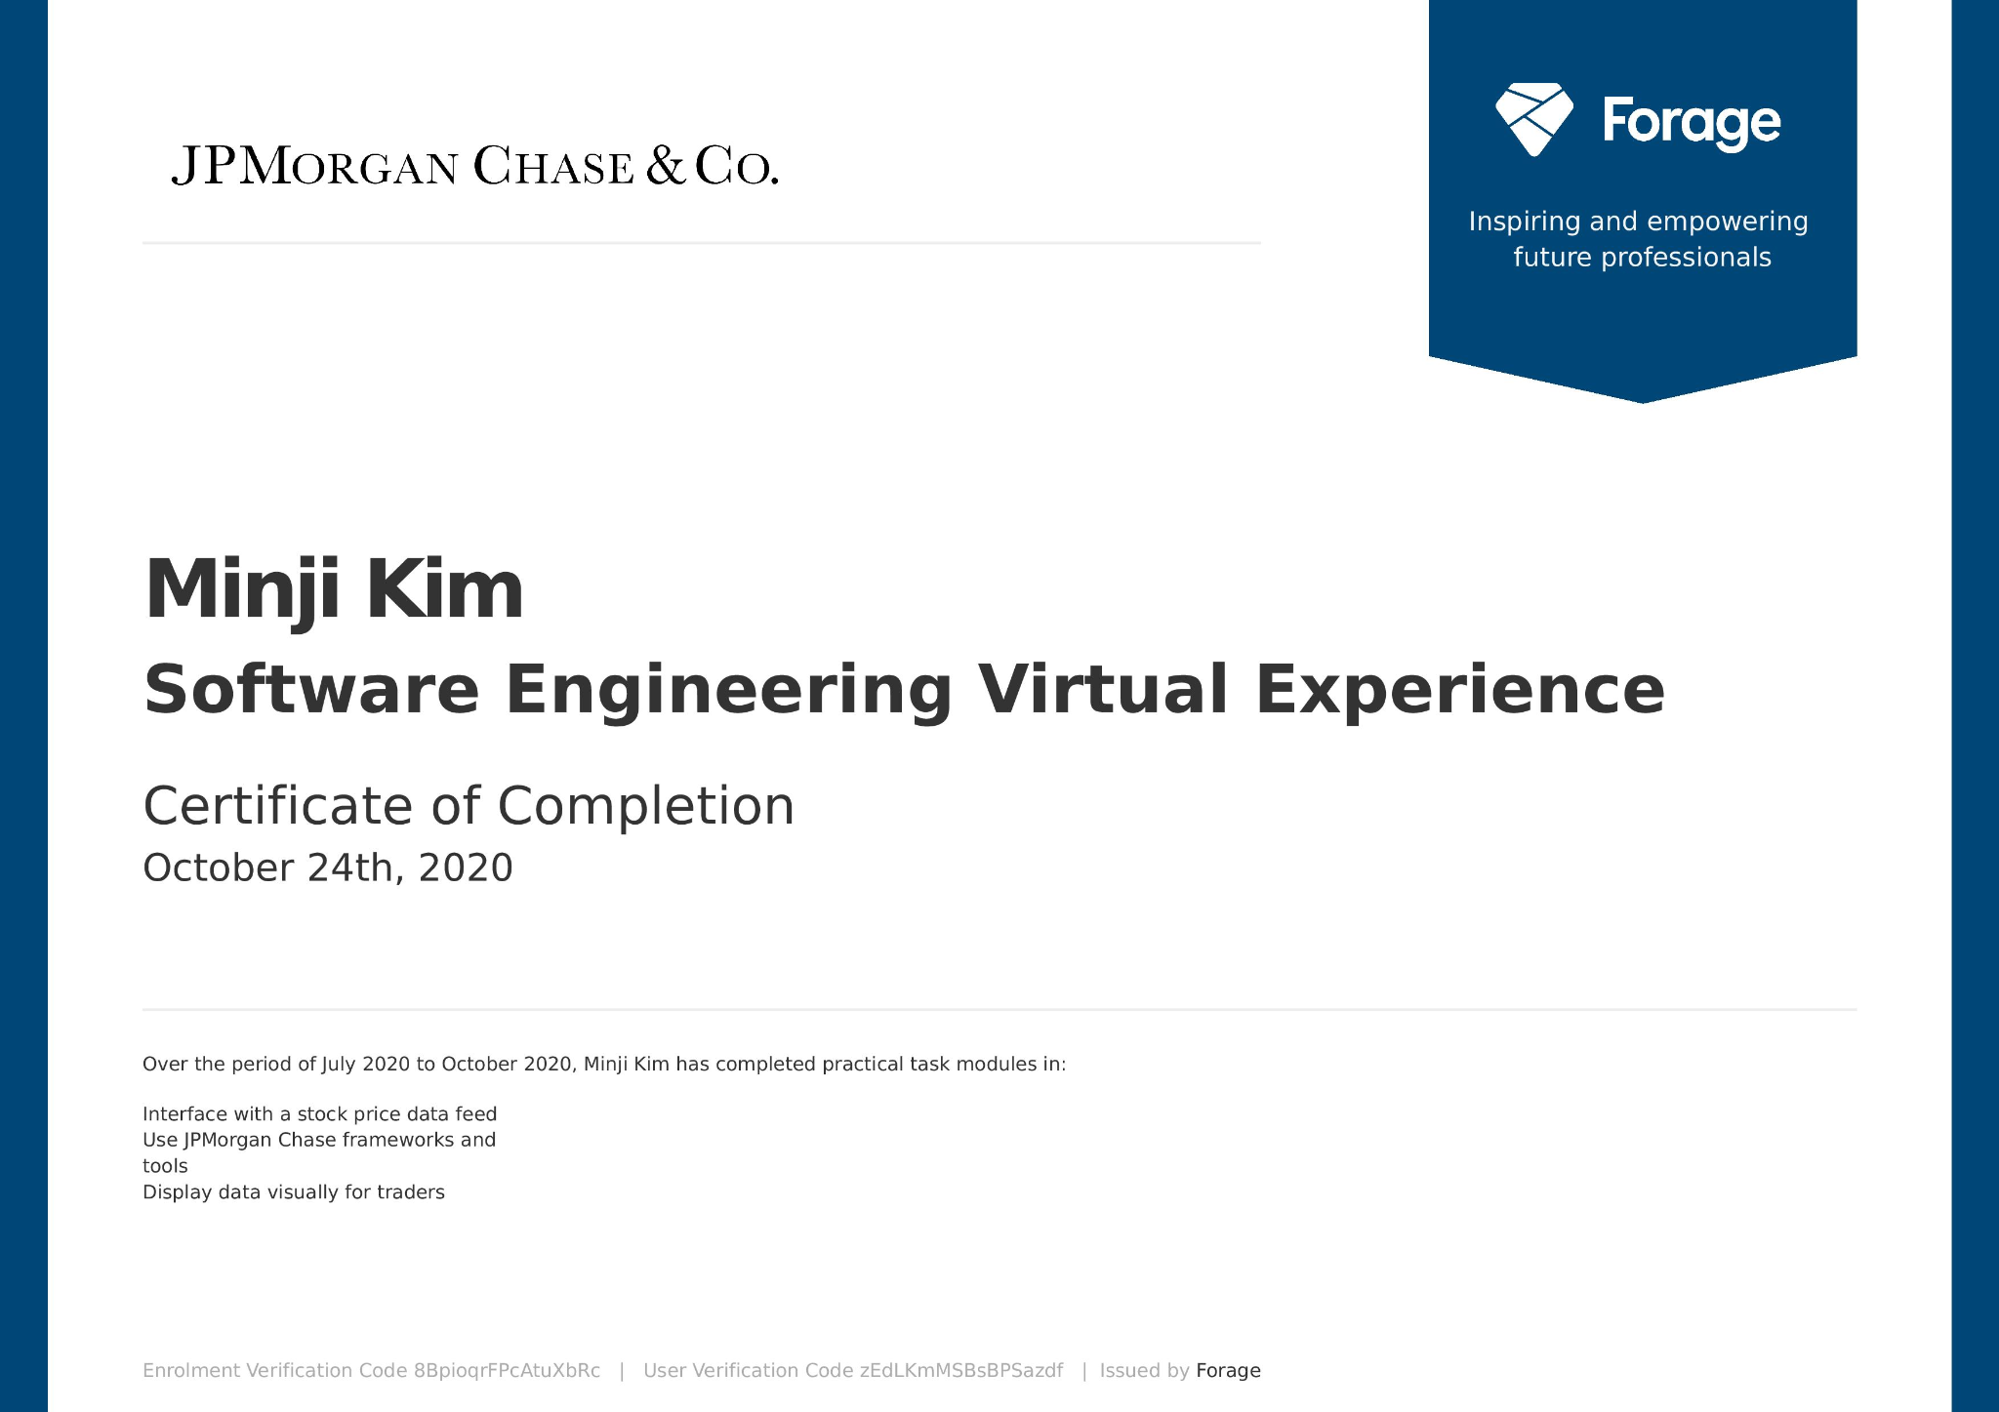
Forage
A platform that connects students and career explorers through short, project-based virtual programs designed by leading companies.
WORKS WELL
NOT SO WELL
Content-based heavy, program modules are very practical, well-vetted curriculum.
Solely content-based and individually driven programs. No in-person opportunities.
Implication: Users want to know what it is like to work for a large well-vetted corporation. Further, quiz-based and module-based curriculum is engaging for a user.

Slide 12

 |  |  |  |  | Flippin
Mentorship Opportunities
Community Building
Practical, Emotional, and Social Support
Focus on Career Education

Slide 13
Our Values in Design
02

Slide 14
Values in Design
Our design is guided by a human-centered philosophy that prioritizes emotional connection, inclusivity, and growth through community. While many platforms focus on providing information or opportunities, we focus on how people feel, learn, and transform during their career transitions.
1. Belonging Over Comparison
Career transitions often feel isolating. Our platform turns that isolation into community by fostering shared journeys. Instead of competing, users grow together by celebrating progress, not perfection. Every feature, from peer circles to reflection prompts, is designed to build a sense of “I’m not alone.”
2. Empowerment Through Vulnerability
True confidence comes from acknowledging uncertainty. We normalize the ups and downs of transition by creating a space where sharing failures, doubts, and lessons is as valued as sharing achievements. This redefines success as progress, not performance.
3. Mentorship Made Human
Mentorship shouldn’t feel transactional or intimidating. Our design integrates mentorship as part of daily interaction. Mentors drop into discussions, offer feedback, and grow alongside users. This relational design removes hierarchy and builds mutual trust.

Slide 15
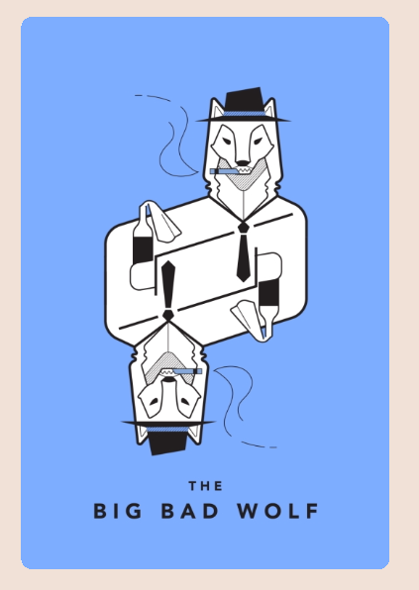
The Big Bad Wolf
What could a bad actor do with your product?
Bad actors or peers could exploit social sharing features—turning encouragement into judgment or pressure. Visibility may lead to mocking, anxiety, or fear of judgment, especially for vulnerable users.
Value Tension:
Authenticity vs. Emotional Safety — openness builds community but increases exposure.
At-Risk Groups:
Low self-esteem users • Younger users • Marginalized groups
Ethical Implications:
AI to flag harmful language
Positive feedback prompts
Reflections private by default

Slide 16
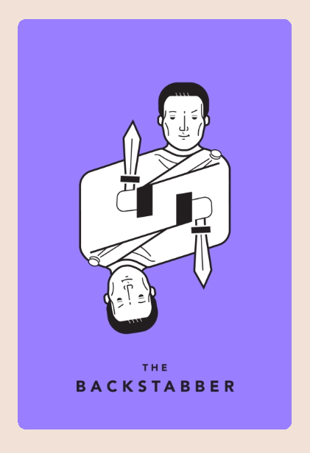
The Backstabber
Privacy & Emotional Safety
Career transitions involve sensitive sharing — breaches of privacy could cause shame or fear of exposure.
  Ethical Implications: Default anonymity, user-controlled visibility, no third-party data sharing.
Mentorship Power Dynamics
Mentors could misuse authority or give harmful advice.
  Ethical Implications: Mentor guidelines, misconduct reporting, early red-flag detection.
Algorithmic Bias
Matching systems may reinforce inequality or exclude marginalized users.
  Ethical Implications: Bias audits, transparent matching, user override or rematch options.

Slide 17
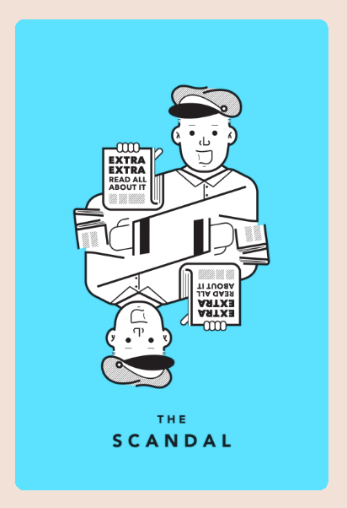
The Scandal
What is the worst headline about your product that you can imagine?
“Social media platform lures innocent career explorer to murderer and meets their demise”
Main User Concerns:
Privacy and safety in peer matching
Sharing sensitive career info (NDAs, company insights)
Exposure to unverified or bad actors, scams, or fake mentors
Ethical Implications:
Identity verification for in-person meetups & mentor roles (optional levels).
Meeting safety features: check-ins, public meetup suggestions, no-home visits policy.
Privacy controls: limit sharing of sensitive info; NDA/content flags for professional posts.
Monetization guardrails: ban selling of mentorship services on-platform unless verified.

Slide 18
Tasks
03

Slide 19
Simple
Moderate
Complex
Read stories or reflections from others going through similar stages of career transitions
Join a group of people with similar career transition goals
Document my progress and get feedback from others making transitions
Discover opportunities to shadow someone in a different career in my area

Slide 20
Storyboard
03

Slide 21
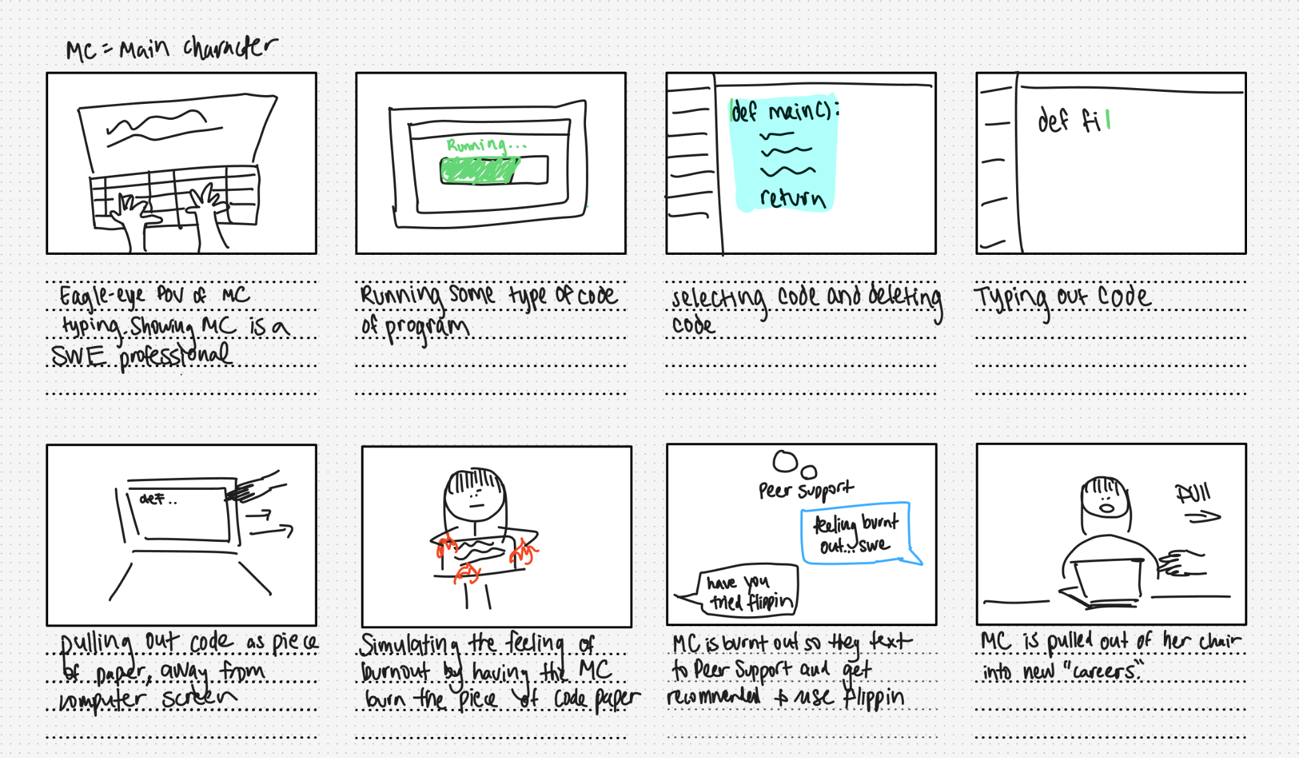

Slide 22
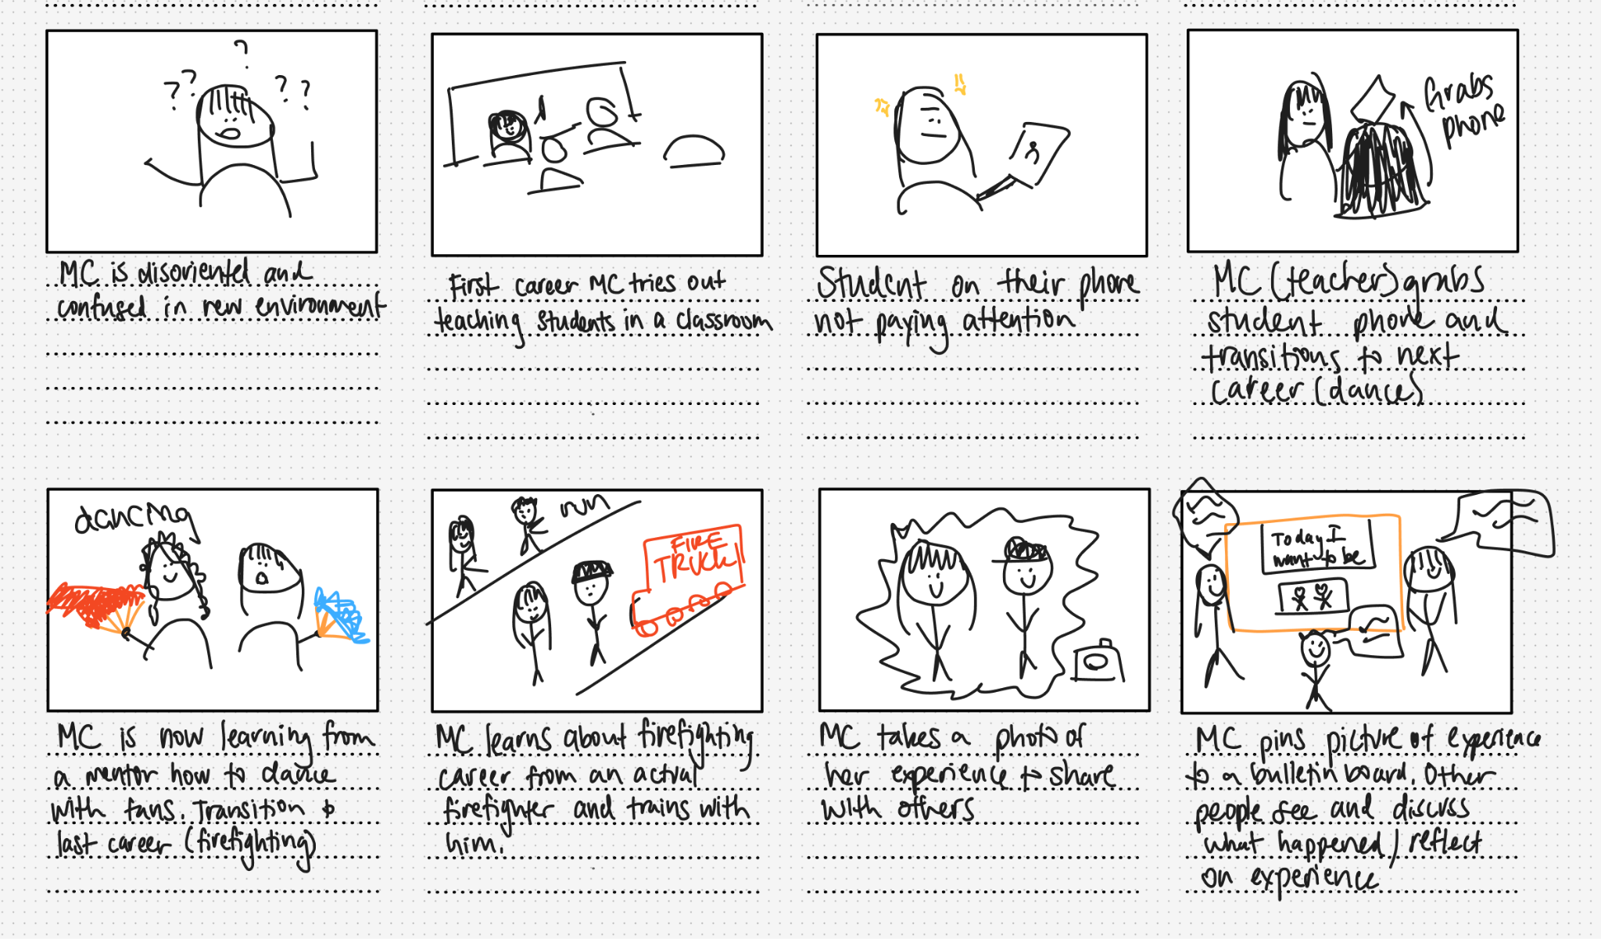

Slide 23
Video
04

Slide 24
Appendix
05

Slide 25
Market Research
Stakeholder & Ethical Implications
Tasks

Slide 26
THANK YOU

