Slide 1
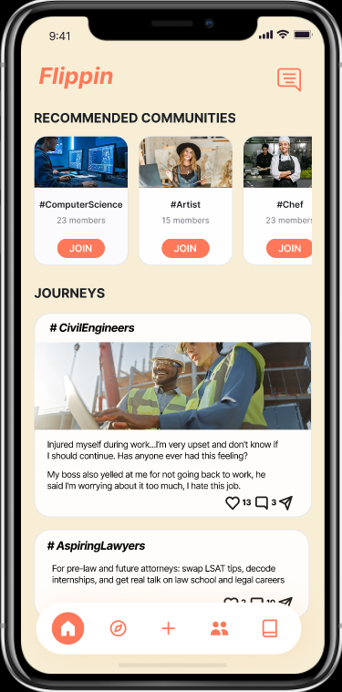
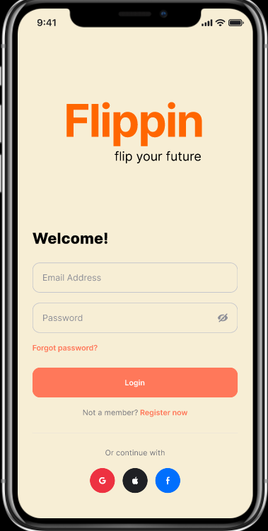
Medium-Fi Prototype

Slide 2

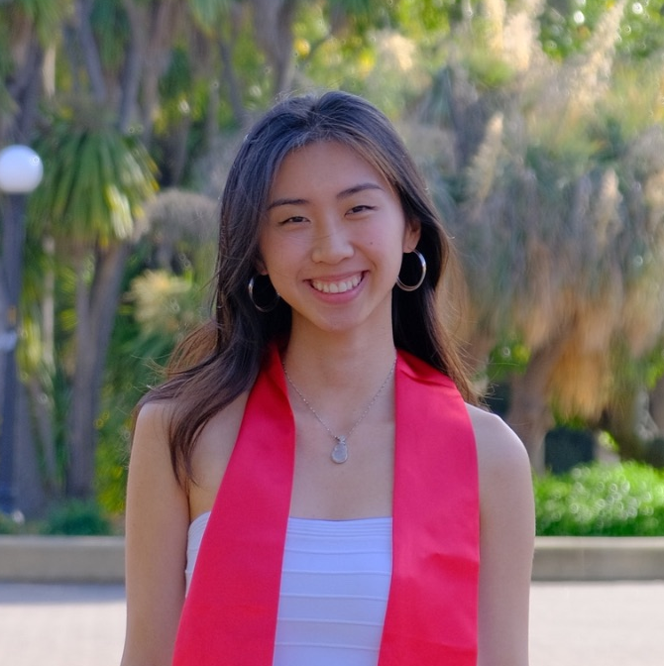
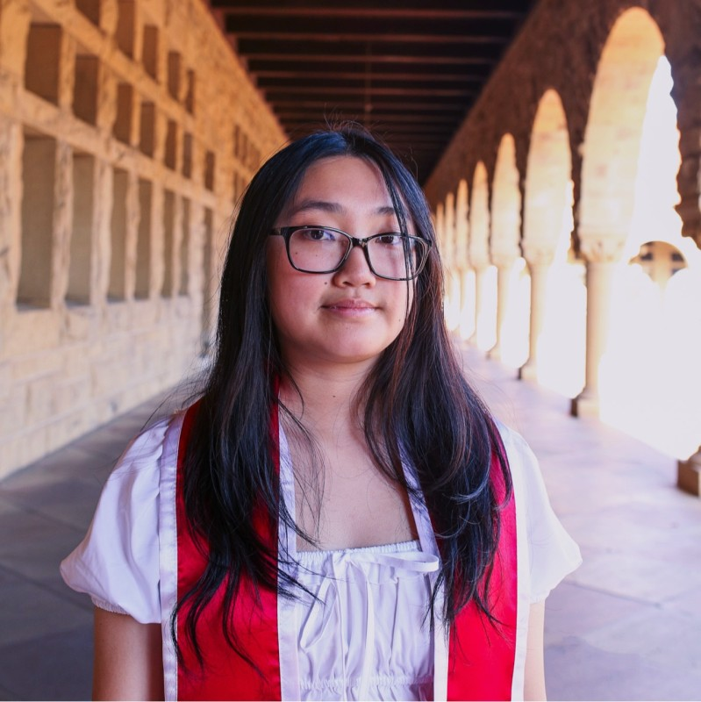
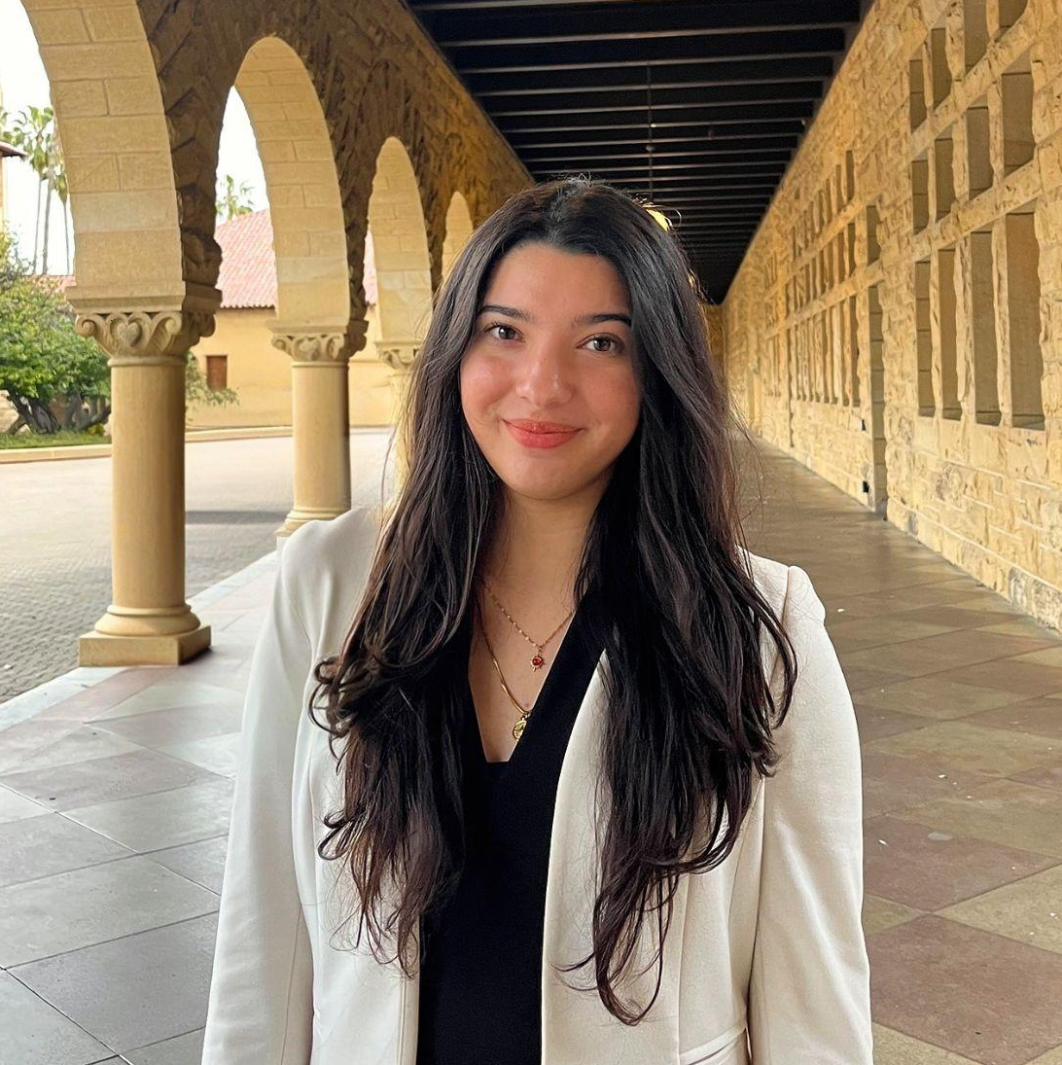
Our Team
Jenny
Cecilia
Ana
Viviana
Computer Science
Guangzhou, China
Computer Science
Portland, Oregon
Computer Science
Torrance, CA
Computer Science
Laredo, TX

Slide 3
PROBLEM
SOLUTION
What does it take to encourage others to flip their futures?
Goal: Use community support to reduce the fear of failure
Job seekers are partial to staying in fields they have experience in rather than exploring fields out of their comfort zone, potentially missing our on life changing opportunities.
Matching users with others peers, so they can hold each other accountable for saying yes to new opportunities, taking action on career exploration, and sharing reflection about their learning experiences.

Slide 4
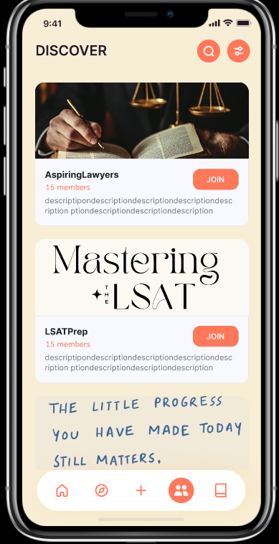
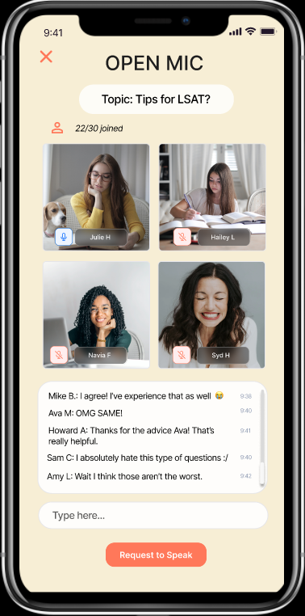
Values in Design: Community
Value 1: Community
Users want to connect with others who are going or went through similar career transitions
Potential Tension
Imposter Syndrome
Unfair Comparisons
Community Groups
Open Mics
Categorizes groups by career fields, skills, or general support
Users can host live spaces to discuss a prompt with other peers

Slide 5
Values in Design: Community
Value 1: Community
Users want to connect with others who are going or went through similar career transitions
Solutions in Progress
Remove like counts
Cater to early stage career transitioners
Community Groups
Open Mics
Categorizes groups by career fields, skills, or general support
Users can host live spaces to discuss a prompt with other peers

Slide 6
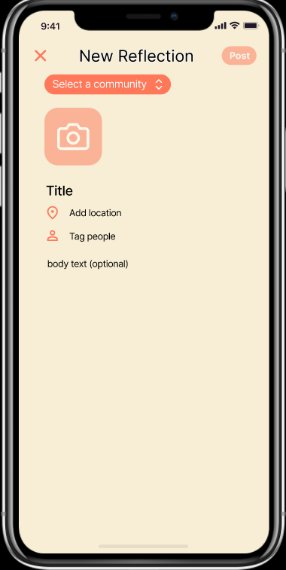
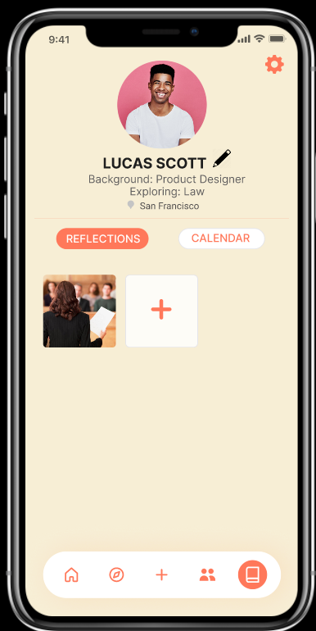
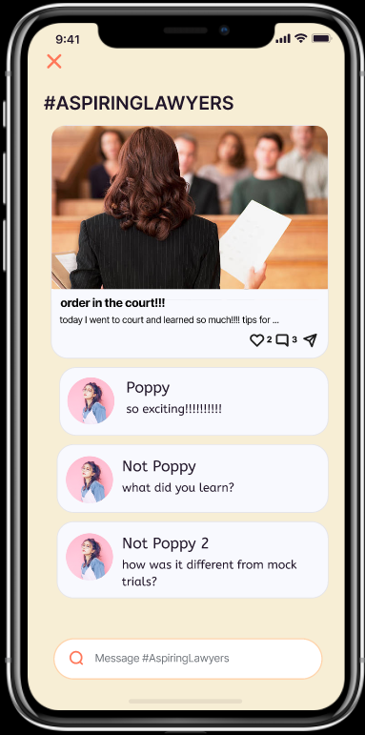
Values in Design: Motivation
Value 2: Motivation
Users want to feel motivated to continue in a career transition
Potential Tension
Hateful Comments
Reflection Posts
Personal Progress
Community Feedback
Users can document their progress through reflection posts
Users can easily access their reflections
Users can hear from their peers and applaud each other’s milestones

Slide 7
Values in Design: Motivation
Value 2: Motivation
Users want to feel motivated to continue in a career transition
Solutions in Progress
Censored Speech
Reporting of hate comments
Reflection Posts
Personal Progress
Community Feedback
Users can document their progress through reflection posts
Users can easily access their reflections
Users can hear from their peers and applaud each other’s milestones

Slide 8
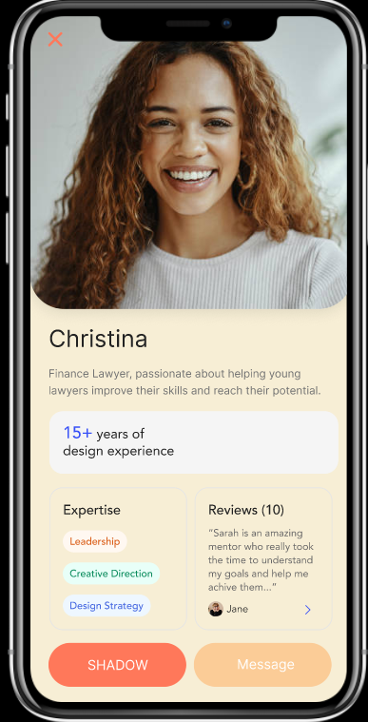
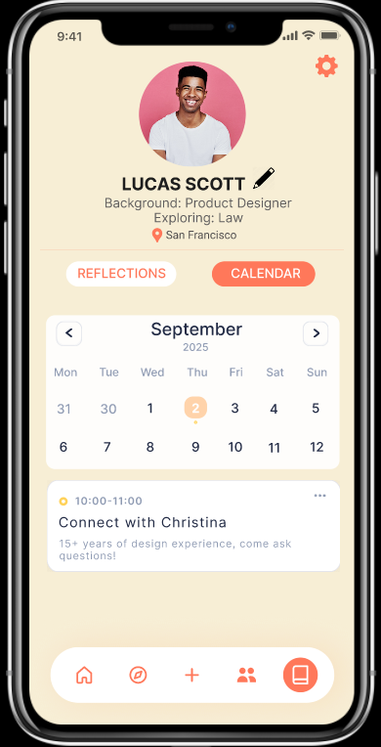
Values in Design: Action
Value 3: Action
Users don’t want to see rejections, but real opportunities to work in another field
Potential Tension
Shadowing Opportunity Scams
Mentor Connection
Shadowing Opportunities
Users can message with people who have reported themselves as available mentors
Users can schedule a shadowing appointment without an interview process

Slide 9
Values in Design: Action
Value 3: Action
Users don’t want to see rejections, but real opportunities to work in another field
Solutions in Progress
User verification process
Mentor Connection
Shadowing Opportunities
Users can message with people who have reported themselves as available mentors
Users can schedule a shadowing appointment without an interview process

Slide 10
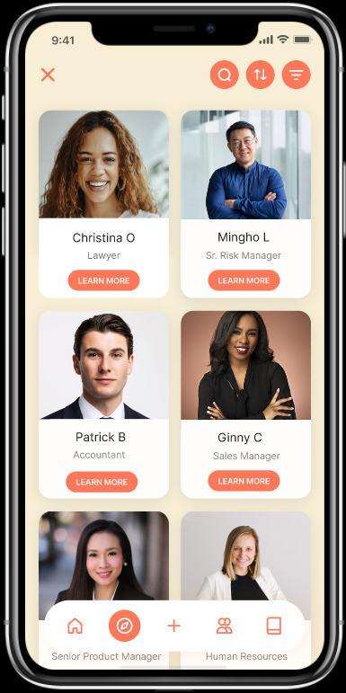
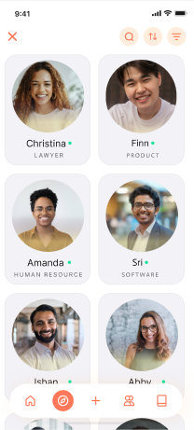
Our Task Flows
Task Flow One
Task Flow Two
Task Flow Three
Join a group of likeminded aspiring lawyers
Document your progress by posting a reflection
Discover and schedule a shadowing opportunity with a mentor (Christina)

Slide 11
Our Task Flows
Our task flows were received well by our testers–described as “human-centered” and a “nice alternative to LinkedIn”. Hence, no changes were made.
Task Flow One
Task Flow Two
Task Flow Three
Join a group of likeminded aspiring lawyers
Document your progress by posting a reflection
Discover and schedule a shadowing opportunity with a mentor (Christina)

Slide 12
Our Usability Goals and Metrics
Robustness
Discoverable
Measure: # of Misclicks
Measure: # of screens visited
We tested to ensure our platforms’ labels, cues, and terminology were intuitive for a new user to explore.
We tested to observe if users were curious to visit other screens and features.

Slide 13
Previously, we observed that…
Discovery
Robustness
Screens Visited
#
misclicks
3
Tester 1
90%
1
Tester 2
85%
0
0
Tester 3
65%
T1
T2
T3
T4
Tester 4
70%
Testers

Slide 14
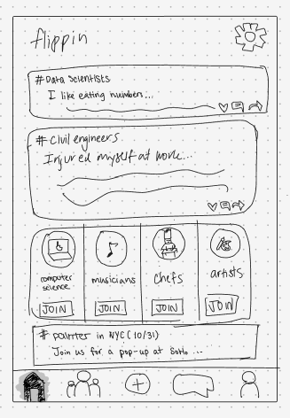
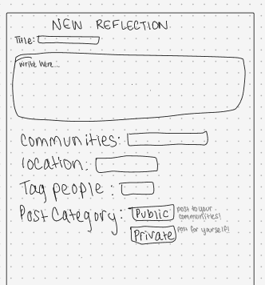
Improvements of Robustness
We learned that…
Users couldn’t find shadow opportunities, which was placed in the communities tab
Users were confused on what the difference of a private or public post was

Slide 15

Improvements of Robustness
Changes
Restructure Taskbar to more intuitive icons
Kept the “+” in the center because none of the testers misclicked it
Relocated the Chat/Community Threads icon to the top right
All posts are public and selected from a dropdown

Slide 16
Improvements of Discoverability
Before…
We offered up to 9 screens:
Login
Home Page
Communities
Show More Shadowing Page with Filtering
Forum Screen
Add Friends From Forum
Profile Page
Add Reflection Post
Chats/Group Threads
Now…
We have around 20 screens with the following features:
Login + Confirmation Screens
Onboarding and Questionnaire Screens
Discover Opportunities Page
Extended Shadow Opportunities Screen
Discover Communities Page
Open Mic Page
Profile Page
Calendar Screen
Settings Page
Add Reflection Post
Host Forum Screen
Chats/Group Threads
And flexibility for more…

Slide 17
Major Changes

Slide 18
Major Change 1: Home Page
Changes
Restructure Taskbar
Relocated the Chat/Community Threads icon to the top right
Relocated Settings to Profile Page
Recommend Communities at the top of the page
“Journeys” Terminology
Warm background color

Slide 19
Major Change 1: Home Page
Justification
The communities icon confused our users and did not imply there were shadowing opportunities there
To open up space for the discover icon, we relocated the chat icon to the top right, drawing inspiration from platforms like Instagram.
Since joining communities is our simple task flow, we realized it should be our main focus and at the top of our homepage
We switched from a white background to be a warmer yellow to make users feel more at ease and likely to open up. White was a bit sterile.

Slide 20
Major Change 1: Home Page
Justification
We also received feedback that in this type of platform, a career transitioner would want to feel that they are not alone by knowing that people come from all types of backgrounds and have stories to tell. We restructured the homepage to instantly show journeys at first look so users are at ease and feel more supported and have a community of people with similar backgrounds.

Slide 21
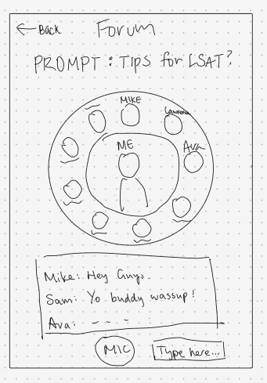
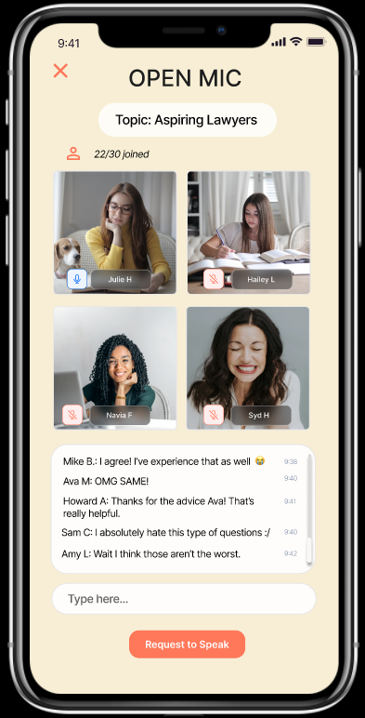
Major Change 2: Forum -> Open Mics
Changes
Redesign of utility from forum discussions to a live space for stories to be shared, although the former is also possible
Removed the use of a circular layout of participants -> now a square layout of each person
“Request to speak” button – creates a queue of speakers

Slide 22
Major Change 2: Forum -> Open Mics
Justification
Through our needfinding we found that people wanted to connect to other people’s stories. However, our forum was more of a discussion rather than a platform for stories, so we thought an open mic would be a more appropriate way to uplift voices and support people's “Journeys”
Square layout ensures equal space uptake by each participant, enforcing that everyone is on the same level.
Requesting to speak prevents too many overlapping voices

Slide 23
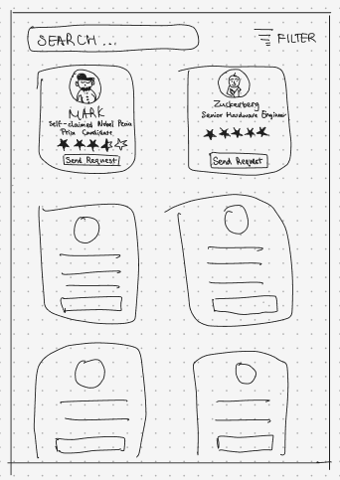
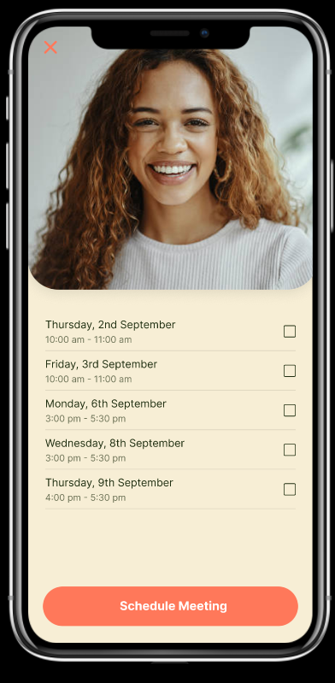
Major Change 3: Scheduling Shadowing
Changes
Send Request originally implied sending a message to a potential mentor, but now it is displayed as “Shadow” and navigates to an immediate scheduling of an appointment

Slide 24
Major Change 3: Scheduling Shadowing
Justification
Streamlines scheduling a shadow session
Removes the fear of rejection
Less of a “LinkedIn” process

Slide 25
Task Flows

Slide 26
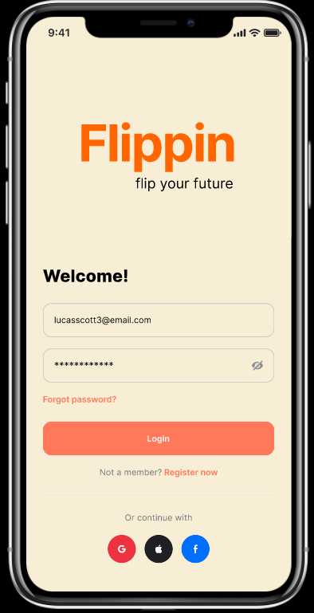
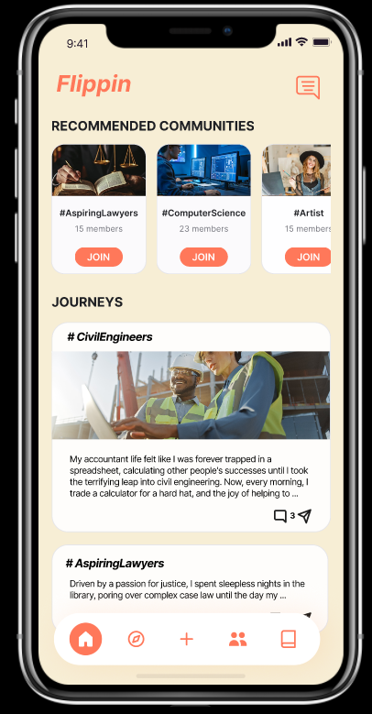
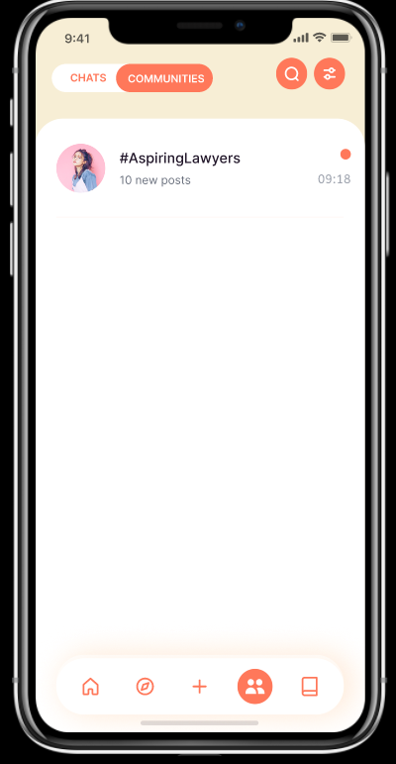
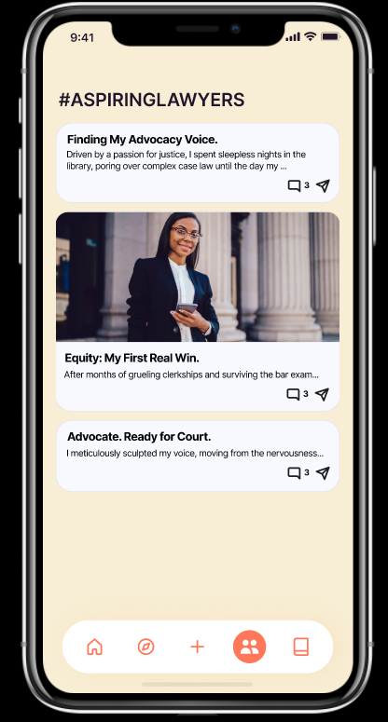
Task Flow 1: Join a group of likeminded aspiring lawyers
Redirected to home page
Press Join then redirect to communities thread
Press on the community to redirect to aspiring lawyers group page
Click to sign in

Slide 27
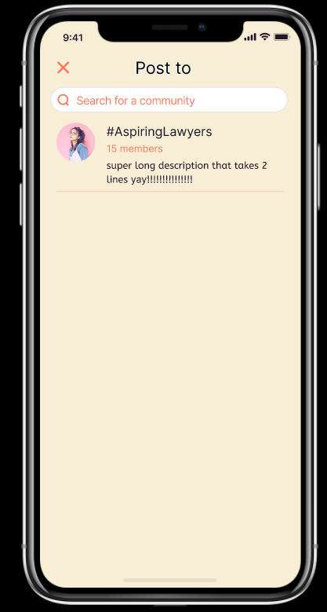
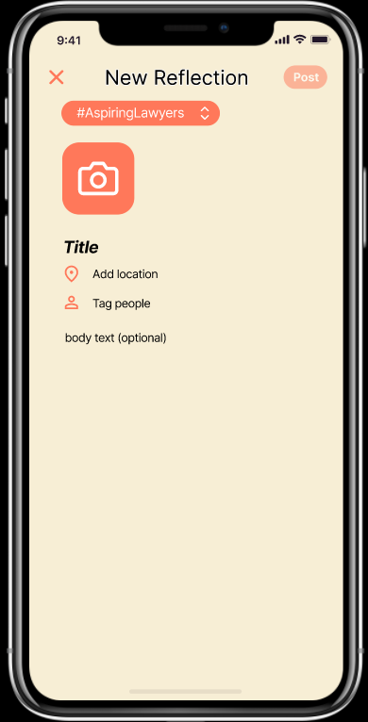
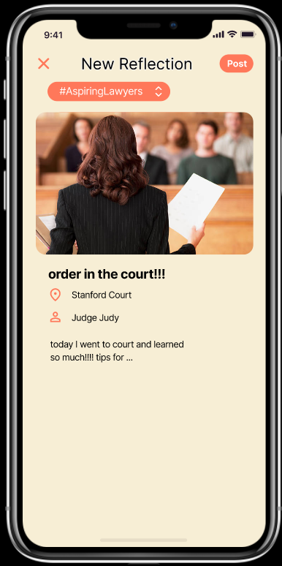
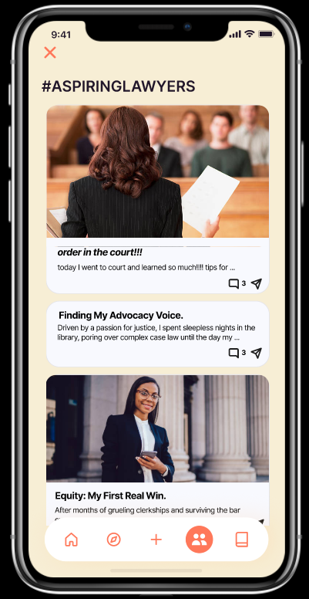
Task Flow 2: Document your progress by posting a reflection
Press select community which navigates to a search screen for communities that the user is a part of
After pressing post, you are redirected to the post feed of the selected community
Select the desired community, in this case, AspiringLawyers, which then renavigates back to the reflection post screen
Finish filling in the rest of the text input by pressing any of the options
Press “+” icon to navigate to Click to sign in
reflection post screen

Slide 28
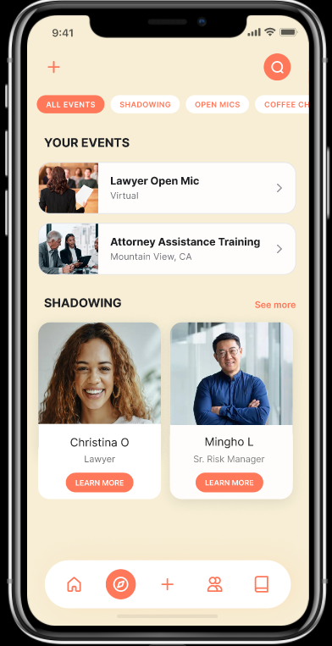
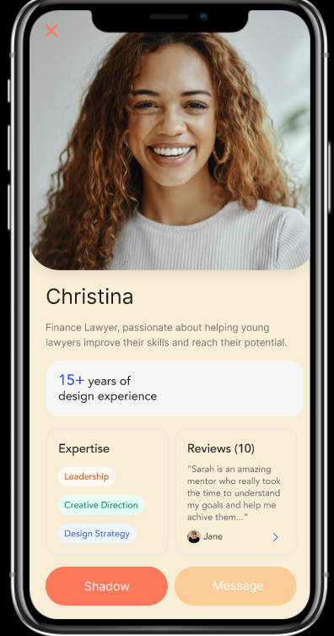
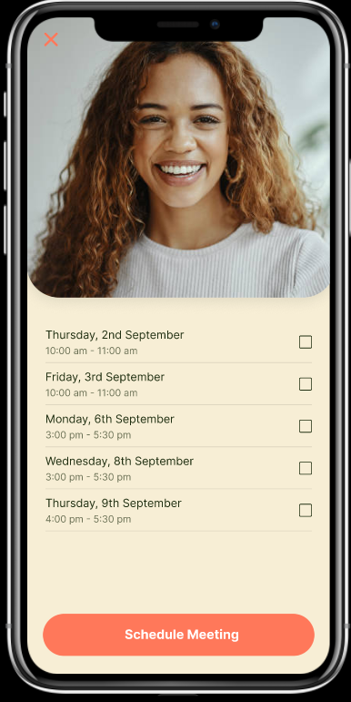
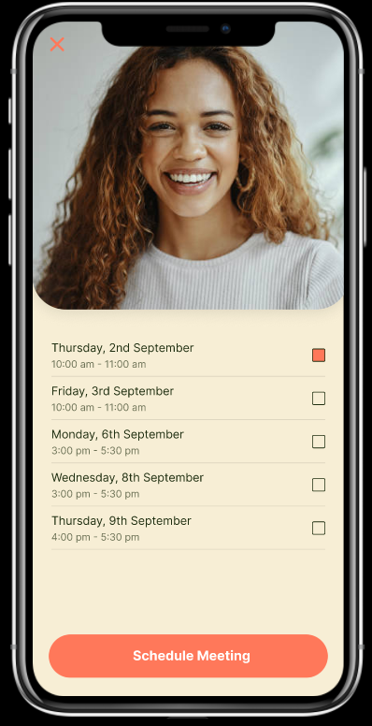
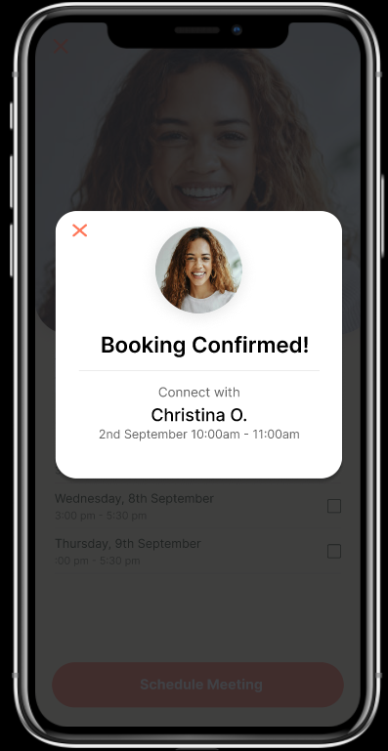
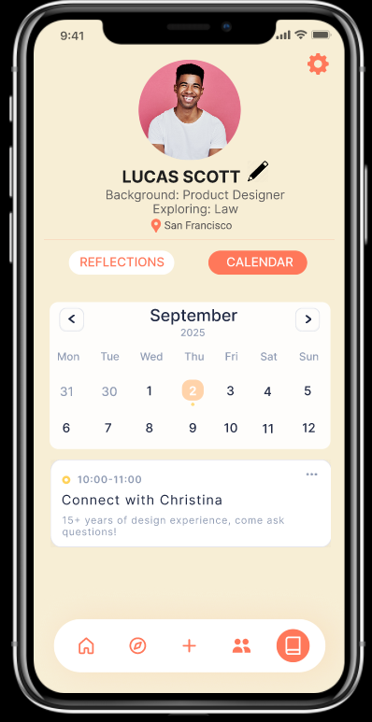
Task Flow 3: Discover and schedule a shadowing opportunity with a mentor (Christina)
After exiting from the popup, you are navigated to your calendar and able to view your booking
Navigate to the discover page on the taskbar
Choose a convenient time
Press the shadow button to prompt navigation to a schedule form
Press schedule meeting, which navigates to a confirmation pop up
Scroll to the bottom of the page and press learn more on Christina

Slide 29
Prototype Implementation

Slide 30
Figma as an Implementation Tool
Cons
No backend integration
Static implementation and data
Acts more as a simulation
Hard to support complex tasks
Justification
Interactivity is easy to test
The lack of backend doesn’t prevent users from interacting with the layout, design, and terminology of our project
Easy to access for future testers through shareable links
It’s important to be able to reiterate design changes as a group in a collaborative way
Pros
Supports collaborative editing
Supports task flow features to prototype
Easily shareable
Can design without coding
Layout and prototype mimics coding
Offers a wide range of templates

Slide 31
Limitations
What were our constraints?
We couldn’t implement any backend processes
Only display hardcoded data
Hardcoded and Wizard-of-Oz features?
Only the specific groups, mentors, or events were able to be interacted with. Ex: Aspiring Lawyers, Christina (mentor), reflection post inputs, etc.
The interactions available are based on our pre-planned notion that our user is interested in exploring law
Impact on User Experience?
Users can’t interact with the UI with their specific career interests
Users can’t have real interactions with other people on the platform, including real comments/feedback/recommendations/responses

Slide 32
Appendix
Our Figma:
https://www.figma.com/design/840UCIf8zr4dQP9h9AAa0O/CS147-Figma?node-id=1-2&p=f&t=JG5oltsMgvpXFPvg-0
Our README:
https://docs.google.com/document/d/14hXFRlf5tj7kykout0Mj7Dq5Qfpc5nbFUhWMy-wBtqo/edit?tab=t.0#heading=h.5idco5wwh8yu

