Slide 1
FLIPPIN
CS147

Slide 2

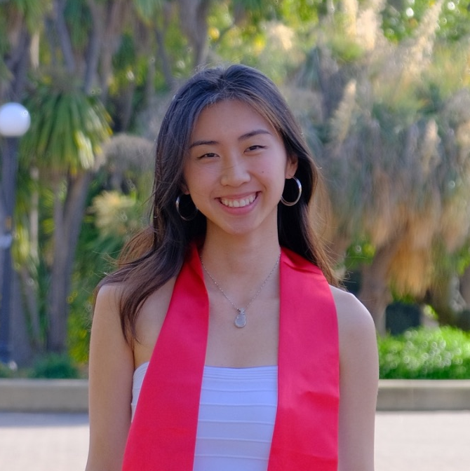

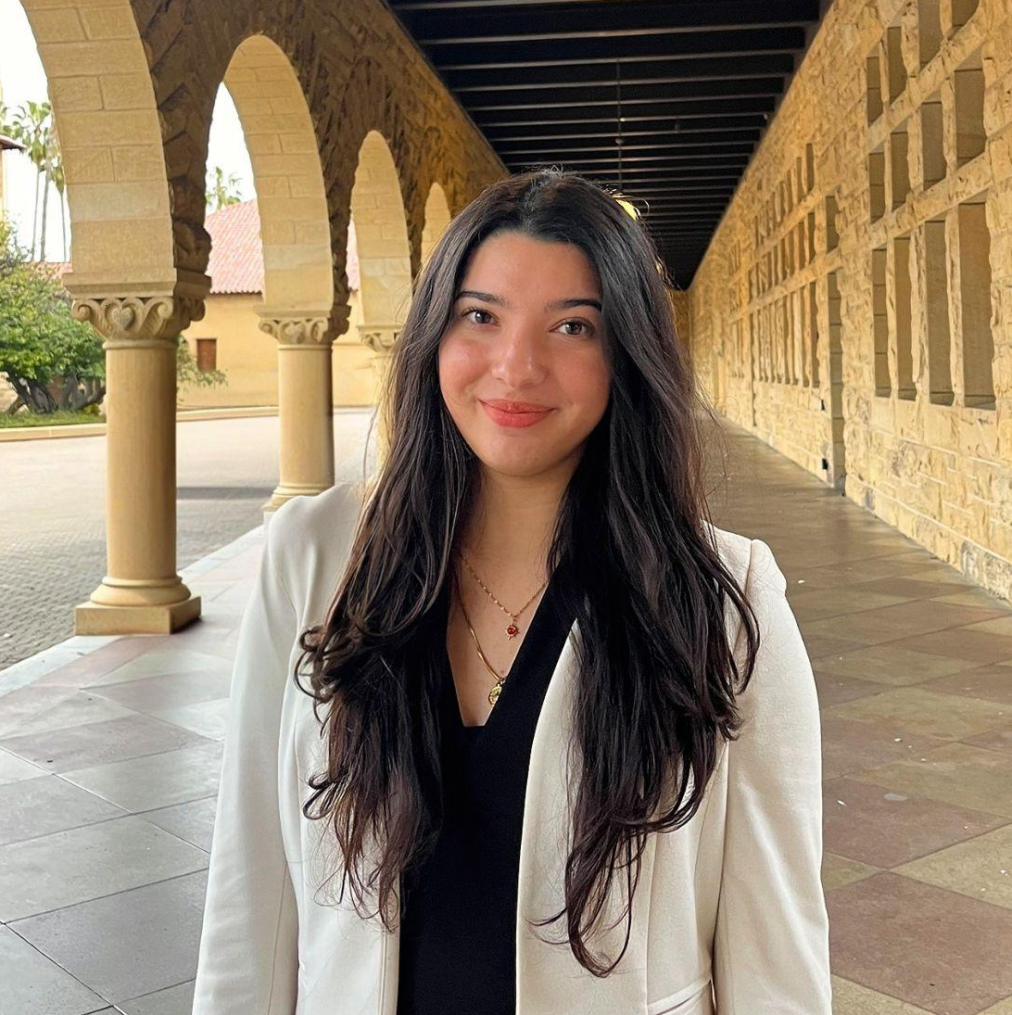
Meet the Teams
MEET THE TEAMS
FLIPPIN
INTRO
Jenny
Cecilia
Ana
Viviana
Computer Science
Guangzhou, China
Computer Science
Portland, Oregon
Computer Science
Torrance, CA
Computer Science
Laredo, TX

Slide 3
Career transitions are HARD…
Even HARDER without
WHO ARE WE?
FLIPPIN
INTRO
FLIPPIN
connections
experience
support

Slide 4
Career transitions are HARD…
Even HARDER without
Find peers to keep each other moving.
Explore, act and reflect fearlessly
to flip your future
WHO ARE WE?
FLIPPIN
INTRO
FLIPPIN

Slide 5
AGENDA
01
Heuristic Evaluations
02
Revised Design + Status
03
Demo

Slide 6
HEURISTICS VIOLATIONS
HEURISTICS RESULTS
FLIPPIN
HEURISTIC EVALS
80 TOTAL
# Viol. (sev 3)
# Viol. (sev 4)
Total
H4: Consistency & Standards
4
2
6
-
-
H5: Error Prevention
1
4
5
H1: Visibility of System Status
0
4
-
4
H3: User Control & Freedom
2
-
2
4
H10: Help & Documentation
3
1
4
-
14
9
23

Slide 7
MOST VIOLATED HEURISTICS
FLIPPIN
HEURISTIC EVALS
23
57
Viol. (Sev 3 & 4)
Viol. (Sev 0, 1 & 2)
28%
11%
11%
H4: Consistency & Standards
H10: Help & Documentation
H5: Error Prevention
Trend / Takeaway: Inconsistencies, unclear guidance, and missing safety checks created confusion, so we’re focusing on making the experience clearer, more predictable, and more supportive.
Notes:
Details which major violations were addressed, which were not, and why

Slide 8
PROPOSED CHANGES
FLIPPIN
HEURISTIC EVALS
H4: Consistency & Standards
H5: Error Prevention
H10: Help & Documentation
Add confirmation screen before entering or joining events.
Add edit/delete options for posts (currently impossible).
Add cancel/reschedule options for shadow meetings.
Add required fields for event creation (location, format, etc.)
Remove all page headers for consistency
Fix inconsistent terminology across account creation
Split “Discover” = joined communities + “Home” = For You Page — not both.
Separated the mentor and mentee onboarding flow
Add explanation about location use for shadowing appointments
Clarify optional fields for posting
Focus on implementing the most violated heuristics to have the most impactful improvement on experience

Slide 9
REVISED DESIGN
FLIPPIN

Slide 10
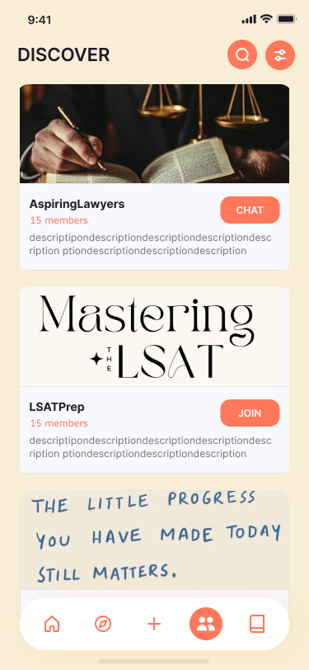
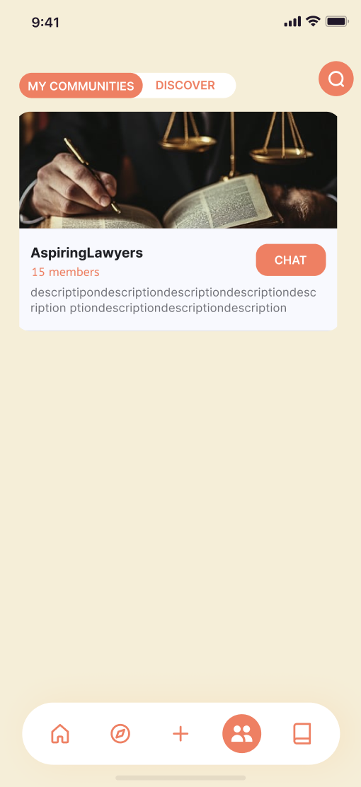
REVISIONS
FLIPPIN
REVISED DESIGN
Before
After
Removed inconsistent headers to improve clarity and visual consistency — enhanced user comprehension, reduced confusion.
Replace Discover with Joined Communities page for focused user journeys — improved user control and task completion rates.

Slide 11
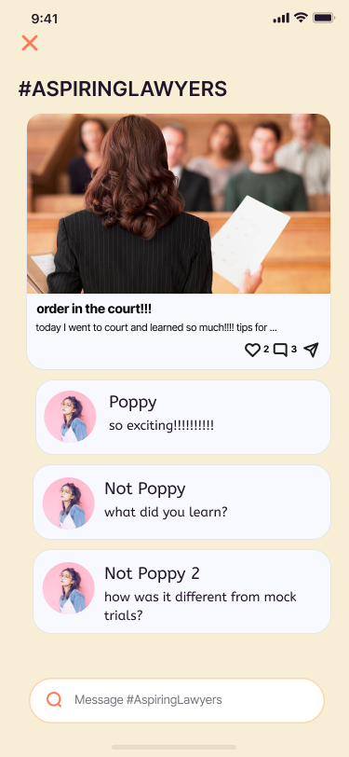
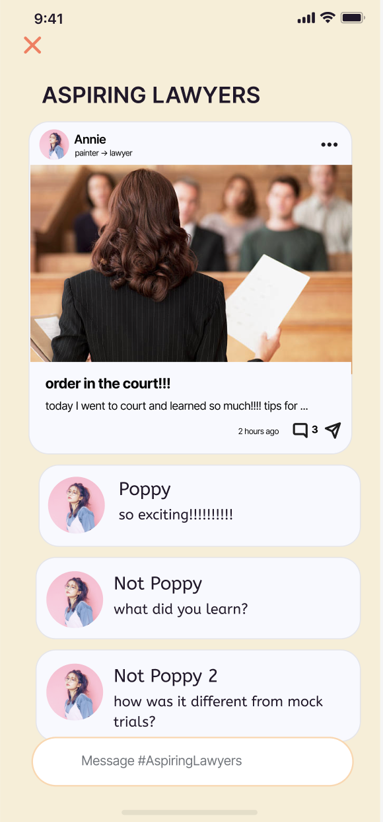
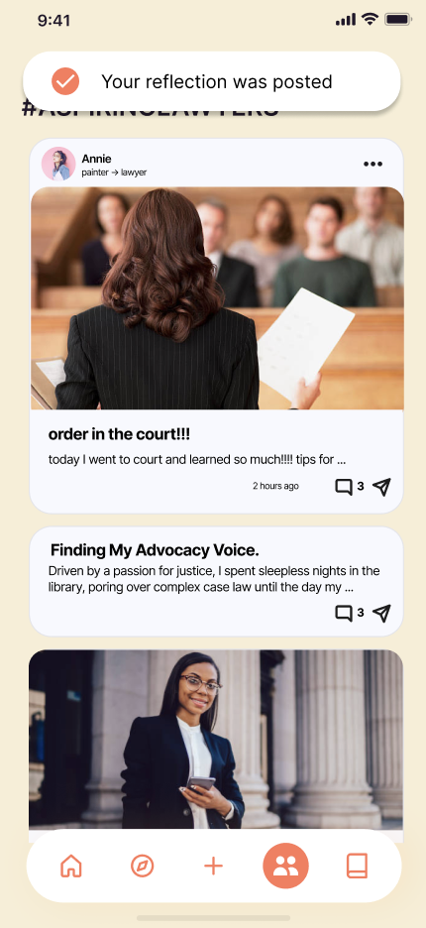
REVISIONS
FLIPPIN
REVISED DESIGN
Before
After
Added author, career transition, timestamps — boosts clarity, post traceability.
Introduced confirmation screens and editable posts to prevent errors and empower users — boosted user control and freedom and visibility of system status

Slide 12
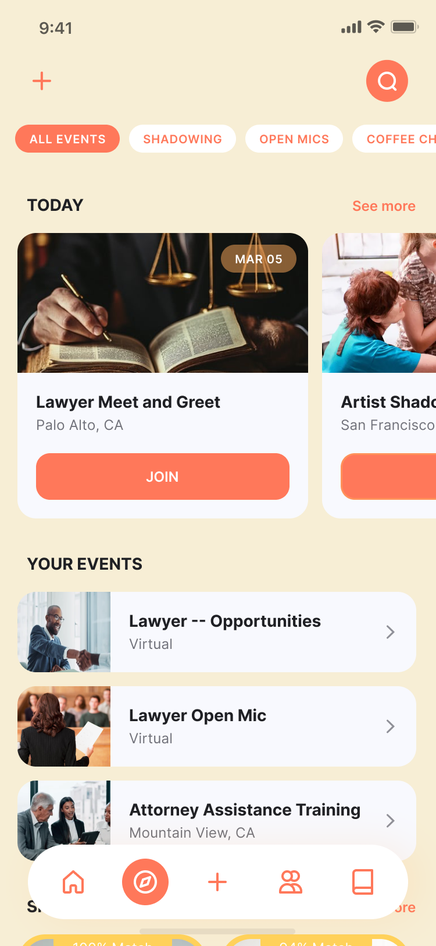
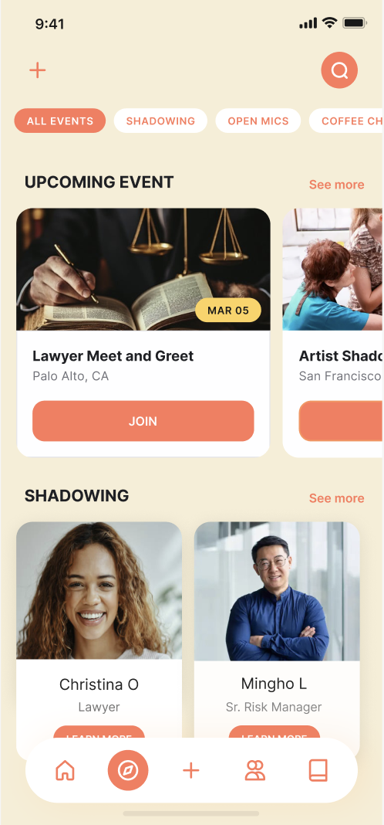
REVISIONS
FLIPPIN
REVISED DESIGN
Before
After
Renamed headers and removed “YOUR EVENTS” — ensures consistent and matches with user’s expectations

Slide 13
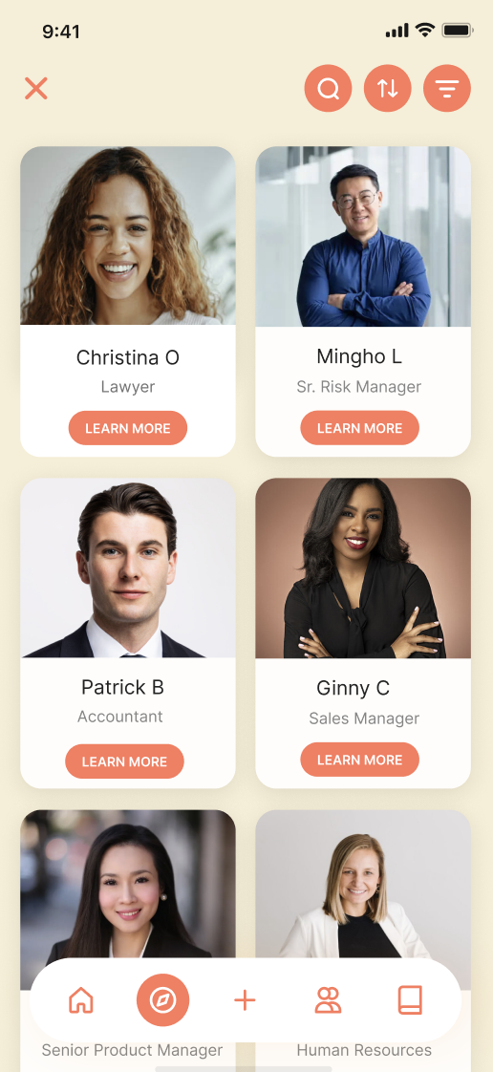
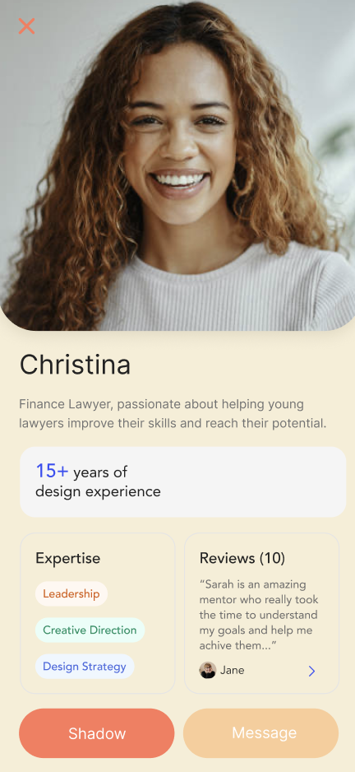
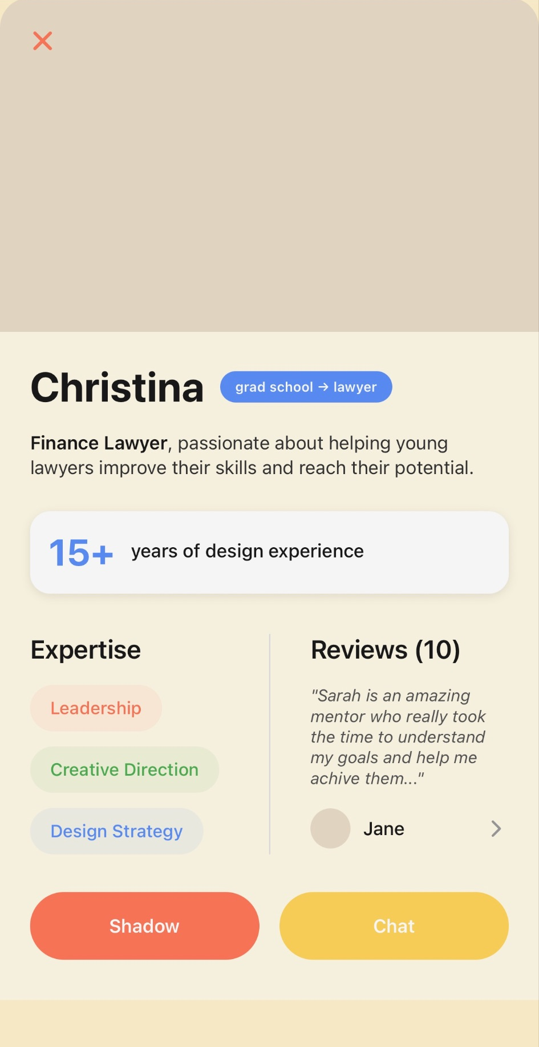
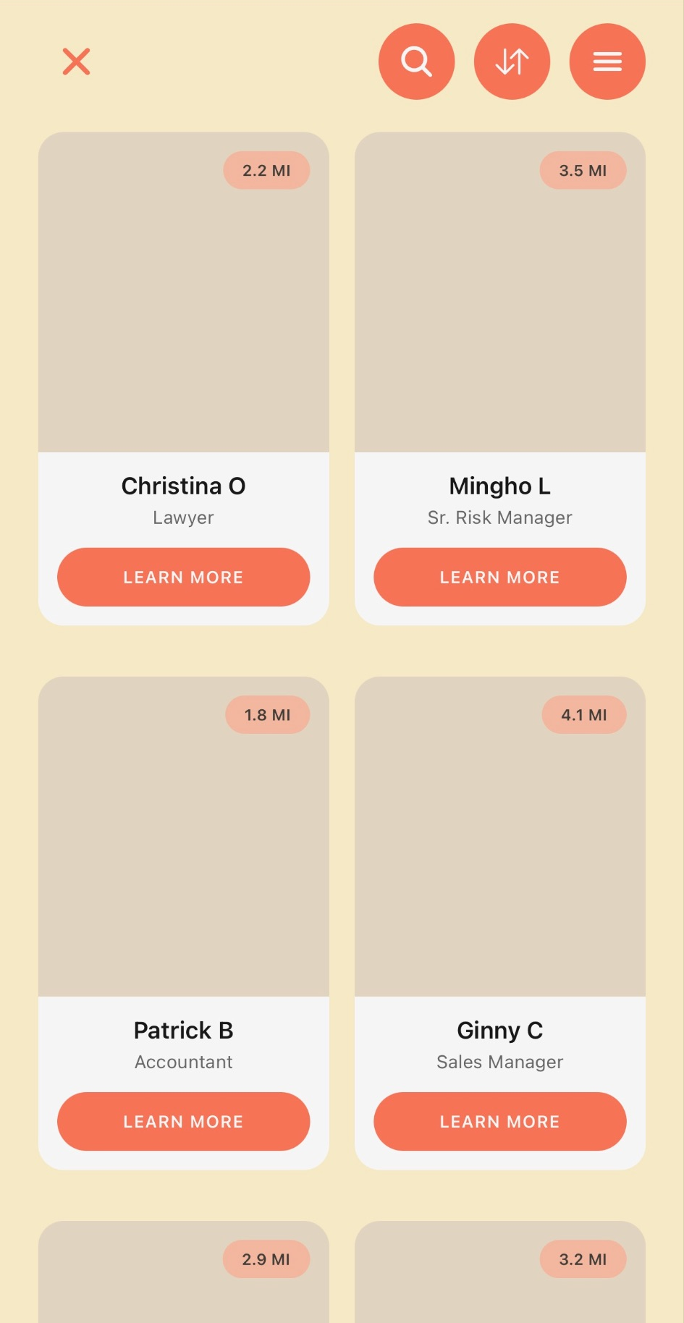
REVISIONS
FLIPPIN
REVISED DESIGN
Before
After
Decreased mentor photo size, bolded key info — sharpens focus on relevant details.
Added mentor’s proximity info — clarifies sorting, enhances user understanding.
Simplified terminology across pages for better user connection — increased seamless navigation and reduced cognitive load.

Slide 14
DESIGN STATUS
FLIPPIN

Slide 15





TOOLS USED
FLIPPIN
DESIGN STATUS
Wizard of Oz
Recommendations and personalizations
Search retrieved of groups and users
Hard Coded Elements
Mentor profiles: pre-existing user profiles (names & photos)
Open Mic Feature
Opportunities and Upcoming Events
React Native
Application Framework
Github
Application Framework
VSCode
IDE
Figma
Design Components
Supabase
Database Management

Slide 16
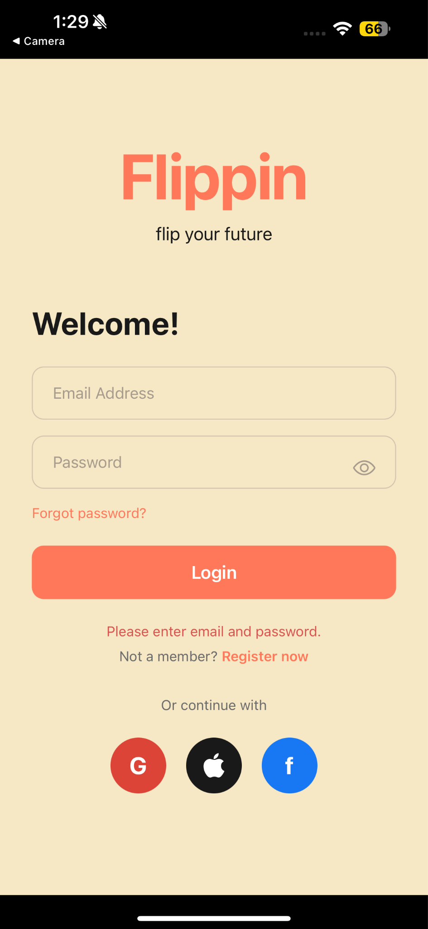
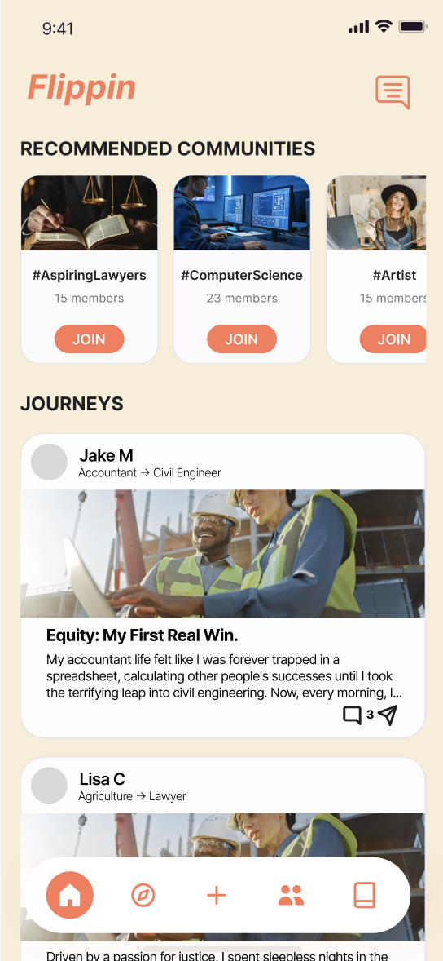
IMPLEMENTED FEATURES
FLIPPIN
DESIGN STATUS
Onboarding
Home
Opportunities
Will indicate which fields are optional during onboarding
Authorization for login
Help User w/ Error
Notes:
Implemented all design improves in Figma

Slide 17
IMPLEMENTED FEATURES
FLIPPIN
DESIGN STATUS
Shadowing / Mentor (complex task)
Notes:
Implemented all design improves in Figma

Slide 18
UNIMPLEMENTED FEATURES + PLAN
FLIPPIN
DESIGN STATUS
Implement All Interactive UI Features
(Nov 22 - Nov 26)
Adding a reflection page (Jenny)
Profile + Setting Page (Vivi)
Communities Tab (Cecilia)
Creating the database (Ana)
Linking Backend w/ Frontend (Nov 28 - Nov 30)
Post Creation (Ana + Cecilia)
User Creation (Jenny)
Joining Communities (Vivi)

Slide 19
DEMO
RESULTS
FLIPPIN
DEMO

Slide 20
THANKS!
CS147
FLIPPIN
DATE

Slide 21
Appendix

Slide 22
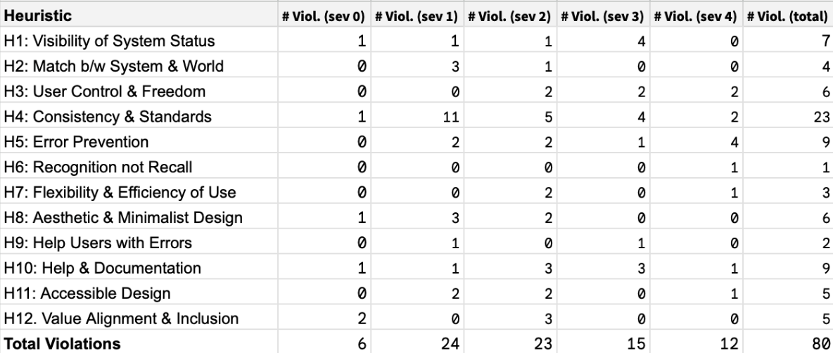
HEURISTICS SUMMARY
FLIPPIN

Slide 23
QUESTIONS + CONCERNS
FLIPPIN
How to design and implement a user reflection page → encourages meaningful user input and supports data collection for personal growth and progress tracking.
Questions about creating a profile settings page with intuitive navigation, clear options for customization, and responsive design to accommodate multiple devices and accessibility needs.
Uncertainty around how to develop a communities tab that effectively connects users with relevant groups, including features for browsing, joining, and interacting within communities while maintaining consistency across pages.
Challenges integrating the backend database with the frontend, focusing on secure data handling, efficient synchronization of user data, and reliable user creation workflows. Proper error prevention and user feedback mechanisms to guide users through account setup are essential.
How to implement editing, deleting, and post creation functionalities within the app that allow users flexibility while preventing errors or data loss, including confirmation screens and undo options to enhance user control and freedom.

