Slide 1


A6: INTERACTIVE MEDIUM-FI PROTOTYPE
by Ananya N, Ayana G, Anthony C, & Felix Z
November 03 2025, Monday

Slide 2
CONTENTS
01
02
03
Introduction
Problem/Solution Overview
Values in Design
04
05
06
Tasks
Usability
Revised Interface
07
08
09
Task Flows
Prototype Implementation
Appendix/Figma

Slide 3
Gentle nudges. Real progress.

Slide 4




Meet the Team!
Ananya N.
Ayana G.
Anthony C.
Felix Z.

Slide 5
CONTENTS
01
02
03
Introduction
Problem/Solution Overview
Values in Design
04
05
06
Tasks
Usability
Revised Interface
07
08
09
Task Flows
Prototype Implementation
Appendix/Figma

Slide 6
Problem
Solution
ADHD learners struggle with:
staying on task
hyperfocusing
breaking down large tasks
finding conducive work environments
Provide an artificial source of body doubling that:
offers reminders to take care of biological needs
provides reflection opportunities to refocus/stay on track
aids in task decomposition

Slide 7
CONTENTS
01
02
03
Introduction
Problem/Solution Overview
Values in Design
04
05
06
Tasks
Usability
Revised Interface
07
08
09
Task Flows
Prototype Implementation
Appendix/Figma

Slide 8
Tasks
Simple: Start a basic work session
This task was successful for all of our low-fi prototype testers.
Moderate: Use reflection reminders → previously Complex
This task can be incorporated into the Simple task, but also addressed separately.
Complex: Utilize task breakdown feature → previously Moderate
This task was unsuccessful as our Moderate task, since our testers found the editing interface overwhelming and confusing to navigate. As a result, we switched our Moderate and Complex tasks to reflect this.
Additional tasks:
Log in/create and account and view profile
Find a friend to send a collaboration request to and coordinate a meeting
View a past session summary

Slide 9
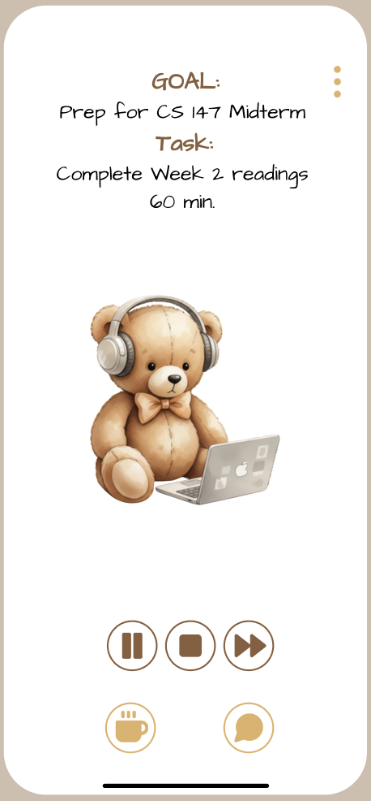
1. Accessibility
1.1 Visibility
Our design makes use of whitespace, Gestalt principles, and Fitts’s Law by:
minimal elements on the screen
grouping clickable items (Gestalt) in the lower 1/5th of the screen
minimizing the distance between navigational elements for ease (Fitts’s Law)
→ Tradeoff: making screens too sparse
Def:
The more discernible an element, feature, or system is, the more likely users will be able to utilize it effectively
Discernibility → intuition

Slide 10
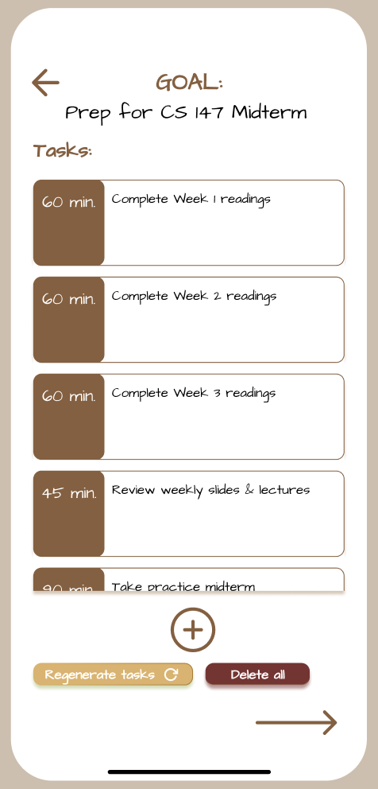
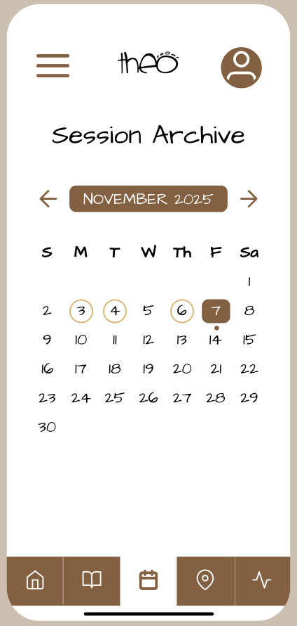

1. Accessibility
1.2 Affordances
Most clickable components in our prototype/design system are color-coded in dark brown , whether by fill or text color.
Def:
Providing visual cues indicating the use of a feature
Buttons are color-coded or surrounded by a
highlighted box
Indicates to the user that a component can be selected and used to progress or edit some part of the platform
→ tradeoff: monotonous (if too many buttons, too much of same color)

Slide 11
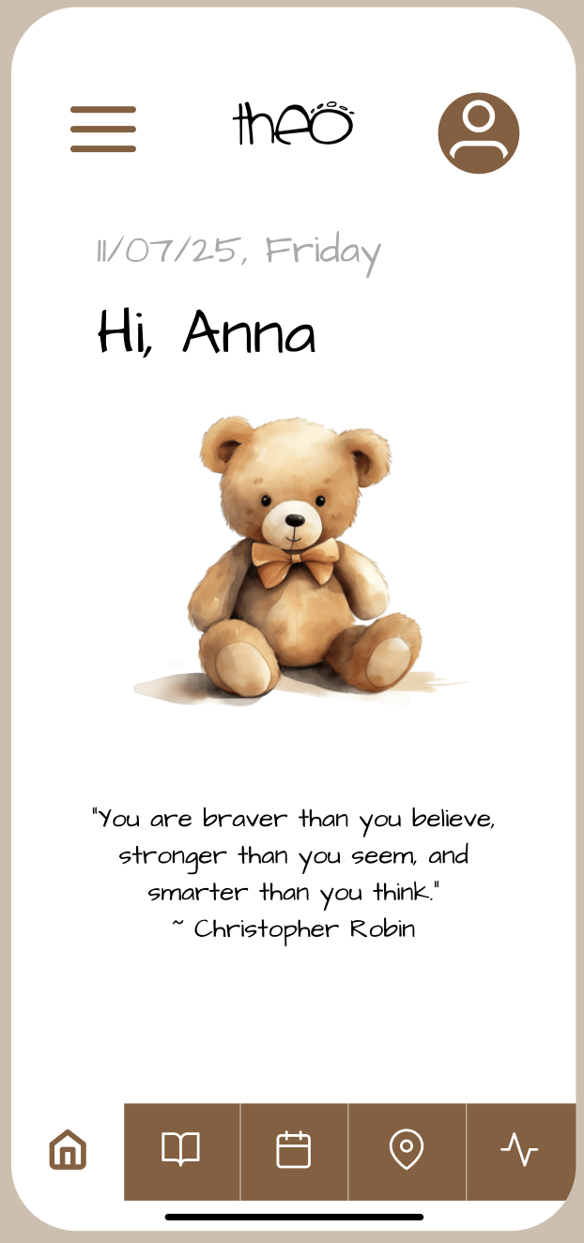
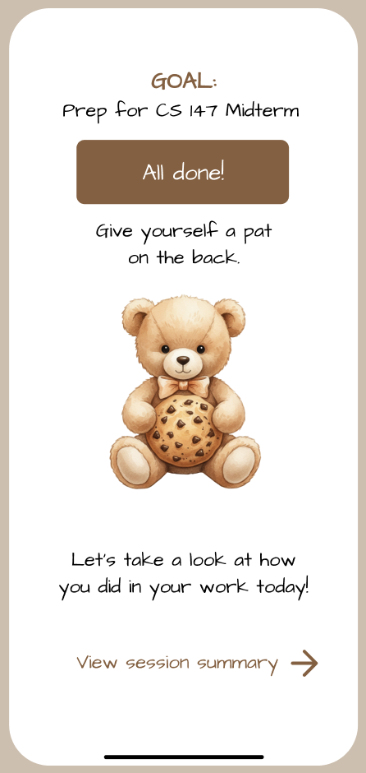
2. Empathy
Def:
Using warmth to lower the barrier to entry and inducing a feeling of support
Warm language, warm colors
We also chose warm
colors to create a
cozy environment: one that’s both easy and welcoming to use.
Tradeoff: inclusivity (“Forgotten” Tarot Card), as the appeal is to a younger and predominantly female demographic (Liew et al.; Antezana et al., 2022).

Slide 12
CONTENTS
01
02
03
Introduction
Problem/Solution Overview
Values in Design
02
04
05
06
Tasks
Usability
Revised Interface
07
08
09
Task Flows
Prototype Implementation
Appendix/Figma

Slide 13
CONTENTS
01
02
03
Introduction
Problem/Solution Overview
Values in Design
04
05
06
Tasks
Usability
Revised Interface
07
08
09
Task Flows
Prototype Implementation
Appendix/Figma

Slide 14
Goals & Key Metrics
Task 1: Starting a Basic Study Session
Goal: Users find the process of starting a session simple and minimally participatory [revised]
Metrics: Fewer than 5 incorrect taps to start and complete session with goal [complete]
Task 2: Engaging with Reflection Feature (revised)
Goal: Users notice and respond to reflection reminder with ease [revised]
Metrics: <2 taps between reflection page and returning to session [complete]
Task 3: Breaking Down a Large Goal (revised)
Goals: Users find and utilize breakdown feature without assistance [revised]
Metrics: Time to find breakdown feature < 10 sec, fewer than 7 incorrect taps to increase Task 1 time from 30 → 40 min. [complete (taps)]

Slide 15
CONTENTS
01
02
03
Introduction
Problem/Solution Overview
Values in Design
04
05
06
Tasks
Usability
Revised Interface
07
08
09
Task Flows
Prototype Implementation
Appendix/Figma

Slide 16
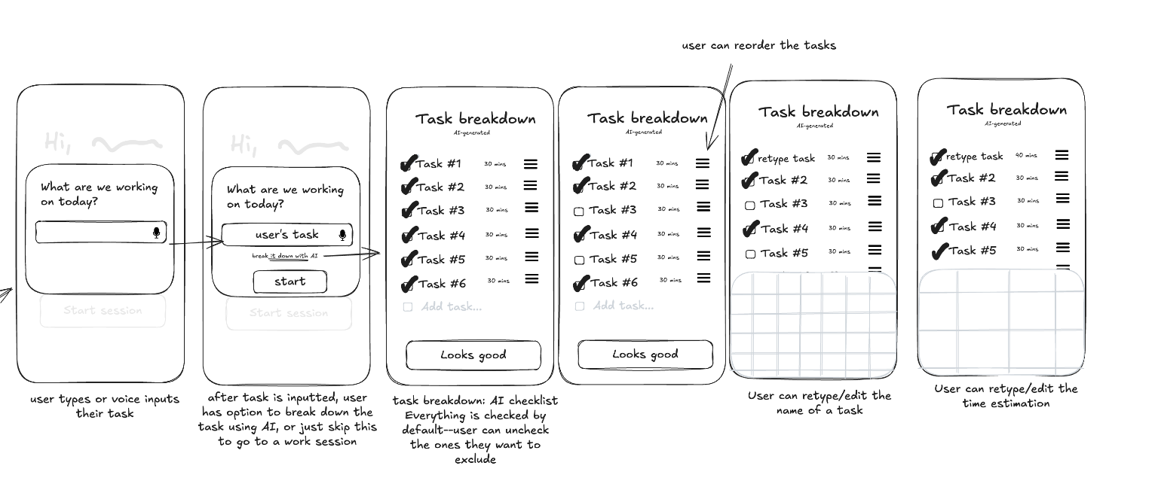
4 biggest changes:
Updated editing interface for task breakdown editing
Provisions to fast-forward through tasks/end session before time is up
Calendar page/session archive to access past sessions
Method for getting task breakdown help without starting a session

Slide 17
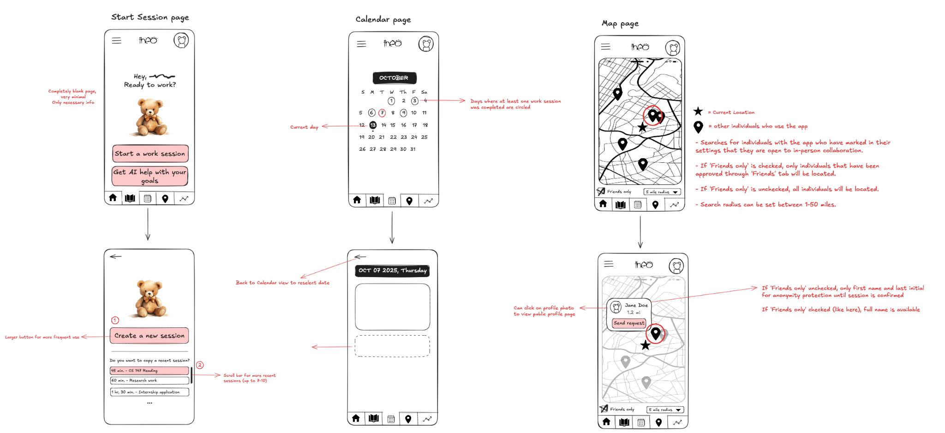

Slide 18
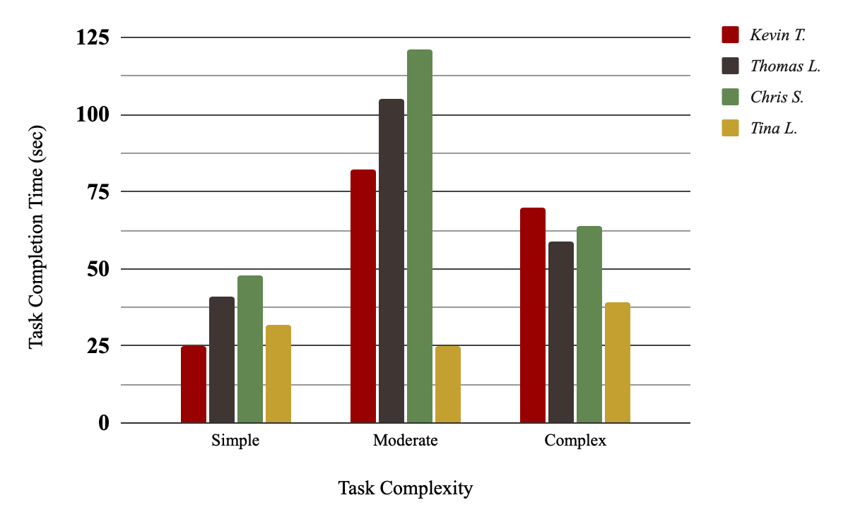
Feedback & Changes
We received feedback from low-fi testers and studio peers/experts that we needed more navigational/editing flexibility (“What happens if I finish early? Or I’m not done?”) and less thinking involved when completing tasks, specifically our then-Moderate task (“What are all these extra buttons for? Do I need to use all these to start the session?”).
So, we:
Updated and simplified task editing interface will aid in completion speed and comprehension of our Complex Task
Fast-forward and other navigation options during session will aid in progressing through Simple Task

Slide 19
CONTENTS
01
02
03
Introduction
Problem/Solution Overview
Values in Design
04
05
06
Tasks
Usability
Revised Interface
07
08
09
Task Flows
Prototype Implementation
Appendix/Figma

Slide 20
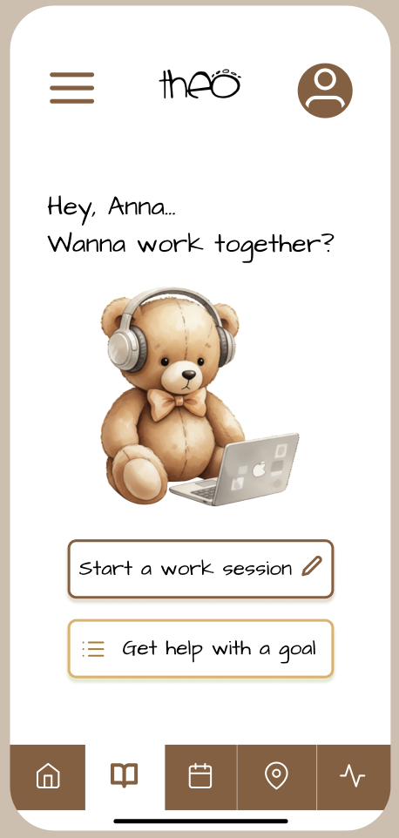
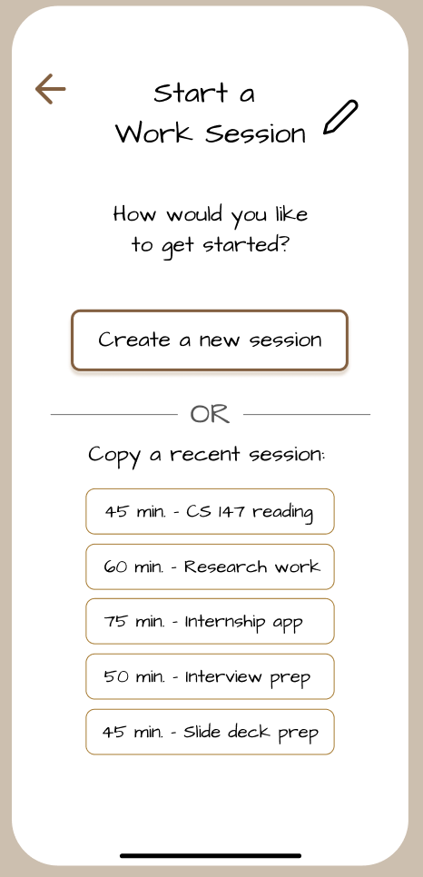
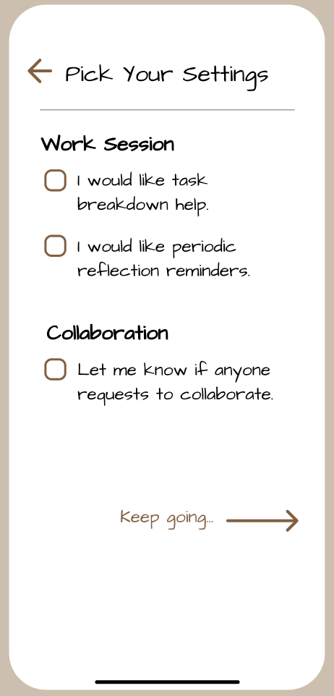
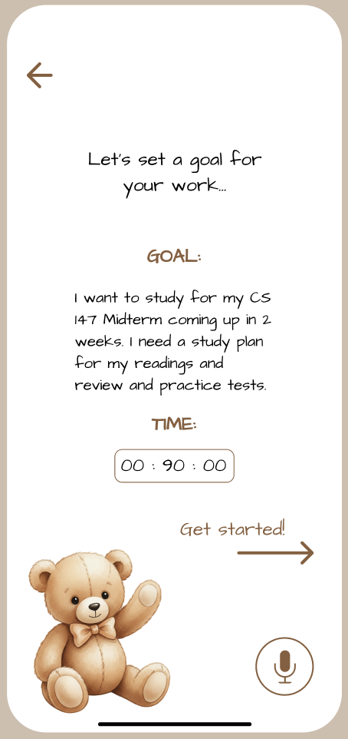
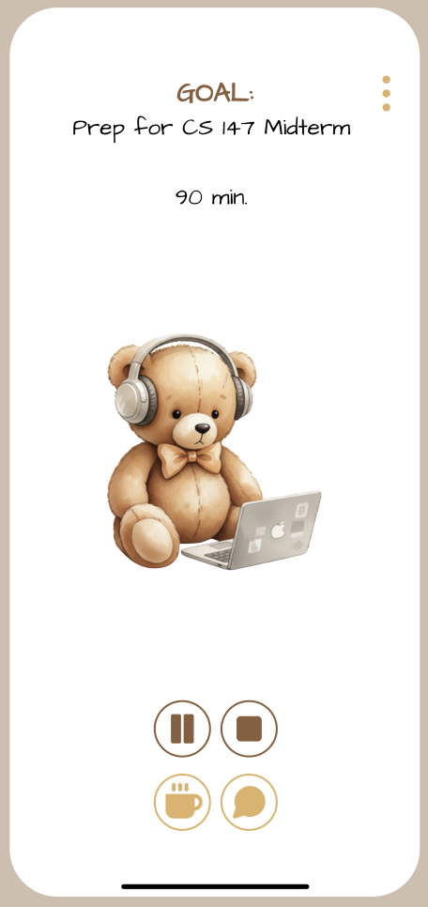
Simple Task: Start a basic work session
Navigation bar for switching to map, calendar, progress, and home
1. Go to Session Page, select “Start a work session”
2. Select “Create a new session”
3. Select settings – do NOT select ‘task breakdown’
4. Enter goal
5. Enter session
Optional reflection reminders
Internal session navigation options: pause, break, chat. (simple vs complex)
Option to save breakdown without session

Slide 21
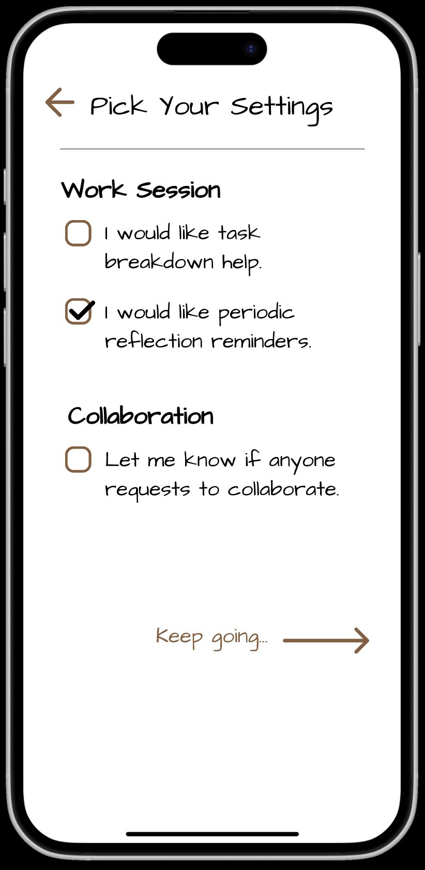
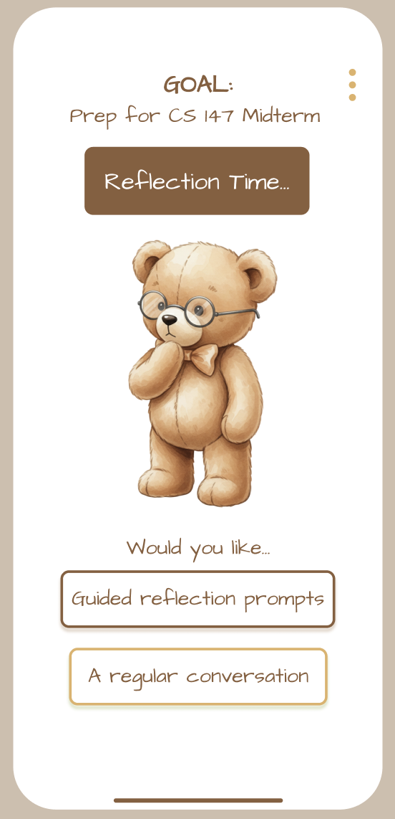
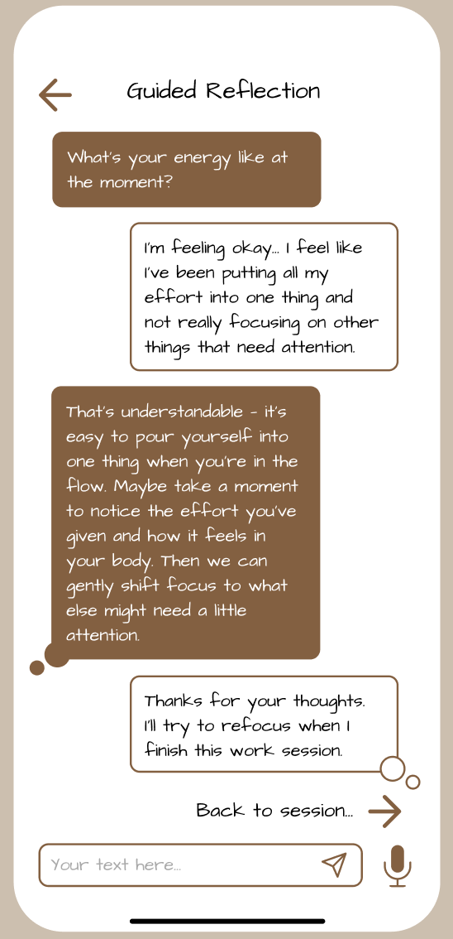
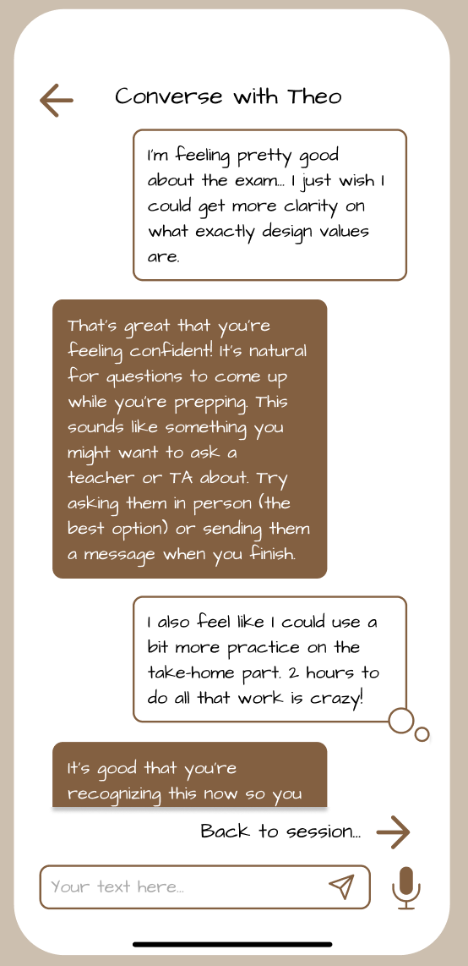
Moderate Task Flow*: Reflect with a chatbot
Originally Complex Task – altered based on user input from low-fi testing
1. Receive reflection opportunity reminder
2. Select “Guided reflection” or “Conversation”
3. Complete reflection, then return to session
*OPTIONAL* check-in/reflection to avoid unwanted distractions

Slide 22
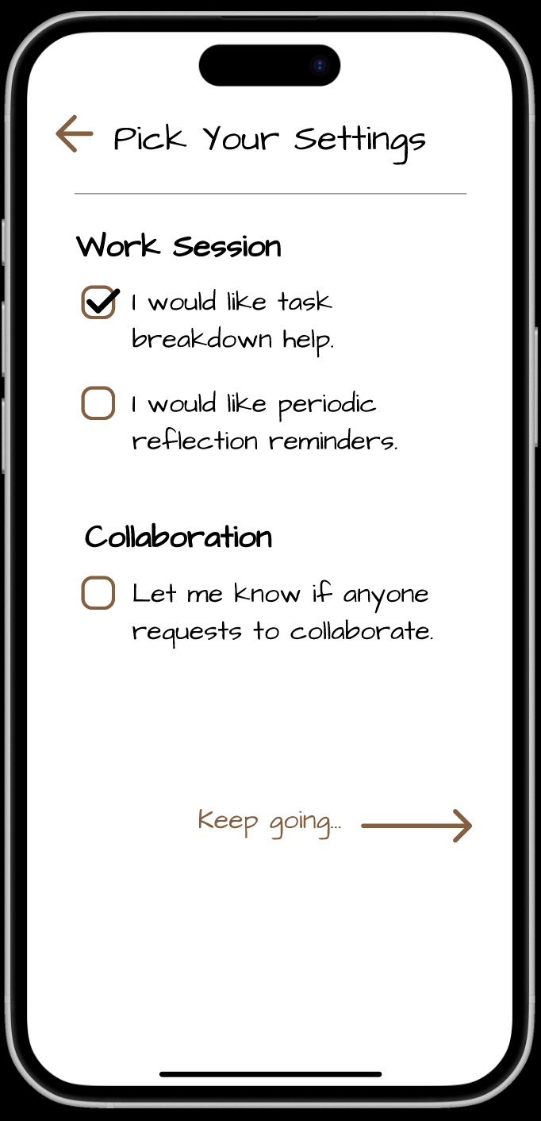
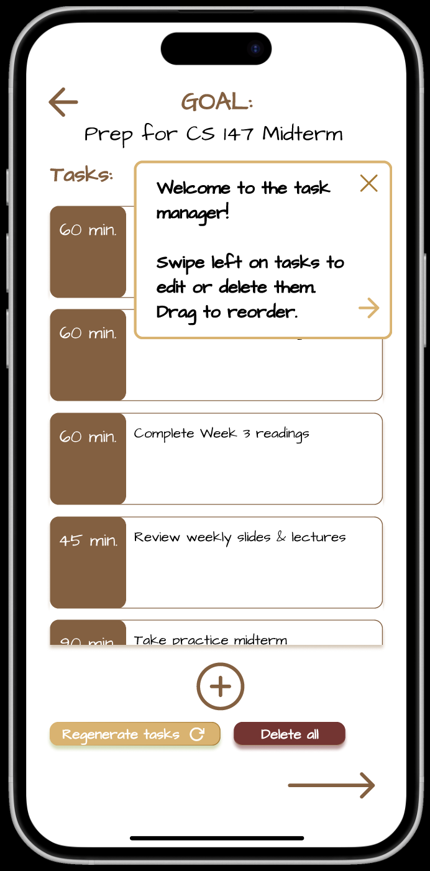
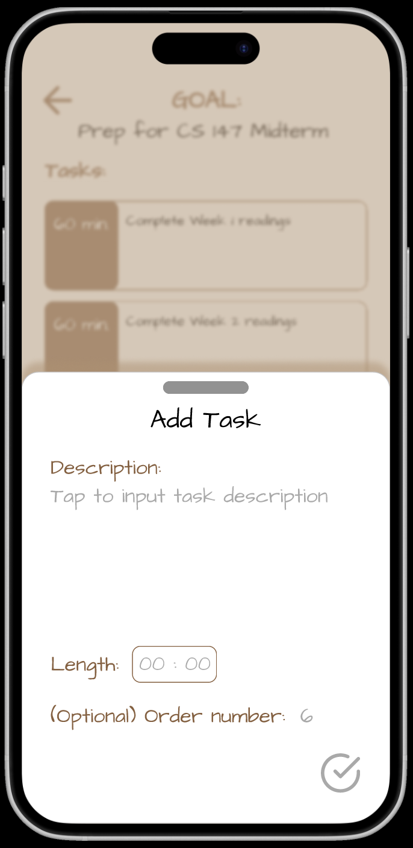
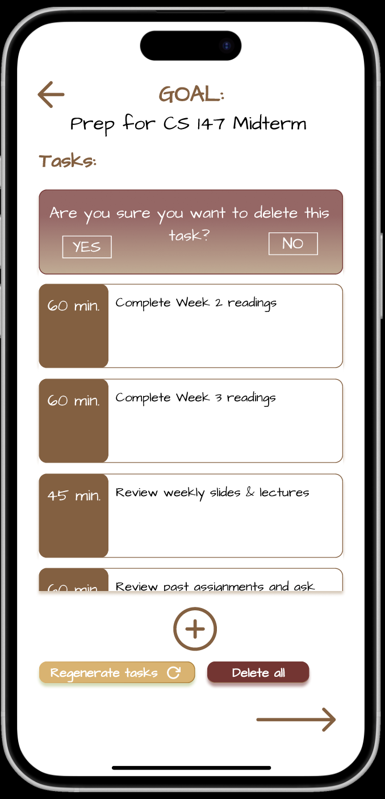
Complex Task Flow: AI-assisted task breakdown
1. Choose “task breakdown help” in Settings.
2. Enter task manager
3. Add a new task to the list
4. Delete a task from the list
Collated editing interface – added mobility, removability, and modifiability of tasks
Add tasks if desired
Notes:
*bulk regenerate task breakdown aka retry feature with llm

Slide 23
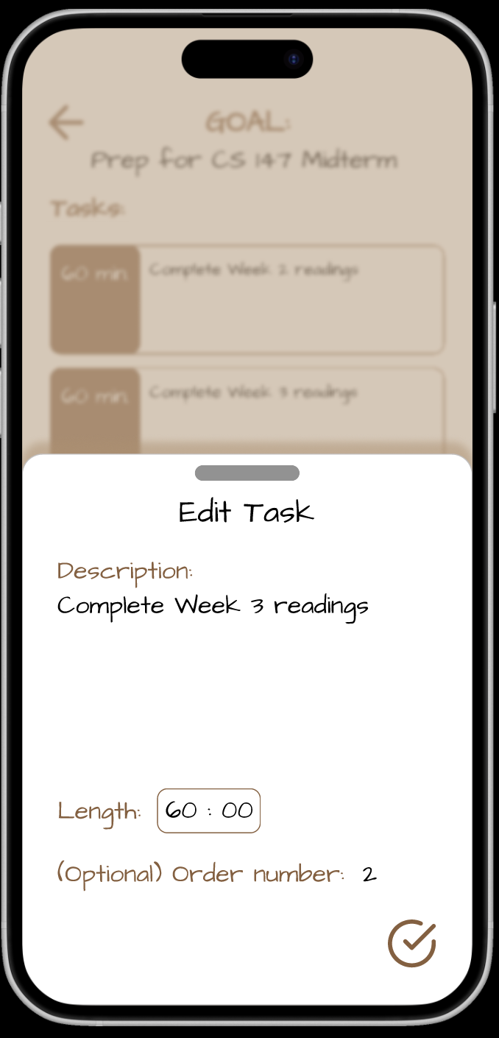
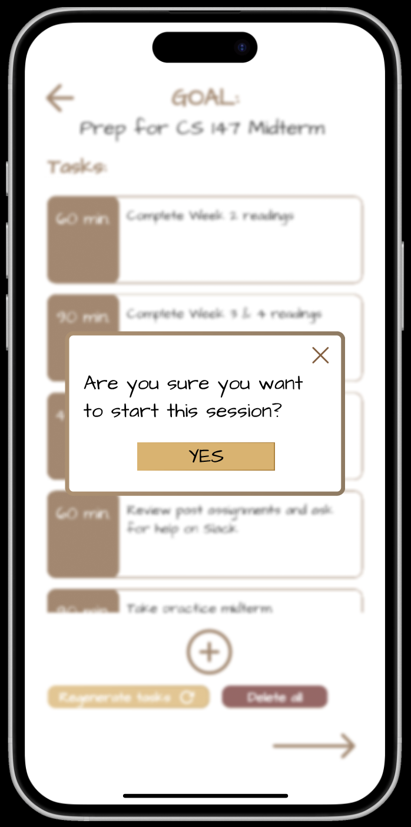
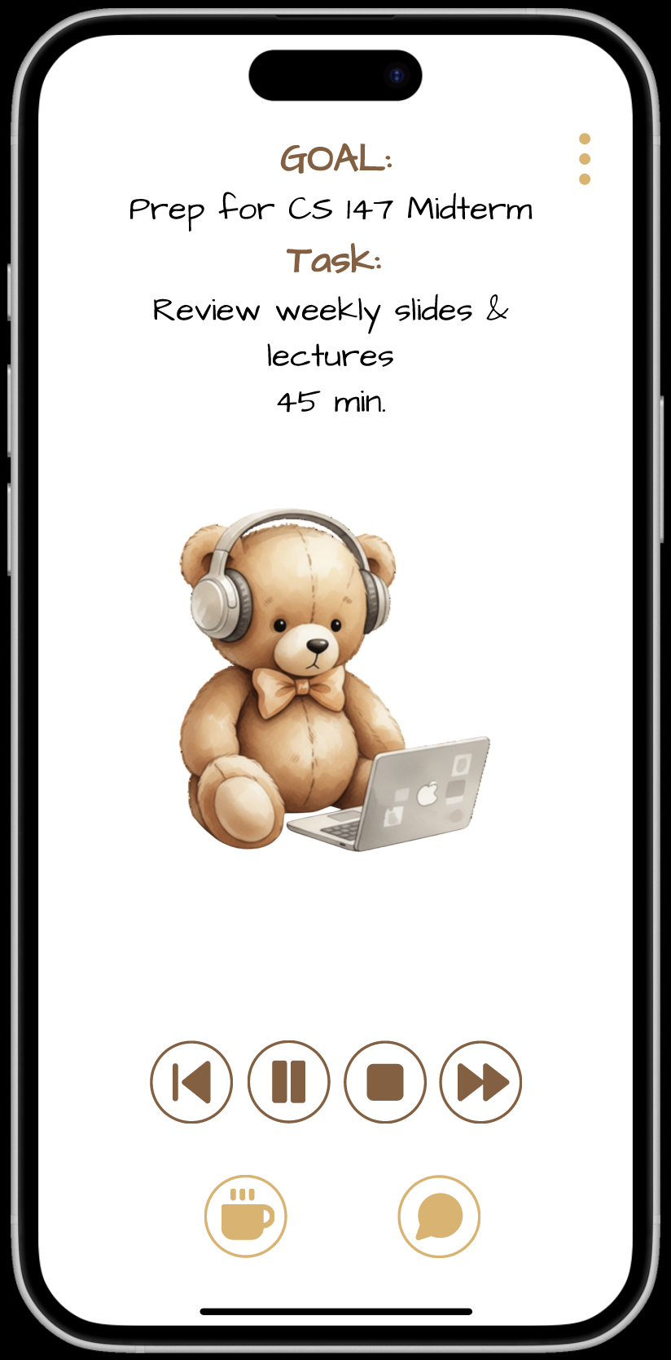
Complex Task Flow: AI-assisted task breakdown (cont.)
“Fast Forward” option to skip/advance tasks ahead of timer
5. Edit a task in the list
6. Confirm edits
7. Enter session, view current task
Notes:
*bulk regenerate task breakdown aka retry feature with llm

Slide 24
CONTENTS
01
02
03
Introduction
Problem/Solution Overview
Values in Design
04
05
06
Tasks
Usability
Revised Interface
02
07
08
09
Task Flows
Prototype Implementation
Appendix/Figma

Slide 25
Implementation & Tools
Main platform: Figma
  Pros: Incredible mechanism implementation, conditional transitions, variable usage
  Cons: Inability to have BTS timer implementation, text input difficult to manipulate, no AI chatbot-like functionality plugin
Pros:
  Provided a sample of each function in the prototype to give the tester an idea of the range of flexibility that could be available
  Strong emphasis on visual layout, color palette, and iconography
Cons:
  No actual work session mentality testability yet, based on Figma limitations noted above
  AI feedback and capabilities untested

Slide 26
Implementation & Tools
We believed our tradeoffs for this prototype were acceptable since:
  Con #1 was evaluated during experience prototype testing in a minimal form
  Con #2 relies on the quality of the AI we use to implement our task breakdown feature with and the prompts we give our reflection chatbot
  Both of these are manageable in the long-term and can be tested in alternative ways.
Hard-code & Wizard of Oz:
  All text input, messaging, and conversations are built into the model
  Task flow is designed to give a sample of each experience, not provide the full functionality and flexibility of the final product
  The user’s information (friends, groups, calendar) comes built into the account

Slide 27
CONTENTS
01
02
03
Introduction
Problem/Solution Overview
Values in Design
04
05
06
Tasks
Usability
Revised Interface
02
07
08
09
Task Flows
Prototype Implementation
Appendix/Figma

Slide 28
Links to Figma Designs
Old Prototype
New Prototype
Link for Heuristic Evaluation/Executable

