Slide 1

CS 147
October 3rd, 2025
A1:
NEEDFINDING
Avey Etaghene, Candace Cang, Siya Goel, Tyler Abernethy

Slide 2
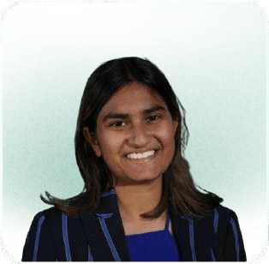
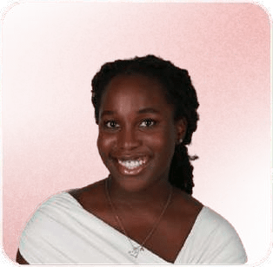
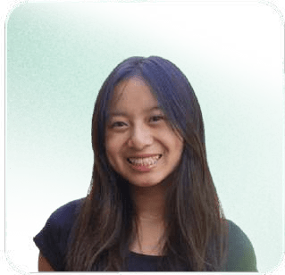
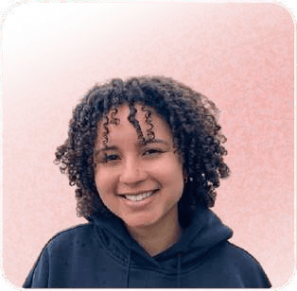
Team Members
Siya Goel
she/her
CS (AI) + Econ ‘26 CS (HCI) ‘27
Avey Etaghene
she/her
Symsys ‘27
CS (HCI) ‘27
Candace Cang
she/her
Design ‘26 CS (HCI) ‘ 27
Tyler Abernethy
they/them
Symsys ‘26
CS (HCI) ‘27

Slide 3


Domain Selection
CS 147

Slide 4



“who uses creative tools?”
In our initial brainstorm, we asked
Developers
Need to storytell
Don’t know much about design tools
Independent contractors don’t have many resources
Non-Profit Leads
Need to do marketing
Don’t have much support on teams
Many different types to explore and learn about
Independent
Learners
Need to craft curricula and lesson plans
Includes a broad pool of people (students, engineers, nonprofits)

Slide 5
“who uses creative tools?”
We then asked
“what is the difference between these two major types of developers?”
software engineers
startup founders

Slide 6
Software Engineers
Startup Founders
minimal resources and time
extensive resources
storytelling
notetaking and documentation
create presentations, ﬂow charts, system design docs
website development
big design teams
handle more tasks than the typical developer
well-defined tasks
design tools (Figma)
more varied skillset
highly technical skillset

Slide 7
Startup Founders
Software Engineers
minimal resources and time
extensive resources
storytelling
notetaking and documentation
create presentations, ﬂow charts, system design docs
website development
big design teams
handle more tasks than the typical developer
well-defined tasks
design tools (Figma)
more varied skillset
highly technical skillset

Slide 8

So why startup founders?
product manager
product designer
Startup
Founders
developer
marketer
recruiter
fundraiser

Slide 9
Who and Why?
product manager
product designer
Early founders
wear many hats.
developer
marketer
recruiter
fundraiser

Slide 10

Why?
Rapid Context Switching
developing
social media
products
marketing
creating
pitch decks
project
management
communication
tasks
small team → variety of work in quick, high pressure environments

Slide 11
Why?
Opportunity
Thinking about AI as “co-founder” collaborators…
Preseed and early startups are quite lean.
There was opportunity for AI to increase workﬂow
We wanted to understand the current workﬂows of founders and learn how AI tools can impact friction, efficiency, and confidence in their startup tasks.

Slide 12

Needfinding Methodology
CS 147

Slide 13
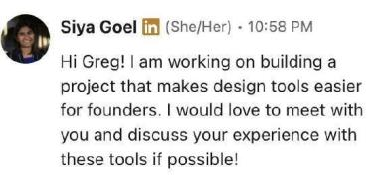
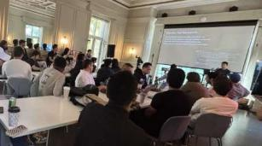
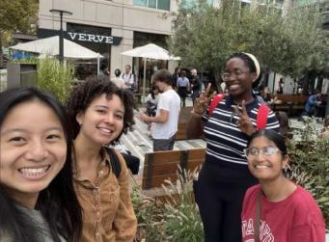
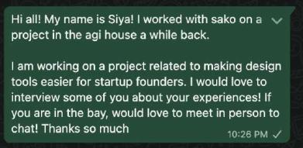
Recruitment Strategies
Personal Network
Targeted and Public Spaces

Slide 14



Selection Priorities
Range of Experiences
technical skill sets
industry/field
work experience
technical vs non-technical backgrounds
Consumer, Fintech, Medtech, Dev Tools, etc.
just graduated, PhD, industry experience, etc.

Slide 15





Selection Priorities
Diversity
geographic origin/location
gender
age
VC support

Slide 16
Selection Priorities
Diversity
geographic origin/location
gender
age
VC support
Challenges: ~12% founders are women, geographic constraints on in-person meetings

Slide 17
Recruitment Challenges and Barriers
busy season for fundraising → founders have less time and bandwidth
lack of accessibility: many founders are in SF, quick turnaround
Stanford students not permitted

Slide 18
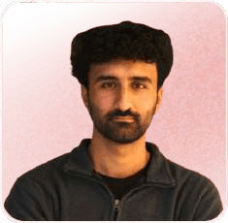
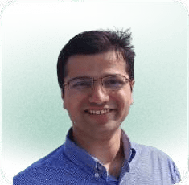
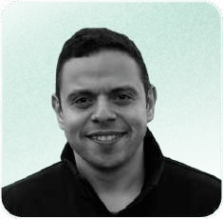
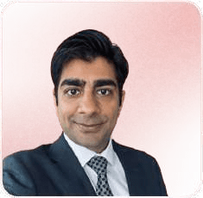


Interviewees
Diversity in Experience and Startup Space
Sam
Recent College Grad Technical
Legal Tech + YC Seed Startup
Silus
8 years finance, consulting, and data science Technical
Fintech + YC Series A
Alex
20+ years of engineering Technical
Dev Tools
Pre Seed Startup
Steven
2x Ex-Founder Nontechnical Consumer Seed Startups
Mike
10 years of finance Nontechnical Consumer
Series A
Samantha
PhD in Genetics + 2x Founder Technical
Medtech Seed Startups

Slide 19
Interviewees
Diversity in Experience and Startup Space
Extreme user: Youngest and most inexperienced founder
Sam
Silus
8 years finance, consulting, and data science Technical
Fintech + YC Series A
Recent College Grad Technical
Legal Tech + YC Seed Startup
Alex
20+ years of engineering Technical
Dev Tools
Pre Seed Startup
Steven
2x Ex-Founder Nontechnical Consumer Seed Startups
Extreme user: Only woman, medical background, 2x Founder
Samantha
PhD in Genetics + 2x Founder Technical
Medtech Seed Startups
Mike
10 years of finance Nontechnical Consumer
Series A

Slide 20
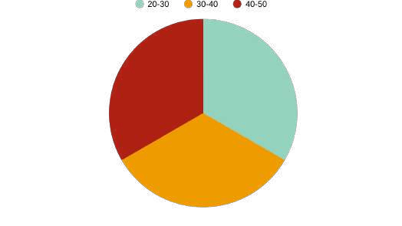
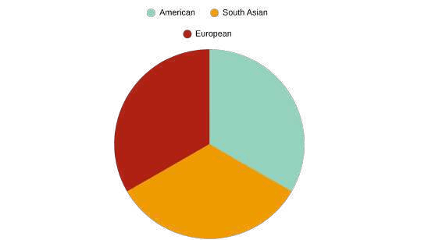
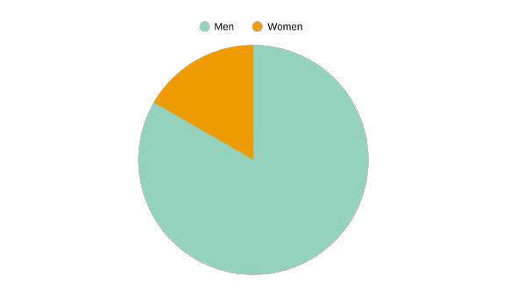
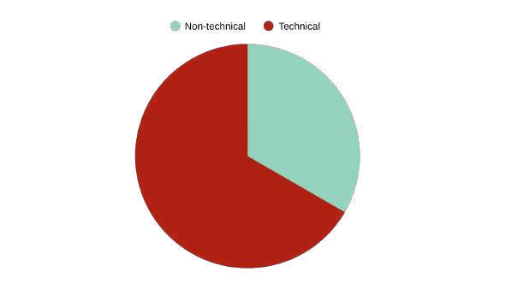
Why these participants? Diversity
Age
Geographic/ Ethnic background
Gender
Technical Experience

Slide 21
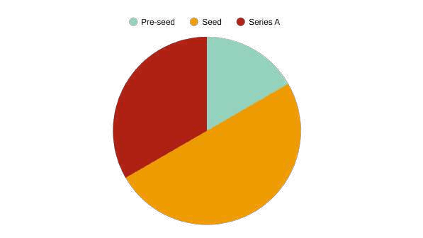
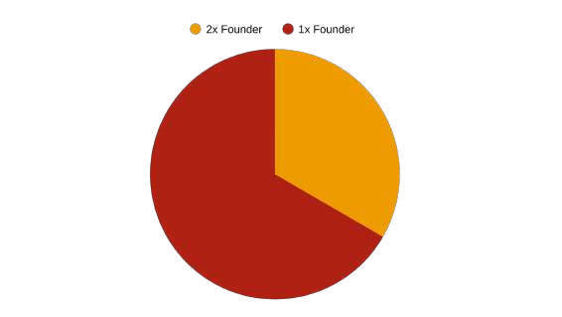
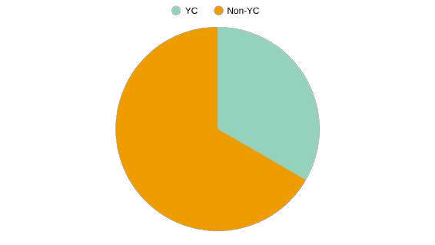
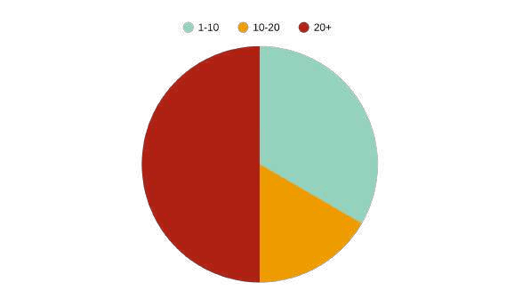
Why these participants? Diversity
Startup Funding
Founder Experience
YC
Status
Team Size

Slide 22




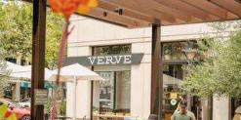
Where
Interview Plan and Logistics
AGI House (2)
Stanford campus (1)
Video call (1)
Cafe Reveille SF (1)
Verve Palo Alto (1)

Slide 23



Interview Plan and Logistics
When
Scheduled the same week as outreach or approached in public
Length
30-50 minutes
Consent
All interviewees signed consent forms
Procedure
1 interviewer, 1-2 notetakers
Candace and Siya were usually interviewers
Avey and Tyler were usually notetakers
Tools
Ethics and Incentives
Respected their time & helped them gain access to Stanford

Slide 24
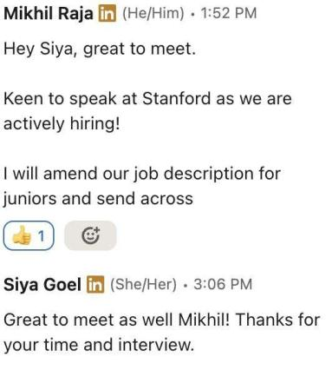
Interview Plan and Logistics
Example Incentive
Ethics and Incentives
Respected their time & helped them gain access to Stanford

Slide 25
Interview Script and Questions
Understanding “why” they were doing the “whats”
Understanding context and background
Understanding creative task workﬂow
Understanding use of GenAI
Understanding pain points for founders

Slide 26
Interview Script and Questions
Understanding “why” they were doing the “whats”
Understanding context and background
“Can you tell me a bit about your background and how you decided to start your venture?”
“How big is your team right now, and what does everyone focus on?”
“Can you tell me a little bit about your startup and your role in it?”

Slide 27
Interview Script and Questions
Understanding “why” they were doing the “whats”
“What tools do you use for your creative workﬂow?”
Understanding creative task workﬂow
“What is the process of communicating with designers like?”

Slide 28
Interview Script and Questions
Understanding “why” they were doing the “whats”
“What challenges do you face in your creative workﬂows and why?”
“Why is it hard to get design tasks done?”
“Why is it hard communicating with designers?”
Understanding pain points for founders

Slide 29
Interview Script and Questions
Understanding “why” they were doing the “whats”
“What are some pain points of using GenAI tools in your creative workﬂow?
Understanding use of GenAI
“How do you wish GenAI was better for your use cases?”

Slide 30

CS 147
Interview Results & Analysis

Slide 31
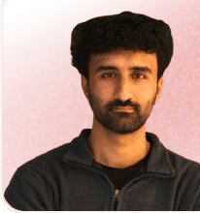
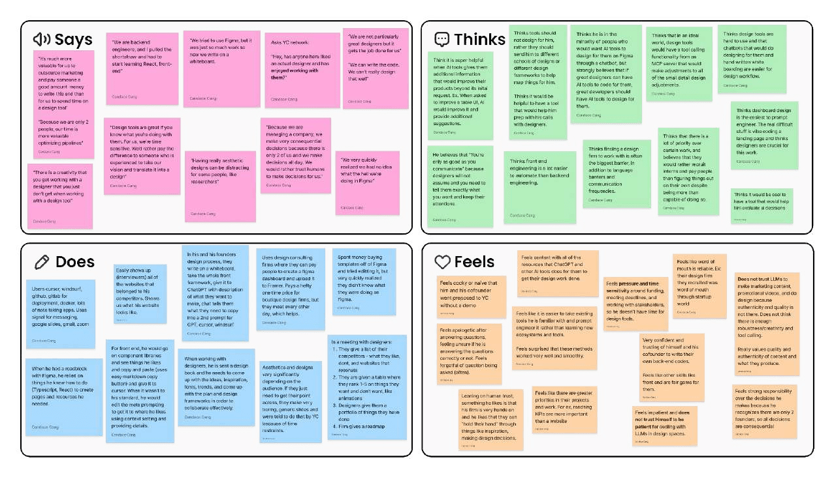
Empathy Map - Sam

Slide 32
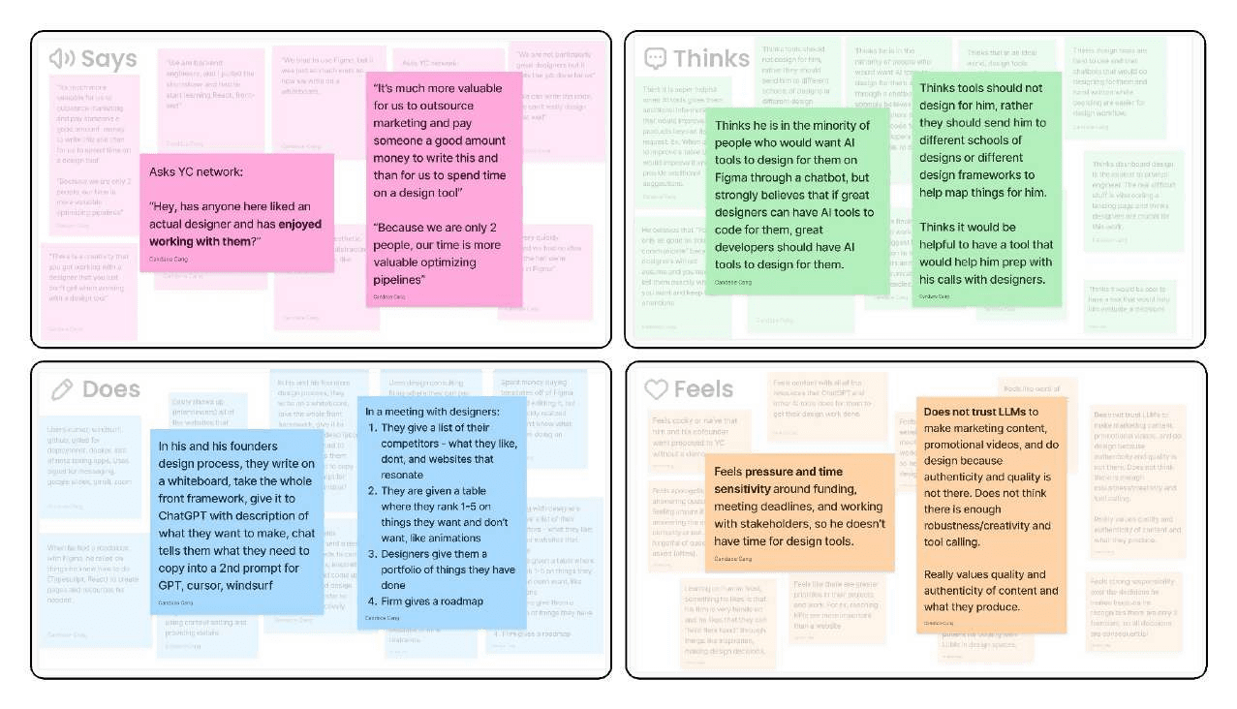
Key Takeaways - Sam

Slide 33
Quote: “Design tools are great if you know what you are doing with them. For us, we are time sensitive.”
Analysis - Sam
Insight: People rely on quick and easy ways to make their workfiows efficient because they have a greater sense of urgency for other priorities for their product and tools they are confident in. Time is more valuable than money because they feel pressure and time sensitivity to meet deadlines.
Need: A tool that would help him in terms of customization and help him prep with his calls with designers.

Slide 34
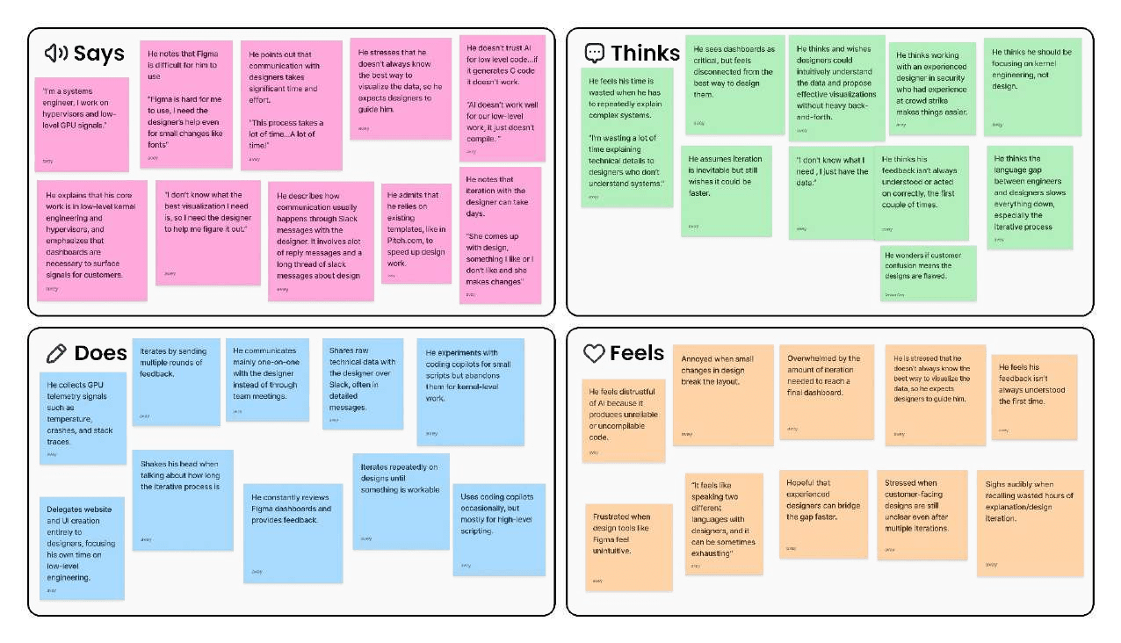
Empathy Map - Alex

Slide 35
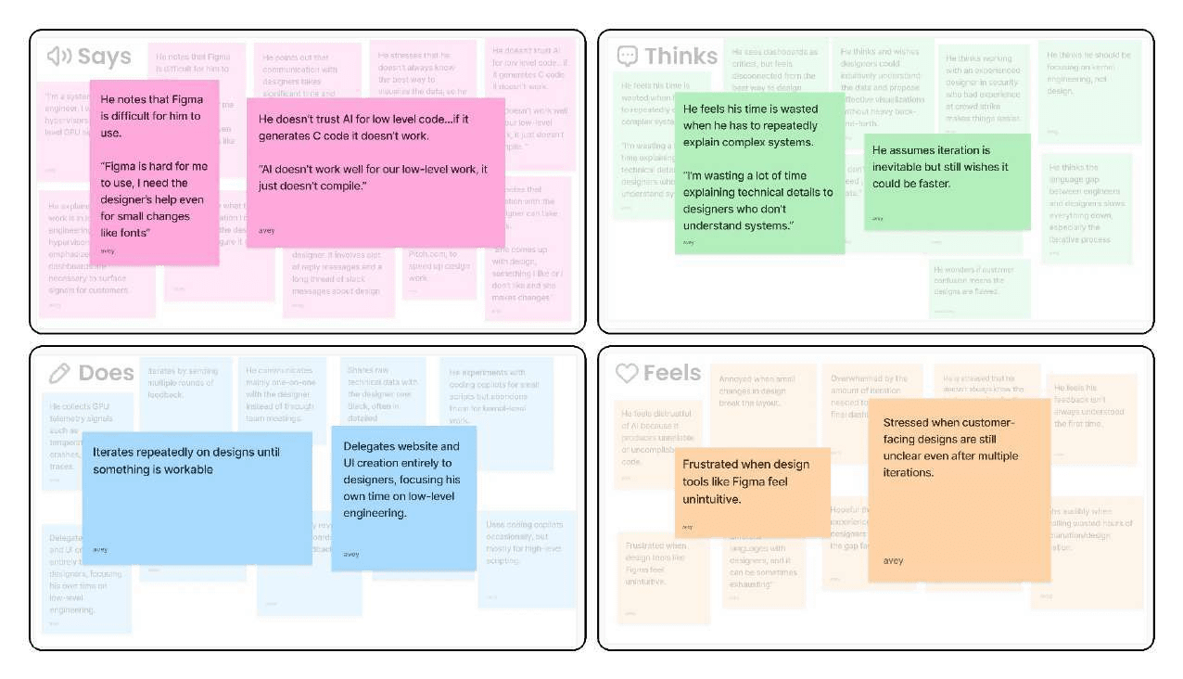
Key Takeaways - Alex

Slide 36
Analysis - Alex
Surprise: Alex’s perspective was surprising because he didn’t think that AI really helped him with his product involving low level code as well as design. This was surprising because many other founders relied a lot on AI to produce their product and design components.
Insight: Because technical founders deeply trust their own engineering expertise but not their creative abilities, they assume designers hold an opposite and create a mindset that reinforces a large gap between the way they think and slowing down collaboration. As a result, they think the communicating with designers is complicated and time consuming.
Need: Alex needs a tool to help him decrease the time and the amount of iteration it takes to talk to his designers and come up with the final product.

Slide 37
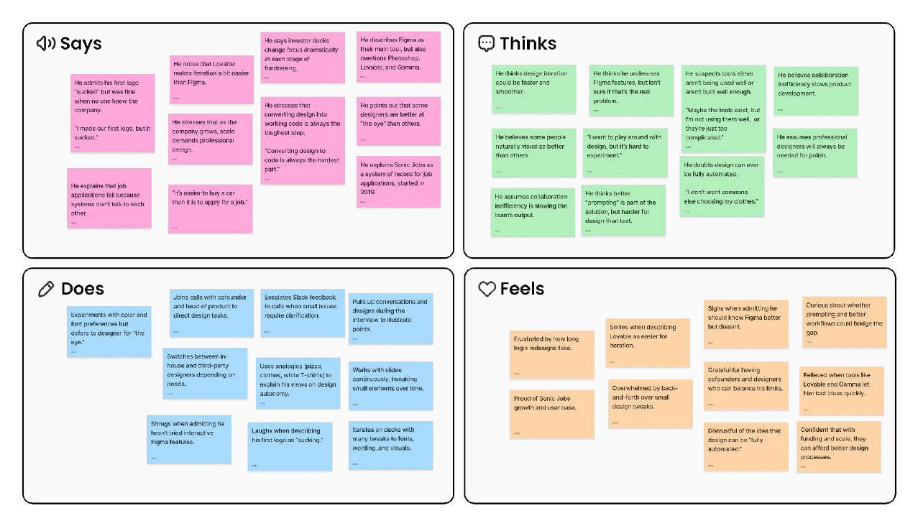
Empathy Map - Mike

Slide 38
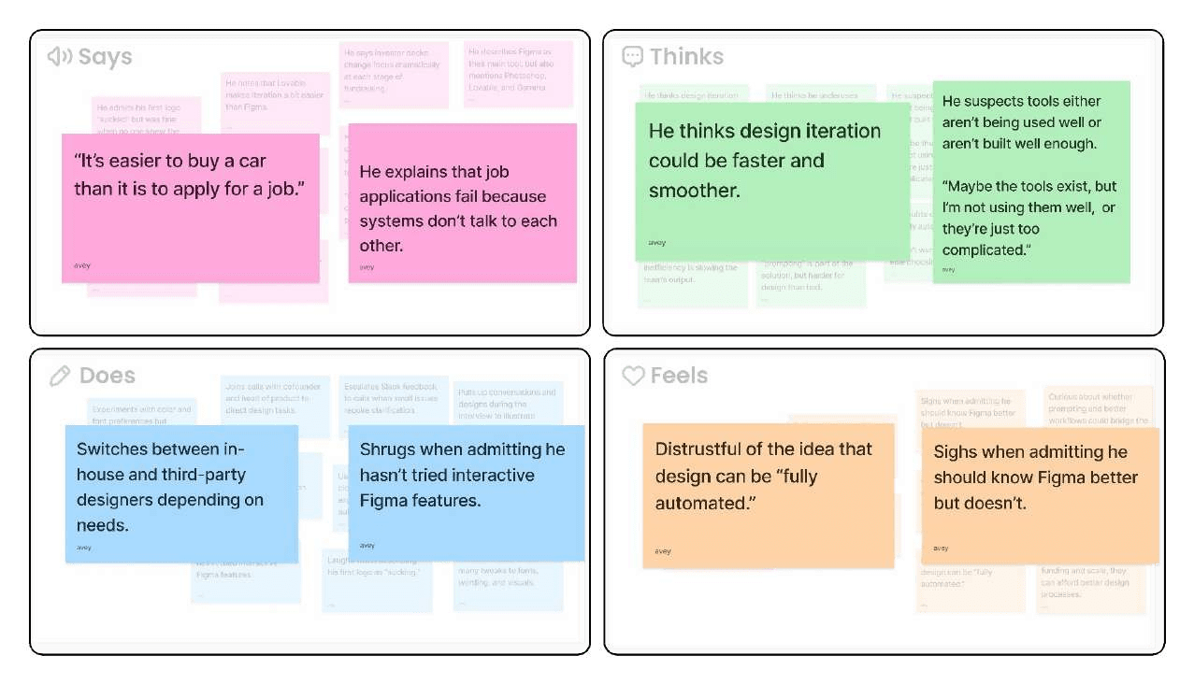
Key Takeaways - Mike

Slide 39
Analysis - Mike
Quote: “Maybe the tools exist, but I’m not using them well, or they’re just too complicated.”
Insight: Founders are willing to engage with design tools but often underuse advanced features, leading to feeling stuck when there’s momentum of ideas. Feeling like they have so much to do, learning new tools is time consuming, but they still want autonomy and control over their work instead of relying on designers for everything.
Need: He needs design tools that make iteration smoother and collaboration easier without requiring deep technical expertise in features like interactive prototyping

Slide 40
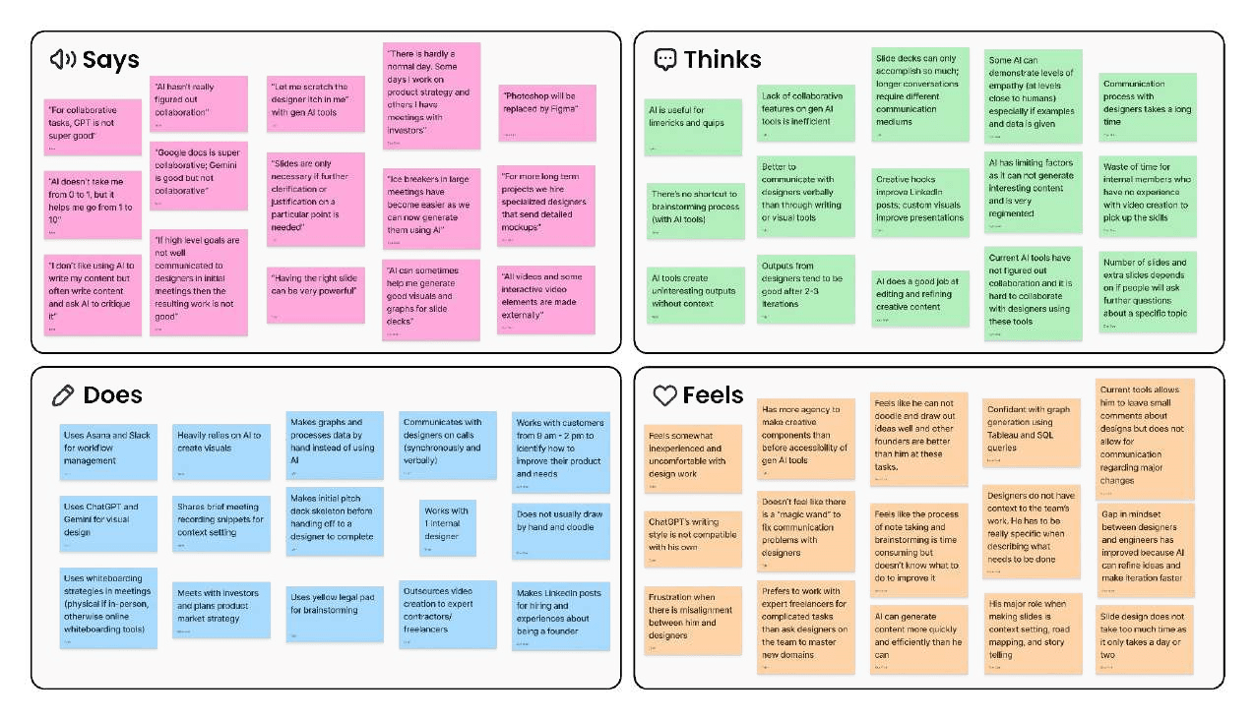
Empathy Map - Silus

Slide 41
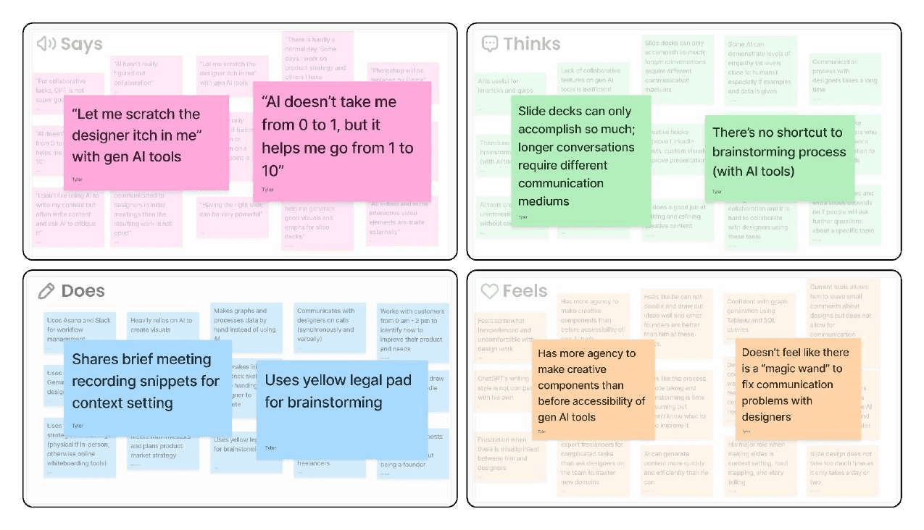
Key Takeaways - Silus

Slide 42
Analysis - Silus
Surprise: Silus is very traditional in terms of brainstorming and uses a notepad to brainstorm. However, he uses GenAI for creative use cases like creating limericks for LinkedIn posts and visuals for slideshow presentations.
Insight: Founders trust AI to add depth and automate detail-oriented parts of product development. But because
they strongly trust their own judgment, they resist letting AI drive the earliest vision or the final decision-making.
Need: A tool that experiments with different creative designs and helps him communicate with designers as someone who does not know much about design.

Slide 43
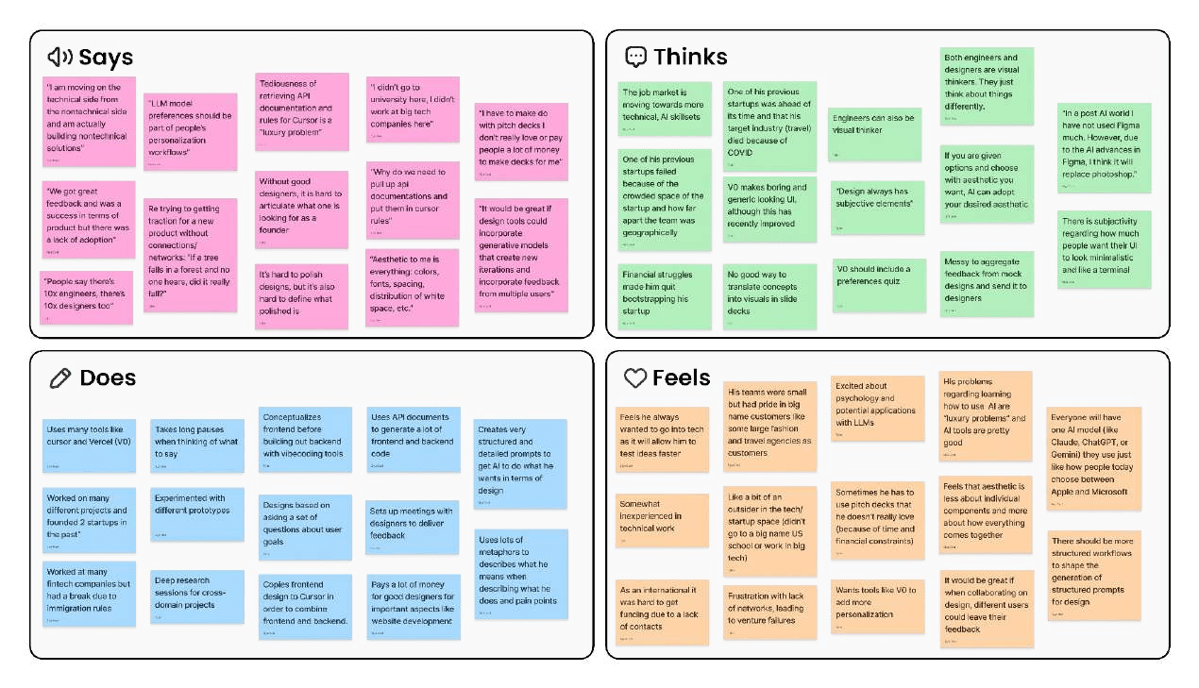
Empathy Map - Steven

Slide 44
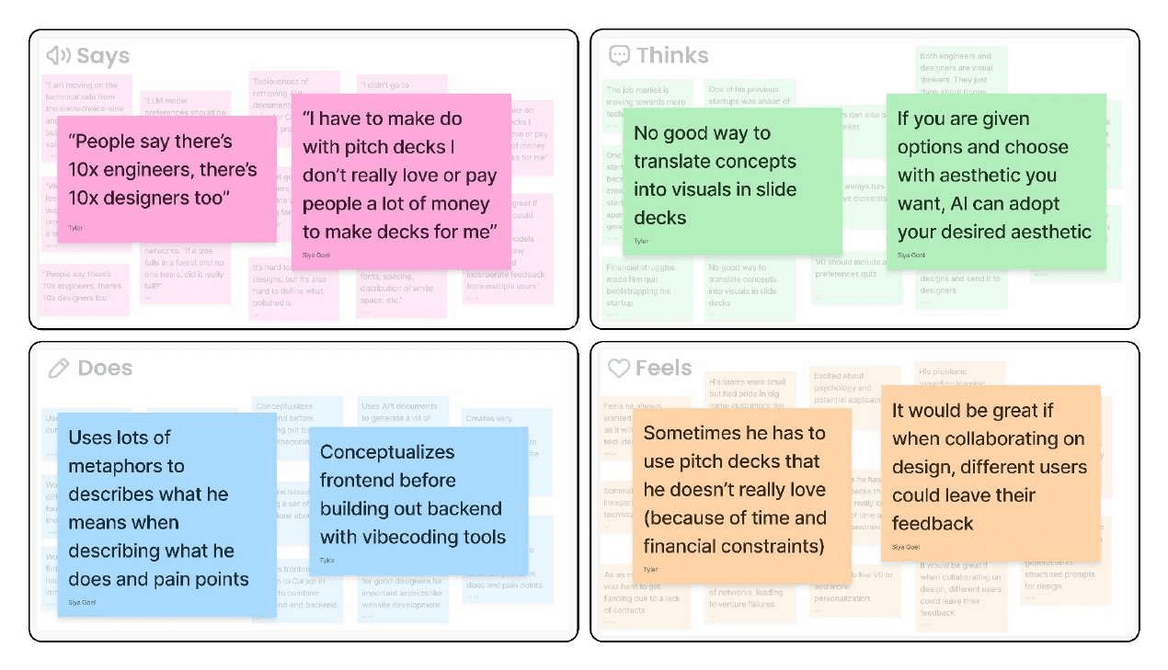
Key Takeaways - Steven

Slide 45
Analysis - Steven
Surprise: Amidst the large development of GenAI in technical applications, it was surprising seeing how Steven wanted to be more technical. Despite this, Steven was not writing code and more so using GenAI tools to become more technical.
Insight: Founders find collaboration on design tools slow and difficult because they need to organize meetings to best communicate changes. These meetings add extra hours to their days, when they feel communication can be better streamlined. They believe customization is lacking and trust that AI can easily generate the aesthetic you want if you specify it.
Need: A design tool that uses a short quiz or selection process, showing users different design options to choose from, in order to better understand their preferences.

Slide 46
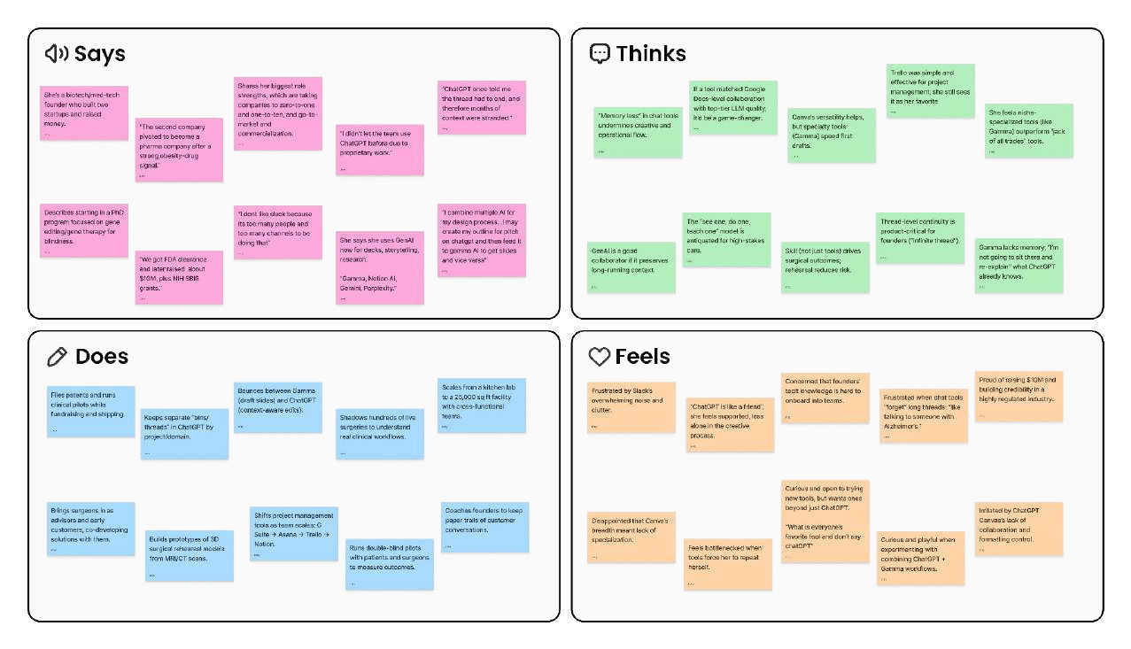
Empathy Map - Samantha

Slide 47
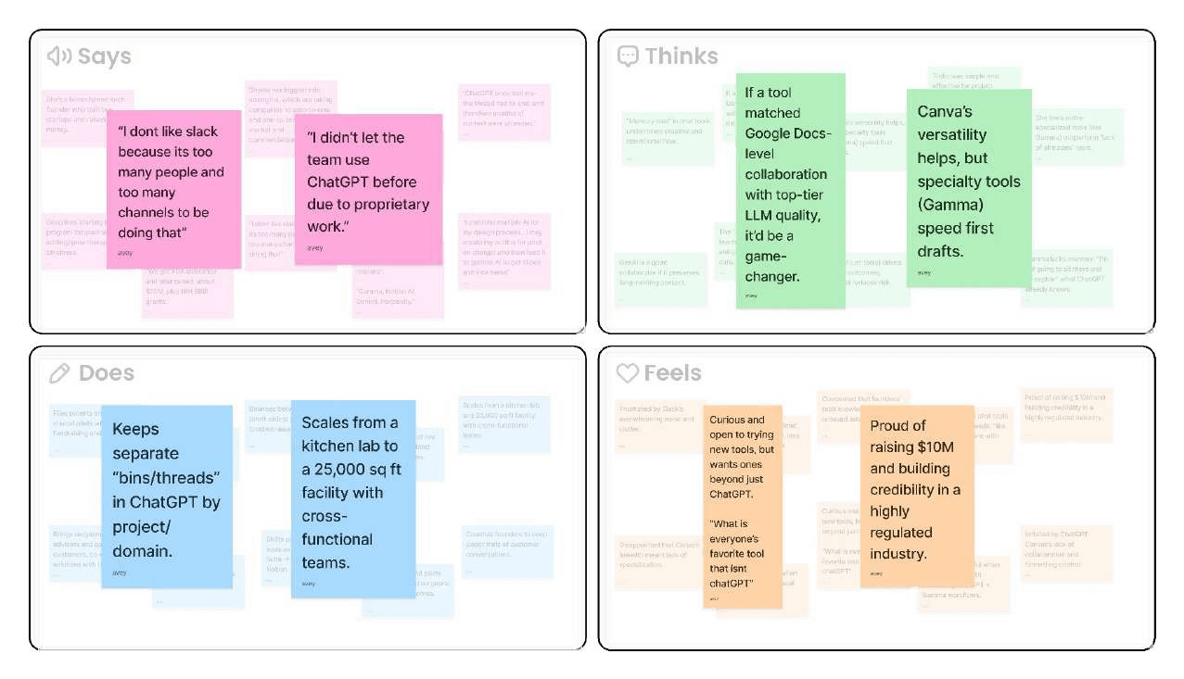
Key Takeaways - Samantha

Slide 48
Analysis - Samantha
Quote: “I combine multiple AI for my design process…I may create my outline for pitch on ChatGPT and then feed it to Gamma AI to get slides and vice versa.”
Insight: Founders are already hacking together workﬂows by combining multiple tools(e.g ChatGPT for outlining, Gamma for slides), but they find this process confusing, frustrating, and inefficient having to switch between tabs because it creates distraction and inconvenience, pulling away from the main task.
Need: She needs seamless workﬂows across AI and design tools so she doesn't waste time jumping between different platforms or re-explaining context.

Slide 49
CS 147
Conclusion

Slide 50
Key Insights/ Putting it all together
Communication and Collaboration
Long iterative process of startup founders collaborating with designers
Founders need to go through Figma and think about what needs to be improved and then give those comments to designers on call
Potential Example: Sharing GPT chats about ideas where multiple people can ask questions

Slide 51
Key Insights/ Putting it all together
Customization
Founders want the ability for GenAI tools to customize to their aesthetic
Design tools do not allow for easy editing by founders. As a result, they need to ask designers to make changed for them.
Potential Example: Quizzes for GenAI tools to learn more about people’s preferences ask questions

Slide 52
Key Insights/ Putting it all together
Lack of Context
Chats are not infinite. As a result, the context of GenAI tools are very limited and can not match founder’s tastes.
No integration between design tools, GenAI chatbots (like ChatGPT), and backend tools
Potential example: A GenAI tool that can “clone the founder’s brain”

Slide 53
Key Insights/ Putting it all together
Opinions of AI on Creativity
Some founders hated AI for creativity work and relied on designers Some founders use genAI to create visuals for their work
Some founders use GenAI for small design tasks and rely on designers for important visuals
In general: Creative potential of AI does not match designers

Slide 54
Whats Next?
More Interviews
Identify Patterns
Narrow Scope
We plan to conduct additional interviews with startup founders and users who can offer unique perspectives on design and social accountability. Our goal is to engage with individuals from diverse backgrounds and lifestyles to capture a wider range of insights.
We plan to further develop more of our key insights and see if the conclusions hold in the additional interviews.
By doing so, we hope to uncover more insights, needs, and surprises and develop POVs and HMWs to better define our project.
We will develop potential solutions for our HMWs. By doing so, we will narrow the area of creative tools and founders down further to an actionable problem we can try to solve.

Slide 55
CS 147
Appendix

Slide 56
Major Documents
Brainstorming and Interview Questions
Interview Notes and Recordings

