Slide 1

CS 147
October 3rd, 2025
A2:
POVs, HMWs, and Solutions
Avey Etaghene, Candace Cang, Siya Goel, Tyler Abernethy

Slide 2
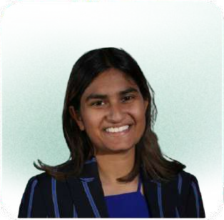
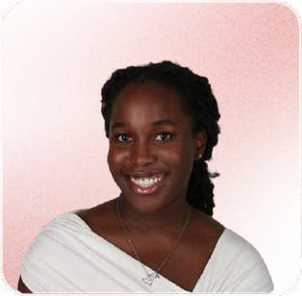
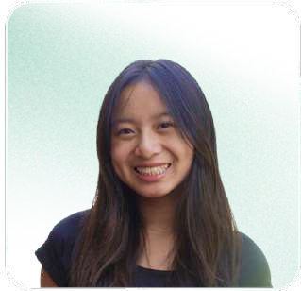
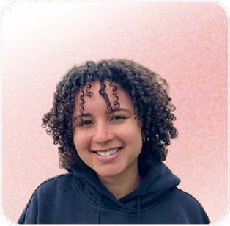
Team Members
Siya Goel
she/her
CS (AI) + Econ ‘26 CS (HCI) ‘27
Avey Etaghene
she/her
Symsys ‘27
CS (HCI) ‘27
Candace Cang
she/her
Design ‘26 CS (HCI) ‘ 27
Tyler A
Symsys ‘26
CS (HCI) ‘27

Slide 3
Scope of Project
Intelligent Tools for Design
to Help Early Stage Founders
Intelligent Tools for Design

Slide 4

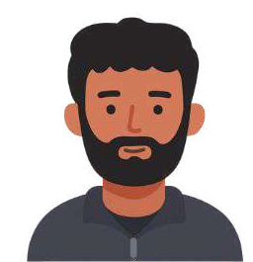

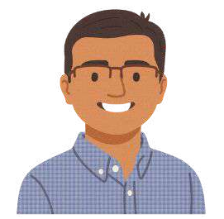


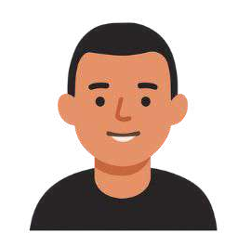
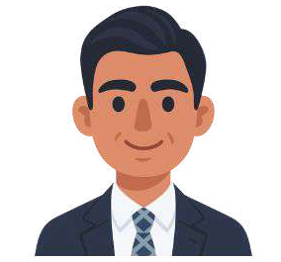
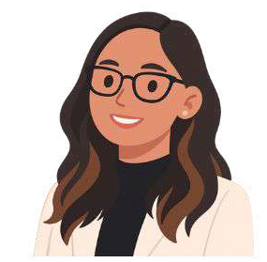
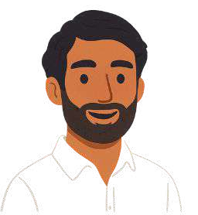


Previous Interviewees
Diversity in Experience and Startup Space
Extreme user: Youngest and
Sam
most inexperienced founder
Silus
8 years finance, consulting, and data science Technical
Fintech + YC Series A
Recent College Grad Technical
Legal Tech + YC Seed Startup
Alex
20+ years of engineering Technical
Dev Tools
Pre Seed Startup
Steven
2x Ex-Founder Nontechnical Consumer Seed Startups
Extreme user: Only woman, medical background, 2x Founder
Samantha
PhD in Genetics + 2x Founder Technical
Medtech Seed Startups
Mike
10 years of finance Nontechnical Consumer
Series A

Slide 5
Recap of Findings
Communication and Collaboration
Opinions of AI on Creativity
Lack of Context
Customization

Slide 6
Recap of Findings
Communication and Collaboration
Customization
Lack of Context
Opinions of AI on Creativity
Working with designers
Current design tools
Chats are not infinite so GenAI tools are limited and can not match founder’s tastes. They need more integration between design tools, GenAI, and backend tools.
Founders either hated AI or heavily relied on AI for creativity for either impactful or smaller visuals.
is an extensive process are difficult to use, so
of Figma comments, long meetings, and lots of waiting.
they rely on designers when they want more customization.

Slide 7

Additional Interviews
CS 147

Slide 8
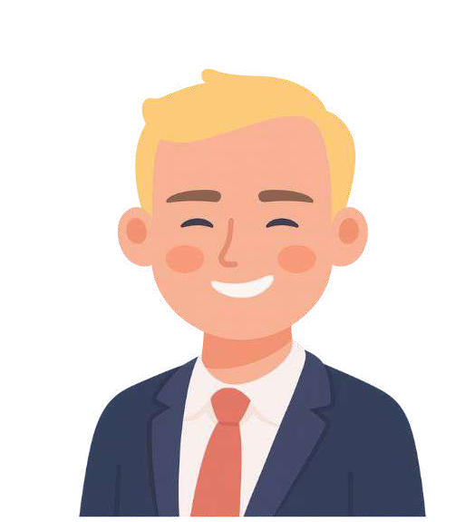
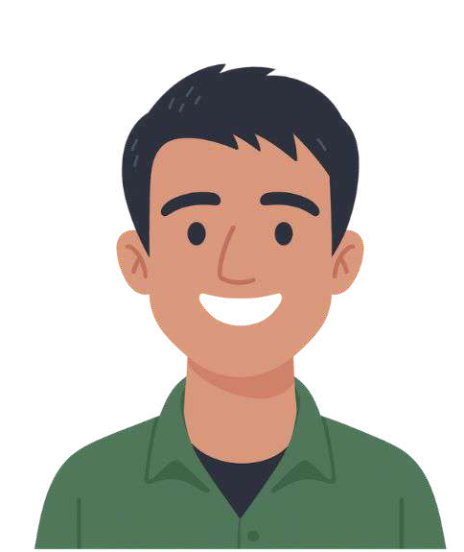
New Interviewees
Alan
2 years of Real Estate Nontechnical Consumer
Pre Seed Startup
Dave
2x Founder, Stanford PhD, 5+ years of engineering Technical
Dev/Research Tools Seed Startup

Slide 9
New Interviewees
Extreme user: Younger and one of the most non-technical founders
non-technical
Alan
2 years of Real Estate Nontechnical Consumer
Pre Seed Startup
Dave
2x Founder, Stanford PhD, 5+ years of engineering Technical
Dev/Research Tools Seed Startup

Slide 10
New Interviewees
Extreme user: Younger and one of the most non-technical founders
Extreme user: Younger and one of the most technical founders
non-technical
technical
Alan
2 years of Real Estate Nontechnical Consumer
Pre Seed Startup
Dave
2x Founder, Stanford PhD, 5+ years of engineering Technical
Dev/Research Tools Seed Startup

Slide 11
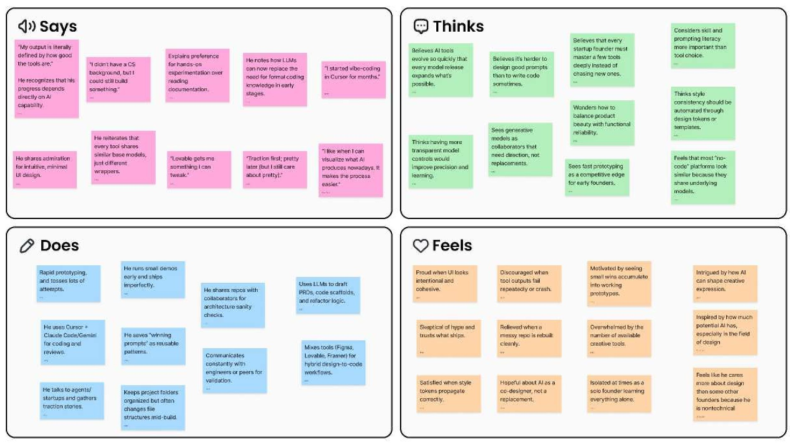
Empathy Map - Alan
non-technical

Slide 12
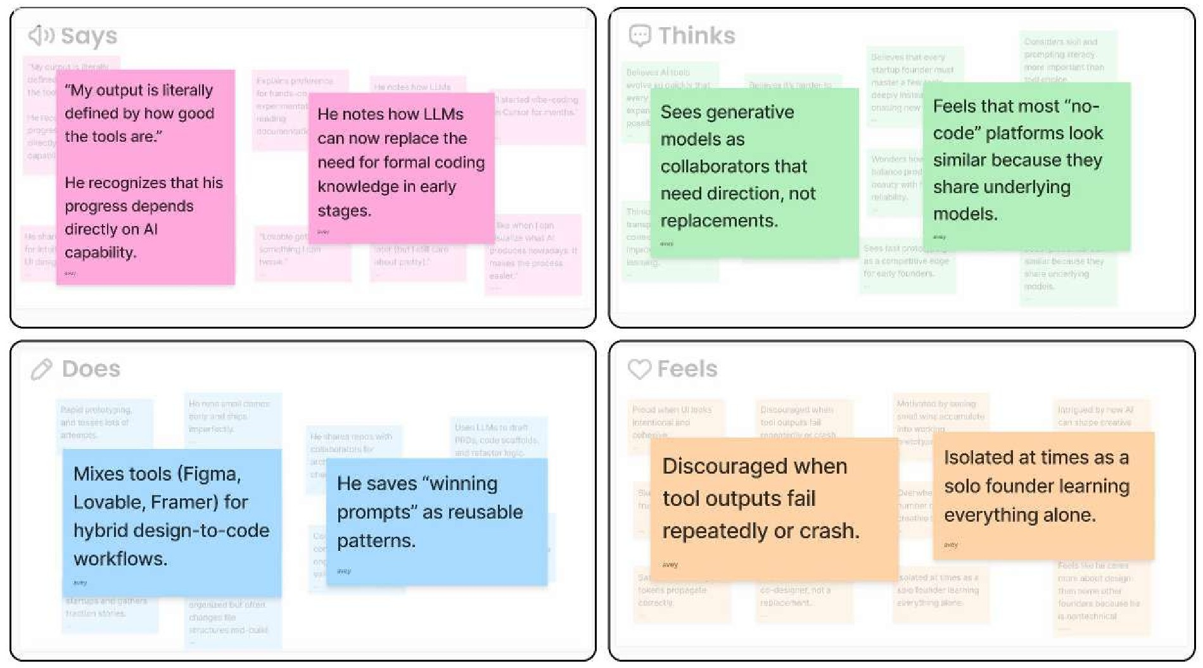
non-technical

Slide 13
Analysis - Alan
Surprise: Alan “has never written a single line of code” → he consistently relies on AI tools to do this for him
Insight: Non-technical founders know their backgrounds put them “behind,” but they feel empowered by AI tools. However, they rely on AI so much, when AI tools fail, they lost confidence in building, almost as if their work is determined by the quality of tools they use.
Need: A way to learn from about the best tools that align with their goals.
non-technical

Slide 14
“Has never written a single line of code”
New Insight - Alan
Builds full products and interfaces
New Insight: AI tools aren’t just assistants, they represent creative and technical identities to non-tech founders
non-technical

Slide 15
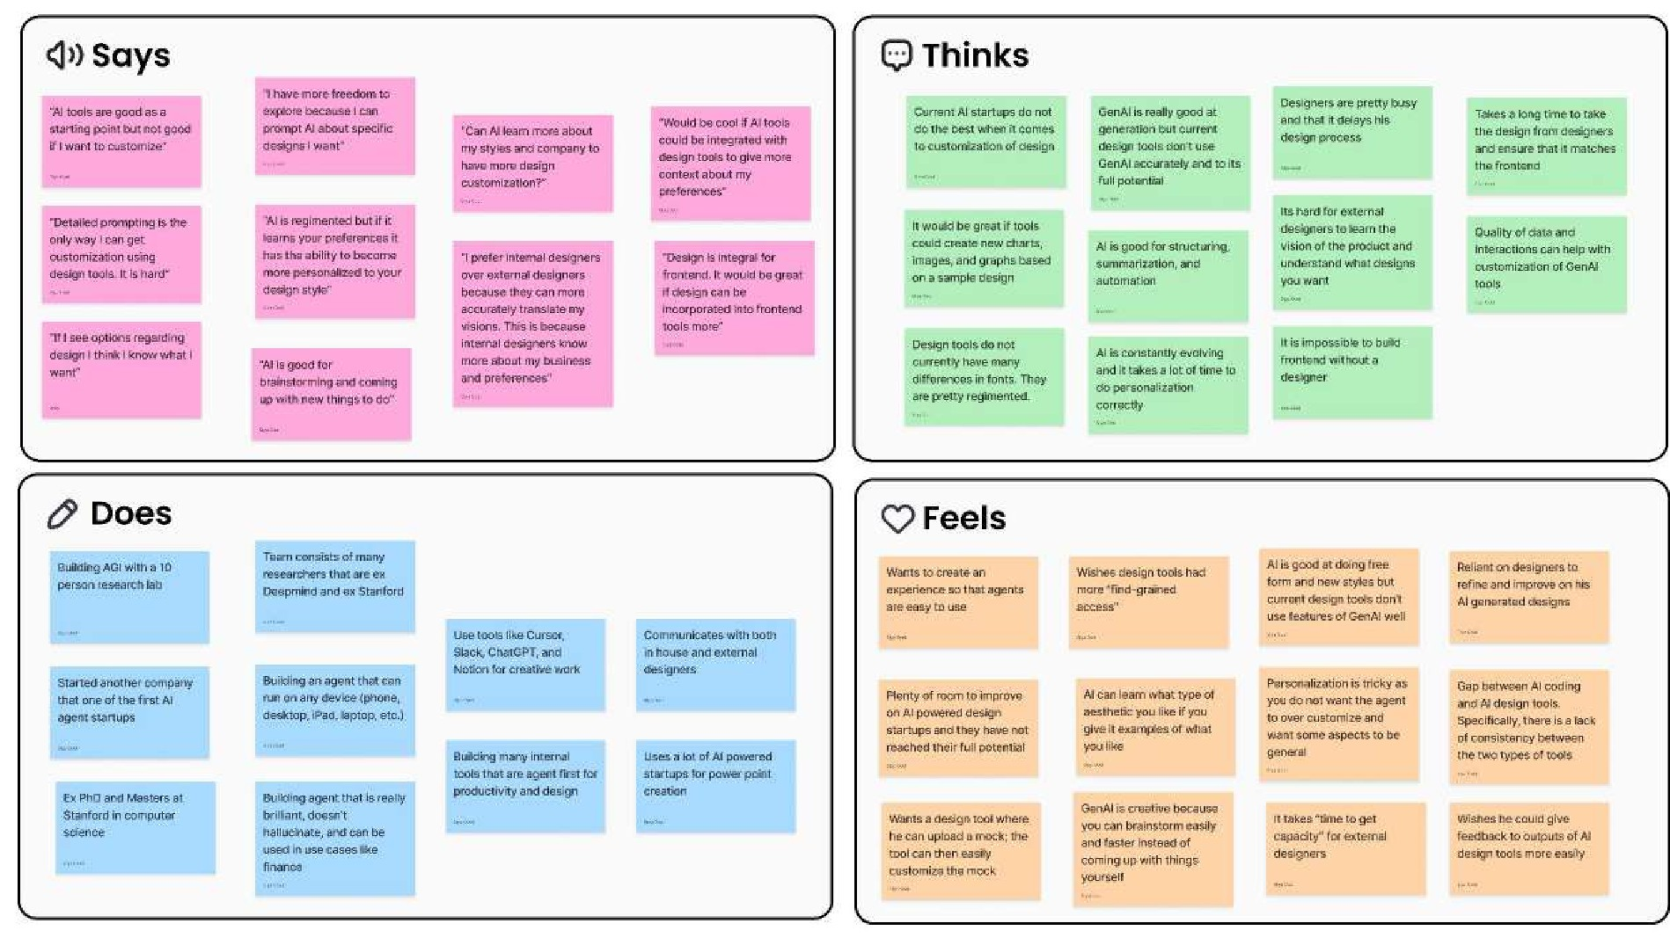
Empathy Map - Dave
technical

Slide 16
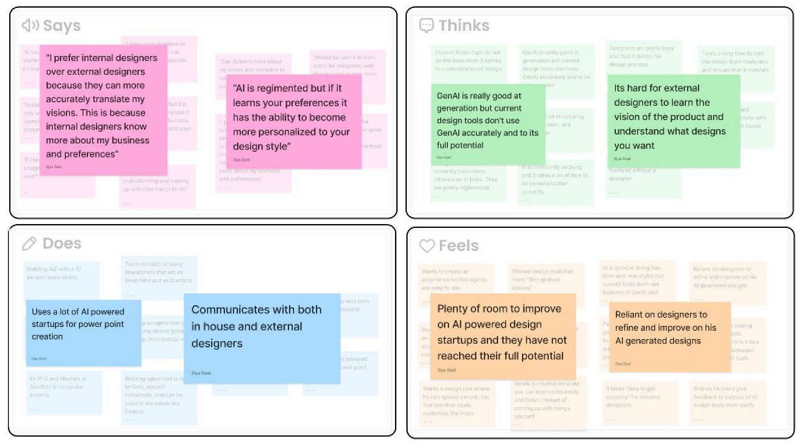
technical

Slide 17
Analysis - Dave
Quote: “AI is regimented but if it learns your preferences it has the ability to become more personalized to your design style”
Insight: Founders want AI to “see” them by understanding what they want and and how they visual products. They want people and tools that can translate their visions and think AI can reach its full potential.
Need: An AI design tool that can accurately learn more about his preferences and aesthetic.
technical

Slide 18
Analysis - Dave
New Insight: Founders want tools that translate their visions and understand exactly what they want
technical

Slide 19

POVs
CS 147

Slide 20
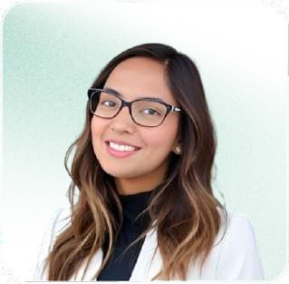
Focused POVs
Communication and Collaboration With Designers
Founders want help with Customization and Creativity
Founders want a way for design tools to integrate tools from different workflows

Slide 21
POV: Alex
We met Alex, an engineer with 20+ years of engineering experience, founding his first preseed startup focused on development tools.
Communication and Collaboration With Designers

Slide 22
POV: Alex
We met Alex, an engineer with 20+ years of engineering experience, founding his first preseed startup focused on development tools.
We were surprised to notice that Alex feels like he wastes time talking to designers for so long and feels stressed that he relies on designers so much for all visualization needs.
Communication and Collaboration With Designers

Slide 23
POV: Alex
We met Alex, an engineer with 20+ years of engineering experience, founding his first preseed startup focused on development tools.
We were surprised to notice that Alex feels like he wastes time talking to designers for so long and feels stressed that he relies on designers so much for all visualization needs.
We wonder if this means Alex dreads important meetings with designers and if it interrupts how he shows up for project needs.
Communication and Collaboration With Designers

Slide 24
POV: Alex
We met Alex, an engineer with 20+ years of engineering experience, founding his first preseed startup focused on development tools.
We were surprised to notice that Alex feels like he wastes time talking to designers for so long and feels stressed that he relies on designers so much for all visualization needs.
We wonder if this means Alex dreads important meetings with designers and if it interrupts how he shows up for project needs.
Communication and Collaboration With Designers
It would be game-changing to make communication with designers seamless and fun, creating an exciting and effortless communication experience.

Slide 25
Key HMWs for Alex
Amp up the good:
HMW create collaborative spaces and tools where design decisions feel like co-creation rather than dependency?
Change the status quo: HMW reduce the need for frequent meetings?
Explore the opposite: HMW transform traditional verbal communication into a visual experience?
Create an analogy:
HMW templatize the design experience and make it like a coloring book?
Remove the bad:
HMW reduce miscommunication between engineers and designers?
Identify unexpected resources: HMW leverage engineers' existing tools and workﬂows to integrate design collaboration seamlessly?

Slide 26
POV: Dave
We met Dave, a 2x founder of research-based seed startups with a technical background.
Founders want help with Customization and Creativity

Slide 27
POV: Dave
We met Dave, a 2x founder of research-based seed startups with a technical background.
We were surprised to notice that Dave believes AI design tools have a regimented aesthetic that can’t adapt to what founders want, leading him to rely on designers to refine his vision.
Founders want help with Customization and Creativity

Slide 28
POV: Dave
We met Dave, a 2x founder of research-based seed startups with a technical background.
We were surprised to notice that Dave believes AI design tools have a regimented aesthetic that can’t adapt to what founders want, leading him to rely on designers to refine his vision.
We wonder if Dave would be more creatively engaged in the design process if he could see his unique aesthetics come to life through AI in a more visual and customized manner.
Founders want help with Customization and Creativity

Slide 29
POV: Dave
We met Dave, a 2x founder of research-based seed startups with a technical background.
We were surprised to notice that Dave believes AI design tools have a regimented aesthetic that can’t adapt to what founders want, leading him to rely on designers to refine his vision.
We wonder if Dave would be more creatively engaged in the design process if he could see his unique aesthetics come to life through AI in a more visual and customized manner.
It would be game-changing to create a design tool that helps founders customize and evolve their visual styles and needs without complete reliance on designers, bridging the gap between creative and AI outputs.
Founders want help with Customization and Creativity

Slide 30
Key HMWs for Dave
HMW capture the feeling and visions that founders want and translate imagination to tangible designs?
HMW give founders tools to translate their creative intent into visuals, even without design expertise?
Explore the opposite:
HMW create design tools that adapt to Dave's creative process instead of forcing him to adapt to the tool?
HMW allow Dave to experiment and develop his aesthetic based on descriptions and examples?
Change the status quo:
HMW make design skills accessible so that any founder can achieve visual output regardless of design experience?
Unexpected resources:
HMW understand Dave’s design choices through the websites and aesthetics he likes and interacts with daily?

Slide 31
POV: Samantha
We met Samantha, a woman and 2x startup founder with a PhD in Genetics who is building a medtech startup.
Founders want a way for design tools to integrate tools from different workflows

Slide 32
POV: Samantha
We met Samantha, a 2x startup founder with a PhD in Genetics who is building a medtech startup
We were surprised to find that Samantha actively combines multiple AI tools in her design process, using Chat GPT for outlining presentations and feeding it to Gamma AI to generate slides.
Founders want a way for design tools to integrate tools from different workflows

Slide 33
POV: Samantha
We met Samantha, a 2x startup founder with a PhD in Genetics who is building a medtech startup
We were surprised to find that Samantha actively combines multiple AI tools in her design process, using Chat GPT for outlining presentations and feeding it to Gamma AI to generate slides
We wonder if founders like Samantha feel that constantly switching between AI platforms turns creativity into extra work, suggesting that they’re being held back not by the tools themselves, but by the fragmented nature of the AI ecosystem.
Founders want a way for design tools to integrate tools from different workflows

Slide 34
POV: Samantha
We met Samantha, a 2x startup founder with a PhD in Genetics who is building a medtech startup
We were surprised to find that Samantha actively combines multiple AI tools in her design process, using Chat GPT for outlining presentations and feeding it to Gamma AI to generate slides
We wonder if founders like Samantha feel that constantly switching between AI platforms turns creativity into extra work, suggesting that they’re being held back not by the tools themselves, but by the fragmented nature of the AI ecosystem.
Founders want a way for design tools to integrate tools from different workflows
It would be game-changing to create a unified creative workspace that maintains persistent context about a founder's vision, brand identity, and preferences across all creative tasks, from initial brainstorming to final slide design.

Slide 35
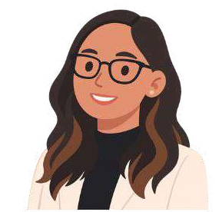
Key HMWs for Samantha
HMW keep founders in a creative fiow by simplifying how they choose and switch between tools?
HMW create an AI ecosystem that remembers Samantha's entire creative journey instead of treating each task as isolated?
Amp up the good:
HMW maintain the creative momentum founders have as they go from brainstorming to design to presentation creation?
Change a status quo:
HMW make sure that founders like Samantha do not have to start from scratch when using a new design tool?
Reduce the bad:
HMW communicate which tools are best for certain tasks to reduce the cognitive overload of decision-making?
Break into pieces:
HMW create a system that understands the relationship between pitch decks, brands, and product vision?

Slide 36


HMWs Chosen on:
1. breadth
could lead to many different solutions
2. tied to POV
linked to these insights
3. inspiring
human-centered, aspirational

Slide 37
Top 3 HMWs
HMW create collaborative spaces and tools where design decisions feel like co-creation rather than dependency?
HMW capture the feeling and visions that founders want and translate imagination to tangible designs?
HMW keep founders in a creative ﬂow by simplifying how they choose and switch between tools?
Alex’s POV
Dave’s POV
Samantha’s POV

Slide 38

Solutions
CS 147

Slide 39
Alex
How Might We
Create collaborative spaces and tools where design decisions feel like co-creation rather than dependency?
A live visual playground that designers and founders can work on together while communicating in real time

Slide 40
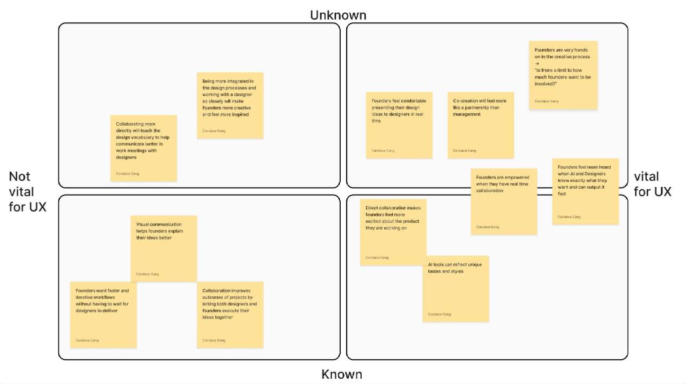
Assumption Mapping

Slide 41
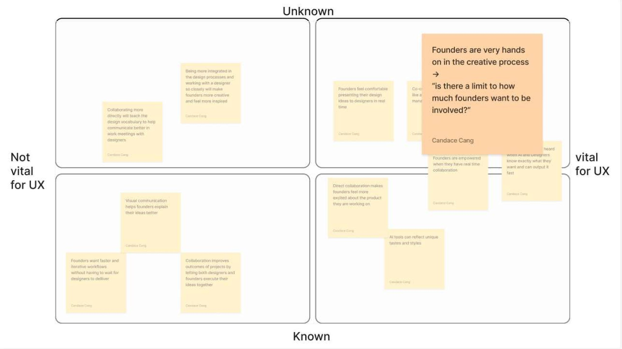
Assumption Mapping

Slide 42
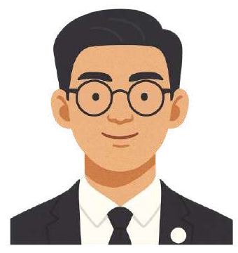
Solution 1 Participant
Thomas
Founder of myCollector, a fintech startup
Stanford Senior majoring in computer science and public policy
Technical seed stage founder

Slide 43

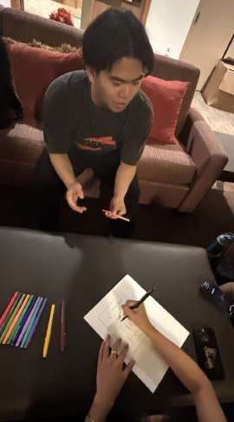
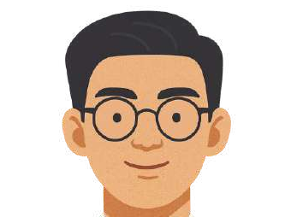
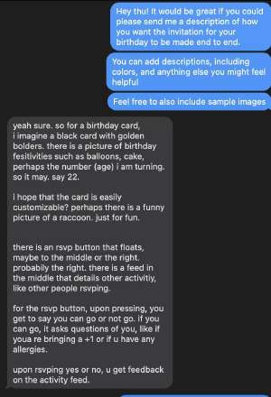
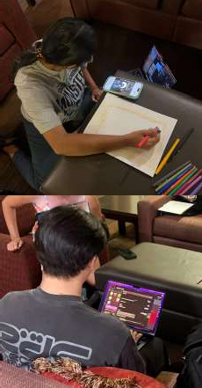
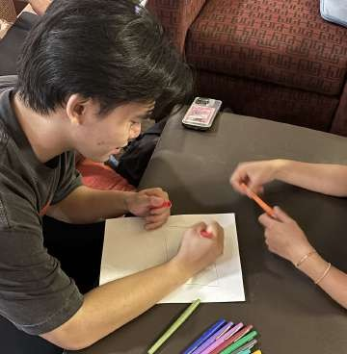
Experience Prototype 1
Collaborative Playground
Idea:
A live visual playground that designers and founders can work on together while communicating in real time
Task to user: Create a birthday invitation
3. Collaborative Editing with voice
(“Playground”)
1. Voice Description 2. Text Description

Slide 44
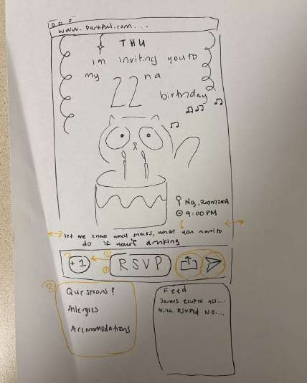
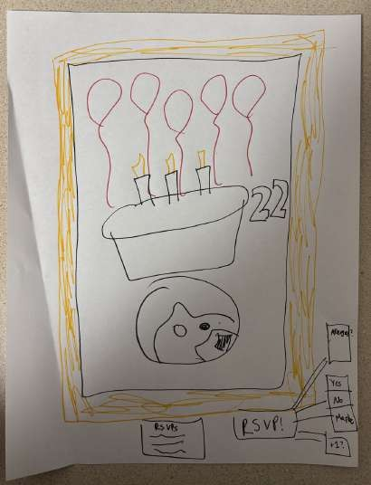
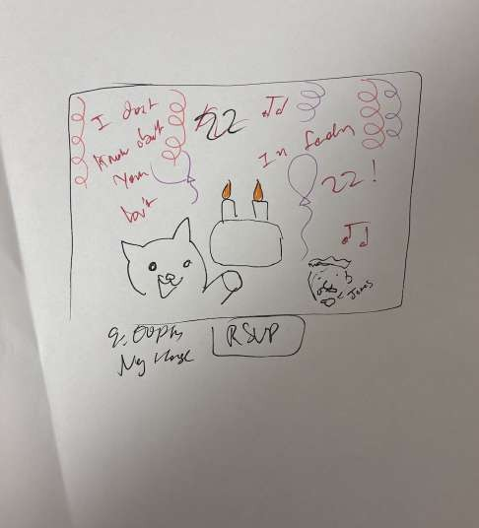
Solution 1 Creations
Voice Conversation
Text Conversation
Collaborative Editing

Slide 45
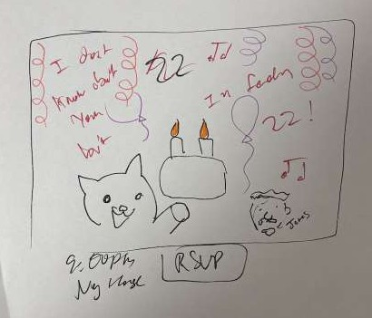
What Worked
Collaborative Editing
Voice conversation
  All required features were drawn
  “I saw all the individual components I mentioned”
  Felt he was “being heard”
Text conversation
  Easier to organize thoughts
Collaborative editing
  Was “fun” and the participant “loved it”
  “I liked putting my ideas on paper with someone who can help me transform my idea”
  “There was a balance between me and the designer designing it. The
designer could help guide me in artistic style.”

Slide 46
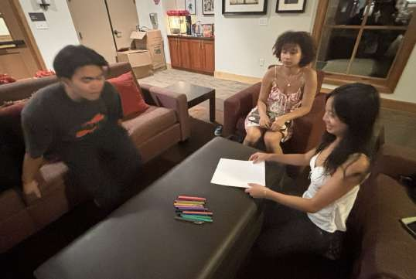
What Didn’t Work
Voice conversation
  Editing format was unclear: “I am not entirely sure what the annotations mean.”
  “Everything is on there but not in the format I want.”
Text conversation
  took too much time, was a pain
  “This would work better in a speak to text model”
  “I didn’t want to give feedback to the picture just because of how long it takes to type”
Collaborative editing
  “Wish there was a brainstorming session before drawing.”
The setup
“Would have loved to give more annotations than drawing. I trust the designer to draw more as they have more expertise.”

Slide 47
Solution 1 Testing & Insights
Assumption: Founders are very hands on in the creative process
Preferred Experience
collaborative editing
voice conversation
text conversation
Preferred Output
voice conversation
collaborative editing
text conversation
Our assumption was supported by participant preference
Tradeoffs observed
Time vs Organization (Text conversation)
Quality of Output vs Involvement (Voice conversation and collaborative editing)

Slide 48
Dave
AI can present a bunch of images and inspirational visuals that users can choose between and it can guide the direction of designs - almost like providing a survey to provide product context
How Might We
Capture the feeling and visions that founders want and translate imagination to tangible designs?

Slide 49
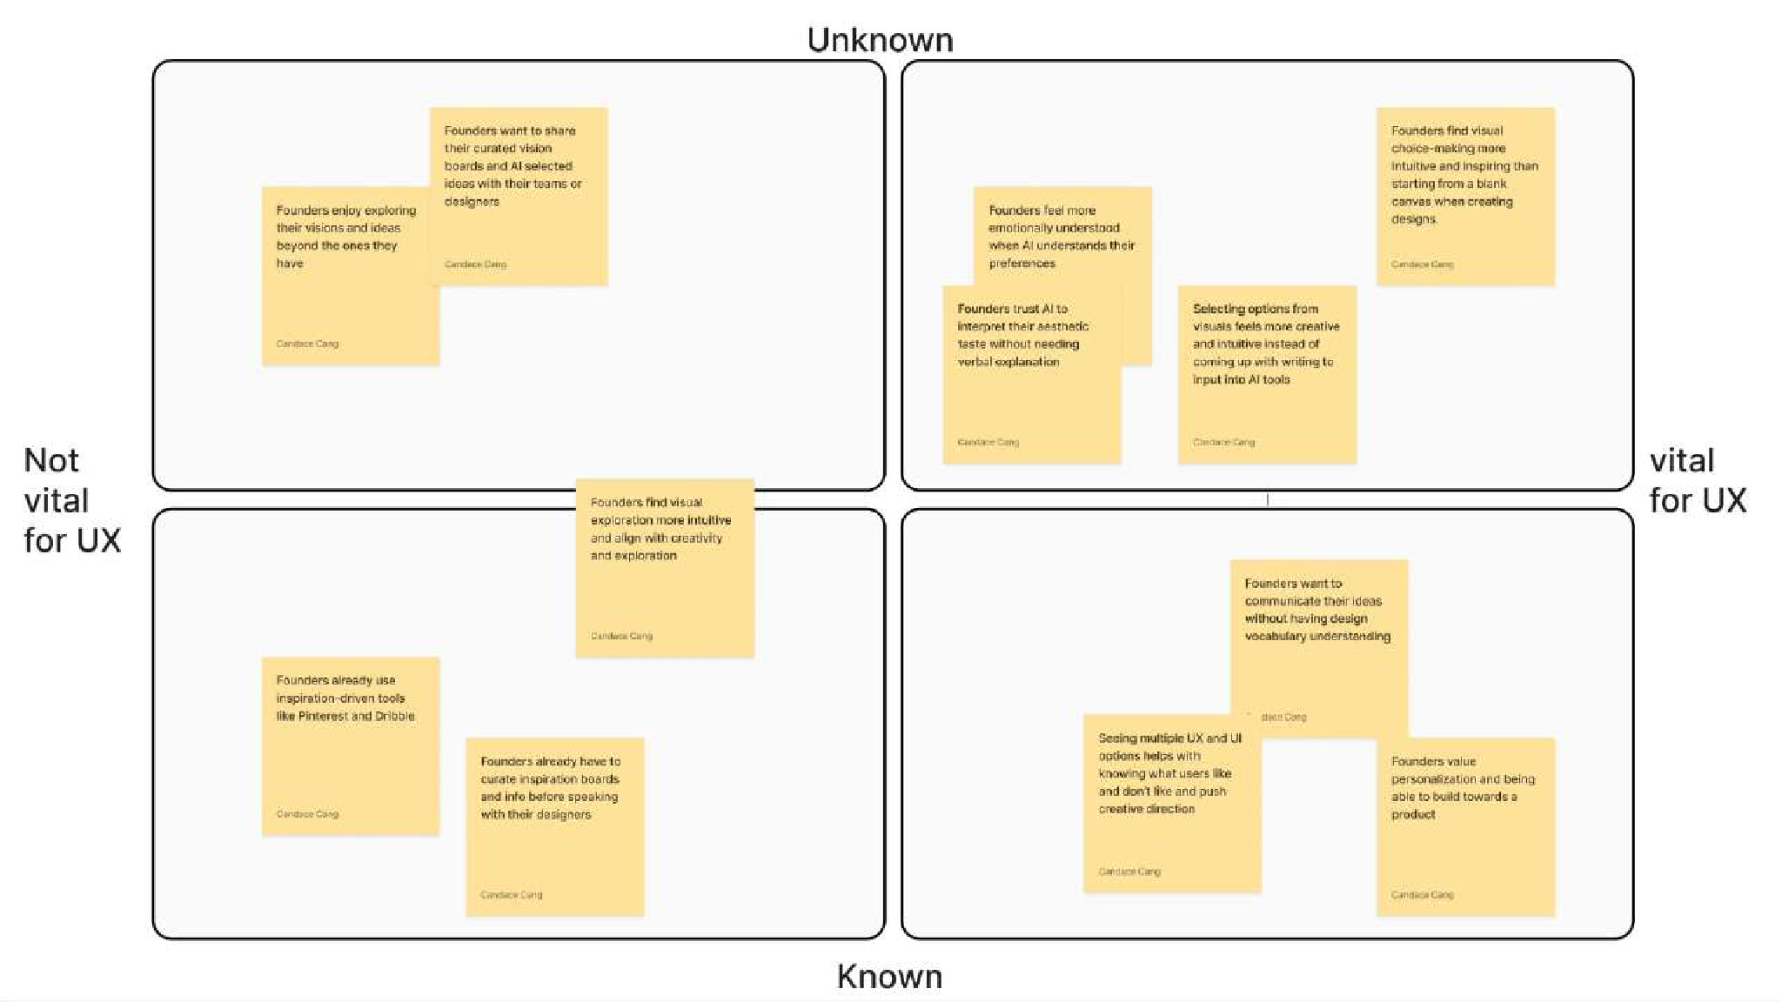
Assumption Mapping

Slide 50
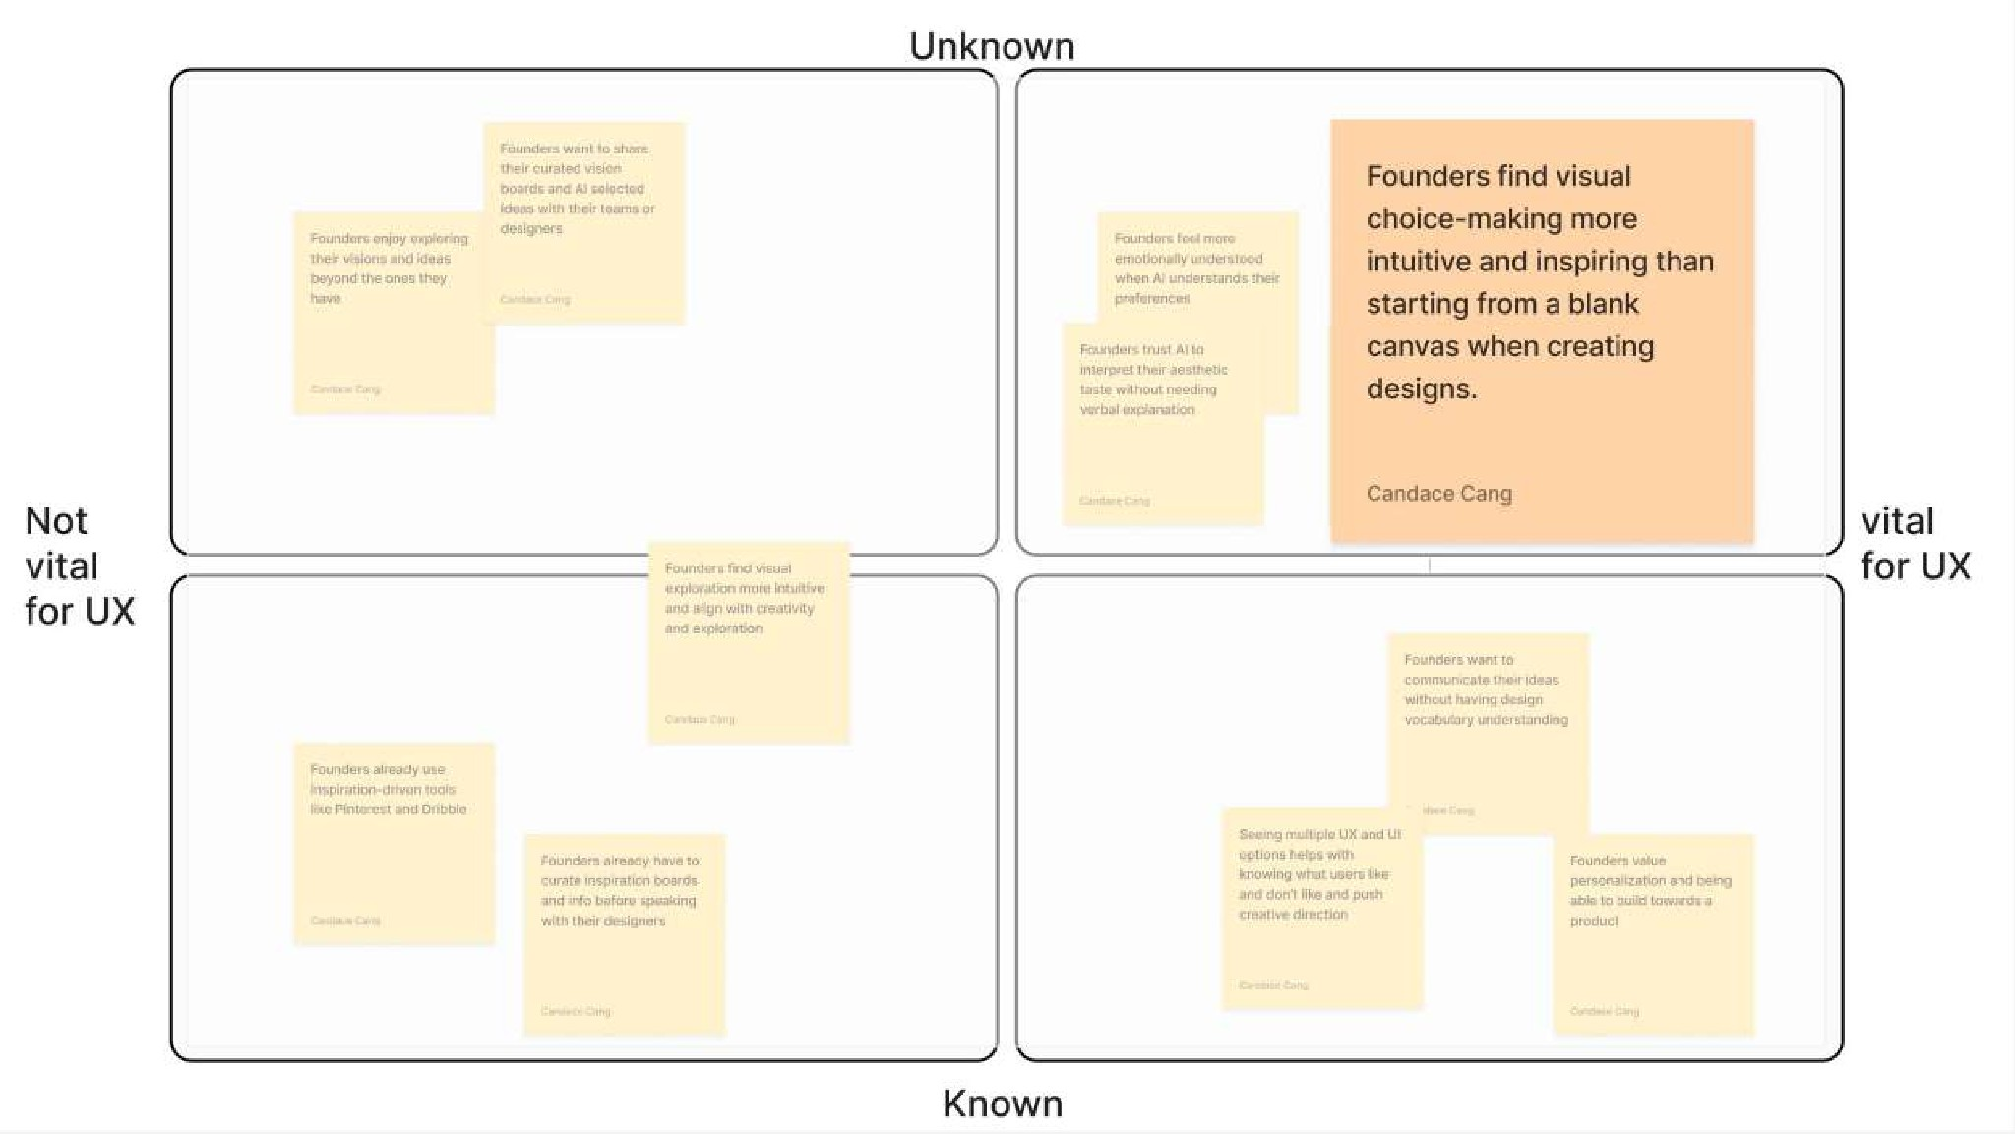
Assumption Mapping

Slide 51
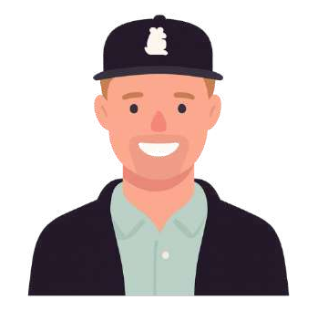
Solution 2 Participant
James
Founder of Glocal, a community engagement consumer platform
20+ years of founding experience, previously founded a food sharing non profit
Nontechnical seed stage founder

Slide 52
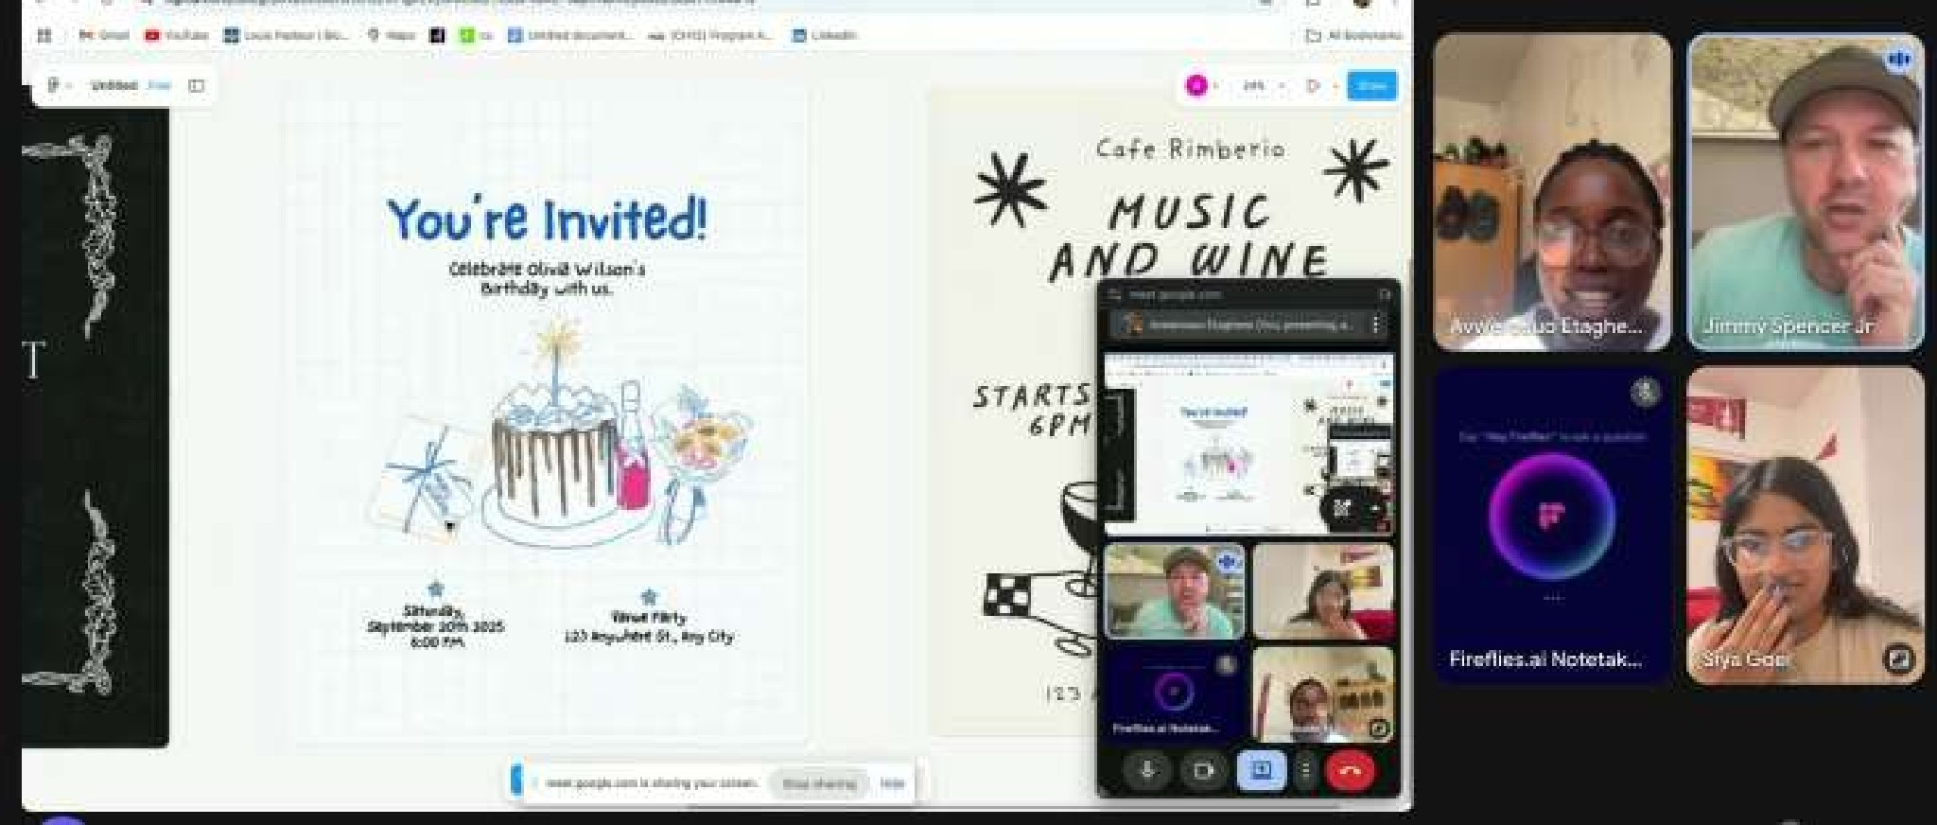
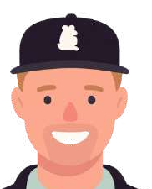
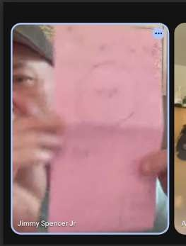
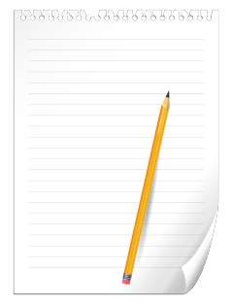
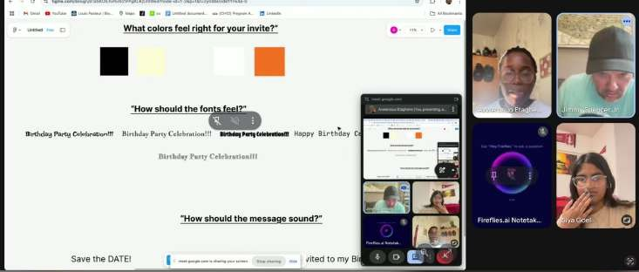
Experience Prototype 2
Providing Design Options
2. Selection of premade options
Idea: AI provides images and inspirational visuals that users can choose between
Task to user: Create a birthday invitation
1. Freehand Drawing (blank canvas)
3. Multi-step construction

Slide 53
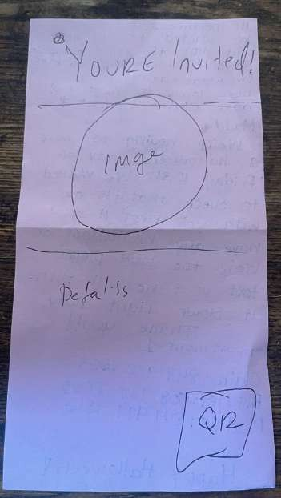
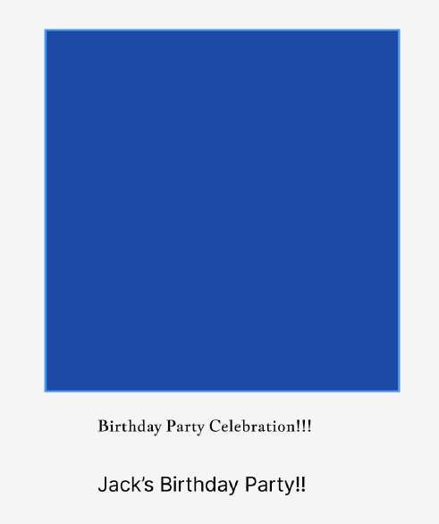

Solution 2 Artifacts
Approach 1
Approach 2
Approach 3

Slide 54
What Worked
What Didn’t Work
Different personalizations: “I wish Approach 2 and Approach 3 allowed me to import images and add components like QR codes”
Wanted more control: “Founders want control. Our default is control. So if that’s get lost in translation then it won’t work.”
Understood individual personalization: “I would prefer to have control over elements so I would pick Approach 1”
Gathered information about options: “I liked the options for Approach 3, that was fine. I would have just liked the opportunity to grab things and design something”
Aesthetic appeal: “Even though I liked Approach 1, I think Approach 2 or 3 (with choices) would have looked better”

Slide 55
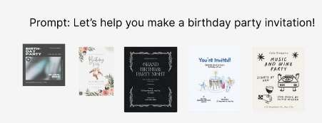
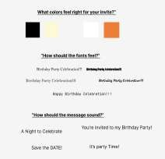
Solution 2 Testing & Insights
Preferred Method
Assumption: Founders find visual choice-making more intuitive and inspiring than starting from a blank canvas when creating designs.
Our assumption was partially rejected
1st: Liked the control
3rd: “May have looked the best but no customization”
“I would have liked approach 3 if I had the ability to import icons and more customization”
2nd: “Like a sandwich” and combination between Approach 1 and 2

Slide 56
Solution for Samantha’s HMW
A how-to skill sharing platform for founders to share tips and tricks on which design tools to use
How Might We
Keep founders in a creative fiow by simplifying how they choose and switch between tools?

Slide 57
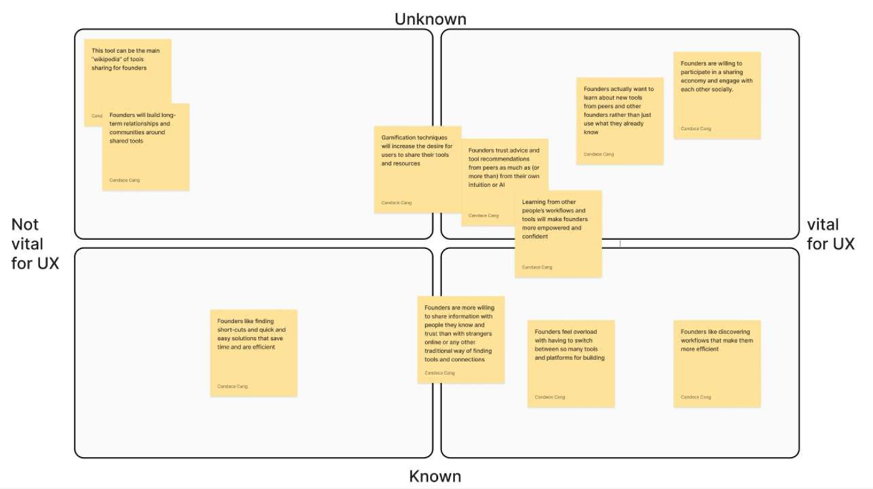
Assumption Mapping

Slide 58
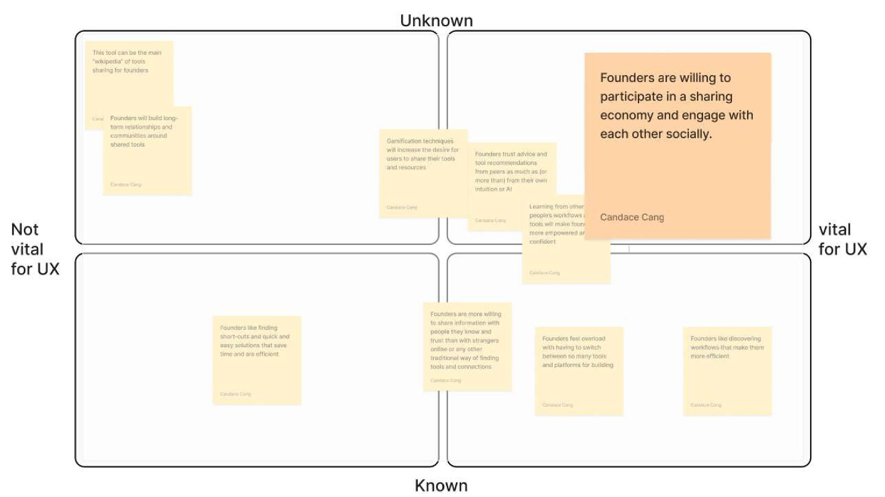
Assumption Mapping

Slide 59
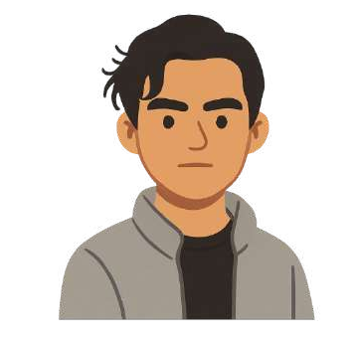
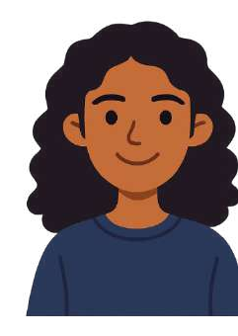
Solution 3 Participant
Antonio
2x Founder
Currently founding Proxi, a medtech startup
Stanford Junior majoring in computer science
Technical seed stage founder
Samantha
Founder of paybac, a fintech startup
Stanford Senior majoring in computer science and public policy
Technical seed stage founder

Slide 60
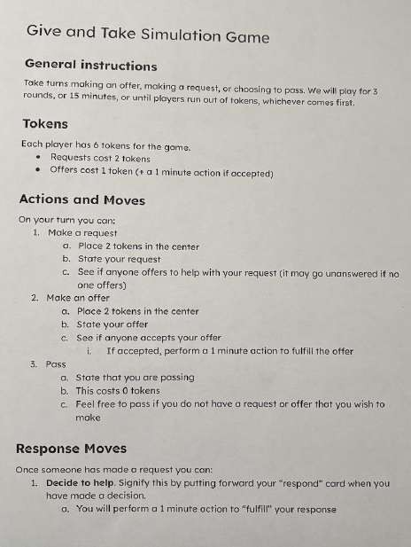
Experience Prototype 3
Give & Take Stimulation
Task: Give founders an opportunity to optionally share/request resources and observe whether they choose to do so.
Idea: A how-to skill sharing platform for founders to share tips and tricks on which design tools to use
Tokens represent limited tokens
Each turn, players can make a request, offer, or pass
  Request: costs 2 tokens
  Offer: costs 2 tokens
  Offer Acceptance: perform 1 min action
Game played twice with variation

Slide 61
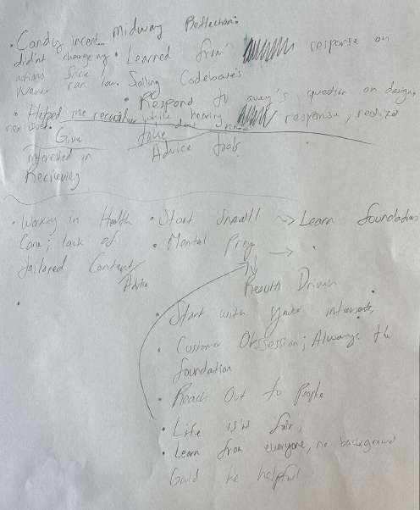
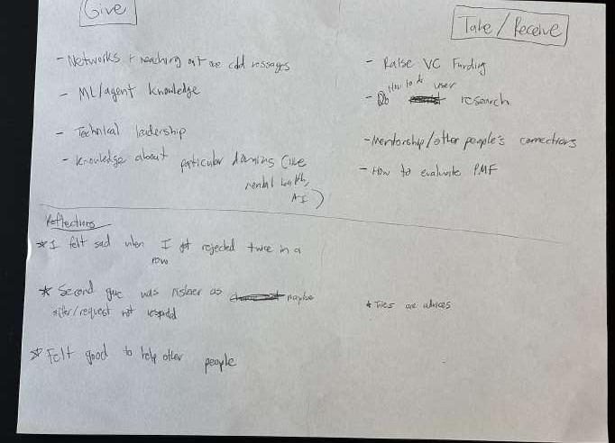
Solution 3 Artifacts
Antonio’s Insights
Samantha’s Insights

Slide 62
What Worked
Participants felt that they were knowledgeable enough to give advice on which design tools to use and when
  “I feel like I am above average about giving advice about when to use design tools”
The exercise helped one of the participants think through real issues he was considering → info/advice sharing is actually useful, even in a simulation
  “I actually wanted to follow up and ask you how I can do more system design”
Coin ﬂip variation (introducing randomness) raised stakes
  “I felt sad when I was rejected twice. I hate this game.”

Slide 63

What Didn’t Work
“token” system didn’t feel meaningful → hard to represent the cost of making an offer or request
  “The candies didn’t change my incentives or actions because I never ran low or had a chance of running low. It was only 3 rounds”
“I don’t know if I am the best to give design specific advice but can give advice on how to raise VC funds”

Slide 64
Insights
Assumption: Founders are willing to participate in a sharing economy and engage with each other socially.
Getting no responses to an ask/request felt bad
One participant asked more and one participant offered more
→ led to a good balance
Self reported “high risk tolerance” led one participant to participate without reservation, he didn’t feel any scared or feel there was a downside
The participants discussed how more experienced participants founders would likely give more advice whereas newer founders are more likely to ask for advice
  “Most successful young founders ask questions”
  “More experienced founders can give and are willing to give more advice”
Our assumption was supported

Slide 65

Summary
CS 147

Slide 66
Ethical Implications
 | Solution 1: Playground for Communication | Solution 2: Choose Between Images for Customization | Solution 3: How-To Skill Sharing Platform for Design Tool Usage
Designs for | Early stage founders that work with designers internally or externally | Early stage founders using on AI for ideation and customization | Early stage founders seeking resources and network
Leaves out | Blind users and non-English speakers | Underrepresented cultural communities AI does not consider | Neurodivergent users or those with learning differences
Additional | Real time communication over a visual platform could expose sensitive data | May reduce variability in the field, especially if AI model is trained on a narrow dataset | Unverified information can spread misinformation, especially for younger founders
Additional | Ambiguous authorship as we won’t know who the true owner is due to collaboration | Aesthetic may copy existing designers without credit | Power imbalance: Some voices may dominate the space deterring newcomers

Slide 67

Summary
Founders consistently wanted to co-create and collaborating rather than relying on AI or templates.
Real-time communication drives connection and makes founders feel “heard” because it’s faster than waiting on delayed feedback.
Collaboration is most motivating when there is visible progress (drawing, building, etc).
Moving forward? Experience 1 expresses a high potential space for increasing creativity through collaboration.

Slide 68
virtual playground that designers and founders can work on together while communicating in real time
Next Steps
Novelty: Even though many virtual playgrounds exist for design, there is no real time communication and are hard for founders to use
UI: Communication is often done on phones so a mobile app is relevant and applicable
Impact: Throughout interview, we saw communication as one of the major pain points.
Additionally, through our experiment, we saw that a virtual platform + real time communication was the preferred method by the participant
Key ethical considerations: Relatively less severe than other choices. Concerns are listed below:
Leaves out: Blind users and non-English speakers
Real time communication over a visual platform could expose sensitive data
Ambiguous authorship as we won’t know who the true owner is due to collaboration

Slide 69
Thank you!
CS 147

Slide 70
Appendix
CS 147

Slide 71
POV 4 - Honorable Mention
We met Silus, a founder of a YC-backed fintech startup with technical and consulting experience.
We were surprised to realize despite his technical background, Silus had fun playing around with creative GenAI tools and “[scratching] the designer itch [in him].”
We wonder if Silus wants opportunities to be more involved in the creative process, explore creativity, and play a greater role in shaping design, reducing reliance on designers.
Founders want to explore creativity
→ similar to Dave’s POV of customization and creativity.
It would be game-changing to help technical founders “scratch the designer itch” in them and get some intuition about/experience in design.
Too specific and exploratory; not as “frustrating” or “unmet” as a need

Slide 72
Ethical Implications in depth
Solution 1: Playground for Communication
Solution 2: Choose Between Images for Customization
Solution 3: How-To Skill Sharing Platform for Design Tool Usage
Designed for: early stage founders
Leaves out: Neurodivergent users or those with learning differences
Unverified information can spread misinformation, especially for younger founders
Power imbalance: Some voices may dominate the space deterring newcomers
Designed for: early stage founders
Leaves out: Blind users and non-English speakers
Real time communication over a visual platform could expose sensitive data
Designed for: early stage founders
Leaves out: Underrepresented cultural communities AI does not consider
May reduce variability in the field, especially if AI model is trained on a narrow dataset
Aesthetic may copy existing designers without credit
Ambiguous authorship as we won’t know who the true owner is due to collaboration

Slide 73
Relevant Links
NEEDFINDING INTERVIEWS
PROTOTYPE INTERVIEWS IMAGES/ARTIFACTS BRAINSTORM IMAGES/SCRIPTS BRAINSTORMING DOCUMENT TEAM NORMS

Slide 74
Solution 1 Overview
HMW create collaborative spaces and tools where design decisions feel like co-creation rather than dependency?
Reasoning:
Balancing Levels of Involvement
founders feel creative vision is lost when they are not closely involved ←→ too much involvement can lead to fatigue
testing what level of engagement improves outcomes
Flexibility
virtual playground enables fiexible, hands-on collaboration
Reduce the bad
real-time collaboration reduces iteration

Slide 75
Solution 3 Overview
HMW keep founders in a creative fiow by simplifying how they choose and switch between tools?
Reasoning:
Founders face similar learning curves with design tools and tool selection
founders value learning from peers
Trust
founders trust advice from other founders more and enjoy community-driven learning
Opportunity for Testing
can a social, sharing-based platform encourage founders to exchange practical knowledge and build stronger engagement?

Slide 76

Solution 1 Methodology
Setup
Methodology
Simulated different modes of communication to see which one the participant preferred
  Voice Conversation
  Text Conversation
  Collaborative Editing
Roles: Siya took pictures and conducted some of the experiment, Tyler observed, and Candace conducted most of the experiment

Slide 77
Solution 1 Overview
HMW capture the feeling and visions that founders want and translate imagination to tangible designs?
Reasoning:
A blank canvas is overwhelming
founders struggle to start from scratch
open-ended design tools are hard to navigate
Choices speed up decision making
choosing between curated visuals clarified their aesthetic direction
Opportunity for Testing
do structured visual choices make the design process more intuitive and inspiring?

Slide 78
Chosen Solutions
Alex’s
A live visual playground that
Dave’s
AI can present a bunch of images
Samantha’s
A how-to skill sharing platform for founders to share tips and tricks on which design tools to use
designers and founders can work and inspirational visuals that
on together while communicating users can choose between and it
in real time
can guide the direction of designs
- almost like providing a survey to provide product context

Slide 79
Solutions chosen because they are:
effective
user-centric
feasible
empathetic
emotion-driven
insight-driven
testable via assumptions

Slide 80
Prototypes
CS 147

