Slide 1

CS 147
October 3rd, 2025
A4:
Concept Video
Avey Etaghene, Candace Cang, Siya Goel, Tyler Abernethy

Slide 2
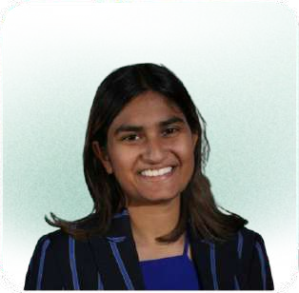


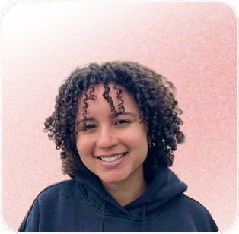
Team Members
Siya G she/her | Avey E she/her | Candace C she/her | Tyler A
CS (AI) + Econ ‘26 | Symsys ‘27 | Design ‘26 | Symsys ‘26
CS (HCI) ‘27 | CS (HCI) ‘27 | CS (HCI) ‘ 27 | CS (HCI) ‘27

Slide 3
Clarus
Create together, instantly
Clarus is a real-time collaboration platform that makes communication between founders and designers effortless. With an intuitive interface, structured comments and digest features, and multimodal feedback, it simplifies design collaboration for founders, enabling ideas to take shape instantly and visibly.

Slide 4
Problem and Solution
Problem
Founders feel like communicating with designers is a long, exhausting process—requiring extensive preparation, length meetings, and lots of waiting, reading, and revisions before seeing results.
Solution
Creating a platform that enables real-time collaboration between designers and founders—allowing founders to feel genuinely “heard” and to see visible progress unfold.

Slide 5



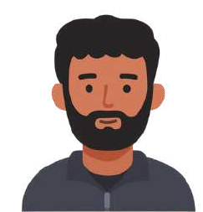





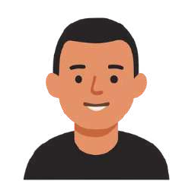
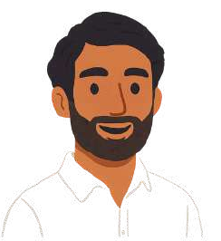

Our primary users are start-up founders
Startup founders who seek a faster, more intuitive and clear way to collaborate with designers
Specific Groups:
first time founders and early stage founders who have limited bandwidth

Slide 6
Clarus is about creating together.
We chose Clarus for several reasons
Clarus means clear in Latin, reﬂecting the app’s mission to bring clarity and transparency to the collaboration process.
The name aligns with our goal of making communication between founders and designers
instant, intuitive, and frustration free, cutting through noise and confusion.
It conveys a sense of focus and alignment, where every comment, visual, and decision contributes to a shared creative vision.
Overall, “Clarus” is clean, memorable, and purposeful—capturing the idea of creating together, clearly and instantly.

Slide 7
Value Proposition
Unlike typical design tools built for experts, Clarus stands out through its focus on communication first collaboration between founders and designers. While most tools prioritize design creation or accessibility, Clarus is built to bridge the communication gap by making collaboration fast, transparent, and human. Instead of struggling through lengthy meetings and scattered feedback, founders can instantly share ideas, give structured input, and see updates evolve in real time.
Sanity Check: Most design tools emphasize ideation and prototyping over collaboration clarity. This concept fills a unique niche because it tackles the conversation layer of design, not just the creation layer. The key difference is Clarus’s real-time feedback system with voice, video, and threaded comments, which enables founders to create together, instantly. No other platform centers communication as the core design experience, making Clarus a truly unique platform.

Slide 8

Market Research
CS 147

Slide 9
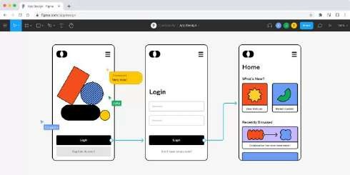
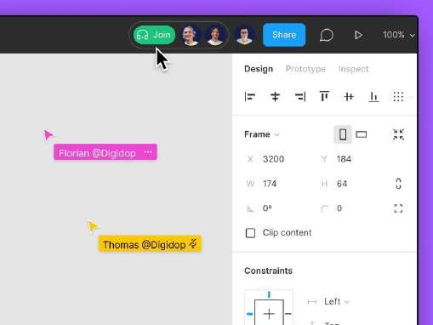
Figma
A collaborative interface-design tool that lets multiple designers co-create, prototype, and iterate in real time directly in the browser.
What Worked/Strengths
Allows multiple people to edit and comment on one mock design
Strong plugin ecosystem & design community
Easy to start, free tier attracts new users
Good retention among design teams
Browser-first means minimal friction for cross-OS users.
What Didn’t Work/Weaknesses
Hard for non-designers to navigate or comment
Overcrowded and too much traffic when too many collaborators join
Comments lack prioritization or filtering
Lack of richer communication modalities like video annotations
Large files can slow down scalability and performance

Slide 10
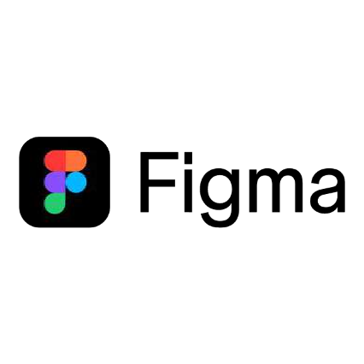
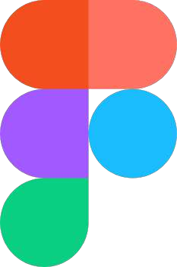
Figma
Implications on Our Solution
Build smarter comment management, threaded discussions, upvoting, and digest summaries for key feedback.
Enable multimodal communication with voice notes, video snippets, or quick sketches linked to specific features.
Design simple onboarding for non-designers, guiding founders on how to view and comment effectively.
Create role-based views so founders, designers, and developers each see what’s most relevant to them.
SIMILARITIES | KEY DIFFERENTIATOR
Like Figma, Clarus supports real-time collaboration, multiple people can co-edit, comment, and iterate on the same project. | Clarus focuses on communication-first design, adding voice/video comments and role-based views that Figma lacks.

Slide 11
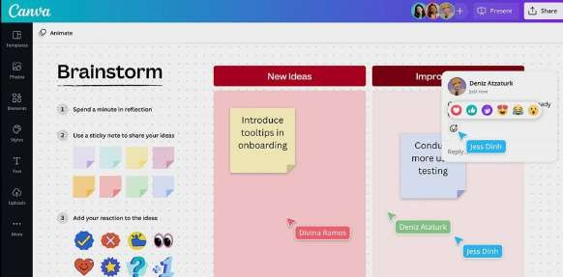
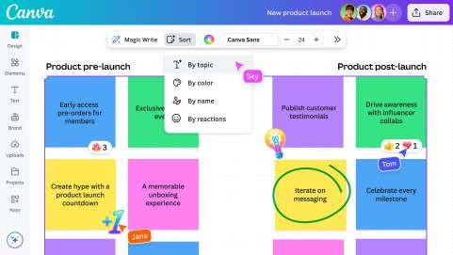
Canva
A simplified design platform that enables anyone to create professional-looking visuals, presentations, and marketing assets without design training.
What Worked/Strengths
Simple drag-and-drop interface for quick designs
Great for non-designers and marketing teams
Large library of templates and brand kits
Smooth real-time collaboration and sharing
Freemium model encourages broad adoption
What Didn’t Work/Weaknesses
Limited for complex or technical design projects
Commenting and feedback tools are basic.
Weak version control for multiple revisions.
Hard to manage detailed design discussions.
Lacks feature-level communication options.

Slide 12
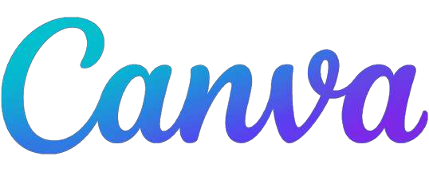
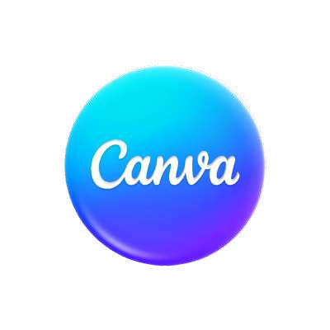
Canva
Implications on Our Solution
Combine Canva’s simplicity with deeper collaboration for product and design teams.
Build structured commenting tools that go beyond basic notes, threads, priorities, and summaries.
Introduce voice and video feedback so discussions feel more personal and less text-heavy.
Keep an intuitive interface that’s friendly for non-designers while supporting complex feedback.
Add clear review and approval ﬂows to manage multi-round
edits efficiently.
SIMILARITIES | KEY DIFFERENTIATOR
Like Canva, Clarus emphasizes simplicity and accessibility, making it easy for non-designers and founders to participate. | Clarus supports deeper collaboration between founders and designers, not just surface-level visual editing.

Slide 13
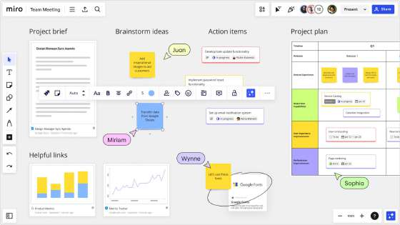
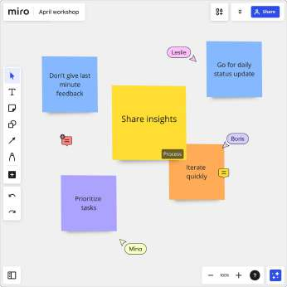
Miro
An online whiteboard and visual workspace that supports brainstorming, mapping, and team collaboration across projects and disciplines.
What Worked/Strengths
Great for brainstorming, mapping, and visual ideation
Flexible infinite canvas with sticky notes, shapes, and frames
TalkTrack enables asynchronous voice or video walkthroughs
Strong integrations with tools like Slack, Notion, and Jira
Ideal for remote teams and collaborative workshops
What Didn’t Work/Weaknesses
Becomes cluttered and hard to navigate with many collaborators
Lacks structure for detailed product or UI design
Feedback can get lost across large boards
Limited prioritization or organization for comments
No role-based filtering or targeted communication features

Slide 14


Miro
Implications on Our Solution
Introduce structured focus zones to prevent clutter and help teams stay organized.
Build clear feedback channels where comments are easy to find, group, and prioritize.
Add multimodal communication (voice notes, video walkthroughs) for async collaboration.
Provide role-based visibility so founders and designers can each focus on what matters most.
Keep the fiexibility of an open canvas, but layer it with clarity and structure for design-focused discussions.
SIMILARITIES | KEY DIFFERENTIATOR
Like Miro, Clarus values visual and asynchronous collaboration, allowing teams to share feedback and ideas across time zones and working styles. | Clarus ties feedback directly to specific design features, not general boards, giving structure to creative discussions.

Slide 15
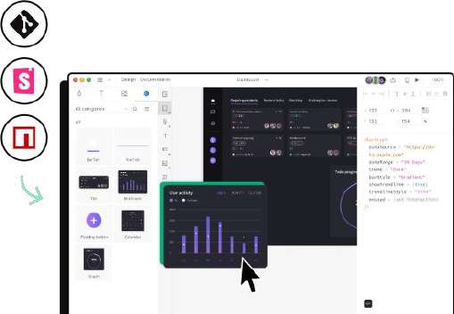
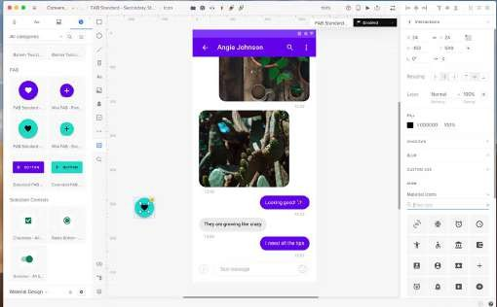
UXPin
A product design and prototyping tool that allows designers to create interactive, code-based prototypes using real data and logic.
What Worked/Strengths
Enables high-fidelity, interactive prototypes using real data and logic.
Strong design-to-development handoff features.
Supports component reuse and state management.
Allows designers to simulate real app behaviors, not just visuals.
Great for advanced product teams needing realism in prototypes.
What Didn’t Work/Weaknesses
Steep learning curve for new or non-technical users
Collaboration isn’t as fiuid as Figma or Canva
Smaller community and fewer integrations
Can feel too complex for early-stage teams or founders
Lacks multimodal or async feedback options (voice, video, digests)

Slide 16


UXPin
Implications on Our Solution
Keep realistic prototyping depth optional, accessible, not overwhelming.
Focus on simplicity and communication clarity over technical complexity.
Add interactive, voice-driven feedback loops for richer collaboration.
Ensure fast onboarding for founders with minimal design experience.
Bridge the gap between prototype and conversation, not just design and code.
SIMILARITIES | KEY DIFFERENTIATOR
Like UXPin, Clarus promotes high-context design discussions, connecting visuals and feedback closely to product development workﬂows. | Clarus prioritizes human communication (voice, video, digest summaries) over technical prototyping depth.

Slide 17
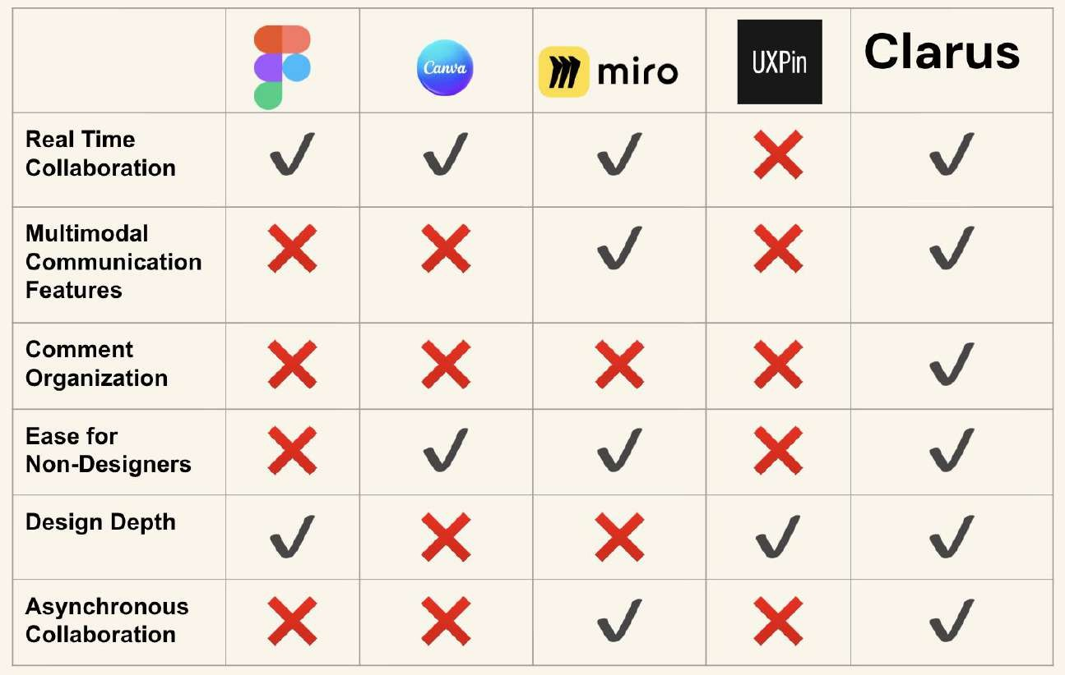

Slide 18
Values in Design
CS 147

Slide 19
Direct/Indirect Stakeholders
Direct Stakeholders
Founders who want to express their ideas to designers clearly, see project in real time, and give structured feedback. The goal of these founders is to decrease friction in communication and feel “heard” in the design outcome.
Indirect Stakeholders
Designers who co-create with founders will receive more clear feedback. Investors will gain more confidence through more rapid branding and design.
Customers will benefit from more better and smoothly designed products.

Slide 20
Values of Clarus
Clarity
Ensure every conversation, comment, and edit is easy to understand. Transform vague feedback into actionable insights and reduce miscommunication between founders and designers.
Transparency
Enable visibility into progress and decision-making so both founders and designers feel aligned. Real-time updates should make collaboration feel open and trustworthy.
Empathy
Design Clarus to adapt to how both founders and designers think and communicate. Whether visual or verbal, the platform should make each user feel understood and “heard.”
Efficiency
Rapid collaboration by removing unnecessary meetings and feedback loops. Every interaction should feel instant and purposeful and should enforce creation without sacrificing quality.
Co-Creation
Founders and designers should feel like they’re building together, not handing work off. Clarus should foster creativity, dialogue, and mutual understanding through interactive collaboration tools.

Slide 21
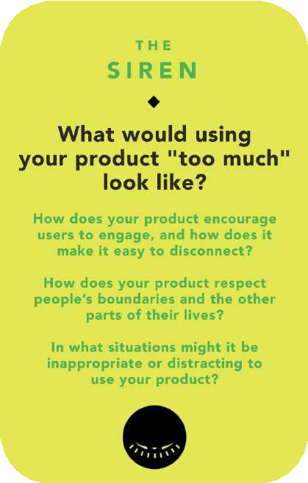
Ethical Implications
Users who consistently rely on real time communication may experience creative fatigue or pressure to respond instantly.
Continuous collaboration can blur work life boundaries, making designers or founders feel they must always be “online” to keep progress moving.
Clarus should encourage healthy collaboration with features like
focus breaks to help users disconnect.
Power dynamics between founders and designers could unintentionally infiuence communication fiow
Founders’ feedback might dominate conversations, limiting space for designers to share creative input and express themselves.
Clarus should promote balanced dialogue, with structured commenting, and shared ownership of design direction.

Slide 22
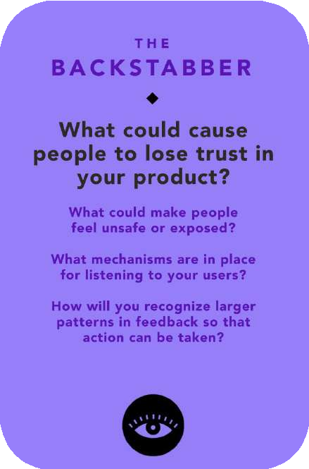
Ethical Implications
Users could lose trust in the platform if Clarus mishandles sensitive design conversations.
If private feedback or creative conversations are shared without consent then designers and founders may feel exposed.
Clarus should implement clear visibility controls and permissions,
ensuring users know who can access their designs and discussions.
If Clarus lacks transparency about how it uses feedback and user data, it could lose user trust.
Users may feel ignored or exploited if their input seems to disappear and is not acted upon.
Clarus should maintain open communication about how feedback informs updates and ensure ethical data practices that make users feel heard and respected.

Slide 23
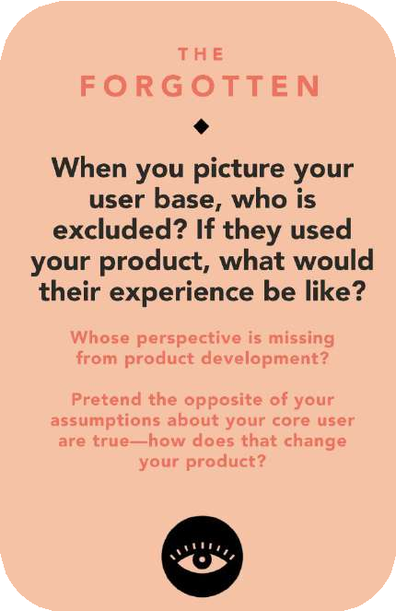
Ethical Implications
Accessibility for users with disabilities
Users with visual, auditory, or motor impairments may face barriers when giving or viewing feedback.
Clarus should include features like adjustable text sizes and captioned visuals and voice memos to ensure equitable participation.
Global collaboration barriers
Founders and designers from different regions may face
language or cultural gaps in communication.
Clarus should integrate translation tools and culturally sensitive design to support inclusive, cross-country teamwork.

Slide 24

Tasks
CS 147

Slide 25
Our tasks are divided into three categories
Simple
Communicate overall vision to designers in real time
Moderate
Giving feedback to designers about deliverables in real time
Complex
Founders and designers both co-create final design

Slide 26
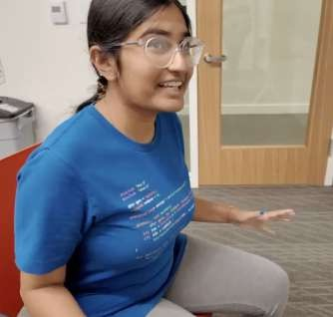

Simple Task
Communicate overall vision to designers in real time
Why?
This is a straightforward, high-level task that requires little effort from the founder
Communicating vision involves only one action: articulating the overall idea to the designer in real time
No need for additional planning, detailed edits, or back and forth communication—just expressing intent, making this task quick, natural, and easy for founders to do regularly
Time Stamp: 0:52-1:00

Slide 27
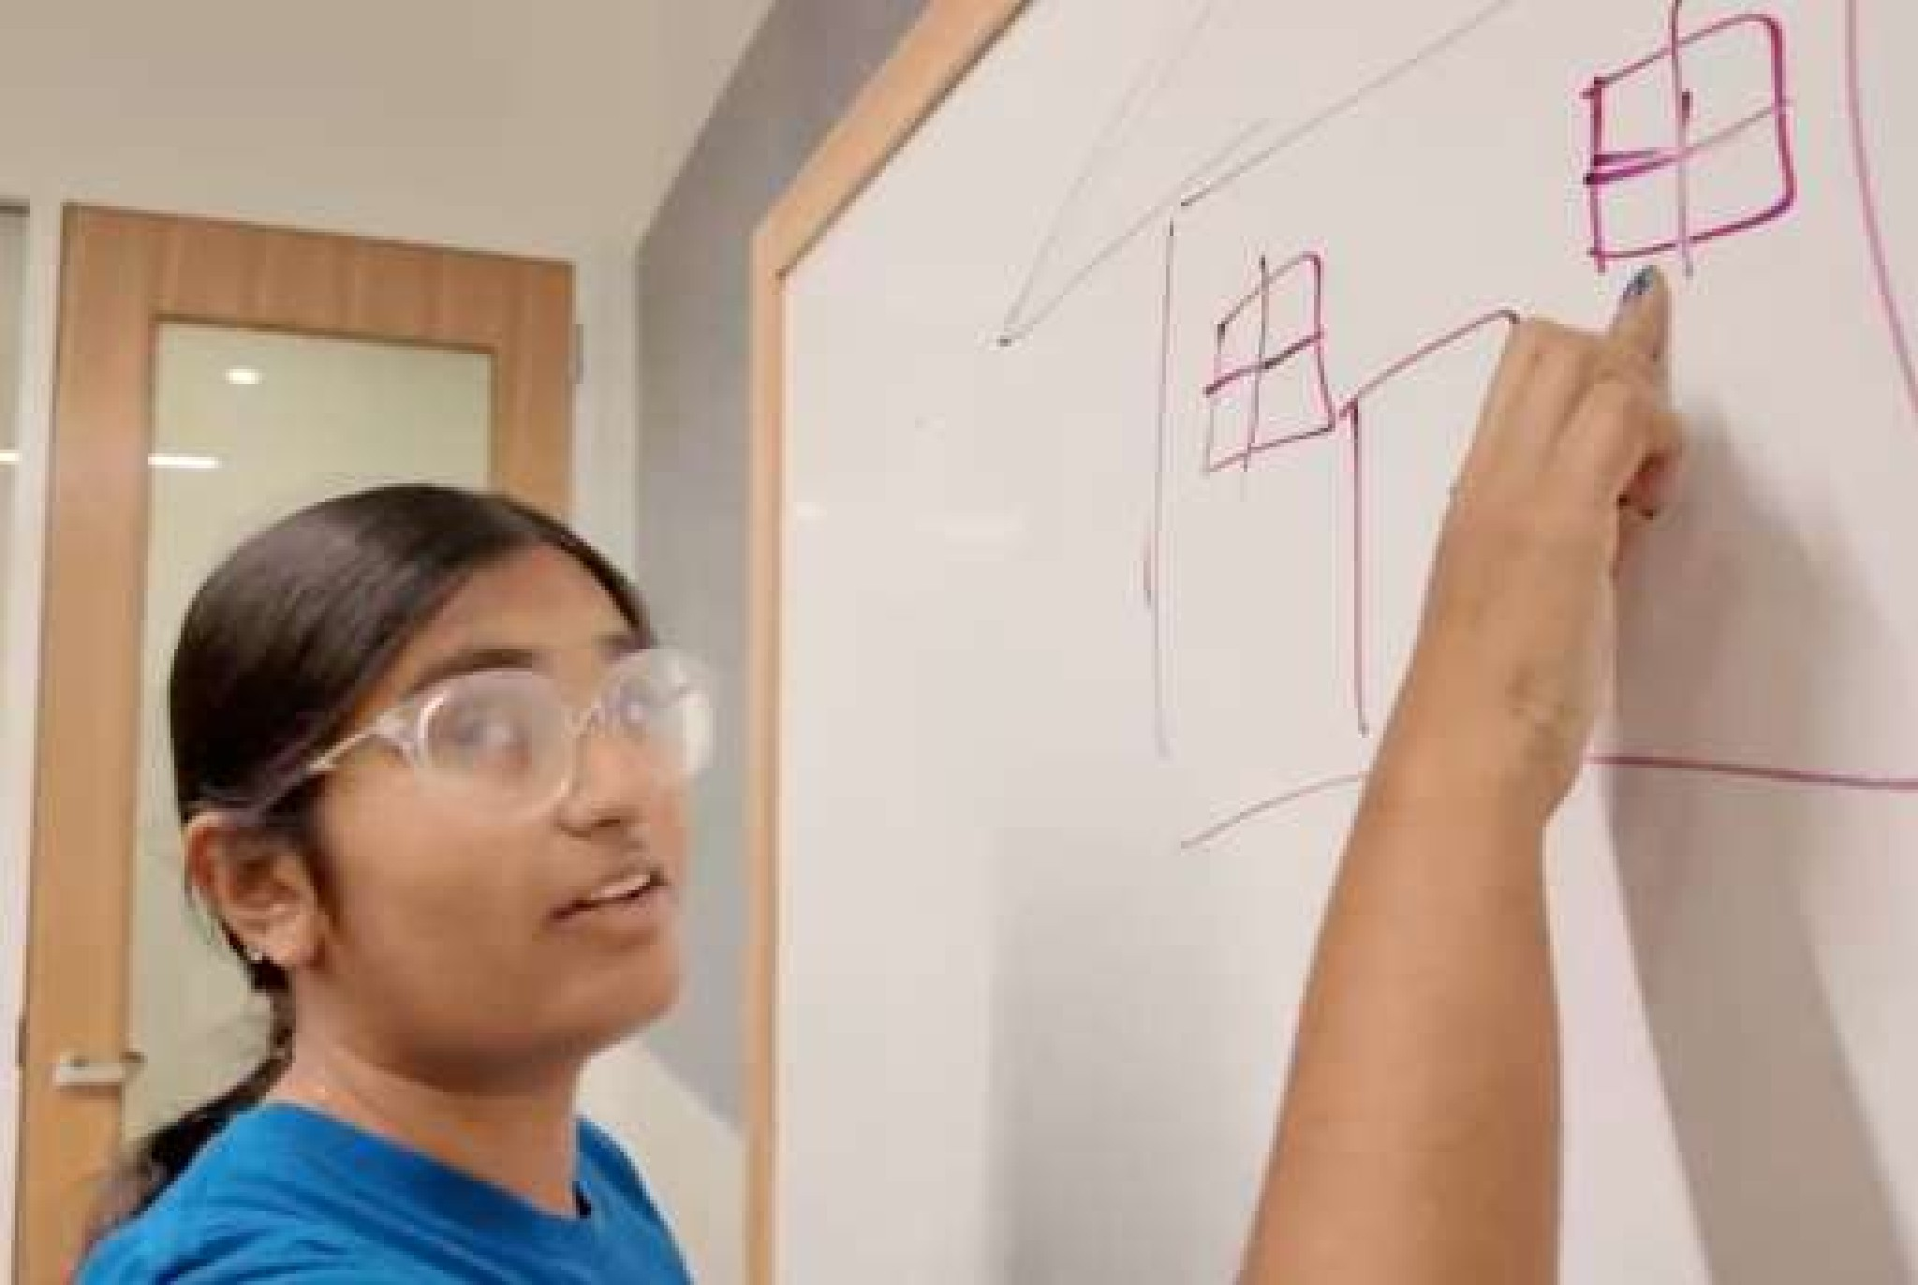
Moderate Task
Giving feedback to designers about deliverables in real time
Why?
Requires more thought as founders evaluate deliverables and share clear feedback
Involves multiple small decisions on what works, what doesn’t, and how to communicate changes
Real-time discussion adds focus, context switching, and quick judgment demands
Includes back-and-forth with designers to
clarify intent and refine ideas
Time Stamp: 1:00-1:12

Slide 28

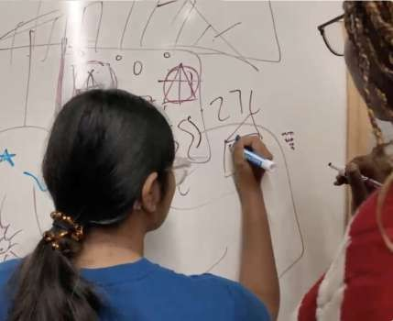
Complex Task
Founders and designers both co-create final design
Why?
Involves simultaneous collaboration where both founders and designers make creative and strategic decisions together
Requires aligning multiple perspectives, negotiating trade-offs, and iterating in real time
Demands higher coordination, communication, and shared tool use to co-create a cohesive final design
Time Stamp: 1:12-1:23

Slide 29
Storyboarding
CS 147

Slide 30
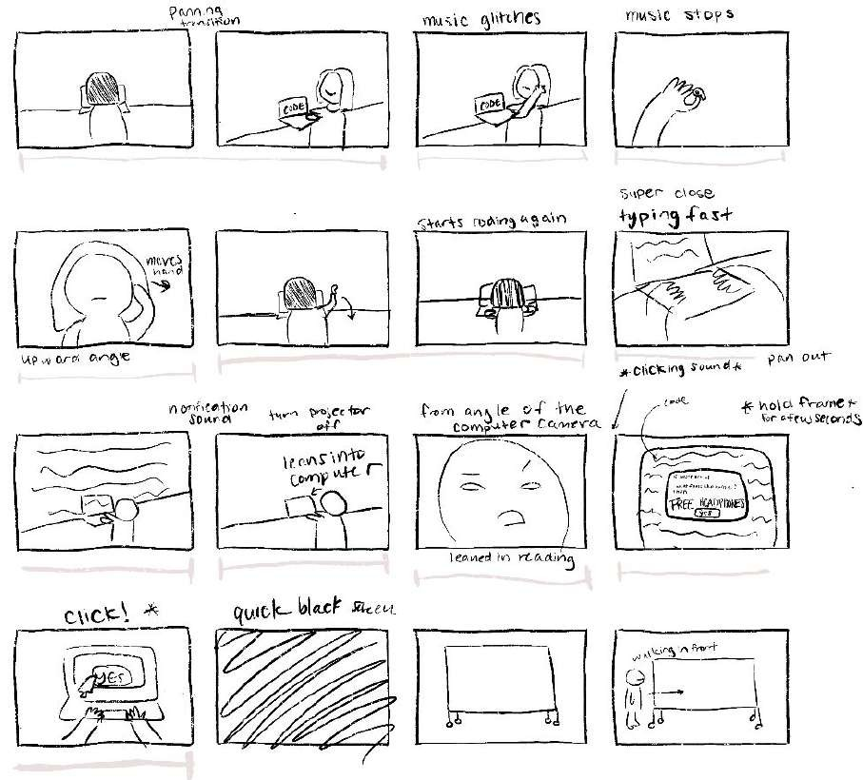
Things we wanted to express
Founder that is busy coding
Founder that needs to
complete a design task
What this shows about the problem
Founders are busy and have
many responsibilities
Often times they need to solve problems that don’t match their skillset

Slide 31
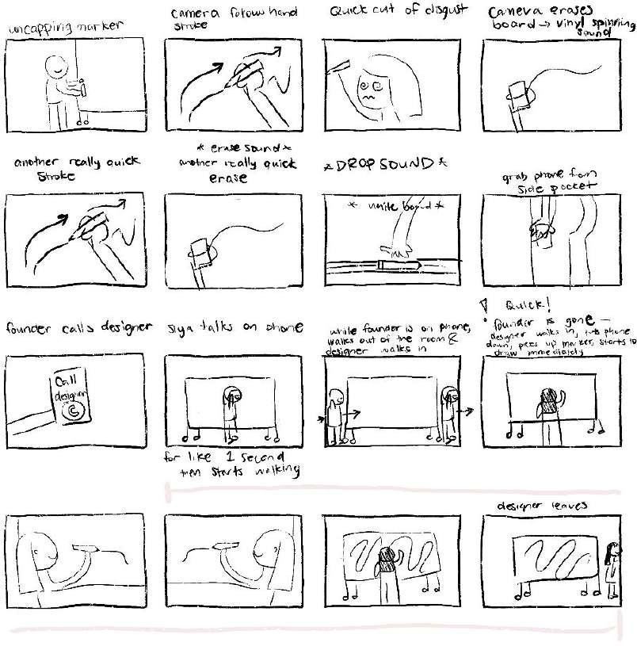
Things we wanted to express
Founder has trouble drawing and calls designer to help them out
Designer helps founder draw independently
What this shows about the problem
Founder gets frustrated with design related tasks
Lack of real time collaboration between the founder and designer

Slide 32
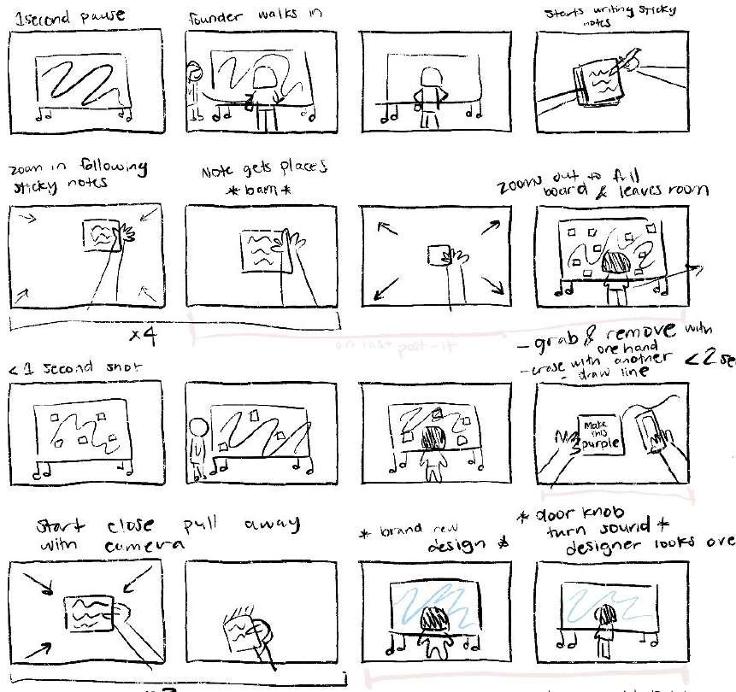
Things we wanted to express
Founder leaving feedback about aspects that they want to change
Designer implements the feedback the founder left
What this shows about the problem
Long iterative process between founder and designer to get to the final product
Emphasizing the disconnect between the founder and designer

Slide 33
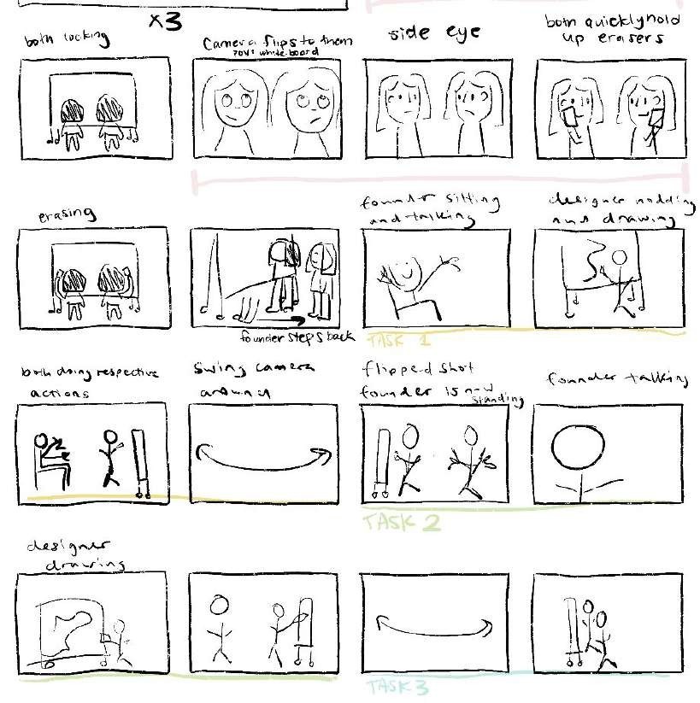
Things we wanted to express
Founder and designer are now in the room together and working
Task 1: Founder is telling vision in real time
Task 2: Founder is giving feedback in real time
What this shows about the solution
The solution has an ability to effectively facilitate instantaneous, clear communication
The process is much faster
than current solutions

Slide 34
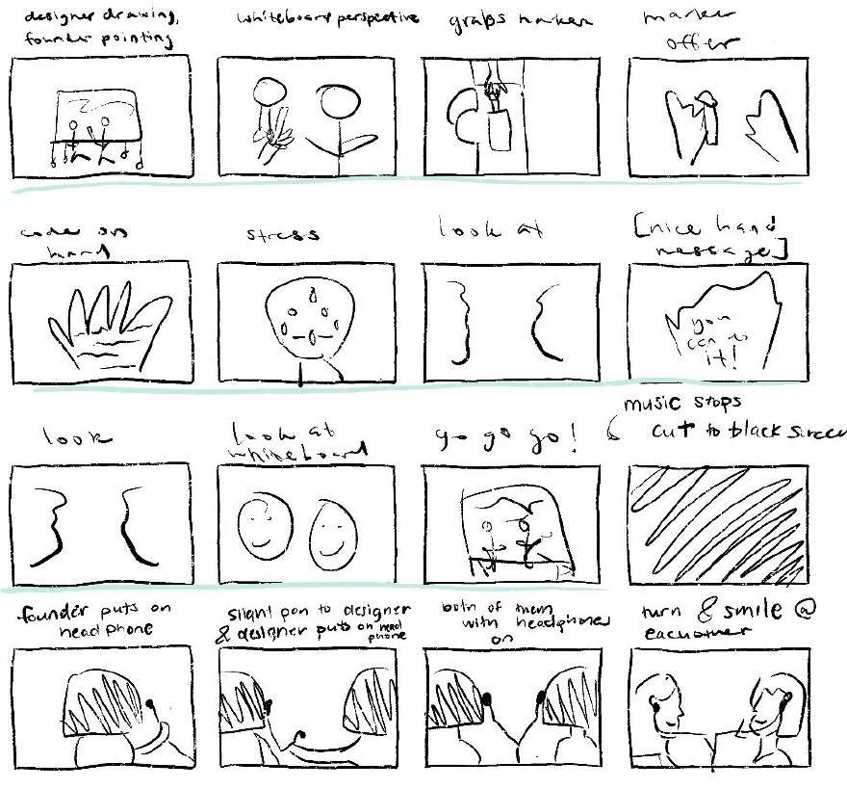
Things we wanted to express
Task 3: Founders and designers co-create in real time
The founder is nervous about designing
What this shows about the solution
The process helps establish effective co-creation and relationships between the founder and designer
Founders can help actively in design through this platform

Slide 35
Our Video
CS 147

Slide 36

Video

Slide 37
Appendix
CS 147

Slide 38
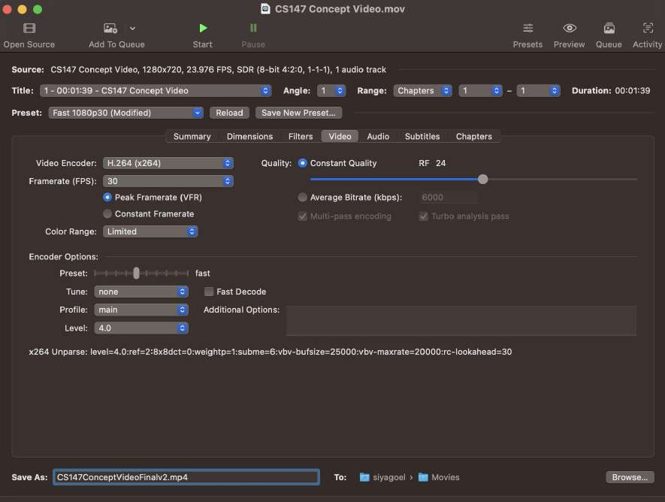
Handbrake

