Slide 1
CS 147
October 3rd, 2025
A5:
Low Fi Prototype
Avey Etaghene, Candace Cang, Siya Goel, Tyler Abernethy

Slide 2



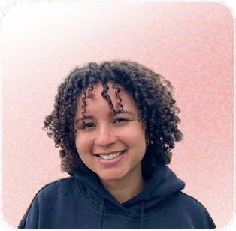
Team Members
Siya G she/her | Avey E she/her | Candace C she/her | Tyler A
CS (AI) + Econ ‘26 | Symsys ‘27 | Design ‘26 | Symsys ‘26
CS (HCI) ‘27 | CS (HCI) ‘27 | CS (HCI) ‘ 27 | CS (HCI) ‘27

Slide 3
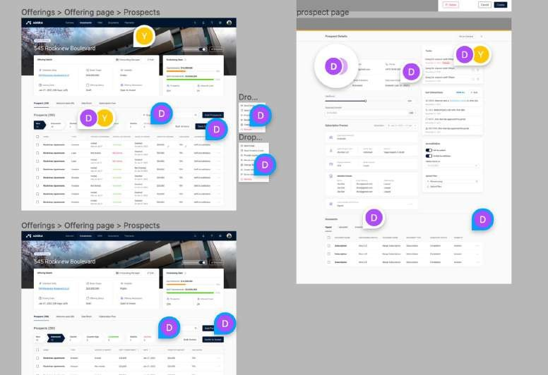
Communication in current design tools is disorganized
comment ﬂows in current tools are:
disorganized
text-based
not transferable to to-dos
overwhelming
lacking revision history

Slide 4



Our solution synthesizes and organizes information
our platform
empowers users with multi-modal communication
text voice video
Status quo
text-based disorganized
overwhelming
not transferable to to-dos
Clarus
multimodal: voice, video, and text support
filtered by role, modality, element, etc.
synthesized with AI
transformed into role-specific to-do lists
lacking revision history
digestible and accessible documentation of edits and comments

Slide 5
Value Proposition
Seamless, fiexible communication between founders and designers
Previous value prop “create together, instantly” was too broad and nonunique

Slide 6






Seamless, fiexible communication between founders and designers
Comments exist in isolation Feedback is fragmented
Status Quo
Our value add
Captures full context of feedback: tone, emotion, and detail.
Organized for realtime clarity and faster creative alignment

Slide 7
Seamless, fiexible communication between founders and designers
Status Quo
Simultaneous Editing
Optimize for doing
Optimize for understanding: foundation of effective work
Shared understanding, communication clarity
Our value add

Slide 8









Table of Contents
1. Concept Sketches
2. Key Screens
3. Task Flows
4. Prototype Construction
5. Testing Results
6. Implications

Slide 9


Sketching Explorations
CS 147

Slide 10

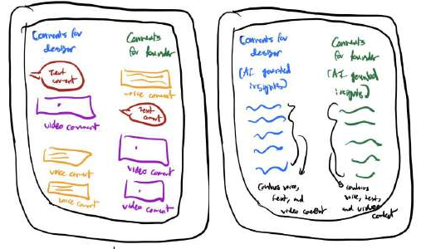
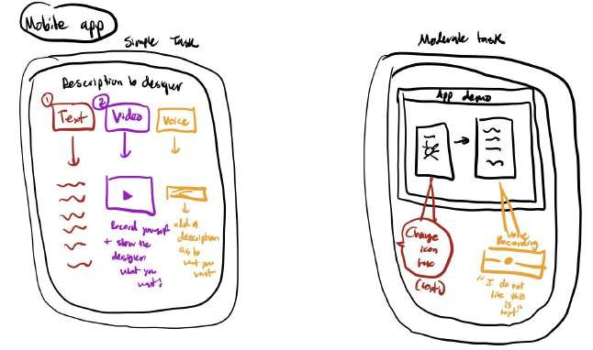
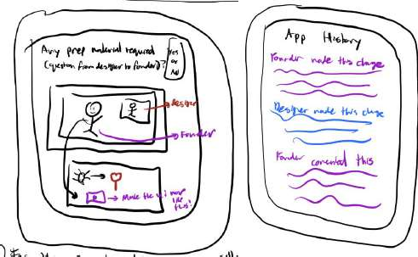
Concept 1 - Mobile App
Commenting and Documentation
Role and task based comment organization
AI-powered insight summaries of comments
Real time video calls, commenting, and editing
Multimodal feedback comments (video, audio/voice, and text)
Version history to see ownership

Slide 11

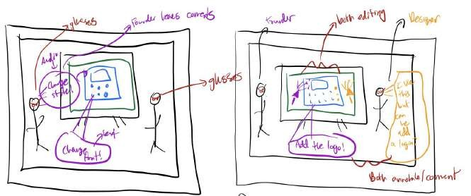
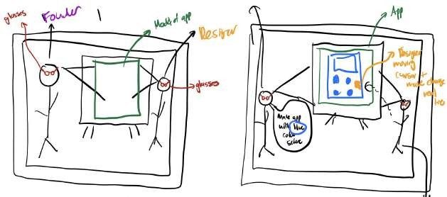
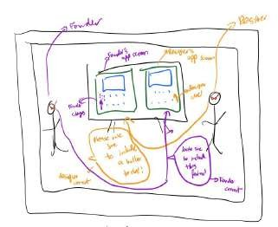
Concept 2 - VR App
Real time feedback and iteration through commenting
Supports editing by multiple users on the same screen
Collaborative real time design of the founder’s vision
Supports editing by multiple users on different screens

Slide 12
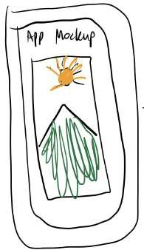
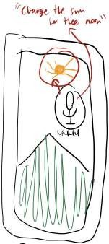
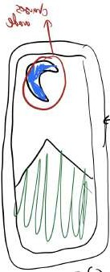


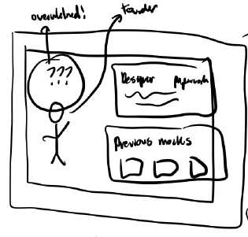
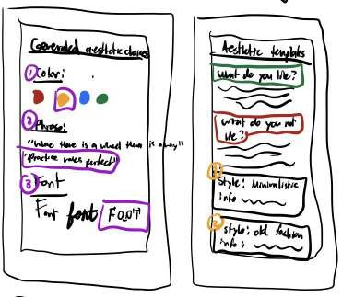
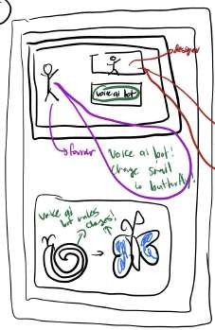
Concept 3 - Mobile App
Voice to Visual AI Solution
Voice AI for UI editing and iteration
AI driven design suggestions, component, and template generators based on past preferences
Real time voice AI for UI editing over calls

Slide 13
First Elimination: VR has low accessibility
We chose to continue with mobile solutions because of limitations with VR
Only 27% of US adults have used VR due to lack of accessibility
89% of VR apps cannot be used by those who have disabilities
Source: AR Insider, ACM

Slide 14
First Elimination: VR has high costs and complexity
We chose to continue with mobile solutions because of limitations with VR
$25,000 per user in industry settings for hardware, software, and support
Over 50% of users ﬁnd cost and setup complexity to be major practical obstacles
Source: Worldviz, G2

Slide 15
Mobile apps are more accessible
More than 78% of the global population
uses mobile apps.
Users in the United States access on average 39 different apps monthly.
Source: SQ Magazine, Tekrevol

Slide 16
Realization Explorations
CS 147

Slide 17
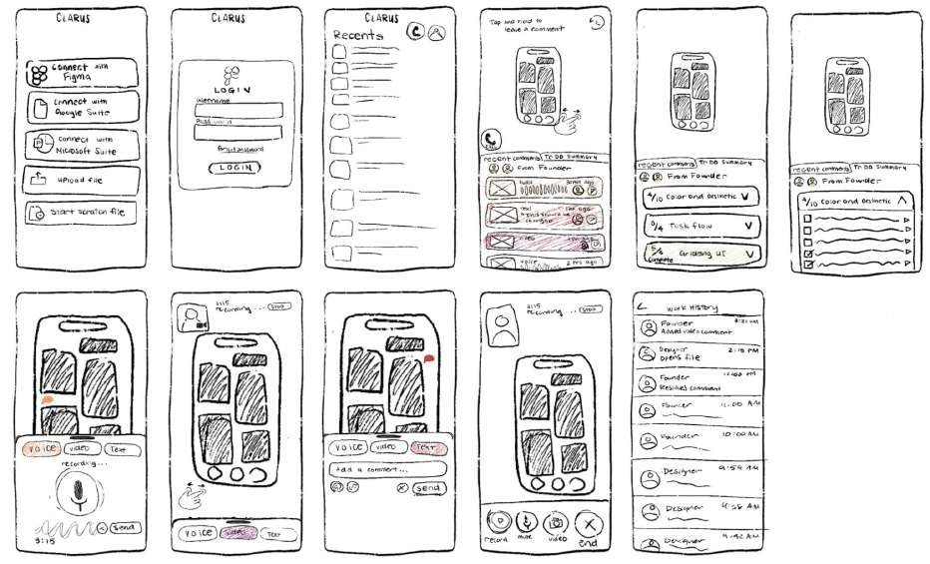

Key Screens 1
Commenting and Documentation
Add comments from 3 different modalities (audio, video, and text).
Get detailed insights into what major todos are and detailed tasks associated with each todo
Import many mock designs from plugins, upload a file, or start a file from scratch
Login and see your contacts
View version history to understand contributions and assign ownership based on who edited each section.
Record video and voice comments and leave text comments
Join realtime video call chats with designers

Slide 18
Pros and Cons
Commenting and Documentation
Pros
Cons
Synthesizes large volumes of feedback for efficient iteration
Privacy concerns regarding voice notes with sensitive information
AI is supplemental rather than essential to the design process
AI reliability is a concern when generating todos for users

Slide 19
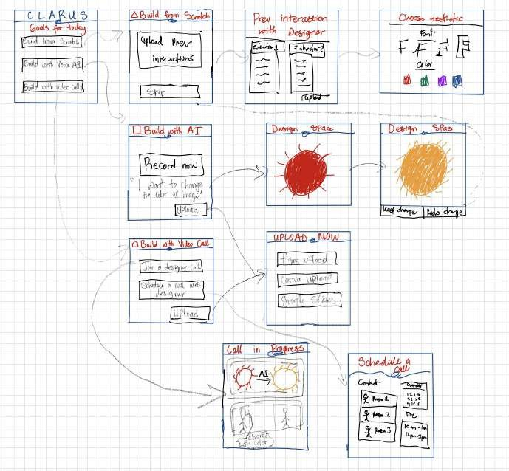
Key Screens 2
Voice to Visual AI Solution
Understand founders’ preferences based on previous interactions with designers
AI determines options for founders to choose from and form aesthetic
All three major tasks described in goals
Making a voice recording
AI making changes to interface based on voice recordings
Upload a file to talk about during meeting and/or annotate using voice AI
Voice AI makes changes in prototype based on discussions between founders and designer
Schedule calls with designers

Slide 20
Pros and Cons
Voice to Visual AI Solution
Pros
Better visualization through immediate changes
Shortens timeline of
iteration process
Cons
Over reliance on AI limiting creative expression
User education needed to learn how to use voice AI

Slide 21
Designers are scared they will be replaced with AI
Ethical Concerns: Perspectives of Designers on AI
62% exploration^{of designers} in^{expr}design^{ess concerns}SilklDigita( ^{tha}Kille, ^{t AI} r^{inhibits}tions)avInno ^{empathy and}
41%
of design professionals are at risk of being replaced with AI (Superside)

Slide 22
Founders do not want AI to do design work for them
Autonomy and Creativity: Perspectives from Founders on AI
From our interviews with founders:
“I don’t think design can be fully automated by AI
- I don’t want someone else choosing my clothes” Mike in A1
“Tools should not design for me but help me communicate with designers” Sam in A1
“AI makes boring and generic looking designs” Steven in A1

Slide 23
We Chose: Commenting and Documentation

Slide 24
Why Our Solution?
Different commenting modes give teams fiexibility in using their preferred mode of communication
text voice video
Motivating insight: “Even though I preferred certain modes of communication, all of them had their own pros and cons” Thomas from A2

Slide 25


Our approach keeps notes organized, synthesized, and easily retrievable
Why Our Solution?
centralized connected
Motivating insight: “Communicating on Slack about design is hard because there are too many channels and too many people” Samantha from A1

Slide 26
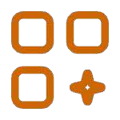
AI summarization helps translate feedback into action
Why Our Solution?
minimally invasive AI features
Motivating insight: “I am wasting a lot of time explaining technical details to designers
who don’t understand systems” Alex from A1

Slide 27
Key Task Flows
CS 147

Slide 28
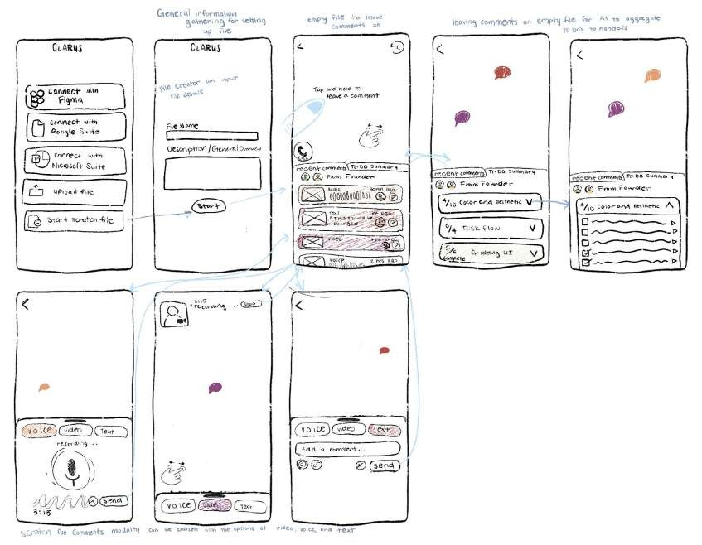
Simple Task
Design and leave comments on a scratch file

Slide 29
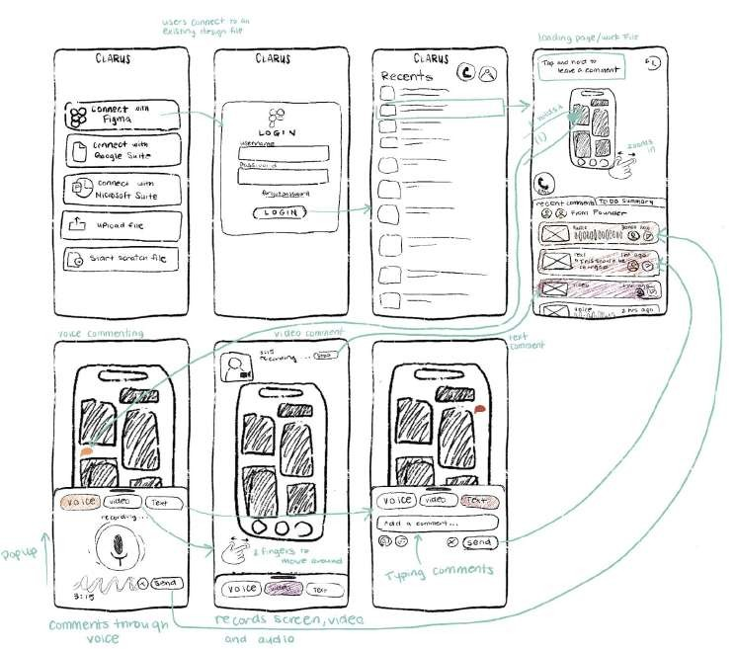
Simple Task
Leave asynchronous multimodal commenting on mockups

Slide 30
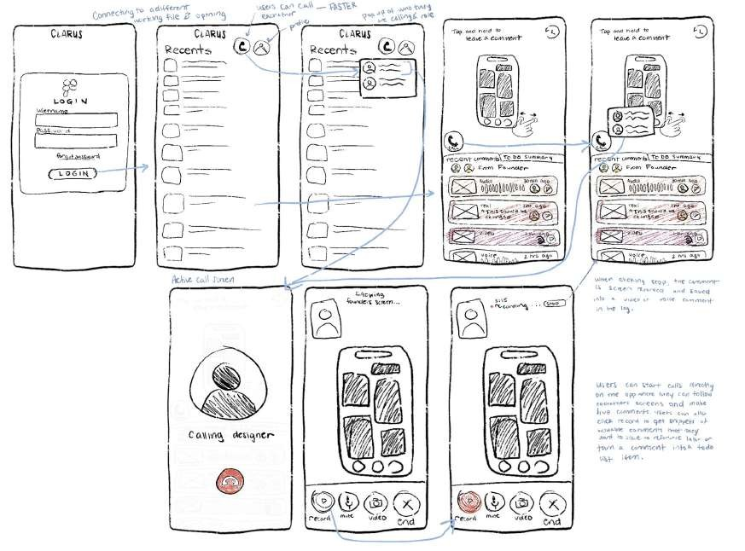
Moderate Task
Realtime calls with designers and live commenting using recordings

Slide 31
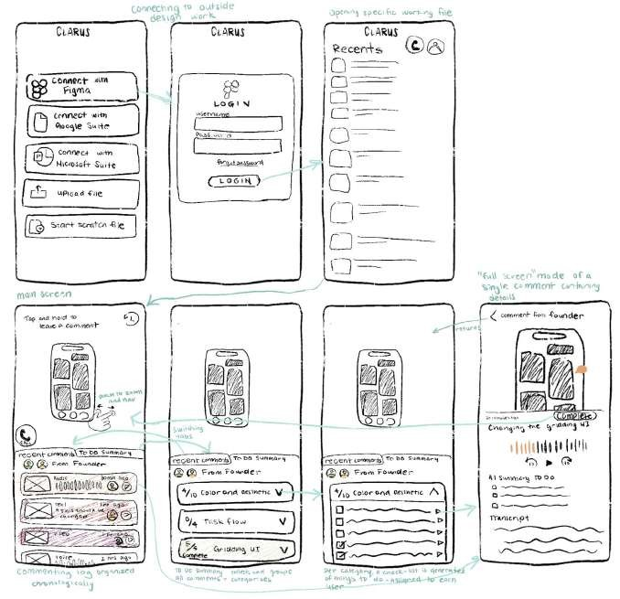
Complex Task
Use AI to generate todo categories and detailed checklists from comments

Slide 32
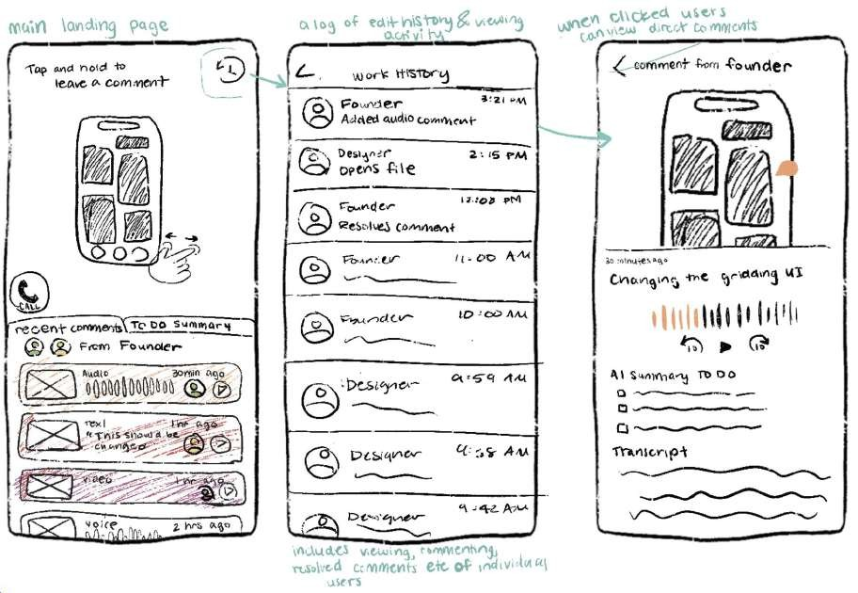
Complex Task
Check version history to see who owns what aspect of the mock up

Slide 33
Revising tasks by narrowing down to three tasks
Design and leave comments on a scratch file
Leave asynchronous multimodal commenting on mockups
Simple
Moderate
Realtime calls with designers and live commenting using recordings
Use AI to generate todo categories and detailed checklists from comments
Check version history to see who owns what aspect of the mock up
Complex

Slide 34
Revising tasks by narrowing down to three tasks
Design and leave comments on a scratch file
Leave asynchronous multimodal commenting on mockups
Choose one as both have a similar ﬂow
Leave asynchronous multimodal commenting on mockups
Simple
Realtime calls with designers and live commenting using recordings
Realtime calls with designers and live commenting using recordings
Moderate
Use AI to generate todo categories and detailed checklists from comments
Check version history to see who owns what aspect of the mock up
Combine into one task ﬂow
Use AI to generate todo categories from comments and view version history
Complex

Slide 35

Low-fi Prototype
CS 147

Slide 36
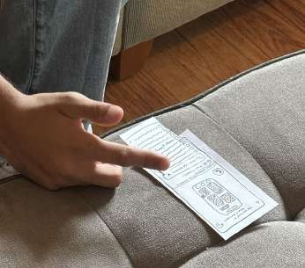
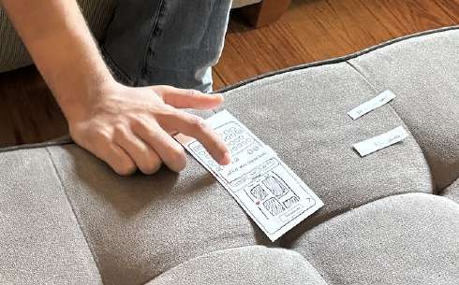
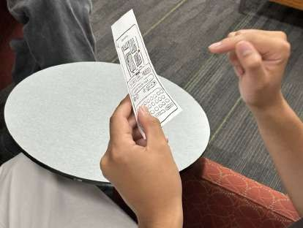
Overview
Environment
We tested the prototype in areas of Stanford campus where the participant preferred. Compensation was given by volunteering to be user tests and beta users for products.
Apparatus
We created a paper prototype that manually responded to actions. We switched paper prototypes in front of our participants and read from a script.

Slide 37
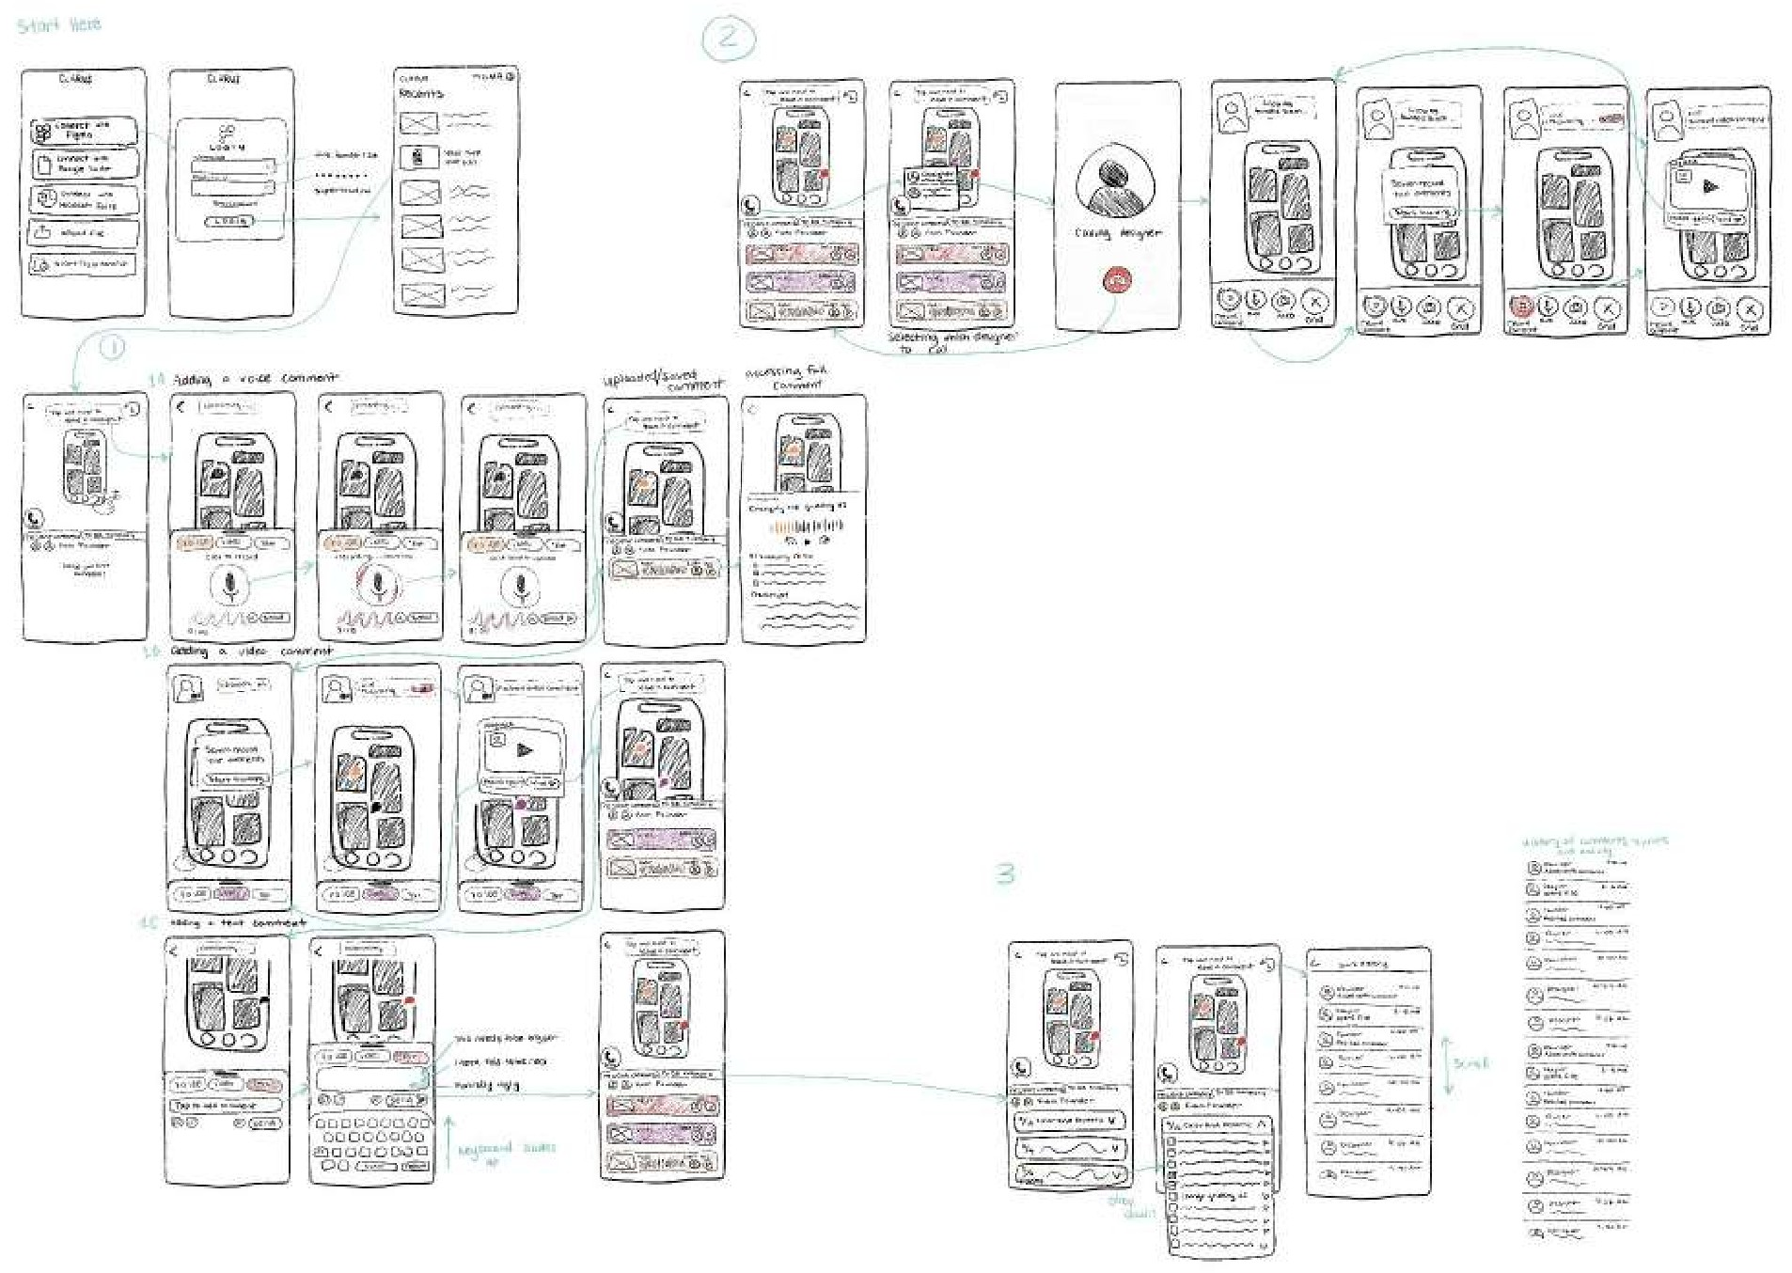
Construction: Features
Home: Login and view previous mocks
2. Moderate Task: Realtime calls with designers and live commenting using recordings
1. Simple Task: Leave asynchronous multimodal commenting on mockups
3. Complex Task: Use AI to generate todo categories from comments and view version history

Slide 38
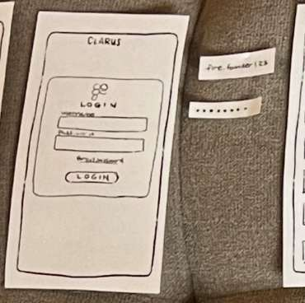
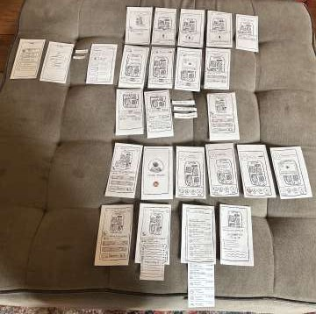
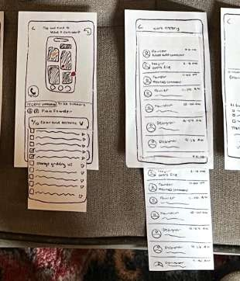
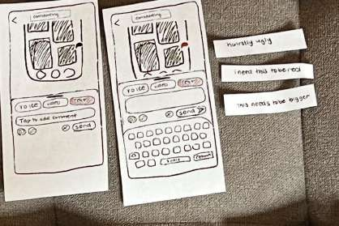
Construction: Interactions
login fiow: username and password fields
text inputs: typing comments
scrolling: sliding paper

Slide 39




Procedure
Facilitator: Siya
Computer: Candace
Notetaker: Tyler
Documenter: Avey

Slide 40









Participants were recruited for their diversity
Sawyer
College Dropout Nontechnical Media Tech + YC
Pre Seed Startup (1-10 people)
Andrew
New Grad Technical HRTech + YC
Series A (20+ people)
Paul
Stanford Student Technical
Dev Tool + YC Seed Startup (1-10 people)
Sally
2 years of tech experience Technical
Medtech
Seed Startup (10-20 people)
Jim
Professor at Stanford Technical
Consumer
Pre Seed Startup (10-20 people)
Through our recruitment, we captured diversity in
technicality
experiences
startup funding
type of startup
team size
ethnicity

Slide 41
Goals and metrics were chosen to identify pain points
User Satisfaction
Average of relevance (1-10) and ease of use (1-10) for each task
Navigation Accuracy
Task Efficiency
Time taken to complete each task
Number of misclicks per task
Why these metrics?
Captures how pleasantly, accurately, and quickly users can complete tasks using design
Measures core dimensions of usability (satisfaction, effectiveness, and efficiency) helping us identify pain points before high fidelity

Slide 42

Testing Results
CS 147

Slide 43
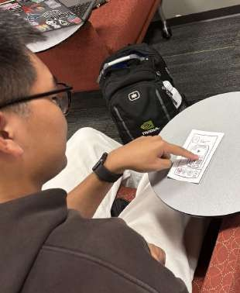
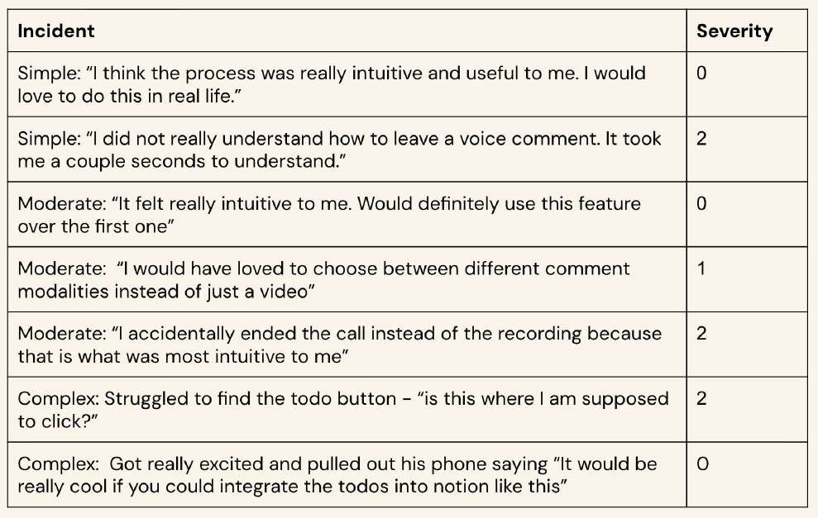

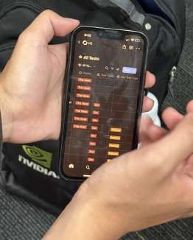
Sawyer wants the todos to be integrated into Notion

Slide 44


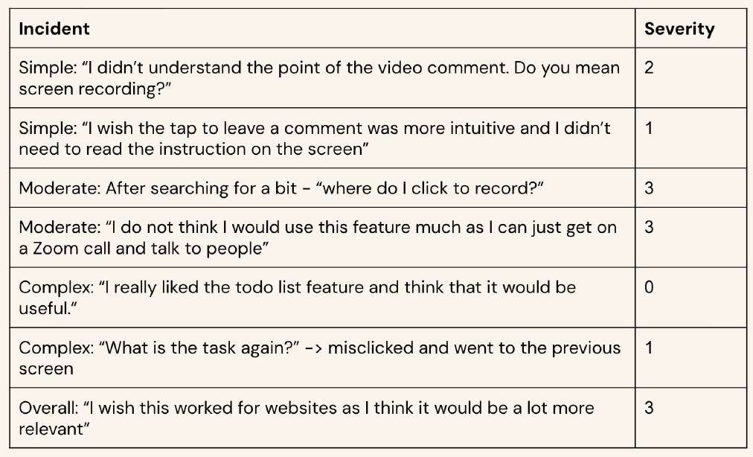

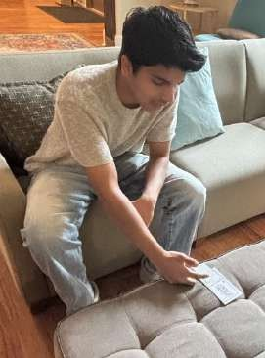
Paul wishes the tasks had more instruction

Slide 45
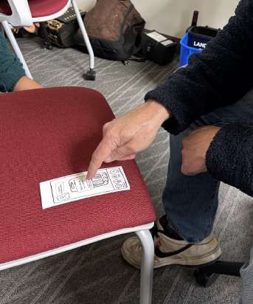
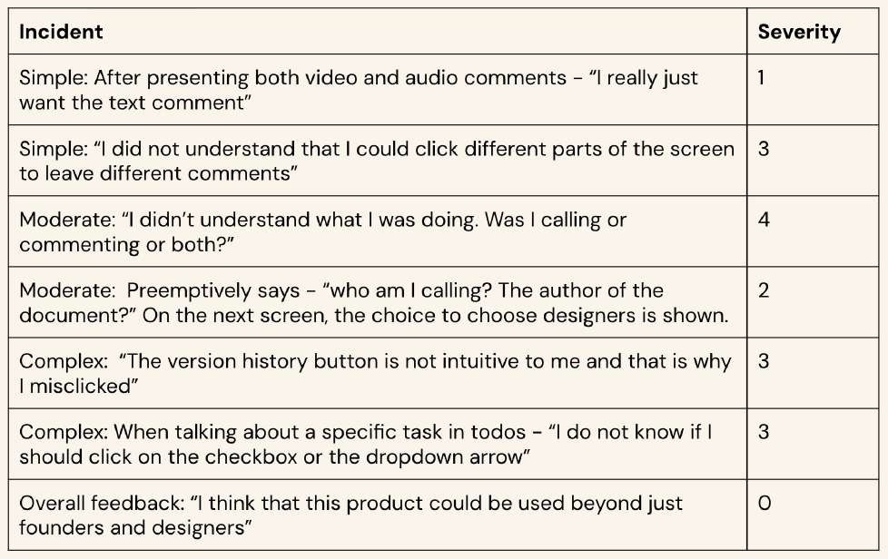
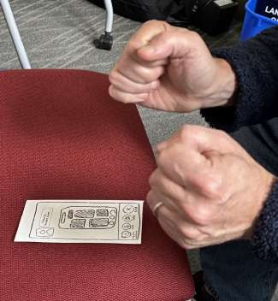
Jim thinks moderate task and buttons are unintuitive

Slide 46

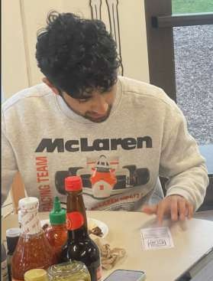
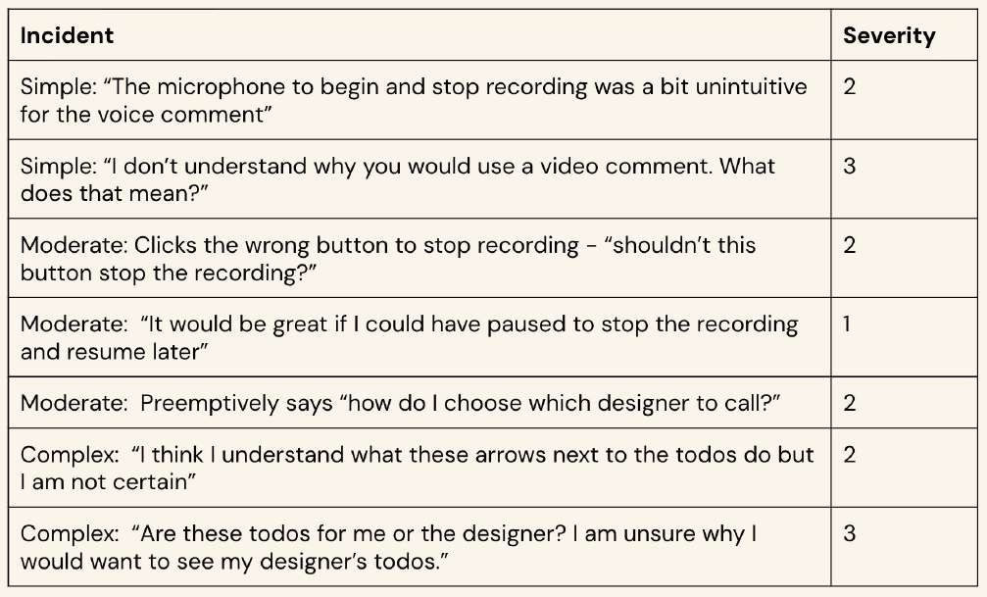
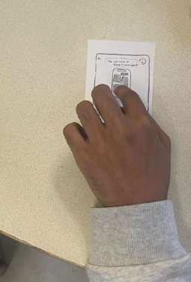
Andrew wishes recording was more intuitive

Slide 47
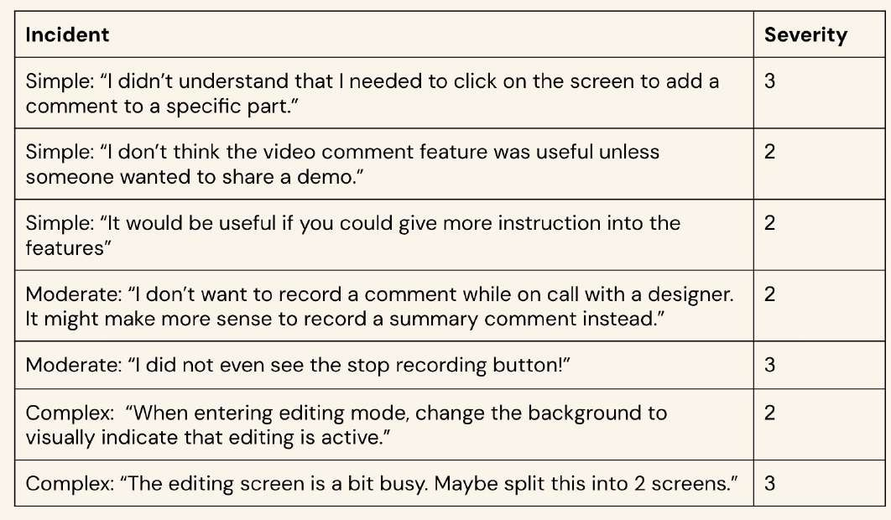
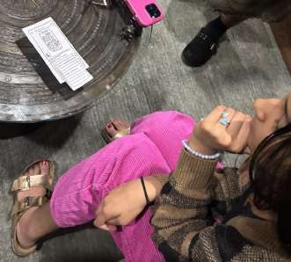

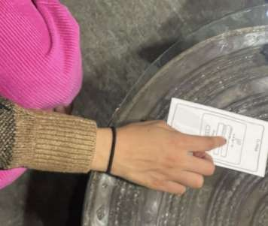
Sally found aspects unclear and cluttered

Slide 48
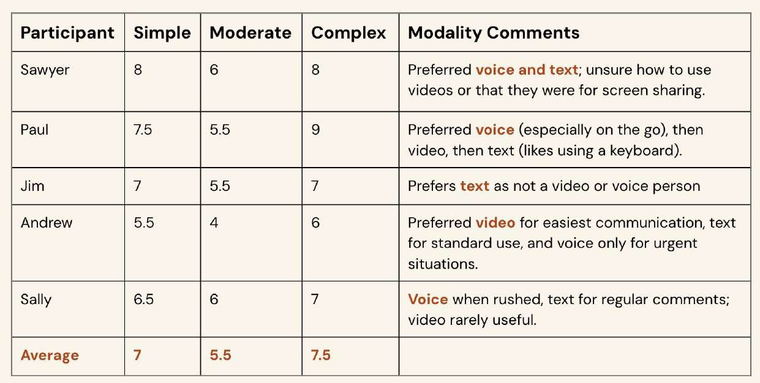
Different modalities are preferred by different people
User Satisfaction - average rank of relevance and ease of use

Slide 49
Usability Goal: User Satisfaction
Insights
Participants’ modality preferences varied
Moderate task had the least satisfaction
The complex task scored slightly higher than simple because of higher relevance
Relevance would increase if product was a
web app
Moderate task “had the “least intuitive ﬂow” - Andrew
“AI summary is very useful” - Paul
Users were fairly satisfied with simple and complex tasks but less so with the moderate one
Overall conclusion:

Slide 50
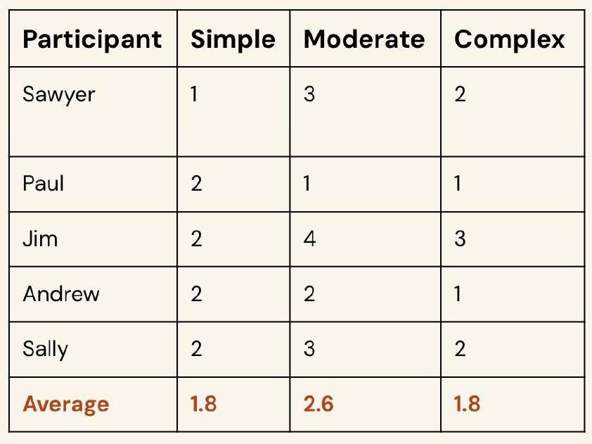
Moderate task had the lowest navigation accuracy
Navigation Accuracy - number of misclicks per task

Slide 51
Usability Goal: Navigation Accuracy
Insights
Usability varied across users
Simple and complex tasks had fewer misclicks
The moderate task had the lowest navigation accuracy
“The simple task was a straightforward process”
- Sawyer
On moderate task: “I do not think this is a very intuitive or useful task” - Jim
All tasks showed high navigation accuracy, though the moderate task had the most misclicks.
Overall conclusion:

Slide 52
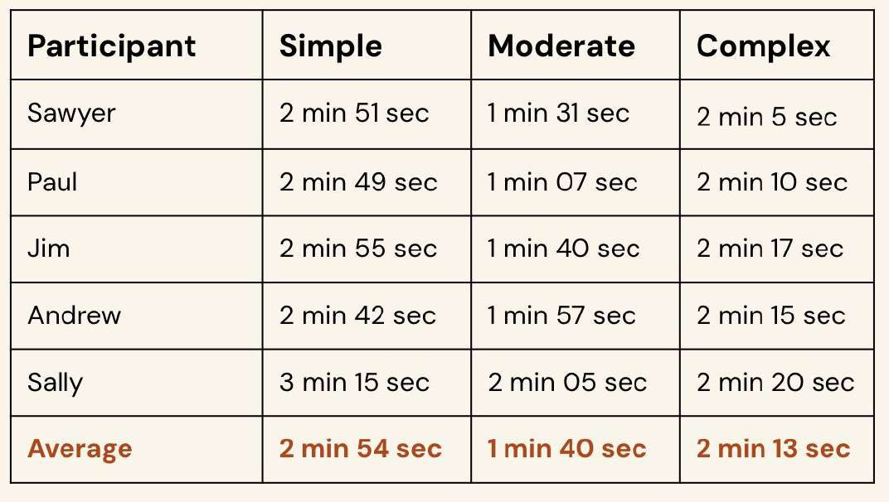
Task efficiency varies with screen count and feedback
Task Efficiency - time taken to complete each task

Slide 53
Usability Goal: Task Efficiency
Insights
Users took similar times to complete the task
Simple task took the longest: involved the most screens
Moderate task took the least time despite more misclicks and lower satisfaction: involved fewer screens
Complex task took a long time despite the low number of screens
  Useful feedback delayed time, potentially skewing results
Ranking by speed: 1. Moderate
Complex
Simple
Overall conclusion:

Slide 54
Successes
Task Execution
User Satisfaction
Qualitative Reports
70% on simple task 75% on complex task
Testers were interested in our solution and suggested ways to add features.
Everyone completed the tasks with little to no assistance

Slide 55




Pain Points
Simple Task
Participants wished commenting instructions were a bit more clear and intuitive
Moderate Task
Unintuitive to record AND leave a comment of the call during the call
Complex Task
Participants struggled to locate buttons and thought some of the icons were confusing
“I didn’t realize I could comment on different parts of the mockup UI”
vs
Confusing UIs and icons

Slide 56
Discussion
CS 147

Slide 57
Implications
Simplify interactions
Users struggled with mixed commenting and video calling ﬂows. Future designs should greater distinct editing and commenting features.
Clarify key terminology
Wording for functions isn’t obvious, suggesting the need for more explicit language to reduce user confusion.
Improving affordance
Icons and button placements were unclear in calling features, indicating more intuitive visual cues to prompt intended action.

Slide 58
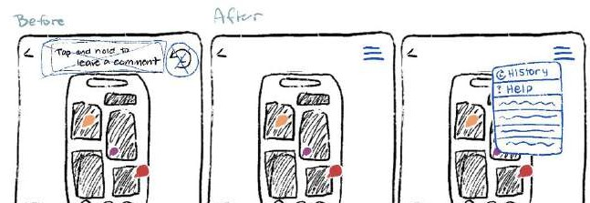
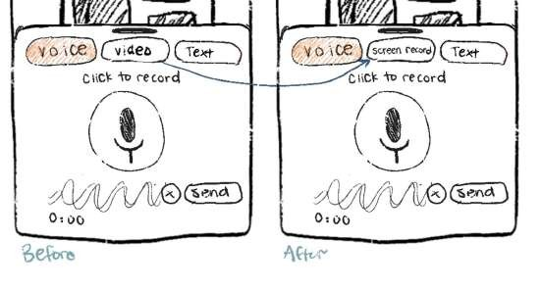
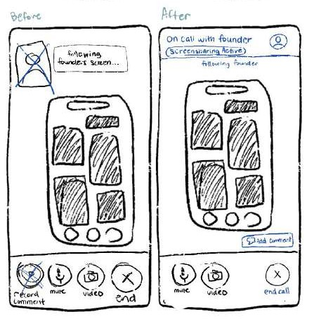
Design Changes
Decluttering: Creating menus for extra features (how-to, activity history, etc)
Renaming “video” to “screen recording” - less emphasis on showing face, more on showing designs
Calling: Adding commenting features as a button while on active calls

Slide 59



Design Changes
Clearer calling fiow: Introducing calling features earlier
Removing arrows and making clearer clickable UI
Commenting vs Editing modes: Greater distinction of comment/edit tasks

Slide 60
What couldn’t testing reveal?
Metrics for user depth
User satisfaction is subjective and doesn’t reveal the whys behind frustrations
Navigation accuracy only counts misclicks but not signs of confusion
Task efficiency may not be the best as time may be spent understanding features and explaining thoughts
AI and real application
Can’t test the reliability of AI features like todo generation and comment analysis
Features like screen recording, voice notes, or video comments can’t be tested for usability or clarity
It can’t simulate live video calls or real-time commenting, so user reactions can’t be evaluated

Slide 61
Appendix
CS 147

Slide 62
Problem and Solution
Solution
Current design tools lack effective communication—when many collaborators work simultaneously, it often leads to clutter and information overload for both designers and founders. Our solution uses AI-driven organization and multimodal feedback systems to reduce overload and streamline collaboration.
Problem
Founders feel like communicating with designers is a long, exhausting process—requiring extensive preparation, length meetings, and lots of waiting, reading, and revisions before seeing results.

Slide 63
Value Proposition
Seamless, fiexible communication between founders and designers
Captures full context of feedback — tone, emotion, and detail.
Takes feedback from fragmented to organized for realtime clarity and faster creative alignment.
Founders can share ideas naturally while designers receive structured, actionable input
without long meetings.
Sanity Check:
Clarus moves beyond simultaneous editing to emphasize shared understanding and communication clarity.
Where other tools optimize for doing, Clarus optimizes for understanding — the foundation of creating together effectively.
Previous value prop “create together, instantly” was too broad and nonunique

Slide 64
Rationale
We chose to continue with mobile solutions because of limitations with VR
Low accessibility
  Only 27% of US adult have used VR due to lack of accessibility (AR Insider)
  89% of VR apps can not be used by those who have disabilities (ACM)
High costs and complexity
  $25,000 per user in industry settings for hardware, software, and support (Worldviz)
  Over 50% of users ﬁnd cost and setup complexity to be major practical obstacles
(G2)
Mobile apps are a lot more accessible as more than 78% of the global population uses mobile apps. In fact, users in the United States access on average 39 different apps monthly. (SQ Magazine, Tekrevol)

Slide 65
Pros and Cons
Commenting and Documentation
Pros:
Cons:
gives options for communication methods: from experience prototypes, each communication modality has pros and cons
synthesizes large volume of feedback for efficient iteration → in interviews, founders mentioned that aggregating feedback was overly time consuming
documents revision history and user roles → from an ethics perspective, credits users for their work and provides transparency and ability to review the design process
communication is central to the user experience → founders mentioned in interviews that status quo communication paradigms were insufficient
AI is supplemental rather than essential to the design process
→ gives designers and founders more autonomy and AI integration is optional depending on organizational perspectives on AI usage
more naturally geared towards our feedback task, rather than generation and collaborative design
not embedded within a design platform → could cause friction in the integration ﬂow
Slower Creative Flow – Heavy focus on documentation may interrupt fast-paced design iteration or discourage spontaneous creativity.
Privacy concerns - voice notes may contain sensitive design and business information. Clear policies are essential
Need to make sure AI is reliable to make necessary changes accurately and create priority todo lists

Slide 66
Pros and Cons
Voice to Visual AI Solution
Pros:
Cons:
tries to accomplish too much, could lead to subpar outputs for everything
overreliance on AI → takes away autonomy, many founders thought AI was not creative enough for visuals
AI implementation is not too feasible → would have to hardcode most of the user experience
immediate changes and creation, better sense of visualization than traditional verbal feedback to visual edits paradigm
shortens timeline of iteration process, saving founders’ time
communicate founder aesthetic preferences to designers → from interviews, founders are struggling to communicate this
Goes beyond basic templates - many design tools in the status quo stick to templates and do not go beyond app. This idea really dives deep into aesthetic and iterative changes to revolutionize this area
AI has access to most design related communication → could cause privacy issues with sensitive business info
Lots of user education needed to learn about how to use voice ai and the app
Loss of designer autonomy - designers may not approve of changes AI is making
Ai may rely on making edits based on ﬂow of voice instead of synthesizing changes → from experience prototype, founder’s train of thought affected order in which things were drawn and priotizied

Slide 67
Constraints of AI
Voice to Visual AI relies on AI for all aspects of the app. This is not a desirable characteristic for designers and founders.
Data about designers and AI
  62% of designers say that designers express concerns that AI inhibits empathy and exploration in design (Digital Silk, Killer Innovations)
  41% of design professionals are at risk in being replaced with AI (Superside)
Findings from interviews with founders
  “Tools should not design for me but help me communicate with designers” Sam in A1
  “I don’t think design can be fully automated by AI - I don’t want someone else choosing my clothes” Mike in A1
  “AI makes boring and generic looking designs” Steven in A1

Slide 68
Why Our Solution?
We chose voice, video, and text commenting to keep feedback personal and clear. Real collaboration requires tone, emotion, and context—not just quick AI-generated notes.
These formats help teammates explain ideas naturally and avoid miscommunication.
While AI speeds up feedback, it often feels detached. Our approach keeps people involved, making feedback feel like a conversation rather than a transaction: human, thoughtful, and connected.
Insights from interviewees
  “I am wasting a lot of time explaining technical details to designers who don’t understand systems” Alex from A1
  “Communicating on Slack about design is hard because there are too many channels and too many people” Samantha from A1
  “Even though I preferred certain modes of communication, all of them had their own pros and cons” Thomas from A2

Slide 69
Observations
Observations from Paul:
Observations from Sawyer:
In simple task, the participant overall enjoyed the process but got a bit stuck in video commenting.
In moderate task, the participant enjoyed the task. Would have liked to commented using different modalities.
In complex task, struggled to find the todo button. Enjoyed the task and requested a feature integration with notion to help with organization
In simple task, the participant did not understand the video comment functionality and thinks it should be rephrased as “screen recording”
In moderate task, the participant thought the fiow was not that intuitive and needed an onboarding fiow.
  Thought it made sense as a whole
The user got excited when using complex task, talking out loud more and voicing opinions on how they would use this feature
The participant wished the product was a website

Slide 70
Observations
Observations from Jim:
In simple task, the participant did not understand they could leave comments on different parts of the screens
In moderate task, the participant did not understand the design fiow at all. They could not tell if they were in the call and/or leaving a comment
In complex task, some buttons were not as intuitive (like to dos and version history)
The participant voiced his thoughts throughout all tasks
Observations from Andrew:
In simple task, the participant did not understand how to begin and stop the recording of the voice comment
In moderate task, didn’t understand how to stop the recording and would have liked an addition of a pause button.
In complex task, didn’t think some of the icons in the todos were intuitive (like the drop down).
In moderate task, didn’t know why he was looking at the designer’s todos.

Slide 71
Observations
Observations from Sally:
In simple task, the participant thought the majority of tasks needed more description and instruction
In moderate task, the participant did not understand why you would record a comment on a video call.
In complex task, the participant thought the editing mode was a bit unclear and had clutter

Slide 72
Sketching Pictures
Crazy 8s
Concept Sketches Key Screens Storyboarding
Low Fi Prototype Images

Slide 73
Testing Documents
Testing Procedures
Pictures of Participants During Testing Testing Notes
Logs were included in the presentation!

Slide 74
Other Deliverables
Sketching Report
Consent Forms Brainstorming Document

Slide 75

Moodboard

