Slide 1

CS 147
October 3rd, 2025
A6: Med Fi Prototype
Clarus
Seamless, fiexible communication between founders and designers
Avey Etaghene, Candace Cang, Siya Goel, Tyler Abernethy

Slide 2
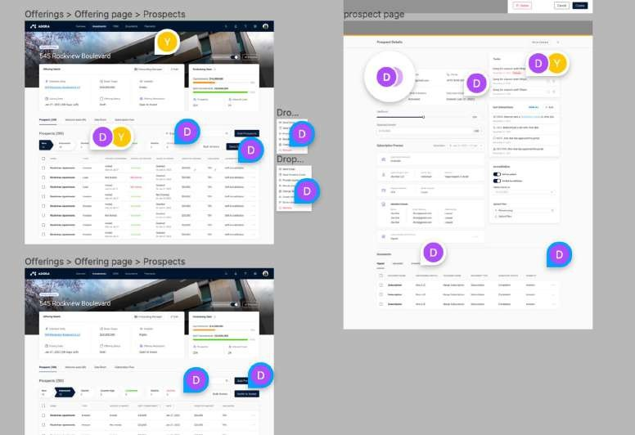
Communication in current design tools is disorganized
comment ﬂows in current tools are:
disorganized
text-based
not transferable to to-dos
overwhelming
lacking revision history

Slide 3



Our solution synthesizes and organizes information
our platform
empowers users with multi-modal communication
text voice video
Status quo
text-based disorganized
overwhelming
not transferable to to-dos
Clarus
multimodal: voice, video, and text support
filtered by role, modality, element, etc.
synthesized with AI
transformed into role-specific to-do lists
lacking revision history
digestible and accessible documentation of edits and comments

Slide 4

Values
CS 147

Slide 5
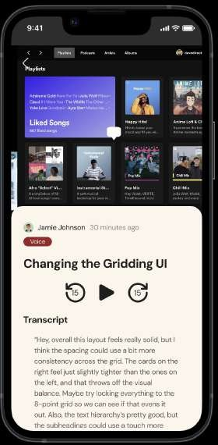
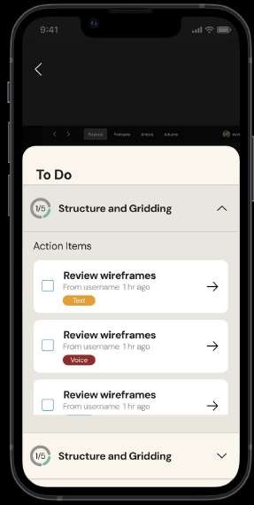
Clarus aims to make every comment understandable and actionable
Clarity
Each comment is pinned to a specific spot, reducing ambiguity about what feedback refers to.
AI generates to-do summaries by converting comments into concrete, organized action items.

Slide 6
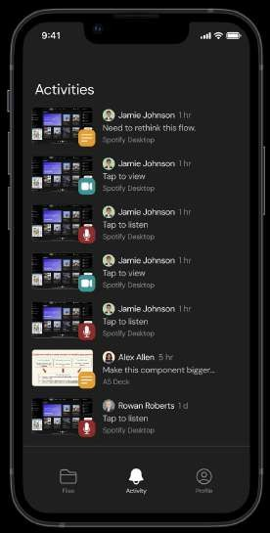
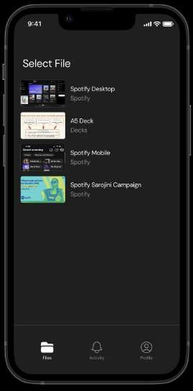
Collaboration in clarus should help founders and designers turn feedback into shared progress
Co-Creation
Shared workspaces display founder
Realtime call with live note taking: enables both parties to co-view the mockup and take notes collaboratively.
and designer activity, fostering shared ownership.

Slide 7
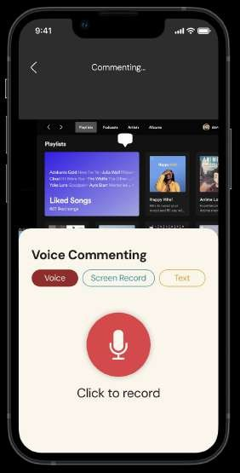
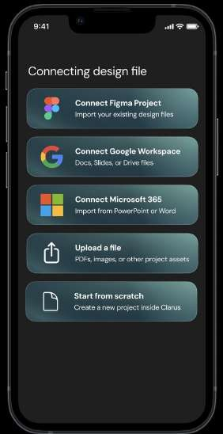
clarus adapts to how different users think and communicate, ensuring everyone feels understood and heard
Empathy
Multimodal commenting (voice, video, text) lets users give feedback in their preferred format
Inclusive logins and integrations (Figma, Google, Microsoft) enable seamless collaboration across tools

Slide 8
clarus balances human expression and structured collaboration, maintaining clarity without losing empathy or co-creation
Tensions in Values
Structure can fiatten tone and nuance of the communicator
Solution: organized yet expressive communication
Multimodal (voice, video, and text) commenting
Users can replay comments to retain original tone and meaning
Real-time collaboration creates clutter
Solution: clear structure without losing collaboration
Comments pinned directly to mockup elements
AI-generated to-do summaries organize shared feedback

Slide 9
Tasks
CS 147

Slide 10
Comment asynchronously on a mockup with voice, video, or text
Simple Task
Low-Fi Prototype Med-Fi Prototype
All 3
types of comments
1
type of comment
reduced complexity

Slide 11
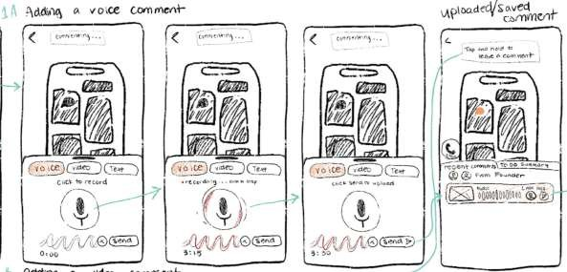
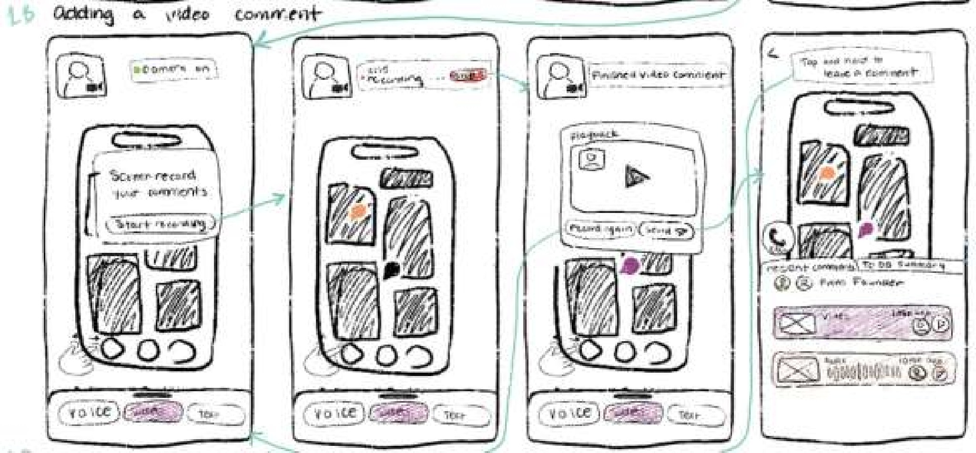
Simple Task
Low-Fi Prototype
Changes Made
Larger and clearer representations to record and replay a voice comment
Replaced ‘video’ with ‘screen recording’ and simplified the process with clearer, larger buttons and fewer distractions
Recent comments now display modality, recency, and time since posting
OR

Slide 12
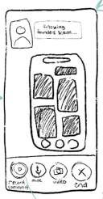
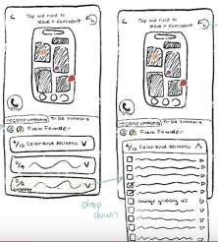
Moderate Task
View and complete AI-generated to-dos
Low-Fi Prototype
Med-Fi Prototype
swapped moderate and complex tasks
manage AI generated to-dos
calling designers

Slide 13
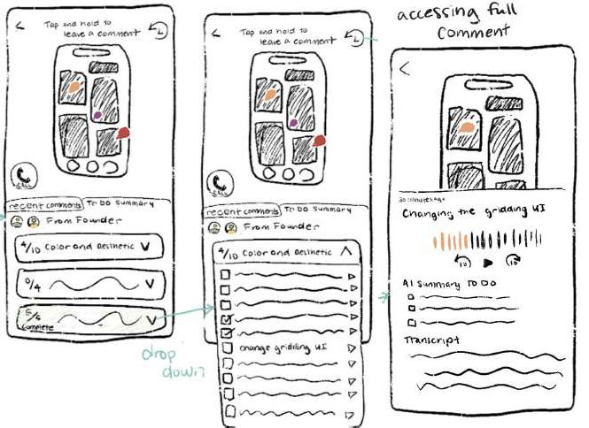
Moderate Task
Low-Fi Prototype
Changes Made
More organized menu bar to easily click on “todos”
Adjusted box shape so
drop-down arrow is easier to notice and understand
Made it clearer how to mark a “todo” as done and view full comments by adding structured, clickable boxes

Slide 14
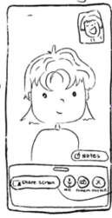
Complex Task
Call designers in real time
Low-Fi Prototype
Med-Fi Prototype
swapped moderate and complex tasks
manage AI generated to-dos
live video calls

Slide 15
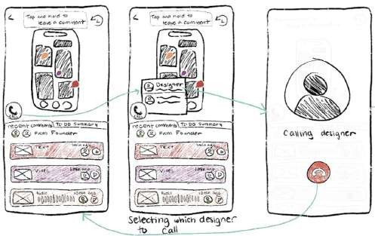
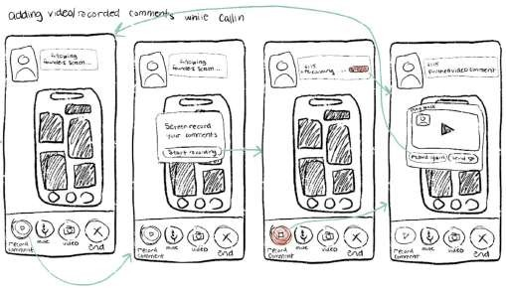
Complex Task
Low-Fi Prototype
Changes Made
Contacts page is in “full screen” to easily see all the designers you can call
Note taking instead of commenting while screen sharing for a more intuitive ﬂow
Simpler, clear icons for key screen sharing tasks and removed unnecessary buttons

Slide 16
Usability Goals
CS 147

Slide 17
Existing metrics overlook key emotional and behavioral insights
Limitations of metrics
User Satisfaction Navigation Accuracy
Task Efficiency
Average of relevance (1-10) and ease of use (1-10) for each task
Doesn’t reveal why users rated high or low
“Ease of use” may vary by user interpretation
Misses emotional factors like frustration or delight
Number of misclicks per task
Time taken to complete each task
Hesitation or uncertainty not captured
Doesn’t capture magnitude of incident
Doesn’t show why misclicks occurred (unclear labels or icons)
Fast times may reﬂect rushing, not usability
Longer times could mean engagement, not inefficiency
Ignores perceived effort—users may finish fast but feel strained

Slide 18
Addressed limitations through qualitative insights
Revised metrics
User Satisfaction Navigation Accuracy
Task Efficiency
Quantitative
1-10 self reported scale Success: Avg. rating ≥ 8;
Quantitative
Number of Misclicks Success: ≤ 1 misclick per task
Quantitative Completion time per task Success Criteria: consistent
completion time across participants
Qualitative
Post-task prompts: “What felt intuitive or confusing?”
Success: ≥ 80% report high confidence (>7/10)
Note signs of frustration (pauses, repeated clicks) Success: ≤ 1 noticed frustration sign per task
Qualitative
Track time hovering/rereading
labels
Success: 20% less hesitation time between rounds
Post-task question: “Was it easy to find what you needed? Why or why not?”
Success: 90% agree navigation felt straightforward
Qualitative
Count backtracks/retries and think-aloud uncertainty Success: backtracks ↓25% across tasks
Confidence rating (1–10) in completing tasks
Success: ≤ 1 mentioned confusion per task

Slide 19
Design Improvements to Achieve Success Criteria
Design Changes and Evidence
User Satisfaction Task Efficiency
Navigation Accuracy
A5 Insights
“I think I get the todo arrows but not fully”, “I didn’t understand the video comment.”
“Where do I click record?”, “I do not know where to find the designer to call”
“screen is a bit busy”, “version history button is not intuitive to me”
Clearer, more clickable buttons (especially for todos)
Introduced countdown before screen recording starts
Added sender, modality, and timestamp to comment previews
Added menu bar for quick task switching (calls, comments, todos)
Used clearer, more legible icons across tasks
Removed user’s face in screen recordings to reduce hesitation
Simplified video call UI by removing extra buttons and steps
Enhanced existing components to streamline and improve commenting ﬂow
Converted “version history” to an “activity page” for easier access
Design Changes

Slide 20
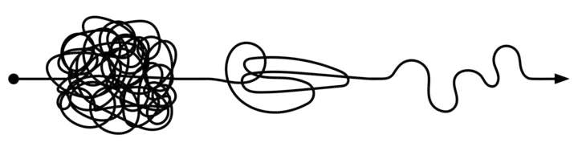
Progress
We improved video calling, screen recording comments, and menu features by clarifying icons and buttons and reducing on-screen clutter. These changes aim to enhance user satisfaction, navigation accuracy, and task efficiency and achieve our success criteria.

Slide 21
Revised Sketches
CS 147

Slide 22

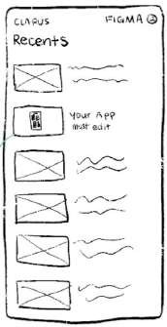
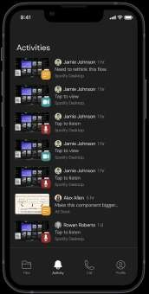
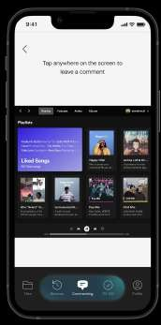
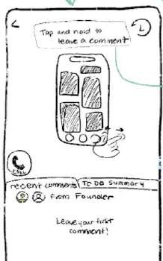
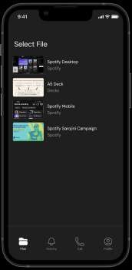




Design Change
1: Menu Bar Changes
Adding Navigation Bar
We added a navigation bar with “files” to view all files and “activity” to see recent comments in order to increase clarity.
In low fi, no way to get to get back to files
Simplified Call Access
We moved calling to the bottom navigation bar to clarify ﬂow for users.
Adding Commenting Menu
We added a “commenting menu” that appears when users open a file to reduce navigation confusion.

Slide 23








Refined the Menu Bar to Reduce Confusion and Improve Task Efficiency
User Satisfaction Navigation Accuracy Task Efficiency
Adding Menu for Files: Simplified Call Access: Commenting Menu:
The new “files” and “activity” tabs make navigation clearer, reducing misclicks and hesitation time.
Moving calls to the “files menu” clarifies call origins and minimizes confusion or frustration.
Clarifying “todos” vs. “recent comments” improves intuitiveness and boosts confidence ratings.
Centralizing file and comment access shortens search time, improving completion consistency.
This change makes call initiation more predictable and reduces unnecessary backtracking or retries
The “commenting menu” streamlines workﬂows, cutting extra steps and improving task speed.

Slide 24
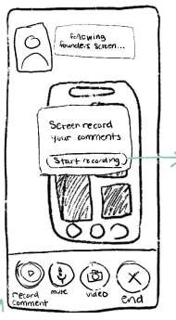
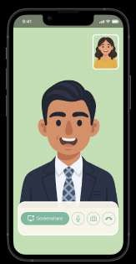
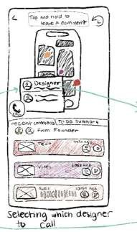
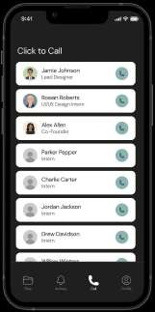

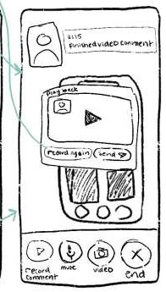
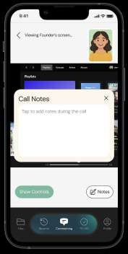
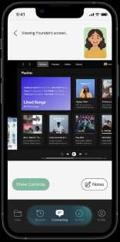
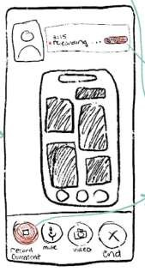



Design Change
2: Video Calling Flow
Control Screen Sharing
We added a clear screen share option for users to choose when to begin sharing.
Enhancing Calling Designers
We made designer contacts full screen, like a phone interface, to improve usability.
Reducing Clutter on Call Screen
We added a “view controls” button that lets users access options like “stop sharing” when needed.
Removing Commenting in Calls
We replaced commenting with note-taking to reduce confusion.

Slide 25








Improving Clarity and Control in Video Calling
User Satisfaction Navigation Accuracy Task Efficiency
Enhancing Calling Designers:
Making the designer selection full screen reduces misclicks and hesitation time, improving navigation accuracy.
Control Screen Sharing:
Allowing users to choose when to start sharing prevents surprise actions and frustration, reducing confusion signs during tasks.
Removing Calling and Commenting:
Replacing simultaneous calling and commenting with note-taking simplifies workﬂow, reducing task complexity and completion time.
Fewer overlapping actions make the process feel more intuitive, increasing satisfaction and confidence ratings.
Reducing Clutter on Call Screen:
Adding a “view controls” button helps users quickly locate key functions (like “stop sharing”), cutting hesitation time.
A clearer interface boosts user confidence and perceived control, raising satisfaction scores.
Giving control over sharing minimizes unnecessary retries, improving task completion consistency.
Cleaner interface improves focus and consistency across participants, leading to smoother and faster task performance.

Slide 26
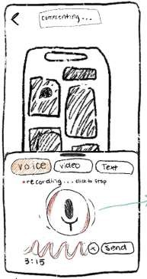
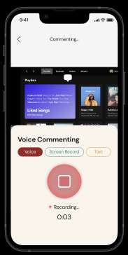
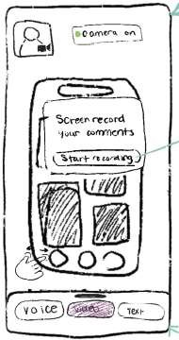
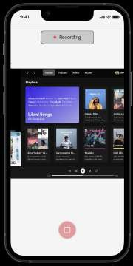

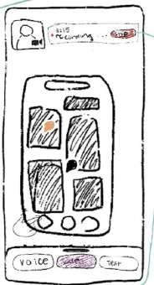
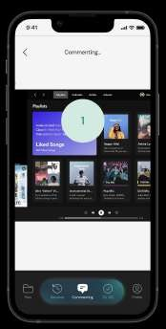
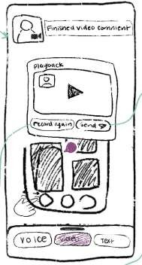
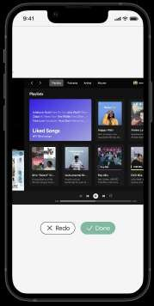
Design Change
3: Voice and “Video” Commenting
Clear Stop Function for Voice Commenting
We added a stop button that replaces the start button once recording begins.
“Video” to “Screen Record”
We removed the camera feature and changed label to “screen recording” to reduce confusion about task functionality.
Countdown Before Screen Recording
We added a countdown to show how much time users have before screen recording begins.
Simpler UI
We removed unnecessary buttons and images to make it more intuitive.

Slide 27








Making Commenting Simple, Clear, and User-Friendly
User Satisfaction Navigation Accuracy Task Efficiency
Stop Function for Voice Commenting:
Adding a clear stop button gives users more control, reducing frustration during voice recording.
“Video” to “Screen Record”:
Removing the camera and renaming to “screen recording” eliminates confusion about what’s being captured, improving user confidence/clarity.
Reduces misclicks and hesitation from unclear labels, strengthening navigation accuracy.
Countdown Before Screen Recording:
The countdown prepares users for recording start, lowering mistakes and hesitation time by improving awareness.
Simpler UI:
Removing unnecessary buttons and images reduces cognitive load and confusion, boosting user confidence
Simplifies retakes and minimizes task restarts, improving completion time consistency across participants.
Helps users begin smoothly without retakes, improving efficiency and reducing task variability.
A cleaner interface streamlines commenting, resulting in faster and more consistent completion times.

Slide 28
Medium Fi Task Flows
CS 147

Slide 29
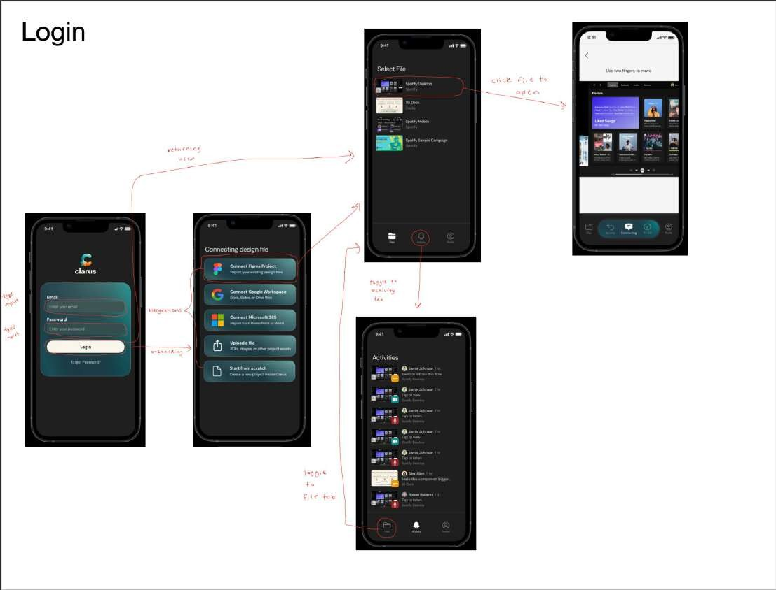
Not a user task, but necessary flow

Slide 30
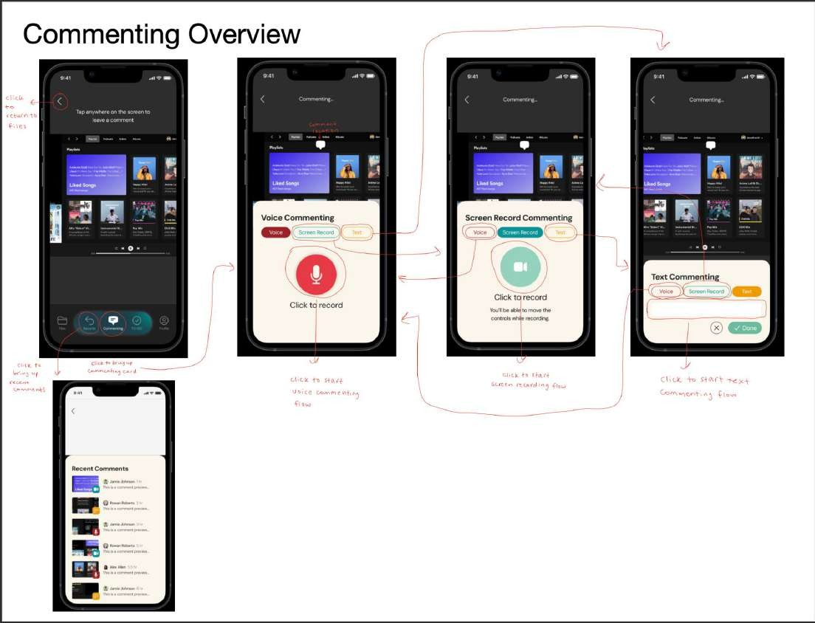
Simple Task

Slide 31
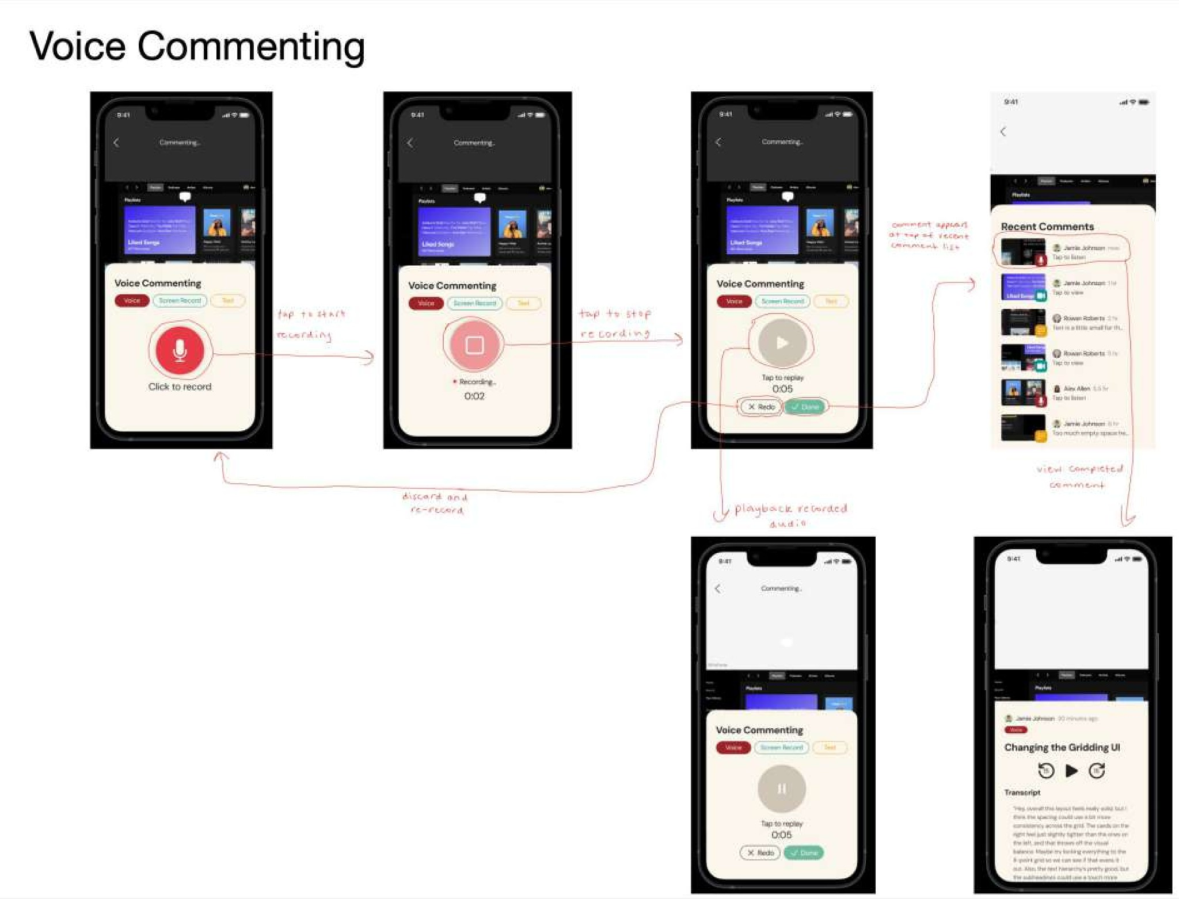
Voice Commenting (Simple Task 1a)

Slide 32
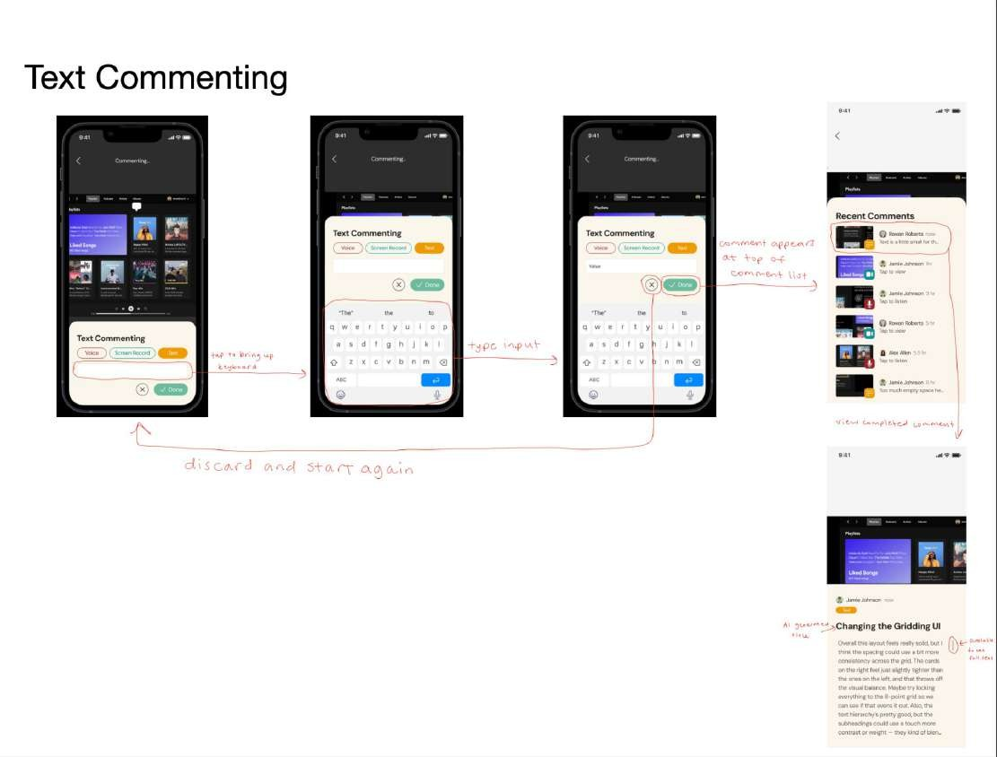
Text Commenting (Simple Task 1b)

Slide 33
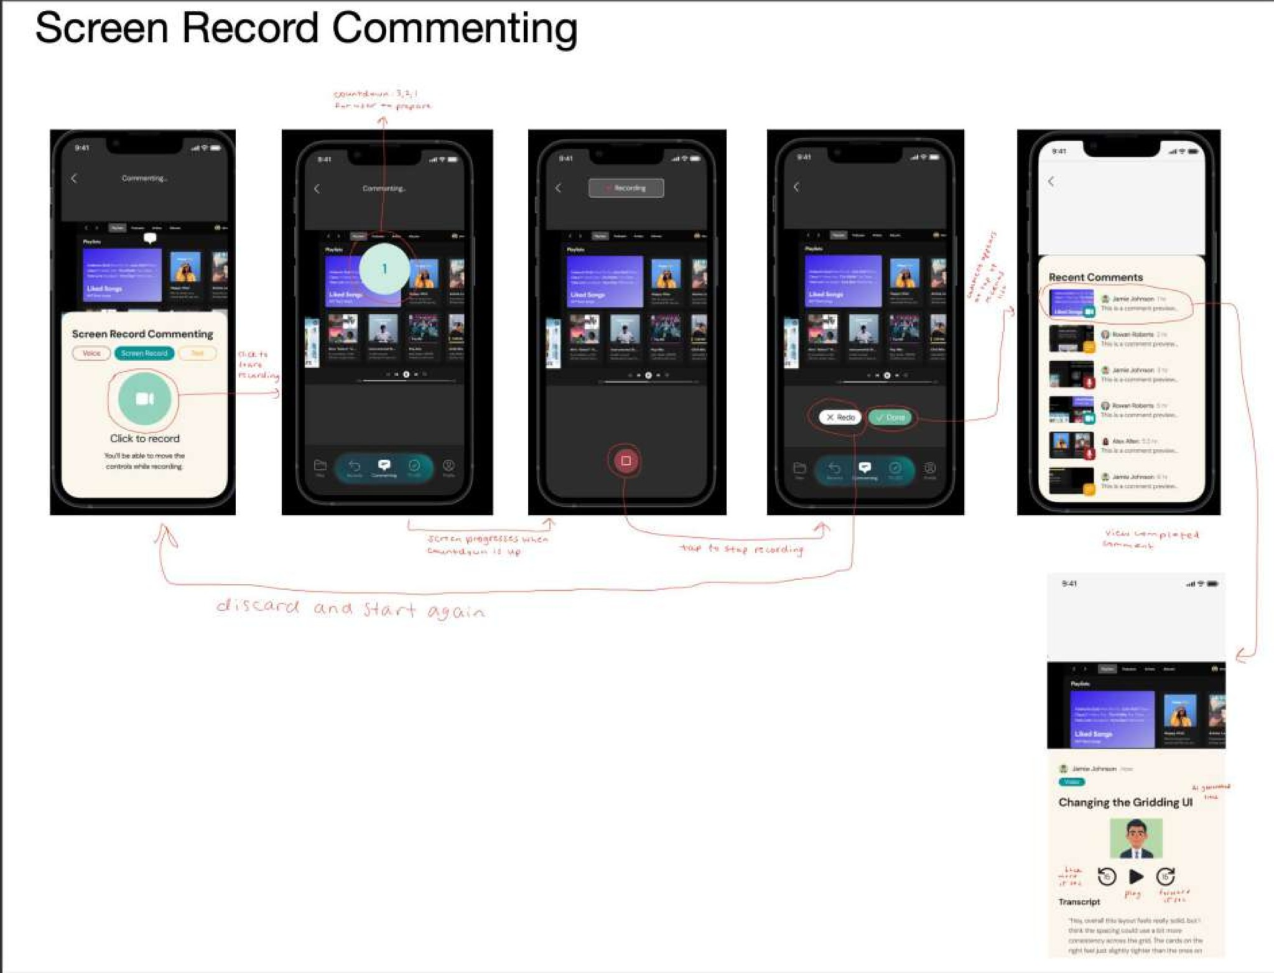
Screen Record Commenting (Simple Task 1c)

Slide 34
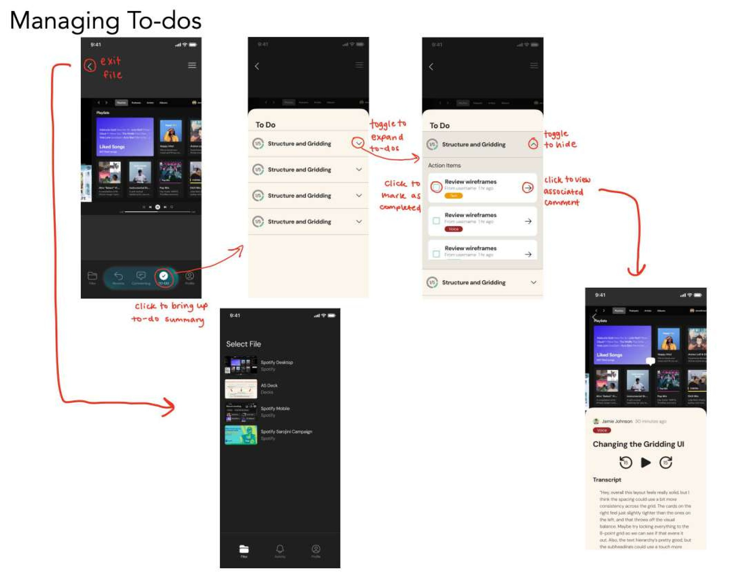
Moderate Task

Slide 35
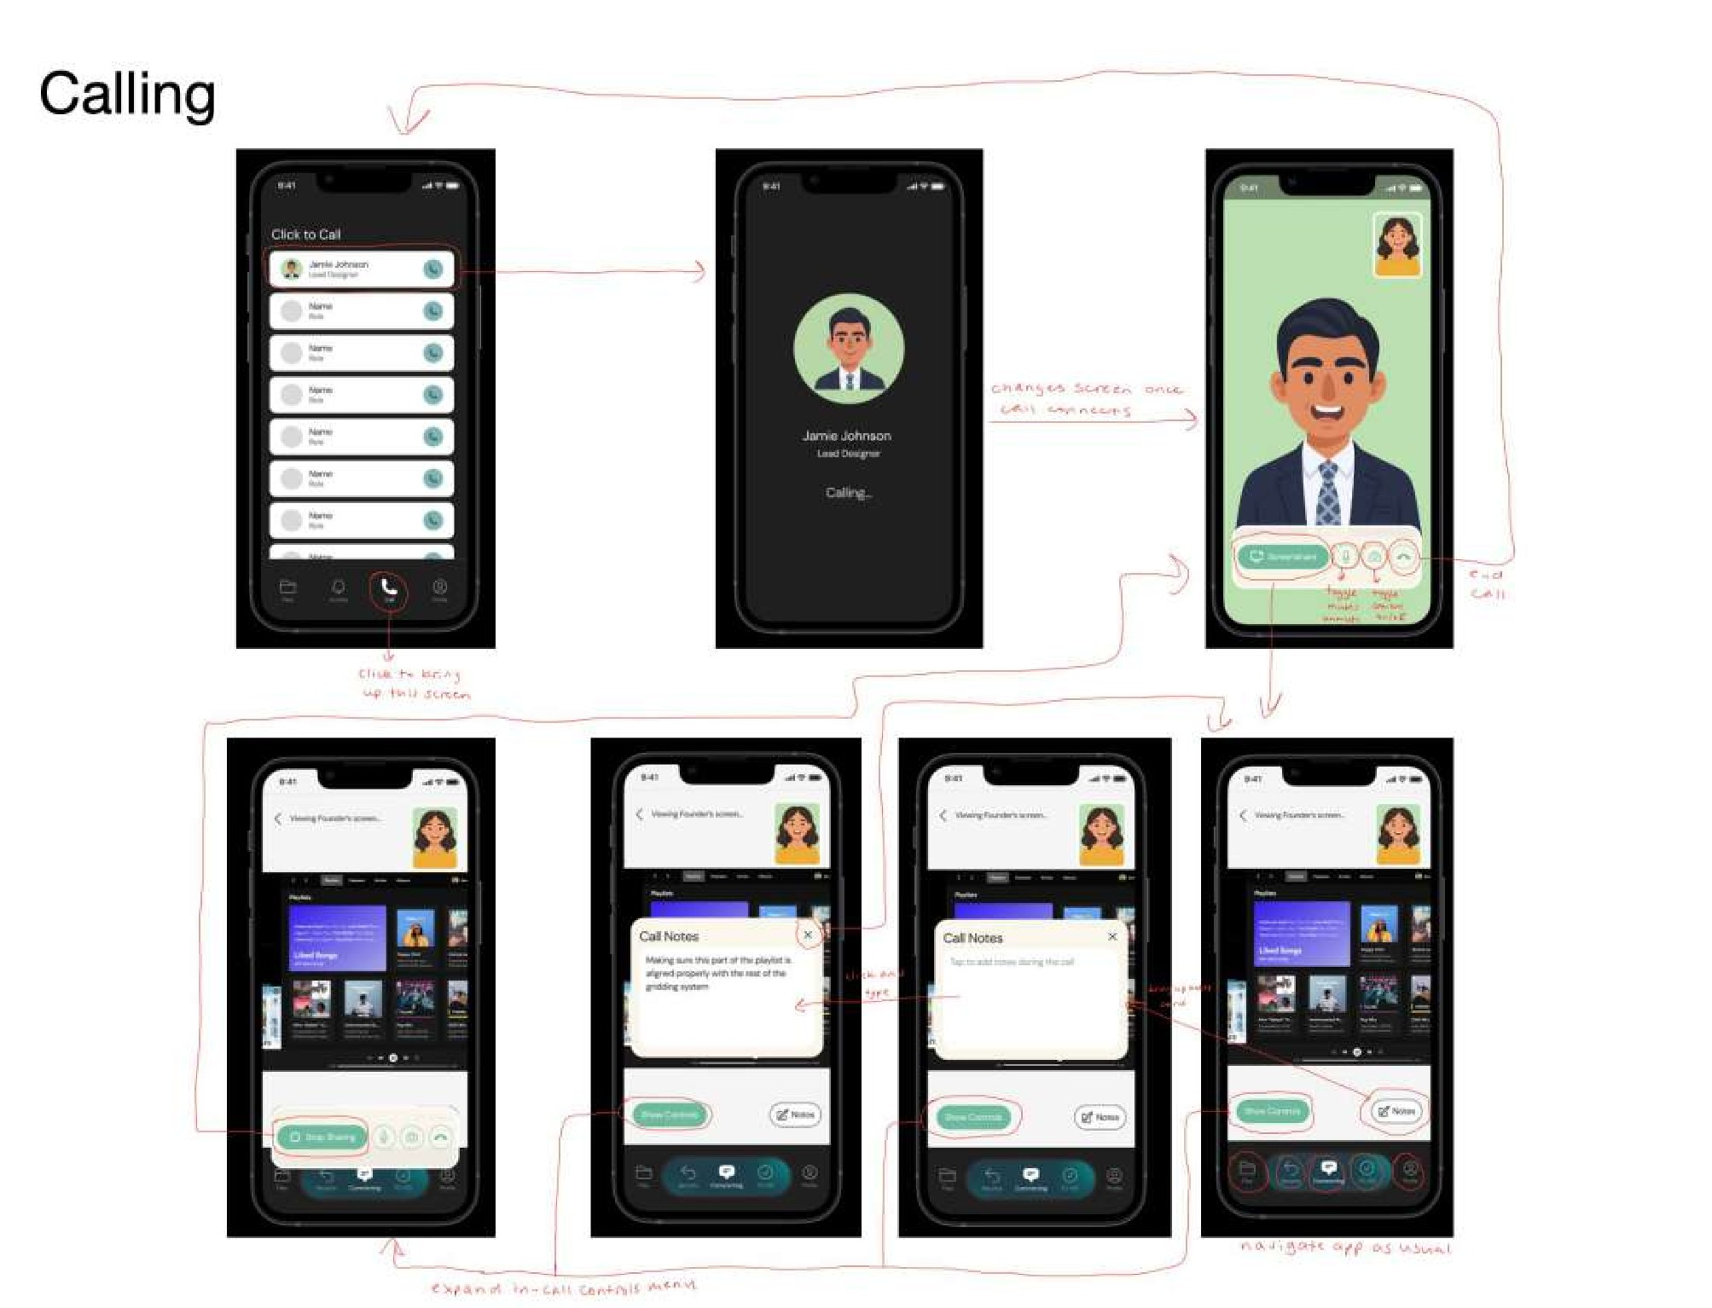
Complex Task

Slide 36
Prototype Implementations
CS 147

Slide 37
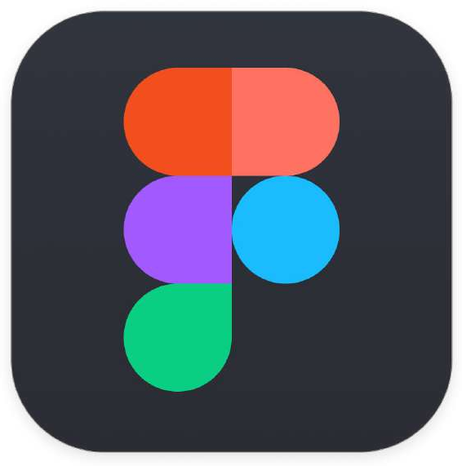
Figma’s testing and prototyping strengths outweighed its drawbacks, allowing fast, consistent iteration and smoother development
Pros and Cons with Figma
We used Figma to build our prototype for its easy collaboration and industry-standard design tools
Pros:
Consistent system design via components
Realistic frontend prototypes
Easy sharing for user testing and feedback
Cons:
Steep learning curve
Unable to develop complex interactions
Design-to-code inconsistencies

Slide 38


Simulated Features
Hard Coded Features (Forced Choice Experience)
Can only interact with preset interfaces/files
Comments appear in the same spot regardless of click location
Listed comments and transcripts use default descriptions and modalities
Wizard-of-Oz Features
Recent activity is not a log of changes made by humans -> can still test engagement without actual activity
People don’t actually interact with humans on call
-> can still test overall calling fiow without interaction

Slide 39

Users experienced only simplified simulations, limiting realism and feature evaluation
Limitations of Prototype
AI features excluded due to lack of Figma integration → couldn’t test reliability or usefulness
Voice/screen recording not supported → users could only simulate comments, limiting evaluation of quality and speed
Live video calls not supported → couldn’t assess call experience or collaboration quality

Slide 40
Appendix
Figma Dev Mode
Figma Production Mode Readme Doc
clarus Website
All Changes Made from Low to Med Fi
Med Fi Annotations PDF

