Slide 1

CS 147
November 21st, 2025
A8: High Fi Prototype Check-in
Clarus
Seamless, fiexible communication between founders and designers
Avey E, Candace C, Siya G, Tyler A

Slide 2
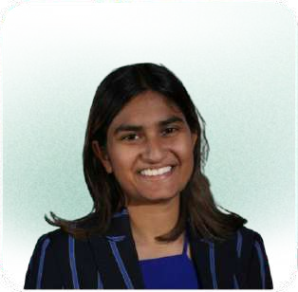


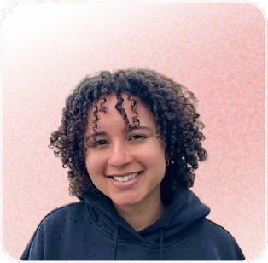
Team Members
Siya G she/her | Avey E she/her | Candace C she/her | Tyler A
CS (AI) + Econ ‘26 | Symsys ‘27 | Design ‘26 | Symsys ‘26
CS (HCI) ‘27 | CS (HCI) ‘27 | CS (HCI) ‘ 27 | CS (HCI) ‘27

Slide 3
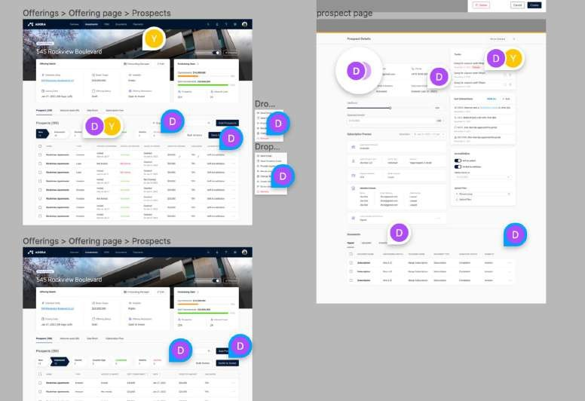
Communication in current design tools is disorganized
comment ﬂows in current tools are:
disorganized
text-based
not transferable to to-dos
overwhelming
lacking revision history

Slide 4



Our solution synthesizes and organizes information
our platform
empowers users with multi-modal communication
text voice video
Status quo
text-based disorganized
overwhelming
not transferable to to-dos
Clarus
multimodal: voice, video, and text support
filtered by role, modality, element, etc.
synthesized with AI
transformed into role-specific to-do lists
lacking revision history
digestible and accessible documentation of edits and comments

Slide 5
Roadmap
1
2
3
4
Heuristic Evaluation Results
UI Revision
Prototype Implementation
High-Fi Demo

Slide 6


Heuristic Evaluation Results
CS 147

Slide 7
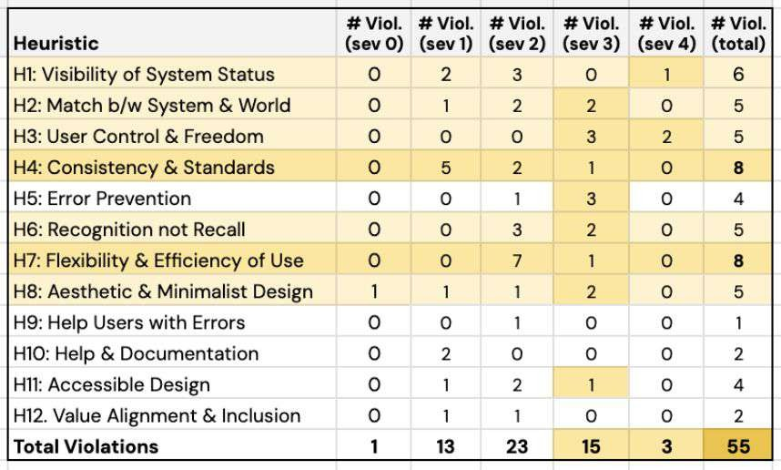
Violation Quantity & Severity Summary
55
Total Violations

Slide 8
Most Violations
8
H4
Consistency & Standards
Vocabulary, buttons, and colors were not fully standardized
8
H7
Flexibility & Efficiency of Use
Concentrated in the moderate task (calling)
6
H1
Visibility of System Status
Lacking confirmation, progress indicators

Slide 9
Most Violations By Task
Moderate Task
Missing visual context, unclear instructions, and weak accessibility forced users to rely on recall.
12
23
Complex Task
Lack of guidance and safeguards in multi-step ﬂows led to confusion and lost progress.
12
Simple Task
Unclear controls, inconsistent UI, and missing exit paths disrupted quick interactions.
Miscellaneous
Minor aesthetic inconsistencies that added small but noticeable friction.
5

Slide 10
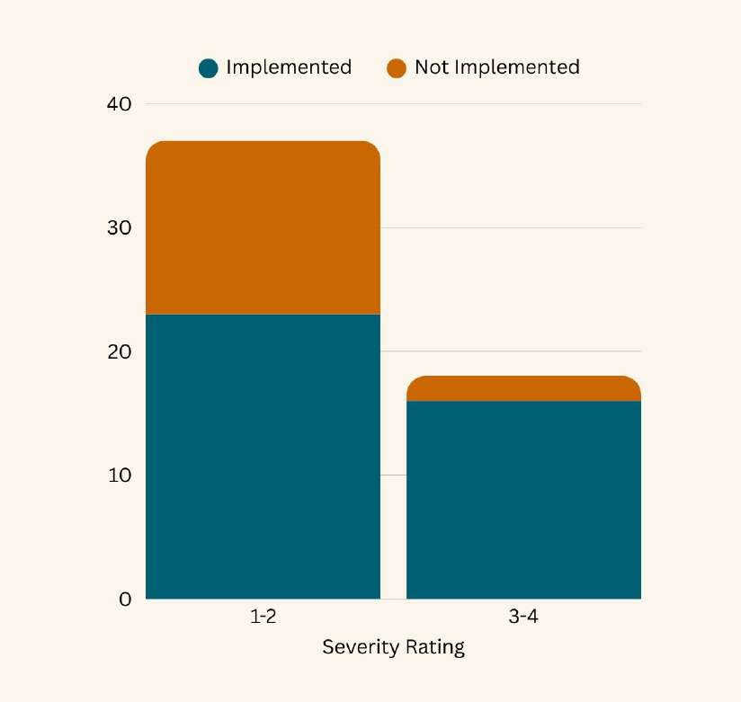
Revisions
39
Total Revisions
88%
Implementation Rate (16/18)
62%
Implementation rate (12/37)

Slide 11
Revisions
39
Total Revisions
88%
Implementation Rate (16/18)
62%
Implementation rate (23/37)

Slide 12
High Level Summary
Users frequently felt stuck
High-risk actions felt abrupt or unsafe
Moderate task caused brain overload
missing visual context, instructions, and accessibility
missing or unclear exit paths
lack of feedback and confirmation

Slide 13

UI & Product Revisions
CS 147

Slide 14
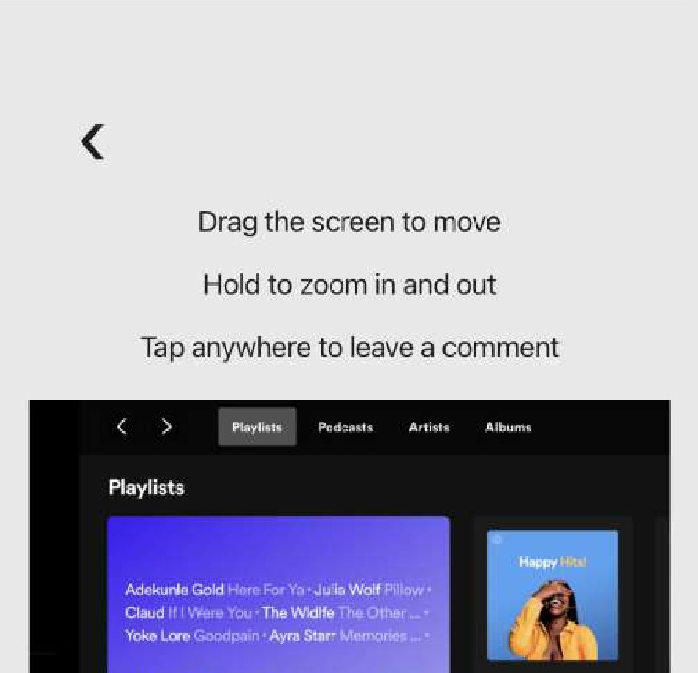
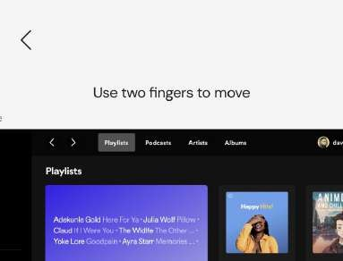
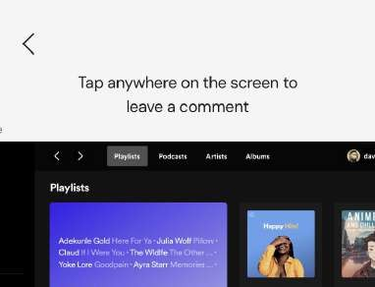
Simple Task: Adding Comments
User instruction simplicity
Revision
Before
H2 “Use two fingers to move” stays even after movement and instructions for leaving a comment only appear after tapping
Combined instruction to decrease interaction length

Slide 15
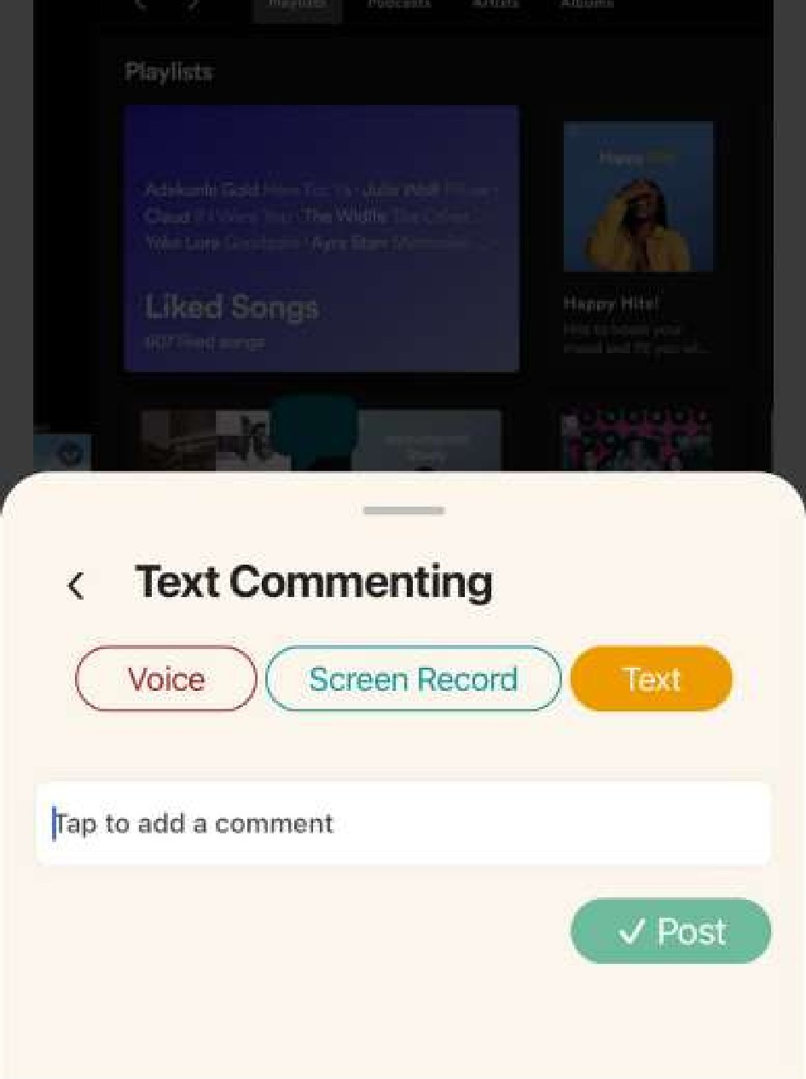
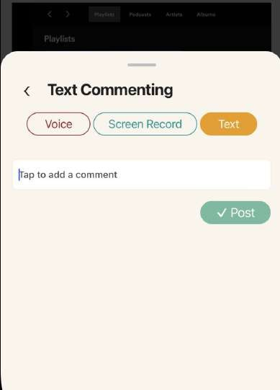
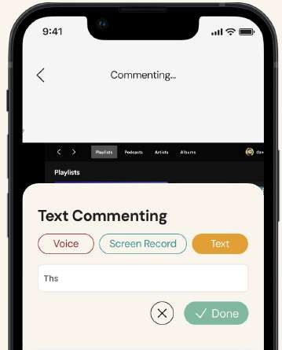
Simple Task: Adding Comments
Flexibility Violations
Revisions
Replaced “X” button with back button
Draggable sliding screen
Before
H8 Popup takes up half the screen, making it hard to see design file
H3 Difficulty seeing and using back buttons

Slide 16
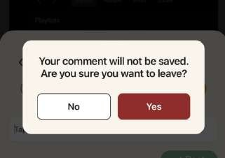
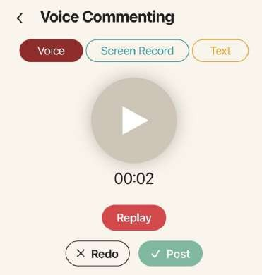
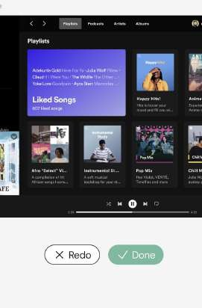
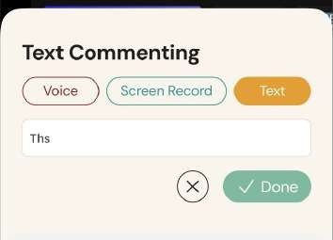
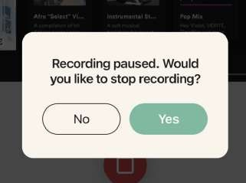
Simple Task: Adding Comments
Error and Flexibility Violations
H3 “X” button restarts users instead of pause/play
H5 When clicking back and “X”, users will lose their progress
H6 Clicking “X Redo” restarts the ﬂow, users can’t replay
Confirmation modal
Added replay button for voice commenting
before ending recording and closing comments

Slide 17
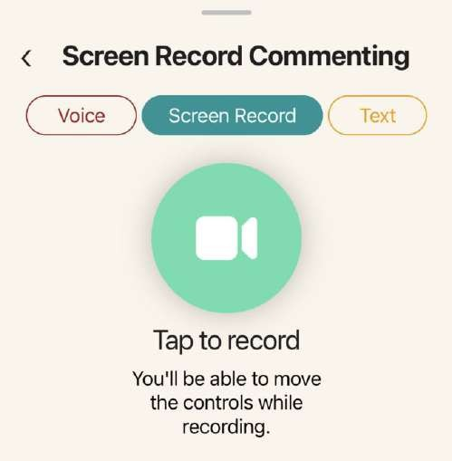
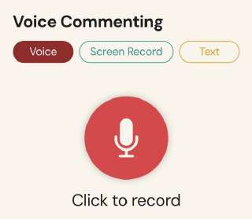
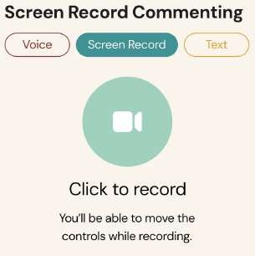

Simple Task: Adding Comments
Revision
Increased vibrancy of the screen recording start to be consistent
Color Consistency
Before
H4 Saturation of start buttons inconsistent
Becomes more vibrant
Becomes more faint

Slide 18
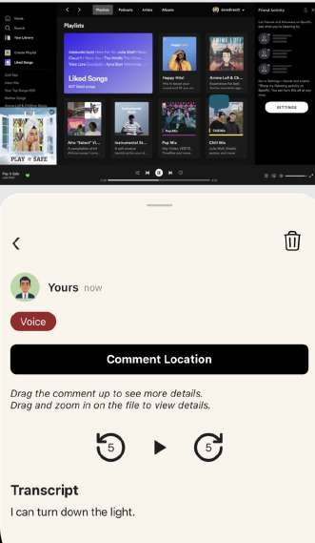
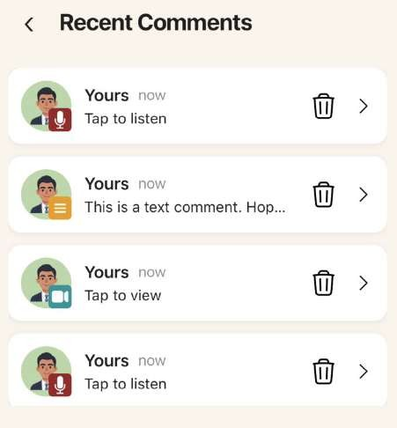
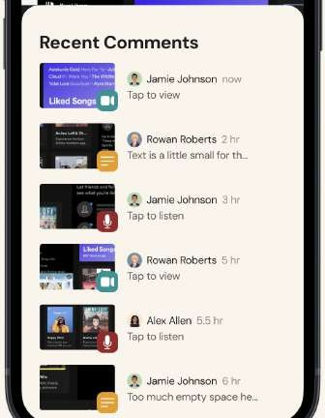
Simple Task: Adding Comments
Revision
Added a delete button to comment cards for comments user made
Deleting comments
Before
H3 Users can’t remove or delete comment

Slide 19
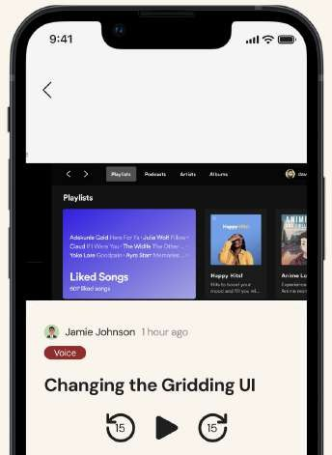
Moderate Task: To Do’s
Back button confusion
Revision
Moved back button from top of screen to directly on comment modal
Before
H3, H8 Back button is unclear and/or not visible

Slide 20
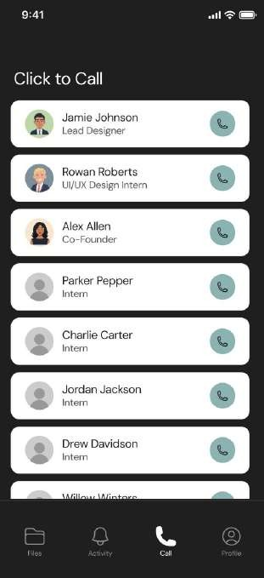
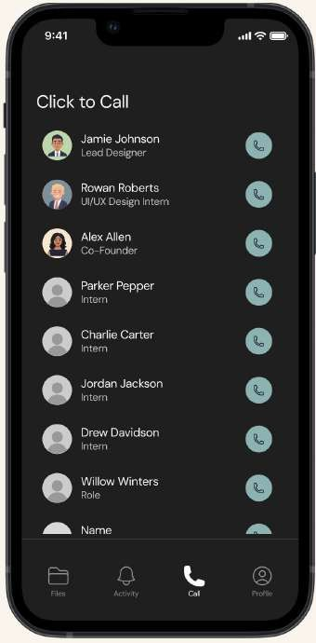
Complex Task: Calling Team
Clicking to call
Before
After
H2 Users can call someone by clicking on the profile picture and entire card
Users can only call clicking the call button

Slide 21
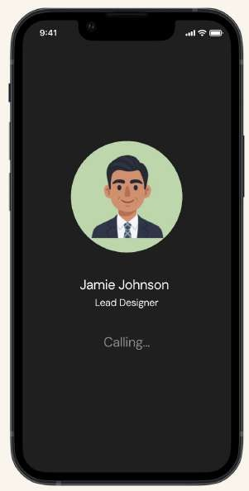
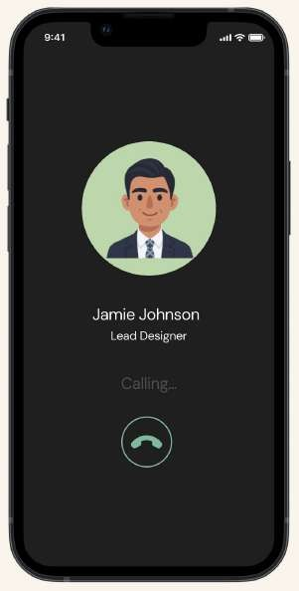
Complex Task: Calling Team
Active Calling
H3 When users are calling, there’s no way to leave
Added end button to calling screen

Slide 22
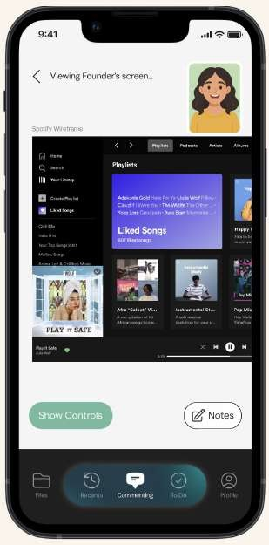
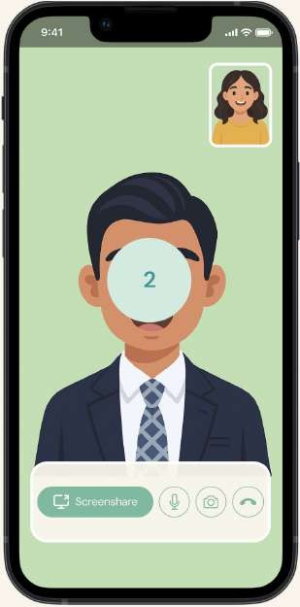
Complex Task: Calling Team
Sharing Screen Warning
H5 When users share their screen, there’s no confirmation to start sharing
Included a countdown before sharing screen

Slide 23
Complex Task: Calling Team
Sharing Screen Warning
H5 Back button and “Stop Screen Sharing” have same functionality
Back button will allow users to navigate through the app instead of controlling screen recording functionality

Slide 24
Did not implement
H11 Accessibility
No live transcription and captions during live calls
Adds to clutter during calls which many users did not like during interviews in A5
H7 Flexibility and Efficiency of Use
No ability to call someone while commenting, must navigate to “files”
From interviews in A5, we discovered that users prefer having the call button here
Gives users the ability to start a call and then navigate to a file. More control and usability

Slide 25

Usability Goals
CS 147

Slide 26
Usability Goals
1
2
3
User Satisfaction Relevance and easy of use for each task
Navigation Accuracy Misclicks and uncertainty for each task
Task Efficiency Ability and time to complete tasks

Slide 27

Progress Towards Usability Goals
Progress
User Satisfaction
Reduced early confusion by simplifying and combining movement + comment instructions.
Improved visibility of essential controls (e.g., back arrow contrast, clearer icons).
Prevented users from feeling stuck by adding clearer exit paths during calling ﬂows.
Still to Consider
Explore personalization of comment ﬂows or call UI to match individual work styles.
Add lightweight success feedback (e.g., “Saved”, “Comment added”) to reinforce confidence.

Slide 28

Progress Towards Usability Goals
Progress
Reduced user confusion by adding clear back buttons.
Reduced accidental call triggers by restricting calls to the call button only.
Made the comment panel draggable + resizable, allowing users to see the underlying design and orient themselves better.
Improved color consistency for start buttons, helping users instantly recognize action states.
Still to Consider
Add lightweight micro-animations to reinforce where users are navigating next.
Track backtrack frequency to identify ﬂows where navigation remains unclear.
Navigation Accuracy

Slide 29

Progress Towards Usability Goals
Progress
Improved the to-do list by clarifying the back button and improving context visibility.
Added delete options for comments, preventing users from re-recording or re-writing due to mistakes.
Reduced rework by making critical actions (e.g., closing recordings) explicit and reversible.
Task Efficiency
Still to Consider
Add smart suggestion shortcuts during commenting (e.g., auto-jump to last comment location).
Explore batch actions (e.g., resolving multiple comments) to streamline repeated workﬂows.

Slide 30
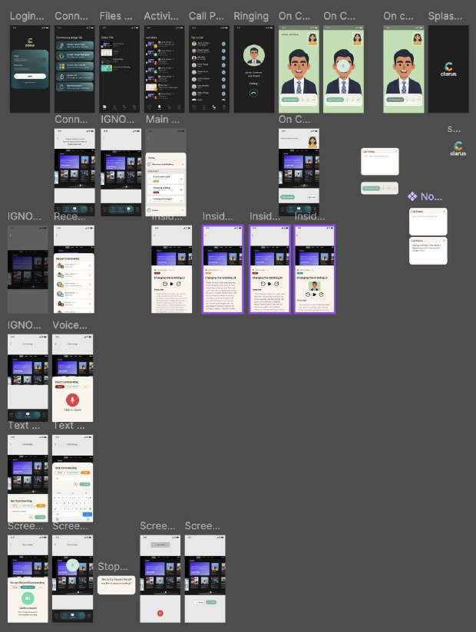
Design Refiection
Redesign focused on
restoring user control
reducing friction
creating clearer & more intuitive pathways
We shifted the experience from one where users frequently felt
To one where actions felt
stuck
uncertain
at risk of losing work
safer
transparent
predictable
Overall, the revised design brought Clarus closer to its goal of enabling fast, expressive collaboration without overwhelming users.

Slide 31
Prototype Implementations
CS 147

Slide 32




Tools Used
React Native
Cross functional language used to code mobile apps
Expo
VSCode
Github
Platform used to share code and collaborate through team
Tool used to test and simulate mobiles devices
Code editor and IDE used

Slide 33


AI Tools Used
Builder.io
To help convert
Figma design to HTML code.
Cursor
Adding functionality and helping with bugs
Used for fast development and implementing complex features which we might struggle to implement ourselves (voice and screen recording text comments, transcription, etc.)

Slide 34
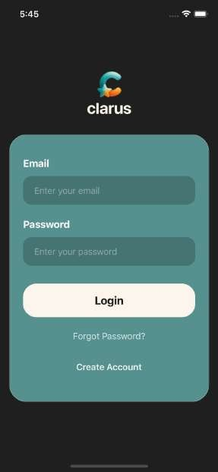
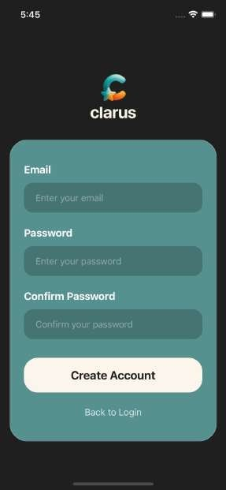
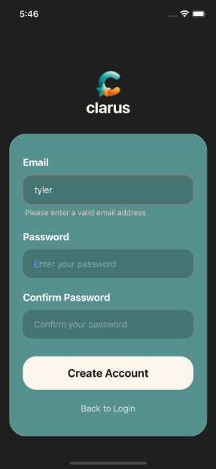
Implemented Features - Authentication
Login Flow
Account Creation
email formatting validation
signup ﬂow design pattern
password matching

Slide 35
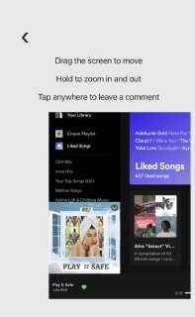
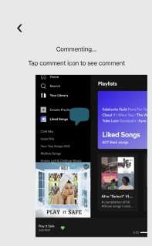
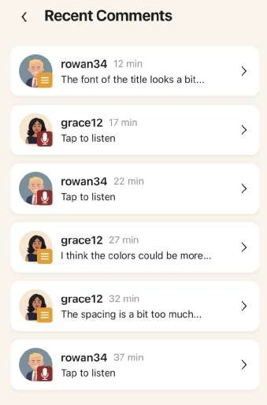
Implemented Features - Commenting Flow
Comments by Designers (hard coded)
Commenting Functionality
Comments by designers are hard coded into a Supabase database and are added to recent comments
Can zoom in and drag on mockups
Leaves a blue comment icon where desired

Slide 36
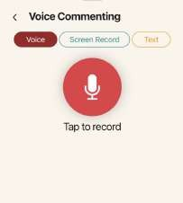
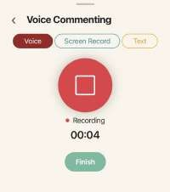
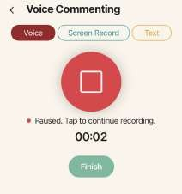
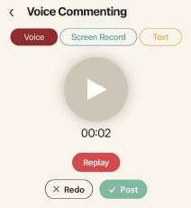
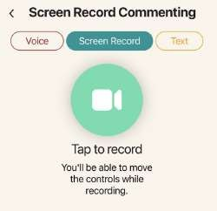
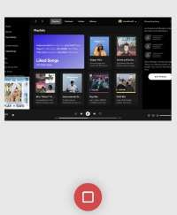
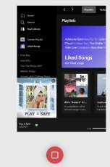
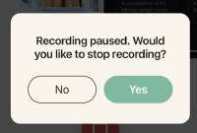

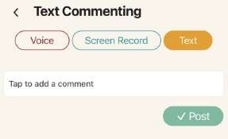
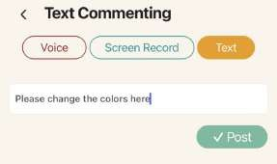
Implemented Features - Types of Comments
Voice record a comment, pause while recording, and replay/redo/post the comment
Voice
Screen record a comment, pause and restart while recording, and redo/post the comment. Zoom in and drag prototype while recording.
Screen Record
Post or delete a text comment
Text

Slide 37
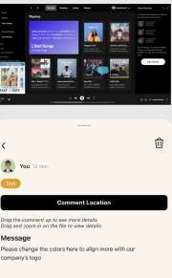
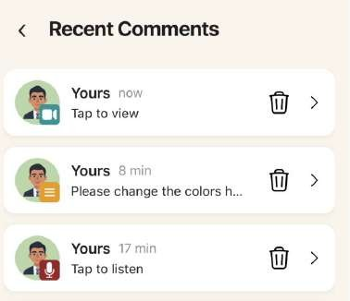
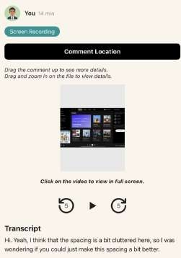
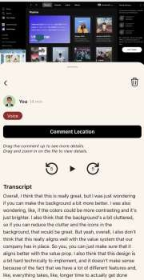
Implemented Features - Viewing Comments
Click on comment location to view exactly where the
When a comment is posted, users are directly taken to the recent comments page. They can delete their own comments and also click on them to go to an individual comment.
comment was added (icon becomes bigger and brighter)
Click to play audio or video
Audio is transcribed using AppliedAI API. Scrollable bar added to transcript

Slide 38


Implemented Features - AI To Dos
All comments are added as action
items from the OpenAI API.
Add comments to todo categories based on the content. This is done using the OpenAI API and monitoring the database for updates.
Clicking on action items opens the comment and items can be marked as done by clicking the checkbox.

Slide 39




Implemented Features - Video Calling

Slide 40


Simulated Features
Hard Coded Features (Forced Choice Experience)
Pre-written comments by designers
  Would require live social networks (increased complexity and limits testing)
Users profile image and username
File (spotify file)
  Does not support uploading files or multiple files
(all link to spotify Figma)
Wizard-of-Oz Features
Simulated calling in complex task
  Avoid connecting to mobile data (privacy concerns and complex)
  Allow testing at all times (don’t need another person logged in to app)

Slide 41
Unimplemented Features
Finishing Task Flows:
HEs and more in depth testing of moderate task functionality
Integrate live video support for calling
Extensions:
Integration:
Combine both repos into one and connect the features of the two repos
Polish UI changes and
task fiows
Supporting multiple files and uploading files
Adding “About clarus” page and profile customization
Persisting comments and link usernames instead of hard coding -> deprioritized

Slide 42
Timeline and Plans on Finishing
Sunday 11/23
Finish Independent Tasks and Begin Integration
Tyler: Complex Task Flow
Siya: Combine Both Repos Into One and Moderate Task Flow
Sunday 11/31
Extensions
Siya: Finish support for enabling multiple files
Candace: Start making “About Clarus Page” and profile customizations
Wednesday 11/26
Finish Integration
Avey: Integrate files and commenting + saving call notes
Candace: Recent page
Thursday 11/27
Polishing
Candace: Polish + start enabling multiple files
Avey: Polish/debugging
Wednesday 12/3
Extensions
Siya: Polish and record demo
Avey: “About Clarus Page” and profile customizations
Thursday 12/3
Polish and Debug
After Expo
CS 147L Requirements and Persisting Comments

Slide 43

Issues and Questions
Integration
Two repos need to be merged into one, which may cause GitHub confiicts
Still need to implement some core features for completed task fiows (adds
technical complexity and roadblocks may emerge)
Extensions
Adding multiple-file support and uploads requires extra work, including converting the Figma file into a variable
Persisting comments after logout adds complexity and isn’t essential for the user experience
Testing and Validation
Need to test and improve on backup fiows for API/database failures
Finalize and polish visual design

Slide 44

Issues and Questions
Integration
Two repos need to be merged into one, which may cause GitHub confiicts
Still need to implement some additional features for completed task fiows (adds technical complexity and roadblocks may emerge)
Testing and Validation
Need to test and improve on backup fiows for API/database failures

Slide 45
High Fi Demo
CS 147

Slide 46

Simple Task
Luma Video (Better quality)
Drive Video

