Slide 1

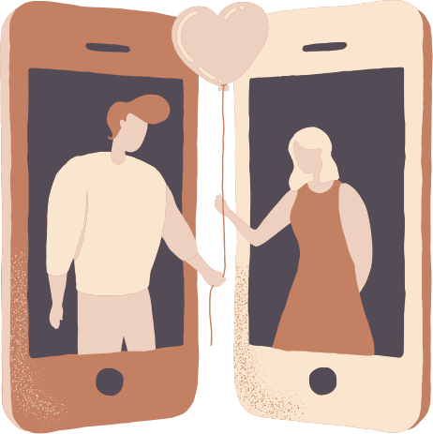
Preserving the Past
Exploring Distance Relationships
By: Evy, Jenny, Tracy, Lucia
Notes:
To Do:
- get kevin and patty's quote for slides 12 and 16 : Tracy
- do patty’s empathy maps and insights/needs : Jenny
- fill out contradictions slide 21
- fill out tensions slide 22
- fill out surprise slide 23
- fill out summary slide 24
- fill out next steps slide 25

Slide 2

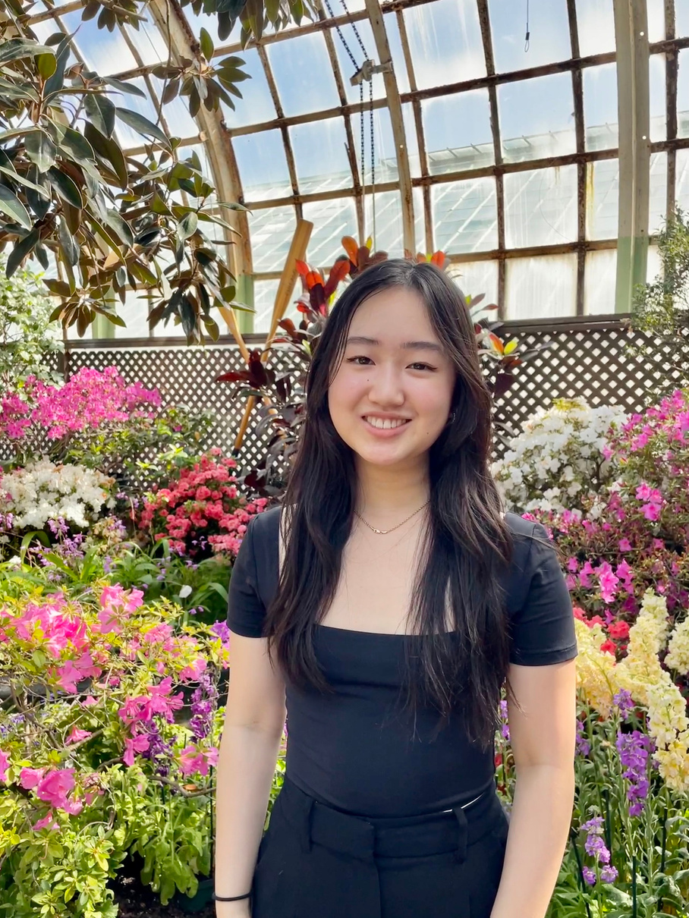


Our Team
Evy Shen
Symbolic Systems
Sophomore
Jenny Duan
Symbolic Systems
Sophomore
Tracy Wei
Symbolic Systems / Design
Sophomore
Lucia Langaney
Computer Science
Sophomore

Slide 3


Domain Selection
Preserving the Past
relatability
long distance relationships
relevancy
interest
culture
tracking life habits
memory loss
travel

Slide 4






Our Participants
Patty*
Married mother with two toddlers and family on the East Coast
Justin*
Hardware store employee with in-laws in Hong Kong
Brian*
Online college student living in Stanford couples housing
Regular Users
Extreme Users
Kevin*
Stanford undergraduate who recently broke up with his long-distance international relationship
Claire*
High school junior who recently closed the gap in her long-distance relationship
Janice*
Grandmother of young grandchildren, Stanford employee
*images are generated by AI
Notes:
we will be doing a deep dive on 3 of these participants

Slide 5
Participant Breakdown
Romantic
Male
Relationship
Type
Gender
Family
Female
Friends
International
Teen
Domestic
Distance
Generation
Adult
Same State
Senior
Notes:
Participants: Why were they chosen?
Why are they appropriate?
How were they recruited/compensated?
Where were the interviews conducted?
Apparatus – any equipment/software used (transcribing, etc.)

Slide 6
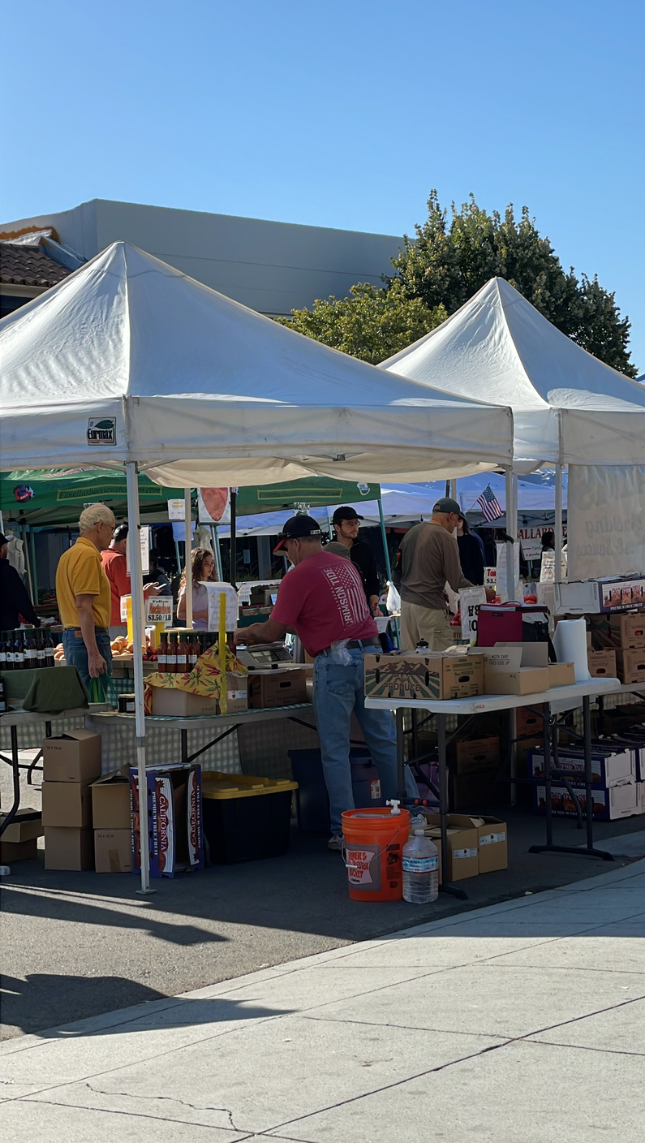
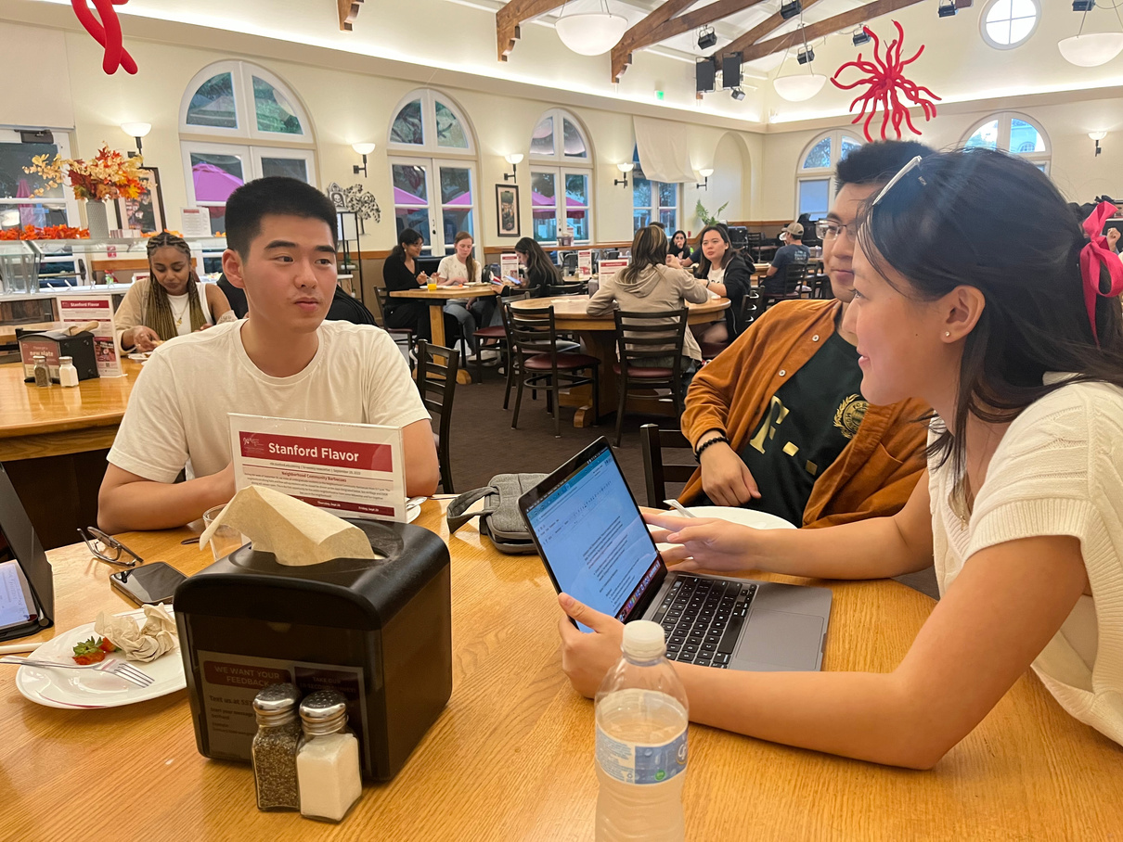
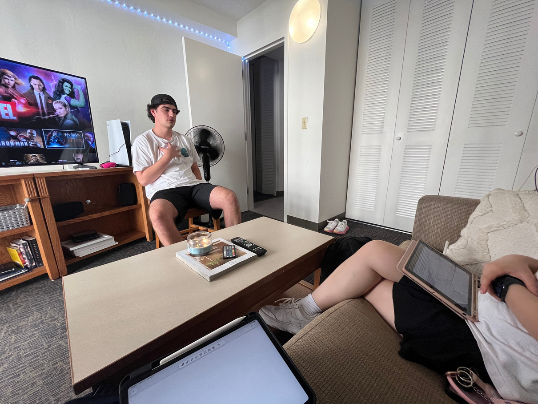
Conducting Interviews
Cal. Avenue Farmer’s Market
Stanford Dining Hall
Stanford Couples Housing
4 interviewees
1 interviewee
1 interviewee

Slide 7
Our Questions
Topic 1: Communication
  How do you typically communicate with your loved one when you are apart?
  What are strategies or tips you've found helpful in making a long-distance relationship work?
  Are there any communication tools or methods that you find particularly helpful?
  How do you and your partner ensure you have quality time together despite the distance?
Topic 2: Challenges
  What are the main challenges you've faced in maintaining this long-distance relationship?
  What emotional challenges have you encountered due to the long-distance nature of your relationship?
  Are there any specific needs or desires in your long-distance relationship that you feel are not adequately met?
  Are there any strategies or activities that help you maintain your emotional well-being?

Slide 8
Brian*
Romantic
21
Online college student living in couples housing with his Stanford girlfriend
“Finding ways to stay engaged even when we’re so far away from each other”
*images are generated by AI

Slide 9
Communication is key in a long-distance relationship
Time difference made it hard to communicate
“Finding ways to stay engaged even when we’re so far away from each other”
His relationship will last in the long-term
Seeing a person’s face is important
Wants to be close to in-person as possible
Words of affirmation are especially important for long distance
“We did not know what to expect”
Figured out their relationship as they went
Communication is essential
Did not have a plan going in to long distance
Facetime is the preference for apps
L.D. didn’t pose a obstacle to their relationship growing
Words of affirmation were key to maintaining romance
Bad wifi and bad connection over Facetime
Access to technology is important to keeping LDR alive
Brian*
His girlfriend is also his best friend
ignored prospect of going long-distance to live in the moment
“You were the first Stanford people we’ve told about our story”
She’s the only person he needs in his life
On the phone/FaceTime 24/7
SAYS
THINKS
DOES
Used an app to watch a movie/TV show together
FEELS
Had to figure out how to communicate, how many times
feels connected to partner when there’s regular communication
Smiles at the thought of partner
feels worried about friends’ perception and stigma
feels confident in his personal choice to move
On the phone 24/7, Facetiming or texting
Became more vulnerable
feels integrated in his partner’s community
game and play Call of Duty together
21
feels secure and fulfilled in his relationship
feels wiling to make major sacrifices for his partner
Says words of affirmation
Online college student living in Stanford couples housing
feels dissatisfied by L.D. communication
send each other memes on Instagram
Would Facetime when he woke up, before sleep, and after class
feels worried about amily’s perception of relationship
feels grateful for his partner’s acts of service toward him
feels difficult to trust
Doordashed every week until he had money to fly out to visit her
Communicates more of his feelings
*images are generated by AI

Slide 10
Communication is key in a long-distance relationship
Figured out their relationship as they went
His relationship will last in the long-term
Facetime is the preference for apps
Seeing a person’s face is important
Words of affirmation are especially important for long distance
Time difference made it hard to communicate
“Finding ways to stay engaged even when we’re so far away from each other”
Communication is essential to keeping the L.D. relationship strong and growing
Replicating interaction that is as close as possible to in-person interaction is a priority, when it’s not always possible to do so because of L.D.
Communication is essential
Words of affirmation were key to maintaining romance
She’s the only person he needs in his life
Access to technology is important to keeping L.D. relationship alive
His girlfriend is also his best friend
“We did not know what to expect”
Bad wifi and bad connection over Facetime
Brian*
Wants to be close to in-person as possible
On the phone/FaceTime 24/7
ignored prospect of going long-distance to live in the moment
L.D. didn’t pose a obstacle to their relationship growing
Did not have a plan going in to long distance
“You were the first Stanford people we’ve told about our story”
SAYS
THINKS
DOES
FEELS
Had to figure out how to communicate, how many times
feels confident in his personal choice to move
Communicates more of his feelings
feels connected to partner when there’s regular communication
Smiles at the thought of partner
feels wiling to make major sacrifices for his partner
On the phone 24/7, Facetiming or texting
Made a lot of personal sacrifices to be with his girlfriend (giving up job, changing to online school, moving across the country)
Feels unsatisfied by long distance communication methods
feels integrated in his partner’s community
Became more vulnerable
feels difficult to trust
Would Facetime when he woke up, before sleep, and after class
Used an app to watch a movie/TV show together
21
feels worried about friends’ perception and stigma
Doordashed every week until he had money to fly out to visit her
feels secure and fulfilled in his relationship
Online college student living in Stanford couples housing
feels dissatisfied by L.D. communication
send each other memes on Instagram
feels grateful for his partner’s acts of service toward him
game and play Call of Duty together
Says words of affirmation
feels worried about amily’s perception of relationship
*images are generated by AI

Slide 11


Our Findings
Tensions
Surprises
Brian thought it was hard to find activities to do together to stay engaged with his girlfriend while they were long-distance.
Brian explained that verbalizing their emotions felt like a hug with the lack of physical affection during long distance.

Slide 12

Insight
Current methods of communication can’t replicate in person interaction that is sought after.
Need
People in long-distance relationships want to feel like they can interact like they do in-person.
*images are generated by AI

Slide 13
Patty*
Family
30
Mother with toddlers, her family on the East Coast
“It’s hard for them [her mom and her kids] to have real interactions. I mean, there’s not much for them to do. And if they do talk, they talk very quickly.”
*images are generated by AI

Slide 14
it’s hard for her parents and grandparents to get to know her kids
hard for her parents and grandparents to get to know her kids
kids were “bouncing around” during Facetime
It’s hard for them to have real interactions
form of communication is sufficient while kids are young
her kids don’t have a close relationship with grandparents
parents and extended family live in Maryland
kids talk so loud “sometimes grandma doesn’t understand them”
Interactions are difficult to foster long-distance
current form of communication won’t be sufficient when kids grow older
her husband’s side of the family doesn’t know their children well
“I feel like nowadays you just take so many pictures”
kids are not interested in talking on the phone
this way for her parents to get to know her own kids is sufficient
she wishes there was a way to organize the photos
her memories are mixed with other random noise in her album
“I wish there was a way to organize all of them [photos]”
Patty*
“there’s not much for them to do”
also suggests that this communication may not be sufficient
photos are stored in just her camera roll
photo album is not the best way to organize her memories
needs a better way to keep track of her children’s milestones
SAYS
THINKS
DOES
Guilty that she can’t connect her kids with her husband’s parents more
FEELS
Talks to her mom every day
feels disconnected from her in-laws
She doesn’t communicate as much with her in-laws
Communicates with family on special occasions
Overwhelmed by amount of photos
She sends photos of her kids to her parents once a week
mixed feelings on sufficiency
helpless with being able to preserve children’s memories adequately
confused on whether she should be doing more to help kids’ communicate
Uses video chat or group chat with parents
30
Uses video chat or group chat with friends
Uses Facebook messenger with grandparents
frustrated that she cannot get a good interaction between her kids and their grandparents
Mother of two toddlers
emotional attachment to photos
sends parents photos of interesting events
anxious that her kids will grow up without knowing their grandparents
desire to stay connected to inlaws despite the physical distance
takes pictures of random events to update family
keep photos of her memories on her phone
not organize her photo album
*images are generated by AI

Slide 15
it’s hard for her parents to get to know her kids
hard for her parents and grandparents to get to know her kids
form of communication is sufficient while kids are young
her kids don’t have a close relationship with grandparents
kids were “bouncing around” during Facetime
It’s hard for them to have real interactions
Interactions are difficult to foster long-distance
parents and extended family live in Maryland
kids talk so loud “sometimes grandma doesn’t understand them”
it’s hard for her parents to get to know her kids
her kids don’t have a close relationship with grandparents because of the distance and communication methods
current form of communication won’t be sufficient when kids grow older
her husband’s side of the family doesn’t know their children well
“I feel like nowadays you just take so many pictures”
kids are not interested in talking on the phone
this way for her parents to get to know her own kids is sufficient
she wishes there was a way to organize the photos
her memories are mixed with other random noise in her album
“I wish there was a way to organize all of them [photos]”
Patty*
“there’s not much for them to do”
also suggests that this communication may not be sufficient
photos are stored in just her camera roll
photo album is not the best way to organize her memories
needs a better way to keep track of her children’s milestones
SAYS
THINKS
DOES
Guilty that she can’t connect her kids with her husband’s parents more
FEELS
Talks to her mom every day
feels disconnected from her in-laws
She doesn’t communicate as much with her in-laws
Communicates with family on special occasions
Overwhelmed by amount of photos
She sends photos of her kids to her parents once a week
mixed feelings on sufficiency
Uses chat to communicate images of her children’s milestones with family
frustrated that she cannot get a good interaction between her kids and their grandparents
helpless with being able to preserve children’s memories adequately
confused on whether she should be doing more to help kids’ communicate
Uses video chat or group chat with parents
30
Uses video chat or group chat with friends
Uses Facebook messenger with grandparents
frustrated that she cannot get a good interaction between her kids and their grandparents
Mother of two toddlers
emotional attachment to photos
sends parents photos of interesting events
anxious that her kids will grow up without knowing their grandparents
desire to stay connected to inlaws despite the physical distance
takes pictures of random events to update family
keep photos of her memories on her phone
not organize her photo album
*images are generated by AI

Slide 16

Our Findings
Contradictions
Tensions
Surprises
Patty says that her current communication with her long-distance family is sufficient, but she also says it may not be sufficient because she wishes they had more interaction.
Patty wants her children to know their grandparents on both sides of the family, but she doesn’t really interact with her in-laws.
Patty thinks that video chat is sufficient given her children’s young age, but her children are in an age where they need nurture and connection from their family.

Slide 17
Insight
People want their children to have a strong connection with their grandparents and/or extended family.
Need
Parents want their long-distance families to be involved in their childrens’ lives even without in-person interaction.
*images are generated by AI

Slide 18
Kevin*
Romantic
19
Stanford undergraduate student with failed international LDR
“Communication, that exchange of happiness, sort of dropped a lot in long distance”
*images are generated by AI

Slide 19
Values deep conversations
“just chit chatting about really trivial stuff”
(of emotional wheel) “it tells you like how to identify precisely locate your emotion in a big wheelbase...that helped me a lot because I was not able to express my emotions correctly”
Doesn’t consider himself an empathetic guy
relationship veered away from original purpose
there’s not enough time to spend together because of time difference
therapy (the emotion wheel) was helpful in identify his emotions
he was unable to provide the verbal support his gf needed
Facetime didn’t allow for meaningful conversations
relationship didn’t bring him fulfillment
Had inherent communication differences
It’s hard to understand gf feelings
Timezone difference didn’t allow information to be shared in real time, especially important news.
“But I'm FaceTime only possible way just communicating. That's really bad.”
it’s easier to give a hug than to offer words of affirmation
Communication and empathy issues became exacerbated through long distance
Kevin*
“I admit that I am not the person to have like, really high level of empathy. But at least I can offer hugs, right? But I cannot offer hugs, over FaceTime”
Never tried apps for couples
friends would judge him for the situation he is in
Precious time was wasted with updates about day
SAYS
THINKS
DOES
feels useless because cannot convey love language due to distance
FEELS
Takes walks and exercises to clear his mind
rushed that he could only share highlights of his day due to limited time
rationally discussed why relationship didn’t work out
Went to therapy to better understand his emotions
Felt frustrated that he couldn’t have deep conversations
Used to facetime 3-4 hours a day
Feels unfulfilled because his emotional needs were not met
Learned to talk through his emotions with an emotion wheel
nostalgic about past deep conversations in person
preferred video chatting (”80% of the time”)
flew to Paris for 20 days to visit gf
19
annoyed that time zone made it hard to update each other
confused on how to express love through words
Stanford Undergraduate with failed LDR
finds it difficult to have empathy for his gf’s problems
Hesitated to share this experience with friends
feels bored about trivial conversations over facetime
Spent about the same time talking with his gf per day as before LD
disappointed conversations became mundane over video chatting
used imessages, facetime, zoom, wechat, and mobile games
texted when FT was not possible
*images are generated by AI

Slide 20
Values deep conversations
“just chit chatting about really trivial stuff”
(of emotional wheel) “it tells you like how to identify precisely locate your emotion in a big wheelbase...that helped me a lot because I was not able to express my emotions correctly”
Doesn’t consider himself an empathetic guy
relationship veered away from original purpose
there’s not enough time to spend together because of time difference
therapy (the emotion wheel) was helpful in identify his emotions
he was unable to provide the verbal support his gf needed
Long distance made empathizing harder
Quality time and satisfying each other’s love language is difficult to achieve over long distance
Facetime didn’t allow for meaningful conversations
relationship didn’t bring him fulfillment
Had inherent communication differences
It’s hard to understand gf feelings
Timezone difference didn’t allow information to be shared in real time, especially important news.
“But I'm FaceTime only possible way just communicating. That's really bad.”
it’s easier to give a hug than to offer words of affirmation
Communication and empathy issues became exacerbated through long distance
Kevin*
“I admit that I am not the person to have like, really high level of empathy. But at least I can offer hugs, right? But I cannot offer hugs, over FaceTime”
Never tried apps for couples
friends would judge him for the situation he is in
Precious time was wasted with updates about day
SAYS
THINKS
DOES
love language became difficult to convey over distance
FEELS
Takes walks and exercises to clear his mind
that when time is limited, he should only share the highlights of his day
rationally discussed why relationship didn’t work out
Went to therapy to better understand his emotions
Felt frustrated that he couldn’t have deep conversations
Used to facetime 3-4 hours a day
Feels that his emotional needs were not met
Frustrated at balancing mundane, “catching up” conversation with his desire for deep, meaningful talks during limited time
Went to therapy and found other ways to better understand his emotions during long distance
Learned to talk through his emotions with an emotion wheel
Feels he had deeper conversations in person
preferred video chatting (”80% of the time”)
flew to Paris for 20 days to visit gf
19
Feels that the time zone made it hard to update each other
Feels its hard to express love through words
Stanford Undergraduate with failed international LDR
he doesn’t have sufficient empathy for his gf’s problems
Hesitated to share this experience with friends
Time spent together is not quality time as conversations became mundane
texted when FT was not possible
Spent about the same time talking with his gf per day as before LD
conversations became mundane over video chatting
used imessages, facetime, zoom, wechat, and mobile games
*images are generated by AI

Slide 21
Our Findings
Contradictions
Tensions
Surprises
Kevin says he wants more deep conversations, but says he is inherently more reserved about his feelings.
Kevin revealed that their conversations were superficial and more centered around updates rather than meaningful.
The differences in their love languages was a challenge in their long distance relationship.

Slide 22
Insight
Time zone differences inhibit the feeling of connectedness as couples struggle to catch each other up on big events.
Need
People in long-distance relationships want to express their joys and sorrows in real time.
*images are generated by AI

Slide 23
Summary
  We talked to 6 people about their long-distance relationships (romantic, familial, and platonic)
  We found that challenges, such as time zone differences and lack of in-person interaction, make it difficult to foster and preserve deep connections and memories.
  We learned that in order to overcome challenges faced in long distance relationships, people need to communicate and engage like they do in person.

Slide 24
Next Steps
  Continue analyzing interview data
  Narrow down our type of long-distance relationship (romantic, familial, platonic)
  Interview more people who are in our chosen long-distance relationship type
  HMW statements and experience prototyping

Slide 25
Thank you!

