Slide 1

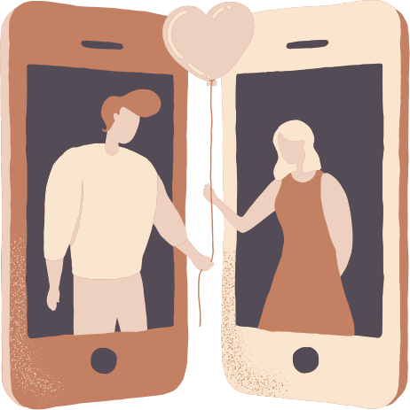
Preserving the Past
Love Unbottled
By: Evy, Jenny, Tracy, Lucia
Notes:
TO DO:
Change the title on slide 1

Slide 2
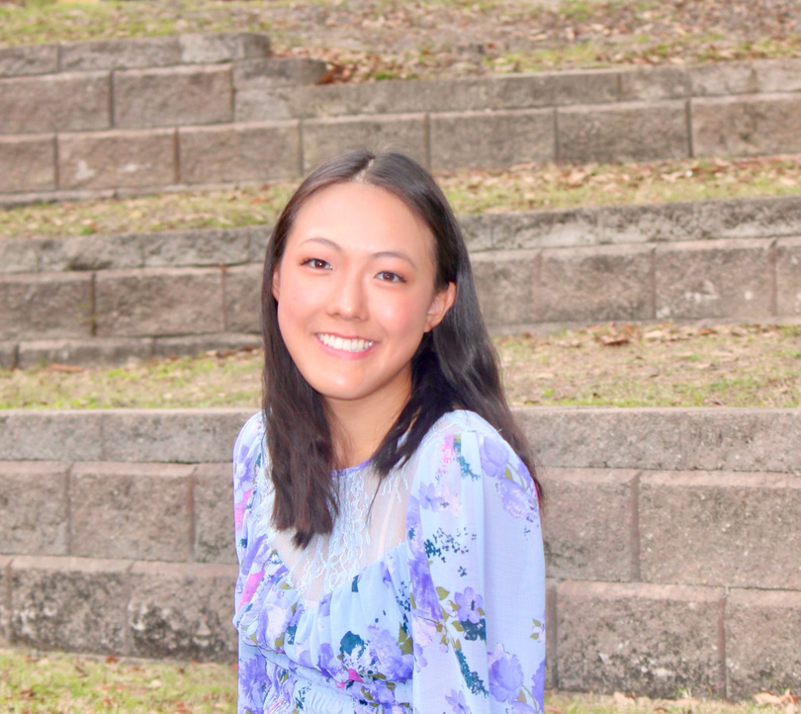
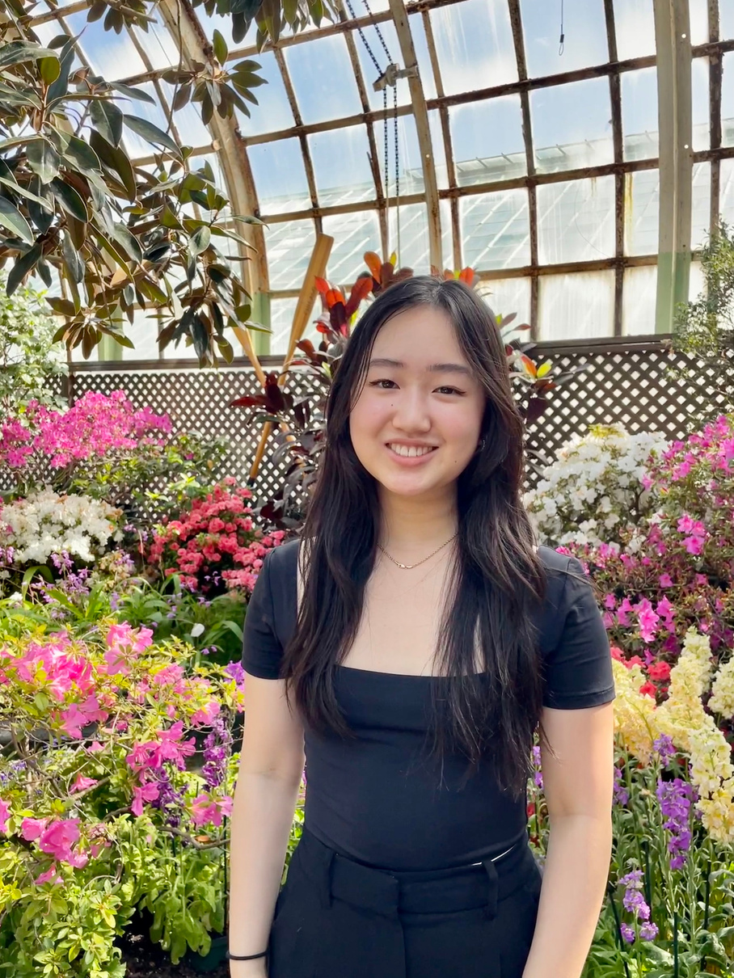
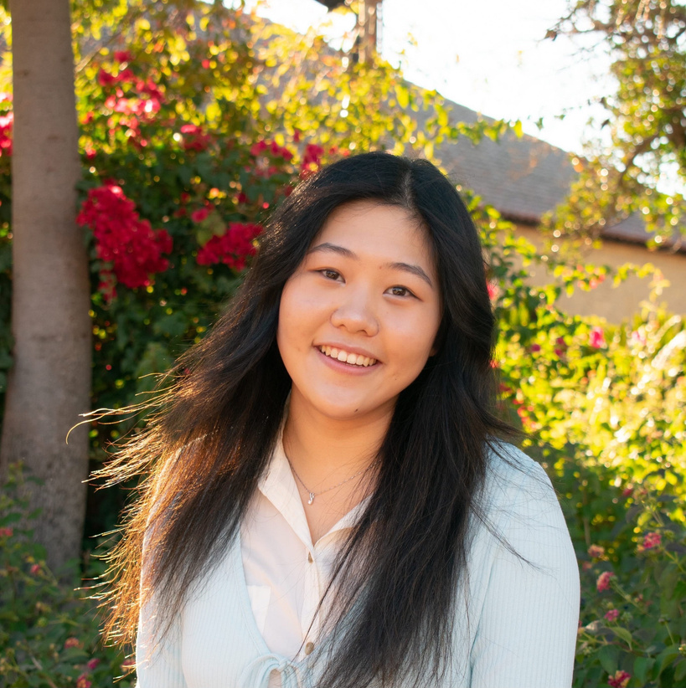
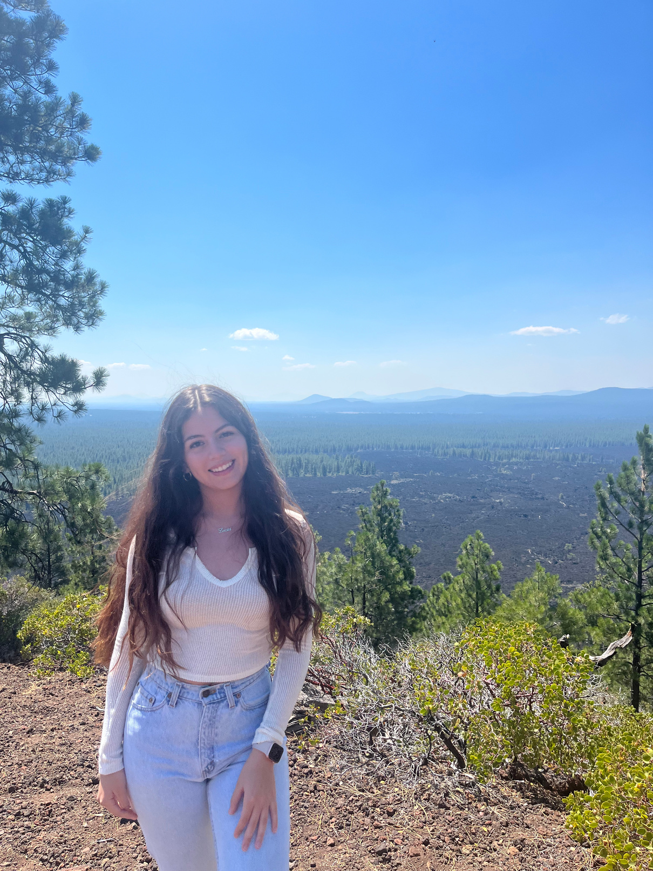
Our Team
Evy Shen
Symbolic Systems
Sophomore
Jenny Duan
Symbolic Systems
Sophomore
Tracy Wei
Symbolic Systems / Design
Sophomore
Lucia Langaney
Computer Science
Sophomore

Slide 3

Domain Selection
Preserving the Past
Refined
Long Distance Relationships
Facilitating Connection Over Conversations

Slide 4
Initial POV
We met...
Patty, a mother of toddlers living in the Bay Area whose family is on the East Coast.

Slide 5
Initial POV
We met...
We were surprised to hear that...
Patty, a mother of toddlers living in the Bay Area whose family is on the East Coast.
her current communication with her long-distance family is sufficient, but she wishes there was more interaction and connection for the kids.

Slide 6
Initial POV
We met...
We were surprised to hear that...
We wonder if this means that...
Patty, a mother of toddlers living in the Bay Area whose family is on the East Coast.
her current communication with her long-distance family is sufficient, but she wishes there was more interaction and connection for the kids.
she is anxious that her kids will grow up without knowing their long-distance family.

Slide 7
Initial POV
We met...
We were surprised to hear that...
We wonder if this means that...
It would be game-changing to...
Patty, a mother of toddlers living in the Bay Area whose family is on the East Coast.
her current communication with her long-distance family is sufficient, but she wishes there was more interaction and connection for the kids.
she is anxious that her kids will grow up without knowing their long-distance family.
help long-distance grandparents become more active in their grandchildrens’ lives.

Slide 8
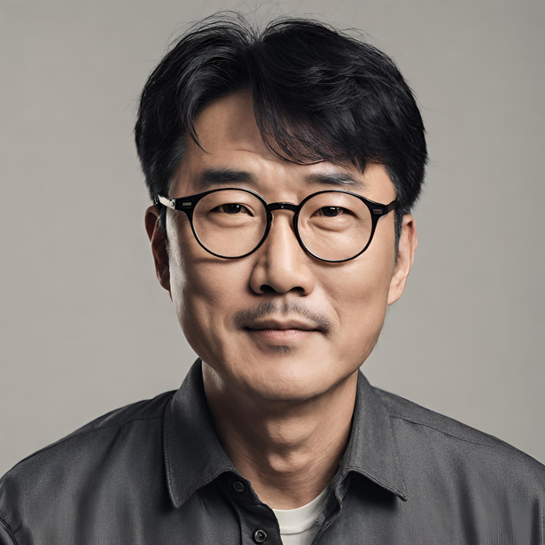

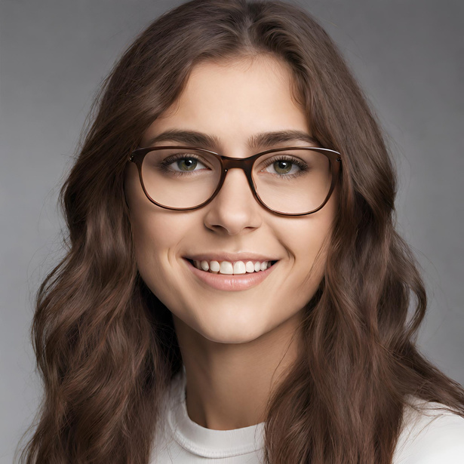
Additional Interviews
Dr. Song*
a father of 2 kids living in the US whose parents and siblings live in South Korea
Chris*
North Carolina Student whose grandma lives in Connecticut
Kayla*
Maryland Student whose best friend moved to Alabama
via Zoom
in-person at UPenn
in-person at UPenn
*images are generated by AI

Slide 9
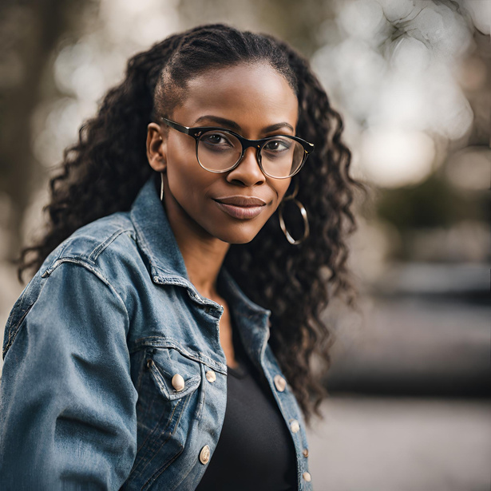
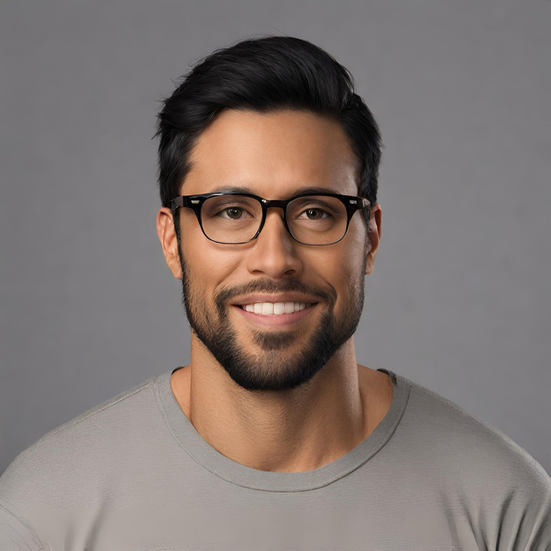


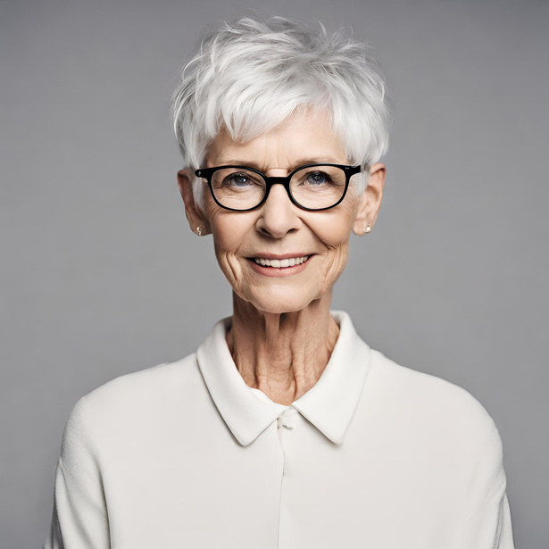
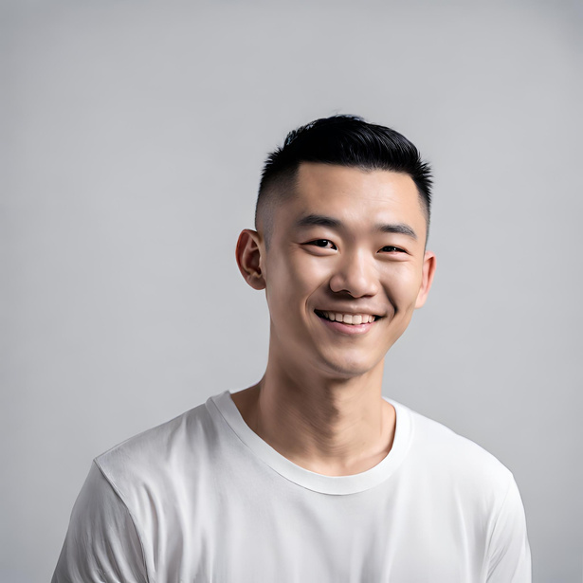
Our Previous Participants
Patty*
Married mother with two toddlers and family on the East Coast
Justin*
Hardware store employee with in-laws in Hong Kong
Brian*
Online college student living in Stanford couples housing
Regular Users
Extreme Users
Kevin*
Stanford undergraduate who recently broke up with his long-distance international relationship
Claire*
High school junior who recently closed the gap in her long-distance relationship
Janice*
Grandmother of young grandchildren, Stanford employee
*images are generated by AI

Slide 10
Learnings
  “I don’t urge my children to make conversation with my parents.” - Dr. Song acts as the intermediary between the kids and parents
    “I am familiar with both Korean and US culture. My parents are only familiar with Korean culture. My kids are only familiar with US culture.”
  “My thought is when I use video call, I might have to be more emotional with my parents. I intentionally avoid using video call with my parents.”
Dr. Song*
a father of 2 kids living in the US whose parents and siblings live in South Korea
*images are generated by AI

Slide 11
Learnings
  There is a knowledge barrier between him and his grandma, as they are unable to call, send photos, or other key communication methods
    “She'll be able to do it, but she'll forget. So it doesn't stick for very long and then that frustrates her. And socially, she doesn't use it very often.”
  Is afraid that grandma won’t remember him because of the distance and she’s experiencing memory loss
    “And so when I'm at school, it's it feels easier to not communicate with her because I'm scared that I'm gonna call her one day and she's not gonna remember who I am.”
Chris*
North Carolina Student whose grandma lives in Connecticut
*images are generated by AI

Slide 12
Learnings
  Trust and care are essential to friendship, even if communication is infrequent
    “And then, like maybe go without talking and then a week where the day where we talk for like at least an hour. So it's kind of like up and down was always at baseline level of life... I'm hoping that as we continue to have this long distance friendship that we can, like, get better at communicating and maintaining”
  Seeing snippets of each others day is a valuable way to connect
    Shared Snapchat story of moments from their everyday lives facilitates connection
Kayla*
Maryland Student whose best friend moved to Alabama
*images are generated by AI

Slide 13
POVs
&
HMWs

Slide 14
POV
We met Kevin, a Stanford undergrad who recently broke up with his long-distance girlfriend of 2 years from overseas.

Slide 15
POV
We met Kevin, a Stanford undergrad who recently broke up with his long-distance girlfriend of 2 years from overseas.
We were surprised to find that their limited time to talk did not lead to more meaningful and precious conversations but was rather occupied with mundane updates.

Slide 16
POV
We met Kevin, a Stanford undergrad who recently broke up with his long-distance girlfriend of 2 years from overseas.
We were surprised to find that their limited time to talk did not lead to more meaningful and precious conversations but was rather occupied with mundane updates.
We wondered if this means that Kevin did not have the chance to form a more meaningful relationship because he was unable to give real-time updates and talk about deeper topics.

Slide 17
POV
We met Kevin, a Stanford undergrad who recently broke up with his long-distance girlfriend of 2 years from overseas.
We were surprised to find that their limited time to talk did not lead to more meaningful and precious conversations but was rather occupied with mundane updates.
We wondered if this means that Kevin did not have the chance to form a more meaningful relationship because he was unable to give real-time updates and talk about deeper topics.
It would be game-changing to shift their conversation priorities to meaningful topics that preserve their connection instead of trivial updates.

Slide 18

HMW
How might we...
make life updates and trivial topics more exciting

Slide 19
POV
We met Dr. Song, a father of 2 kids who moved to the US from South Korea in 2006 and whose parents and siblings currently live in South Korea.

Slide 20
POV
We met Dr. Song, a father of 2 kids who moved to the US from South Korea in 2006 and whose parents and siblings currently live in South Korea.
We were surprised to realize that he acts as an intermediary between his children and his parents but does not urge his children to make conversation with his parents due to cultural and linguistic barriers.

Slide 21
POV
We met Dr. Song, a father of 2 kids who moved to the US from South Korea in 2006 and whose parents and siblings currently live in South Korea.
We were surprised to realize that he acts as an intermediary between his children and his parents and does not urge his children to make conversation with his parents due to cultural and linguistic barriers.
We wondered if this means that he thinks that his children and their grandparents are so different that they can not communicate with them without him as a bridge.

Slide 22
POV
We met Dr. Song, a father of 2 kids who moved to the US from South Korea in 2006 and whose parents and siblings currently live in South Korea.
We were surprised to realize that he acts as an intermediary between his children and his parents and does not urge his children to make conversation with his parents due to cultural and linguistic barriers.
We wondered if this means that he thinks that his children and their grandparents are so different that they can not communicate with them without him as a bridge.
It would be game-changing to remove the cultural barrier between his children and their grandparents.

Slide 23
HMW
How might we...
create opportunities for parents to support shared storytelling and bonding between children and their grandparents?

Slide 24
POV
We met Patty, a mother living in Palo Alto whose family is on the East Coast.

Slide 25
POV
We met Patty, a mother living in Palo Alto whose family is on the East Coast.
We were surprised to realize that she feels that her communication with her long-distance family is sufficient but wishes there was more interaction and connection for her kids.

Slide 26
POV
We met Patty, a mother living in Palo Alto whose family is on the East Coast.
We were surprised to realize that she feels that her communication with her long-distance family is sufficient but wishes there was more interaction and connection for her kids.
We wondered if this means that she’s anxious her kids will grow up without knowing their long-distance family.

Slide 27
POV
We met Patty, a mother living in Palo Alto whose family is on the East Coast.
We were surprised to realize that she feels that her communication with her long-distance family is sufficient but wishes there was more interaction and connection for her kids.
We wondered if this means that she’s anxious her kids will grow up without knowing their long-distance family.
It would be game-changing to facilitate convenient and engaging ways for family members to feel connected to their children.

Slide 28
HMW
How might we...
make children interested in connecting with their long-distance relatives?

Slide 29
Solutions
&
Assumptions

Slide 30
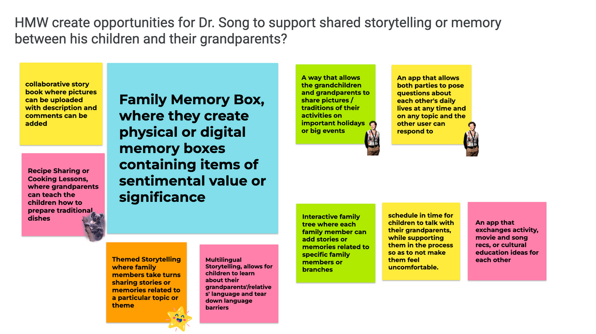
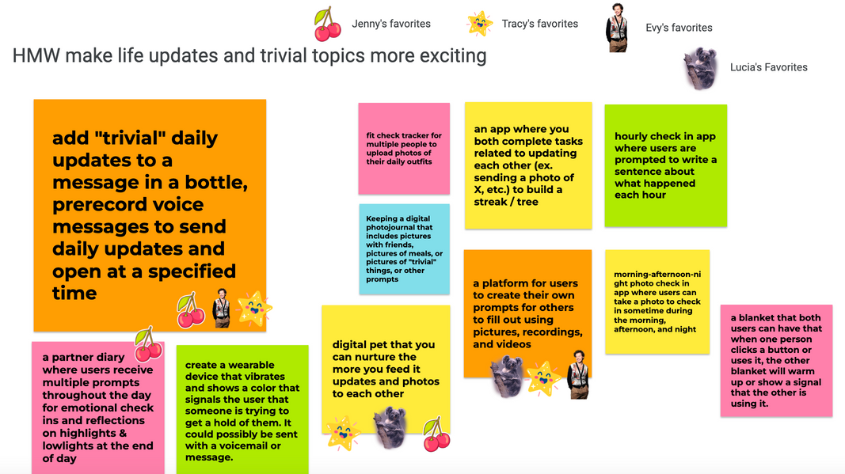
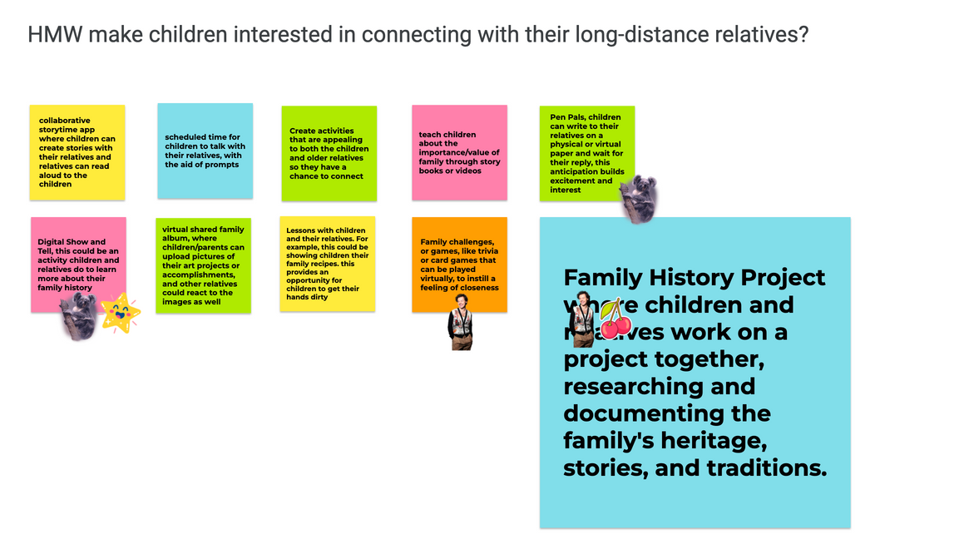
Brainstorming Solutions

Slide 31

1.
Message in a Bottle
The idea: Users add updates to a message in a bottle, prerecord voice messages to send daily updates and open at a specified time

Slide 32
1.
Assumptions
  Receiving and recording mundane moments brings value to the sender and receiver
  It is not a burden to record your mundane moments
  People want to take time to go through a curated recap of another’s day
  Waiting to open messages creates anticipation and excitement
  People are willing to wait to share their vulnerable or challenging moments.

Slide 33
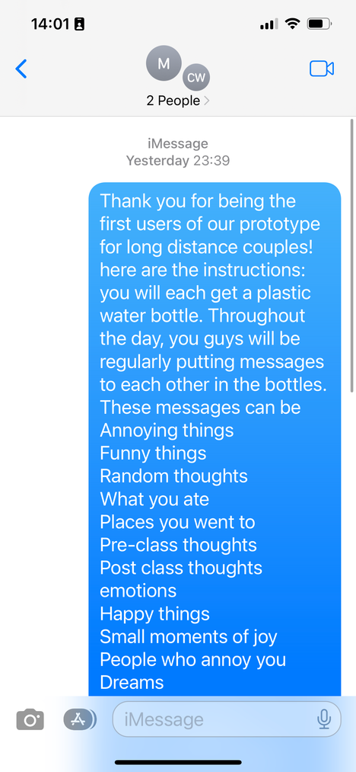

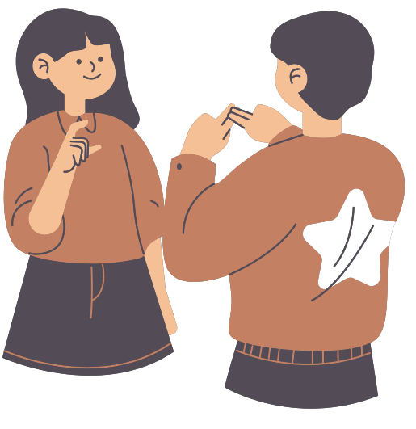




1.
Experience Prototype
Had them fill their bottles with updates / random thoughts throughout the day
They exchanged their bottles at the end of the day and open each other’s messages
Maxine & Cody (gf/bf, both Stanford undergrads) given 2 empty bottles

Slide 34

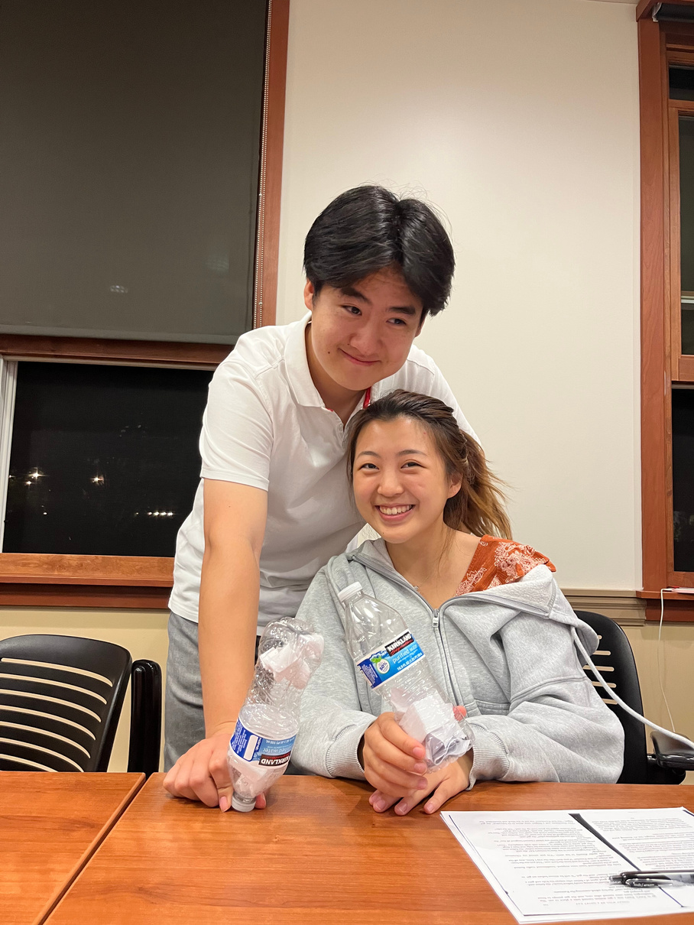
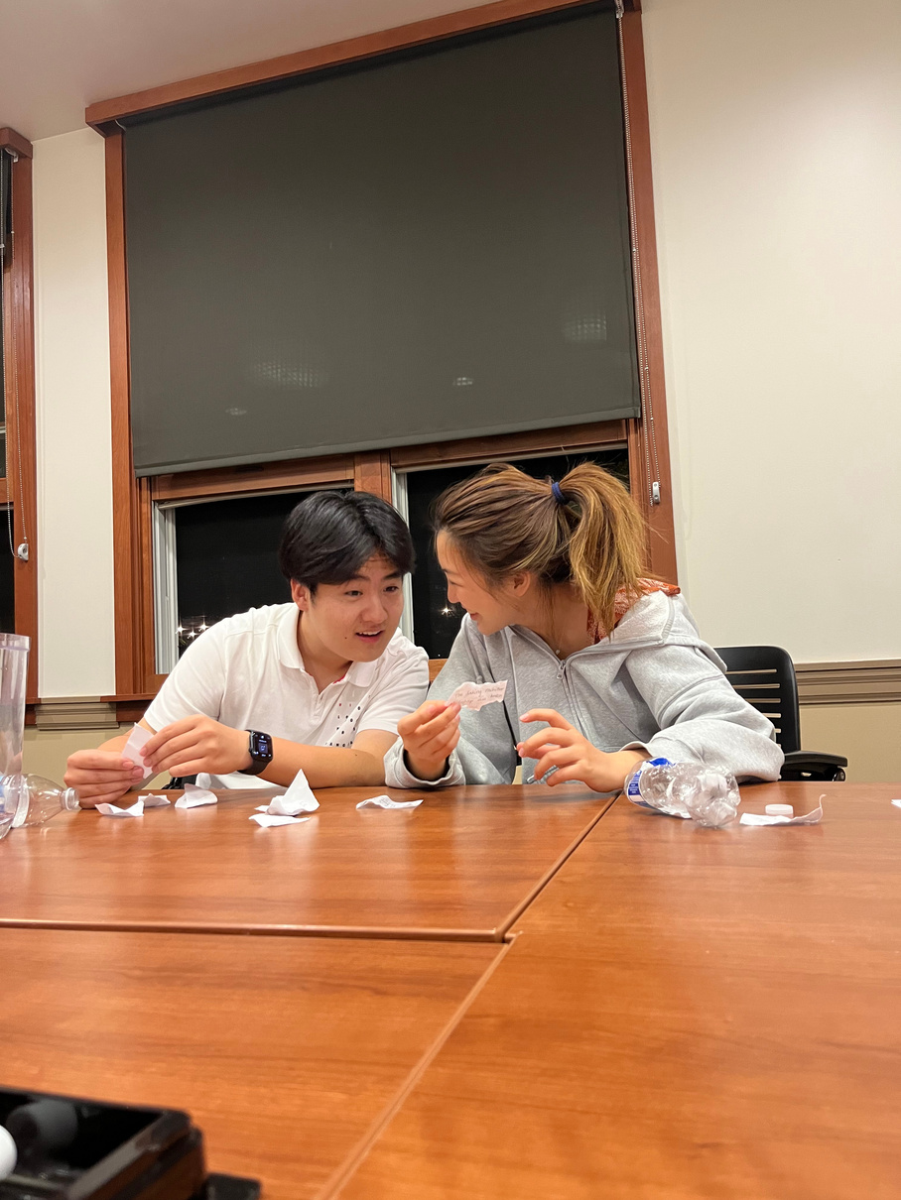
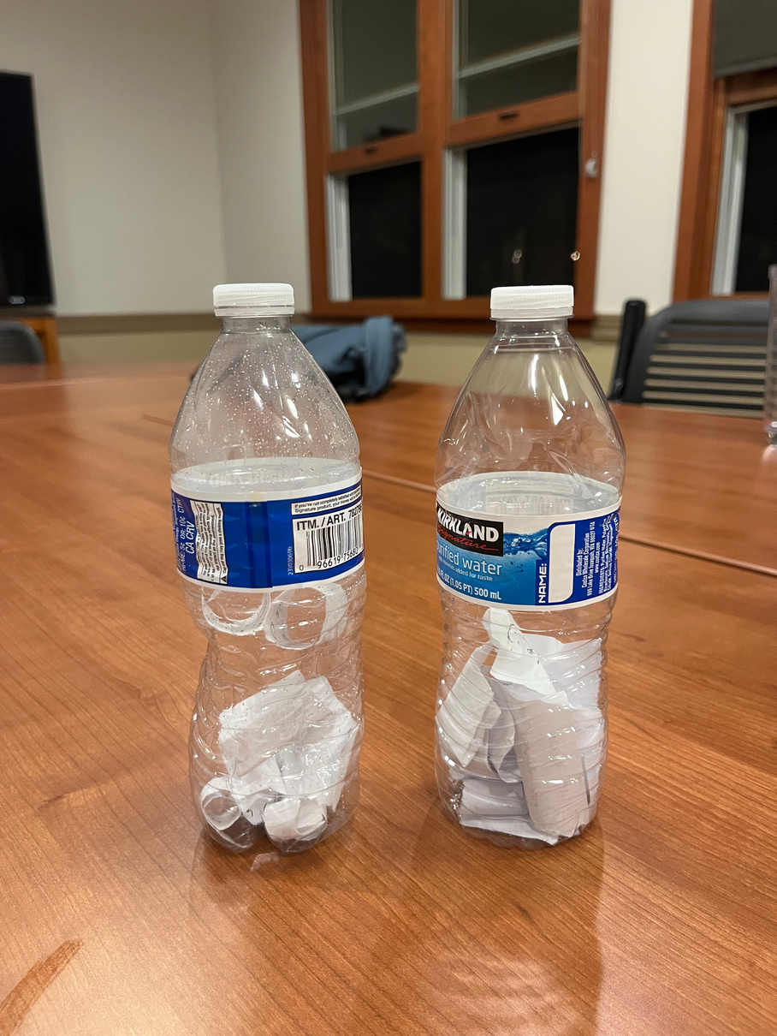
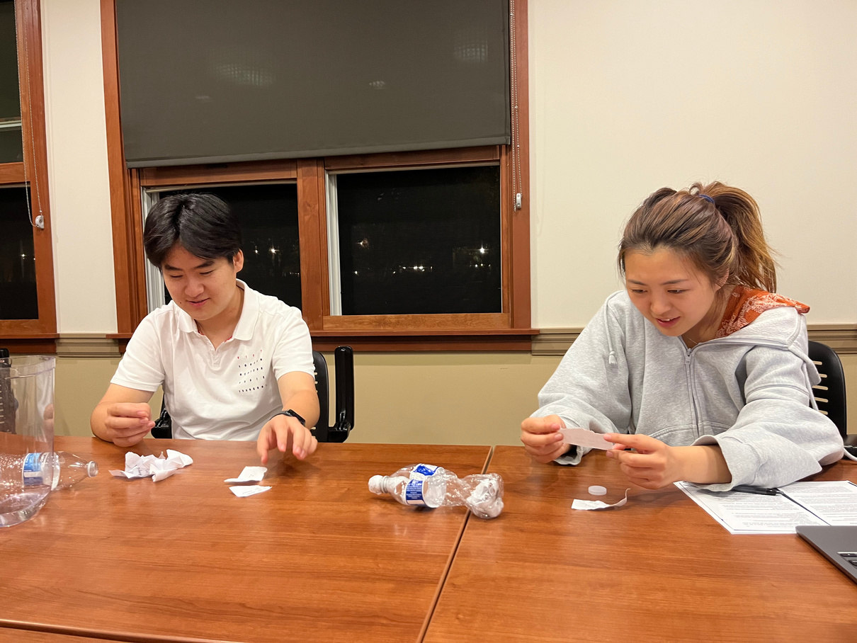
exchanging notes
conversations
a day’s worth of little notes
reading each other’s messages
Recruited through mutual friends
Environment of Exchange: Ng Study Room

Slide 35
Results

Slide 36

Results
Things that worked...
  Both were happy to share things they otherwise would’ve forgotten
  Recording wasn’t inconvenient
  Felt excited to share later
  More efficient updating; could ask clarification on things that piqued their interest

Slide 37
Results
Things that worked...
Things that didn’t work...
  Both were happy to share things they otherwise would’ve forgotten
  Recording wasn’t inconvenient
  Felt excited to share later
  More efficient updating; could ask clarification on things that piqued their interest
  Updates aren’t detailed
  Would rather just receive updates in real time
  Couple was not long-distance -> couple didn’t have many communication problems

Slide 38

Results
Things that worked...
Things that didn’t work...
Learnings
  Both were happy to share things they otherwise would’ve forgotten
  Recording wasn’t inconvenient
  Felt excited to share later
  More efficient updating; could ask clarification on things that piqued their interest
  Updates aren’t detailed
  Would rather just receive updates in real time
  Couple was not long-distance -> couple didn’t have many communication problems
  People want their updates to be a balance of efficient, detailed, and interesting
  Mundane moments and random thoughts are interesting for both the receiver and sender

Slide 39

2.
Family Memory Box
The idea: Relatives create physical or digital memory boxes containing items of sentimental value or significance and take turns sharing why they entered a certain item.

Slide 40
2.
Assumptions
  Having a dedicated space for memories enhances the emotional connection to those memories
  People have moments of significance tied to objects, pictures, or videos

Slide 41
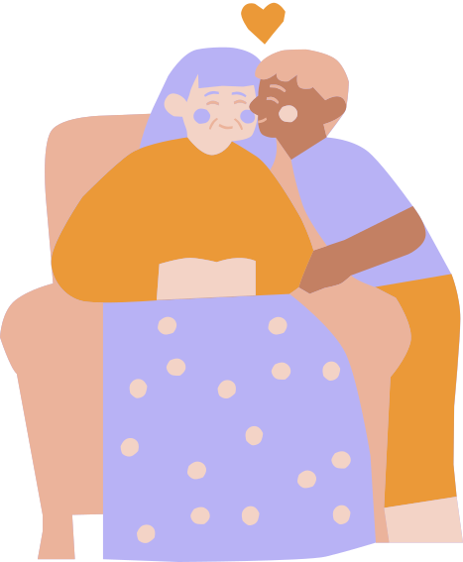

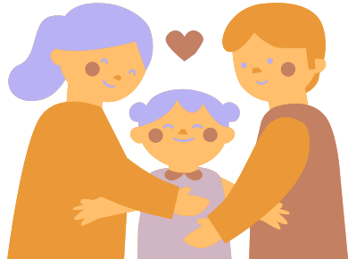




2.
Experience Prototype
child and grandparent talk about what memories are important to their family
they put objects associated with those memories into a box, or other form of compilation
they go through the collection together with another family member

Slide 42
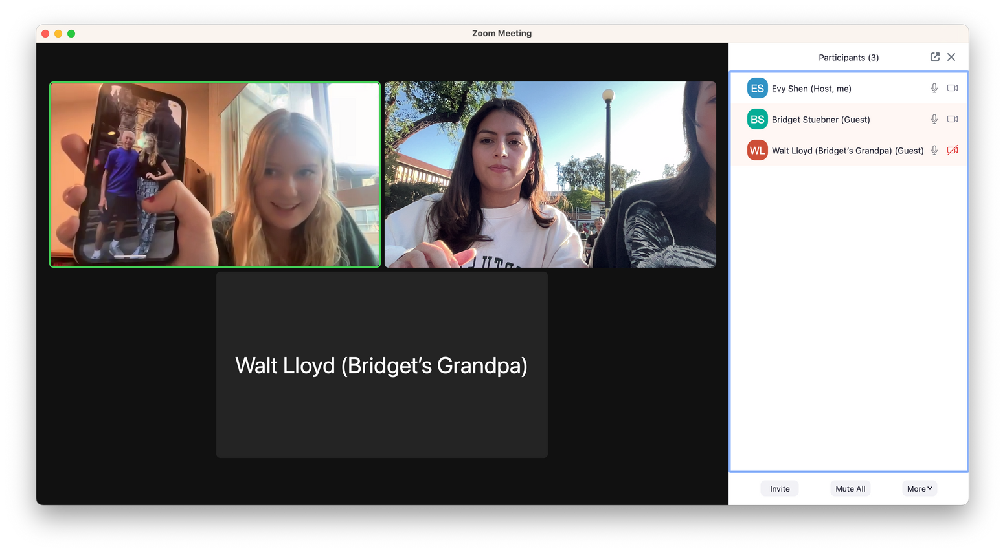
🧑 Participants:
Bridget - Stanford undergrad
Bridget grandfather - lives in Palm Springs
🏠 Environment: Zoom due to long distance
Sharing Memories Together

Slide 43
Results

Slide 44
Results
Things that worked...
  Both were able to come up with meaningful memories to share
  Sharing brought up emotions of closeness
  The activity reminded them that they are loved

Slide 45
Results
Things that worked...
Things that didn’t work...
  Both were able to come up with meaningful memories to share
  Sharing brought up emotions of closeness
  The activity reminded them that they are loved
  It was difficult to have a physical box when users were LD
  Had connection issues with older relative
  Some significant things do not have physical manifestations. Some only exist in memory.

Slide 46
Results
Things that worked...
Things that didn’t work...
Learnings
  Both were able to come up with meaningful memories to share
  Sharing brought up emotions of closeness
  The activity reminded them that they are loved
  It was difficult to have a physical box when users were LD
  Had connection issues with older relative
  Some significant things do not have physical manifestations. Some only exist in memory.
  This prototype was not effective for relatives who are already very close
  Older relatives feel a greater sense of nostalgia than than the younger relatives because they have more time in their day to reflect

Slide 47

3.
Family History Project
The idea: Children and relatives work on a project together, researching and documenting the family's heritage, stories, and traditions.

Slide 48
3.
Assumptions
  Children and younger family members have an interest in their family's heritage and history.
  Children have the capacity to research and document their family history.
  Children and their relatives will have engaging conversations or interactions upon going through the process of document their family history.

Slide 49
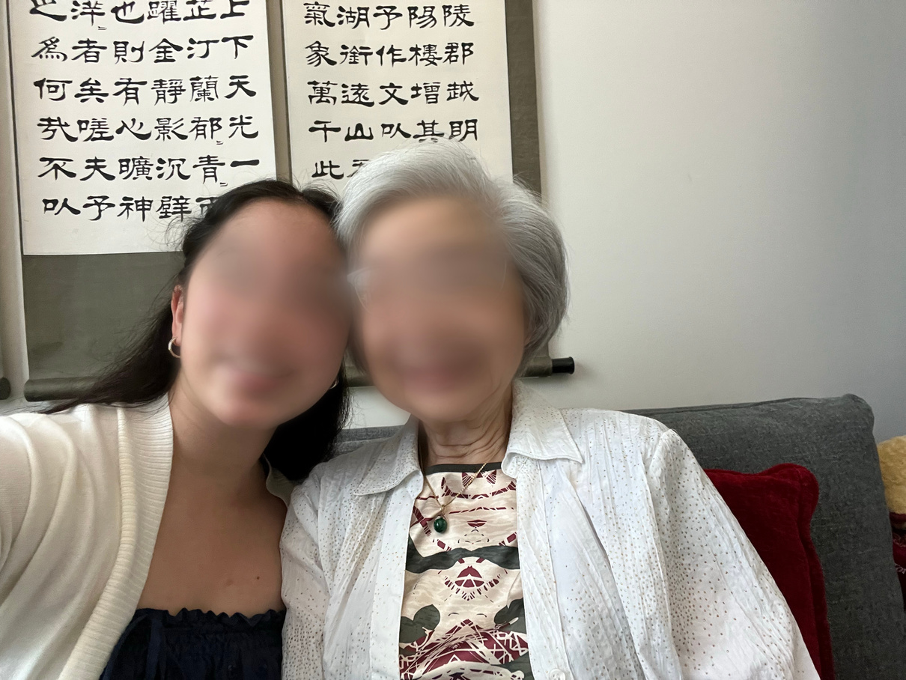
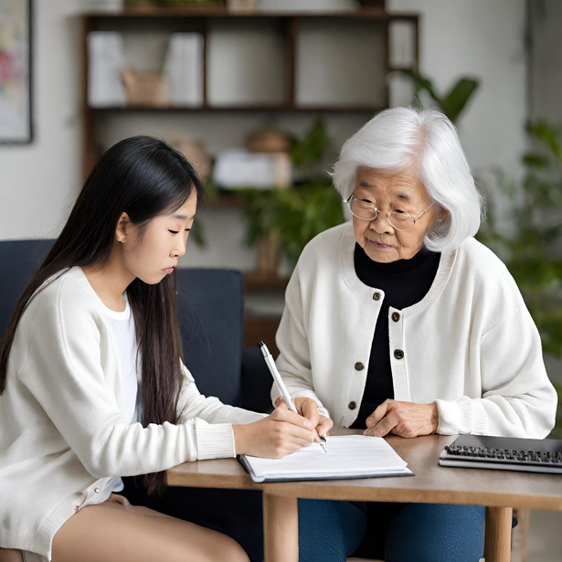


3.
Experience Prototype
Participants are given:
  a notetaking paper with prompts
  voice memo app
They go through the prompts on the paper together and take notes/voice record their answers.
What is an interesting part of your family history?
______________________________
What traditions do we celebrate as a family?
____________________________
Can you describe one of your childhood memories
🧑 Participants:
  Lisa - Stanford undergrad
  Lisa’s grandmother - lives in the Bay Area
🏠 Environment: Lisa’s grandmother’s house
*faces blurred for privacy of participants

Slide 50
Results

Slide 51
Results
Things that worked...
  Stories that Lisa had never heard before (like her grandmother’s childhood during WWII) were shared.
  Lisa felt like she grew closer to her grandmother.
  Lisa liked having these notes to look back on.

Slide 52
Results
Things that worked...
Things that didn’t work...
  Stories that Lisa had never heard before (like her grandmother’s childhood during WWII) were shared.
  Lisa felt like she grew closer to her grandmother.
  Lisa liked having these notes to look back on.
  The information-sharing seems very one-sided, often coming from Lisa’s grandmother.
  Lisa mainly listened and took notes

Slide 53
Results
Things that worked...
Things that didn’t work...
Learnings
  Stories that Lisa had never heard before (like her grandmother’s childhood during WWII) were shared.
  Lisa felt like she grew closer to her grandmother.
  Lisa liked having these notes to look back on.
  The information-sharing seems very one-sided, often coming from Lisa’s grandmother.
  Lisa mainly listened and took notes
  Working together on recording family history deepens bonds between family members.
  This interaction is usually one-way, with the older generation talking while the younger generation listens.

Slide 54
What’s next?
  We plan to move forward with the messages in a bottle idea, but revised.
  Ethical Implications
    People may intend their messages in their bottle to only be seen by the receiver, but it may be leaked if there are problems with data security.
  Who does this serve?
    This solution serves people in relationships (friends, family, romantic partners)
  Who does this leave out?
    This solution may leave out people who do not have access to the internet or digital devices would be excluded.

Slide 55
Thank you!

Slide 56
Appendix
ALL HMW Statements:
  Patty:
    make it convenient for family members to communicate with their children?
    make children interested in connecting with their long-distance family members?
    eliminate possible language and technology barriers?
    deal with time zone differences if we want to facilitate real-time interactions?
    create engaging activities that will make children interested in connecting with their long-distance relatives?
    leverage technology to provide tools that simplify communication?
    promote regular and meaningful interactions between families living in different time zones?
    create a sense of consistency in long-distance family interactions to help children feel more secure?
    make it easier for older relatives to share their heritage and wisdom?
    encourage families to capture and share their memories to foster a sense of shared identity and heritage?
  Dr. Song:
    create opportunities for his children to learn about their cultural background?
    explore the potential fears or apprehensions Dr. Song might have about his children losing touch with their cultural roots?
    encourage Dr. Song's children to actively engage in conversations with their grandparents?
    address any hesitations that his children might have about interacting with their grandparents from a different cultural background?
    enable Dr. Song's children to communicate easily with their grandparents despite the linguistic barriers?
    explore the perspective of the grandparents and how they feel about the perceived barriers in communicating with their grandchildren?
    identify common ground or topics that both Dr. Song's children and their grandparents can engage in, regardless of their cultural differences?
    increase Dr. Song’s children’s interest in their cultural background?
    provide resources or support for Dr. Song in his role as an intermediary, ensuring he feels valued and not overwhelmed?
    create opportunities for shared storytelling or memory sharing between Dr. Song's children and their grandparent
  Kevin:
    facilitate easy updating?
    make conversation centered around deeper topics easier to transition into?
    address the challenge of time zones and differing schedules?
    create uninterrupted quality time for couples?
    remove the need for trivial updates?
    incorporate emotional check-ins for couples to better understand each other's emotional well-being?
    assist couples in reflecting on the quality of their interactions and encouraging them to deepen their connection?
    capture moments and experiences in real time?
    make life updates and trivial topics more exciting?
    help couples accommodate each other’s love languages?

Slide 57
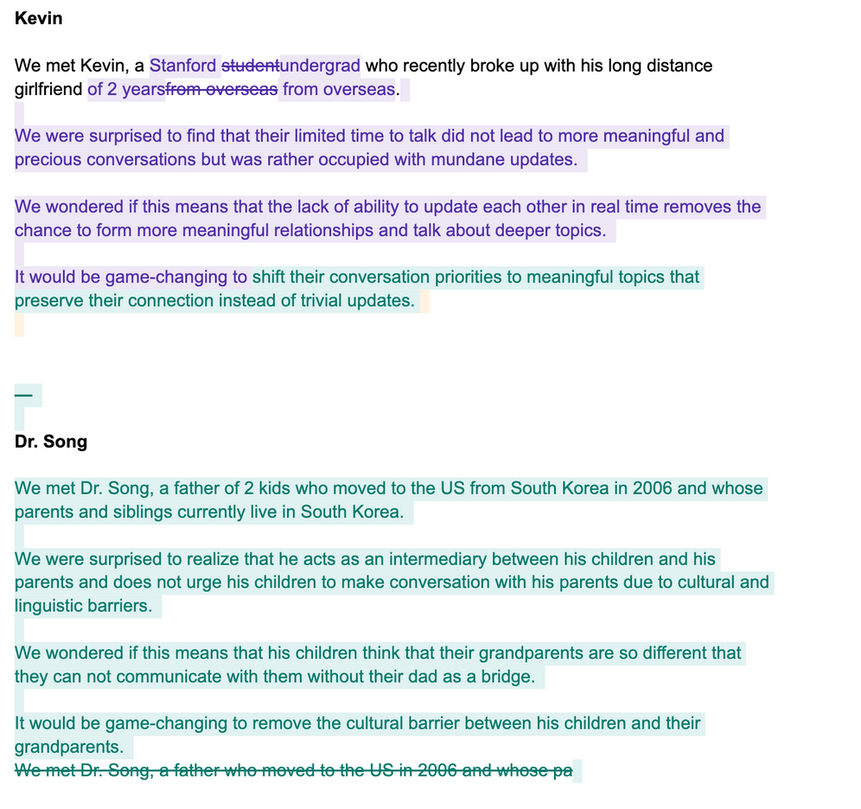
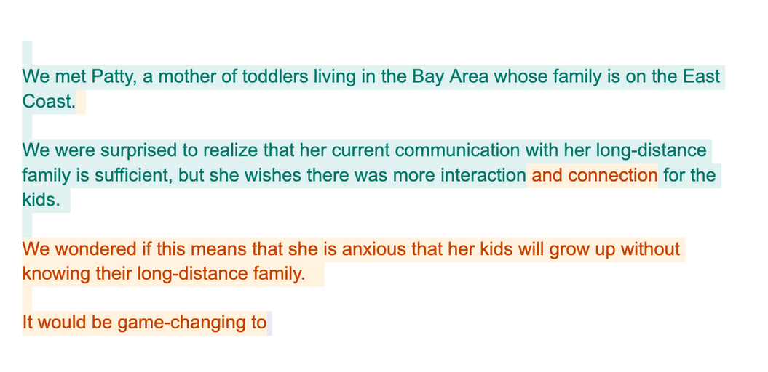
Appendix
POVs Brainstorm

Slide 58
Appendix
Solution Brainstorm

