Slide 1

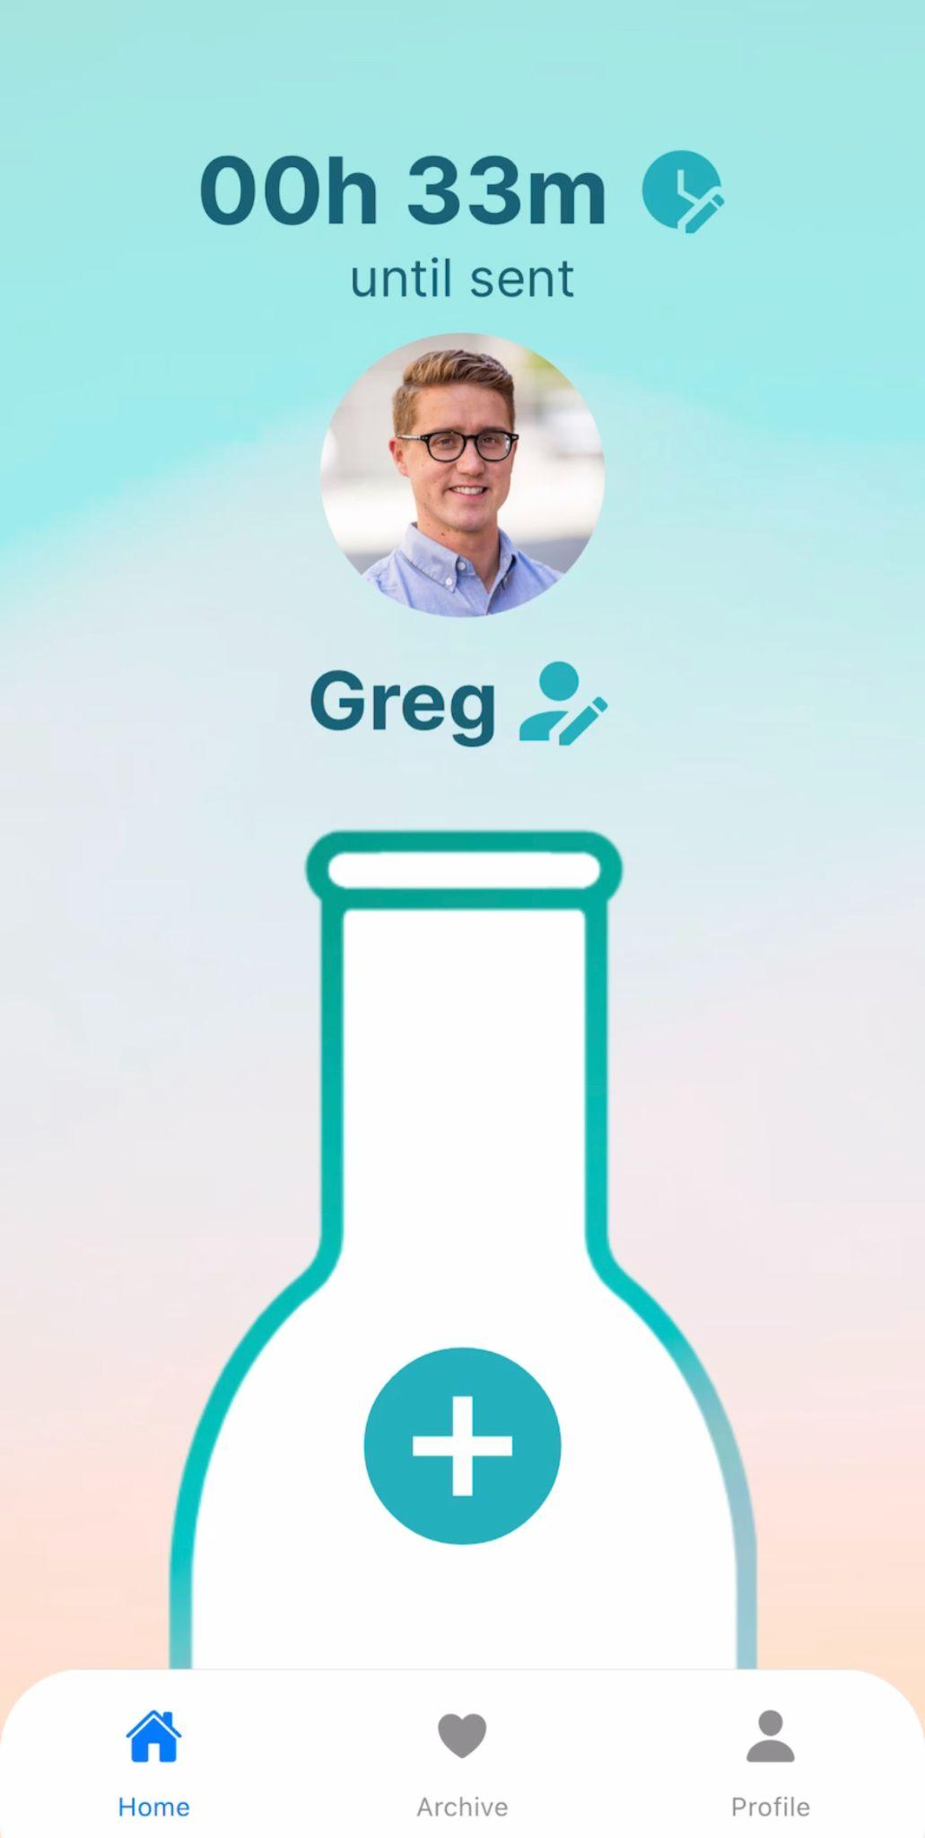
BOTTLE
uncap your day with others

Slide 2
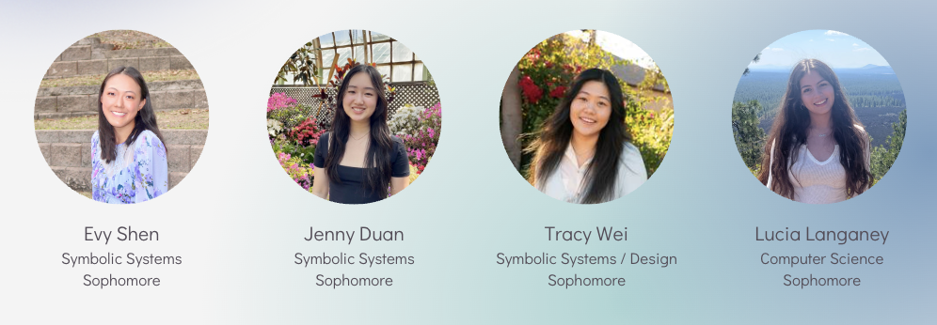
TEAM

Slide 3
OVERVIEW
PROBLEM
SOLUTION
Busy lives and time-zone differences make it difficult for long-distance loved ones to share updates in real-time. During limited conversations, people have a hard time recounting little moments throughout their day, moments we believe are critical in maintaining emotional intimacy in relationships.
Bottle makes updating easy:
1) Users store “mundane” updates throughout their day (text, image, videos, etc.) to a bottle, in which
2) they exchange with a receiver’s, to be opened and shared at a set time, optionally over a video call, enriching conversations and creating engagement through built-up anticipation.

Slide 4
TALK OUTLINE
01
03
02
04
Heuristic Evaluation Results
Prototype Implementation Status
You can describe the topic of the section here
UI and Product Revisions
Demo of Prototype

Slide 5

01
Heuristic Evaluation
Results

Slide 6
HEURISTIC EVALUATION SUMMARY
2.13%
25.5%
38.3%
27.6%
6.38%
Sev 0: 1 Sev 1: 12 Sev 2: 18 Sev 3: 13 Sev 4: 3
Most violated heuristics: consistency & standards (H4) and accessibility (H11)

Slide 7
HEURISTIC EVALUATION SUMMARY
15%
Enhance error prevention mechanisms, especially in viewing and managing sent content.
Improve visibility of system status, particularly in indicating active screens and navigation.
Prioritize accessibility concerns, including text legibility and providing alternative input methods.
Enhance the value alignment and inclusion by allowing users to edit their media for authenticity.
Efficiency in features, e.g. time and recipient selection

Slide 8
SELECT LEVEL 3 AND 4 VIOLATIONS
H1: Visibility of System Status
Severity 3: Navbar does not visually indicate which screen is focused/active– Lack of visual cues can make users feel lost and uncertain about their current location.
H7: Flexibility and Efficiency of Use Description:
Severity 4: The bottles are unclickable– general confusion on how to open a bottle.
H6: Recognition Rather than Recall
Severity 3: Name of the bottle owner is not displayed in the “Select Media” or “Insert Moment” screen.
H11: Accessible Design
Severity 3: Date text underneath bottles in “Bottle Archive” screen is really small

Slide 9
SELECT LEVEL 3 AND 4 VIOLATIONS
(unrevised)
H11: Accessibility
Severity: 3 The text box does not expand when a user begins to type; this can quickly become a visual issue when people want to tell longer stories in the format of the bottle.
-> word limit: sharing the mundane little moments
H12: Value Alignment and Inclusion
Severity 3: For all forms of media, there is no ability to edit (i.e., crop a picture, cut a voice memo, edit a video). Giving users ownership over their spontaneous media aligns with the value of inclusion and authenticity.
-> no editing to promote genuine inside look into daily moments.
Notes:
Here are some level 3 and 4 heuristic violations that were ultimately decided to be kept due to our values and vision for the app:
1) We decided against expanding the text box because we plan on implementing a word limit, so text crowding would never be an issue. This word limit is intended to improve digestibility, aligning with our value of sharing the mundane little moments, rather than restrict storytelling.
2) We wanted to preserve the authenticity of everyday moments so we decided against a feature to edit, similar to that of bereal. In doing so, we intend promote genuine inside look into daily moments.

Slide 10
02
UI & Product Revisions
Notes:
- revision 1: time and receiver
- revision 2: bottle owner displayed for insert moments
- revision 3: no indication of what screen we’re on on the nav bar
- revision 5: thin text -> bolded text and made it bigger (#47)
- revision 6: “submit” instead of “insert moment” - explain why we didn’t revise
- revision 7: add data limit to bottle -> display size limit (#35)
- revision 8: #26 -> technical error on figma
- revision 9: #20 -> our app is like bereal, once you put a message in the bottle, you can’t take it out
- revision 10: save bottle to library/archive
- revision 11: #6

Slide 11
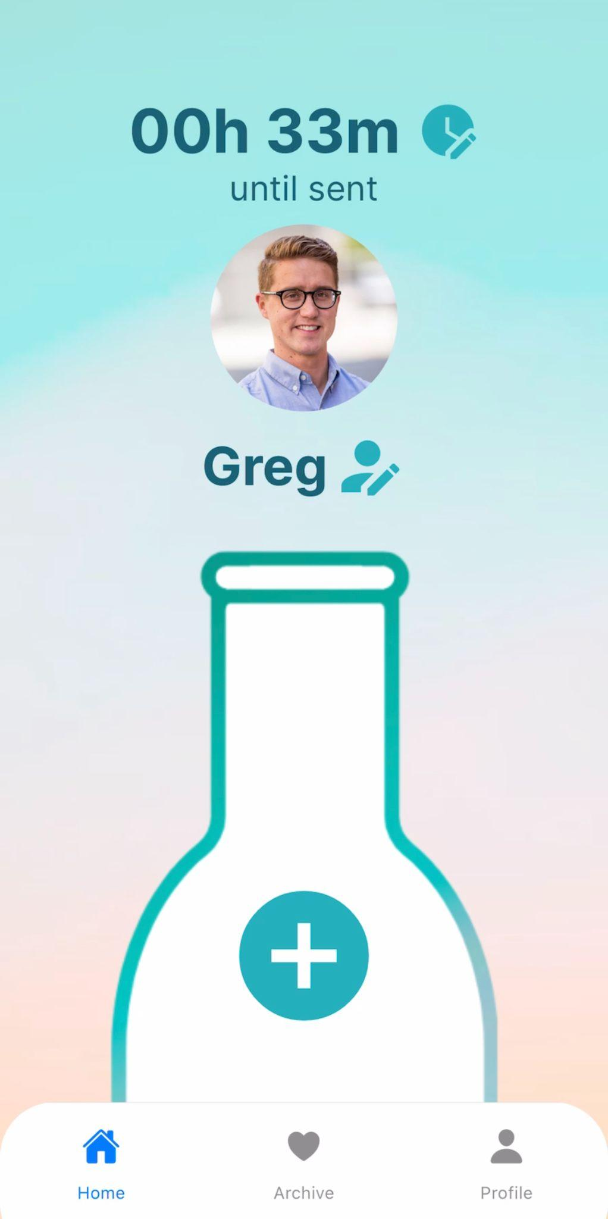
REVISION 1:
Task Flow 2
Change time & receiver

Slide 12
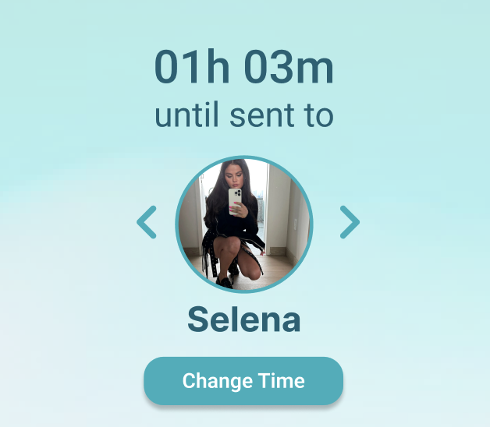
REVISION 1A:
Buttons to edit time & receiver
before
To change receiver → swipe through entire receiver list
Change time button distant from countdown → doesn’t follow Gestalt’s
after
Using Gestalt principle of proximity, we placed the change time button next to the countdown time and edit receiver next to the receiver name.

Slide 13
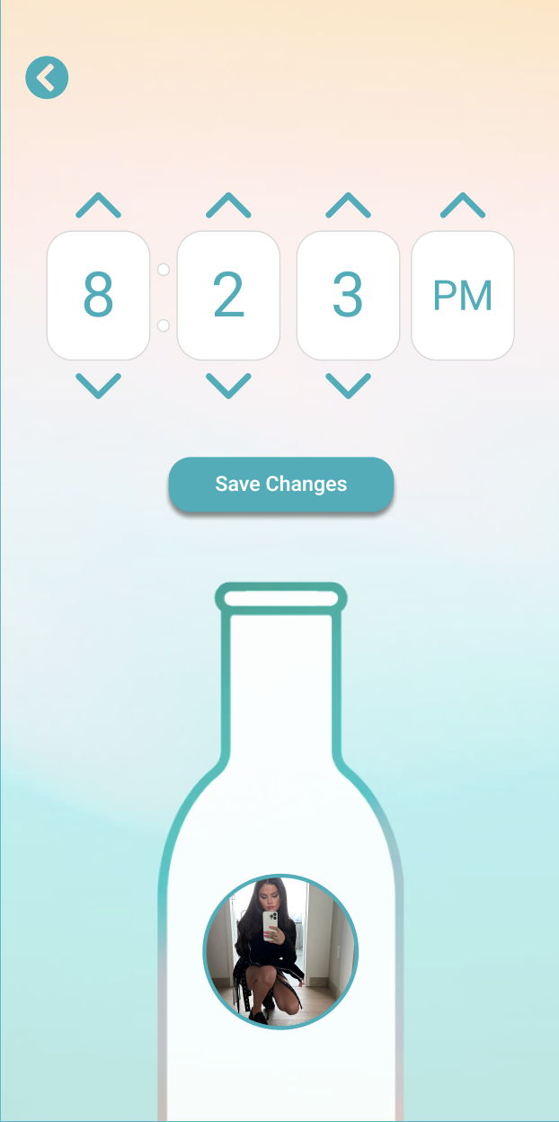
ISSUE 11 (H7):
Time selection is only editable by arrows that increase or decrease each value by 1.
It takes a lot of clicks to get to certain times. Consider the initial time 12:00. If one wanted to make the time 6:55, it would take over 15 clicks to get there.
severity 3

Slide 14
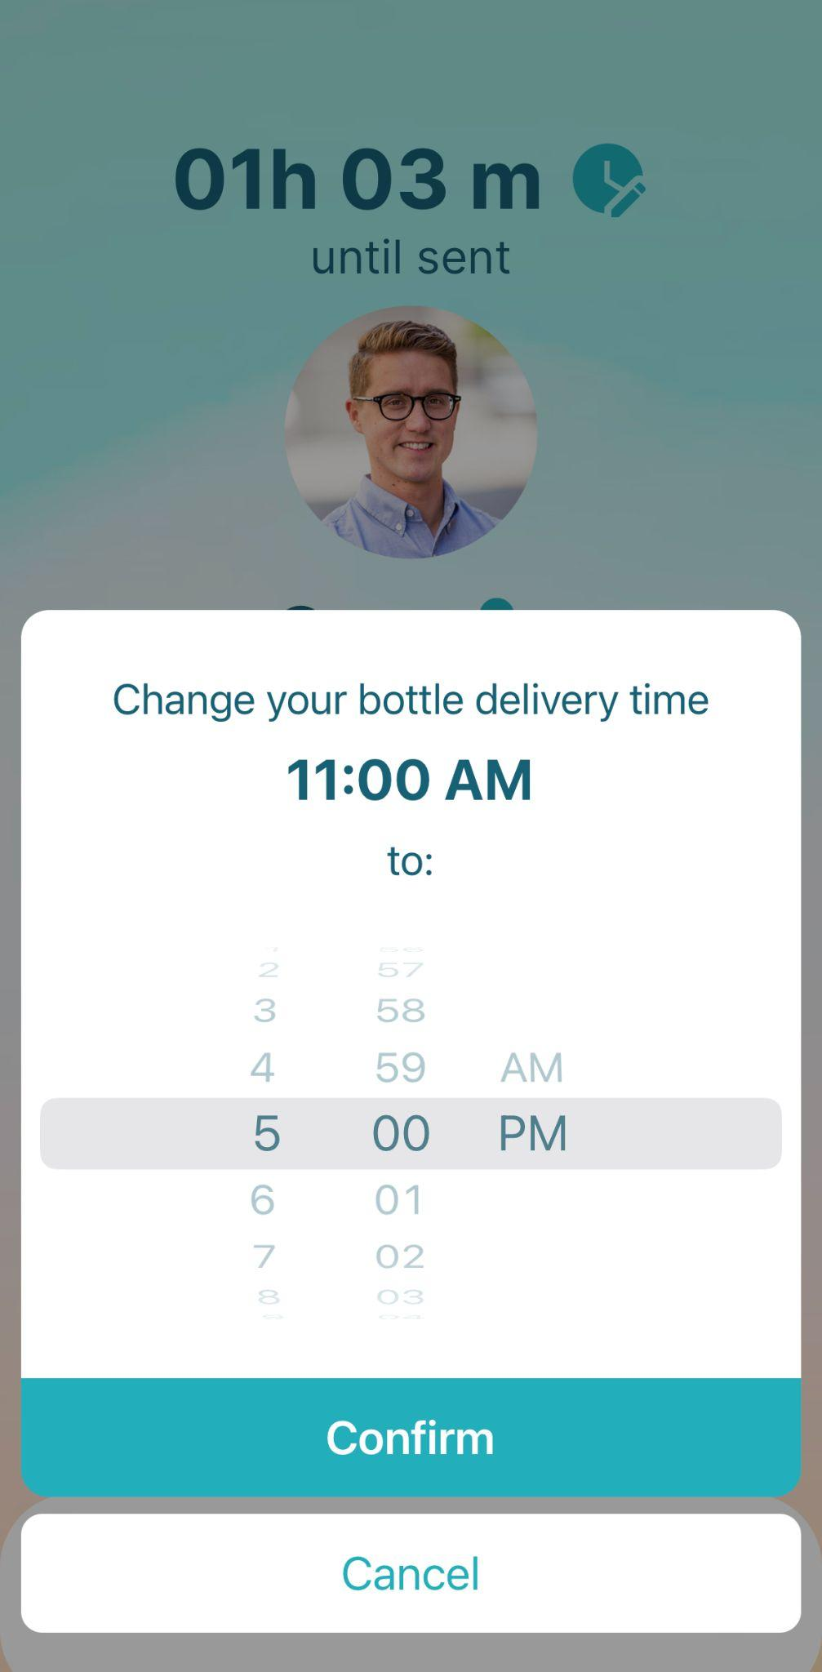
REVISION 1B: Changing time
RATIONALE
We now have the change time as a pop-up, eliminating moving back and forth between screens.
We also opted for a more intuitive wheel roll for editing the time.
before
after

Slide 15

ISSUE 12 (H7):
User must navigate through person-selection by pressing arrow buttons to more left or right one at a time.
Does not offer shortcuts for faster selection if the user has a specific person in mind.
severity 4

Slide 16
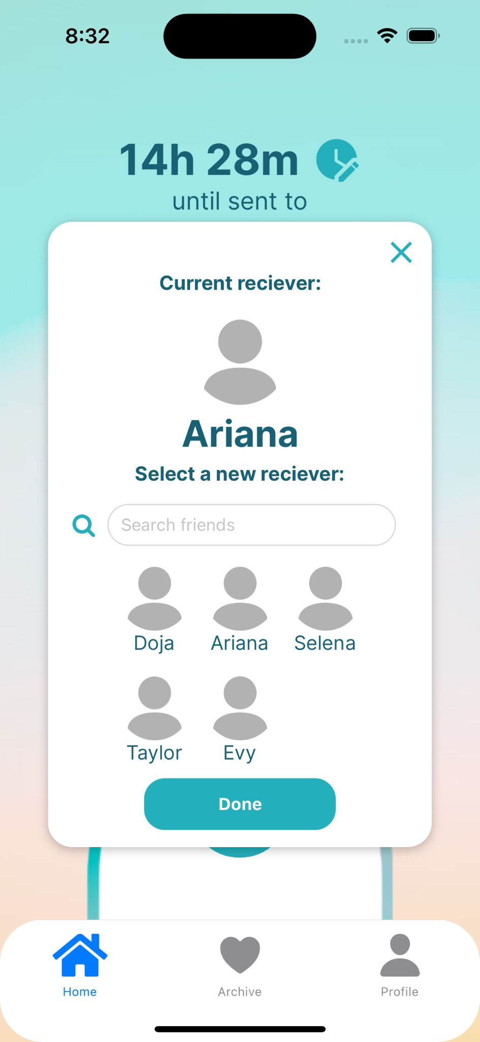
REVISION 1C: Changing receiver
RATIONALE
We now have the change receiver as a pop-up and a search bar to find a receiver.
This eliminates tediously swiping through people to select.
before
after

Slide 17

ISSUE 19 (H1):
Navbar does not visually indicate which screen is focused/active
Lack of visual cues can make users feel lost and uncertain about their current location.
severity 3

Slide 18
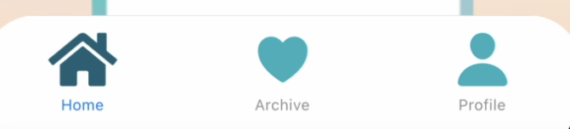
REVISION 2: Nav Bar
before
after
RATIONALE
Used darker accent to visually indicate which screen the user is currently on
Moved home icon to the very left (conventional position in nav bar)
Labelled icons with names of the screens they navigate to → prevents confusion about what each icon represents
From heuristic evaluation → no visual indicator which screen the user is on
Home icon is unconventionally in the center

Slide 19
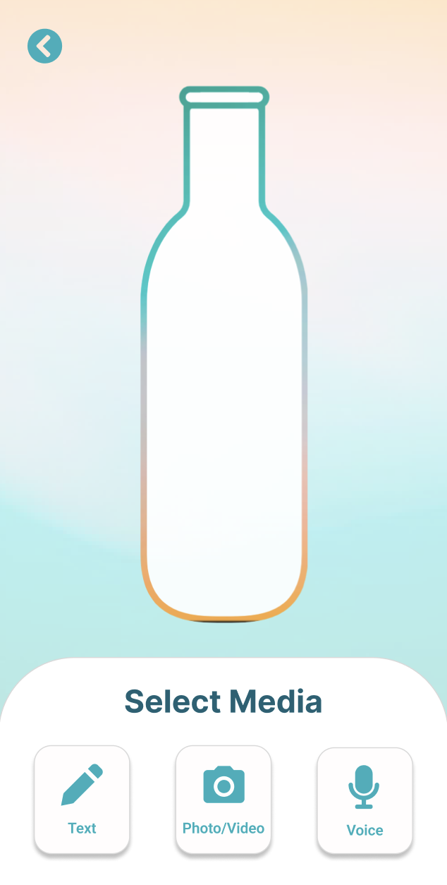
ISSUE 3 (H6):
Name of the bottle owner isn’t displayed in the “Select Media” or “Insert Moment” screen.
The absence of the recipient may confuse users because they are uncertain of whom the current message is for.
severity 3

Slide 20
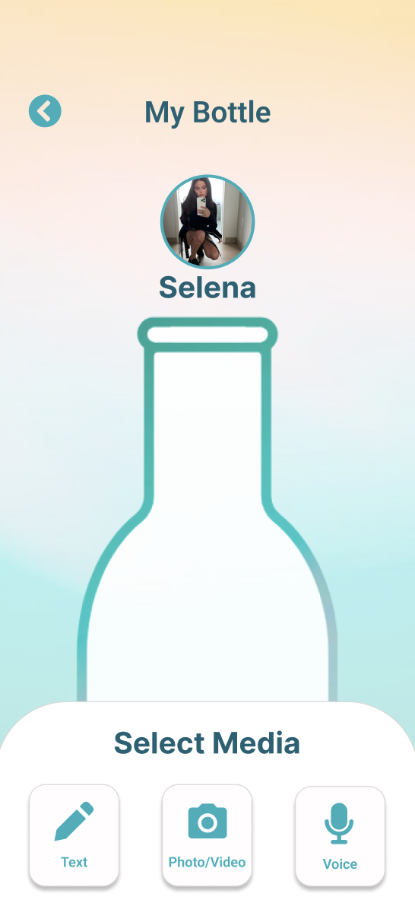
REVISION 3:
Add moment page
RATIONALE
Added “My Bottle” title to screen to clarify that this is the user’s own bottle.
Added receiver name & photo next to bottle to clarify the recipient of this bottle that the user is adding to.
before
after

Slide 21
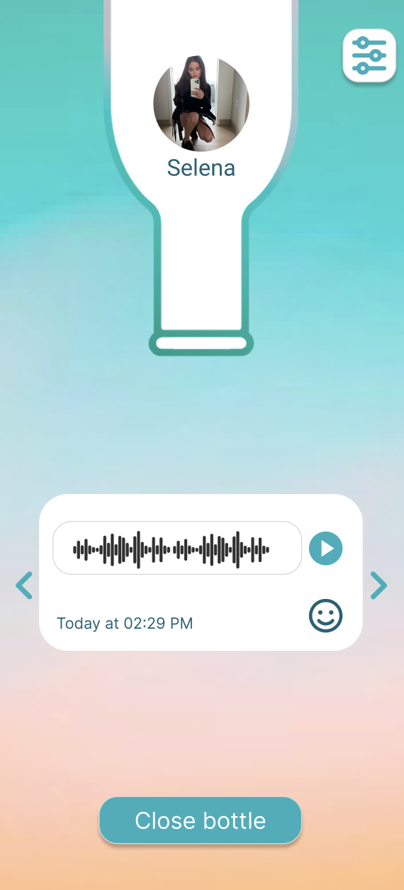
ISSUE 47 (H11):
Text is generally very thin on buttons/on captions
The text often used is white on a medium blue background. This can be difficult to see, especially for those who want high contrasts.
severity 3

Slide 22
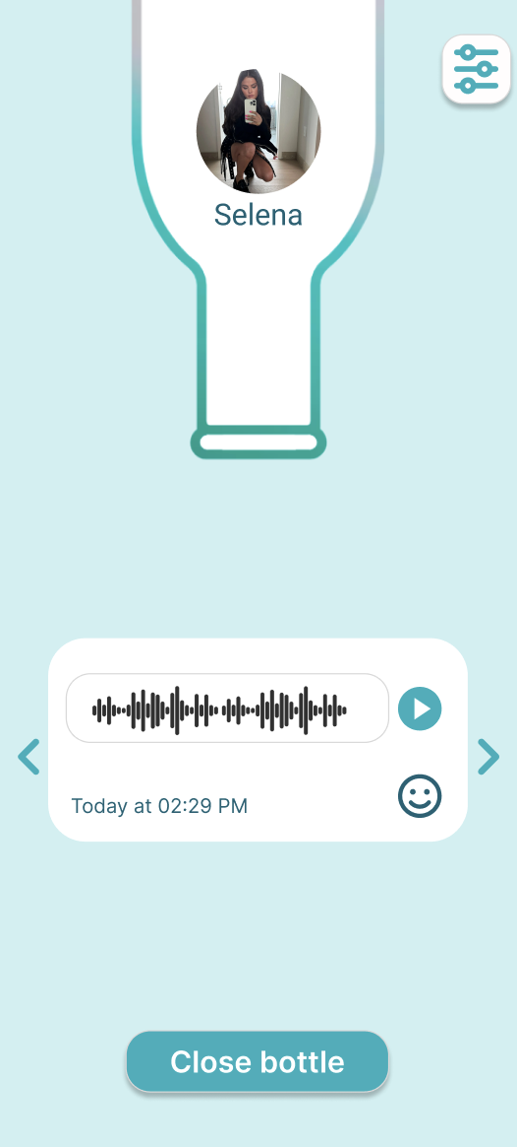
REVISION 4:
Thicken button text
RATIONALE
Thin white text on the teal button is hard to read → thicken & bolded text to be more readable
Gradient background was distracting → changed background to solid lighter color
before
after

Slide 23
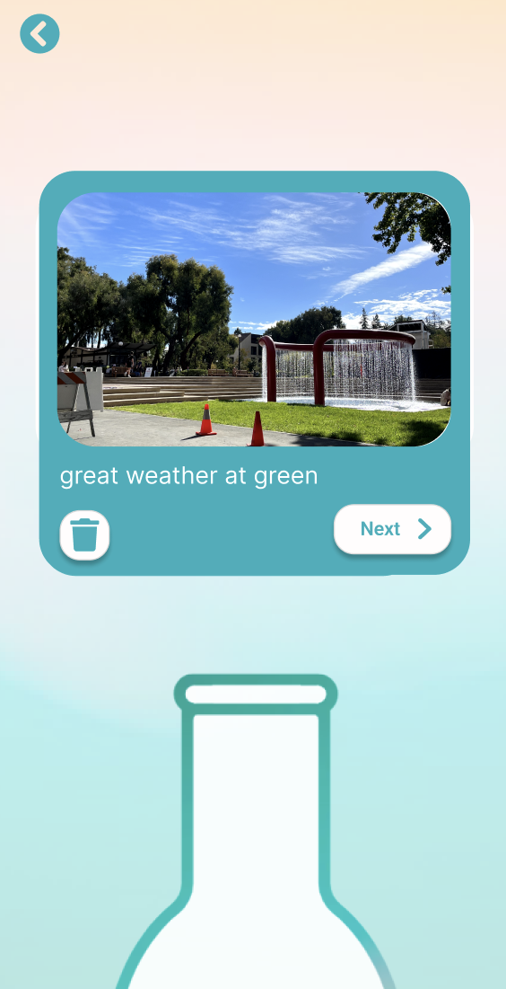
ISSUE 35 (H5):
There should be a displayed limit to size of data that can be added to the bottle
Adding very large/long videos or data intensive media to the bottles could severely impact application performance or result in a crash
severity 3

Slide 24
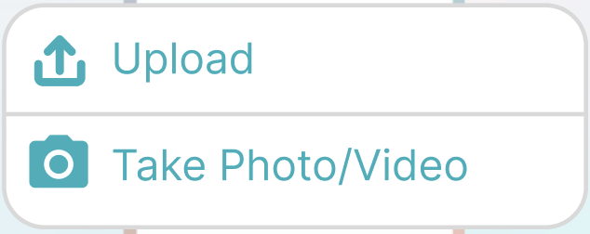
REVISION 5:
Error for
large files
RATIONALE
The bottle has a limit to the size of data that it can store → If the file size is too big, we will give an error and ask the user to upload a new file.
ERROR
File size too large
before
after

Slide 25
Revisions: Severity 1-2
Add button doesn’t look clickable (#2 / Severity 1 / H2) → Revised design colors to match other buttons
No clear indication of time being changed (#13 / Severity 2 / H1) → Countdown time now changes after time is changed and new time appears in the edit time pop-up
No trash to restart text upload (#39 / Severity 2 / H4) → Added trash button to text upload
Date text under bottles in Archive screen are too small (#23 / Severity 2 / H11) → Made font size bigger
Colon separating hours and minutes is faint in color (#28 / Severity 1 / H11) → Colon color now matches the rest of the time text

Slide 26
PROGRESS TOWARDS USABILITY GOALS
Efficiency
Memorable
Improved process of editing recipient details
Made changing the time more direct and with less clicks
Removed action of tedious swiping to change the recipient → gallery & search
Including visual and written indicators of bottle owners & receivers
Added receiver details next to bottle when inserting new moment
Added title “My Bottle” to clarify that the user is adding to their own bottle
Increased readability of text
Increased size of text
Increased thickness of text
Increased contrast between text color and background colors
Revised nav bar for clarity
Included visual indicator of which screen of the nav bar the user is on
Labelled each icon of the nar bar
Reordered icons in nav bar
Accessibility

Slide 27
03
Prototype and Implementation

Slide 28
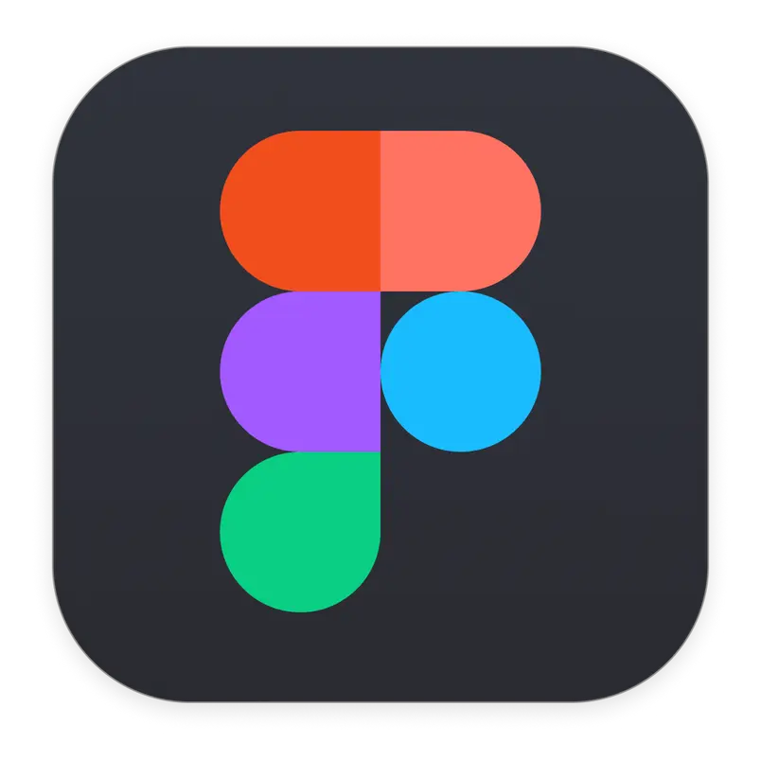




Tools & Frameworks
Figma
For design components
React Native
Application
framework
GitHub
Repo that where we push & pull code updates
Expo
Building & simulation
VSCode
IDE

Slide 29
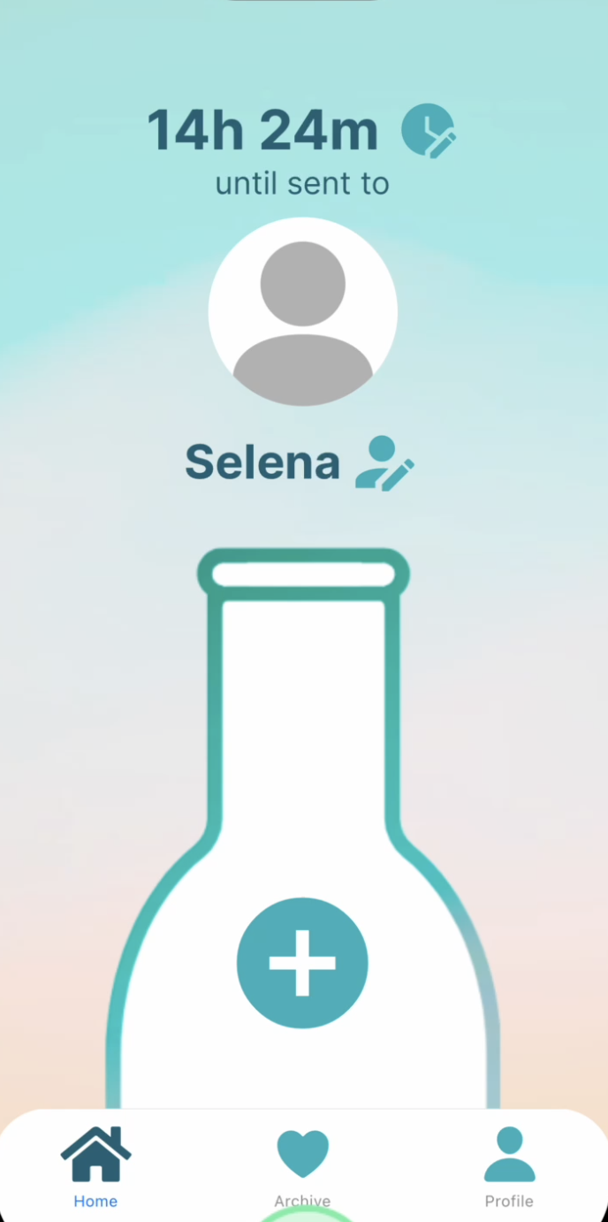
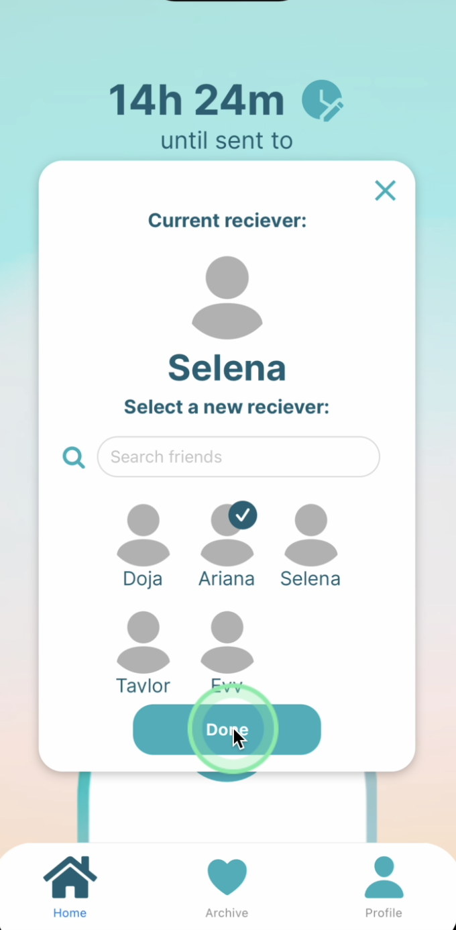
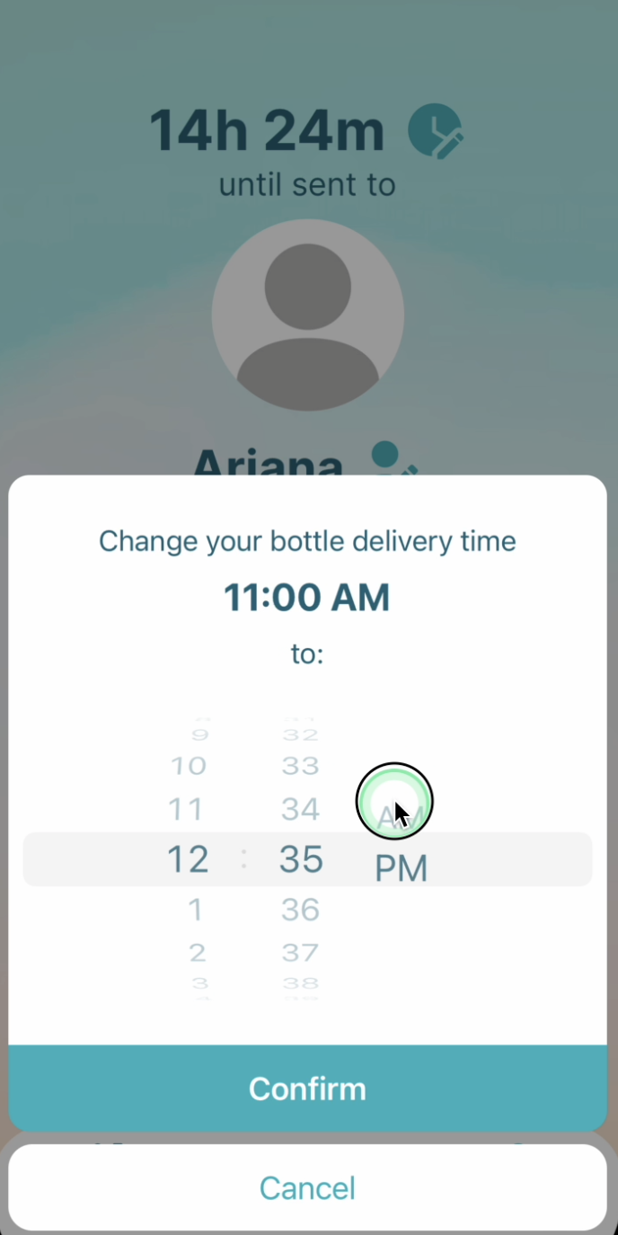
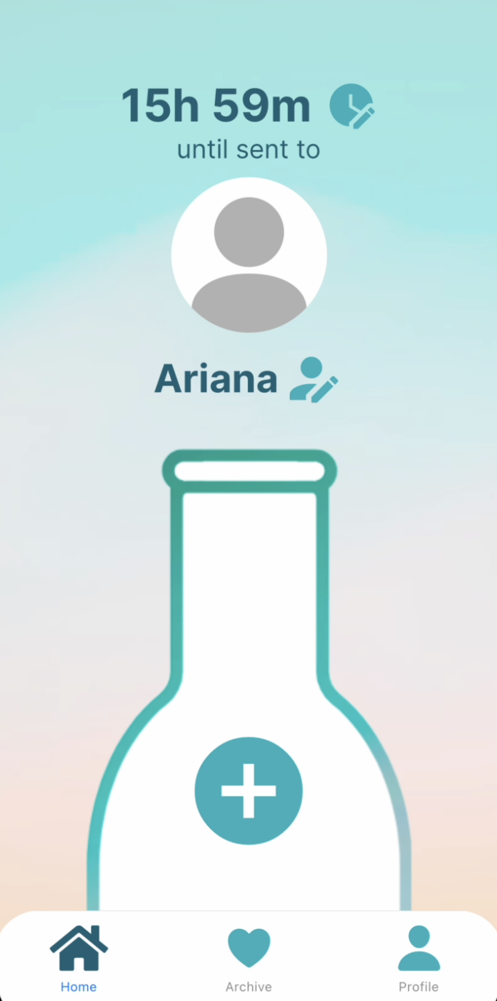
Implemented Features
Moderate Task: Change recipient details (time & receiver)
*recipients saved to Supabase backend
** profile photos will be added later due to Supabase issues with changing images

Slide 30
Unimplemented Features & Plan
Simple Task: Adding moments
Complex Task: Find moments by emotion & …
1
2
3
Selecting media & adding moment
Opening bottles & display moments
Login / sign up
We will have a weekend “hackathon” to finish
4
5
Profile
Bottle archive (& saving to archive)

Slide 31
Wizard of Oz
Hard-Coded
Time Travel
Adjust the time to opening time to enable bottle opening
*Changing opening time is NOT hard-coded
Search bar
Can type in words but search function doesn’t work
00h 00m
Profile images
Images of friends are hard-coded (will be replaced with actual images by final version)

Slide 32
Issues & Questions
Photos for receivers are currently blank because we are trying to figure out how to switch photos when selecting a different user using Supabase → we’ve been directed to resources and will go to OH to make the fix
If Bottle were to become a real app, we would need to consider how the bottle is received on both sides since it’s two-way.
How many bottles are being sent? To multiple users?
  The user can send one bottle to each recipient, per day.

Slide 33
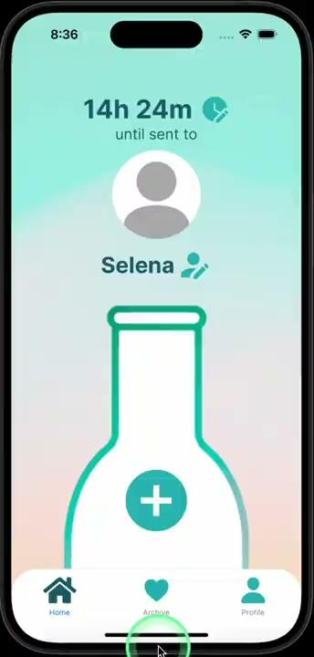
04
Demo

Slide 34
05
Appendix

Slide 35
All other severity 3 violations:
H1: Visibility of System Status
Severity 3: Navbar does not visually indicate which screen is focused/active.
Rationale: Lack of visual cues can make users feel lost and uncertain about their current location.
Addressed in revisions
H2: Match Between System & Real World
Severity 3: The “sort by date” text/button opens up a calendar view.
Rationale: “Sort by Date” text suggests that it will record the list of bottles chronologically, but it opens a calendar view instead.
No revision because this violation was caused by a Figma prototyping error
H3: User Control and Freedom
Severity 3: When filtering bottles by date, pressing back on the “Under Construction” page takes you two steps back in the flow instead of one.
Rationale: This can be confusing for the user who expects to go back a single action.
Addressed in revisions
H5: Error Prevention
Severity 3: There is no way to see what has been sent previously in the bottle.
Rationale: Users may not remember if they have sent something, leading to potential redundancy.
No revision because we want to preserve the authentic and spontaneous act of adding moments in real-time
H7: Flexibility & Efficiency of Use
Severity 3: The bottles are unclickable, and users can’t figure out how to open a bottle.
Rationale: When a primary function of the app is not immediately obvious, it impedes user experience.
No revision because bottles are not meant to be clickable since they can only be opened when they hit the opening time or after they’ve saved the bottle to their archive

Slide 36
All other severity 4 violations:
H3: User Control and Freedom / Severity: 4 / Found by: A, B
Description: No back buttons in account creation.
Rationale: If a user messes up and misclicks “create account” but they meant to sign in, they aren’t able to go back.
We will fix this in our account creation walkthrough of the app and add a back button.
H7: Flexibility and Efficiency of Use / Severity: 4 / Found by: A, B
Description: The bottles are unclickable. More broadly, I can’t figure out how to open a bottle.
Rationale: When a primary function of the app - opening a bottle - is not immediately obvious, it greatly impedes user experience and efficiency. Clicking the bottle was the intuitive way to open a bottle, but that didn’t work.
No revision because bottles are not meant to be clickable since they can only be opened when they hit the opening time or after they’ve saved the bottle to their archive

