Slide 1
Defining and Ideating
Preserving Language
By: Jen, Dria, Arjun, & Daniel

Slide 2
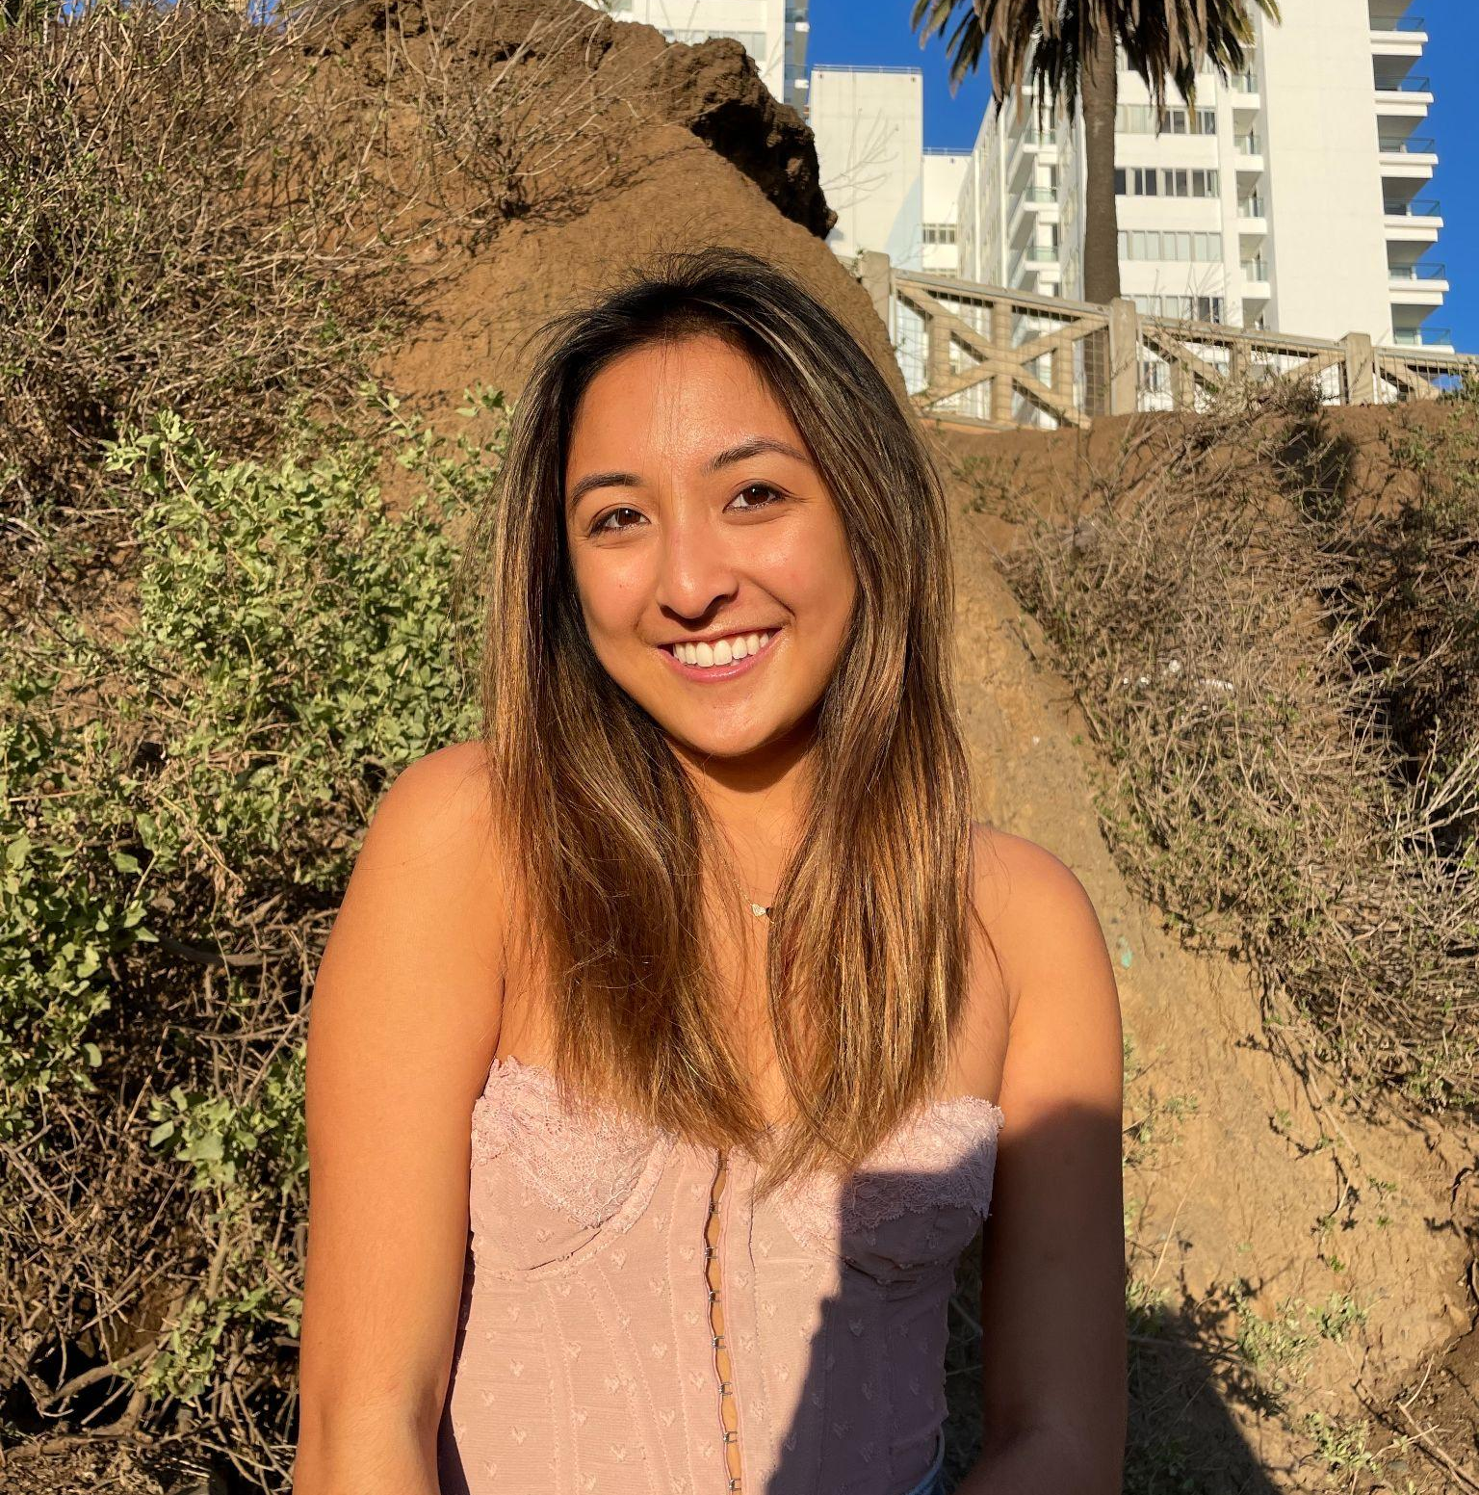
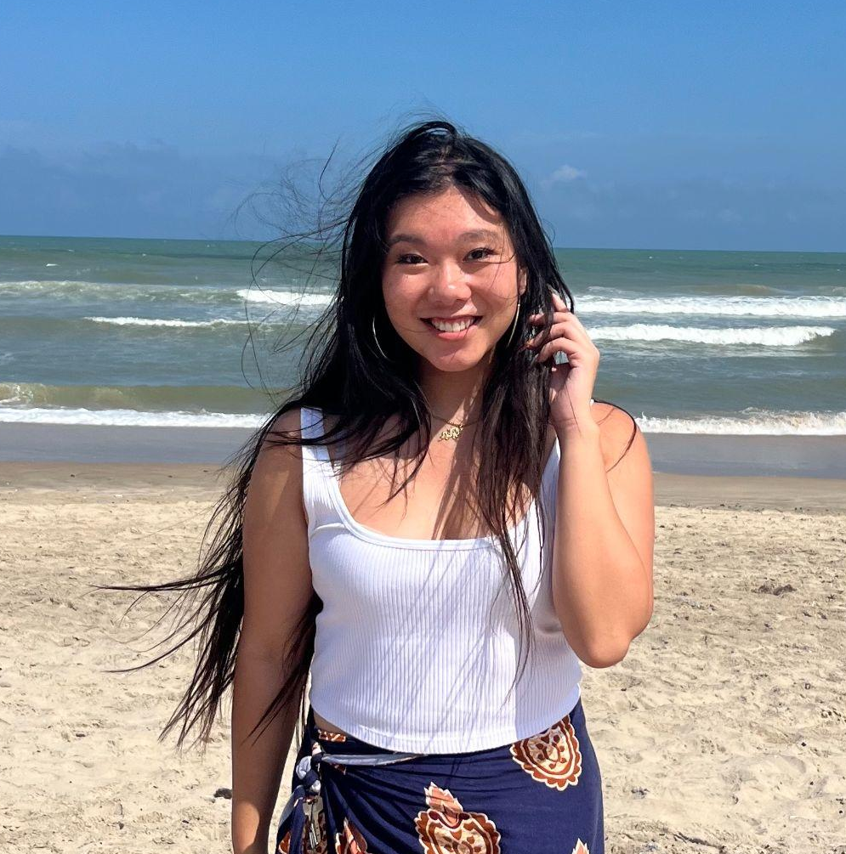
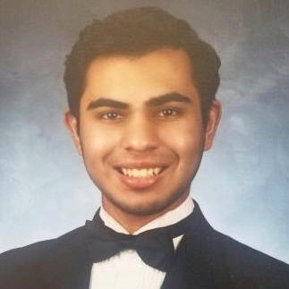
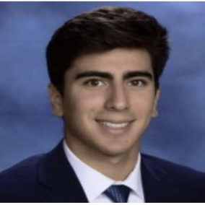
Our Team
What is one language you’ve lost in touch with?
Dria Lee
Spanish
Jennifer Fung
Twi
Arjun Sharma
Daniel Trejo
Italian

Slide 3
PROBLEM DOMAIN
ASL Speakers ⇨ ASL LEARNERS
Notes:
Language retention - practicing with others, by yourself, engaging ways to do this post course

Slide 4
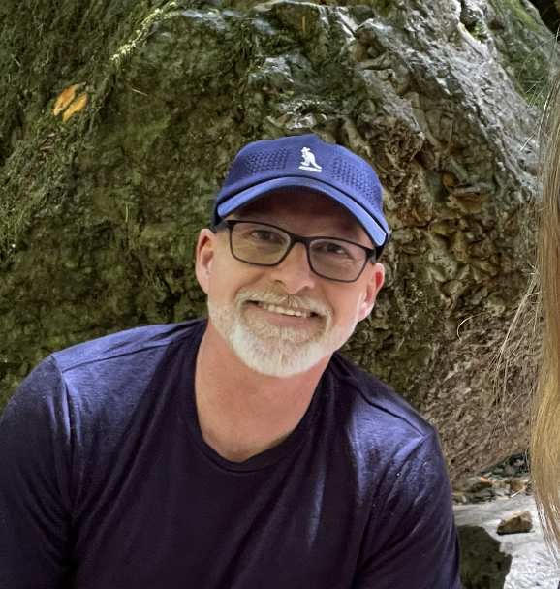
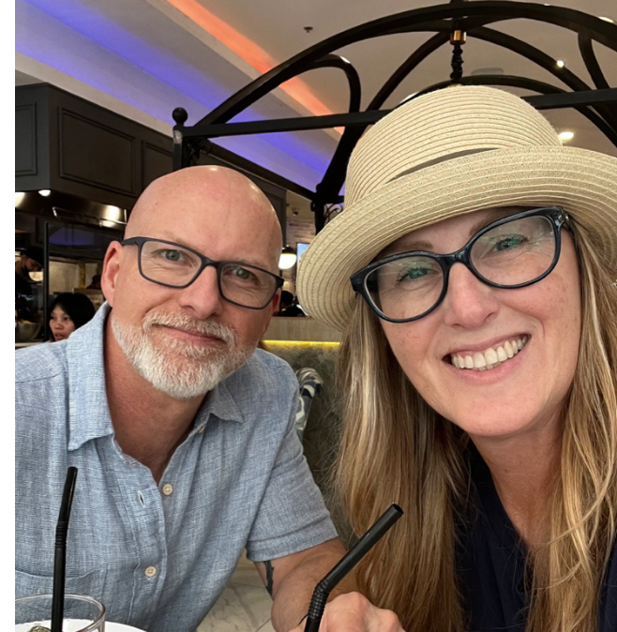
More Interviews!
🥸
Sean Collins
Dee Collins
Husband and wife, have worked as ASL interpreters for Bible translation since 2007.

Slide 5
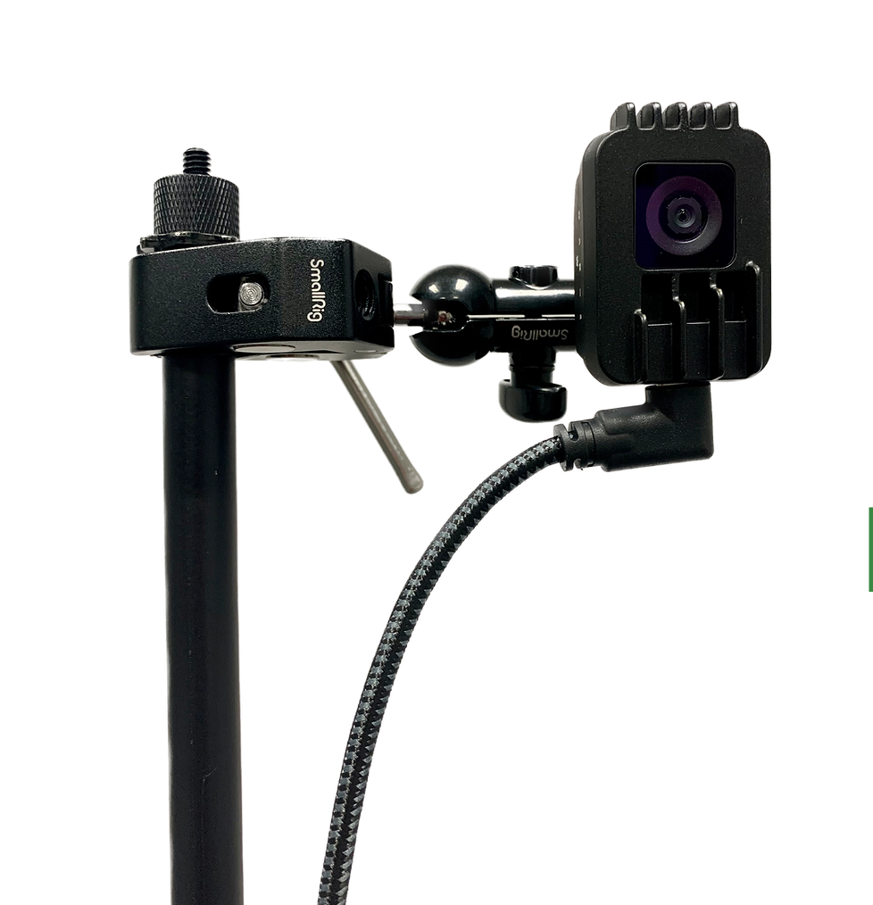
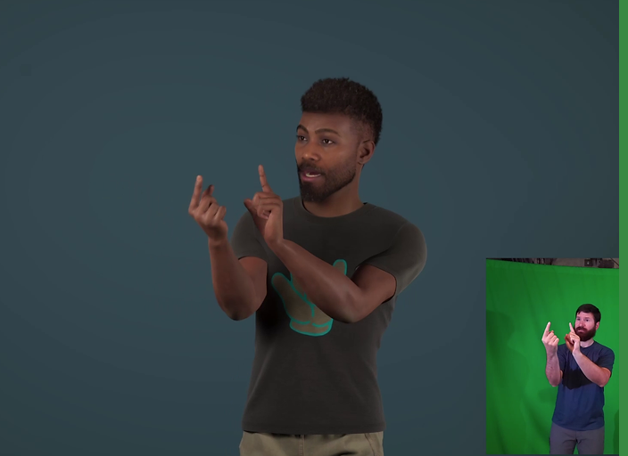
Sean Collins
Context:
Built AI software Chameleon, allowing deaf to create anonymous content for other deaf people through video avatars.
Key Findings:
A barrier to deaf having a public voice is video
Affordable and accessible to deaf populations
386 sign languages in the world, utilizes features that target expression / sign accuracy for each language
Notes:
Working on software for 10 years with no salary. AI software Chameleon + Unreal (gaming engine). Stand in front of camera and sign, doesn’t need green screen or any fancy materials, uploads to Unreal and turns into an avatar in minutes. Bible translation for deaf people HAS to be on video. Deaf people wouldn’t want to do translation then, since in some countries you can’t talk about Jesus or they were scared of being judged by signing. Serves deaf community worldwide, 386 languages in the world, ASL is only translation for the Bible.

Slide 6
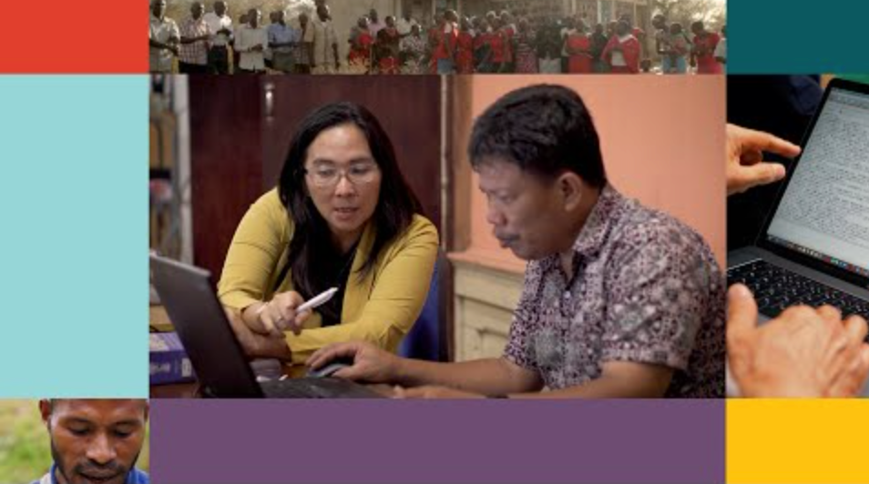
Dee Collins
Context:
ASL interpreter since 2007. Travels around the world for bible translation.
Key Findings:
Most of the time the translator is deaf, despite having hearing people on both teams
Important for sign language users to be involved in the work
Storytelling is part of deaf culture
Notes:
American ASL Bible has taken 39 years to translate. Can’t be involved with deaf populations without putting in the work. Deaf communities want stories.

Slide 7

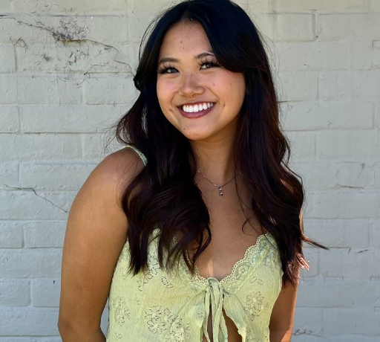
POV #1: Melanie
We met… Melanie, an ASL student and influencer but not currently enrolled in ASL classes in her college.
We were surprised to realize that… Despite being an ASL tik tok influencer, it’s been hard for her to retain her ASL communication skills.
We wonder if this means… whether there is a lack of ASL speakers in her community or lack of integration between them.
It would be game changing to… help learners connect and learn with one another.
Notes:
Revised and Selected POVs

Slide 8
How Might We…
Increase everyday exposure to learning languages?
Foster a post-course community where speakers can practice their language together?
Notes:
Foster a community where speakers can practice their language with one another after finishing school
Increase everyday exposure to different targeted languages
Include deaf speakers in everyday environments without the need for an interpreter
Create an engaging platform that people want to go on, not just to learn.
Connect people like Melanie to ASL speakers in her community
Connect people like Melanie virtually to ASL speakers across the globe
Increase the accessibility of ASL resources to better serve those learning ASL in areas where it is less common
Incentivize ASL learning in communities with higher populations of deaf individuals
Establish programs that promote lifelong ASL learning and interaction for individuals who finish their formal education
Create a mobile app that has daily ASL games, challenges, and exercises to keep users motivated
Organize regular ASL conversation clubs or meetups in communities both virtually and in person so ASL speakers feel a sense of belonging
Develop an ASL mentorship program to provide ongoing support
Encourage businesses to employ deaf speakers or offer ASL friendly services, where ASL is regularly used and practiced
Create a platform that makes it easier for ASL users to organize events and meet irl (finding accessible locations, getting word out, rsvping + exchanging contact info)

Slide 9
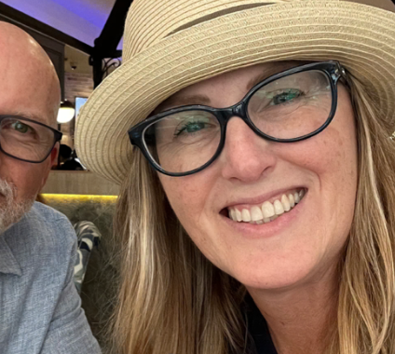
POV #2: Dee
We met… Dee, an ASL interpreter for Wycliffe Bible Translators who helps deaf communities around the world.
We were surprised to realize that… when meeting with international teams, the common language is often ASL, despite having hearing people on both teams.
We wonder if this means… ASL has the most potential to connect people across different languages.
It would be game changing to… utilize teaching ASL for people to communicate across different parts of the world.
Notes:
When they had a skype call with a Bible translation group in Japan, and despite them having 2 hearing people on their team, those two only spoke Japanese and they didn’t speak that. Only one person spoke ASL and that was their common language.

Slide 10
How Might We…
Empower ASL speakers to speak on a global scale?
Notes:
How Might We’s: Encourage people across the world to learn ASL aside from their spoken language
Use ASL to bridge communication gaps across diverse cultures and languages
Develop tools that make ASL a universal language to connect people worldwide (regardless of their language)
Empower deaf speakers to become content creators on a global scale
Create a video based - ASL community
Use AI video to communicate with ASL speakers
Use video for ASL speakers to practice their signing skills
Explore ASL’s potential in connecting people across languages and cultures
Allow non-deaf individuals to still participate in such a platform for deaf content creators
Use AI to translate ASL into a written/spoken language
Make it easier to virtually communicate with ASL
Make the internet more ASL-friendly
Adapt everyday features of modern technology to be more inclusive of ASL (eg. making phone calls)

Slide 11
Our Solutions
1
2
3
Language Speaking Event
Videos without sound
Language Karaoke

Slide 12
Solution: Organize “hang outs” where post-learners can spontaneously meet up and practice their targeted language together
Assumption: The spontaneous meet-up would provide the perfect opportunity for students wanting for opportunities to practice

Slide 13
Prototype 1
We wanted to see if post-language learners would be interested in meeting up with people they didn’t know who share similar goals.
Participants: 6 Stanford students who have all taken a Spanish course in the past.
The Task: Sending them each a text at 10 am inviting them to come to Coupa and speak in Spanish together.
Following up if they couldn’t come and asking them what would make them more interested.
Hey! I’m planning a meet-up at Coupa Cafe at 2pm for people who want to get together and practice speaking in Spanish! Let me know if you’re interested.
Notes:
Include pictures of setup, prototype description, how you recruited, why are they relevant
Hey! I’m planning a meet-up at Coupa Cafe at 2pm for people who want to get together and practice speaking in Spanish! Let me know if you’re interested.

Slide 14
Key Insights:
Key Learnings:
Spontaneous, same-day events are difficult for people to commit to. Even if students have interest, language practice is oftentimes less of a priority than other, more pressing matters.
In order to motivate people to prioritize language learning, we must either present it in a way that seems like less of a commitment and has a lower barrier to entry, or simply give them more notice ahead of time.
What worked?
One student responded enthusiastically to go, but then didn’t show up
What didn’t work?
No one was free at the scheduled time
3/6 participants didn’t see the message or didn’t respond until after the meet
When asked why they couldn’t come, participants said they were all busy
“I would have gone if I was free, but only because it was you and not a stranger”
Notes:
What worked, what didn’t work, what you learned, and what this means for solution going forward

Slide 15
Solution: Create a video platform that relies solely on image and eliminates sound.
Assumption: Viewers would receive the same quality of experience without audio as with audio.

Slide 16
Prototype 2
We wanted to understand to what extent does audio affect a person’s social media experience.
Participants: Two students with full hearing abilities
The Task: Listening to three different TikToks once without audio and once with audio and rate their experiences.
1. Monologue-style video
2. Sports Highlight video
3. Dance video
Notes:
Include pictures of setup, prototype description, how you recruited, why are they relevant

Slide 17
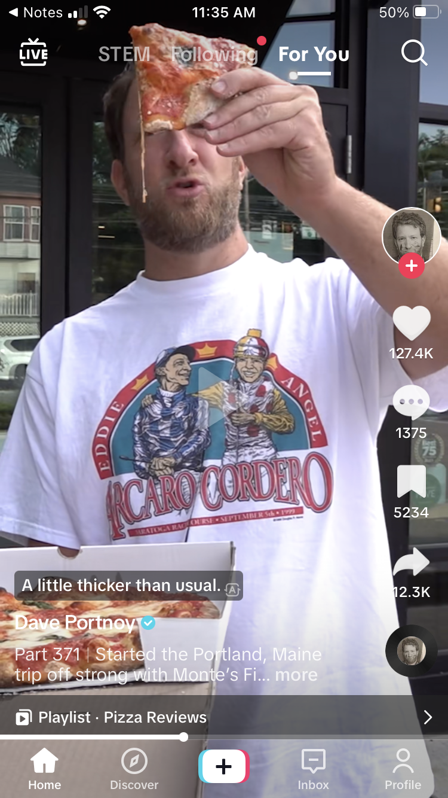
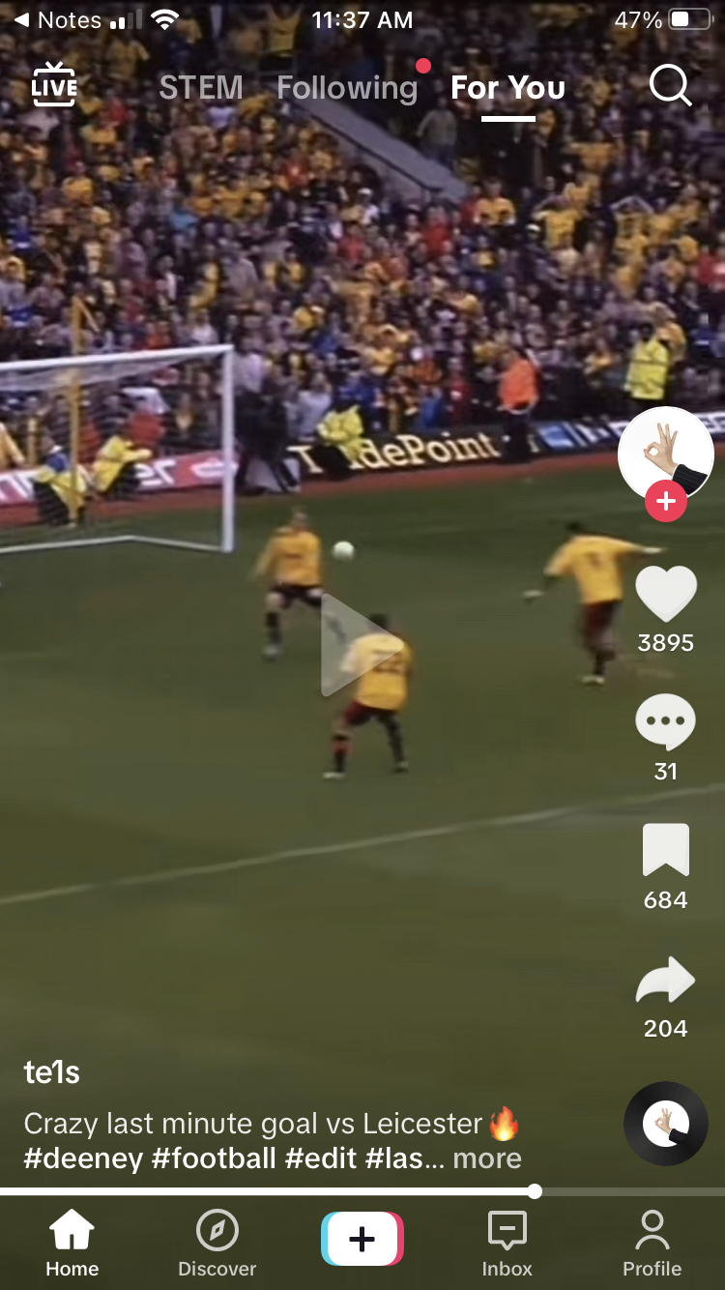
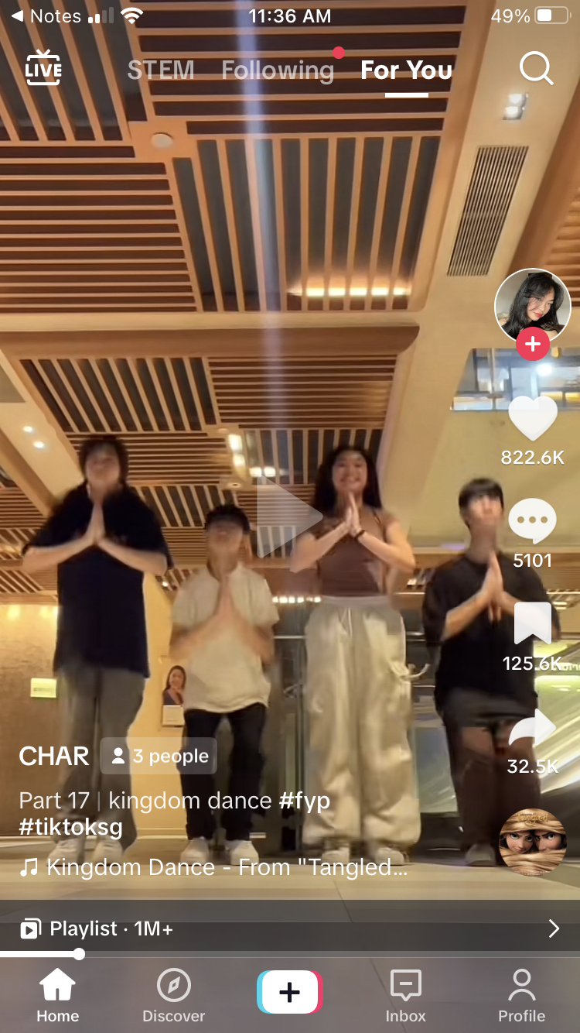
TikTok Videos
1: Pizza Review
2: Last minute goal in soccer
3. Dance Video
Notes:
What worked, what didn’t work, what you learned, and what this means for solution going forward

Slide 18
Key Insights:
What worked?
Monologue (1): Understanding of content was the same with and without audio
Sports Highlight (2): Without audio was still exciting to watch
What didn’t work?
Monologue (1): Easier to focus with the audio
Sports Highlight (2): The audio vastly improved the experience by eliciting more emotion from participants. Both reported getting goosebumps after watching the video with audio
Dance (3): The sound is needed to provide a rhythm for the dance and to help participants understand why the dancers were moving in such a way. Without the audio, the video looked “silly”
Key Learnings:
Audio in social media elevates the learning experience because it activates two senses and styles of learning (audio, visual) for the viewer.
We learned that we can improve social media experience through other senses as well. However, since audio has proven to be the most effective medium of learning, it would be beneficial to mold the other sense-based learning to be as similar to audio as possible. This could be through visual cues or haptics that mimic the sound of a video.
Notes:
What worked, what didn’t work, what you learned, and what this means for solution going forward

Slide 19
Prototype 3
We wanted to see if singing in another language and receiving feedback (e.g. on pronunciation) would positively influence the language learning process.
Participants: One student learning Spanish.
The Task: Watching two different Spanish karaoke videos on YouTube and singing along to them.
1. Despacito – Luis Fonsi
2. Bailando – Enrique Iglesias
Notes:
Include pictures of setup, prototype description, how you recruited, why are they relevant

Slide 20
Key Insights:
What worked?
Both songs selected were popular Spanish songs that the student had heard before.
What didn’t work?
Having a live person ‘judging’ the participant (e.g. pronunciation) to simulate the app’s feedback mechanism.
Key Learnings:
People who are still learning new languages do not feel comfortable singing in front of an audience
It seems a language karaoke application would work best for those who are already comfortable singing, as well as proficient in the language they are learning.
“I didn’t feel very confident singing in Spanish because it felt like I was being judged”
Notes:
What worked, what didn’t work, what you learned, and what this means for solution going forward

Slide 21
Key Learnings
Even if students have interest in continuing their practice of a language, committing to a social practice is like another class.
Audio in video drives emotions in viewers.
Deaf speakers want to have a voice in society, but the main barriers to this are showing face and lack of audio.

Slide 22
Our Final Solution
A visual-prioritized video platform that enables deaf speakers to tell their stories.
Uses physical features (phone vibrating) and emoji icons so that deaf creators, activists, teachers, etc can tell their stories without the fear of being judged.
Notes:
Which solution (or combination) to go forward? Ethical implications? Who does it serve, who might it leave out?

Slide 23
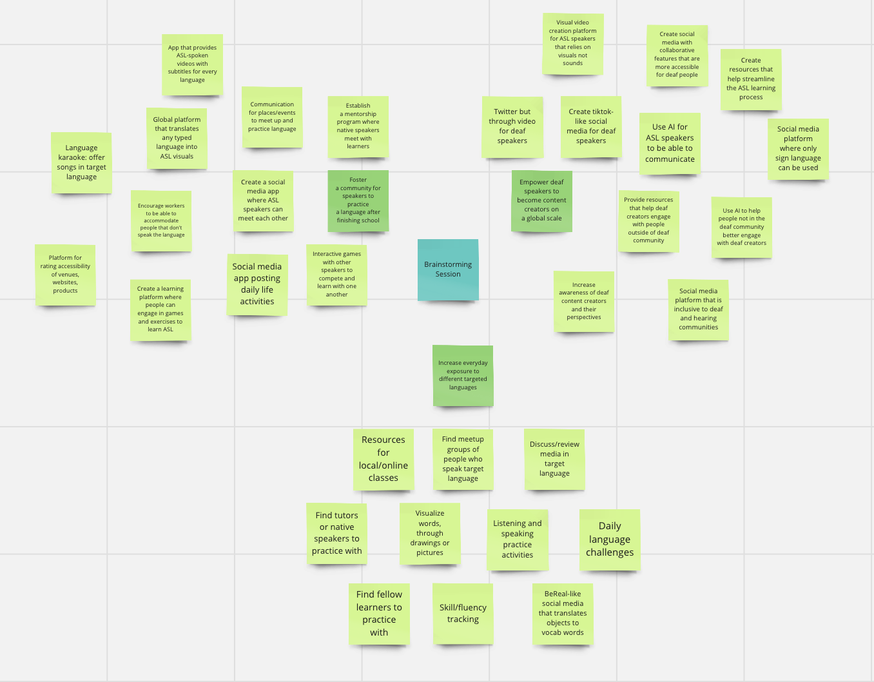
Solution Brainstorm
Notes:
Which solution (or combination) to go forward? Ethical implications? Who does it serve, who might it leave out?

