Slide 1


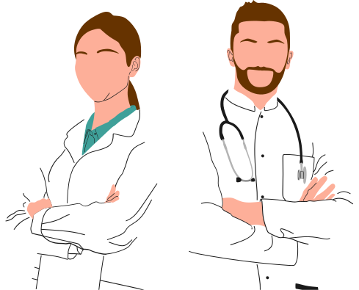
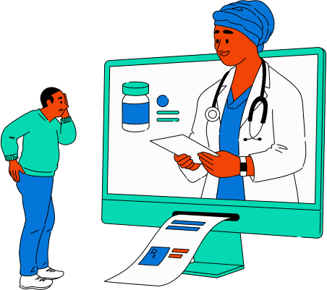
CS 147
FINDING ASSURANCE IN INSURANCE
Angela Mao, Delali Bruce, Abbie Maemoto, Susan Lee
Notes:
Our topic in accessible healthcare that we would like to focus on this quarter is helping young people better understand and navigate the healthcare insurance system. And therefore, our overall goal this quarter is to help young people find assurance in insurance.

Slide 2


OUR TEAM
delali
abbie
cs & design ‘26
cs ‘25
kombucha enthusiast
celsuis enthusiast
angela
susan
cs ‘25
cs ‘25
strawberry acai
refresher enthusiast
film enthusiast
Notes:
Introductions:
- all studying some variation of computer science, but we all have various interests and strengths that make us an effective team
- Susan: dev
- Delali: digital design
- Angela: corporate back end experience + design work
- Abbie: dabbled in a bit of everything, but focus on needfinding

Slide 3



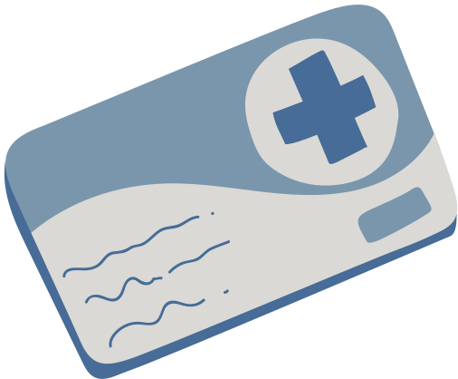
PROBLEM DOMAIN
Our inspiration
Our own experiences as students arriving at Stanford and seeking medical attention
How do young people navigate their healthcare experience?
Understanding insurance plan benefits
Finding affordable, in-network care
Finding care upon moving to a new city
Moving from parent insurance to an independent
Notes:
Although the 4 of us come from different backgrounds, we have a shared experience that may resonate with many of you.
Raise your hand if you have a regular primary care doctor here in the Bay.
(play the recording)
We all have health insurance tied to our parents' occupations, but none of us know much about our insurance plans and we have all had an extremely hard time understanding insurance jargon and finding in-network providers.
That got us thinking about how this is a shared experience amongst many college students who are moving to a new place for the first time. So then we began thinking about the values young people hold in terms of navigating their healthcare experience including:
1. Understanding the benefits and limitations of their health insurance plans (albeit that many do not possess this knowledge)
2. Young people want to find affordable, in-network care
3. Young people seem to be on the move, and thus it's important to be able to find care in new cities
4. and lastly, many of us are soon reaching the age where we can no longer be on our parents' health insurance, and therefore young people need to learn how to navigate this transition

Slide 4

NEEDFINDING CRITERIA
  Young demographic (20-30 y.o.)
  Moved to a new city within the last 5 years
WHO
  Young people face challenges with insurance transitions
  Seek medical help on their own, perhaps for the first time
WHY
  Both in-person & virtually (6 total)
  Interviewee’s location of preference (places of comfort)
WHERE
  At least 2 team members present
  1 person interviewing, 1 person note-taking & filming
  Incentivized with “Thank You” tokens of appreciation (i.e. coffee)
NORMS
  Zoom for virtual interviews; iPhone camera for filming
  iPhone voice memos for audio-only
HOW
Notes:
Quickly reviewing the needfindig criteria we used to find interviewees, we looked for a young demographic ranging from college students to early career professionals who ideally are not originally from the Bay as to explore the problem of moving to a new city.
We chose young people as our demographic bc 1. we understand them best as young people ourselves, 2. young people are the ones facing transitions in their health insurance as they become adults and find jobs, and 3. a lot of newly independent young people are finding care on their own for perhaps the first time ever!
We had a total of 6 interviews this week, 4 of which we'll highlight in the presentation and 2 of which live in the appendix. Of the 4 highlighted today, 2 were in-person and 2 were conducted virtually. In-person meetings were held in the interviewee's location of preference which usually ended up being a place of comfort.
For team interviewing norms, we had 2 members present for each interview, one which conducted the interview and the other which took notes and recorded the interview. Interviewees were usually receptive to our cold emails as many of them actually wanted a space to share their thoughts on their healthcare experiences, but we also incentivized them by sending thank you tokens of appreciation like buying them a coffee.
And lastly, all virtual interviews were done on zoom, audio recordings were done on iphone voice memos, and pictures were taken via iPhone.

Slide 5


QUESTIONS EXPLORED
  Tell us about a time you sought care in a new city- how did you go about finding it?
  Do you have health insurance?
    If so, tell us about your current plan and its benefits. Tell us how you find care within your network plan.
    If not, tell us about the motivations behind opting out of
  What resources do you use to find the best care for your needs?
Notes:
In line with what we've already discussed, here are some of the main topics we explored in our interviews. We wanted to understand how people new to the Bay navigated their healthcare needs, whether or not they had health insurance, their understanding of their own healthcare plan, and the resources patients use to meet their personal healthcare needs.

Slide 6


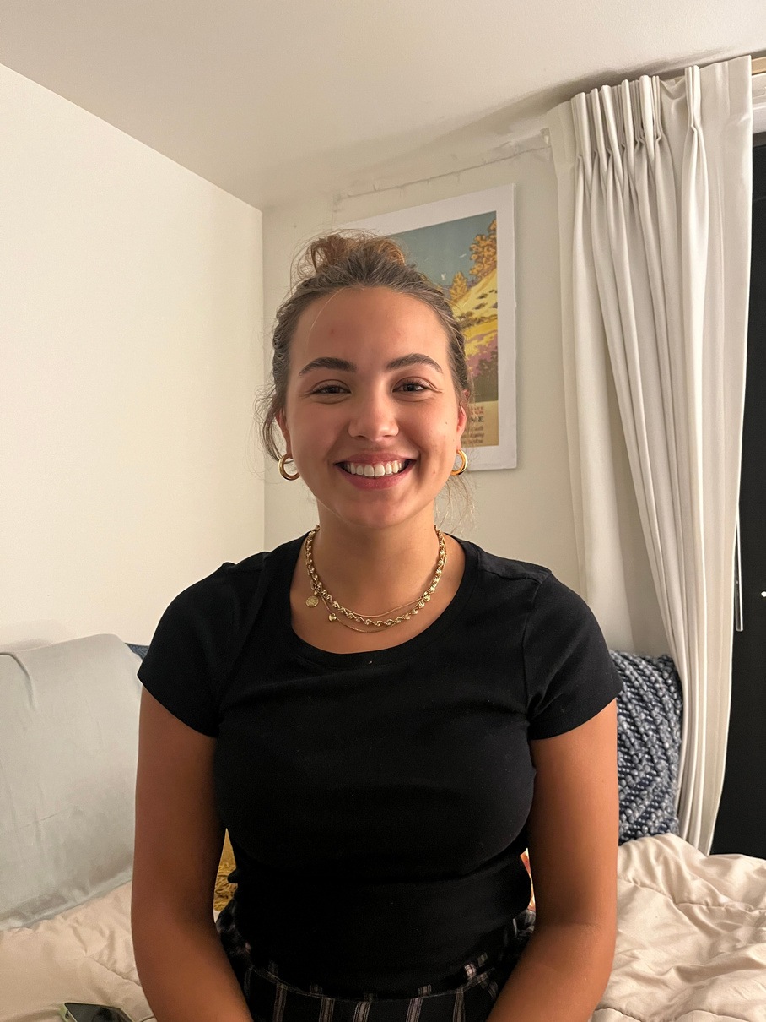


!! EXTREME USER !!
Extreme User in Frequency of Care
  Seeks medical care often (2-3x/month)
  10+ treatment methods prescribed
Why High Frequency is Extreme:
  Plethora of experience in finding out-of-state healthcare
    Diversity in type and quality of care
  More visits = more co-pays
    Want to explore how financials play a role in
influencing healthcare decisions
Anastazja K.
Junior at Stanford
Earth Systems
Stanford, CA
Notes:
Before we dive in, I want to highlight how we selected our extreme user. Our extreme user is extreme in the vertical of frequency of care. Anastazja is our extreme user, and she seeks medical care as a college student 2-3 times per month and has been prescribed more than 10 types of antibiotics and has had countless tests run.
We consider this to be a very insightful extreme case because:
1. high frequency means she has a lot of experience in finding out of state healthcare (she's from Indiana)
2. and along those same lines, she has had a wide diversity in the type of care she's received for her different needs
3. and because she's had so many visits, she also has many medical bills to pay and we want to understand the financial stressors in healthcare decisions.

Slide 7



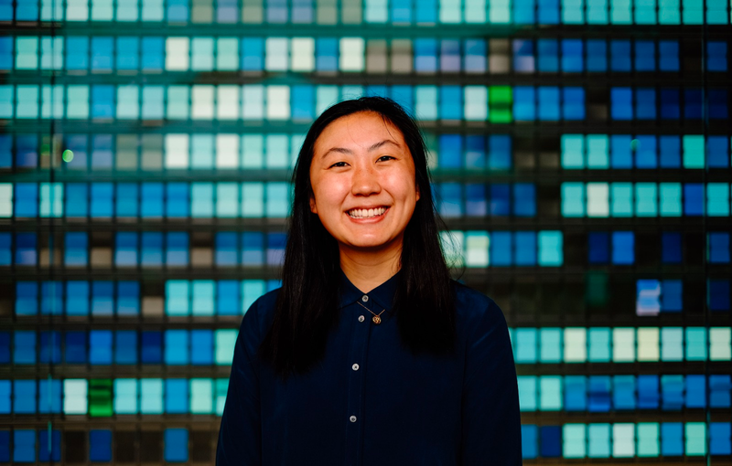
FEATURED INTERVIEWEES
Alia
“Bob”
Connie Liu
Anastazja K.
Biotech start-up founder
San Francisco, CA
Management Consultant
Boston, MA
Entrepreneur
Palo Alto, CA
Junior at Stanford
Earth Systems
Stanford, CA
Notes:
present the 4 main
- Alia (zoom)
- Bob (zoom)
- connie (in-person)
- Anastazja (in-person)

Slide 8
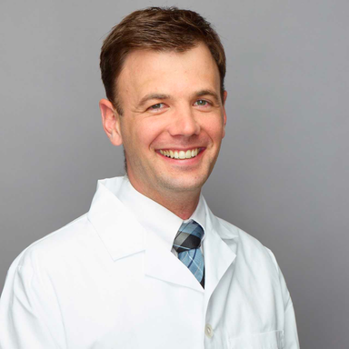
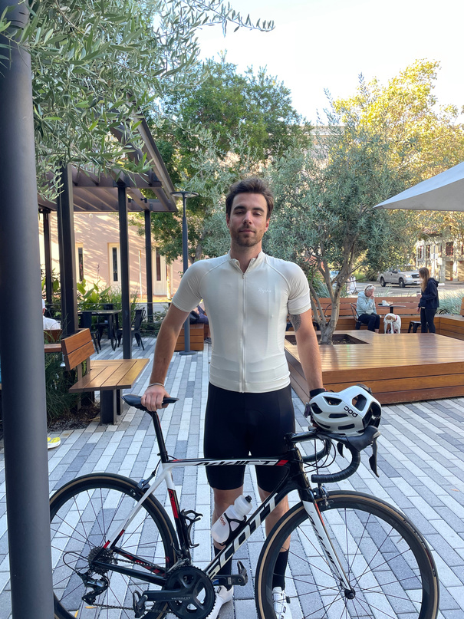
ADDITIONAL INTERVIEWEES
Dr. David Svec
Lyubo
Internal Medicine at Stanford Medicine
Palo Alto, CA
UX Designer
Palo Alto, CA
** SEE APPENDIX **
Notes:
Dr. Svec- virtual
Lyubo- in-person

Slide 9
“There is so much bureaucratic infrastructure that is really intimidating when all you need to know is where to go to get help that is affordable”
Anastazja
Junior at Stanford
South Bend, IN
** Extreme User **
Notes:
1. Anastazja
- college student
- junior studying earth systems
- extreme user

Slide 10
“I’m not an expert on how my own health insurance works”
“My healthcare journey here has been so difficult because of all of the transitions”
The lack of communication between medical stakeholders is systemic
Physical health is a big part of mental health and well-being
Many doctors prescribe “quick-fixes” rather than thinking about the bigger picture of a patient’s health
Universities are inequitable when it comes to providing care to athletes vs students
“Getting things transferred to the West Coast has been incredibly difficult”
“The system is designed for someone with a one-off infection, not a recurring infection”
SAY
THINK
“I had to call and beg and cry to be seen“
“Had to call and email and talk to so many different doctors to establish a relationship”
“None of my doctors noted me down for a follow-up”
“it’s nearly impossible for my doctor in South Bend, Indiana to communicate with Stanford”
It’s easier to pay more money than navigate the complexities of health insurance.
Getting primary care is essential, regardless of the cost
Quality of care is subpar at the university-level
Quick access to medication is the best reliever for health-related anxieties
“I feel like I’m always the middle man between medical institutions”
“I had a lung infection and recurring UTIs”
Finding the right care provider is a long and difficult process that requires lots of trial and error.
“I needed further assistance”
When quality of care is unsatisfactory, there is greater compulsion to frequent the clinic more often
The logistical nightmare of transferring insurance disincentivizes her to switch out of her Indiana-based insurance
“I’ve been mishandled by Stanford Hospital”
“My health insurance is tied to my father’s job which means its limited to the state of Indiana”
“I’ve had to advocate for myself again and again”
Greater frequency of care is a significant source of stress
Having access to own records should be a given, not a fight
Constantly advocating for herself to the Student Health Services
Paid $10-15k in medical bills over 2 years
Forced to find an out-of-network primary urologist in the Bay
Deep mistrust in hospital systems and medical professionals
Tired of having to advocate for herself when quality, recurrent care should be a given
Grateful for easy online interfaces for access to care
Relief from hearing a medical professional’s opinion
Has to call providers in both Indiana and Stanford constantly to get medical records
Gestures very adamantly as she describes her prolonged journey of treating a recurrent problem
Anxiety about recurring health problems
Used to live in South Bend, Indiana but now is at Stanford
Takes cranberry pills as a way to offset UTI symptoms until she can get care
Pride in taking initiative of her own healthcare
Frustrated with long call wait times across different medical providers
Angry about the inaccessibility of her own records
9 rounds of antibiotics, chest X-ray, kidney ultrasound, CT scan, and other minor procedures and scans
Indifferent about the cost of care, as long as she can receive quality care
Laughs uncomfortably when talking about her infections
Goes to Stanford hospital very frequently (at least once per quarter)
Teared up when talking about her frustrations with being forced to go to Stanford Hospital
Visits Vaden Health Center frequently (at least 1-2 times per month)
Comfort in having regular check-ups with a physician
Extremely nervous about when new or recurring symptoms will surface
Sensitive about the stigma behind seeking frequent healthcare
Has to fly home to Indiana to receive primary care
Need to seek external validation that she is healthy in order to live happily
Rides horses as a form of well-being
Cares deeply about the environment and natural Earth systems
DO
FEEL
Notes:
- there was so much information extracted from Anastazja's story, so instead of reading every single note, I'm going to sum up our findings
- Anastazja has many recurring medical issues including UTIs and a lung infection. She is under her father's health insurance which only works in the state of Indiana, so she frequents Vaden for care. However, Vaden treats her as if she's a patient with a one-off medical issue rather than a recurrent one. Therefore, her symptoms keep recurring and she continuously has to advocate for herself to re-receive care. Because she can't find in-network providers, she goes to Stanford Hospital to get treated for things as simple as the flu, resulting in hospital bills totaling over $10,000. She is frustrated that her providers in South Bend, IN cannot communicate with her providers at Stanford, and she has had to continuously re-do procedures that she's already done. She has also experienced mishandling in her patient care, and thus has a deep mistrust in the healthcare system.

Slide 11
“I’m not an expert on how my own health insurance works”
“My healthcare journey here has been so difficult because of all of the transitions”
The lack of communication between medical stakeholders is systemic
Physical health is a big part of mental health and well-being
Many doctors prescribe “quick-fixes” rather than thinking about the bigger picture of a patient’s health
Universities are inequitable when it comes to providing care to athletes vs students
“Getting things transferred to the West Coast has been incredibly difficult”
“The system is designed for someone with a one-off infection, not a recurring infection”
Finding healthcare upon moving to a new city during a new and exciting time in life is extremely difficult
The patient shouldn’t have to continuously advocate for their own care to their own doctors
SAY
THINK
“I had to call and beg and cry to be seen“
“Had to call and email and talk to so many different doctors to establish a relationship”
“None of my doctors noted me down for a follow-up”
“it’s nearly impossible for my doctor in South Bend, Indiana to communicate with Stanford”
It’s easier to pay more money than navigate the complexities of health insurance.
Getting primary care is essential, regardless of the cost
Quality of care is subpar at the university-level
Quick access to medication is the best reliever for health-related anxieties
“I feel like I’m always the middle man between medical institutions”
Healthcare for college students is meant to treat one-time problems, not recurrent issues
“I needed further assistance”
“I had a lung infection and recurring UTIs”
There needs to be better communication between medical professionals and stakeholders
Finding the right care provider is a long and difficult process that requires lots of trial and error.
When quality of care is unsatisfactory, there is greater compulsion to frequent the clinic more often
The logistical nightmare of transferring insurance disincentivizes her to switch out of her Indiana-based insurance
“I’ve been mishandled by Stanford Hospital”
“My health insurance is tied to my father’s job which means its limited to the state of Indiana”
“I’ve had to advocate for myself again and again”
Greater frequency of care is a significant source of stress
Having access to own records should be a given, not a fight
Constantly advocating for herself to the Student Health Services
Paid $10-15k in medical bills over 2 years
Forced to find an out-of-network primary urologist in the Bay
Deep mistrust in hospital systems and medical professionals
Tired of having to advocate for herself when quality, recurrent care should be a given
Grateful for easy online interfaces for access to care
Relief from hearing a medical professional’s opinion
Has to call providers in both Indiana and Stanford constantly to get medical records
Takes over-the-counter medication as a way to mitigate symptoms until she can find care
Severe anxiety about whether or not she has received adequate care
Gestures very adamantly as she describes her prolonged journey of treating a recurrent problem
Anxiety about recurring health problems
Exhausted from having to communicate with so many different stakeholders in her own care
Used to live in South Bend, Indiana but now is at Stanford
Takes cranberry pills as a way to offset UTI symptoms until she can get care
Pride in taking initiative of her own healthcare
Frustrated with long call wait times across different medical providers
Angry about the inaccessibility of her own records
9 rounds of antibiotics, chest X-ray, kidney ultrasound, CT scan, and other minor procedures and scans
Has to take a flight home to seek primary care from physician with all her medical records
Indifferent about the cost of care, as long as she can receive quality care
Laughs uncomfortably when talking about her infections
Goes to Stanford hospital very frequently (at least once per quarter)
Teared up when talking about her frustrations with being forced to go to Stanford Hospital
Visits Vaden Health Center frequently (at least 1-2 times per month)
Comfort in having regular check-ups with a physician
Extremely nervous about when new or recurring symptoms will surface
Sensitive about the stigma behind seeking frequent healthcare
Has to fly home to Indiana to receive primary care
Need to seek external validation that she is healthy in order to live happily
Rides horses as a form of well-being
Cares deeply about the environment and natural Earth systems
DO
FEEL
Notes:
To summarize each component of the empathy map:
1. Finding healthcare in a new city is hard, especially in college where there is so much transition
2. Healthcare in college is meant to treat one-off infections; it's not sustainable long-term care
She has taken over the counter medication, such as cranberry pills, as a way to mitigate symptoms, and she only receives primary care back in Indiana.
Taking what anastazja has said and done, we believe anastazja thinks that she shouldn't have to continue advocating for her own care and she believes that better communication between medical providers and stakeholders would prevent this constant cycle of advocating for herself.
She feels severe anxiety about whether or not she is physically health, but she is also exhausted from having to communicate with insurance and care providers in both Indiana and Stanford.

Slide 12
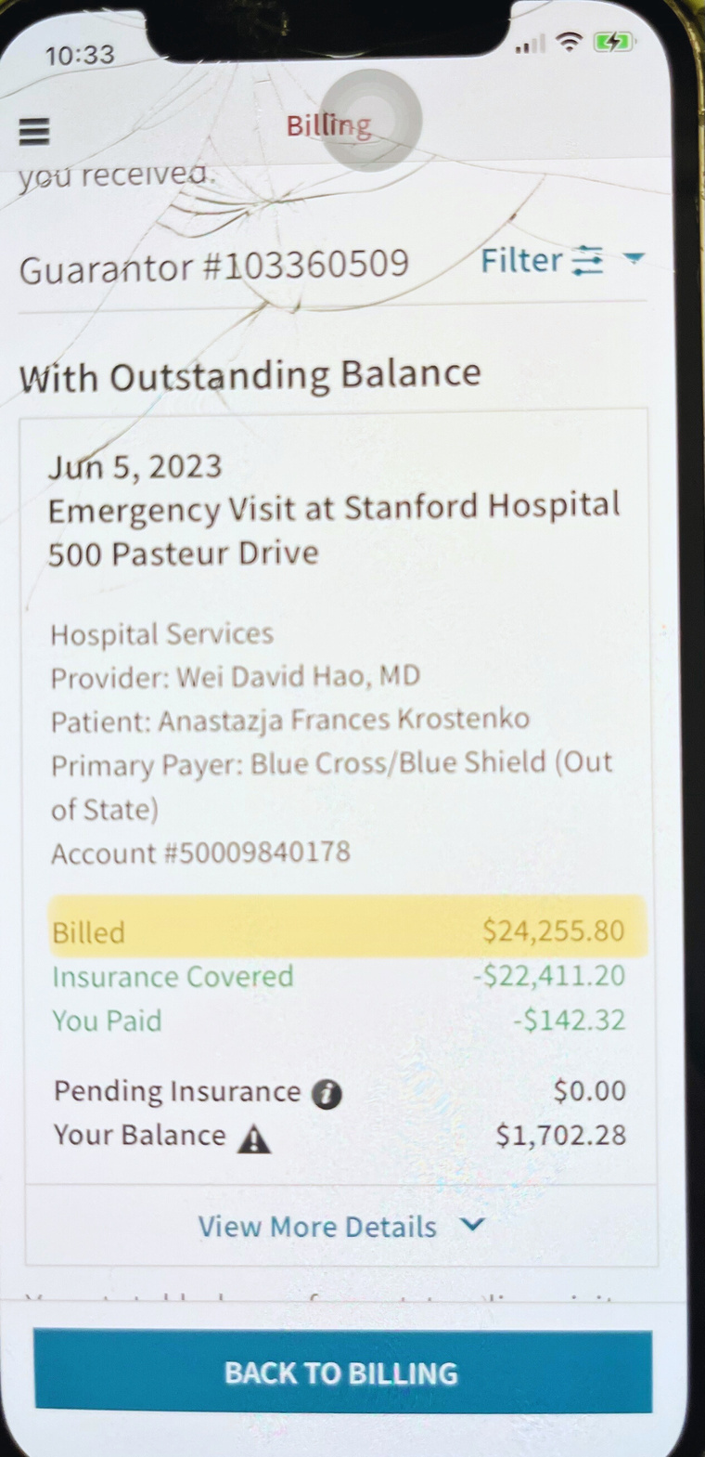
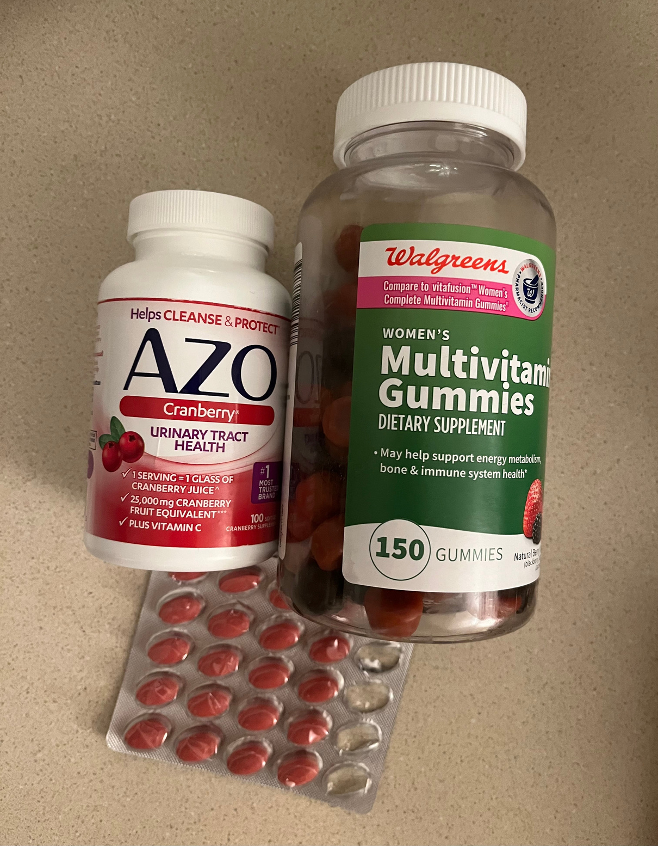
Notes:
picture of her hospital bill from being treated for the flu
a small example of her "medicine cabinet" of cranberry pills

Slide 13



Insight
  Students who don’t have easy access to quality care with their insurance are more likely to seek frequent care than students who have regular physicians due to anxieties around physical and mental health.
Need
Anastazja
  Students want to easily be able to find doctors who can provide personalized care based on their home medical records.
Notes:
- lack of easy access to quality care leads to anxieties around physical health that makes patients want to seek further care
- students need a tool that will help them easily find doctors that fit their personal needs and can obtain home medical records

Slide 14
Insight
  People would rather spend more money on quality personalized care than pay less through insurance because of the inconvenience of filtering through best-fit clinics.
Need
Anastazja
  Students need a way to filter through in-network physicians based on their own personalized needs and desires.
Notes:
- Anastazja pays out of pocket for her care at Stanford, and we believe that people would rather spend more money on qualilty care than filter through a massive list of physicians given by insurance
- students need a better way to filter through in-network physicians based on their personal wants for their care

Slide 15
  “The money I have spent to travel back home for in-network care could cover the cost of my surgery”
Alia
Biotech Founder
San Francisco, CA
Notes:
- Alia: founder living in the Bay, graduated from Georgetown

Slide 16
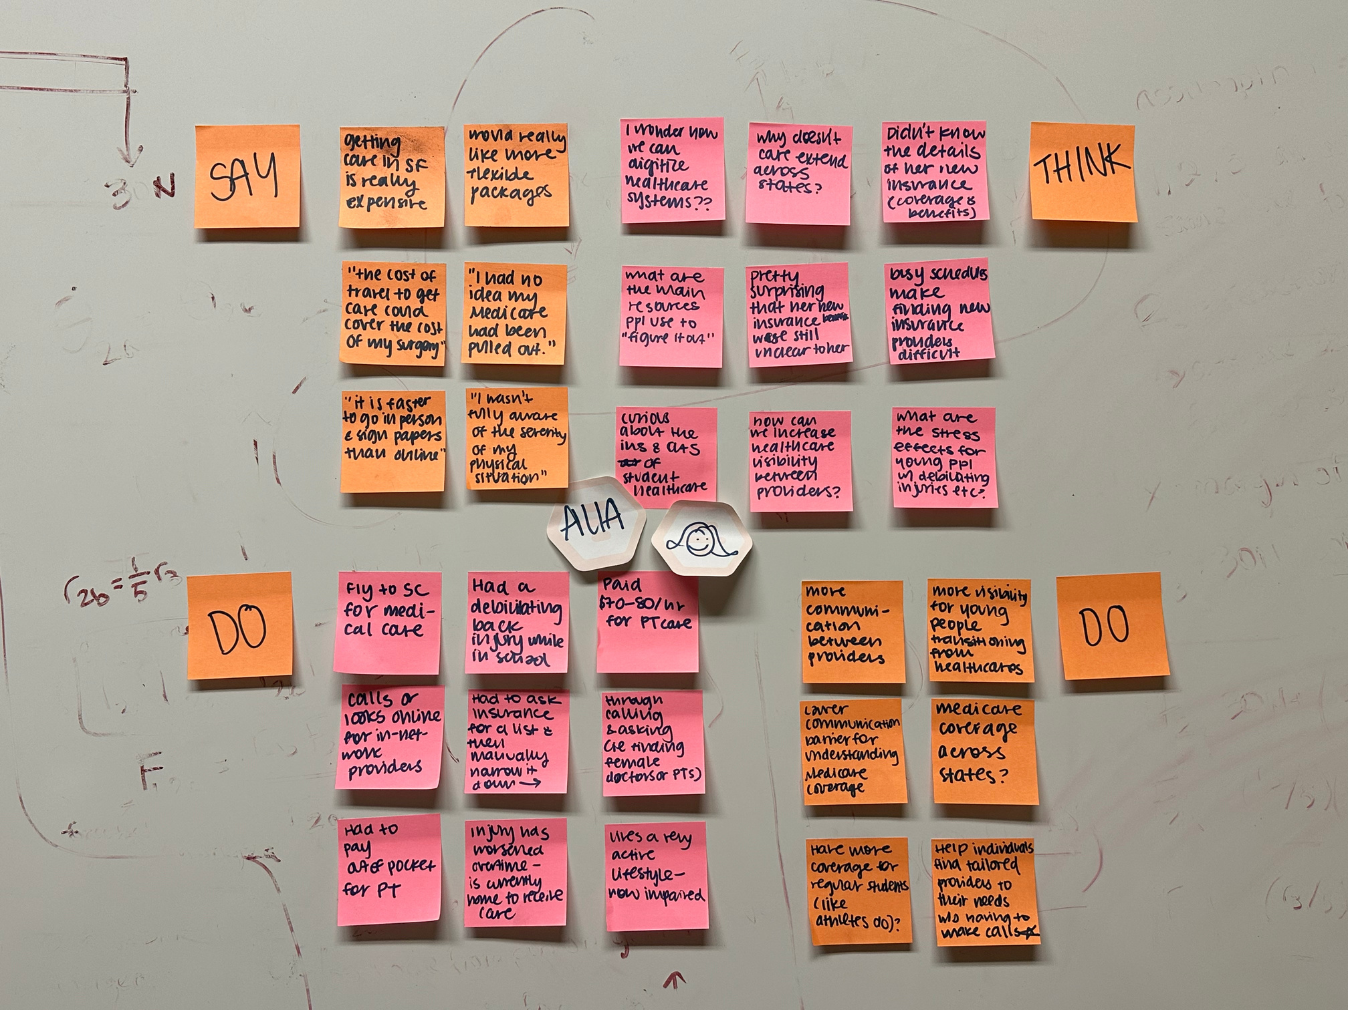
Notes:
- and this is just a quick example of how our team went about doing the empathy maps; we came together and did massive sticky note brainstorming

Slide 17
“I wasn’t fully aware of my situation and I let things build up unconsciously’’
“I only have state coverage so I have to go back home for check ups”
“I thought the pain was just going to go away”
SAY
“The football players get referred out and are fully covered, but when you’re just a student, you’re not”
THINK
How can the referral process be digitized?
Care should not be confined to state lines
There is preferential and inequitable bias for athlete well-being over student well-being at universities
“I didn’t think about insurance when I moved.”
“After college, there was no referral out to another insurance provider.”
The lack of communication between Medicare and physicians is
It is not a priority in her life to learn about the extent of care her insurance will cover
“I found the cheapest out-of-pocket PT...I could have done the same routine in my dorm room”
“I’m paying $70 for the same exact thing I learned in the last class, so I stopped”
How am I supposed to “figure it out for myself” when I am pushed into the deep end after college?
“My family is on Medicare, and it differs by state, and they don’t tell you when you’re no longer covered. It could happen at any moment, any age.”
“There needs to be wider coverage with Medicare”
Learning about insurance plans is difficult when juggling an extremely busy schedule
“I wish there was a more flexible plan that works across different states”
Paying out of pocket is better than being prescribed meds that render useless
Medicare should let me know in advance when I need to renew my plan
“I transitioned to United Healthcare, but I don’t even know if I can use it in the Bay”
“You just want to go in, get checked out, and get your referral to a specialist”
“There needs to be better communication between Medicare and the physician”
The slowness of the whole referral and treatment process is a big part of why I need surgery
“I don’t want to pay for 2 things at once, but I want care at home and in the Bay”
Insurance providers don’t actually care about helping people with finding healthcare
Easy-to-use digital interfaces should replace the phone call model Medicare uses
Has to call Medicare in order to get referrals
Paid out-of-pocket for a physical therapist near Georgetown
Had to fly back home in South Carolina to get surgery
Got wisdom teeth out, and had to get referred out
Frustrated by the lack of communication between Medicare and physicians
Angry that she was misdiagnosed so many times by the school nurse
Annoyed that she has to travel coast to coast for healthcare
Found out that she was dropped by Medicare
Travels coast to coast for healthcare constantly
Frustrated by the lack of accessibility to necessary referrals for surgery
Had to transition to United while waiting for her Medicare renewal to go through
Finds in-network providers via phone call
The need for flexibility in her health insurance plan
Confused by how Medicare chooses when people must renew their plan
Took ibuprofen to the point where it now renders ineffective
Goes through 3-4 agents before she can find someone to work on her problem
Home in South Carolina will always be an important part of her life, and thus essential to her healthcare needs
Financially exasperated by constantly having to pay out of pocket for the sake of convenience
Discouraged because she believes that there is no solution for her problem
Confused about how to filter through best care options based on her personal preferences
Turns her forms for Medicare in via pen and paper because it’s faster than email
Learned insurance jargon via going through the healthcare process herself
Filtered through list of physical therapists from school nurse by herself
Chuckled when talking about the logistical disorganization of Medicare
Comfortability is of utmost importance when receiving care
DO
FEEL
Notes:
- Alia is a founder in the Bay who has struggled to receive care for her back pains. Her back pains emerged at Georgetown and she paid out of pocket for physical therapy, which ultimately rendered useless. She and her family are on Medicare, but we were surprised to learn that Medicare can drop a user off the plan without any given notice, as in the case of Alia. She continues to fly back home to South Carolina to receive care because her Medicare is only valid in her home state. As stated in her quote, the amount she has spent on travel alone could cover the cost of her back surgery.

Slide 18
“I wasn’t fully aware of my situation and I let things build up unconsciously’’
“I only have state coverage so I have to go back home for check ups”
“I thought the pain was just going to go away”
SAY
“The football players get referred out and are fully covered, but when you’re just a student, you’re not”
THINK
I thought I could take care of it on my own
How can the referral process be digitized?
Care should not be confined to state lines
There is preferential and inequitable bias for athlete well-being over student well-being at universities
Lack of communication between Medicare, physicians at home, and physicians in the Bay is the reason it has taken years to get surgery
“I didn’t think about insurance when I moved.”
“After college, there was no referral out to another insurance provider.”
The lack of communication between Medicare and physicians is
It is not a priority in her life to learn about the extent of care her insurance will cover
“I found the cheapest out-of-pocket PT...I could have done the same routine in my dorm room”
“I’m paying $70 for the same exact thing I learned in the last class, so I stopped”
How am I supposed to “figure it out for myself” when I am pushed into the deep end after college?
“My family is on Medicare, and it differs by state, and they don’t tell you when you’re no longer covered. It could happen at any moment, any age.”
“There needs to be wider coverage with Medicare”
I was kicked off my Medicare plan without warning
Learning about insurance plans is difficult when juggling an extremely busy schedule
“I wish there was a more flexible plan that works across different states”
Paying out of pocket is better than being prescribed meds that render useless
Medicare should let me know in advance when I need to renew my plan
“I transitioned to United Healthcare, but I don’t even know if I can use it in the Bay”
“You just want to go in, get checked out, and get your referral to a specialist”
“There needs to be better communication between Medicare and the physician”
The slowness of the whole referral and treatment process is a big part of why I need surgery
“I don’t want to pay for 2 things at once, but I want care at home and in the Bay”
Insurance providers don’t actually care about helping people with finding healthcare
Easy-to-use digital interfaces should replace the phone call model Medicare uses
Has to call Medicare in order to get referrals
Paid out-of-pocket for a physical therapist near Georgetown
Had to fly back home in South Carolina to get surgery
Got wisdom teeth out, and had to get referred out
Frustrated by the lack of communication between Medicare and physicians
Angry that she was misdiagnosed so many times by the school nurse
Annoyed that she has to travel coast to coast for healthcare
Phone calls to Medicare require long process of going through 3-4 agents before getting help
Found out that she was dropped by Medicare
Travels coast to coast for healthcare constantly
Frustrated by the lack of accessibility to necessary referrals for surgery
Had to transition to United while waiting for her Medicare renewal to go through
Finds in-network providers via phone call
The need for flexibility in her health insurance plan
Confused by how Medicare chooses when people must renew their plan
Frustrated by the lack of flexibility of health insurance plans across state lines
Goes home to South Carolina frequently for care
Took ibuprofen to the point where it now renders ineffective
Goes through 3-4 agents before she can find someone to work on her problem
Home in South Carolina will always be an important part of her life, and thus essential to her healthcare needs
Financially exasperated by constantly having to pay out of pocket for the sake of convenience
Discouraged because she believes that there is no solution for her problem
Confused about how to filter through best care options based on her personal preferences
Turns her forms for Medicare in via pen and paper because it’s faster than email
Learned insurance jargon via going through the healthcare process herself
Filtered through list of physical therapists from school nurse by herself
Chuckled when talking about the logistical disorganization of Medicare
Comfortability is of utmost importance when receiving care
DO
FEEL
Notes:
- Pulling out the key aspects of each quadrant, Alia believed that she could take of her pain on her own and when she realized she couldn't, she was surprised to learn that she had been kicked off Medicare without any warning. She goes home to South Carolina to get all care, and in trying to renew Medicare, she has to use phone call which forces her to talk to 3-4 agents before getting help.
- Alia thinks that the lack of communication is much to blame for the long wait time to receive surgery
- Frustrated by the travel she has to do just bc of the inflexibility of insurance plans across state lines

Slide 19
Insight
  Lack of transparency and flexibility from insurance providers forces people to return home to receive more efficient care.
Alia
Need
  Users need a digitized, cross-state referral system that streamlines the healthcare process.
Notes:
- returning home for care is common for out-of-state young people
- need a better referral process to streamline the timeline of getting care

Slide 20
  “I’m fairly educated and I can barely figure this out.”
Connie
Entrepreneur
Palo Alto, CA
Notes:
- Connie: young adult founder living in East Palo Alto with 6 other housemates; runs a startup providing consulting-like services to other pre-seed startups

Slide 21
SAY
“I was already employed... which was a godsend because I wasn’t under insurance all of undergrad... they found a 5 pound ovarian cyst.”
“I had to file for short-term disability, which was such a trash process.”
“I’m fairly educated and I can barely figure this out.”
“Kaiser went on strike so I had to... pay out of pocket to get a diagnosis.”
THINK
Thinks quality care is necessary but not to the point where she would get the most expensive plans.
There should be a more streamlined process to activate/deactivate MediCAL
Why don’t San Mateo officials even understand MediCAL themselves?
Believes quality care is necessary but not to the point where she would get the most expensive plans.
“I think I just have low trust in most health plans.”
“It was kind of stressful [switching around health insurance].”
“As a young, healthy person, I don’t think it’s necessary to get a high [cost] insurance.”
“After that incident, any time I can get Kaiser, I just get Kaiser. They did great.”
Paying out of pocket is necessary when Kaiser can’t provide (goes on strike).
Filing for short-term disability should be less complicated.
Believes Kaiser to be the best health insurance for herself.
Finding available doctors should be easier.
“All the times I wasn’t on Kaiser, I never found a good doctor. I tried 6 doctors.”
“During MediCAL I didn’t even bother going to the doctor... health issues were light and I wasn’t desperate enough/”
“I don’t know the terms of the insurance because that was kind of dense and hidden.”
“I would essentially look for the best one that cost me nothing”
Employers offering different health insurance plans to their employees is a good thing.
As an employer herself, believes she should provide accessible insurance for her employees.
There is a lack of education on health insurance and healthcare even when people are educated.
Has to call San Mateo multiple times to activate/deactivate MediCAL
Asked father to help choose insurance plan when employed by Nueva
Paid out of pocket to get diagnosed for hyperthyroidism when Kaiser went on strike.
Tried 6 doctors when not using Kaiser.
Confused why health insurance is so difficult to navigate.
Annoyed at difficulty of filing for short-term disability
Thankful for comprehensive employee health insurance under Nueva
Frustrated by not finding available doctors even though website said they were available.
Impassioned when emphasizing how difficult filing for short-term disability was.
Expressive gestures when expressing thankfulness she was employed when she discovered her cyst.
Switches insurance when starting new companies
Didn’t go to the doctor when on MediCAL because there were no available doctor appointments.
Went to the teledoc but didn’t actually use it after MediCAL didn’t work out.
Stressed by constantly having to switch health insurance or go on MediCAL when creating startups.
Unsure about how her insurance works still (Kaiser).
Satisfied with Kaiser’s insurance, especially after her cyst surgery.
Feels safe with her current plan due to her health and young age.
Filed for short-term disability during recovery after cyst surgery because she didn’t have enough paid leave from her job at Nueva
Pursues active lifestyle: yoga and the gym.
Provides free insurance for her startup employees.
Grateful for parent support in choosing insurance when employed under Nueva.
Searched for available doctors online when on MediCAL
Feels insecure about other health plans and insurance options.
Exasperated by difficulty of activating/deactivating MediCAL.
DO
FEEL
Notes:
- In her early career, she was on Medical but didn't even bother going to the doctor anymore after she tried 6 times to find an effective doctor. Plus there were no available doctors
- calling the San Mateo mediCal was a headache and had to continuously call
- still doesn't really know much about her insurance, even tho now she's on Kaiser
- low trust in most health plans

Slide 22
SAY
“I was already employed... which was a godsend because I wasn’t under insurance all of undergrad... they found a 5 pound ovarian cyst.”
“I had to file for short-term disability, which was such a trash process.”
“I’m fairly educated and I can barely figure this out.”
“Kaiser went on strike so I had to... pay out of pocket to get a diagnosis.”
THINK
Thinks quality care is necessary but not to the point where she would get the most expensive plans.
There should be a more streamlined process to activate/deactivate MediCAL
Why don’t San Mateo officials even understand MediCAL themselves?
Believes quality care is necessary but not to the point where she would get the most expensive plans.
Has trouble navigating her own health insurance let alone deal with constantly switching to Medical.
Education on different health insurance plans and types of insurance should be better.
“I think I just have low trust in most health plans.”
“It was kind of stressful [switching around health insurance].”
“As a young, healthy person, I don’t think it’s necessary to get a high [cost] insurance.”
The healthcare system should be more organized, up-to-date, and knowledgeable about their own system.
“After that incident, any time I can get Kaiser, I just get Kaiser. They did great.”
Paying out of pocket is necessary when Kaiser can’t provide (goes on strike).
Filing for short-term disability should be less complicated.
Believes Kaiser to be the best health insurance for herself.
Finding available doctors should be easier.
“All the times I wasn’t on Kaiser, I never found a good doctor. I tried 6 doctors.”
“During MediCAL I didn’t even bother going to the doctor... health issues were light and I wasn’t desperate enough/”
“I don’t know the terms of the insurance because that was kind of dense and hidden.”
“I would essentially look for the best one that cost me nothing”
Employers offering different health insurance plans to their employees is a good thing.
As an employer herself, believes she should provide accessible insurance for her employees.
There is a lack of education on health insurance and healthcare even when people are educated.
Has to call San Mateo multiple times to activate/deactivate MediCAL
Asked father to help choose insurance plan when employed by Nueva
Paid out of pocket to get diagnosed for hyperthyroidism when Kaiser went on strike.
Tried 6 doctors when not using Kaiser.
Confused why health insurance is so difficult to navigate.
Annoyed at difficulty of filing for short-term disability
Thankful for comprehensive employee health insurance under Nueva
Frustrated by not finding available doctors even though website said they were available.
Annoyed how complicated switching insurance and activating/deactivating plans is.
Impassioned when emphasizing how difficult filing for short-term disability was.
Expressive gestures when expressing thankfulness she was employed when she discovered her cyst.
Switches insurance when starting new companies
Didn’t go to the doctor when on MediCAL because there were no available doctor appointments.
Went to the teledoc but didn’t actually use it after MediCAL didn’t work out.
Stressed by constantly having to switch health insurance or go on MediCAL when creating startups.
Unsure about how her insurance works still (Kaiser).
Satisfied with Kaiser’s insurance, especially after her cyst surgery.
Feels safe with her current plan due to her health and young age.
Sometimes doesn’t seek out a doctor when not on Kaiser because it’s not worth the hassle.
Filed for short-term disability during recovery after cyst surgery because she didn’t have enough paid leave from her job at Nueva
Pursues active lifestyle: yoga and the gym.
Provides free insurance for her startup employees.
Grateful for parent support in choosing insurance when employed under Nueva.
Searched for available doctors online when on MediCAL
Feels insecure about other health plans and insurance options.
Exasperated by difficulty of activating/deactivating MediCAL.
DO
FEEL
Notes:
- highlights of the empathy map:
- switching insurance plans and also managing Medical is a massive headache- too convoluted
- would rather not see a doctor than go through the hassle of finding a good one
- wants to be educated on different health insurance plans and better organization within the system

Slide 23
Insight
  The processes for switching insurance plans is arduous, and understanding different plans is difficult. Even after switching plans, factors like outdated information on doctor availability, long wait times, and internal strikes make finding care difficult.
Connie
Need
  There is a need for a faster / more convenient way to find tailored in-network solutions for people looking for care, and a more streamlined process for understanding and switching plans.
Notes:
- biggest problems: outdated information, long wait times, internal strikes
- need: tailored in-network solutions w more streamlined process for understanding and switching plans

Slide 24
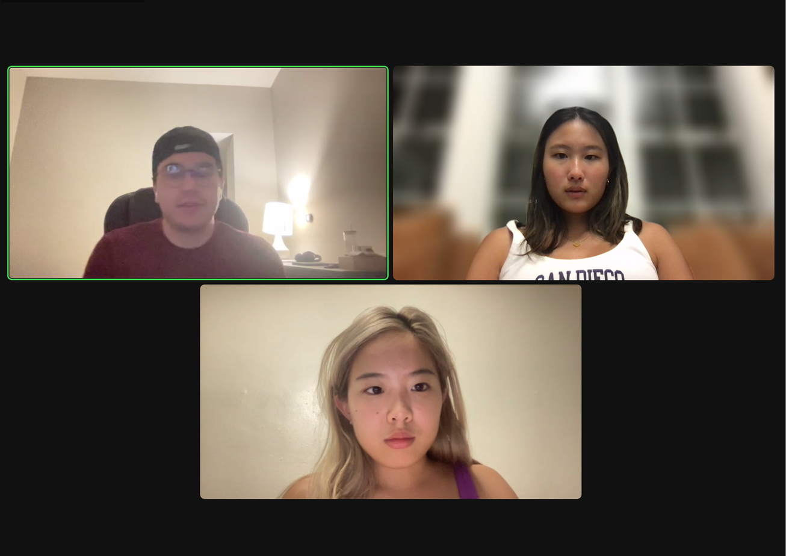

  “If I have to pay out of pocket for an emergency, I will do it, I will call an ambulance”
“Bob”
Management Consultant
Boston, MA
Notes:
- consultant (wanted to remain anonymous)

Slide 25
SAY
”“I’ve been traveling every week since training began”
“I will do it, I will call the ambulance if I need”
“However, I’ve never had an emergency while traveling luckily”
“Honestly, as a consultant, when I travel, I’m working, so being healthy is super important.”
“I wouldn't mind paying out of pocket if something did go wrong especially if I can probably get my company to reimburse me”
THINK
The company's enrollment process made health decisions easier
I’m in the economic position to pay out of pocket -> health is more important than money
Getting healthcare set up in Boston will be a long/tedious process
It might be negative to disclose [condition] to [consulting company]
“I’ve been working on getting my healthcare set up in Boston but I’ve been busy”
“I think young ppl should have a better understanding of state laws when it comes to prescription medication
“I really wish education about healthcare was taught more in school”
“I’ll try to stay in network, but will go out of network if needed”
Transitioning from school to job insurance is easier with the same provider
Prescription medication laws vary significantly by state and can be barriers to necessary care
““Oh, I’m originally from Miami, and I still go home to do my yearly checkups…”
“[Consulting company] made it really easy to enroll in health insurance “
Schools lack important education on navigating healthcare systems
Aetna’s familiarity and benefits make it the best choice for him
“I have [condition] which requires me to have medication, which I did not disclose to my company”
““It’s been difficult for me to get prescription medication in my new state because of state laws””
Traveling and health need to be well-balanced for work efficiency
Going out-of-network should be a last resort, but it's feasible if necessary
Seeking reimbursements from the company for health expenses is possible
The perception of state laws impacting prescription access is problematic
“I grew up FLI, it would have been useful to know the difference between HSA/FSA”
“I’ve been really lucky to make good money out of college and have stable comployment”
Brings advil with him while traveling
Talked to family for an hour before choosing insurance plan from company
Uses insurance from school/company, never had to “search for own insurance”
Stays in hotels/works when traveling
Confident that he will get healthcare if he ever needs it
Supported/grateful for his family in making healthcare decisions
Annoyed by the task of transitioning check-ups away from Boston
Grateful that he’s never experienced sickness/need for healthcare while traveling
Still goes home in-state to Florida to go for regular checkups
[Consulting company] made it really easy to enroll in health insurance
Choose premium for all of his insurance options at [consulting company]
Actively schedules checkups during breaks/family visits
Worried about disclosing his medical condition to the company
Relieved he hasn't encountered emergencies during travel
Frustrated that he can’t get prescription medicine in Boston when he needs it regularly
Satisfied with his job's health insurance enrollment process
Had a period without health insurance after university and before job insurance
Goes back to Florida to get medication refill
Actively decided on Aetna for its benefits
Has not needed to find healthcare while traveling yet
Grateful for the economic security he currently has
Discontent with the gap in school's education on healthcare
Concerned about staying within the insurance network when seeking care
Comfortable with his current health insurance setup
Stuck with same insurance (Aetna) from college to company
Feels secure in the healthcare plan he chose
Chooses to be with HSA over FSA
DO
FEEL
Notes:
- consultant who travels a lot
- goes home for yearly check ups
- can't get prescriptions in non-home state
- doesn't know much about insurance; his information about insurance comes from his family and his employer

Slide 26
SAY
”“I’ve been traveling every week since training began”
“I will do it, I will call the ambulance if I need”
“However, I’ve never had an emergency while traveling luckily”
“Honestly, as a consultant, when I travel, I’m working, so being healthy is super important.”
“I wouldn't mind paying out of pocket if something did go wrong especially if I can probably get my company to reimburse me”
THINK
The company's enrollment process made health decisions easier
I’m in the economic position to pay out of pocket -> health is more important than money
Getting healthcare set up in Boston will be a long/tedious process
It might be negative to disclose [condition] to [consulting company]
Growing up FLI, the insurance process and terminology was extremely unclear
There is a negative stigma behind disclosing health conditions to employers
“I’ve been working on getting my healthcare set up in Boston but I’ve been busy”
“I think young ppl should have a better understanding of state laws when it comes to prescription medication
“I really wish education about healthcare was taught more in school”
“I’ll try to stay in network, but will go out of network if needed”
Transitioning from school to job insurance is easier with the same provider
Prescription medication laws vary significantly by state and can be barriers to necessary care
““Oh, I’m originally from Miami, and I still go home to do my yearly checkups…”
“[Consulting company] made it really easy to enroll in health insurance “
Schools lack important education on navigating healthcare systems
Aetna’s familiarity and benefits make it the best choice for him
Would rather receive more expensive, high-quality care than cheaper, low-quality care
“I have [condition] which requires me to have medication, which I did not disclose to my company”
““It’s been difficult for me to get prescription medication in my new state because of state laws””
Traveling and health need to be well-balanced for work efficiency
Going out-of-network should be a last resort, but it's feasible if necessary
Seeking reimbursements from the company for health expenses is possible
The perception of state laws impacting prescription access is problematic
“I grew up FLI, it would have been useful to know the difference between HSA/FSA”
“I’ve been really lucky to make good money out of college and have stable comployment”
Brings advil with him while traveling
Talked to family for an hour before choosing insurance plan from company
Uses insurance from school/company, never had to “search for own insurance”
Stays in hotels/works when traveling
Confident that he will get healthcare if he ever needs it
Supported/grateful for his family in making healthcare decisions
Annoyed by the task of transitioning check-ups away from Boston
Grateful that he’s never experienced sickness/need for healthcare while traveling
Still goes home in-state to Florida to go for regular checkups
[Consulting company] made it really easy to enroll in health insurance
Takes care of his own health issues because of the nature of his work
Actively schedules checkups during breaks/family visits
Annoyed that care is tied to his hometown in Boston when he is constantly traveling for work
Choose premium for all of his insurance options at [consulting company]
Worried about disclosing his medical condition to the company
Relieved he hasn't encountered emergencies during travel
Frustrated that he can’t get prescription medicine in Boston when he needs it regularly
Satisfied with his job's health insurance enrollment process
Had a period without health insurance after university and before job insurance
Goes back to Florida to get medication refill
Actively decided on Aetna for its benefits
Has not needed to find healthcare while traveling yet
Grateful for the economic security he currently has
Discontent with the gap in school's education on healthcare
Concerned about staying within the insurance network when seeking care
Comfortable with his current health insurance setup
Stuck with same insurance (Aetna) from college to company
Feels secure in the healthcare plan he chose
Chooses to be with HSA over FSA
DO
FEEL

Slide 27
Insight
  Certain individuals do feel confident in their ability to find healthcare. However, young people still tend to have their healthcare decisions/offices tied to their family and hometown.
“Bob”
Need
  There is a need for young people to learn how to transition recurring healthcare services to locations they relocate to. Overall, there’s a need for education about healthcare for young adults, especially those who move to different states.
Notes:
- healthcare is rooted in home towns --> not conducive to travel-heavy work life
- need: translating healthcare services to a new city AND general education about different insurance options

Slide 28
KEY TAKEAWAY THEMES
Young people are traveling back home to receive care
Medicare vs Private Insurance
Healthcare provider & stakeholder communication
Willingness to pay out-of-pocket

Slide 29




WHAT’S NEXT?
  EXPAND INTERVIEW SCOPE
  DIG DEEPER INTO INTERVIEWS
  NARROW DOWN PROBLEM
  CREATE POVS
  Interview users with more diverse backgrounds and get more expert opinions on insurance in the US specifically
  Continue analyzing trends and themes we find in our interviews
  Determine what specific problem within accessing insurance we want to focus on
  Formulate point of views from our potential users

Slide 30
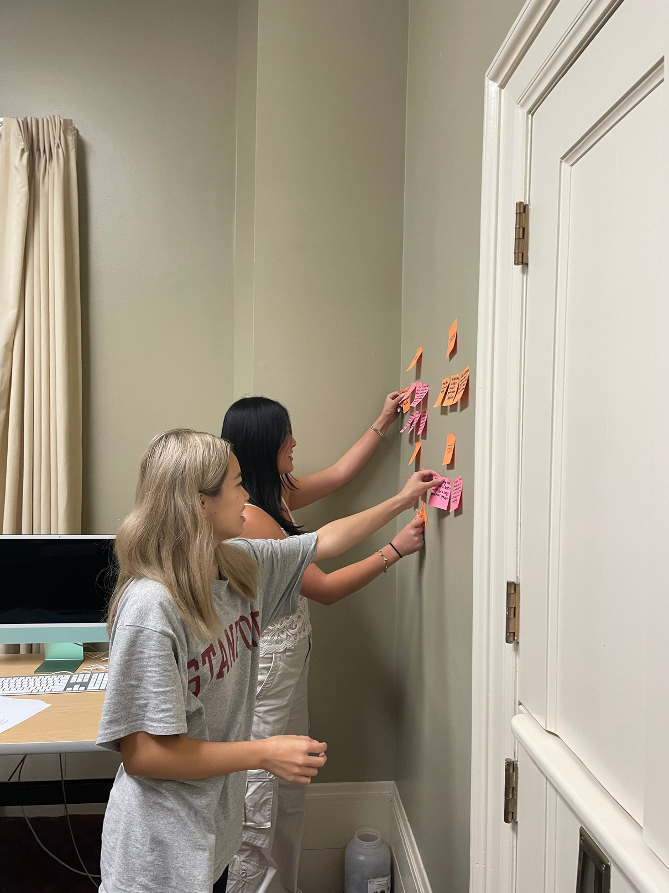
Thank You For Listening!
Questions?

Slide 31
APPENDIX

Slide 32
ADDITIONAL INTERVIEWEES
Dr. David Svec
Lyubo
Internal Medicine at Stanford Medicine
Palo Alto, CA
UX Designer
Palo Alto, CA
** SEE APPENDIX **

Slide 33
“Insurance doesn’t influence much on the inpatient side of things... fortunately we don’t have substantial impacts from it.”
“Insurance mostly impacts us once we’re trying to get patients back to outpatient care. That’s primary care or specialty care.”
SAY
“The only thing I’m uncertain about is the Kaiser system, since Kaiser is such a closed system.”
“When patients leave the area, it’s generally all in the patient’s hands to find new doctors, hospitals, etc.”
THINK
Getting personal checkups might take too much of his time and isn’t worth it.
Thinks that he can identify is health for the most part as a doctor, bypassing checkups.
Believes that the insurance process is a hassle, even from the perspective as a doctor.
Switching to a different health insurance would not be worth it.
“We recommend that they call their insurance carrier so that their records end up all in the same place.”
“In emergency situations, care is always given no matter what. The insurance is dealt with later.”
“I’m perfectly healthy, but I am part of clinical research trials where they check my vitals for free.”
Expensive health insurance is worth it when he can trust the insurance.
Since not all insurance systems are unified (ex: Kaiser is different from others), insurance is even more complicated.
“I haven’t gone to a doctor in so many years.”
Believes Stanford’s health insurance is the best for him since he knows the people working there.
Care is the most important priority when dealing with patients.
“I’m on the Stanford health insurance, which is a bit expensive, but it’s nice knowing everyone.”
“EMTALA says you need to accept patients if you have clinical capability irrespective of insurance.”
“If they’re uninsured it’s a big problem” (context: patients traveling to different states and need care)
There should be better communication between doctors, patients, and insurance to ensure referrals are in-network.
Although he cares for patients, he doesn’t believe it’s his responsibility to determine what’s in-network.
Doesn’t go to his own personal checkups.
Clinical days where he checks on 8-12 patients (inpatients).
Enrolls himself in clinical research trials for science and his own checkups.
Feels lucky to not have to deal with insurance too much as a doctor.
Uncertain about how insurance works especially for outpatient care.
Feels grateful that he is healthy for the most part and that he hasn’t had to use his health insurance.
Satisfied and trusts Stanford health insurance; confident they will provide him the care if he ever needs it.
Teaches, conducts research, works on quality improvement, safety control, and patient safety on non-clinical days.
Works mainly in inpatient care (essentially urgent care/ER)
Works with Stanford Health Consulting Group to improve Stanford hospital system.
Feels somewhat regretful that it’s mostly on patients to determine if their insurance can cover the care they receive.
Loves his work researching, teaching, and providing care for patients.
Confident in his ability to check up on his health for the most part.
Is grateful that as an inpatient doctor he doesn’t have to deal with insurance too much.
Got more animated when talking about how he enrolls in clinical research trials and checks on himself.
Tries his best to refer patients to in-network specialists, providers, etc.
Chief Medical Officer at Stanford Healthcare TriValley, providing care to East Bay and beyond.
Got contemplative when discussing how it’s mostly on patients to navigate insurance after he recommends specialists / PCPs.
Dubious about some aspects of insurance, like how each state’s laws vary, which can complicate things.
Resolute and firm on prioritizing care over insurance. Would not sacrifice care over anything.
DO
FEEL

Slide 34
“I found a family friend to help find surgery and post-surgery care when my family had just moved to the States.”
“I went to the ER more to alleviate my personal anxiety [in case something was wrong].”
“My mom is considering switching to Palo Alto Medical due to long wait times getting appointments with specialists.”
“It’s something like more than 2 months out for appointments and MRIs.”
SAY
THINK
Health is ultimately the most important: would rather go to ER and alleviate personal anxiety about his health than be unsure.
Community is an important resource when navigating health insurance and healthcare.
Going to the ER shouldn’t have to take so long.
Navigating health insurance shouldn’t be such a difficult process, especially when switching within the same company.
“It wasn’t an easy process to switch to individual health insurance.”
“I work at a large and outdated company so I was mostly self-navigating through Workday.”
“Pushing technology on scale tends to be like that. It’s really you and the Internet, what info can I find for myself, and what community do I have to help piece that picture together.”
“My experience was much more funneled than my friend from the European Union.”
Outdated technology also contributes to the hassle of navigating health insurance.
Switching insurances is a hassle; switching out of Kaiser wouldn’t have been ideal for him.
Doctor and appointment availability should be faster, especially for less healthy patients like his mother.
Searching for new insurance (ex: for his mother) should be an easier process.
“I knew ultimately my end-goal was to go through Kaiser and mitigate for amounts as best as I can.”
“I had to wait 3.5 hours in the ER... I ended up getting out at 4:30 am.”
Making it easier to understand health insurance terms would be helpful, and making them easier to remember would be nice.
Education about health insurance is limited. It was because of his community that he was able to understand the process.
Enjoys bike riding in his free time.
Consults community and family friends for help when navigating health insurance.
Chose Kaiser again due to already having been in Kaiser when younger.
Feels lucky his search for health insurance was easier than his friends immigrating from other countries.
Thankful his ER visit was 99% covered; paid less than $100.
Frustrated by long ER waits and variability in wait length.
Confused by the paperwork and insurance options when transitioning to individual health insurance.
Asked parents for help when initially switching to individual health plan.
Chose Kaiser again due to already having been in Kaiser when younger.
Stumbled over some health insurance terms like co-pay and HMO/PPO during the interview.
Made sure to get the insurance with the lowest monthly pay.
Comfortable and confident with his current insurance
Thankful he only had to switch from Kaiser (parents) to Kaiser (individual).
Annoyed by the outdated Workday technology used to handle insurance papers.
Feels grateful he had a community (ex: family friend) to support his search.
Used Workday to handle insurance switch process when getting his job.
Gets regular checkups as necessary.
Made confused gestures when talking about switching insurance plans after employment; not too confident in explaining his insurance.
Concerned about his mom’s long appointment wait time and current search to switch insurances.
Confident in his youth and health and that he won’t need to use his insurance much.
Feels sympathetic towards friends who had a much harder time finding insurance.
DO
FEEL

