Slide 1




CheckUp
“Care On Your Calendar”

Slide 2


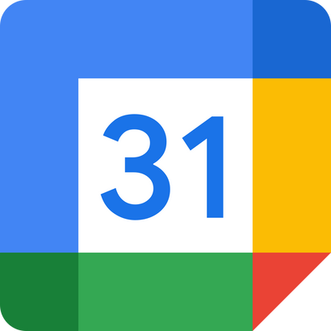


Our Name
Value Proposition
“Checking Up” means...
Our one-liner is “A personal secretary for your medical appointment needs.”
CheckUp is a novel solution to the lack of traction for healthcare-specific calendar scheduling apps
Finding time in busy schedules
Remembering to self-evaluate
Prioritizing health & well-being
CheckUp
Notes:
1a: How we thought of our name. We thought of the name CheckUp because our app will automatically "check up" on your calendar to book your appointments, and because it will send your reminders to "check up" on you to remind you to book important recurring appointments
1b: one-liner value proposition: Our whole pitch is a personalized healthcare secretary

Slide 3



The User
Problem
Solution
Young, tech-savvy working professionals who have recently moved to a new city
People don’t schedule medical appointments because of:
A virtual secretary that schedules regular medical appointments with physicians based on patient preferences & calendar app data
  Busy schedules
  Forgetfulness
  Negligence
  Tedious booking processes
CheckUp
Notes:
2: user, problem, and solution

Slide 4

Market Research
CheckUp
Notes:
The following slides address point 3a

Slide 5

A patient portal for sharing health records, guidance, appointment scheduling, and patient-physician communications
What Doesn’t Work
What Works
  Providers cannot see patient records from other providers
  Slow response time to chats
  Lack of updated physician info
  Unpolished & non-intuitive UI
  Effective appointment tracking
  Easy-to-understand lab results
  Quick billing system
  Fast access to live chats with doctors
CheckUp
Notes:
- a mobile app by Epic
- a central hub for all things healthcare
- tracks and makes appointments, connects patients with live chat, helps patients keep track of their own records
- looked at patient reviews via trustradius
- summary of pros: enjoy the fact that all capabilities are hosted within the app
- summary of cons: not intuitive for non-tech savvy people; slow response times; lack of updated data

Slide 6
A patient portal for sharing health records, guidance, appointment scheduling, and patient-physician communications
What We Can Take Away
Intuitive, easy-to-use user experience is critical in gaining user traction. Patients want flexibility and autonomy in their choice of care.
Why Our Solution is Unique
Whereas MyChart is a “one-stop-shop” for digital healthcare as a whole, CheckUp is specifically designed for the busy, working professional. As a plug-in to an existing calendar, it is a natural integration into the daily lives of our target market, addressing the intuition and ease-of-use concerns with MyChart.
CheckUp
Notes:
- checkUp is different because we're not trying to be a central hub for all capabilities
- we have a very specific target market, busy working professionals
- ours is not an app; it is a plug in for existing calendar apps

Slide 7

“Power to the patient”
An online service that allows people to find and book in-network and in-person or telemedicine appointments for medical or dental care.
What Works
What Doesn’t Work
  Simple process to input insurance and find available doctors
  Location-based doctor sorting
  Visible physician ratings
  Reviews don’t include comments; users can’t see specific good/bad points about a doctor
  Sponsored doctors mess with ranking; interferes with accessibility
CheckUp
Notes:
What Works:
Easy-to-book streamline from identifying problem (ex: eye appointment), inputting health insurance info + location, and showing doctors with appointments.
Anyone can book an appointment in any location, and doctors are sorted by location.
Reviews make it easy to identify a good doctor or bad doctor.
What Doesn't Work continued:
- Overall star rating don’t seem to match up with individual ratings, reflecting possible doctoring or misinformation
What makes our solution unique:
This scheduling is manual; we would be automating the schedule matching to find the best doctor for patients, making it easier for patients to see when they're available and who the best available doctor is.

Slide 8
“Power to the patient”
An online service that allows people to find and book in-network and in-person or telemedicine appointments for medical or dental care.
What We Can Take Away
Location-based doctor matching in addition to user preferences allows for easier access to care; something we can apply to our solution.
Why Our Solution is Unique
CheckUp streamlines the scheduling process further, personalizing doctor matches further based on users’ schedules and automating this process.
CheckUp

Slide 9
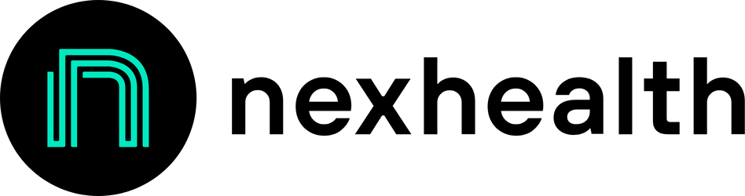
“Connecting patients, doctors, and developers”
A patient management platform that allows for appointment scheduling, reminders and confirmations, patient communication, and online payments.
What Works
What Doesn’t Work
  Two-way live communication from doctor to patient makes it easy to communicate changes
  Online booking is accurate and customizable
  Doctors are able to set recurring reminders about booking appointments
  Doesn’t recommend doctors to your personal needs
  Patients still need to book via website, social media, QR code, etc: the process isn’t automatic
CheckUp
Notes:
What NexHealth does:
1. appointment scheduling (online booking , allowing patients to schedule, reschedule, or cancel appointments easily) 2. reminders: (automated to patients using email or SMS), 3. patient communications (two-way messaging between patients and providers), 4. online payments 5. integration w/ electronic health/medical records, and patient reviews. Reads more like it serves doctors more than patients.

Slide 10
“Connecting patients, doctors, and developers”
A patient management platform that allows for appointment scheduling, reminders and confirmations, patient communication, and online payments.
What We Can Take Away
One useful feature NexHealth had was a waitlist, where 50% of cancelled appointments were filled in 3 minutes. We can also use this concept in CheckUp.
Why Our Solution is Unique
Using NexHealth is dependent on already knowing which doctor you want to see and that your doctor happens to use NexHealth to manage their bookings. In CheckUp, we will automatically browse doctors and schedule the appointment with no intermediary steps.
CheckUp

Slide 11

“Beyond patient communication into active engagement“
An online platform that helps medical firms and practitioners communicate effectively with their patients.
What Works
What Doesn’t Work
  Reduced time & energy in administration (scheduling & following up with patients)
  Keeps track of patient data (questions, notes, and charts)
  Transcription services
  Mainly used by dermatologists and not all doctors
  System glitches lead to missed appointments
  UI difficulties lead patients to end up calling anyways
CheckUp
Notes:
What has worked for them:
They have alleviated the time and energy that goes into the administrative side of scheduling and following up with patients
Patients do not have to call anymore instead they can text their doctor and leave a message or to schedule an appointment
They keep track of important patient data including questions, notes, and charts
They have transcription services for patient messages to help staff save time
What hasn’t worked for them:
Their service has not been widely adopted by doctors (mainly used by dermatologists right now)
UI difficulties with notifications and bugs that make some patients feel like it is actually easier to just call
Some patients miss vital appointments if the system / service fails or glitches
What we can take away:

Slide 12
“Beyond patient communication into active engagement“
An online platform that helps medical firms and practitioners communicate effectively with their patients.
What We Can Take Away
We need to make our solution more direct to consumer, meaning we do not need to acquire doctors or practitioners for our users to get the help they need
Why Our Solution is Unique
Our solution addresses the actual pain point of patients finding and scheduling with a doctor, rather than exclusively focus on doctors to keep track of their patient’s medical data
CheckUp

Slide 13


Competitor Analysis
CheckUp
Personalized doctor matching
Automatic scheduling & booking
Insurance accommodation
Easy-to-see appointments
Automatic reminders to schedule appointments
CheckUp
Notes:
3b: competitor analysis

Slide 14

Ethical Considerations
CheckUp

Slide 15





Direct
Stakeholders
Indirect
Stakeholders
  Patients: those who share calendar app data with CheckUp
  Caregivers
  Front-desk receptionists
  Government/Policymakers
  Physicians/clinics
  Mobile Operating System Providers
  Insurance companies
CheckUp
Notes:
4a: Indirect and direct stakeholders
Our rationale here was that the two main groups here are patients and doctors. However, affordability is also a huge point and insurance directly stands between patients and doctors, which is why we included those 3 as direct stakeholders. For indirect stakeholders, we realized that caregivers (of young, old, very sick, etc) also need to book appts for the people they are taking care of. Front desk receptionists are also involved in the scheduling process. Government/policymakers and mobile operating system providers are a bit more far removed, but are still affected by how patients find healthcare (are they doing it legally/safely? What kind of tech is affected?)

Slide 16

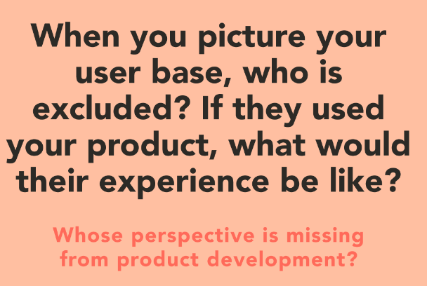
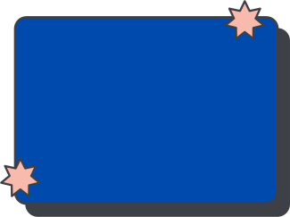
Ethical
Considerations
  Those who do not use a digital calendar
  Those who use a digital calendar, but do not include all of their day-to-day events (ex. lunch time)
Implications: We are developing the product around the assumption that young professionals use digital calendars. In leaving these groups out, we leave ourselves at risk for building a product around a false assumption.
CheckUp
Notes:
4b: ethical implication
Amongst young people, we assume that most people digitize their calendars. This may be more common among students/professionals, although we also see parents/adults using calendars as well. We worry about excluding a non-tech saavy population, such as elderly people.

Slide 17
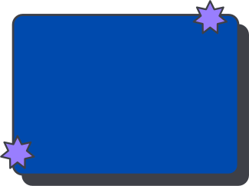

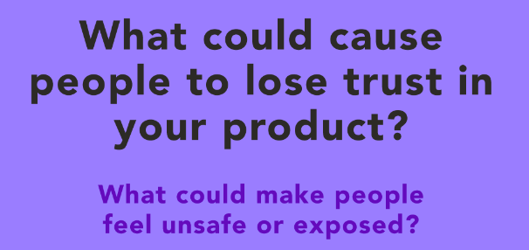
Ethical
Considerations
Concern: Calendar data privacy breaches
Implications: One big factor in the success of our product is user trust in sharing their calendar data with us. If our product starts making medical appointment recommendations based on calendar content (rather than availability), users will see a clear demonstration of a breach in data privacy, causing people to lose trust in Checkup.
CheckUp
Notes:
4b: ethical implication
With any healthcare app, we need to consider that data privacy is of utmost concern, since we'll need insurance information, health information, and availability information.

Slide 18

Tasks
CheckUp

Slide 19



Simple
Simple
Patients want to know when it is time to go to the doctor’s.
Patients want to schedule appointments based on mutual availability of themselves and the doctor.
Moderate
Patients want to find availability in their calendars to go to the doctor’s.
Complex
Patients want to see physicians based on personal preferences.
CheckUp
Notes:
5: The tasks we thought about! Some other tasks we thought that didn't make the final cut were:
a. Patients want to be reminded when to book appointments
b. Patients want to cancel appointments if something arises
c. Patients want to avoid calling doctors directly
d. Patients want to reschedule their appointments if their schedules change

Slide 20

Annotated Storyboard
CheckUp
Notes:
6: In our storyboard, we really want to personify CheckUp as your personal secretary who will do magic for you by making sure you get the healthcare you need.

Slide 21
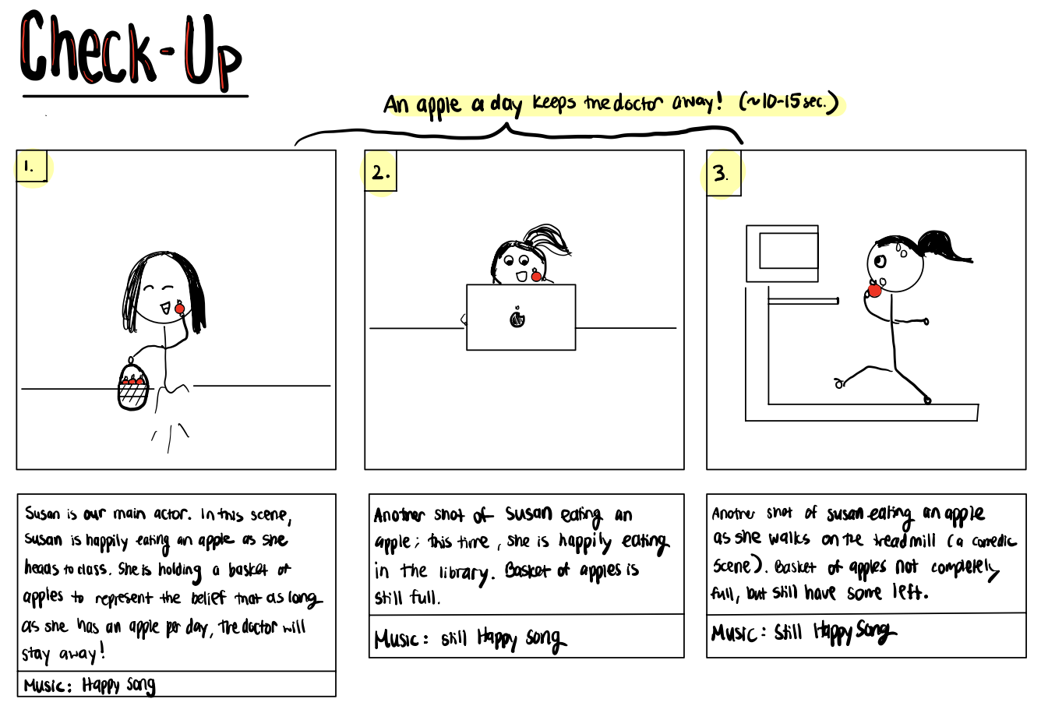
CheckUp

Slide 22
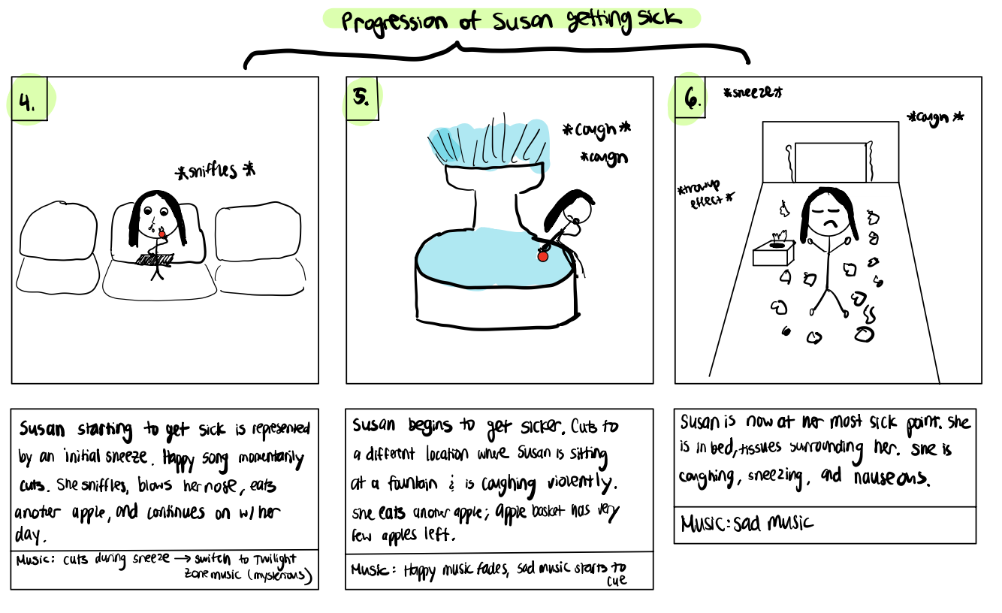
CheckUp

Slide 23
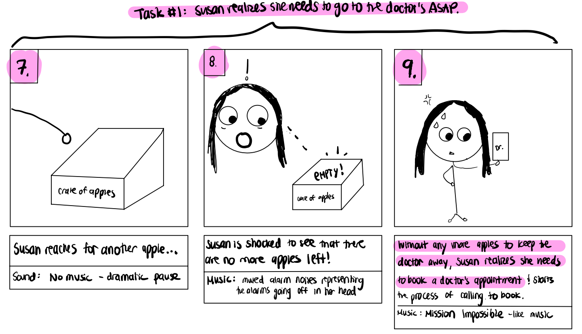
CheckUp

Slide 24
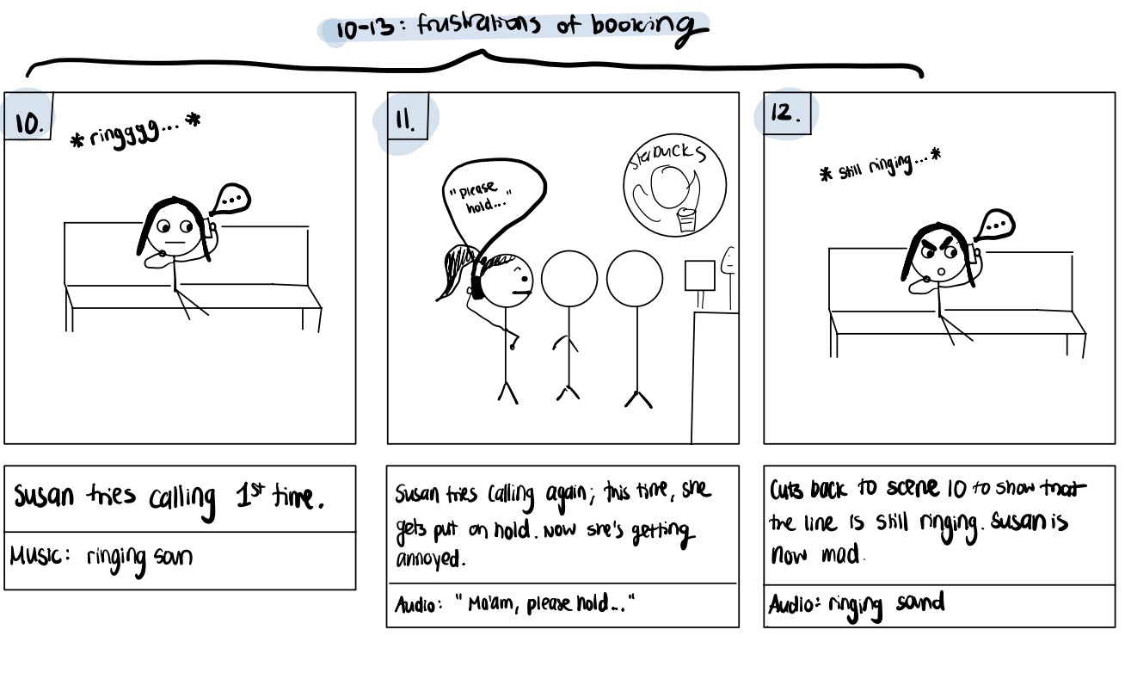
CheckUp

Slide 25
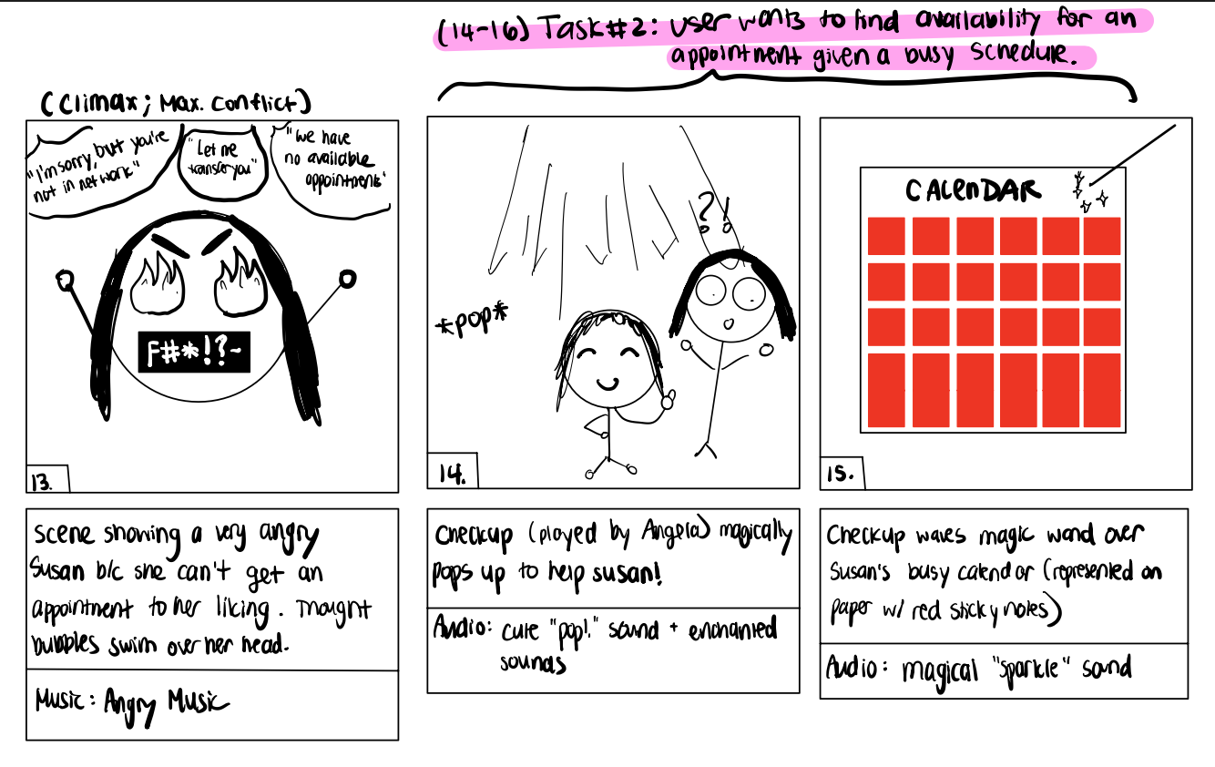
CheckUp

Slide 26
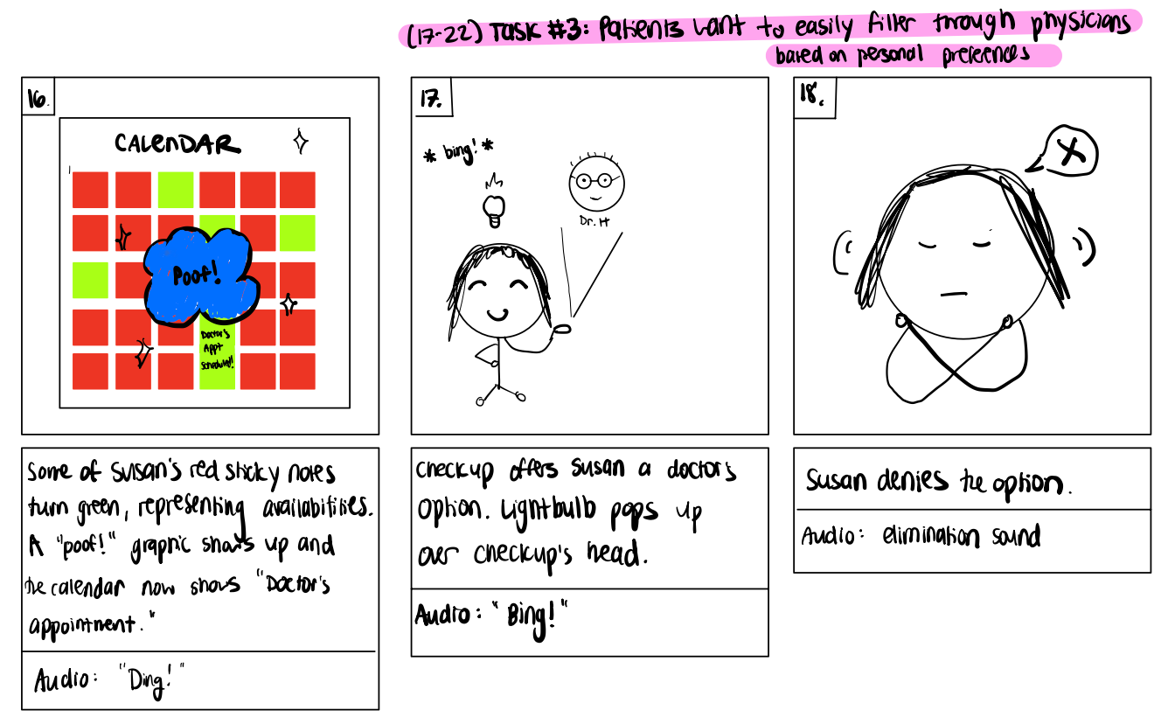
CheckUp

Slide 27
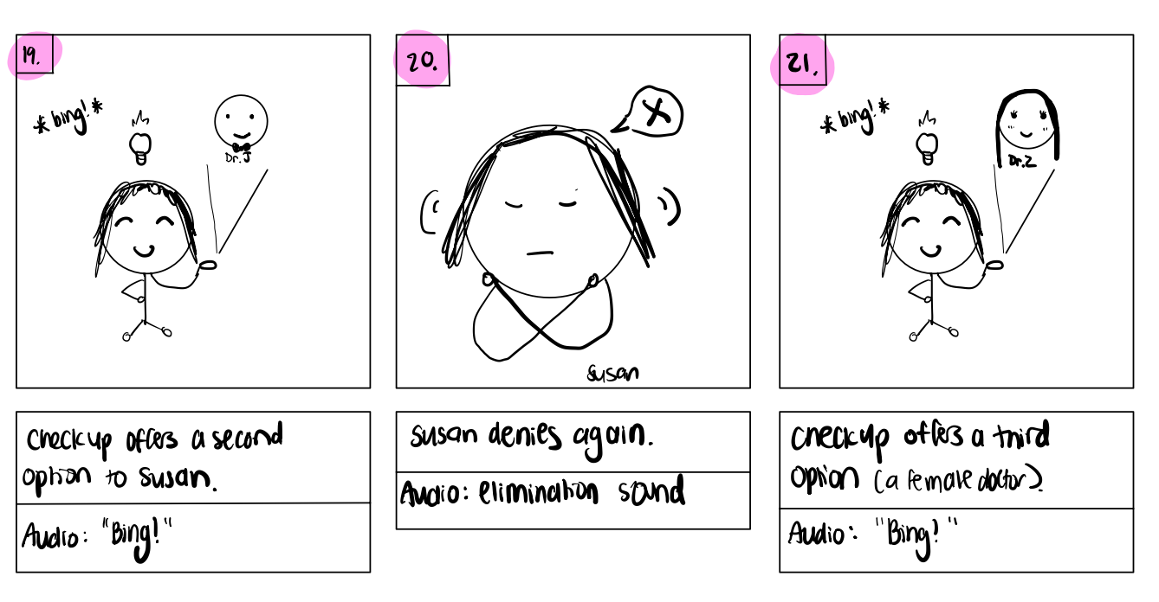
CheckUp

Slide 28
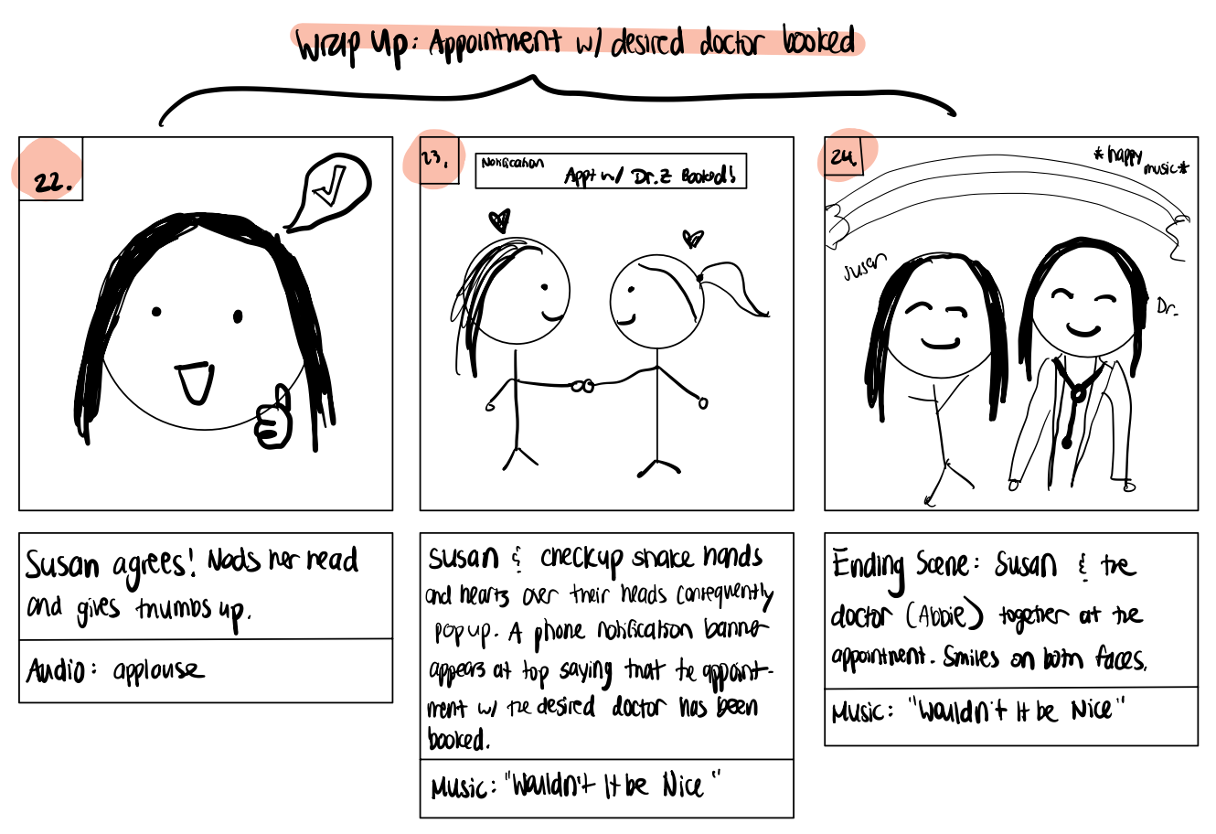
CheckUp

Slide 29
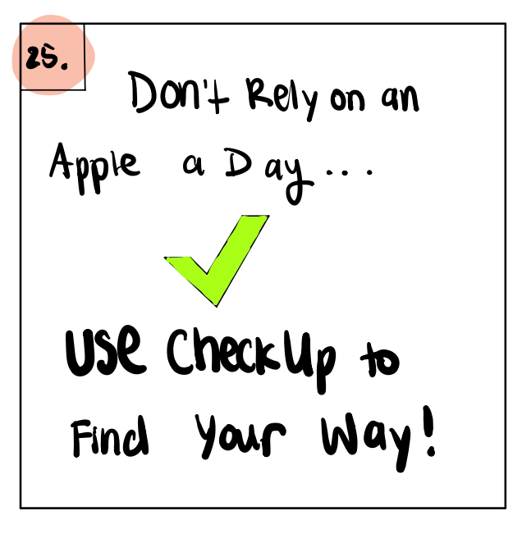
CheckUp

Slide 30


Enjoy the video!
CheckUp
https://www.youtube.com/watch?v=u4DJVv-oHho&ab_channel=delalipop
Notes:
7: video link.
URL if presentation doesn't click: https://www.youtube.com/watch?v=u4DJVv-oHho&ab_channel=delalipop

Slide 31
CheckUp
Thank You! Any Questions?

