Slide 1
From the time of her first cycle to menopause, the average American woman will have around 450 periods in her lifetime.

Slide 2
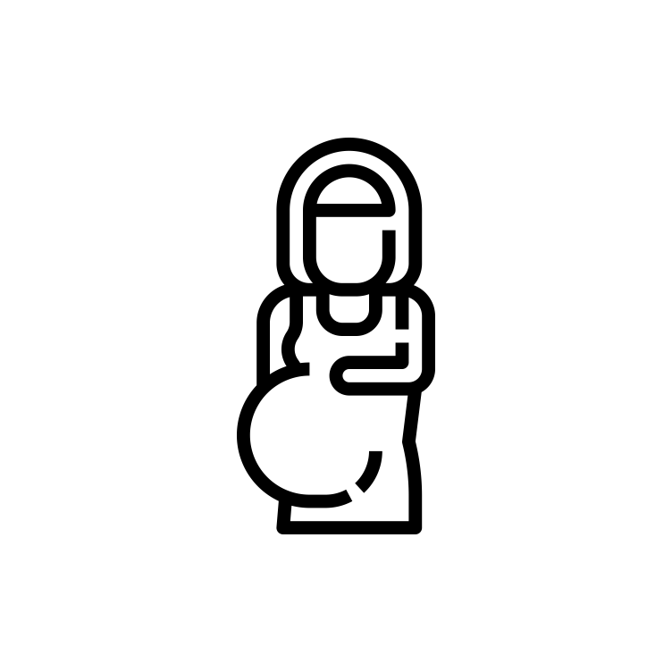
Women’s Health
Total Addressable Market: Globally valued at USD 41.35B in 2022 and is expected to grow at an annual growth rate of 5.4% from 2023 to 2030.
Three Main Focuses
Menopause: a point in time 12 months after a woman's last period.
Menstruation: is the monthly shedding of the lining of your uterus.
Contraception: is the use of medicines, devices, or surgery to prevent pregnancy.

Slide 3

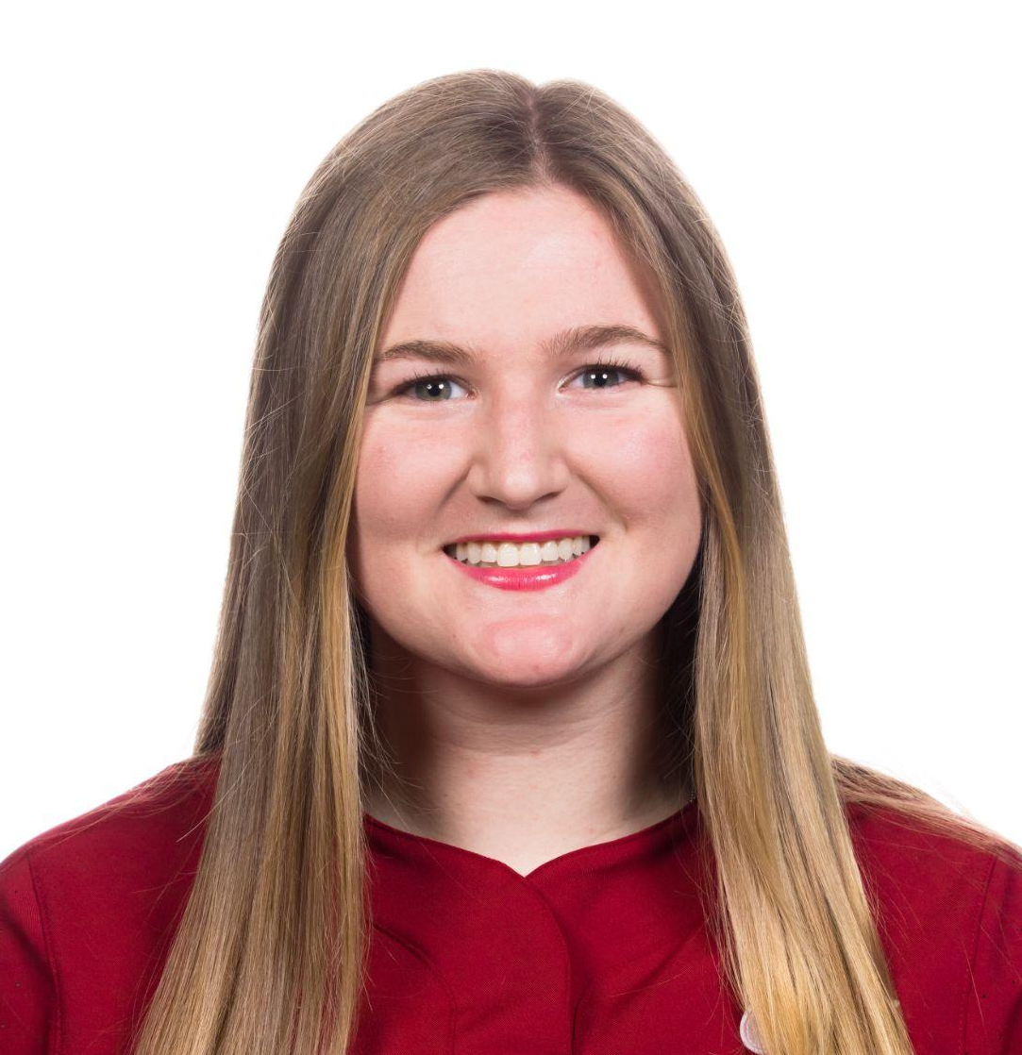


Meet the Team!
Shreya
Coterm in CS
Allie
BS in CS
Emily
Coterm in CS
Eric
Bs in CS

Slide 4



Roadmap
Analysis
Interview Results
Needfinding Methodology
-
Notes:
So, let’s take a deep dive into the role of social media.

Slide 5
Roadmap
Analysis
Interview Results
Needfinding Methodology
-
-
Notes:
So, let’s take a deep dive into the role of social media.

Slide 6
Needfinding Methodology

Slide 7
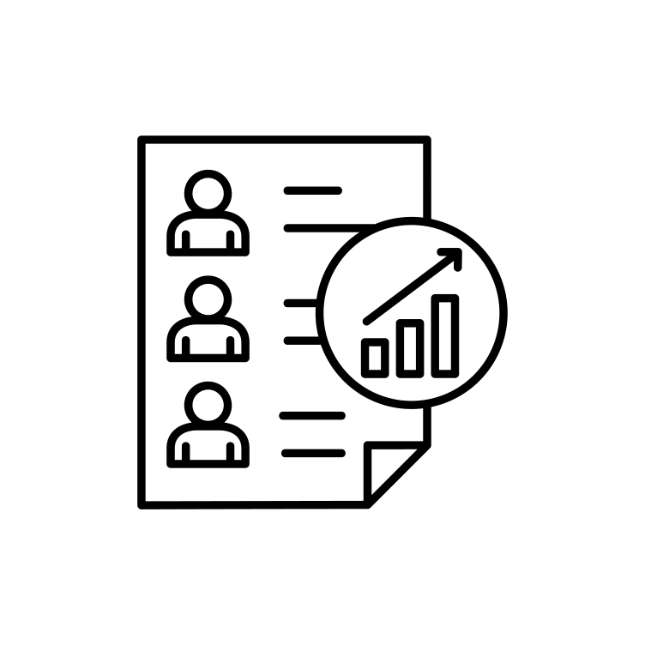
Participants
Dr. Marcia Stephanick (Domain Expert)
Professor of Medicine Professor of Obstetrics and Gynecology. She is currently the Principal Investigator of the Women’s Health Initiative.
Prakriti Garima
45 year old woman going through pre-menopause, Friend’s mom
Raagavi Ragothaman (Extreme User)
23 year old woman with PCOS (Extreme User), Acquaintance
Rosann
62 year old woman

Slide 8

Questions
In an ideal world, what technology in women’s health would you like to see?
What are your biggest worries as you age with your women’s health?
How do you feel about the use of technology and telehealth services in women’s health?
Do you have any specific questions or concerns related to women’s health that you’d like to see addressed or discussed more frequently?

Slide 9
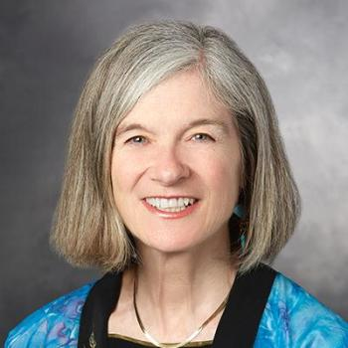
Interview 1: Dr. Stefanick (Domain Expert)
Who? A domain expert who runs the Women’s Health Initiative, a study following 4,500 post-menopausal women aged 50-75 since 1994. OB-GYN and Professor of Medicine at Stanford, pioneered research in post-menopausal hormones
How? Conducted by Emily and Eric over Zoom
Why? Chosen for expertise in women’s health problems and treatments
What? Women’s health needs change over time, but impersonal treatments are often used irrespective of their individual symptoms

Slide 10
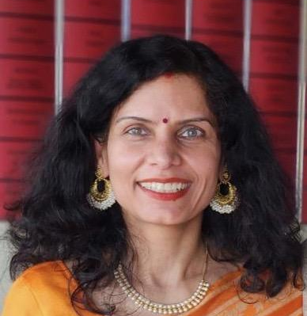
Interview 2: Prakriti
Who? Prakriti is a friend’s mom who is going through pre-menopause
Where? Conducted by Allie and Shreya over Zoom
Why? Chosen for her age and pre-menopause
What? Prakriti is frustrated because she had no idea that late periods and hot flashes relating to pre-menopause start at 45. Since everyone’s symptoms are different, she doesn’t feel like she knows what’s normal and abnormal.

Slide 11
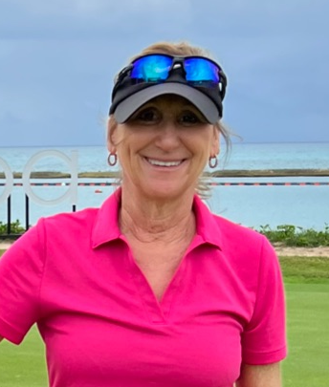
Interview 3: Rosann
Who? Rosann is a friends mother who is post-menopause
Where? Interview conducted by Allie and Shreya in person
Why? Chosen for her age, phase in her menstrual cycle, and personal experiences in the healthcare industry
What? Rosann has become frustrated with having to frequently be her own healthcare advocate with her endometriosis as she ages, and feels that she essentially has to help herself.

Slide 12

Interview 4: Raagavi (Extreme User)
Who? Raagavi is a friendly acquaintance who has mentioned concerns about her menstrual health and experiences with PCOS
Where? Conducted by Allie, Eric, and Shreya in person
Why? Chosen for her PCOS diagnosis
What? Treatment and diagnosis for PCOS and other period disorders is extremely tedious. Since symptoms are so varied for women, it’s hard for both menstruators and gynecologists to pinpoint diagnosis just based off of symptoms. Suggested treatments are often really unhelpful for PCOS.

Slide 13
Interview Results

Slide 14
“There are hundreds of possible hormone treatments available to women that a primary care physician doesn’t even know about.”
Dr. Stefanick
“Treatment options for PCOS that are not prescribed are extremely generic and include information such as ‘eat healthier’ and ‘maintain a low carb diet.’ This is pretty damaging to someone’s understanding of their condition and themselves.”
Raagavi
“Since everyone’s symptoms for menopause are so different, I wish there was a way to figure out what symptoms are considered normal.”
Prakriti

Slide 15

Tensions
The Same Drugs are Prescribed: There are hundreds of possible drug formulations, but only 1 or 2 are prescribed for most women.
Period disorders are barely understood by both field experts and menstruators: Disorders such as PCOS and endometriosis don’t have clear cut treatments and the lifestyle recommendations to treat them are pretty frustrating.
Older women going through menopause might not understand all of their symptoms: Different phases of menopause have very different symptoms that are not necessarily widely talked about.

Slide 16
Analysis

Slide 17
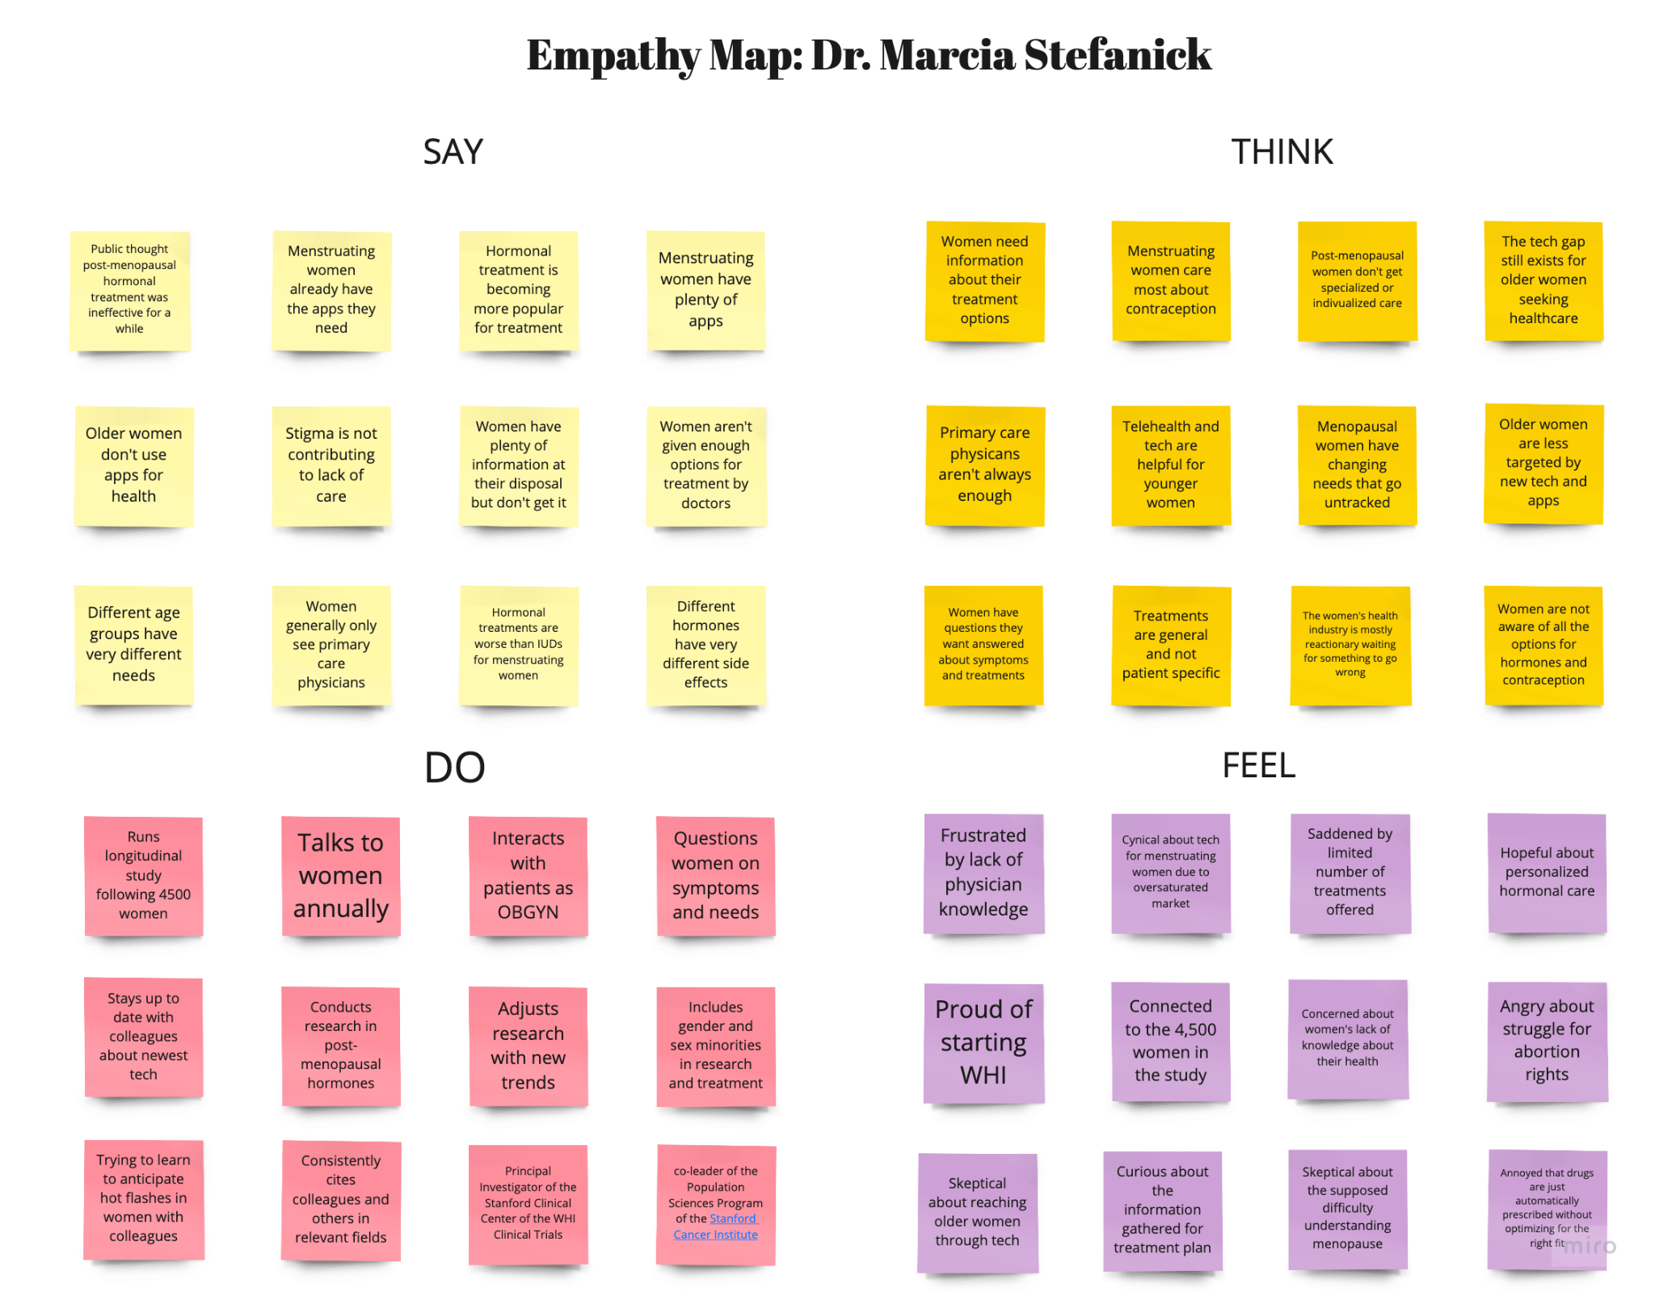

Slide 18
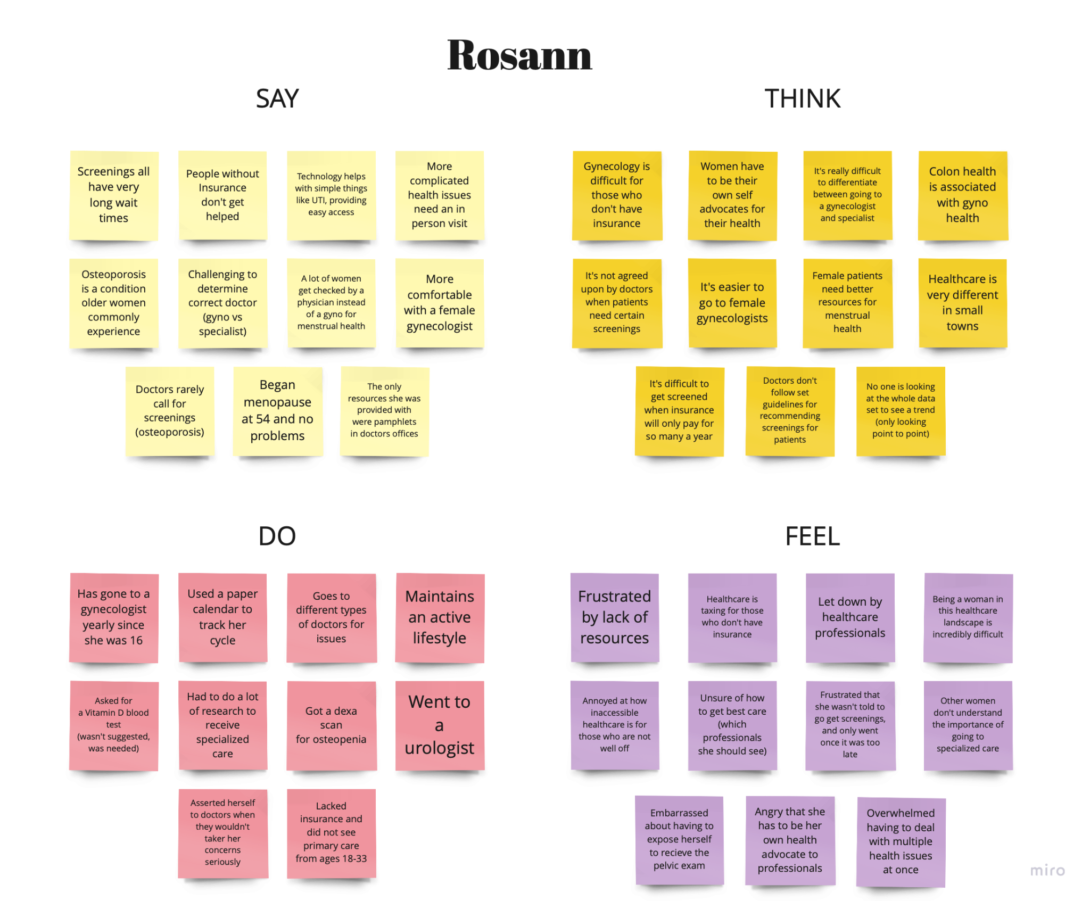

Slide 19

Key Insights
Navigating menstrual health as an older woman seems daunting, especially because menopause has many phases and conditions
Women have specific symptoms depending on their age and treatment, but this information is not used to inform better treatment as they age.
Period disorders are not widely understood, causing a lot of uncertainty and lack of clarity for those who experience them

Slide 20
Summary

Slide 21

Key Learnings
There is a lack of drug personalization for contraception, and menopause hormone therapy.
There is inefficiency in determining whether a woman has a period disorder, as they are not well-understood.
Having women’s health issues can be extremely disempowering because many times women have to be their own advocate.
Many women find it difficult to recognize their symptoms as menopause, as symptoms can vary widely.

Slide 22

What’s next?
Four Interviews Lined Up
Unpack additional interviews and understand the women’s health landscape more deeply.
Brainstorm Solutions
Synthesize the interview insights to begin brainstorming potential solutions.
Testing Solutions
Construct potential low-fi prototypes before selecting a final concept.

Slide 23
Any Questions?

