Slide 1
Around 66% of women ages 15 - 44 use some form of contraception.

Slide 2
Original Domain:
Women’s health
More focused problem domain:
Empowering people to make the right women’s health care decisions for them

Slide 3

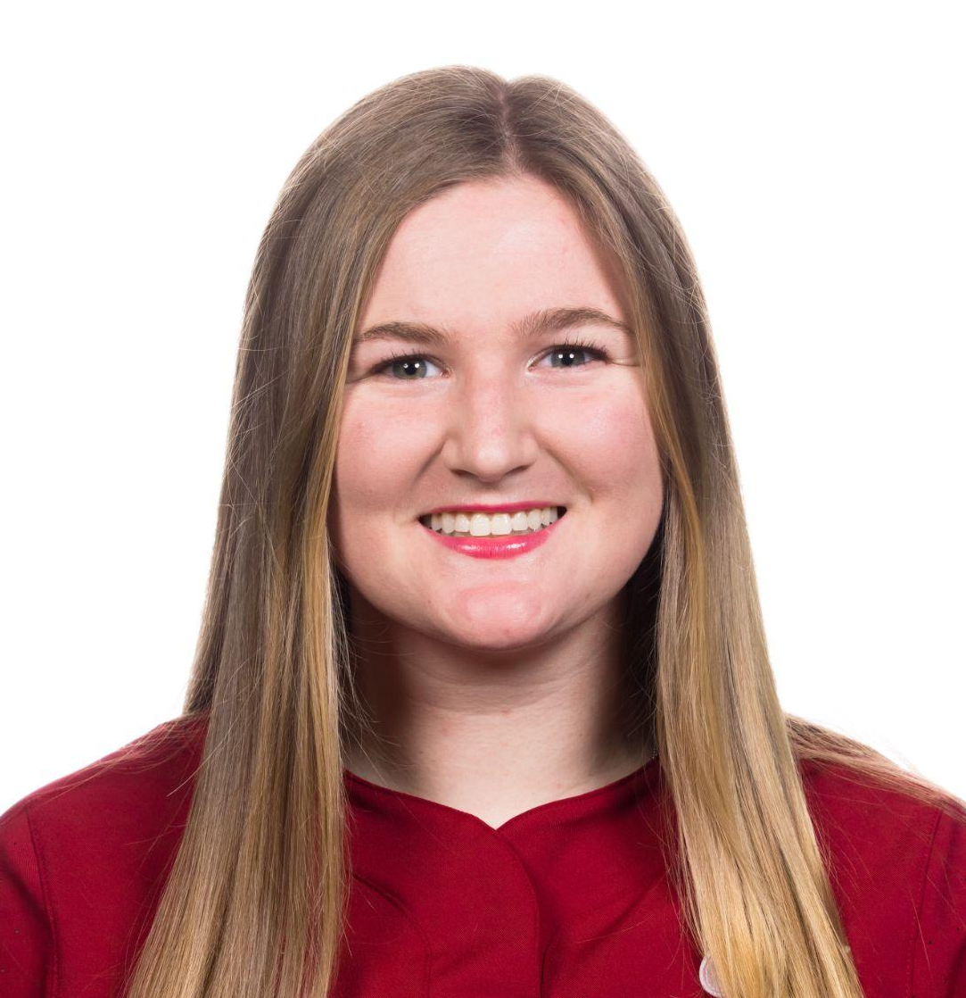


The Team
Shreya
Coterm in CS
Allie
BS in CS
Emily
Coterm in CS
Eric
Bs in CS

Slide 4





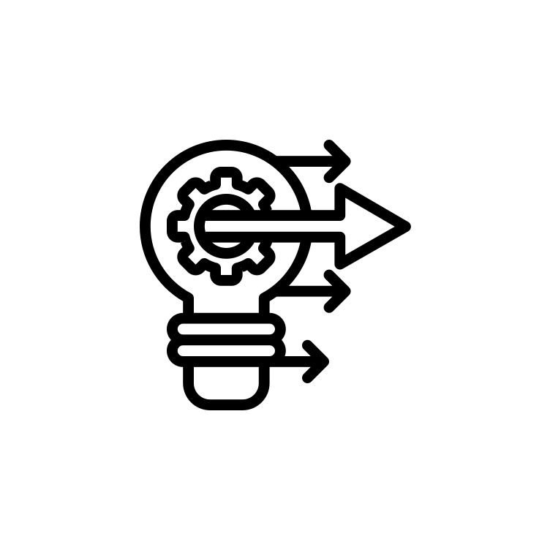
What’s Next?
Experience Prototypes
Roadmap
Solutions
HMWs
POV Development
Needfinding Results
-
Notes:
So, let’s take a deep dive into the role of social media.

Slide 5
What’s Next?
Experience Prototypes
Roadmap
Solutions
HMWs
POV Development
Needfinding Results
-
Notes:
So, let’s take a deep dive into the role of social media.

Slide 6
Additional Needfinding Results

Slide 7
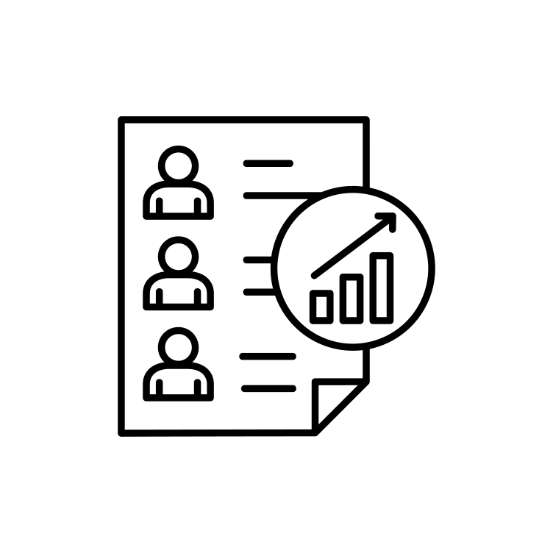
Participants
Brianna, a 40-year-old sexual health specialist and premenopausal women with irregular periods.
Angela, a 66-year-old retired high school teacher who recently went through menopause.
Emily, a 23-year-old med school applicant who struggled with finding good contraceptives.

Slide 8


Additional Needfinding Results
Women’s personal values and past experiences influence their treatment choice: Brianna cares about her menstrual health but rejected conventional hormonal treatments.
Women have to advocate for their women’s health every time they change doctors: Angela finds it frustrating to distill down your medical history to a few lines.

Slide 9
Additional Needfinding Results
Women have difficulty finding the right contraceptive with their unique symptoms and struggles: Emily found it stressful and time consuming to figure out a good contraceptive method for herself.

Slide 10
POV Development + HMWs

Slide 11

Final POV 1
We met…
Emily, a 23 year old medical school applicant, who has had difficulty finding the right contraceptive method for her.
We were surprised to notice…
While she did talk to her doctor about contraceptive options, she needed to do her own research on what contraceptives were a viable option for her.
We wonder if this means…
Finding a contraceptive that works best is a stressful and time-intensive experience for users.
It would be game-changing to…
Simplify how menstruators understand their symptoms and needs.

Slide 12
How might we simplify how women record their symptoms?
Notes:
Interview 1: Emily
How might we better inform women about their contraceptive options?
How might we take away the stress of choosing a contraceptive?
How might we make the process of changing contraceptive methods simple?
How might we find a better match for a user looking for a new contraceptive?
How might we inform doctors about contraceptives so that women don’t have to do their own research?
How might we use a patient’s reaction to a contraceptive to inform which one they choose next?
How might we adjust contraceptive options to a patient’s preferences?
How might we redefine what makes a ‘good’ contraceptive?
How might we use family history to inform a contraceptive choice?
How might we simulate a patient’s contraceptive use before they actually use it?
How might we crowdsource information about a contraceptive to find a better match for a patient?

Slide 13
Final POV 2
We met…
Brianna, a 40-year-old administrative worker in student sexual health who is premenopausal and struggles with irregular periods and autoimmune disease.
We were surprised to notice…
Despite her complicated medical history, she was still prescribed a one-size-fits-all hormonal treatment.
We wonder if this means…
That there is a lack of personalization of treatment in relation to menstrual health which is extremely frustrating to users.
It would be game-changing to…
Personalize women’s health medications based on preferences and patient history.

Slide 14
How might we personalize health medications/contraceptives for women based on their preferences and experiences?
Notes:
Interview 2: Brianna
How might we allow initial women’s health prescriptions to be based on patient medical history?
How might we incorporate family history into helping prescribe menstrual treatments?
How might we eradicate the need to change contraception prescription?
How might we personalize health medications/contraceptives for women based on their preferences and experiences?
How might we introduce women to knowledge of different types of birth control and their side effects?
How might we empower women to understand how to pivot to other medications based on their symptoms?
How might we create an easier experience for women to find treatments that work for them?
How might we incorporate community into womens’ menstrual health?
How might we include the user's personal values in their treatment?
How might we provide alternatives to hormonal treatment for menstruation?
How might we help women understand common menstruator’s symptoms and side effects after using hormonal therapy?

Slide 15
Final POV 3
We met…
Angela, who is a 66-year-old retired school teacher who recently finished menopause.
We were surprised to notice…
That when older women leave the workforce they change doctors frequently due to different insurance plans.
We wonder if this means…
That it’s frustrating for older women to have to become their own self-advocate to ensure continuity of medical care.
It would be game-changing to…
Empower women to be able to provide their medical women’s health history efficiently and simply.

Slide 16
How might we make relaying medical history simple and efficient?
Notes:
Interview 3: Angela
How might we remove the need to update doctors on medical histories?
How might we help women keep track of their own medical histories?
How might we allow a previous doctor and new doctor to build a rapport?
How might we streamline the process of seeing a new gynecologist for women?
How might we make the medical history create a close relationship with a new doctor?
How might we help women quickly find new doctors that are in their network?
How might we make relaying medical history simple and efficient?
How might we help patients keep rapport with doctors despite changing insurance/healthcare providers?
How might we help women advocate their own medical histories while changing doctors?
How might we simplify how women record their symptoms?
How might we introduce alternatives to in-person gynecologists that are efficient and effective (e.g. telehealth services)?

Slide 17
Solutions

Slide 18
HMW
Solution
Give women recommendations for hormonal therapies based on previous health history and current menstrual symptoms.
How might we personalize health medications/contraceptives for women based on their preferences and experiences?

Slide 19
HMW
Solution
Continuous questionnaire that periodically sends notifications to get symptomatic feedback based on contraception and menstrual health
How might we simplify how women record their menstrual symptoms?

Slide 20
HMW
Solution
Takes notes during doctors visits based off of recording, creates a patient's own version of doctors notes automatically which can be shared with new doctors
How might we make relaying medical history simple and efficient?

Slide 21
Experience Prototypes

Slide 22
Critical Assumptions
Patients WANT:
Their own version of doctor’s notes.
Personalized drug medication for women’s health
To Track their symptoms AND will respond to a questionnaire.

Slide 23
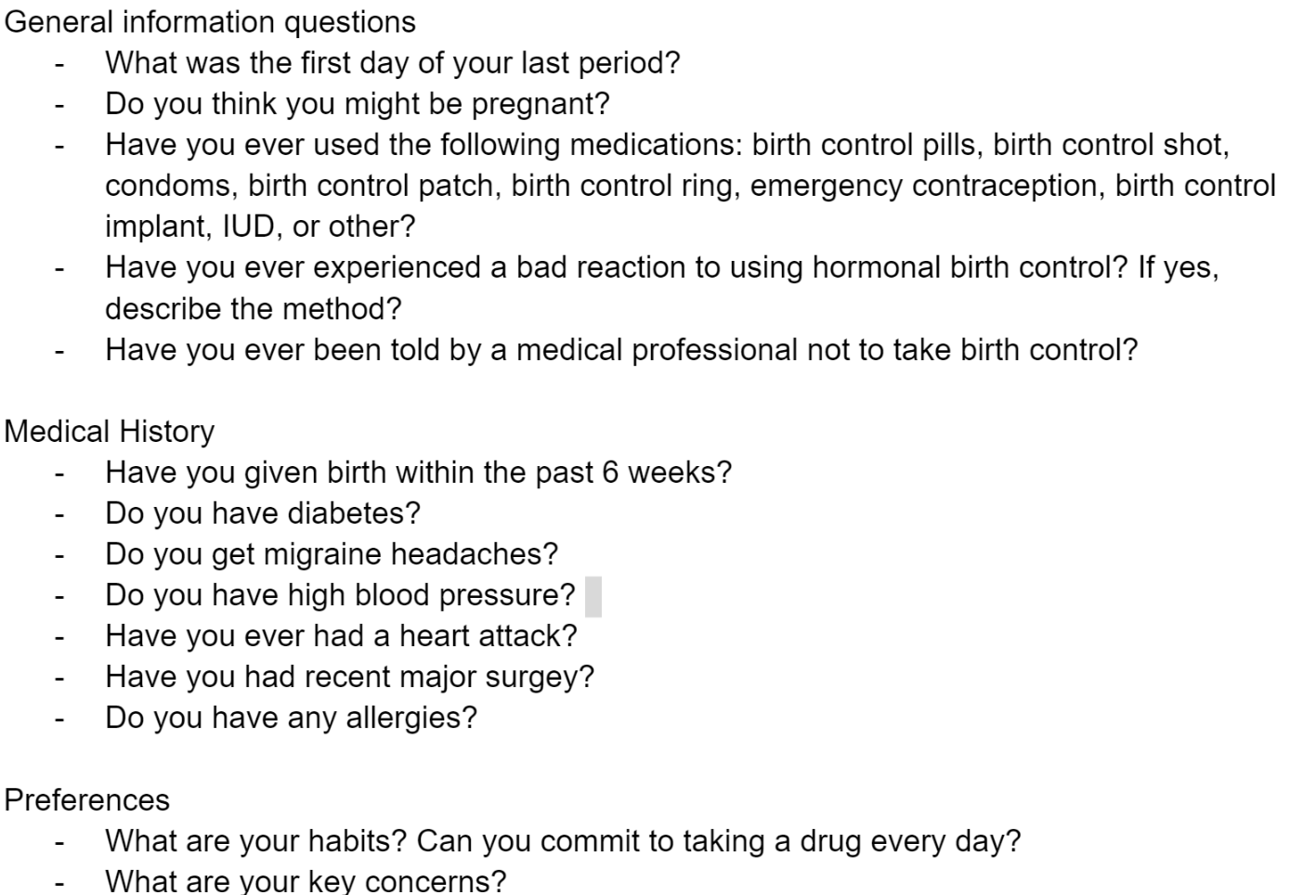
Experience Prototype 1
Solution
Personalized recommendations for hormonal therapies.
Critical Assumptionsotion
Women want personalized drug medication.
Process
Series of questions about contraception + algorithm = personalized specific contraception.
Questions
Types: general health, medical history and preferences questions.

Slide 24

What Worked, What Failed
Users: Multiple college aged women.
What Worked
Process made her feel listened to and empowered as she currently is not on contraception due to fear.
What Failed
Needed more questions to be comfortable taking the guidance.

Slide 25
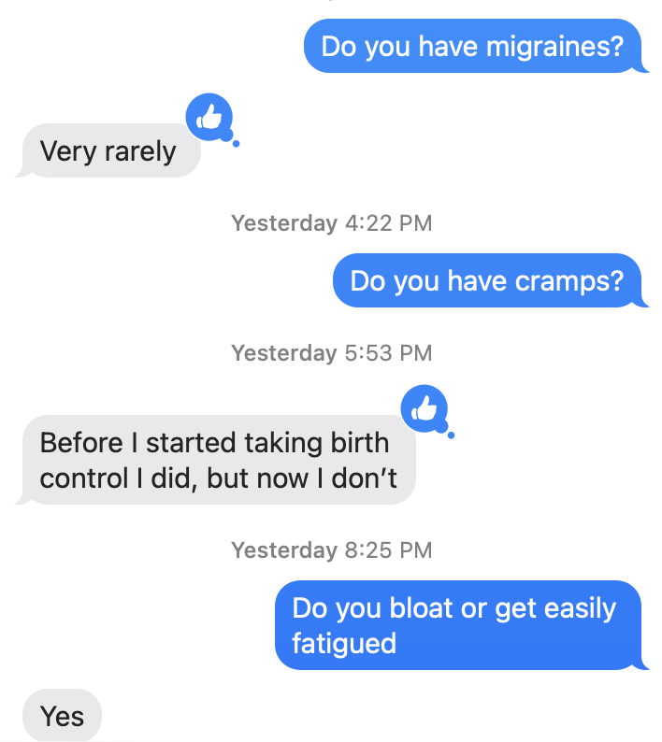
Experience Prototype 2
Solution
Continuous questionnaire app that periodically sends women notifications to get symptomatic feedback that’s based on contraception and menstrual health
Critical Assumption
Users will want to track their symptoms and will respond to a questions being sent to them
Process
Participants were sent questions about common menstrual symptoms that would be sent to the user at random intervals throughout the to simulate an app notification.

Slide 26
What Worked, What Failed
Users: Multiple college aged women.
What Worked
Both users were willing to respond to the questions, and responded quickly
They liked the spacing of the questions (they didn’t feel spammed)
What Failed
Users would have preferred checking off yes or no instead of typing a response

Slide 27
New Learnings & Validations
New Learnings
Participants liked getting notifications about possible symptoms
Participants felt they were more likely to keep track of symptoms if they were prompted by an external source
Validation
The critical assumption was validated as the participants were willing to respond to questions to track their symptoms

Slide 28
Experience Prototype 3
Solution
Takes notes during doctors visits based off of recording, creates a patient's own version of doctors notes automatically which can be shared with new doctors
Critical Assumptions
Women want an easy way to share menstrual health histories with new doctors
Process
Ask 2 women to summarize their menstrual health histories, experiences with gynecology visits, and period symptoms currently. Provide them a summary of the points that they mentioned and ask them how they feel about the “doctor notes” that were provided to them. Would they send it to other doctors?

Slide 29
What Worked, What Failed
Users: Multiple college aged women.
What Worked
Our two candidates really enjoyed that they got a record of their menstrual history not even for future gynecologists but for personal knowledge
Prompting women to dig deep into their period history helped them recall symptoms and conditions they had forgotten
What Failed
Women didn’t know when they would see a gynecologist next so didn’t know how relevant these notes were for future visits

Slide 30
What’s Next?

Slide 31
Solution Selected

Slide 32

Solution
Combine our first two solutions: effective and regular menstrual symptom tracking and catered contraception/menstrual regulation suggestions
When users join the app, we prompt them to provide their menstrual history and family history
We ask them if they’re looking for contraception/non-hormonal therapy recommendations in which case we provide them with some
If not, users can use the app to track their symptoms and general health

Slide 33
Ethical Implications
Menstrual health is poorly understood generally – it might be hard to give super catered contraceptive/non-contraceptive recommendations since not all side effects have been identified
We want to be careful with giving individuals lifestyle directions to follow

Slide 34

Who does it serve? Who might it leave out?
Currently prioritizes cisgender women
Non-menstruating women or women unable to get pregnant may feel excluded
Assumes some level of access to healthcare and technology

Slide 35
Appendix

Slide 36
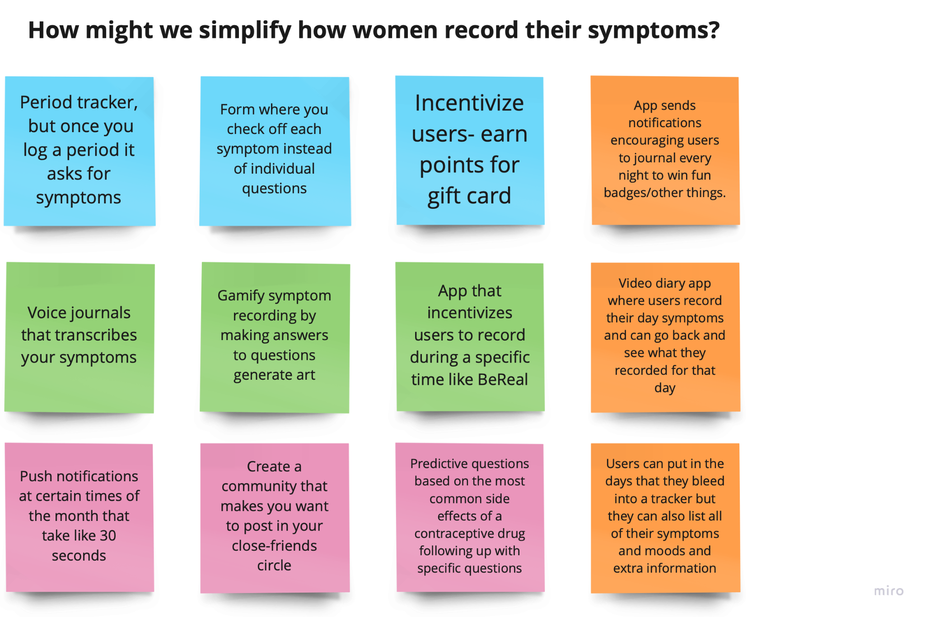

Slide 37
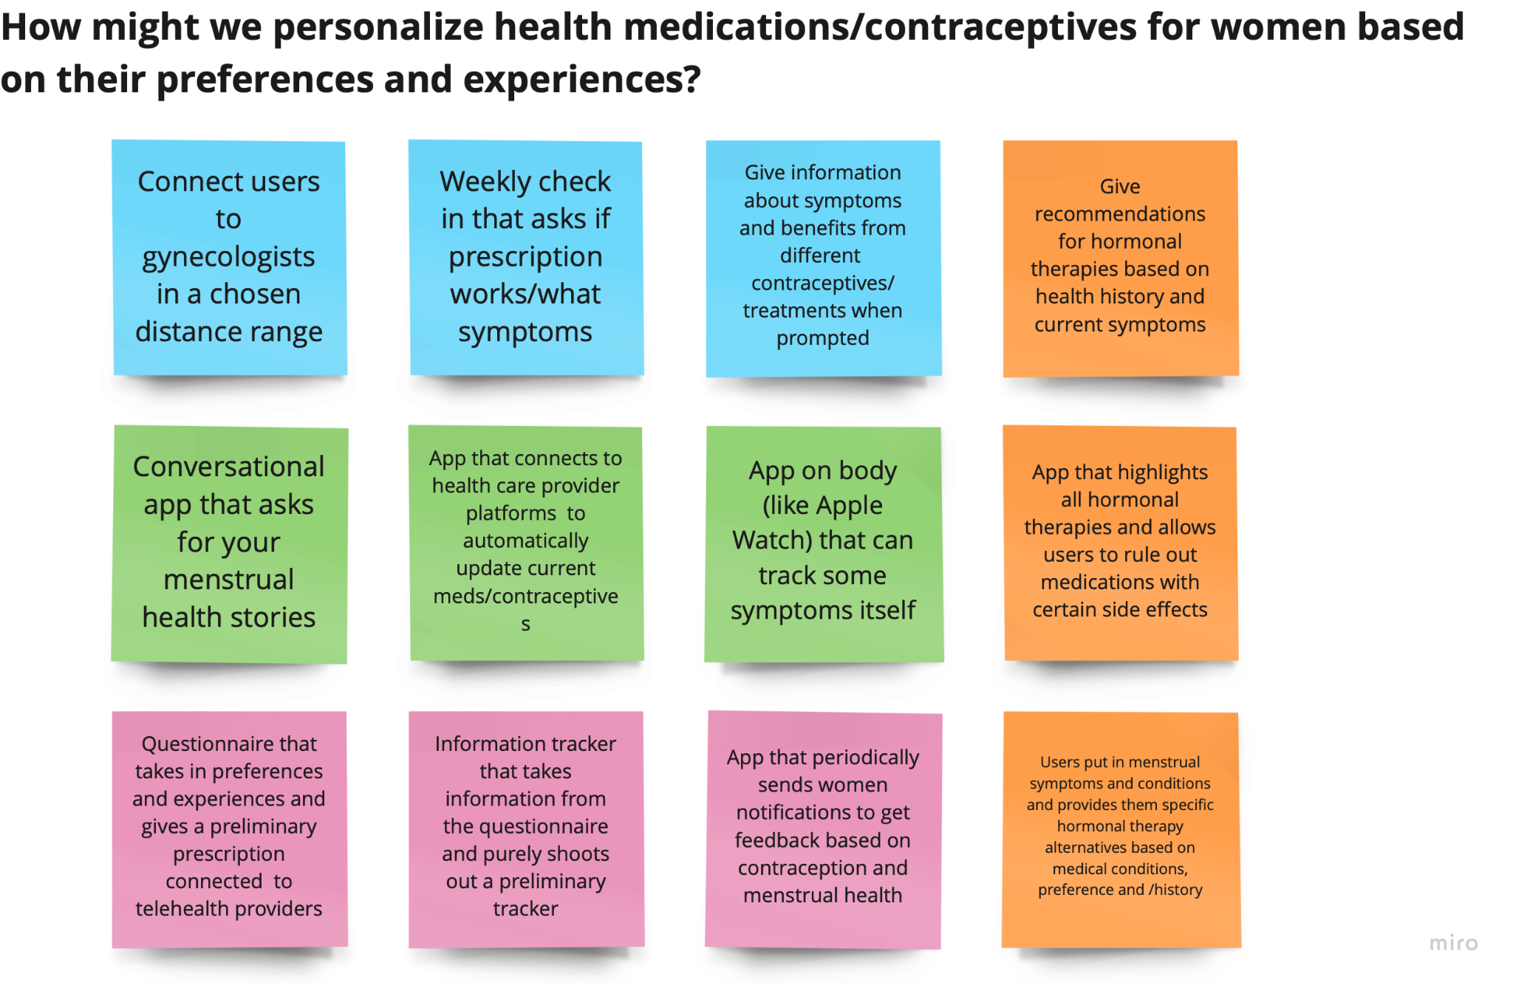

Slide 38
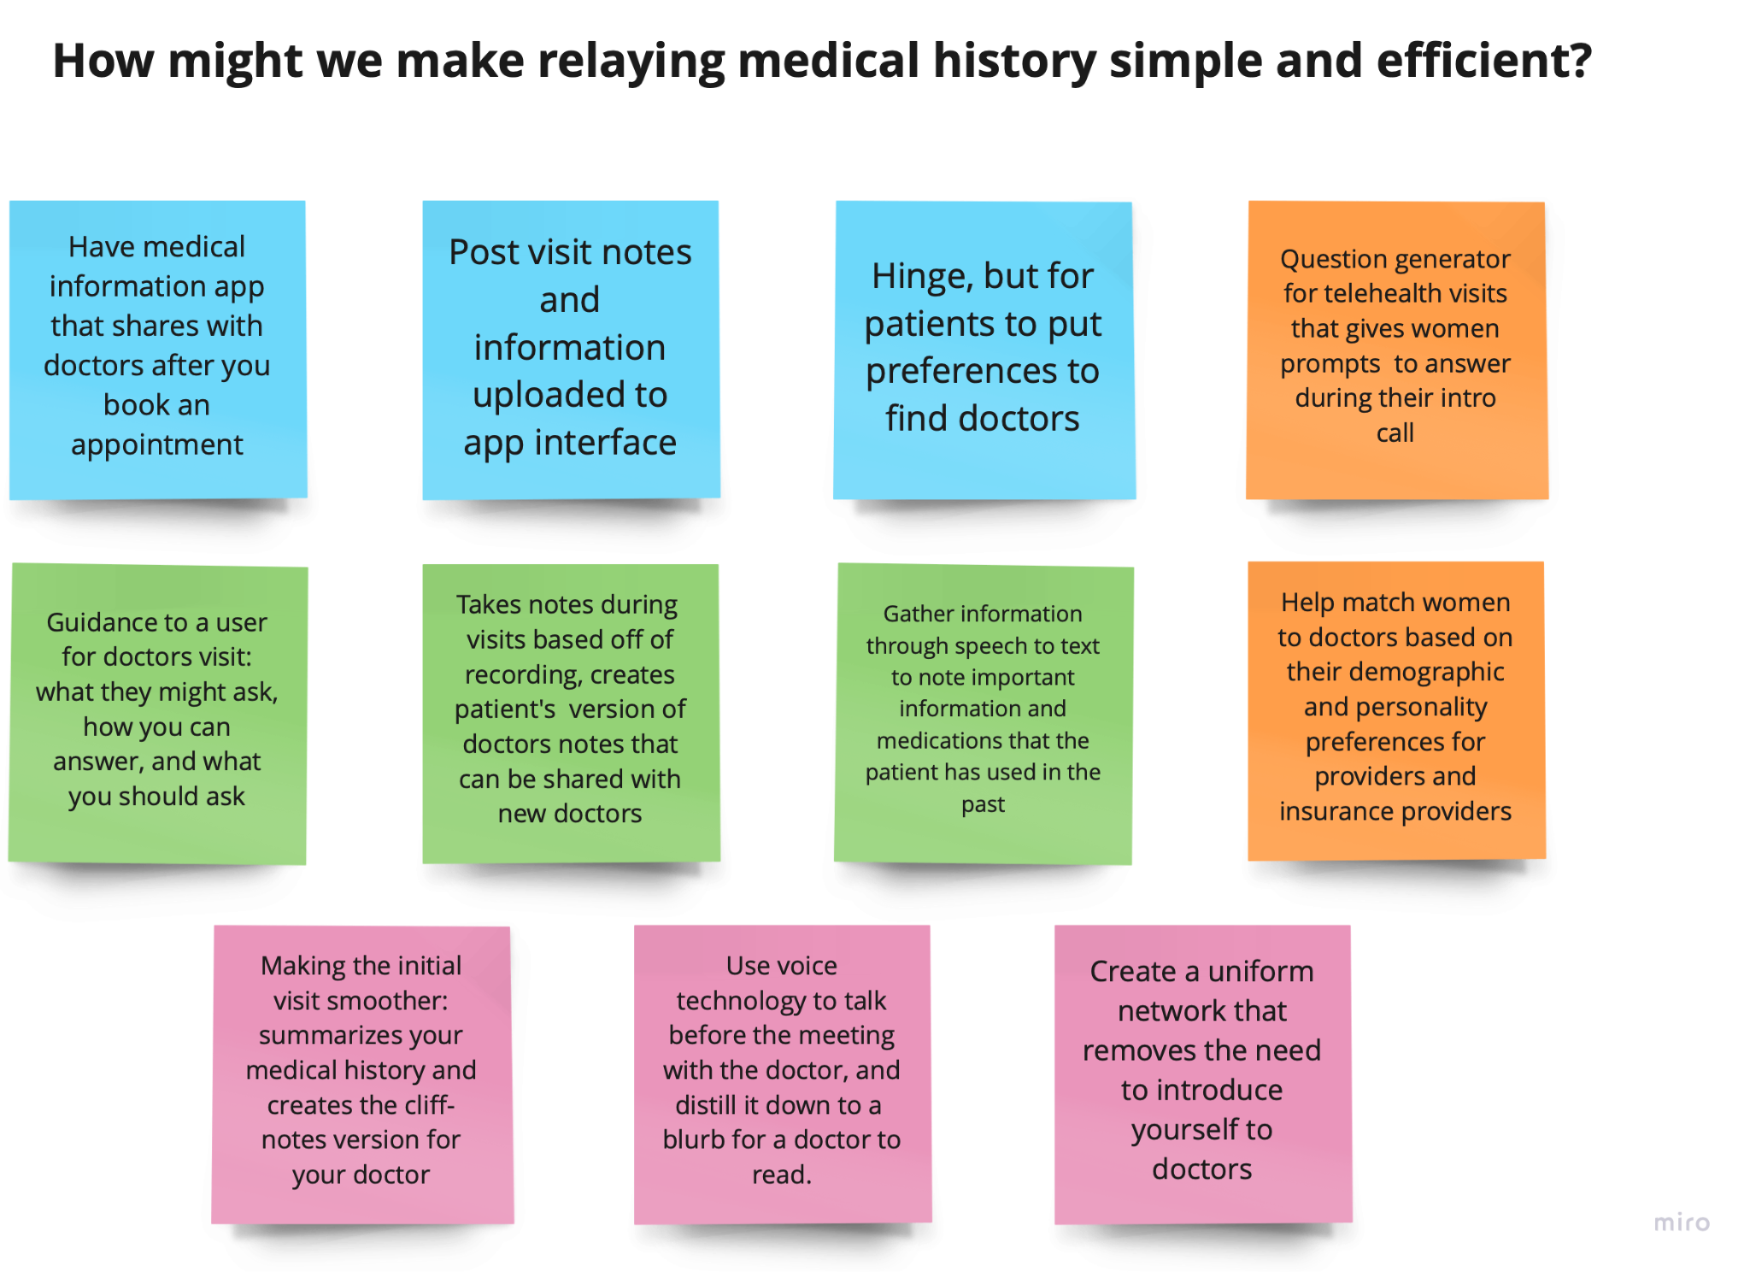

Slide 39
Any Questions?

