Slide 1
CS147
Assignment 4
Emily, Eric, Shreya, Allie

Slide 2




The Team
Shreya
Coterm in CS
Allie
BS in CS
Emily
Coterm in CS
Eric
Bs in CS

Slide 3

Introducing IUDIY
IUDIY = DIY + Contraception Method
The name captures our mission of engineering personalized contraception.
Value Proposition
Find contraception that is right for you, and minimize the side effects of contraception.

Slide 4

Problem Overview
Primary User
Menstruators who are seeking to better understand their period symptoms and treatment options.
Problem Tackling
The same treatments are often offered to menstruators with very different symptoms, preferences, and needs → menstruators need to be their own period expert and advocate.

Slide 5

Proposed Solution
1. User fills out a previous medical history questionnaire and medication preferences form.
2. User gets a first prescription of contraception, based on an algorithm.
3. User continuously tracks their symptoms to identify symptoms/side-effects and change the prescription as needed.

Slide 6
Market Research

Slide 7

Similar product 1
Agyn
‘The Birth Control Test’: (requires taking a blood sample)
DNA and hormone analysis
Clinically accurate, medically actionable results
Personalized birth control recommendations
Access to nearly 200 highly effective birth control options
Contraceptive counseling visit (video‑based)
At‑home collection materials
Cost: $369

Slide 8

Product Review 1
What’s Has/Has Not Worked?
Extremely expensive and insurance is not accepted.
Only accessible in the USA, excluding NY, and NJ.
Allows biology to dictate medication.
Uniqueness of Our Solution:
Our concept has no geographic boundaries.
Implications of Our Solution:
Greater inclusivity of women irrespective of location.

Slide 9

Similar product 2
Ro
‘Modern Fertility Birth Control’:
Connect with a provider to find out which prescription birth control pill is right for you.
No consultation free and no insurance required.
Ongoing care, plus virtual recommendation to pair with a pill that meets your preferences.
Cost: $19 per month.

Slide 10
Product Review 2
What’s Has/Has Not Worked?
Only considers pills, excludes IUDs, patches etc.
Includes Emergency Contraception with first shipment.
Uniqueness of Our Solution:
We consider other methods of contraception such as IUDs.
Implications of Our Solution:
Greater contraceptive fit as we consider more options.

Slide 11

Similar product 3
Alpha
‘Alpha for Birth Control’:
Describe your symptoms online
Connect with a Medical Provider
Get Whole- Person Care
Birth control options start @ $15 a month and you are able to choose your preferred pharmacy.

Slide 12
Product Review 3
What’s Has/Has Not Worked?
Provides a diversity of options for contraception.
Cost is a large factor in determining what prescription is offered.
Uniqueness of Our Solution:
All our medications will be at the same price.
Implications of Our Solution:
Allow for the right birth control without replacing care providers.

Slide 13

Similar product 4
Nurx
‘Get Birth Control Online with Free Delivery’:
Answer a few health questions on online intake form and get a medical consult
Receive a birth control recommendation
Online pharmacy fills the prescription and delivers a 3 month supply
Cost: $25 medical consult + birth control price as per insurance (often free)

Slide 14
Product Review 4
What’s Has/Has Not Worked?
Medical consult is helpful but not super comprehensive
Pricing is very reasonable, very accessible birth control
Delivery is convenient
Uniqueness of Our Solution:
More comprehensive medical screen + additional symptom tracker
Implications of Our Solution:
Really hone in on the perfect birth control solution for patients
based on a really comprehensive screening

Slide 15
Values in Design

Slide 16

Stakeholders
Direct
  Pharmacists
  Healthcare Providers
  Menstruators
Indirect
  Insurance Companies
  Medical Clinics
  Algorithm Developer

Slide 17

Ethical Implications
Recommending treatment options as non-medical experts.
  We seek to enhance the patient-doctor relation, not replace it.
  Our advice is not a diagnosis or prescription, but a question to ask the doctor.
  There are patients whose cases are so complex that it can act as a starting point for a patient-doctor conversation rather than replace it fully.

Slide 18
Ethical Implications
Care = a function of cost.
  Access becomes a function of whether you can afford the prescription that is best for you.
  Some insurance plans only cover certain brands of pills or generic versions.
  Certain demographics will be excluded as paying for prescription becomes a barrier to choosing the correct version for you.

Slide 19
Tasks

Slide 20

Task 1
Users recording their menstrual health symptoms daily/regularly on and off their period
Simple

Slide 21
Task 2
Users providing their health background/family health history plus preferences
Moderate

Slide 22
Task 3
Users find their perfect contraception prescription with minimal side effects based on their history and preferences.
Complex

Slide 23
Video

Slide 24
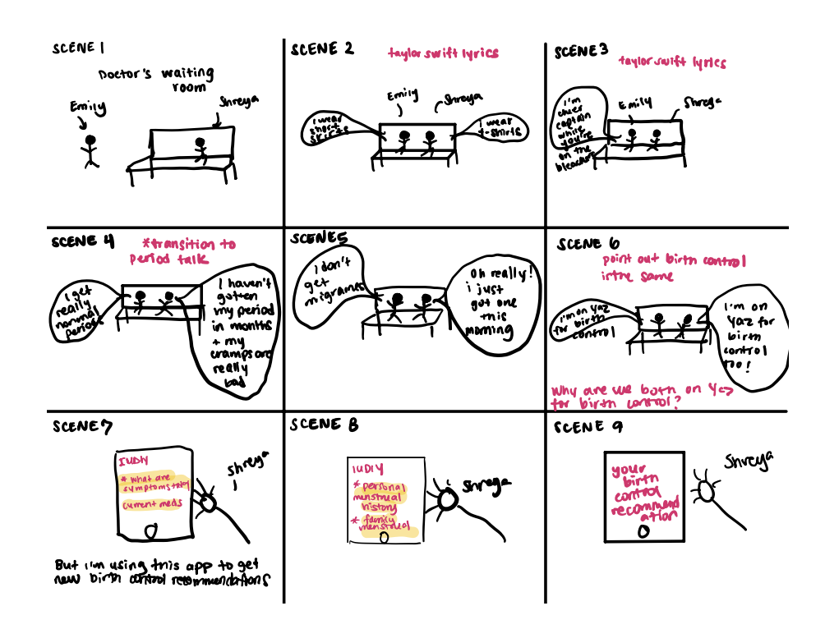

Slide 25


Slide 26
Appendix

Slide 27
YouTube link for video
https://youtu.be/0rh9Ayh46yI

