Slide 1
Almost one-third of contraceptive users (31%) say they are experiencing side effects from their current method, and just over half (52%) say the side effects are more severe than they expected.

Slide 2

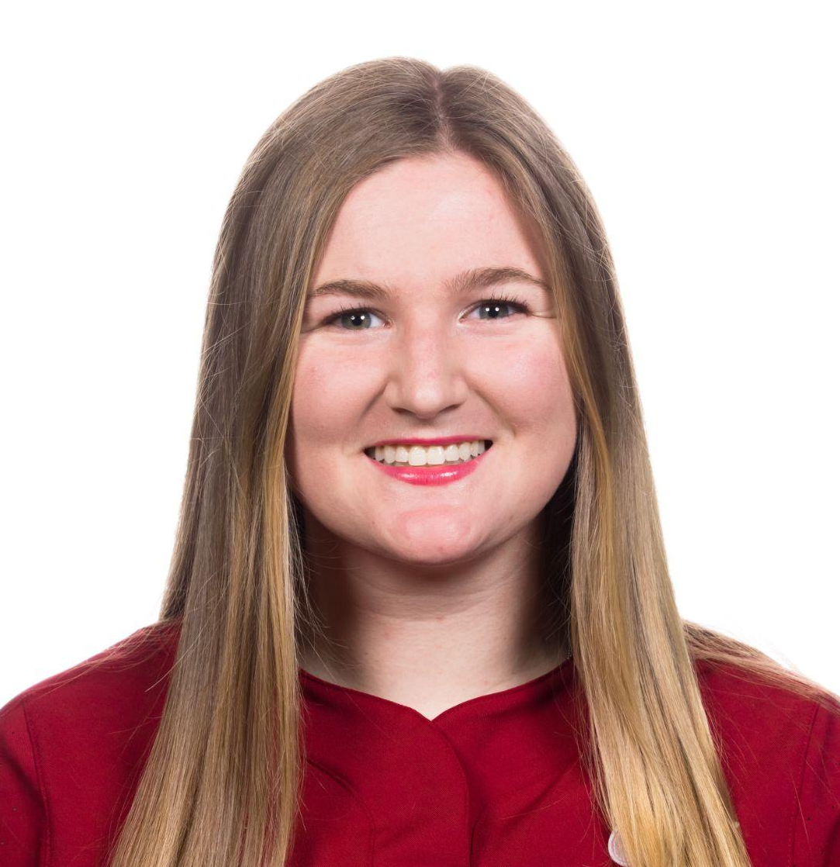


The Team
Shreya
Coterm in CS
Allie
BS in CS
Emily
Coterm in CS
Eric
Bs in CS

Slide 3

Problem/ Solution Overview
Menstruating people need personalized women’s health care instead of a one-size-fits-all solution.
With IUDIY, we empower users to understand their needs and get a personalized treatment recommendation.

Slide 4

Introducing IUDIY
IUDIY = DIY + Contraception Method
The name captures our mission of engineering personalized contraception.
Value Proposition
Find contraception that is right for you, and minimize the side effects of contraception.

Slide 5






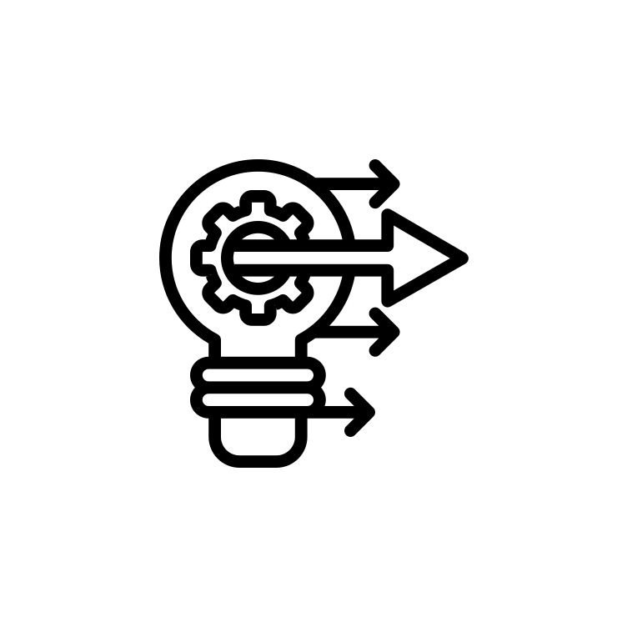
Testing Results
Discussion
Testing Methodology
Roadmap
Low-fi Prototype
Low-fi Prototype Construction
Selected Interface & Rationale
Sketching Explorations
-
Notes:
So, let’s take a deep dive into the role of social media.

Slide 6
Testing Results
Discussion
Testing Methodology
Roadmap
Low-fi Prototype
Low-fi Prototype Construction
Selected Interface & Rationale
Sketching Explorations
-
Notes:
So, let’s take a deep dive into the role of social media.

Slide 7
Sketching Explorations

Slide 8
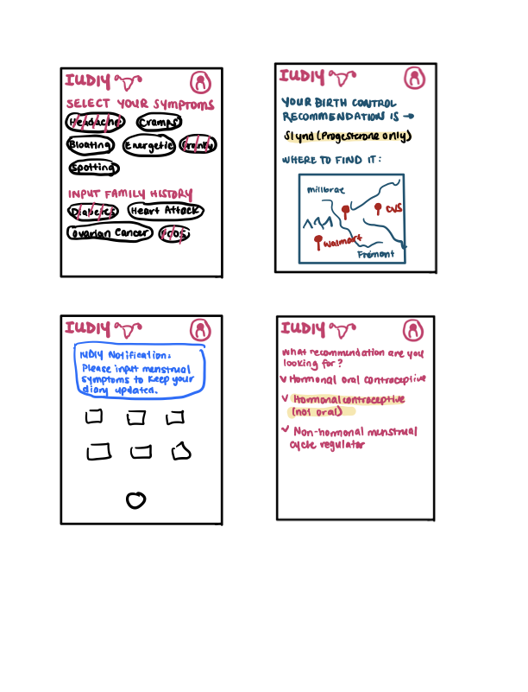
Realization 1 Concept Sketches

Slide 9
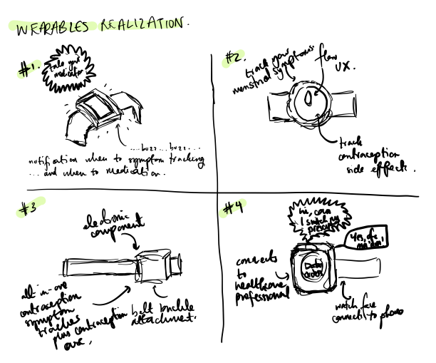
Realization 2 Concept Sketches

Slide 10
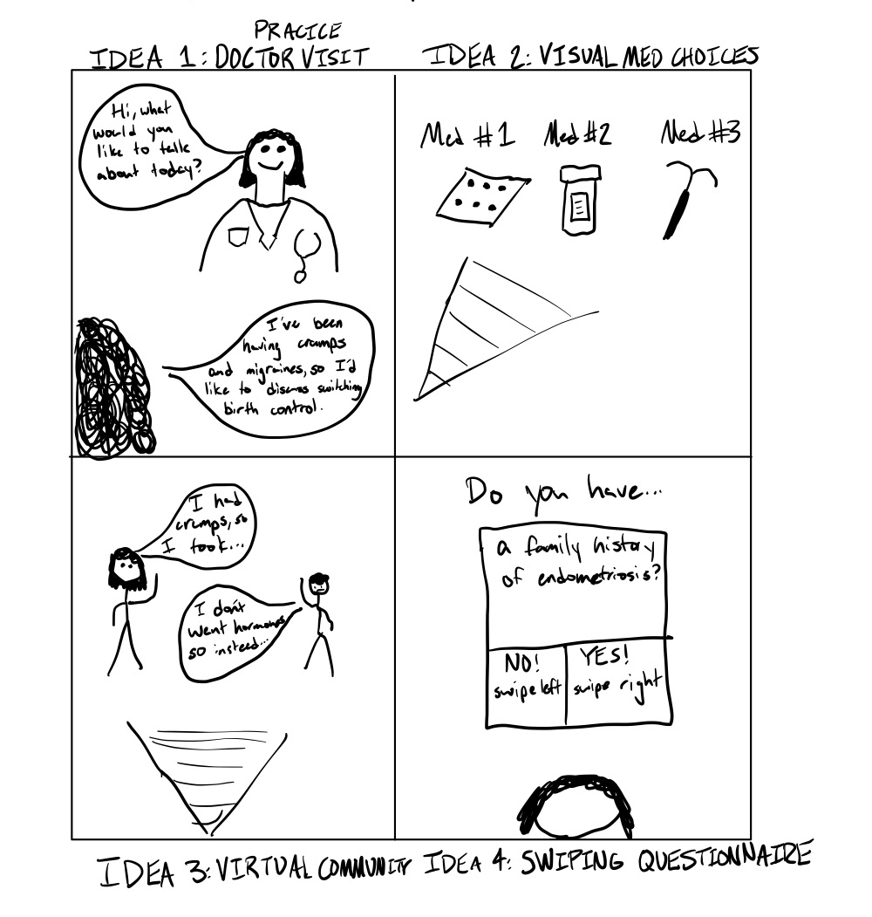
Realization 3 Concept Sketches

Slide 11
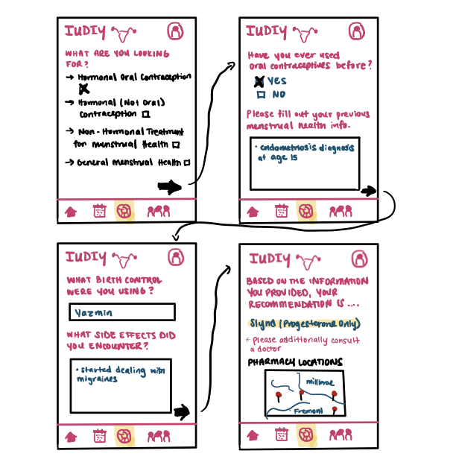
App Realization Fleshed Out

Slide 12
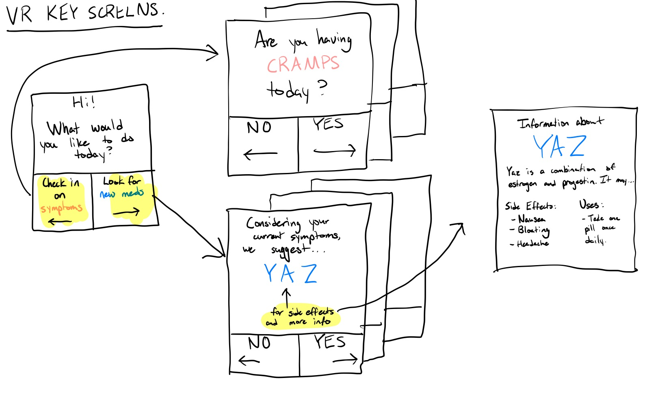
VR Realization Fleshed Out

Slide 13
Selected Interface & Rationale

Slide 14
App Interface Pros & Cons
Pros
App is more accessible than VR.
Quickly logging is easy, and intuitive for user.
Cons
An app is not an immersive experience.
More similar to existing products.

Slide 15
VR Interface Pros & Cons
Pros
Immersive experience allows for increased engagement
Swipe-based interface is familiar and fun.
Cons
Not easily accessible to lower income brackets or people unfamiliar with VR
Takes too much time to use

Slide 16
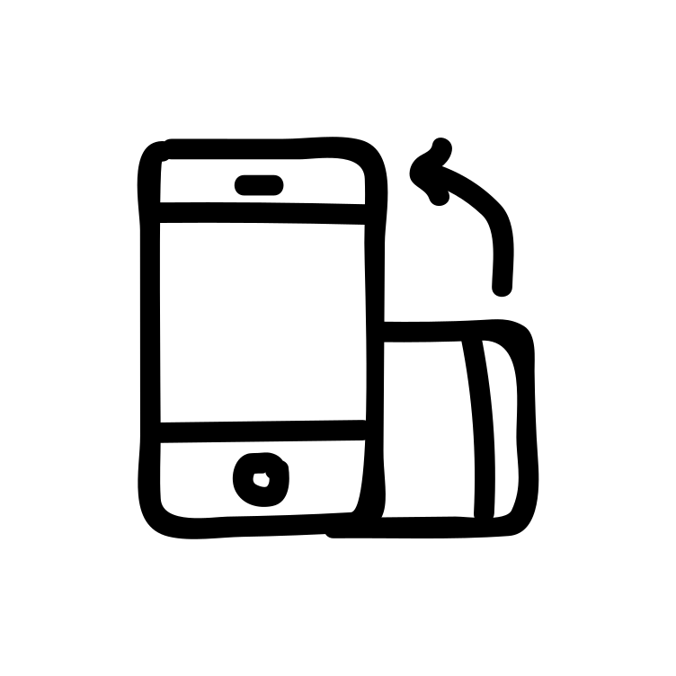
Selected Interface- Mobile App
Relevant Data
Flo has 200 million downloads and over 40 million active users showing that an app in the menstrual/contraceptive health sector can succeed
Constraints
Different screen sizes
Memory usage
Data security
Network bandwidth
Findings
Out of all of our interviews no one easily had access to a VR setup while they all had mobile phones

Slide 17

Design Evaluation
Most accessible interface out of our options
The market is wide-open for more/better apps in the women's health market
Takes users time constraints into account

Slide 18
Low-fi Prototype Construction

Slide 19

How it was made?
Paper Prototyping Construction
Brainstormed all the potential task-flows and put the most common ones in the navigation bar.
No color to keep the UI simple.
All the screens should look the same so it looked like it could have come from the previous screen.

Slide 20

Features
Home
App-point of entry.
Prescriptions
Section to change prescription, investigate your prescription and
Check-in
Log daily symptoms and side-effects.
Profile
Profile information is constructed based on initial preferences questionnaire.

Slide 21

Interactions
In-Person Process
Users touched the paper where they would click.
Zoom Procedure
Users would say where they would have clicked.

Slide 22
Low-fi Prototype

Slide 23
Simple Task Flow
Please log your symptoms.

Slide 24
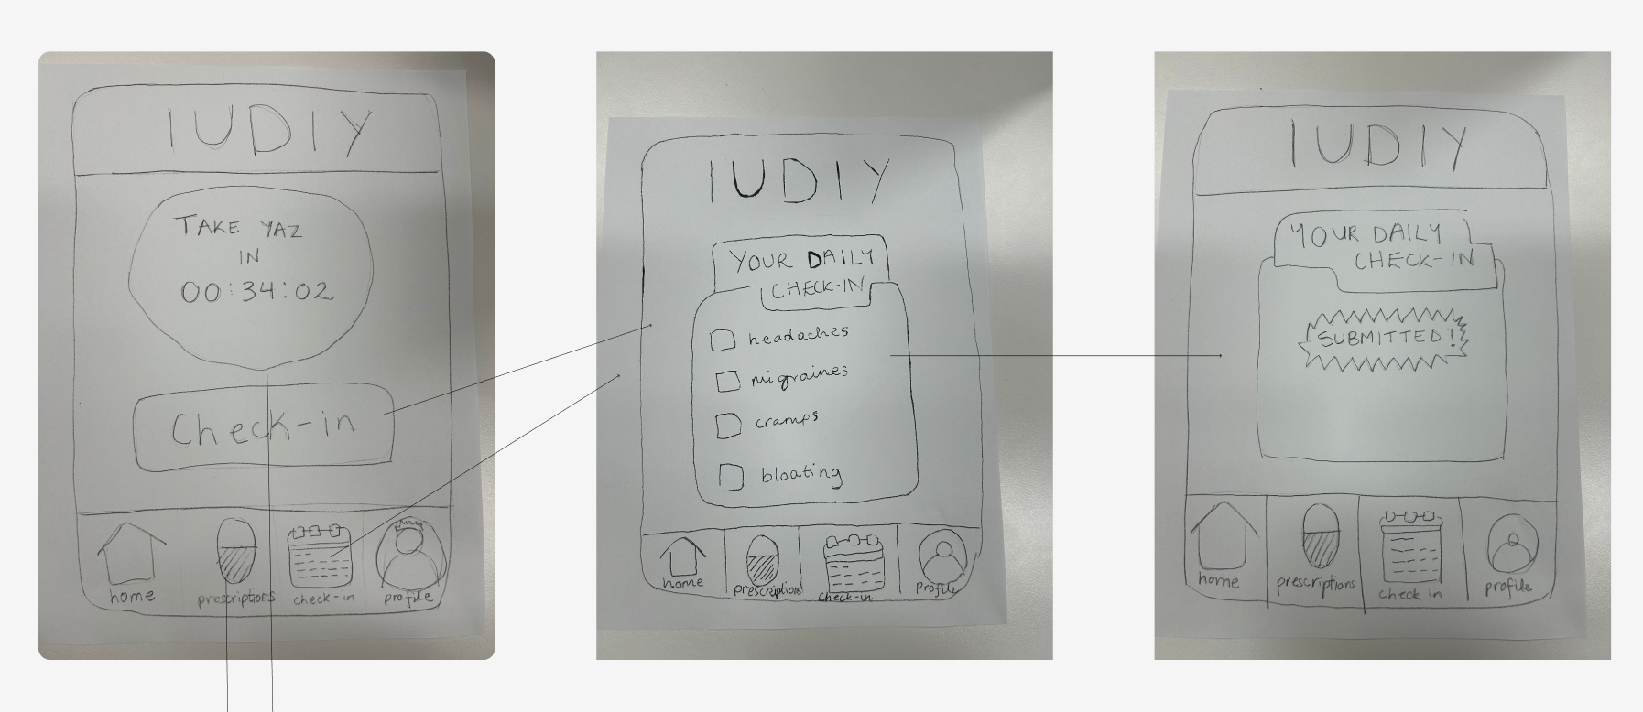
Home screen includes check in button, navigation bar, and reminder timer
Home screen includes check in button, navigation bar, and reminder timer
Check-in tracks symptoms with checkbox interface
Submitted screen shows user is done with check-in and recommendations are updated

Slide 25
Moderate Task Flow
Find a pharmacy that carries your current prescription.

Slide 26
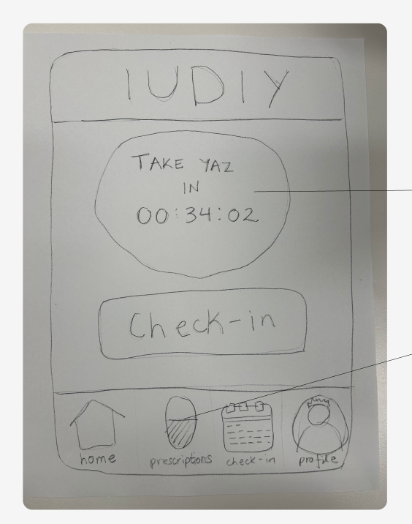
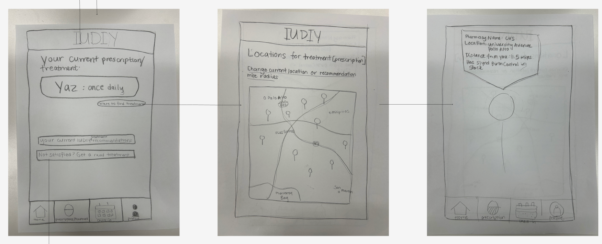
Home screen includes check in button, navigation bar, and reminder timer
Home screen navigates to recommendation page from timer or navigation bar
Prescription screen shows current meds and buttons to recommendations
Map showing different pharmacies or treatment centers
Screen shows details about the pharmacy or doctor’s office and what they offer

Slide 27
Complex Task Flow
Change your current contraceptive recommendation.

Slide 28
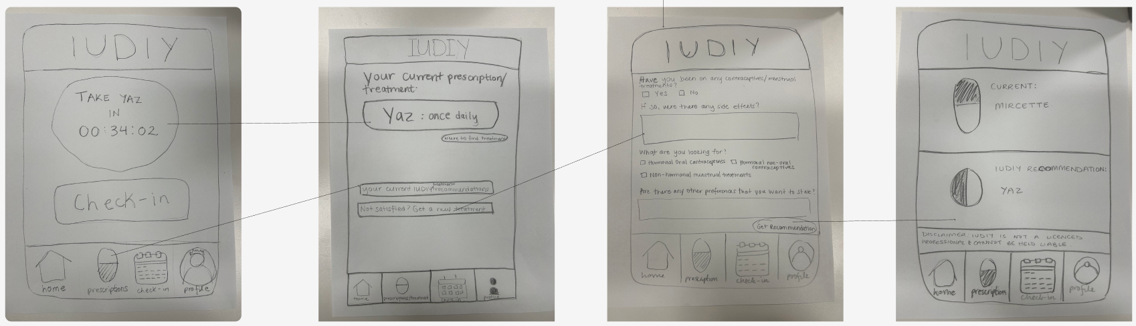
Home screen navigates to recommendation page from timer or navigation bar
Questionnaire leads to new recommendation
Home screen navigates to recommendation page from timer or navigation bar
“Not satisfied?” lets users get new recommendations
Screen showing updated recommendation vs old recommendation

Slide 29
Testing Methodology

Slide 30

Participants
Demographics
24 year old woman, on an IUD.
32 year old, new-mother, with two kids.
26 year old woman, taking contraception.
23 year old woman, taking contraception.
Recruitment
NextDoor was super helpful in recruitment.
Compensation
$0

Slide 31
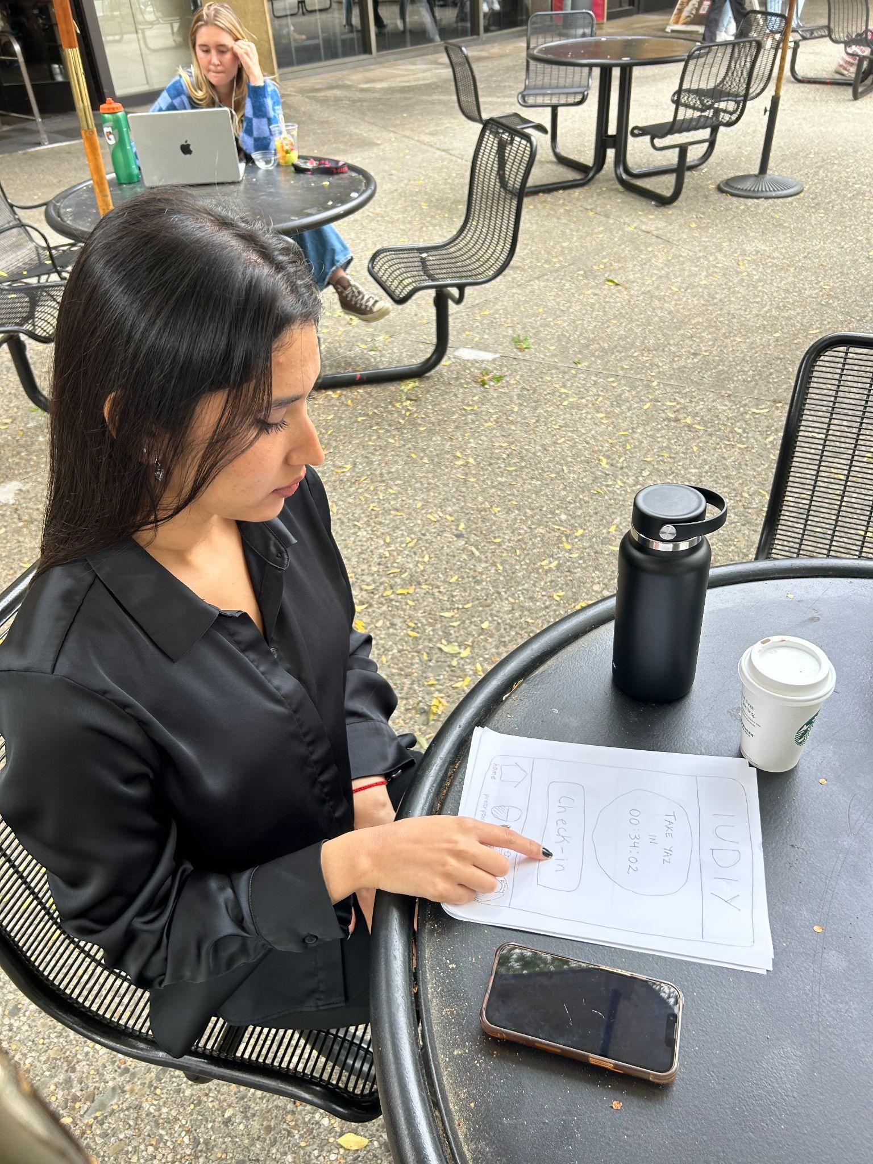

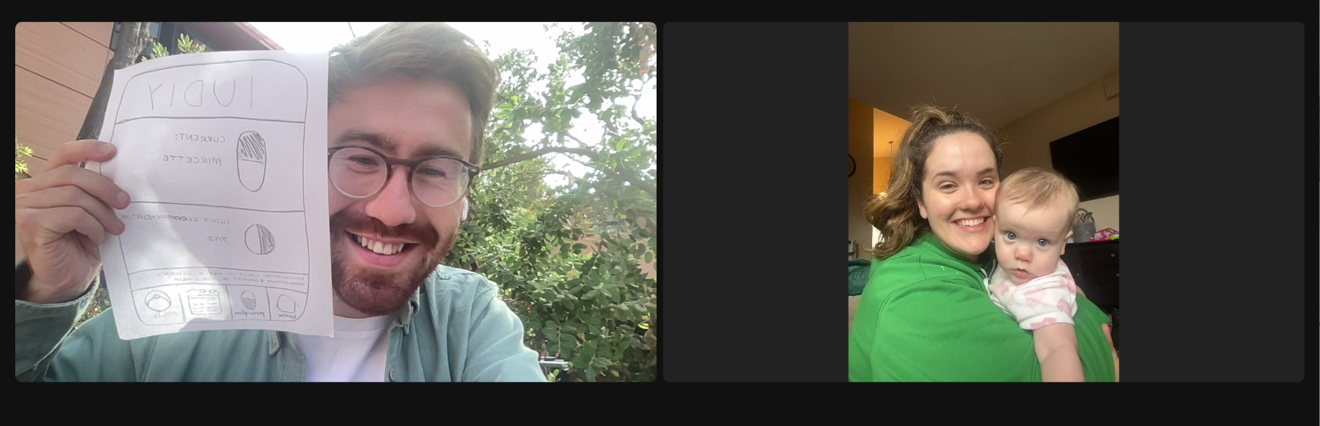
Environment and Apparatus
Three interviews in person, one via Zoom
In person interviews: we read out a script and had users try to complete different tasks by “clicking a button”
Over Zoom, asked which buttons she would click if in person

Slide 32

Testing Procedure
Team Member Roles
Each team member tested one person and asked them to complete all three tasks.
Process Description
Limited concept introduction to test intuitiveness
Timed each task
Recorded the number of errors
Led a guided conversation to understand errors.

Slide 33

Usability Goals & Key Measurements
Key Measurements
# of Clicks: Measure of intuitiveness and ease.
# of Errors: Measure of user-friendliness.
Usability Goals
Complex - clicks < 4
Moderate - clicks < 3
Simple - clicks < 2

Slide 34
Testing Results

Slide 35

Process data
“Check-ins was confusing terminology” and users clicked the profile to log their symptoms.
The ‘where to find treatments’ button is too small
On the paper prototype, it’s hard to see that the location pins on the map are clickable
Need to include back buttons on the prototype
Need a submit button for check-in – whoops!
Users expected new recommendations to be generated with a new check in, not by explicitly changing it

Slide 36

Bottom-line data
Simple task took 25% longer than moderate task and had more errors, but due to simple mistake (ambiguous phrasing)
Initial metrics by error number were met, but could have been more ambitious
Complex task had 2 errors, medium had one, and none for easy
In the pharmacies task, the clicking on a location pin aspect took 2 times the amount of time that it did to get to the map page

Slide 37

Other relevant observations
  ‘Not satisfied? Get yourself a new treatment’ button had too much text
  No submit buttons on pages
  Confusion around final screen, questions around how to set recommendation as the new prescription

Slide 38

Usability Goals vs. Key Measurements
Error rate was met but didn’t set very high expectations for it
Vague wording for buttons so it was harder to navigate than expected
Overall, people were able to achieve the tasks set forth but took longer than we want

Slide 39
Discussion

Slide 40

Implications of Findings
Interviewees were not able to complete a lot of the tasks quickly because of ‘unclear wording’ for some of the sections
Finding the locations for the prescriptions page was a bit vague
It was hard for people to go back if they messed up because there were no back buttons
Getting a new prescription was the easiest task so not many changes needed

Slide 41

Design Iterations
Make wording for buttons a bit more clear
Emphasize clicking functionality in actual prototype
Cut down on extra words for the prescriptions page
Add ‘back’ and ‘submit’ buttons

Slide 42

Limitations of Testing
Visual Impairments: Our one Zoom interview made it difficult for the user to see the smallest buttons, but this affected data uniformly
Accessibility: No issues through testing, but participant demographic did not include neurodivergent or visually impaired people
Age: All participants under 40

Slide 43
Appendix

Slide 44
Selected Interface Evaluation
Full list of pros and cons for selected interface rationale
Link to prototype
  https://www.figma.com/file/y9jpNhjLUGYl38X1GHrCep/cs147-allie%2Fshreya%2Femily%2Feric?type=design&node-id=0%3A1&mode=design&t=X7twqFlt67DJfkgE-1

Slide 45
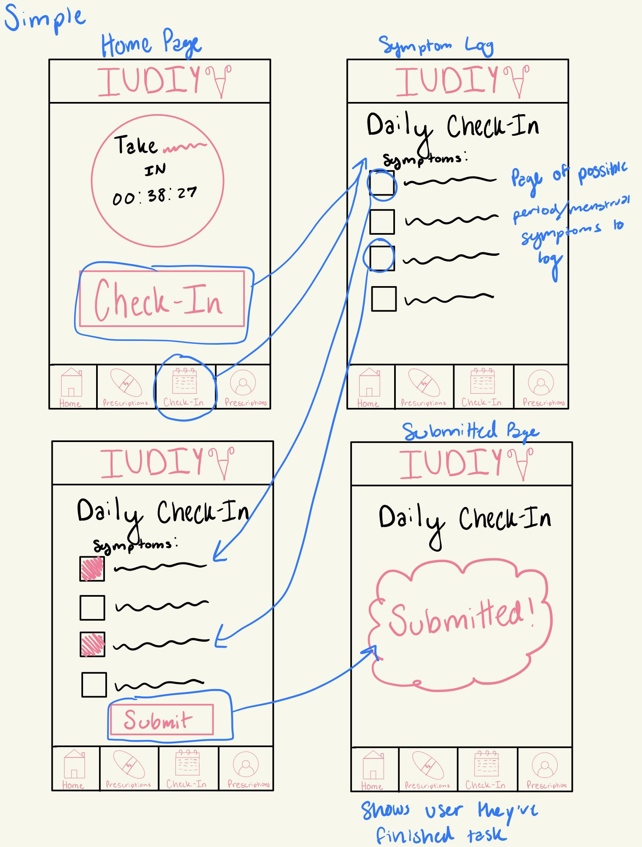
Simple Task Storyboard

Slide 46
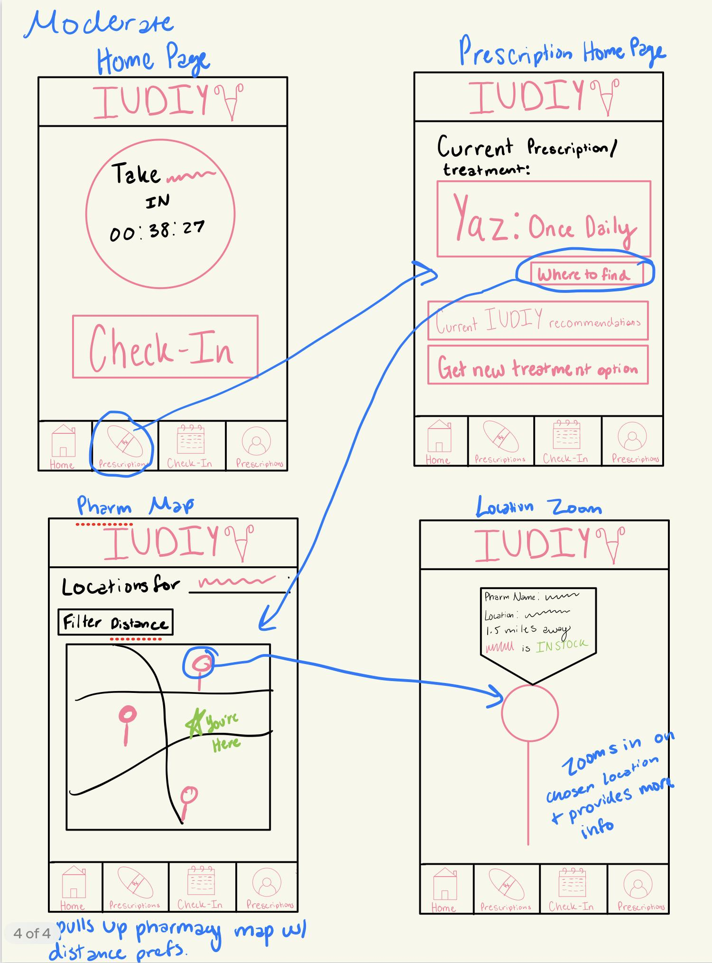
Moderate Task Storyboard

Slide 47
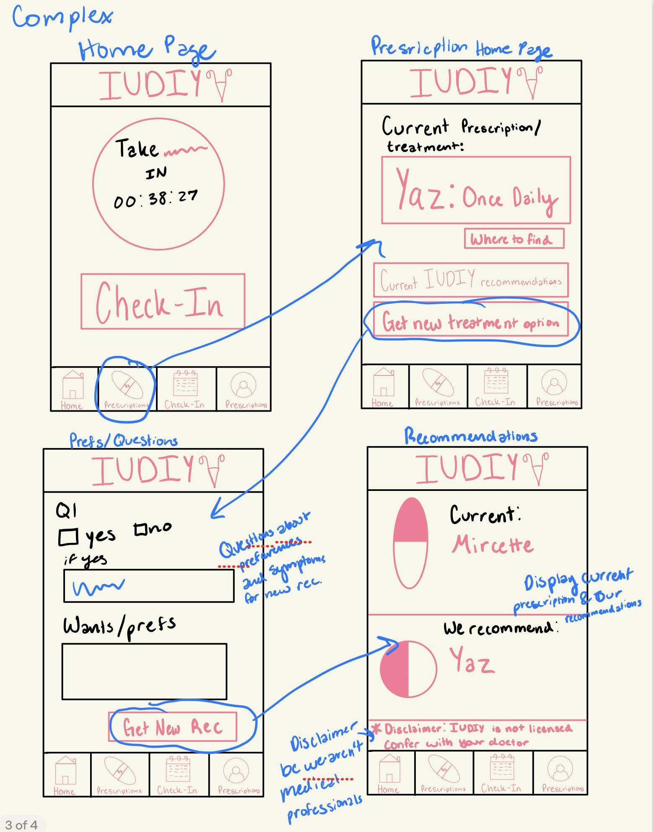
Complex Task Storyboard

Slide 48
Any Questions?

