Slide 1
Assignment 3: Concept Video
Anna Gao, Becca Dia Crosse, Cyan DeVeaux, Hunter Zhang

Slide 2
About Thyme
How did your team land on the name?
Thyme is a play on words for time, as well as an analogy for taking care of a plant. When you take care of a plant, you start to develop a routine for care. Caring for the plant never stops, it just becomes more of a habit - in the same way that caring for yourself never stops, it just becomes more of a habit.
  Our goal is to help people “turn a new leaf” in their physical and mental health.
One liner: take thyme. be well.
Value Proposition: From our market research, we’ve found that our app is unique from other medical journal and medication tracking apps due to its “gamification feature.” Similar to language learning apps like Duolingo, our app keeps a “streak” that increases every time a user successfully fills out their medication journal or takes their medication for that day.

Slide 3
Our Problem Domain
Primary user: People who take medication frequently, and with limited medical knowledge.
Problem: There is a communication gap between the medical professionals and the patients who do not have enough medical knowledge.
Proposed solution: Thyme is a medication journal app that serves as a medical "translation" layer between patients and doctors, helping to reduce the communication gap between medical professionals and patients.

Slide 4
01
Market Research
What does our competition look like?

Slide 5

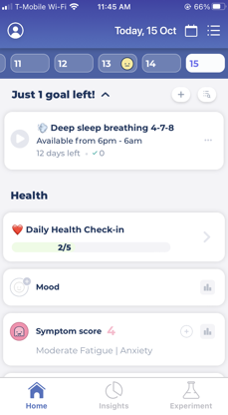
Bearable
Symptom Tracker, Mood Journal, and Health App
What works for our problem space
Allows users to track a variety of health-related information (e.g., physical symptoms, mental symptoms, mood, sleep)
Takes into account user’s health goals
Visualizations of insights over time
What doesn’t work for our problem space
Lack of feedback when inputting information
Overwhelming amount of information to fill out
Valuable features hidden behind paywall
Lack of personalization (felt lackluster)

Slide 6
Bearable
Symptom Tracker, Mood Journal, and Health App
What are the implications
It is important not to overwhelm users with amount of options to fill out
User goals and other forms of user input can help shape journaling options
Visualizations and feedback can help motivate users to continue to fill out their journal
It could be nice for users to be able to reflect their personality into their journal

Slide 7

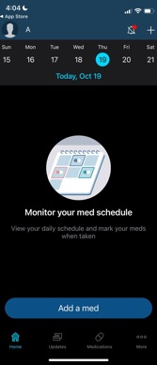
Medisafe Medication Management
Pill and Medicine Management
What works for our problem space
Keeps track of medication, refills, and upcoming doctor appointments
Allows the user to remind family members and friends who are also on the app to take their medication
Includes information on drug interactions for each medication the user takes
What doesn’t work for our problem space
Lack of user flexibility (they can’t take a medication early)
Too many reminders throughout the day
Notes:
Medisafe allows users to :
get medication reminders, track whether they took their meds, keep a list of their meds, remember when it’s time to refill, check for drug interaction, track side effects/symptoms, track measurements (e.g. blood pressure)

Slide 8
Medisafe Medication Management
Pill and Medicine Management
What are the implications
Interoperability with different health apps (i.e. Apple Health) to be able to sync health data across different apps
HIPAA Compliance (in order to guarantee user security and privacy, and compliance with regulations)
User friendly/focused - keeps the purpose of the app focused and easy to understand

Slide 9

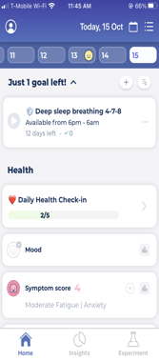
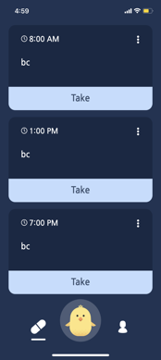
Max - Pill reminder
Medication Alarm & Tracker
What works for our problem space
Friendly and entertaining environment
UI and app behavior encourages usage
Customizable functionality
Unique notifications
What doesn’t work for our problem space
No safeguards against reword(taking all your pills at once)
Limited functionality & stored info beyond basics
No real privacy features

Slide 10
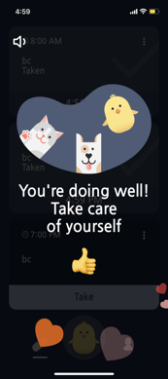
Max - Pill reminder
Medication Alarm & Tracker
What are the implications
Sensibility to risk- This app encourages taking medication, even at inappropriate times
User friendly functionality- This app is easy to navigate
Engaging features - engaging and customizable visuals may important features to certain audiences

Slide 11

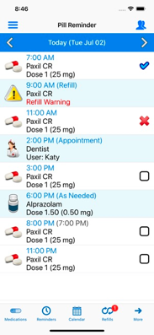
Pill reminder - All in One
Pill and Medication Calendar
What works for our problem space
Tracks the medication usages in a natural way(calendar and list).
Send out reminders for the refills.
Simple Navigation.
Reminder notifications for Doctor appointments.
What doesn’t work for our problem space
No safeguards against reword(taking all your pills at once).
Outdated and buggy UI resulting bad UX.
No real-time sharing feature.

Slide 12
Pill reminder - All in One
Pill and Medication Calendar
What are the implications
In-app purchase - This app takes $1.99 to unlocked all its features. That means a lots people might delete the app once they found out about the purchase.
Reminder Notifications - People will use this app to remind them when to make refills.
No calendar preview - Even though there is calendar but there is no preview of the medication. It takes users an additional click to see the details.

Slide 13
02
Stakeholders and Ethical Implications
Our Values in Design

Slide 14
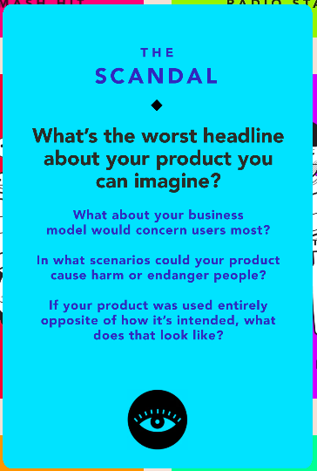
Ethical Implications: Tarot Card #1
Prompt: “What is the worst headline you can imagine about your product?”
Headline 1: App causes addictive & abusive medication use just to “beat the game” for the patients
Underlying value tensions: Tension between encouraging consistent user engagement for their own health benefits and promoting medication misuse or addiction
Previously overlooked stakeholders: Users with addictive behaviors
Addressing these ethical implications:
avoiding punitive measures and enabling flexibility in the gamified elements to mitigate addictive and abusive medication use
including a recovery celebration feature to encourage wellness for those with addictive behaviors
Notes:
More detailed version of this slide in the appendix

Slide 15
Ethical Implications: Tarot Card #1
Prompt: “What is the worst headline you can imagine about your product?”
Headline 2: “Medical Data leaked into the wrong hands”
Underlying value tension: Tension between helping users store/share medical information and keeping health information private and personal
Previously overlooked stakeholders: People who are tech skeptics/tech illiterate
Addressing these ethical implications:
We could allow the patients/users to: 1.Customize the sensitive information they want to store and share with other parties in”reports” 2. Safeguard who has access to each generated “report”

Slide 16
Our Stakeholders
Direct Stakeholders:
users of the app or patients who use our app to:
  track and journal their medication use habits, reaction, experience
  share their journal with medical professionals or friends
caretakers who:
  help others manage their medication, and thus use the app to keep track of that person’s reactions and experiences with medication
Indirect Stakeholders:
Family members or medical providers who receive the information / are concerned with the health of primary users
Doctors/pharmacists who patients are able to share their journals with, in order to communicate certain symptoms from medications
(Malicious intentions, for us to address + safeguard against) Companies who might want to use our confidential data about our patients to dictate the price of the medicine

Slide 17
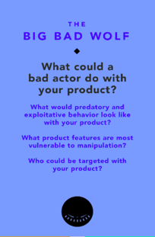
Ethical Implications: Tarot Card #2
Prompt: “What could a bad actor do with your product?”: Manipulate information or use a user’s information to their advantage, and not the user’s
Underlying value tensions: Tension between facilitating communication between indirect + direct stakeholders and protecting sensitive user data
Previously overlooked stakeholders: People who are susceptible or vulnerable to manipulation
Addressing these ethical implications:
1. Add a disclaimer reminding users to only share information with people they trust. 2. Add verification of medical professionals or family members to determine who is allowed access to medical information from the patients.
3. Adding biometric safeguarding features to gain access to our app.
Notes:
More detailed version of this slide in the appendix

Slide 18
03
App Tasks

Slide 19
1.Encouragement to take medicine
2. Frequency of medication administration tracked
In our prototype video, we addressed many anticipated tasks :
1. Goals created and tracked
2. Prevent overuse of medication
1.Health information easy to share with professionals
2. Medication info sharable virtually with concerned parties
3. Gamify app experience
➜➜➜
Simple Tasks
Moderate Tasks
Complex Tasks

Slide 20
This task will be used daily or very frequently
Simple task(s)
This is likely a task that the user will use the most
Encouragement to take medicine
Track frequency of medication use

Slide 21
This is a feature which not every user will use, but still may be common
Moderate task(s)
Fewer users (elderly expected) will need help not taking medication more than needed
Create & Track Goals
Prevent overuse of medication

Slide 22
Few may use apps in presence of a medical professional
Complex task(s)
Because of the private nature of health, few users inclined to share health info
additional:
Process of gamifying will be extensive on our part as we confront concerns
Assist in communication with professionals
Invite others to track medication use
Reward consistent behaviors related to user goals

Slide 23
04
Video Storyboards

Slide 24
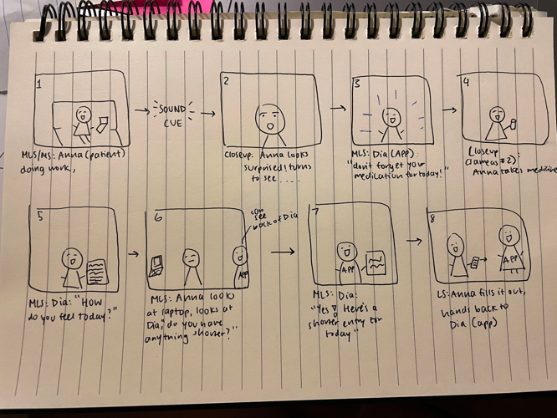
Scene 1:
Storyboarded

Slide 25
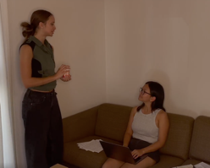

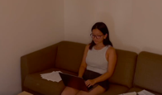
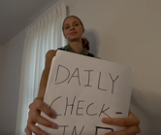



Scene 1:
Filmed
Notes:
Some shots that were storyboarded as medium long shots were filmed as close ups (and vice versa) based on how much time we had for each shot)

Slide 26
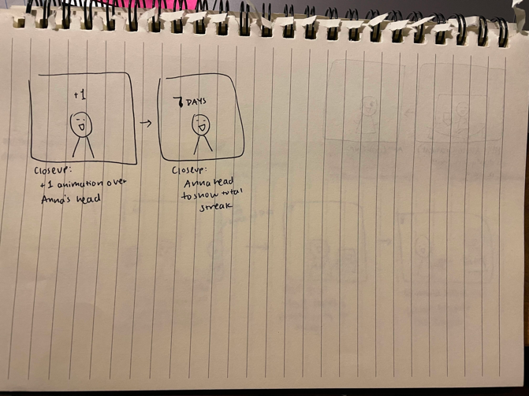
Scene 1:
Storyboarded
(cont)

Slide 27

Scene 1:
Storyboarded
(cont)
Notes:
+1 and one week added in post edit

Slide 28
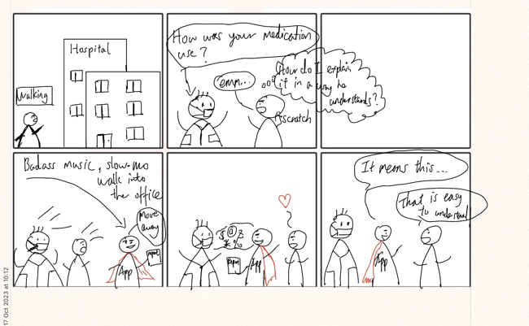
Scene 2:
Storyboarded

Slide 29
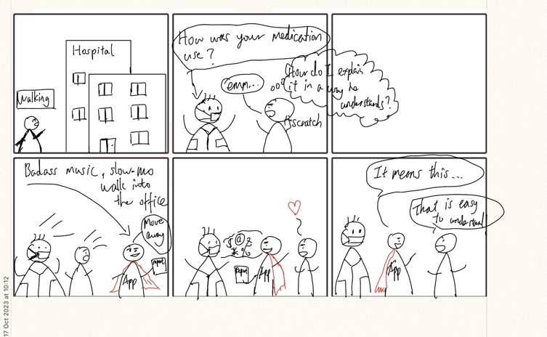

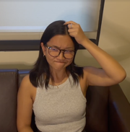
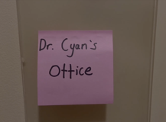

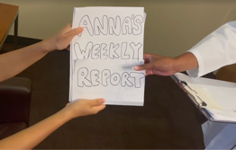
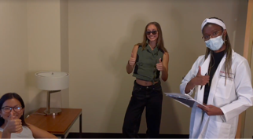

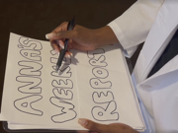
Scene 2:
filmed
Notes:
We storyboarded first and then filmed all scenes - after filming the first scene, we gained more insight and expertise into what we liked and figured out more about our
vision for the video. We ended up taking more close ups than anticipated, but with the outside structure of the storyboard.
In the original storyboard, we had the app directly hand the report to the doctor, but we ended up deciding that the app should hand it to the patient who then hands it to the doctor. This is with the retrospect of our tarot cards and considerations of user privacy.

Slide 30
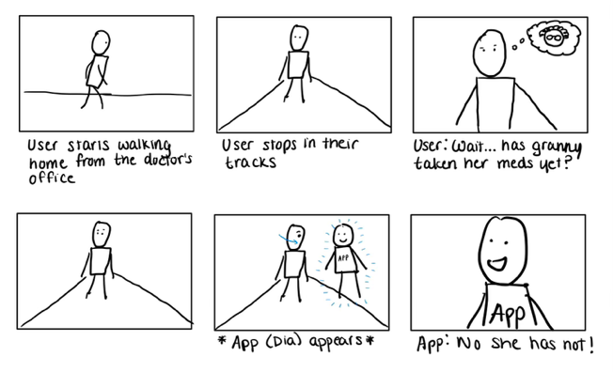
Scene 3:
storyboarded
Notes:
This scene stayed pretty close to the storyboard!

Slide 31

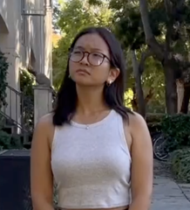
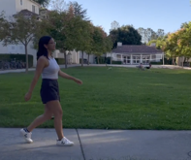
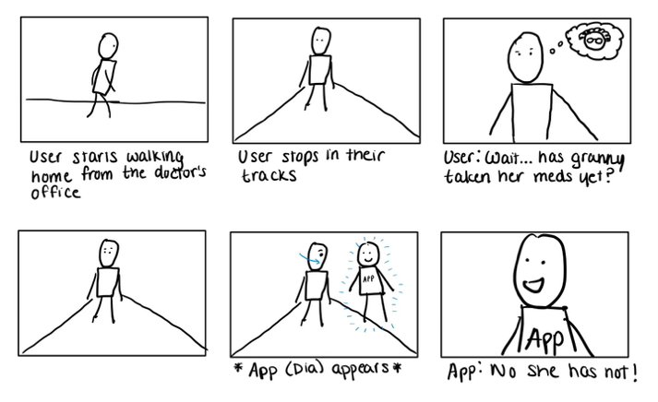


Scene 3:
filmed
Notes:
This scene stayed pretty close to the storyboard!

Slide 32
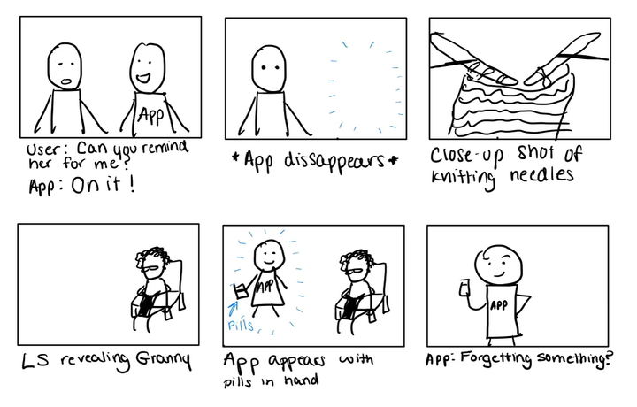
Scene 3:
storyboarded

Slide 33
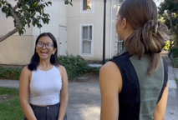
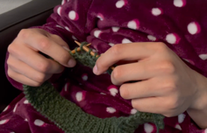
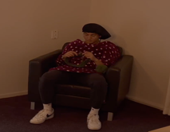
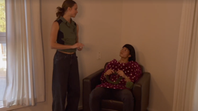
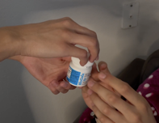
Scene 3:
filmed

Slide 34
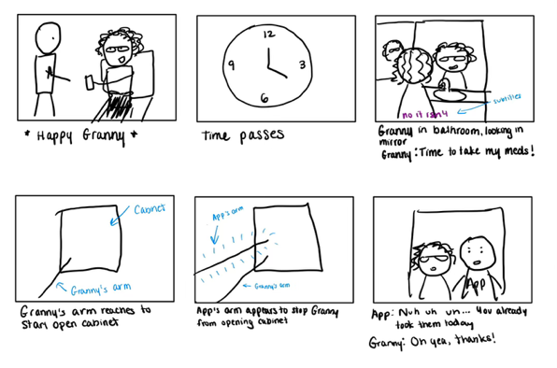
Scene 3:
(storyboarded)
Notes:
Changed the granny in bathroom to be granny in the kitchen due to lighting and overall space to film

Slide 35
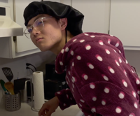
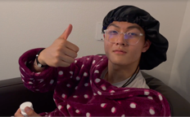

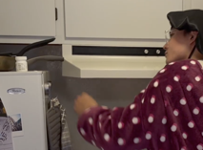
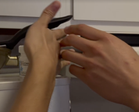

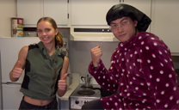
Scene 3:
(filmed)
Notes:
Changed the granny in bathroom to be granny in the kitchen due to lighting and overall space to film

Slide 36
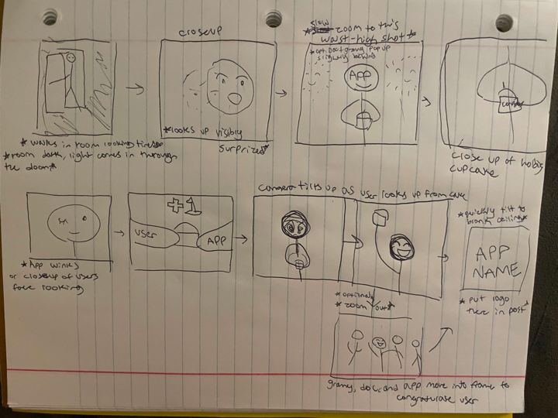
Scene 4:
storyboarded

Slide 37
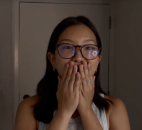
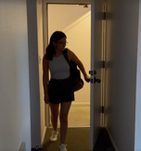

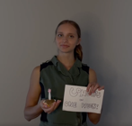
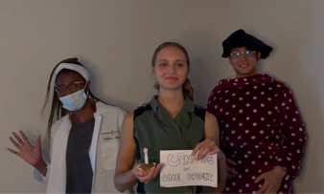

Scene 4:
filmed
Notes:
Given the amount of time left for the video, this scene (that doesn’t contain a task) ended up being a bit shorter than storyboarded, but still in a way that conveyed the celebration feature of the app!

Slide 38
05
Concept Video Link
https://youtu.be/uMzvB4SUjdU

Slide 39
Appendix

Slide 40
Links to our brainstorming processes :)
Concept video & components brainstorming: https://docs.google.com/document/d/1-AOezjsrTtro76r0wIPMcABdmg2NU7JOT7G5Wfo3iok/edit
Market research: https://docs.google.com/document/d/1GaNOcx46XkEXrfxxF6HZlxsZ1S5RcOL7_FS64_jQKnU/edit

Slide 41
Ethical Implications: Tarot Card #1
First Tarot Card: “What is the worst headline you can imagine about your product?”
Headline 1: App causes addictive and abusive medication use just to “beat the game” for the patients
Does this ethical implication reflect an underlying value tension?
  This ethical implication reflects the tension between making it easier to log health updates + encouraging user engagement for their own health benefits and promoting medication misuse or addiction
Does it point to any stakeholders you may have previously overlooked?
  We may have overlooked users with previous histories of addictive behaviors in developing our medical journaling solution.
How might you go about addressing these ethical implications in your design?
  We would address these ethical implications through:
    avoiding punitive measures and enabling flexibility in the gamified elements to mitigate addictive and abusive medication use
    includes a recovery celebration feature where users with past addictive behaviors can see their progress through their recovery journey (to encourage both wellness through medication and overall self care)

Slide 42
Ethical Implications: Tarot Card #1
Headline 2: “Medical Data leaked into the wrong hands”
Does this ethical implication reflect an underlying value tension?
  This ethical implication reflects the tension between helping users with the process of storing/sharing medical information and keeping health information private and personal
Does it point to any stakeholders you may have previously overlooked?
  This may point to tech skeptics/people who may not understand technology, in addition to people who are vulnerable or susceptible to manipulation by other people (due to letting users control who the info is shared with).
How might you go about addressing these ethical implications in your design?
  We could allow the patients/users to
    customize the sensitive information they want to store and share with other parties,
    view and safeguard exactly which generated report and which sensitive information has been showed with who

Slide 43

Ethical Implications: Tarot Card #2
Second Tarot Card:
What could a bad actor do: Bad actors may manipulate information (e.g., abusive partners and people with Munchausen syndrome) or use a user’s information to their advantage, and not the user’s (e.g., using data to determine which medications can be used to make the most profits or secondary users using data to monitor and control primary user)
Does this ethical implication reflect an underlying value tension?
  This ethical implication reflects a tension between facilitating communication between indirect and direct stakeholders and protecting sensitive user privacy/data
Does it point to any stakeholders you may have previously overlooked?
  People who are in controlling situations or otherwise vulnerable to manipulation
How might you go about addressing these ethical implications in your design?
  Add a disclaimer to remind users to only share information with people they trust
  Only the verified medical professionals or family members are allowed access to medical information from the patients.
  Adding biometric safeguarding features such as fingerprint and facial recognition to gain access to our app.

