Slide 1
thyme
Low-fi Prototyping & Pilot Usability Testing
Anna Gao, Becca Dia Crosse, Cyan DeVeaux, Hunter Zhang

Slide 2
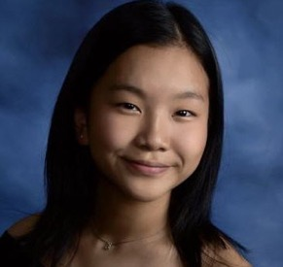

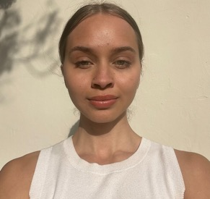
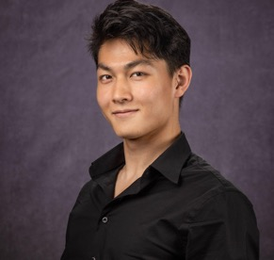
Team Pillionaires
Anna
Cyan
Dia
Hunter

Slide 3
Problem:
Solution:
Communication gap between the medical professionals and the patients with limited knowledge about their medication
A medication journal that helps patients track their medication use and serves as a medical "translation" layer between patients and doctors

Slide 4
thyme
Take thyme. Be well.
Value Proposition: To keep a “streak” that increases every time a user successfully fills out their medication journal or takes their medication for that day.

Slide 5
Outline of Talk
Concept Sketches
Selected Interfaces
Low-fi Prototypes
Usability Testing
Results & Discussion

Slide 6
01
Concept Sketches

Slide 7
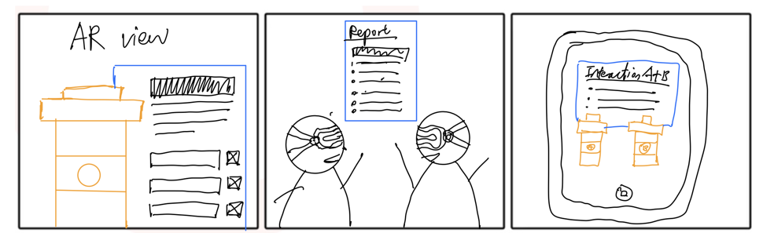
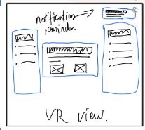
Concept 1: AR/VR

Slide 8
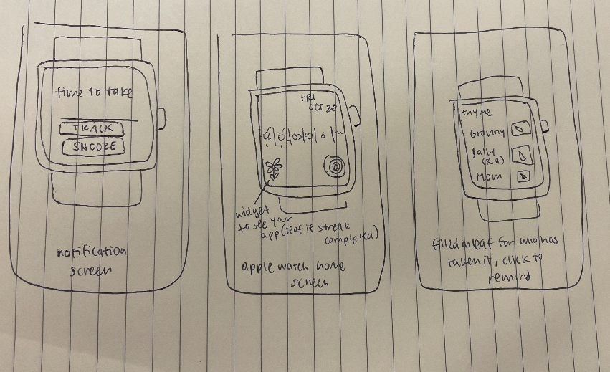
Concept 2: Apple Watch

Slide 9
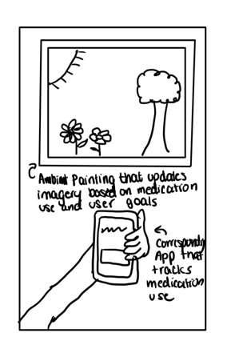
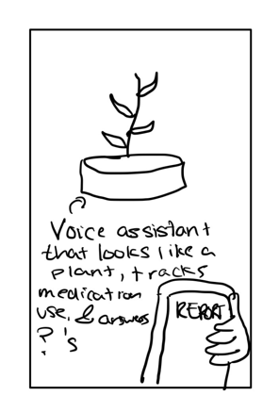
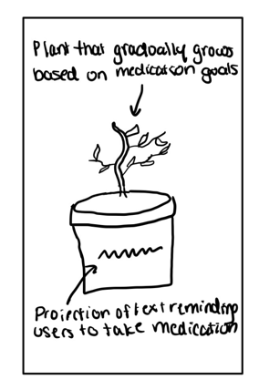
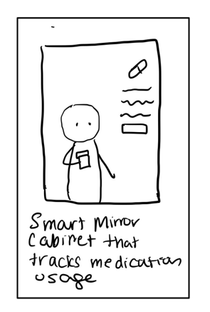
Concept 3: Ambient Computing

Slide 10
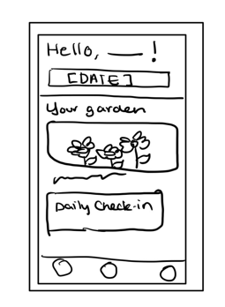
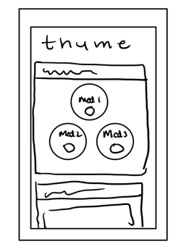
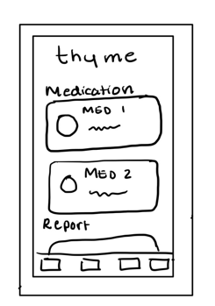
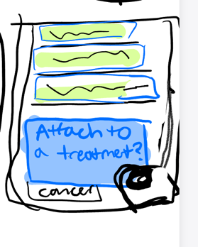
Concept 4: Mobile App

Slide 11
Concept 4: Mobile App

Slide 12
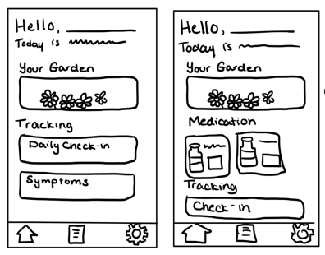
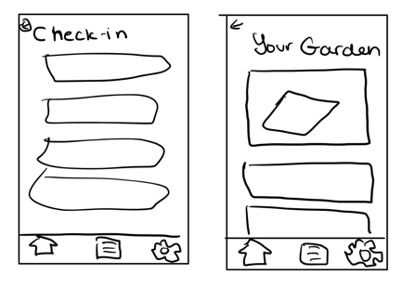
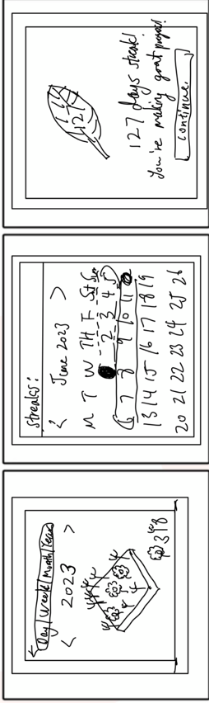
Garden Realization

Slide 13
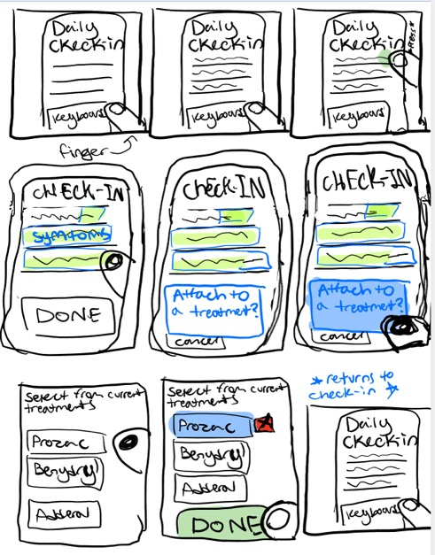
Symptom Tracking Realization

Slide 14
02
Selected Interface

Slide 15
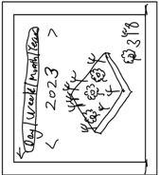
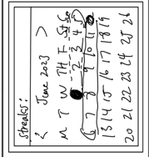
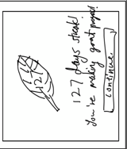
Garden Realization
Pros
Visualized accomplishment:
Visual reward system shows the streak -> extra motivation
Appealing to audience: Users may find gamified feature engaging
Cons
Easy to abuse:
Users may abuse gamified system
Perception Limitation: Prior tech experience may impact understanding of gamified elements

Slide 16
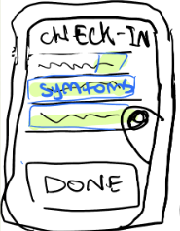
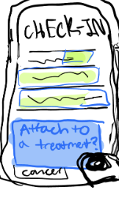
Symptom Tracking Realization
Pros
Intuitive Design:
Way to understand, without extensive training.
Easy Usability:
One-click track the streak.
Professional report:
Bridges the communication gap.
Cons
Requires manual input:
Users may find typing check-ins tedious
Input Dependent:
Quality of report is dependent on user input.

Slide 17


Final Realization
thyme :)

Slide 18
03
Low-fi Prototype

Slide 19
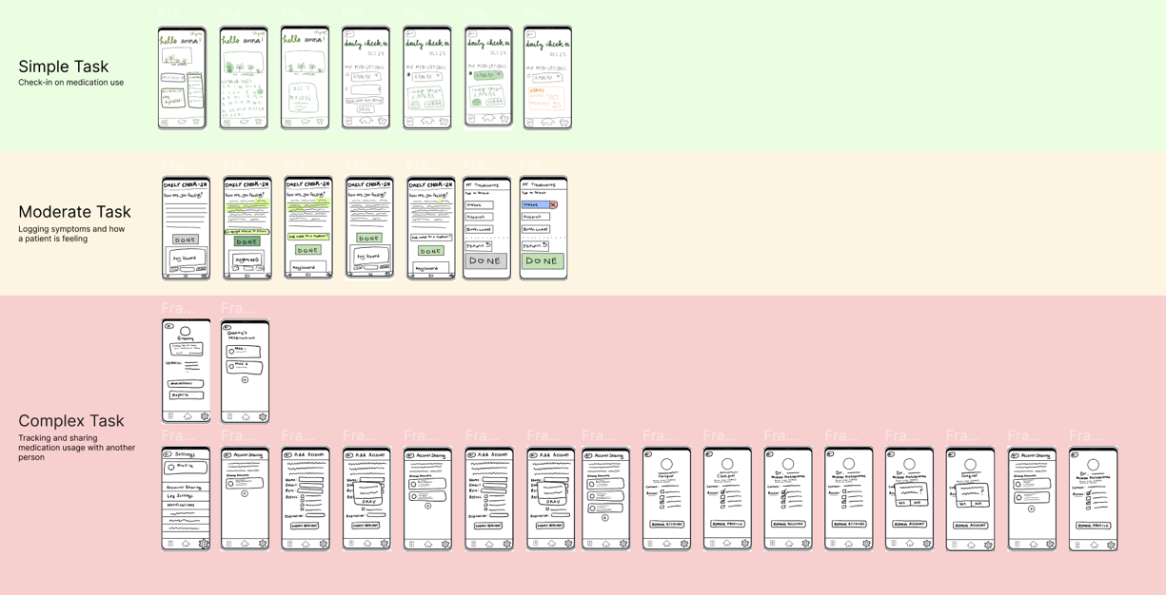

Slide 20
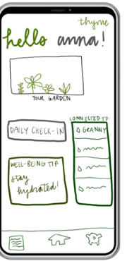
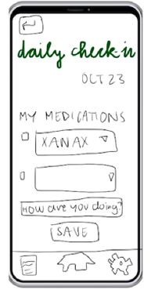
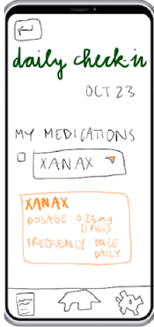
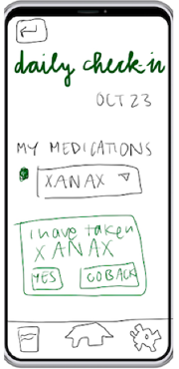


Simple Task:
Daily Check-in on Medication Use

Slide 21
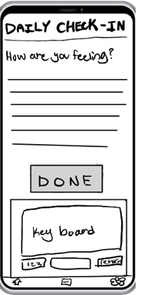
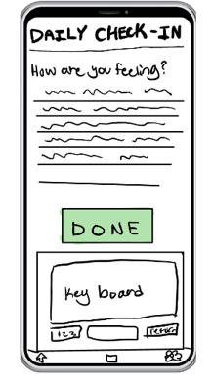
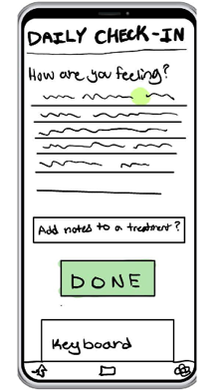
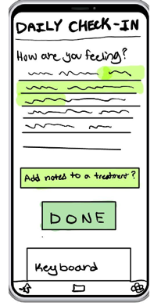
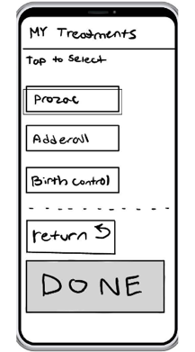
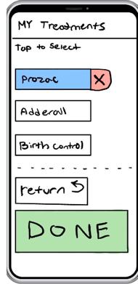
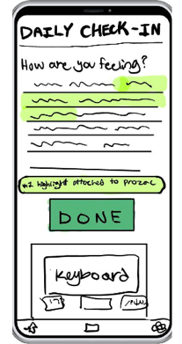

Moderate Task:
Logging symptoms and how a patient is feeling

Slide 22

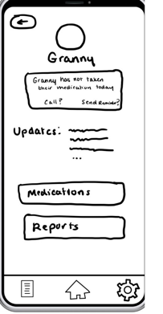
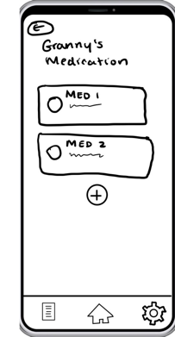

Complex Task:
Tracking and sharing medication usage with another person

Slide 23
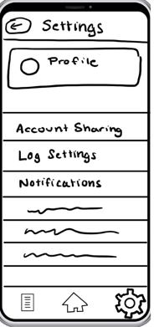
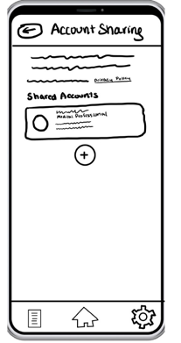
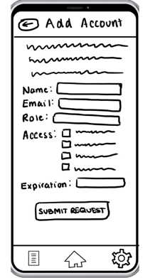
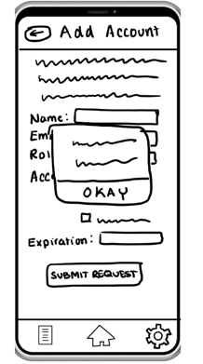
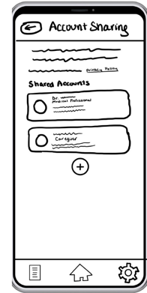
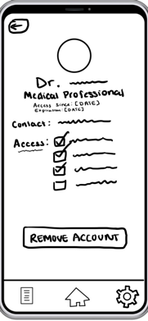


Complex Task:
Tracking and sharing medication usage with another person

Slide 24
04
Usability Testing

Slide 25
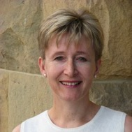
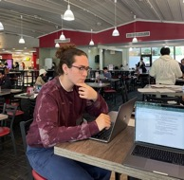
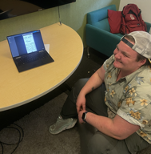
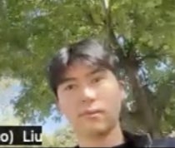
Participants
Katrin
Amaru
Mads
Leo
Middle-aged
Stanford Staff Member
Met remotely
Compensation: None
21 years old
Stanford student
Met in person
Compensation: None
~30 years old
Stanford Staff Member
Met in person
Compensation: None
23 years old
Duke GSB Student
Met remotely
Compensation: None

Slide 26
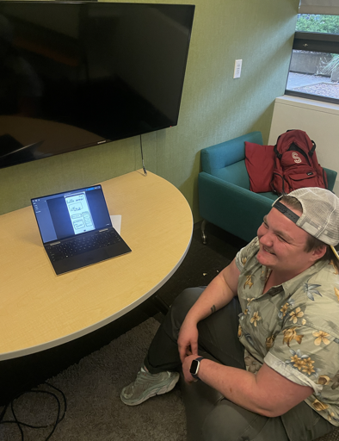
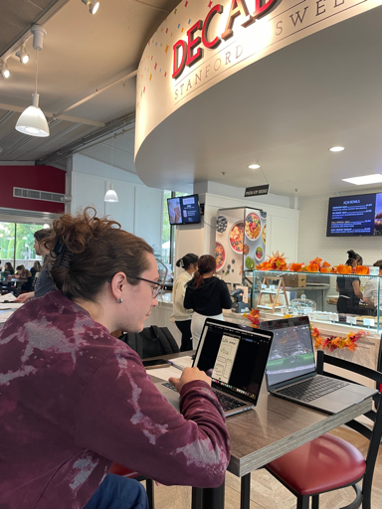
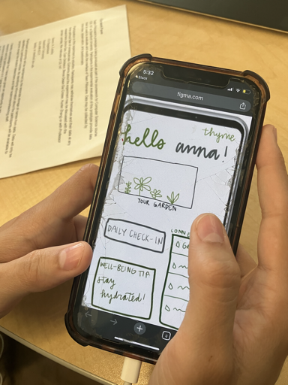


Environment and Apparatus

Slide 27
Procedure and Process
Introduction
Demo
Test
Questions
Greeted participants and introduced project
Provided a demo of the prototyping system
Assigned three tasks for the participant to complete
Asked follow-up questions about their experience
Team roles varied by participant, everyone had the chance to serve as facilitator and notetaker/observer

Slide 28
Usability Goals + Key Measurements
Pleasing
Efficiency
Discoverable
Measured through:
Post-testing survey
Measured through:
Time per task completed
Measured through:
- Screens accessed

Slide 29
05
Results & Discussion

Slide 30

Usability Goal #1: Efficiency

Slide 31



Usability Goal #2: Discoverability
Task 1:
A couple of participants did not discover the feature to view more information about their medication
Task 2:
No one discovered highlight feature
Task 3:
A couple of participants did not discover the ability to modify the settings of a shared account
Other: Only one person discovered the garden, no one discovered account tracking

Slide 32
Usability Goal #2: Discoverability
Task 1:
A couple of participants did not discover the feature to view more information about their medication
Task 2:
No one discovered highlight feature
Task 3:
A couple of participants did not discover the ability to modify the settings of a shared account
Other: Only one person discovered the garden, no one discovered account tracking

Slide 33
Usability Goal #3: Pleasingness
“calm”
“clearly organized”
“intuitive”
“intentional”

Slide 34




Tensions
Unclear Phrases
Accessibility
Uncertainty surrounding how certain prompts were phrased
Issues with font size and visual clutter
Access Points
Unclear Iconography
Conflicting viewpoints on having multiple vs one way of accomplishing a task
Issues identifying the meaning and function of specific icons/buttons

Slide 35

“What’s that doodad in the corner?” - Amaru
“I can understand why this page symbol would be a log. But that wasn't 100% clear to me.”
- Katrin

Slide 36
Implications +
Findings
Implications
1.Transparency with share feature
2.Appropriate gamification amount
Good design intentionality

Slide 37
Implications +
Findings
Implications
1.Transparency with share feature
2.Appropriate gamification amount
1.Completion time ↓ after familiarized with screens
2.Tasks completed in short amount of time
Good design intentionality
Intuitive design & learnability

Slide 38
Implications +
Findings
Implications
1.Transparency with share feature
2.Appropriate gamification amount
1.Completion time ↓ after familiarized with screens
2.Tasks completed in short amount of time
1.”Calm” and “casual” descriptions of experience
2. Multiple nature+happy emojis
Good design intentionality
Intuitive design & learnability
Calming/ Pleasant overall experience
Clear brand identity

Slide 39
Implications –
Findings
Implications
1.Confusion on clickability
2.Dislike of icon visuals
Clearer iconography

Slide 40
Implications –
Findings
Implications
1.Confusion on clickability
2.Dislike of icon visuals
1.”How are you doing”
2.Small font / features
Clearer iconography
Functionality phrasing & access issues

Slide 41
Implications –
Findings
Implications
1.Confusion on clickability
2.Dislike of icon visuals
1.”How are you doing”
2.Small font / features
1. Tension: multiple access points
2.Cluttered home page
Clearer iconography
Functionality phrasing & access issues
Design inefficiencies

Slide 42
What’s Left Unrevealed?
How possible is exploration in this context?
  Did having tasks reduce exploration?
What is the best UI layout for general users?
  Mixed responses to design components
Would an older demographic respond the same?
  All participants aged <60

Slide 43
Results based Design changes
Make “Garden” feature more prominent
  Users didn’t explore, but liked it once found
Improve highlight feature / determine necessity
  No participants found, mixed opinions when shown
Clean up design + consistency
  Received feedback on the untidiness of lo-fi design

Slide 44
Thanks!
Please keep this slide for attribution

Slide 45
Appendix

Slide 46
APPS | Pros | Cons!
Garden Realization | Users may enjoy the visual feedback of a garden growing when accomplishing their goals The younger patients would love our gamified feature The users can easily track the number of days of the steak and generate a report from it. The user can easily generate a professional report with a single click. | Older patients might not want to use the gamified feature. The user may want to abuse the gamified system just to plant more thymes. Users may find completing check-ins tedious
Symptoms Tracker Realization | People who take notes would likely grasp the highlight feature easily It’s easy to cancel selections at any time Features only pop up when certain actions are initiated instead of being there all the time (saves space on UI) Users can easily return back to the screen they came from without losing progress Users can easily track how a new medication is making them feel Users can organize their understandings of different info | Users may find completing check-ins tedious user might form incorrect assumptions about their symptoms (maybe would need additional doctor insight here) User might not provide enough information during their check-in that they can look back on User might get overzealous with the highlight feature and highlight more than is accurate User may convince themselves that they are feeling certain things idk

Slide 47
Link to Low-fi Prototype on Figma: https://www.figma.com/file/lheiJ36RBd3ONuOmxaVTFB/Low-fi-prototype?type=design&node-id=0%3A1&mode=design&t=rka54OP9bhPy9D55-1

Slide 48
Script
Greeting Script: Hello, thank you again for participating in our session. Today, you will be testing out our medication journaling application. To do this, you will be clicking through our digitized paper prototype. We will be asking you to complete a series of tasks to test our application’s usability. However, you’re welcome to explore as you complete these tasks.
Demo Script: First, we will quickly demonstrate how to navigate through our application.
[Demo how to click on Figma]
T1 Script: To begin, the first task you will complete is a daily check-in. Your goal is to log your daily medication use. Please think out loud (say what you’re thinking) as you navigate through this task.
T2 Script: Thank you for completing the first task (yippee!), in this next task you will logging your symptoms and how you’re feeling. Remember to think out loud as you complete this task.
T3 Script: Thank you for completing the first two tasks. In the next task, you will be add one additional medical-report sharing account.
Wrap-up Script: Thank you for completing all three tasks (yippee x3). After going through this experience, do you have any thoughts, feedback, or questions?
Q1: How did the visuals make you feel?
Q2: Are there any aspects you particularly liked?
Q3: If you were designing this application, is there anything you would change?
Q4: On a scale from 1-5, how much fun did you have?
Q5: What emoji does this app remind you of?
Q6: How intuitive was it to complete tasks/traverse the app?

Slide 49
Testing Prep- Findings script
Things to Observe:
Positive incidents
Critical incidents
  usability incidents (not knowing where to go to start a task)
Usability Goals:
  Pleasing (high user satisfaction)/fun
    Measurables: facial expressions/body language/tone of voice (how confident they are completing a task) - engagement
      /qualitative through asking questions
  Efficiency: How quick users can complete tasks
    Measurables: Time/task completed
  Discoverable - how many screens does the user go through (that are not apart of a task explicitly), i.e. the garden screen
    Measurables: Mark how many of the total screens the user accessed
Process data (what is happening)
bottom-line data (time spent per task or # of errors)

Slide 50
Critical Incidents
Participant | Critical Incident | Severity Rating
Katrin | After selecting their first medication, they had trouble going back to answer the remaining questions/add an additional medication | 2 - minor usability issue
Katrin | During Task 2, the participant was uncertain that the icon on the bottom was meant for a log and felt it should be changed to something more clear | 1 - cosmetic issue
Leo | During Task 1, participant almost failed to complete the task because they only hit the accept button 1 of 2 times, a step which we added as another level of user confirmation | 2 - minor usability issue
Leo | During Task 3, when asked to add a user,the participant removed a user instead. Added a user after instructions were restated | 1 - goal misunderstanding

Slide 51
Critical Incidents 2
Participant | Critical Incident | Severity Rating
Amaru | Participant struggled to complete task 1, said that the button they were meant to click was not obvious as a button | 2 - minor usability issue
Amaru | Participant disliked that there were multiple ways to get to the same place | 1 - cosmetic issue
Mads | During task 3, participant expressed that they liked the option to add/ remove contacts, as well as the fact that contacts had information attached. Said it granted agency to users. | 3 - major usability success
Mads | When shown highlighting feature, participant liked that it was discoverable but not obvious. Thought that if it was too obvious it might encourage users to highlight when they may not need to | 2 - minor usability success

