Slide 1
Team Pillionaries
⬇
Anna Gao,
Becca Osaze Dia Crosse,
Cyan DeVeaux,
Hunter Zhang

Slide 2
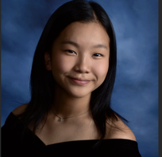
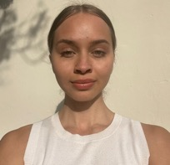

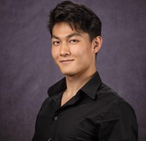
Team Pillionaire:
⬇
⬇
Anna
Gao
Becca Osaze Dia Crosse
Cyan DeVeaux
Hunter Zhang

Slide 3
Demystifying Medication
⬇
⬇
We rallied behind the idea of making medication use simpler… But what was the best approach? For that we used needfinding tactics

Slide 4
Interview 1: Mike
⬇
⬇
Mike is a retired teacher living in San Jose

Slide 5
Semi-Structured Interview Details
Location: At Mike’s home in San José, CA
Roles: Cyan (Interviewer), Hunter (Notetaker)
Recruitment Method: Word of mouth
Compensation: None
Reason selected:
  Due to age, Mike’s medication needs are higher than the broader population
Sample Interview Questions:
  How do you make a decision surrounding starting or stopping a new medication?
  What are the most difficult or annoying parts of medication use in your opinion?
  Tell us about a time you had trouble with your medication. What did you think and how did you feel?
Apparatus: Cellphone to record, Otter.ai for transcription
Extreme User:
  Elderly people have caretakers and rely heavily on doctors, helping them with their medication to make usage significantly easier -> less likely to use an app

Slide 6
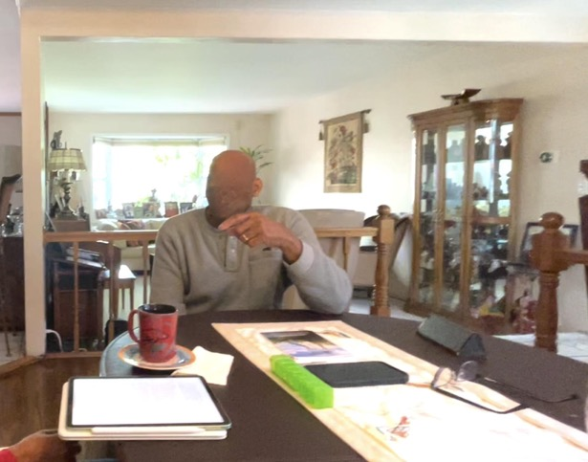
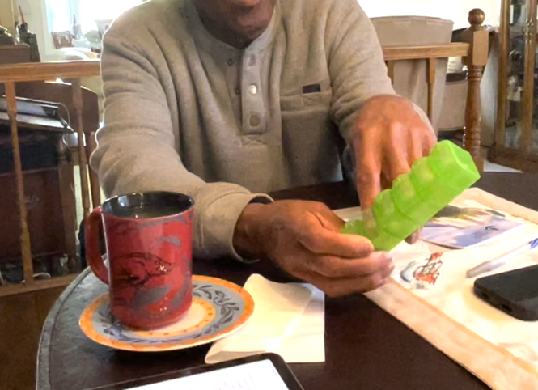
Quotes:
“For me…”
"Everything goes smoothly”
“New medication has a lot of paperwork”, “...gets too technical”
99% of the experience is positive

Slide 7
Interview 2: Dr. Keesha
⬇
⬇
Dr. Keesha, PharmD, is a Pharmacy Resident at Penn Presbyterian Medical Center

Slide 8
Semi-Structured Interview Details
Location: Remotely over Zoom
Roles: Cyan (Interviewer), Hunter (Notetaker)
Recruitment Method: Social media
Compensation: None
Reason selected:
  Domain Expert: As a Pharmacist, Keesha has expertise on medication and experience interacting with patients surrounding medication
Sample Interview Questions:
  Tell us about a time you to helped a patient understand the medication they were taking. What did you think and feel?
  What are the most common issues with medication use you see with patients?
  Tell us about a time where an issue with medication use What did you think and feel?
Apparatus: Cellphone to record, Otter.ai for transcription

Slide 9
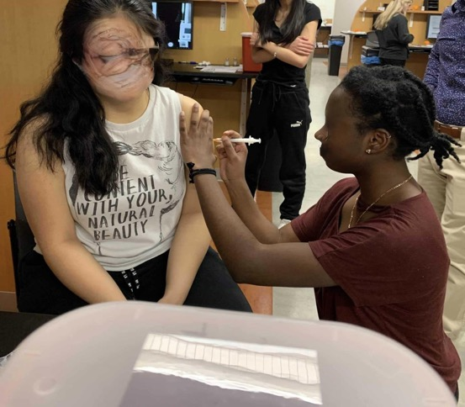
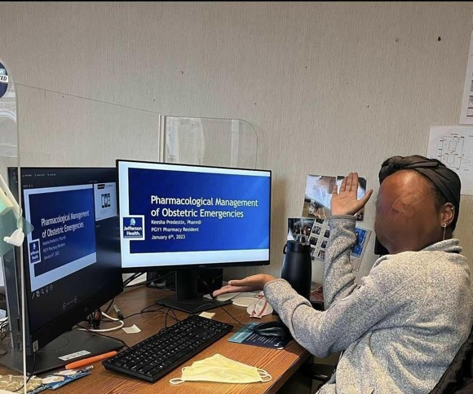

Slide 10
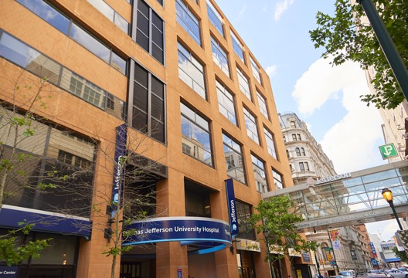
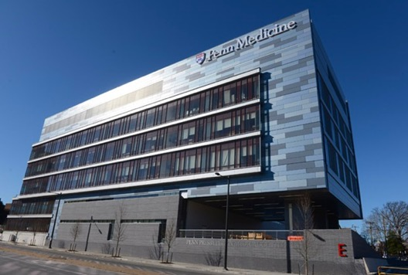



Slide 11
SAYS
DOES
⬇
⬇
“Medical literacy is at a 5th grader level in America”
“I do not know”
“Going to the bathroom is very dangerous”
“Difference in treatment”
Held up 5 fingers
Verbally emphasize
Verbally emphasize
Nervous laughter

Slide 12
FEELS
THINKS
⬇
⬇
Struggling -> explain medical terms to patients
Frustration -> patients have no idea about their medication
Tired -> overworked
Nervous, resigned, angry, powerless -> discrimination, patients can not afford medication
People improve their medical literacy
People pay attention to their meds
Wishes for a more balanced pharmacist and patient ratio
Discriminations are really everywhere, hopes to truly eliminate it one day

Slide 13
OBSERVATIONS
INFERENCES
⬇
⬇
Patients do not get enough time with doctors to ask about meds
have a lot of questions for the pharmacists
Pharmacists are overworked by a lot
Discrimination is a barrier to patients receiving quality healthcare
Doctors are busy, no individualized attention to all the patients
Doctors struggle to explain medication that the patients would understand
Imbalance between pharmacists and patients
Discrimination is just everywhere…

Slide 14
Interview 3: Naomi
⬇
⬇
Stanford student

Slide 15
Semi-Structured Interview Details
Location: In Naomi’s dorm
Roles: Dia (Interviewer), Anna (Notetaker)
Recruitment Method: Anna’s friend/word of mouth
Compensation: None
Reason selected:
  Due to her medical conditions, Naomi takes a variety of medication and is comfortable discussing her experiences with pharmacists and doctors.
Sample Interview Questions:
  Walk us through a time when you had trouble with accessing medication. What did you think and feel?
  When a doctor prescribes you a new medication, what does your research process of that new medication look like?
  What questions do you usually ask a pharmacist when receiving your prescription?
Apparatus: Voice Recording using built-in software
Quotes:
“No one knows what gabapetin is just from its name”
“I need to do research because I don’t want to die in bed”
“I take a screenshot of the time to remember when I last took my medication”
A lot of meds + little time -> social anxiety -> propose app

Slide 16

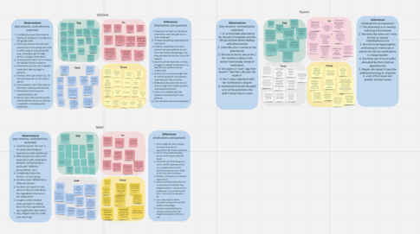
Key Learnings
Patients prefer consistency: experience and access to medication
Both pharmacists and patients are stressed
Different backgrounds -> different experience access to medication
Patients know little about medication
Patients experience varying degrees of what they feel they should know vs what they want to know
Information that are important to understand:
  Cost, effect, interaction w/ other treatments and substances, alternatives, duration of use, name

Slide 17
What’s Next
⬇
⬇
Doctor:
Dr. Kim
Mike Naomi
Tech Usage
Interview more people in the middle
Patients:
Mike
Naomi
Pharmacist:
Dr. Keesha
Interview a Doctor to understand the whole picture and workflow

Slide 18
Thanks!
⬇
⬇

