Slide 1
Kith&Kin Medium Fidelity Prototype
Haven Whitney, Hung Bui, Esi Korantemaa Donkor, Tenzin Dolkar

Slide 2
Overview
Problem
Solution
Parents face isolation and feel overwhelmed as they begin to raise children, leading to detrimental mental and physical health effects.
Provide parents greater access to in person community: guidance, empathy, and shared experience improves parent and child health.

Slide 3
Values in Design
01
02
Health and Wellness
Inclusion
03
04
Safety
Human Connection
Visual aesthetic; Content promoting wellness events
Filter options including age, language, background, and location radius
Community guidelines; background checks; moderation
Multiple avenues of connection including private messaging, community boards, and public events

Slide 4
01
Tasks
Prototype slides and flow

Slide 5
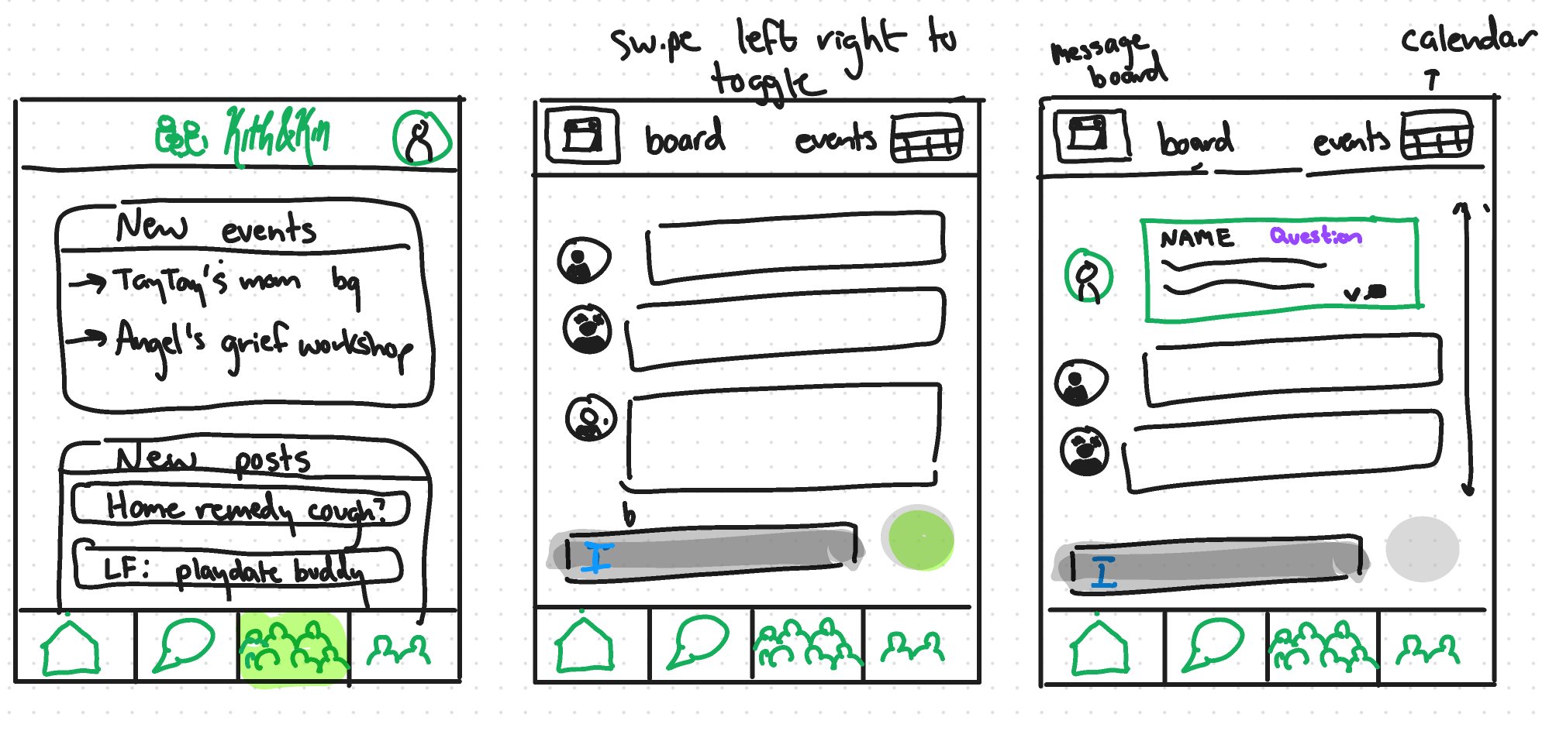
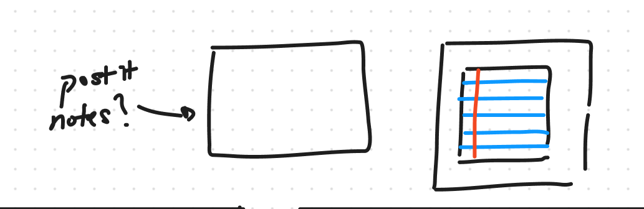
Simple Task: Ask a question on a community board.

Slide 6
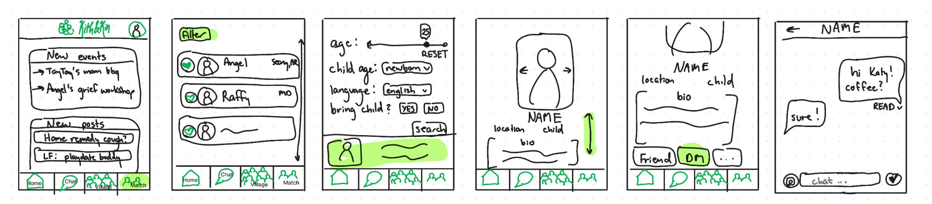
Moderate Task: Find and connect with a parent by sending a DM.

Slide 7
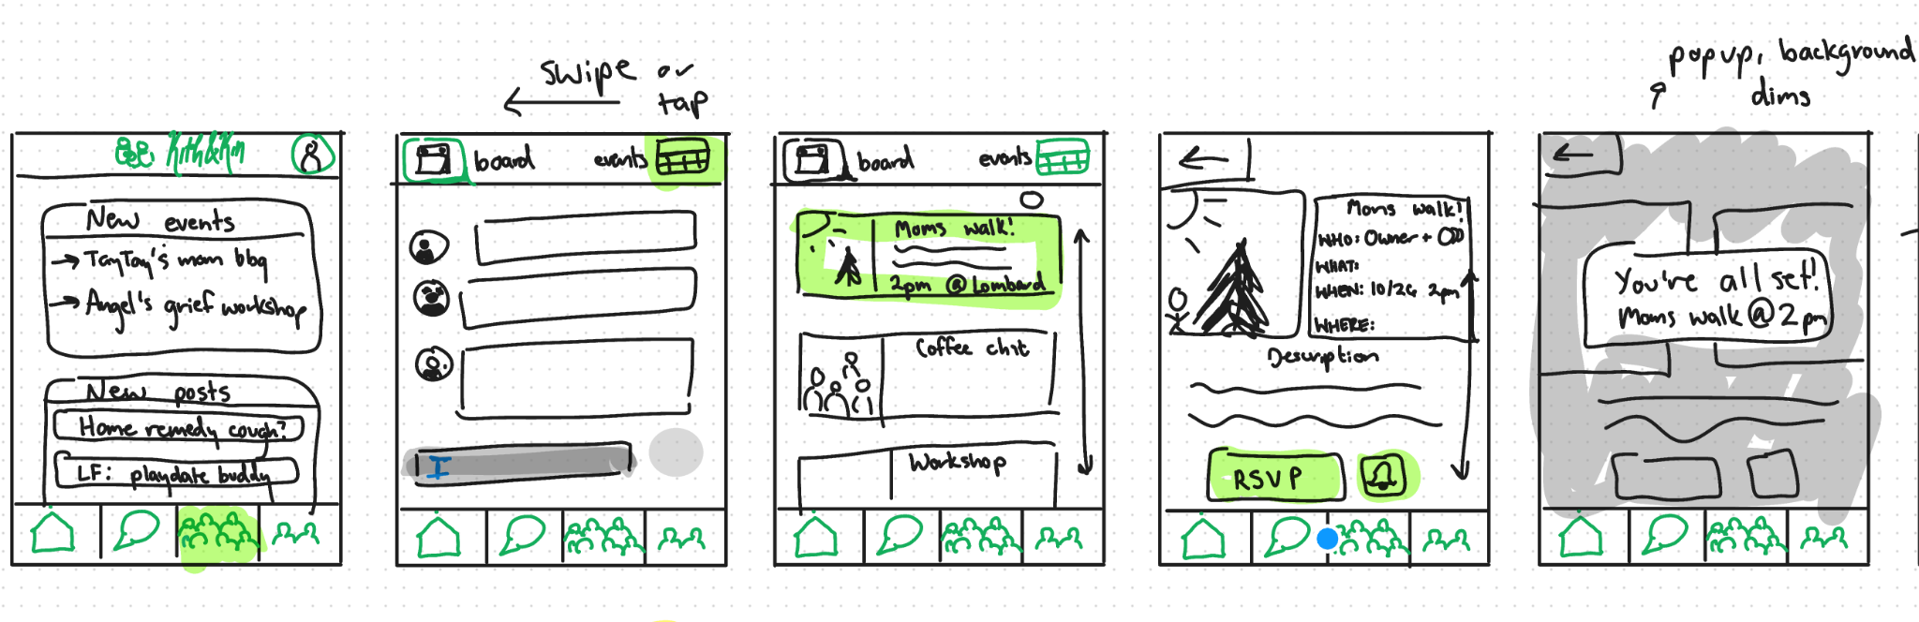
Complex Task: Search for and RSVP to an event nearby.

Slide 8
02
Usability Goals + Measurements

Slide 9
Usability Goals/Measurements
Goals
Measurements
We want our app to be…
Easy to navigate
A positive experience for the user
We will measure our success by…
Asking users to rate on a scale of 1-5 UI intuitiveness and timing test duration
Gathering qualitative feedback following the test

Slide 10
Product Progress
Goals -> Progress
Easy to navigate -> created intuitive icons such as for chatting and labeled the top of the pages as “Events” and “Connect” to clarify the purpose of icons further. Consistent color and symbols meaning.
A positive experience for the user -> pleasing & minimalist aesthetic. Features such as connecting with other parents, gathering as a community, and posting difficult questions create a sense of community and ease of burden from parenting alone with doubts and fear.

Slide 11
03
Revised Sketches

Slide 12
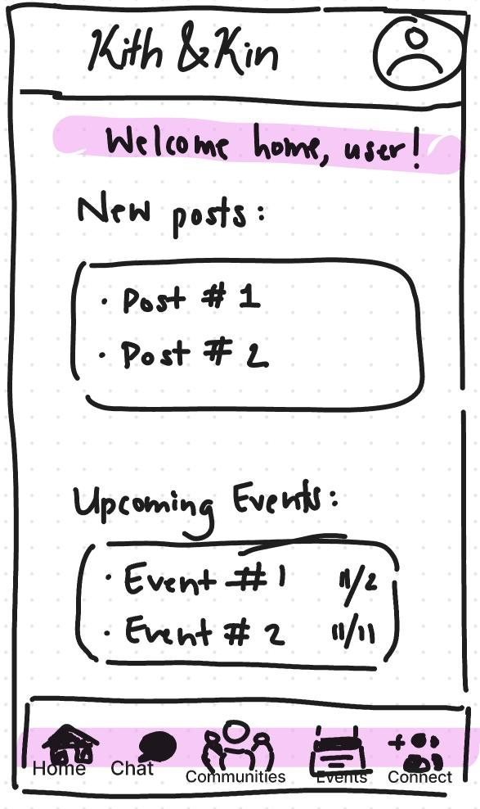
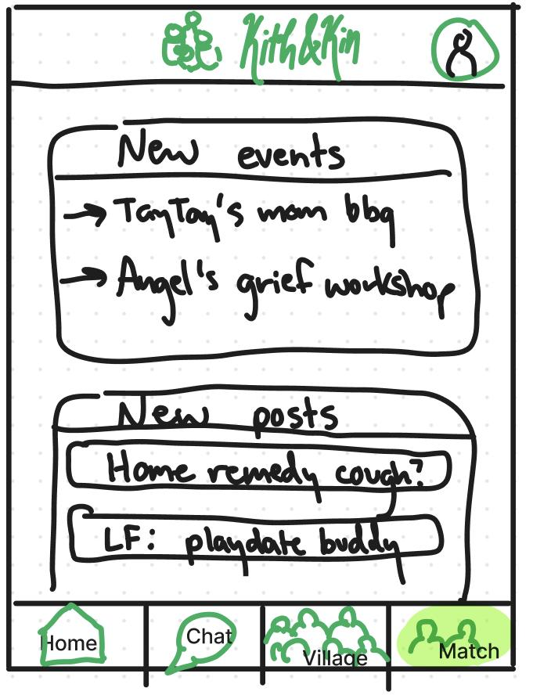
Navigation Bar
Rationale
Usability Progression
Low-fi testing revealed the icons on the nav bar were not intuitive as users struggled to locate “Events”, and interpret “Village” vs “Match”
>
Providing a navbar link to the events page and distinguishing between village and match by renaming them communities and connect makes the app easier to navigate

Slide 13
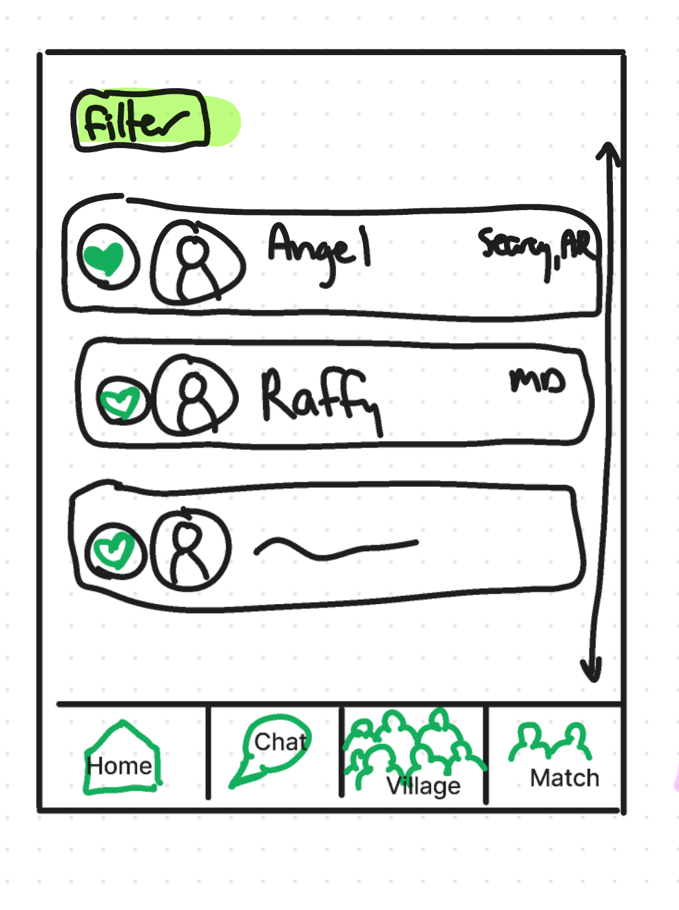
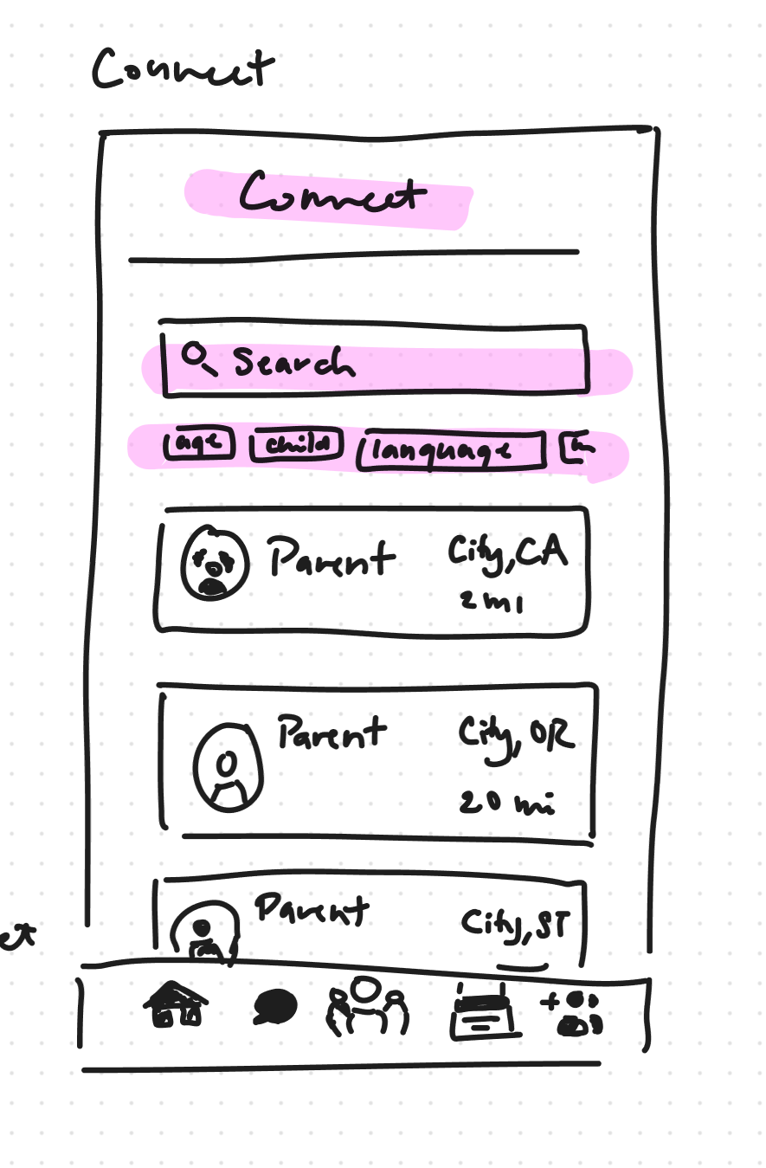
Filter and Search
Rationale
Usability Progression
The heuristics we learned regarding user freedom suggested that users should have the ability to find and filter through other parents and messages more efficiently.
>
By allowing for a much quicker way to find a recent message or a particular demographic, we make the app more easy to navigate.
Notes:
To connect and messages

Slide 14
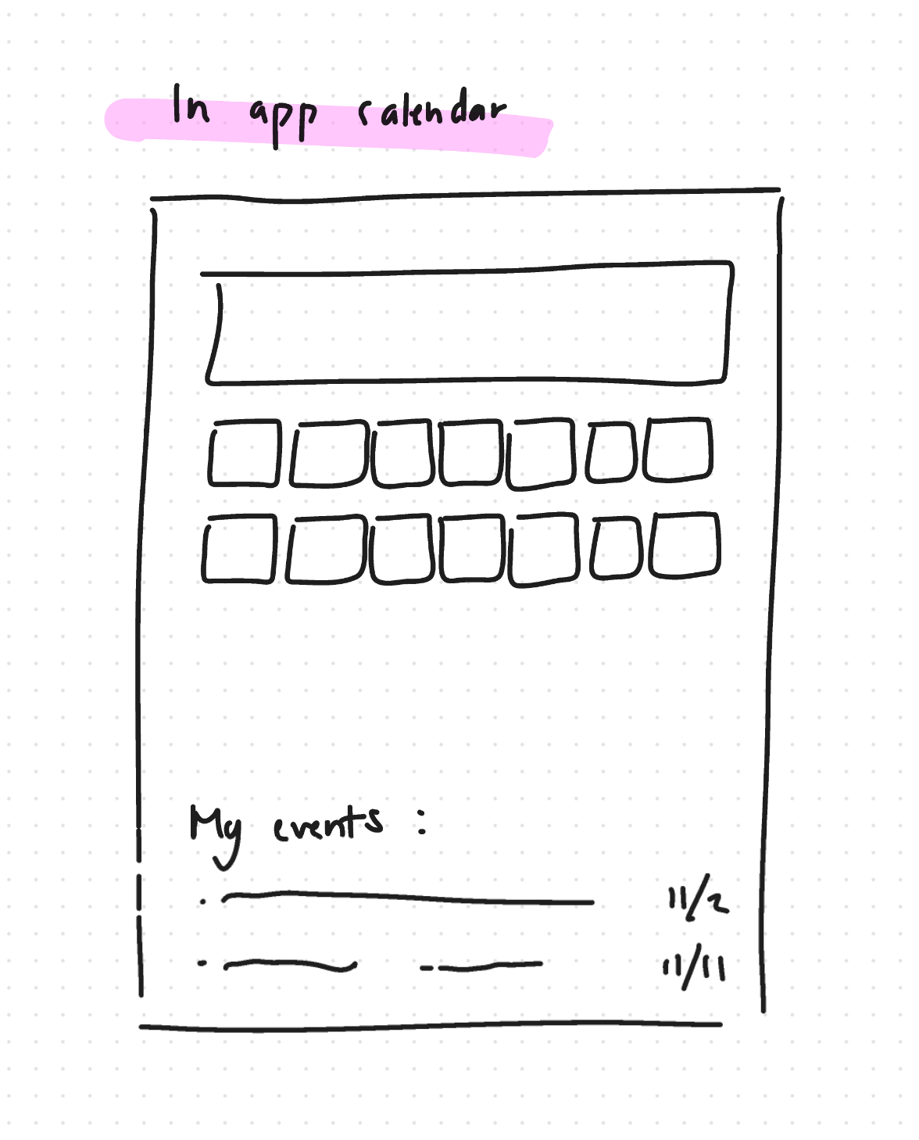
In-app calendar
Rationale
Usability Progression
It was mentioned during user testing that there was no clear way to find all of the events a user had RSVP’d to, and that a calendar could help keep track.
We believe that having access to all of the events you’re looking forward to in one place will make for a more positive experience, as it can reduce the likelihood of missing out on a connection.

Slide 15
04
Medium Fi Task Flows

Slide 16
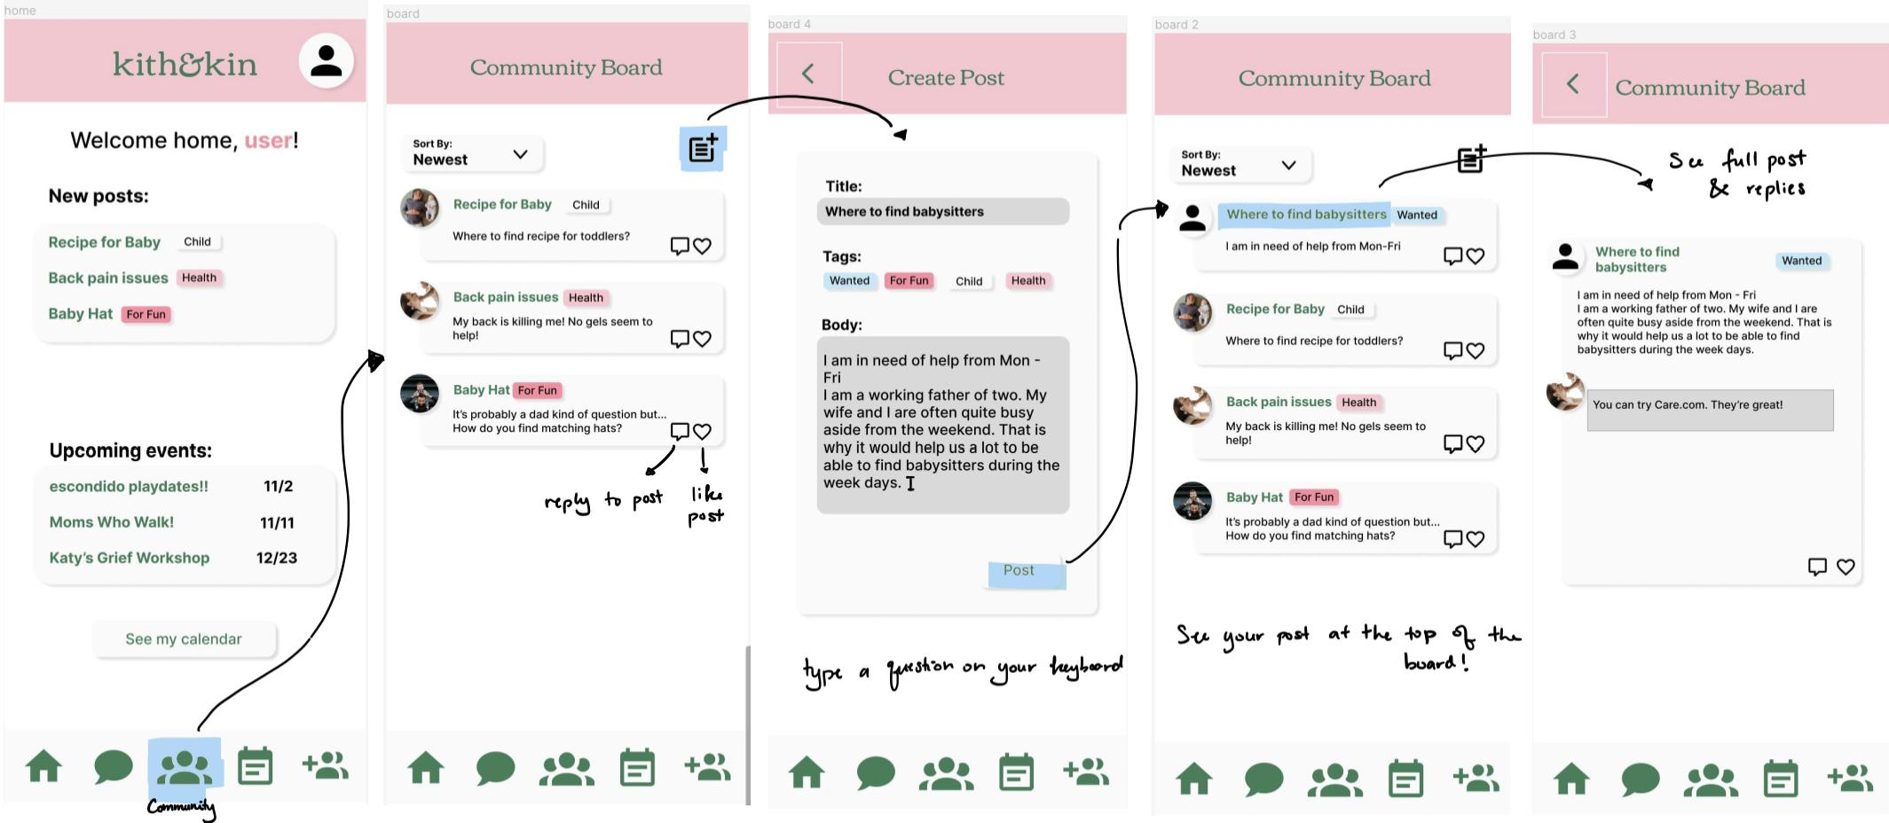
Simple Task: Ask a question on a community board.

Slide 17
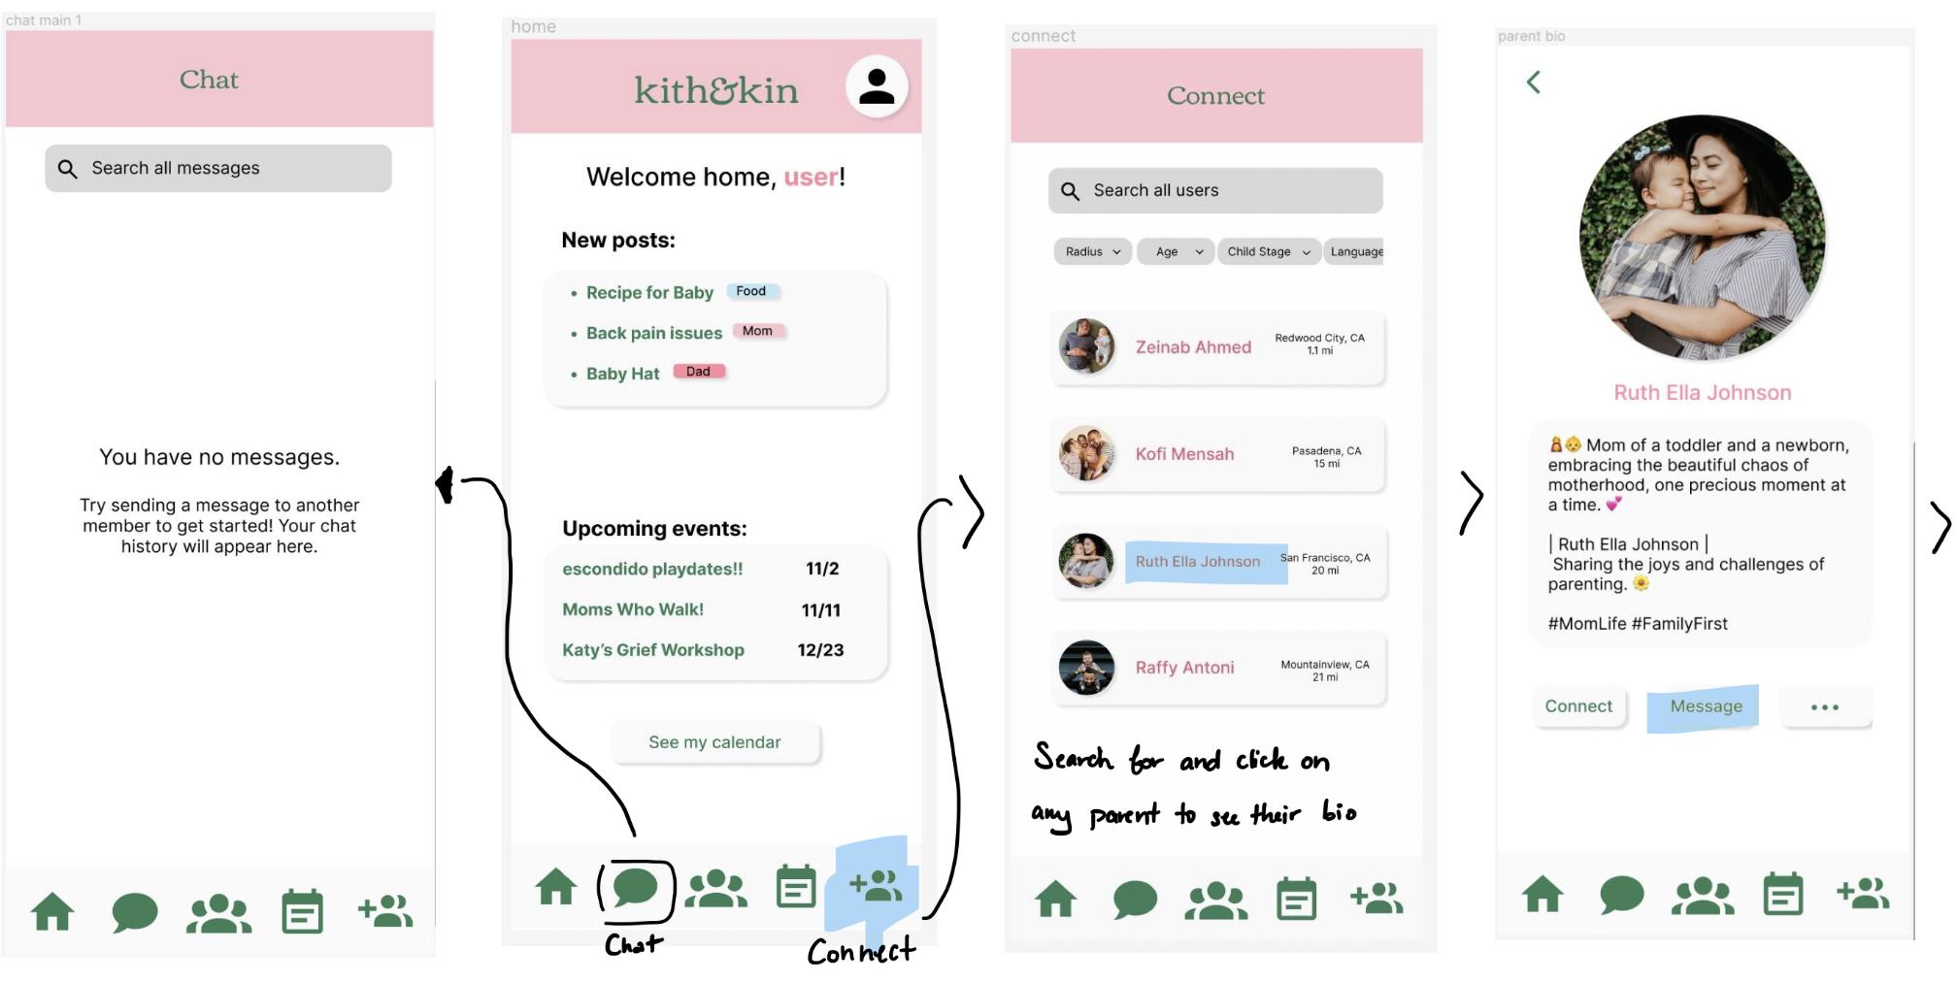
Moderate Task: Find and connect with a parent by sending a DM.

Slide 18
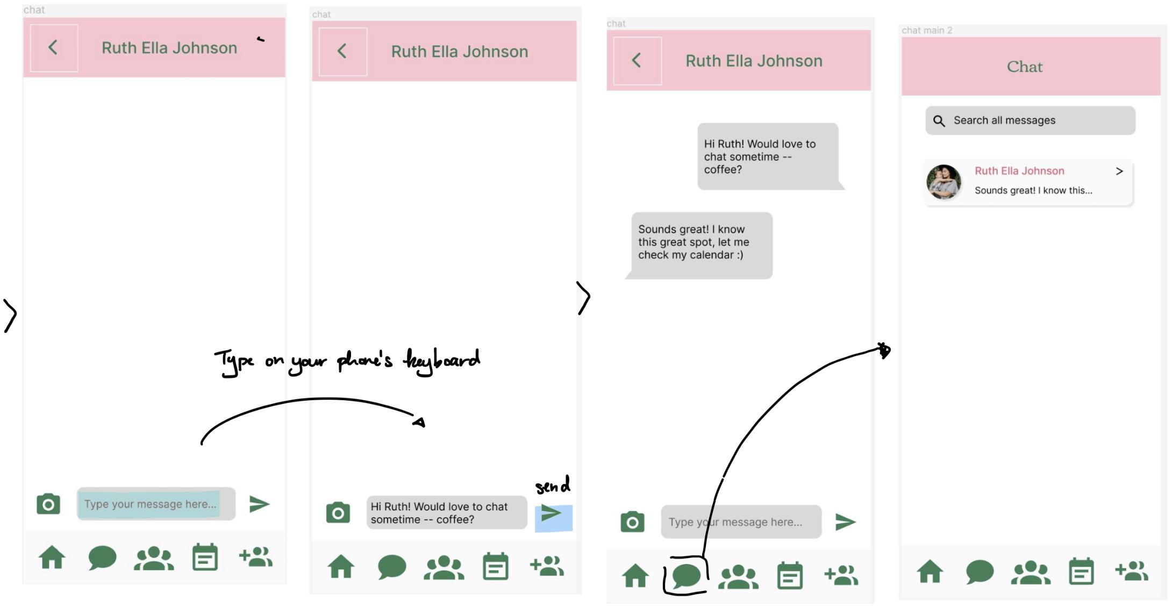
Moderate Task: Find and connect with a parent by sending a DM.

Slide 19
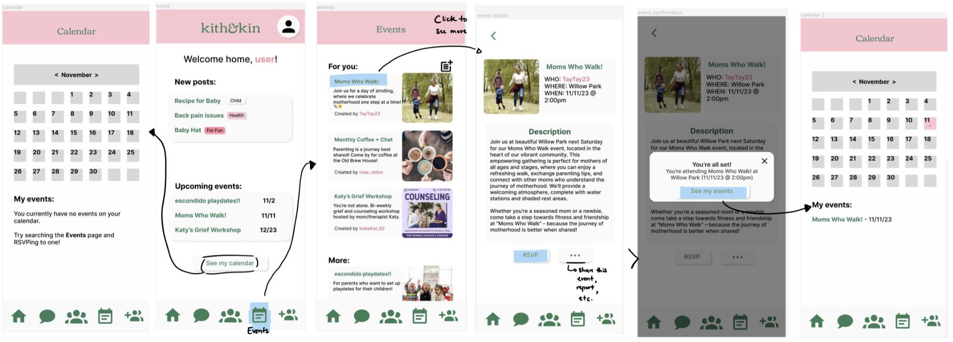
Complex Task: Search for and RSVP to an event nearby.

Slide 20
05
Prototype Implementation

Slide 21
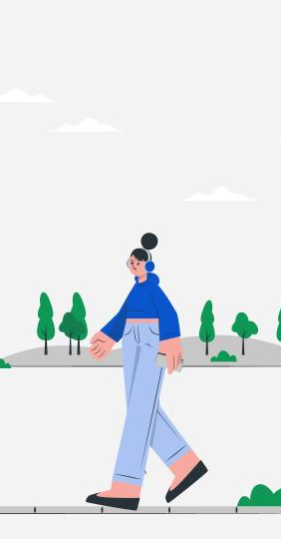
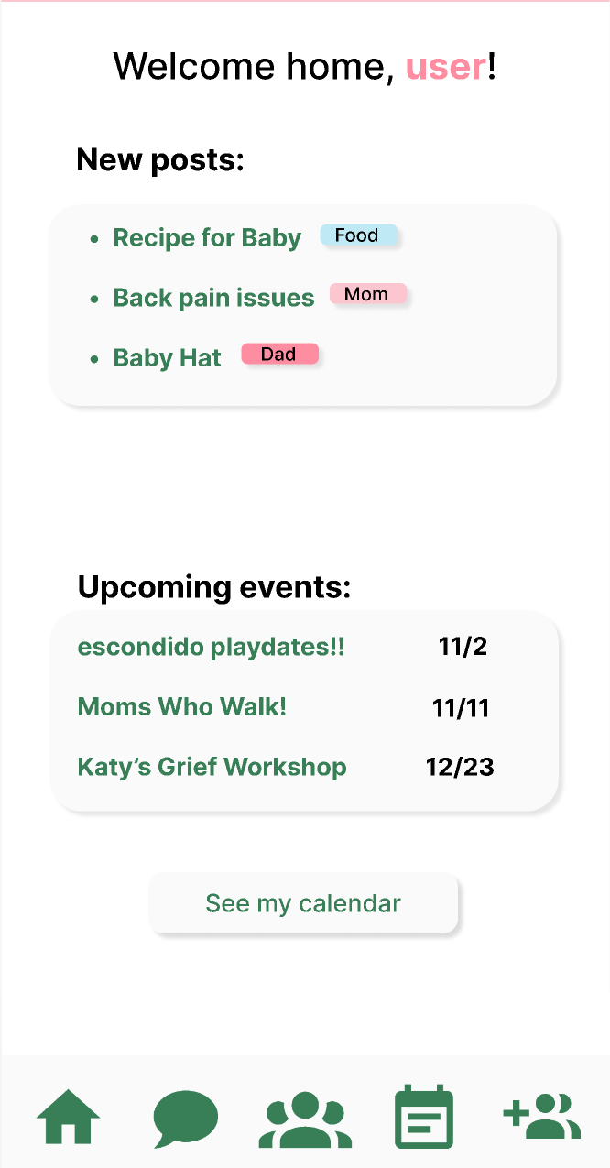
Mobile mockup
Tools
Limitations
We used Figma to build our prototype. It was intuitive, collaborative, and easy to create identical components across multiple frames of the app. However, interaction complexity and sophistication isn’t that robust.
We were unable to show true interaction between different users as this is a prototype without real online servers. Further, blocking and moderation features can’t be implemented for the same reasons.

Slide 22
Hard-coded features
The following features were hardcoded for the prototype:
Choosing a parent to message
Sending a message and its contents
Choosing an event to RSVP to
The most recent events are static

Slide 23
Appendix

Slide 24
Prototype Link
https://www.figma.com/proto/YApoHC5QvjDSGCLsvRkEec/A6-Medium-Fi?type=design&node-id=10-2&t=skIb7xjSYTxM0WWj-1&scaling=scale-down&page-id=0%3A1&starting-point-node-id=10%3A2&mode=design

Slide 25
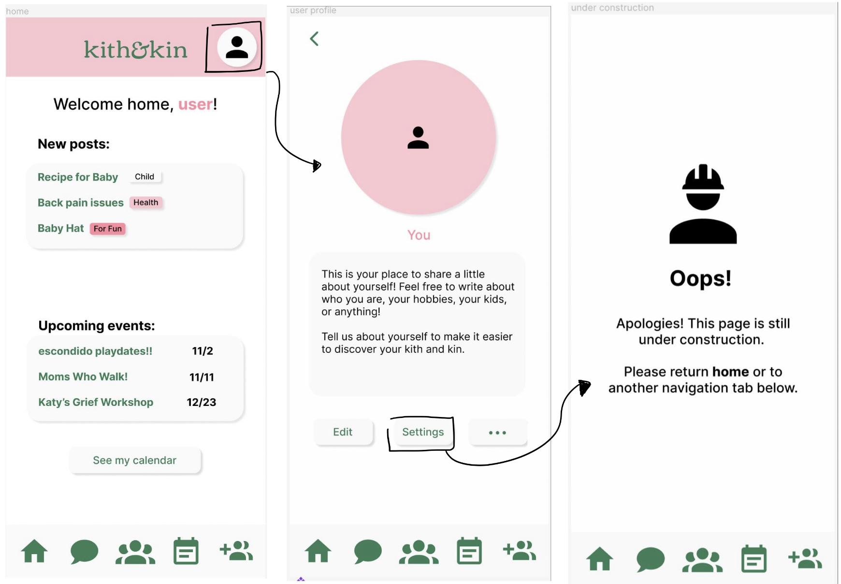
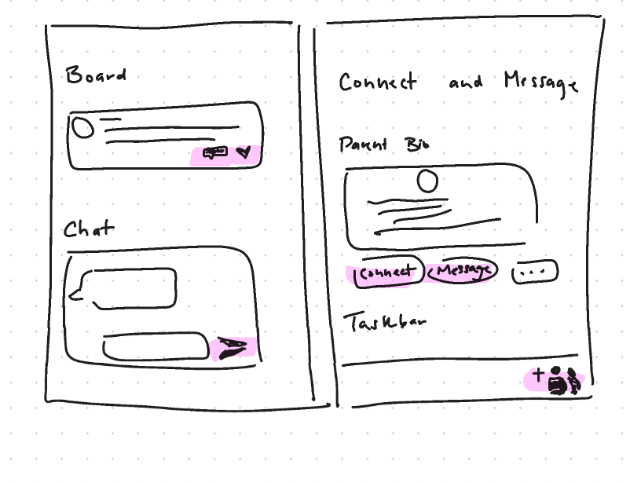
Additional Changes & Features
Icon consistency/clarity

