Slide 1
Family Matters: Healthcare Access Needs for Parents and Families
Tenzin Dolkar, Esi Donkor, Haven Whitney, Hung Bui

Slide 2
Introduction

Slide 3
Team Members
Tenzin
Haven
Esi
Hung
Junior in Symsys major curious about app development & healthtech intersection.
Senior CS major excited to learn about more about design!
Senior majoring in Human Biology interested in health and technology
Senior majoring in CS with an interest in healthcare and technology

Slide 4
Problem Domain: Healthcare for Families
How we chose:
Why we chose:
Family Experiences
Supporting Parents
Our team deeply values family wellbeing because of our own personal and cultural backgrounds.
Parenting is a job for which people need and deserve support.
Building Community
Interest in Healthcare
We have a professional interest in healthcare.
Children are a present and essential part of our community and deserve to be treated as such.
Work with children
Strengthening Society
We enjoy learning from and working with children in educational and mentorship settings
A society that invests in child care and well being invests in its future.
Notes:
How/why: personal experiences with families; social structures around community and individualism; group interest and connection to healthcare
As a group, we’ve worked with children in medical and mentoring settings and were interested to look into the unique difficulties of parents within the healthcare system, especially considering the often isolated experiences of families and raising children in the United States.
We also have had discussions with professionals and peers in the medical community who shared their interest in the domain, suggesting it would be an area with lots of room for potentially effective solutions.

Slide 5
Needfinding Methodology

Slide 6
Participants
Extreme user
Cat
Mohammed
Emma
Pediatric resident at Lucille Packard working across the board with clinics and hospitals
Setting: Zoom
Interviewer: Tenzin
Script: Haven
Diversity, Equity, and Inclusion (DEI) educator & father of 2
Setting: Living room
Interviewer: Tenzin
Script: Esi
Early childcare educator and professional & mother of 2
Setting: Nursery school
Interviewer: Haven
Script: Esi
All participants were found through personal networks and connections of the researchers.
Notes:
Recorded their voices and zoom video
We reached out to people we know/ connected with
Interesting: depending on what solution we focus, all could be extreme user. Mo FLI background if talking about finding resources. For this research, Emma due to her background and exspertise in childcare and extraneous circumstances during COVID.

Slide 7
Interview Questions
Who is in your support network?
Have you noticed any recurring issues/concerns of parents with regards to health care or childcare?
Do you find these surprising?
Why/why not?
Do you access any childcare/food support? Ex. food stamps, food closets/banks/soup kitchens, WICs
Where do you primarily find resources for childcare or healthcare?
What are your primary health concerns regarding your children?
What was your best/worst experience with (finding) childcare or healthcare?
Notes:
We wanted to have that breadth since we’ve different experience wide arrays

Slide 8
Results

Slide 9
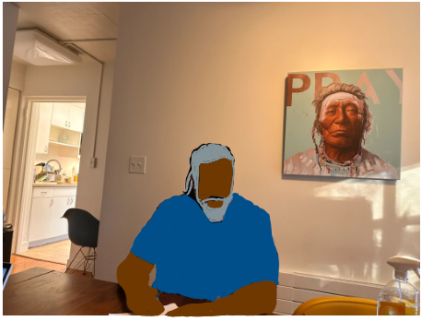
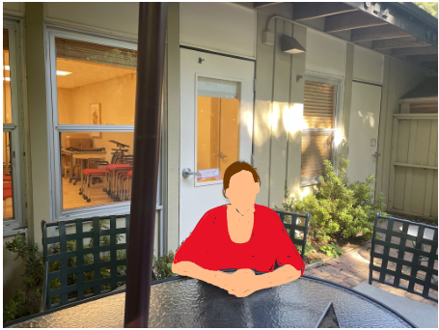
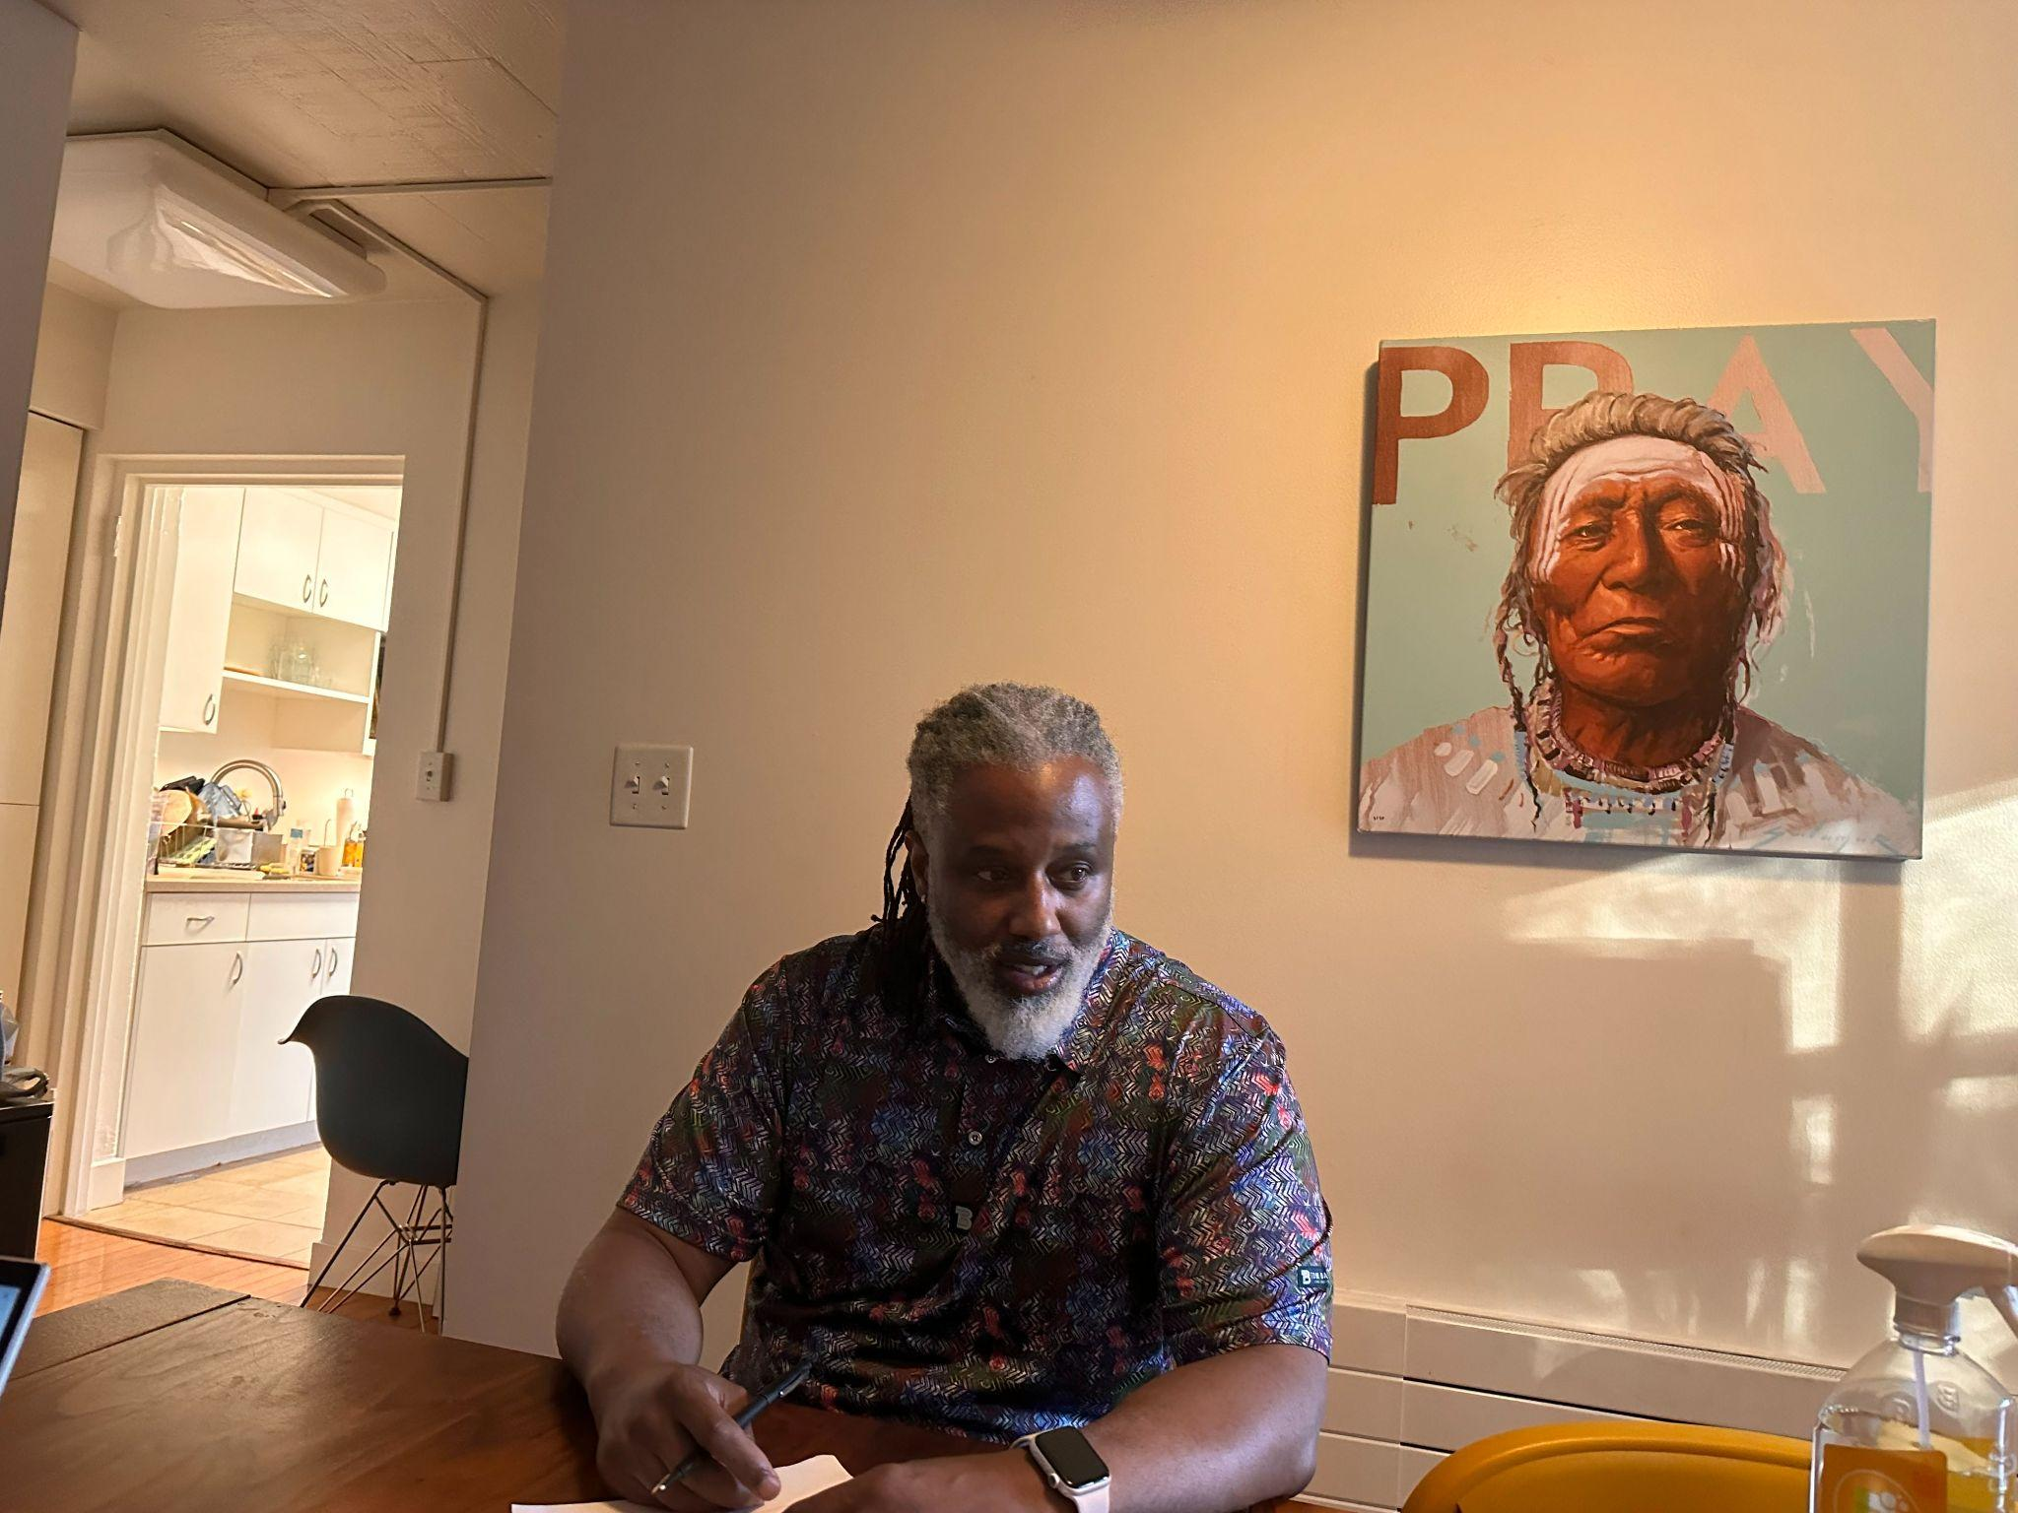
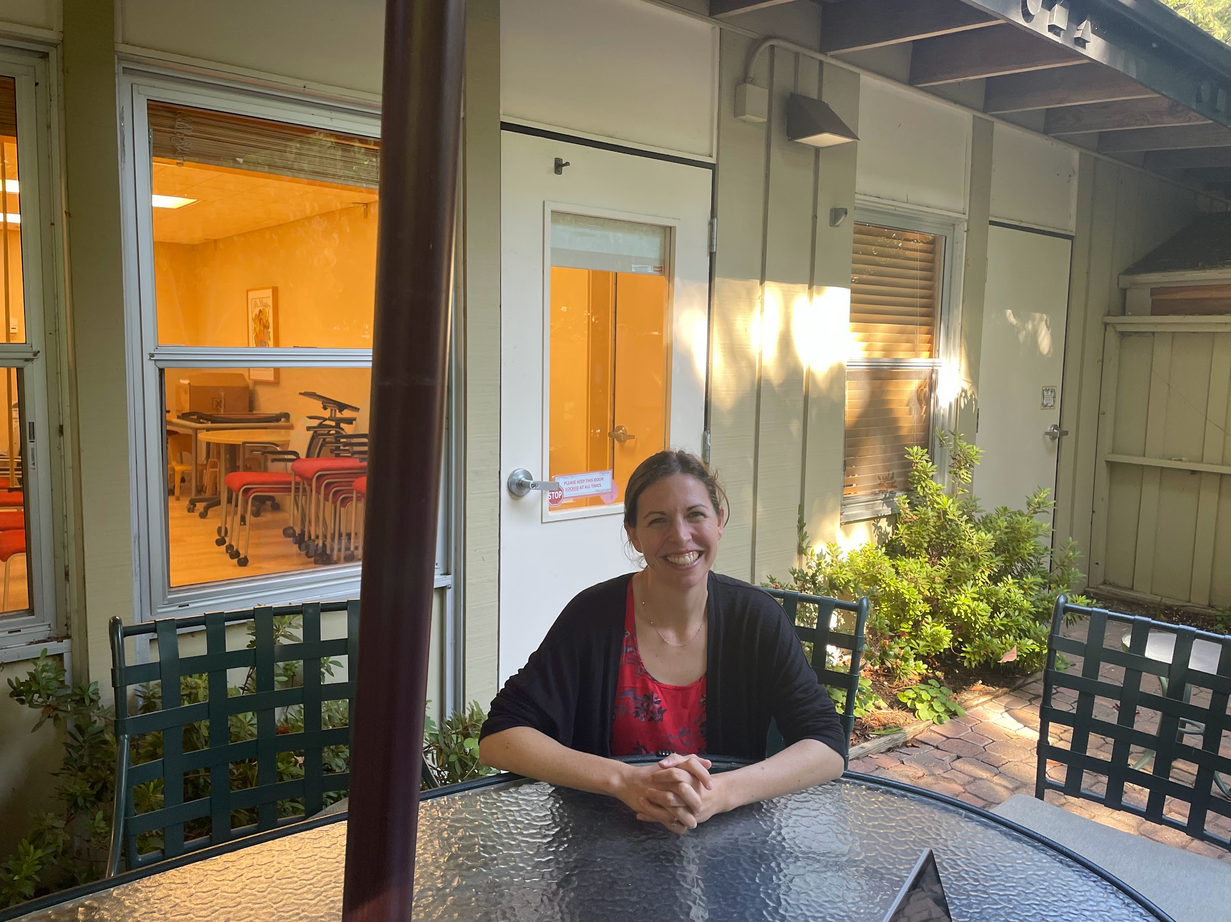
Pictures & setting
We did not take a photo of Catherine’s interview as it was over Zoom.
Notes:
We didn’t take a photo of Cat’s meeting as it was over Zoom.

Slide 10
Cat: Key quotes and Surprises
Wealthier diabetes patients had access to apps, monitors and pumps. Low-income kids don’t have access to attend chronic disease camps and glucose monitor pumps
Physicians frequently answer same email questions which takes up a lot of time.
Caregiver hunger dropped from 85% to 18% after giving 2 food vouchers and delivering to the room.
It took 45 mins to setup the interpreter online, no interpreter available at nights/weekends, hard to find indigenous dialect interpreters
Has a patient experiencing organ rejection from an indigenous community speaking Mixteco-bajo without translators. She doesn’t feel that she’s doing right without knowing what to do
A parent had a hard time getting to hospital & vouchers aren’t as effective due to food and housing insecurity taking precedence over appointments

Slide 11
Mohammed: Key Quotes and Surprises
Background navigating resources
Cross-cultural connections
“At a school of diverse cultural and economic backgrounds, parenting became the primary social identity. We made lifelong bond with preschool parents.”
“Coming from a low-income family with a mother who enrolled me in private schools and enrichment programs showed me that those were accessible to me.”
Sensitivity
Confidence accessing help
”I once took my son to a teaching hospital for a skin condition examined only to have him quickly surrounded by multiple students prodding at him.”
“I’m a prideful person so I felt pretty confident. I let go of some guilt when a friend said ‘you’ve paid into social welfare systems, it’s fair for you to use them when you need to’.”
Notes:
Positive surprise: coming from is bcgkrond, we werent expecting his confidence and saviness to know ho wto navigat el. He had a role model, he was prideful person capable of doing so. eresoere

Slide 12
Emma: Key Quotes and Surprises
Empathy
Expert opinions
Feeling informed
“I really just needed more than anything someone who could come check in on me.”
“I tried a few childcare apps, but … they didn’t have any proof of credentials or anything.“
“I think you need a healthcare professional that can offer you a range of options, not just pushing one agenda.”
The pandemic
Mental health
Parenting/healthcare advice
“It was very isolating being a parent during the pandemic, and I began experiencing postpartum depression.”
“Feeling strong feeds into mental health, especially after your body has changed from pregnancy.”
“I was the first of my friends to have a kid… so I write documents and give lots of advice on what to do.”

Slide 13
Analysis

Slide 14
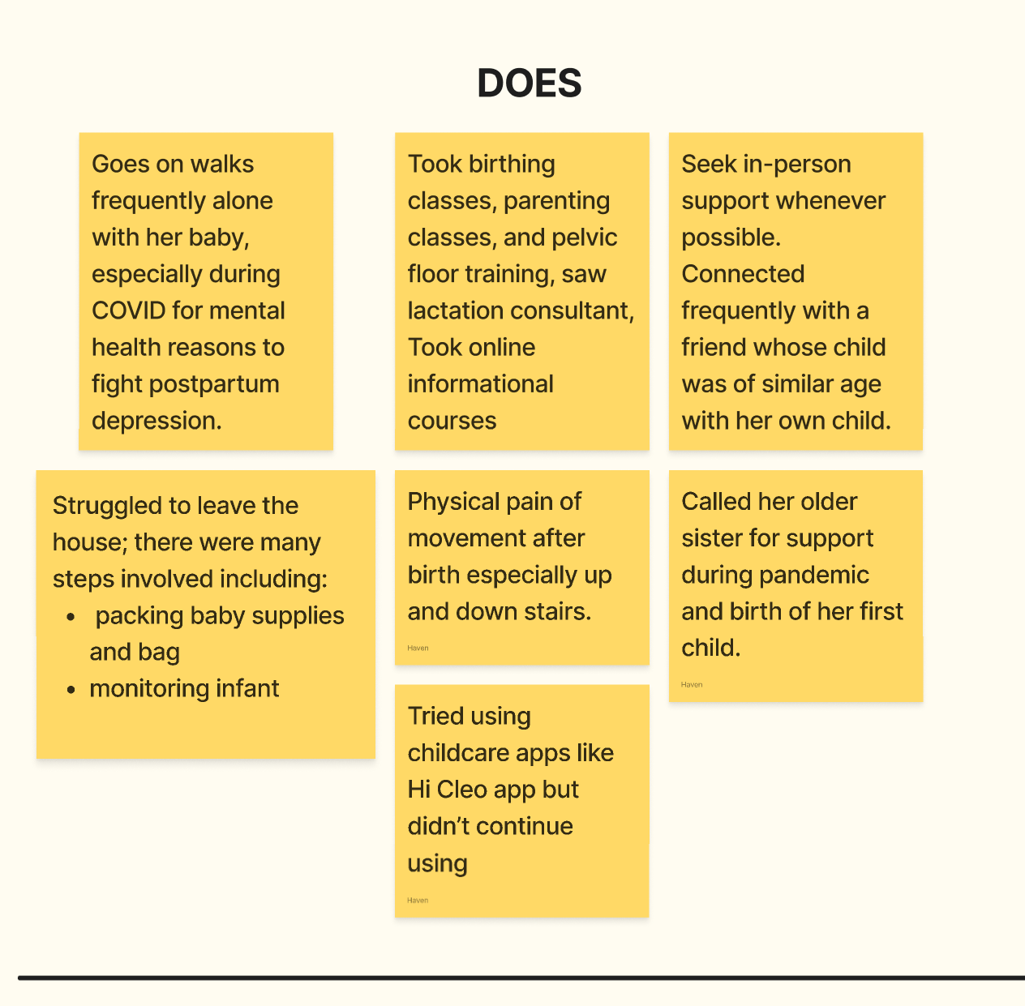
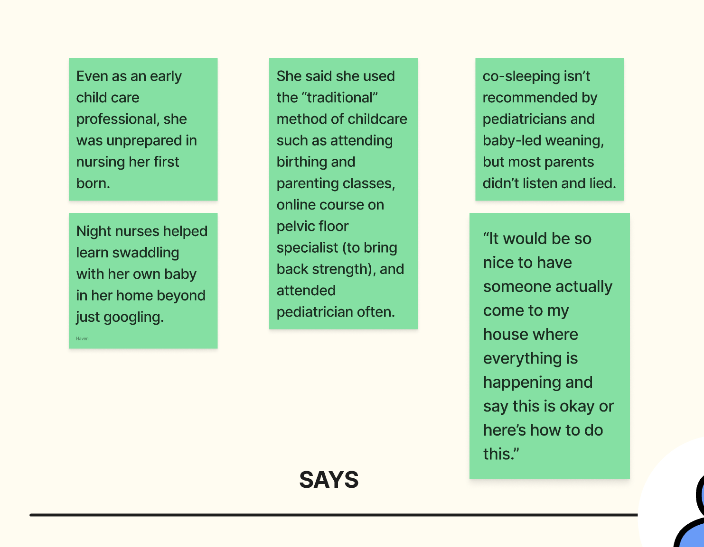
Empathy Map | Says & Does
https://www.figma.com/file/vJbLtN2d8wsWo7mhL8SKuc/A1-Empathy-Maps?type=whiteboard&node-id=0%3A1&t=eiizrV1goaN5jdAO-1
Notes:
She felt that she followed “traditional” methods, we can see what she does

Slide 15
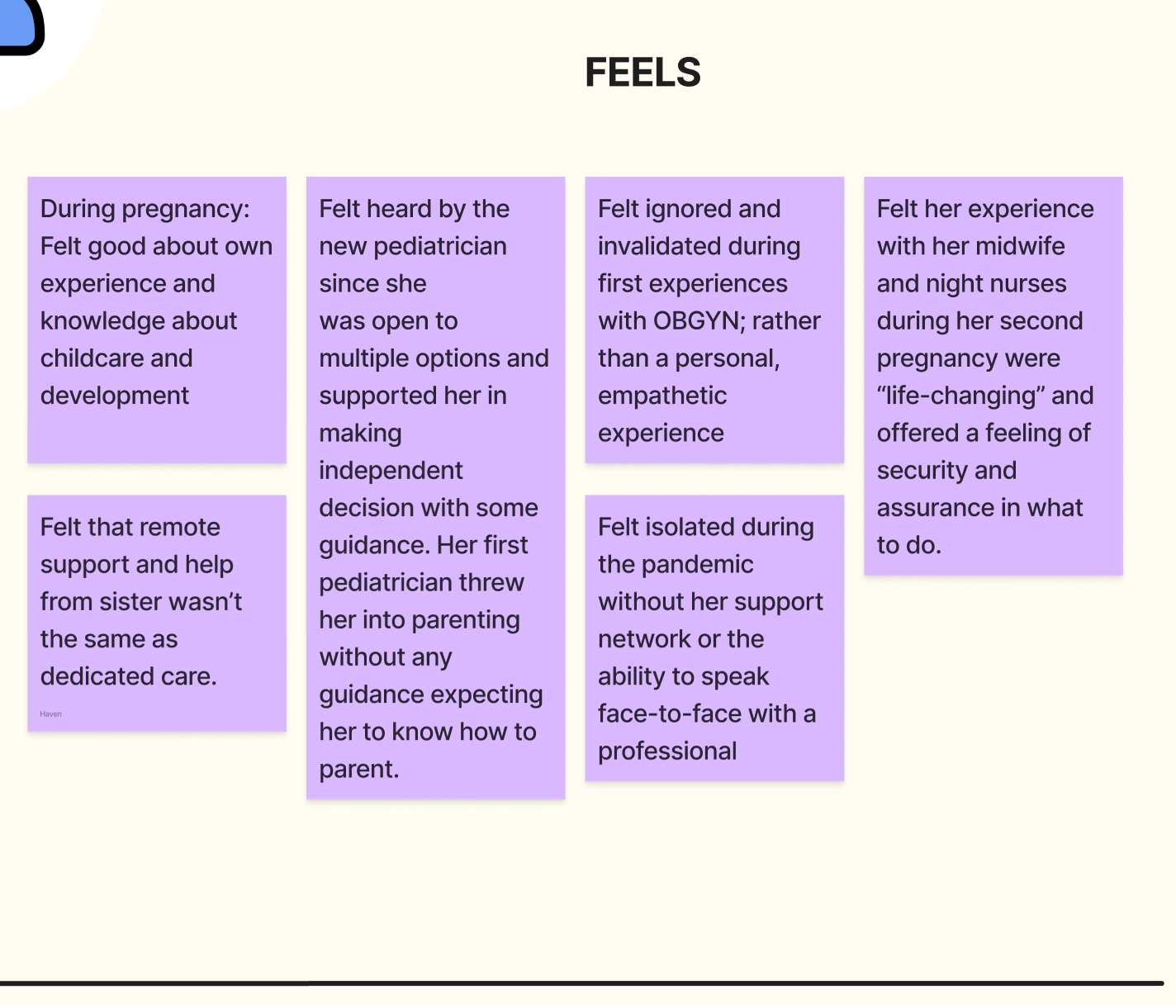
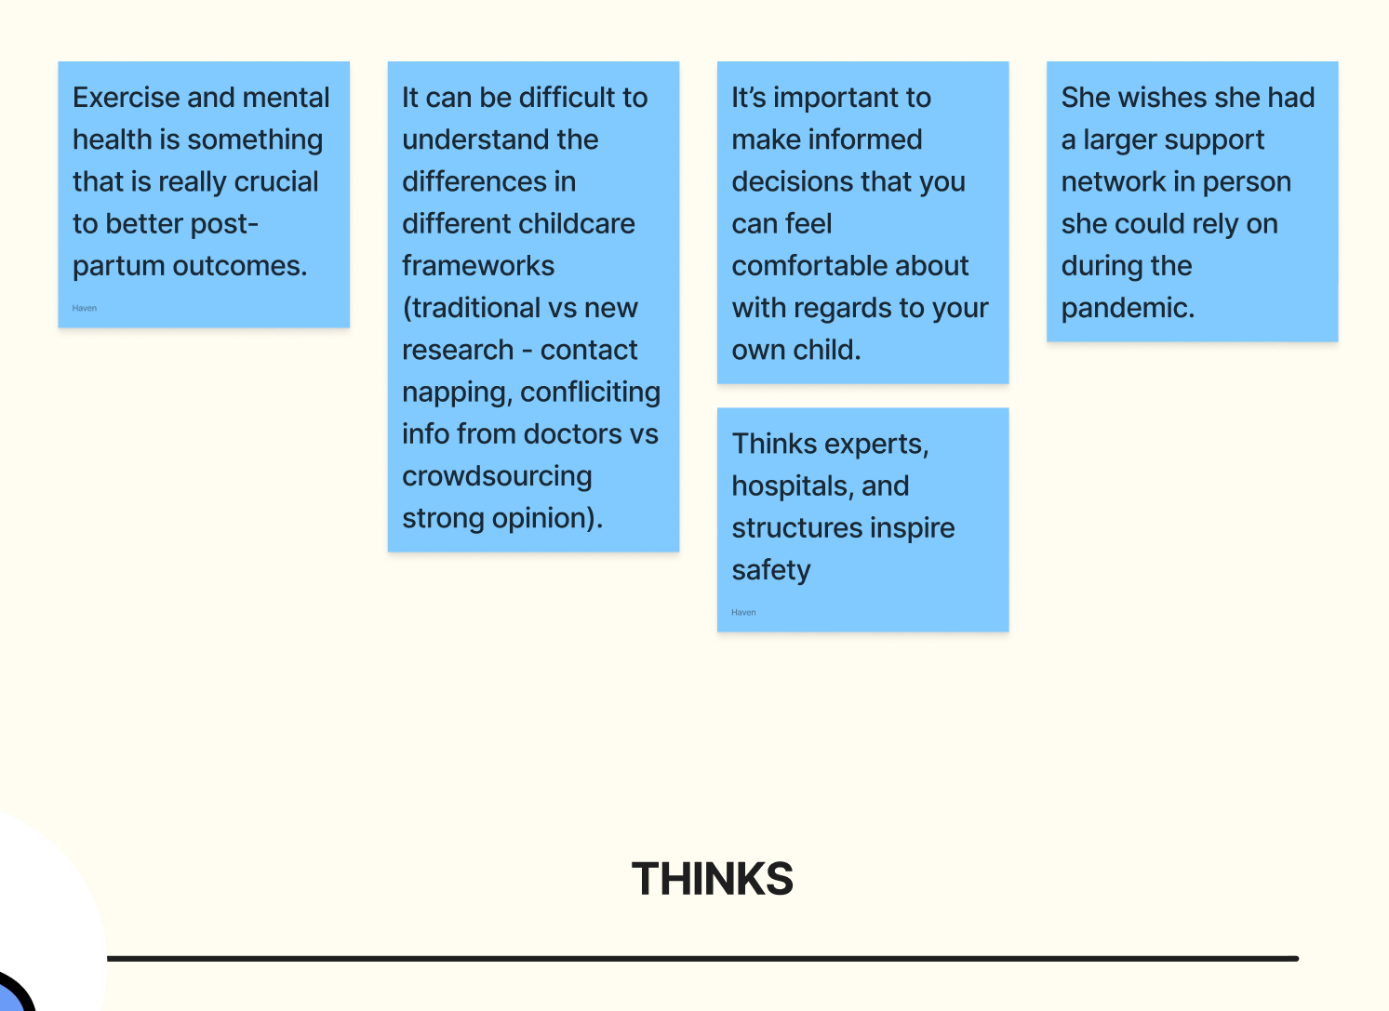
Empathy Map | Thinks & Feels
https://www.figma.com/file/vJbLtN2d8wsWo7mhL8SKuc/A1-Empathy-Maps?type=whiteboard&node-id=0%3A1&t=eiizrV1goaN5jdAO-1

Slide 16
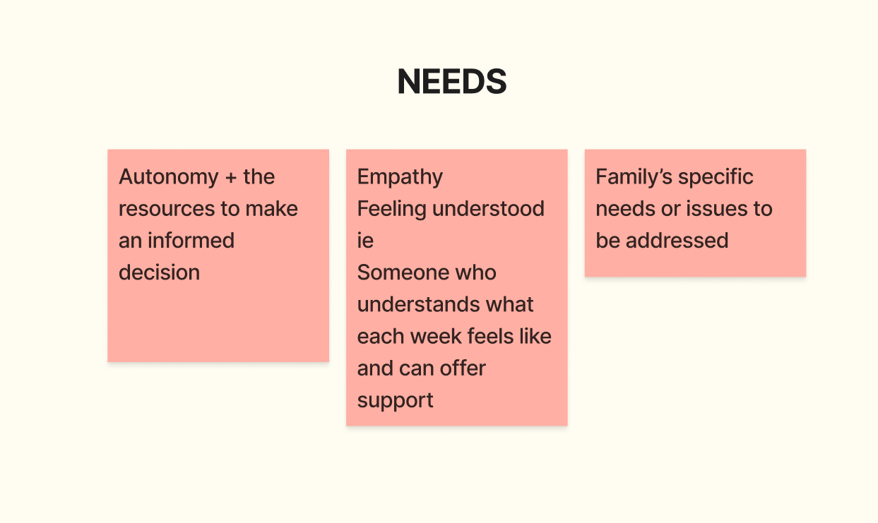
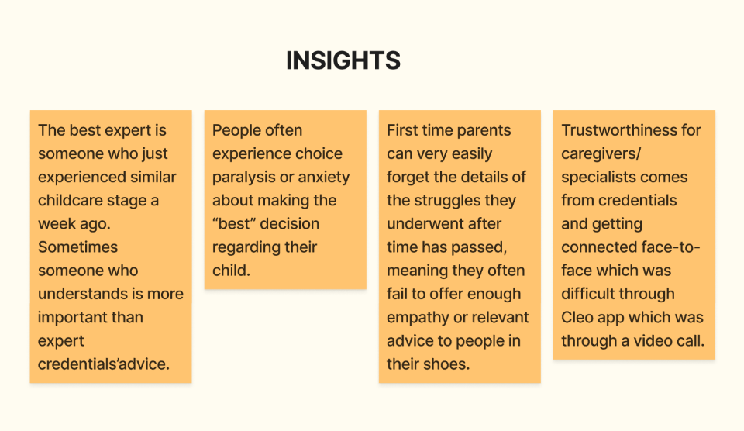
Needs and Insights
https://www.figma.com/file/vJbLtN2d8wsWo7mhL8SKuc/A1-Empathy-Maps?type=whiteboard&node-id=0%3A1&t=eiizrV1goaN5jdAO-1

Slide 17
Summary

Slide 18
Key Learnings
Communities are vital
No one-size-fits-all approach
1
4
Guidance, empathy, and shared experience improves parent and child health.
Everyone’s background and experiences are different and shape their needs.
2
3
Resources are hard to navigate
Healthcare is personal
Information on them can be difficult to find, digest, and evaluate.
People have happier healthcare experiences when they feel understood and connected to.

Slide 19
What’s Next?
More interviews
1st step
We have several more interviews for next week lined up in a variety of fields.
Understanding POVs
2nd step
We plan to identify the “game changing” elements of each person’s experience.
Ideation
3rd step
We will narrow our focus and brainstorm potential solution spaces from what we’ve learned.

Slide 20
Thank you!
Tenzin Dolkar, Esi Donkor, Haven Whitney, Hung Bui

Slide 21
Brainstorming Infographics
MERCURY
MARS
It’s the smallest and innermost planet
Despite being red, it’s a cold place
JUPITER
The fifth planet from the Sun and the largest
SATURN
VENUS
The second-largest in the Solar System
It has a beautiful name and it’s hot

Slide 22
Positive parenting infographics
Jupiter
1
2
Mars
Jupiter is a gas giant and the biggest planet in the Solar System
It's full of iron oxide dust, which gives the planet its reddish cast
Venus
3
4
Earth
Venus has a beautiful name and is the second planet from the Sun
Earth is the third planet from the Sun and the only one that harbors life

Slide 23
Positive parenting infographics
MerCURY
It’s a gas giant and the biggest planet in the Solar System
Awareness of assistance programs and empowerment
2
1
“Coming from a low-income family with a mother who found enrichment programs showed me those things were accessible to me.”
MerCURY
It’s a gas giant and the biggest planet in the Solar System

Slide 24
Positive parenting infographics
Mercury
Mercury is the closest planet to the Sun and the smallest one
Venus
Venus has a beautiful name and is the second planet from the Sun
Earth
It’s the third planet from the Sun and the only one that harbors life
Mars
It's full of iron oxide dust, which gives the planet its reddish cast
Jupiter
Jupiter is a gas giant and the biggest planet in the Solar System

Slide 25
Positive parenting infographics
Earth
39%
Earth is the third planet from the Sun and the only one that harbors life in the Solar System
Venus
71%
Venus has a beautiful name, but the temperatures are extremely high there!

Slide 26
Positive parenting infographics
Venus
60%
It’s terribly hot and its atmosphere is extremely poisonous
Mars
40%
It's full of iron oxide dust, which gives the planet its reddish cast
Jupiter
80%
Jupiter is the fourth-brightest object in the night sky

Slide 27
Positive parenting infographics
1
2
3
4
Mercury
Jupiter
Venus
Earth
It’s the closest planet to the Sun and the smallest in the Solar System
Jupiter is a gas giant and the biggest planet in the Solar System
Venus has a beautiful name and is the second planet from the Sun
Earth is the third planet from the Sun and the only one that harbors life

Slide 28
Positive parenting infographics
Sun
Jupiter
Mercury
Earth
Venus
The Sun is the star at the center of the Solar System
It’s a gas giant and the biggest planet of them all
It’s the closest planet to the Sun and the smallest
The Earth is the only planet that harbors life
Venus is the second planet from the Sun

Slide 29
Positive parenting infographics
Ceres
Jupiter
Saturn
Ceres is located in the main asteroid belt
It’s the biggest planet in the Solar System
Saturn is a gas giant and has several rings
A
B
C

Slide 30
Positive parenting infographics
Sun
67%
It’s the star at the center of the Solar System
Ceres
98%
Ceres is located in the main asteroid belt
Jupiter
42%
It’s the biggest planet in the Solar System
Mars
83%
Despite being red, Mars is actually a cold place

Slide 31
Positive parenting infographics
A
Mercury is the closest planet to the Sun and the smallest one in the Solar System
Mercury
B
It’s the third planet from the Sun and the only one that harbors life
Earth
C
It's full of iron oxide dust, which gives the planet its reddish cast
Mars

Slide 32
Positive parenting infographics
Mercury
1st step
It’s the closest planet to the Sun and the smallest one
Venus
2nd step
It has a beautiful name and is the second planet from the Sun
Mars
3rd step
It's full of iron oxide dust, which gives the planet its reddish cast

Slide 33
Positive parenting infographics
Mercury
21%
44%
Mars
It’s the closest planet to the Sun and the smallest one
Despite being red, Mars is actually a cold place
Earth
67%
85%
Sun
It’s the only one that harbors life in the Solar System
The Sun is the star at the center of the Solar System

Slide 34
Positive parenting infographics
Jupiter
Venus
It was named after the Roman god of the skies and lightning
Venus has a beautiful name and is the second planet from the Sun
Neptune
Mercury
It's the fourth-largest object by diameter in the Solar System
It’s the closest planet to the Sun and the smallest one in the Solar System

Slide 35
Positive parenting infographics
Key points to positive parenting success
01 | 02 | 03 | 04
Effective parenting | Consistent parenting | Active parenting | Attentive parenting
Mercury is the closest planet to the Sun and the smallest one in the Solar System | It’s terribly hot, even hotter than Mercury, and its atmosphere is extremely poisonous | Earth is the third planet from the Sun and the only one that harbors life in the Solar System | Saturn is a gas giant and has several rings. It's composed mostly of hydrogen and helium

Slide 36
Positive parenting infographics
A
B
C
D
Pluto
Ceres
Neptune
Venus
Pluto is now considered a dwarf planet
Ceres is located in the main asteroid belt
Neptune is the farthest planet from the Sun
Venus is the second planet from the Sun

Slide 37
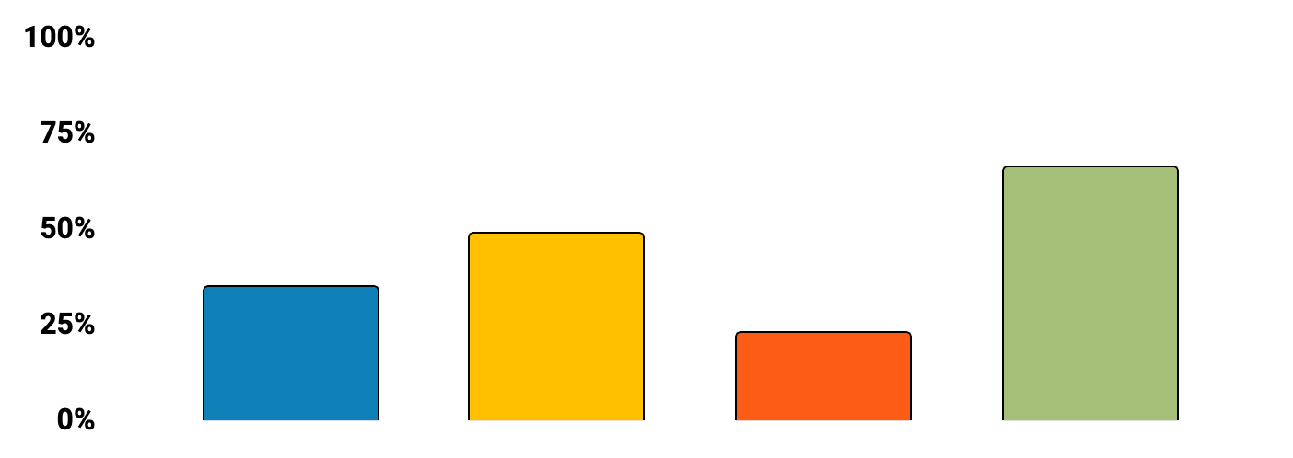
Positive parenting infographics
Authoritarian
Permissive
Uninvolved
Authoritative
Mercury is the smallest planet
Saturn is the ringed planet
Pluto is now a dwarf planet
Ceres is in the asteroid belt
Follow the link in the graph to modify its data and then paste the new one here. For more info, click here

Slide 38
Positive parenting infographics
Mercury
Mars
Sun
Mercury is the closest planet to the Sun
Despite being red, Mars is a cold place
It’s the closest star to planet Earth
Venus
Jupiter
Neptune
Venus is the second planet from the Sun
It’s the biggest planet in the Solar System
It’s the farthest planet from the Sun

Slide 39
Positive parenting infographics
Ceres
Ceres is located in the main asteroid belt
53%
Sun
It’s the closest star to planet Earth
39%
Saturn
Saturn is a gas giant and has several rings
71%

Slide 40
Positive parenting infographics
Jupiter
Earth
Mars
Venus
It’s the third planet from the Sun and the only one that harbors life
It's full of iron oxide dust, which gives the planet its reddish cast
Venus is terribly hot and its atmosphere is extremely poisonous

Slide 41
Positive parenting infographics
Step 1
42%
37%
Step 2
Step 3
The Sun is the star at the center of the Solar System
Jupiter is the biggest planet in the Solar System
Despite being red, Mars is actually a cold place

Slide 42
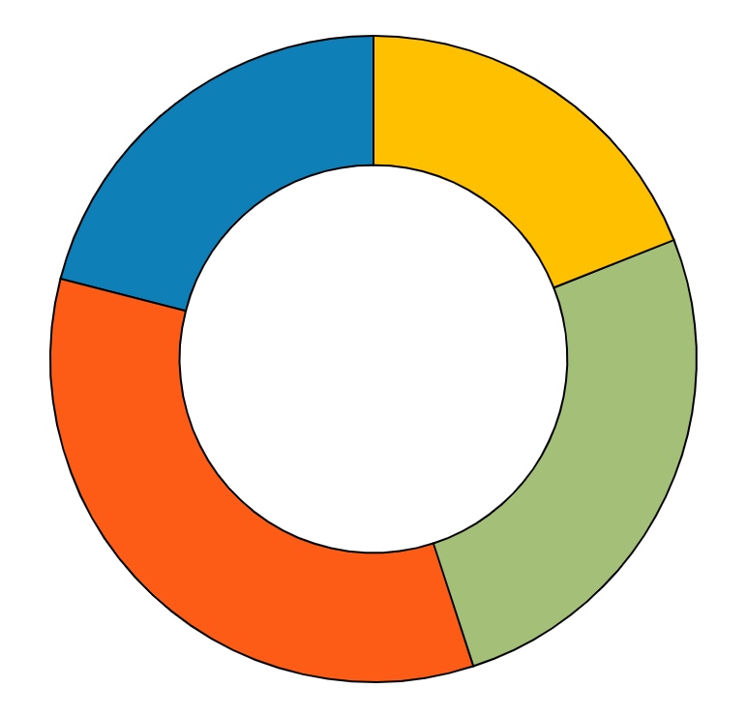
Positive parenting infographics
Venus
Mercury
Venus has a beautiful name and is the second planet from the Sun
Mercury is the closest planet to the Sun and the smallest one
32%
23%
Mars
Jupiter
It's full of iron oxide dust, which gives the planet its reddish cast
Jupiter is a gas giant and the biggest planet in the Solar System
25%
20%
Follow the link in the graph to modify its data and then paste the new one here. For more info, click here

Slide 43
Positive parenting infographics
Mercury
It’s the closest planet to the Sun and the smallest one
Jupiter
It’s a gas giant and the biggest planet in the Solar System
Neptune
Neptune is the farthest planet from the Sun
Sun
The Sun is the star at the center of the Solar System
Ceres
Ceres is located in the main asteroid belt
Venus
It has a beautiful name and is the second planet from the Sun

Slide 44
Positive parenting infographics
Jupiter
A
Jupiter is a gas giant and the biggest planet in the Solar System
Mercury
B
Mercury is the closest planet to the Sun and the smallest of them all
Venus
C
Venus has a beautiful name and is the second planet from the Sun
Earth
D
Earth is the only planet that harbors life in the Solar System
Mars
E
It's full of iron oxide dust, which gives the planet its reddish cast

Slide 45
Key Quotes and Surprises
Mars
Earth
Despite being red, Mars is actually a cold place
It’s the only one that harbors life in the Solar System
1,897
4,186
3,763
7,647
Venus
Jupiter
Venus is the second planet from the Sun
Jupiter is the biggest planet in the Solar System

Slide 46
Positive parenting infographics
 | Step 1 | Create a safe, interesting environment
 |  | Neptune is the fourth-largest planet by diameter in the Solar System
 | Step 2 | Have a positive learning environment
 |  | Jupiter is a gas giant and the fourth-brightest object in the night sky
 | Step 3 | Use assertive discipline
 |  | Saturn is composed mostly of hydrogen and also helium
 | Step 4 | Have realistic expectations
 |  | Mercury is the closest planet to the Sun and the smallest of them all
 | Step 5 | Take care of yourself as a parent
 |  | Venus has a beautiful name and is the second planet from the Sun
5 Steps to Positive Parenting

Slide 47
Parents icon pack

Slide 48
Instructions for use (premium users)
As a Premium user, you can use this template without attributing Slidesgo.
You are allowed to:
Modify this template.
Use it for both personal and commercial purposes.
Hide or delete the “Thanks” slide and the mention to Slidesgo in the credits.
Share this template in an editable format with people who are not part of your team.
You are not allowed to:
Sublicense, sell or rent this Slidesgo Template (or a modified version of this Slidesgo Template).
Distribute this Slidesgo Template (or a modified version of this Slidesgo Template) or include it in a database or in any other product or service that offers downloadable images, icons or presentations that may be subject to distribution or resale.
Use any of the elements that are part of this Slidesgo Template in an isolated and separated way from this Template.
Register any of the elements that are part of this template as a trademark or logo, or register it as a work in an intellectual property registry or similar.
For more information about editing slides, please read our FAQs or visit Slidesgo School:
https://slidesgo.com/faqs and https://slidesgo.com/slidesgo-school

Slide 49
Infographics
You can add and edit some infographics to your presentation to present your data in a visual way.
Choose your favourite infographic and insert it in your presentation using Ctrl C + Ctrl V or Cmd C + Cmd V in Mac.
Select one of the parts and ungroup it by right-clicking and choosing “Ungroup”.
Change the color by clicking on the paint bucket.
Then resize the element by clicking and dragging one of the square-shaped points of its bounding box (the cursor should look like a double-headed arrow). Remember to hold Shift while dragging to keep the proportions.
Group the elements again by selecting them, right-clicking and choosing “Group”.
Repeat the steps above with the other parts and when you’re done editing, copy the end result and paste it into your presentation.
Remember to choose the “Keep source formatting” option so that it keeps the design. For more info, please visit Slidesgo School.

Slide 50
Problem Domain: Healthcare for Families
Family Experiences
Community
Despite being red, Mars is actually a cold place
It’s the star at the center of the Solar System
Work with children
Parenting
Earth is the third planet from the Sun
Ceres is located in the main asteroid belt
Interest in Healthcare
Society
Venus is the second planet from the Sun
Saturn is a gas giant and has several rings
Notes:
Our team wanted to focus on the access of health and child care to families and parents.
How/why: personal experiences with families; social structures around community and individualism; group interest and connection to healthcare
As a group, we’ve worked with children in medical and mentoring settings and were interested to look into the unique difficulties of parents within the healthcare system, especially considering the often isolated experiences of families and raising children in the United States.
We also have had discussions with professionals and peers in the medical community who shared their interest in the domain, suggesting it would be an area with lots of room for potentially effective solutions.

