Slide 1
Kith&Kin
IT TAKES A VILLAGE
Tenzin Dolkar, Haven Whitney, Esi Donkor, Hung Bui

Slide 2
Kith&Kin means Friends & Family with a fun twist to it
Represents the types of support network users will find
Although other apps might relate to our value proposition, Kith&Kin specifically caters to parents of younger children in finding social networks and support system while our competitor apps have either too broad of a reach or strictly targeted towards women
Kith = friends
Kin = family

Slide 3
Problem & Solution
Problem | Solution
Parent Isolation & Loneliness | Meetup with other parents 1-on-1 with similar child age group, location proximity, language spoken, etc.
Limited Support Network | Share and celebrate each other’s small parenting milestones within close network of friends (i.e. BeReal)
Difficulty Finding Resources & Parenting Questions | Ask for help & questions on community board to learn new remedies/ tips while bonding through shared struggles

Slide 4
01
Market Research
Simple Leaves

Slide 5
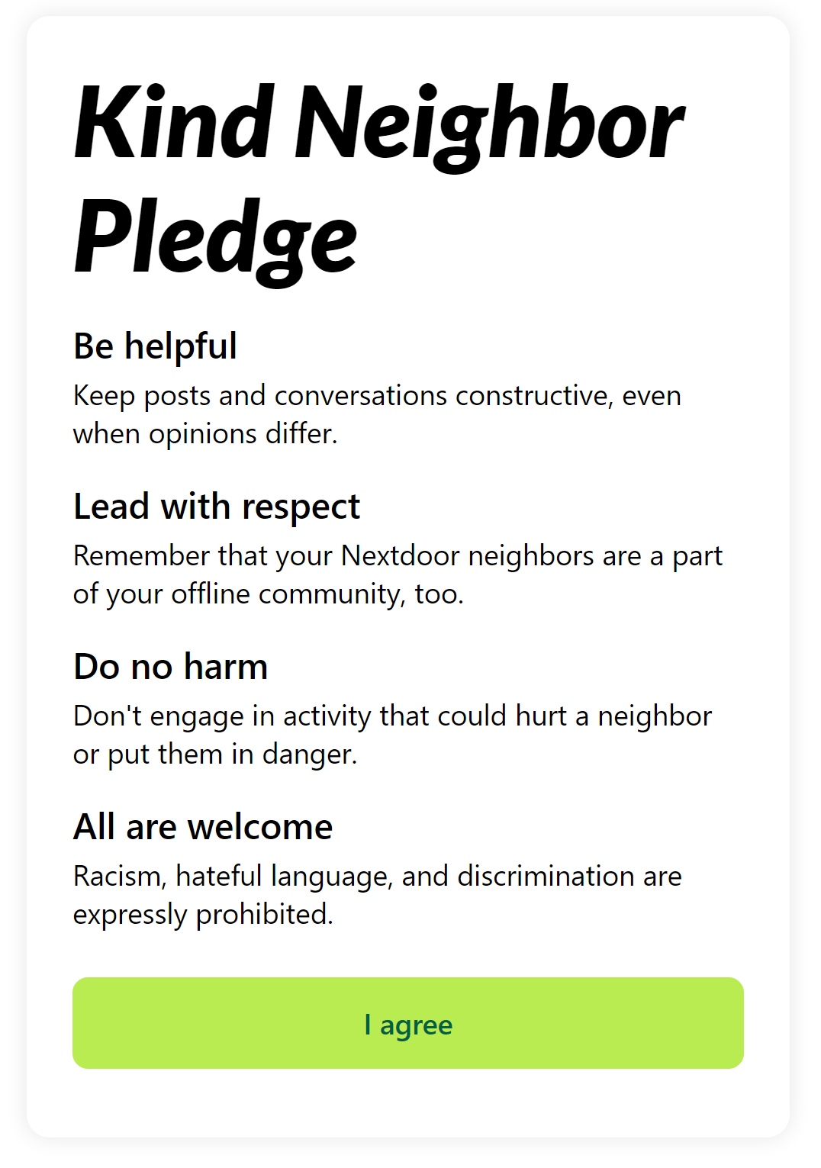
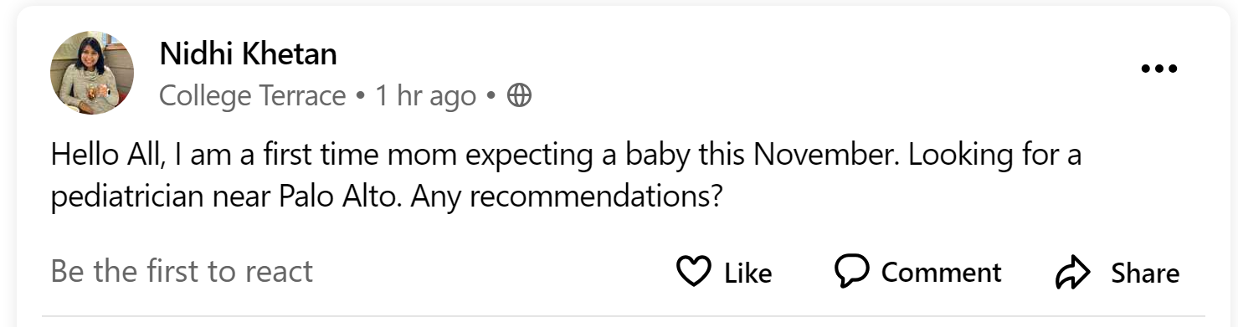
Nextdoor - Direct Competitor
Features:
Creates an online platform for building communities with neighbors
Lets you connect to people you already know by sharing contacts with other accounts, your phone, send automated invites, etc
UI is very intuitive, similar to other social media apps like Facebook
Handles moderation with nudges and ability to report posts
How we’re unique:
Focus on families specifically, not just all neighbors
Have more specific resources/groups for things like searching for a professional pediatrician, rather than in general chat

Slide 6
Social.mom
Cons
Pros
Combination of social media & expert advise videos
Users authenticated
Customizable distance and child age
Telemedicine services with answers from doctors 24/7
Questions answers platform among parents
Cute graphic & pink visuals targeting audience
Telemedicine fee starting aat $30/mo
Our app additionally has community event gathering posts
Unlike Social.mom, our age group isn’t as broad and caters to parent of infants up to age 6
Our app is inclusive of parents of all genders, unlike Social.mom

Slide 7
Wunder by Understood
Wunder is a free community app for parents of kids with learning and thinking differences, like ADHD and dyslexia
What works:
Wide range of topics and expert-approved advice in content library and resources tab
Ability to personalize app based on background and interests
Ability to connect with experts in the app
What could be improved:
Parent community can be intimidating and some are not very interactive ie there are several posts but few conversational threads
Wunder places you in private groups based on your selected interests which limits your experience
What makes Kith&Kin unique and implications:
Narrower target audience: parents of children aged 0 - 6 years.
Ability to private message other users to foster one-on-one interactions
Takeaway: include community moderators and expert-verified informational pages

Slide 8
Peanut-App.IO
What works:
The app offers a variety of support groups for moms with different topics ranging from diets, nutritions, health, sports, to sleep.
Diverse community with a lot of moms from different backgrounds.
Lots of message boards with lots of definitive guides for moms on FAQs.
What doesn’t work:
Identity and safety checks are a concern, as many have reported that males catfishing as women to meet mothers on the app. No way to verify identity
Meetups tend to be for moms who want to playdate for their kids. For mothers whose kids have special needs, it’s really difficult.
A lot of unrelated contents: sexy selfies, online sellers trying to find an audience, propaganda.
What we can take away:
Identity and safety checks are really important and needs to be enforced
Filters should help to match moms with similar interests, backgrounds to help with compatibility
Work on interface and navigation to ensure moms are aware of what resources are available to them without being lost in the app.

Slide 9
02
Values in Design
Simple Leaves

Slide 10
Stakeholders
Parents: main users of the app who are meeting with strangers and interacting with questions and milestone celebrations
Direct
Children: the experiences and advices shared on the app will influence the children’s health and wellbeing
Educators/ childcare workers: they spend most time with children and their responsibility of giving childcare advices would be reduced with the app providing spaces for parents to ask questions and connect
Indirect

Slide 11
Ethical Implications
The Scandal: Worry about safety; “Man met on community app kills mother of 3”
Our app would need to have security measures to screen users, create a sense of trust, and protect the privacy of users. We would also include guidelines for safety in our user norms, the option to report users, and community moderators.
The Siren: becoming an influencer platform, becoming toxic/parents comparing themselves
Our community guidelines could include a walkthrough on empathy and supporting peers. We would also have the option of only sharing posts within private groups where members are mutual friends.

Slide 12
03
Tasks
Simple Leaves

Slide 13
Simple
Moderate
Complex
Schedule a meetup with a parent (swipe left/right) + filtering community (languages)
Private messaging (connecting with schedule meetup)
Parents RSVP to a local event or one-on-one
Search for profile and add parents to your neighborhood
On community board, ask a question on a message board
Creating specific smaller community group (“moms who cook”)
Filter parents based on interests and backgrounds
Schedule and joining video calls
Share a recent parenting win with your friends (“villagers”), respond and interact with others
Blocking a harmful member / able to moderate / reporting contents
Able to set a max number of contacts you make (hid profile once they have met certain number of people, feature to set your interest in meeting up

Slide 14
04
Storyboards
Simple Leaves

Slide 15
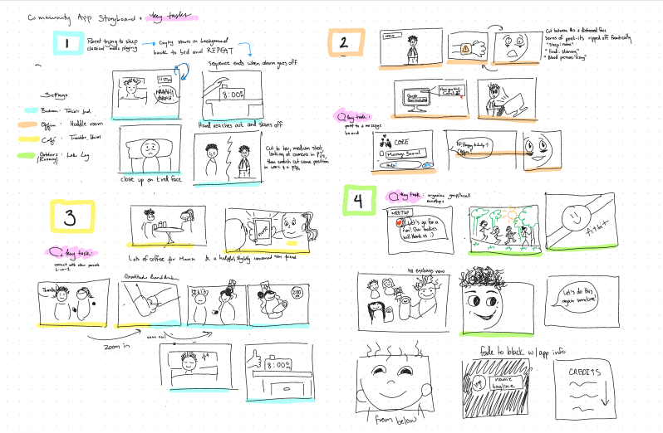


Storyboard

Slide 16
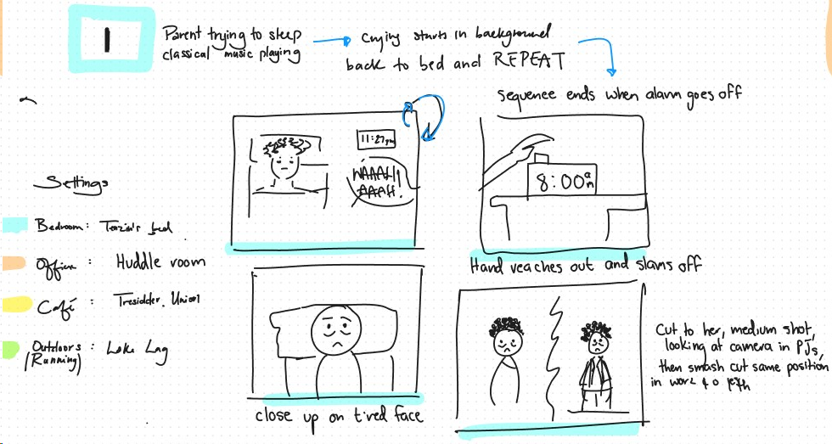
Storyboard

Slide 17
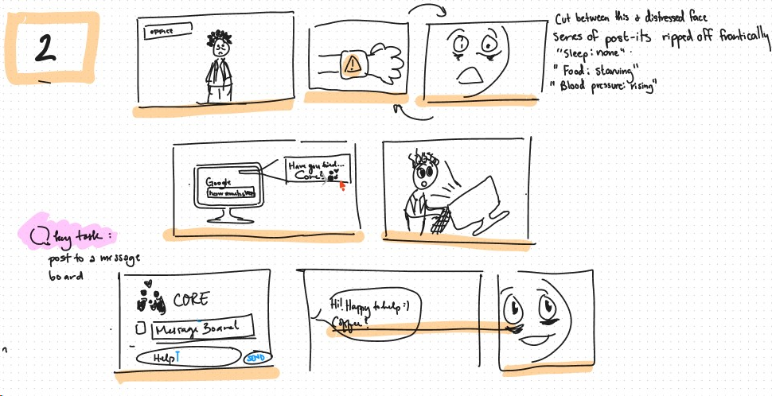
Storyboard

Slide 18
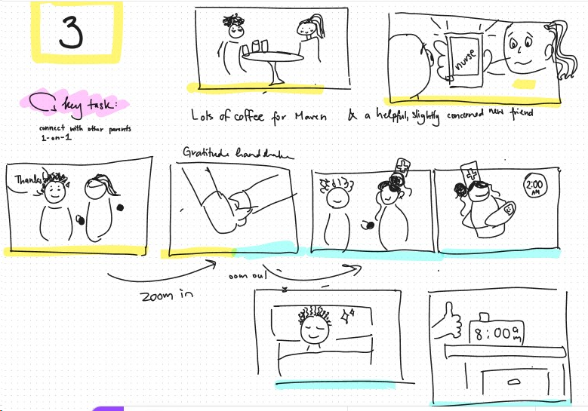
Storyboard

Slide 19
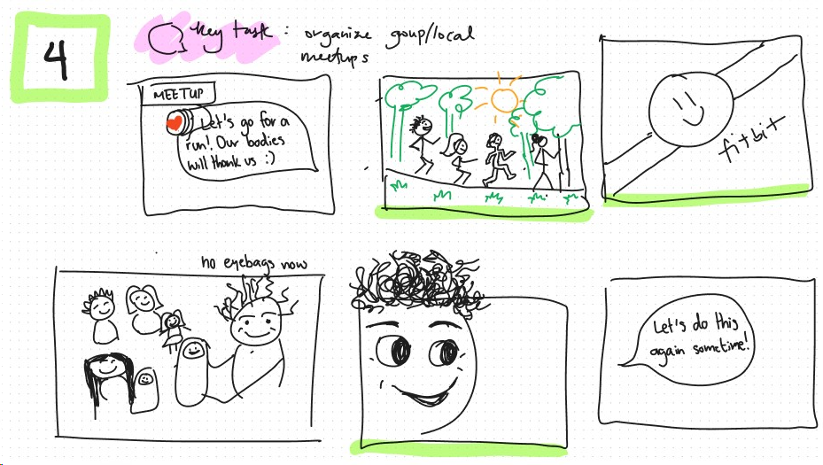
Storyboard

Slide 20

Storyboard

Slide 21
05
Concept Video
2022
Simple Leaves

Slide 22
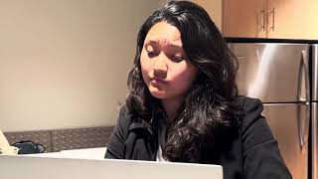
https://youtu.be/GPwThWVgZmw

Slide 23
06
Appendix
Simple Leaves

Slide 24
More Similar Apps
Sober Mom Squad:
  A place for moms who are sober or who are just dipping their toes in exploring an alcohol free lifestyle, and everything in between
  Resource libraries for moms who are trying to stay free of alcohol
  Sober Mom Sis (Support in Sobriety)
  Community support for mothers who have alcohol addiction

Slide 25
