Slide 1
POVs, HMWs, & Experience Prototypes
Team #1

Slide 2

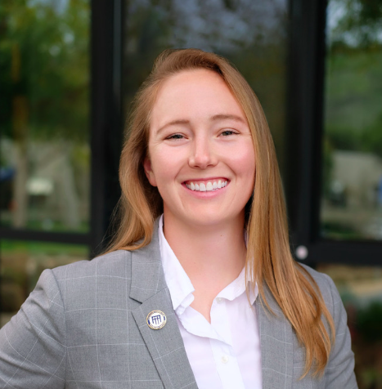
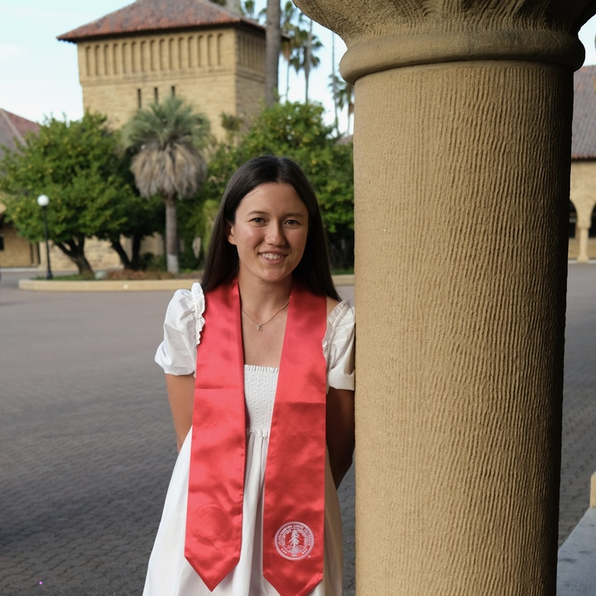
Our team
Fahad
Nabi
Lyndsea Warkenthien
Elysia
Smyers

Slide 3
01
Needfinding

Slide 4
Individuals enduring a transition in life
Individuals enduring a negative transition in life
Our original focus:
Now focusing on…
…to address gaps in our previous interview batch.

Slide 5
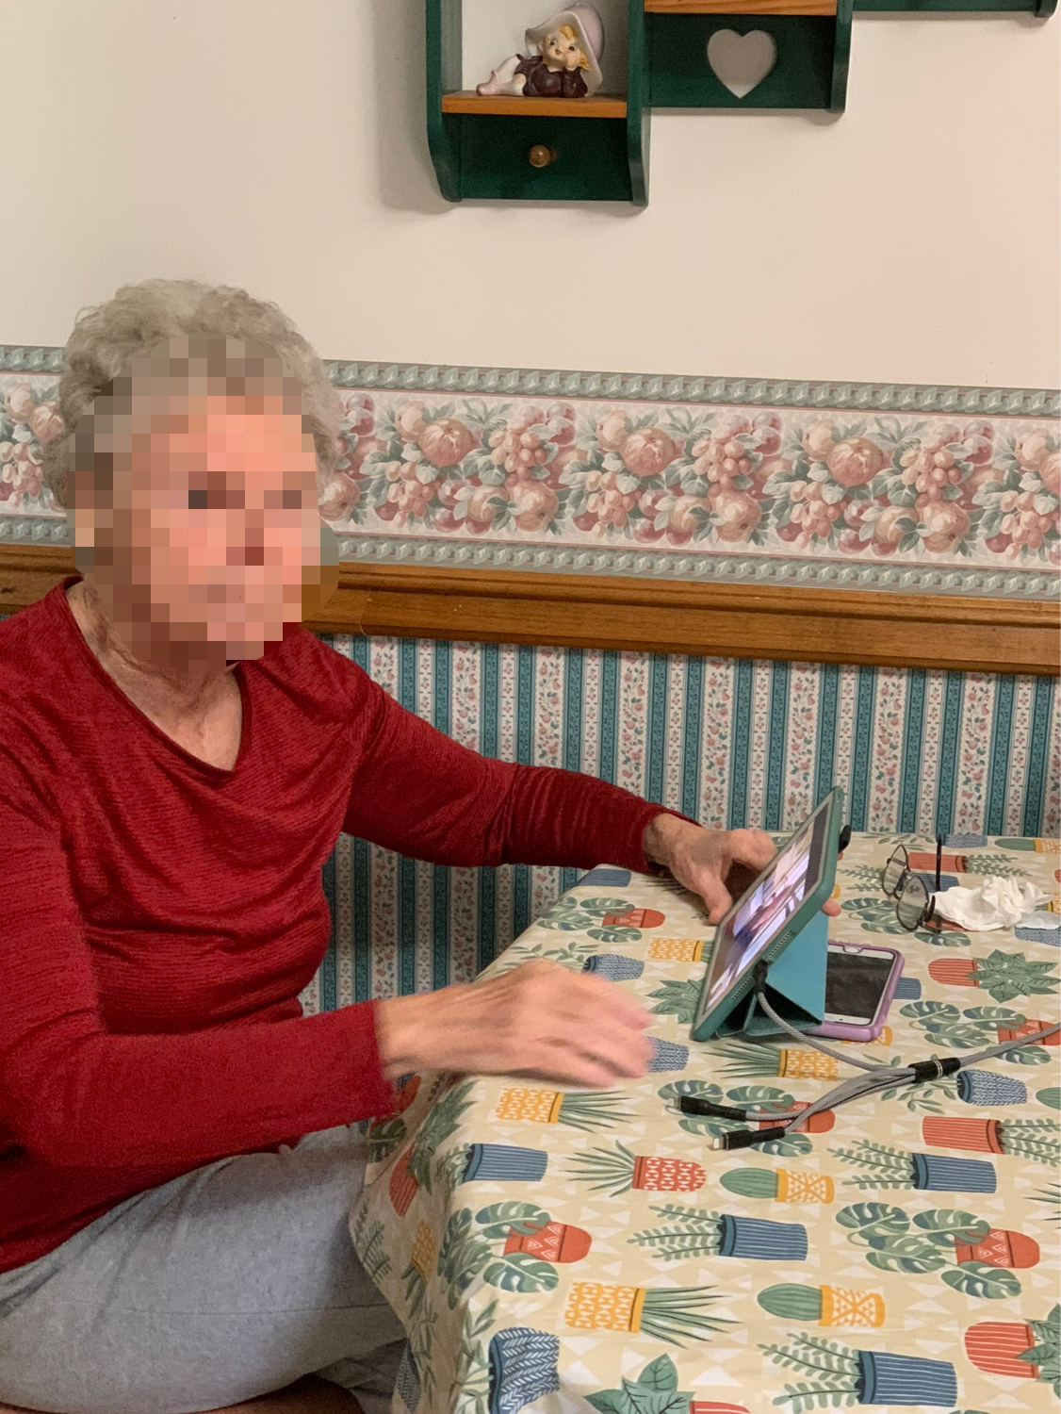
Carla
An 83 year old, experiencing a hardship transition following the passing of her husband of 40 yrs:
Finds that her mood is continuously in flux: her mood affects her desire to engage in both physical and mental activities
Her motivation increases when the physical activity is a game! She has been playing 18 holes of Golf weekly for over 70 years
Expresses gratitude for her social circle and family in helping her through this transition
Motivation does not originate from a single source

Slide 6
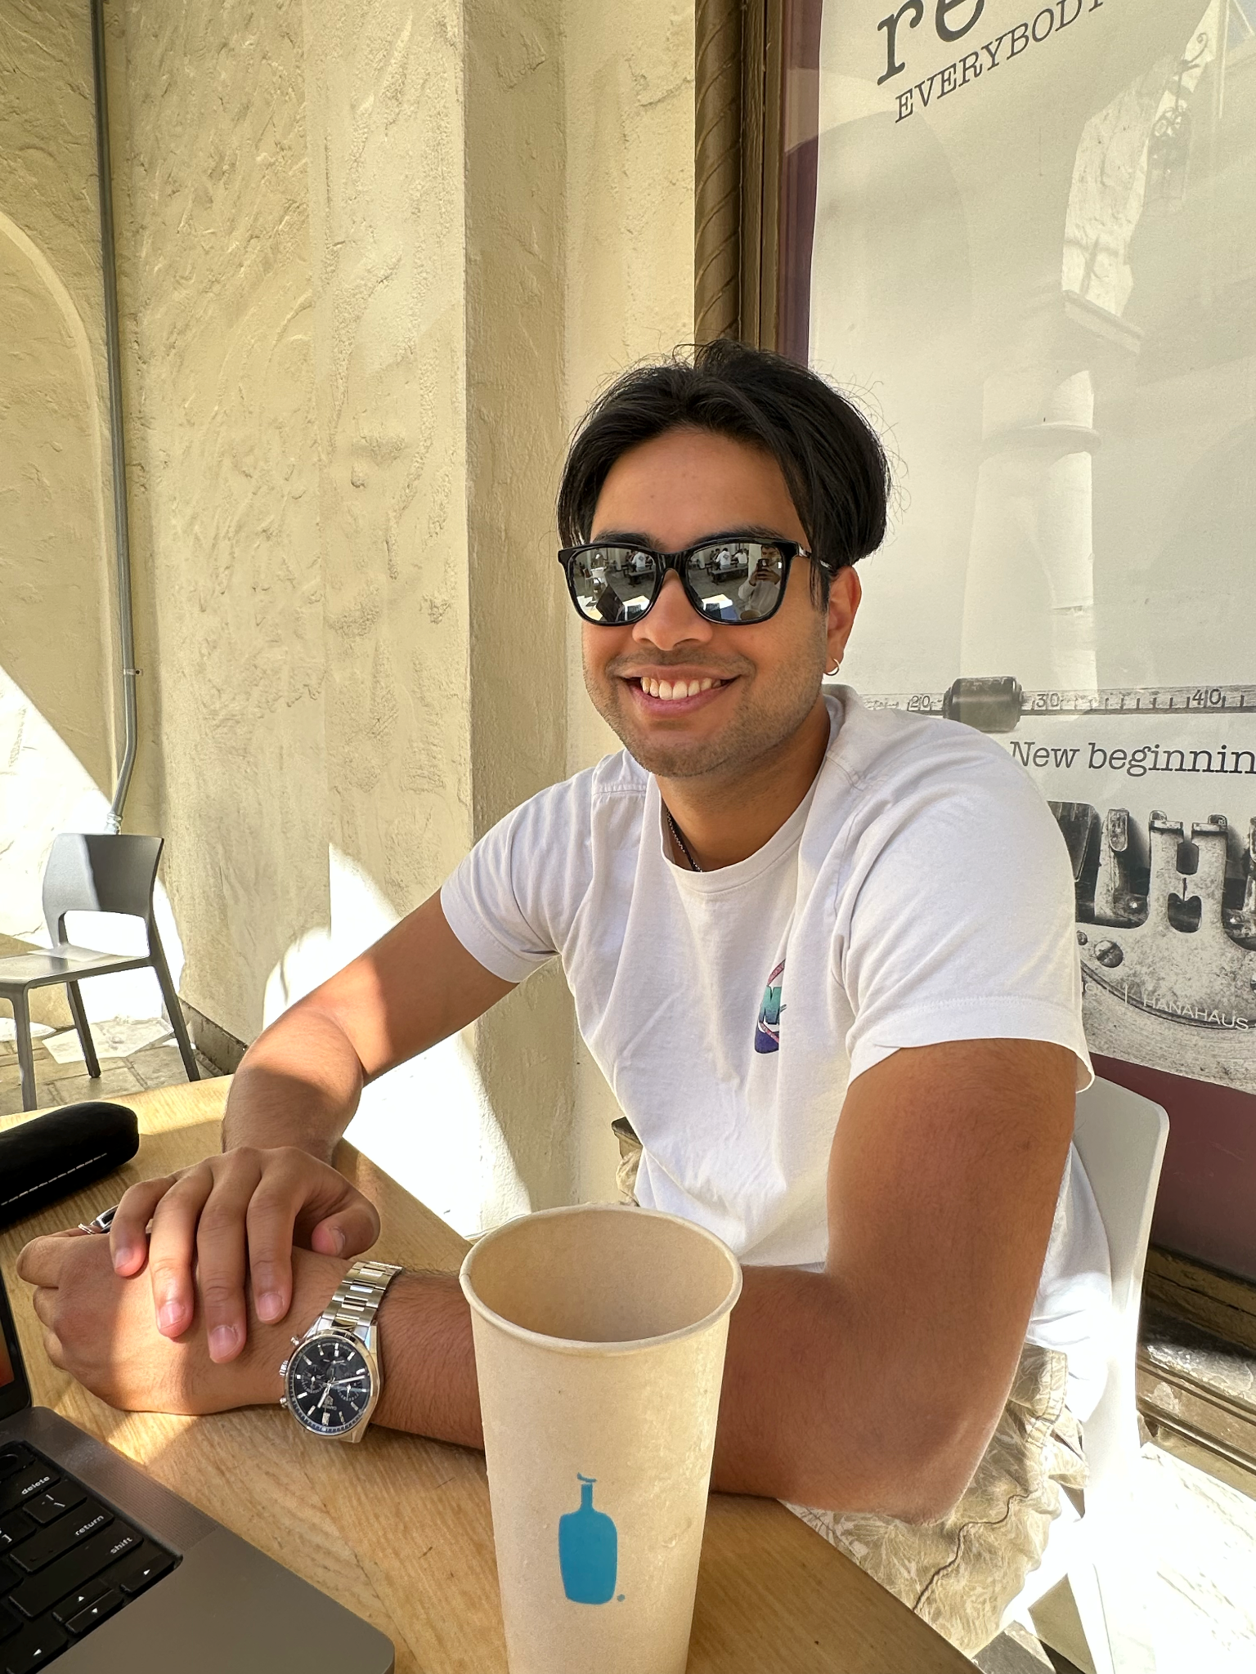
Kiran
A recent Stanford graduate who is currently in a transition between Undergraduate and medical school. He is taking time off to apply to medical schools.
Achilles injury in college shifted Kiran's perspective -> now focuses on staying healthy and having fun rather than being competitive
Started playing adult soccer through word-of-mouth connections
Kiran felt he needed more supportive resources especially for his mental health during recovery
People have social motivations for working out just as much as physical motivations

Slide 7
Social and enjoyment emphasis of an active lifestyle is especially important for those enduring a difficult transition, as it can help individuals feel connected with others as a support system.

Slide 8
02
POVs

Slide 9
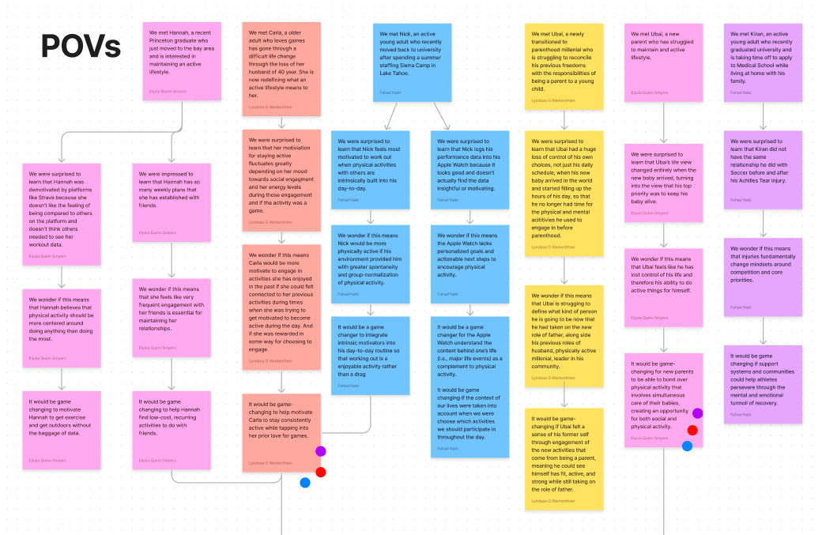

Slide 10
Carla’s POV
We met Carla, a older adult who loves games and has gone through a difficult life change through the loss of her husband of 40 years. She is now redefining what an active lifestyle means to her.
We were surprised to learn that her motivation for staying active fluctuates greatly depending on her mood, but feels more energized for activities that include games.
We wonder if this means Carla would be more motivated to engage in activities that she used to love if she could be externally rewarded in some way by engaging.
It would be game-changing to help motivate Carla to stay consistently active by tapping into her prior love for games.

Slide 11
Ubai’s POV
We met Ubai, a new parent who has struggled to maintain an active lifestyle.
We were surprised to learn that Ubai’s life view changed entirely when the new baby arrived, turning into the view that his top priority was to keep his baby alive.
We wonder if this means that Ubai feels like he has lost control of his life and therefore his ability to do active things for himself.
It would be game-changing for new parents to be able to bond over physical activity that involves simultaneous care of their babies, creating an opportunity for both social and physical activity.

Slide 12
03
HMWs

Slide 13
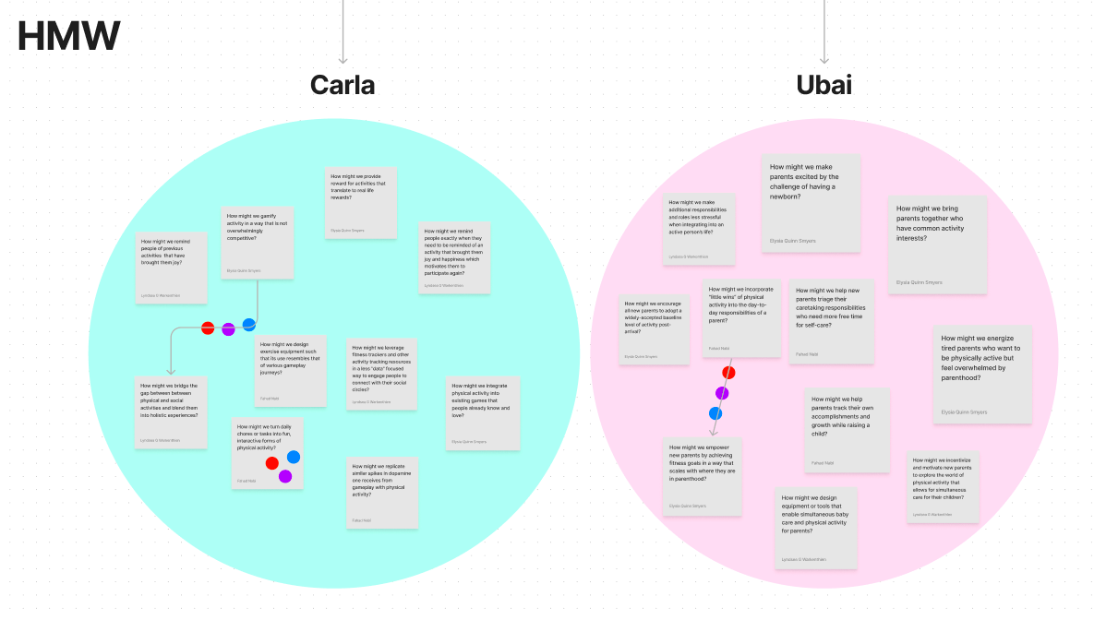
Notes:
See slide for 10+ HMWs

Slide 14
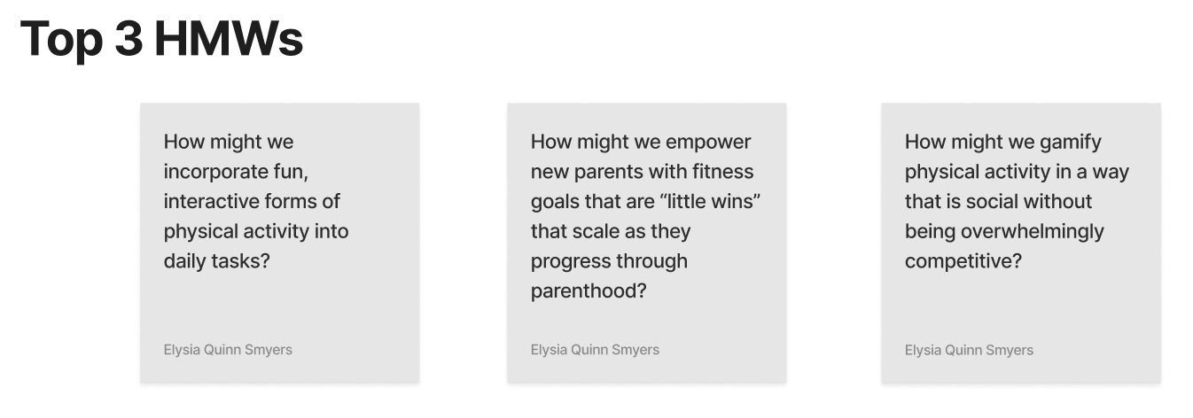

Slide 15
04
Solutions

Slide 16
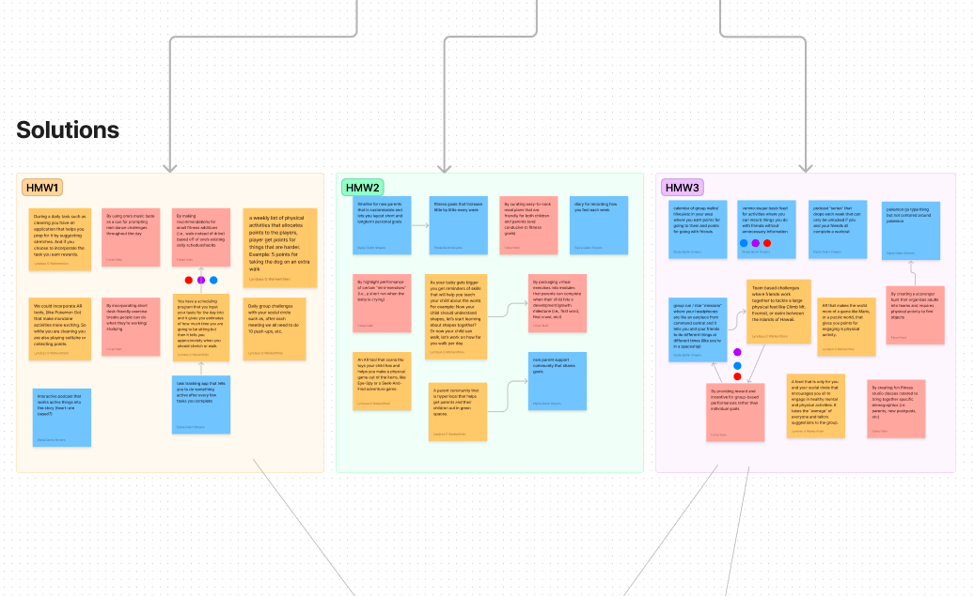

Slide 17
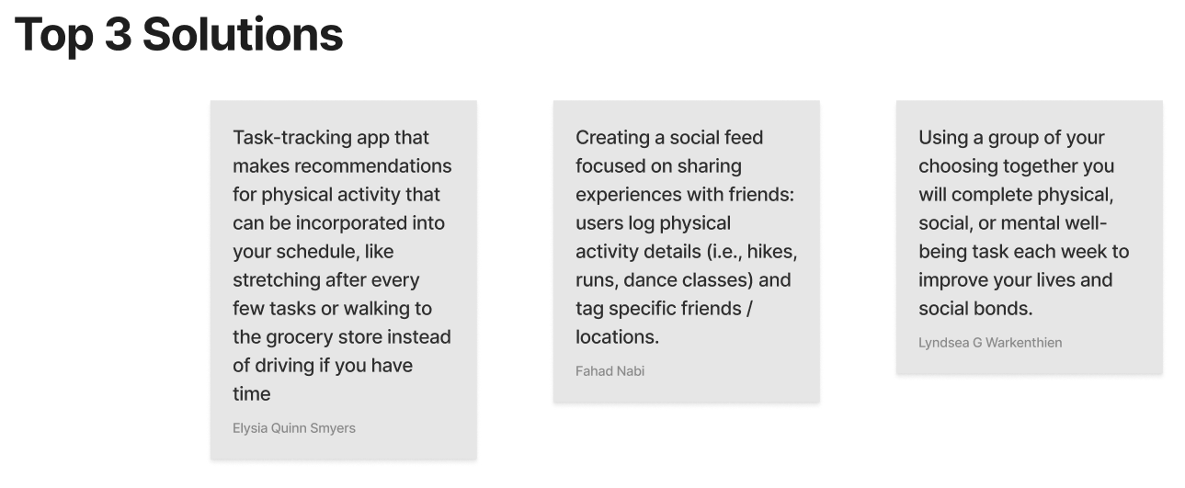

Slide 18
05
Prototypes

Slide 19
Experience Prototype #1
Task-tracking app that makes recommendations for physical activity that can be incorporated into your schedule, like stretching after every few tasks or walking to the grocery store instead of driving if you have time

Slide 20
Assumption to test:
People will integrate recommendations of physical activity into their schedule from an application where they must import their current schedule

Slide 21
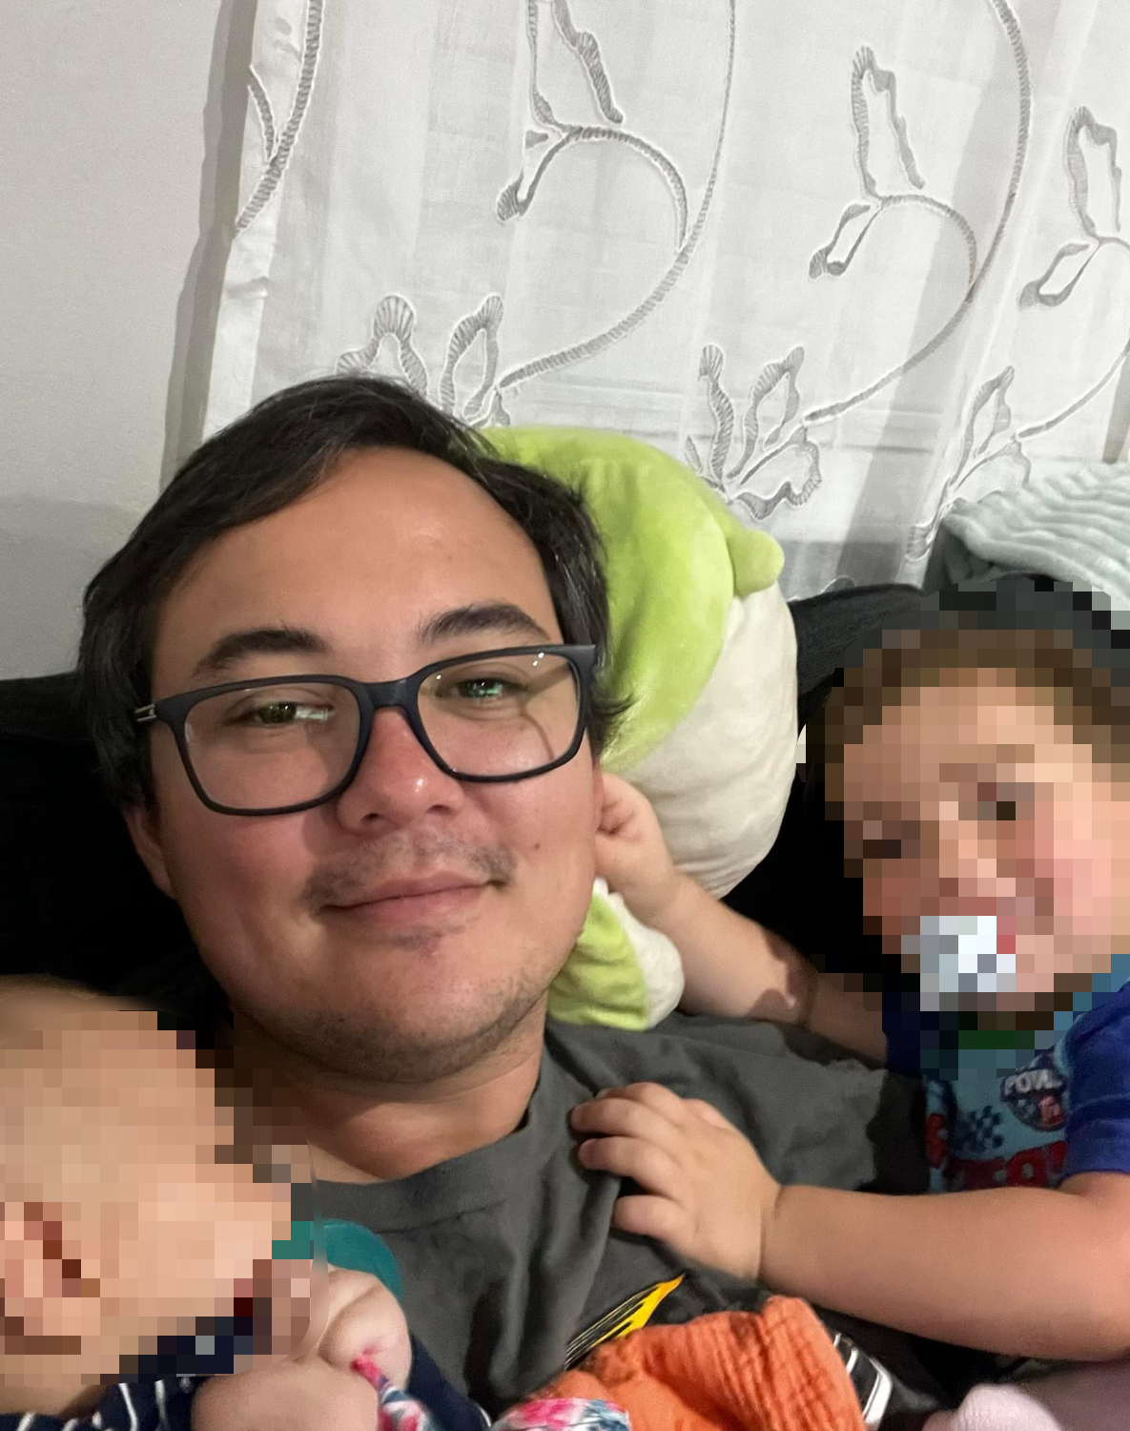
Prototype #1
The subject: Adam
New parent
Has a job with organized schedule

Slide 22
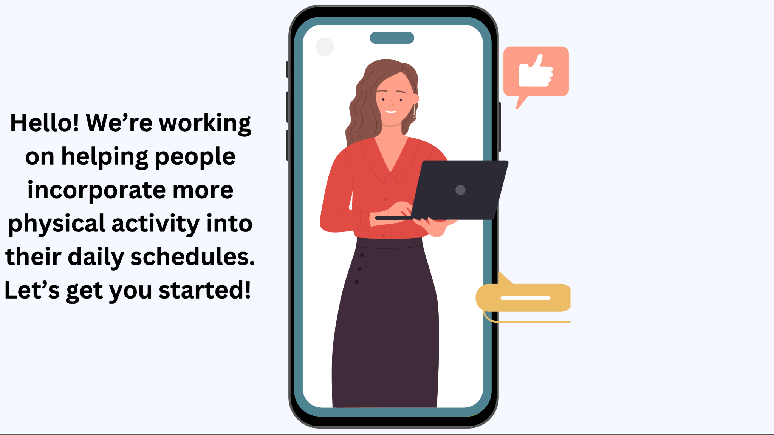
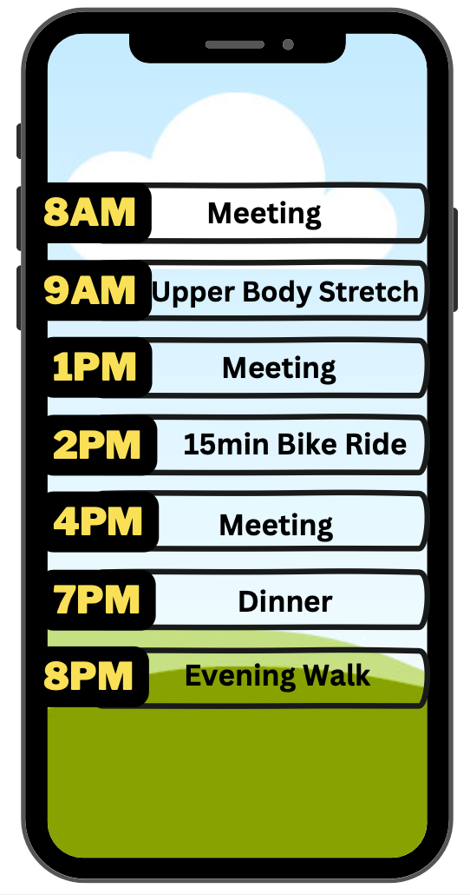
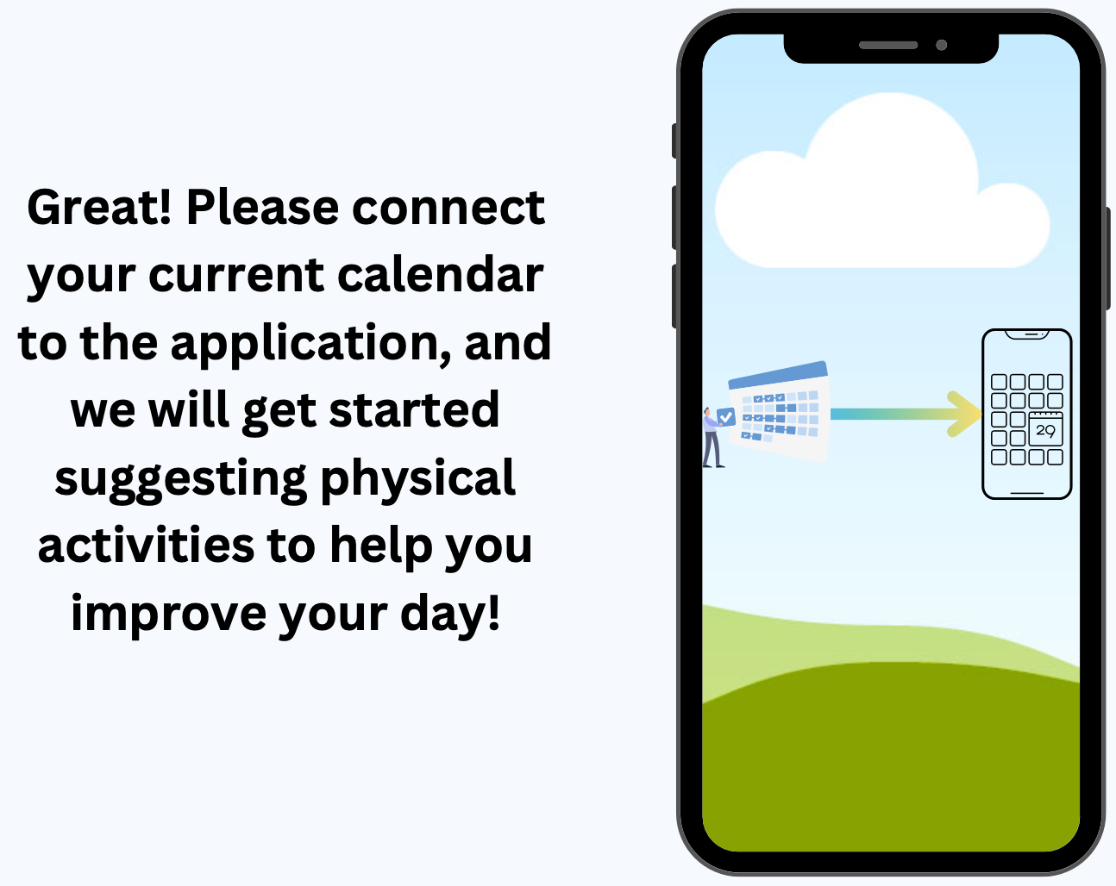

Slide 23
Prototype #1 Results
The result: No-go
Reminders to do simple things like stretching or walking around could be useful
Importing schedule is easy if straightforward, but complications might arise with secure calendars
“Breaks” will vary in ability to actually take a break
More logical solution could be to schedule blocks in your calendar during the day, for which an extra app would be overhead
Quote:
“While I think the application could be helpful it doesn’t allow me to input all the other responsibilities I have into the application. I have a lot I need to do I don’t put on a digital calendar.”

Slide 24
Experience Prototype #2
Creating a social feed focused on sharing experiences with friends: users log physical activity details (i.e., hikes, runs, dance classes) and tag friends / locations.

Slide 25
Assumption to test:
There is motivation or incentive to share physical activities with friends on a recurring basis.

Slide 26

Prototype #2
The subject: Emily
An active postgraduate student that lives in San Jose and is currently looking for job opportunities
Active now more than ever on social media so she can connect with friends that are now far away

Slide 27
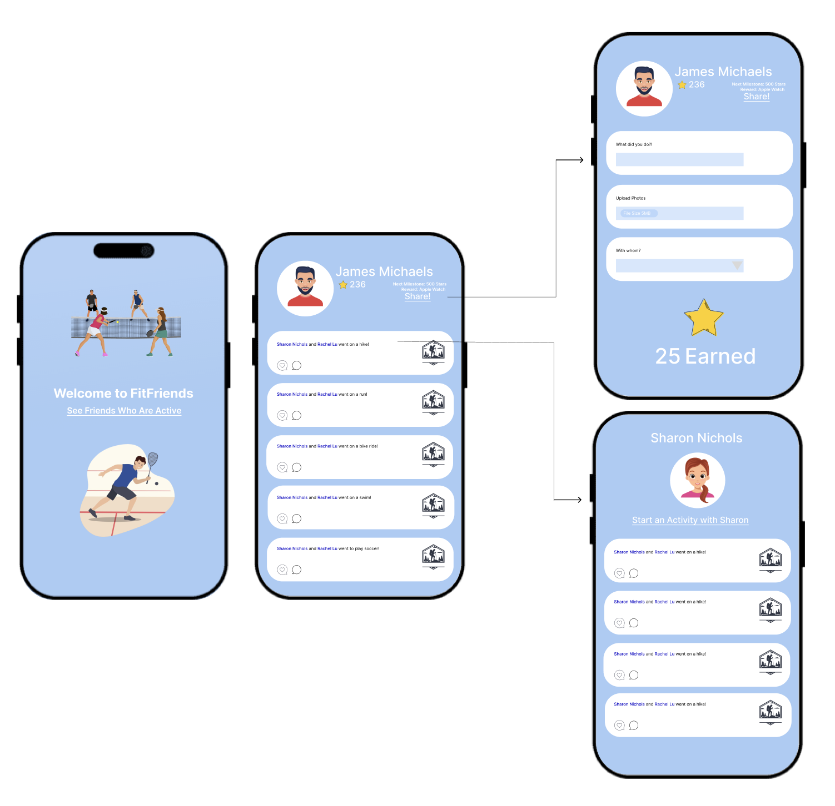
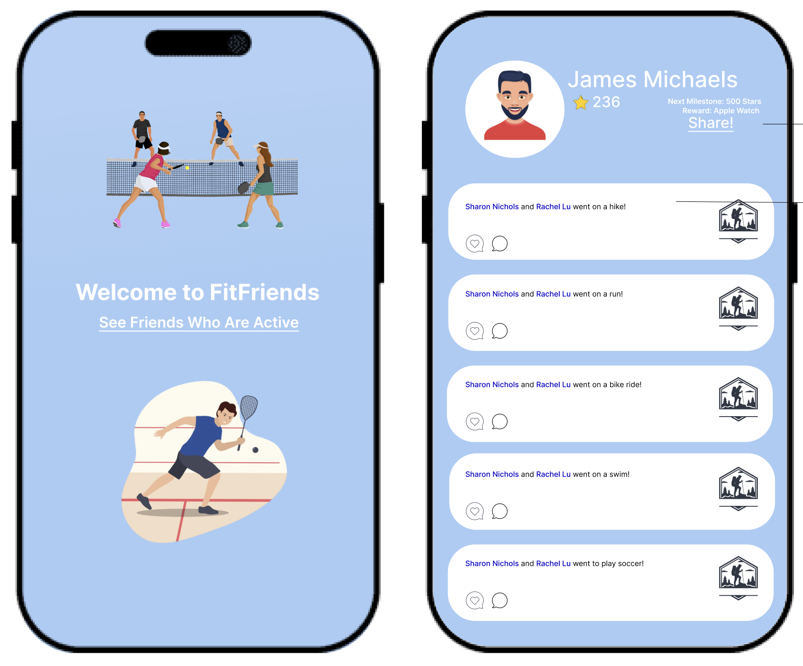

Slide 28
Prototype #2 Results
The result: Go
Positive feedback loop of social accountability: Emily is motivated to work out and share activities when she sees friends doing so
Emily would be most inclined to share if close friends were engaged on the platform
Quotes:
“If others are active, I’d love to be active and would instantaneously share what I was up to whether alone or with friends.”
Close friends: “since Sharon is now far away and we don’t live together anymore, I’d love to do activities we used to do together either alone or with other friends, and that help strengthen our own relationships.”

Slide 29
Experience Prototype #3
Using a group of your choosing together you will complete physical, social, or mental well-being tasks each week to improve your lives and social bonds.

Slide 30
Assumption to test:
Group fitness incentives are motivating and enjoyable for groups of friends.

Slide 31
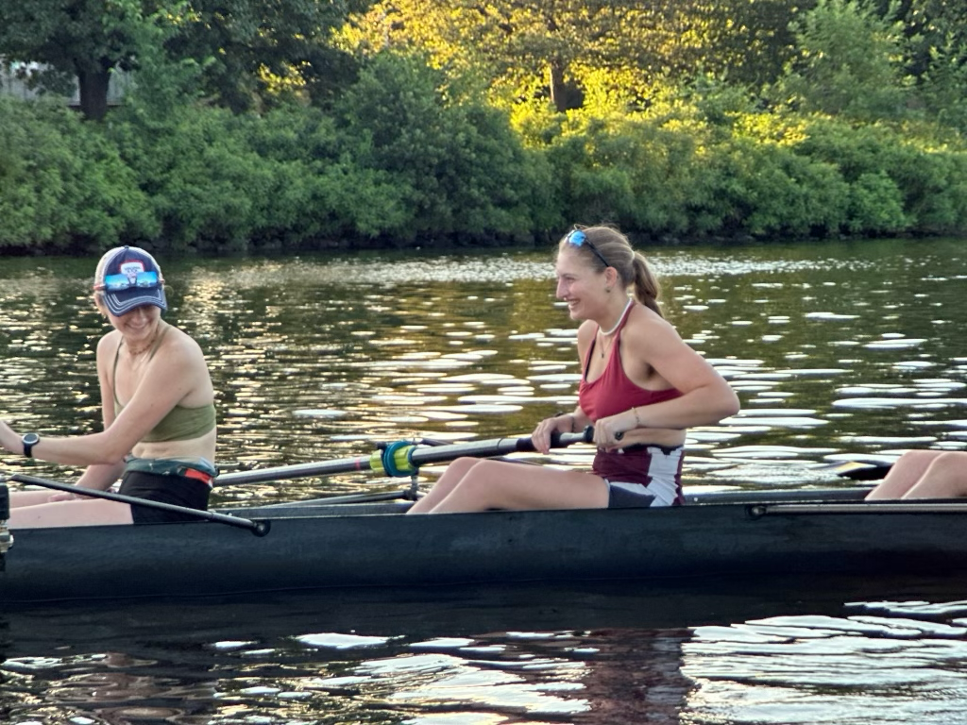
Prototype #3
The subject: Eva
A postgraduate student who was a D1 rower while at Stanford
Currently working and training for a regatta
Very competitive
Has maintained an active lifestyle and will continue to need an active lifestyle after the regatta passes

Slide 32
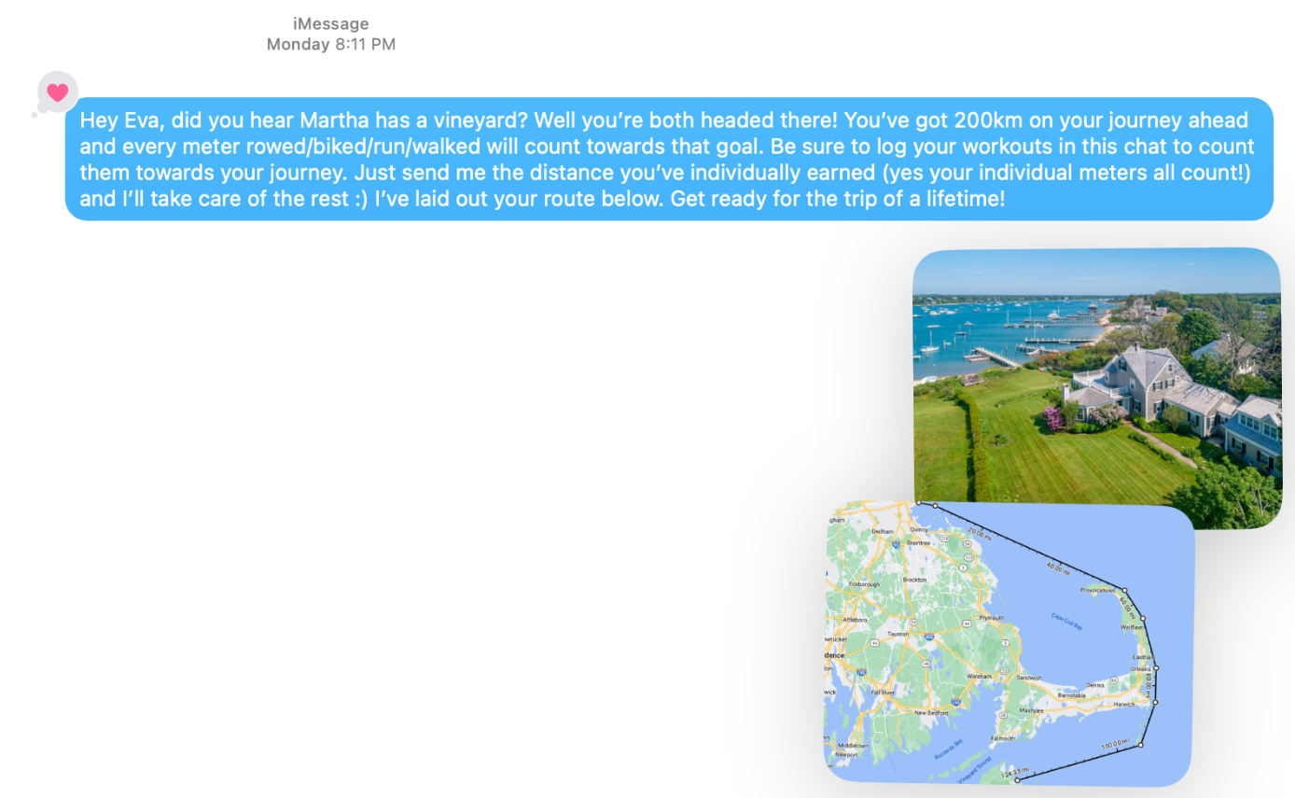

Slide 33
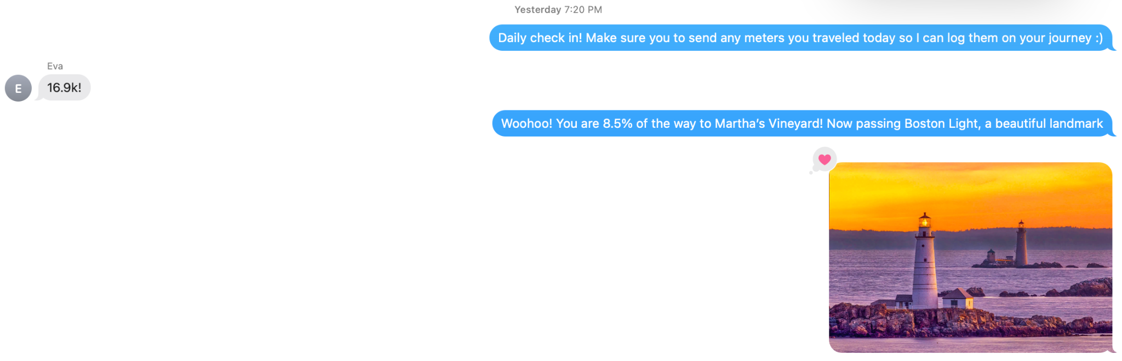

Slide 34
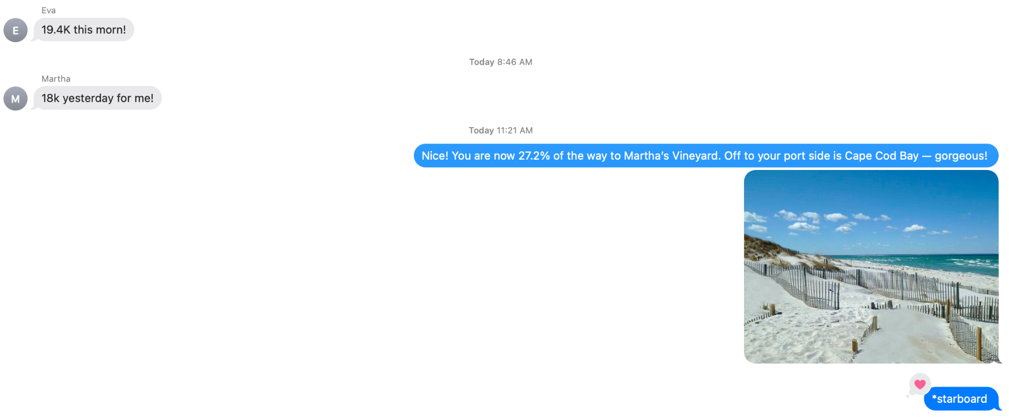

Slide 35
Prototype #3 Results
The result: Go
Thought it was fun, liked the picture updates
Finds the concept of a group goal motivating, maybe even more so if the emphasis was on minutes
Quotes:
“Like if I had 5k remaining to Martha’s Vineyard, I would definitely just get up and go for a run”
“My teammates are my inspiration”
Other Feedback:
Make it easier to interpret quickly: short messaging, quick button responses
Properly scope distance goals: not reaching the goal was demotivating
Make messaging clear that it’s a group goal

Slide 36
06
What’s Next?

Slide 37
Our Solution
Merging the activity feed and group goals prototypes
Focus on close ties / groups of friends
Group fitness goals for which you can customize your goal based on time frame
Keep presented information simple: just distance or time
Regular updates on your progress
Easy ways to give encouragement to friends
Audience:
Adults who want to be active and aren’t working towards other fitness goals
Adults looking to stay connected with friends near and far

Slide 38
Ethical Considerations
Demotivating individuals with disabilities who can’t travel distances as easily
Leaving out individuals with few interpersonal connections
Privacy concerns
  Ensure that users are aware of the data that will be collected from them and how it will be used.
  Allow users to give informed consent before sharing their activity data with the group.
  Implement robust data encryption and protection measures to ensure data security.
Some individuals might feel anxious or overwhelmed with regular updates, especially if they are not able to meet their goals. Ensure there are settings to adjust the frequency of notifications or updates.
Encourage breaks or resting periods, highlighting that rest is an important part of physical health.

Slide 39
Thank you!

Slide 40
Appendix

