Slide 1

Concept Video Creation & Development
Team #1
Lyndsea, Fahad, and Elysia

Slide 2



Our team
Fahad
Nabi
Lyndsea Warkenthien
Elysia
Smyers

Slide 3
01
Solution Concept

Slide 4
Our platform is a community-focused platform designed for individuals undergoing lifestyle transitions. We prioritize physical and mental wellness by encouraging group-goal accomplishments, uniting people in their shared journey towards better well-being.
What is Enosi?
Our Mission Statement: A collective pursuit of well-being.
The Birth of Our Name: Derived from the Greek word, Enosis, which refers to the movement of communities that formed the modern political and social union of Greece

Slide 5
02
Market Research

Slide 6
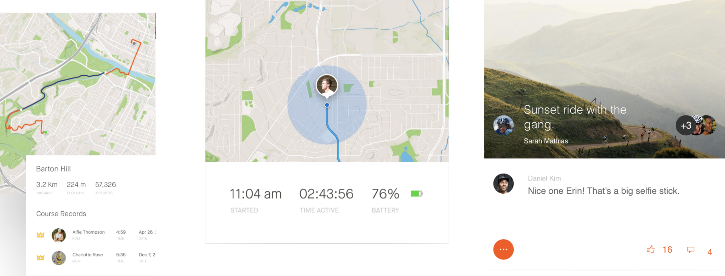
Strava

Slide 7
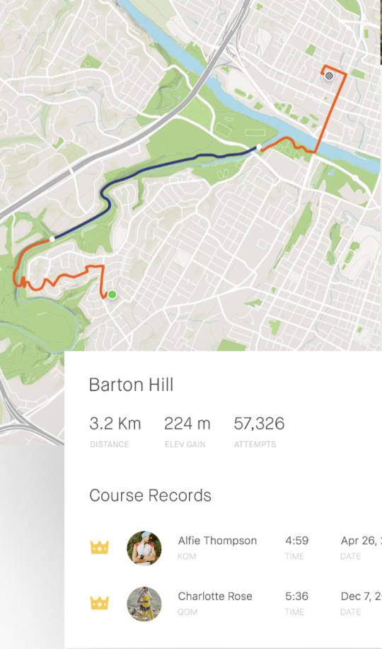
Strava
Mission Statement
To build the most engaged community of athletes in the world. Every day, we're searching for new ways to inspire athletes and make the sports they love even more fun.
Mobile and Desktop Application
Quantitative tracking of workouts and goals
Includes a social feed where users can like and comment, promoting community and social motivation around fitness goals
What Works In Our Problem Space?
Lack of shared activities between groups of people, as the focus is on individualized tracking and habits
Niche focus on runners, athletes, and fitness enthusiasts, but doesn’t address user group of individuals undergoing transitions
Med-High Barrier to Entry - Complex Fitness Measurements/Metrics
What Doesn’t Work?
How We Differentiate
We provide people undergoing similar lifestyle transitions, with a space for motivation, support and accountability from others as they work towards shared goals together. Strava lacks this form of social connection, as it is highly individualized.

Slide 8
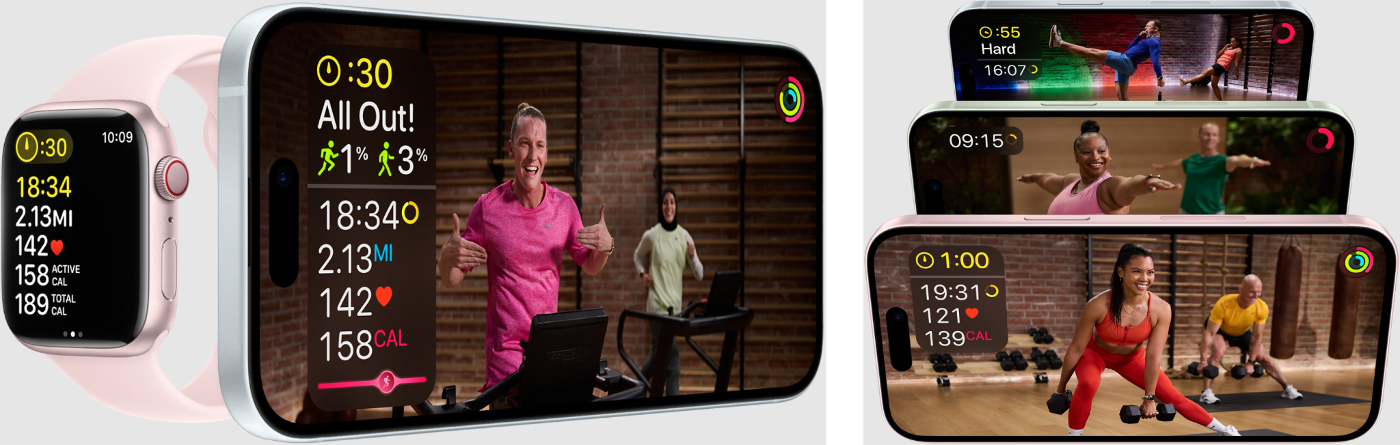
Apple Fitness+

Slide 9
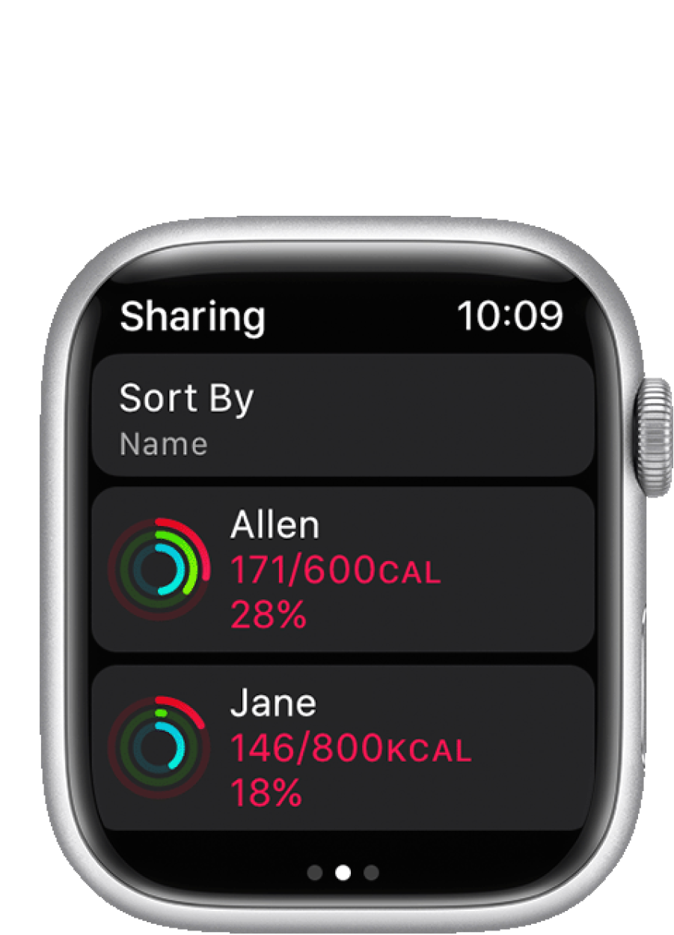
Apple Fitness+
Mission Statement
Fitness for everyone. Every way you want.
Integrates in the Fitness app on iPhone, IPad, Apple TV/Watch
Comprehensive offering of workout types for all levels of fitness
Personalization using real-time metrics for custom fitness plans
Can share fitness progress with other members, and challenge others to friendly competitions
What Works In Our Problem Space?
Sharing fitness goals or participating in a shared competitions requires all parties to have a Apple Watch -> High Barrier to Entry
Fitness+ is free for 3 months, then $80 annually. Limits accessibility.
Absence of social connection amongst groups of people who choose to take the same class or activity
What Doesn’t Work?
How We Differentiate
We provide a platform with a lower cost, access to anyone with a smartphone or laptop, and provide users with the ability to build a support system tailored to their life experiences.

Slide 10
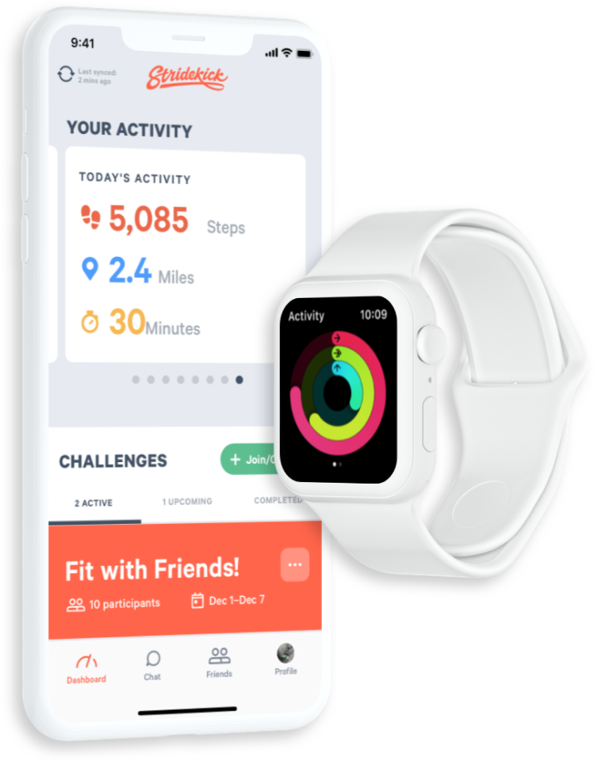
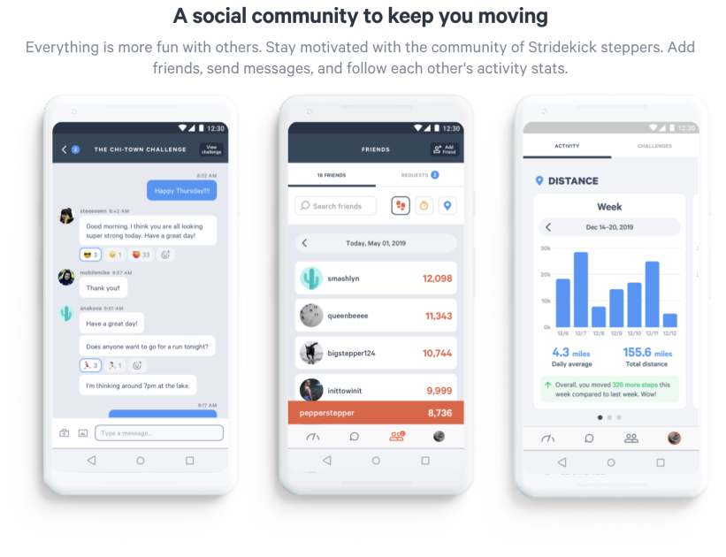
Stride Kick

Slide 11
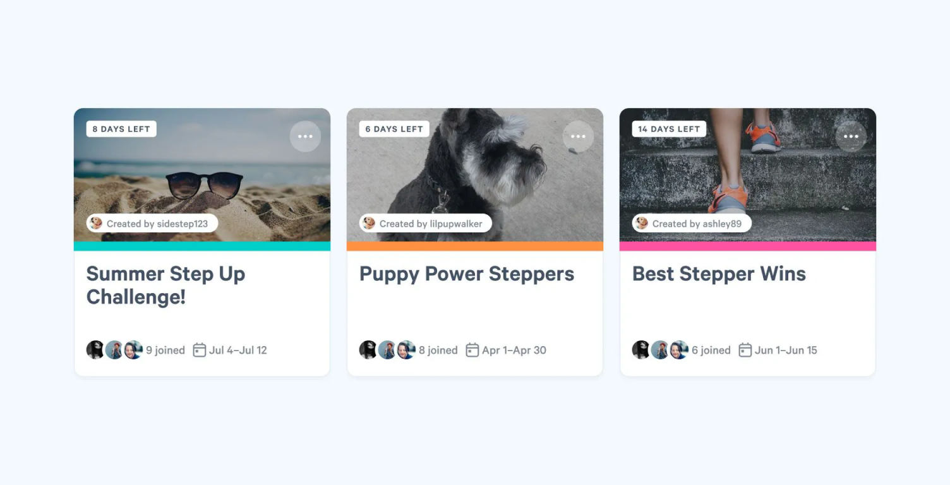
StrideKick
Mission Statement
Connect a fitness tracker and compete in free step challenges on StrideKick.
Ability to create customized challenges, with options to invite people
Distinct challenge modes: Leaderboard, Streak, and Target
Team-based challenges focused on achieving a shared goal like total miles walked, or total minutes meditated along w/prizes
What Works In Our Problem Space?
Risk of demotivation with the emphasis on leaderboards and prizes
Limited community-building, communication, and bonding activities beyond fitness challenges
Lack of personalization of one’s personal circumstances or lifestyle
What Doesn’t Work?
How We Differentiate
We provide a holistic, inclusive social platform that incorporates life transition education, mixed group social interactions, and features to promote relationship-building beyond challenges for continuous motivation.

Slide 12



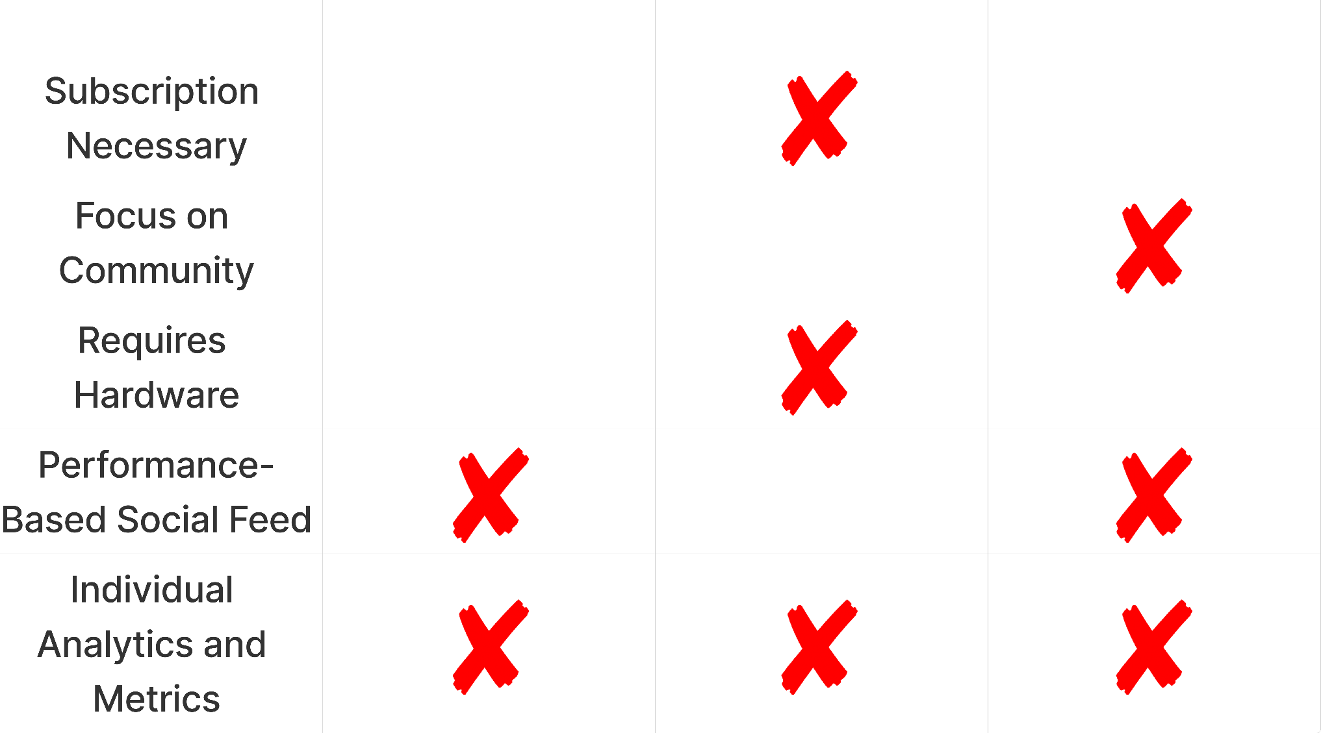
Competitive Analysis

Slide 13
02
Ethics and Design Values

Slide 14
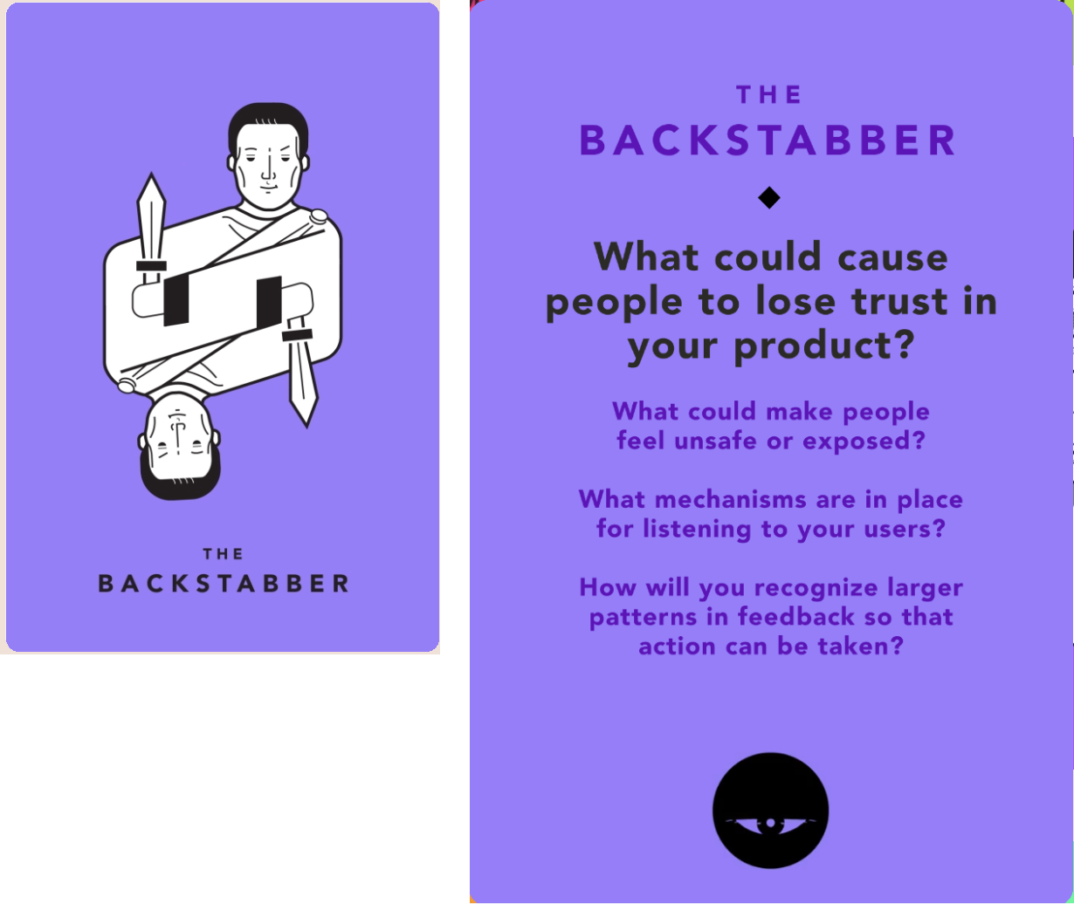
Ethics
Key Actions We Will Take:
Ensure that users are aware of the data that will be collected from them and how it will be used.
Allow users to give informed consent before sharing their activity data with the group.
Implement robust data encryption and protection measures to ensure data security.
Ensure there are settings to adjust the frequency of notifications or updates.
Opt-in for data sharing, analyzing data, using data for algorithmic improvement
Explain and give pop-ups when users are going into areas that are going to share their data/location, such at activity mapping/tracking, example: remind users at a frequency rate of every 3 weeks that we are tracking their locations while logged into the app

Slide 15
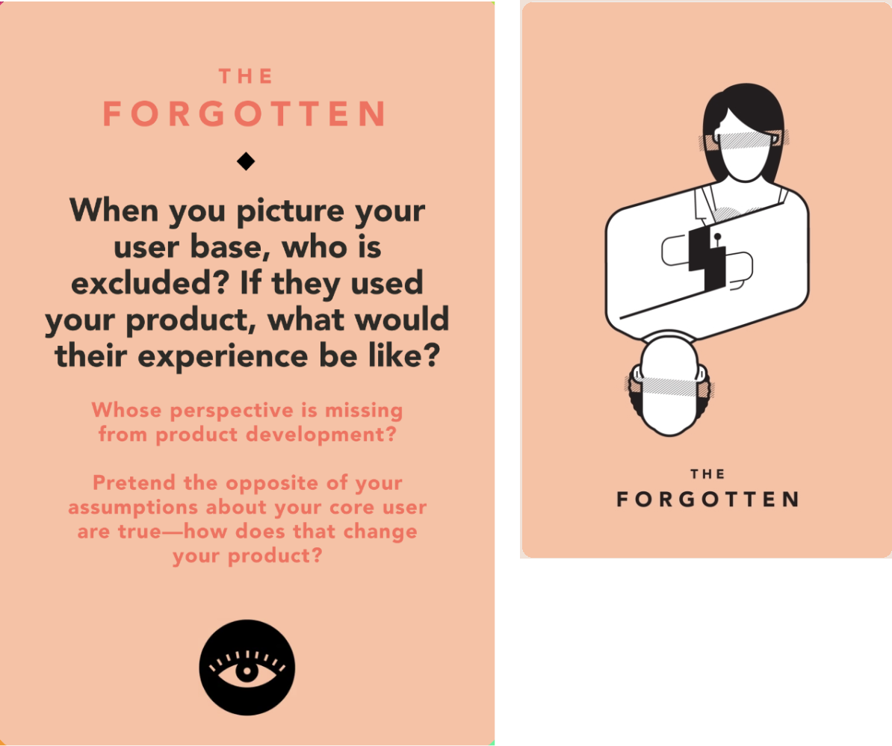
Ethics
Key Actions We Will Take:
Account for individuals who are newly accessing activity trackers and set appropriate physical goals
Warn users they they should consult with their doctors before engaging in recommended physical goals
Conduct a quarterly audit of social, racial, and socioeconomic impacts that our application may have; how can we mitigate biases humans have in the real world, for when they build communities online?
Outreach to active individuals who passively consume social media, but are wary to actively share their own individual performance or activities with others
Empower users who don’t have a large circle of interpersonal connections, via providing them with tools to discover new users and people

Slide 16
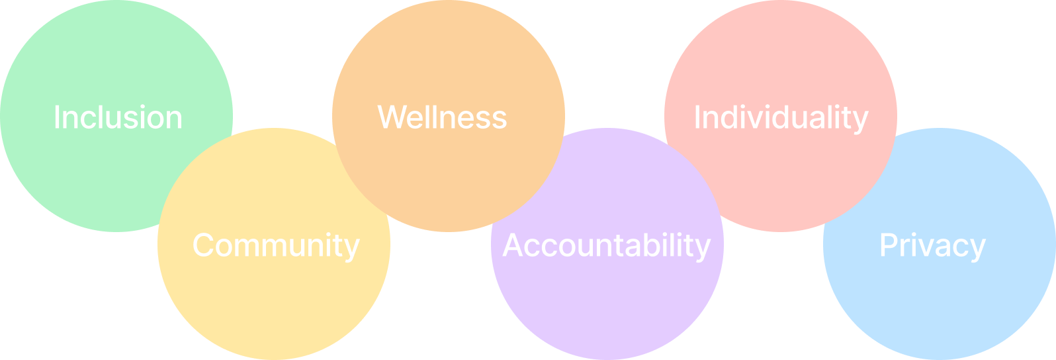
Design Values

Slide 17
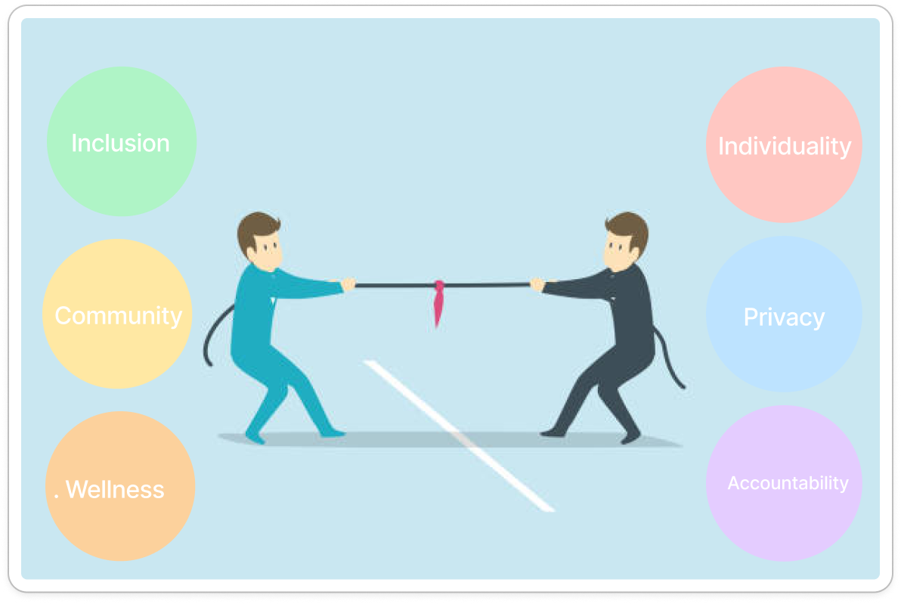
Balancing Tensions
Finding the right balance between design values will require extreme user testing, ongoing user feedback, and evaluating tradeoffs with our MVP.
Inclusivity vs. Individuality: While building an inclusive community, specific individual preferences may not be represented in the whole product offering.
Community vs. Privacy: Building community requires one to put themselves out there, and share individual life experiences which may be private for some.
Wellness vs. Accountability: Strict accountability may have adverse effects on one’s own physical and mental wellness if they aren’t aware of their limitations.

Slide 18
03
Key Stakeholders

Slide 19
Users Undergoing Lifestyle Change.
Social Group and Content Moderators.
Tech Companies with Fitness Tracking Capabilities.
Family Members and Friends of Users.
Designers, Developers, and C-Suite.
Matt & Teaching Team.
Key Stakeholders

Slide 20
04
Tasks

Slide 21


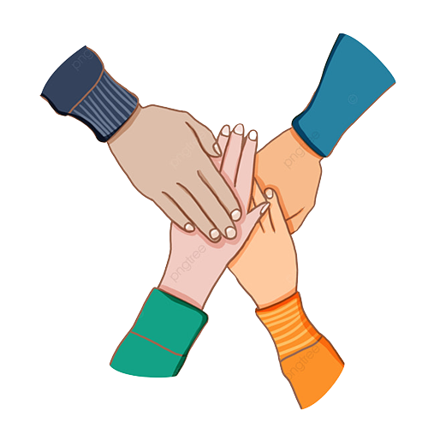
SIMPLE Set A Shared Goal
TASK
MODERATE Log A Physical Activity
TASK
COMPLEX Express Encouragement TASK and Support to Others
I
II
III

Slide 22
05
Storyboarding

Slide 23
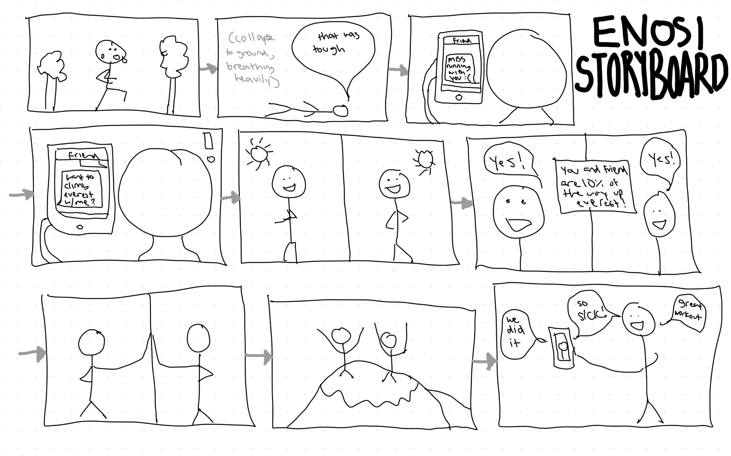
Implied Setting Change
Sense of Support from Running Buddy to Loneliness
Mood Shift
Energetic to Tired

Slide 24
Task 1
Set A Shared Goal
Mood Shift
Supported to Motivated
Task 2
Log A Shared Activity
Mood Shift
Tired to Supported

Slide 25
Task 3
Express Encouragement and Support to Others
Mood Shift
Motivated to Proud/Accomplished

Slide 26
06
Concept Video

Slide 27
Thank you!

Slide 28
Figma
Appendix

