Slide 1
Composing communities
Sophie Jin, Collin Jung, Gene Tanaka, Bryson Ochieng
Notes:
https://miro.com/welcomeonboard/dnAxZUlSYW1CT0tUU2thM3pualBRVGdkMHk2d1hxcFRKenlDeVl4WjR6eDF1WDhVaUtBR3Q5M1BuSmJGZGhHaHwzNDU4NzY0NTMxMjUwMzUzMjc4fDI=?share_link_id=360959027607

Slide 2
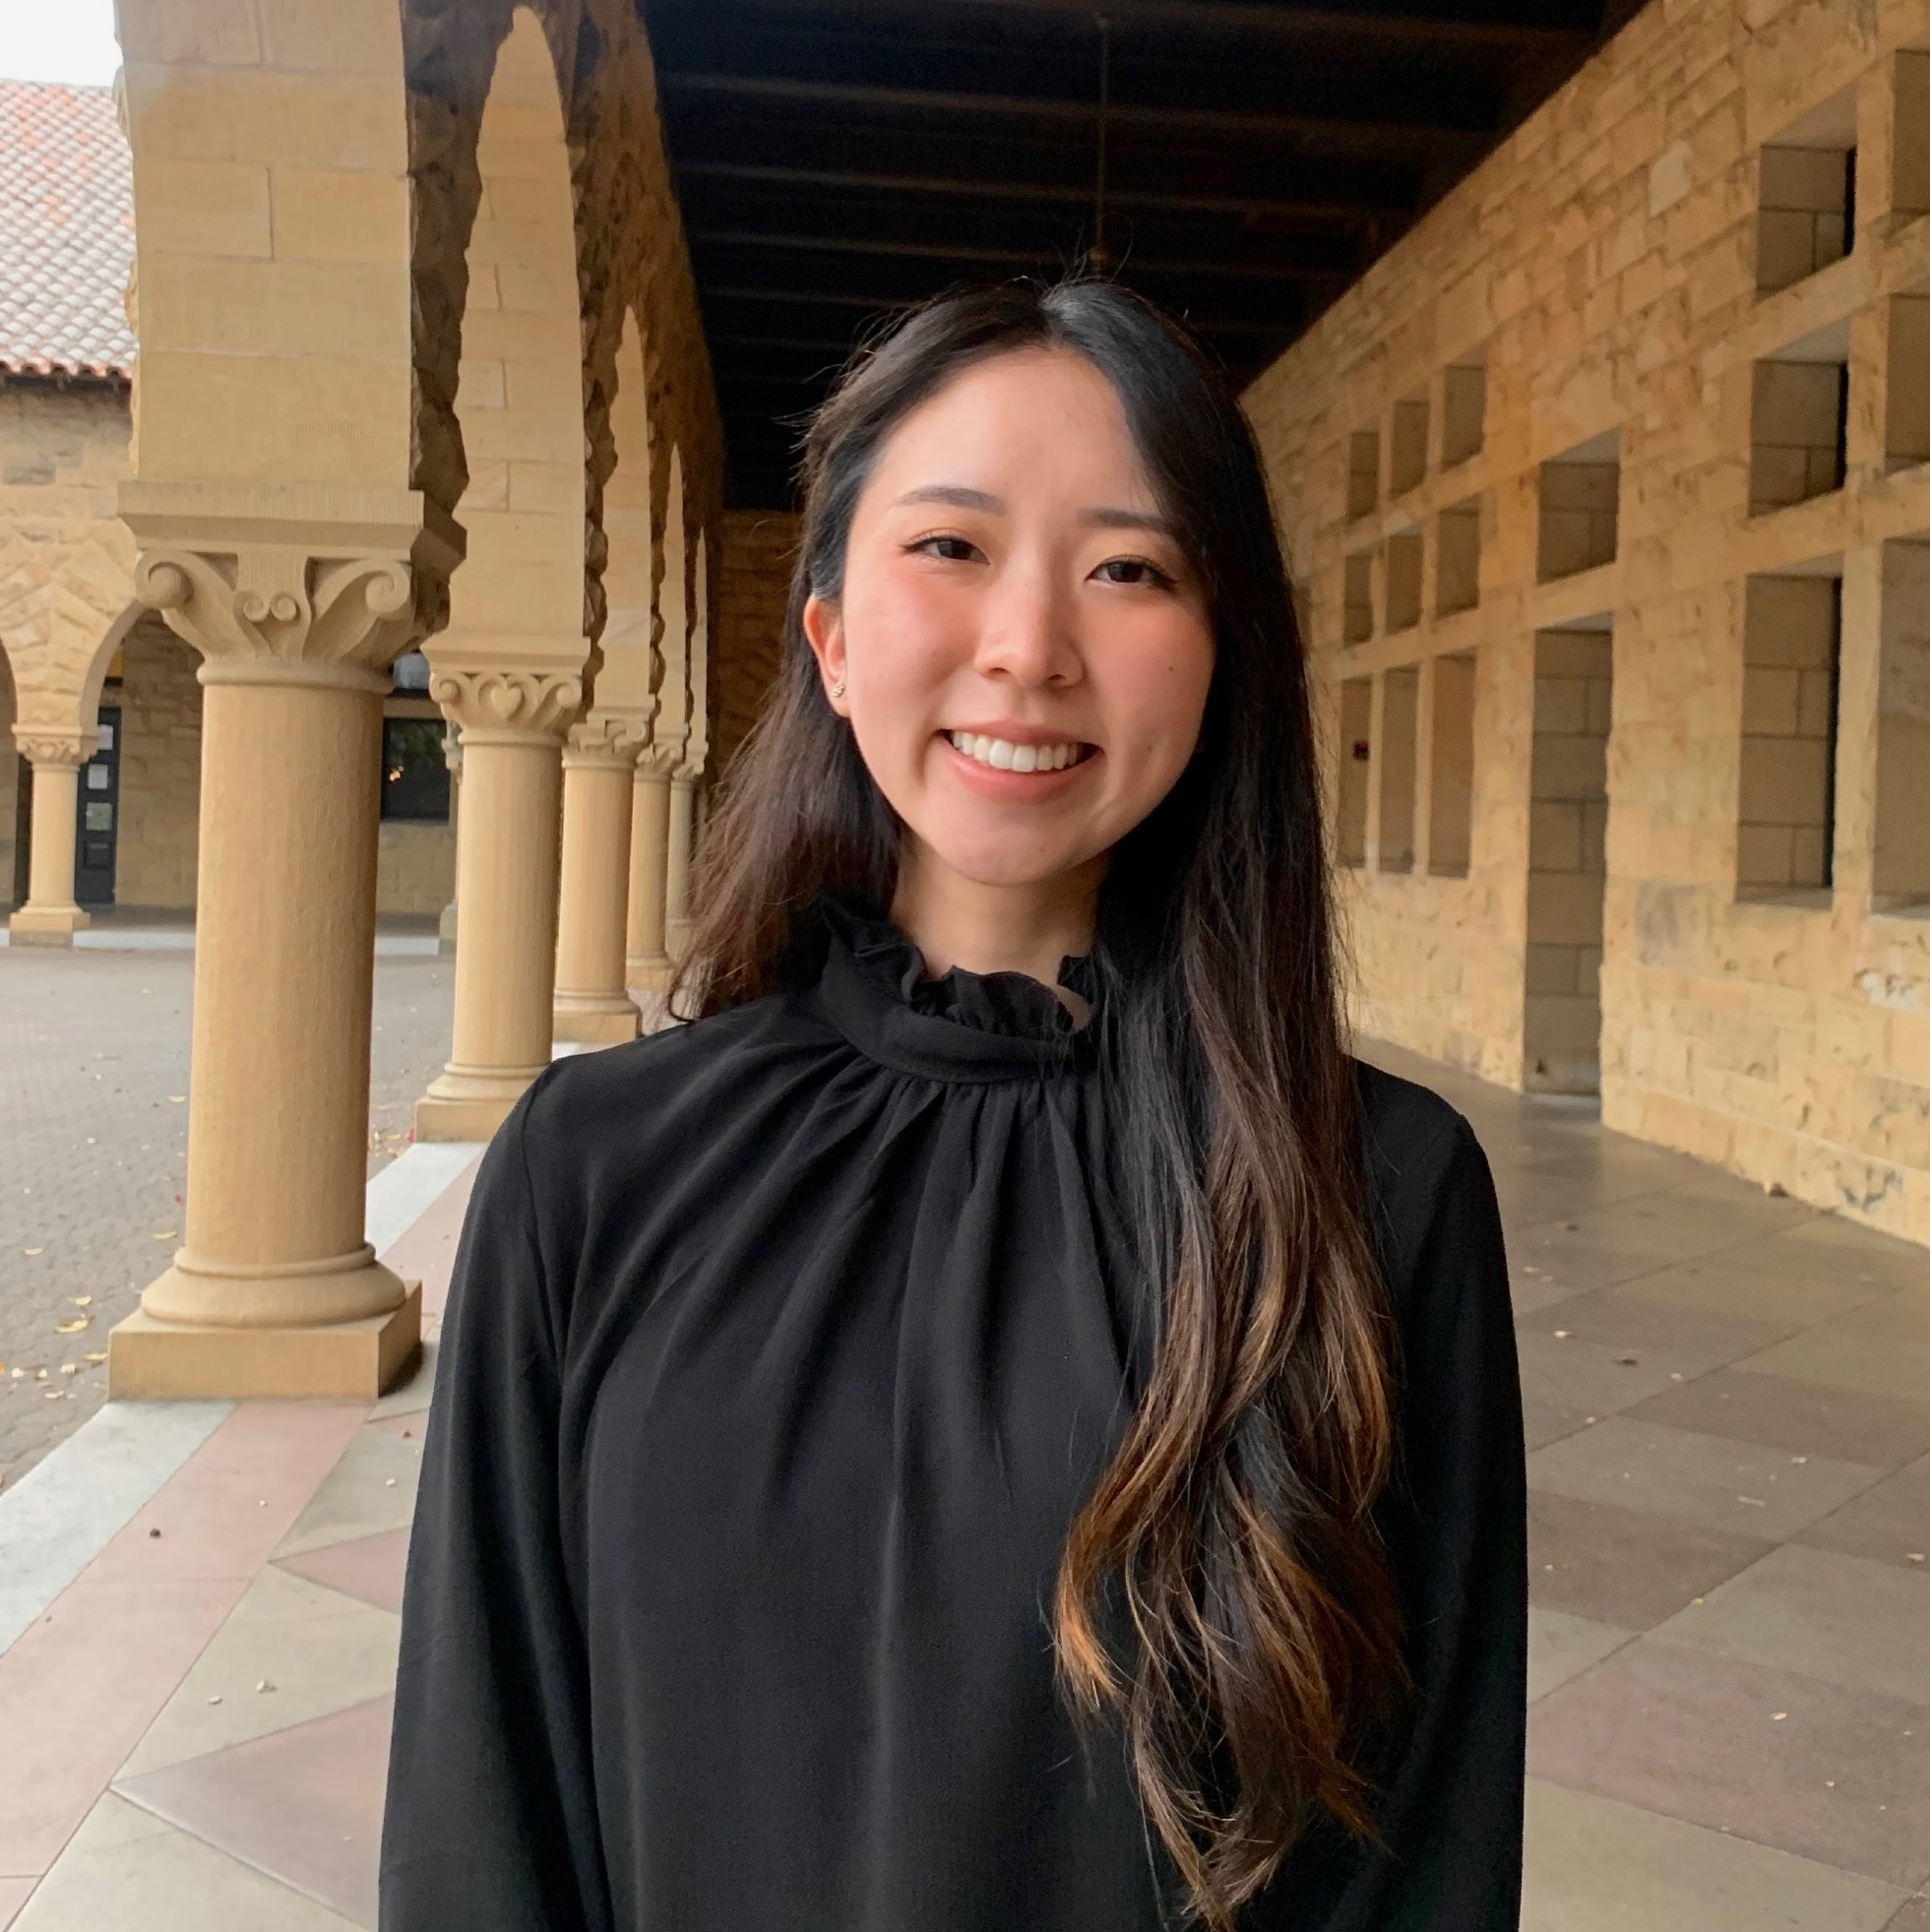

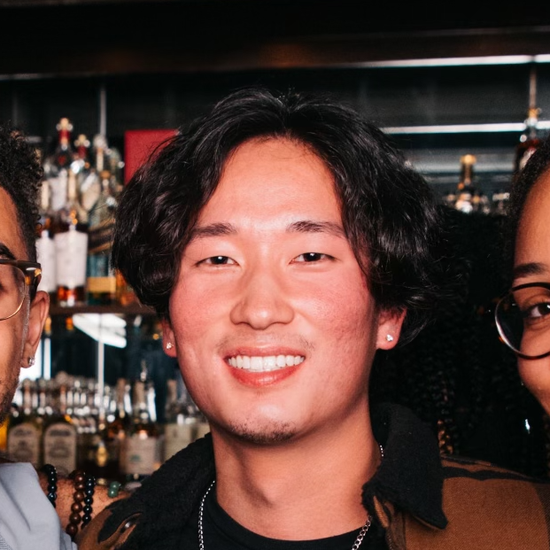
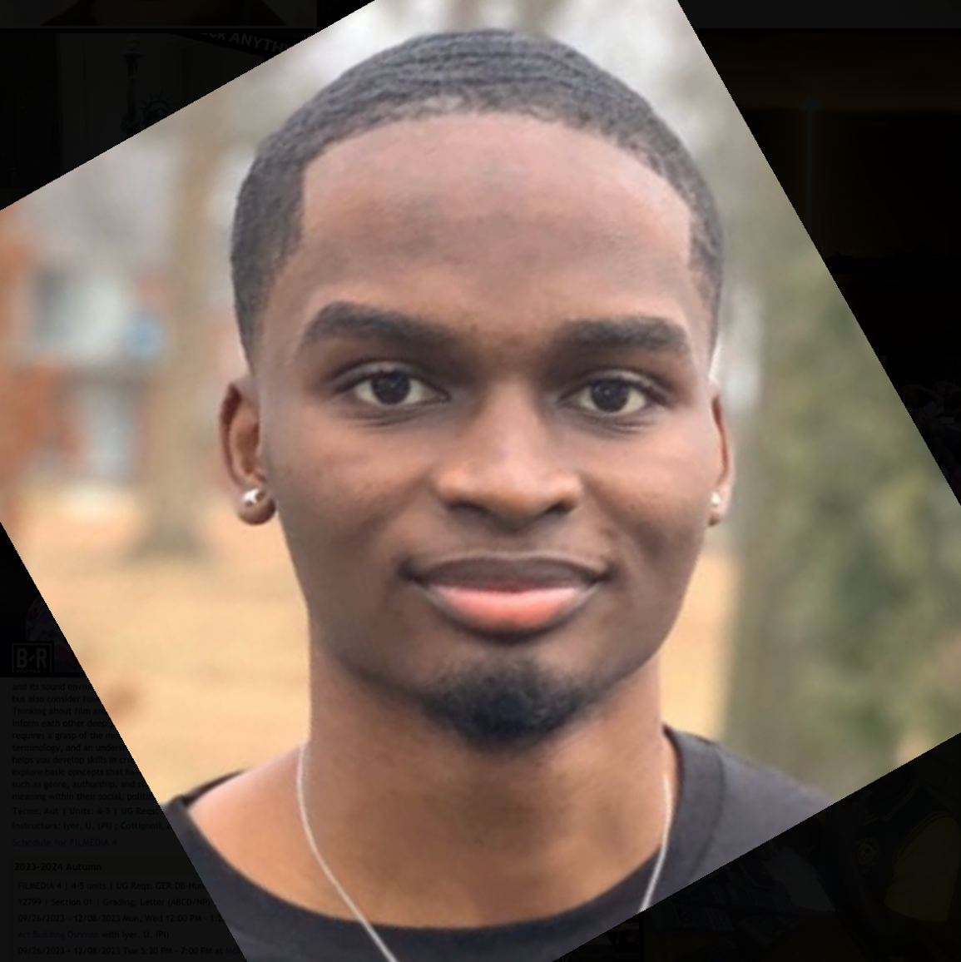
Our Team
Sophie jin
Collin Jung
Gene Tanaka
Bryson Ochieng
Grad Student
Computer Science
Irvine, CA
Junior/Coterm
Computer Science
Champaign, IL
Grad Student
Computer Science
Oakland, CA
Senior
Computer Science
Newark, NJ

Slide 3

Problem domain:
Easily relatable
Collaborative experience
Accessible
Music!

Slide 4
Methodology

Slide 5
Choosing Participants
What we asked
Conducting the interview
Diversity in age, gender, and musical experience
Favorite genre? Memories associated with music? Where do you listen to music?
Mix of random and scheduled interviews

Slide 6
methodology
participants
where
Extreme user
Random participants + scheduled interviews
Diversity in age range & gender to get broad range of musical experiences
Extreme user scheduled via Zoom
Random participants from off-campus cafes
Avid music listener/critic
Has experience working in the music industry
What we asked
Member roles
Tools
Favorite genre of music?
Favorite memories listening to music?
What kinds of environments do you enjoy music in?
We all conducted interviews individually/in pairs, Gene interviewed the extreme user
All of us worked on empathy mapping & analysis together
Notebook
Phone

Slide 7


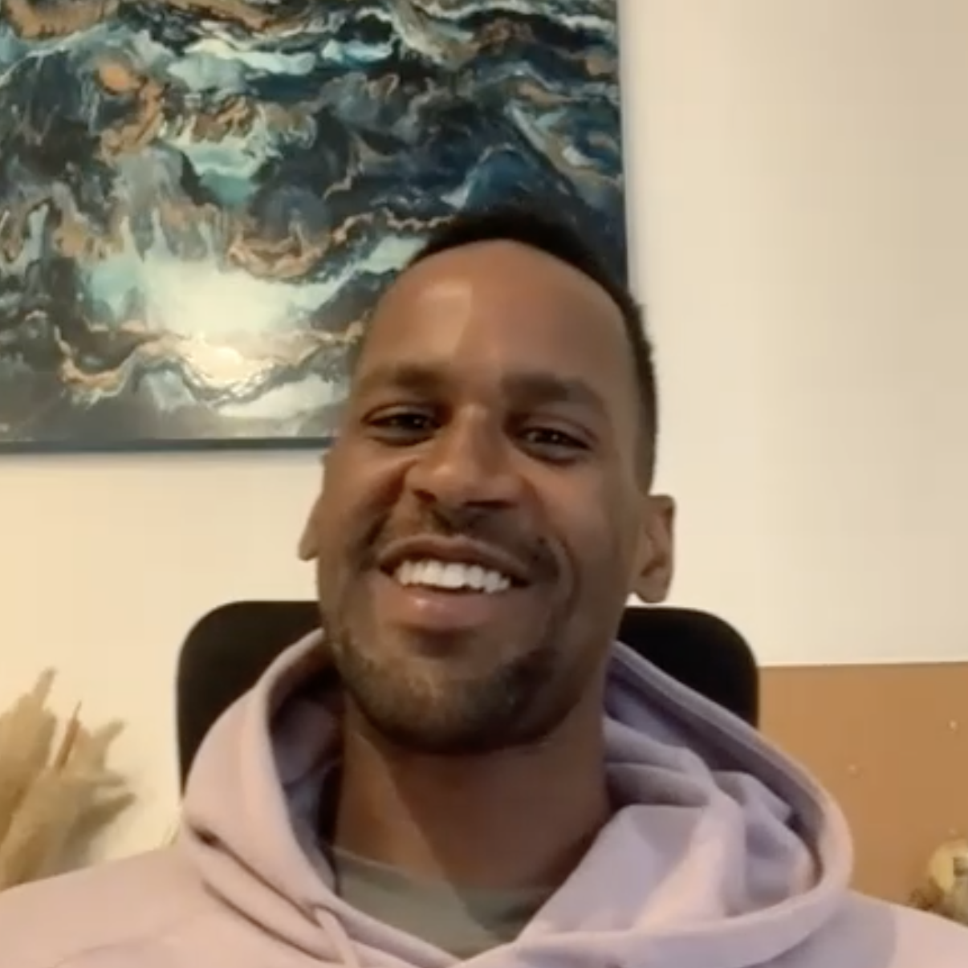
Who we interviewed
Mary Lynn F., 60 years old
Palo Alto, CA
Ben Z, 21 years old
Atlanta, GA
Emon B, 32 years old
Detroit, MI

Slide 8
Interview results

Slide 9
“I wish music was easier for me to listen to, because I love it”
Mary Lynn

Slide 10
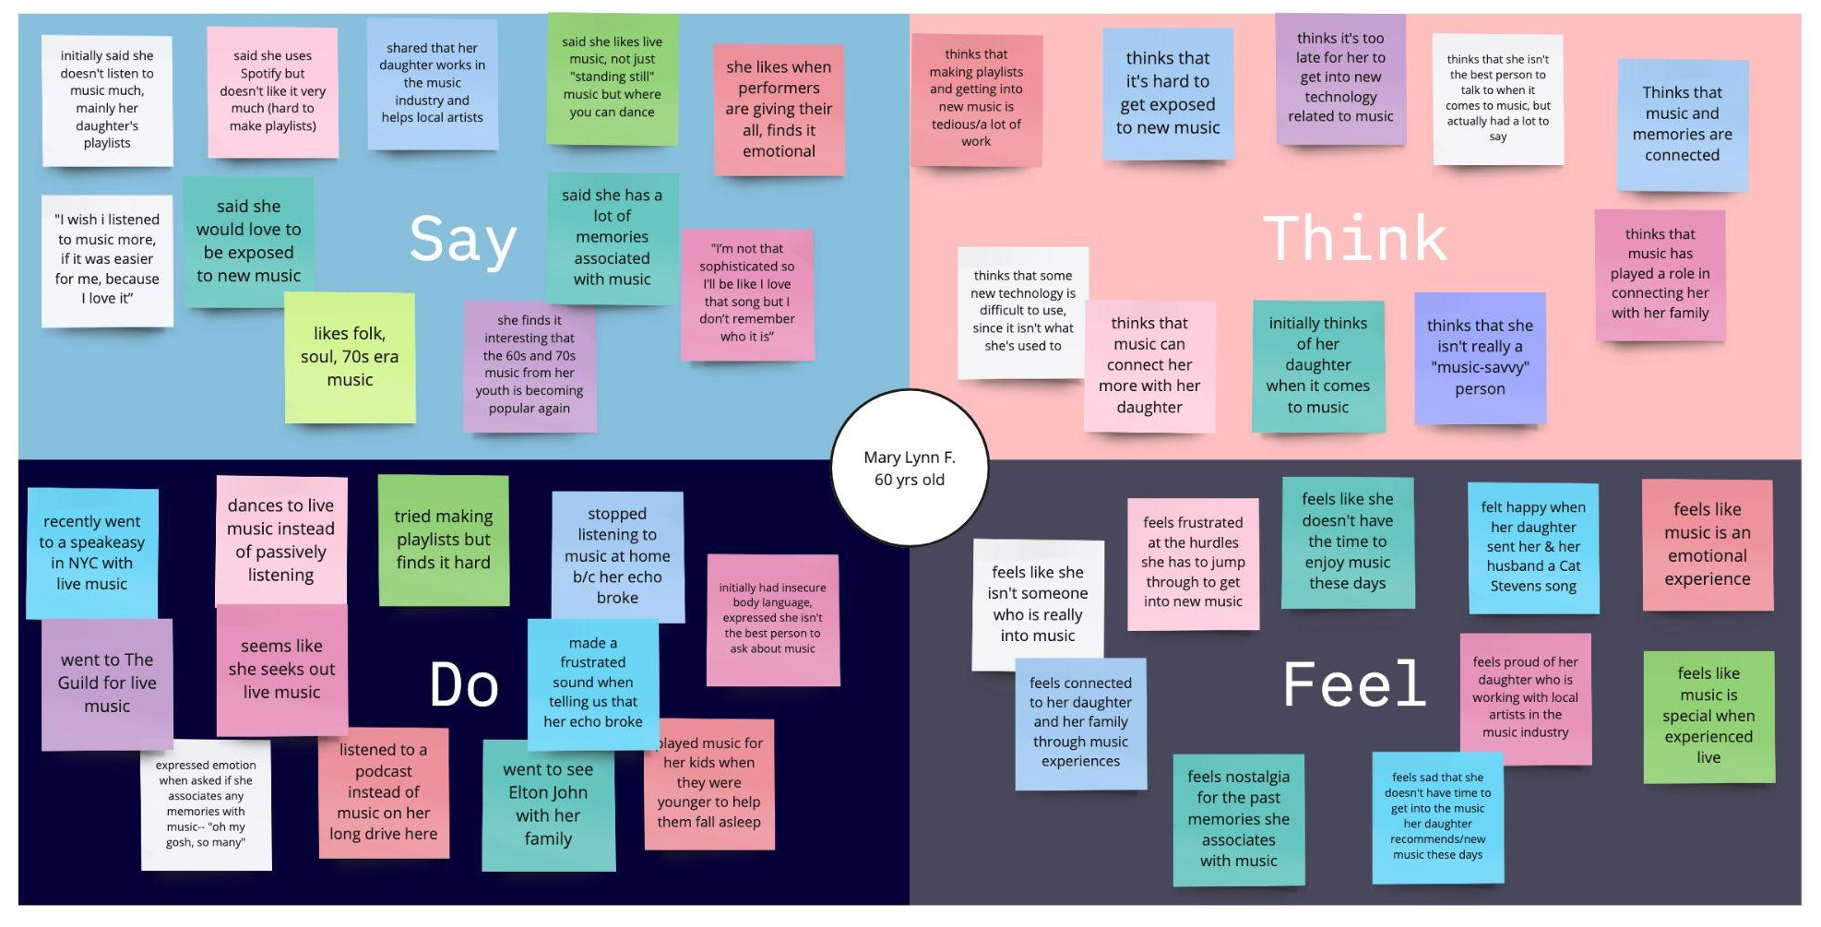

Slide 11
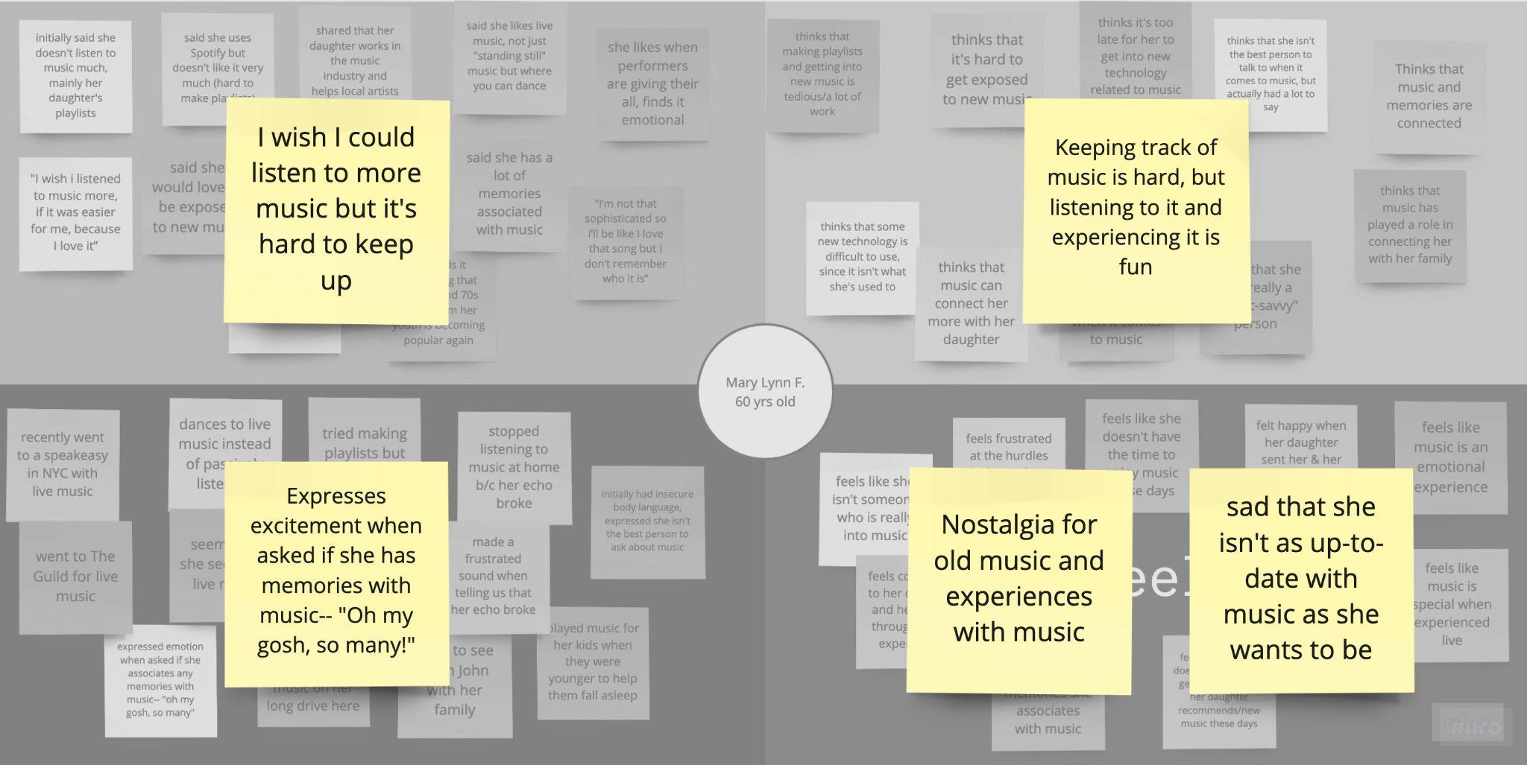

Slide 12
observations
inferences
Surprising that she claims not to know much about music but then is excited to talk about her memories with music.
Associates music with family
Frustrated at new tech (like Spotify)
Mary Lynn is nostalgic of simpler times when music was easier to keep up with
She views music as an experience that connects her more with others
insights
needs
New technology that’s supposed to make things easier can actually be a barrier for older generations who want to listen to music but don’t know how to use it
People like Mary Lynn need a way to keep up with music and enjoy new music without needing to be tech-savvy
Mary lynn

Slide 13
observations
inferences
Uncomfortable navigating the current music world
Surprisingly, enjoys music more than she lets on
insights
needs
New music technology acts as a barrier
More accessible ways to interact with music
Mary lynn

Slide 14
“We need a Shazam that can tell me the name of a song based on humming”
Ben Z

Slide 15
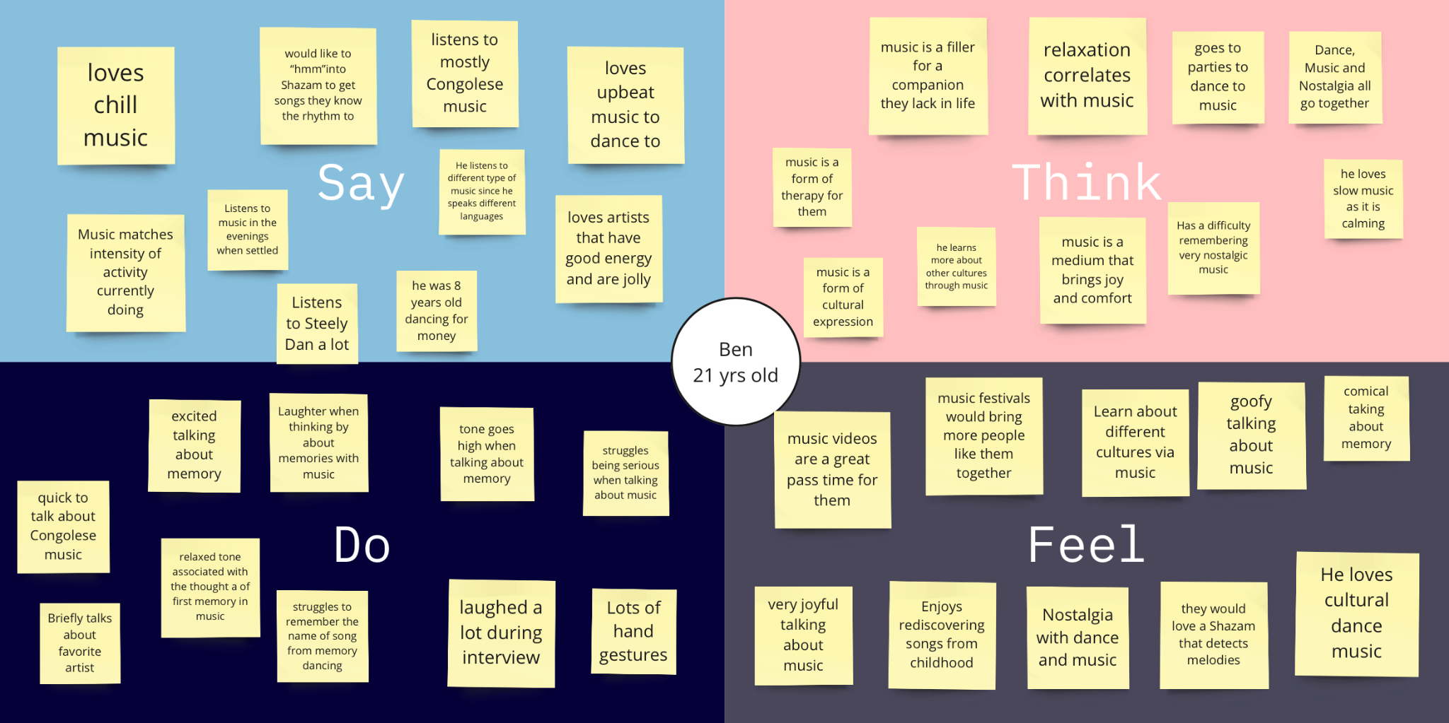

Slide 16
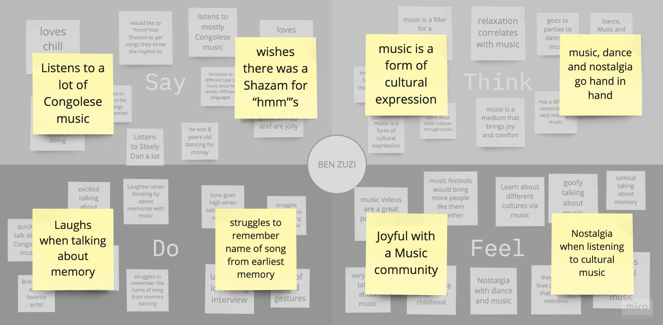

Slide 17
observations
inferences
Surprised he was very comical and laughed a lot during interview
Spoke a lot about dancing and upbeat music
Spoke a lot about family and music in memories
Connects to his culture and family through music
Needs music to uplift him during the day
Music is a form of cultural expression.
insights
needs
BEN Z
He would benefit form a tool that connects him to people with similar music taste
He would love a tool that connects him to dancers of music he loves
He needs a “Shazam” that can tell him music based on “hmm”’s
He needs a community that shares music taste.

Slide 18
observations
inferences
Comical
Dance at functions
Family memories
Music connects to family
Upbeat music is uplifting
Cultural expression
insights
needs
BEN Z
Community of similar taste
Connection to community of dancers
Humming Shazam
Community of music listeners

Slide 19
“In the teenage stage of the internet, blogs were highlighting all types of different artists for different reasons. We moved to streaming and it feels like software is deciding what music gets promoted.”
Emon

Slide 20
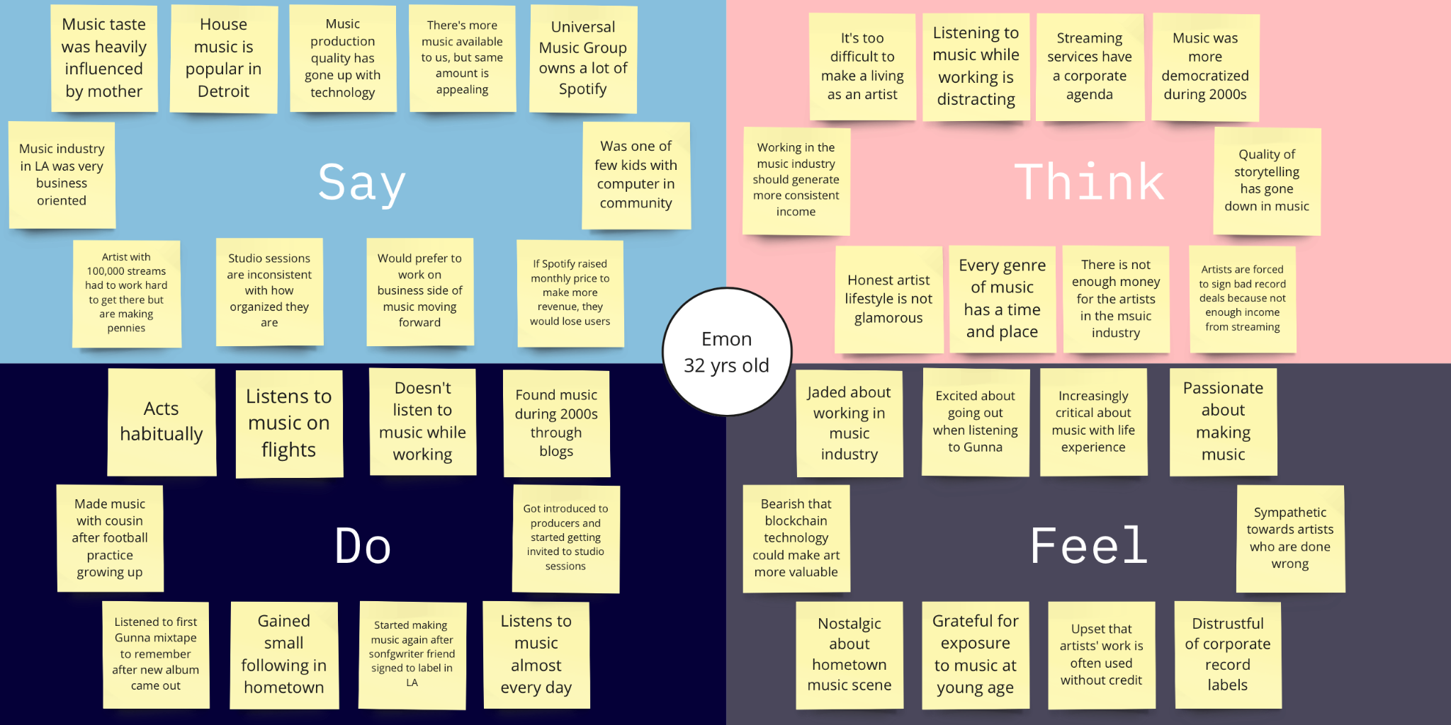

Slide 21
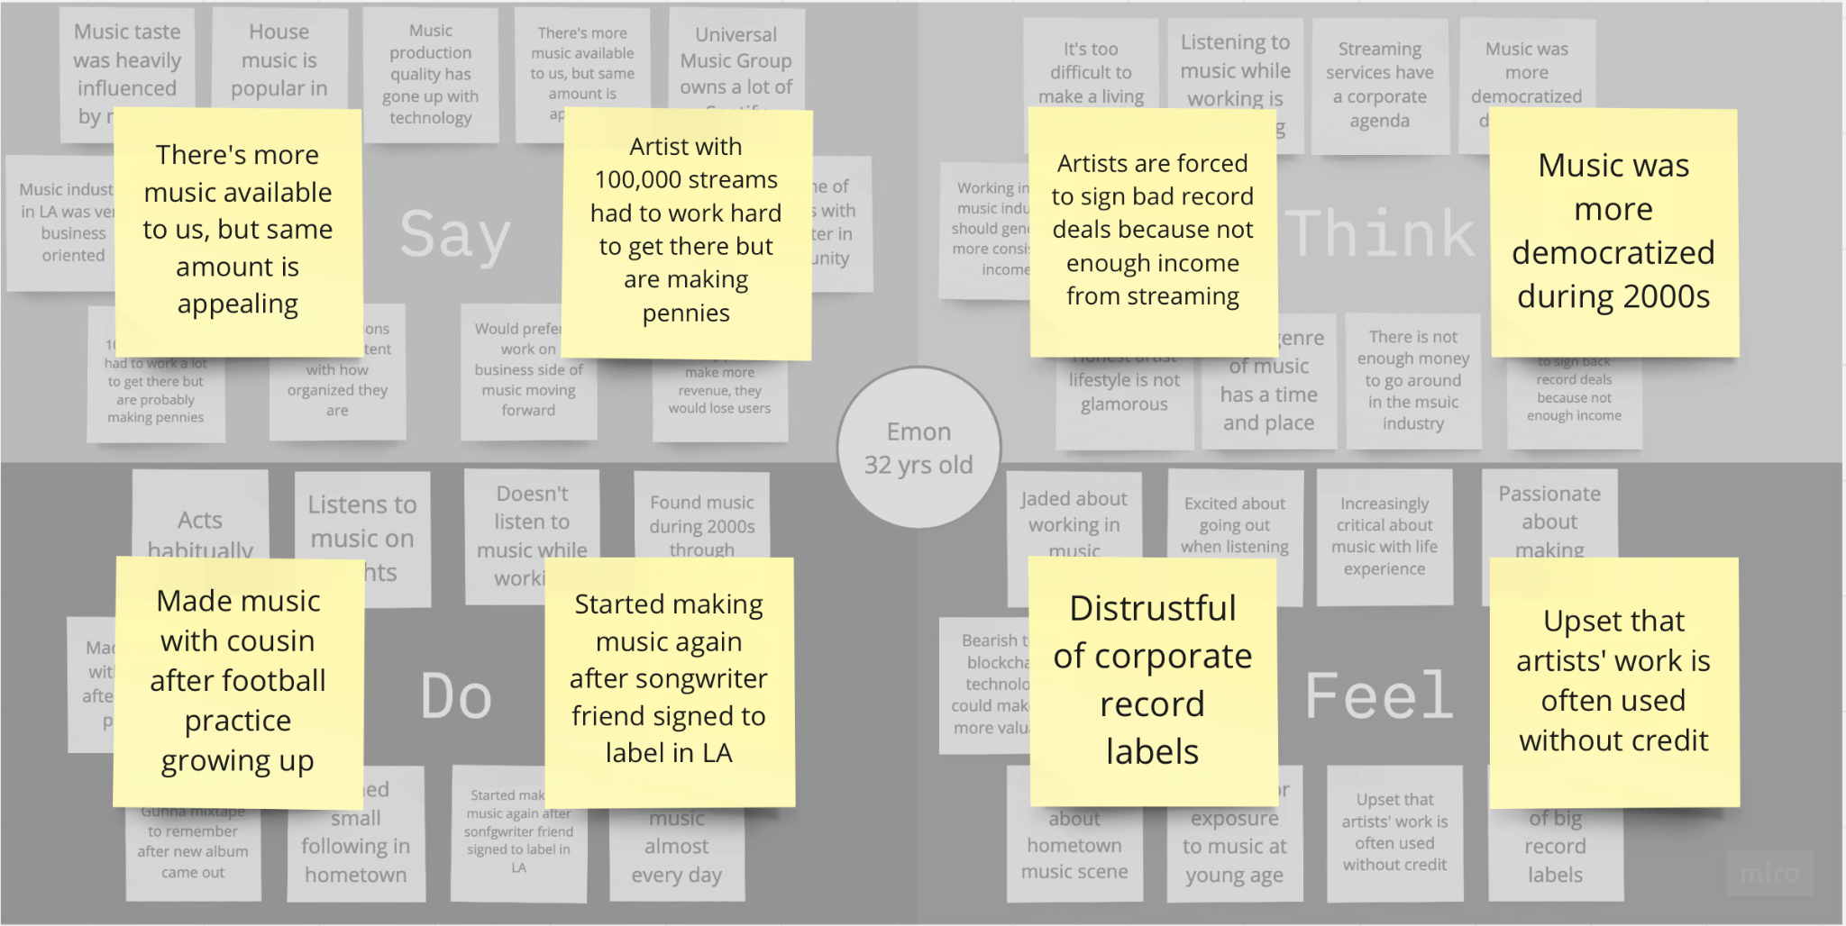

Slide 22
observations
inferences
Emon has formed strong bonds with friends and family through music.
Music continues to be a big part of Emon’s daily life despite his issues with the industry.
Emon is passionate about making music, but is pessimistic about his ability to make a fair living off of it.
insights
needs
Surprisingly, the internet (and specifically streaming) is not as democratizing of music as they seem.
The business side of music can interfere with artists’ creative process.
A way to discover new music without biases from corporate forces.
Artists to get paid fairly for their work.
Emon

Slide 23
observations
inferences
Strong bonds with friends and family
Has issues with industry but still enjoys music
Loves making music, but not the small paychecks
insights
needs
Internet is not as democratizing as it seems
Business interferes with artists’ creative process
A way to separate music from industry pressures
Emon

Slide 24
Concluding remarks
Key insights
People need a new, easy way connect with one another through music
Music needs to be more accessible
People need better ways to find new music
Next steps
Find new perspectives while refining our need
Think about potential solutions

