Slide 1
Define & Ideate
HOME
TABLE OF CONTENTS
PLAYLIST
01
Intro + Needfinding
02
POVs/HMWs/Solutions
03
Experience Prototypes
04
What’s next?
#FYP (For You Playlist)
THANKS!
CS 147
FYP

Slide 2
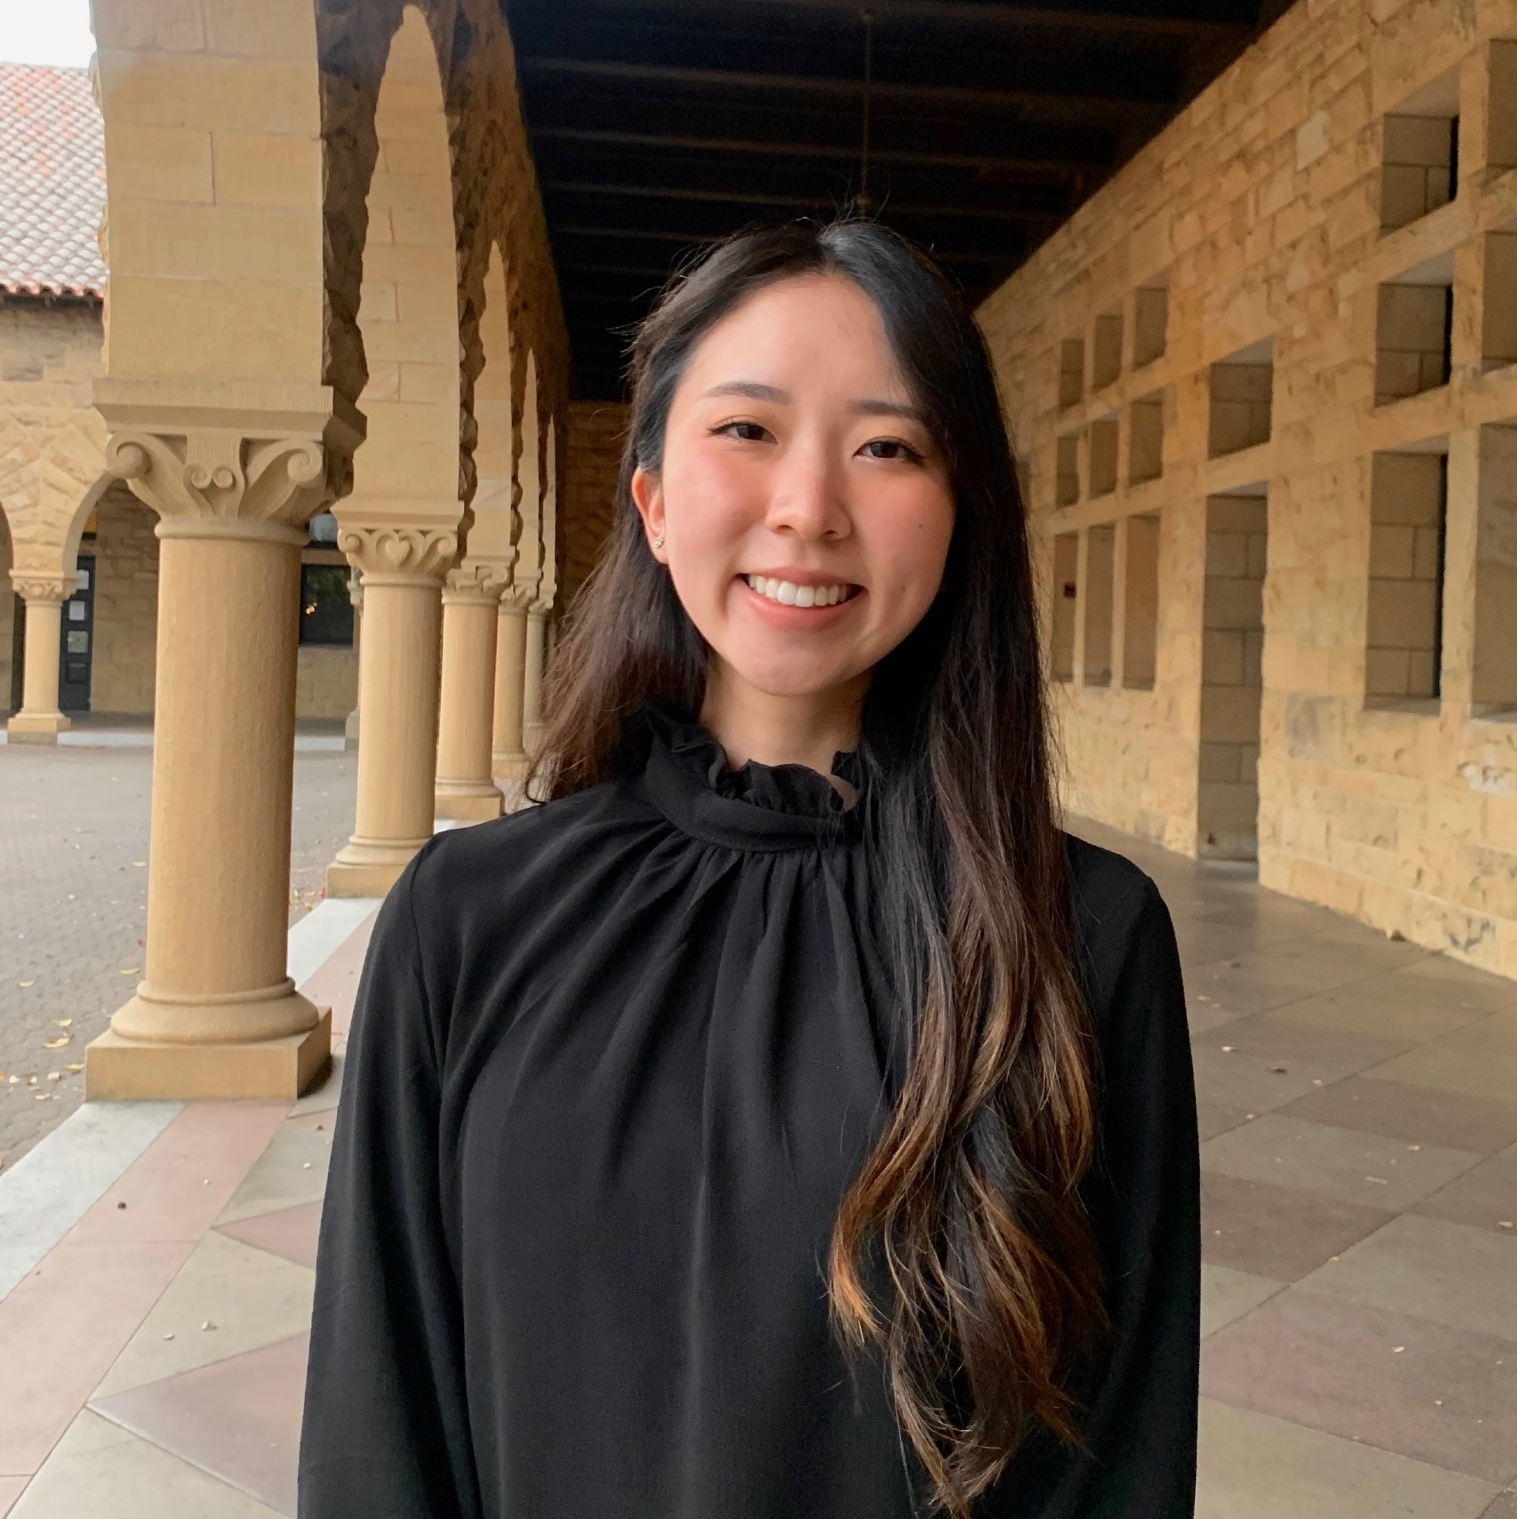

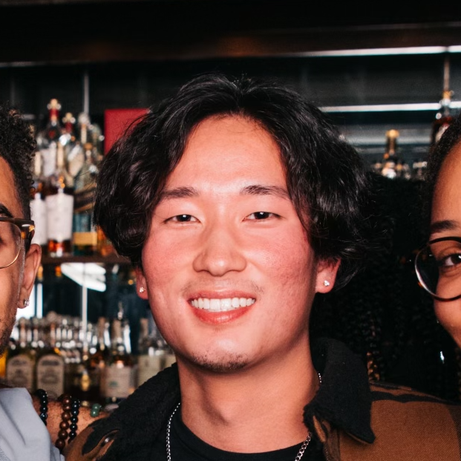
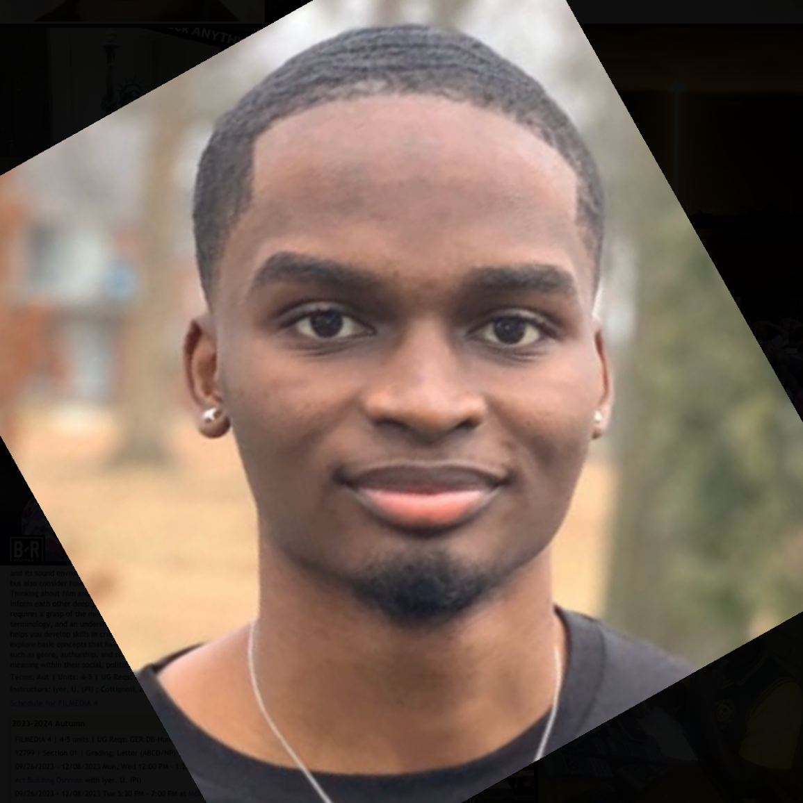
Our team:
Sophie Jin
Collin Jung
Gene Tanaka
Bryson Ochieng
Grad Student
Computer Science
Irvine, CA
Junior/Coterm
Computer Science
Champaign, IL
Grad Student
Computer Science
Oakland, CA
Senior
Computer Science
Newark, NJ
CS 147
FYP

Slide 3


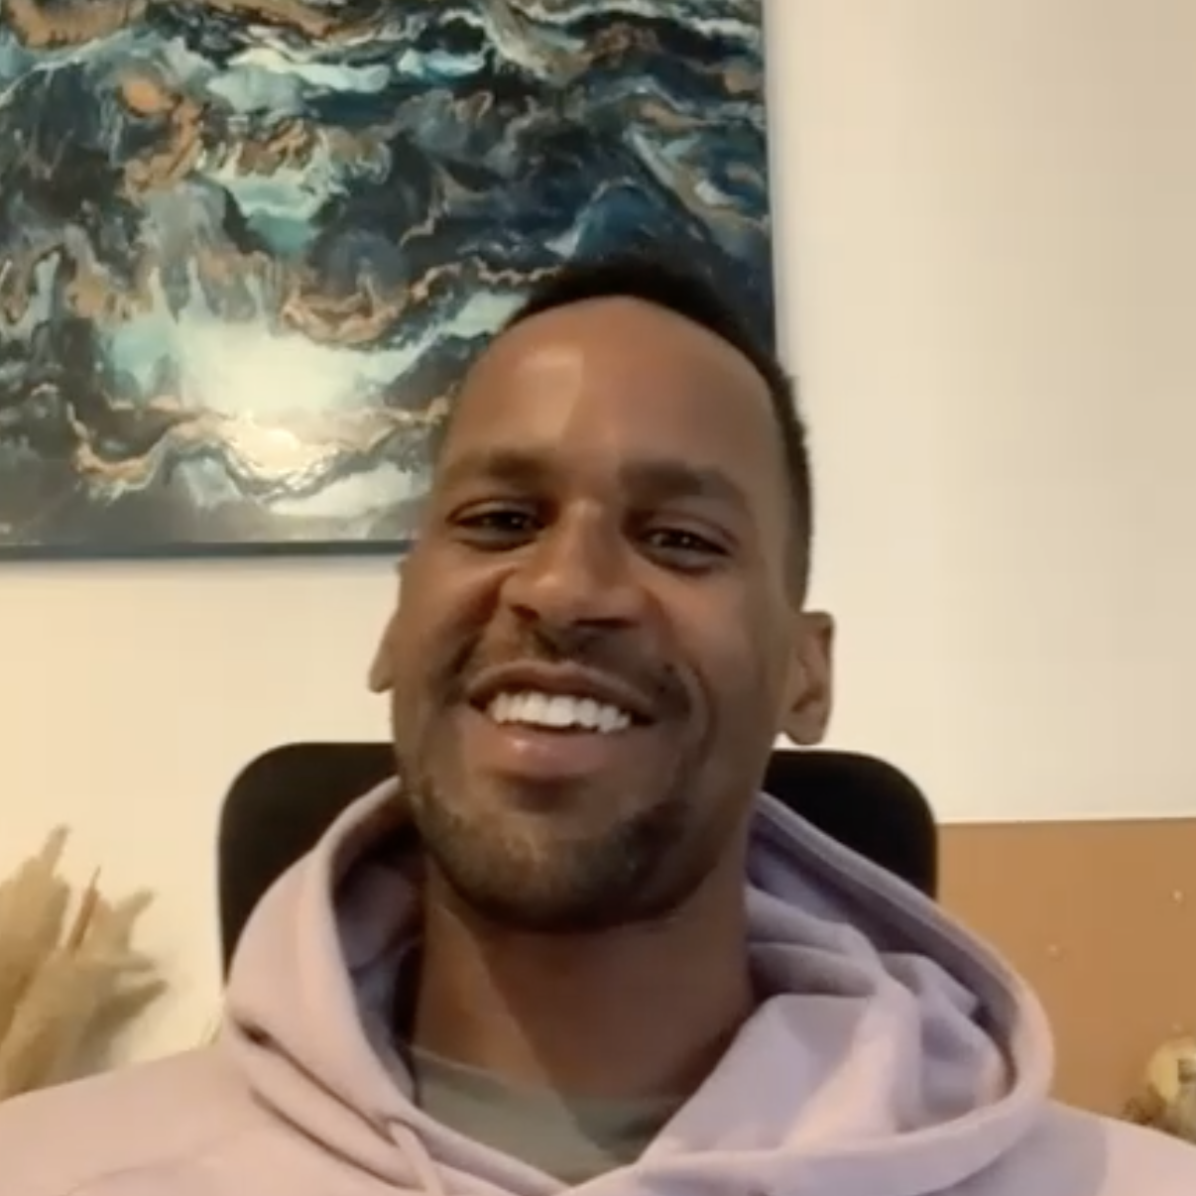
Interview Recap
Mary Lynn, 60
Ben, 21
Emon, 32
We need more accessible and engaging ways to keep up with music
We need ways for people to connect with a community of music listeners
We need a way to separate music exposure from industry pressures
CS 147
FYP

Slide 4
New Problem Domain
CS 147
FYP
Notes:
Majority of listeners are casual listeners -> They pick from music they know -> Play music
Instead of this black box in middle, we want to make finding new kinds of music inviting and fun for the casual listener
This allows for more variety and enjoyability

Slide 5



New Problem Domain
Making exposure to new music inviting and fun
Pick from music they know
Casual Listeners
CS 147
FYP
Notes:
Majority of listeners are casual listeners -> They pick from music they know -> Play music
Instead of this black box in middle, we want to make finding new kinds of music inviting and fun for the casual listener
This allows for more variety and enjoyability

Slide 6

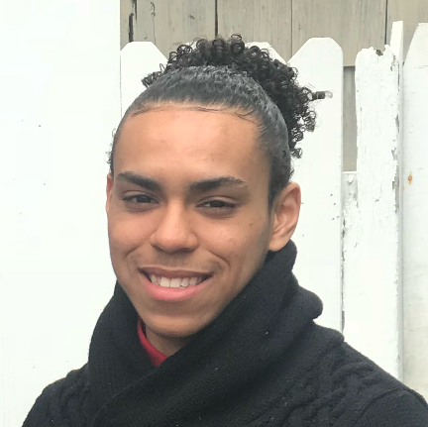
Our New Interviewees
Krystal Lau, 25
Author
Interview conducted @ Starbucks on University Ave
Miguel Rodriguez, 20
DJ
Interview conducted on Zoom
CS 147
FYP

Slide 7
Krystal
Observations:
Insights:
An author who makes playlists to match the vibe of what she’s writing. Doesn’t like Spotify’s “tunnel vision”.
She feels like she may be missing out on a variety of music by only sticking to what she knows.
CS 147
FYP

Slide 8
Miguel
Observations:
Insights:
DJ who listens to music in a variety of environments. Finding new music based on emotions and new genres is impactful for him.
Wants a way to find new music that is personal and connects with his emotions.
CS 147
FYP

Slide 9
Key Learnings
01
People like to stay open-minded about music
02
People want to discover music in more complex, personal ways
CS 147
FYP

Slide 10
POVs
CS 147
FYP

Slide 11
POV 1 - Krystal
We met…
Krystal Lau, a 25 year old author and casual music listener in the bay area who listens to music while she writes.
We were surprised to realize…
That she relies on Spotify for music suggestions but doesn’t like how it gives her “tunnel vision” by only recommending the same types of songs she already listens to.
We wonder if this means…
That she feels like she’s missing out on new genres of music that she could enjoy but hasn’t found yet.
It would be game-changing to…
Find a way for Krystal to get music suggestions that are both diverse and appealing to her.
CS 147
FYP

Slide 12
How might we…
suggest music that someone might like beyond just looking at what they already listen to?
CS 147
FYP
Notes:
Brainstorm:
Suggest random song each day that is not in their library
Music based on your area
Music based on your current mood
Suggestions based on what your close friends are listening to **
Music based on the weather
Personality Test for music ****
Music based on your favorite books
Basing predictions on daily activities
Music based on time of the day
Music based on your favorite foods
Your friends suggest music for you **

Slide 13
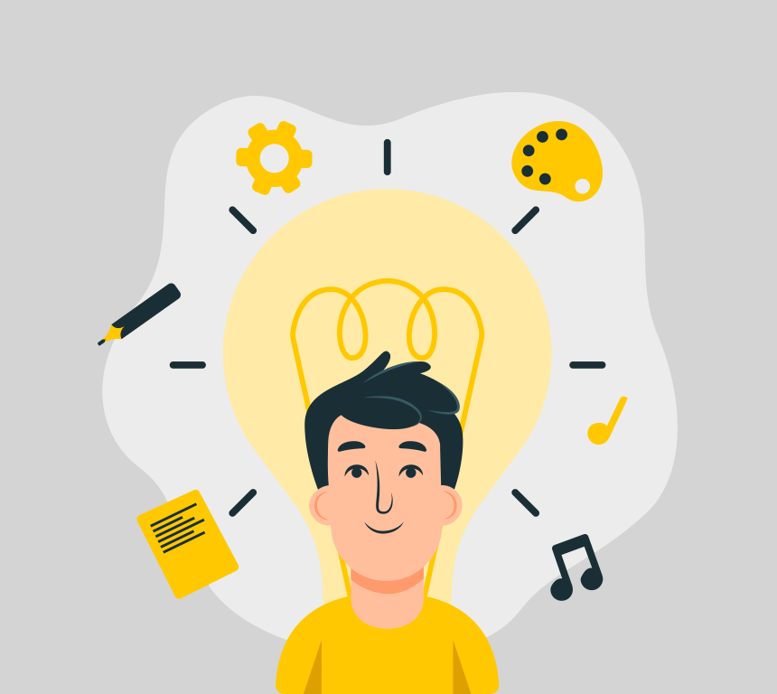
Solution - Personality test for music
Solution:
Key assumption:
Find music that people might like based on an interactive personality test!
People like getting music suggestions in ways that are more personalized, interactive, and engaging.
CS 147
FYP
Notes:
personality/mood changes over time, a key assumption is that it’s even possible to measure personality like this.

Slide 14
Experience Prototype
Part 1: Fill out personality questions
Pick a song
How should a song make you feel?
What style do you like songs to be recorded in?
How important are lyrics to you?
How fast do you like the tempo of your songs to be?
Part 2: Receiving recommendation
Tester gave song based on answers
CS 147
FYP

Slide 15
Experience Prototype
Questions to ask:
How did filling out this quiz make you feel?
Had you heard of the song we recommended before?
Did you like the recommendation that you got?
Assumptions:
Possible to create ‘music personality’ quiz
Quizzes are enjoyable
‘Music personality’ is consistent
CS 147
FYP

Slide 16
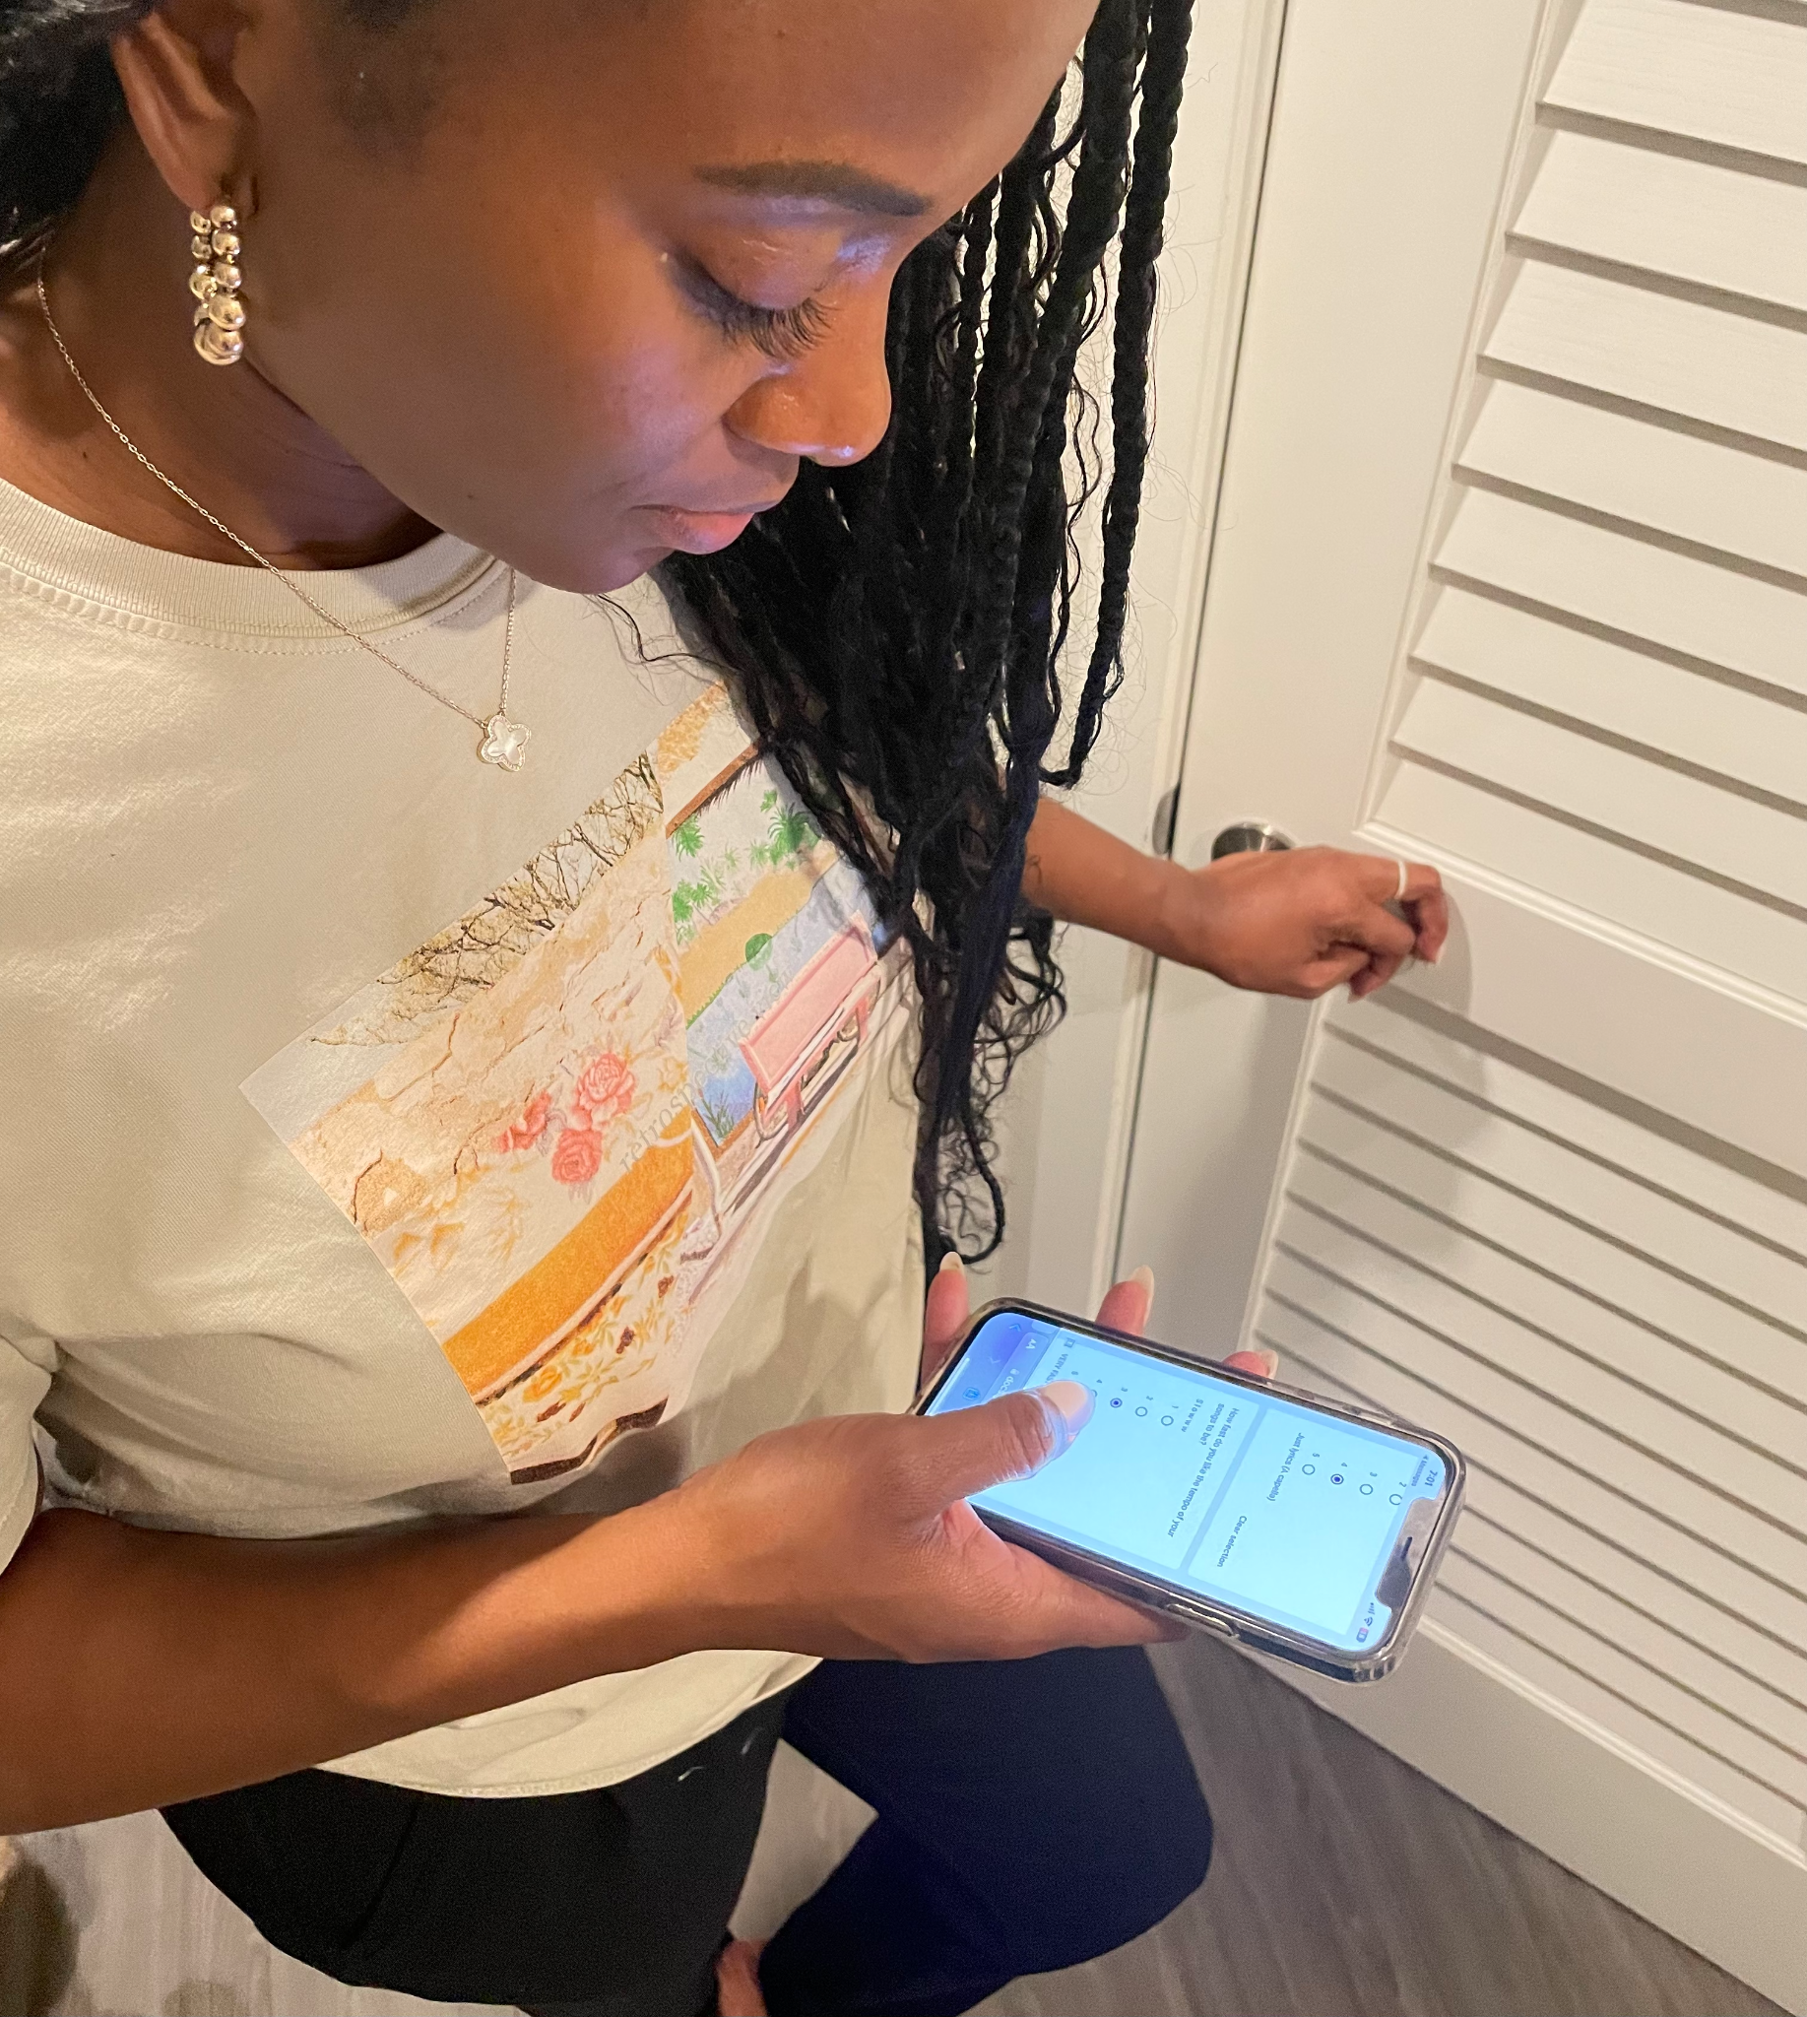
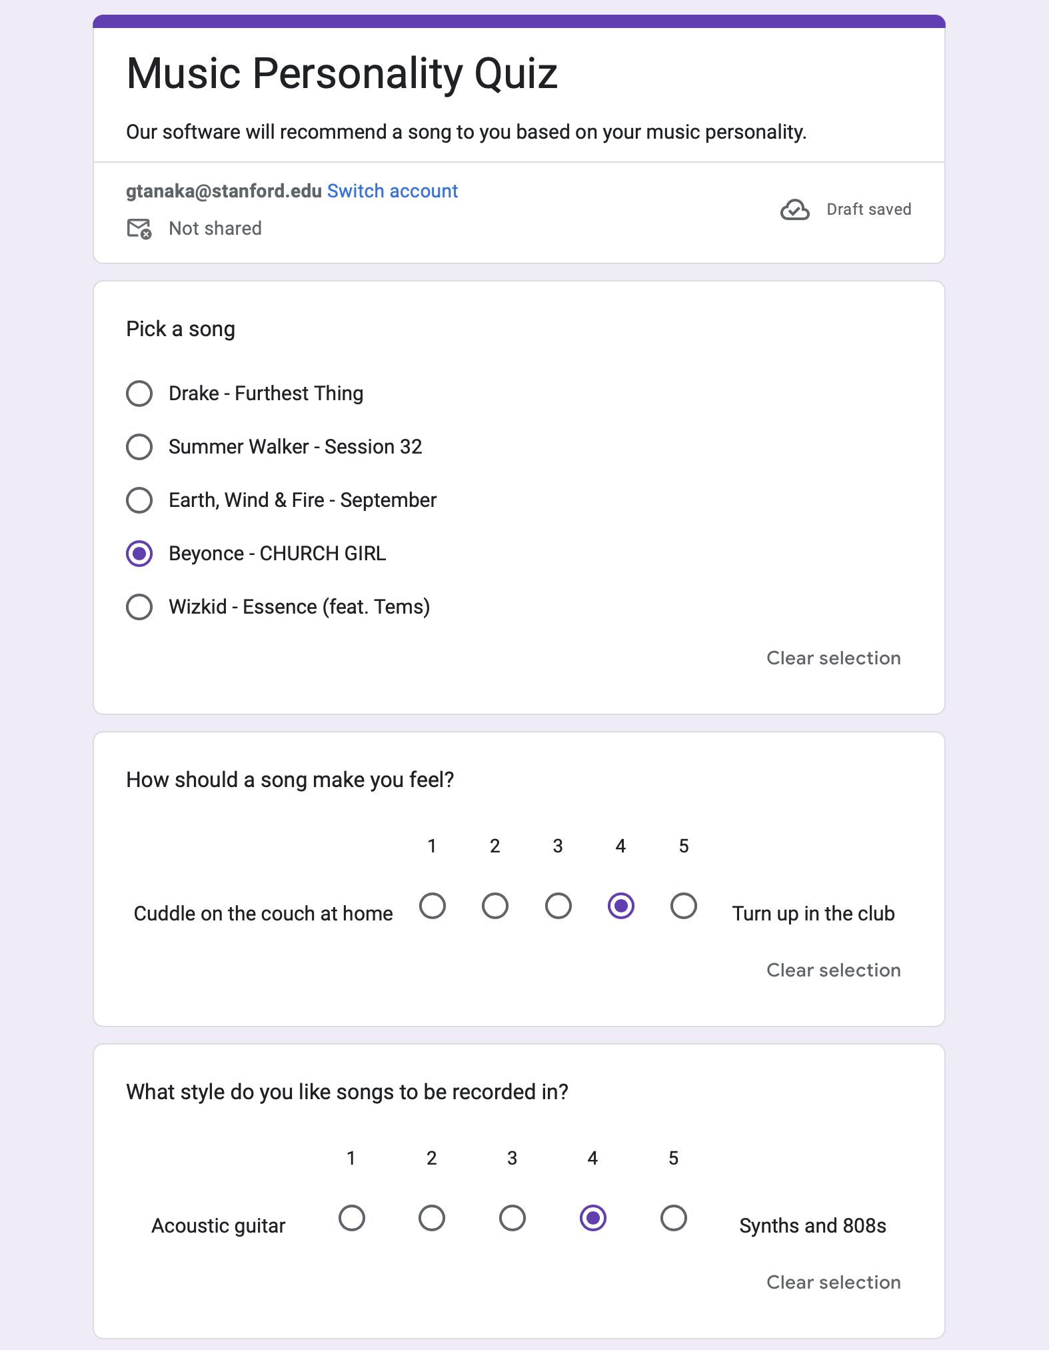
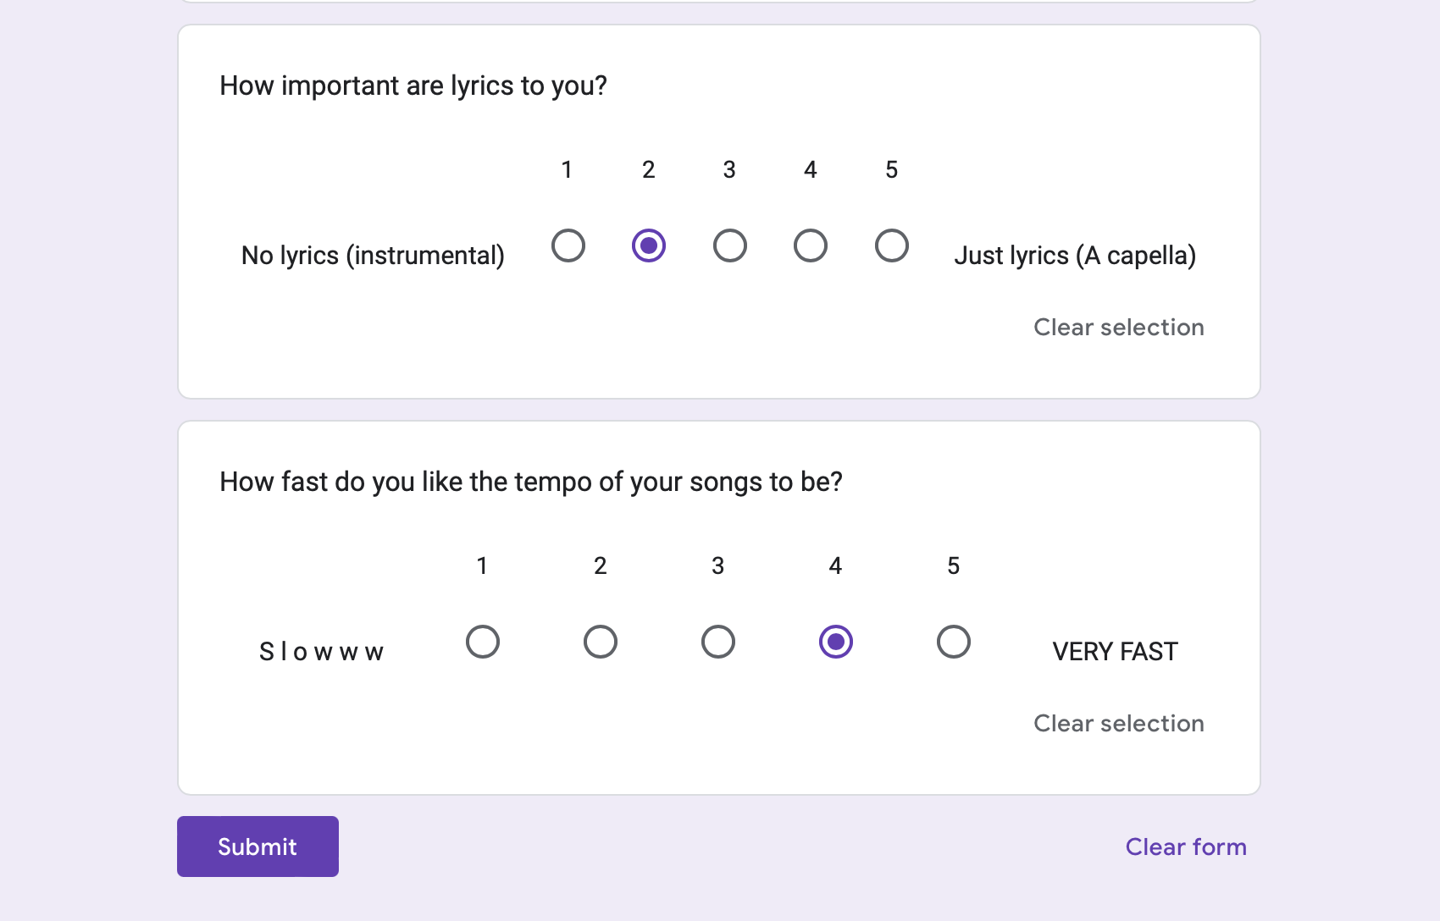
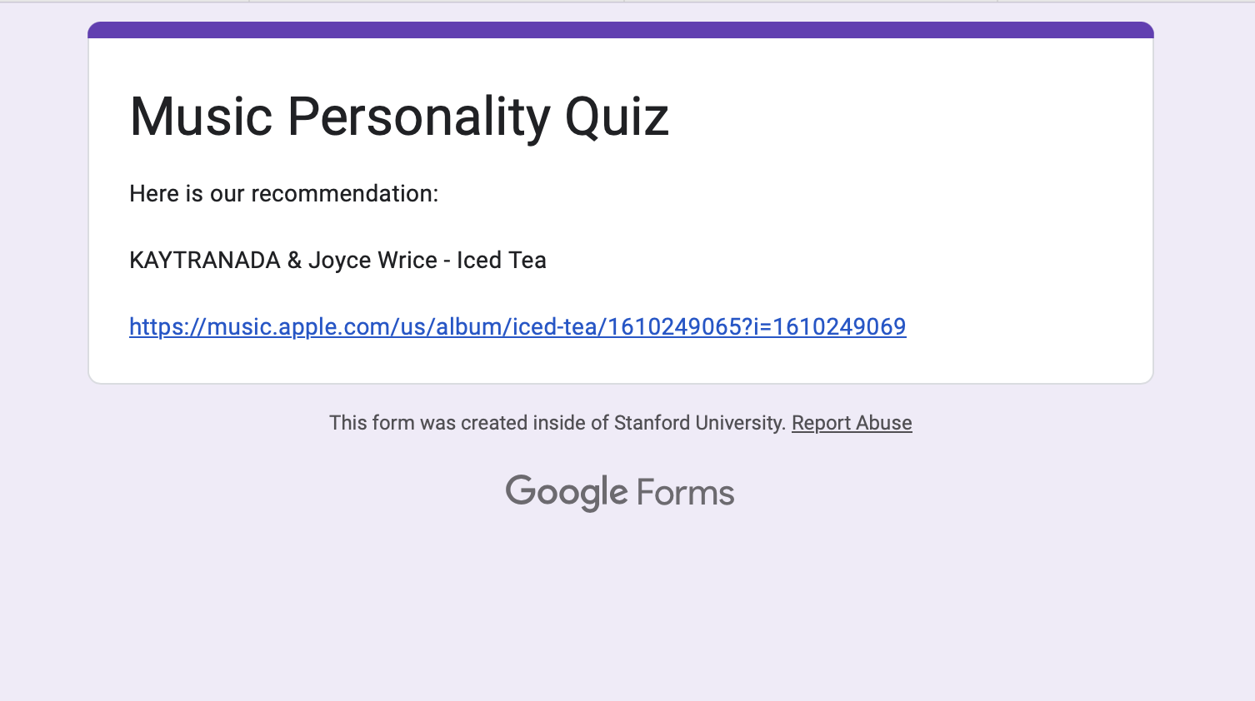
Experience Prototype - Personality Test
Shaude, 26 - Working professional, casual music listener
CS 147
FYP

Slide 17
Insights
What worked
What didn’t work
Simple
Intriguing questions
Fun
Mood changed second day
CS 147
FYP
Notes:
Enjoyable to think through the questions and actively introspect about what kind of mood they were in

Slide 18
Key takeaways
Quizzes should adapt - mood strongly affects taste
Quizzes should be easy and fun
People like engaging with music in a personal way
CS 147
FYP

Slide 19
POV 2 - Mary Lynn
We met…
Mary Lynn, a 60 year old woman and casual music listener from Palo Alto who mainly hears about new music from her daughter.
We were surprised to realize…
She was excited and had a lot to say about her memories with music, even though she said it was hard to keep up to date with music on modern platforms.
We wonder if this means…
That her unfamiliarity with new technology makes it tedious for her to keep up with new music recommendations.
It would be game-changing to…
Find a way for Mary Lynn to learn new song suggestions in a way that feels inviting and fun instead of burning her out.
CS 147
FYP
Notes:
Original POV:
We met Mary Lynn, a 60 year old woman from Palo Alto who casually enjoys music.
We were surprised to realize that even though she claims not to be up to date with music & apps like Spotify, she was excited and had a lot to say about it.
We wonder if this means that uncomfortability with music technology leads to apprehension for talking about music. It would be game-changing to find a way for her to keep up with music in a way that feels inviting and fun.

Slide 20
How might we…
make finding new kinds of music a fun activity instead of a chore?
CS 147
FYP
Notes:
Brainstorm:
Making a quick image quiz (like the Harry Potter Patronus quiz) that generates playlists for you based on your answers **
Making playlists based on artists rather than songs (add artists to a playlist, and every day it randomly generates music from those artists) **
Instagram feed where people can post a song each day & see their friends’ posts
Music guessing game (e.g. guess what year this song is from? Maybe will help them realize they like music from a certain era, & can generate playlist based on the game)
Generating playlists based on memories (e.g. the last time I listened to music I had so much fun dancing with my friends! – generates playlist of music you can dance to)
Generating playlists based on your zodiac sign(s)
Playlists based on your major/intellectual interests
Top songs internationally ****
Playlist generation based on specific adjectives/demographics (e.g. female asian rappers, indie korean bands, old Chinese ballads)
Shazam that automatically accumulates songs into a playlist
Recommending genres that are actually not in your library ****

Slide 21

Solution - Diversifying music suggestions
Solution:
Key assumption:
Diversify the pool of music suggestions by expanding scope.
People like to be exposed to new kinds of music that is different to what they already listen to, but don’t always know how to find it.
CS 147
FYP

Slide 22
Experience Prototype
Part 1: giving them what they want
Make participant list countries they’ve been or want to go to
Ask them if they know any songs from this country
Show them trending music from those country
Part 2: not giving them what they want
Make participant list three genres they like
Show them songs from genres they didn’t list
CS 147
FYP

Slide 23
Experience Prototype
Questions to ask:
Are you often exposed to music from other countries or new music in general?
Have you ever made a playlist by finding things you don’t already listen to?
Would you say this is an engaging way of finding new music?
Assumptions:
People aren’t often exposed to music that is diverse in nationality
People like to be exposed to new kinds of songs even if they don’t like them at first
It’s hard for people to be exposed to new music once they’re in their comfort zone of genres they like
CS 147
FYP

Slide 24
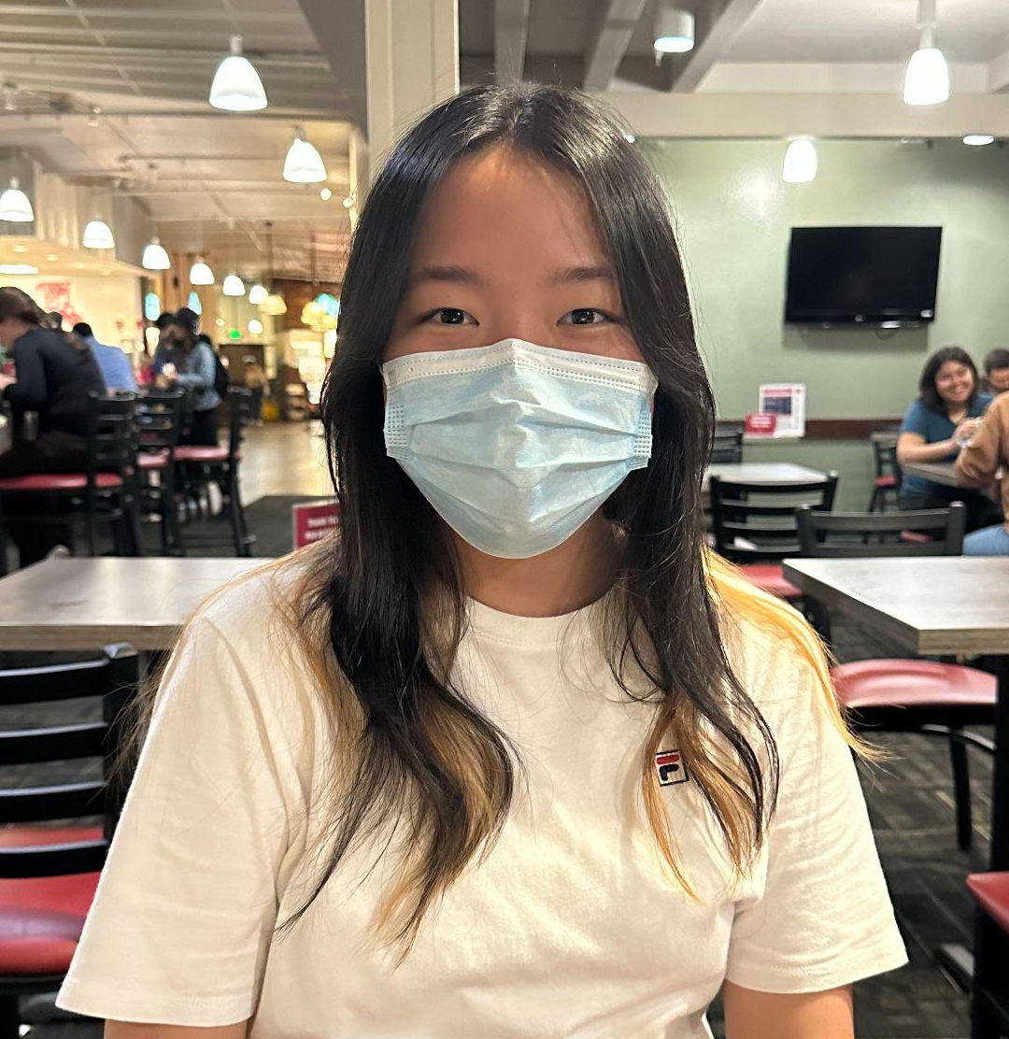
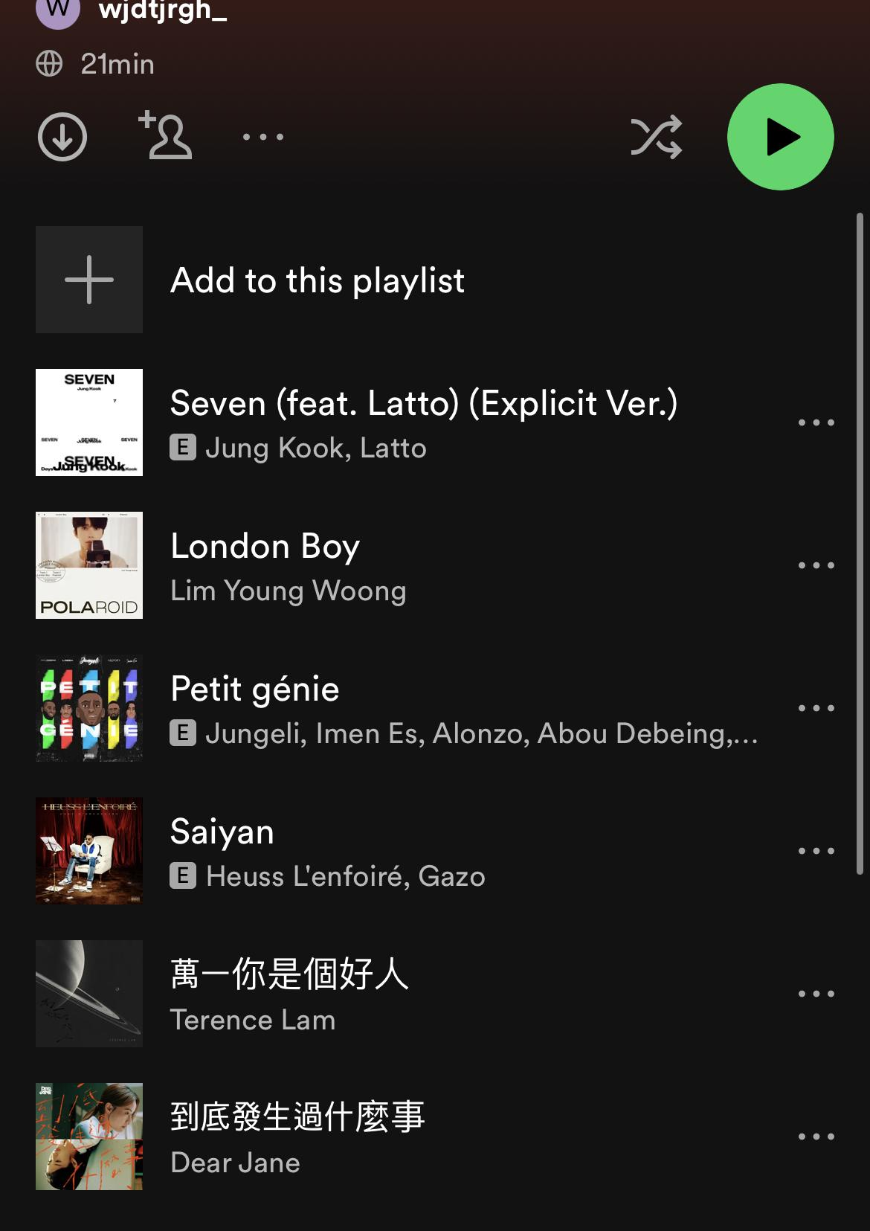
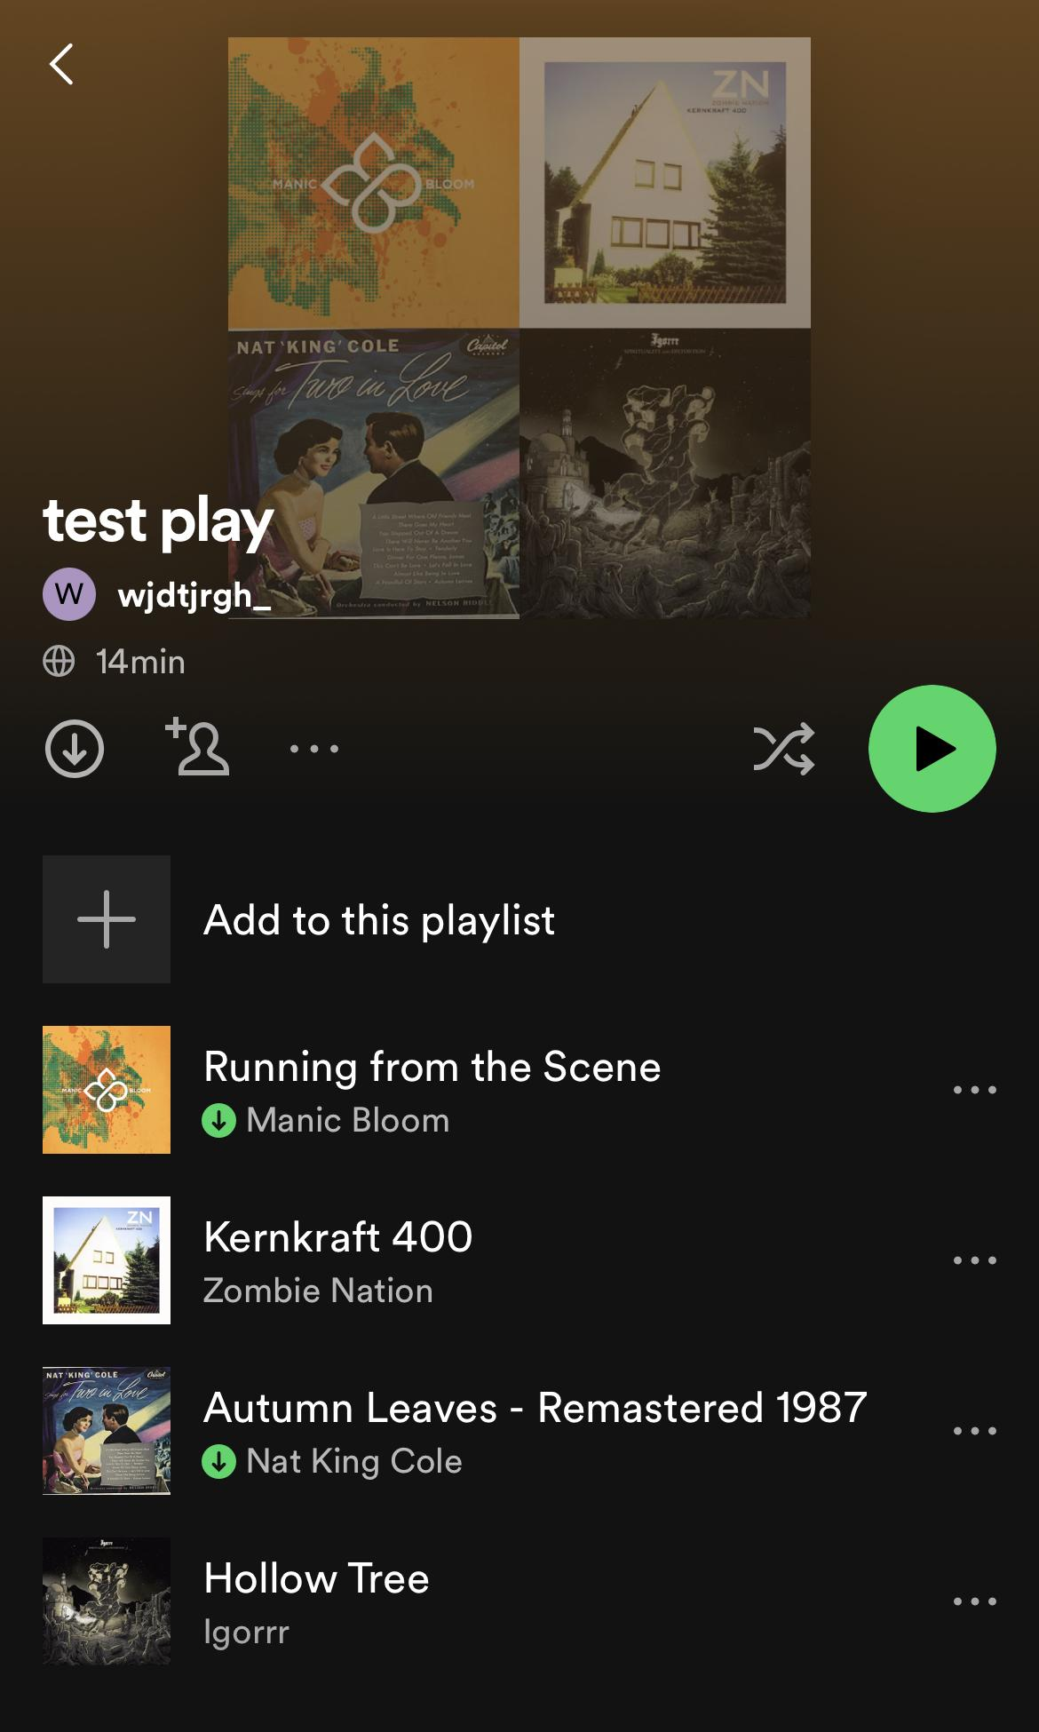
Experience Prototype
Countries chosen:
Korea
China
France
Genres chosen:
Pop
K-pop
Indie
Dorothy, 16
High school student
Casual music listener, usually gets new recommendations from friends
CS 147
FYP

Slide 25
Insights
What worked
What didn’t work
Mostly new songs
Liked being open-minded
It takes time to warm up to new things
CS 147
FYP

Slide 26
Key takeaways
First impressions aren’t always the end
New music is hard to find but people like to hear new things
Everyday listeners want a mix of familiar and new
CS 147
FYP

Slide 27
POV 3 - Miguel
We met…
Miguel Rodriguez, a DJ from New Jersey who listens to music in a variety of environments.
We were surprised to realize…
His favorite genre of music is Hip-Hop but his favorite album is from a different genre of music.
We wonder if this means…
That he likes to be open minded to finding different types/genres of music as a DJ who often interacts with music in social settings with diverse audiences.
It would be game-changing to…
Find a way to help Miguel find new music that aligns with his interest in the social spaces that music interacts with.
CS 147
FYP

Slide 28
How might we…
leverage the community-building and social aspects of music to help people find new music?
CS 147
FYP
Notes:
Brainstorm:
Music Tinder (swiping on someone else’s songs)
Book clubs for a weekly artist
BeReal but for what song you’re listening to at the moment
App that randomly switches what you’re listening to to what someone else in the area is listening to
Dating app where you can choose to be matched based on either how different or how similar your playlists are
App that tells you artists performing in your area and people in your area who are going
Social media app where you take a daily quiz to get a song rec & you can share it with your friends
TikTok for you page for songs or artists
App to connect people with DJs in the area for events
Find study groups based on music you like to study to

Slide 29

Solution - Music Matchmaking
Solution:
Key assumption:
Use social media to help people find music by interacting with a community!
People often find it more engaging to find music suggestions through friends or community than on their own.
CS 147
FYP

Slide 30
Experience Prototype
Part 1: Music Tinder
Participant selects a playlist from their feed of playlists posted by their friends
Participant says “like” or “not like” for each song
Swiping right to add a song to their playlist and left if not interested and up to move to another friends playlist
Part 2: Recommendations
At the end, give them a short playlist based on the songs they swipe right to
CS 147
FYP

Slide 31
Experience Prototype
Questions to ask:
Did you hear any new music you hadn’t heard before?
Was this an enjoyable experience?
How did you feel about the suggestions?
Assumptions:
People are curious about others’ music tastes
People like connecting with others who have similar tastes
People like finding new things through social means
CS 147
FYP

Slide 32
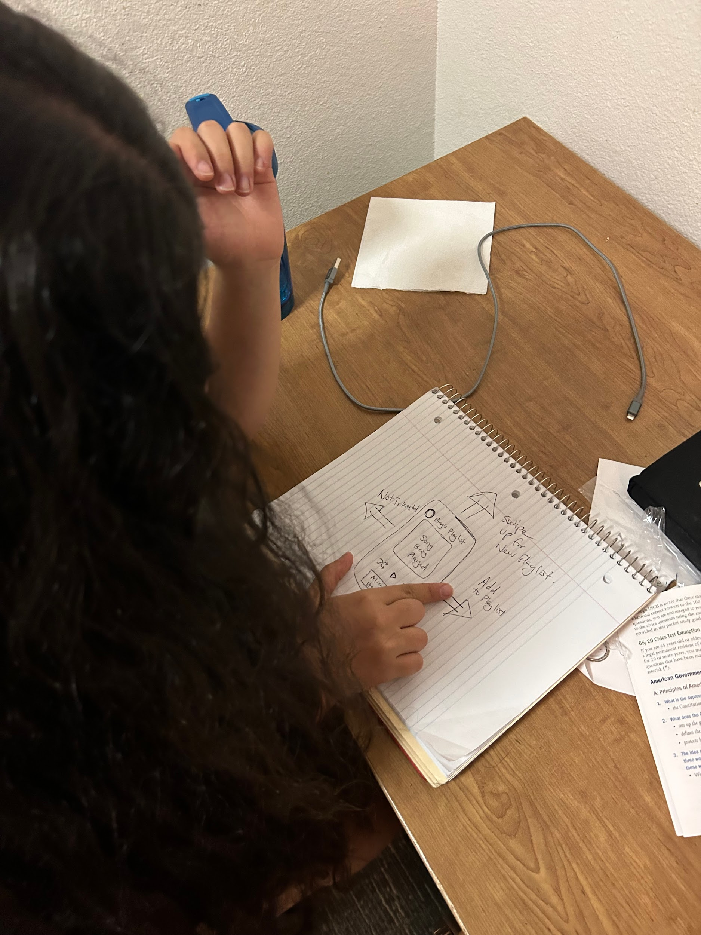
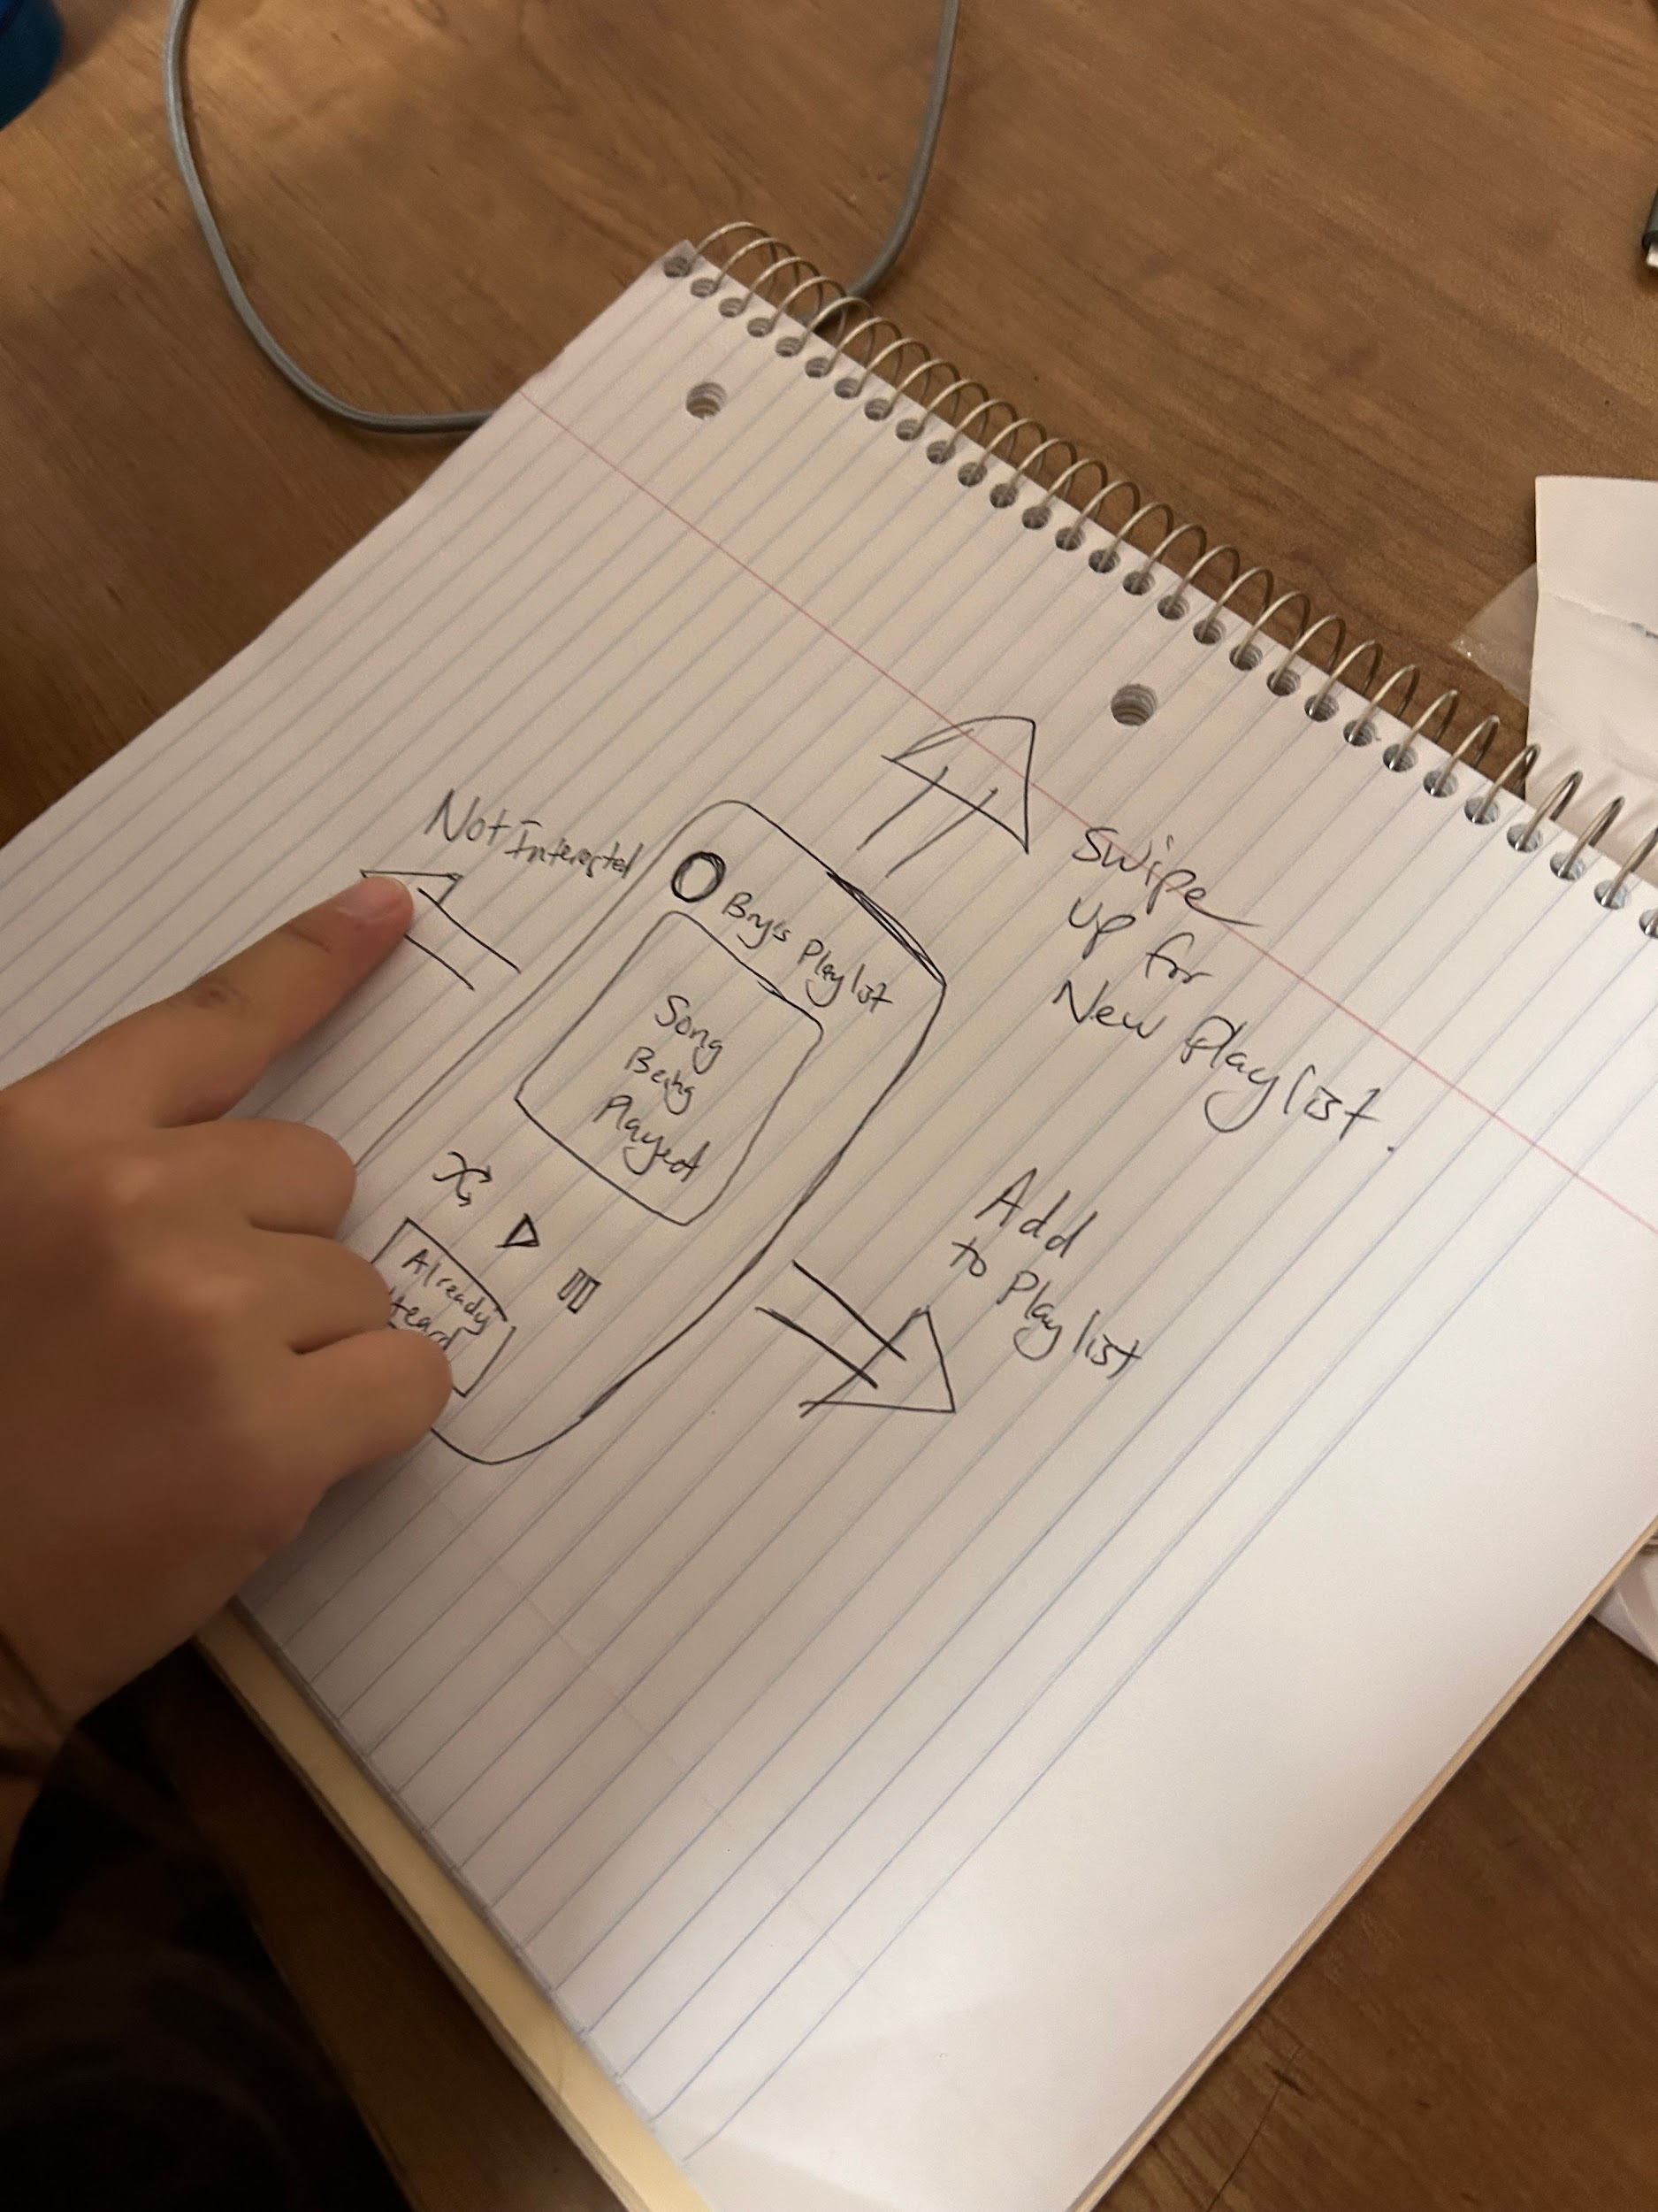
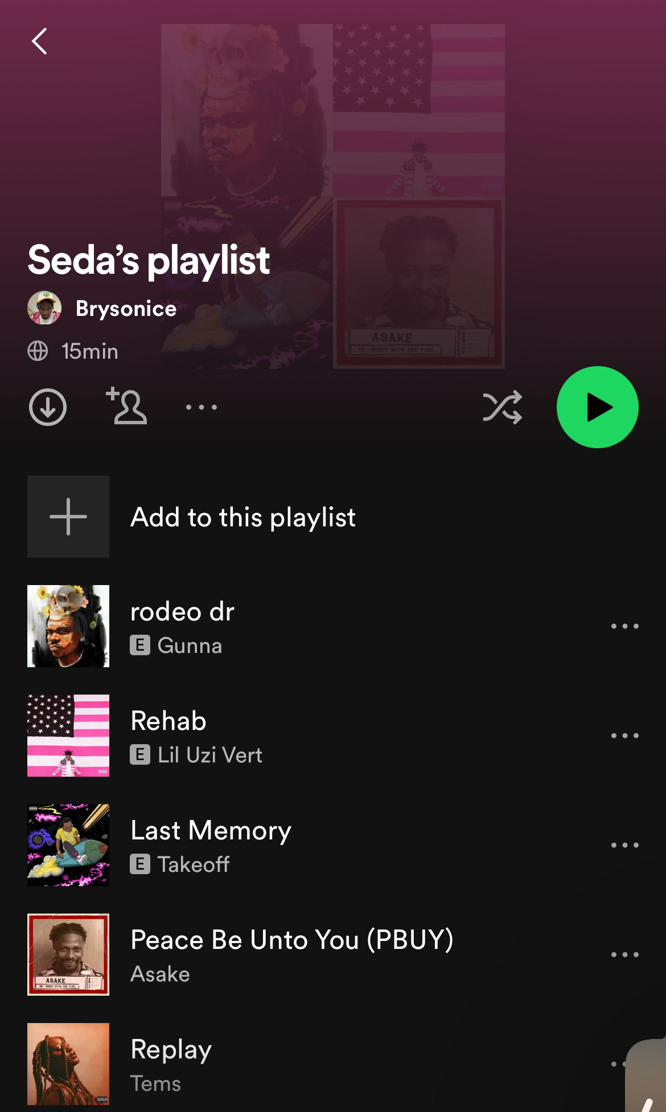
Experience Prototype
Seda, 20
Casual music listener
CS 147
FYP

Slide 33
Insights
What worked
What didn’t work
Exposure to new music
Community building based on music
Poor engagement with some playlists
CS 147
FYP

Slide 34
Key takeaways
Combining social networks and music discovery can be more fun/engaging
People often like turning to friends for new music suggestions
Sharing music tastes can be hard for people that are shy
CS 147
FYP

Slide 35
What’s next?
CS 147
FYP

Slide 36

Final solution
Leveraging community for personalized music suggestions
CS 147
FYP

Slide 37
Final solution
Ethical implications:
  Age range?
  Ability to freely comment?
  Privacy?
Who does it serve?
  Everyday music listeners
  Likely younger, tech-savvy people
Who might we leave out?
  Those who are not social media savvy
  Those who shy away from sharing their tastes online
CS 147
FYP

Slide 38
Thank you!
CS 147
FYP

