Slide 1
Market Research + Concept Video
HOME
TABLE OF CONTENTS
PLAYLIST
01
Project name + solution overview
02
Market research
03
Tasks
Retune
04
Storyboards
THANKS!
CS 147
Retune

Slide 2
Project name - Retune
“Refresh your tunes”
Our app will streamline the process of finding new music into an interactive, social experience
Share what you like with others while also finding new artists and songs
Retune because new music will not replace old music, but offer a way to mix up your vibes
CS 147
Retune
Notes:
Project name and value proposition
a. How did your team land on the name?
b. One-liner value proposition that conveys what customers get out of your product (e.g., Stripe “Payment infrastructure for the Internet”)
c. Sanity check: could your value proposition be applicable to many other apps or is it particular to yours? You want the latter.

Slide 3
Retune
Problem/solution overview
Primary user:
  Casual, everyday music listeners who don’t have time to actively search for new music
Problem:
  Need to make exposure to new music inviting, fun, and convenient
Solution:
  Leverage community for personalized and interactive music suggestions
CS 147
Retune
Notes:
Problem/solution overview
a. 1-3 sentences total
b. Who the primary user is
c. Problem you are tackling
d. Brief synopsis of your proposed solution

Slide 4
Retune
Solution
Our app will allow people to share their daily music and experiences with a broader community! Post a picture accompanied with a song, along with a caption that can be anything from a daily quote, how you’re feeling at the moment, or why you’re listening to that song. Commenting capabilities allow for social interaction, while adding songs to customized playlists in the app allow you to remember new tunes you find!
CS 147
Retune
Notes:
Problem/solution overview
a. 1-3 sentences total
b. Who the primary user is
c. Problem you are tackling
d. Brief synopsis of your proposed solution

Slide 5
Market Research
CS 147
Retune

Slide 6
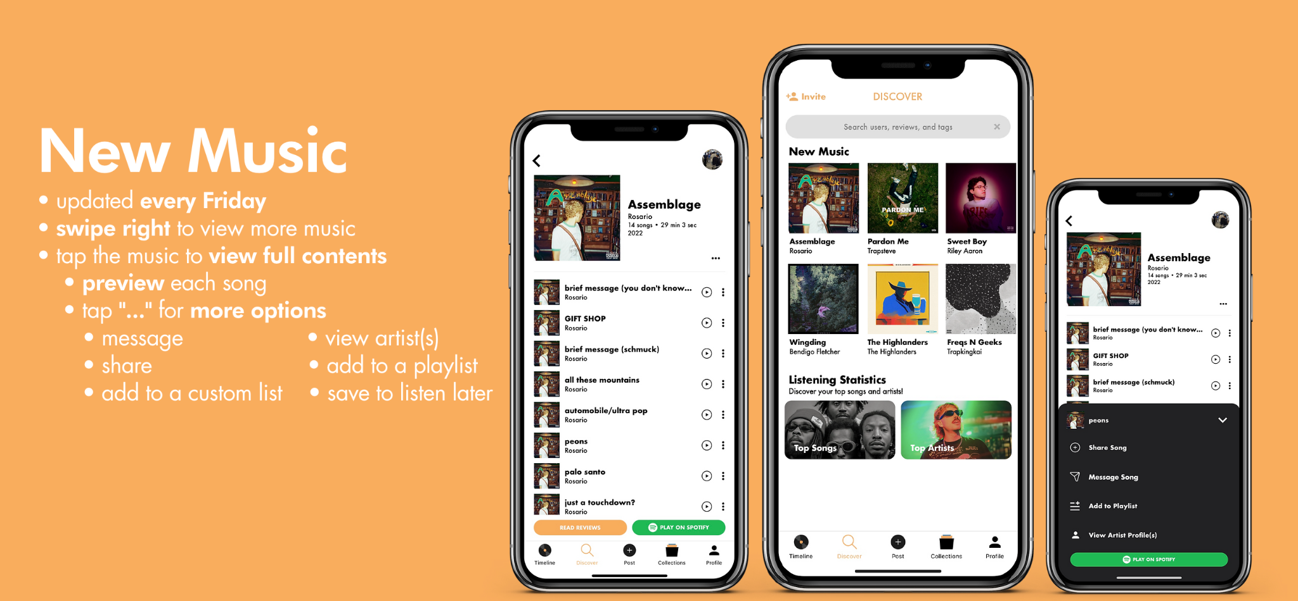
groupie
“the music community you’ve been searching for”
CS 147
Retune

Slide 7
groupie
“the music community you’ve been searching for”
What works?
What’s different?
Takeaways
Gain exposure to local artists & fellow app-users
Able to construct playlists within the app
Ability to add songs to a “listen later” playlist
Customizable profile
Review based system– less popular artists/songs might not get as much traction
More about reviewing the music itself rather than how the music relates to your day-to-day life
We want to stay away from a review-based system, which might prevent people from being open-minded about less popular songs
We want the app to be more about using music to share current feelings and events, rather than strictly ‘rating’ the songs
CS 147
Retune

Slide 8
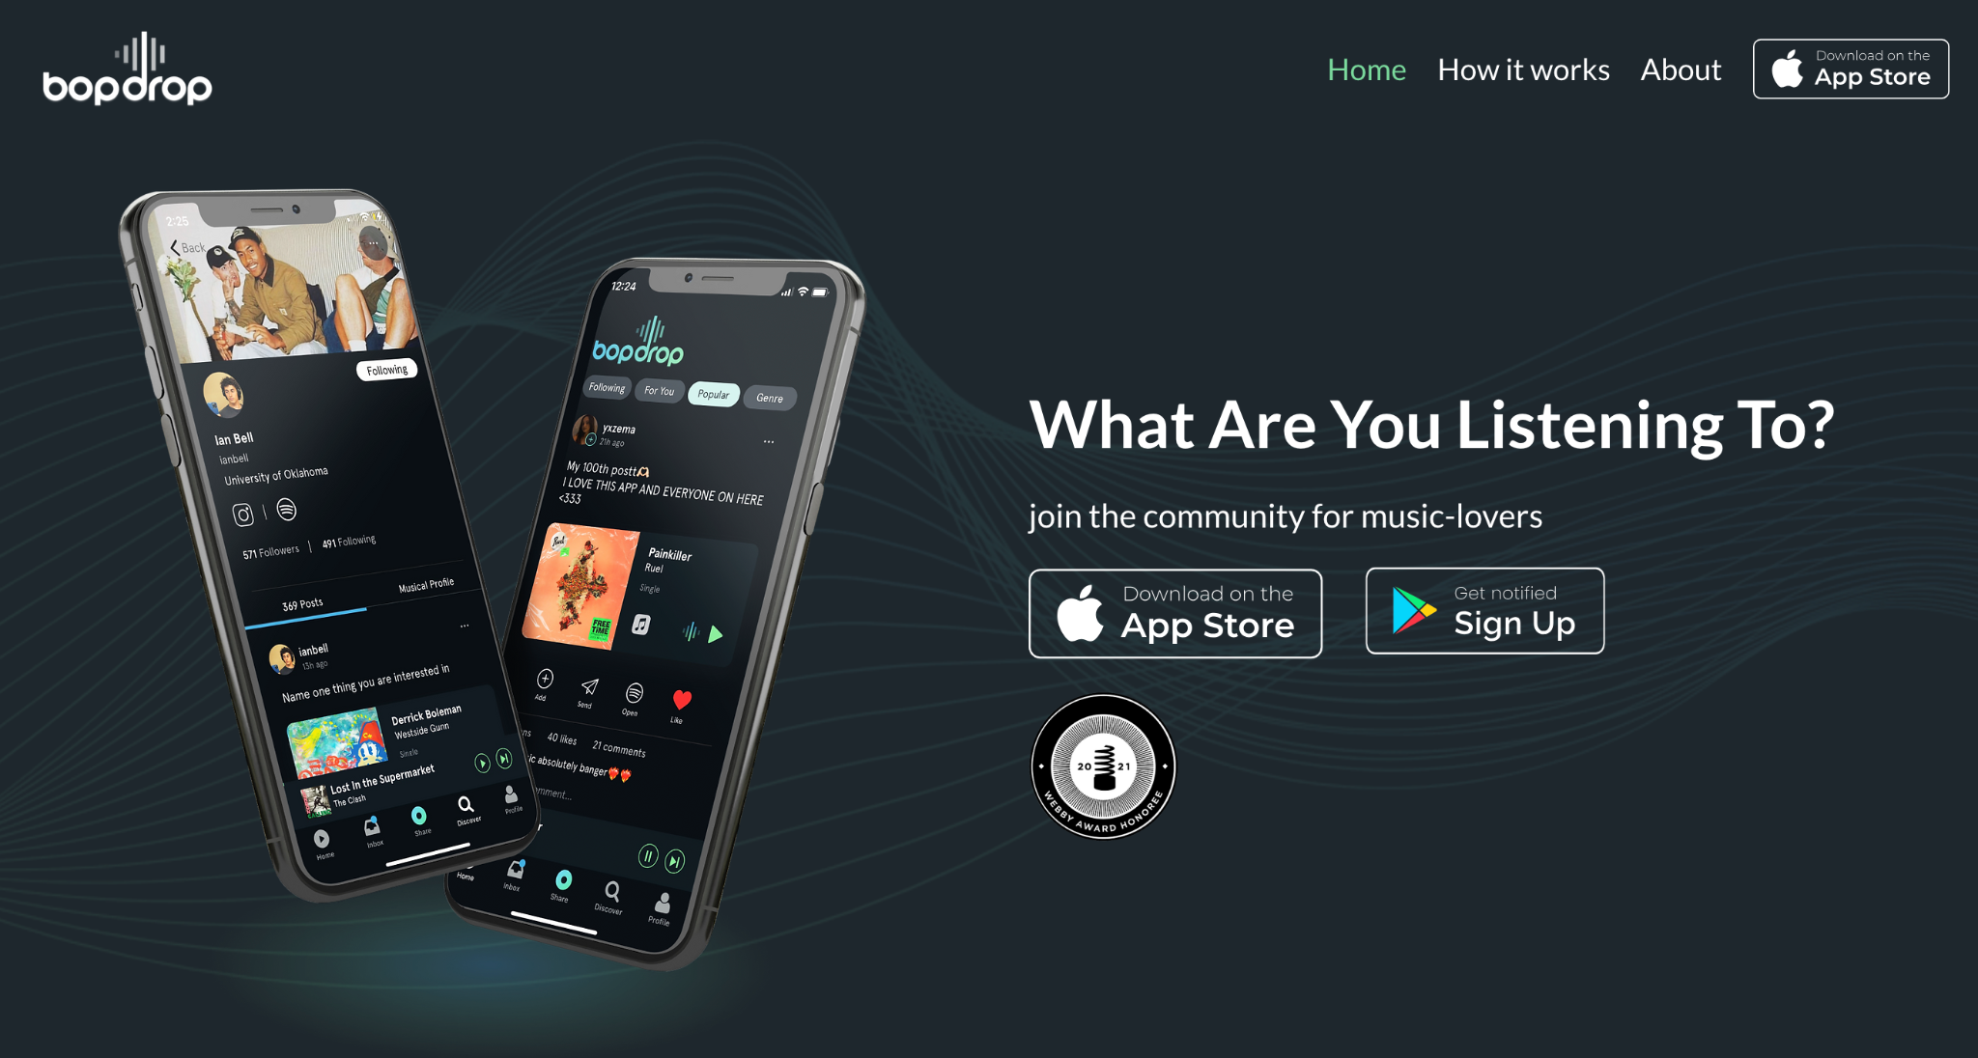
bopdrop
“bopdrop is going to change the way you find & share music”
CS 147
Retune

Slide 9
bopdrop
“bopdrop is going to change the way you find & share music”
What works?
What’s different?
Takeaways
Can DM people songs, enables discussion
Can listen to music while scrolling through the app
Can construct playlists directly from posts
Only compatible with iPhone
Can only post one song per day (and one song at a time) which is limiting for how people’s moods change through the whole day
We don’t want to limit how many songs people can post– we want people to use the app to document their feelings or experiences with music throughout the day
CS 147
Retune

Slide 10
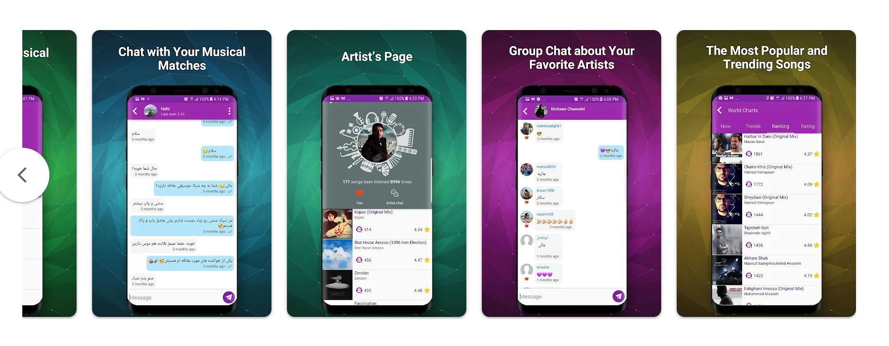
Musera
“Music Social Network”
CS 147
Retune

Slide 11
Musera
“Music Social Network”
What works?
What’s different?
Takeaways
Can discover friends listening to similar songs
DM and groupchat options
“Shazam” sort of feature built into app
Gives suggestions based on top ranking/trending songs– may prevent people from hearing lesser-known things
Also a rating-based system, which may bury many new artists or songs
We want our app to pull from all kinds of songs that all kinds of people are listening to, not just the top charts
Our app isn’t about what’s popular, but about what people are connecting with
CS 147
Retune

Slide 12
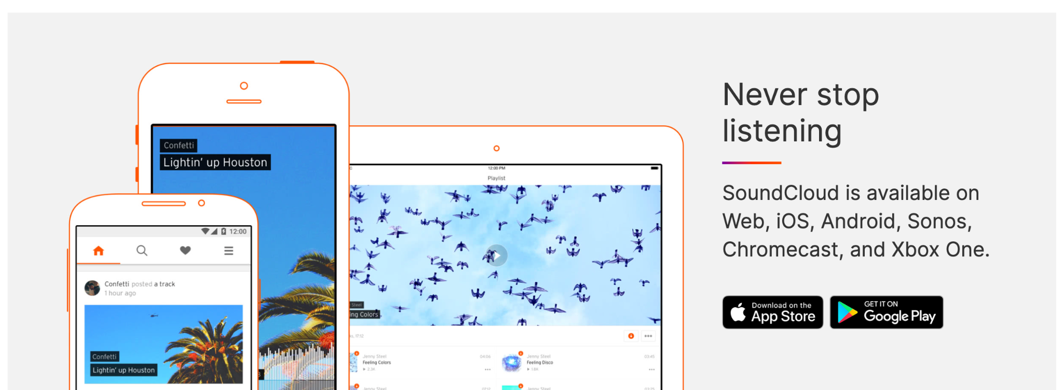
SoundCloud
“Discover New Music”
CS 147
Retune

Slide 13
SoundCloud
“Discover New Music”
What works?
What’s different?
Takeaways
Artists post their music on a feed that is exposed to different listeners
Audiences are allowed to interact with music via comments thus building a community around the music
Only artists or creators are allowed to post music of their choice whereas our app allows users to post music that they enjoy
Through features like comment sections and sharing we can foster discussions and build communities around the music
CS 147
Retune

Slide 14


Competitor Competition Matrix
 | groupie | bopdrop | Musera | SoundCloud | Retune
Exposure to less well-known music
Focus on social interaction
Open to all users
Unlimited posting
CS 147
Retune

Slide 15
Design values
CS 147
Retune

Slide 16




Individuality
Inclusivity
Fun
Ease of use
Allowing people to express their unique personalities and experiences through sharing music.
Encouraging open-mindedness and allowing people to share their thoughts without the fear of judgement or criticism.
Making the process of discovering new music inviting and fun rather than tedious.
Making it easy for users of all technological backgrounds to interact with an online community.
CS 147
Retune

Slide 17
Stakeholders
Direct:
Casual music listeners
  Can use to socialize and find new music
Artists
  Our product will feature their work
Indirect:
Record labels
  Copyright concerns
Streaming services e.g. (Spotify, Apple Music)
  Integration / API
  May benefit if we connect users’ personal Spotify/other accounts to the app
CS 147
Retune

Slide 18
Ethical Implications
The Scandal
  Artist compensation
    Popular artists on platform should be compensated fairly
  Data privacy
    Personal data (location, email, birthdate) should be encrypted
The Big Bad Wolf
  Hate speech / bullying / abuse
    Community guidelines should prevent hateful content while protecting freedom of speech
The Forgotten
  Tech-savvy requirement
    UI should be simple and clear enough to be accessible to non-tech savvy users
CS 147
Retune

Slide 19
Tasks
CS 147
Retune

Slide 20
Simple
Find new artists and songs to listen to
A user is tired of listening to the same music over and over again, and wants to find new songs that can revamp their listening experience.
Simple task; scrolling through the app will likely allow them to gain exposure to new kinds of songs or artists.
CS 147
Retune
Notes:
Finding some new music to listen to
Discovering new artists and genres

Slide 21
Moderate
Discover what friends are listening to
A user wants to be able to know what songs their friends are listening to day-to-day.
Moderate task; this involves building community within the app, through e.g. adding friends, adding people you meet on the app, etc.
CS 147
Retune

Slide 22
Complex
Share music you’ve learned with other people
A user who is excited about a new song they found, or an old song they’ve revisited, wants to be able to share this excitement with people in their community.
Complex task; this involves making your own posts, choosing what songs/playlists and images to post, and deciding what you want to share.
CS 147
Retune

Slide 23
Storyboarding
CS 147
Retune

Slide 24
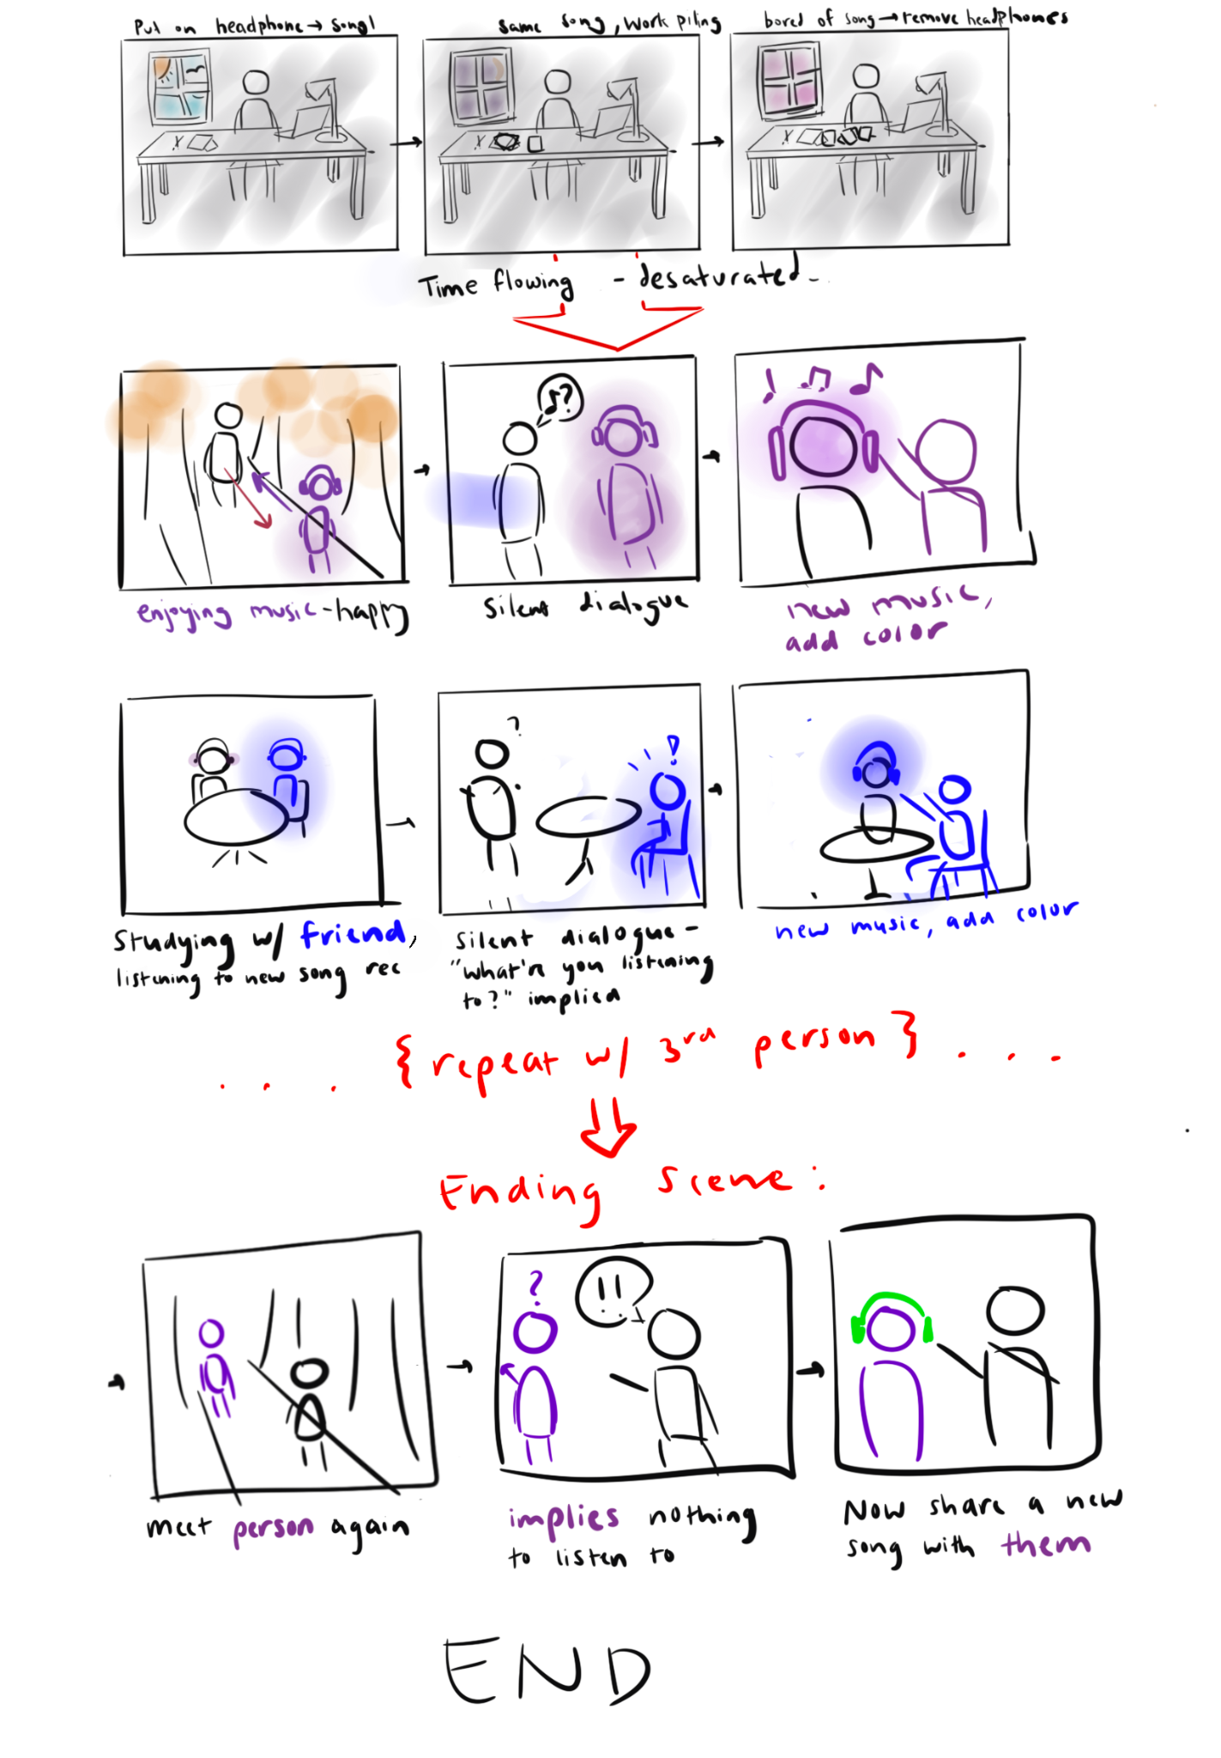
Overall storyboard; close-ups in following slides
CS 147
Retune

Slide 25
CS 147
Retune

Slide 26
CS 147
Retune

Slide 27
CS 147
Retune

Slide 28
CS 147
Retune

Slide 29
Video link:
https://youtu.be/vKbCQ6XUfr0
CS 147
Retune

