Slide 1
Sketching, Low-fi Prototyping & Pilot Usability Testing
HOME
TABLE OF CONTENTS
PLAYLIST
01
Intro
02
Sketches
03
Low-Fi Prototype
Retune
04
Testing
05
Discussion
THANKS!
CS 147
Retune

Slide 2
Project name - Retune
“Refresh your tunes”
Replace old music Mix up your vibes
Replace old music
Share your favorite songs, request new songs
Discover music through a social experience
CS 147
Retune
Notes:
Project name and value proposition
a. How did your team land on the name? Retune because new music will not replace old music, but offer a way to mix up your vibes
b. One-liner value proposition that conveys what customers get out of your product (e.g., Stripe “Payment infrastructure for the Internet”)
c. Sanity check: could your value proposition be applicable to many other apps or is it particular to yours? You want the latter.
We offer not just discovering music, but doing it through social experience
Our app will streamline the process of finding new music into an interactive, social experience

Slide 3
Retune
Problem/solution overview
Primary user:
Problem
Solution:
Casual listeners
Exposure to music is daunting
Leverage community, personalize suggestions
CS 147
Retune
Notes:
Problem/solution overview
a. 1-3 sentences total
b. Who the primary user is
Casual, everyday music listeners who don’t have time to actively search for new music
c. Problem you are tackling
Need to make exposure to new music inviting, fun, and convenient
d. Brief synopsis of your proposed solution
Leverage community for personalized and interactive music suggestions

Slide 4



Retune
Solution
Post songs based on your day!
Find a community!
Share and discover music!
CS 147
Retune
Notes:
Our app will allow people to share their daily music and experiences with a broader community! Post a picture accompanied with a song, along with a caption that can be anything from a daily quote, how you’re feeling at the moment, or why you’re listening to that song. Commenting capabilities allow for social interaction, while adding songs to customized playlists in the app allow you to remember new tunes you find!

Slide 5
Sketching Explorations
CS 147
Retune

Slide 6
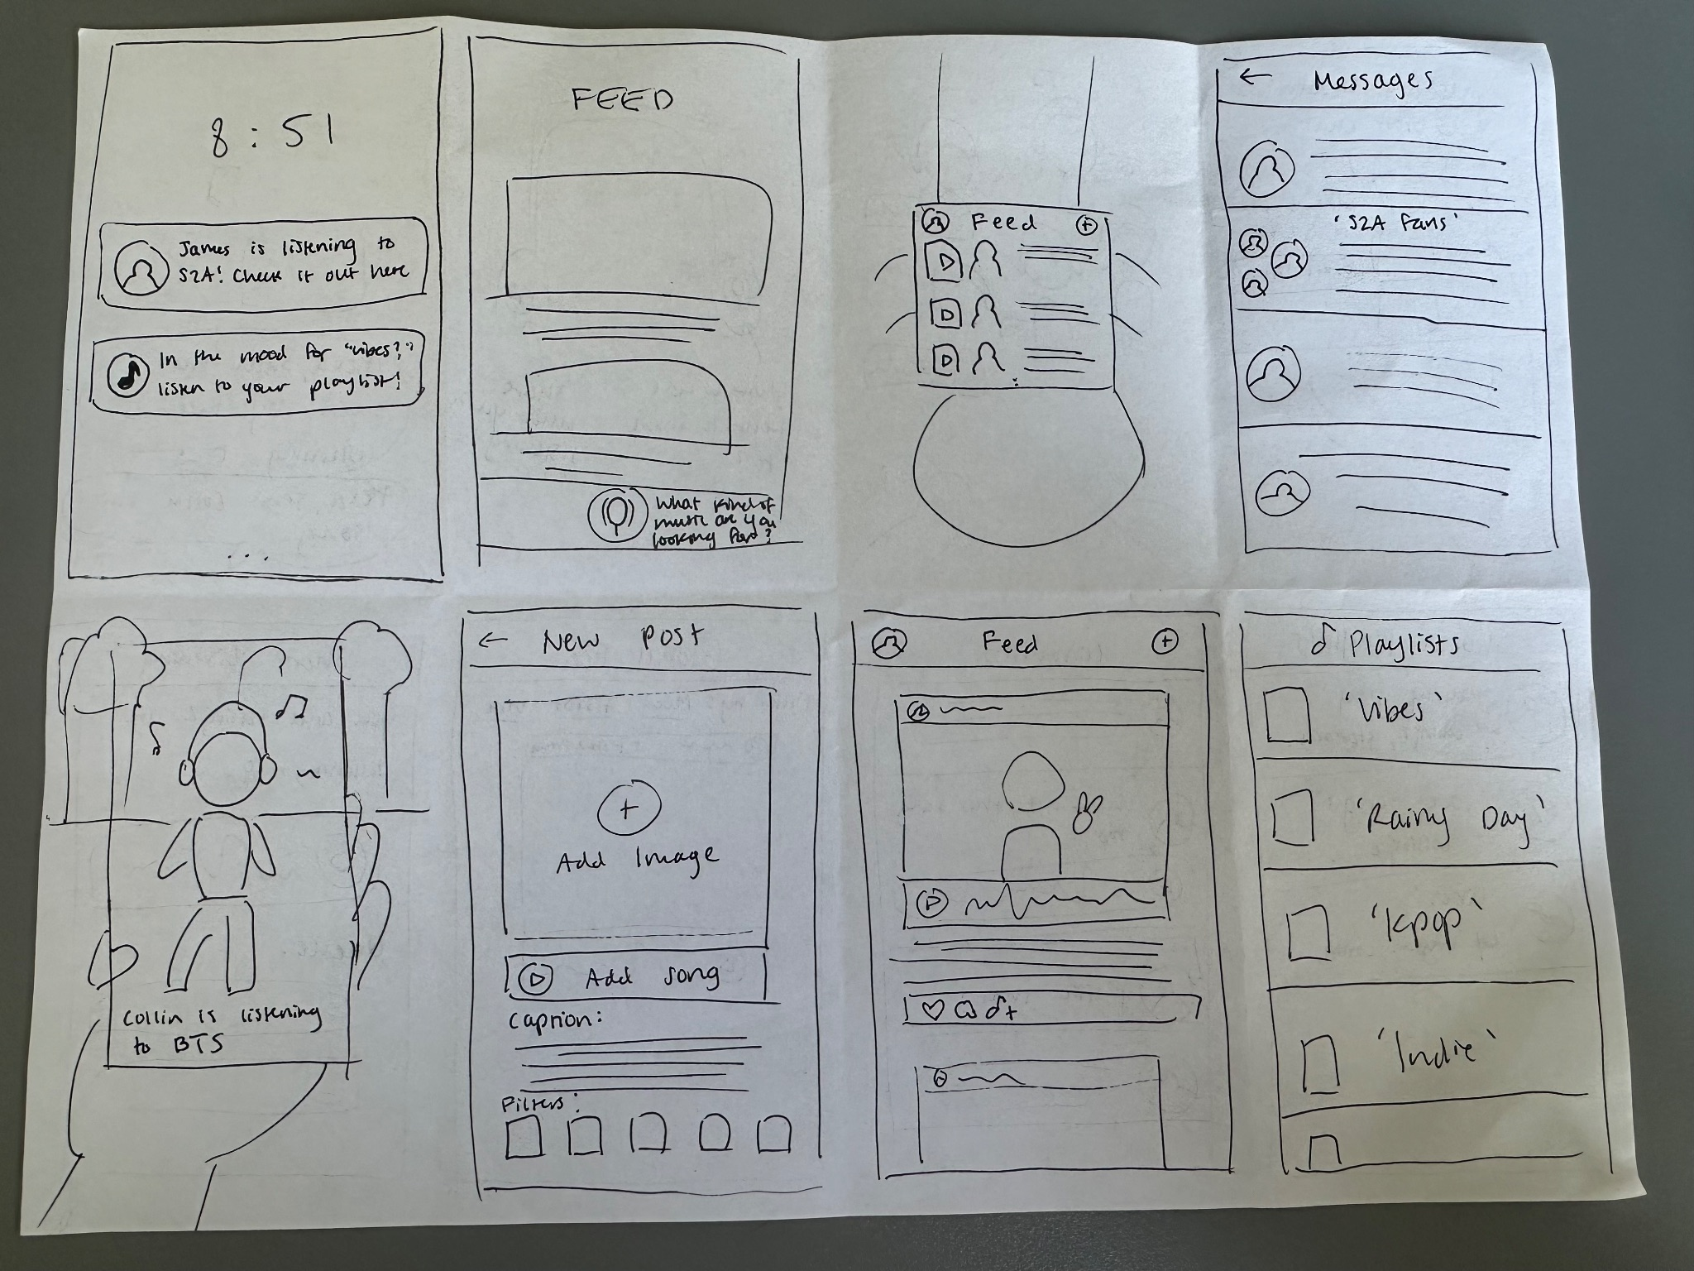
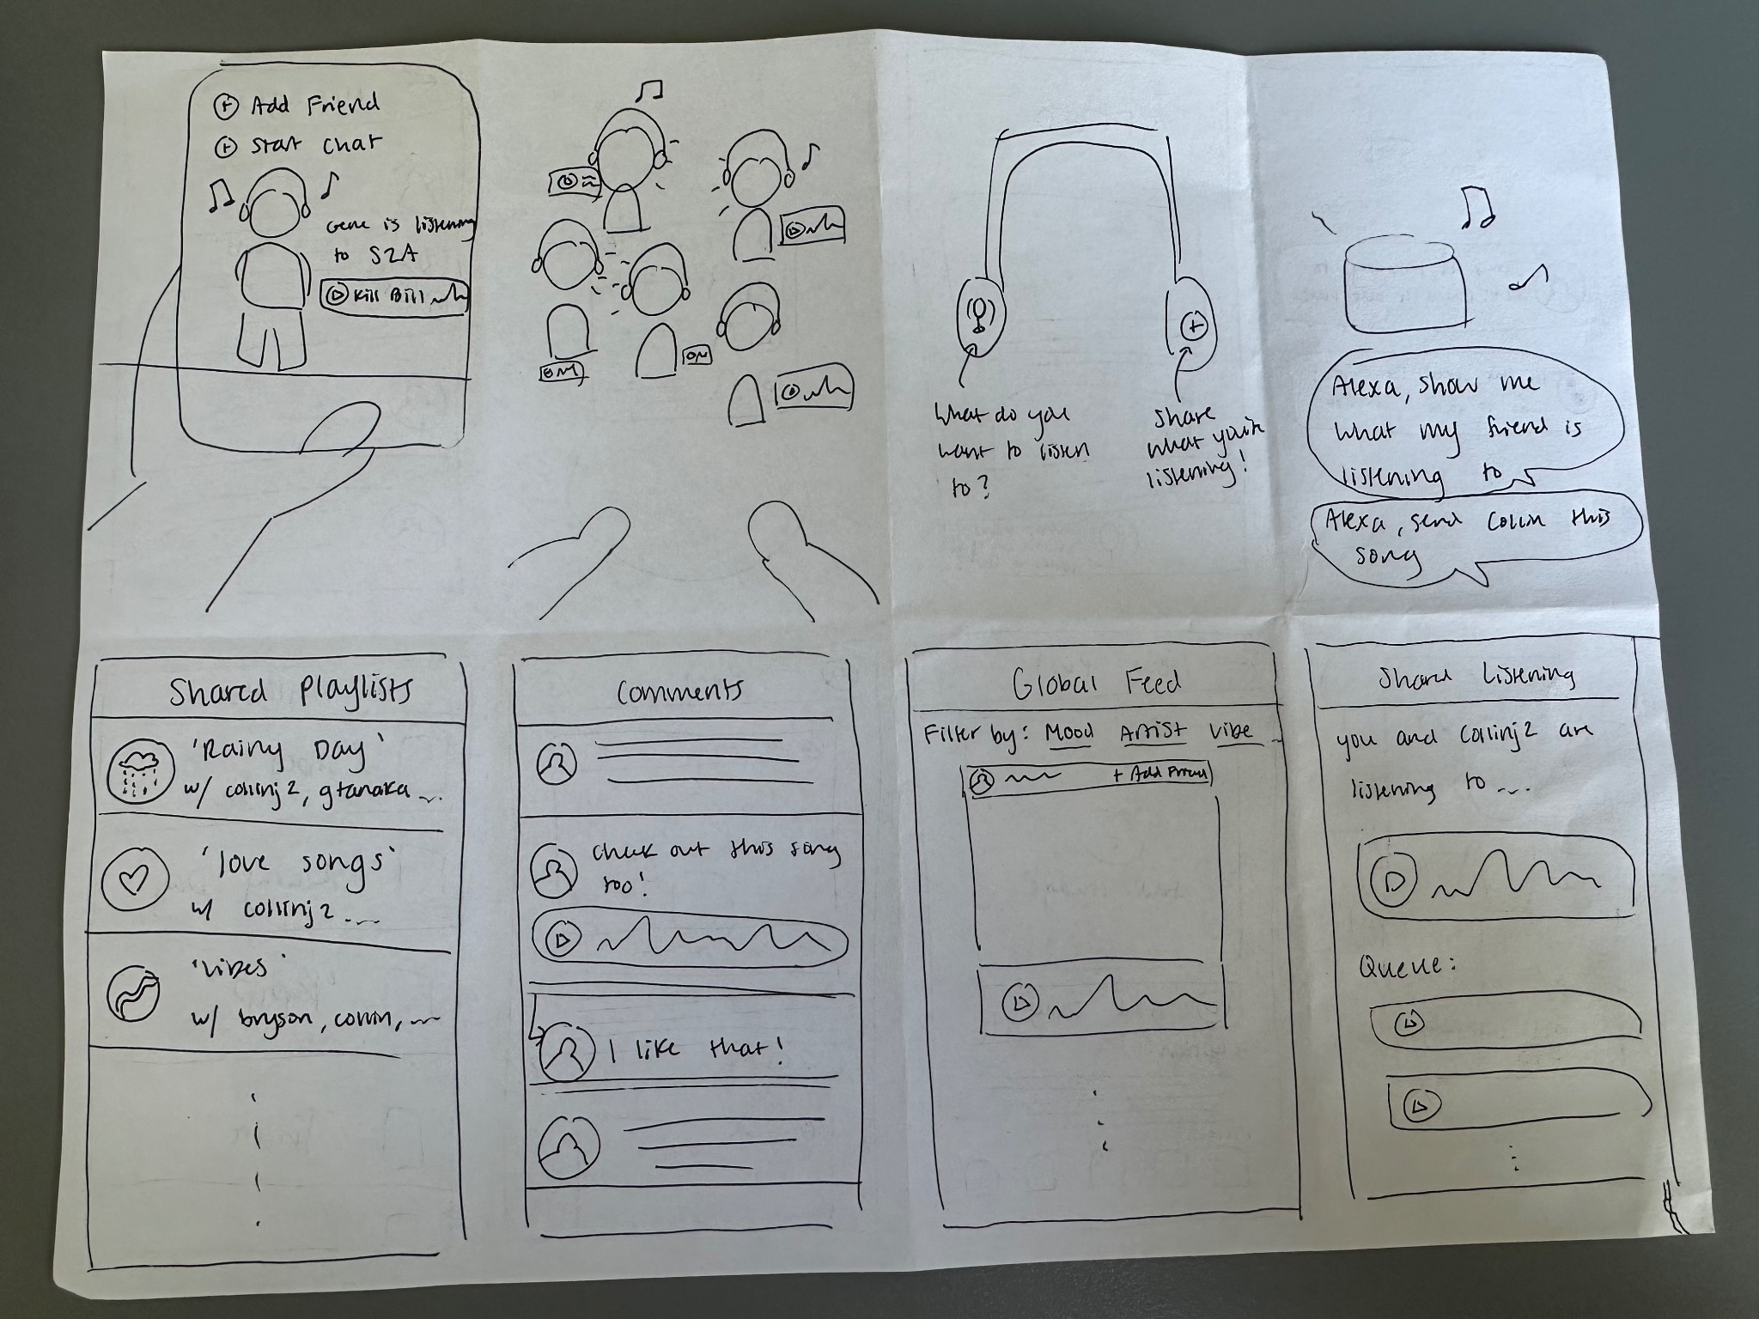
Concept Sketches: Crazy 8s
CS 147
Retune

Slide 7
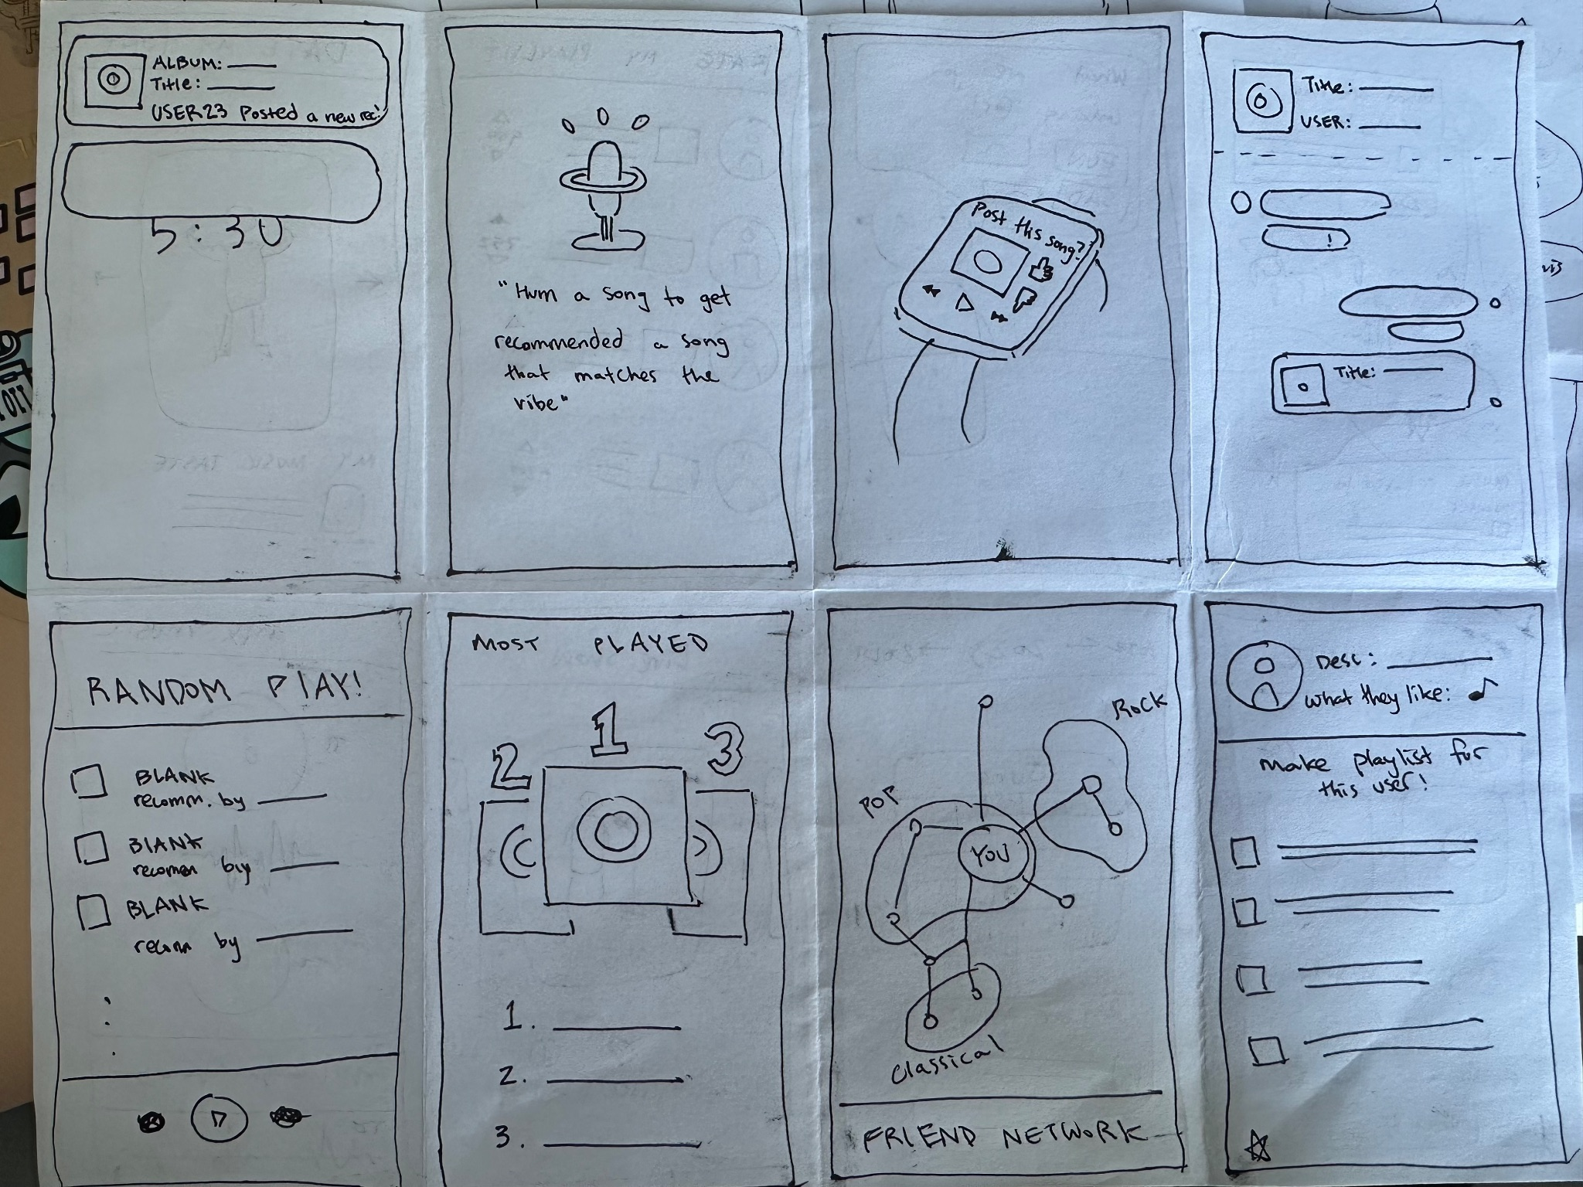
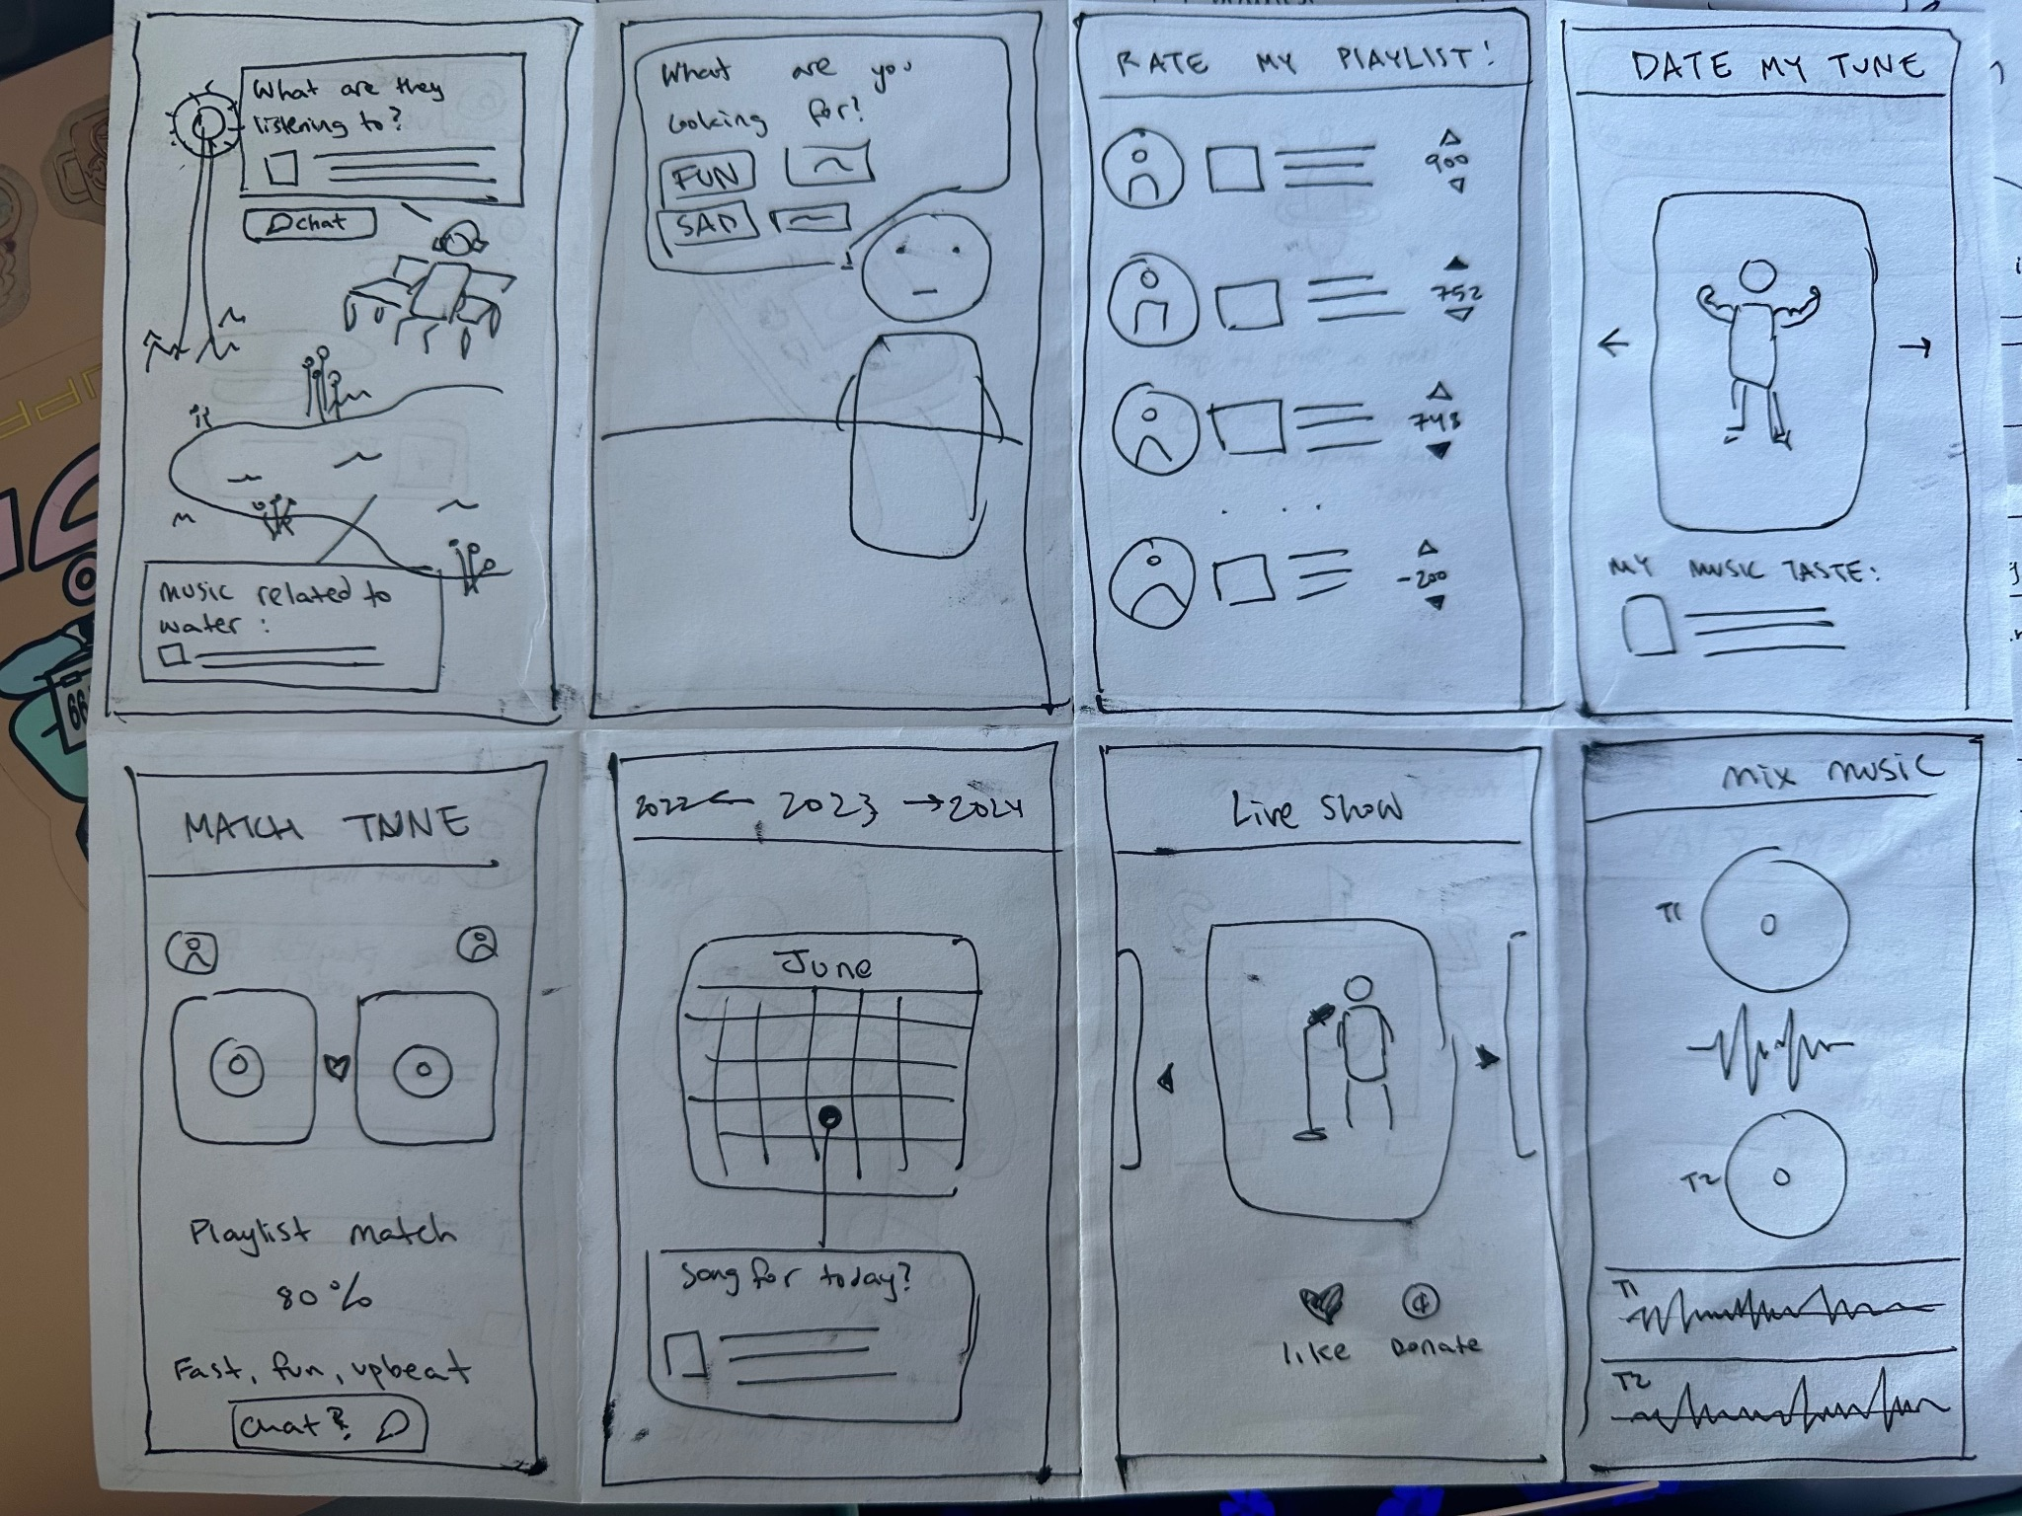
Concept Sketches: Crazy 8s (continued)
CS 147
Retune

Slide 8
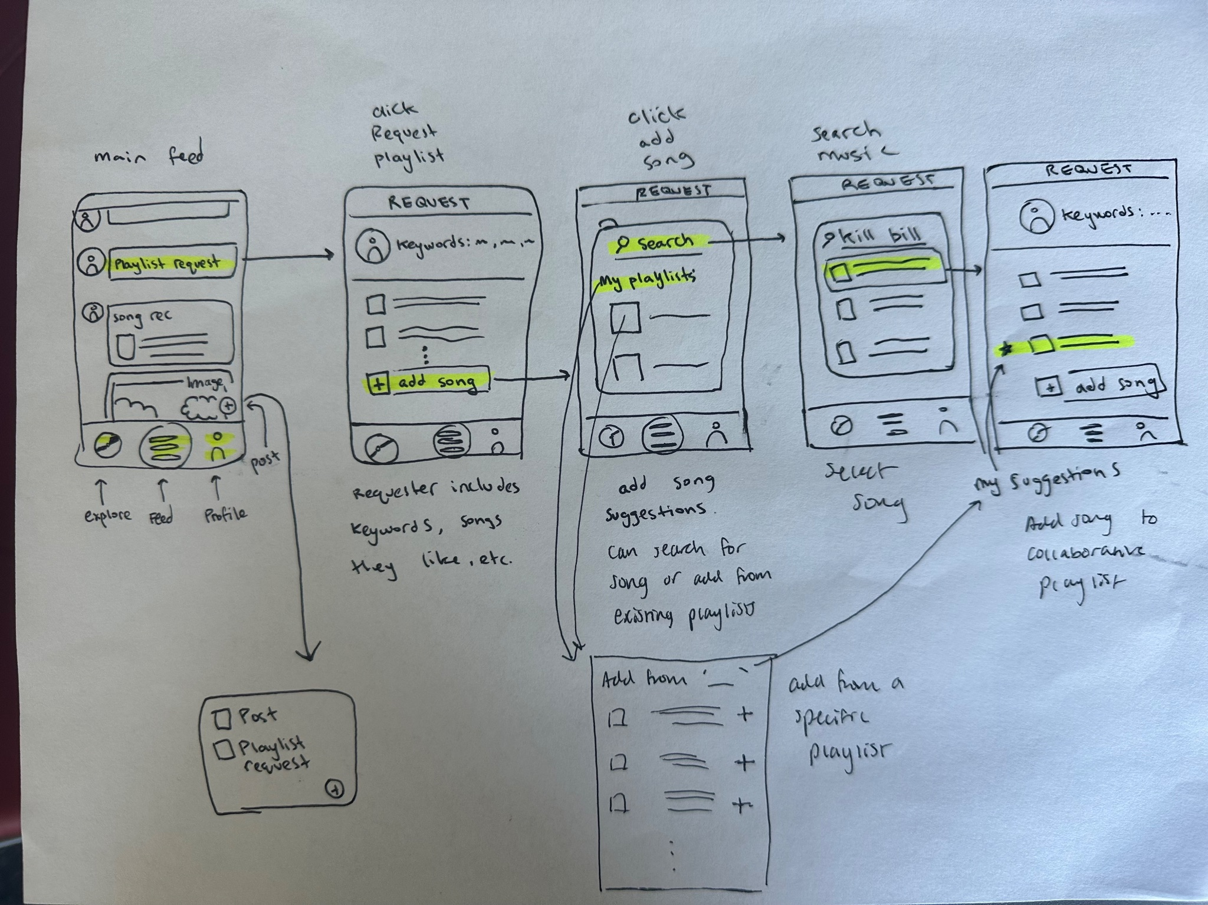
Realization (Choice 1): Playlist Requests
Pros:
  Interactive
  Collaborative
Cons:
  Text heavy
  Unclear how to find new friends
CS 147
Retune
Notes:
Pros:
Feed includes interactive element of collaborative playlist
Cons:
Seems text heavy, may overwhelm users, especially ones unfamiliar with social media
The social aspects of the app also seem a bit unclear, since this was an important part of our brainstorming/needfinding
It seems a little complex, and our needfinding pointed to the need for more simple and intuitive ways to find music

Slide 9
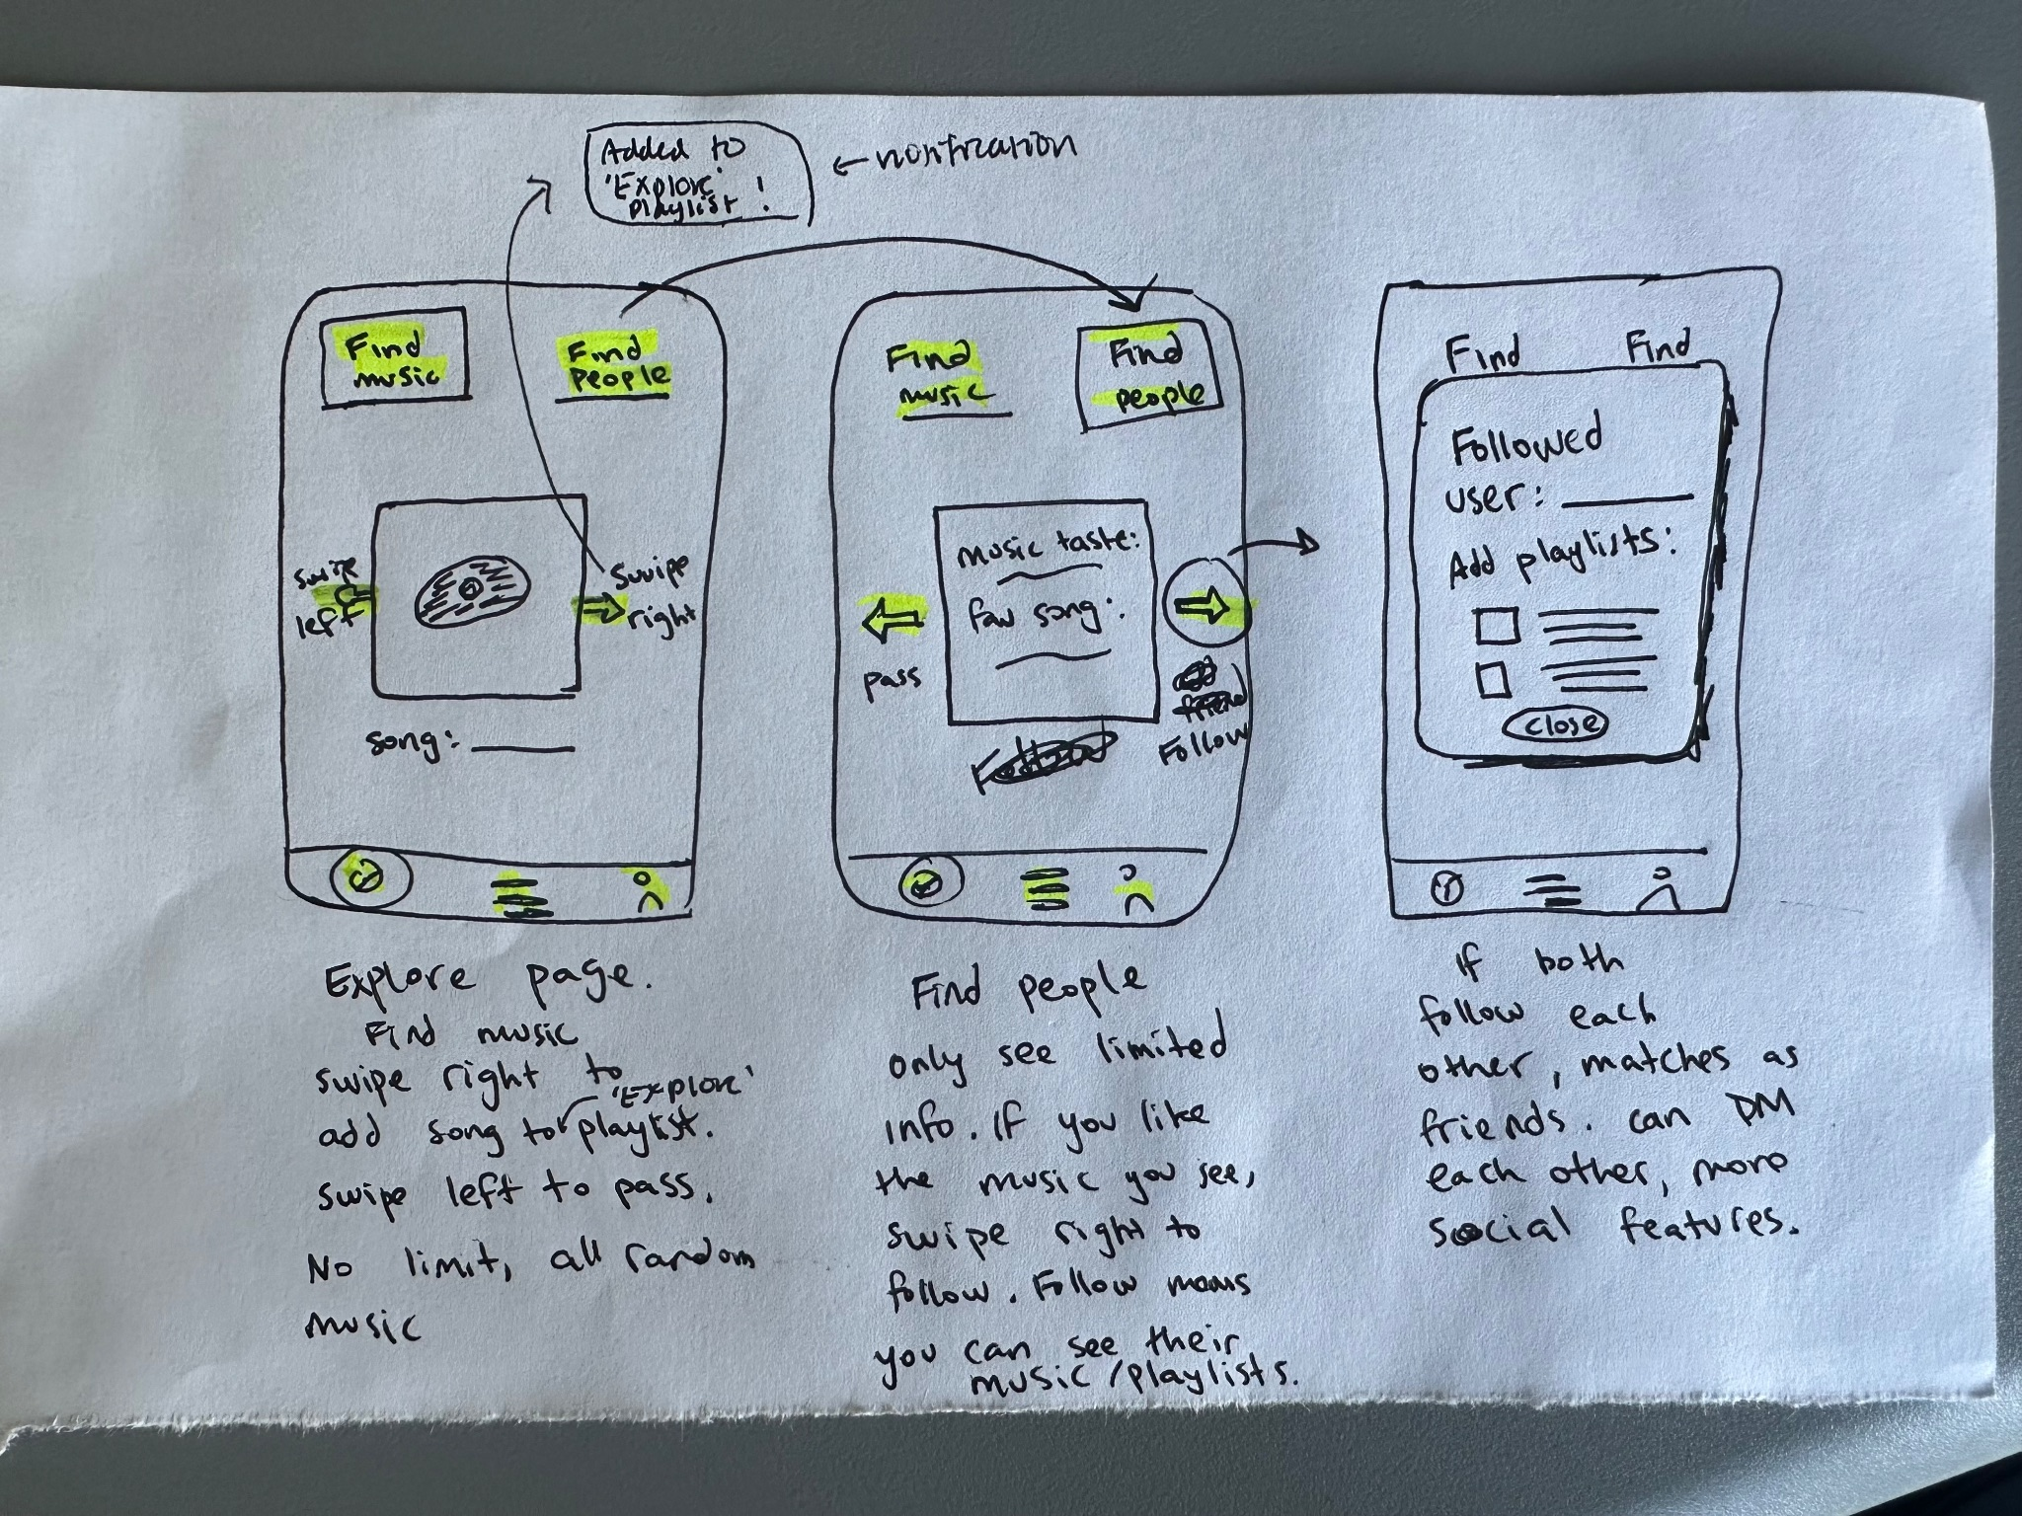
Realization (Choice 2): Explore feed for music & friends
Pros:
  Interactive
  2 options for explore
Cons:
  Needs a more detailed feed
CS 147
Retune
Notes:
Can explore BOTH people and music, hitting on the two main themes of our app
Presents multiple ways of engaging with the app to retain interest
But hard to represent the experience without being able to populate a detailed explore page

Slide 10
Winner: Explore Page for music and people!
Highlights the social aspect
Encapsulates main theme of app
CS 147
Retune
Notes:
Helps users experience the social aspect of the app, which was our main theme
Gain an experience of what the app might feel like upon first interaction

Slide 11
Our tasks: Updated!
Find something new to listen to
Discover what friends are listening to
Reshare new music you’ve learned with other people
Find a song and add it to your playlist
Find a friend to add
Add one of your new friend’s songs to your playlist
CS 147
Retune
Notes:
Wanted to hone in on the intermediary steps needed to engage with the app
Start building the interactions we were originally looking at.

Slide 12
Low-Fi Prototyping
CS 147
Retune

Slide 13
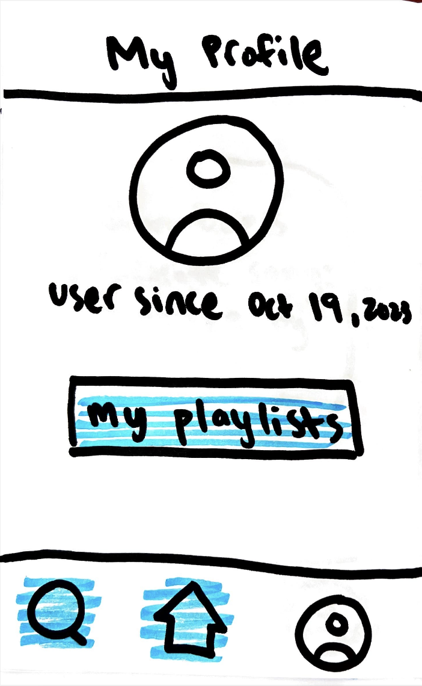
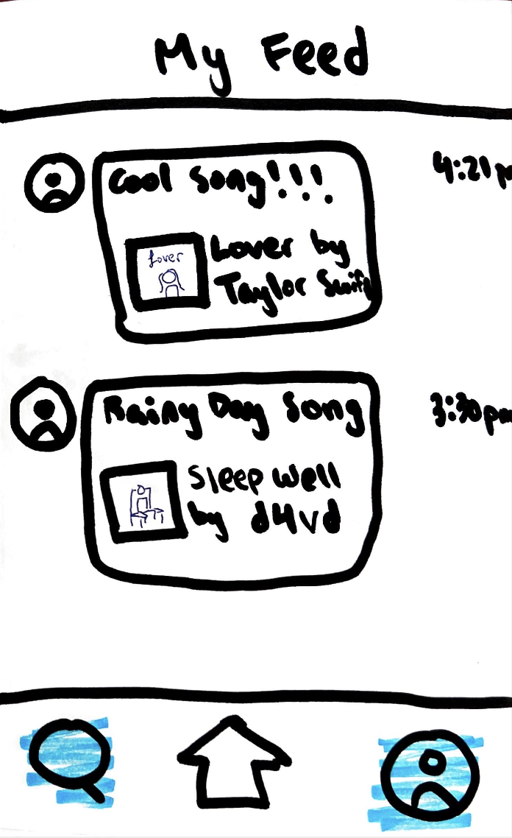
CS 147
Retune
Notes:
this is our Starting page

Slide 14
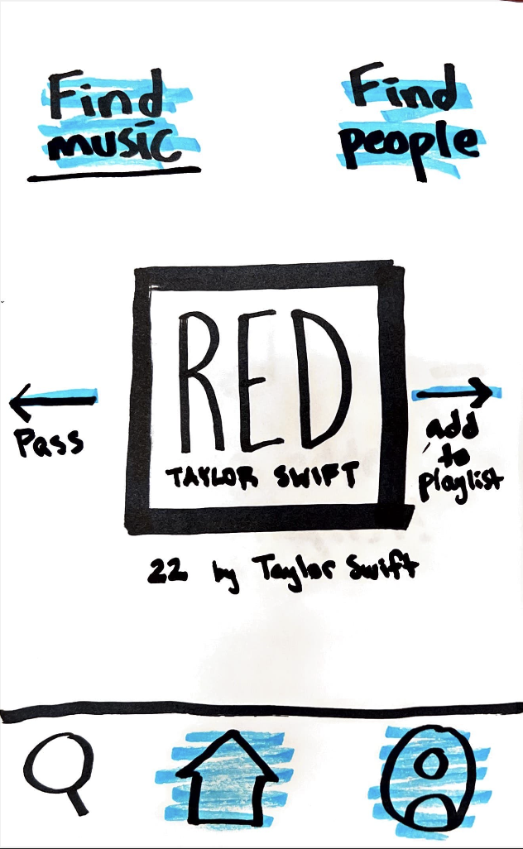
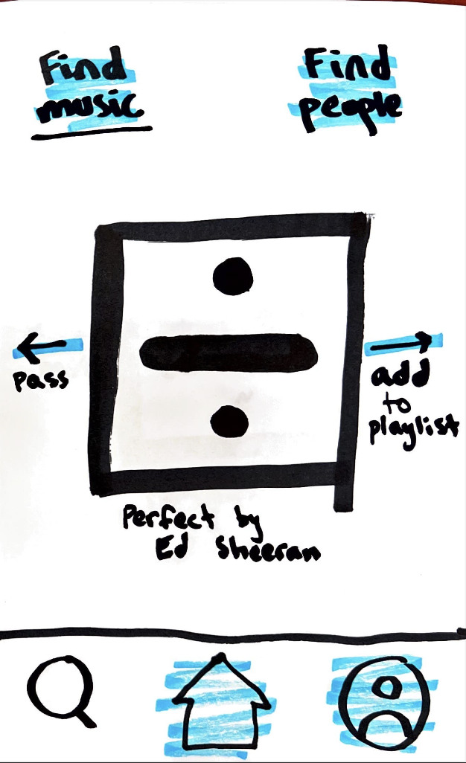
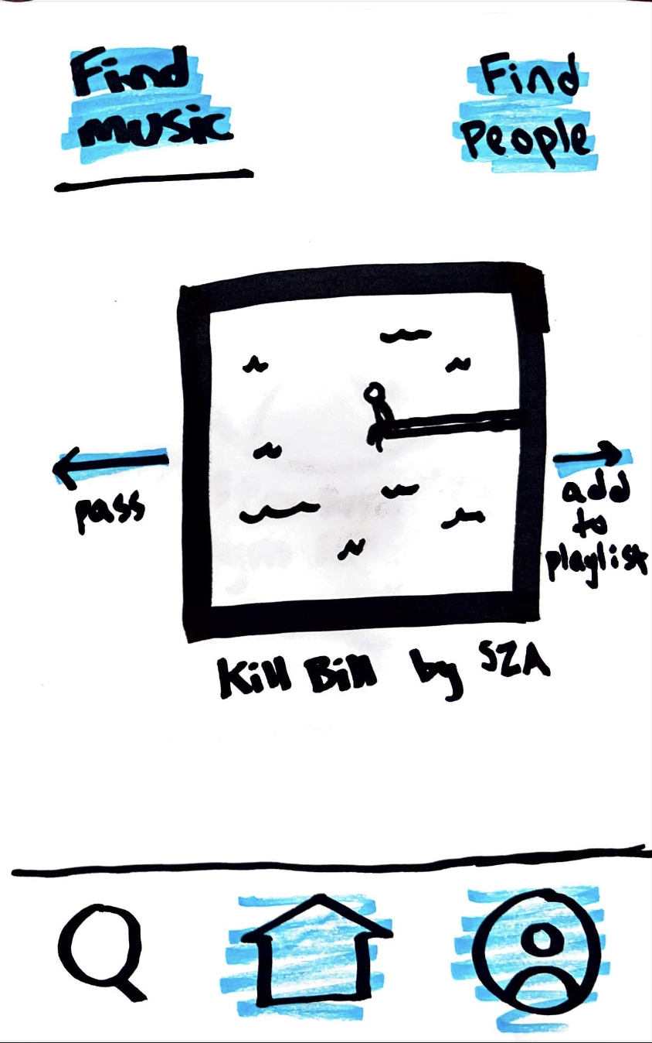
Task Flow 1: Find a song and add it to your playlist
CS 147
Retune

Slide 15

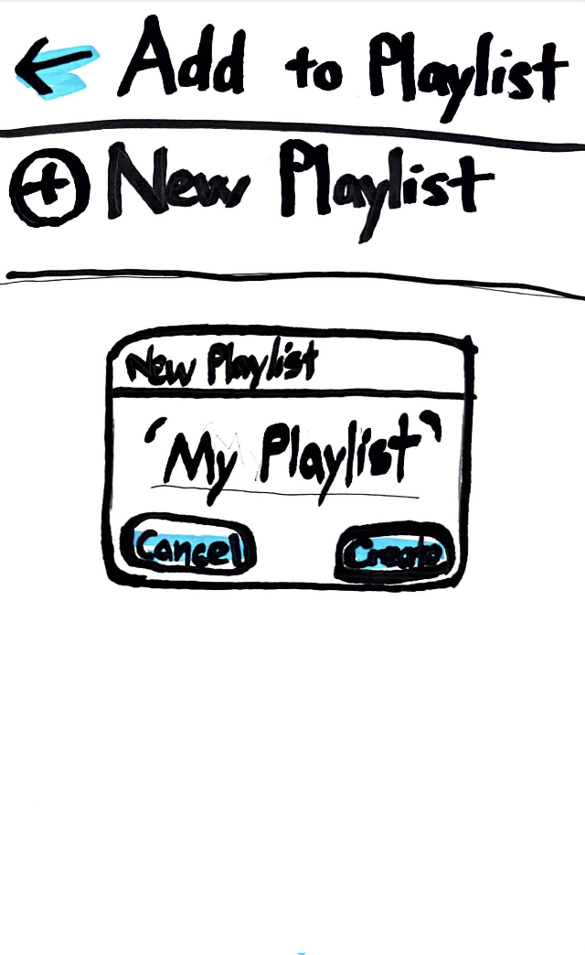
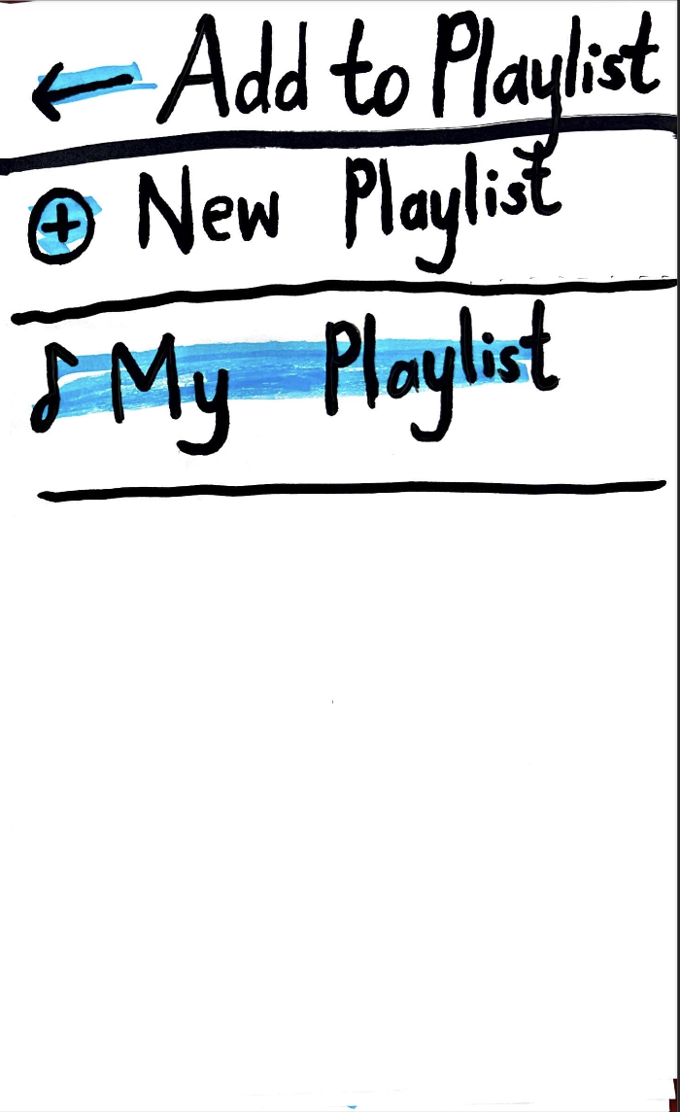
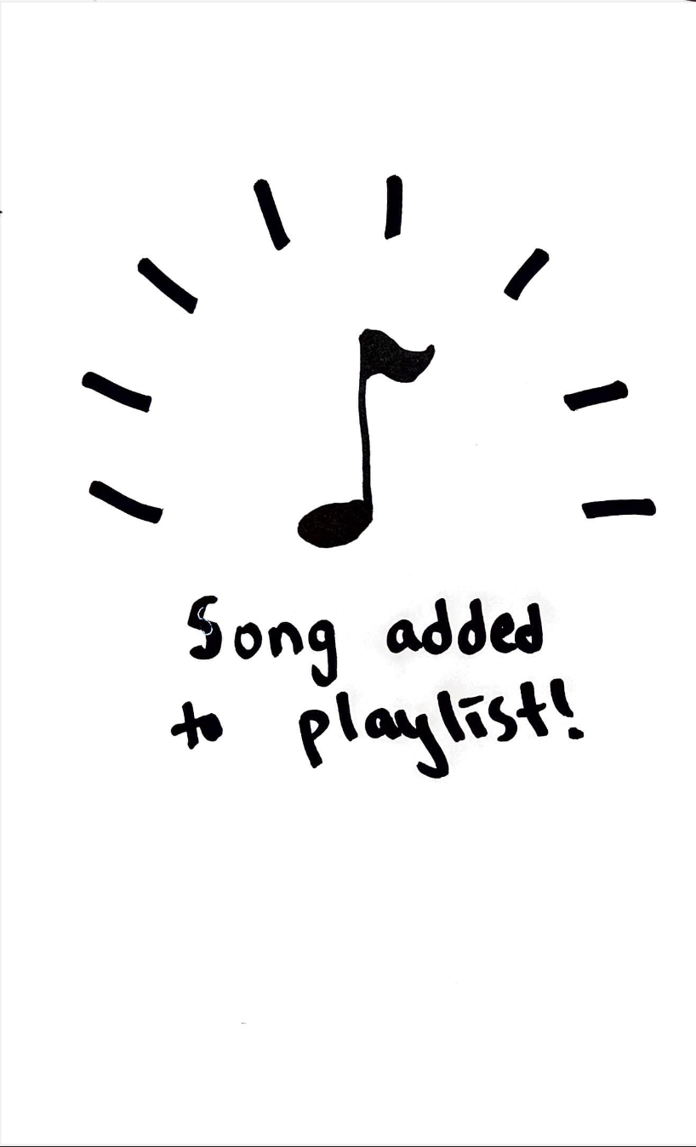
Task Flow 1: Find a song and add it to your playlist (Part 2)
CS 147
Retune

Slide 16
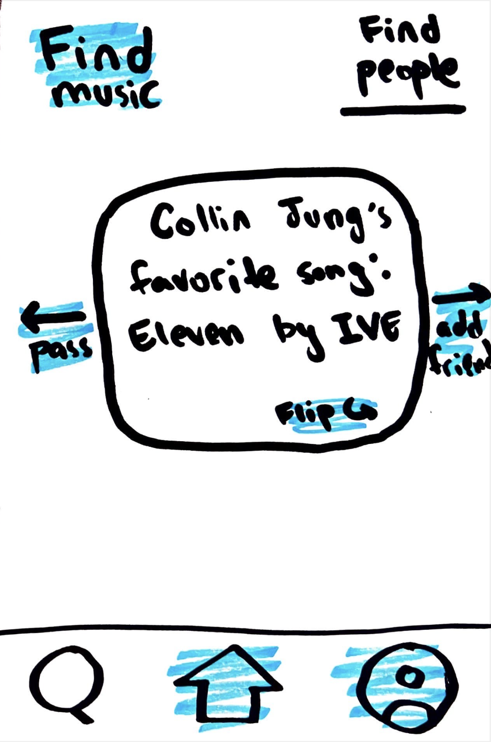
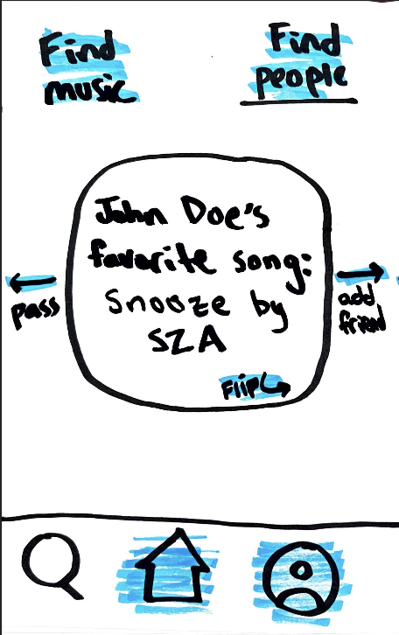
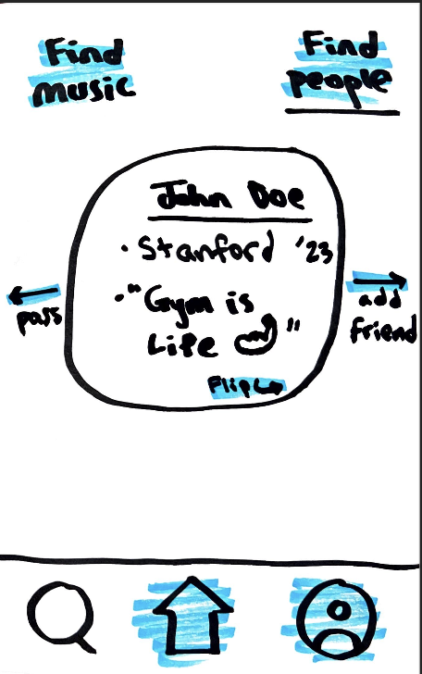
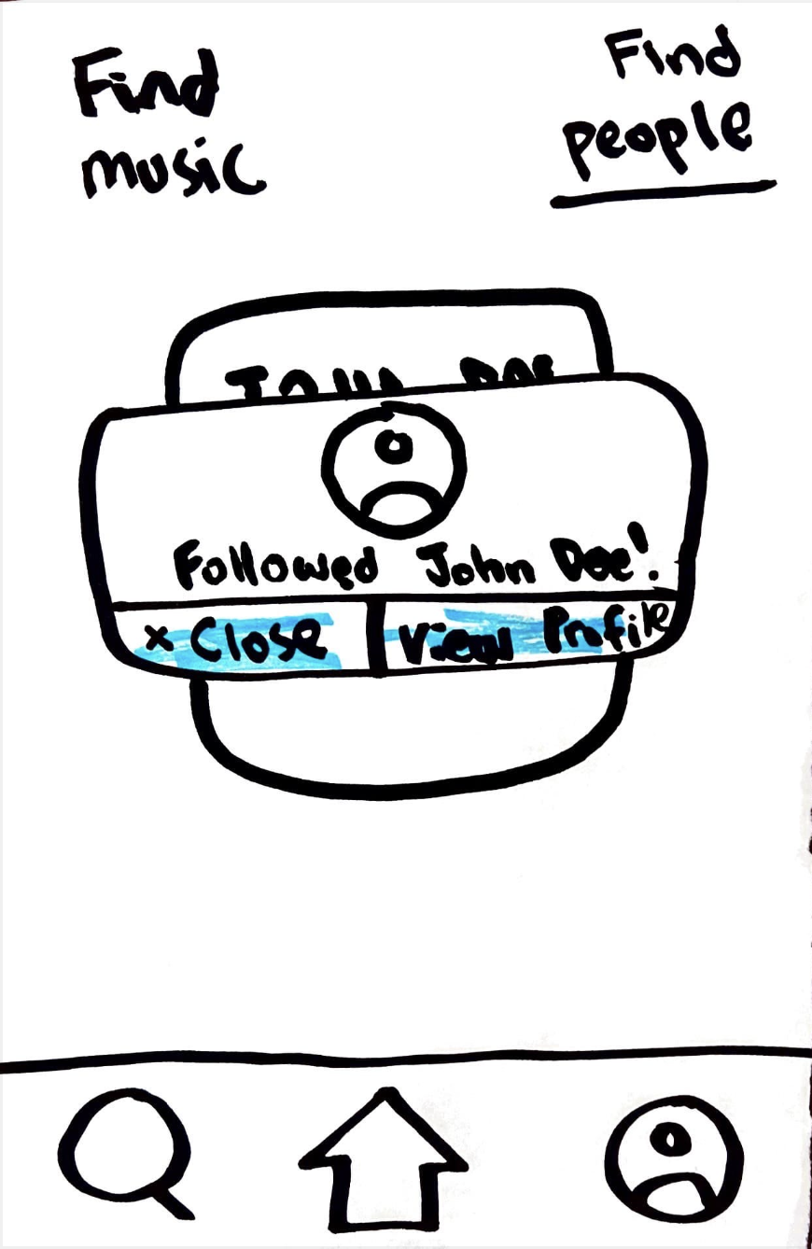
Task Flow 2: Add a friend
CS 147
Retune

Slide 17
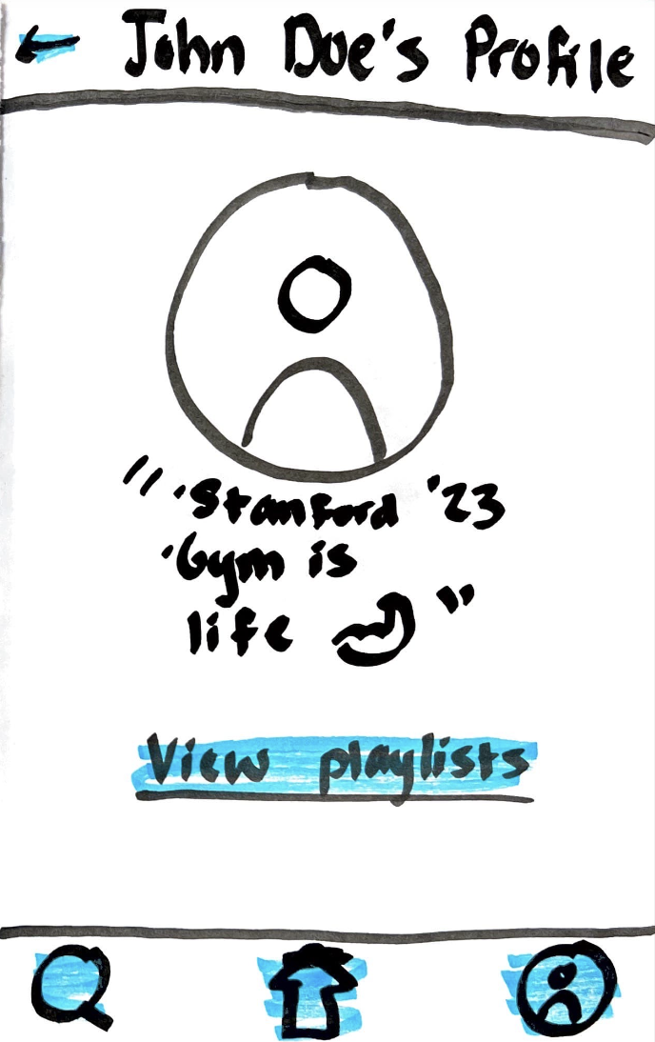


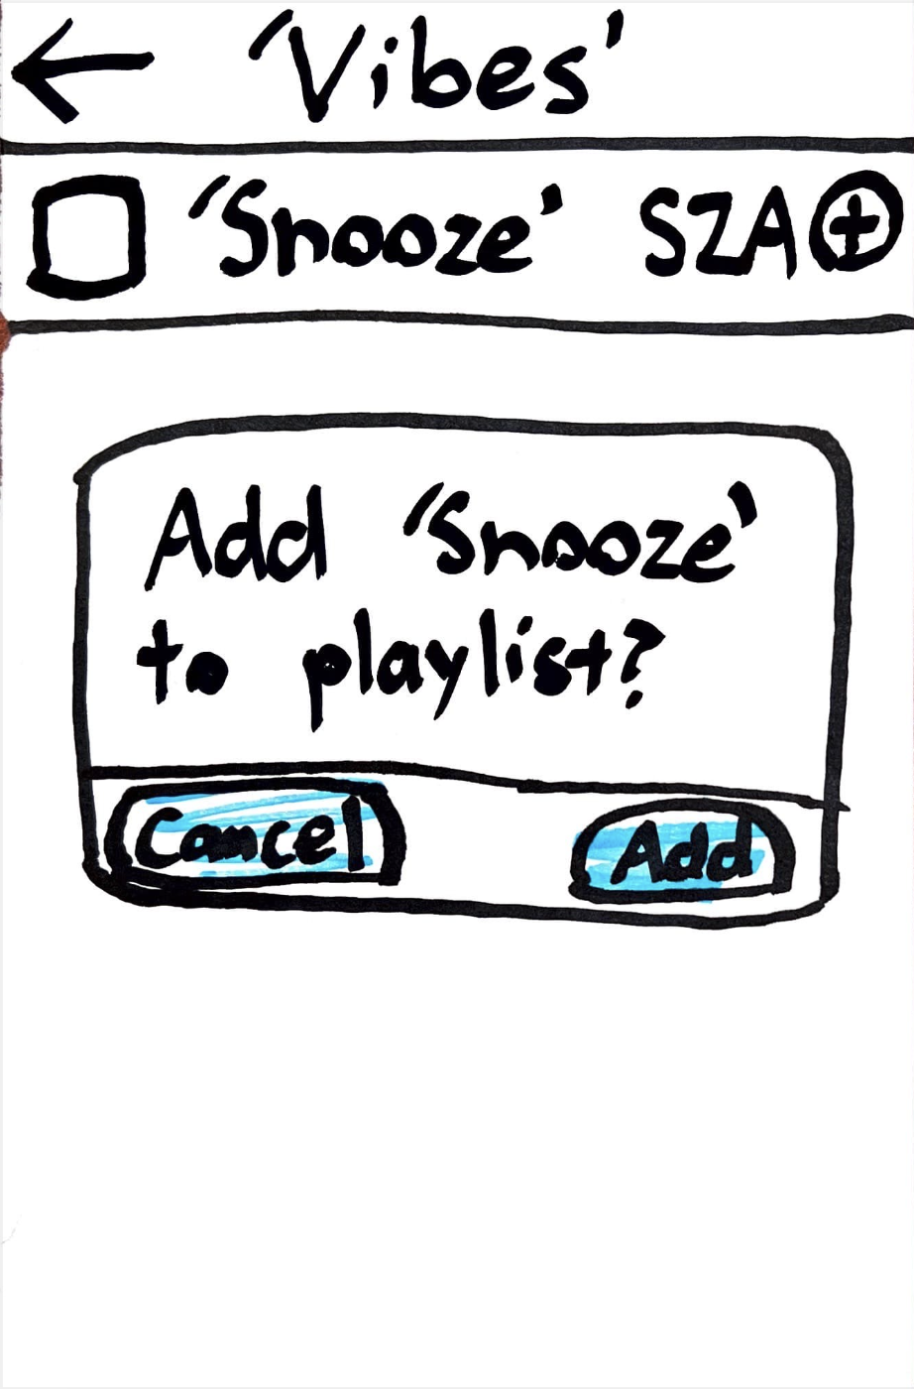
Task Flow 3: View your friend’s playlists and add their song to your playlist
CS 147
Retune

Slide 18
Task Flow 3: View your friend’s playlists and add their song to your playlist (Part 2)
CS 147
Retune

Slide 19
Testing
CS 147
Retune

Slide 20
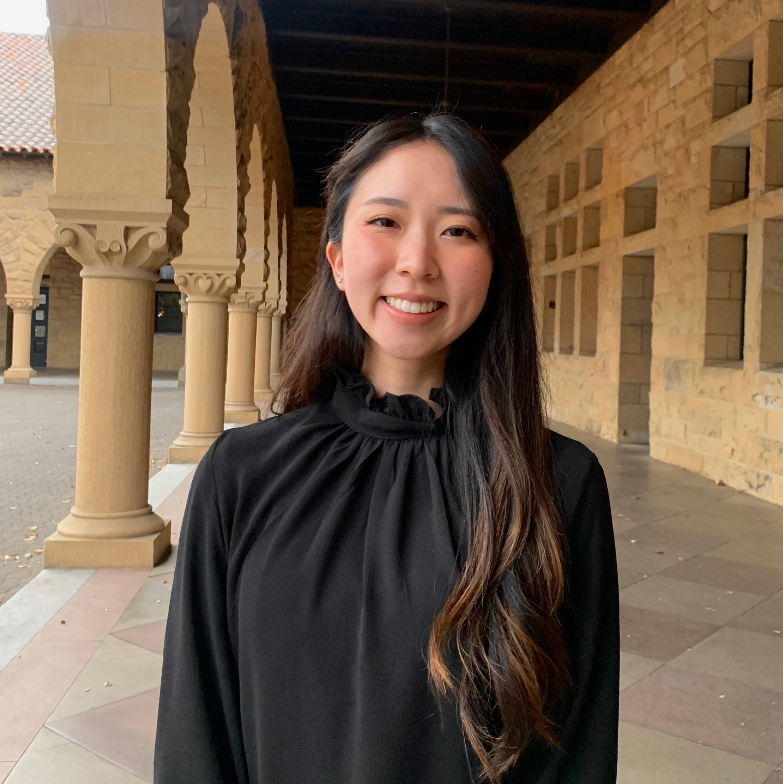


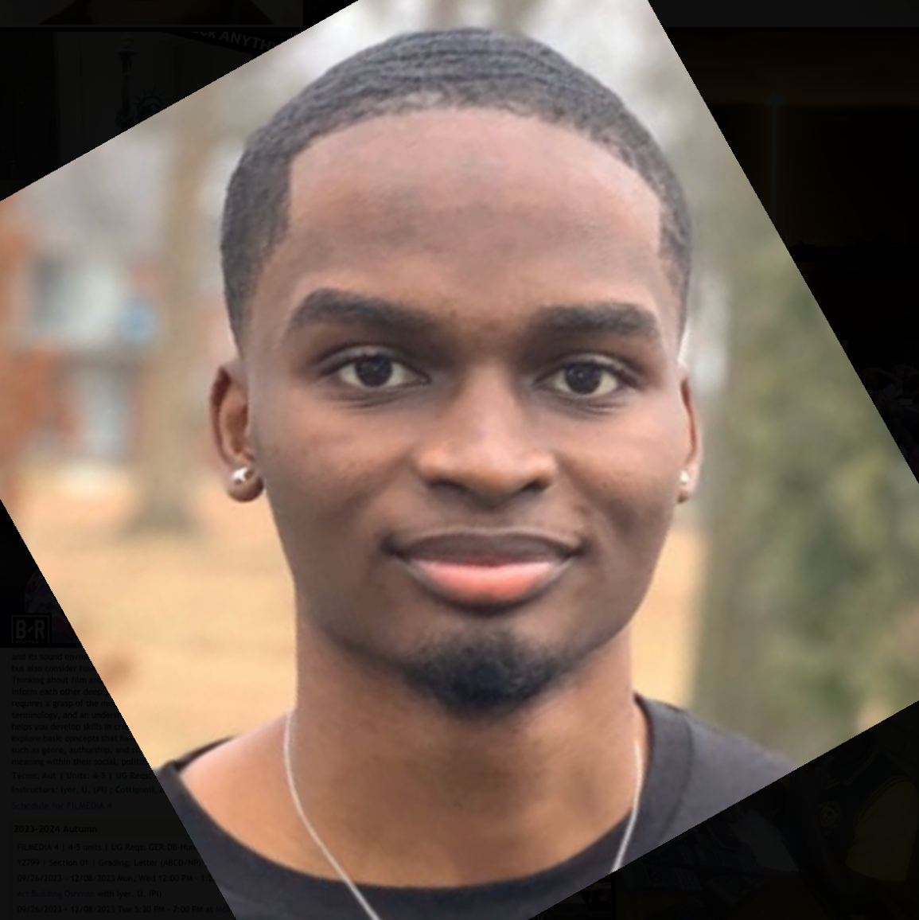
Methodology
Member roles:
Sophie
Facilitator
Collin
Computer
Gene
Observer
Bryson
Observer
CS 147
Retune
Notes:
Cami Doo, 25
Whayden D Cami Doo, 25
Law student
21
Grace M 22

Slide 21




Methodology
Participants:
Cami D., 25
Law student
Grace M., 23
Lab researcher
Whayden D., 24
Software Engineer
Joo-Mee L., 45
Professional violinist
CS 147
Retune
Notes:
Cami Doo, 25
Whayden D Cami Doo, 25
Law student
21
Grace M 22

Slide 22

Methodology
Environment:
CS 147
Retune
Notes:
we used each paper as a screen and switched them out based on clicks

Slide 23
Methodology
Procedure:
Context and rules
Give tasks
Reflective questions
CS 147
Retune
Notes:
Give context for our app and team (Ask participant to treat pieces of paper like a phone screen and to explore while talking out loud)
Give participant tasks, one at a time and observe/take notes
At the end, ask reflective questions:
Did anything stand out as confusing/difficult?
Did anything stand out as particularly interesting or enjoyable?

Slide 24
Methodology
Usability goals/Key measurements:
Learnable : Determine how intuitive tasks are
Efficient : See how long it takes to complete a task
CS 147
Retune
Notes:
Measure: Determined intuition by counting ‘misclicks’/see if they can complete task in expected number of steps
Measure: Observe how fast it takes for them to find what button they’re supposed to click next

Slide 25
Results
CS 147
Retune

Slide 26

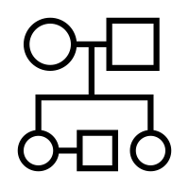

Data
01
One non-tech savvy person had trouble
Our simple task took the most “thinking out loud”
02
Icons unclear for a few participants
Our moderate task garnered a few misclicks
03
All enjoyed the social aspect.
Users were more confident carrying out the complex task
CS 147
Retune
Notes:
One participant who wasn’t ‘tech-savvy’ took the most time on tasks
A few participants weren’t clear as to what the icons represented
All participants found the social aspects/seeing other people’s profiles to be especially interesting
since users were seeing the app for the first time
After doing the first two tasks

Slide 27
Overall Observations
Easy to understand
More guidance needed
Usable for non tech-savvy?
Interest in social features
Conflicting goals of app
CS 147
Retune
Notes:
Tasks were generally easy to understand
More guidance needed when discovering people
Our participant Joo-Mee expressed that she wasn’t tech-savvy, and had the most difficulty carrying out our three tasks. This makes us think that we need to be more careful moving forward as to whether the app is intuitive for all possible users.
Users wanted to see new friends’ full playlists and were interested in the more social capabilities
Users added songs based titles or artists they were already familiar of

Slide 28
Bottom-line Data: Usability goals
Learnable?
  Accessible icons
Efficient?
  Clearer interactive features
CS 147
Retune
Notes:
Going back to usability goals and key measurements
Make sure the purpose of icons is clear to the users
Counted 5 total misclicks across 4 participants, mainly in confusion as to what the icons meant. A couple of misclicks also came from our non tech-savvy user
But most participants were able to complete tasks in the expected number of steps
Make sure the pressable icons/ buttons are clear to the users
Some users tried to interact with non-interactable items
A total of 3 hints had to be given across two participants who was unsure where to go next
But overall, most participants had the correct thought process as to what to look for and where to go
The task that took the most ‘thinking’ was the simple task, likely because people were seeing the app for the first time

Slide 29
Critical Incident: Level 1, Grace
Used wrong navigation button
CS 147
Retune
Notes:
Grace tried to touch “Find Music” when she first navigated to the Explore page.
Reason: She didn’t realize she was already looking at the “Find Music” function
Key Takeaway: We need to make it clear what tab users are on

Slide 30
Critical Incident: Level 2, Whayden
Confusion when discovering music
CS 147
Retune
Notes:
Whayden tried to touch “My Playlist” on his own Profile when instructed to find music
Reason: He wanted to find songs from within his own playlists
Key Takeaway: We need to draw users to the Explore page so that they expand their music tastes rather than sticking to their own

Slide 31
Critical Incident: Level 2, Cami
Couldn’t add song to playlist
CS 147
Retune
Notes:
Reason: She forgot that she was in the middle of adding a song to her playlist because she had to create a new playlist
After creating playlist, user needs to tap again
Key Takeaway: Header should be clearer about what song is being added

Slide 32
Critical Incident: Level 3, Cami
Difficulty finding explore page
CS 147
Retune
Notes:
Reason: Cami perceived the search icon to be a place to search for song using words rather than an explore page, and was confused as to where she could browse song options. We had to provide a hint
Key Takeaway: It is critical that NavBar has most intuitive icons possible

Slide 33
Critical Incident: Level 3, Joo-Mee
Got lost trying to find people
CS 147
Retune
Notes:
Reason: Joo-Mee couldn’t figure out how to find people to add. She tried going to her profile first and didn’t know where to go from there. We had to give her a hint to navigate to the explore page. She was also confused that she had to press “pass” to view the next person on the page
Key Takeaway: Is our app giving enough visual and textual information, especially for non tech-savvy users?

Slide 34
Discussion
CS 147
Retune

Slide 35
Takeaways
To be careful of:
Clear UI showing current page
Intuitive icons
CS 147
Retune
Notes:
Things to be careful of:
We should be clear about what stage or process a user is currently in
Icon and design choice should be clear/intuitive on first glance
Design changes: ADD TEXT

Slide 36
Takeaways
To tap into:
Community-curated playlists
Random discovery
CS 147
Retune
Notes:
Things to tap into:
People are interested in the concept of getting “human-being curated” playlists
People like the random aspect of the explore page

Slide 37
Takeaways
What testing couldn’t reveal
Day-to-day feed
Interactions with audio
CS 147
Retune
Notes:
What testing couldn’t reveal
What someone’s home feed and personal feed might look like after prolonged use of the app
How a user might interact with audio capabilities of the app, like listening through playlists or listening to snippets of songs on their feed

Slide 38
Thank you!
CS 147
Retune

Slide 39
Appendix
CS 147
Retune

Slide 40
Grace
Incident | Severity
Pressed “find music” when already on “find music” page | 1
Tried to rename new playlist but our prototype didn’t support it | 1
Tried to go to Feed instead of Explore to find a friend | 2
CS 147
Retune

Slide 41
Whayden
Incident | Severity
Hit “my playlists” when tasked to find new music | 1
Pressed “Find Music” in order to refresh the feed when looking for new music instead of swiping at first. | 2
Didn’t know how to go back to home page as the home button was not as clear to him as we expected | 1
CS 147
Retune

Slide 42
Cami
Incident | Severity
Didn’t know where explore page was – thought it was a search button. Needed to give hint | 3
Needed to press on newly created playlist in order to finalize adding the song. Needed to give hint | 2
Initial reaction was to search for a specific song instead of going to explore page to find song | 2
At first glance, thought “home” icon was an arrow | 1
CS 147
Retune

Slide 43
Joo-Mee
Incident | Severity
Wanted to filter by genre and find a classical piece to add to her playlist. Had to explain that we only had pre-populated songs for the prototype | 2
Didn’t know where to go to add a friend, tried going to her own profile first & looking at playlists. Needed to provide hint | 3
Confused on how to view next person while on Collin’s explore profile. Needed to provide hint to tell her how to swipe ‘pass’ on people | 3
CS 147
Retune

