Slide 1
Med-fi Prototype
HOME
TABLE OF CONTENTS
PLAYLIST
01
Intro
02
Tasks
03
Usability goals
Retune
04
Revisions
05
Med-fi prototype
THANKS!
CS 147
Retune

Slide 2
Project name - Retune
“Refresh your tunes”
Replace old music Mix up your vibes
Share your favorite songs, request new songs
Discover music through a social experience
CS 147
Retune
Notes:
Project name and value proposition
a. Retune because new music will not replace old music, but offer a way to mix up your vibes
b. Thus “Refresh your tunes” which is our One-liner value proposition conveys what customers get out of Retune
c. We do not only offer discovering music, but also allow user to do so through a social experience, that is,
Our app will streamline the process of finding new music into an interactive, social experience

Slide 3
Retune
Problem/solution overview
Primary user:
Problem:
Solution:
Casual listeners
Exposure to music is daunting
Leverage community
CS 147
Retune
Notes:
Problem/solution overview
b. Who the primary user is
Casual, everyday music listeners who don’t have time to actively search for new music
c. Problem we are tackling is
Need to make exposure to new music inviting, fun, and convenient
d. We address this by
Leveraging community for personalized and interactive music suggestions

Slide 4



Retune
Solution
Post songs based on your day!
Find a community!
Share and discover music!
CS 147
Retune
Notes:
Our app will allow people
to share their daily music and experiences with a broader community!
Post a picture with a song and a caption that can be a daily quote or how you’re feeling at the moment, or why you’re listening to that song.
Commenting on posts allows for social interaction, while adding songs to mix up playlists in the app allows you to save new tunes you find!

Slide 5




Design Values
Individuality
Inclusivity
Fun
Ease of use
Customizable posting & community building
Promote open sharing w/o fear of judgement, through music
Finding new music = fun!
Randomness through explore
Auditory interaction
Accessible for all users
CS 147
Retune
Notes:
Individuality:
We want users to be able to create their own posts and build their own communities by adding friends they know or people they find via the explore feed.
Inclusivity:
We want music to be the medium for discussion and engagement on our app, which will hopefully promote a safe space
This is why a song accompanies each post on our app, to center the engagement around music
Fun:
We want to make the process of discovering new music inviting and fun rather than boring by turning it into a social process.
We’re trying to do this by adding a randomness aspect through the explore feed, which exposes users to new kinds of songs and people
Also, the app is not only visually interactive but auditory, with the ability to hear song snippets
Ease of use:
Making it easy for users of all technological backgrounds to interact with an online community.
We’ve tried to make the app simple and intuitive by relying more on visual elements to convey information rather than text

Slide 6
Value tensions?
 | Individuality | Inclusivity | Fun | Ease of Use
Individuality |  | Different opinions? |  | Customizable– less simple
Inclusivity | Social bubbles
Fun |  | Too social– inaccessible?
Ease of Use
Notes:
Individuality vs Inclusivity:
If we allow people to express themselves freely through posting and commenting, it may lead to less inclusivity when there’s difference in opinions
Fun vs inclusivity:
If we focus too much on making the app a social experience, we may isolate certain kinds of users who are more shy or private
Individuality vs ease of use:
If many features are customizable, it makes them more complex to navigate through, which may be less intuitive for non tech-savvy users
Inclusivity vs Individuality:
If we let people experience the app however they individually want to, they could get stuck in their own social bubbles instead of finding new kinds of music and people

Slide 7
Our tasks: Updated!
From simple to complex:
Find a song and add it to your playlist
Find a friend to add
Add one of your new friend’s songs to your playlist
Find a new friend to add
Check out the music your friends are into
Make a post of your own!
CS 147
Retune
Notes:
We’ve updated our task flows to cover the full functionality of our app and to account for our revisions from A5.
For example, we’ve removed the ‘find songs’ page on the explore feed based on participant feedback, so our tasks have changed a bit
New Flow is; we find a new friend to add based on music taste, update our playlists based on if we add a song from our new friends and then we can post using our own current favorite songs.

Slide 8
Methodology
Usability goals/Key measurements:
Learnable : Determine how intuitive tasks are
Efficient : See how long it takes to complete a task
CS 147
Retune
Notes:
Measure: Determined intuition by counting ‘misclicks’/see if they can complete task in expected number of steps
Measure: Observe how fast it takes for them to find what button they’re supposed to click next
We’ve tried to make progress towards these goals by simplifying and streamlining the functionality of our app, which we’ll explain a bit more in our revisions

Slide 9
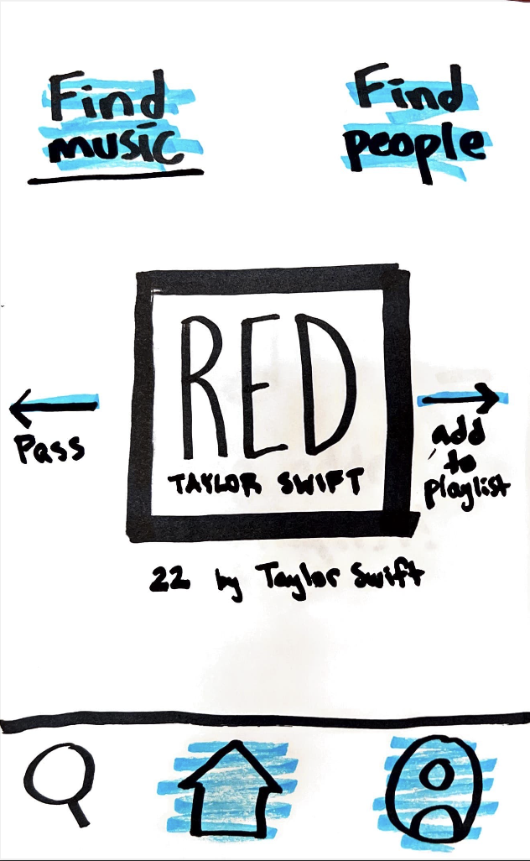
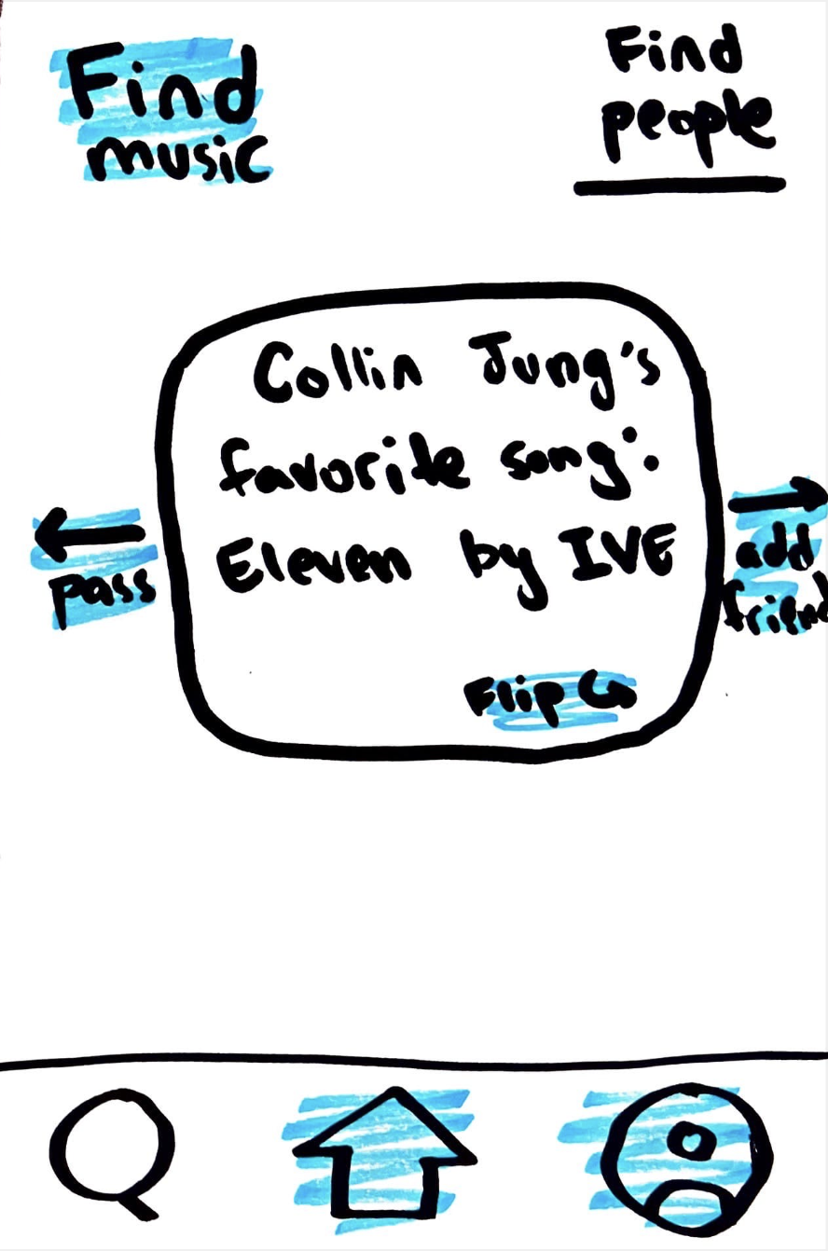
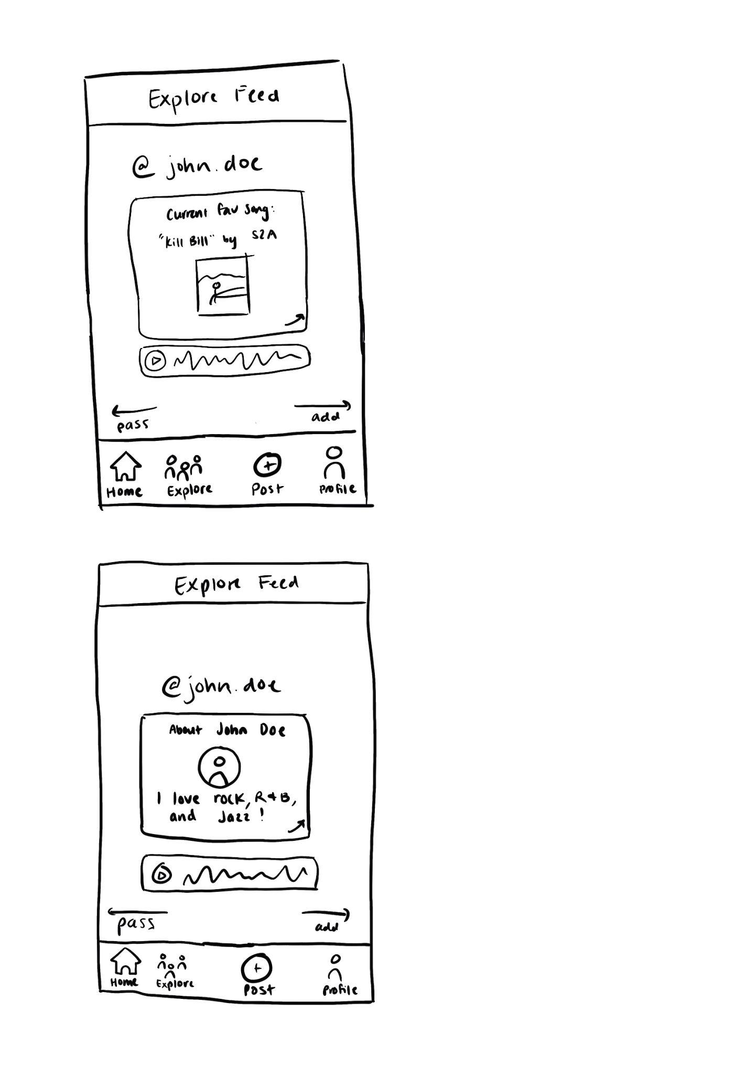
Revision 1: Streamline Explore Page
CS 147
Retune
Notes:
We decided to combine the “find people” and “find music” explore pages into one explore page
We did this because in our testing we found that participants got confused between the “find people” and “find music” functionalities and found the page to be cluttered
We found that “find music” was a bit repetitive because people can find new music through new people
Overall, we wanted the explore page to be more cohesive and representative of our main theme, which is to leverage community to find new music

Slide 10
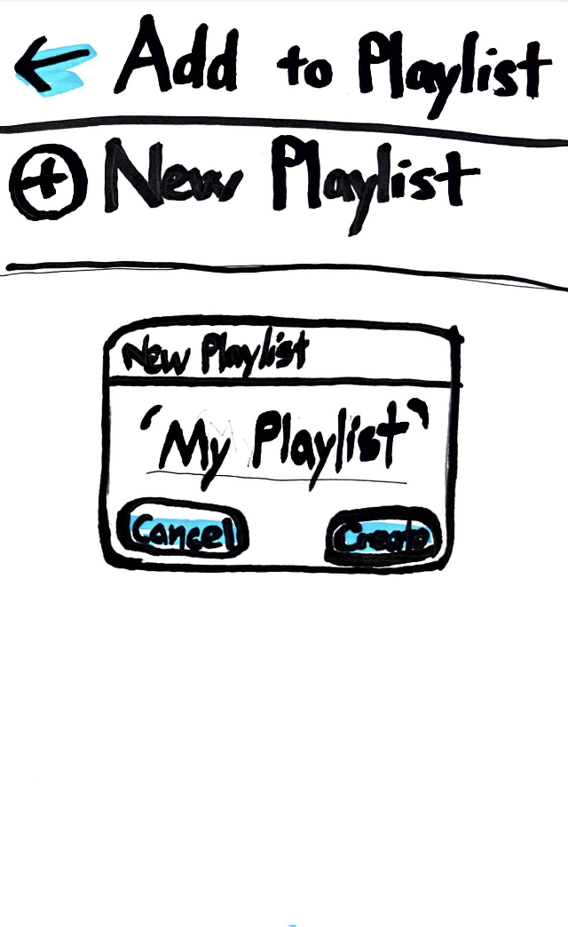
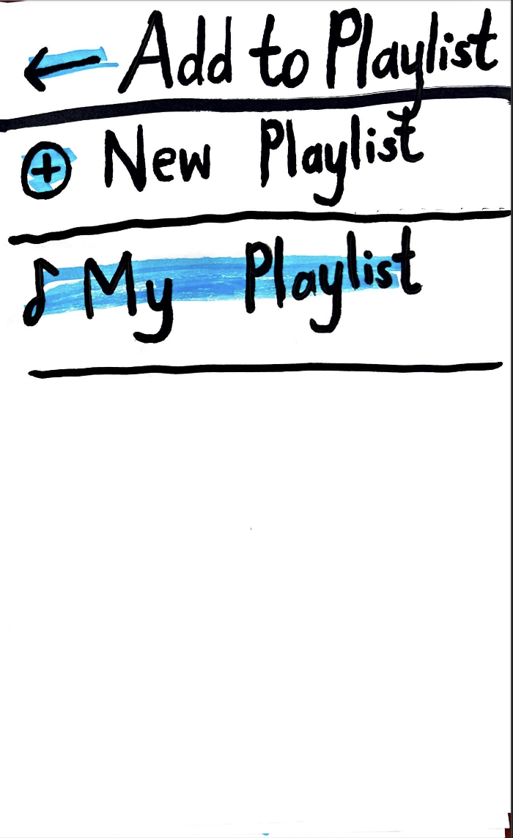
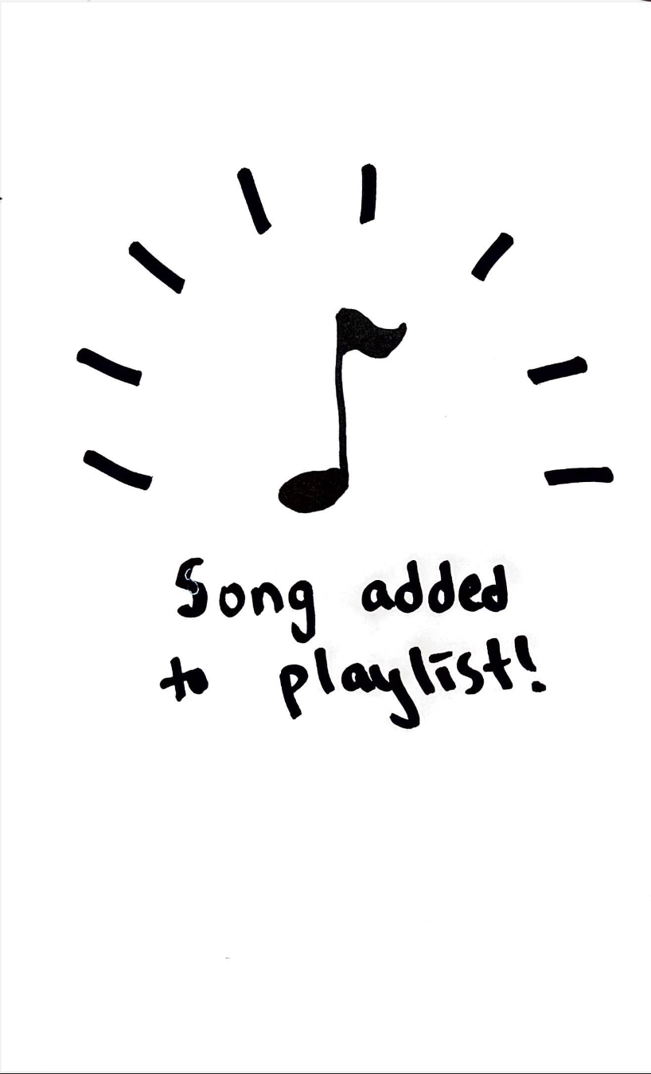
Revision 2: Simplify app capabilities
CS 147
Retune
Notes:
As we’ve reflected more on our needfinding and tests, we felt that maybe our app was trying to do too much, which went against our original idea of making finding new music less tedious
For one, during our low-fi testing we found that adding songs one at a time in this way actually took a fair amount of steps and felt a little tedious for our participants
This also made us think back to our needfinding interviews, where a couple of less tech-savvy interviewees mentioned that they feel overwhelmed by the amount of apps there are for listening to music
We don’t want to add yet another app where users have to create their own playlists from scratch, and where these playlists are confined to our app specifically
Instead, we thought it’d be better for people to find new music through our app, but then use their own music streaming service of choice in order to add songs and listen to them, because casual music listeners likely already have a streaming app that they prefer and that they’ve built many playlists on
So now we’re focusing on four main functionalities: a home feed for friends, an explore feed for random people, posting, and customizing your profile

Slide 11
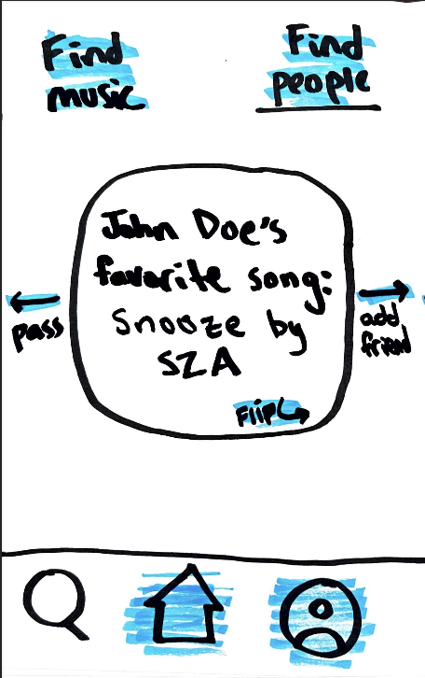
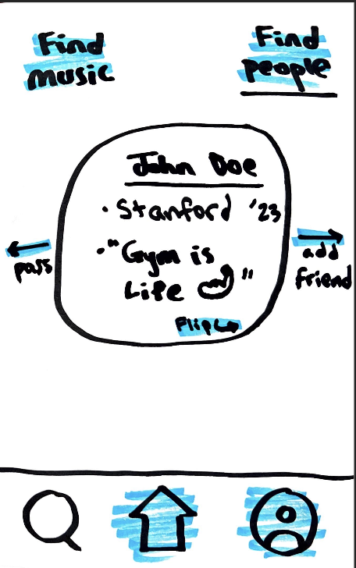
Revision 3: More visual elements
CS 147
Retune
Notes:
We added more images to be more descriptive of the user and their corresponding current favorite song ie. An image of the user and an image of the songs cover art both on the feed.
Our participants were mostly interested in the social aspects of the app, so we thought adding a more detailed profile on the explore page as well as playing their favorite song could enhance the social engagement of the app
This also incorporates some of the features that we liked from the “Find songs” page that we’ve now removed
We’ve also made our footer more visually detailed, as well as added captions since some of our participants couldn’t tell what the icons were

Slide 12
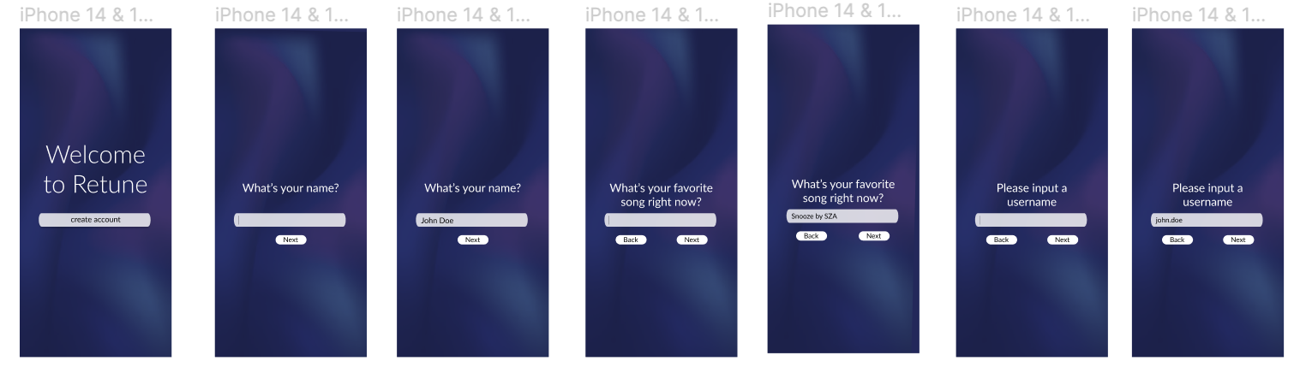
(Additional) Task flow: Initial Login
CS 147
Retune

Slide 13
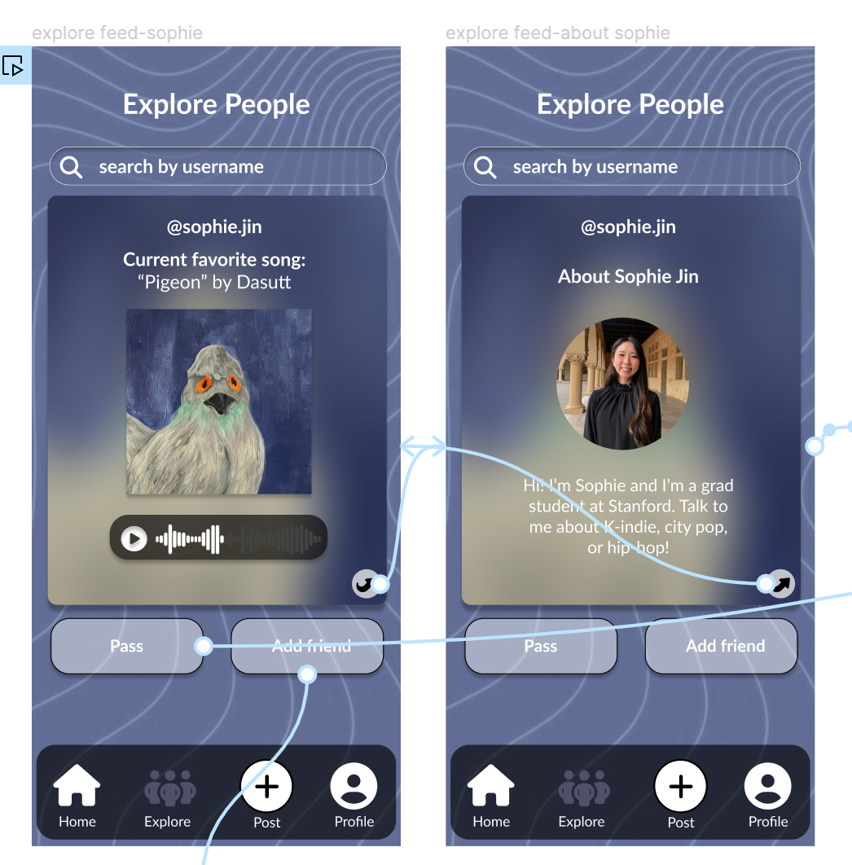
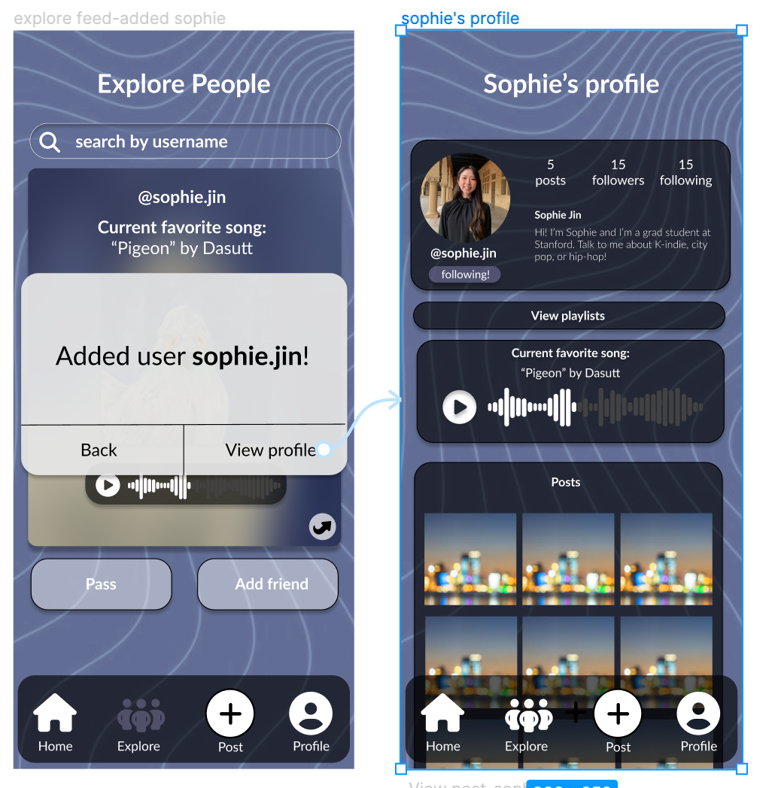
Task flow 1: Find a friend to add
CS 147
Retune

Slide 14
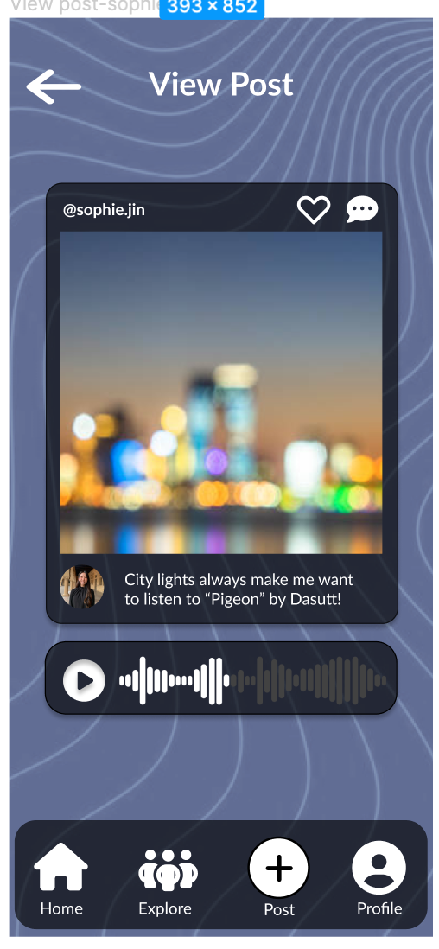
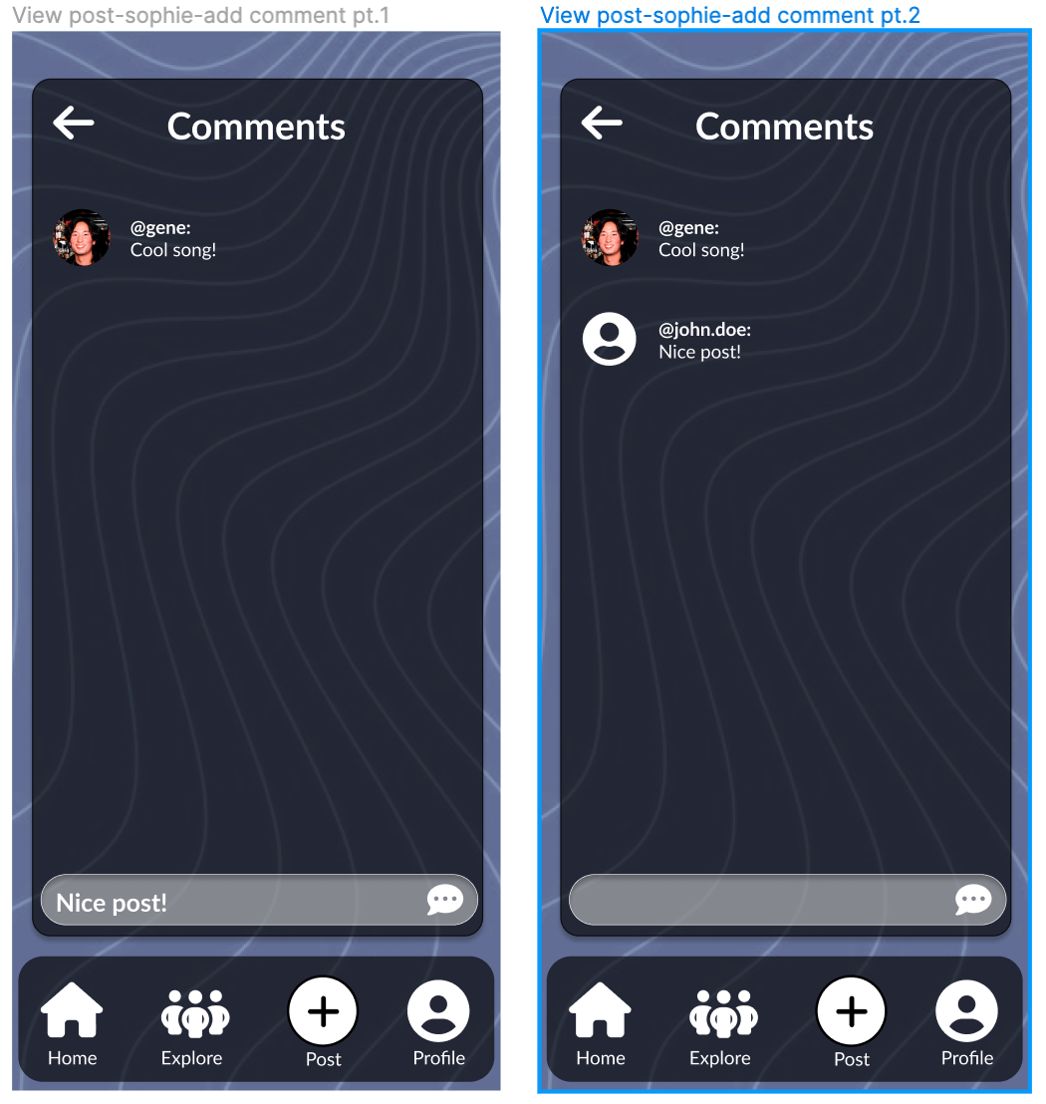
Task flow 2: Check out the music your friends are into
CS 147
Retune

Slide 15
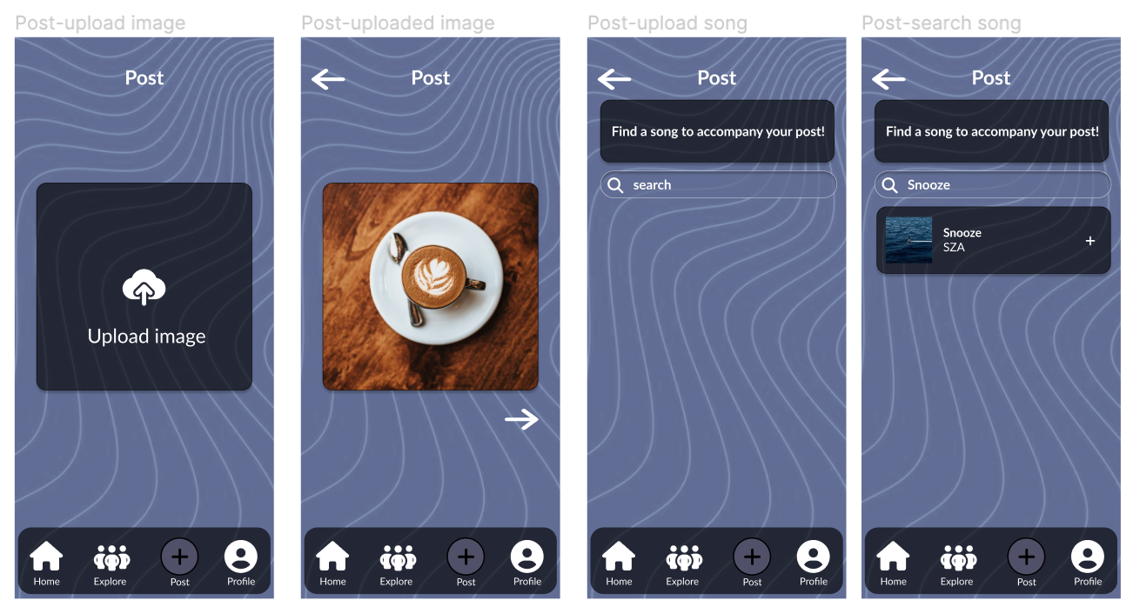
Task flow 3: Make a post of your own! (pt. 1)
CS 147
Retune

Slide 16
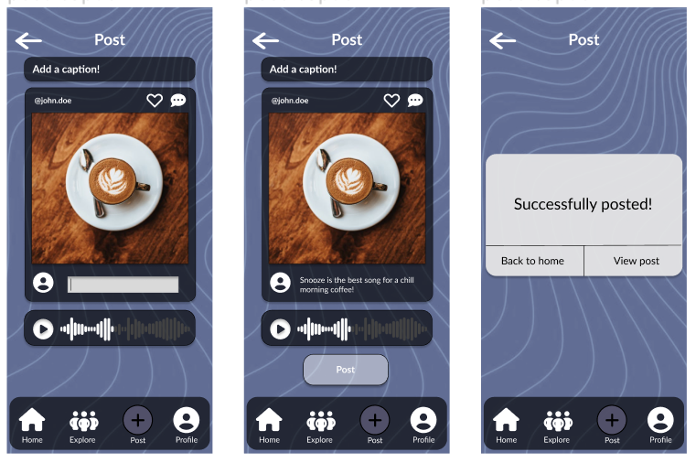
Task flow 3: Make a post of your own! (pt. 2)
CS 147
Retune

Slide 17
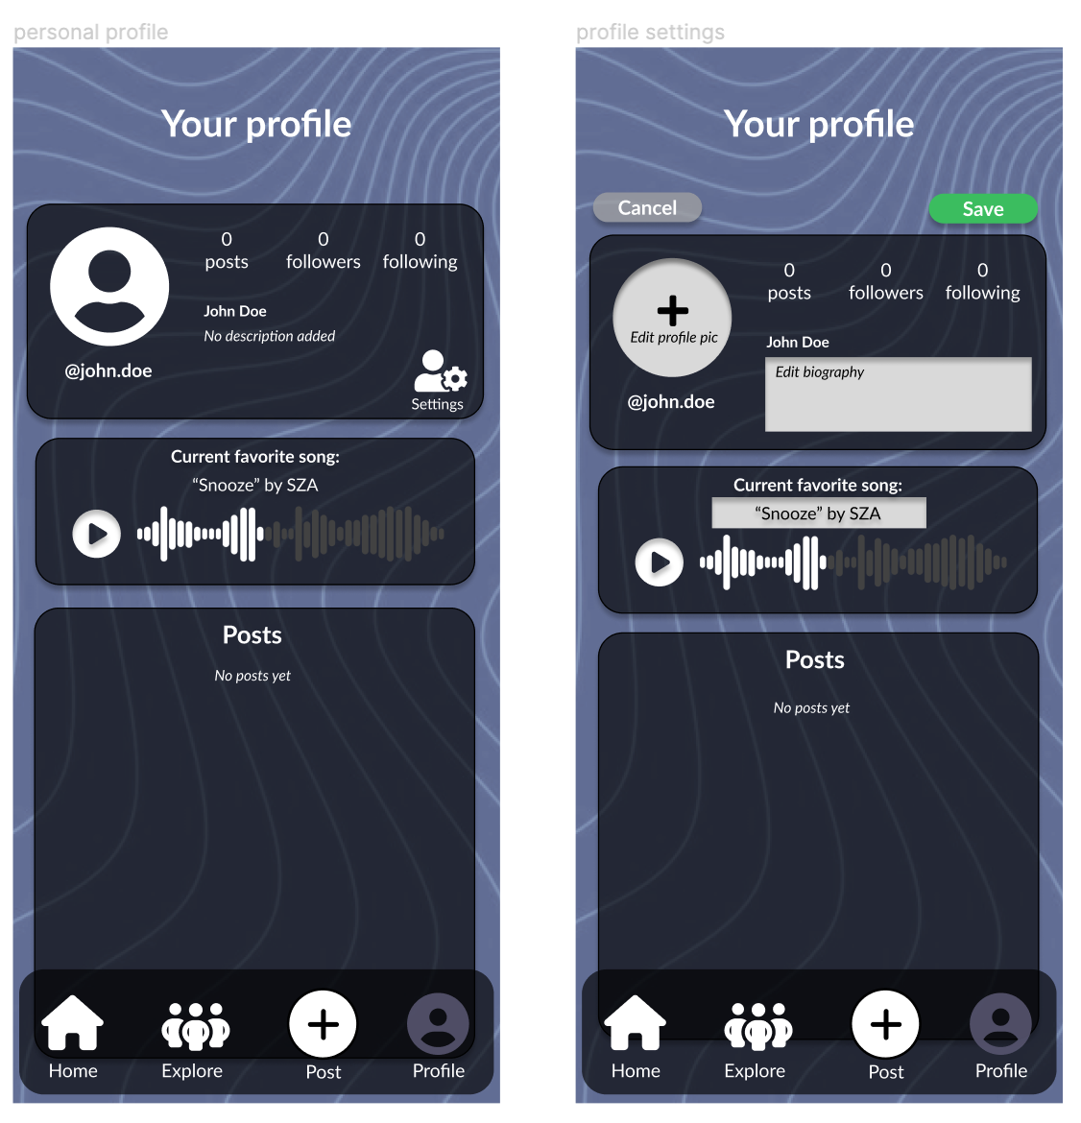
(Additional) Task flow: Customize profile
CS 147
Retune

Slide 18
Prototype Implementation- Figma
Pros:
Visual, simple
Clear task flows
Cons:
Difficult to implement social media app:
  Can’t implement free commenting/posting
  Hard-coded profiles and explore feed
Can’t get full experience without audio
CS 147
Retune

Slide 19
Prototype Implementation- Figma
Limitations:
No audio capabilities
No customization capabilities (e.g. for profile, posting)
Hard-coded/Wizard of Oz features
Pre-populated explore & home feed
Pre-populated user post & profile
CS 147
Retune

Slide 20
Appendix
CS 147
Retune

Slide 21
Figma link:
https://www.figma.com/proto/0UQdikWSsncXfSLyHCYzqU/Retune-Med-fi?type=design&node-id=1-9&t=aRM5AZGvgS0R3bPi-1&scaling=scale-down&page-id=0%3A1&starting-point-node-id=1%3A9&mode=design
CS 147
Retune
Notes:
https://www.figma.com/proto/0UQdikWSsncXfSLyHCYzqU/Retune-Med-fi?type=design&node-id=1-9&t=aRM5AZGvgS0R3bPi-1&scaling=scale-down&page-id=0%3A1&starting-point-node-id=1%3A9&mode=design

