Slide 1
Hi-fi Prototype
HOME
TABLE OF CONTENTS
PLAYLIST
01
Intro
02
HE results
03
Revisions
Retune
04
Prototype Status
05
Demo
THANKS!
CS 147
Retune

Slide 2
Project name - Retune
“Refresh your tunes”
Mix up your vibes
Share your favorite songs, request new songs
Discover music through a social experience
CS 147
Retune
Notes:
Project name and value proposition
a. Retune because new music will not replace old music, but offer a way to mix up your vibes
b. Thus “Refresh your tunes” which is our One-liner value proposition conveys what customers get out of Retune
c. We do not only offer discovering music, but also allow user to do so through a social experience, that is,
Our app will streamline the process of finding new music into an interactive, social experience

Slide 3
Retune
Problem/solution overview
Primary user:
Problem:
Solution:
Casual listeners
Exposure to music is daunting
Leverage community
CS 147
Retune
Notes:
Problem/solution overview
b. Who the primary user is
Casual, everyday music listeners who don’t have time to actively search for new music
c. Problem we are tackling is
Need to make exposure to new music inviting, fun, and convenient
d. We address this by
Leveraging community for personalized and interactive music suggestions

Slide 4



Retune
Solution
Post songs based on your day!
Find a community!
Share and discover music!
CS 147
Retune
Notes:
Our app will allow people
to share their daily music and experiences with a broader community
Post a picture with a song and a caption that can be a daily quote or how you’re feeling at the moment, or why you’re listening to that song. Find new music through other people’s posts
Our app is integrated with Spotify, so you can pull from the music you’re currently listening to and engage with the community

Slide 5
Outline
01
HE results
Revisions
02
Prototype Status
03
Demo
04
CS 147
Retune

Slide 6
Heuristic Evaluation Results
2%
42%
36%
20%
Total violations: 45
Severity 0
Severity 1
Severity 2
Severity 3
CS 147
Retune
Notes:
We had no severity 4 violations

Slide 7
Heuristic Evaluation Results: Summary
User freedom with processes
  Fix: streamline screen transitions
Consistency with design
  Fix: standardize style and wording
Intended use of app?
  Leveraging community
CS 147
Retune
Notes:
Here is a summary of some of our main takeaways
One of our main comments was about user freedom when it comes to exploring the functionality of the app. The evaluators found it frustrating when they couldn’t move back and forth between pages when making posts, or that they couldn’t scroll freely on the home feed. Our planned fix for this is to streamline the transitions between all of our different screens, and add back buttons that allow the user to make revisions when needed.
Another comment was that a few elements of our design were inconsistent. For example, it wasn’t always clear when things were supposed to be clickable because the styling was unclear, and there was inconsistent wording that caused confusion. Moving forward, we plan to have standardized styling and wording for the components of our app in order to ensure consistency.
One of the last overarching comments was about the intended use of our app. It seemed confusing to some of our evaluators that they couldn’t make playlists and save songs within the app. This is a feature we considered, but upon further reflection, we wanted to clarify why we’re not adding this feature in our app. Our
reasoning comes from our needfinding interviews and our low-fi prototype testing. Some of our needfinding participants mentioned how it can get overwhelming when there’s so many music streaming apps coming out. Many of them rely on one app (like Spotify or Apple Music) for all of their playlists and streaming, and don’t show any interest in switching to another app since they’ve already invested so much in what they currently use. Furthermore, when testing the playlist feature in our low-fi prototype, constructing playlists seemed to be a bit of a tedious task for our participants. This is why we want our app to focus on leveraging community to hear new song suggestions, instead of being an app where you have to build or rebuild playlists from scratch. Our hope is that people will come to our app to socialize and find new music suggestions, and then integrate these new suggestions into the music apps that they’re already comfortable using.

Slide 8
Heuristic Evaluation Results: Severity 3 Violations
Violation | Fix
There is no back button if one passes on a person in “Explore People.” | Users will be re-shuffled into feed even if you pass the first time
Home page with feed unable to scroll properly. | Scroll view for home feed
Different wording between “following” and “add friend.” | Standardize wording
Not clear that the username is a button. | Standardize button design
CS 147
Retune
Notes:
Some more detail on our severity 3 violations. We’ve highlighted the fixes that you’ll be able to see in today’s hi-fi demo
Some more detail on the severity 3 violations. One thing to note is that on the slides we’ve only included ones that we think are addressable within the scope of the class; for example, some privacy concerns came up but we haven’t included them because although they’re important considerations, we don’t believe they’re a priority at this moment since we’re only presenting the app with testing data.

Slide 9
Heuristic Evaluation Results: Severity 3 Violations (cont)
Violation | Fix
Have song name with the audio clip. | Updated song component to include song info.
Be able to do something with the music you see | Addressed earlier
User can’t go back after choosing a song. | Implemented revision capabilities for task flows
CS 147
Retune

Slide 10



Recap: Our task flows
Find a new friend to add
Check out the music your friends are currently into
Make a post of your own!
CS 147
Retune
Notes:
Before we get into our revisions, here’s a recap of the task flows for our app

Slide 11
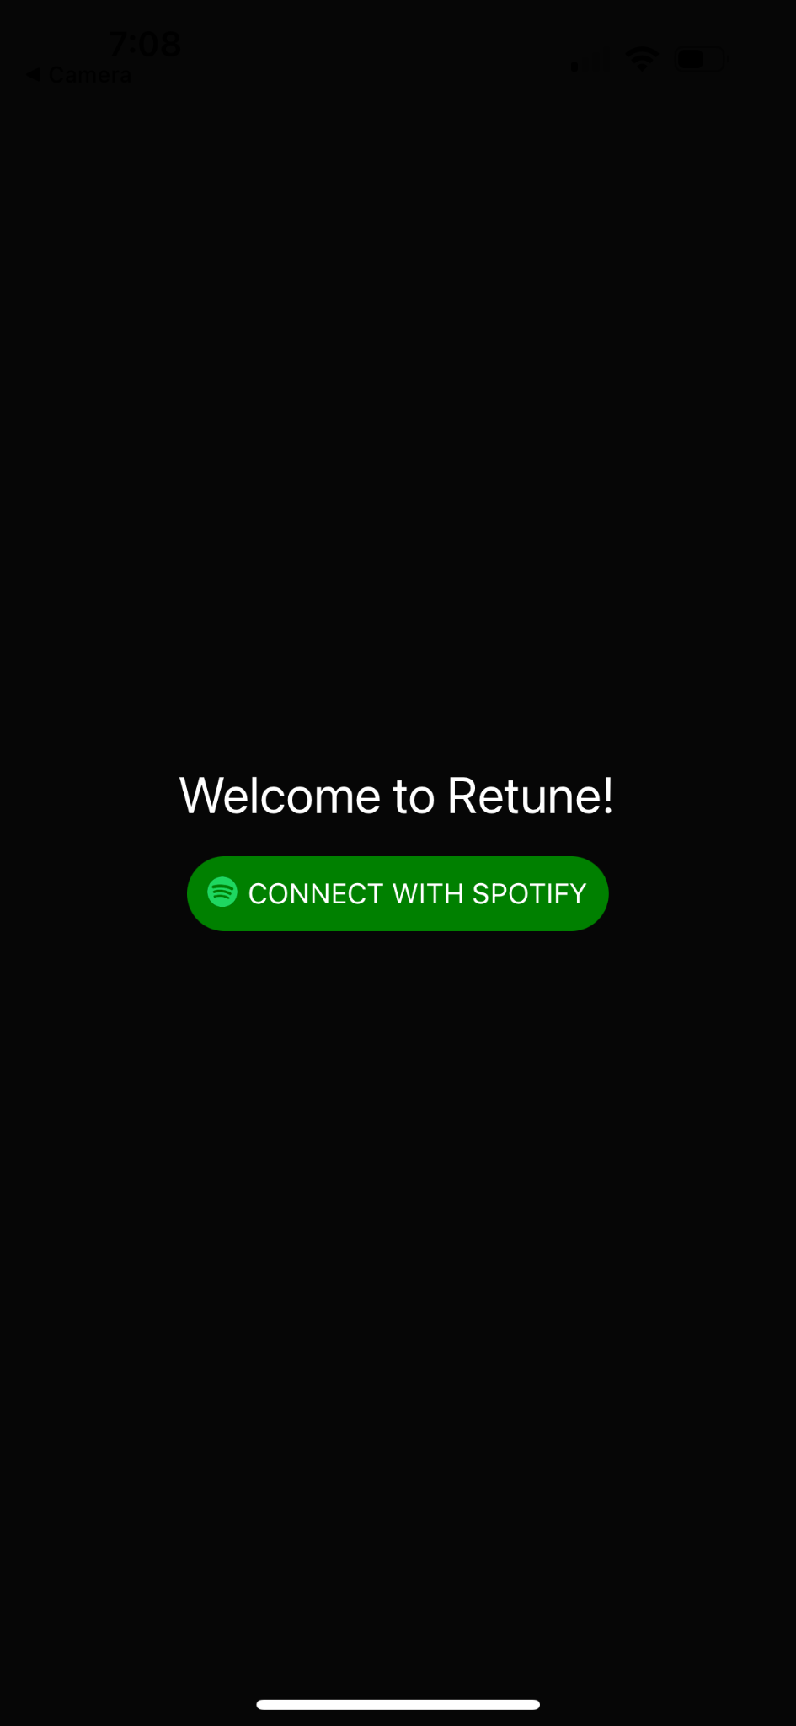
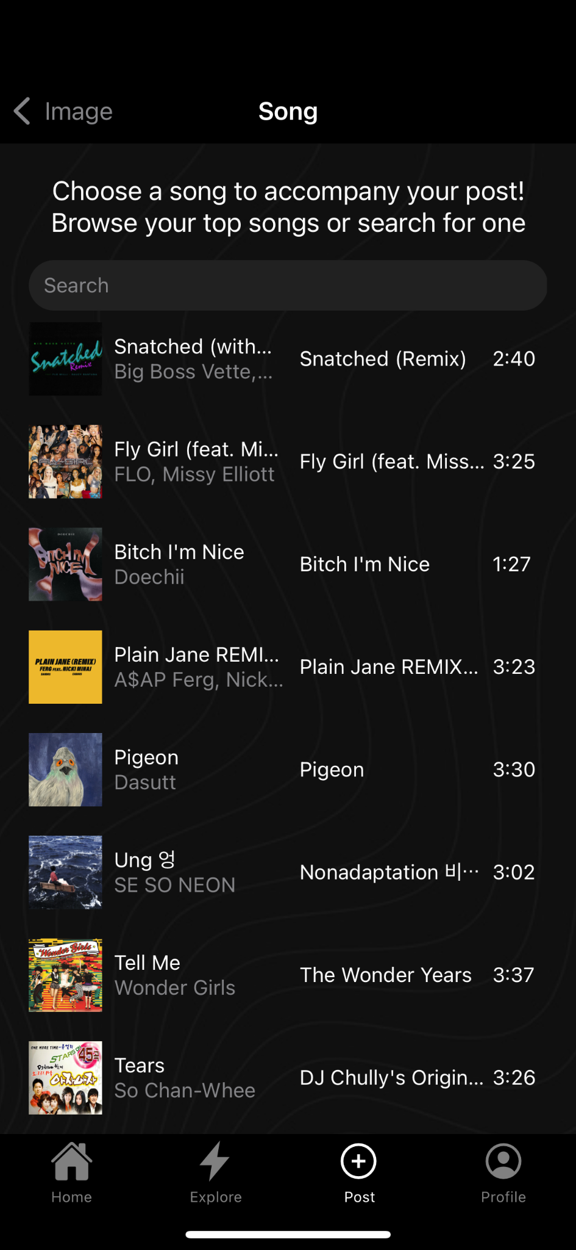
UI Revisions: Spotify API
CS 147
Retune
Notes:
We’ve integrated our app with Spotify to pull from what users are currently into. By using the Spotify API we can pull from a user’s top tracks and allow them to search for songs directly in the app.
Disclaimer: Ideally we would be able to integrate our app with a variety of music streaming services– for the sake of this class we’ve decided to go with Spotify since it’s what we’re most familiar with

Slide 12
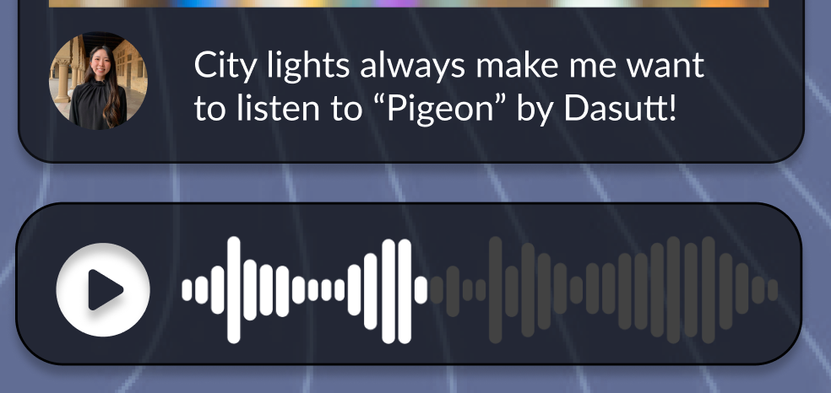
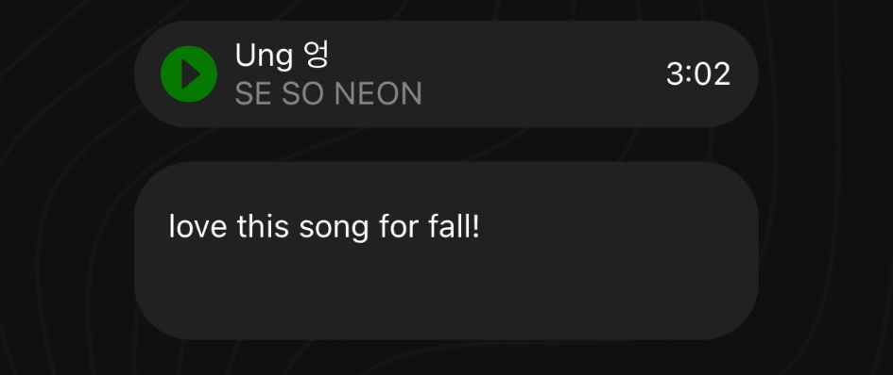
UI Revisions: more detailed song preview
CS 147
Retune
Notes:
Based on the heuristic evaluation feedback, we’ve added more information for our song audio snippets so users can immediately see the song name and artist

Slide 13
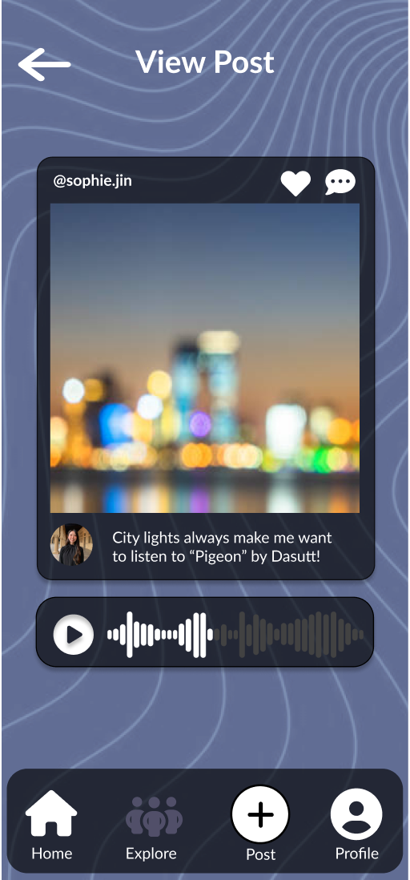
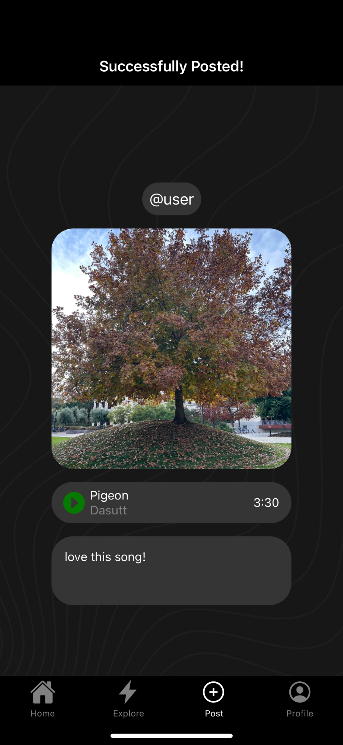
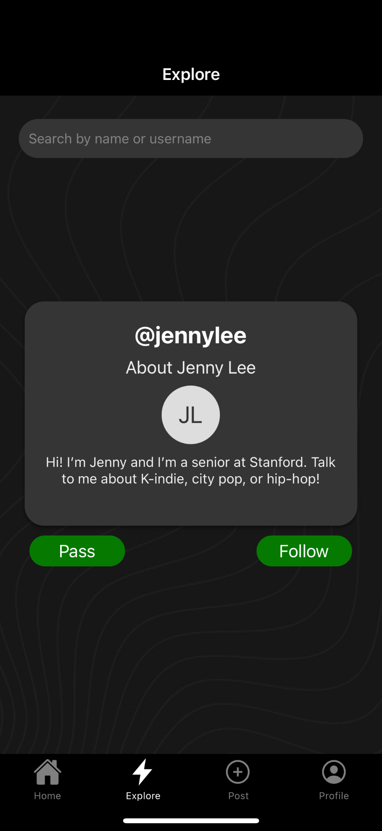
UI Revisions: simplified the use of color
CS 147
Retune
Notes:
We’ve simplified the design to look more minimal and sleek, with less color so it’s easier on the eye and the text is easier to read.

Slide 14
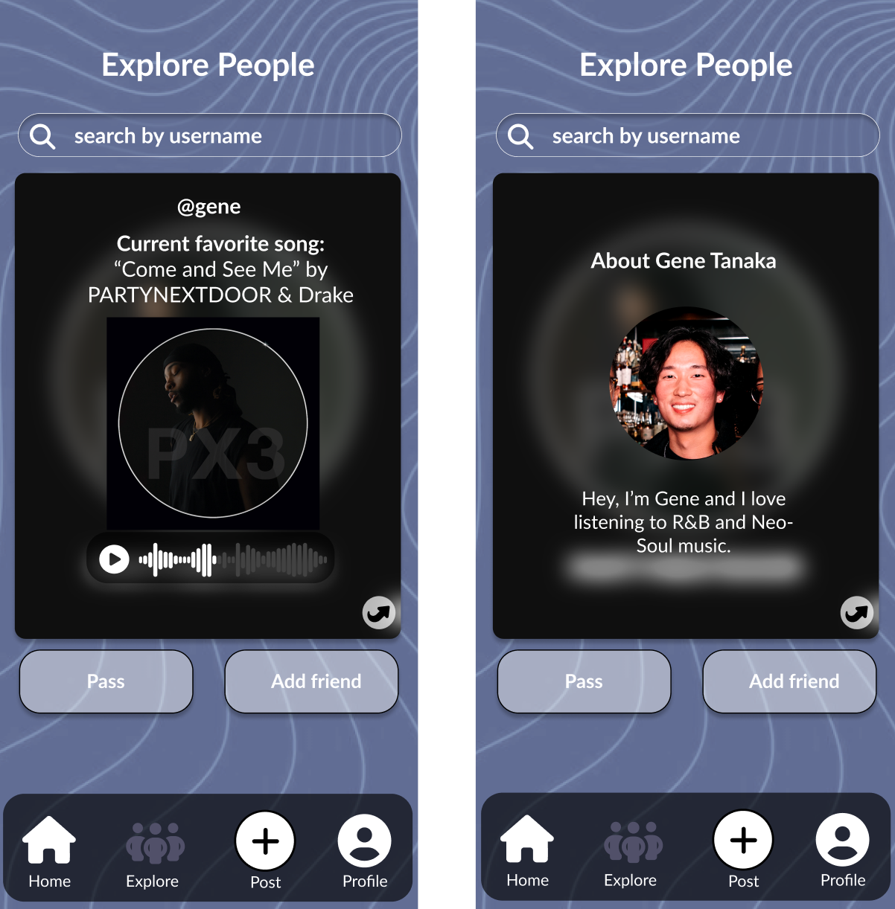
UI Revisions: relevant information immediately visible
CS 147
Retune
Notes:
We’ve made relevant information more readily available upon first glance. For example, on our explore feed, instead of having to flip a card, we’ve presented all of the relevant user information at once. Note: it’s not visible here yet, but our ‘favorite song’ preview will also be displayed underneath the profile card for our final prototype.

Slide 15
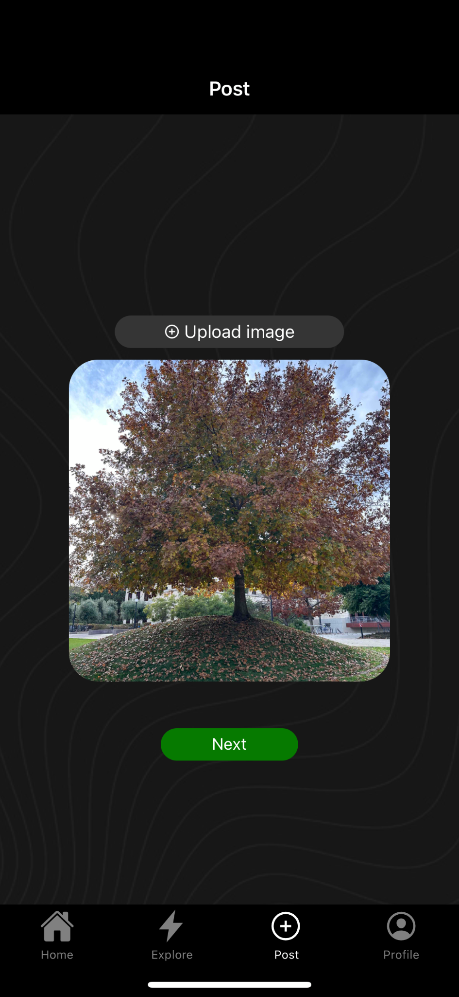
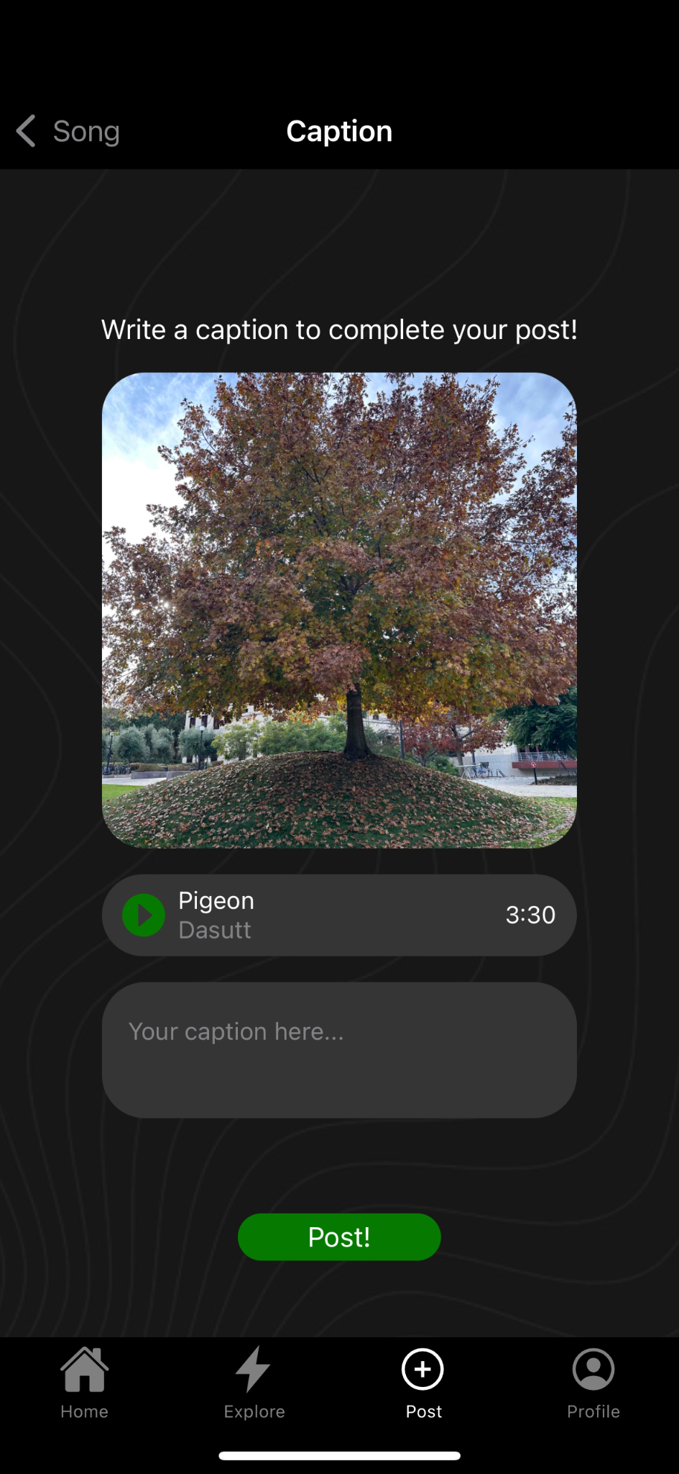
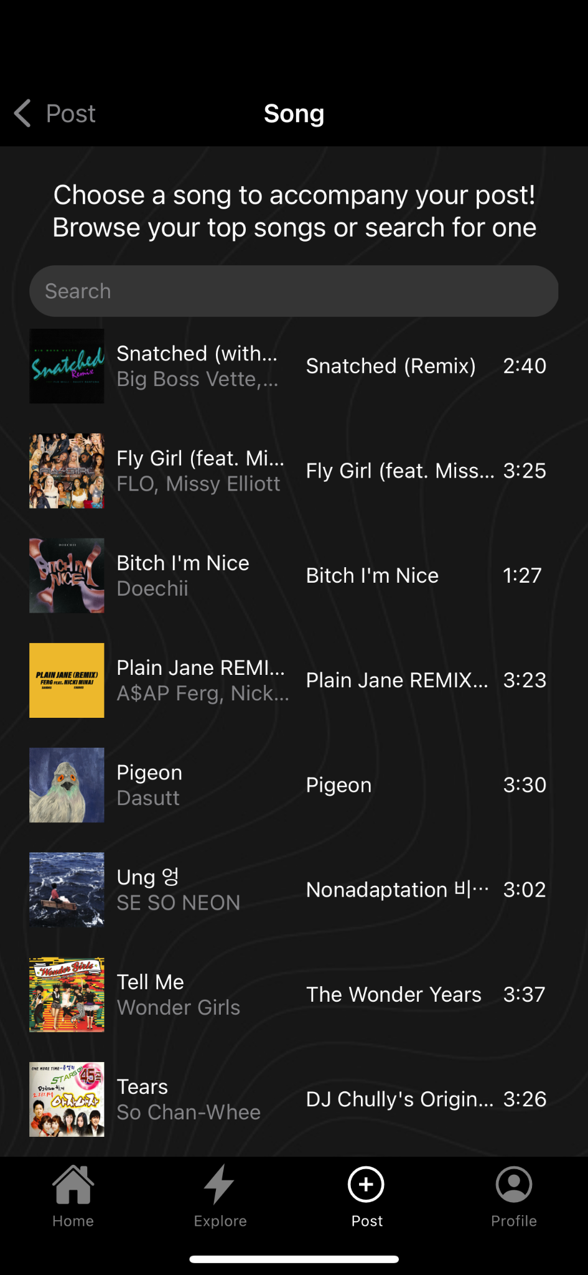
UI Revisions: User freedom with task flows
CS 147
Retune
Notes:
Based on feedback, we’ve added more user freedom with our task flows. In our posting task flow, which you’ll see a demo of today, users are able to go back and revise their image, and song choice if needed.

Slide 16
Progress Towards Usability Goals
Learnable?
Minimized use of color
More documentation
More user freedom
CS 147
Retune
Notes:
For our progress towards usability goals, our first usability goal was for the app to be learnable.
For one, we think that minimizing the use of color will make it clearer for the user to know where they’re supposed to go.
We also provided more documentation so the user knows what to do and what stage they’re at, like adding specific headers for each page and making it clear where text inputs are supposed to go.
Lastly, we’ve tried to account for user freedom, adding room for user error and revision in our task flows.

Slide 17
Progress Towards Usability Goals
Efficient?
Relevant information immediately visible
Integration with existing music streaming services
CS 147
Retune
Notes:
Our second usability goal was for the app to be efficient.
We think that by simplifying the features and making all relevant information visible on first glance, users will be able to know what they want to do quicker and more efficiently carry out their tasks.
Also, since we’ve integrated our app with Spotify, users will be able to more efficiently share their current favorite songs.

Slide 18



Prototype Implementation Status
Framework / tools
React Native / expo
Github
Supabase
CS 147
Retune
Notes:
We’ve chosen to go with react native / expo for our development, and are also using Github to collaborate. We’re also using Supabase for our backend storage system

Slide 19
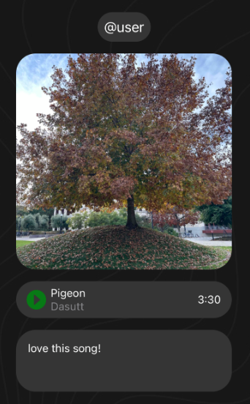
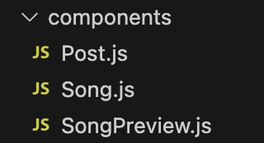
Implemented features
Navigation
Nav bar is fully functioning
Components
Added components for posts and song previews, with working audio
Backend
Implemented the structure for our data storage with Supabase
CS 147
Retune

Slide 20
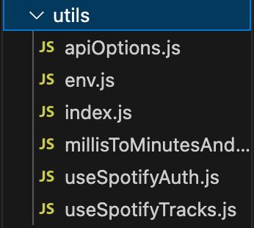
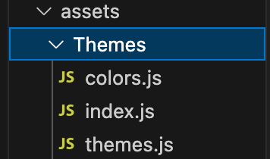
Implemented features
Spotify API
App is integrated with Spotify API
Pulling top tracks, searching for songs
(Parts of code borrowed from previous work in CS 147L)
Styling
Themes folder for colors
Standardized styling for elements (e.g. buttons, search bars, posts)
CS 147
Retune

Slide 21
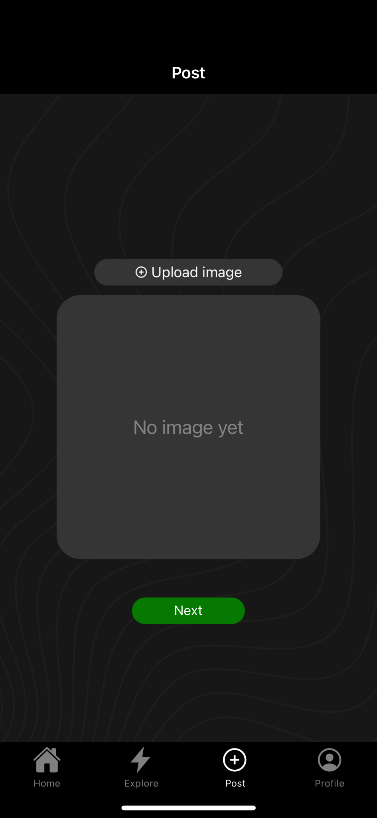
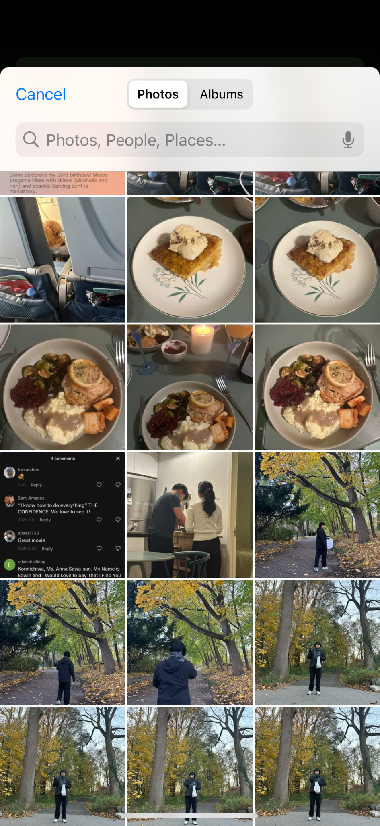
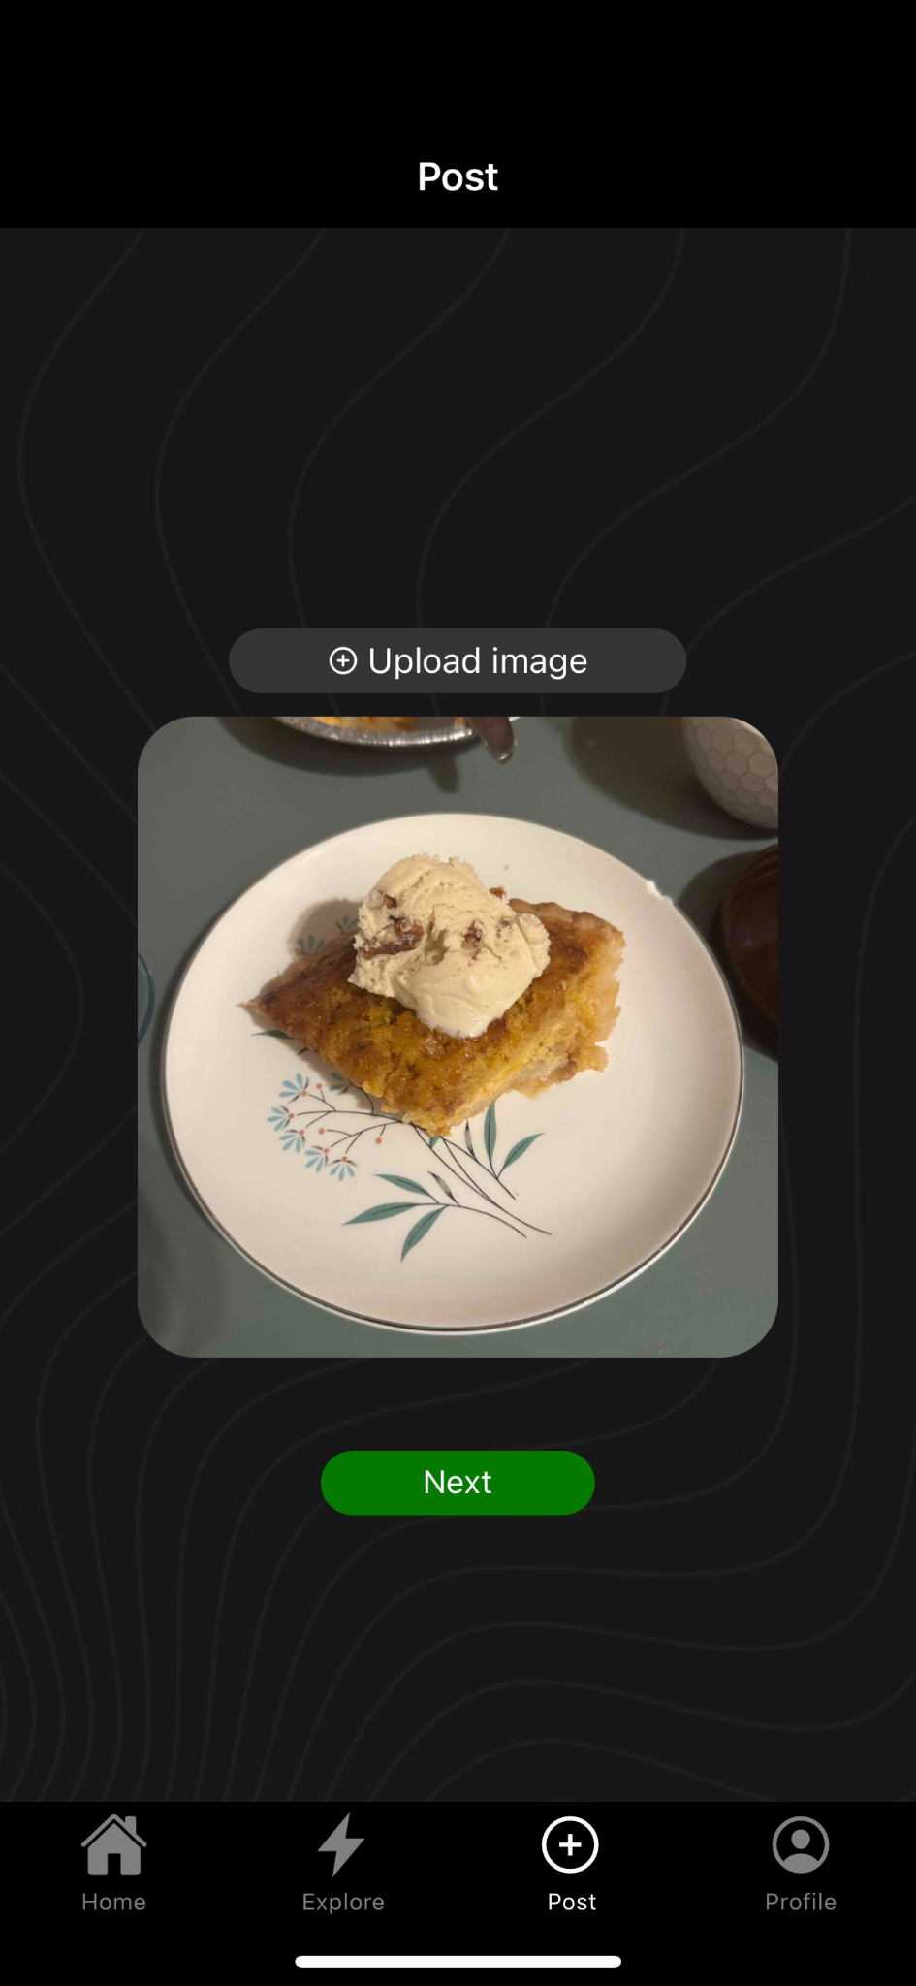
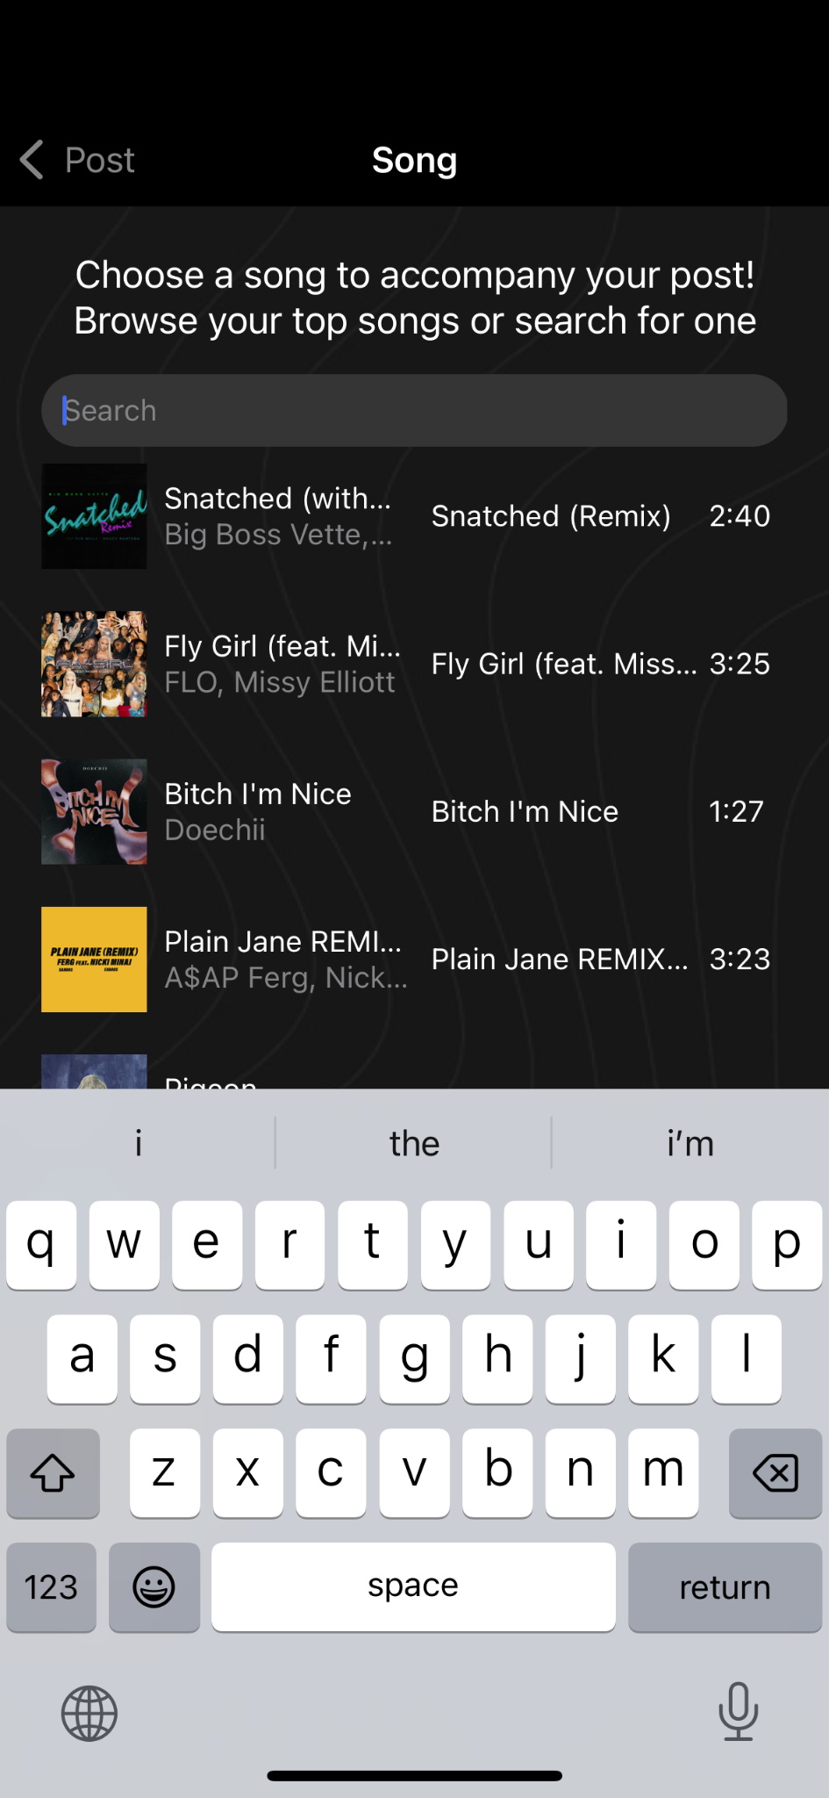
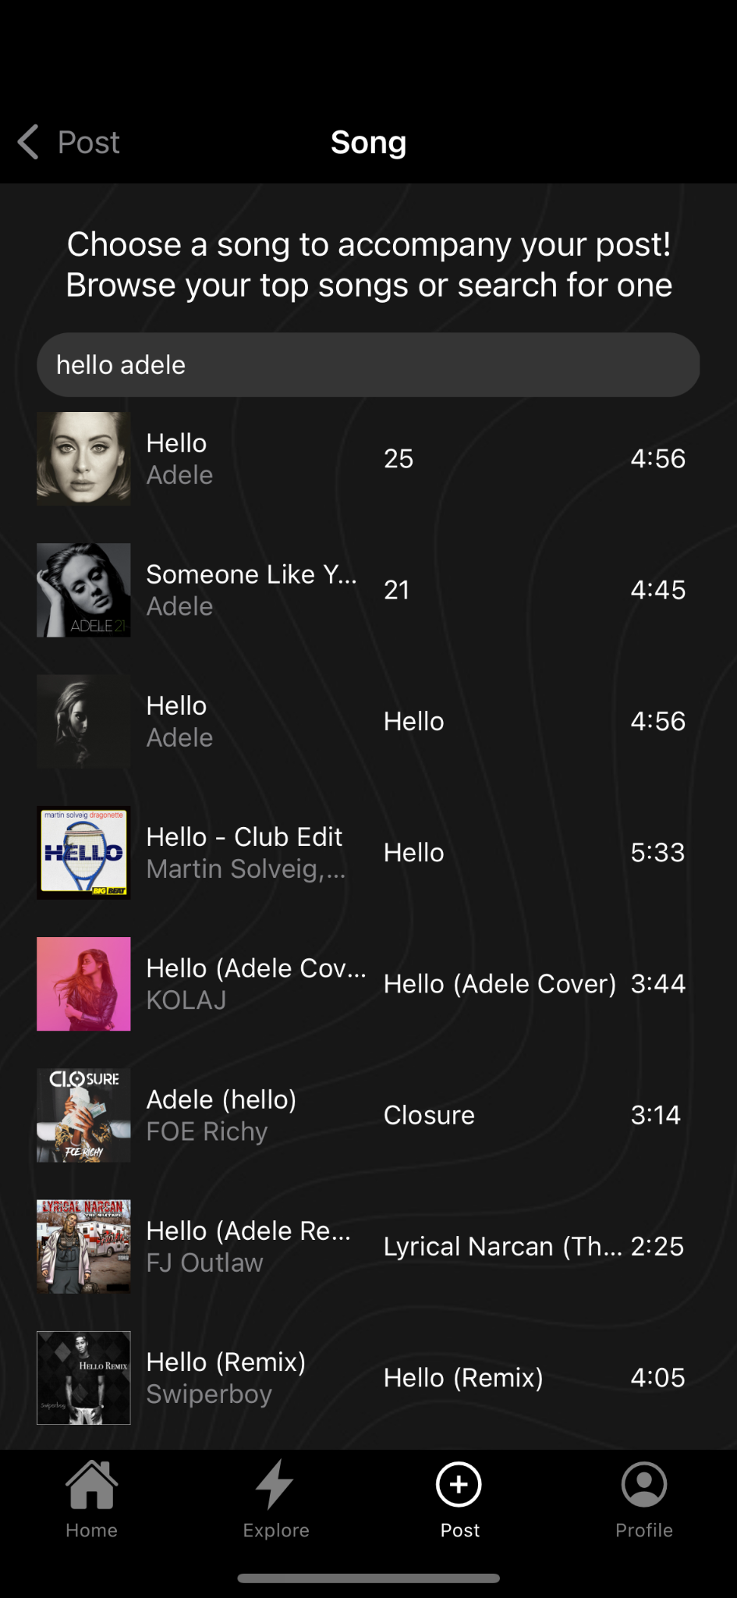
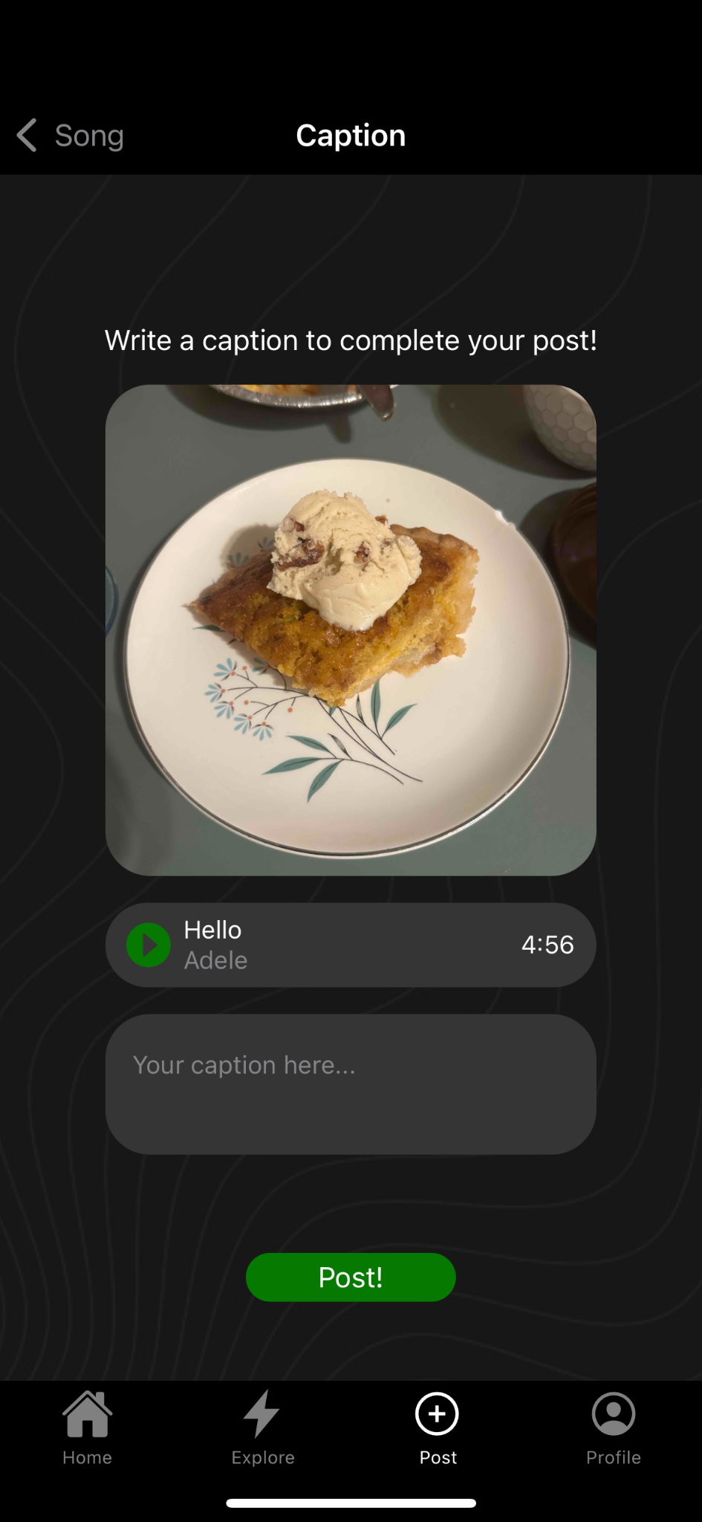
Implemented features
Posting
Posting task flow fully implemented
CS 147
Retune

Slide 22
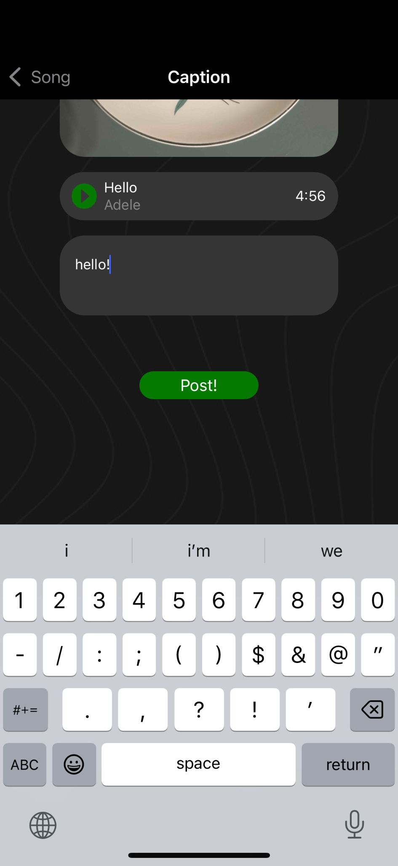
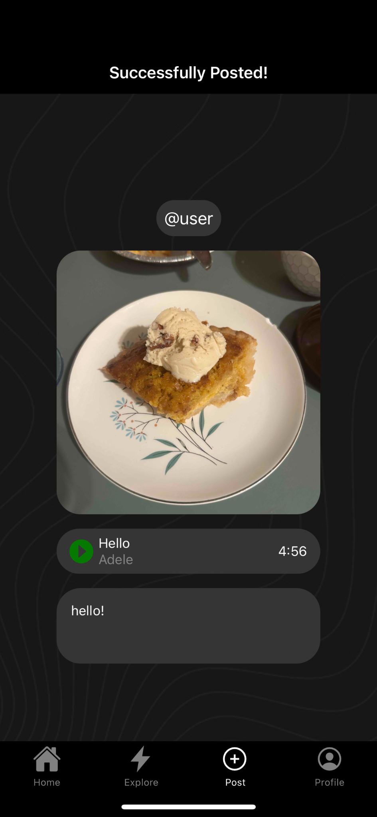

Implemented features
Posting (cont.)
Posting task flow fully implemented
CS 147
Retune

Slide 23
Unimplemented features
Fully integrating backend & frontend
  Populating feeds and profile page from stored data
  Storing user info (i.e. username, bio, favorite song) and displaying it
Customizable profile page
  Implementing profile page with customizable profile picture, bio, and favorite song
  Populating profile with recent posts
Styling
  Fine-tuning and making style consistent across all pages
CS 147
Retune

Slide 24
Unimplemented features- Plan
Fully integrating backend & frontend
  We plan to finish by the end of this weekend!
Customizable profile page
  Finish skeleton by end of the week
  Integrate w/ backend by end of weekend
Styling
  Standardize styling by early next week
CS 147
Retune

Slide 25
Wizard of Oz / Hardcoded Elements
Wizard of Oz
  Our users will likely have to be manually populated
  Songs must be available on Spotify to be used
Hard-coded
  Images, users, etc. are hard-coded for now but will be dynamically added once our backend is complete
CS 147
Retune

Slide 26
Issues/Questions
Privacy
  Privacy would be a big concern if this app were to actually go public.
  We would have to consider public/private account management and comment management if the app were released on a larger scale.
  Wondering how much we should consider privacy for the scope of our final prototype?
CS 147
Retune

Slide 27

Prototype demo
CS 147
Retune
Notes:
Note– the Spotify login is skipped because I’ve already logged in before, but on first open it would take you to the Spotify login page

