Slide 1
Live music: getting the experience
Lizi Ottens, Steven Beckley, Max Murrell

Slide 2
Intro

Slide 3

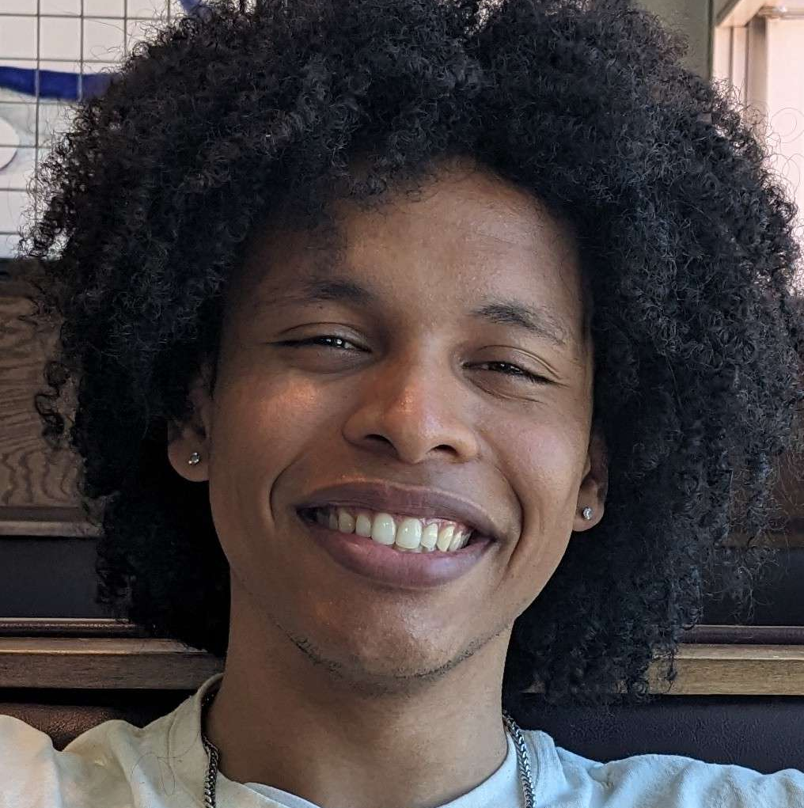

Our Team
Max
Steven
Lizi

Slide 4
Problem Domain: Live Music

Slide 5
Needfinding Methodology

Slide 6



Our Participants
Evan
A Harvard student recruited for the number of concerts they attend
Easha
A Stanford student recruited for their experience as a performer
Terry
Waiting at the bar of a local restaurant with excellent recurring live Jazz music.

Slide 7
Guiding questions
What role does music play in your life?
  How often do you listen to music?
  Do you make music at all?
  Which genres appeal to you the most?
How often do you attend live music events?
Do you prefer live music or recorded music?
What might prevent you from going to a live event?
What’s your favorite part about live music?
What’s your least favorite part?
Tell me about a fun concert you’ve been to?
  What was fun about it?
What other types of things do you like to do for fun?

Slide 8
Interview Results

Slide 9
“Joy [Akala] was cool because more so than the music, I was really into the atmosphere and the environment. It made me realize why people go to live concerts.”
- Easha

Slide 10
“It unifies people. You can play music in any country and someone will start tapping their foot”
- Evan, on what music means to him

Slide 11
“"First I wanted good food. Turned out they had live music and it's frequent!"”
- Terry, on finding live music

Slide 12
Analysis
Notes:
Common themes: experience over music - people they go with, more social
Surprises: It’s about the experience over the actual music, but is willing to spend more on certain artists and not others
Doesn’t go in big groups: will sometimes even go alone and meet people there
Contradiction: Both enjoyed smaller venues with more intimacy, but also enjoyed really big hype music
Love walking around and finding live music, but they also like to know when there’s a pattern

Slide 13
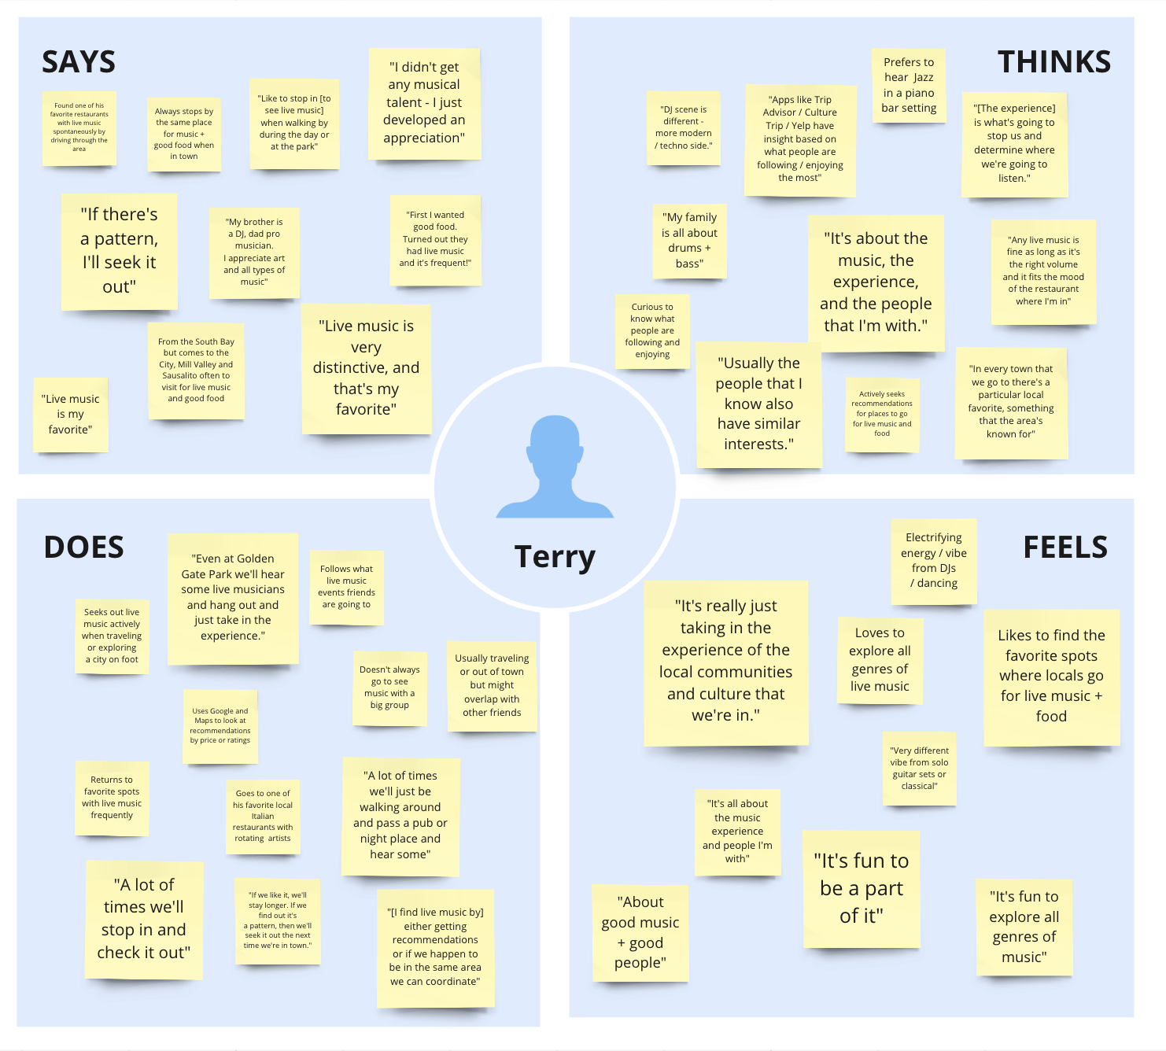

Slide 14
Contradictions
Live music events for Terry are about the experience and people they’re with; however, they don’t always attend with a group of people but consistently follow what events others are going to.
Insight 💡: We wonder if this means that social connection is a key part of the live music experience, even if people aren’t physically present at the type of event in-person.

Slide 15
Contradictions
Live events for Evan are about the experience more so than the actual music, but Evan says that he goes to concerts of artists that he follows and listens to.
Insight 💡: We wonder if this means that the experience is more than just the ambiance and vibe, there’s also an element of fandom and seeing artists that you know.
Evan says he listens to a variety of genres of music, but when he talked about the concerts he had been to and his experiences, they were all rap concerts
Insight 💡: If live music is about the experience, maybe there is something greater about the experience of rap concerts specifically that draws in people like Evan

Slide 16
Surprises
Doesn’t go in big groups: will sometimes even go alone and meet people there
Insight 💡: Live music is more about the experience to them than the actual music
For Terry, live events are “about good music and good people.”
Insight 💡: We wonder if this means that live music is desirable not only for listening but for social connection or a unique experience.

Slide 17
Tensions
Terry really enjoys spontaneously dropping in on live music events he discovers in coffee shops, restaurants, parks or venues while walking around a city, but primarily ends up defaulting to his favorite live music venues instead.
Insight 💡: We wonder if this means that new live music events / venues are highly desirable, but difficult to discover spontaneously without more help.

Slide 18
Surprises
Evan gets annoyed when people have their phones out the whole time
Insight 💡: We wonder if there is a way that we can encourage people to enjoy live music without recording it or taking pictures on their phone
Evan is very frustrated with the inflated resale prices of concerts (especially rap concerts) and feels like only certain artists are worth the price of the ticket
Insight 💡: We wonder if people would enjoy live music events more if they didn’t have to worry about the prices of the tickets

Slide 19
Insights and Needs
Common themes in our insights:
  Music as a social device
  Prices making live music less desirable
  Experience of live music evokes emotions of excitement
We wonder if this means that we can encourage more people to attend live music by:
  Shifting the perception of live music to be more about the social aspect
  Making concerts and live music more accessible price wise
  Making concerts more discoverable

Slide 20
Summary

Slide 21
Next Steps
More interviews: get a wider variety of perspectives
Narrow down the problem within the space of live music
Brainstorm HMW statements

Slide 22
Thank you!

