Slide 1
Live Music: Narrowing Our Scope
Lizi Ottens, Steven Beckley,
Max Murrell

Slide 2
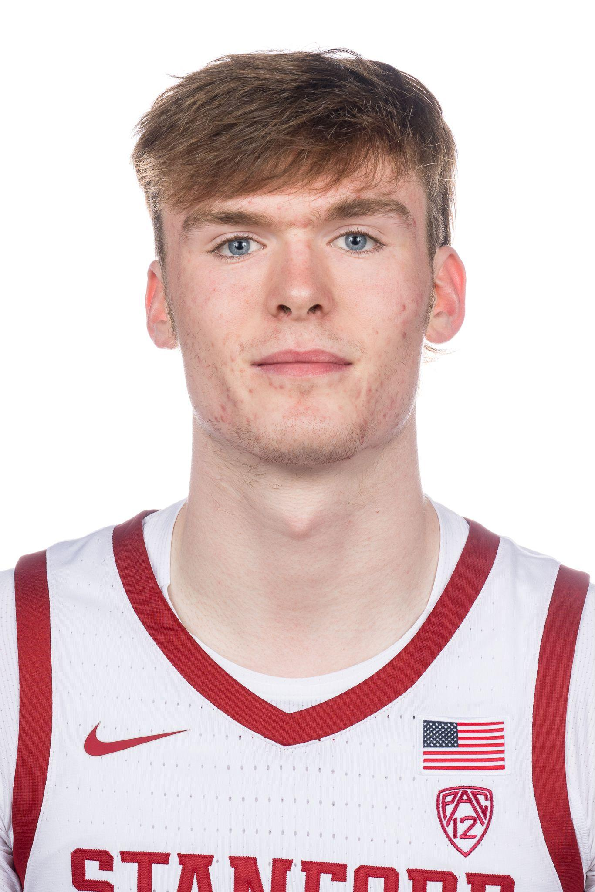
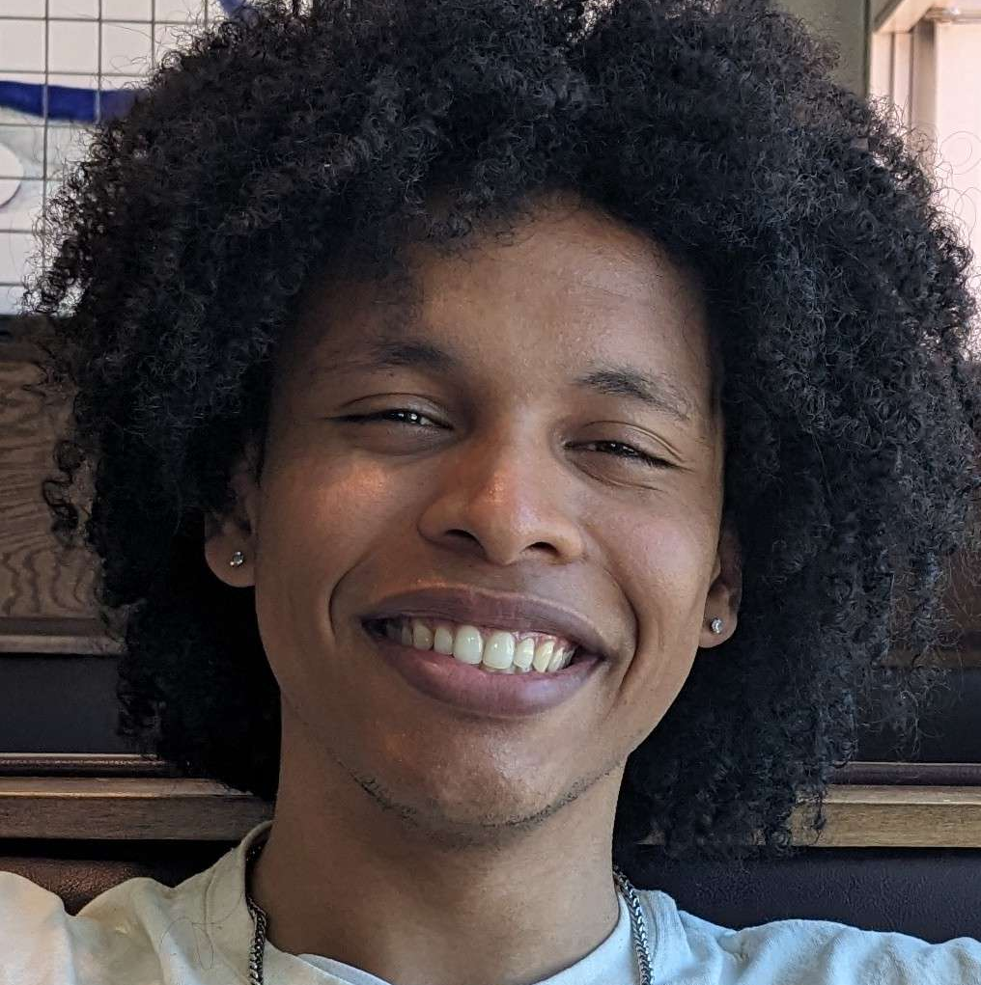
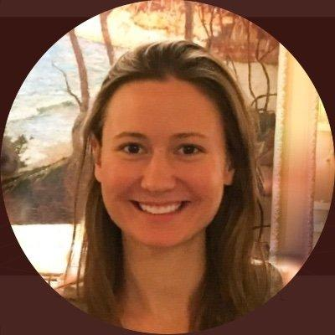
Our team
Team TuneTribe
Max
Steven
Lizi

Slide 3
Our Domain
Live Music
Music as a Community
What are the key aspects of live music that people enjoy? How can we improve the experience?
How can we leverage music to build community and connections?

Slide 4
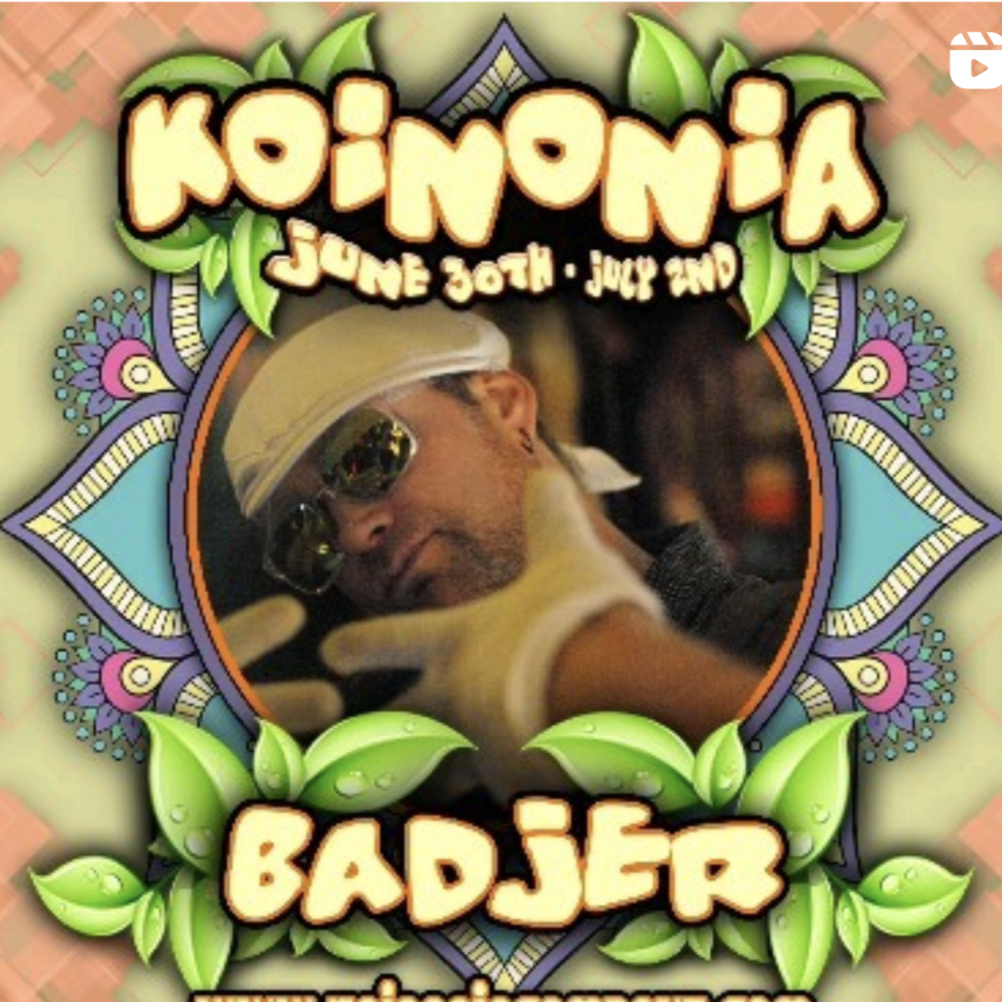

Additional Interviews
Bad Jer
Elle
A DJ and audio engineer living in San Diego who performs at large and small events
A Biology researcher living in San Francisco who attends live music often

Slide 5
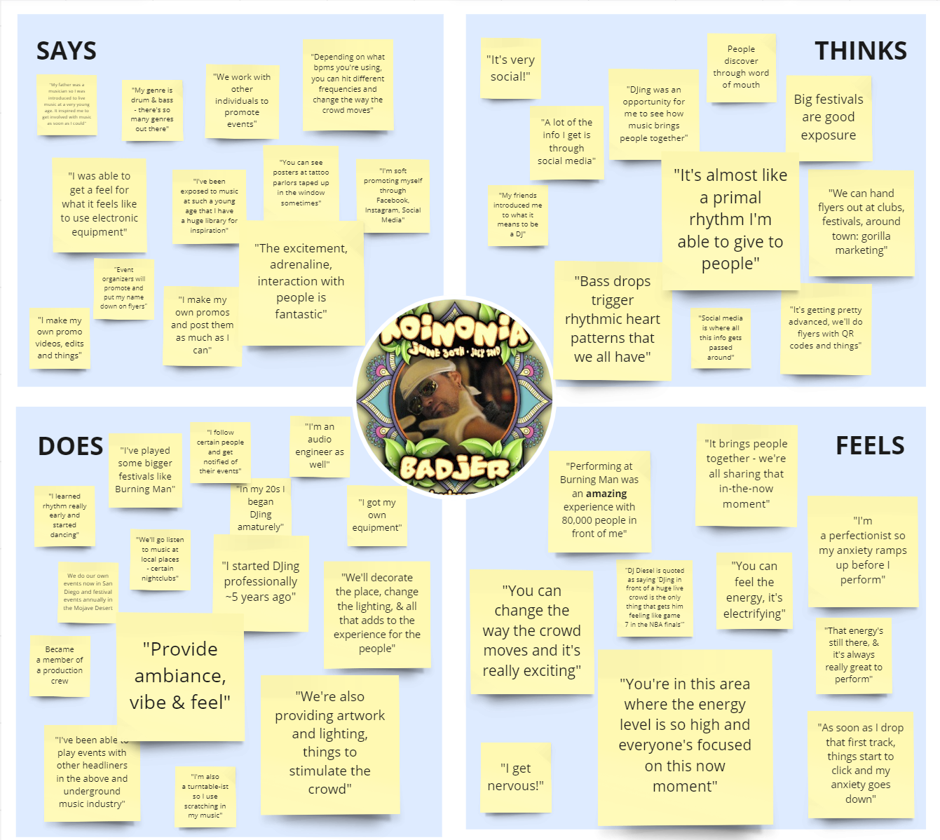
Bad Jer
Takeaways
Live events can connect people through the present moment, not only the music
Music has a physical aspect to it when it’s live, the vibrations from the bass and other sensations contribute to the live concert experience.
Promotion is a major part of being a successful artist and gathering crowds.

Slide 6
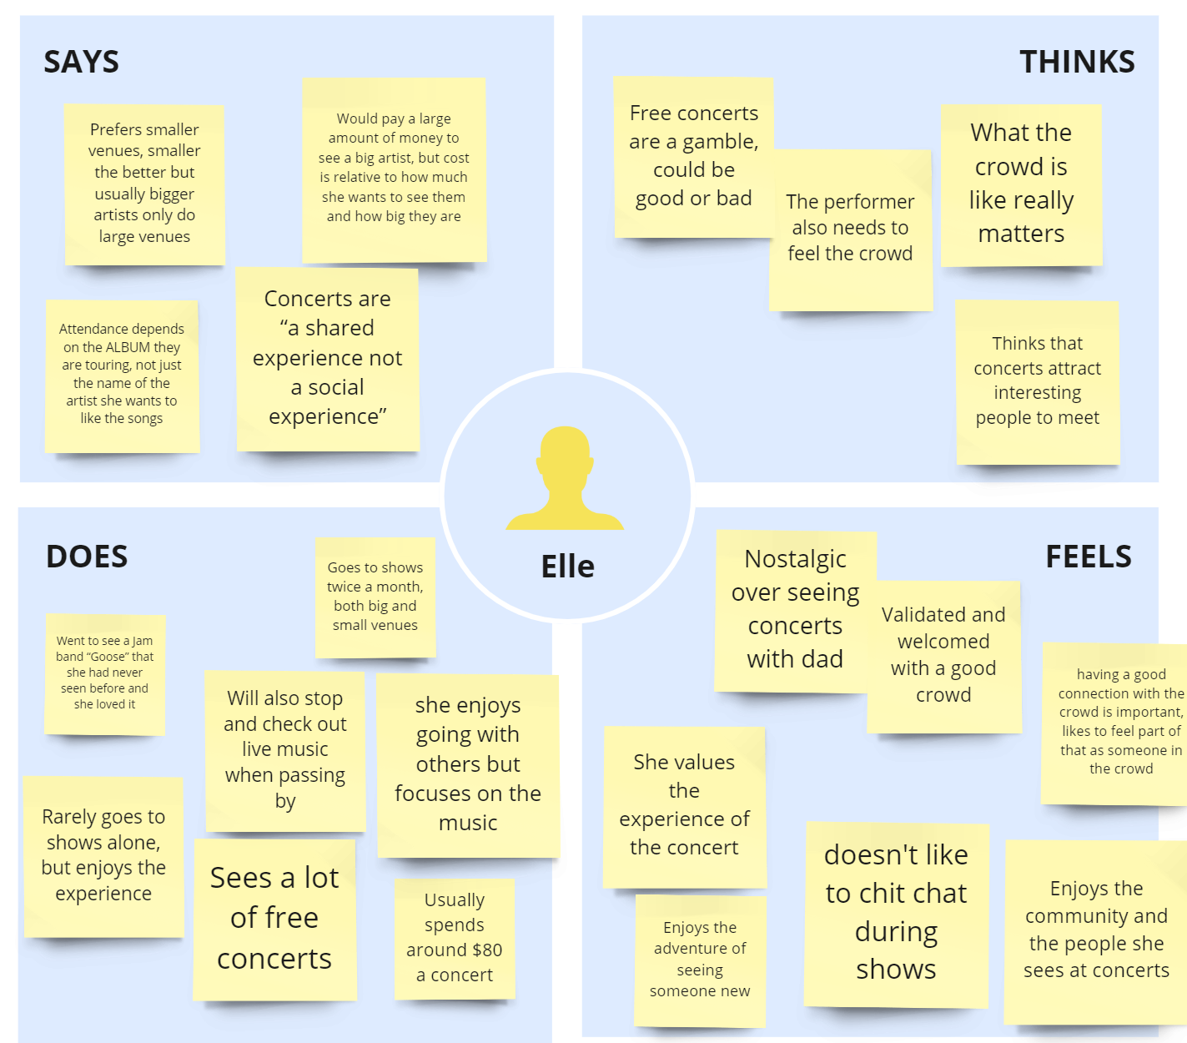
Elle
Takeaways
Believes concerts should be “a shared experience not a social experience”
Enjoys the community and the people she sees at concerts, that they attract interesting people to meet, maybe concerts are also about meeting people she finds interesting
What the crowd is like is really important, a dead or unenthusiastic crowd can really impact the concert experience.

Slide 7
FOCUS:
POVs from potential users

Slide 8

POVs
We met… Easha, a singer-songwriter who performs often on Stanford’s campus and is an avid music listener.
We were surprised to realize… Although Easha never goes to concerts in large groups, it’s important to her who else is in the crowd alongside her and is annoyed when others don’t appreciate the music.
We wonder if this means… Easha would enjoy the experience of going to a concert with a large group of similar people.
It would be game-changing to… Have a way to cultivate the experience of being in a crowd by surrounding users with people who enjoy music in the same way you do.
Easha

Slide 9
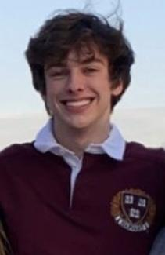
POVs
We met… Evan, a college student at Harvard that goes to a live music event once or twice a month.
We were surprised to realize… Evan listens to many different genres of music, but all of the concerts that he talked about were rap concerts.
We wonder if this means… that if live music is really about the experience, then maybe there is something about rap concerts that provides a more desired experience for Evan
It would be game-changing to… Have a way to discover live music based on the type of experience you want to have.
Evan

Slide 10

POVs
We met… Terry, a man waiting at the bar of a local restaurant with excellent recurring live Jazz music.
We were surprised to realize… Terry really enjoys spontaneously dropping in on live music events he discovers, but usually ends up defaulting to his favorite live music venues instead.
We wonder if this means… that new live music events / venues are highly desirable, but difficult to discover spontaneously without more help.
It would be game-changing to… Have an easy way for people to find new live music in their area.
Terry

Slide 11
POVs
We met… Bad Jer, a DJ and audio engineer living in San Diego who performs at large and small events
We were surprised to realize… How live music performances not only provide audio and visual content, but physical sensations of feeling the rhythm
We wonder if this means… That multimodal experiences including haptics are highly desirable to live music goers
It would be game-changing to… Find new ways to allow people to physically feel the music they’re listening to
Bad Jer

Slide 12
POVs
We met… Elle, a young graduate who often attends live music events
We were surprised to realize… Although Elle believes concerts should be “a shared experience not a social experience”, she greatly enjoys meeting “cool” and interesting people in the crowd and the feeling of being a part of a crowd.
We wonder if this means… Given the opportunity, Elle may like to use concerts as a means to meet interesting people with similar tastes
It would be game-changing to… Have a way to discover/create communities through live music events and introducing people with similar tastes in music.
Elle

Slide 13
FLARE:
Ideating with HMWs and brainstorming

Slide 14
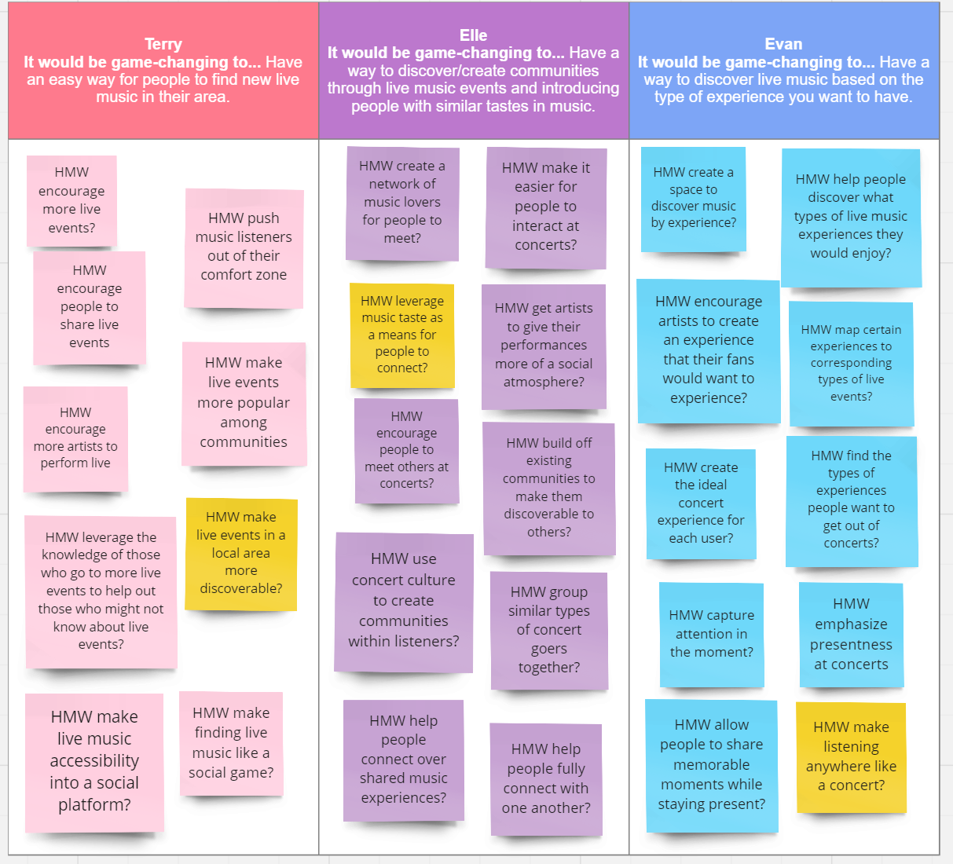
HMWs
HMW make live events in a local area more discoverable?
HMW leverage music taste as a means for people to connect?
HMW make listening anywhere like a concert?

Slide 15
Solutions
Music Radar
App that uses location to advertise and direct users towards live music events.
Musical “Dating App”
App that connects people based on their music taste
At-Home Concert
VR concert experience to recreate the ambiance and feeling of a live music event.

Slide 16
FOCUS:
Creating and testing
experience prototypes

Slide 17
Experience Prototyping
Music Radar
Musical “Dating App”
At-Home Concert

Slide 18
Experience Prototyping
Idea:
Critical Assumption:
Music Radar
Users be willing to follow directions to a live event not knowing the artist.

Slide 19
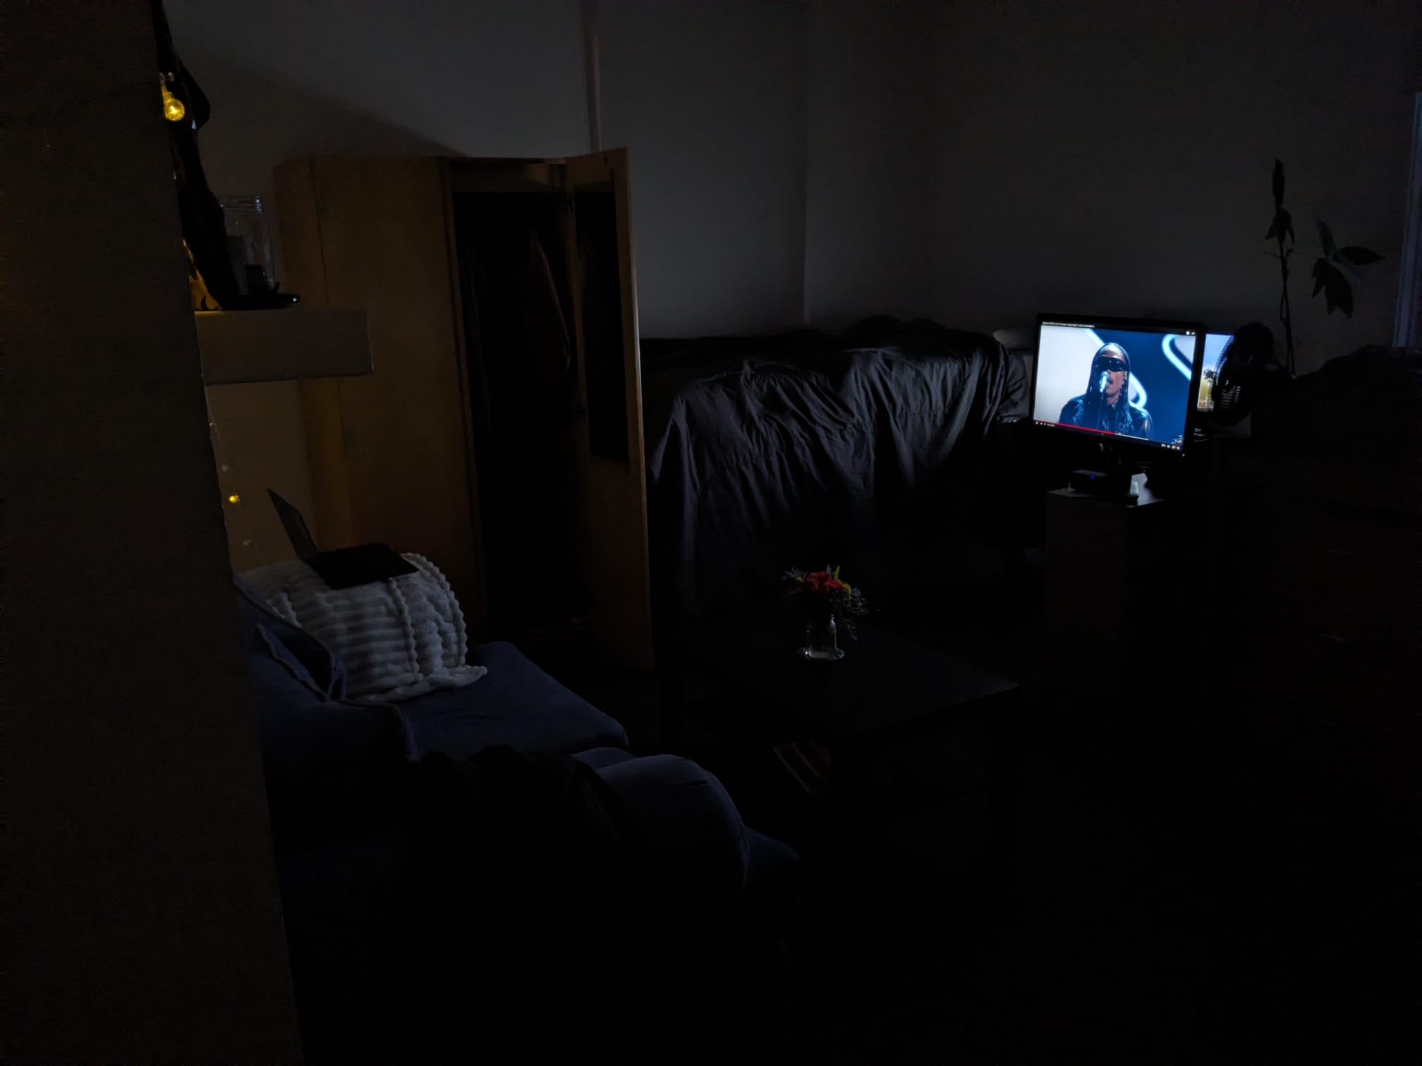
The Setup
A “live music event” to discover through written directions.
The directions are clear, but not the most efficient path to the venue.
The venue is obviously underwhelming, which is a real risk when using our proposed app

Slide 20
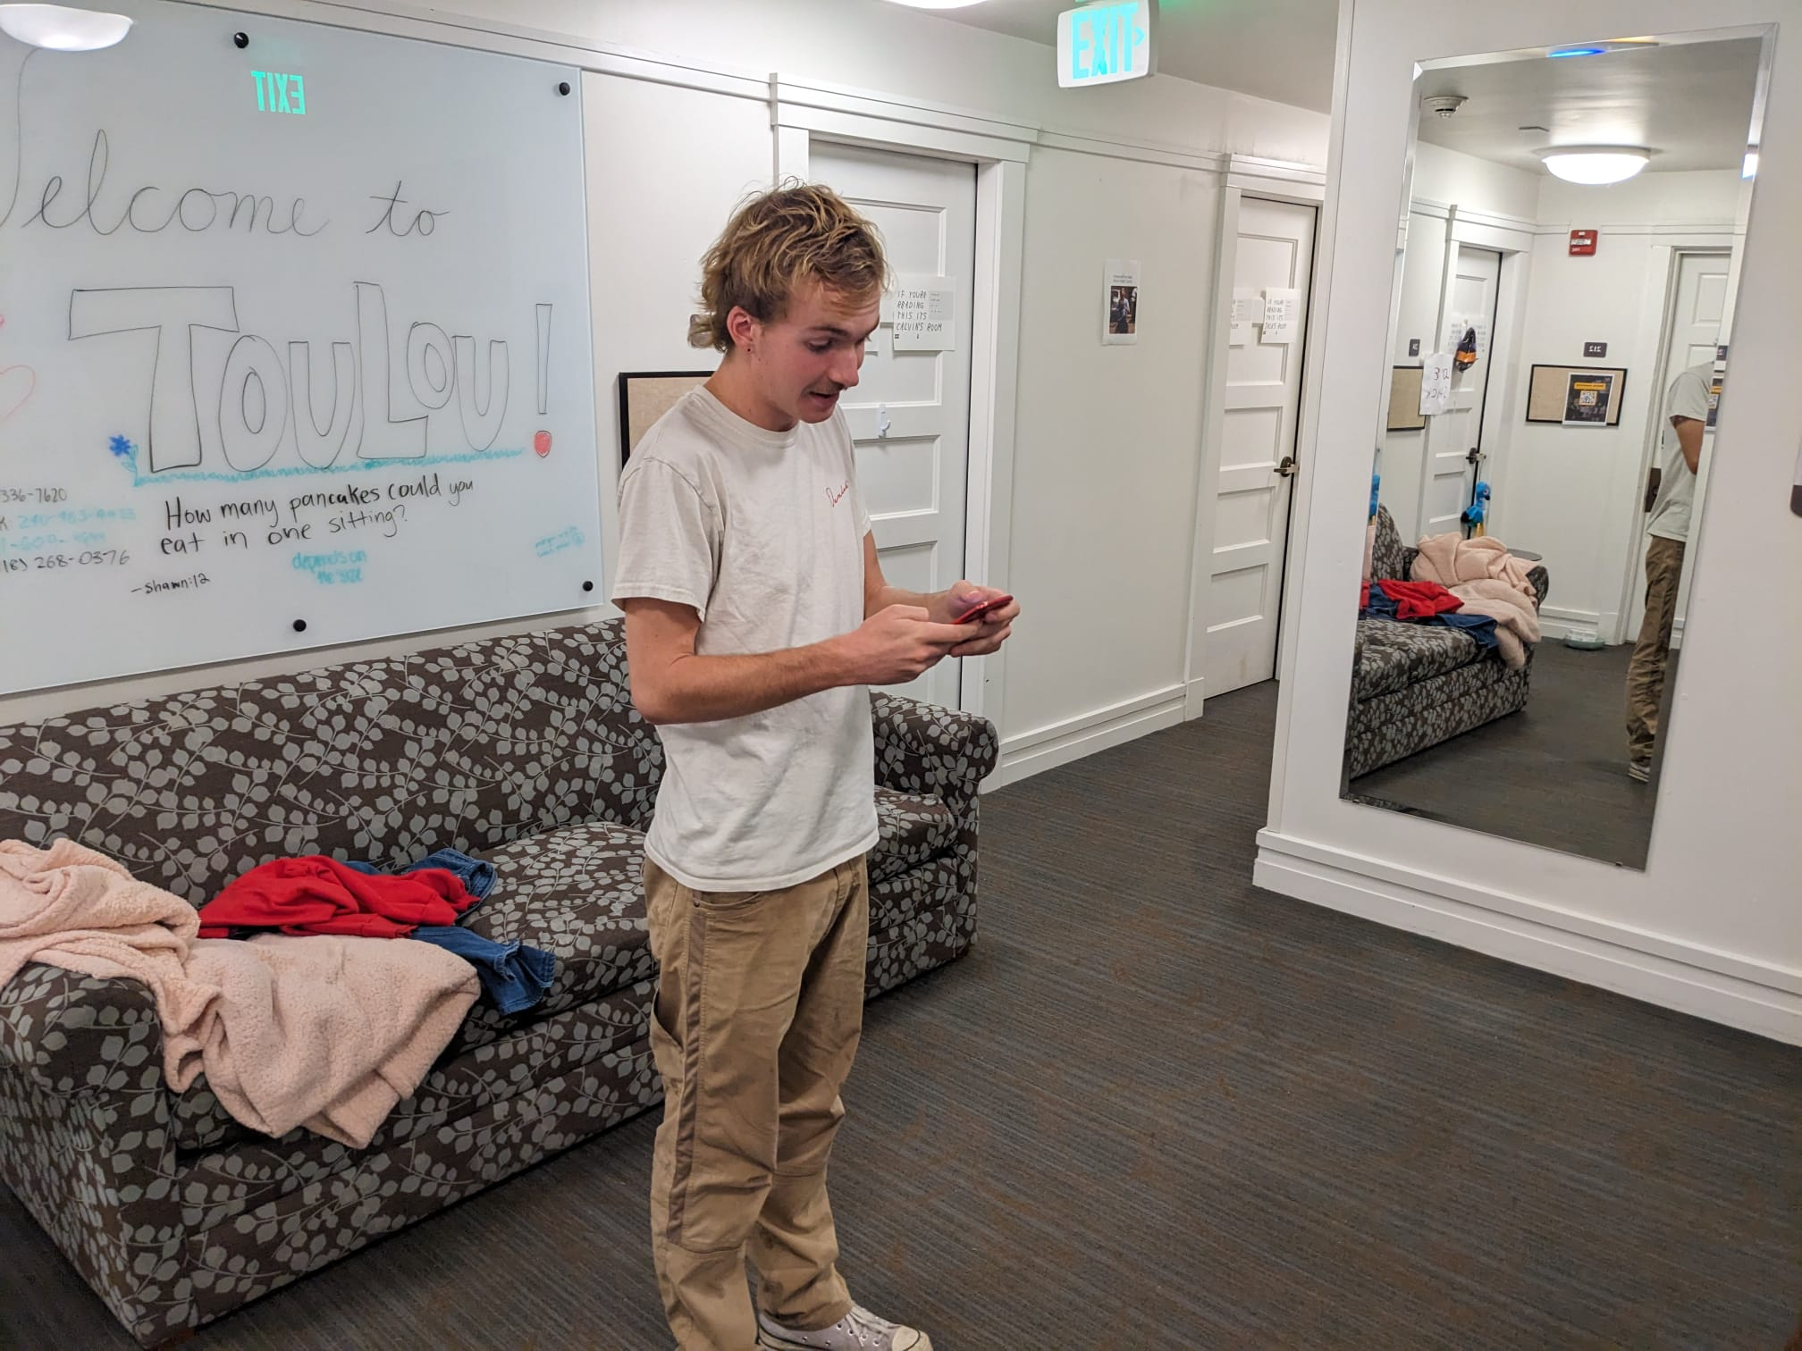
The Test
The tester was instructed to follow the directions given to him via his phone to “discover” his next new favorite musician from a potentially spectacular show.

Slide 21
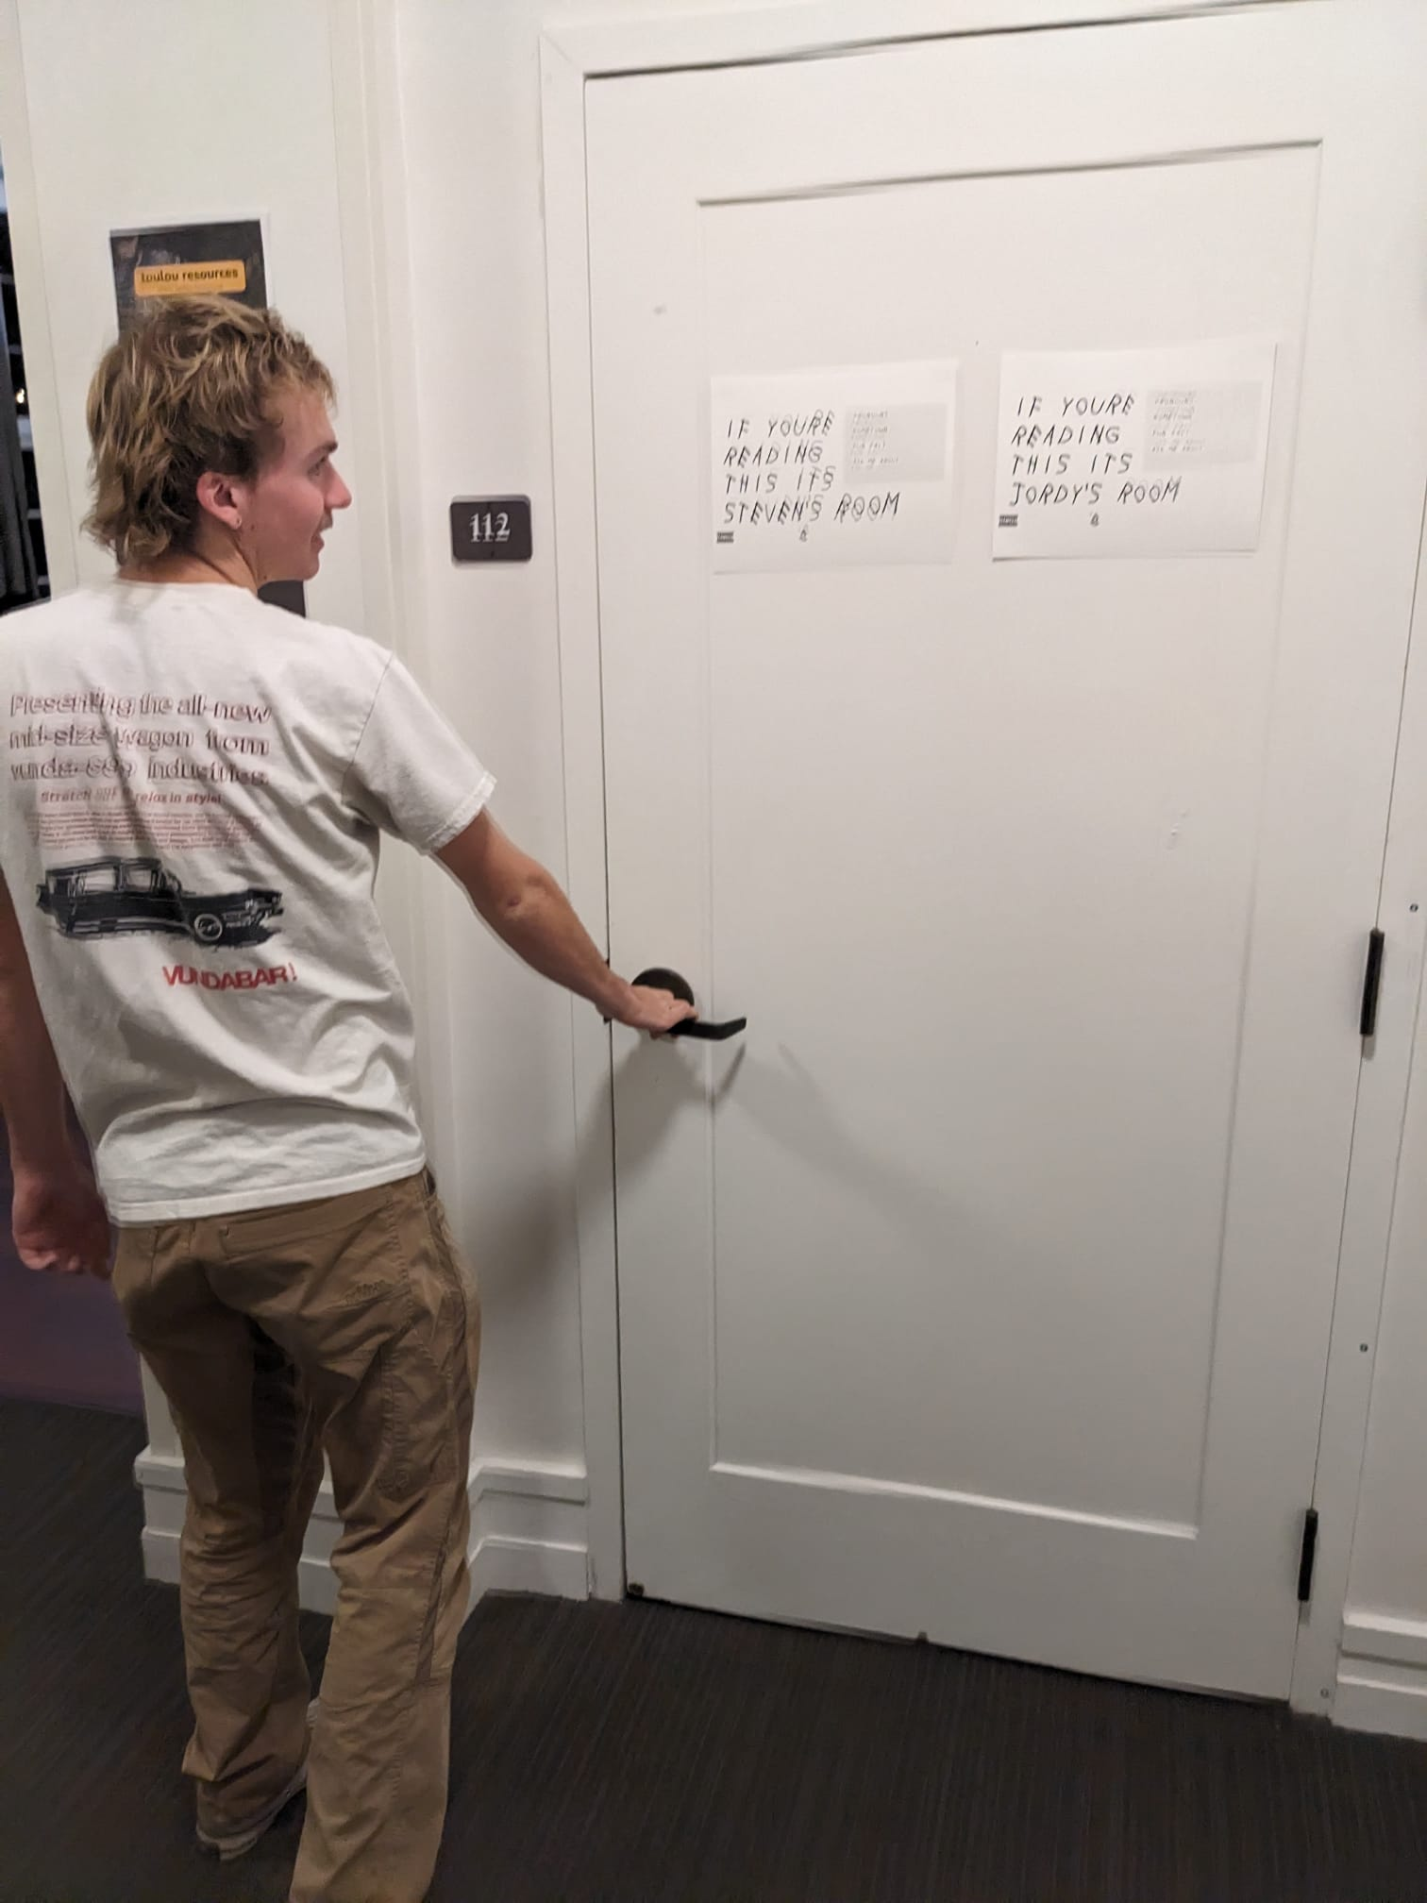
After a windy journey through a dormitory, he arrived at the location using my instructions

Slide 22
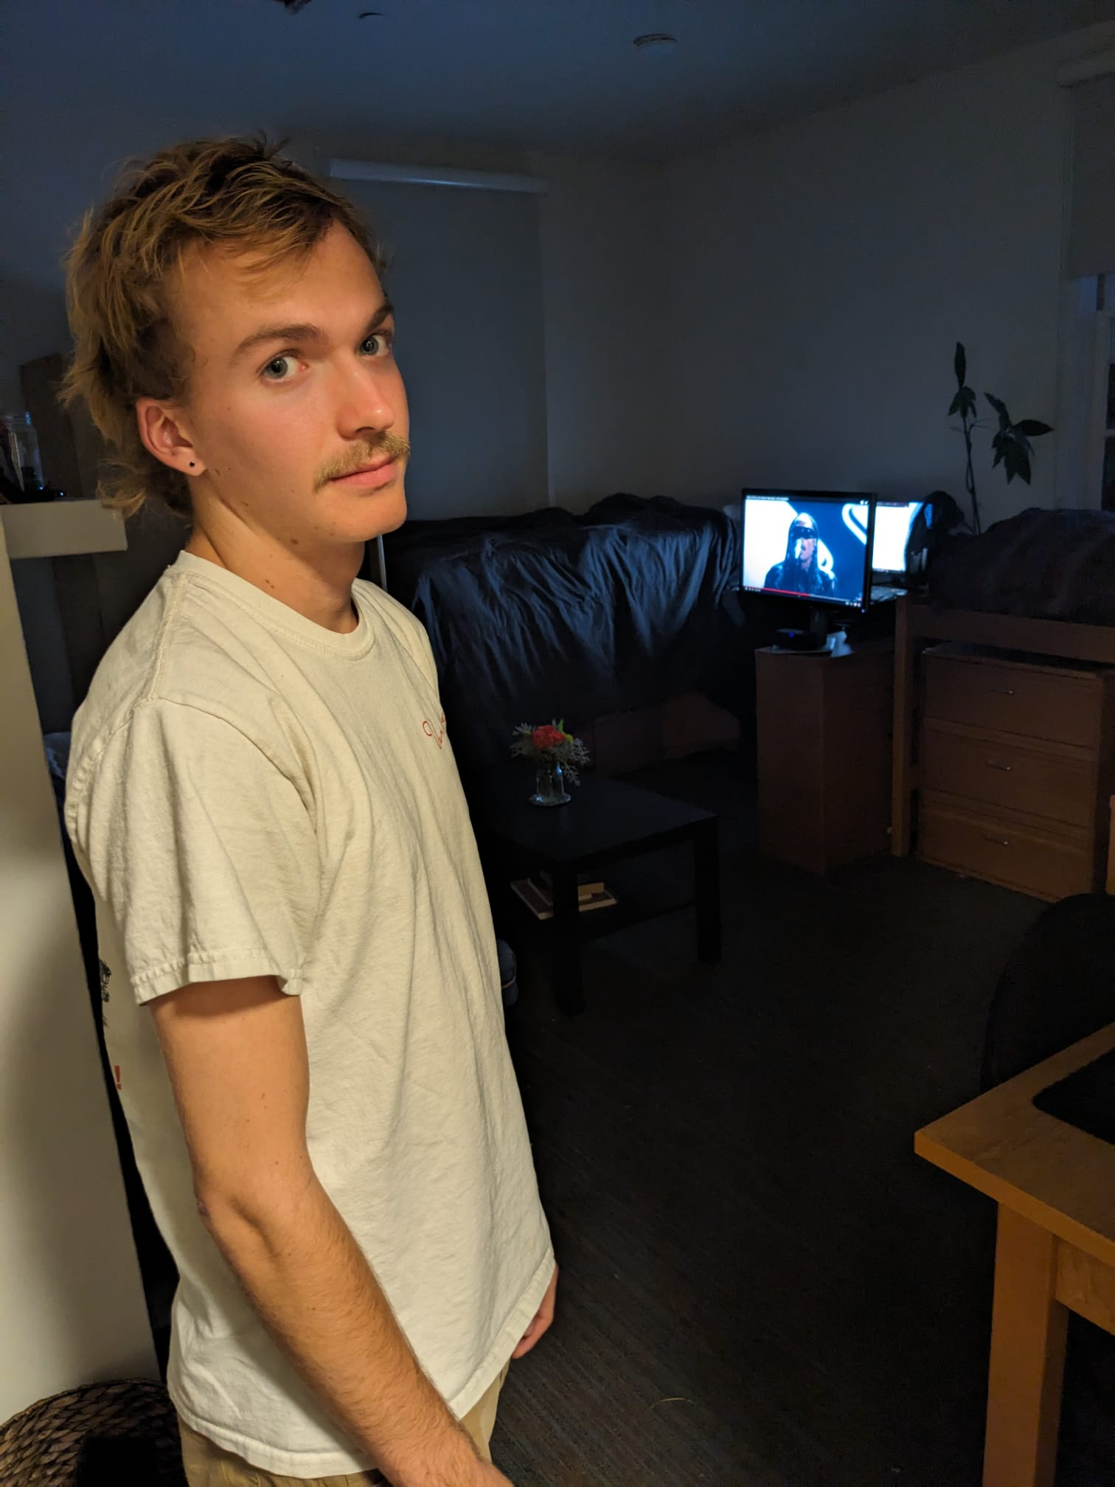
My tester was less than impressed by the live performance that awaited him
However this provided great insights!
Shouldn’t be consistently underwhelming
Enjoyed the adventure of following a windy path
Understands the risk of seeing an unknown artist and would be more likely to go if he was familiar with the venues he was being directed to.
Would want some idea of what type of music it is

Slide 23
Takeaways
Users are willing to buy into the risk of seeing an unknown artist, yet are more comfortable attending a venue that they already have some familiarity with.
There is a limit to how many bad shows users will see before they quit the app.
Users are willing to follow convoluted directions if it feels like part of the adventure.

Slide 24
Experience Prototyping
Idea:
Critical Assumption:
Music “dating app”
People will use music taste as a criteria to connect with people

Slide 25
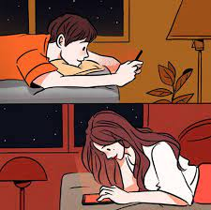
The Setup
Tell the tester to find someone that they want to get to know better.
Have them send music back and forth with this person as a way to get to know them
The idea is to use music taste as a potential icebreaker to get to know the other person

Slide 26
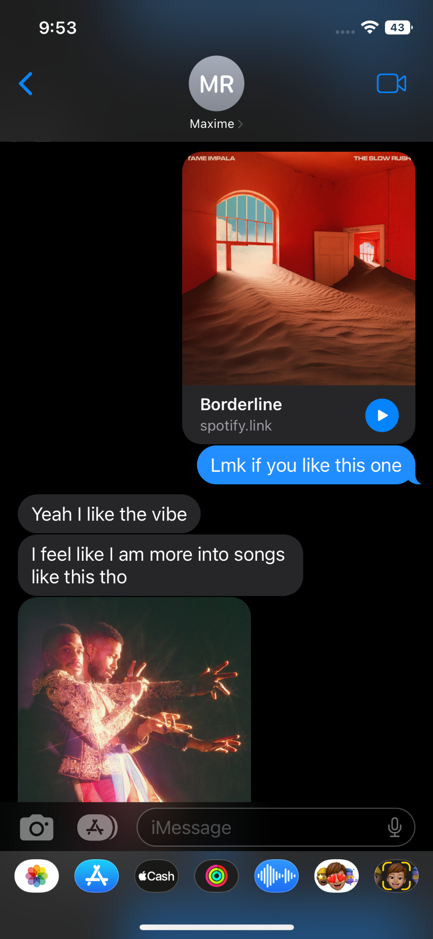
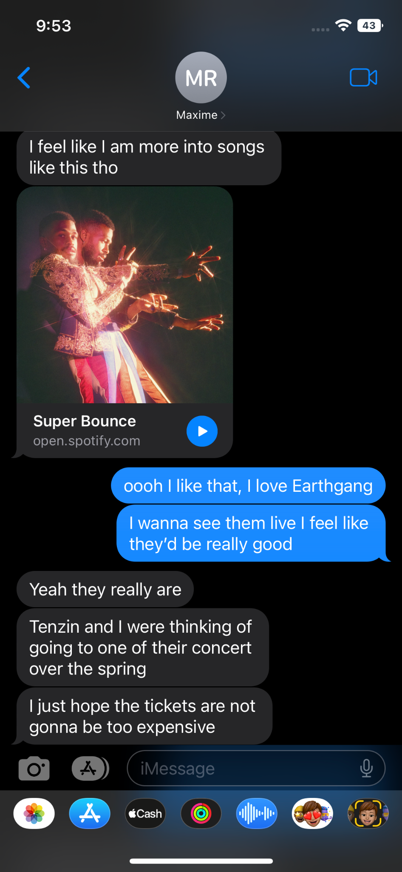
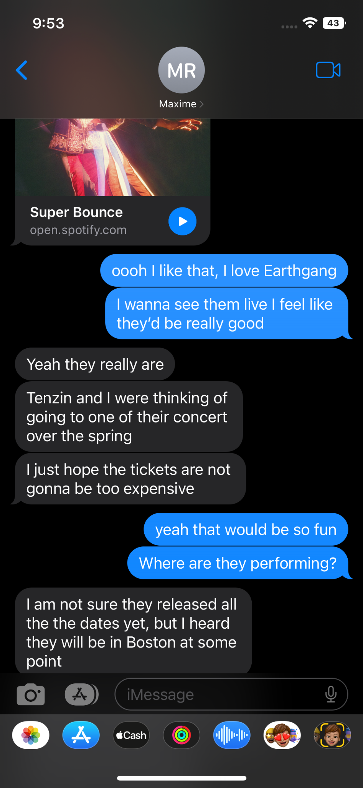
The tester was pleased with this prototype, but wasn’t blown away.
Pros:
They thought it was a good way to break the ice and start conversation
Sparked other conversations
Was able to also find some new music
Cons:
Felt like she didn’t want to send songs too much or for too long
Didn’t want the idea to become “overused”
Learnings:
Using music should be to spark and supplement conversation, not control the conversation

Slide 27
Takeaways
Is able to spark conversation
Emphasize variety
Apprehension regarding oversharing

Slide 28
Experience Prototyping
Idea:
Critical Assumption:
At-Home Concert
Users will respond positively to multimodal stimuli that can simulate the ambiance of a live concert.

Slide 29
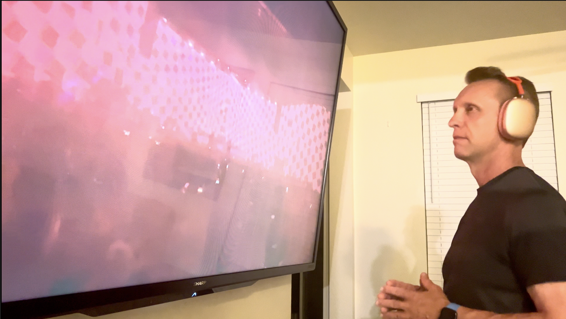
The Setup
X Prototype 1: Audio only through headphones
X Prototype 2: “Live VR Concert”- Audio and live concert footage from a subjective perspective on a massive screen
X Prototype 3: “Live VR Concert” + Headphone “Haptics” to physically feel the beat

Slide 30
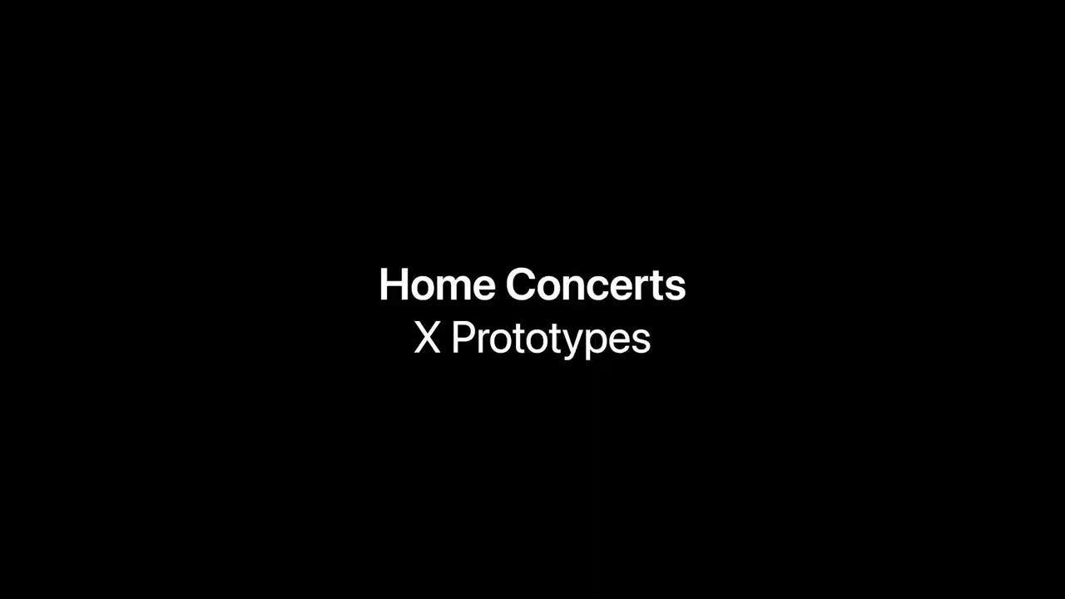

Slide 31
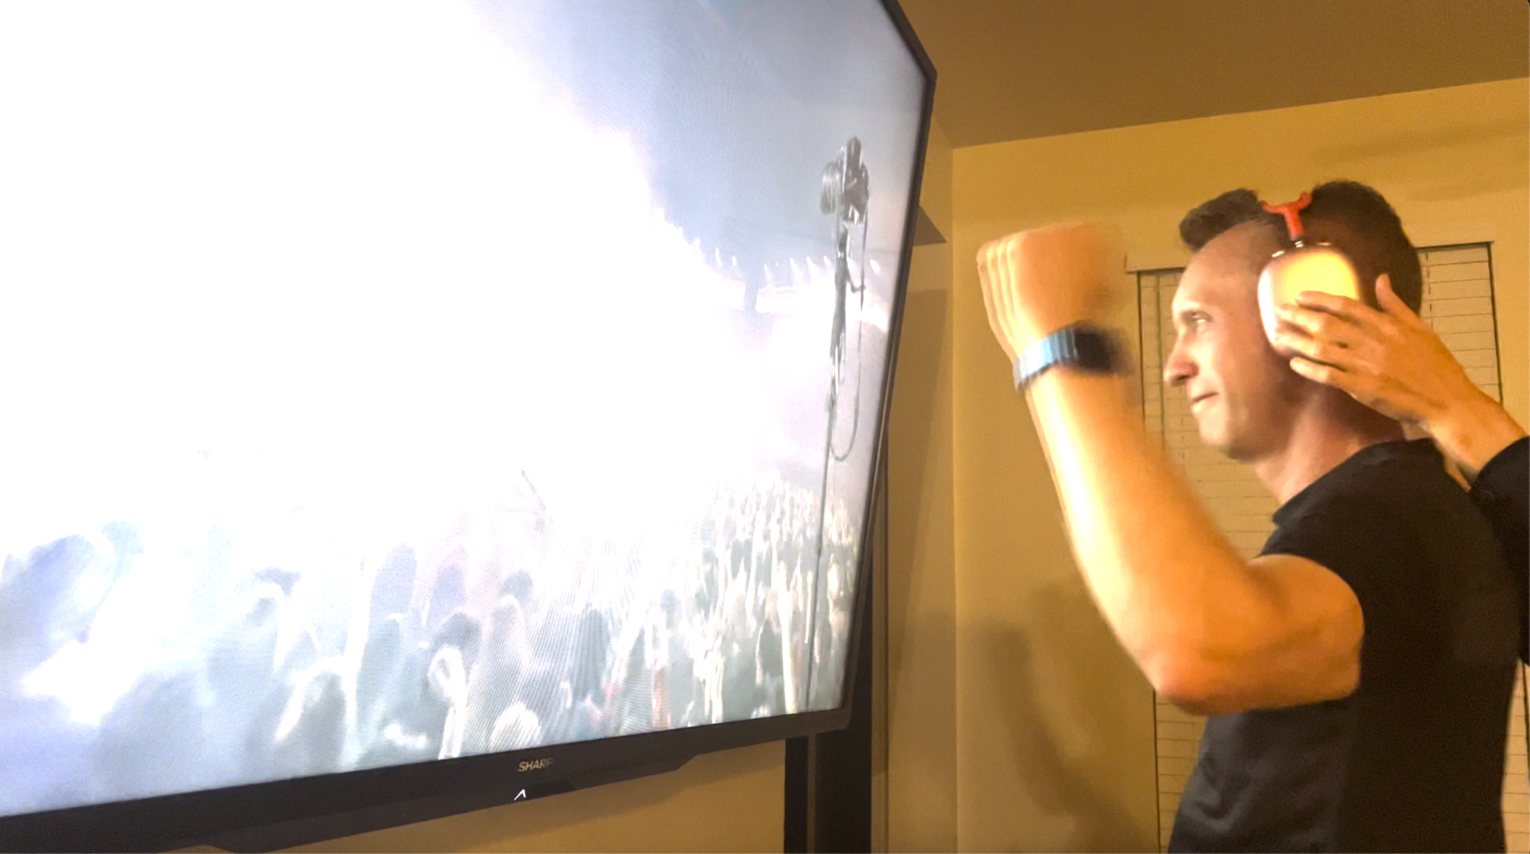
The tester was pleased with the experience of a live home multimodal concert.
“Feeling something breaks you out of a shell!”
“Visuals were exciting but 1 dimensional. Music makes it 2 dimensional. Feeling makes it 3 dimensional.”
“If I feel music, it’s more impactful than if I hear it.”

Slide 32
Takeaways
The more dimensions, the better.
Audio + Visuals > Audio
Audio + Visuals + Haptics = Best
Haptics in other locations (back, torso) may be preferable in future prototypes.

Slide 33
Moving Forward
Music Radar
Music Radar
Musical “Dating App”
At-Home Concert

Slide 34
Music Radar
User concerns
Could lead users through dangerous or inaccessible areas
May increase pedestrian inattentiveness
Could be used by people operating vehicles.

Slide 35
Music Radar
Accessibility concerns
Mobility
Safety
Location

Slide 36
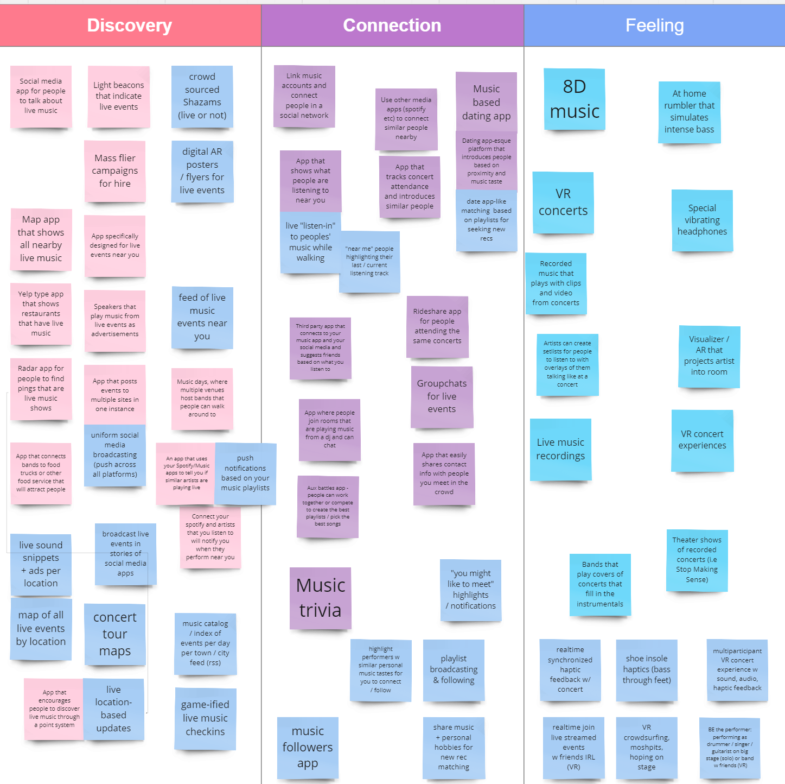
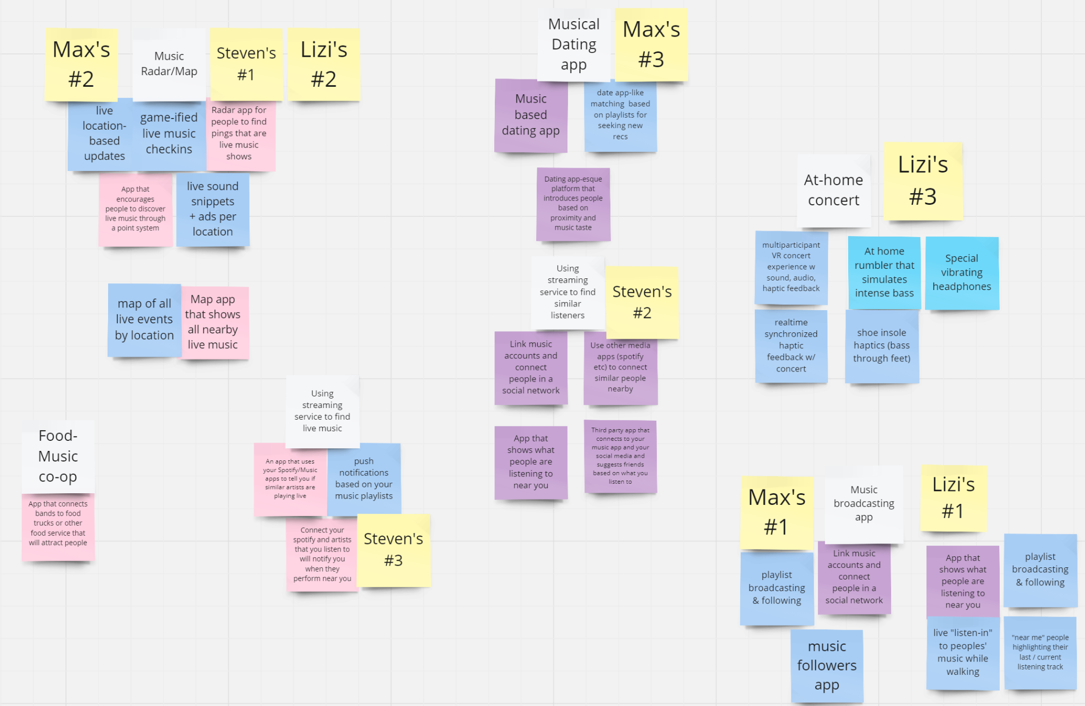
Appendix
Solution Brainstorming
Ranking and picking solutions

