Slide 1
A4: Concept Video
Team TuneTribe

Slide 2
Project Name
TuneTribe
Connection of two major values: Music (Tune) and Community (Tribe), our project is about about using tunes to find your tribe.
“Find the beat of your community”

Slide 3
Problem/ Solution Overview
Small live music events provide good times and are a good way to bring a community together for a fun event, however finding small venues and artists is difficult due to their lack of advertising. Users who live near cities or downtown areas can try to find events on their own by walking around, yet wandering aimlessly yields inconsistent results. Simultaneously, users who are small-time musicians who need more publicity but can’t afford large amounts of advertising would benefit from an easy way to draw crowds. Our app seeks to facilitate finding live local events, bring music-lovers together, and spread awareness of small shows by providing a space for users to post and see other live events in their area that they can attend.

Slide 4
Market Research

Slide 5

Market Research #1: Songkick Concerts
App designed for discovering bands and finding concerts nearby based on your music preferences.

Slide 6
Market Research #1: Songkick Concerts
What Works
Integrating data from music streaming apps to deliver personalized recommendations
Makes it easy to find venues.
What Doesn’t Work in Our Space
Doesn’t have many small artists and bands
No way to easily promote your own events

Slide 7
Market Research #1: Songkick Concerts
Comparison
TuneTribe is focused on enabling users to discover new artists performing smaller events, while Songkick focuses on discovering and finding bigger artists who are less affordable to see.
What We Can Take Away
When using the Songkick app, there was difficulty transferring data from music streaming platforms. Tunetribe may be better off using a different approach to discovering user preferences and interests. We can use how they formatted the app to improve usability on TuneTribe’s platform.

Slide 8

Market Research #2: Google Maps
App designed for searching, locating, and navigating to businesses/venues.

Slide 9
Market Research #2: Google Maps
What Works
Feature incredibly accurate directions and maps of locations.
Makes it easy to find venues and rate and comment on them.
What Doesn’t Work in Our Space
No feature to discover artists or live events in the area.
No way to easily promote your own events

Slide 10
Market Research #2: Google Maps
Comparison
TuneTribe is focused on enabling users to discover artists and events, while Google Maps focuses on discovering and finding locations and venues.
What We Can Take Away
Although Maps has a different user goal, we can take notes from their powerful search capabilities, business / venue information display, and accurate direction giving capabilities, especially their feature of direction for pedestrians on foot.

Slide 11


Market Research #3: Bandsintown Concerts
In TIME Magazine’s Best Apps of the Year for Never Missing Another Show

Slide 12
Market Research #3: Bandsintown Concerts
What Works
Find any concert, festival, or venue near you
Follow artists and receive push notifications for their events
Discover new artists and events based on your personal tastes
What Doesn’t Work in Our Space
No connection between event attendees with each other and artists
No centralized way to see nearby events happening now with respect to your and your friends’ locations

Slide 13
Market Research #3: Bandsintown Concerts
Comparison
Bandsintown Concerts targets the discovery and purchase of tickets for major live concert venues whereas TuneTribe focuses on deepening connection between individuals and artists in local communities through live local music event discovery and promotion for all event sizes
What We Can Take Away
TuneTribe would enable centralized promotion and discovery for local live music events within communities that are both free and paid and enable greater connection between event goers and artists alike

Slide 14

Market Research #4: Pokemon Go
App designed to a game in which users control their character by physically walking around.

Slide 15
Market Research #4: Pokemon Go
What Works
Pokemon Go utilizes real-time location tracking in order to display a user on an interactive map that shows locations that can pop up and disappear.
App is designed for a user walking around their community, not for drivers.
Encourages users to meet other users in real life through meeting around virtual hubs
What Doesn’t Work in Our Space
Pokemon Go is ultimately only designed to be a game, does not feature any real life locations or features to find music or live events

Slide 16
Market Research #4: Pokemon Go
Comparison
Tune Tribe uses common interest in music to bring users together at live venues, Pokemon Go uses common interest in Pokemon and virtual events to bring users together.
What We Can Take Away
We can take inspiration from how Pokemon Go uses virtual beacons to bring people together at real life locations, as well as their design choices when focusing around a user walking around on their phone when designing for Tune Tribe.

Slide 17
Market Research
 | Songkick Concerts | Google Maps | Bandsintown | Pokemon Go | TuneTribe
Live event beacons | Displays live events | Does not show live events | Shows live events, but not in an easily accessible map | Features live event beacons that users flock to | Displays live events in real time
Connection with other Users | Doesn’t allow for commenting or connecting with other users | Allows for commenting and sharing of venues | Does not have any community building features | Features friends and other ways to connect with other users | Features commenting and other ways to connect users
Discovery of Artists and music | Features music discovery | Does not feature music discovery | Allows for discovery and search of live music | Does not feature music discovery | Features music and live venue discovery

Slide 18
Stakeholders

Slide 19
Stakeholders
Direct Stakeholders:
Musicians, people looking for events, music lovers, people looking to meet other music fans
Indirect Stakeholders:
Venue owners (Bar owners, cafe owners, etc.), Venue employees, pedestrians, vehicle drivers.

Slide 20
Ethical Implications

Slide 21
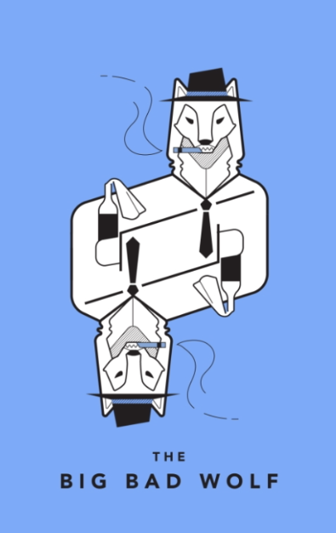
Ethical Implication #1
What could a bad actor do?
Bad actors could target users in vulnerable demographics by befriending and tracking continuous location, social groups, and shared contact information.
Underlying value tension
Users want easier ways to connect with each other and discover live events; however, live location and personally identifiable information can be exploited by bad actors.

Slide 22
Ethical Implication #1
Underlooked Stakeholders
Vulnerable Populations such as Youth and Elderly are seeking wholesome live music events and connection, though require additional protection on our platform to ensure privacy and safety.
Mitigations
Mitigations could include:
i) Two factor authentication via parent, legal guardian, or authorized representative
ii) Verification of profiles via facial recognition.

Slide 23
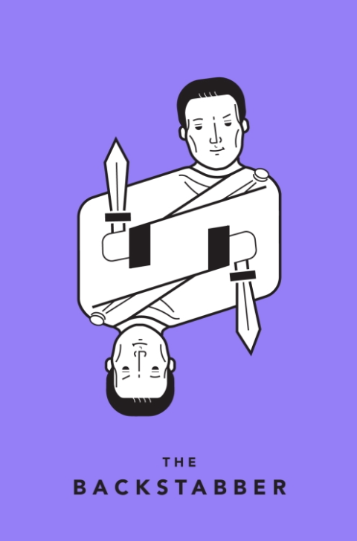
Ethical Implication #2
What could cause people to lose trust in our product?
If users were to have a dangerous encounter related to the product, they would be hesitant to use it again. If the product led users to unsatisfactory experiences, failure to meet user expectations would also make them lose trust in the product.
Underlying value tension
Users want a safe way to explore new music, however if we have an app that doesn’t take the right precautions, we run the risk of people mixing in with the wrong people. Users will also want to believe they are making a safe bet by choosing to attend a random event.

Slide 24
Ethical Implication #2
Underlooked Stakeholders
Younger users may be exposed to things that are not age-appropriate and may not have parental permission. Venue owners and employees may also opt out of shouldering the burden of keeping the space safe with unregulated crowds
Mitigations
Mitigations could include:
(i) Have event approved before it being posted
(ii) Work closely with venues to assure safety

Slide 25
Tasks

Slide 26
Tasks
Finding a music venue near you (simple). This should be the simplest task to do on the app, you open the app and multiple suggested music venues near your location appear.
Navigating to an event (moderate). This is a moderate task as depending on the location of the event and the user, this could be difficult due to roads and directions.
Sharing event with friends to connect (moderate). This task is moderate as it would require a user to choose a format and share the event with others through their preferred method
Creating an event as a performer (complex). This task would require a user to create an event along with a description, the event would also have to be vetted for illicit content.

Slide 27
Storyboard & Annotations

Slide 28
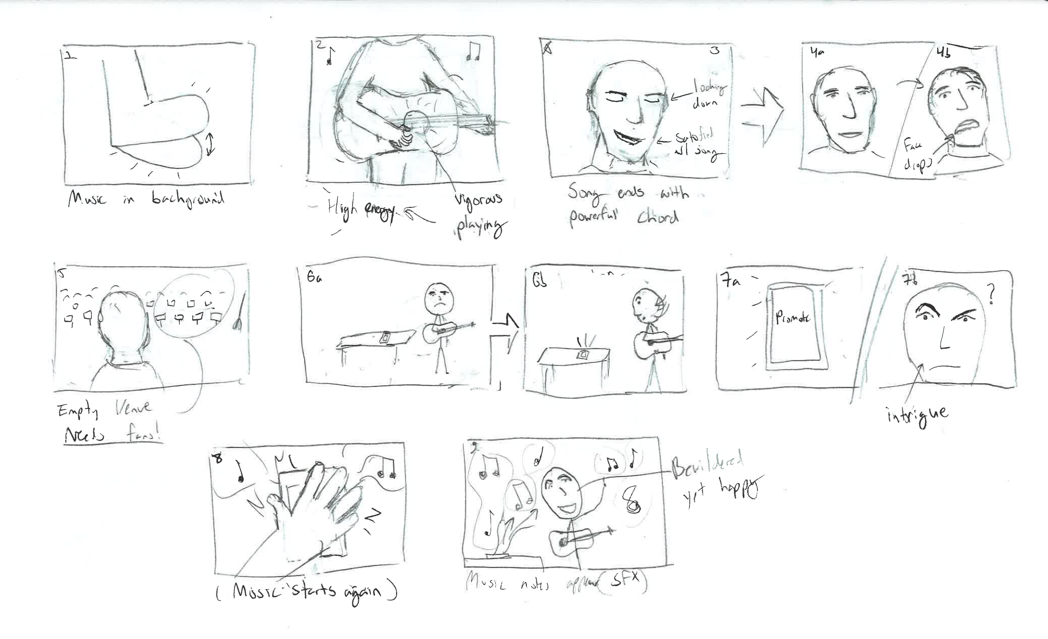
Storyboard & Annotations
Opening Sequence – Define Michael’s Need (The Performer)
Scene 1
Composition: Stage lighting / spotlight on center
Framing: Zoomed on performer’s foot in full frame
Dynamic Action: Foot keeping beat to music
Length: 4 seconds
Scene 3
Transition: Cut
Composition & Framing: Zoomed out to performer’s upper body in frame center, strumming guitar. Ends song on big riff with smile
Expression: Deep focus on playing
Length: 4 seconds
Scene 5
Transition: Cut
Composition & Framing: Performer’s subjective view of the auditorium, empty
Dynamic Action: Broom stick leaning along the wall falls and empty sound echos
Length: 4 seconds
Scene 2
Transition: Cut
Composition & Framing: Close view of center of guitar that performer’s holding
Dynamic Action: Performer’s playing guitar
Emotion: Playing vigorously with full energy
Length: 4 seconds
Scene 4
Transition: Cut
Composition & Framing: Performer’s face in frame center, see them look up
Expression: Smile fades from happy to blank / hopeless expression
Length: 4 seconds

Slide 29
Storyboard & Annotations
Sequence 2 - Michael’s Action in Hope of Solution
Scene 6
Transition: Cut
Composition & Framing: Allocentric view of performer on stage in auditorium, full body and stage in view. Magic button is visible on a stool next to the performer and in the spotlight.
Dynamic Action: Button flashes & gains performer’s attention. Performer rotates neck and head to focus full attention on the button
Length: 4 seconds
Scene 8
Transition: Cut
Composition & Framing: Closeup view of performer’s eyes with upper face in full frame
Dynamic Action: Expression softens, eyes widen with intrigue
Length: 4 seconds
Scene 10
Composition & Framing: Same
Dynamic Action: Trail of notes begins flowing out of button. Performer is bewildered and watches them float up to the ceiling & beyond
Length: 4 seconds
Scene 9
Transition: Cut
Composition & Framing: Allocentric view of performer on stage in auditorium, full body and stage in view. Magic button is visible on a stool next to the performer and in the spotlight.
Dynamic Action: Performer quickly reaches out and slaps button with rigor. Sound echoes throughout the auditorium. Hold for end of scene.
Length: 4 seconds
Scene 7
Transition: Cut
Composition & Framing: Overhead view of button in full frame
Dynamic Action: Button flashes with legible “Promote” lettering
Length: 4 seconds

Slide 30
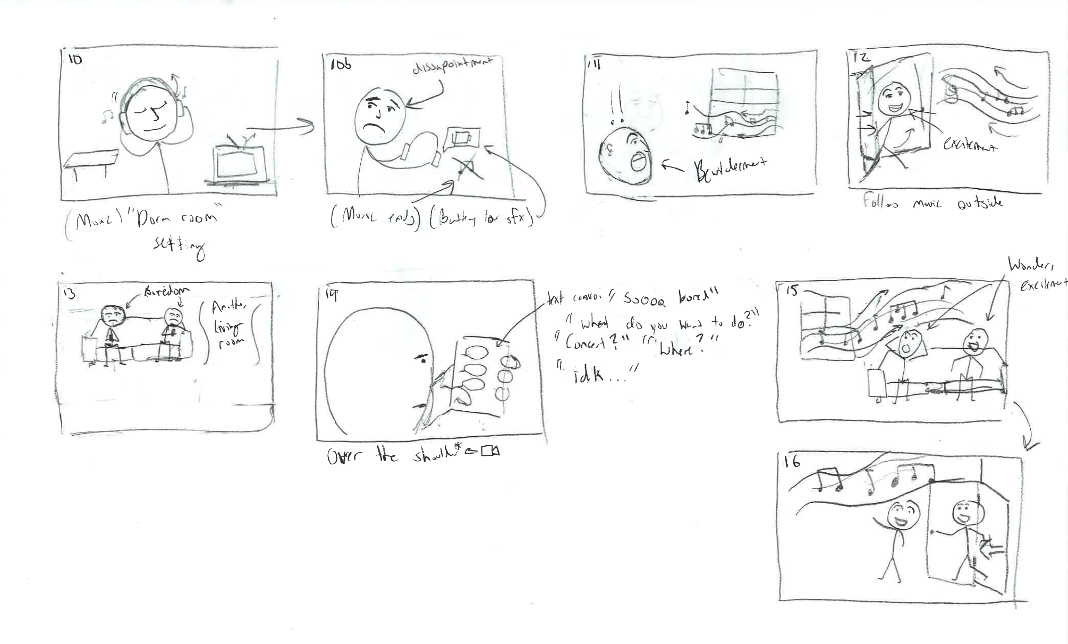



Storyboard & Annotations
Sequence 3 - Define Jane’s Need & Action Toward Solution
Scene 11
Transition: Cut
Composition & Framing: Dorm room; ½ body side shot of Jane looking out the window while alone in her room
Dynamic Action: Large group of people walk by Jane’s window, talking in high spirit and audibly having fun in the evening. Jane looks out the window longingly
Emotion: Jane is hit with a deep feeling of loneliness
Length: 4 seconds
Scene 12
Composition & Framing: Same as 11
Dynamic Action: Music notes float in through window. Jane looks up at them, stands up and starts to follow them
Expression: Like it’s the first time he’s seen snow
Length: 4 seconds

Slide 31
Storyboard & Annotations
Sequence 4 - Define Jake & Bobby’s Need & Action Toward Solution
Scene 13
Composition & Framing: Group in frame full body, sprawled on couch looking at their phones and texting each other
Expression: Boredom
Length: 3 seconds
Scene 14
Composition & Framing: Group chat view
Dynamic action: Scrolling conversation about what to do & boredom; music note floats in
Length: 4 seconds
Scene 15
Composition & Framing: Group in frame full body, sprawled on couch looking at their phones and texting each other
Dynamic action: Group gets up and follows the notes out together, look back and forth between each other and notes as they exit
Expression: Bewilderment & excitement
Length: 4 seconds

Slide 32
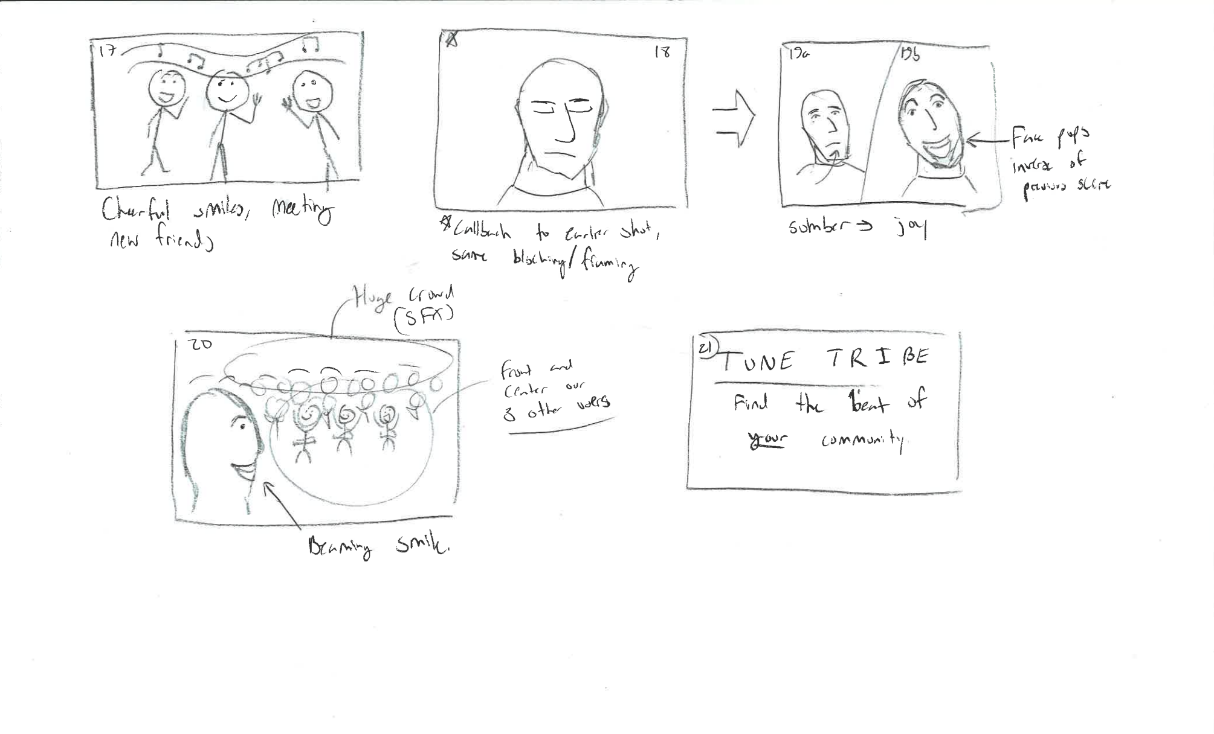
Storyboard & Annotations
Sequence 5 - Connection
Scene 17
Composition & Framing: Jane, Jake, and Bobby enter into frame with ¾ body in view and meet for the first time over their shared quest to discover the live music
Dynamic action: Jane enters from left while Jake and Bobby enter from right. All shake hands and enter the live concert event together away from the camera
Expression: Bewilderment & excitement
Length: 4 seconds

Slide 33
Storyboard & Annotations
Sequence 5 - Connection with Crowd for Michael
Scene 18
Transition: Cut
Composition & Framing: Return to allocentric view of performer on stage with full body and stage in view. Magic button is visible next to the performer and in spotlight.
Dynamic action: Michael’s expression shifts from dismay to pure excitement
Expression: Excitement (presumed due to seeing the incoming crowd because of the audience appearing - not revealed yet)
Length: 4 seconds
Scene 19
Transition: Cut
Composition & Framing: Michael’s subjective view of the crowd. Jane, Ally, James, and Bobby are all in the crowd
Dynamic action: Jane, Ally, James, and Bobby cheering and clapping in excitement for Michael
Expression: Excitement
Length: 4 seconds

Slide 34
Storyboard & Annotations
Ending Sequence - Credits
Scene 20
Transition: Cut
Composition & Framing: Black screen, ‘TuneTribe’ displayed in large font; ‘Find the Beat of Your Community’ displayed below; Credits displayed in large font per guidelines
Length: 4 seconds

Slide 35
Concept Video

Slide 36
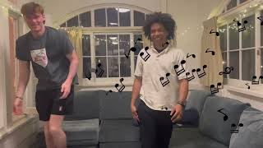

Slide 37
Appendix
Additional Market Research

Slide 38

Market Research #4: MeetUp
Social Media Platform for Hosting and Organizing In-Person Events

Slide 39
Market Research #4: MeetUp
What Works
Social platform to discover new events and meet new people in a large community
What Doesn’t Work in Our Space
Not tailored to live music events

