Slide 1
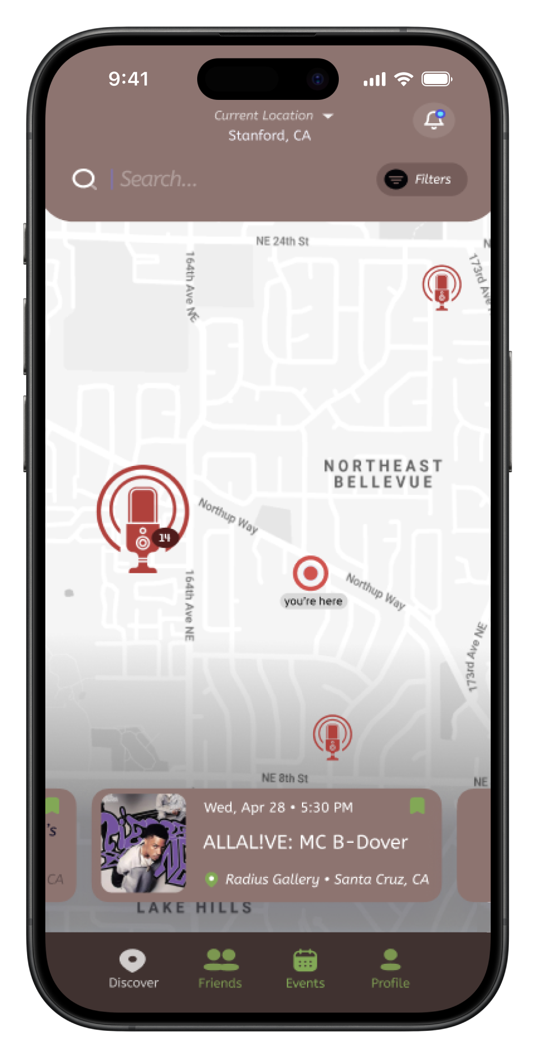

TuneTribe
Find the beat
of your community

