Slide 1

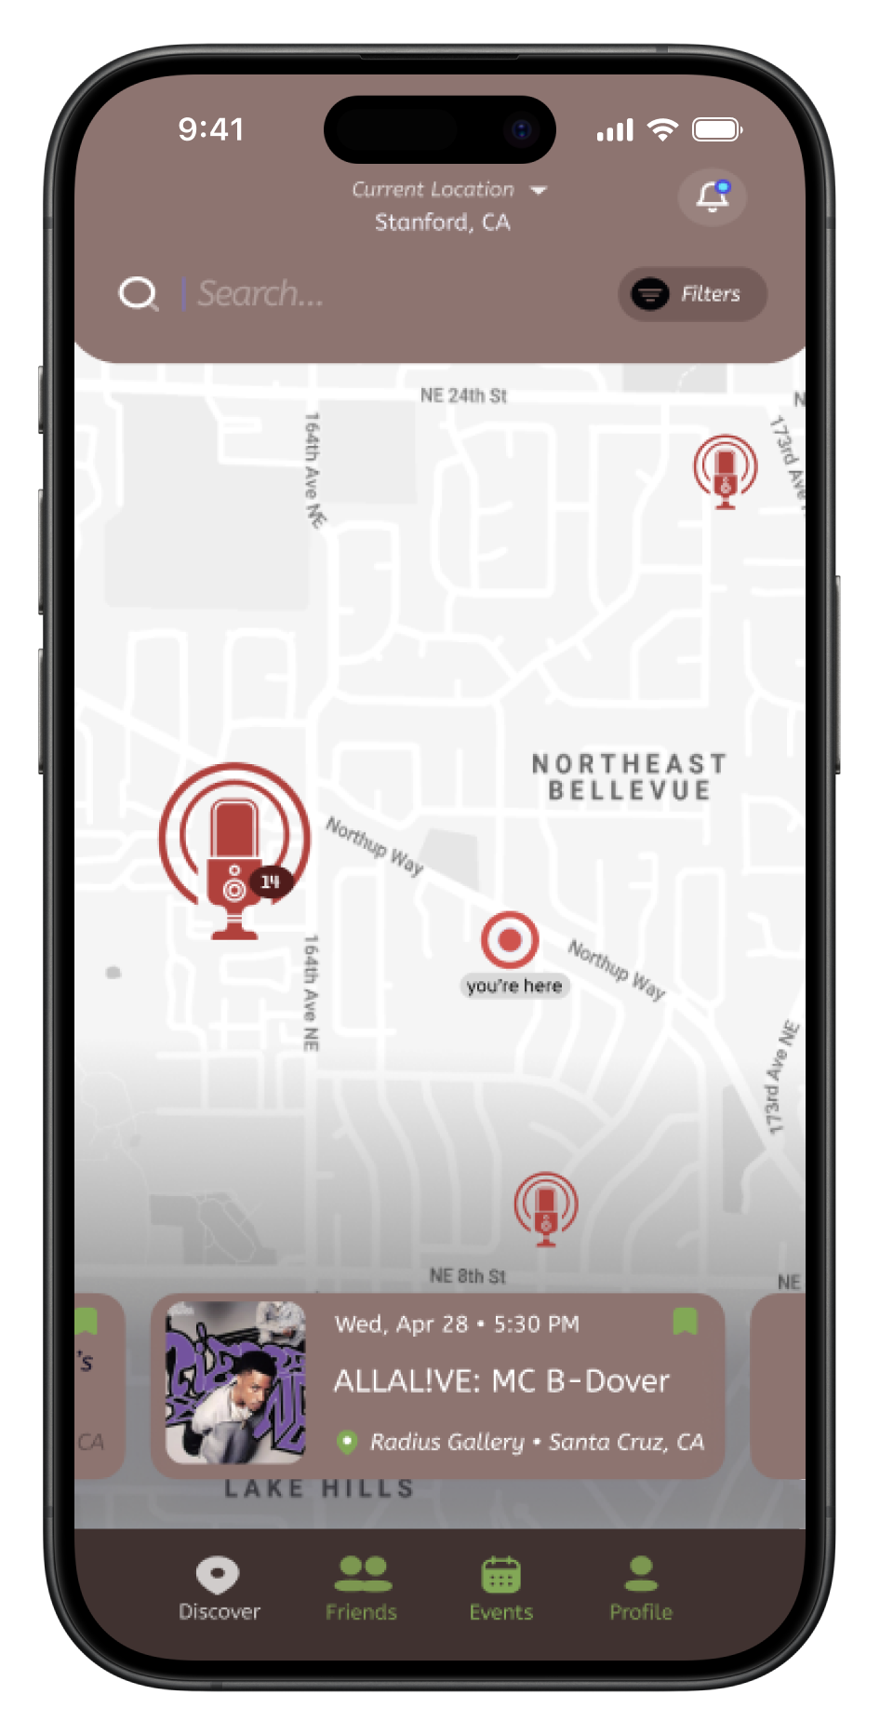
TuneTribe
Design Process
Find the beat of your community
Discover
Live Local Events
Connect
With Friends Over Music
Promote
Your Events Locally
Problem
Live music is desirable, but difficult to discover
Events are about shared experiences, yet few offerings target connection
Without a marketing budget, promoting for artists is hard
Solution
Centralized & Community-First * Democratized Promotion * Personalized & Incentivised * Integrated with Social Media Apps
TuneTribe | Lizi O., Max M., Gracielly A., Steven B. | CS147 Autumn 2023
https://web.stanford.edu/class/cs147/projects/HarmoniousTies/TuneTribe

