Slide 1
NEEDFINDING
Sofia Kim, Sheng Moua, Jennifer Quach, and Gracielly Abreu

Slide 2




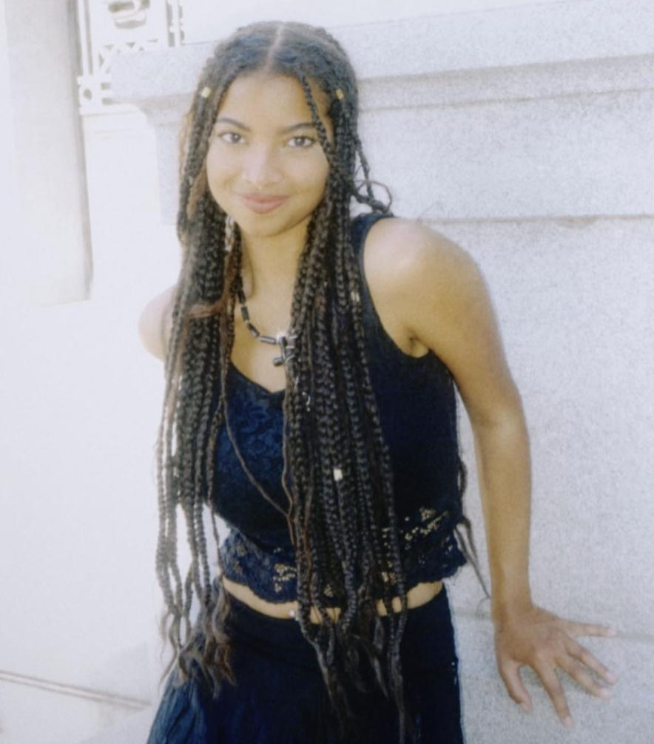
WHO WE ARE
SOFIA KIM
SHENG MOUA
JENNIFER QUACH
GRACIELLY ABREU
‘25
Symbolic Systems
Santa Cruz, Bolivia
‘25
Computer Science
Eau Claire, WI
‘25
Symbolic Systems
Lincoln, NE
‘26
Computer Science & Design
Orlando, FL

Slide 3
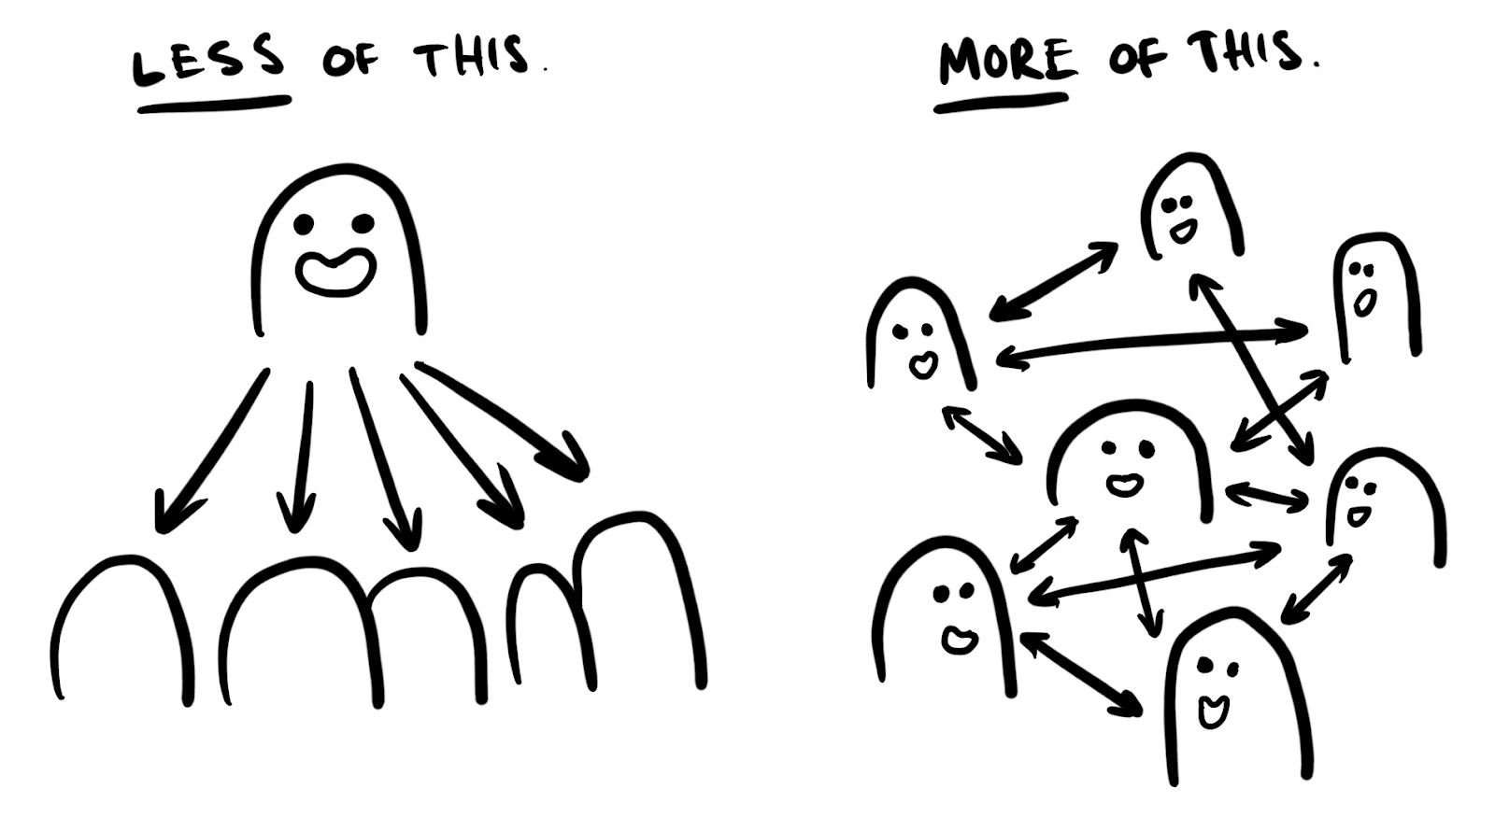
DOMAIN OF INTEREST:
Festival Community Building
… a shared interest amongst members
… exploring the value of shared experiences
… researching unique perspectives

Slide 4
NEEDFINDING METHODOLOGY

Slide 5
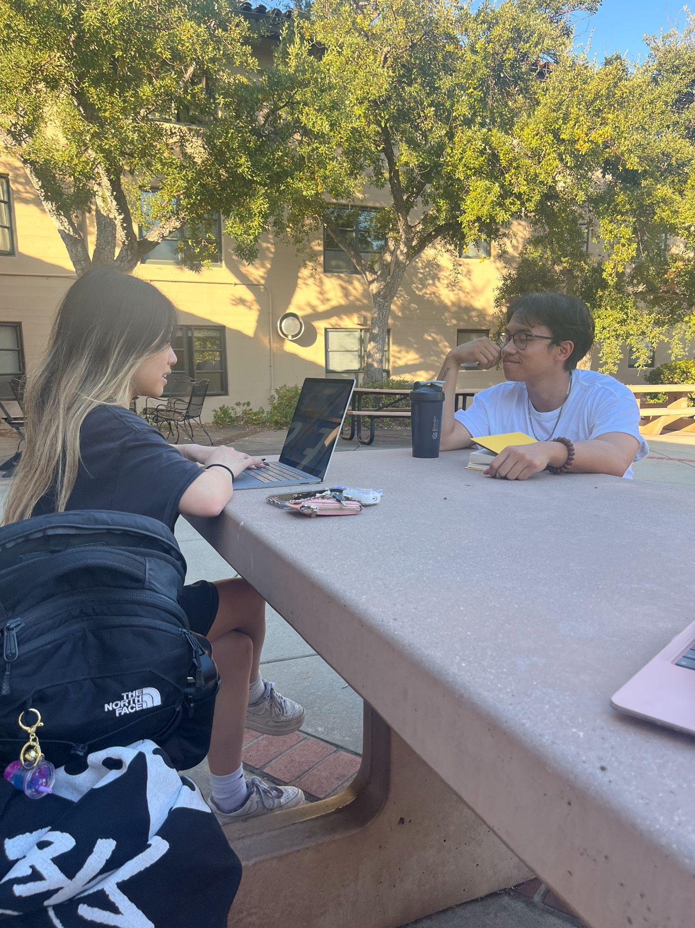
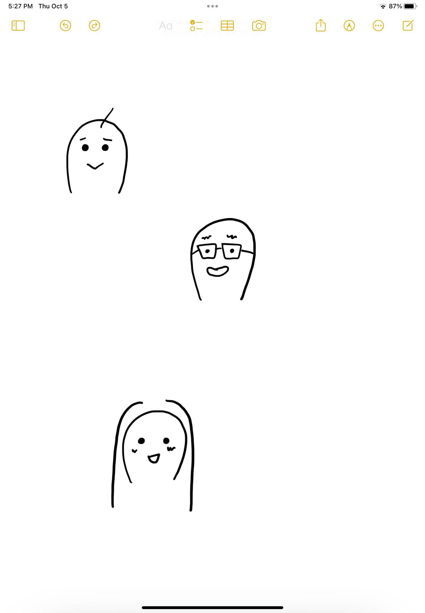
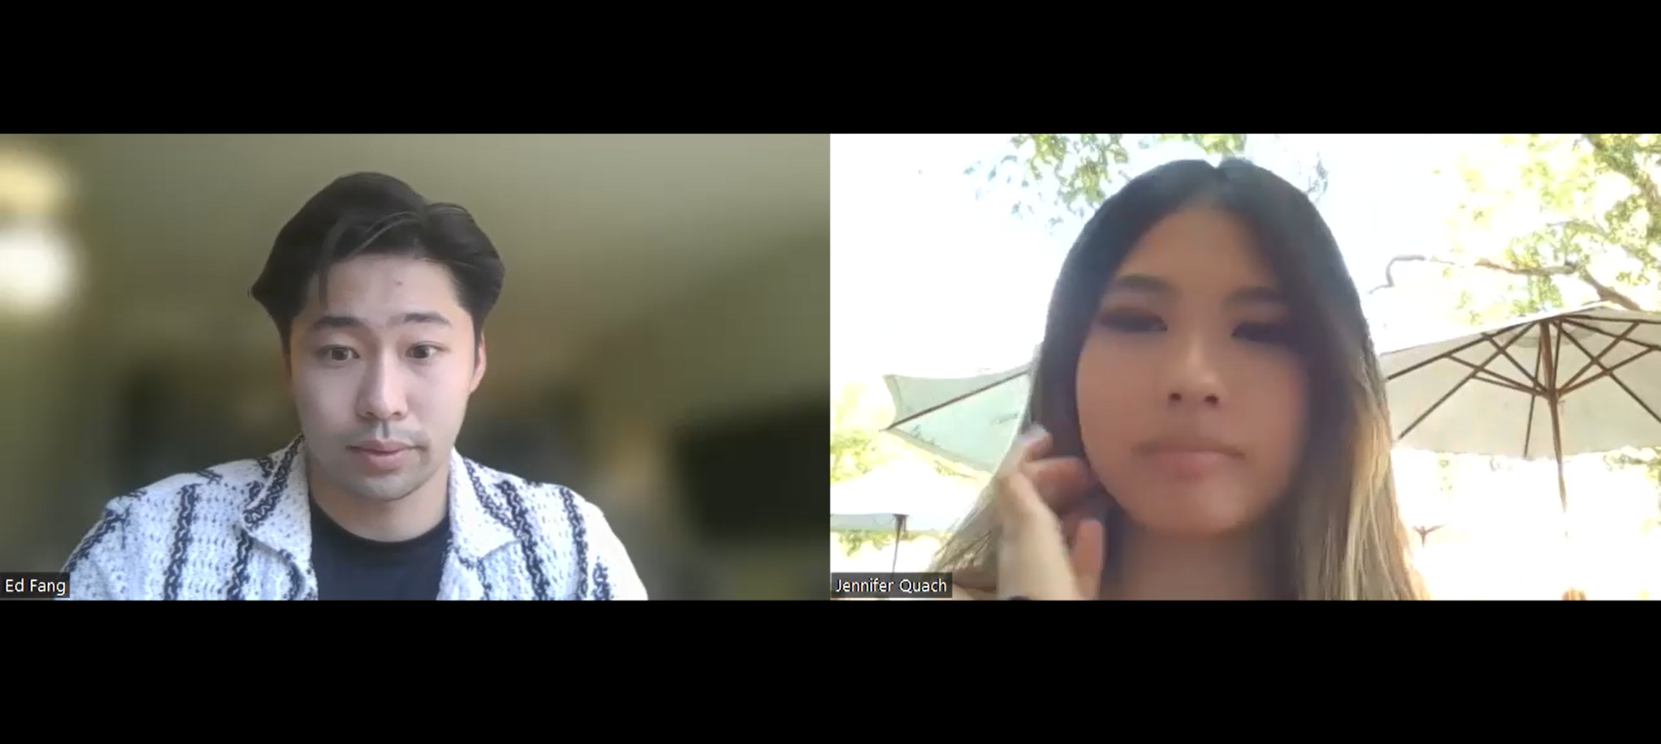
FINDING PARTICIPANTS
Perspectives to consider:
Range of experience and age
Differences in musical interests
Broadening scope outside of Stanford Students
Ended up with…
  2 extreme users, 1 average user
  Jen - interviewer, Sheng - notetaker

Slide 6

OUR INTERVIEWEES
JULIET
ALEX
EDWARD
Nursing student @CVTC
Extreme user - attended only one festival
Psychology student @Stanford
Average user
Started as a solo raver
Senior data scientist @TikTok
Extreme user - rave veteran & nomad

Slide 7
GUIDING QUESTIONS
“How important is community for festivals?”
“What are some of the biggest challenges in attending festivals with a group?”
“Would you go to a festival alone? Why or why not?”
“Has not being able to find a person to go with deterred you from attending a festival?”
“Have you joined any new communities or made new acquaintances through your festival goings? Tell me about a time you developed a new connection through the scene.”
“What do you look for in finding people to attend festivals with, and how did you meet the people in your current group?”

Slide 8
JULIET
“I’m scared to do things on my own… The people you go with do make or break the experience.”

Slide 9
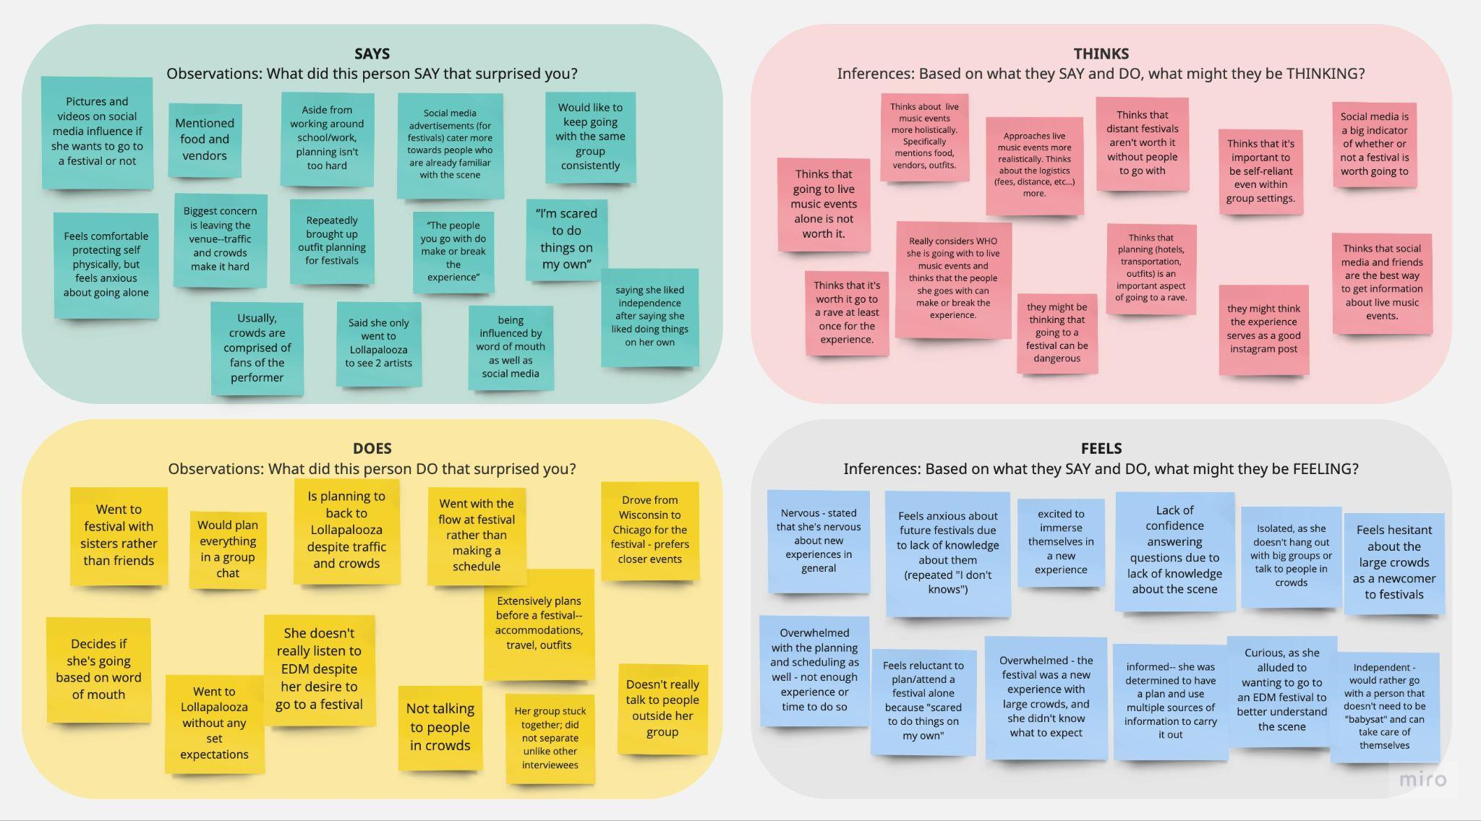

JULIET

Slide 10
ALEX
“There really isn’t a centralized festival community at my school, only certain individuals… That’s why I go alone.”

Slide 11
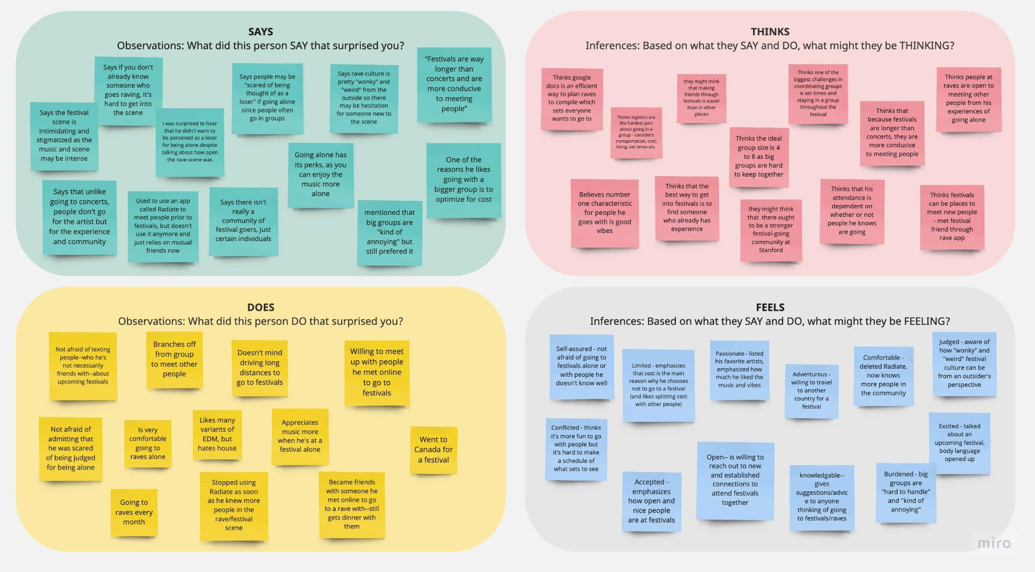
ALEX

Slide 12
EDWARD
“Elements of festival culture has transcended just the festival scene… even concerts like Taylor Swift are adopting festival community traditions like kandi [bracelets exchanged to represent memorable interactions]... ”

Slide 13
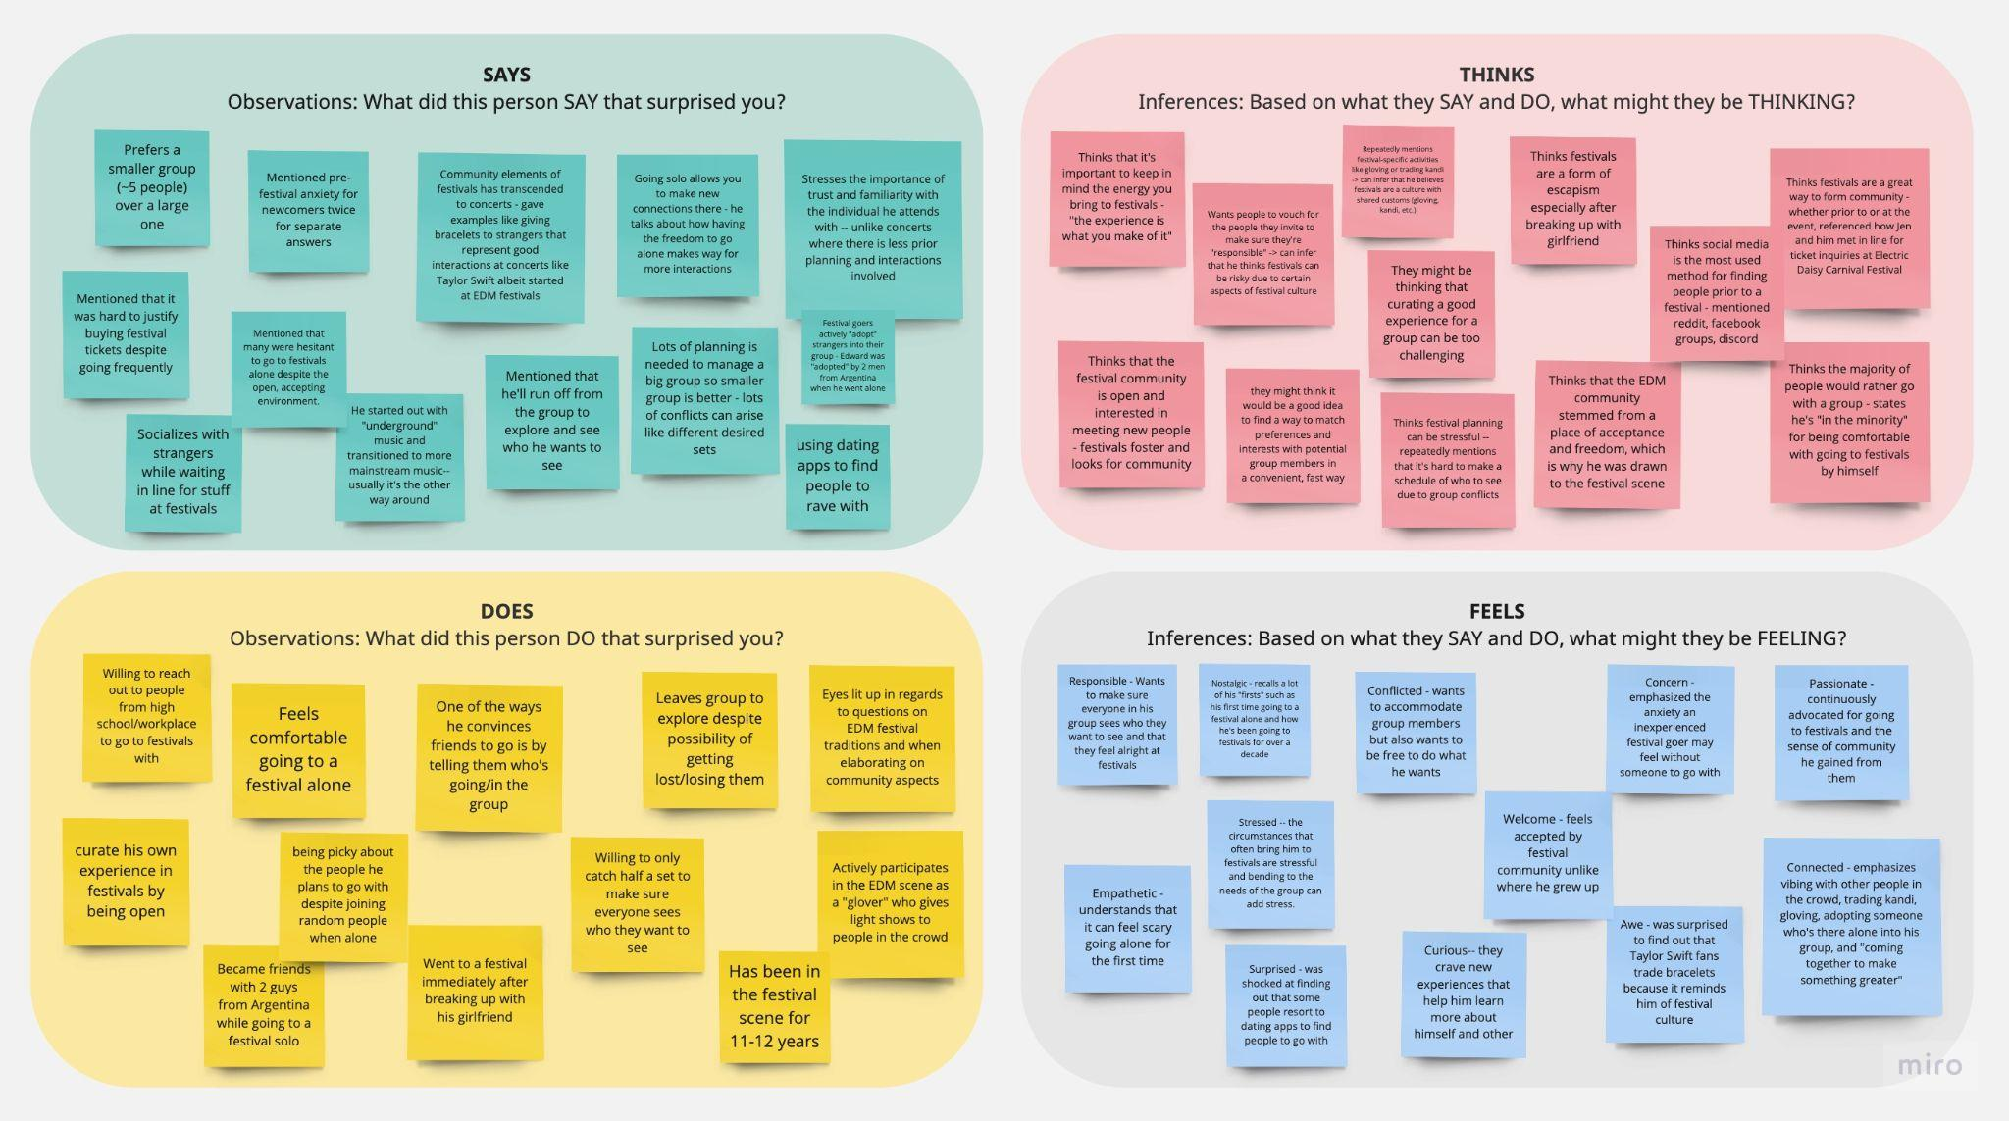
EDWARD

Slide 14
TENSIONS, CONTRADICTIONS, AND SURPRISES
TENSIONS
Everyone in a festival group has more responsibilities than they would at a concert… people are more comfortable going with those they can truly trust
Most receive information on festivals from social media, but what to expect, how to plan, and who to connect with prior to the event is foreign to newcomers
Festivals are stigmatized and can be overwhelming due to large crowds, intense music, unfamiliar cultures and traditions, and possible prohibited activities
The best way to enter and stay in the festival scene is to already know someone who has experience going - going alone isn’t a popular option
Notes:
People want freedom, whether going to festivals alone or in a group.
Even when people go within a group, independence and freedom is still valued. One might be in a group but that doesn’t mean they want to feel constrained by others. This is why WHO is in the group and the quality of the group matters. You want a group that makes you feel comfortable. If this isn’t possible and your needs aren’t met, going alone might be better.
Solo raving anxiety vs. bad group stress
Cost is a barrier for attending festivals, but going with others can minimize fees.
Cost is an obvious barrier to festivals, but the fact that all three interviewees mention this did come to us as a bit of a surprise because we didn’t really consider this before.\
Festivals have their own culture that can make it hard for newcomers to enter the scene.

Slide 15
INSIGHTS & NEEDS #1
INSIGHT: Interviewed users described problems that can arise in group festival settings that are particular to larger groups (8+ members). These included inability to meet up after splitting up, schedule conflicts, and potential bad energy amongst members. No one wants to take care of someone who can’t handle themselves, and there is a sense of responsibility for all members of a festival group.
NEEDS: People interested in festivals should be familiar with the people they are attending with in order to fully prepare for and enjoy the festival experience.
Notes:
Logistics and planning is more important for groups, than when going solo.
Alex and Edward both emphasize how important planning is when going with groups because one needs to consider the needs of the whole group, including set lists, etc… One would think that when going to festivals (something fun) detailed planning isn’t as required but its actually v important to ensure best experience. Planning can be stressful tho.
It’s not just about having a group, it’s about having the right one.
People have standards as to what they want in their group. The vibes are very important, this is why people tend to obtain groups through mutual friends and want others to vouch for them before proceeding.
Group Dynamics Solutions: Attendees desire the flexibility to attend events both solo and with groups. There is a need for tools or platforms that help people find like-minded individuals or groups to attend events with, taking into account shared interests and personality compatibility.t

Slide 16
INSIGHTS & NEEDS #2
INSIGHT: There is no central festival community at schools and those with little (or misunderstood) knowledge about festivals can be dissuaded into attending them. Social media posts tend to cater towards those that are already familiar with the scene.
NEEDS: Information on festivals should be more accessible to those without festival going experience in order to alleviate pressure when planning and increase interest in attending.
Notes:
Logistics and planning is more important for groups, than when going solo.
Alex and Edward both emphasize how important planning is when going with groups because one needs to consider the needs of the whole group, including set lists, etc… One would think that when going to festivals (something fun) detailed planning isn’t as required but its actually v important to ensure best experience. Planning can be stressful tho.
It’s not just about having a group, it’s about having the right one.
People have standards as to what they want in their group. The vibes are very important, this is why people tend to obtain groups through mutual friends and want others to vouch for them before proceeding.
Group Dynamics Solutions: Attendees desire the flexibility to attend events both solo and with groups. There is a need for tools or platforms that help people find like-minded individuals or groups to attend events with, taking into account shared interests and personality compatibility.t

Slide 17
INSIGHTS & NEEDS #3
INSIGHT: Festivals foster community and community strengthens the festival experience. The people and crowd make or break the experience, and there are embedded traditions and shared values in the scene that draw people together, separating them from a standard concert experience. However, this “community” is only accessible by those already in the scene.
NEEDS: The community aspect of the festival experience should be inclusive to newcomers and those with little experience in attending them. The process of connecting interested individuals with one another should be streamlined and popularized in order to give everyone a sense of the true festival experience.
Notes:
Logistics and planning is more important for groups, than when going solo.
Alex and Edward both emphasize how important planning is when going with groups because one needs to consider the needs of the whole group, including set lists, etc… One would think that when going to festivals (something fun) detailed planning isn’t as required but its actually v important to ensure best experience. Planning can be stressful tho.
It’s not just about having a group, it’s about having the right one.
People have standards as to what they want in their group. The vibes are very important, this is why people tend to obtain groups through mutual friends and want others to vouch for them before proceeding.
Group Dynamics Solutions: Attendees desire the flexibility to attend events both solo and with groups. There is a need for tools or platforms that help people find like-minded individuals or groups to attend events with, taking into account shared interests and personality compatibility.t

Slide 18
SO TO SUMMARIZE THE PROCESS THUS FAR…

Slide 19
SUMMARY
We started with talking to people with gaps in experience in the scene…
We explored the festival scene and what makes it different from regular concerts.
We identified the hesitations that people may have towards attending festivals, which included planning logistics, stimatization, and lack of knowledge in the scene.
We found that it’s not just about going with a group, but finding the right one.
Notes:
Logistics and planning is more important for groups, than when going solo.
Alex and Edward both emphasize how important planning is when going with groups because one needs to consider the needs of the whole group, including set lists, etc… One would think that when going to festivals (something fun) detailed planning isn’t as required but its actually v important to ensure best experience. Planning can be stressful tho.
It’s not just about having a group, it’s about having the right one.
People have standards as to what they want in their group. The vibes are very important, this is why people tend to obtain groups through mutual friends and want others to vouch for them before proceeding.
Group Dynamics Solutions: Attendees desire the flexibility to attend events both solo and with groups. There is a need for tools or platforms that help people find like-minded individuals or groups to attend events with, taking into account shared interests and personality compatibility.t

Slide 20
NEXT STEPS
DIVERSIFY
1
FOCUS
2
DEFINE
3
Conduct more interviews with a wider variety of people.
Narrow down domain of interest and establish problem space.
Generate POVs and HMW statements.

Slide 21
THANKS!
Questions?
Contact us!
sofiakim@stanford.edu
smoua@stanford.edu
tmquach@stanford.edu
gabreu@stanford.edu

