Slide 1
POVS AND EXPERIENCE PROTOTYPES
Sofia Kim, Sheng Moua, Jennifer Quach, and Gracielly Abreu
Notes:
Hi everyone… -> name -> “I’ll be presenting on the POVs and experience prototypes that my group worked on this past week.”

Slide 2




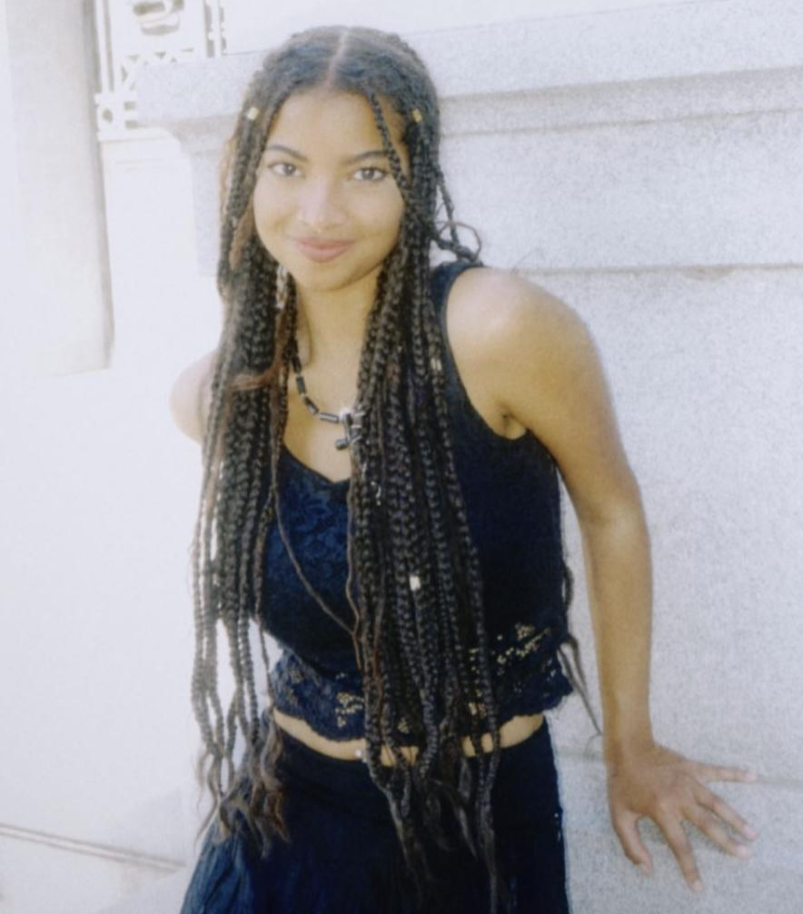
WHO WE ARE
SOFIA KIM
SHENG MOUA
JENNIFER QUACH
GRACIELLY ABREU
‘25
Symbolic Systems
Santa Cruz, Bolivia
‘25
Computer Science
Eau Claire, WI
‘25
Symbolic Systems
Lincoln, NE
‘26
Computer Science & Design
Orlando, FL
Notes:
As a reminder of who we are..team consists of -> read names

Slide 3
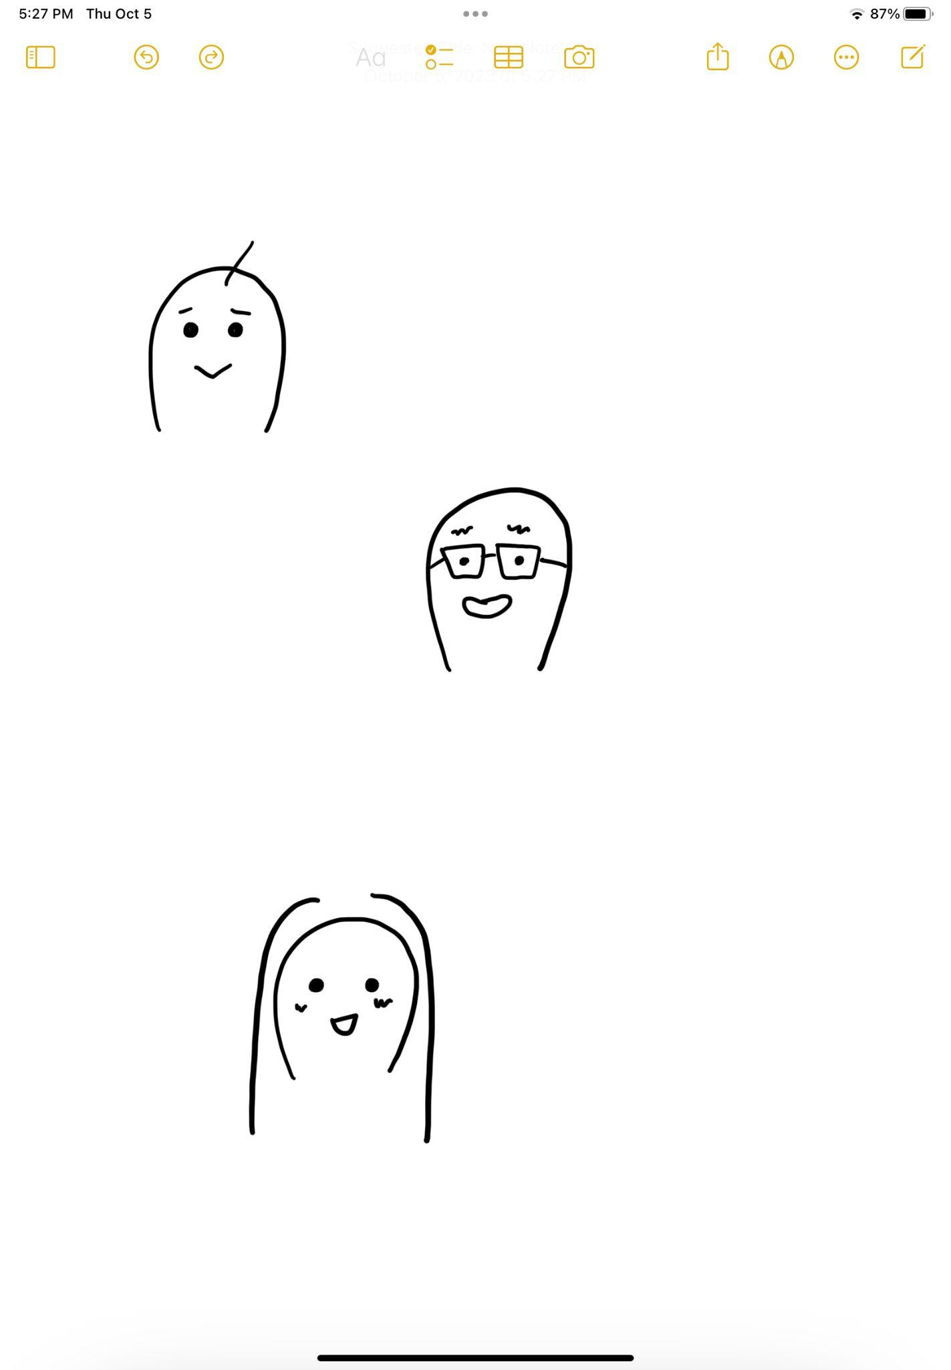

A RECAP…
JULIET
ALEX
EDWARD
Nursing student @CVTC
Extreme user - attended only one festival
Psychology student @Stanford
Average user
Started as a solo raver
Senior data scientist @TikTok
Extreme user - rave veteran & nomad
Notes:
Last week, we interviewed *CLICK* juliet… *CLICK* alex… *CLICK* edward.

Slide 4
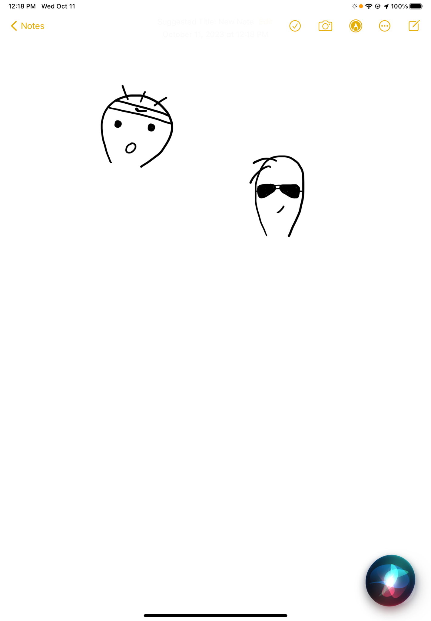
THIS WEEK’S INTERVIEWEES…
DILLON
JOSH
CS Student @ UC-Santa Cruz
Extreme user - Little interest in music
DJ & Producer
Domain expert - DJs for venues and interested in festivals

Slide 5
ADDITIONAL LEARNINGS
Dillon
Not everyone goes to festivals for the music—some go for the experience or to have fun with their friends.
The fear of being linked to stereotypes can discourage individuals from attending festivals.
Festivals can be physically taxing—it’s important to recognize that everyone has different physical limitations.
A person’s environment heavily influences their relationship with music.

Slide 6
ADDITIONAL LEARNINGS
Dillon
Not everyone goes to festivals for the music—some go for the experience or to have fun with their friends.
The fear of being linked to stereotypes can discourage individuals from attending festivals.
Festivals can be physically taxing—it’s important to recognize that everyone has different physical limitations.
A person’s environment heavily influences their relationship with music.

Slide 7
ADDITIONAL LEARNINGS
Dillon
Not everyone goes to festivals for the music—some go for the experience or to have fun with their friends.
The fear of being linked to stereotypes can discourage individuals from attending festivals.
Festivals can be physically taxing—it’s important to recognize that everyone has different physical limitations.
A person’s environment heavily influences their relationship with music.

Slide 8
ADDITIONAL LEARNINGS
Dillon
Not everyone goes to festivals for the music—some go for the experience or to have fun with their friends.
The fear of being linked to stereotypes can discourage individuals from attending festivals.
Festivals can be physically taxing—it’s important to recognize that everyone has different physical limitations.
A person’s environment heavily influences their relationship with music.

Slide 9
ADDITIONAL LEARNINGS
Dillon
Not everyone goes to festivals for the music—some go for the experience or to have fun with their friends.
The fear of being linked to stereotypes can discourage individuals from attending festivals.
Festivals can be physically taxing—it’s important to recognize that everyone has different physical limitations.
A person’s environment heavily influences their relationship with music.

Slide 10
ADDITIONAL LEARNINGS
Josh
It’s important to cater the music to the audience and the venue.
There are geographical divides when it comes to music taste and culture.
The best crowds are diverse in terms of background and “vibes.”
Promoters and social media play a big role in gathering attendees.

Slide 11
ADDITIONAL LEARNINGS
Josh
It’s important to cater the music to the audience and the venue.
There are geographical divides when it comes to music taste and culture.
The best crowds are diverse in terms of background and “vibes.”
Promoters and social media play a big role in gathering attendees.

Slide 12
ADDITIONAL LEARNINGS
Josh
It’s important to cater the music to the audience and the venue.
There are geographical divides when it comes to music taste and culture.
The best crowds are diverse in terms of background and “vibes.”
Promoters and social media play a big role in gathering attendees.

Slide 13
ADDITIONAL LEARNINGS
Josh
It’s important to cater the music to the audience and the venue.
There are geographical divides when it comes to music taste and culture.
The best crowds are diverse in terms of background and “vibes.”
Promoters and social media play a big role in gathering attendees.

Slide 14
ADDITIONAL LEARNINGS
Josh
It’s important to cater the music to the audience and the venue.
There are geographical divides when it comes to music taste and culture.
The best crowds are diverse in terms of background and “vibes.”
Promoters and social media play a big role in gathering attendees.

Slide 15
DOMAIN OF INTEREST:
Festival Community Building
Forming connections…
through festival culture
Notes:
With the all the information we gathered from our interviewees, we decided to keep our domain of interest but place an emphasis on *CLICK* forming connections before, during, and after festivals *CLICK* through festival culture.

Slide 16
INITIAL POV: ALEX
We met…
Alex, a psychology major at Stanford who enjoys a more adventurous nomadic lifestyle.
We were surprised to realize…
that there is a lot of stigma and confusion surrounding the festival scene.
We wonder if this means…
he’s ever felt judged or hesitant on introducing people to the scene.
It would be game-changing to…
identify the key misunderstandings that separate experienced from inexperienced or hesitant individuals.

Slide 17
INITIAL POV: ALEX
We met…
Alex, a psychology major at Stanford who enjoys a more adventurous nomadic lifestyle.
We were surprised to realize…
that there is a lot of stigma and confusion surrounding the festival scene.
We wonder if this means…
he’s ever felt judged or hesitant on introducing people to the scene.
It would be game-changing to…
identify the key misunderstandings that separate experienced from inexperienced or hesitant individuals.

Slide 18
INITIAL POV: ALEX
We met…
Alex, a psychology major at Stanford who enjoys a more adventurous nomadic lifestyle.
We were surprised to realize…
that there is a lot of stigma and confusion surrounding the festival scene.
We wonder if this means…
he’s ever felt judged or hesitant on introducing people to the scene.
It would be game-changing to…
identify the key misunderstandings that separate experienced from inexperienced or hesitant individuals.

Slide 19
INITIAL POV: ALEX
We met…
Alex, a psychology major at Stanford who enjoys a more adventurous nomadic lifestyle.
We were surprised to realize…
that there is a lot of stigma and confusion surrounding the festival scene.
We wonder if this means…
he’s ever felt judged or hesitant on introducing people to the scene.
It would be game-changing to…
identify the key misunderstandings that separate experienced from inexperienced or hesitant individuals.

Slide 20
INITIAL POV: ALEX
We met…
Alex, a psychology major at Stanford who enjoys a more adventurous nomadic lifestyle.
We were surprised to realize…
that there is a lot of stigma and confusion surrounding the festival scene.
We wonder if this means…
he’s ever felt judged or hesitant on introducing people to the scene.
It would be game-changing to…
identify the key misunderstandings that separate experienced from inexperienced or hesitant individuals.

Slide 21
FINAL POVs

Slide 22
REVISED POV #1: ALEX
We met…
Alex, a junior at Stanford who started attending festivals by himself before meeting other people in the scene.
POV
We were surprised to realize…
he was conscious of the stigmas surrounding the festival scene, describing it as “weird” or “wonky” from an outsider’s perspective.
We wonder if this means…
the lack of knowledge toward festivals contributes to a spread of its misrepresentation and thus dissuades people from attending.
It would be game-changing to…
democratize information on festivals to those that lack experience in it.

Slide 23
REVISED POV #1: ALEX
We met…
Alex, a junior at Stanford who started attending festivals by himself before meeting other people in the scene.
POV
We were surprised to realize…
he was conscious of the stigmas surrounding the festival scene, describing it as “weird” or “wonky” from an outsider’s perspective.
We wonder if this means…
the lack of knowledge toward festivals contributes to a spread of its misrepresentation and thus dissuades people from attending.
It would be game-changing to…
democratize information on festivals to those that lack experience in it.

Slide 24
REVISED POV #1: ALEX
We met…
Alex, a junior at Stanford who started attending festivals by himself before meeting other people in the scene.
POV
We were surprised to realize…
he was conscious of the stigmas surrounding the festival scene, describing it as “weird” or “wonky” from an outsider’s perspective.
We wonder if this means…
the lack of knowledge toward festivals contributes to a spread of its misrepresentation and thus dissuades people from attending.
It would be game-changing to…
democratize information on festivals to those that lack experience in it.

Slide 25
REVISED POV #1: ALEX
We met…
Alex, a junior at Stanford who started attending festivals by himself before meeting other people in the scene.
POV
We were surprised to realize…
he was conscious of the stigmas surrounding the festival scene, describing it as “weird” or “wonky” from an outsider’s perspective.
We wonder if this means…
the lack of knowledge toward festivals contributes to a spread of its misrepresentation and thus dissuades people from attending.
It would be game-changing to…
democratize information on festivals to those that lack experience in it.

Slide 26
REVISED POV #1: ALEX
We met…
Alex, a junior at Stanford who started attending festivals by himself before meeting other people in the scene.
POV
We were surprised to realize…
he was conscious of the stigmas surrounding the festival scene, describing it as “weird” or “wonky” from an outsider’s perspective.
We wonder if this means…
the lack of knowledge toward festivals contributes to a spread of its misrepresentation and thus dissuades people from attending.
It would be game-changing to…
democratize information on festivals to those that lack experience in it.

Slide 27
POV #2: DILLON
We met…
Dillon, a freshman from UCSC and an introvert who doesn’t listen to music regularly.
POV
We were surprised to realize…
that even though he’s not very interested in music, he’d still be willing to attend a music festival with people with similar preferences and interests.
We wonder if this means…
some people go to festivals to spend time with others in a social setting rather than for the music.
It would be game-changing to…
connect Dillon with people who are like-minded in his motivations to connect with others at festivals.

Slide 28
POV #2: DILLON
We met…
Dillon, a freshman from UCSC and an introvert who doesn’t listen to music regularly.
POV
We were surprised to realize…
that even though he’s not very interested in music, he’d still be willing to attend a music festival with people with similar preferences and interests.
We wonder if this means…
some people go to festivals to spend time with others in a social setting rather than for the music.
It would be game-changing to…
connect Dillon with people who are like-minded in his motivations to connect with others at festivals.

Slide 29
POV #2: DILLON
We met…
Dillon, a freshman from UCSC and an introvert who doesn’t listen to music regularly.
POV
We were surprised to realize…
that even though he’s not very interested in music, he’d still be willing to attend a music festival with people with similar preferences and interests.
We wonder if this means…
some people go to festivals to spend time with others in a social setting rather than for the music.
It would be game-changing to…
connect Dillon with people who are like-minded in his motivations to connect with others at festivals.

Slide 30
POV #2: DILLON
We met…
Dillon, a freshman from UCSC and an introvert who doesn’t listen to music regularly.
POV
We were surprised to realize…
that even though he’s not very interested in music, he’d still be willing to attend a music festival with people with similar preferences and interests.
We wonder if this means…
some people go to festivals to spend time with others in a social setting rather than for the music.
It would be game-changing to…
connect Dillon with people who are like-minded in his motivations to connect with others at festivals.

Slide 31
POV #2: DILLON
We met…
Dillon, a freshman from UCSC and an introvert who doesn’t listen to music regularly.
POV
We were surprised to realize…
that even though he’s not very interested in music, he’d still be willing to attend a music festival with people with similar preferences and interests.
We wonder if this means…
some people go to festivals to spend time with others in a social setting rather than for the music.
It would be game-changing to…
connect Dillon with people who are like-minded in his motivations to connect with others at festivals.

Slide 32
POV #3: EDWARD
We met…
Edward, a 29-year-old data scientist at TikTok who frequently travels to attend raves and now works as a part-time festival promoter.
POV
We were surprised to realize…
that Edward championed the process of festival community elements transcending to non-festival environments.
We wonder if this means…
generational traditions within the festival scene strengthen the bonds between attendees.
It would be game-changing to…
nourish the festival and non-festival scene by intermixing the values between both communities.

Slide 33
POV #3: EDWARD
We met…
Edward, a 29-year-old data scientist at TikTok who frequently travels to attend raves and now works as a part-time festival promoter.
POV
We were surprised to realize…
that Edward championed the process of festival community elements transcending to non-festival environments.
We wonder if this means…
generational traditions within the festival scene strengthen the bonds between attendees.
It would be game-changing to…
nourish the festival and non-festival scene by intermixing the values between both communities.

Slide 34
POV #3: EDWARD
We met…
Edward, a 29-year-old data scientist at TikTok who frequently travels to attend raves and now works as a part-time festival promoter.
POV
We were surprised to realize…
that Edward championed the process of festival community elements transcending to non-festival environments.
We wonder if this means…
generational traditions within the festival scene strengthen the bonds between attendees.
It would be game-changing to…
nourish the festival and non-festival scene by intermixing the values between both communities.

Slide 35
POV #3: EDWARD
We met…
Edward, a 29-year-old data scientist at TikTok who frequently travels to attend raves and now works as a part-time festival promoter.
POV
We were surprised to realize…
that Edward championed the process of festival community elements transcending to non-festival environments.
We wonder if this means…
generational traditions within the festival scene strengthen the bonds between attendees.
It would be game-changing to…
nourish the festival and non-festival scene by intermixing the values between both communities.

Slide 36
POV #3: EDWARD
We met…
Edward, a 29-year-old data scientist at TikTok who frequently travels to attend raves and now works as a part-time festival promoter.
POV
We were surprised to realize…
that Edward championed the process of festival community elements transcending to non-festival environments.
We wonder if this means…
generational traditions within the festival scene strengthen the bonds between attendees.
It would be game-changing to…
nourish the festival and non-festival scene by intermixing the values between both communities.

Slide 37
TOP 3 HMWs

Slide 38
ALEX’S POV
We met…
Alex, a junior at Stanford who started attending festivals by himself before meeting other people in the scene.
POV
How might we make festivals feel less overwhelming for new attendees?
We were surprised to realize…
he was conscious of the stigmas surrounding the festival scene, describing it as “weird” or “wonky” from an outsider’s perspective.
We wonder if this means…
the lack of knowledge toward festivals contributes to a spread of its misrepresentation and thus dissuades people from attending.
It would be game-changing to…
democratize information on festivals to those that lack experience in it.

Slide 39
DILLON’S POV
We met…
Dillon, a freshman from UCSC and an introvert who doesn’t listen to music regularly.
POV
How might we enhance connection and social interaction at festivals?
We were surprised to realize…
that even though he’s not very interested in music, he’d still be willing to attend a music festival with people with similar preferences and interests.
We wonder if this means…
some people go to festivals to spend time with others in a social setting rather than for the music.
It would be game-changing to…
connect Dillon with people who are like-minded in his motivation to connect with others at festivals.

Slide 40
EDWARD’S POV
We met…
Edward, a 29-year-old data scientist at TikTok who frequently travels to attend raves and now works as a part-time festival promoter.
POV
How might we promote the niche festival scene through its traditions?
We were surprised to realize…
that Edward championed the process of festival community elements transcending to non-festival environments.
We wonder if this means…
generational traditions within the festival scene strengthen the bonds between attendees.
It would be game-changing to…
nourish the festival and non-festival scene by intermixing the values between both communities.

Slide 41
SOLUTIONS
MATCHMAKING SERVICE WITH PROFILES
1
DIGITAL CONNECTIONS
2
FESTIVAL SCAVENGER HUNT
3
Pair new attendees with more experienced festival-goers based on compatibility.
Create a digital medium for festival attendees to add each other as friends if have a musical connection.
Gamify the festival experience to encourage attendees to learn about festival traditions.

Slide 42
MATCHMAKING SERVICE WITH PROFILES
Solution #1
Solution:
Have the festival newcomer take a quick questionnaire. Based on the results, match them with an experienced festival-goer.
Key Assumption:
If we pair new festival attendees with more experienced attendees, it might make them feel less overwhelmed

Slide 43
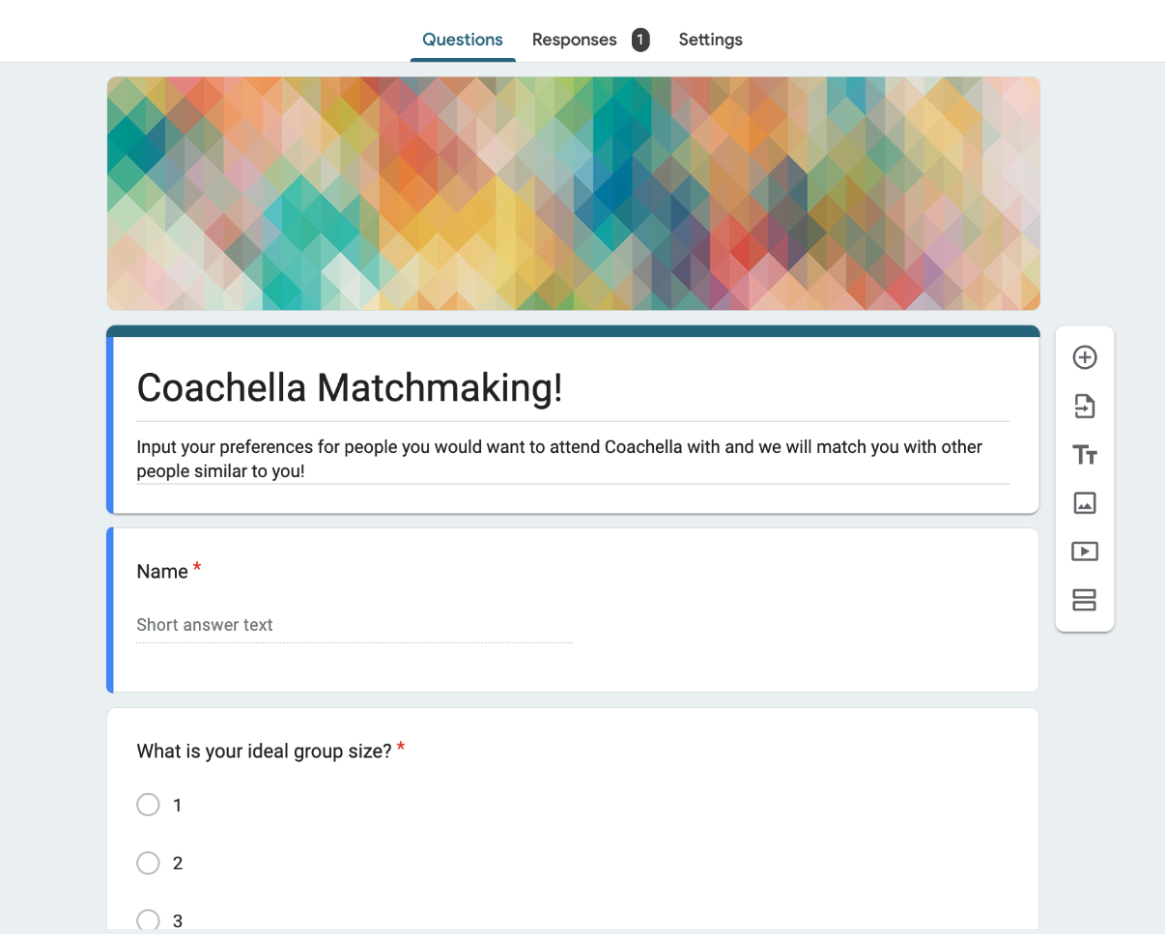
EXPERIENCE PROTOTYPE
Provide participant with matchmaking form for a hypothetical festival
  Input preferences for ideal festival group
Provide participant with hypothetical match based on preferences
Debrief

Slide 44
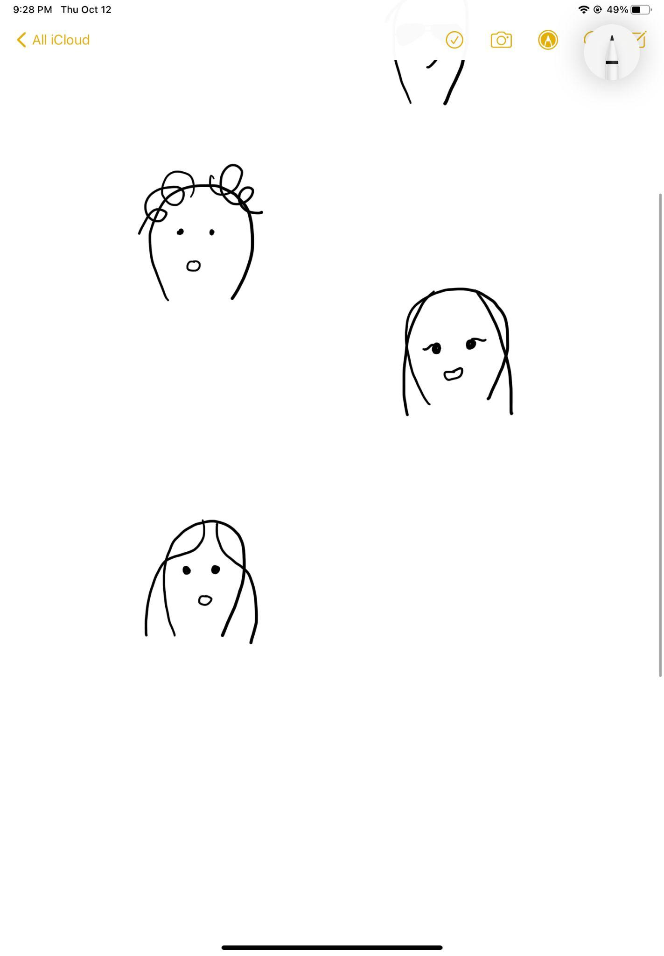
PARTICIPANT
Solution #1
English & design major @ Stanford
Has gone to Coachella and Head in the Clouds
  Attended with friends
More introverted, doesn’t venture outside of friend group
STELLA

Slide 45
RESULTS
What worked?
What didn’t?
Learnings
Felt like it could be a fun experience
Survey didn’t take too much time and easy for participant to fill out
Participant felt anxious about going to festival with strangers
Would still feel anxious even if she could meet up with them beforehand
There are safety concerns regarding matchmaking services
People want to go to festivals with people they trust
People may prefer a group matchmaking service instead - less commitment

Slide 46
DIGITAL CONNECTIONS
Solution #2
Solution:
Connecting festival-goers using common music taste as a basis for fostering community.
Key Assumption:
The process of choosing friends based on their music taste will likely evoke some emotional resonance that will allow the user to make accurate predictions of shared interests and values

Slide 47
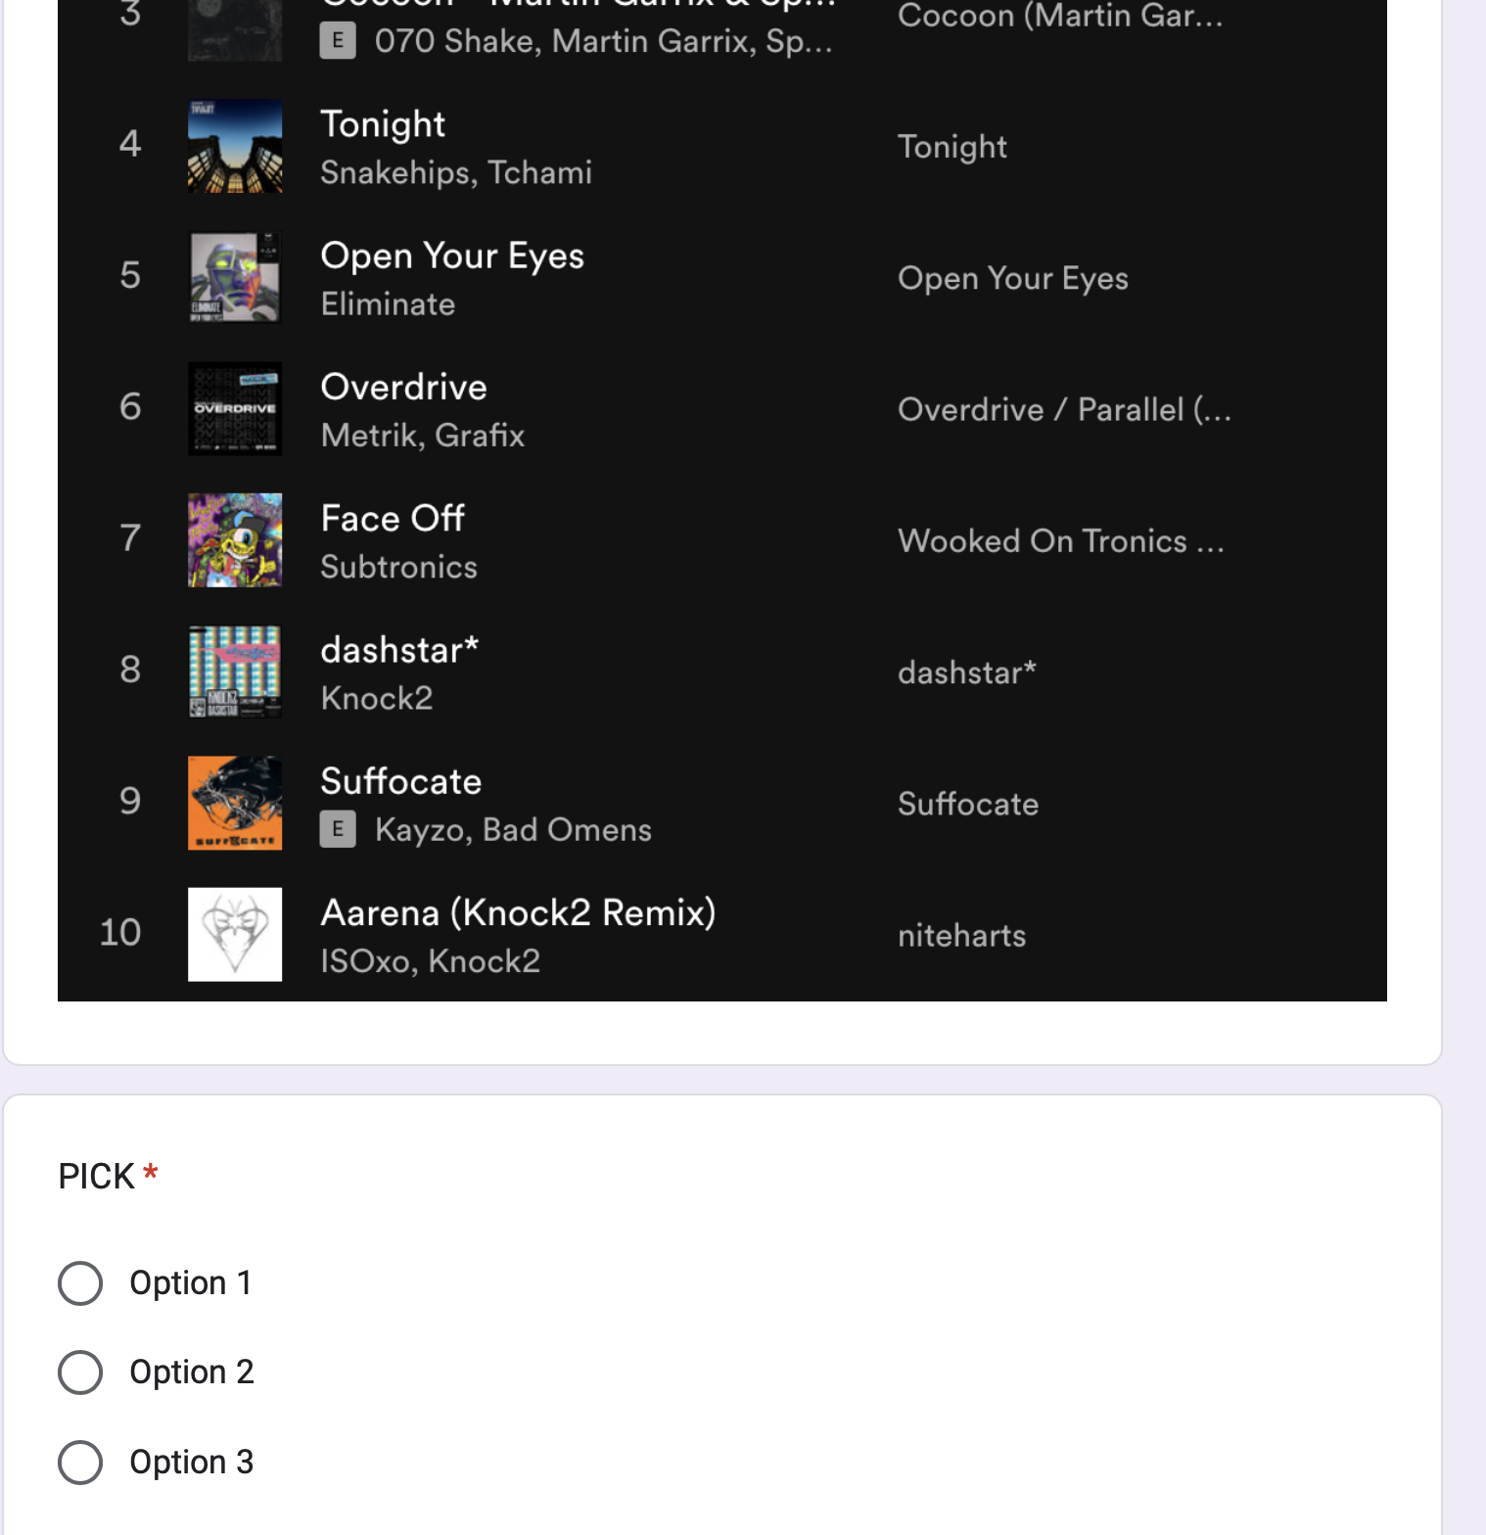
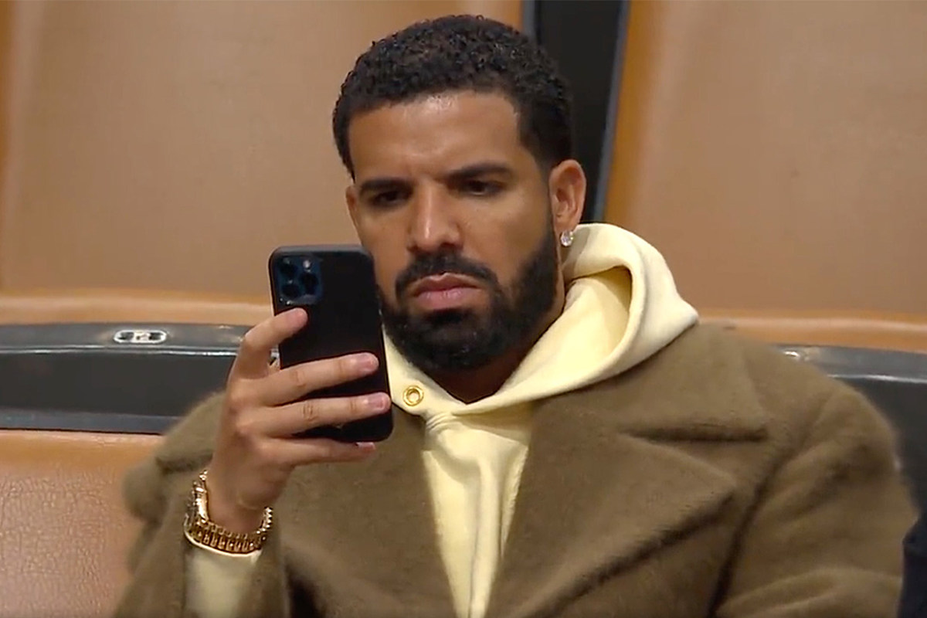
EXPERIENCE PROTOTYPE
Solution #2
Ask participants to think about the music they listen to and what they would like to listen to at a festival
Show participants a series of spotify playlists and ask them to choose who they believe would be the best person to attend a festival with
Have them evaluate why they chose that person and what assumptions they made based on the songs shown.

Slide 48
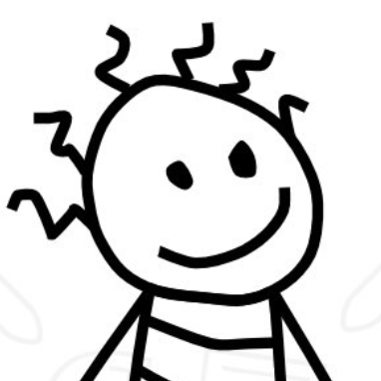

PARTICIPANTS FOR SOLUTION #3
SHEDEN
RAINA
CS Student @ Stanford
Interested in attending festivals and concerts, listens to music frequently
IR Student @ Stanford
Doesn’t have a diverse music playlist, but loves music

Slide 49
RESULTS
Solution #2
What worked?
What didn’t?
Learnings
When experience was able to play the songs, the person felt confident about choosing a person based on their playlist
This could be a quick and fun way to measure compatibility
Participants who weren’t familiar with the music in the playlists ended up choosing arbitrarily
Setting the prototype via Google forms limited interactibility with the songs– less information available to user
Music taste can be a great tool to bring people together
May not be a strong enough indicator of compatibility but when paired with other matchmaking techniques, can increase accuracy

Slide 50
FESTIVAL SCAVENGER HUNT
Solution #3
Solution:
Gamifying the festival experience by rewarding points for capturing specific moments/festival objects on camera.
Key Assumption:
The user will be more receptive to potentially foreign festival traditions and new experiences, making attendance more exciting for new users.

Slide 51
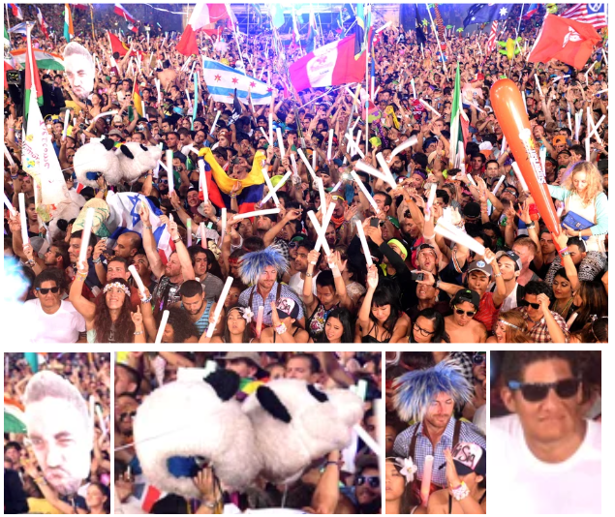
EXPERIENCE PROTOTYPE
Ask participants to describe what they imagine when they hear the word festival
Show participants the smaller pictures of individual items significant to festivals and ask for opinions
Inform participants about items.
Ask participants to find item in picture of a festival
Debrief their emotions behind the activity and how their perception of festivals were after the prototype.
Picture used for prototype.

Slide 52
PARTICIPANTS
EUGENE
MARIANNE
CS Student @ Stanford
Hip-hop/rap enthusiast who has only attended Rolling Loud
Prior perception: Large crowds, mosh pits, headbanging
Makeup artist
Interested in attending festivals having done makeup for festival goers yet has never been
Prior perception: People dressed up, lots of lights

Slide 53
FESTIVAL SCAVENGER HUNT
Solution #3
What worked?
What didn’t?
Learnings
Exciting and fun way to know what to expect at festivals
Learned new festival terms and what to keep an eye out for at festivals
Participants learned about the meaning and value of traditions
Pictures seemed overwhelming
Some confusion on what participants were looking for
Some participants noted that they would be at the festival solely for the music
Assumption was valid
Users don’t know what to look for if they are new to the scene
Meaning behind traditions/customs (kandi, totems, etc.) are important to realizing community values within the scene
Notes:
What worked:
Exciting and fun way to know what to expect at festivals – Marianne liked the panda totem.
Learned new festival terms and what to keep an eye out for at festivals
Both were surprised and positively responded to the values attached to the traditions, such as totems being a way for groups to find each other in crowds
What didn’t?
PIctures were overwhelming since they depicted large crowds.
Participants were confused, - more explanation behind each custom was needed
Eugene noted that he went primarily for the music and hadn’t paid attention to the traditions before, which wouldn’t be a priority for him when attending
Learnings
Assumption was valid: All participants learned more about the festival scene and their perception was positively changed
Users don’t know what to look for if they are new to the scene - traditions and terms are niche and festival-specific
Meaning is important and can enhance a festival goers experience

Slide 54
WHAT’S NEXT?

Slide 55
WHAT’S NEXT…
Move forward with a combination of solution 2 and 3.
ETHICAL IMPLICATIONS
Festivals are expensive—not necessarily an accessible hobby.
WHO MIGHT IT LEAVE OUT?
People who want to go to a festival with people but don’t have a group.
Notes:
Have decided to move forward with solution 2 and 3 with emphasis on digital connection aspect of solution 2 and festival tradition scavenger hunt of solution 3.

Slide 56
WHAT’S NEXT…
Move forward with a combination of solution 2 and 3.
ETHICAL IMPLICATIONS
Festivals are expensive—not necessarily an accessible hobby.
WHO MIGHT IT LEAVE OUT?
People who want to go to a festival with people but don’t have a group.
Notes:
Festivals can cost upwards of hundreds of dollars – can be hard for people if they don’t have much supplemental income

Slide 57
WHAT’S NEXT…
Move forward with a combination of solution 2 and 3.
ETHICAL IMPLICATIONS
Festivals are expensive—not necessarily an accessible hobby.
WHO MIGHT IT LEAVE OUT?
People who want to go to a festival with people but don’t have a group.
Notes:
Combined solution doesn’t address making groups to go with, is more focused on connecting with others AT the festival

Slide 58
APPENDIX

Slide 59
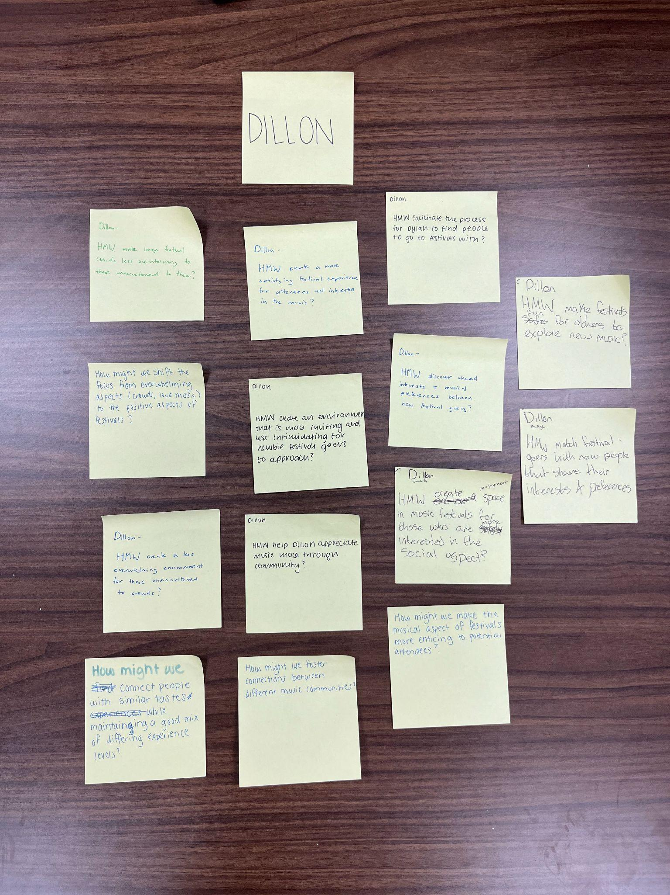
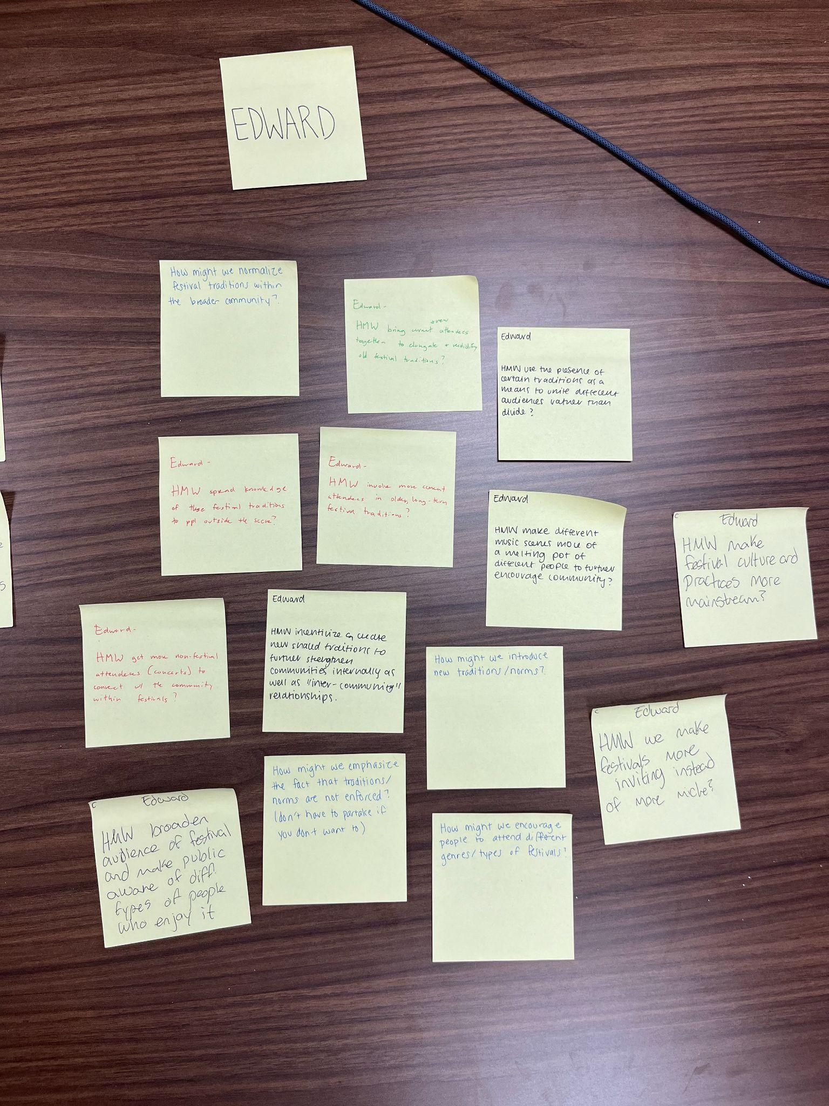
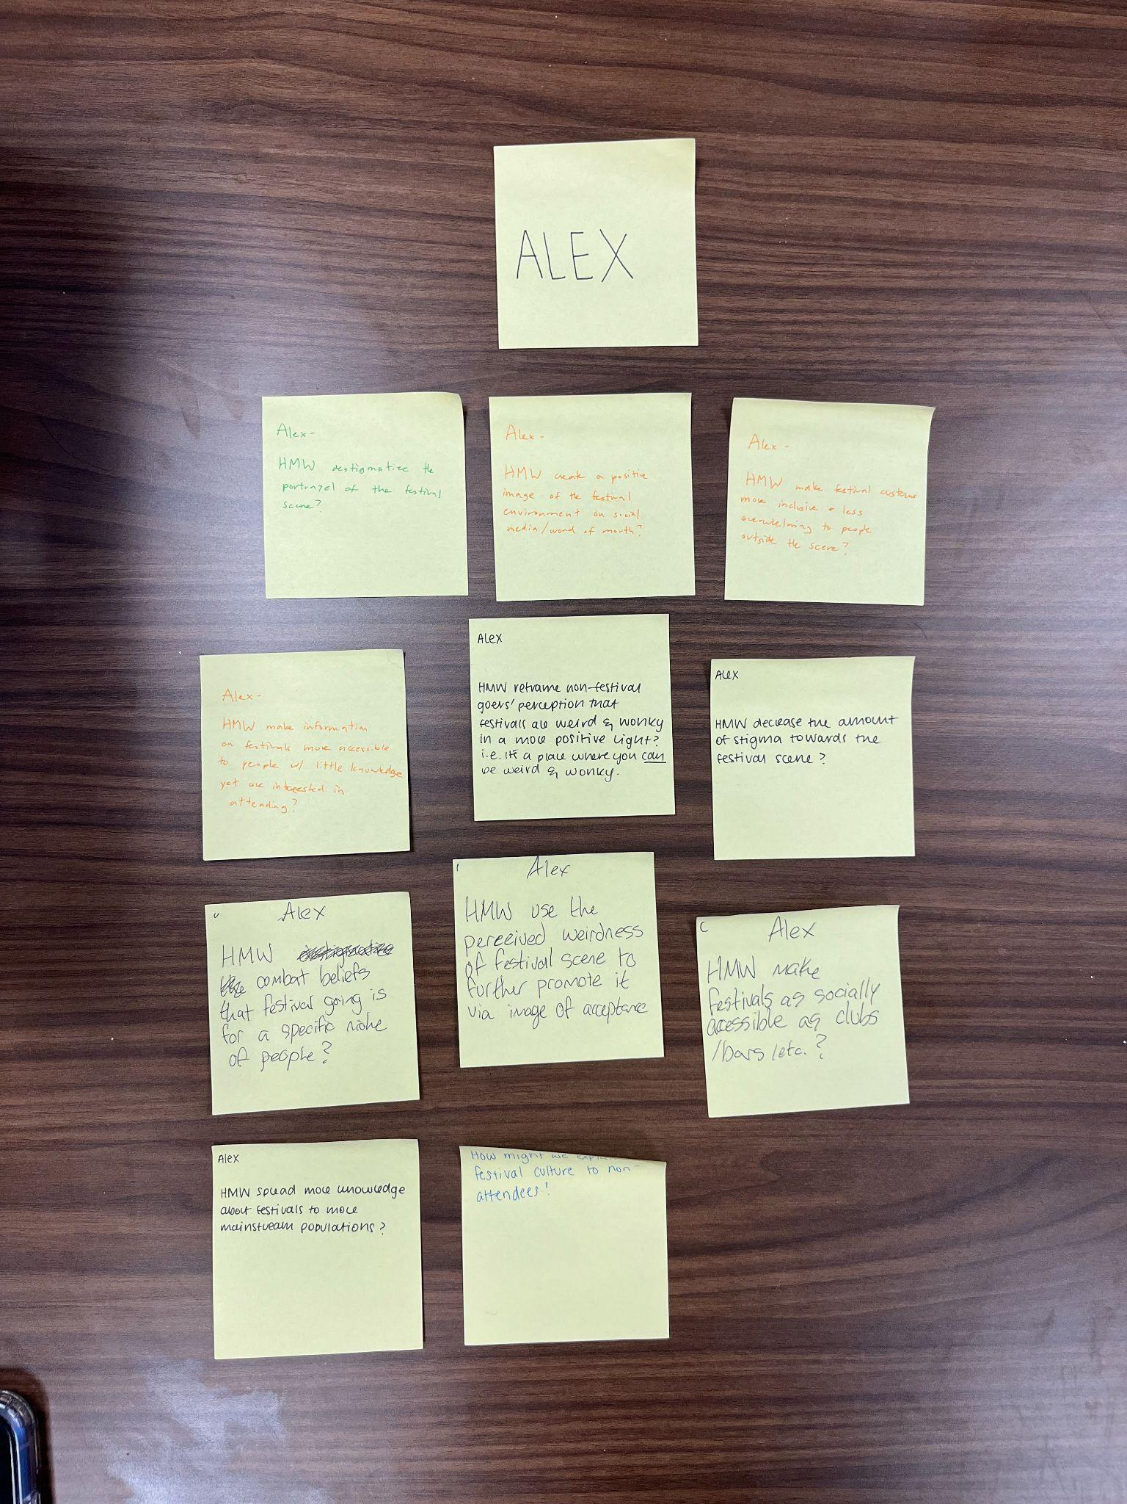
HMWs

Slide 60
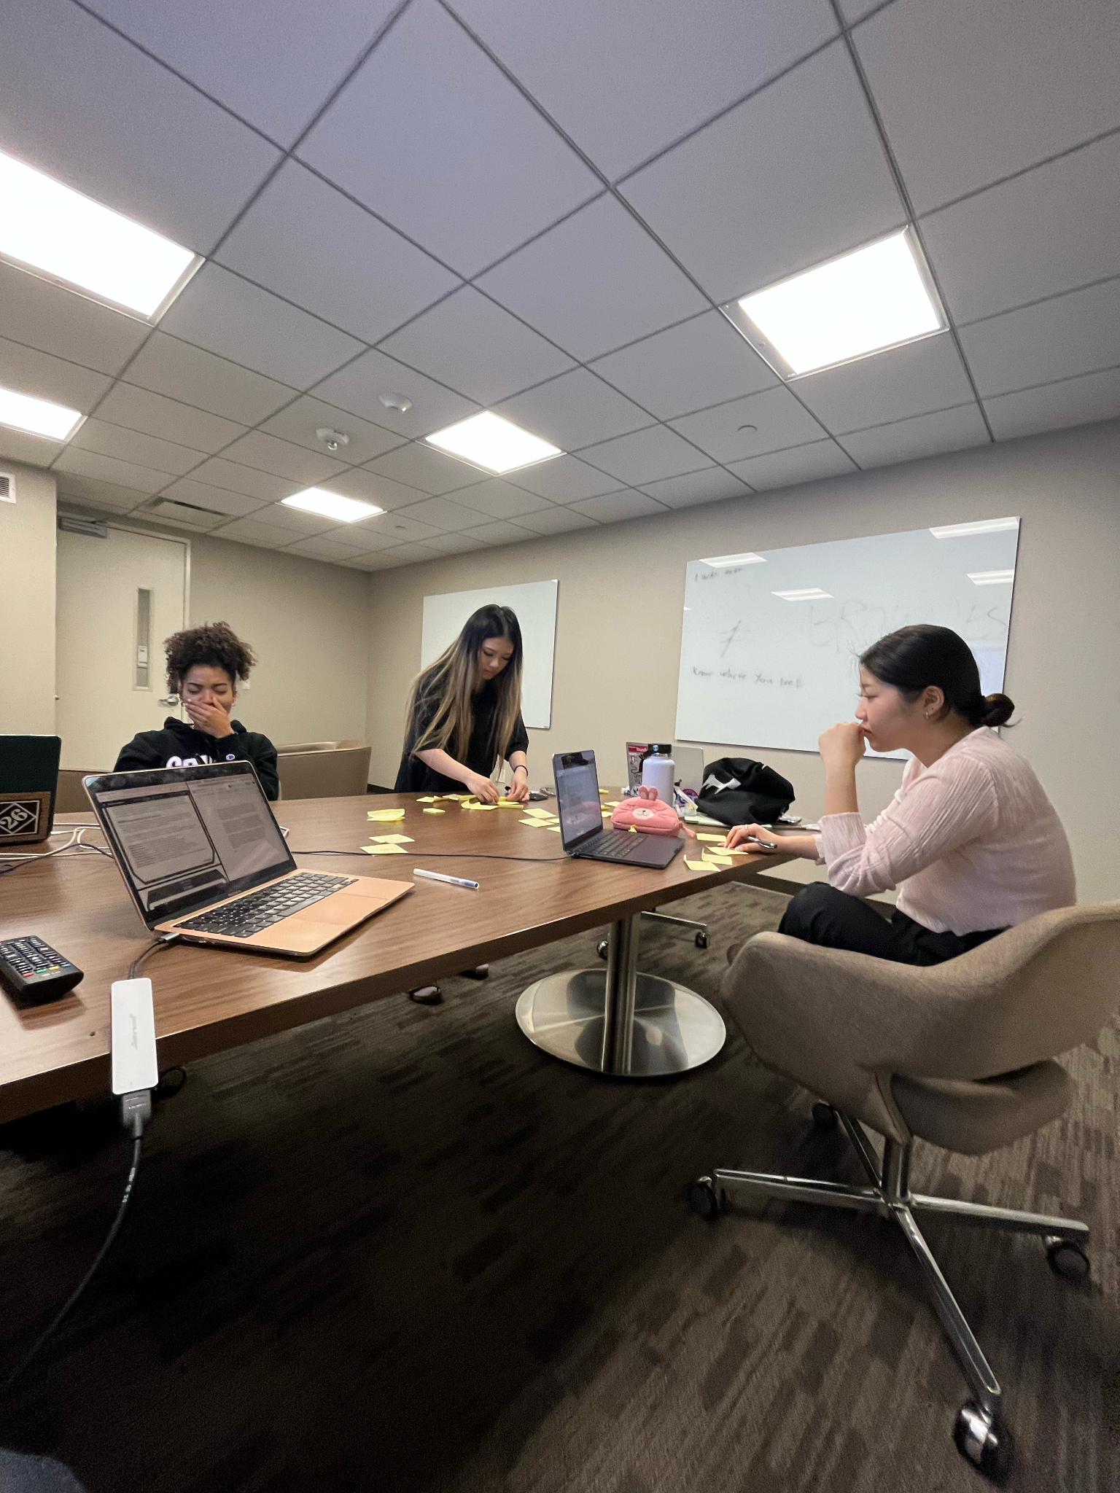

Slide 61
THANKS!
Questions?
Contact us!
sofiakim@stanford.edu
smoua@stanford.edu
tmquach@stanford.edu
gabreu@stanford.edu

