Slide 1
CONCEPT VIDEO
Sofia Kim, Sheng Moua, and Jennifer Quach

Slide 2
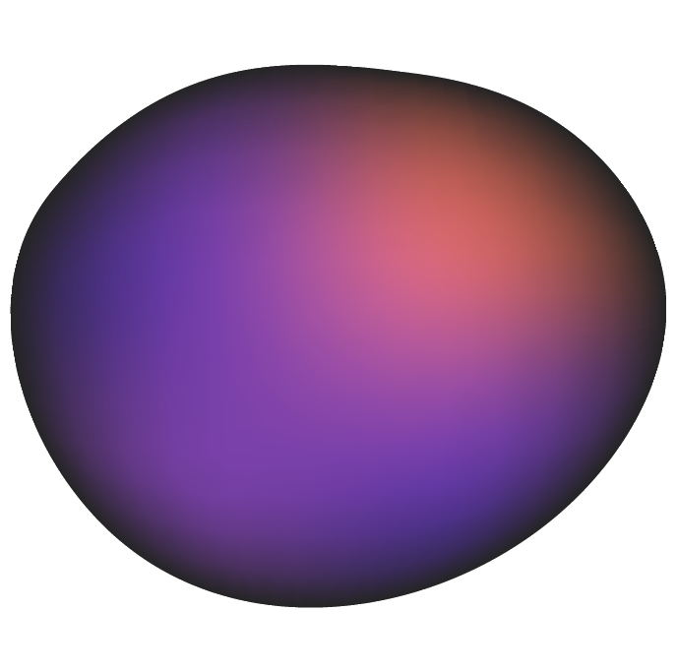



WHO WE ARE
SOFIA KIM
SHENG MOUA
JENNIFER QUACH
‘25
Symbolic Systems
Santa Cruz, Bolivia
‘25
Computer Science
Eau Claire, WI
‘25
Symbolic Systems
Lincoln, NE
Notes:
As a reminder of who we are..team consists of -> read names

Slide 3
A RECAP…
OUR HMWs
How might we make festivals feel less overwhelming for new attendees?
How might we enhance connection and social interaction at festivals?
How might we promote the niche festival scene through its traditions?
Notes:
And here are the 3 solutions we came up with… the first solution

Slide 4

A RECAP…
OUR PREVIOUS SOLUTIONS
MATCHMAKING SERVICE WITH PROFILES
1
DIGITAL CONNECTIONS
2
FESTIVAL SCAVENGER HUNT
3
Pair new attendees with more experienced festival-goers based on compatibility.
Create a digital medium for festival attendees to add each other as friends if have a musical connection.
Gamify the festival experience to encourage attendees to learn about festival traditions.
Notes:
And here are the 3 solutions we came up with… the first solution

Slide 5
PROBLEM
SOLUTION
PROBLEM/SOLUTION OVERVIEW
A social platform that gamifies the festival experience—learn about upcoming events, add friends, and capture pictures of festival traditions to earn achievements
New festival attendees find it difficult to get into the scene because of the complex and overwhelming festival culture

Slide 6
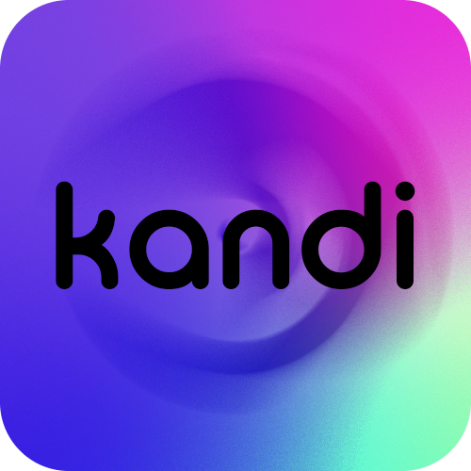
PRESENTING OUR PROJECT NAME & VALUE PROPOSITION:
Motivation:
We chose “kandi” as the name of our project because in festival culture kandi refers to the brightly colored beaded bracelets used to memorialize a special moment shared with someone or a connection at music festivals. The main premise of our app is to help festival goers connect by gamifying the festival experience.
glow together.

Slide 7
VALUES IN DESIGN
COMMUNITY
ENJOYMENT
SIMPLICITY
INCLUSIVITY
Prioritizing community-building through making deeper connections with other festival attendees.
Increasing overall enjoyment by promoting fun and satisfaction.
Allowing for the experience of attending a festival to be easier and more intuitive
Advocating for physical and digital spaces that are inviting and inclusive of everyone.

Slide 8
STAKEHOLDERS
DIRECT
Festival attendees
Event promoters
DJs and artists
Festival vendors
Festival organizers
Festival workers
Directly involved with the festival and can gain insight and knowledge about upcoming festivals.

Slide 9
STAKEHOLDERS
INDIRECT
Transportation providers (i.e., Uber, Lyft, shuttles)
Local businesses around festival venue
Hotels/Airbnbs in the area around the festival
Impacted financially by the decisions and recommendations of festival-goers.

Slide 10
POTENTIAL ETHICAL IMPLICATIONS
Less in-person involvement during festivals because of distraction with phones. Might take away from the true festival experience
People could use our feature of connecting and friending other people for bad motives. There is risk for personal information to be used in unwanted ways.

Slide 11
MARKET RESEARCH

Slide 12

RADIATE
MARKET RESEARCH
Radiate is an EDM festival centered social media platform that seeks to foster community and connect festival goers with others going to the same events through forums, public profiles, and a group creation section.
What Works:
All-rounded app which can help plan events, form a group, and even sell/buy tickets
Facilitates discussion within the festival community with festival specific forums that only feature posts regarding festival experiences, outfits, or questions
Can easily connect attendees with one another through a tinder-like swiping medium
Lets users directly chat with others with a section for group chats
What Doesn’t Work:
Complex and congested UI seems to gear towards experienced festival goers, shying new attendees from using the app
Choosing who to connect with is based on a tinder-like profile swiping method used by many to date rather than befriend
Little anonymity and safety concerns for when groups meet up in person
Inappropriate content promoting illicit activities is not filtered out

Slide 13

FACEBOOK GROUPS
MARKET RESEARCH
Facebook groups are online communities within the Facebook platform where people with shared interests, hobbies, or goals come together to connect, interact, and collaborate.
What Works:
Accessible - most people already have a Facebook account, so there’s no need to sign up for a different platform
Established user base facilitates post engagement
Group admins and rules curb harassment and rude behavior, maintaining respectful environment
Users can directly engage with posts from DJs and events
What Doesn’t Work:
Algorithm limitations and complicated UI make it difficult for users to see the newest posts
Plethora of hacked accounts and scammers
Mostly used to sell tickets - hard to find real sense of community
Lack of privacy due to public nature of profiles; difficult to keep private life and hobbies separate

Slide 14

DISCORD
MARKET RESEARCH
Discord is a social platform where users can join communities called “servers” as well as communicate through messaging, video calls, and voice calls.
What Works:
Can foster sense of community within server
Flexibility; any user can join/create any type of server based on personal interests
Allows for people to connect through voice channels and text
Organized channels dedicated to specific topics
  I.e. finding people to go to certain festivals with, festival info & tips, buying/selling tickets, photo vault
What Doesn’t Work:
Limited to the rave scene
Focuses more on connecting before and after festivals rather than during
Hard to make deeper connections

Slide 15
MARKET ANALYSIS
MARKET RESEARCH
Categories | Radiate | Facebook Groups | Discord
Easy to use | ❌ | ✅ | ❌
Easy to make new connections | ✅ | ❌ | ❌
Can use to get information about festivals | ❌ | ❌ | ✅
Inclusive for all types of festivals | ❌ | ✅ | ❌
Rewards festival attendance | ❌ | ❌ | ❌

Slide 16
TASKS
SIMPLE
MODERATE
COMPLEX
Individual challenge: users complete tasks individually (i.e. taking pictures of glovers, trading kandi)
Why simple? Captures the essence of gamifying festivals
Add a friend on the platform
Why moderate? Adds an extra layer of connection at festivals
Small group challenge (~5 or less people): users complete tasks within a group (i.e. create a totem for your group, coordinate outfits)
Why complex? Requires group coordination and intentional planning
Other tasks:
Moderate: create/join a festival group
Complex: Community (per festival) challenge: attendees going to the same festival work towards a challenge together

Slide 17
STORYBOARDING
Notes:
Establish context, what are we trying to convey

Slide 18
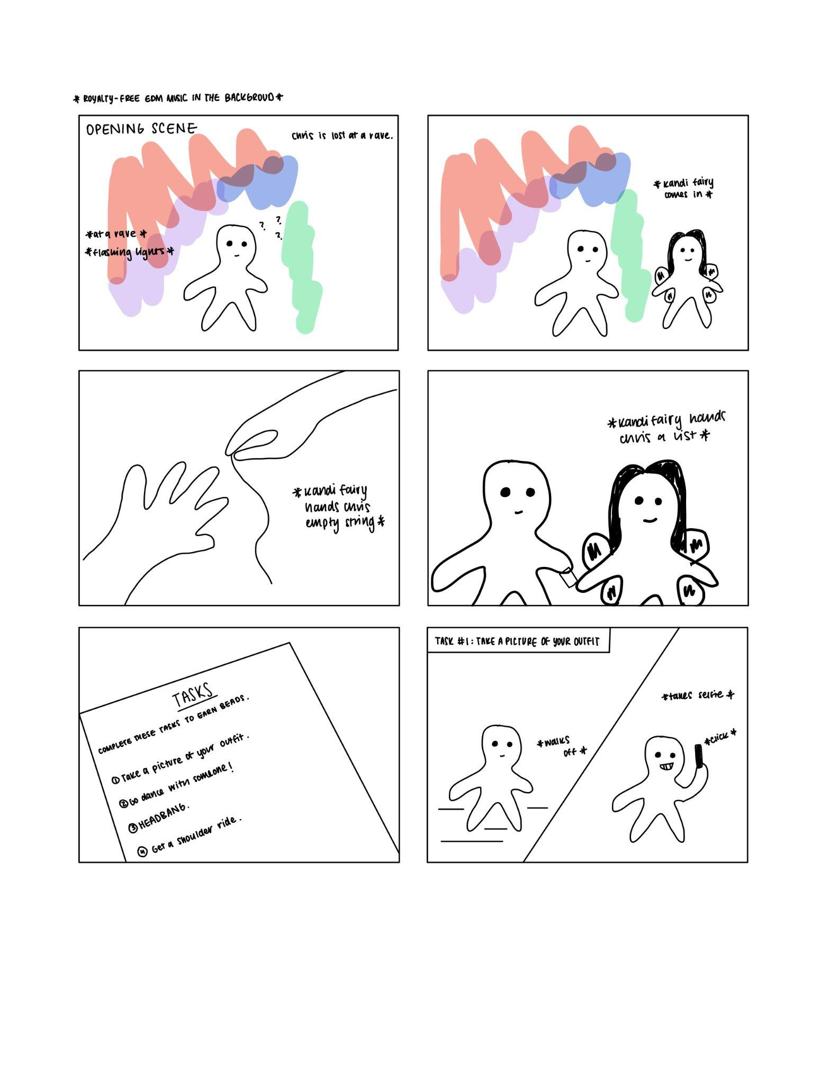
Note, this is Chris’ first time at a music festival. He doesn’t know what to do.

Slide 19
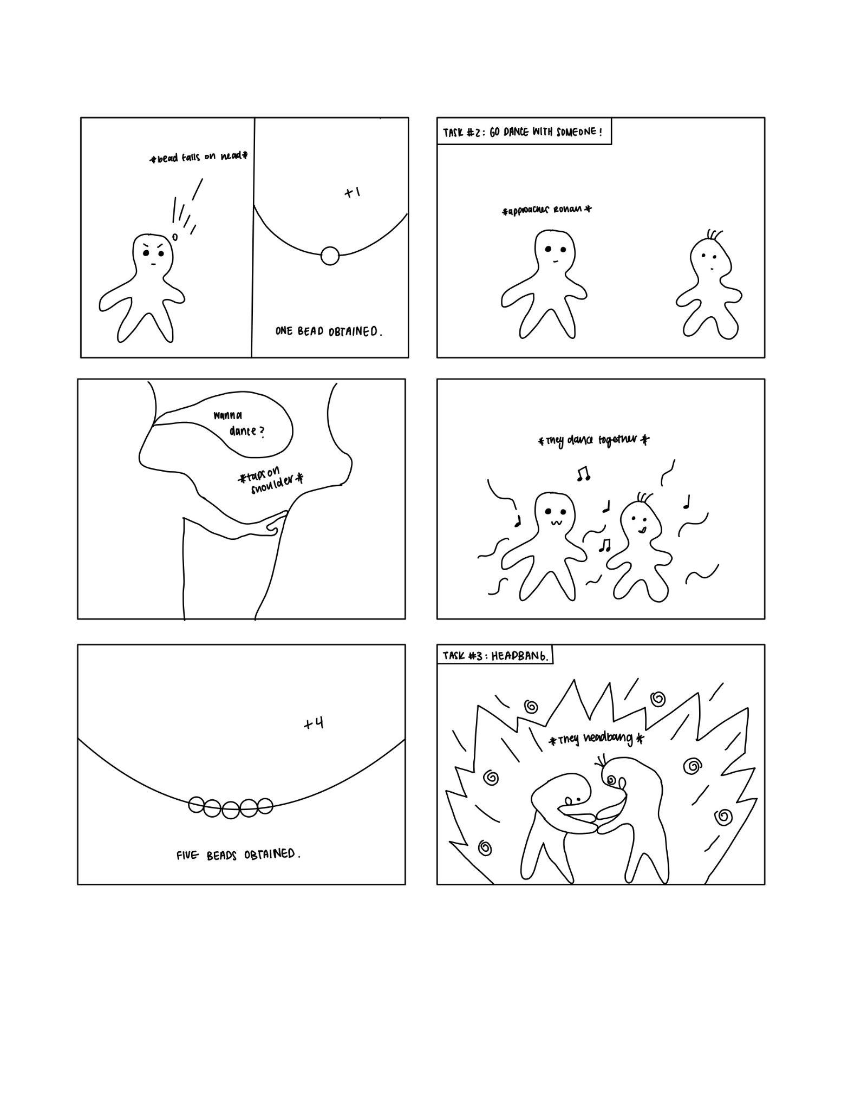
Chris feels a sense of relief, he is given guidance. He feels like he’s on a quest.

Slide 20
Chris is having fun. He’s happy that he’s made a new friend. He feels a sense of community.

Slide 21
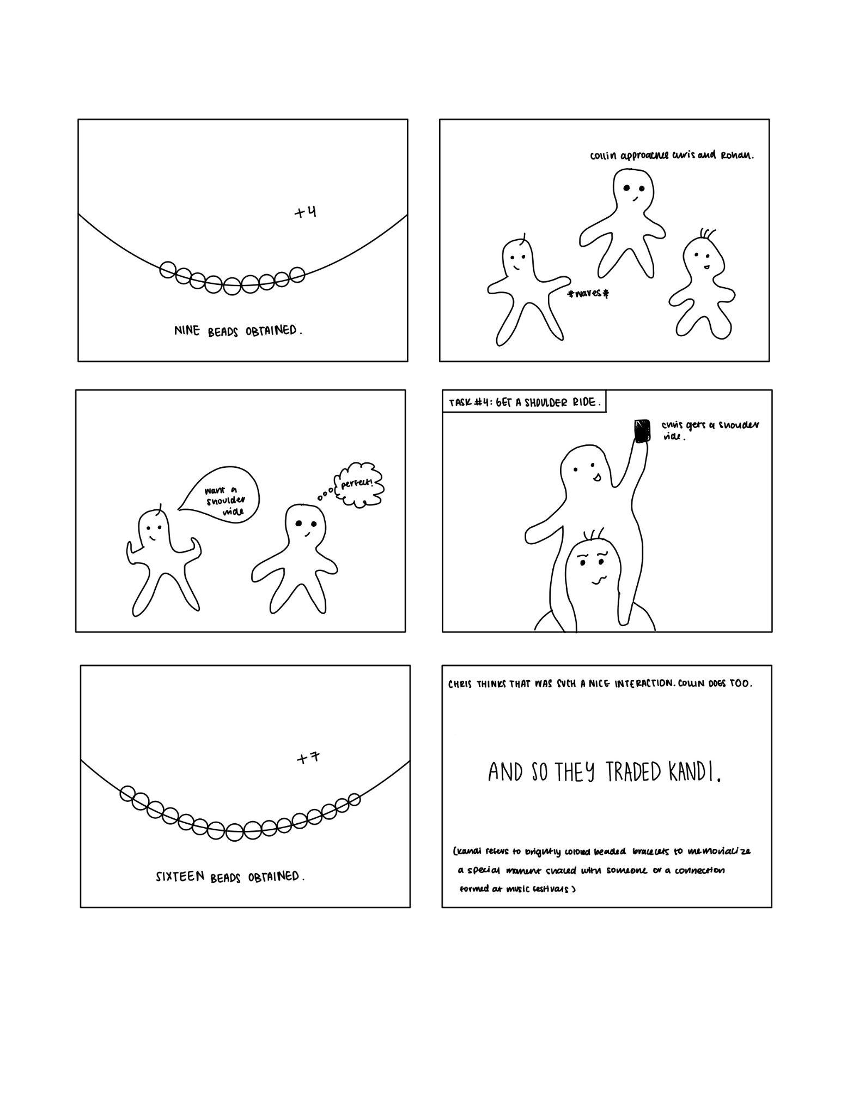
Chris feels accomplished at all he’s done. He’s had the festival experience!

Slide 22
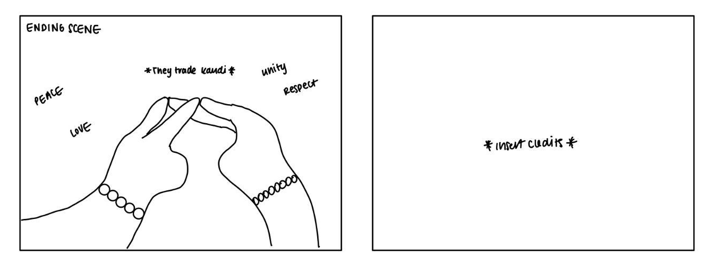
Chris trades kandi with Collin, commemorating a memorable experience,

Slide 23
CONCEPT VIDEO

Slide 24
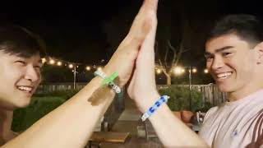
Notes:
https://youtu.be/m0E4VogikMU

Slide 25
THANKS!
Questions?
Contact us!
sofiakim@stanford.edu
smoua@stanford.edu
tmquach@stanford.edu

