Slide 1

LOW-FI PROTOTYPING & USABILITY TESTING
Sofia Kim, Sheng Moua, Jennifer Quach

Slide 2




WHO WE ARE
SOFIA KIM
SHENG MOUA
JENNIFER QUACH
‘25
Symbolic Systems
Santa Cruz, Bolivia
‘25
Computer Science
Eau Claire, WI
‘25
Symbolic Systems
Lincoln, NE
Notes:
As a reminder of who we are..team consists of -> read names

Slide 3
VALUE PROPOSITION:
Celebrate connections,
one bead at a time

Slide 4
OUR SOLUTION
THE PROBLEM
In gamifying the festival experience, we envision a platform that eases users of any experience into the community by rewarding tasks like creating and joining groups, sharing and receiving news, adding friends, and capturing festive memories.
The festival environment can be overwhelming and isolating to new attendees, making it difficult to enter the scene.

Slide 5

PREVIEW
SKETCHING EXPLORATIONS
USABILITY TESTING
1
3
LOW-FI PROTOTYPE
DISCUSSION
2
4
Concept sketches and realizations
Methodology and results
Construction and task flows
Implications, observations,
and considerations

Slide 6
CONCEPT SKETCHES

Slide 7
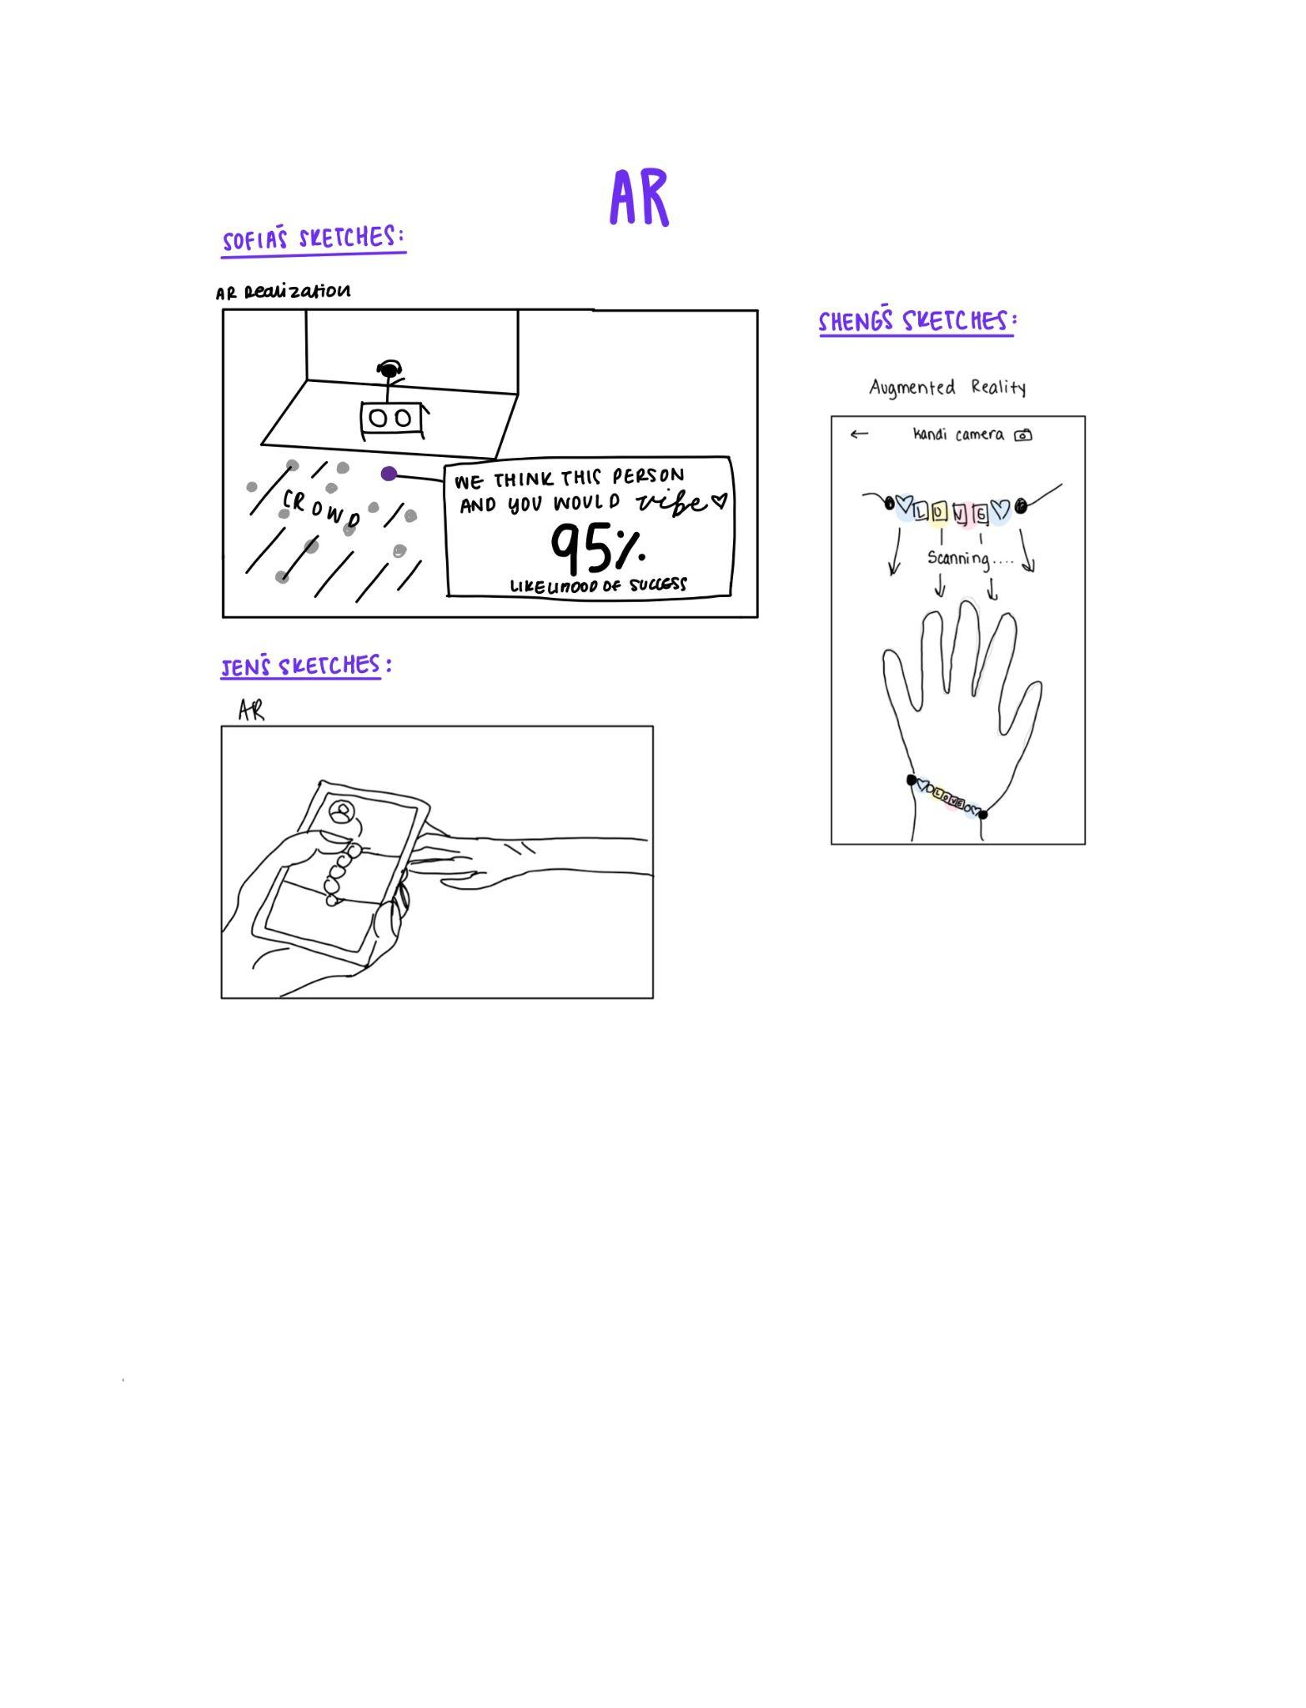
CONCEPT 1: AUGMENTED REALITY

Slide 8
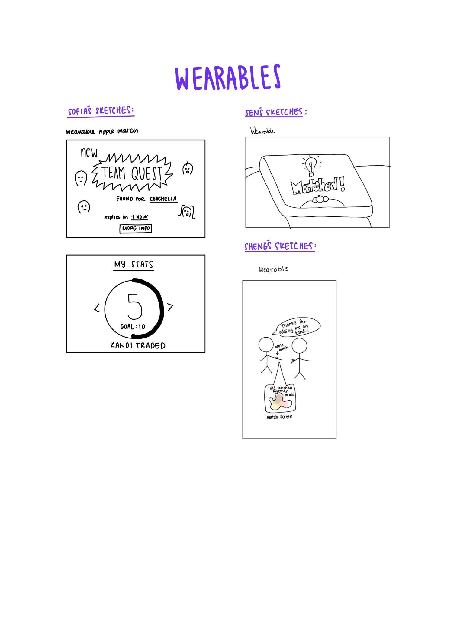
CONCEPT 2: WEARABLES

Slide 9
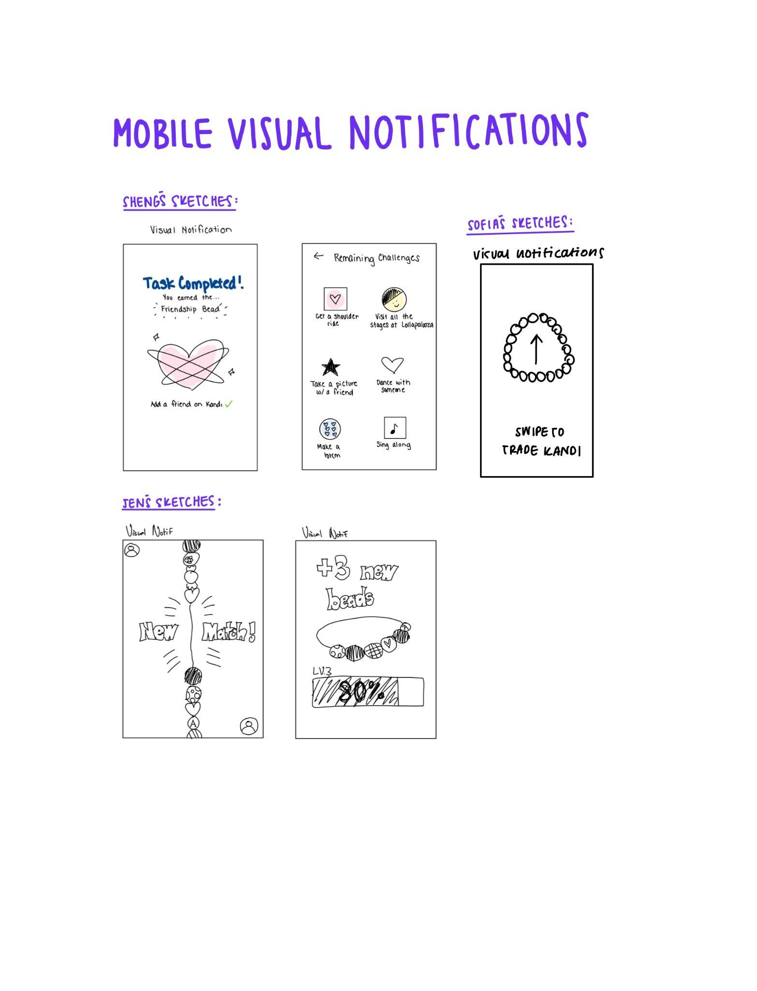
CONCEPT 3: VISUAL NOTIFICATIONS

Slide 10
CHOSEN REALIZATIONS

Slide 11
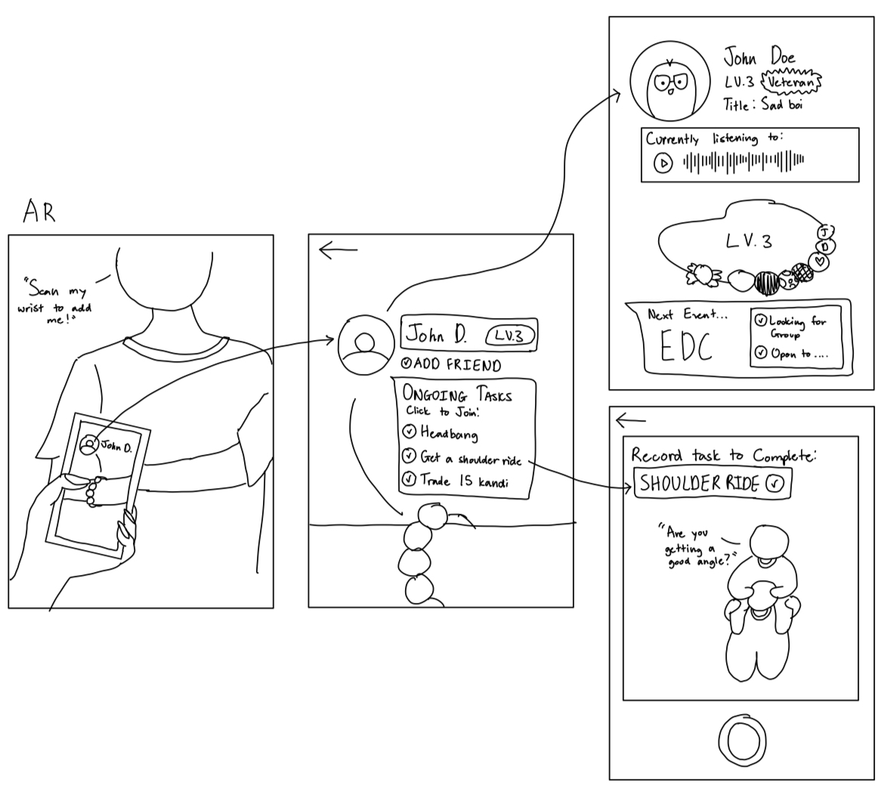
AUGMENTED REALITY

Slide 12
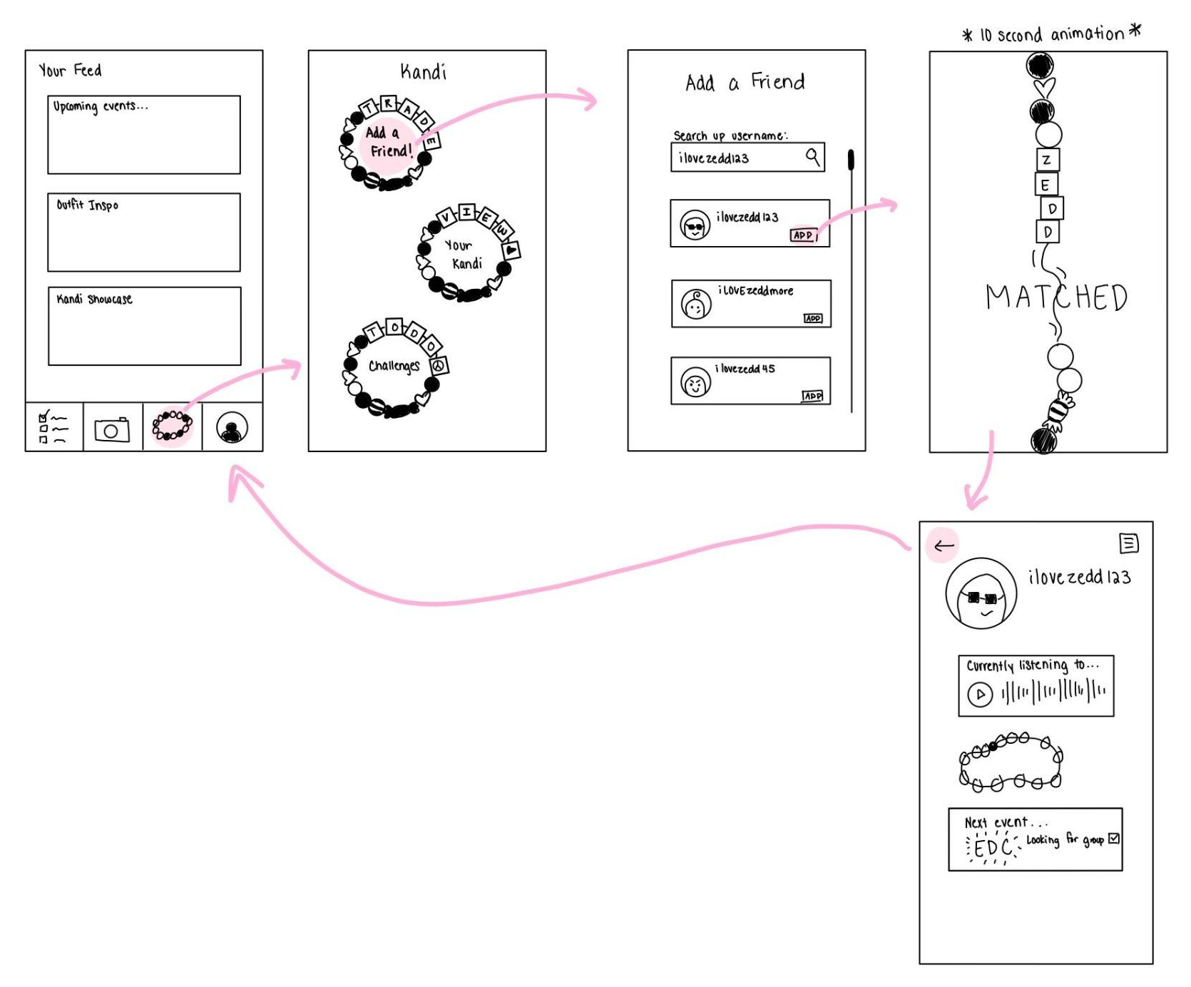
MOBILE VISUAL NOTIFICATIONS

Slide 13
AUGMENTED REALITY
Chosen realization #1
PROS:
More of an immersive experience
Mimics the physical interaction of “trading kandi”
Novel medium
CONS:
Digital interactions take away from the true live festival experience
Potentially incompatible with older or niche devices
Less functional in darker or brighter environments

Slide 14
MOBILE w/ VISUAL NOTIFS
Chosen realization #2
PROS:
User familiarity with mobile interfaces
In-depth display of information – view details, view full profiles, etc.
Get access to more features within the app
CONS:
Common UI – oversaturation of similar mobile applications
Less incentive to use in a festival setting
May lead to congestion of content on a mobile screen

Slide 15
SELECTED INTERFACE…

Slide 16
MOBILE APP w/ VISUAL NOTIFS
Rationale:
With our goal of integrating users into a seemingly overwhelming scene, a complex AR interface that may only function on certain devices and in particular environments can hinder its ease of use.

Slide 17
LOW-FIDELITY PROTOTYPE
Notes:
From there, we revised Alex’s POV and created 2 more.

Slide 18
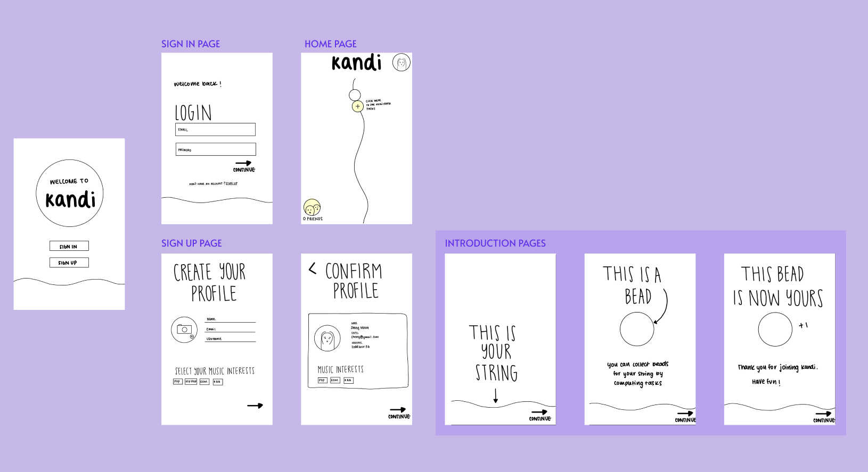
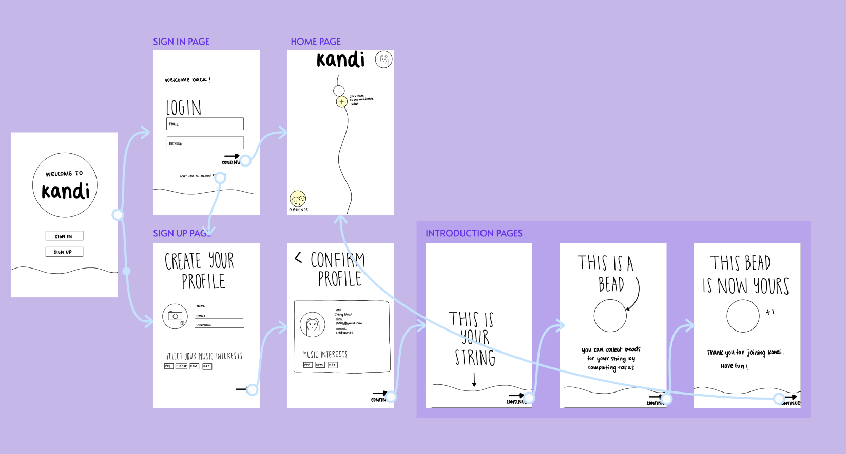
INTRO: ONBOARDING
Create your profile and get introduced to the app

Slide 19
3 TASK FLOWS

Slide 20
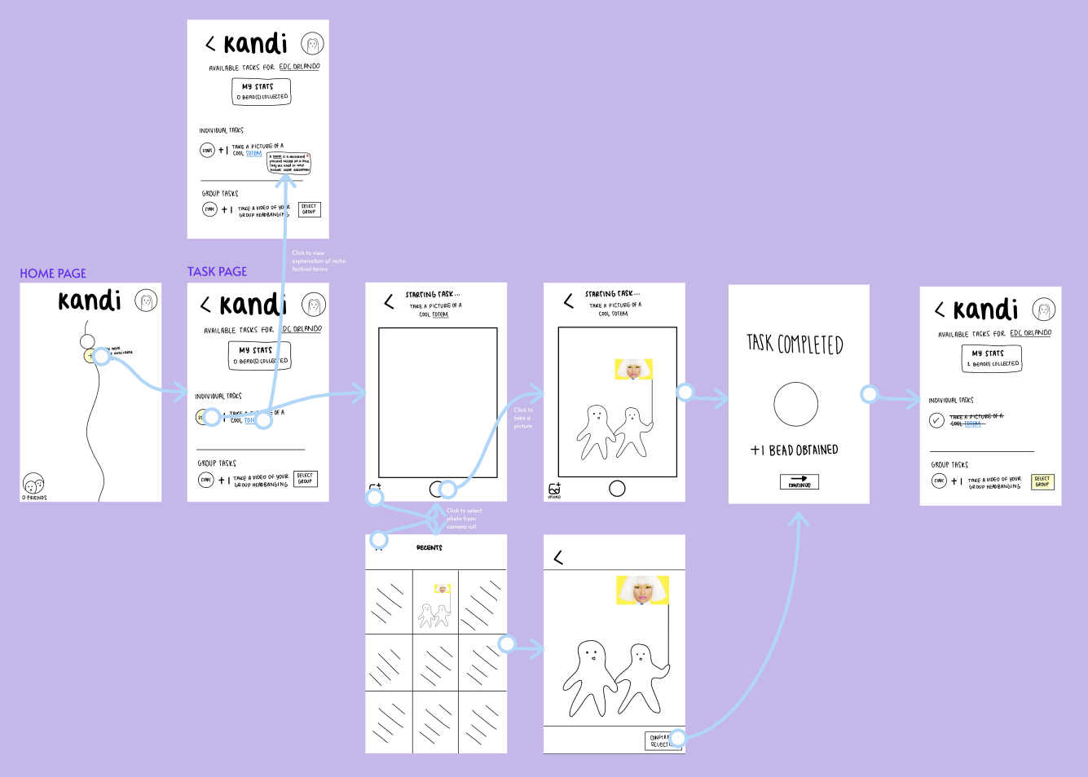
SIMPLE TASK
View and complete individual festival tasks

Slide 21
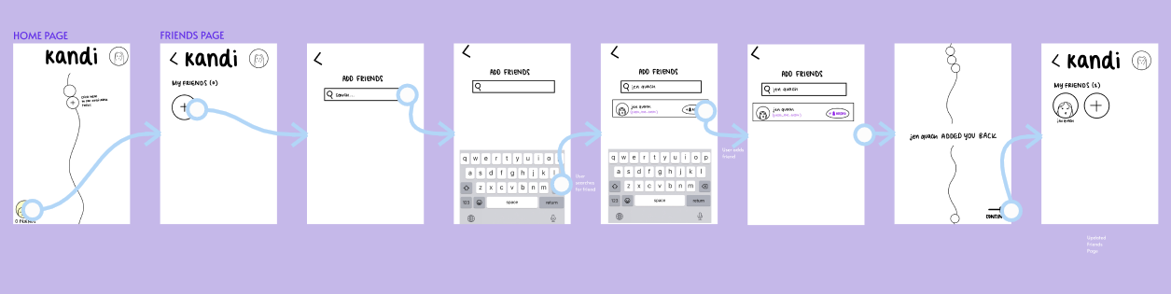
MODERATE TASK
Add and connect with other members of the community

Slide 22
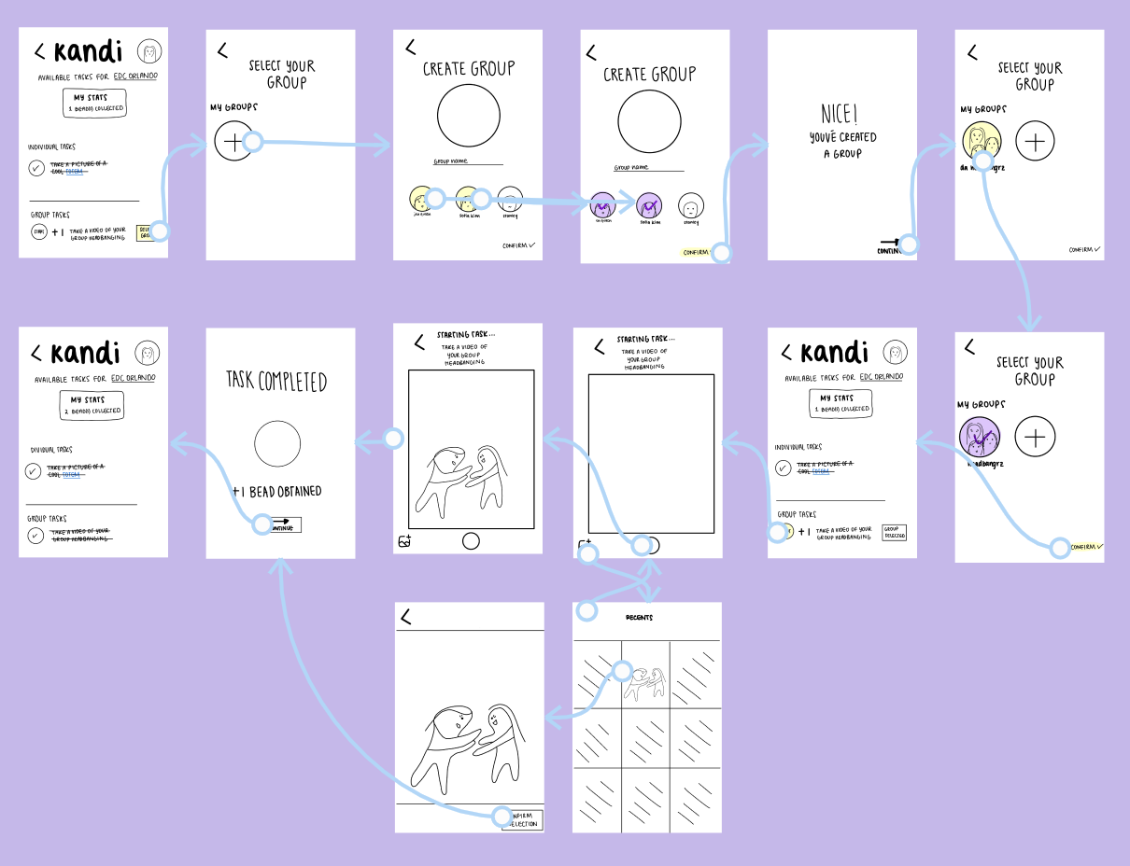
COMPLEX TASKS
Join or create a group to complete community tasks with friends

Slide 23
USABILITY TESTING

Slide 24
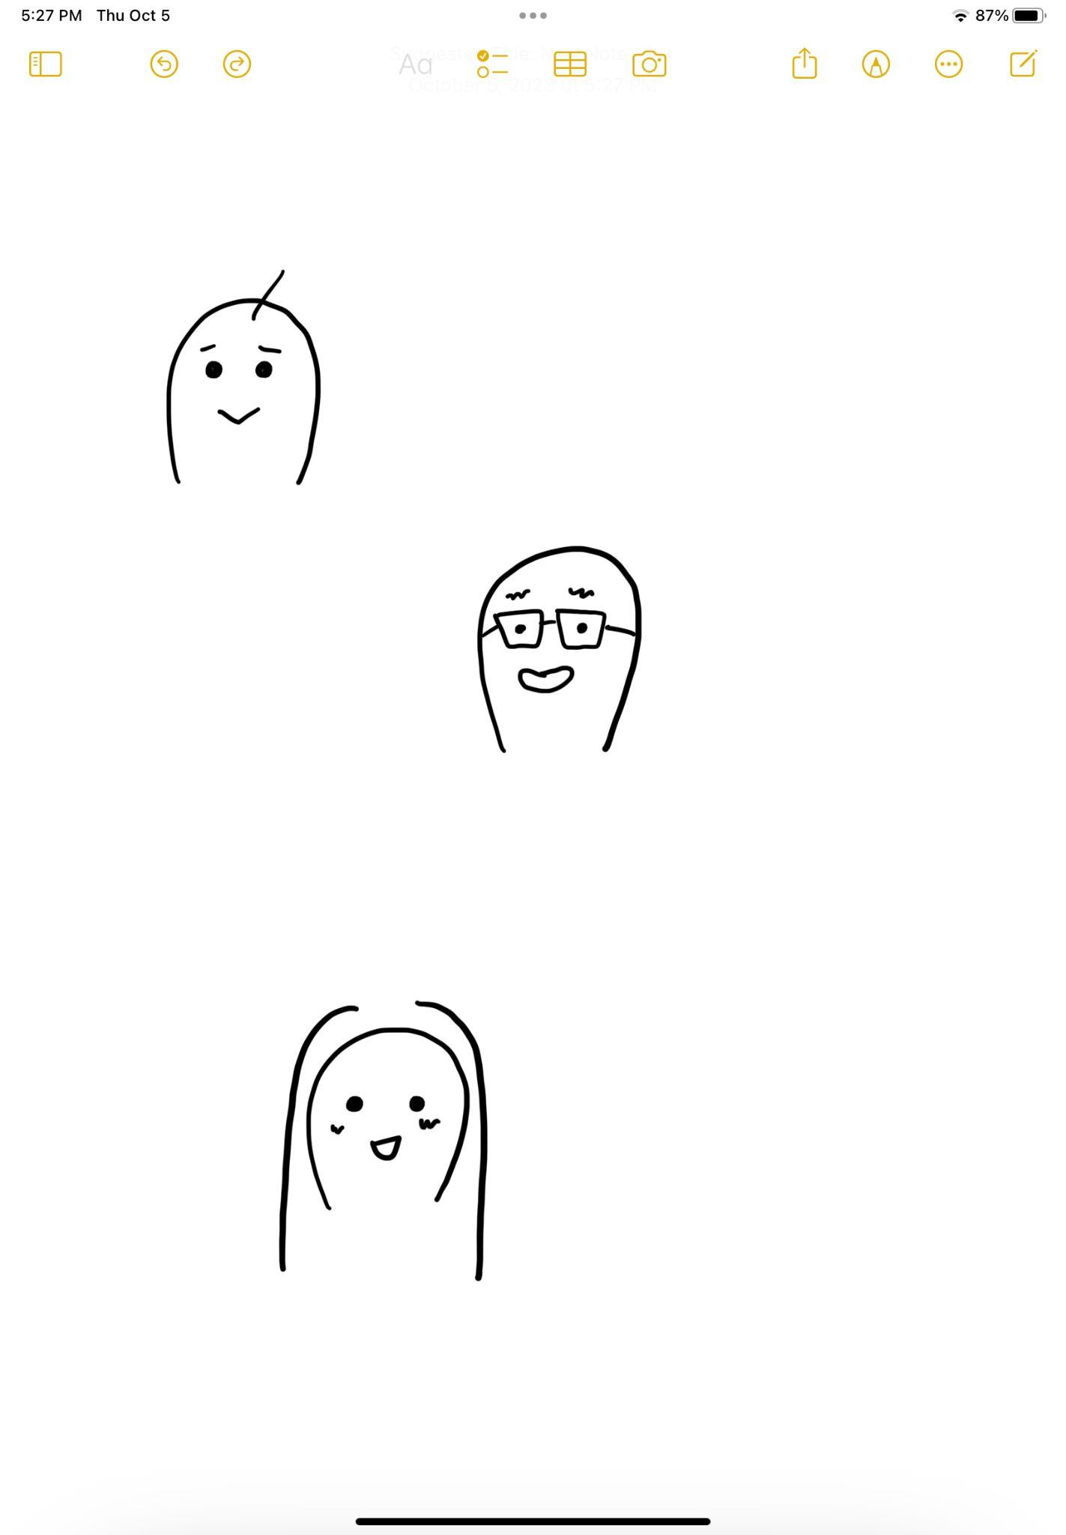
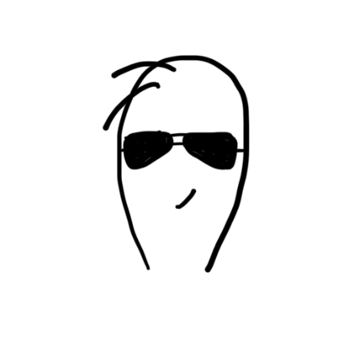
RECRUITMENT
BRIAN
ANDREW
DANA
Freelance Website Developer and part-time Bobarista
Met at workplace in Cupertino Village
Attended around 2 events
UC Berkeley CS student
Met at Cupertino Village
Average event goer
UCLA Grad headed to Law School
Met at Cupertino Village
Has only attended one event
Notes:
Last week, we interviewed *CLICK* juliet… *CLICK* alex… *CLICK* edward.

Slide 25
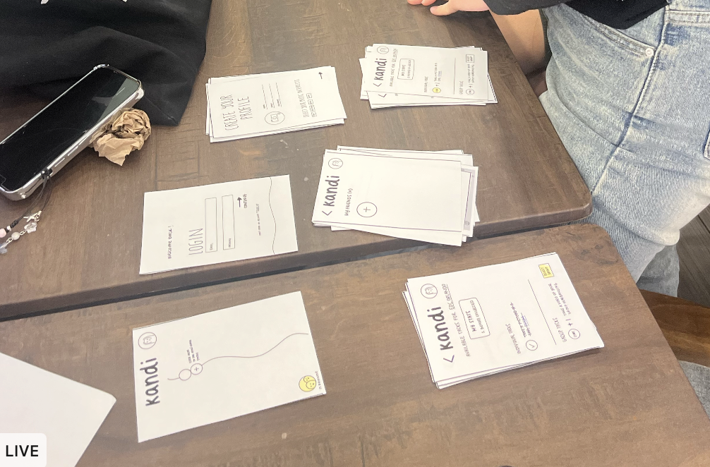
ENVIRONMENT & APPARATUS
We created a paper prototype with cards that represented screens with buttons that participants can point to, which would switch to the next card.
Roles:
Jen – Facilitator and greeter
Sofia – Computer
Sheng – Note-taker and observer

Slide 26
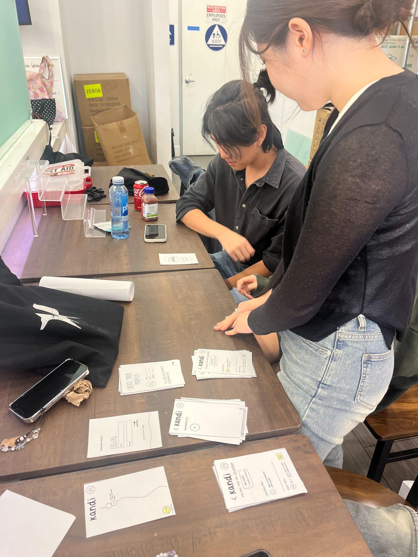
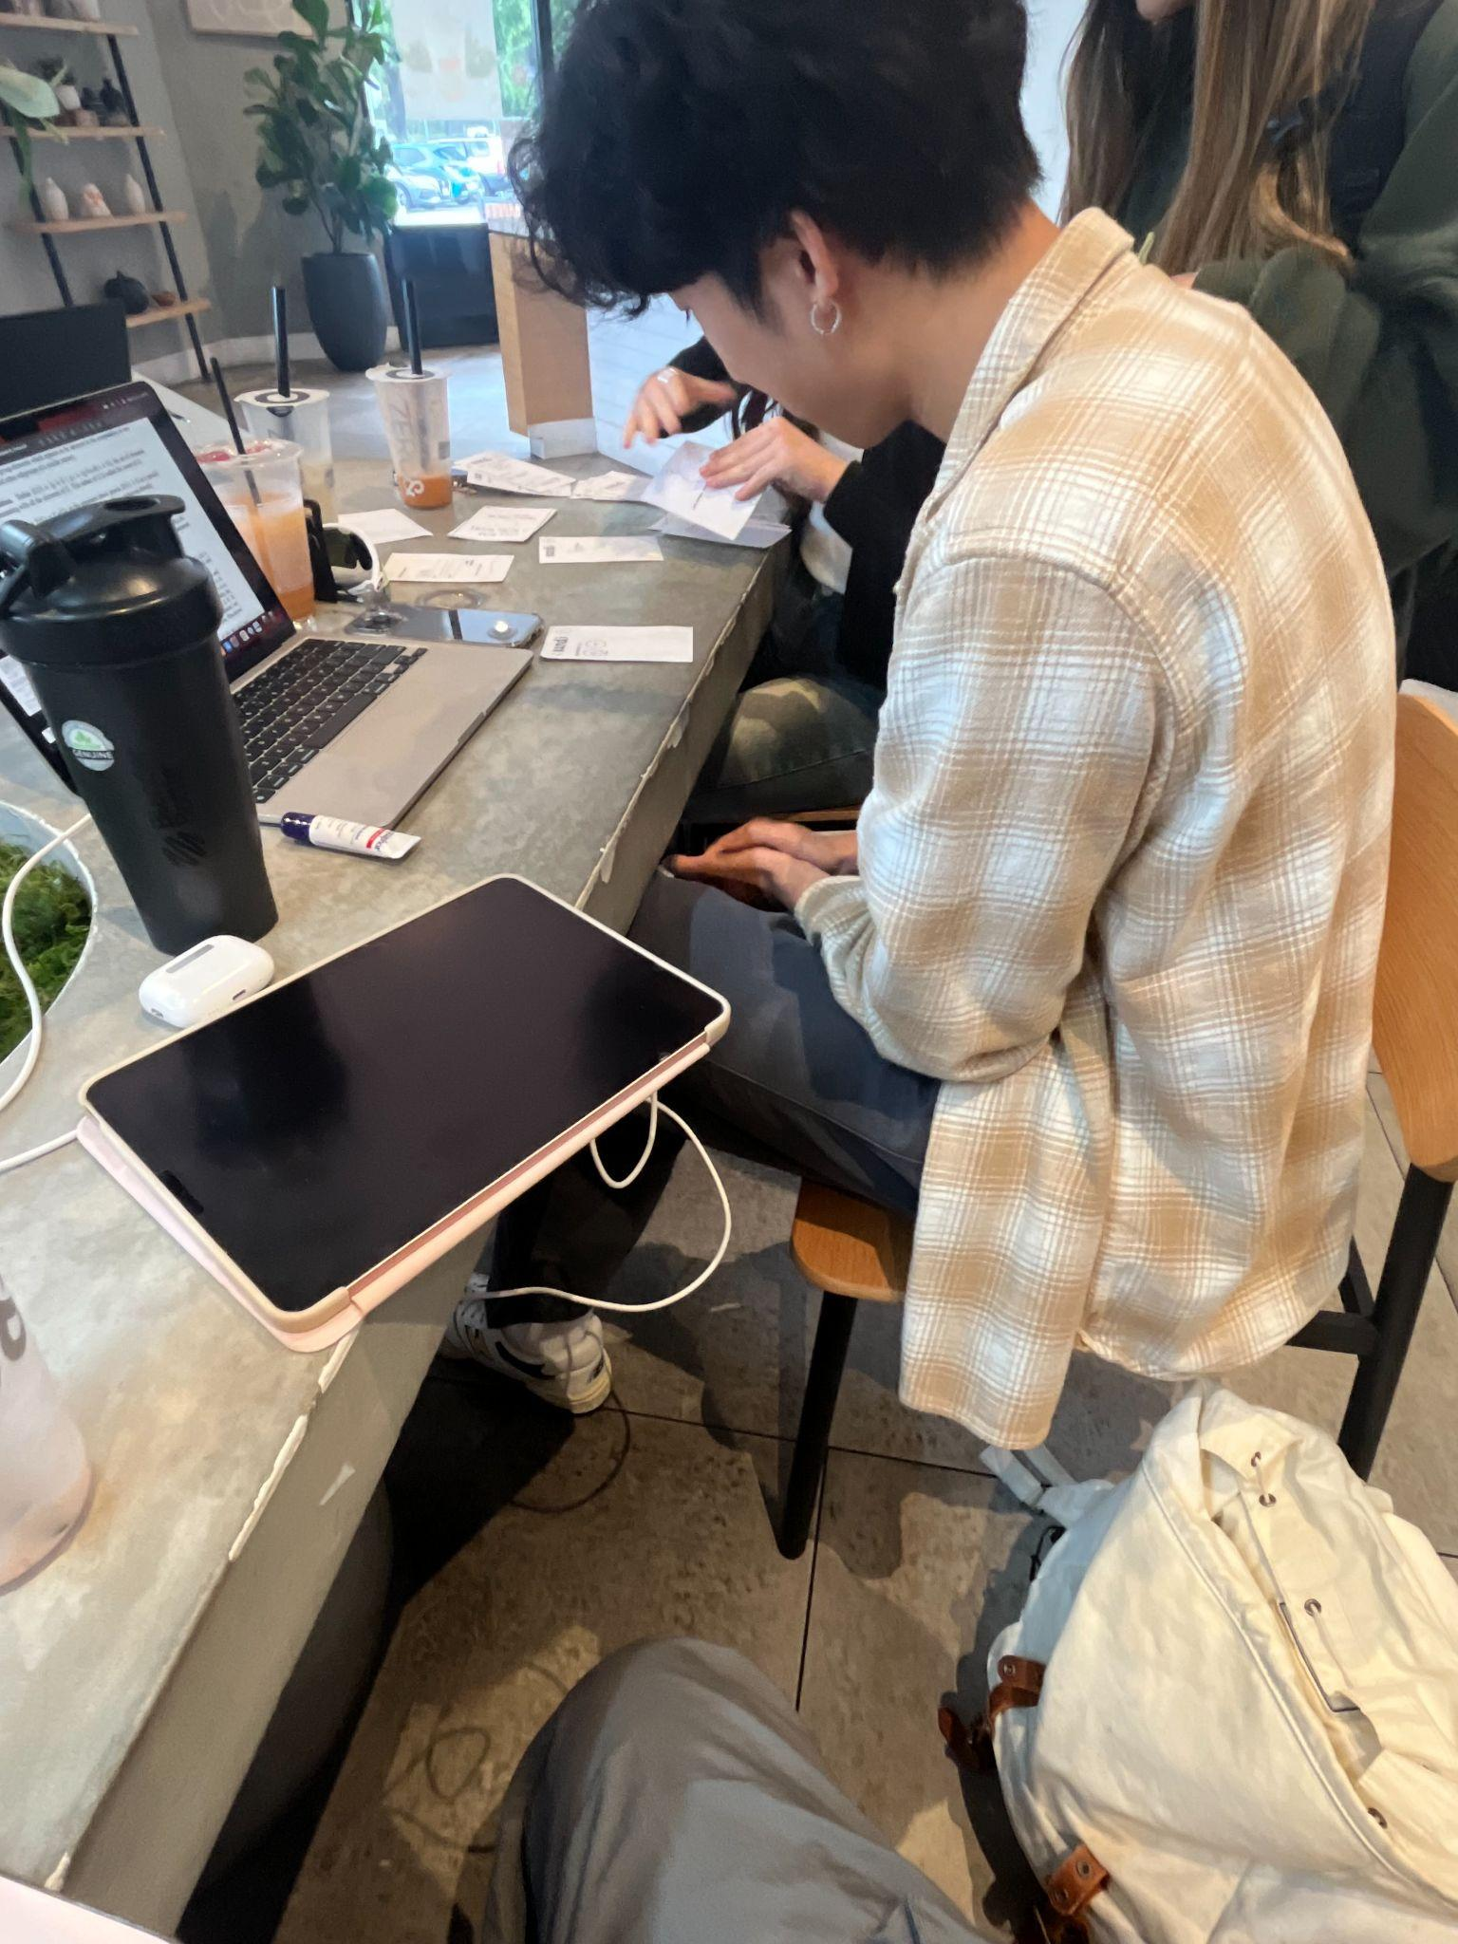
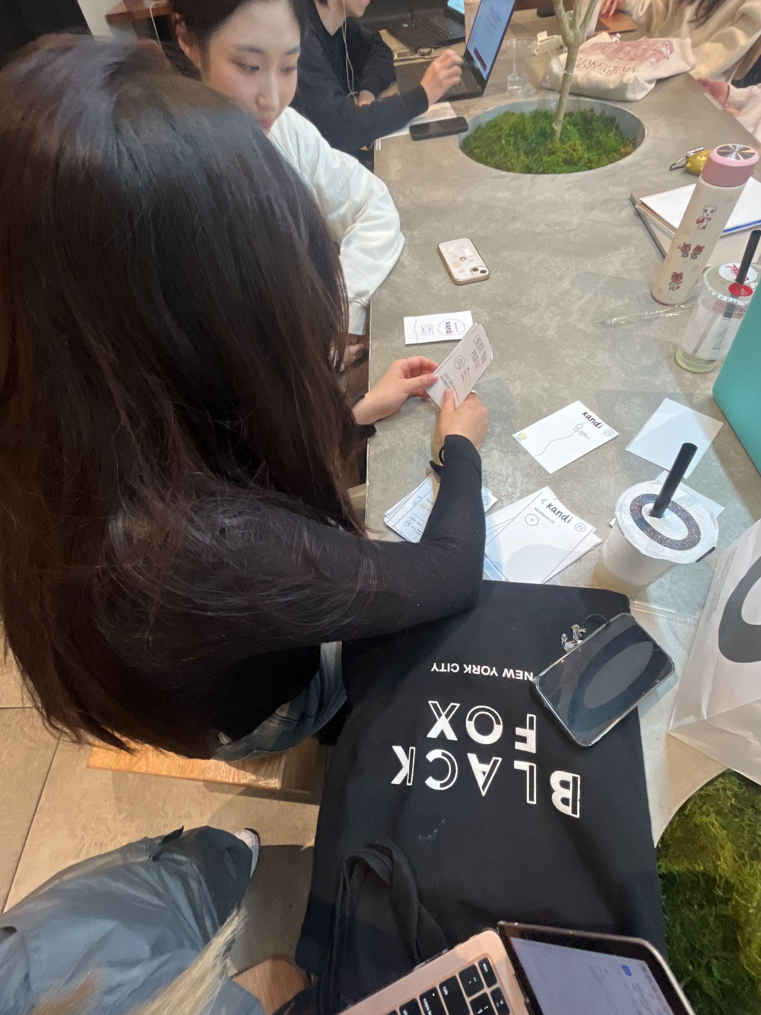
BRIAN
ANDREW
DANA
Notes:
Tried making more specific

Slide 27
TESTING PROCEDURE
Gave context behind Kandi and a hypothetical scenario: the user just downloaded the app for an upcoming event at EDC Orlando
Participants were given 3 tasks to try all 3 features of the homescreen (profile creation, manage friends, view and complete tasks); Participants navigated with auditory direction to gauge intuitiveness of app
Final debrief consisted of a discussion on functionality, intuitive navigation, additional features to implement, and overall satisfaction
Notes:
Tried making more specific

Slide 28
USABILITY GOALS & KEY MEASUREMENTS
USER SATISFACTION
1
INTUITIVE NAVIGATION
2
FUNCTIONALITY
3
Asked how likely the user would be in using each feature by giving it either a low, medium, or high potential usage rating
Measured by the number of mis-clicks; Noted questions or incidents where participant is unable to complete a facilitated task
Measured through task completion, noting facilitated tasks that were indirectly succeeded
Notes:
And here are the 3 solutions we came up with… the first solution

Slide 29
RESULTS AND DISCUSSION
Notes:
From there, we revised Alex’s POV and created 2 more.

Slide 30
PROCESS DATA
Results and Discussion
All participants…
2 participants…
1 participant…
Appreciated aesthetics and simplicity of design
Successfully completed simple, moderate, and complex tasks
Expressed confusion on what to do after taking a picture of their task
Understood and easily navigated the home screen
Didn’t understand the main intent of the app
Expressed interest in a greater emphasis on social connection features,
Struggled with the group selection and group task confirmation process due to redundant steps
Asked what Kandi was during the onboarding process
Wanted a way to see which friends were at the same event real-time
Expressed desire for a calendar feature on friends’ profiles to see future event schedule
Concerned over lack of visual differentiation between group and individual tasks
Notes:
What worked:
Exciting and fun way to know what to expect at festivals – Marianne liked the panda totem.
Learned new festival terms and what to keep an eye out for at festivals
Both were surprised and positively responded to the values attached to the traditions, such as totems being a way for groups to find each other in crowds
What didn’t?
PIctures were overwhelming since they depicted large crowds.
Participants were confused, - more explanation behind each custom was needed
Eugene noted that he went primarily for the music and hadn’t paid attention to the traditions before, which wouldn’t be a priority for him when attending
Learnings
Assumption was valid: All participants learned more about the festival scene and their perception was positively changed
Users don’t know what to look for if they are new to the scene - traditions and terms are niche and festival-specific
Meaning is important and can enhance a festival goers experience

Slide 31
MORE OBSERVATIONS
Confusion about how the app will confirm a task is completed
Expressed concerns over how to manage the “view tasks” screen once more group tasks and individual tasks were given
Didn’t understand whether the whole group or just one person would submit confirmation for completing a group task
Asked if some tasks were festival specific

Slide 32
BOTTOM-LINE DATA

Slide 33
USABILITY GOALS & KEY MEASUREMENTS
USER SATISFACTION: Potential Usage scale (low, medium, high)
1
INTUITIVE NAVIGATION: Number of mis-clicks
2
FUNCTIONALITY: Task success rate
3
One user voted medium, two users voted high
2 Mis-clicks during group selection process
All simple, moderate, and complex tasks were successfully completed
Notes:
And here are the 3 solutions we came up with… the first solution

Slide 34
CHANGES TO DESIGN
KEY IMPLICATIONS
Adding a bluetooth connection feature to see who is at the event real-time
Implement a profile calendar to show friends planned future events
Clicking on beads would show memories of the media used to complete tasks
Streamlining group selection process and adding a separate section for group tasks
Add levels for kandi to show experience
Users wanted to enhance social aspect of the app to see who is currently at an event and how to see the schedules of your friends
Wanted more visual clarity on how tasks are completed and organizing group and individual tasks

Slide 35
WHAT DID TESTING NOT REVEAL?
Would the app be used more during the festival or after?
How often would the user use the app?
Implementation concerns?
Notes:
Have decided to move forward with solution 2 and 3 with emphasis on digital connection aspect of solution 2 and festival tradition scavenger hunt of solution 3.

Slide 36
THANKS!
Questions?
Contact us!
sofiakim@stanford.edu
smoua@stanford.edu
tmquach@stanford.edu
gabreu@stanford.edu

Slide 37
APPENDIX

Slide 38
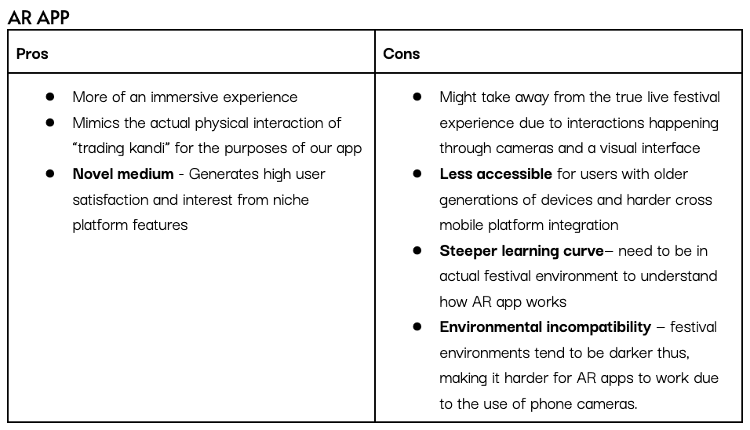
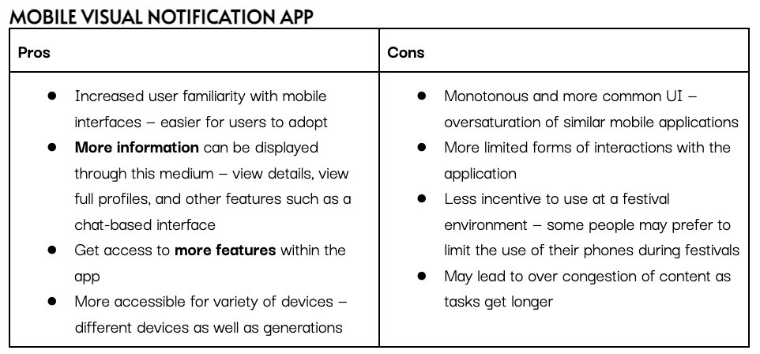
PROS AND CONS FOR
SELECTED INTERFACE

Slide 39
LINK TO LOW-FI PROTOTYPE ON FIGMA
https://www.figma.com/file/uNvzGnBBYrtMgi6hSX6bYu/kandi-prototyping-cs147?type=design&node-id=0%3A1&mode=design&t=CCGIXwUWEXRdzY8Y-1

Slide 40
LINK TO TESTING SCRIPT
https://drive.google.com/file/d/1TGx8zNIW4JWcKXsfYCAbtDqi7japr58M/view?usp=drive_link

Slide 41
PARTICIPANT 1: BRIAN
CRITICAL INCIDENT LOG
Incident | Severity Rating
Attempted to start group task before selecting a group | 4
Struggled with group selection — selected friends for the group but didn’t click the confirm button. | 3
Successfully added a friend with ease | 0
After taking a picture for one of the tasks felt confused regarding whether they had to do something to confirm the picture was taken | 3
Found friends page easily (within 1 second and with no prompting) | 0
Wanted more confirmation that group had been created–such as a screen with the group name and/or members before returning to the task screen after group creation | 3
Easily navigated to the task screen | 0
Concerned about how the app is going to confirm that the uploaded picture/video is actually fulfilling the task specifications - “How are you going to check that I actually did it? AI?” | 4

Slide 42
PARTICIPANT 2: ANDREW
CRITICAL INCIDENT LOG
Incident | Severity Rating
Confusion with lack of visual differentiation between individual tasks and group tasks | 2
Appreciated the simplicity and intuitiveness of the design | 0
Difficulty understanding the purpose of the overall app in community building | 4
Would like to see a bluetooth friends connection feature to identify who's at what event | 1
Didn’t know whether to click on “select group” or “start task” for group task | 3
Instantly knew how to access “friends” page and “tasks” page as well as how to return to home screen | 0
Understood premise and concept of app | 0
Struggled with group selection screen — after selecting group members didn’t know whether to click confirm | 3

Slide 43
PARTICIPANT 3: DANA
CRITICAL INCIDENT LOG
Incident | Severity Rating
Would forget to click continue button | 2
Asked what Kandi was in the initial home screen, as there was a lack of a definition— didn’t understand what the beads were | 2
Didn’t understand whether the whole group participated in group tasks or just one group leader to take the picture | 3
Completed “add a friend” task smoothly | 0
Knew what buttons to click for certain tasks | 0
Wished there was a calendar feature to show future events friends are going to | 0
Confused about task generation and completion - “Are some tasks specific to certain festivals? Or can you complete them all at one festival?” | 2
Potential privacy concern - “Can other people see the picture you use for your task?” | 3

