Slide 1
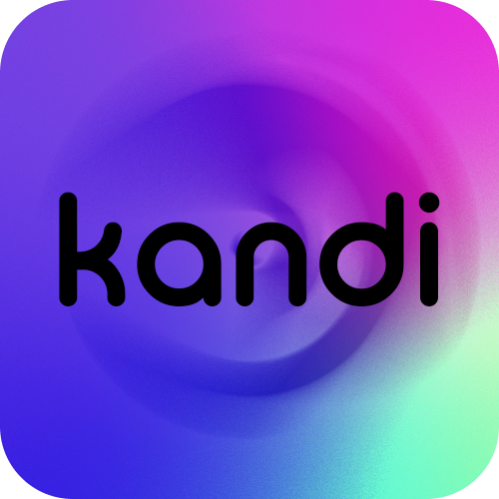
INTERACTIVE MEDIUM-FI PROTOTYPE
Sofia Kim, Sheng Moua, and Jennifer Quach

Slide 2
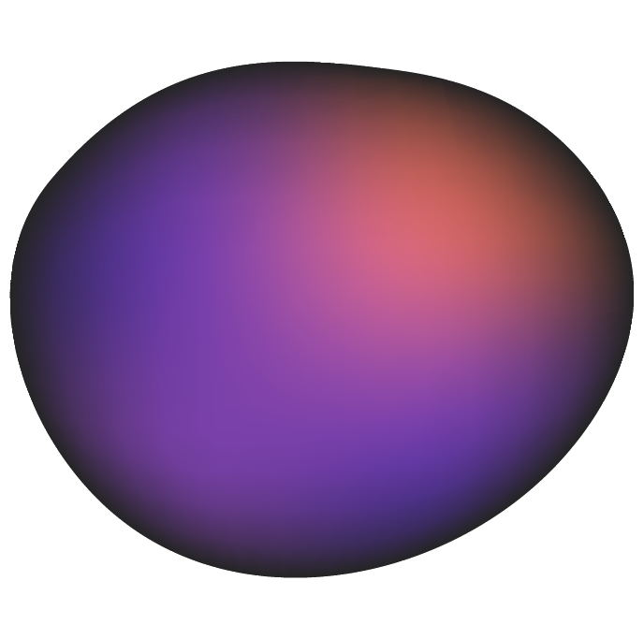



WHO WE ARE
SOFIA KIM
SHENG MOUA
JENNIFER QUACH
‘25
Symbolic Systems
Santa Cruz, Bolivia
‘25
Computer Science
Eau Claire, WI
‘25
Symbolic Systems
Lincoln, NE
Notes:
As a reminder of who we are..team consists of -> read names

Slide 3
VALUE PROPOSITION:
Celebrate connections, one bead at a time

Slide 4

THE PROBLEM
OUR SOLUTION
In gamifying the festival experience, we envision a platform that eases users of any experience into the community by rewarding tasks like creating and joining groups, sharing and receiving news, adding friends, and capturing festive memories.
The festival environment can be overwhelming and isolating to new attendees, making it difficult to enter the scene.

Slide 5
VALUES ENCODED

Slide 6
Our design values…
INCLUSIVITY
COMMUNITY
1
3
EFFICIENCY
JOY OF USE
2
4
All users with any experience or knowledge in the festival scene can comfortably make use of all provided features.
The app should intentionally foster online and in-person interactions, removing contemporary obstacles for connection-making in the scene.
UI should be intuitive and effective in allowing the user to easily achieve the goals of the app.
The app should provide enough satisfaction for repeated and long uses, championing user retention.

Slide 7
VALUE-ALIGNED FEATURES
1
INCLUSIVITY
3
COMMUNITY
2
EFFICIENCY
4
JOY OF USE
Tasks start off beginner-friendly and get more niche once the user becomes more integrated into the scene and the app
Festival jargon definitions are provided
Your friends can see your set list and a calendar with your next events
Complete group tasks by joining or creating a group
View user profiles to scope out similar music tastes, future events, and desired characteristics
Access previous memories through your beads and uploaded media that you used to complete tasks
Complete tasks to unlock achievements and rewards
Actively avoids clutter of information by having a simple homepage that leads to different screens
Actively reduces redundancy of button-clicking to ensure efficient completion of tasks

Slide 8
VALUE CONFLICTS
Inclusivity vs. Joy of Use
Community vs. Efficiency
We want to make the app accessible to all users regardless of experience by first presenting beginner-friendly tasks. That leads to possible decreased satisfaction amongst more experienced users.
Address by: Creating tasks that can be enjoyable for users of all experiences and connecting new users with experienced ones.
Managing groups, creating groups, and making task completion a collaborative experience is hard to leverage with efficiency especially during a festival scene, which is already overwhelming by itself.
Address by: Streamlining the group selection and creation process by assigning a group leader and minimizing steps and buttons between each screen.

Slide 9
TASK OVERVIEW

Slide 10
TASKS
SIMPLE
MODERATE
COMPLEX
Complete an individual challenge—users view and complete individual festival tasks
Changes:
Changed UI of task homescreen to more easily differentiate between individual tasks
Changed UI to avoid clutter of information once task list gets longer
Tasks will not feel more like achievements rather than to-dos
Add a friend and connect with others in the community
Changes:
Added profile calendar to view future events friends are going to
Added setlist building feature to showcase and compare your sets and your friends’ sets
Changed UI of friends list to quickly see which events friends will be at rather than a contact-list type screen
Group challenge–-users join or create a group to complete community tasks (i.e. create a totem for your group, coordinate outfits)
Changes:
Reduced steps between group creation and group selection process to prevent confusion over redundancy of clicks
Enhanced collaboration through a group leader and enforced group submissions to complete tasks

Slide 11
USABILITY GOALS & KEY MEASUREMENTS

Slide 12
USABILITY GOALS & KEY MEASUREMENTS
USER SATISFACTION
1
INTUITIVE NAVIGATION
2
FUNCTIONALITY
3
Asked how likely the user would be in using each feature by giving it either a low, medium, or high potential usage rating
One user voted medium, two users voted high
Measured by the number of mis-clicks; Noted questions or incidents where participant is unable to complete a facilitated task
2 Mis-clicks during group selection process
Measured through task completion, noting facilitated tasks that were indirectly succeeded
All simple, moderate, and complex tasks were successfully completed
Notes:
And here are the 3 solutions we came up with… the first solution

Slide 13
PROGRESS TOWARDS USABILITY GOALS
USER SATISFACTION
1
INTUITIVE NAVIGATION
2
FUNCTIONALITY
3
Users will be able to view past memories; all uploaded media to complete tasks will now be accessible by clicking on beads that have been earned.
Reduced redundancy of clicks between screens, especially for group selection process, for easier navigation and task completion.
Focus more on social and community-building aspect of app by adding profile event calendars and set lists.
Notes:
And here are the 3 solutions we came up with… the first solution

Slide 14
REVISED INTERFACE DESIGN

Slide 15
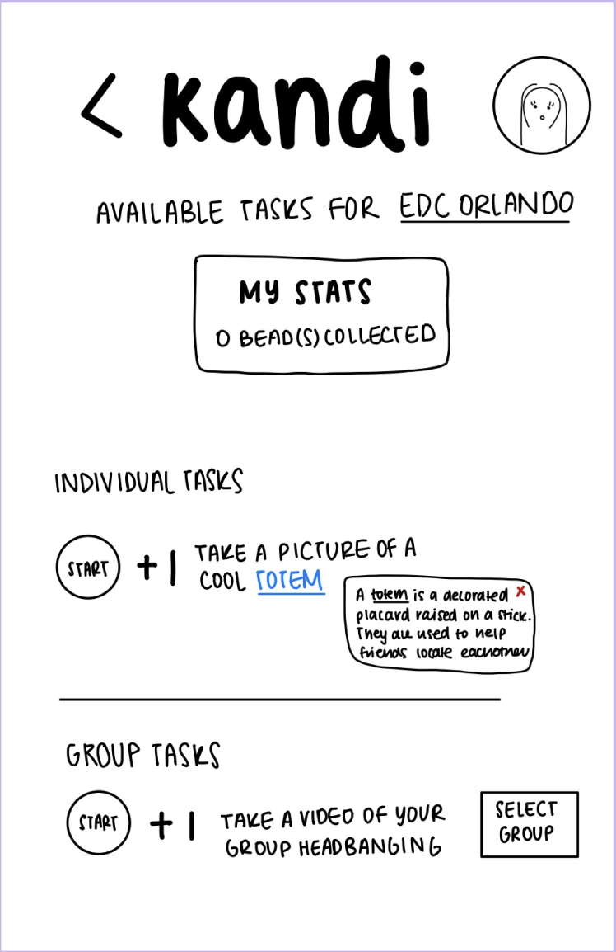
MAJOR DESIGN CHANGE 1: Task Screen
Feedback
“I’m a bit confused… are tasks specific for every festival or can you complete all of them at one festival?”
Participant
“The separation between the individual and group tasks is a little cluttered… too many options… how will it be organized if there’s more than one task for each category?”
Participant

Slide 16
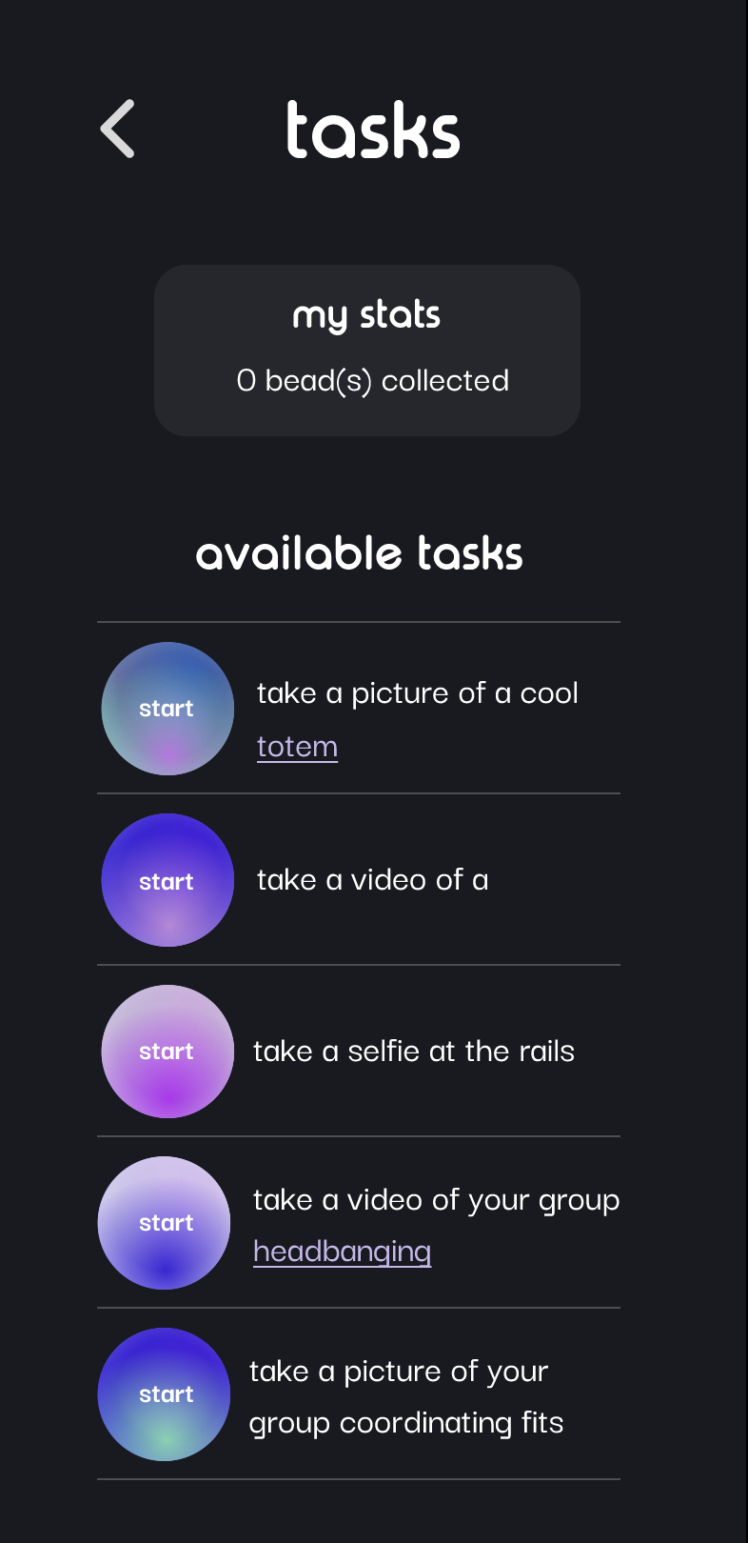
MAJOR DESIGN CHANGE 1: Task Screen
Change
We streamlined the task completion process by removing the option to specify which festival the user is completing the tasks at, as well as the explicit categorization of tasks into individual/group tasks.
Rationale
Testers expressed that the lo-fi task screen was cluttered and somewhat confusing in comparison to other screens
The “select group” button confused testers—they weren’t sure whether to press “start” or “select group” first
Would be difficult to generate unique tasks for every festival

Slide 17
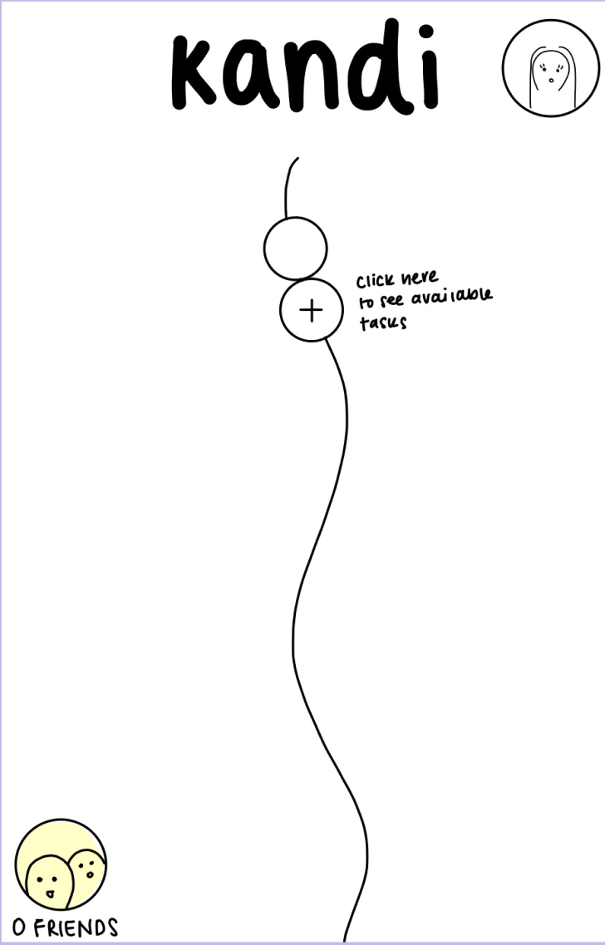
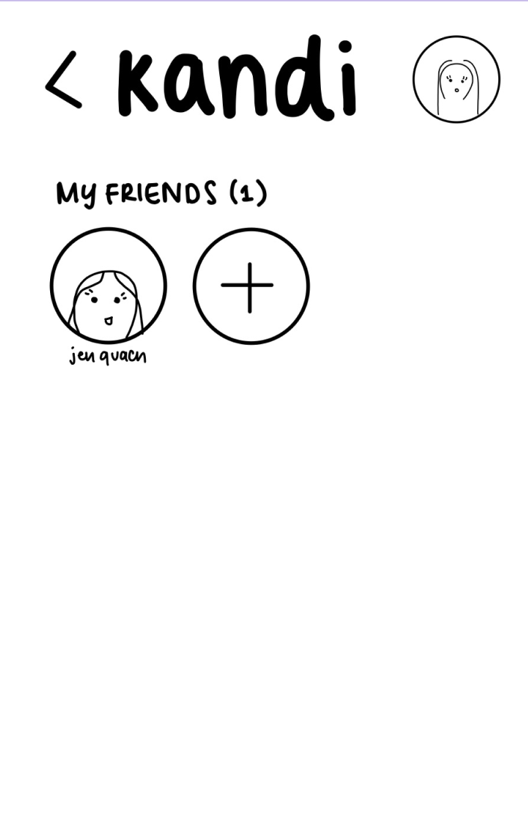
MAJOR DESIGN CHANGE 2: Community/Friends Page
Feedback
“What else can you do with friends besides completing group tasks? I want to be able to see what upcoming events my friends are going to.”
Participant
“I always see my friends’ stories and realize that they were at the same festival as me too late. ”
Participant

Slide 18
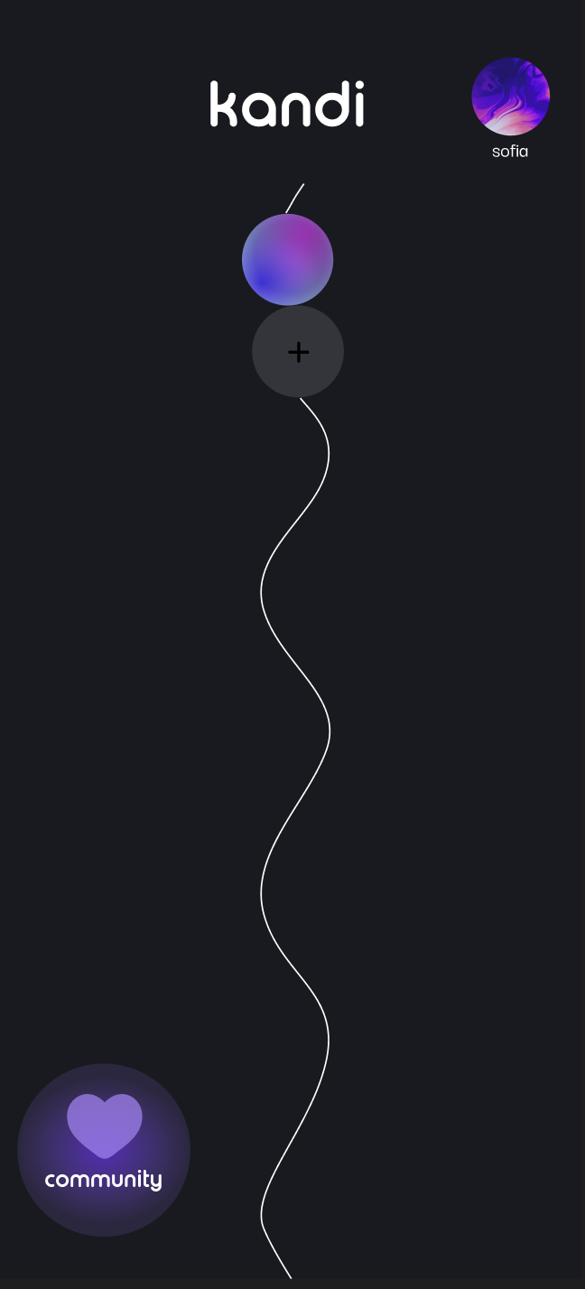
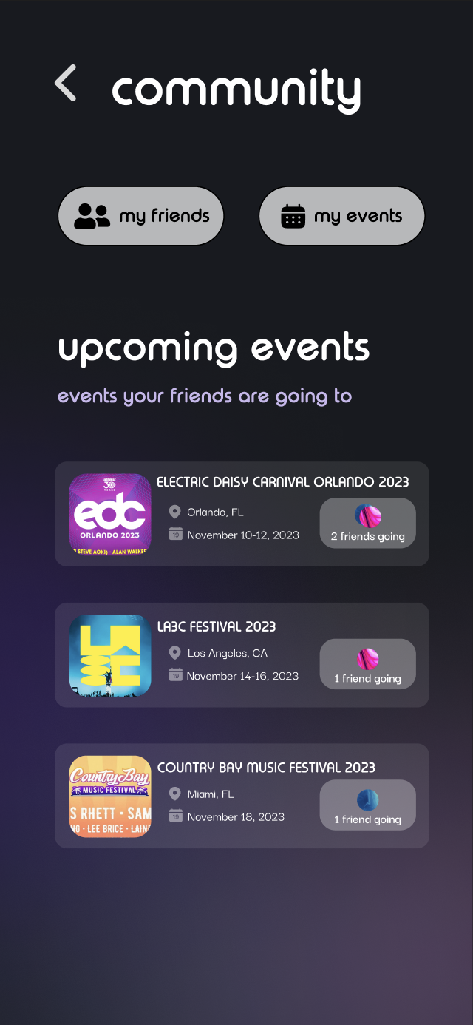
MAJOR DESIGN CHANGE 2: Community/Friends Tab
Change
We expanded the “friends” tab into a more general community tab where you can add friends and upcoming events you’re going to. If there are events that the user’s friends are also going to, those events show up under the “upcoming events” category.
Rationale
2 out of 3 testers expressed that they wanted to be able to see what events their friends are also going to
Expanding upon the community aspect encourages the user to make more connections
1 tester expressed concerns about the functionality of the app → “Collecting beads by itself isn’t much of an incentive for more experienced festival goers.”

Slide 19
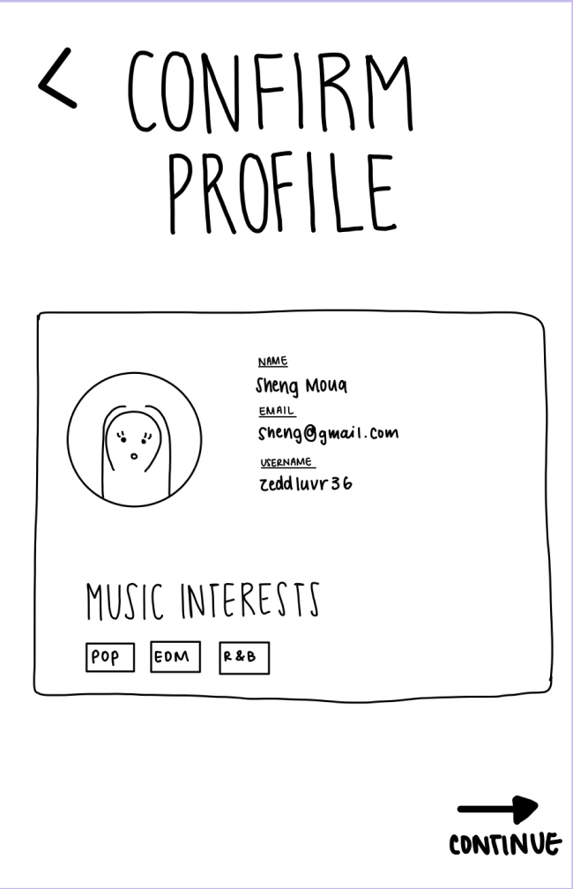
MAJOR DESIGN CHANGE 3: Profile Information
Feedback
“I want to be able to add my favorite songs or link my Spotify on my profile… sort of like Hinge.”
Participant
“It would be cool to be able to add music… so you can check out what you’re friends are listening to. ”
Participant

Slide 20
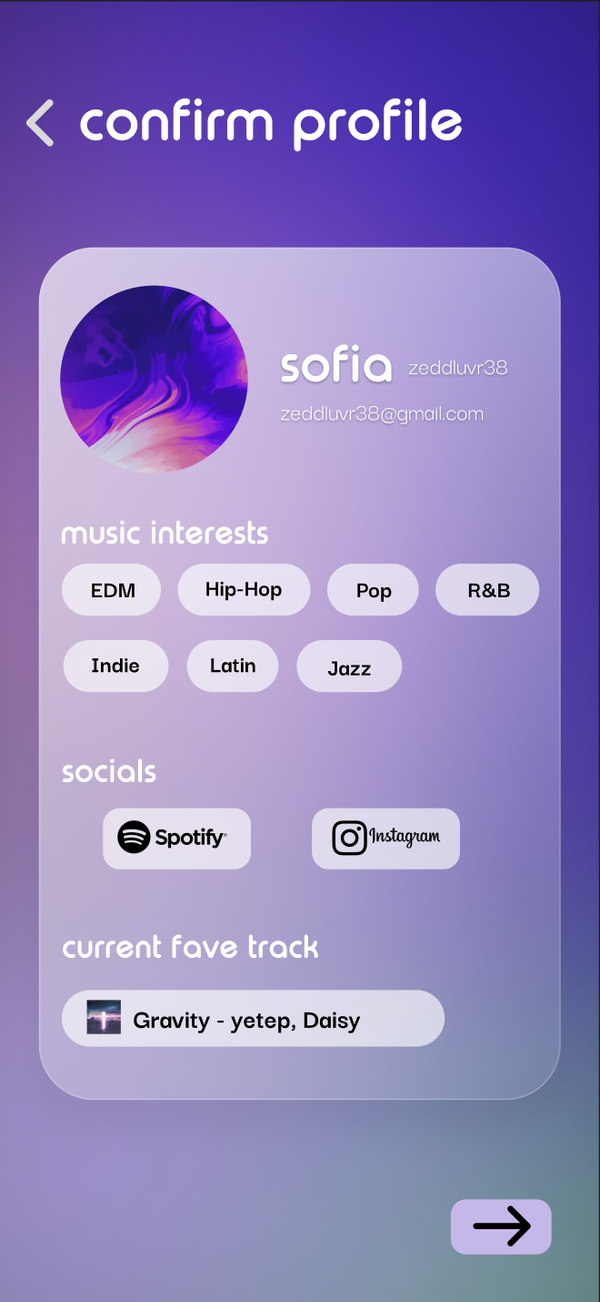
MAJOR DESIGN CHANGE 3: Profile Information
Change
We added the ability to link your social media on your profile page. Additionally, we added a “favorite track” feature so that your friends can see and listen to your current favorite track.
Rationale
Lo-fi profile card was too minimalistic—lacked features that would encourage users to look at other profiles
Testers expressed the need for more interactivity on profile page
Design—adding more features helps to eliminate unnecessary empty space

Slide 21
MED-FI PROTOTYPE TASK FLOWS

Slide 22

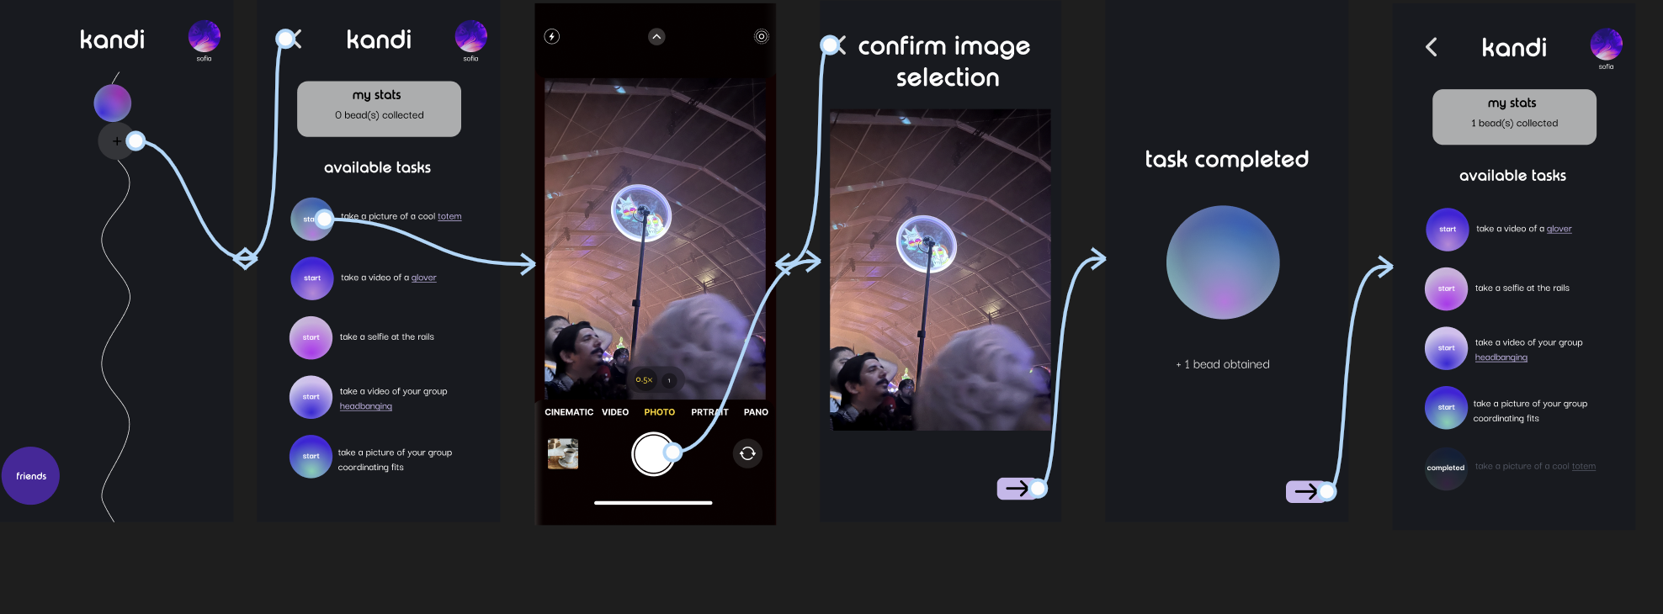
SIMPLE TASK: View and complete individual festival tasks
Click on “+” button to access task page
Click on any one of the available tasks to begin
Take picture to prove task completion
Confirm to submit the photo for task verification
Task completion confirmation screen
Task page now shows task as completed

Slide 23
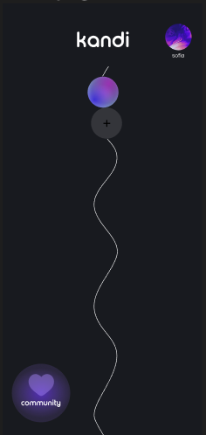
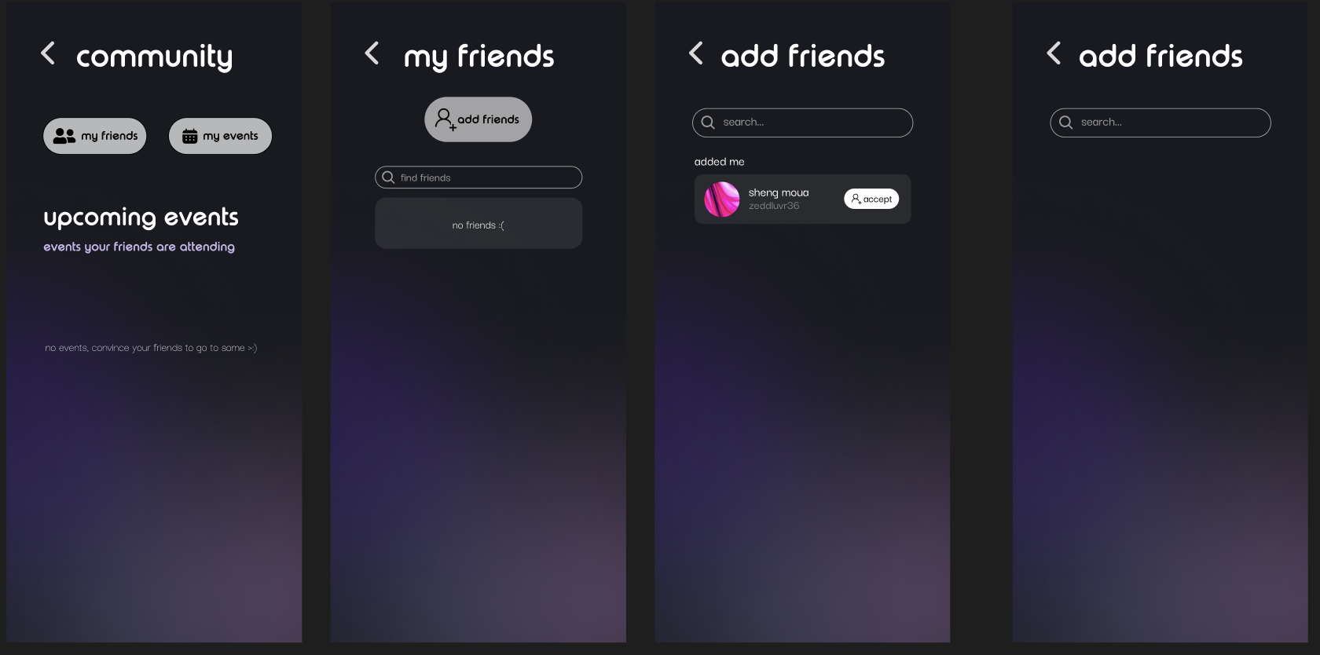
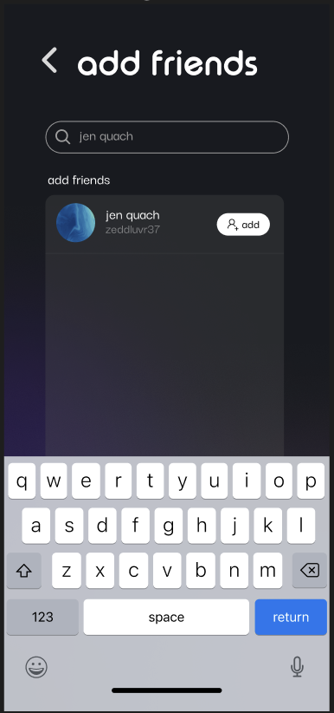
MODERATE TASK: Add a friend (part 1)
Click on “community” button to access friends and events page
Click on “my friends” button to view and add friends
Click “add friends”
Confirm or reject friend requests
Click on search bar to start searching for friends
Search up friend and click “add” to send friend request

Slide 24
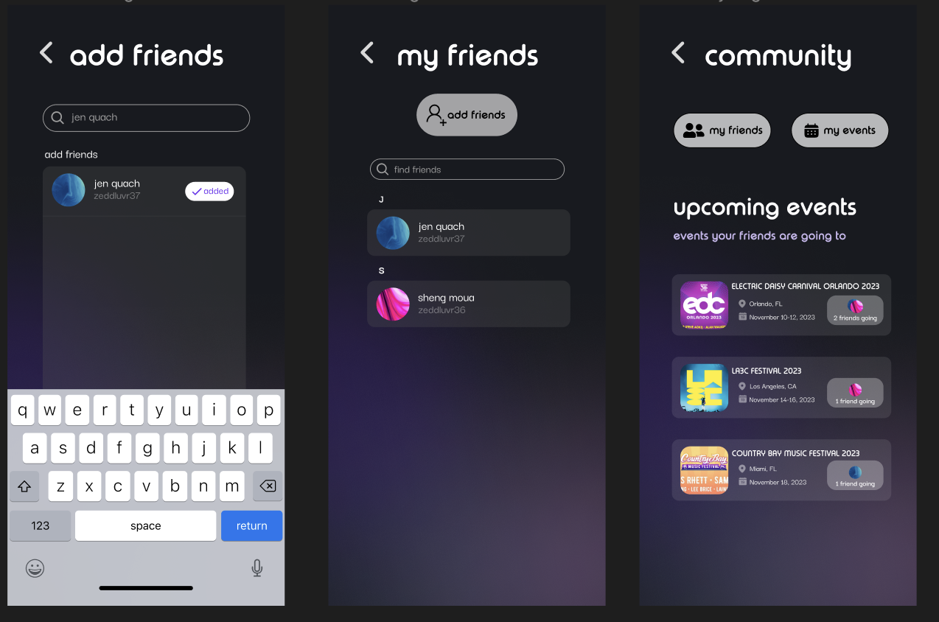
MODERATE TASK: Add a friend (part 2)
Button shows that request was sent. Click back arrow to return to friends page.
View friends who have added you. Click back arrow to return to community page.
See what events your friends are also going to.

Slide 25
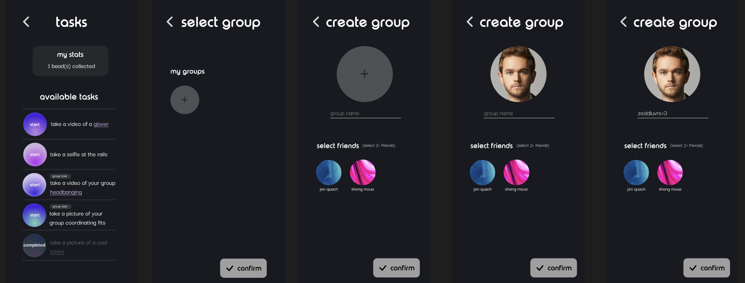
COMPLEX TASK: Complete a group task (part 1)
Click “start” for a task that specifies a group activity
Click the “+” button to create a group since there are no existing groups
Select “+” to add a picture for group
Click text input box to enter group name

Slide 26
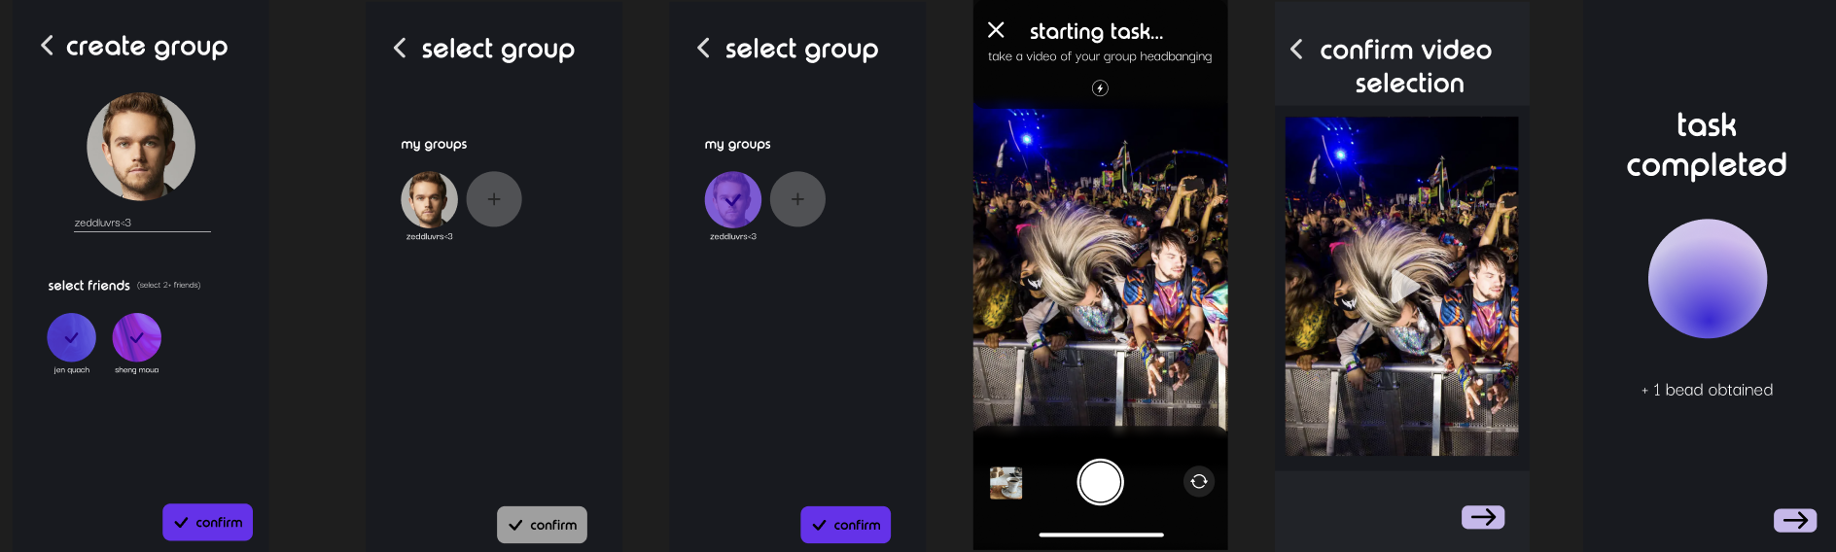
COMPLEX TASK: Complete a group task (part 2)
Select the friends you want to add to the group and click confirm to create group.
Click on group icon to select it.
Click confirm button to select group.
Upload media of group task
Click next arrow to proceed
Click next arrow to return to task screen

Slide 27
PROTOTYPE IMPLEMENTATION

Slide 28
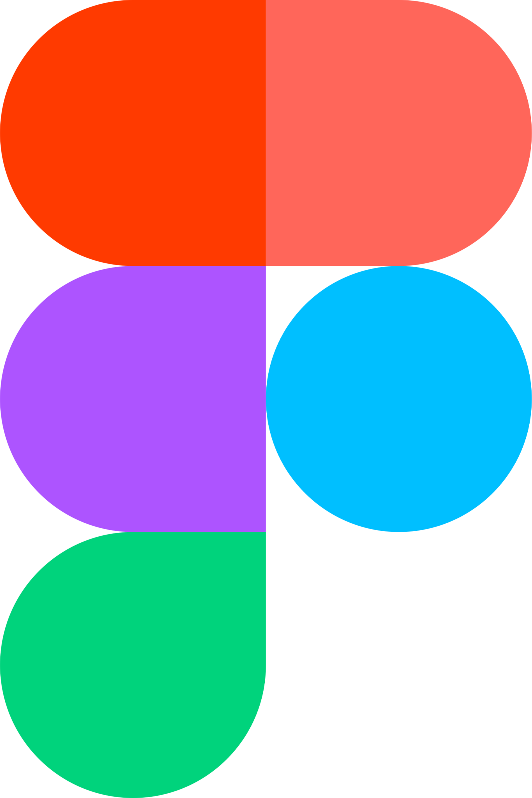
DESIGN AND PROTOTYPING TOOLS:
Figma used to create prototype
Cons:
Slow when handling large files, making it hard to edit and make changes
Limited 3D tools and support
Transitions can be confusing
Pros:
Good for collaboration due to real time sharing
Cloud-based
Convenient design tools (e.g., creating and reusing components, alignment tools)
Large community — able to use community designs in own designs (e.g., keyboard, camera roll)

Slide 29

DESIGN AND PROTOTYPING TOOLS:
Adobe Photoshop used to create logo and other designs
Cons:
Expensive—requires a subscription to use
Hard to collaborate with group members who don’t have photoshop
Steep learning curve—amount of tools and features can be overwhelming
Pros:
Professional and advanced design and editing tools
Large community—lots of resources (i.e, tutorials) at your disposal
Creative cloud integration—can seamlessly integrate with other Adobe software such as Adobe Animate

Slide 30
LIMITATIONS & TRADEOFFS
Users cannot edit their profile after account creation
  Prototype only provides a clickable interface without the ability to process typed user information and display changes
Static task screen
  User receives the same tasks, the same number of tasks, and all tasks are completed in the same way. Tasks are not replaced after completion
Ability to view completed tasks
  User is unable to click earned beads to view old pictures/videos due to design tool limitations/unrelated to major task flows
Unable to view or edit personal event calendar
  User is unable to add upcoming events to personal calendar because it’s not related to a major task flow

Slide 31
WIZARD OF OZ
When completing a task, the media is automatically selected and uploaded for the user.
  Prototype cannot simulate an actual camera for the user to take a photo
  No algorithm implemented to ensure the media submitted is true to the task
User does not add a friend of choice—username is already filled in
  Fabricated fake profiles due to the lack of real users for our med-fi prototype
All information for profile and group creation are autofilled.
  Figma prototype is unable to process typed information or display resulting changes, so the information for group and individual profiles are hard-coded

Slide 32
HARD-CODED ITEMS
Not required to be fully implemented for task flows:
All user profile information
  User cannot pick favorite music genres, link their actual social media, or choose a favorite track to display on profile.
All group information.
  Group picture and members are pre-set. User cannot specify which friends they want to add to the group.
“Upcoming events” in the community tab
  Events are hard-coded, as well as the users going to each event.

Slide 33
THANKS!
Questions?
Contact us!
sofiakim@stanford.edu
smoua@stanford.edu
tmquach@stanford.edu
gabreu@stanford.edu

Slide 34
APPENDIX

Slide 35
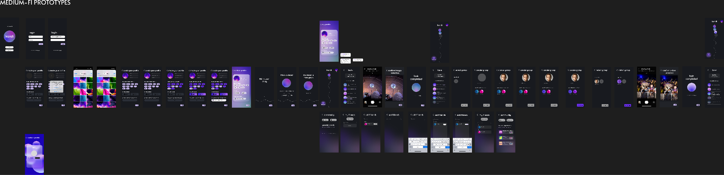
MED-FI PROTOTYPE

Slide 36
LINK TO FIGMA PROTOTYPE
https://www.figma.com/proto/uNvzGnBBYrtMgi6hSX6bYu/kandi-CS147-AU23?type=design&node-id=303-964&t=JqOvmkCQDaeFfddT-0&scaling=min-zoom&page-id=303%3A498

